Slide 1


Slide 2
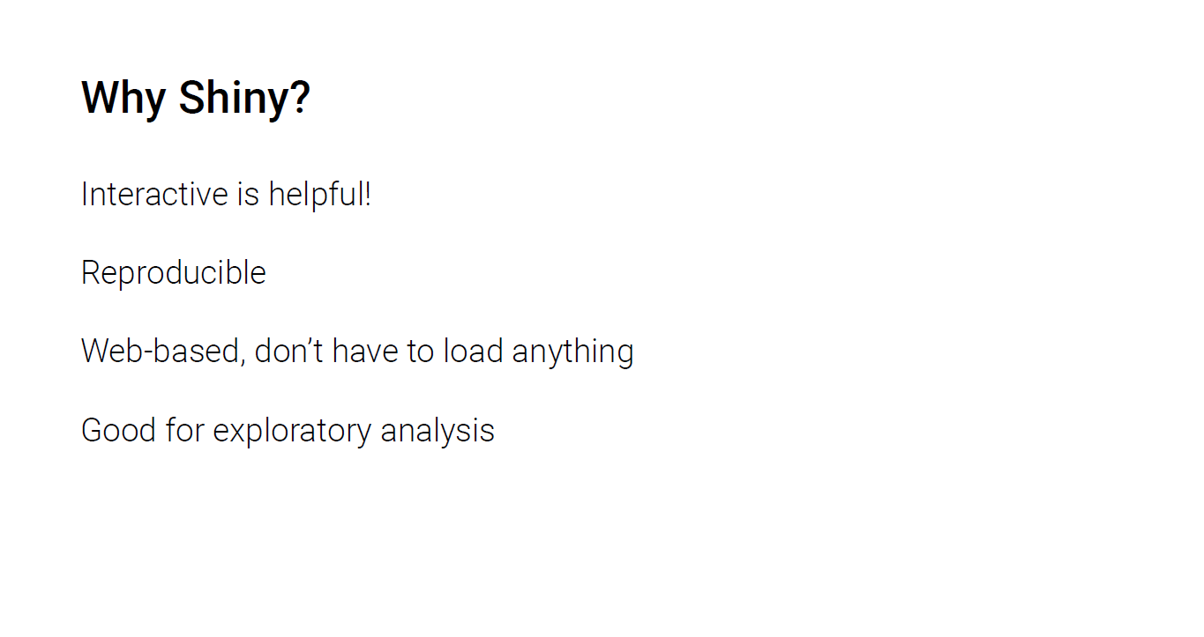

Slide 3
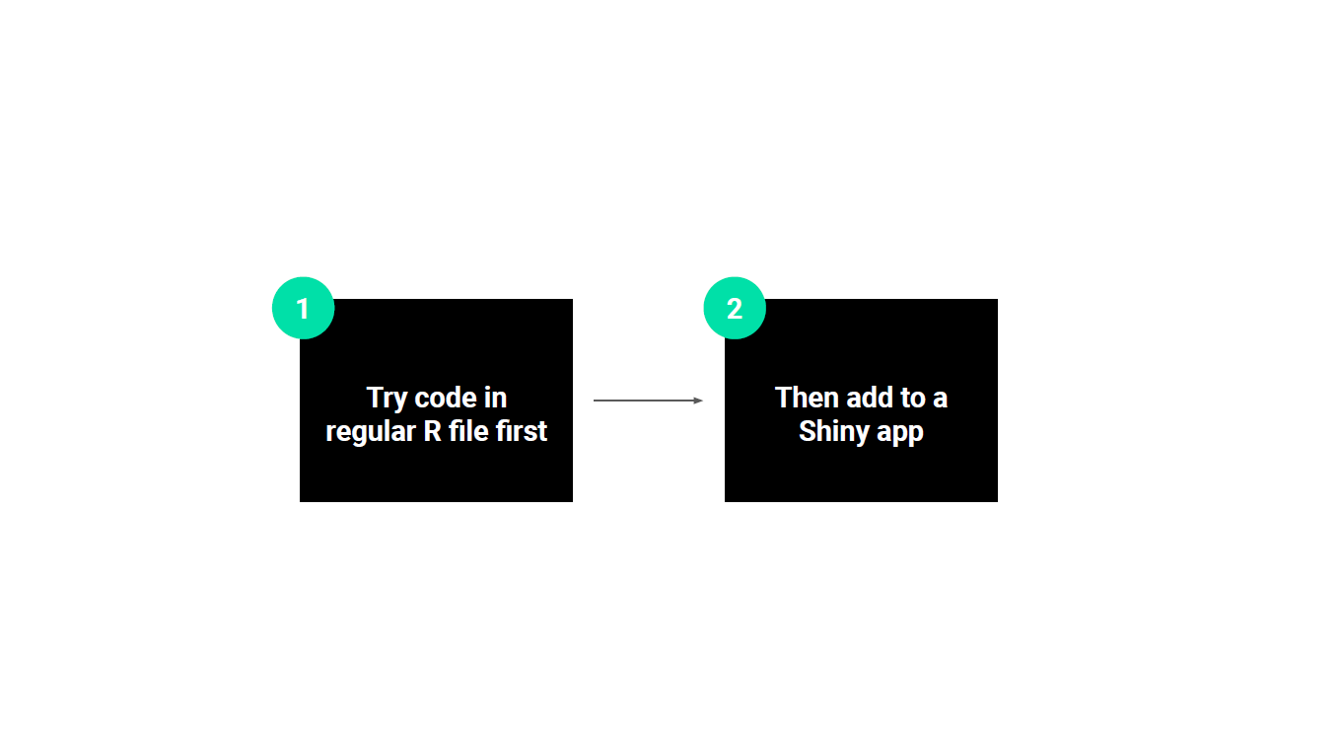

Slide 4
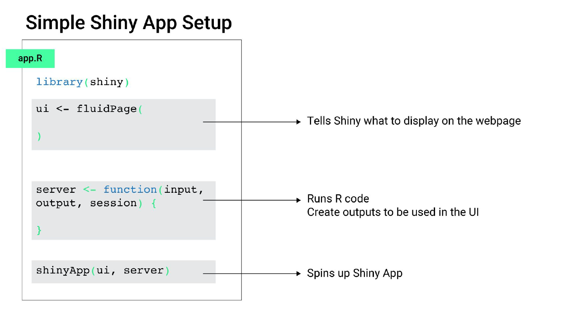

Slide 5
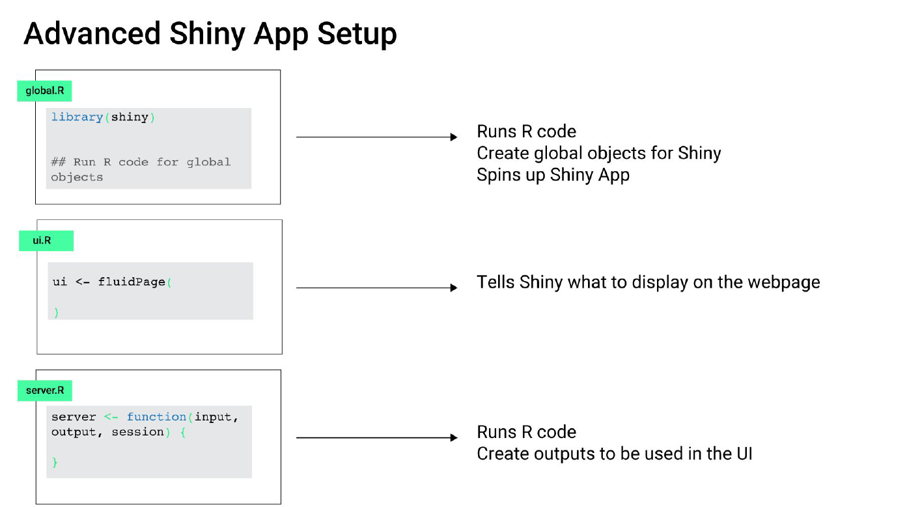

Slide 6
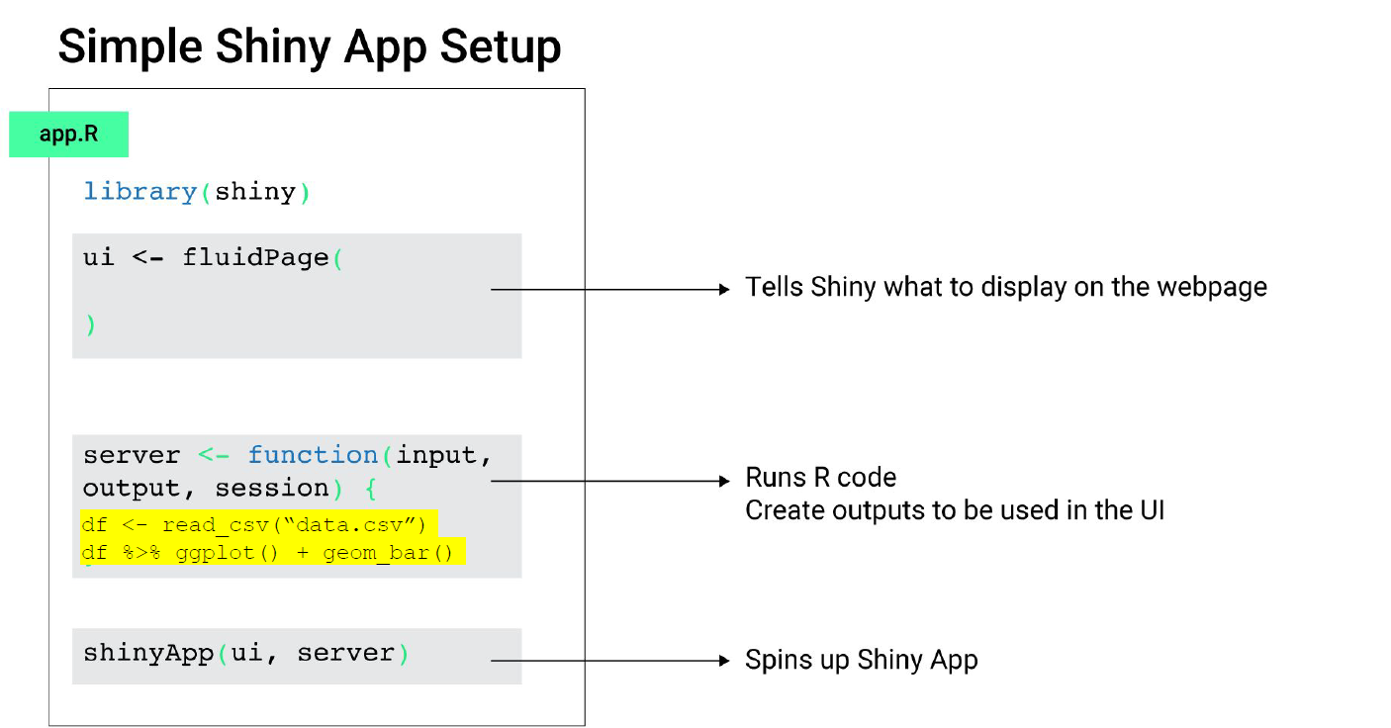

Slide 7
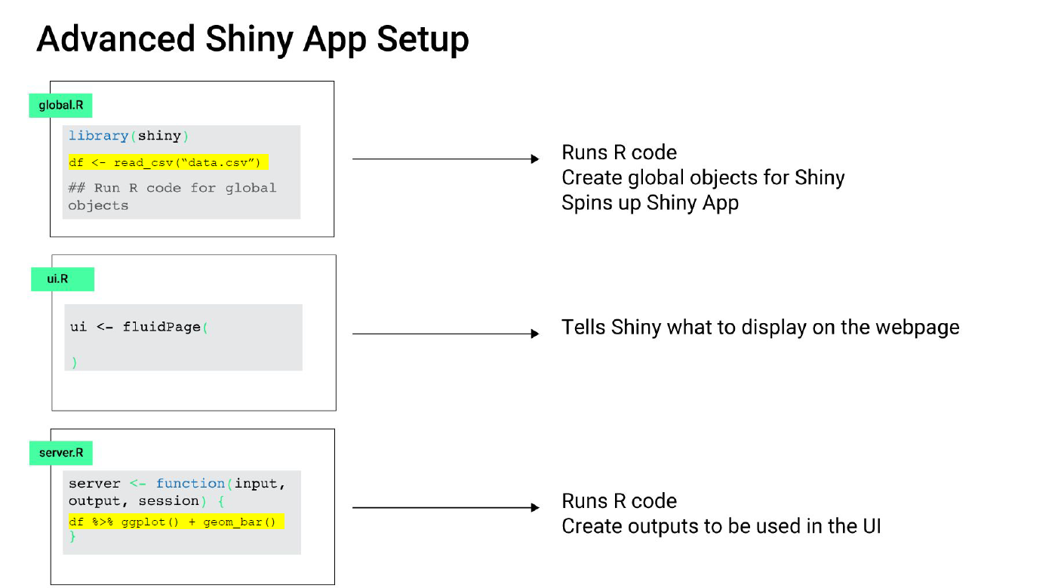

Slide 8
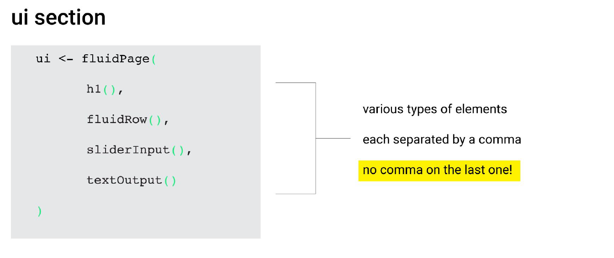

All Layout Options in Rshiny - https://shiny.rstudio.com/articles/layout-guide.html
All HTML Tags in Rshiny - https://shiny.rstudio.com/articles/tag-glossary.html
All Shiny Widgets - https://shiny.rstudio.com/gallery/widget-gallery.html

Slide 9
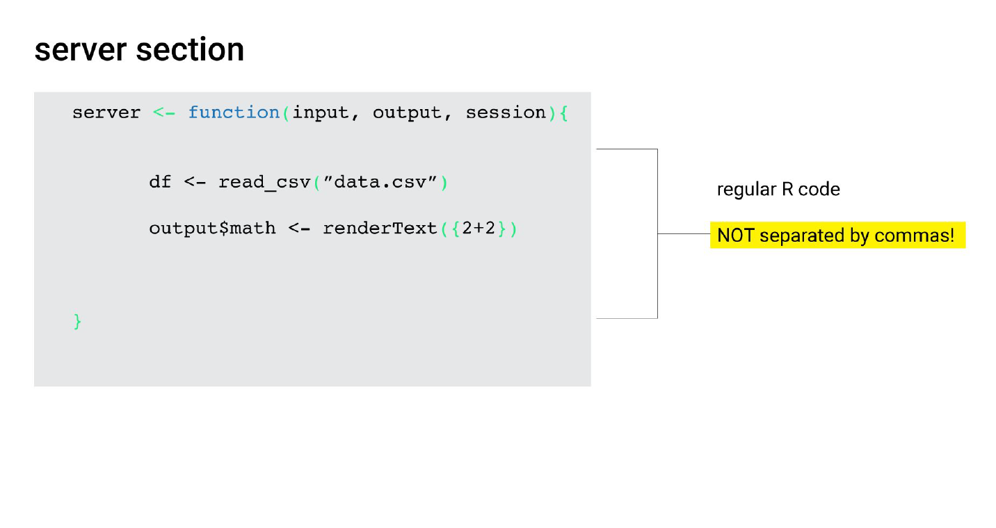

Slide 10
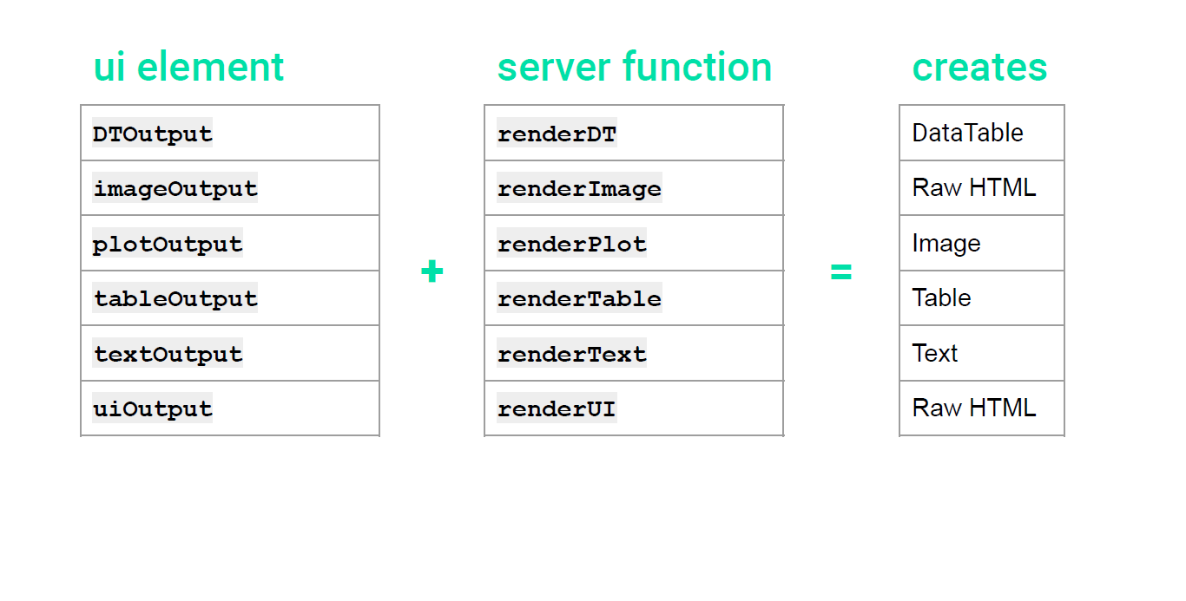

Slide 11
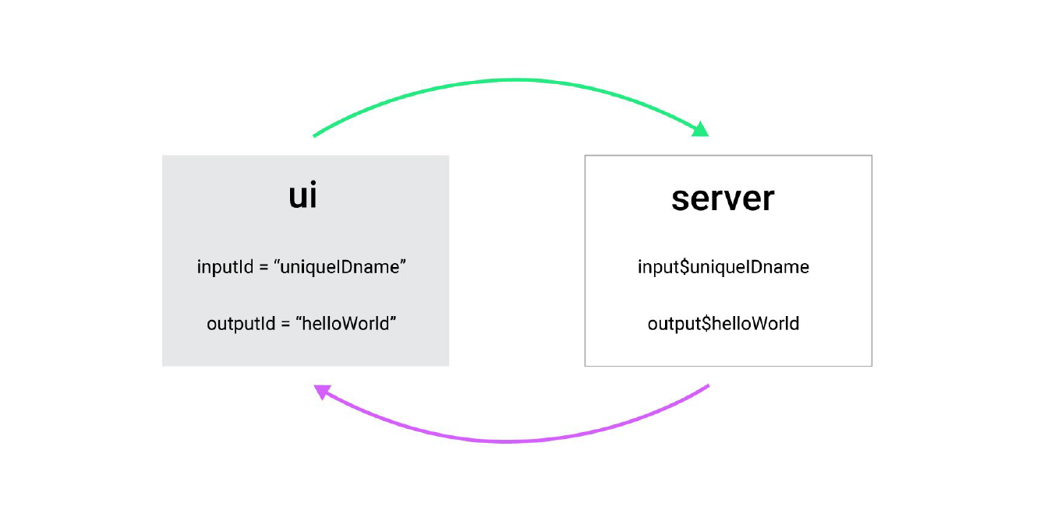

Slide 12
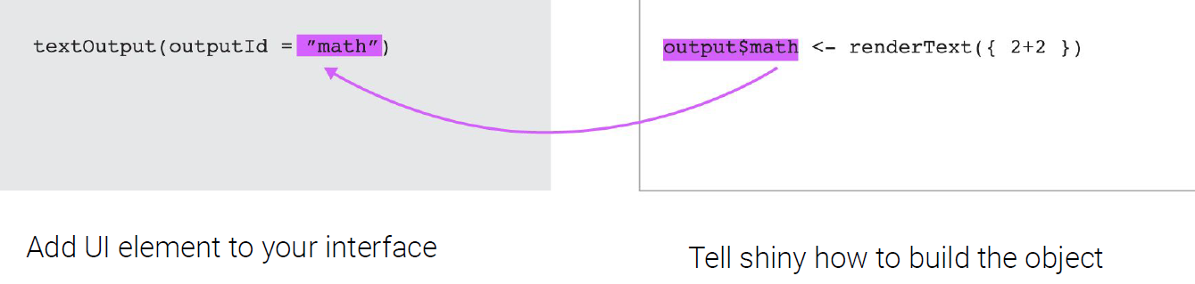

Slide 13
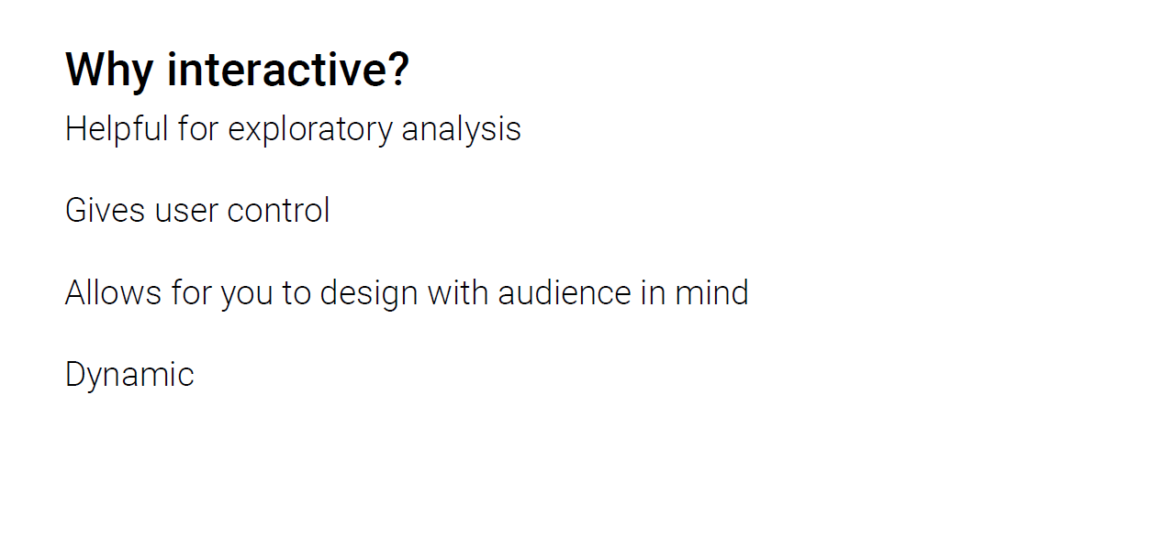

Slide 14
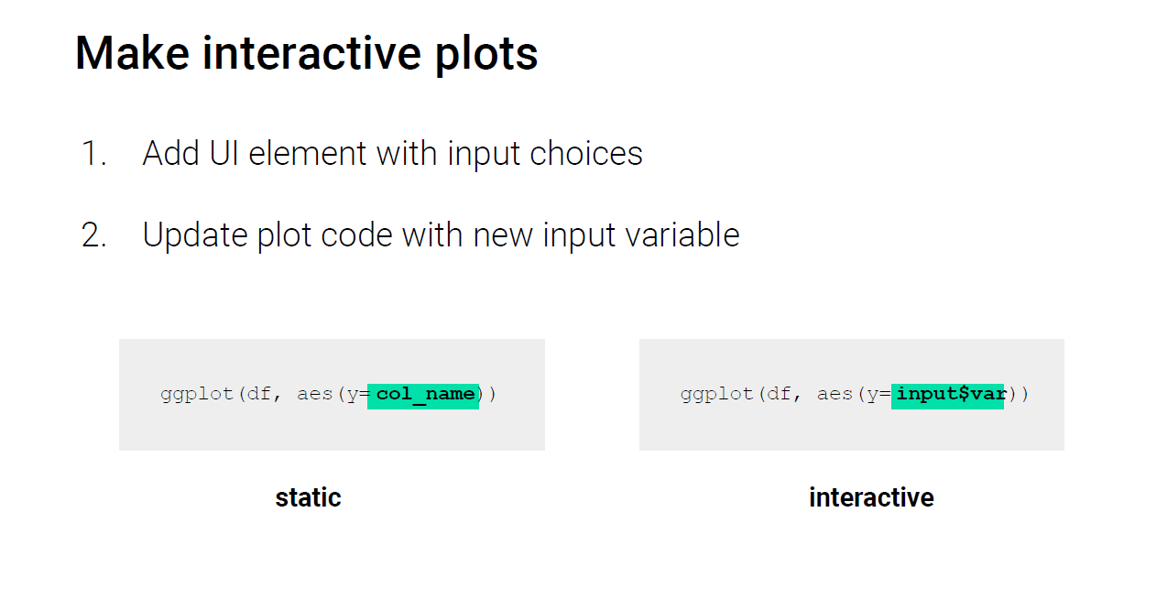

Slide 15
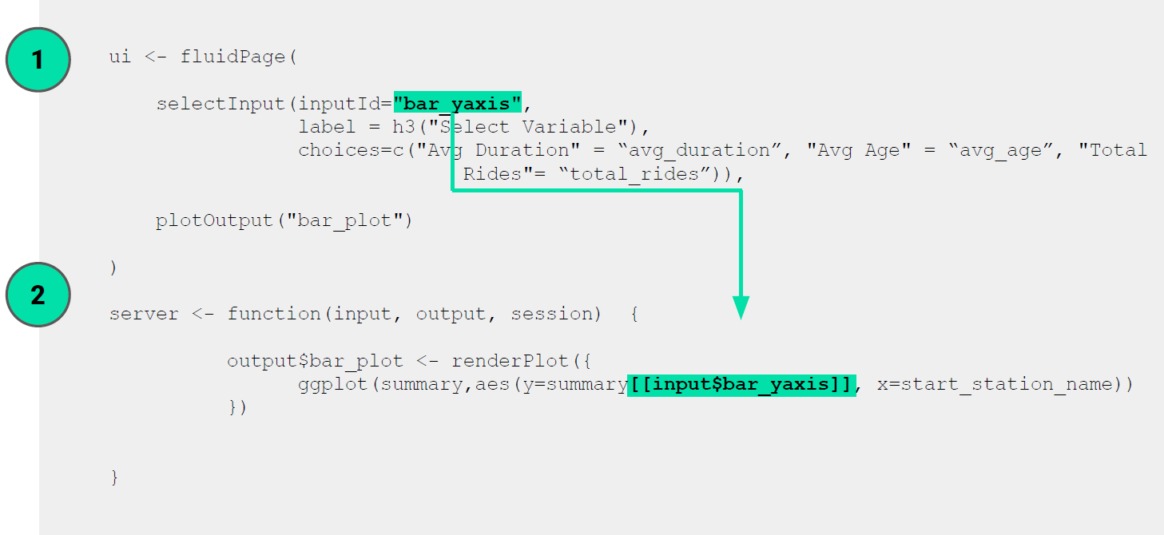

Slide 16
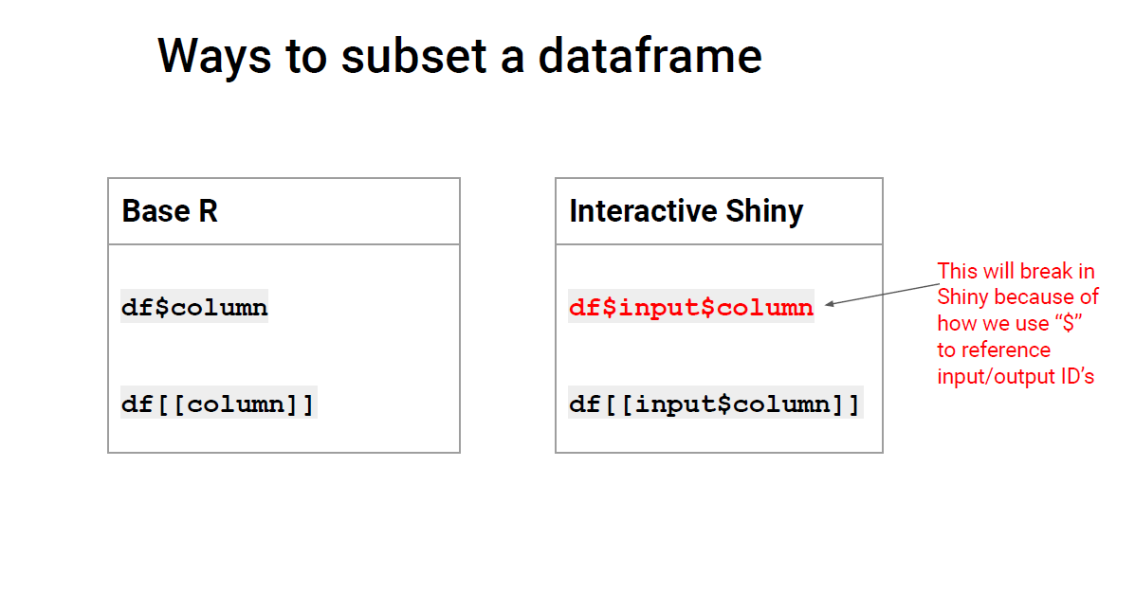

Slide 17
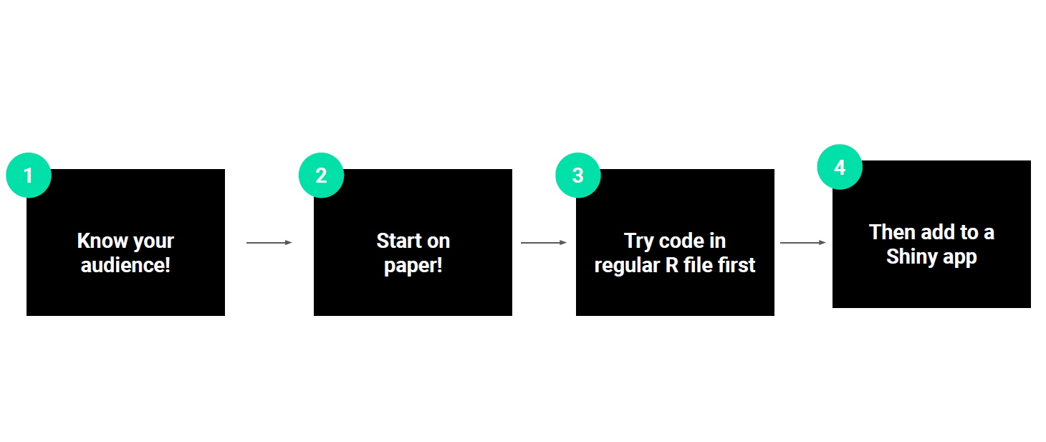

Slide 18
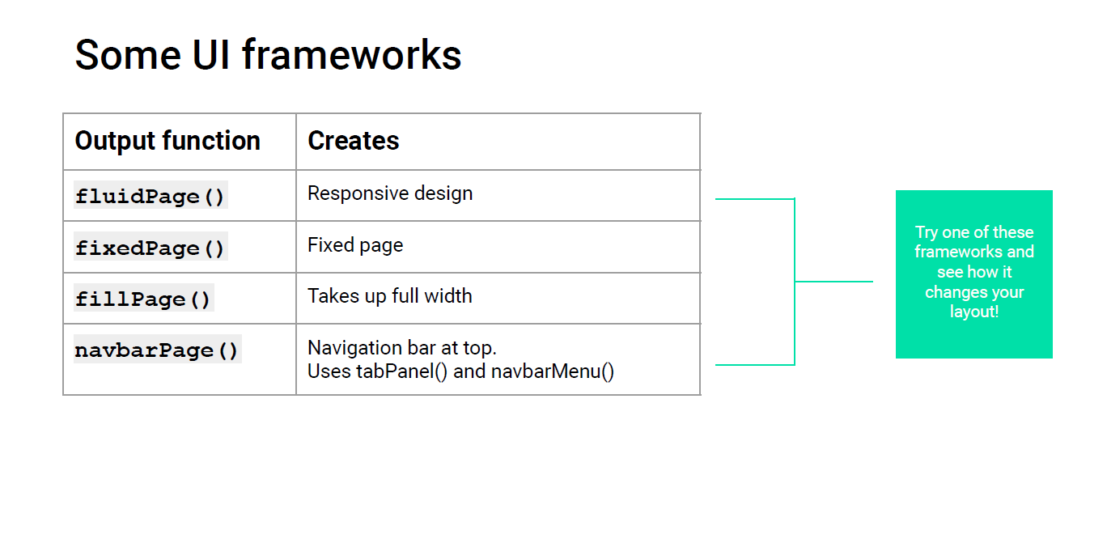

Slide 19
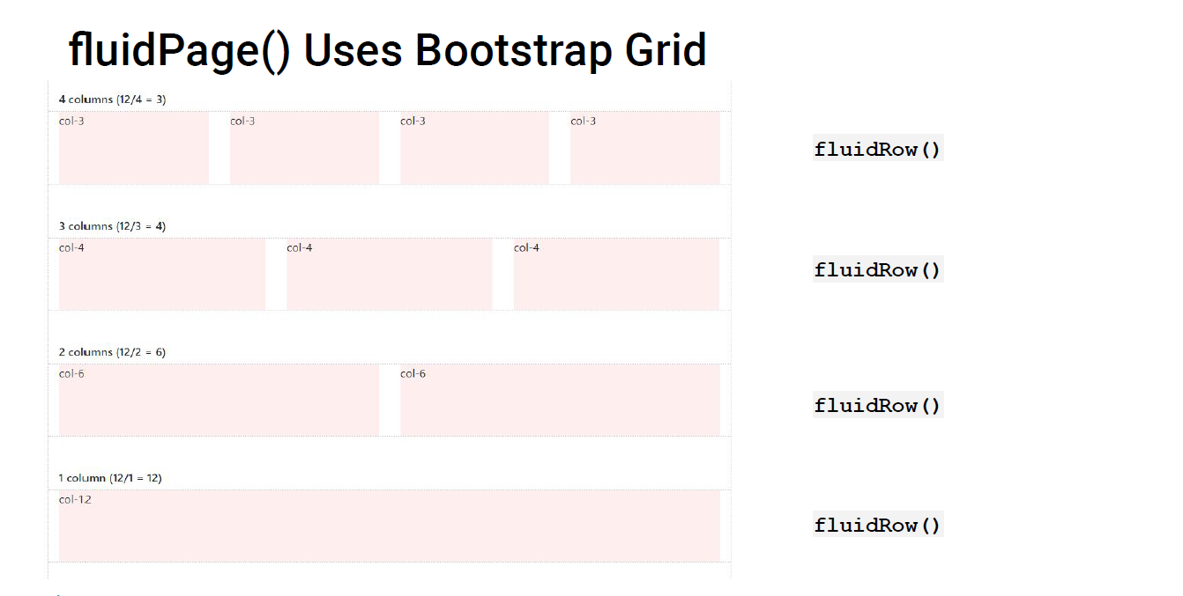

Slide 20
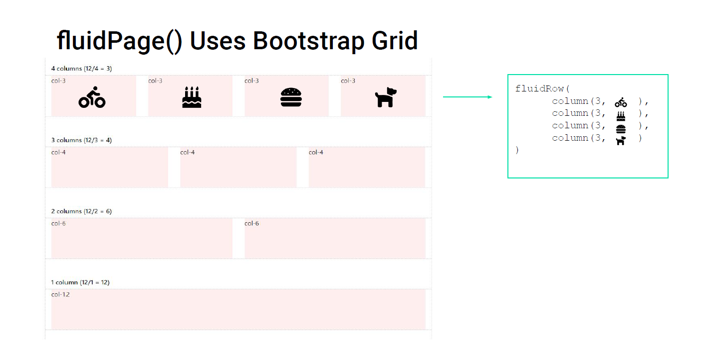

Slide 21
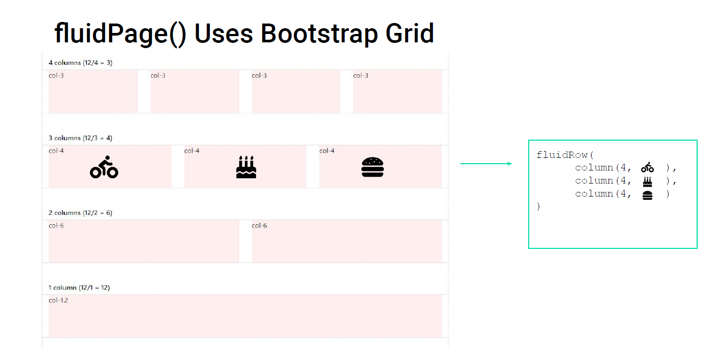

Slide 22
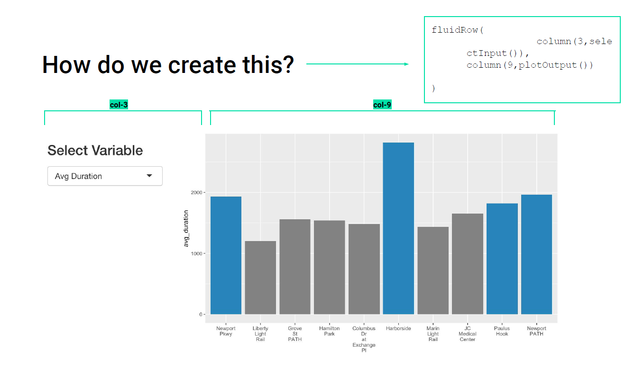

Slide 23

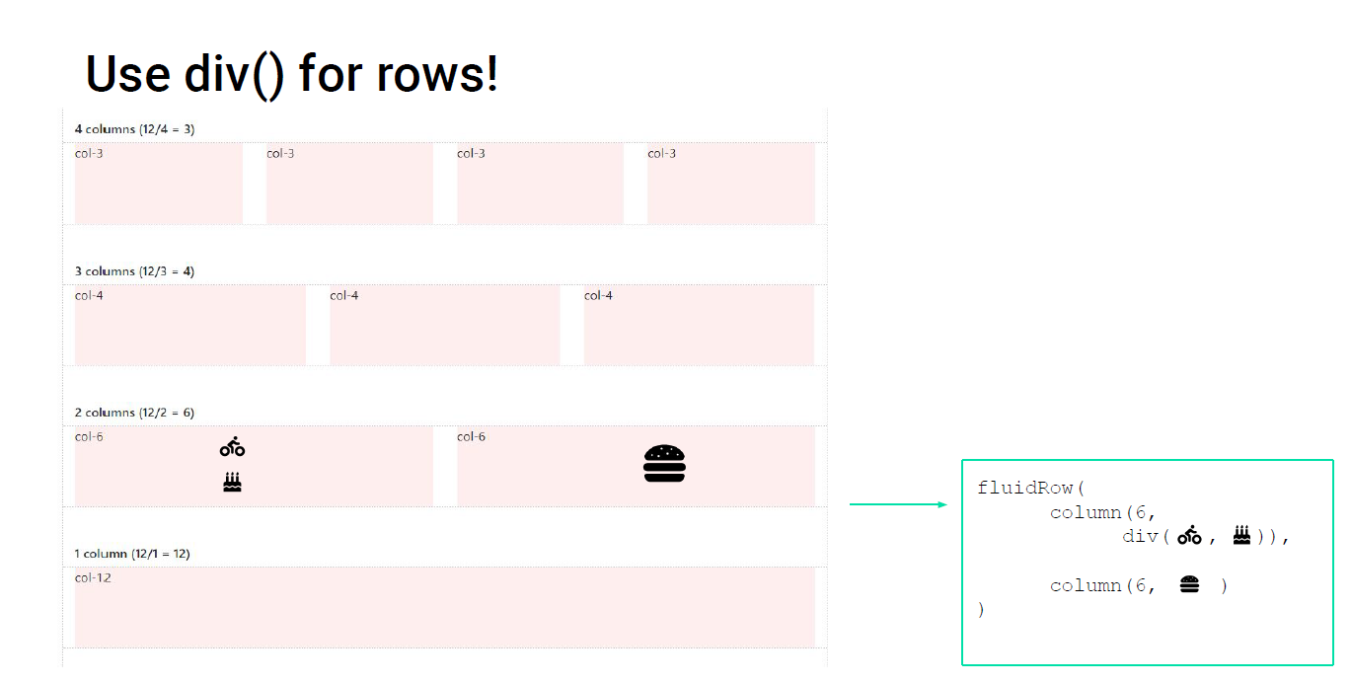

Slide 24
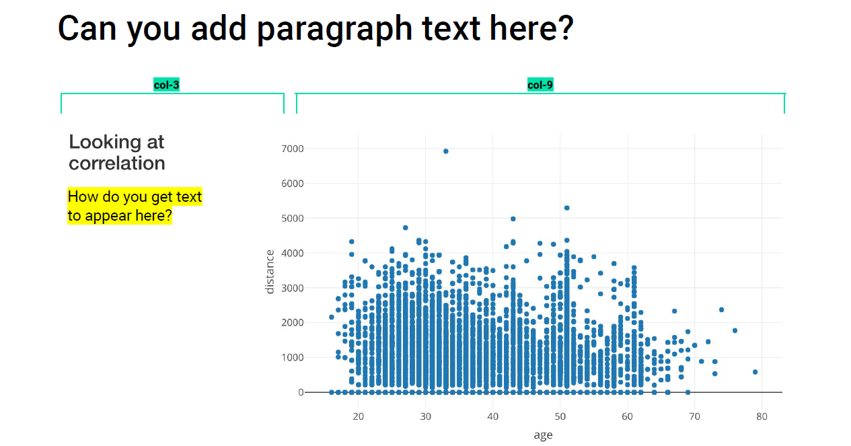
fluidRow(
column(3,
div(h3("Looking at correlation"),
p("Here is where we can put some text!")),
column(9, plotly::plotlyOutput("scatter")) ),

Slide 25
APPENDIX

Slide 26
USEFUL LINKS
Tutorial - https://shiny.rstudio.com/tutorial/
All Layout Options in Rshiny - https://shiny.rstudio.com/articles/layout-guide.html
All HTML Tags in Rshiny - https://shiny.rstudio.com/articles/tag-glossary.html
All Shiny Widgets - https://shiny.rstudio.com/gallery/widget-gallery.html

Slide 27
SAMPLE CODE
library(shiny)
library(shinyWidgets)
library(shinythemes)
# Define UI for application that draws a histogram
ui <- fluidPage(
titlePanel( h1("TEST APP!", align = "center") ),
sidebarPanel( (""),
position = "Right",
div(uiOutput("brand_selector"),style = paste( "font-size:70% ; width:100%" ) ),
width = 3
# div( downloadButton('downloadData', 'Download data',width = '100%'), style = paste( "font-size:70% ; width:100%" ))
),
mainPanel(div(DT::dataTableOutput("table") ,
style = paste( "font-size:70% ; width:100%" ) ) ) )
server <- function(input, output) {
library(odbc)
library(ggplot2)
library(dplyr)
library(readr)
library(DT)
snowflake <- DBI::dbConnect(odbc::odbc(), “database_name", uid=“username", pwd=‘password’)
dbGetQuery(database,"use role MY_TEAM;")
dbGetQuery(snowflake,"use warehouse MY_WH;")
init_sql <- dbGetQuery(
snowflake,"SELECT * FROM database LIMIT 10;")
##This part renders the Dropdown values
output$test_selector = renderUI({
comp = init_sql %>% distinct(COLNAME)
##This is a UI element but placed here since it references the dataset that is calculated above
selectInput(inputId =“Input",
label = "Choose a Input",choices = comp,
selectize = TRUE)
})
output$table <- DT::renderDataTable({
test_table <- init_sql %>% filter(PRODUCT == input$name) %>%
select(TOTAL,COL1,COL2, COL3, COL4,COL5,
COL5, COL6, COL7,COL8) %>%
arrange(desc(TOTAL))
test_table <- as.data.frame(test_table)
DT::datatable(
test_table,
options = list(
autoWidth = TRUE,
scrollX = TRUE
) )
})
# output$downloadData <- downloadHandler(
# filename = function() {
# paste(“test_table", ".csv", sep = "")
# },
# content = function(file) {
# write.csv(datasetInput_filtered(), file)
# }
# )
}
# Run the application
shinyApp(ui = ui, server = server)

