Slide 1
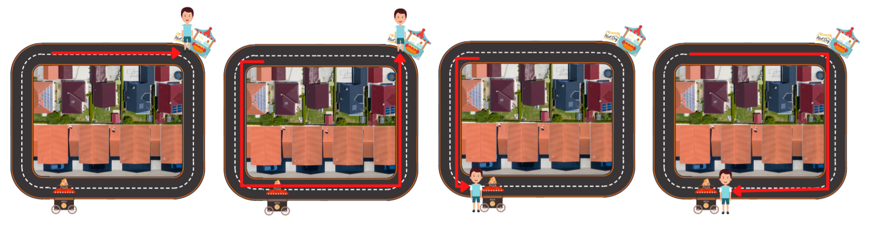
Consent
Demographics
Instructions
t
Trials
Bio
Biography (1 of 8)
“This is Taylor. Taylor’s favourite food is hotdogs. They know the area well and are sporty”
Action outcomes (x4 per start)
Rating
Rating
Rating
Rating
X 16 trials
Debrief
Dropdown menus to rate likelihood of path (x4, 1:7)
Start position (1 of 2)
Here hotdog visible

Slide 2
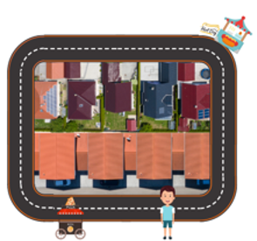
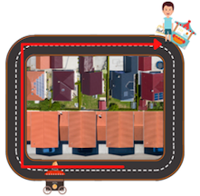
Consent
Demographics
t
Instructions
Screen 1
Action outcome added as red arrow (1 of 4 per start)
Bio
Biography (1 of 8)
As in Exp1a
Screen 2
Start position (1 of 2)
Here pizza visible
Screen 3
5 secs
1 trial = screens 1,2,3
Text
Debrief
X 8 trials
Participant types response

Slide 3
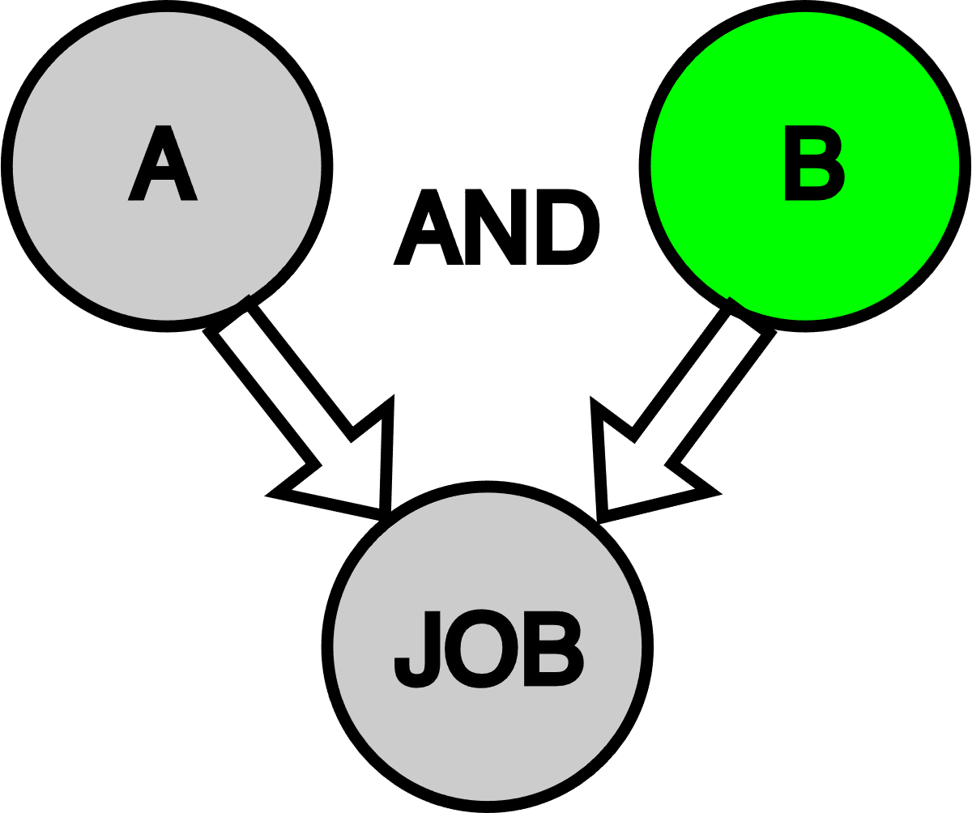
Consent
Demographics
t
Instructions
1.
What happened this time
“Both A and B needed…”
General situation:
What happens,
How often,
Causal structure
“Has skill A 50% of time…
If has skill A, demonstrates it 10% of time…
All 8 explanations
4 variables x {0,1}
Participant chooses 1
2.
“…Had B and did not get the job”
“What’s the best explanation for what happened?”
“What’s the best explanation for what happened?
3.
Candidate did not have skill A
Candidate had skill A
… did not demonstrate skill A
… demonstrated skill A
… did not have skill B
1 trial = screens 1:5
x 12
Debrief
12 worlds (A,B,E)
(7 D, 5 C)

