Slide 1
Tycoon Lesson 7
Inventory – Paintball Guns

Slide 2
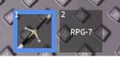
What is an inventory?
Roblox has a feature that comes with it called the inventory, it allows us to store tools and weapons the player can use.
Whenever you play a game on Roblox that uses the bar at the bottom for things like food, or tools or weapons, that is the inventory.

Slide 3

How does the inventory work?
There’s a special type of Roblox object called a tool that are used in the inventory. Under Players and then a specific player there is a folder called the Backpack, the Backpack contains all the tools not being used currently. Notice how they aren’t in the workspace, why do you think that is?

Slide 4
How does the inventory work?
When we select a tool in our inventory, by pressing the right key for it (1-9), it appears on our player model, we can now interact with it by clicking or pressing different keys.
Our paintball gun aims by moving the mouse and fires by clicking.
When our paintball gun hits a part, it will paint it that colour and when it hits another player it will make them lose health.

Slide 5
Picking up a tool
The reason tools in our backpack aren’t stored in the workspace, is because everything in the workspace exists in our game and while a tool isn’t being used we don’t want the player to see it in the world.
If a tool is in the world it’s very easy to pick up. Tools in Roblox require you to just walk over them to pick them up. But once you’ve picked it up it disappears! This means that if you get reset or if someone tries to get one again it will be lost.
So what we need to do is use some code to make sure this doesn’t happen!

Slide 6
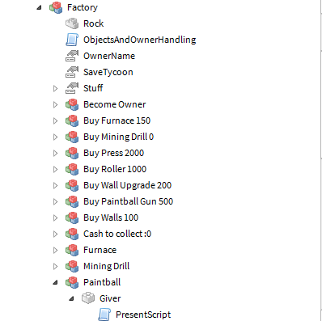
Where our script is located

Slide 7
:clone()
The :clone() function attaches, as we are using the : colon operator, to an object.
When :clone() is called, it will make an exact copy of that object, meaning all the properties are the same.
This is really useful for the giver we want to make.

Slide 8
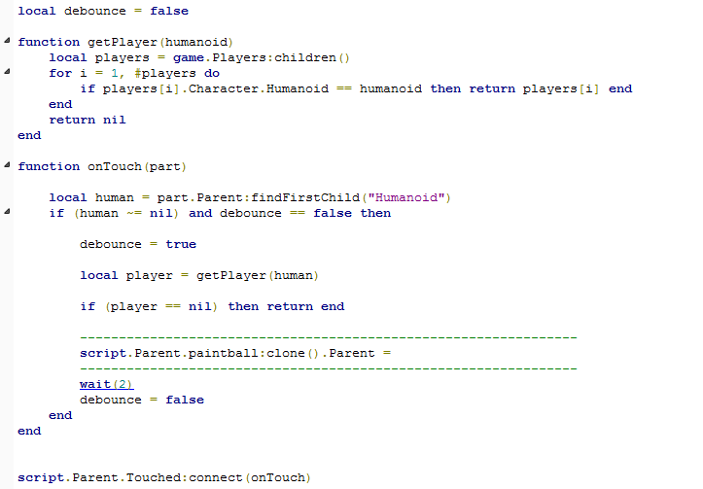
Our code so far
Our code is almost complete. It tracks when a player touches the giver bar and if they are a player, then it makes a clone by using the :clone() function and sets it’s parent. But it doesn’t set the parent to anything yet!

Slide 9
Exercise
We need to fix the code!
Here are some clues:
The parent of the clone needs to be a certain location to be in the inventory.
The place where tools are stored in a player’s inventory is under Players.player.Backpack.

Slide 10
Answers next slide

