Slide 1
Tycoon Lesson 6
Intro to Events – Tracking “Wipeouts”

Slide 2
What is an event?
When something happens in real life, we react to it. It might be something like, when someone enters the room we say hello.
When in code we react to something happening, it’s called an event.
We’ve met events before, when a player steps on an upgrade to buy it or when a tycoon part hits the get block, they are Touched events.
Events work by connecting to functions, this means that they will always react the same way, for example in real life we could have on a Person Enter the Room event we will say “Hello name”.

Slide 3
Why do we use events?
Events are reactive whereas using if statements are proactive.
Proactive can be hard because we are testing if something has happened all the time over and over, and we might even miss it!
Reactive is much simpler because it will tell us when something has happened instead of us having to find out. All we have to do is listen to the event.
So how do we listen to events?

Slide 4
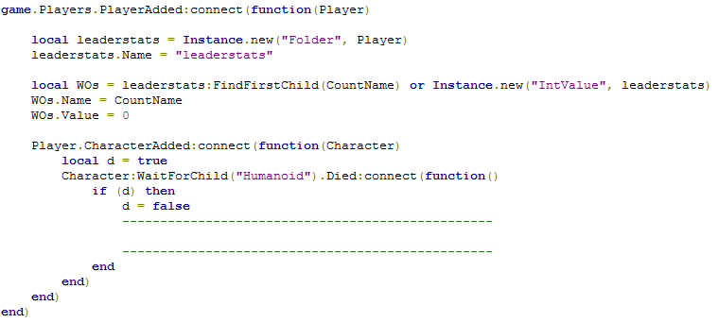
Listening to events
Let’s look at the code so far.
Here we are listening for when a player is added to the game.
Here we are listening for when a player “dies”.

Slide 5
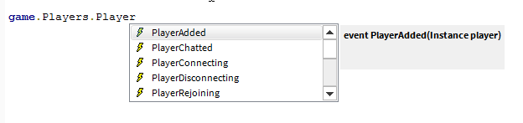

Where are events?
Events are stored inside objects, like properties, for example game.Players has many events including “PlayerAdded” and “PlayerChatted”. Can you guess when those events trigger?
There’s also many for Parts
Here you can see “Touched” which we have used many times as well as some other ones for parts.

Slide 6

Connecting to events
Once we have our event, we need to “listen” to it or connect to it.
Here we have the PlayerAdded event, we have used :connect() to listen to it, and tell it what to do with a function.
PlayerAdded “passes” us one input, the player that was added, we have chosen to call it player here. Other events can pass us different inputs.
What do we think this script is doing?

Slide 7
Our code
Here we are using a leaderboard, similar to how “cash” appeared before, but we’ve added “WOs” to track when the player dies.
So far it doesn’t do anything! We don’t do anything once they die. To fix the code we need to increase WOs.Value property by 1.

Slide 8
Answers next slide

Slide 9
