Slide 1
Tycoon Lesson 4
Removing Objects and Colon Operator – Making a rolling press

Slide 2
The colon operator
A colon operator : allows us to apply a function (do something) to what we put it on the end of.
The simplest one is :destroy() which when put on the end of an object, will delete it.
Here’s an example:
myPart = workspace.Part
myPart:destroy()
So what are we doing here?

Slide 3
:destroy()
myPart = workspace.Part
myPart:destroy()
Here we have destroyed myPart.
Even thought we haven’t told destroy() what it is going to destroy, because it is attached with a : colon operator to myPart, it knows to destroy myPart.

Slide 4
:FindFirstChild()
:FindFirstChild() works in a similar way, but also takes an input.
For example, if we needed to find a part named myChild inside myParent we’d do this.
myParent:FindFirstChild(“myChild”)
Not only does this look for myChild, but specifically inside myParent, as the : Colon operator was used.
But why “FirstChild”?
Let’s take a look why.

Slide 5
First Child
If there are more than 1 child named the same thing, then if we use myParent.myChild it will refuse to work! This is because it is ambigious, meaning there are multiple answers. But if we use FindFirstChild() instead, it will just give you the first it finds!
myParent
myChild
myChild
myChild

Slide 6
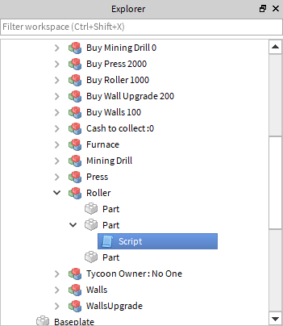
Finding the Script

Slide 7
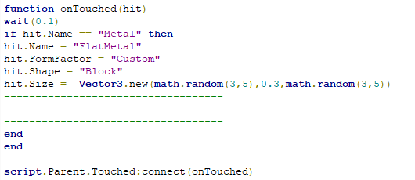
Making our Roller
So far in the code we are testing if the part hitting the roller is our refined metal. If it is, it is changing some of it’s properties, including it’s size, to make it a nice, flat sheet. But it won’t work right now! That’s because we still have the rock mesh on the part!

Slide 8
Making our roller
To make our roller make nice, flat sheets of metal we need to remove the mesh in the part! Let’s have a think about how to do this:
If we use :destroy() on the mesh it will delete it.
We can find a mesh inside our part by using hit:FindFirstChild(“Mesh”)
See if you can work out how to put this information together.

Slide 9
Answers next slide

Slide 10
