Slide 1


Slide 2
OSBORNM
GITHUB
.COM
TWITTER
CODEPLEX

Slide 3
MUSIC ?
♫
♪
♩
♪
♬
♫

Slide 4
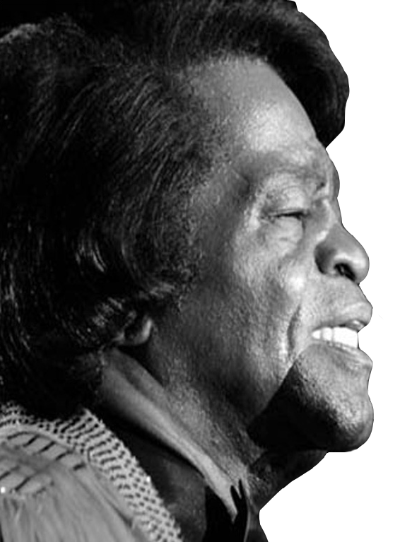
“ The one thing that can solve most of our problems is dancing ”

Slide 5
ANXIETY
music reduces
* Study conducted by University of Windsor http://web4.uwindsor.ca/musicandwork

Slide 6
WORK
HAPPY
LEFT
RIGHT

Slide 7

I WANT IT NOW

Slide 8
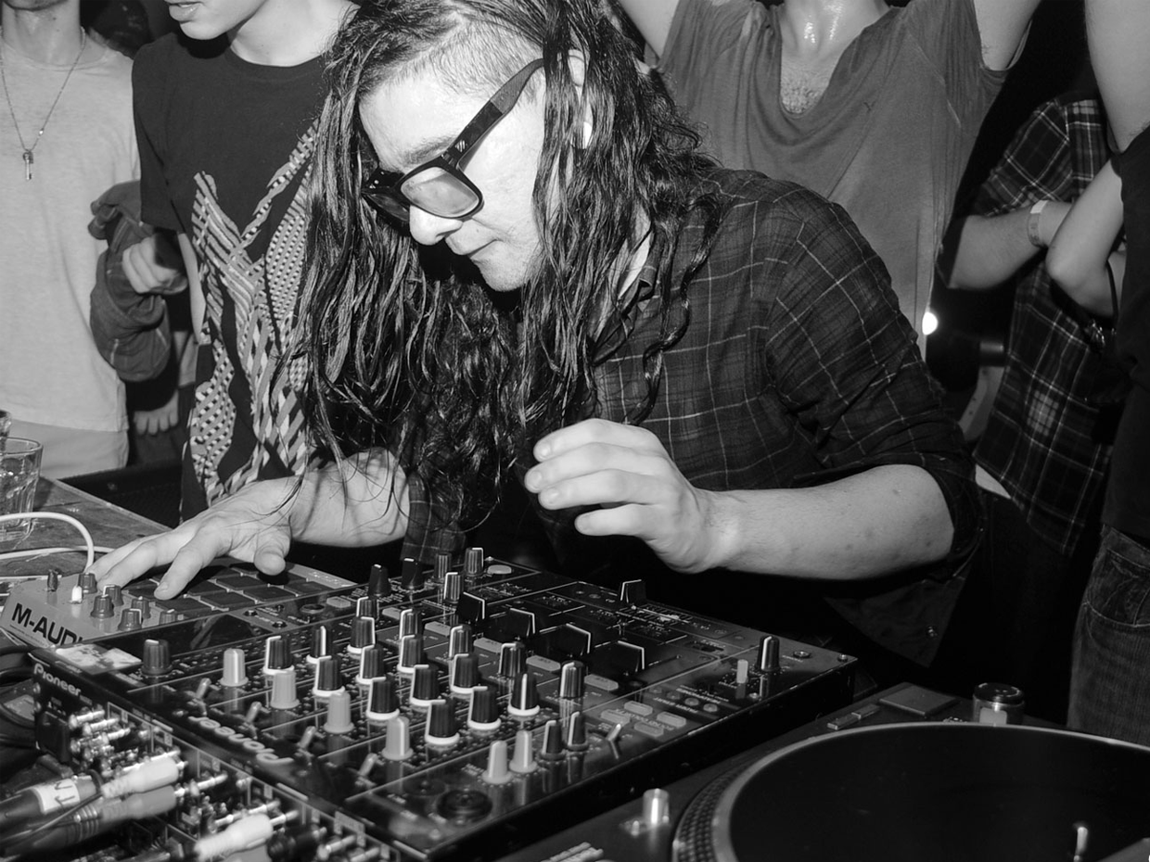

Slide 9
LAST.FM
PANDORA
ITUNES
GROOVESHARK
ITUNES
TURNTABLE.FM
ZUNE
GROOVESHARK
SPOTIFY
PANDORA

Slide 10
LAST.FM
PANDORA
ITUNES
GROOVESHARK
ITUNES
TURNTABLE.FM
ZUNE
GROOVESHARK
SPOTIFY
PANDORA

Slide 11

INTRODUCING
YOUR TEAM’S DJ

Slide 12
API CENTRIC

Slide 13
MULTI-CLIENT

Slide 14
HANDS FREE

Slide 15

TELL ME
MORE
TELL ME

Slide 16
DEMO
DEMO
DEMO
DEMO
DEMO
DEMO
DEMO
DEMO
DEMO
DEMO

Slide 17

GITHUB.COM\OSBORNM\PLAYR
GET
INVOLVED

Slide 18
OSBORNM
GITHUB
.COM
TWITTER
CODEPLEX

