Slide 1
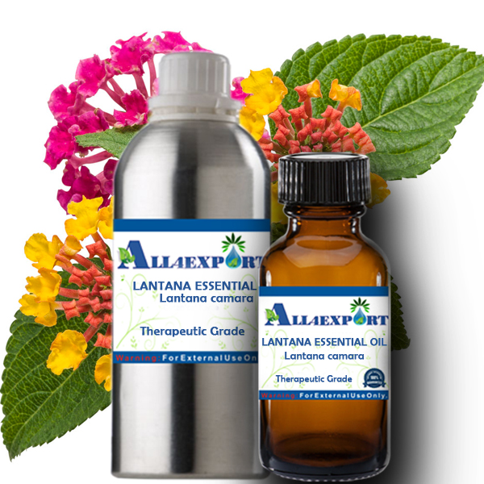
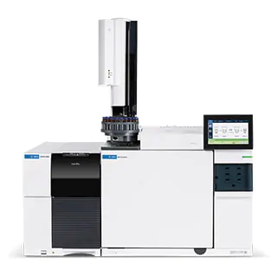


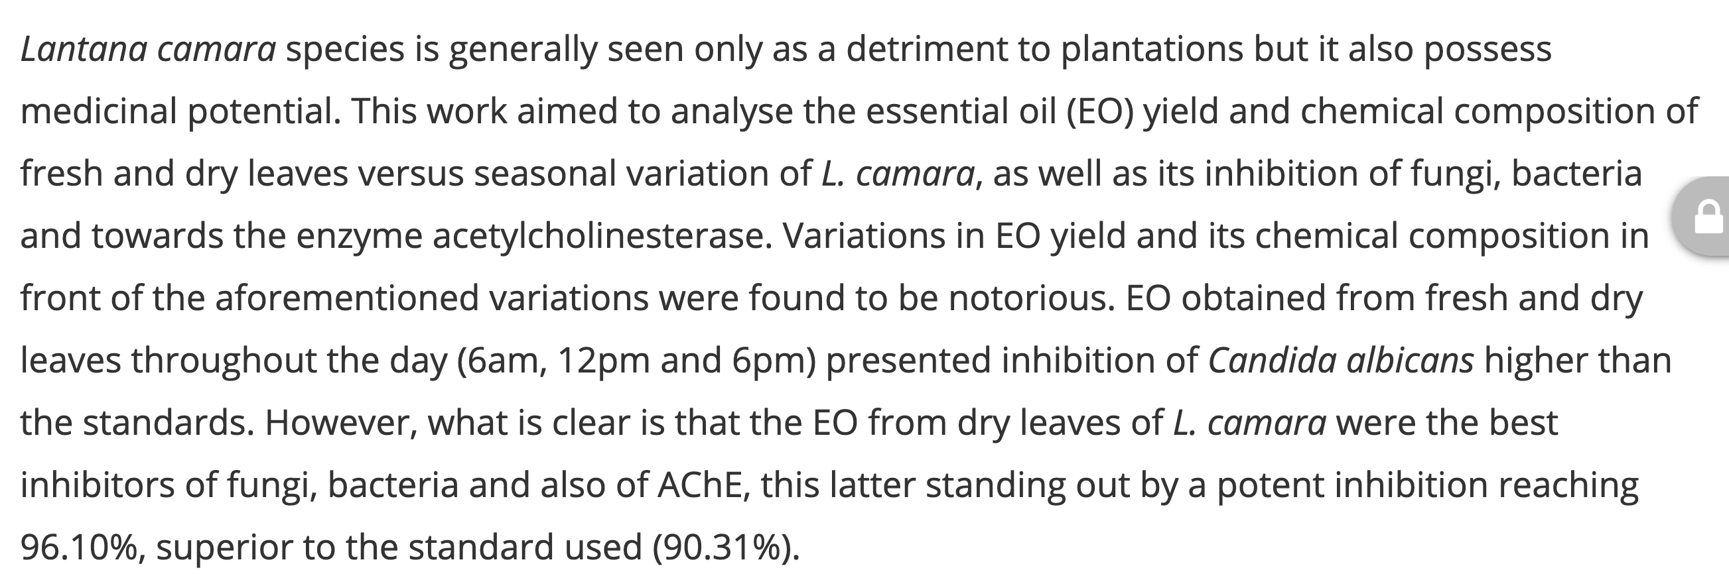

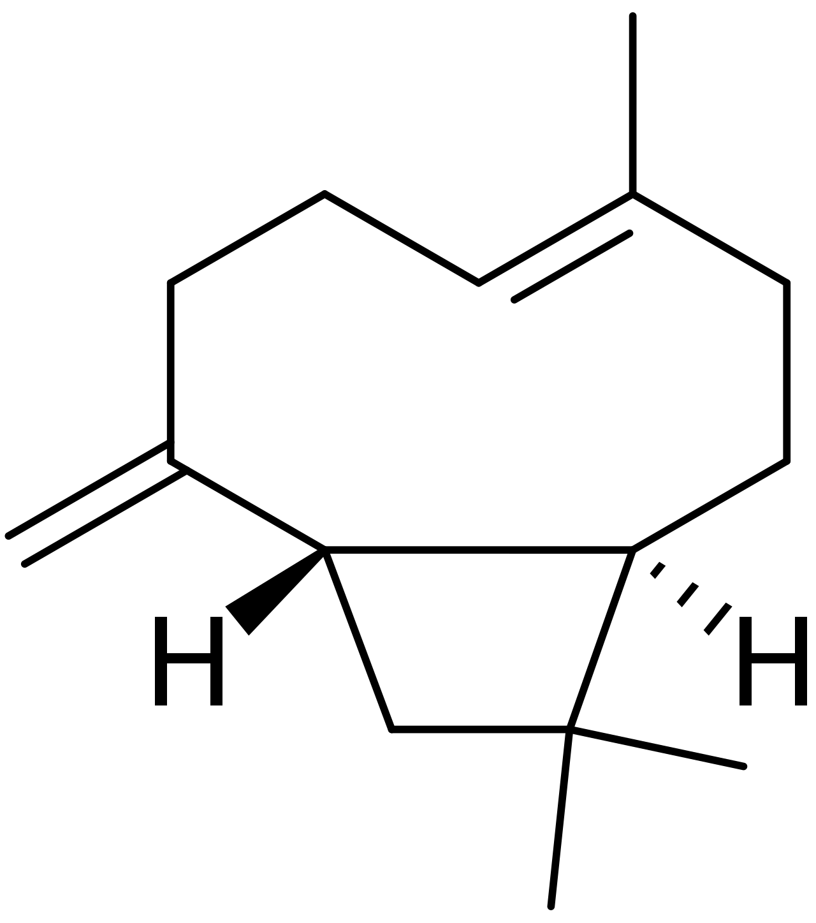
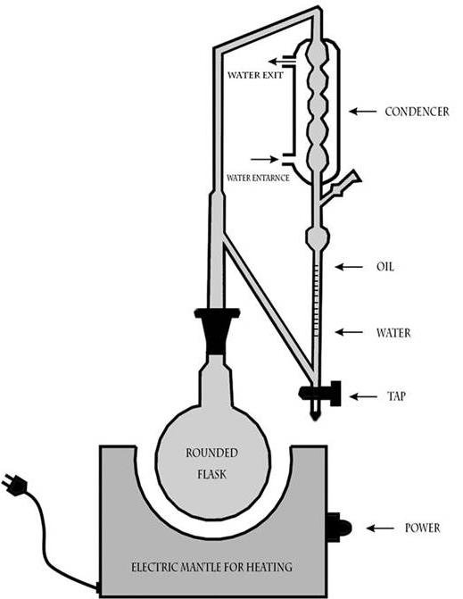
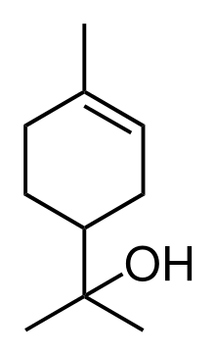
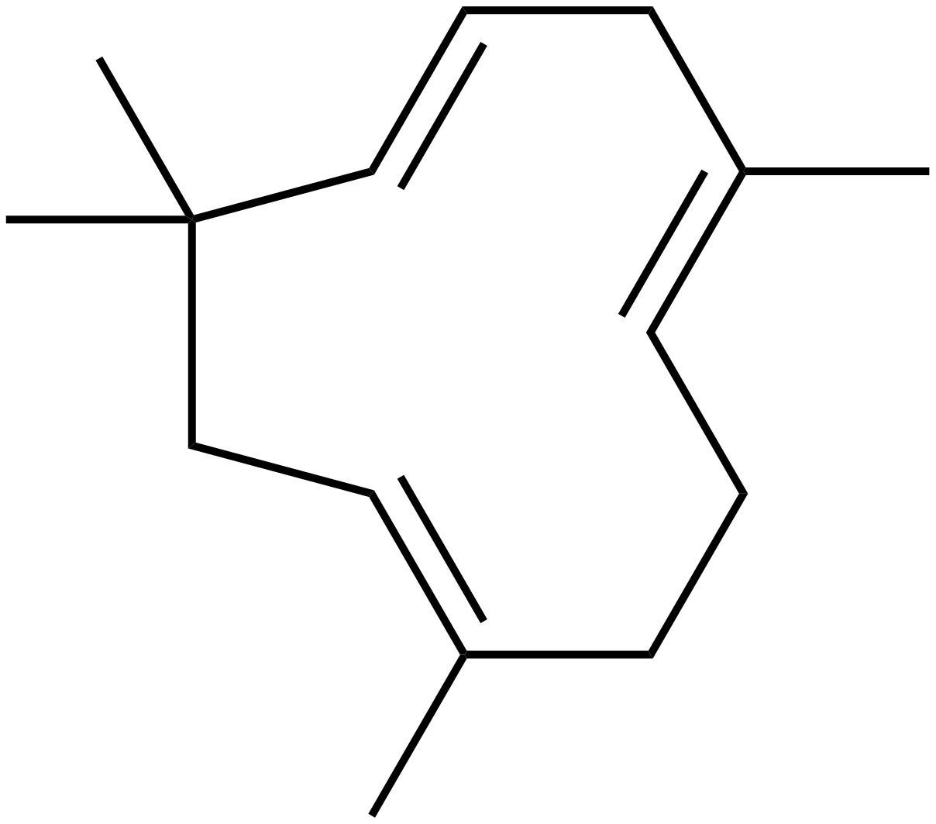

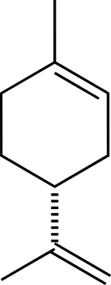
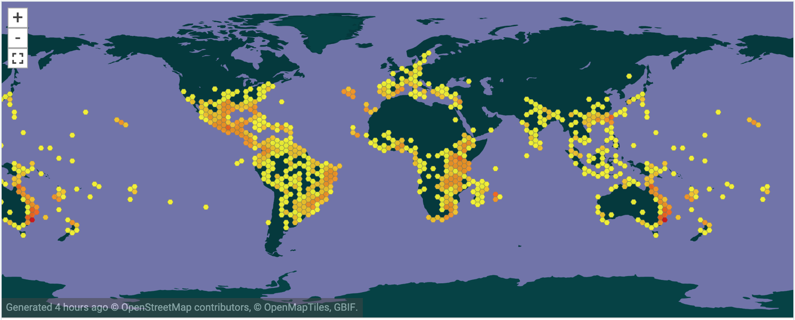
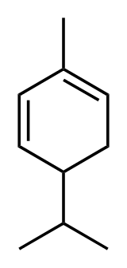
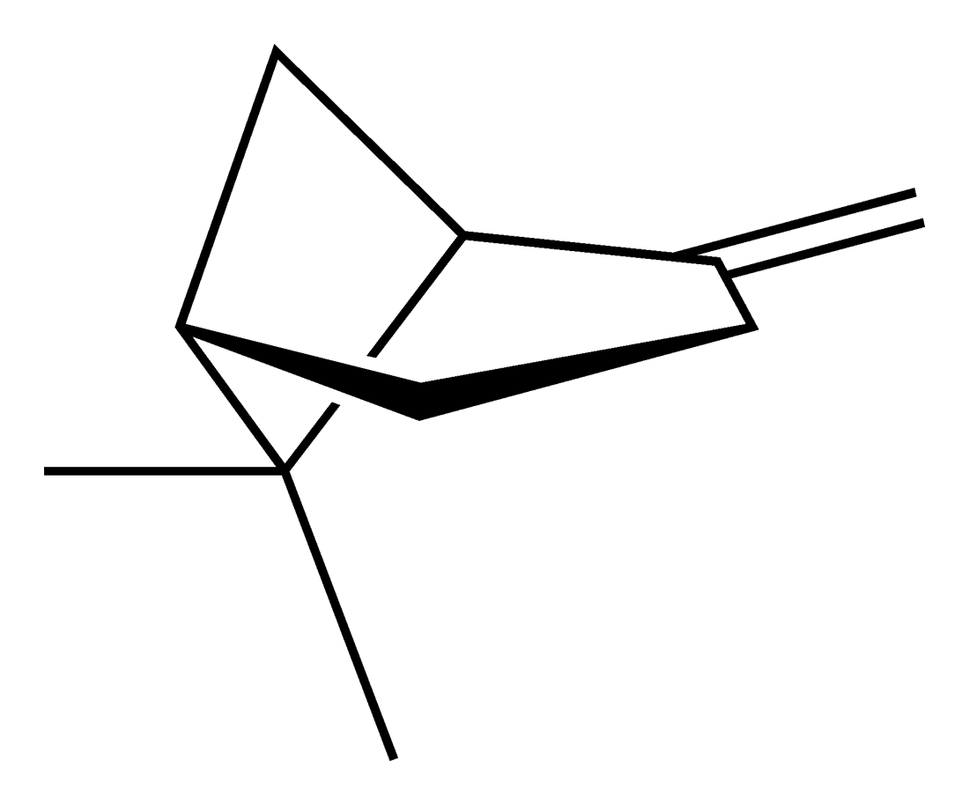
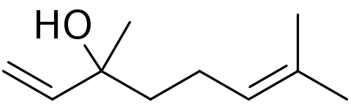
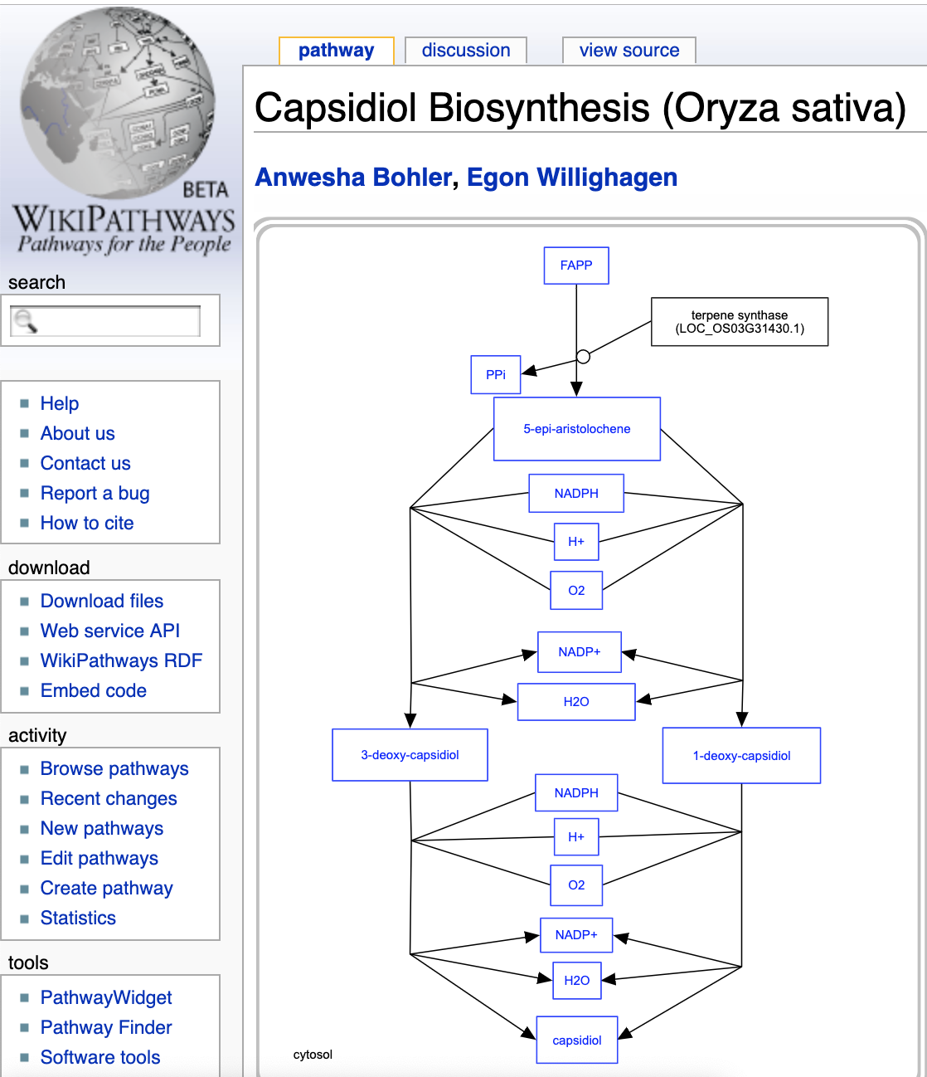
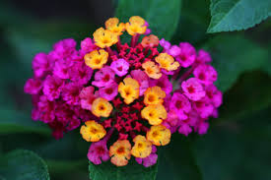
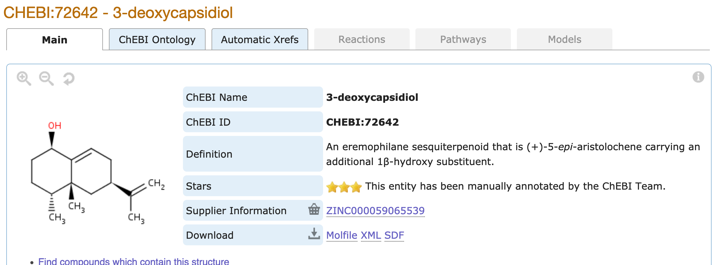
EssoilDB: A semantic phytochemical knowledgebase
Benefits:
Potential preventive and therapeutic agents in pharmacology.
In aroma-therapy, for transdermal delivery of medicines.
Vinita Lamba, Shruthi M¹, Manish Kumar¹, Ambarish Kumar¹, Gitanjali Yadav^{1,2}, Peter Murray-Rust^{2,3}
¹ National Institute of Plant Genome Research, New Delhi, IN; ² University of Cambridge, UK; ³ ContentMine Ltd, Cambridge, UK
Benefits:
Potential preventive and therapeutic agents in pharmacology.
In aroma-therapy, for transdermal delivery of medicines.
For 13 years EssoilDB in NIPGR has captured the plant literature on terpenes; now it’s being upgraded to use new technologies:
TextAndDataMining (TDM) and semantic ontology (Wikidata)
Lantana Essential Oil ^{[4]}
Papers are searched with EssoilDB 2.0/WikiFactMine dictionaries, extracted to enhance EssoilDB 2.0, and progressively indexed
Lantana Essential Oil ^{[4]}
ingestion + annotation of current articles
Check semantics
EssoilDB 2.0
Bibliography (1600)
Independent
variables
Crossref Unpaywall
disambiguate
Location (500)
extraction
GC/MS Instrument – Agilent Technologies ^{[3]}
plant
plantpart
terpene
agriculture
bibliography
microorganism
normalize
plant (1860)
profile (????)
measurement
GC/MS Instrument – Agilent Technologies ^{[3]}
GBIF
Compounds emitted in single experiment
plantpart
compound (7500)
date-time
Pubchem OPSIN
enzyme
datetime
nonplant species
populate
conditions
freetext mined data linked to
EssoilDB 1.0
Syntax, spelling, semantics, disambiguate, link
Wikifactmine Dictionaries (20+)
crops, funders, government, habitat, invasive, pests, soiltypes, viruses…
Wikidata and WikiFactMine link all the components!
Lantana
plantpart
β-caryophyllene
Clevger Apparatus Hydrodistillation ^{[1]}
α-humulene
germacrene D
extraction
α-terpineol
limonene
compound
{Records: ca. 7157}
davanone
α-phellandrene
γ-curcumene
β-pinene
β-elemene
linalool
1,8-cineole
myrcene
1-octen-3-ol
sabinene
γ-cadinene
GBIF
measurement
Commonly used plantparts of Lantana
profile (????)
Compound
Wikipathways

