Slide 1

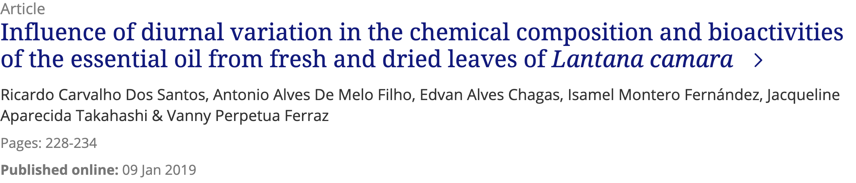

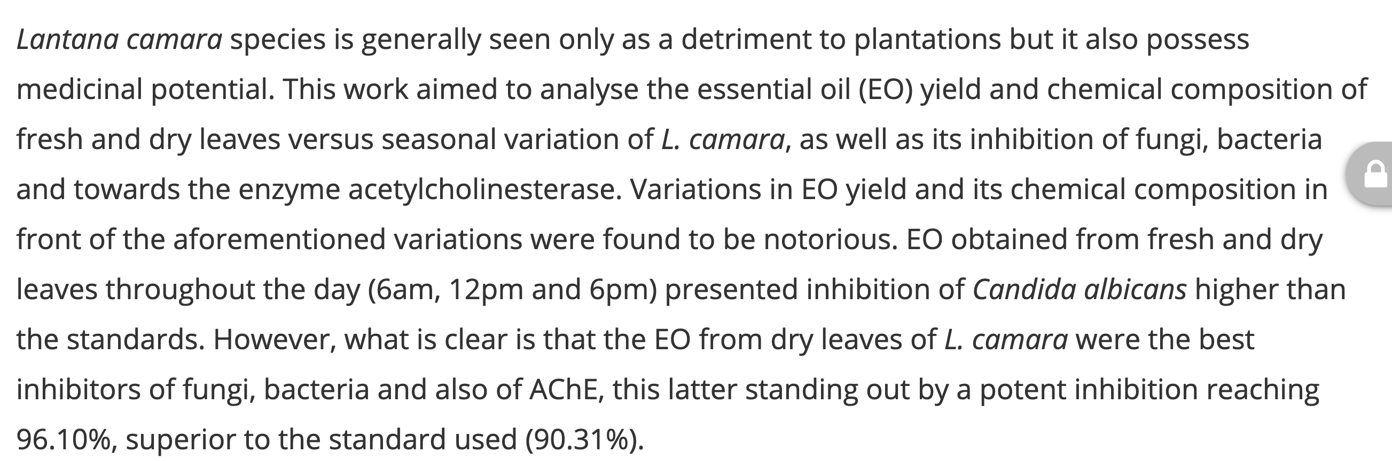

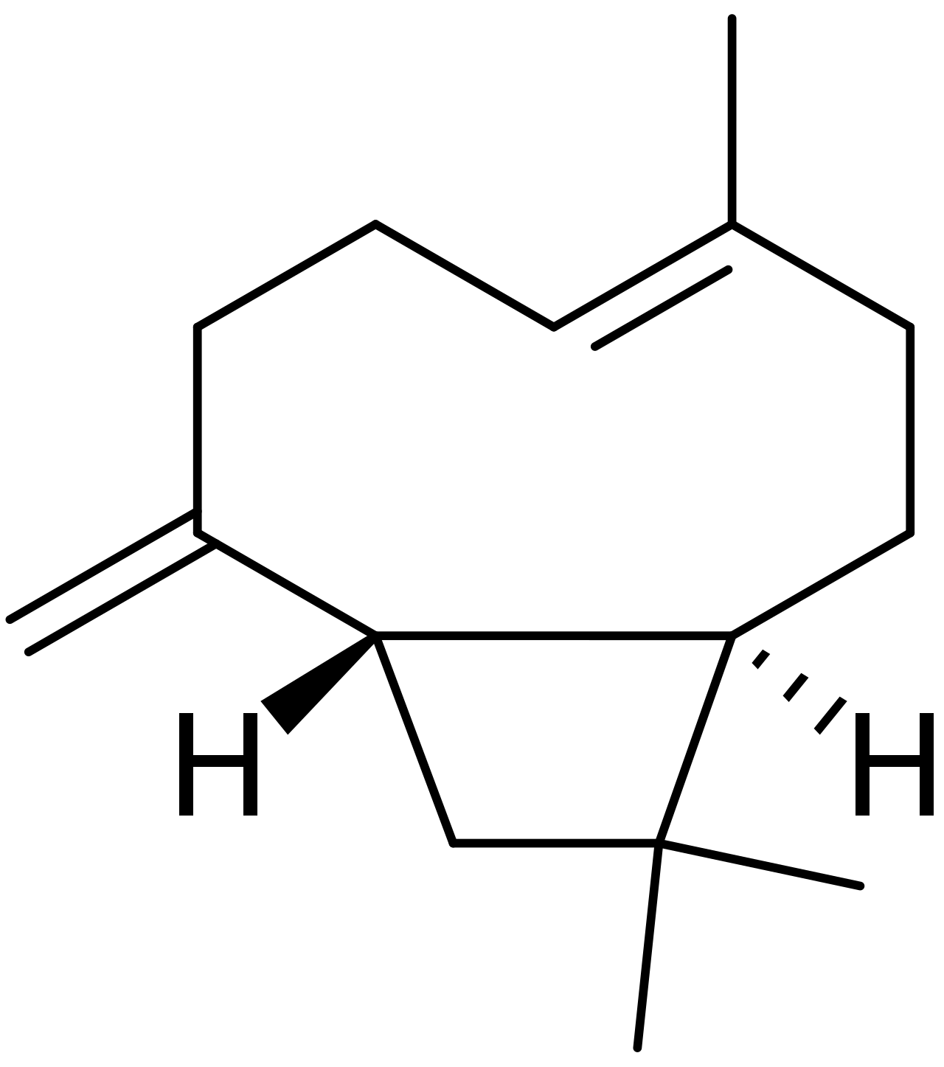
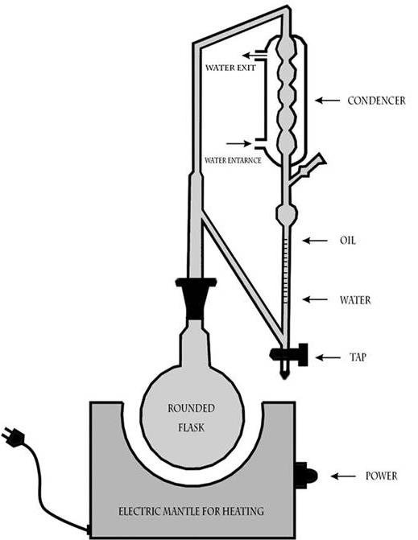
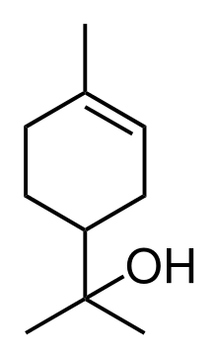
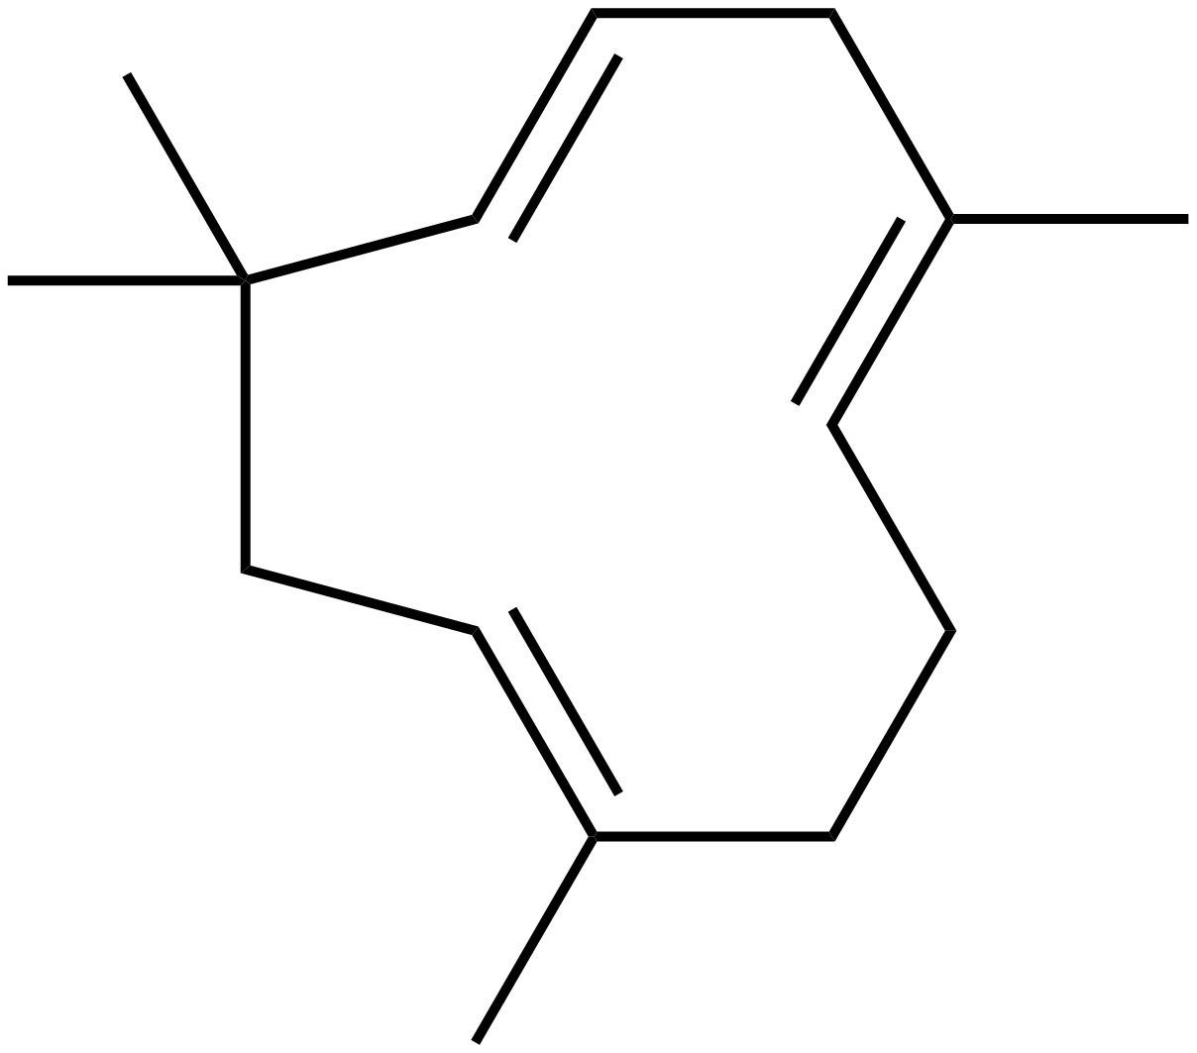
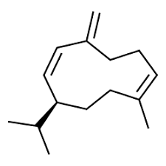
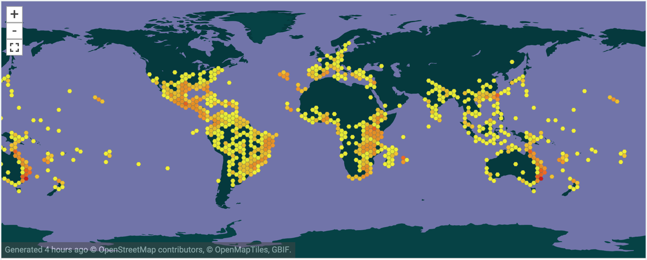

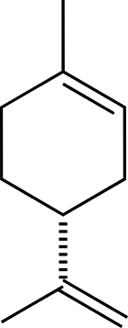
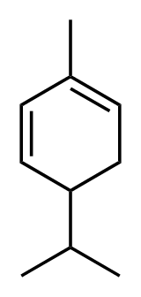
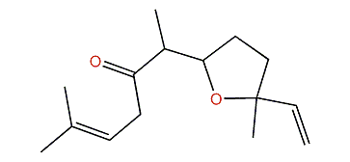
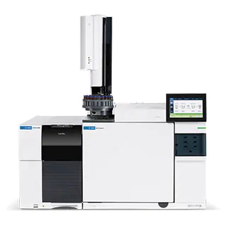
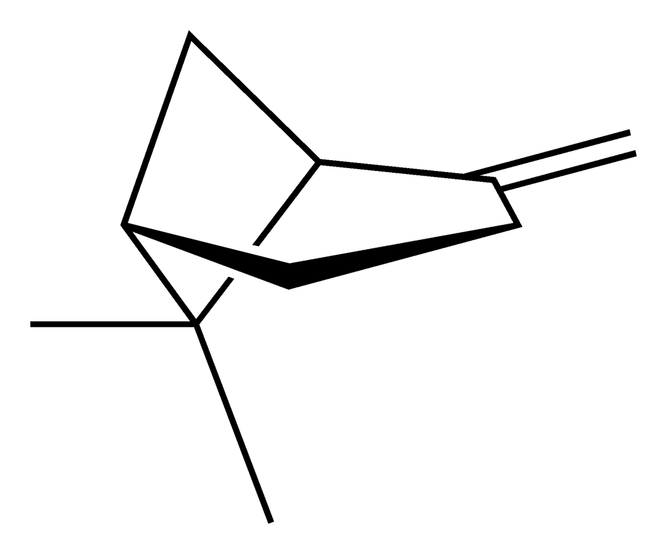
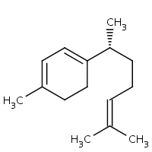
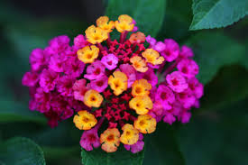
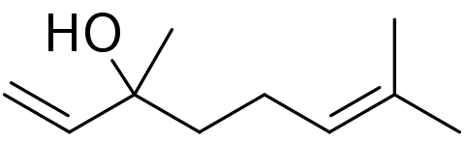
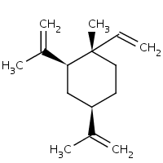
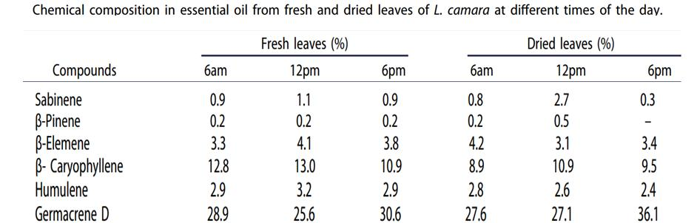
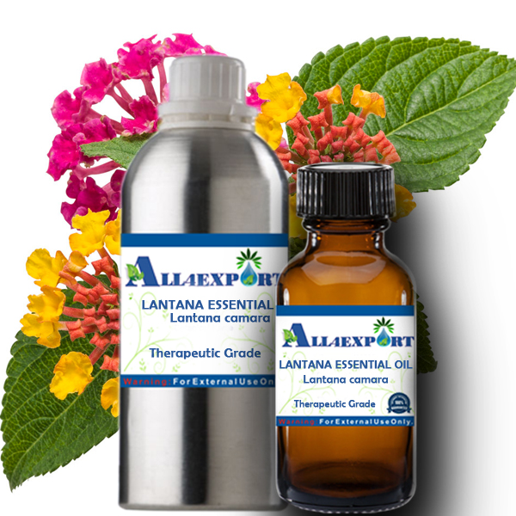
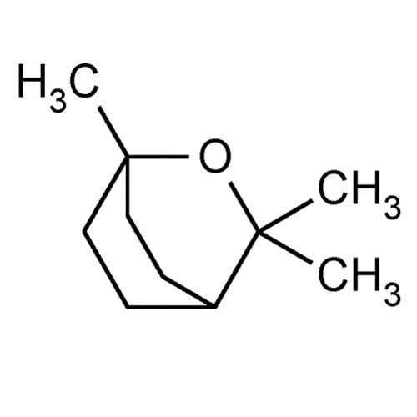

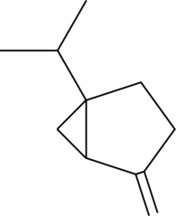
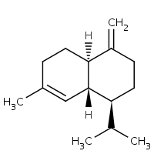
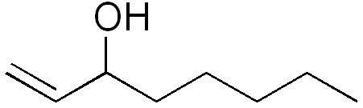
EssoilDB: A semantic phytochemical knowledgebase
Vinita Lamba, Shruthi M¹, Manish Kumar¹, Ambarish Kumar¹, Gitanjali Yadav^{1,2}, Peter Murray-Rust^{2,3}
¹ National Institute of Plant Genome Research, New Delhi, IN; ² University of Cambridge, UK; ³ ContentMine Ltd, Cambridge, UK
Plants are capable of generating a diverse spectrum of volatile organic compounds for maintaining communication and fruitful adaptive interaction with their environment. These are proven to be important protective and signalling molecules & constitute a platform for plant–plant interaction. For 13 years, EssoilDB in NIPGR, has captured the plant literature on terpenes (class of phytochemicals)
In 2019-02 [1] GY, VL, AK collaborated with ContentMine/PMR to run a workshop on mining the plant literature. We deployed Open text-mining tools (ContentMine’s getpapers, AMI) and used Wikipedia/Wikidata to create WikiFactMine dictionaries (e.g. pests, microorganisms, soiltypes, invasive species, spices…) and showed that Open semantic text-mining was robust and could be deployed in many areas of Plant Science.
Wikidata (a Wikimedia project) has over 50 million items of Open semantic information including on Open Plant Science. Items have unique identifiers (Q numbers) related by properties (P).
Example: “the invasive species Lantana camara has Global Invasive Species Database ID 56” is represented by the triple: Q332469 P5626 “56”
This is creating a global knowledge graph.
Now we are creating a new version of EssoilDB (2.0) with semantic objects linked to Wikidata
TextMining uses E2.0 and also builds E2.0
Bibliography (1600)
ingestion + annotation of current articles
EssoilDB table
Check semantics
EssoilDB 2.0
Crossref Unpaywall
dictionary
disambiguate
Independent
variables
bibliography
Location (500)
profile (????)
extraction
plant
plantpart
terpene
agriculture
microorganism
normalize
plant (1860)
Compounds emitted in single experiment
measurement
GBIF TRNS
plantpart
compound (7500)
date-time
Pubchem OPSIN
enzyme
datetime
nonplant species
populate
conditions
freetext mined data linked to
EssoilDB 1.0
Syntax, spelling, semantics, disambiguate, link
Wikifactmine Dictionaries (20+)
crops, funders, government, habitat, invasive species, organisms,, pests, soiltypes, viruses…mono-, di-, triterpens,
key
Table(count)
Open lookup/disambiguation
Components in EssoilDB 2.0 (illustrated by L. camara)
β-caryophyllene
Clevger Apparatus Hydrodistillation ^{[1]}
α-humulene
germacrene D
extraction
α-terpineol
limonene
Compound
(7000+)
davanone
α-phellandrene
γ-curcumene
GBIF
β-pinene
β-elemene
linalool
1,8-cineole
myrcene
1-octen-3-ol
γ-cadinene
measurement
sabinene
Profile
Commonly used plant-parts of Lantana
Compound
References PMR
Rexammples of querries PMR
Funding and thanks
https://tigr2ess.globalfood.cam.ac.uk/news/adventures-r-reflections-tigr2ess-workshop-r-genomics-and-data-mining

