Slide 1
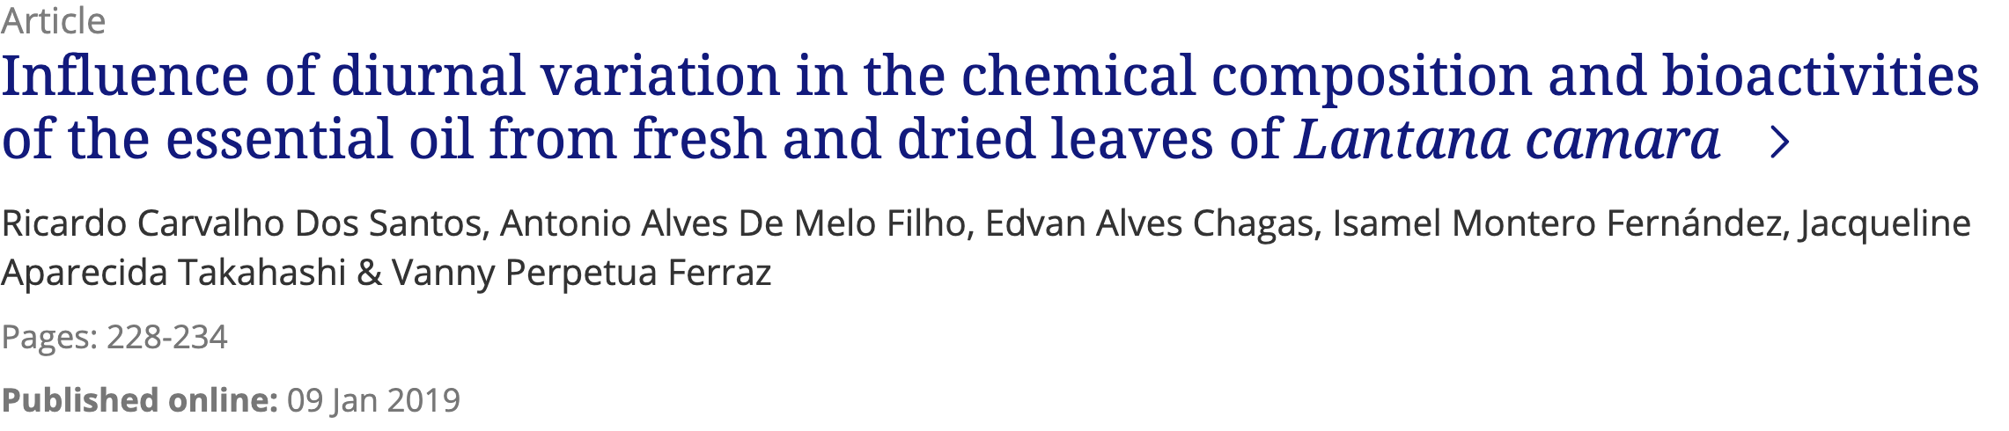

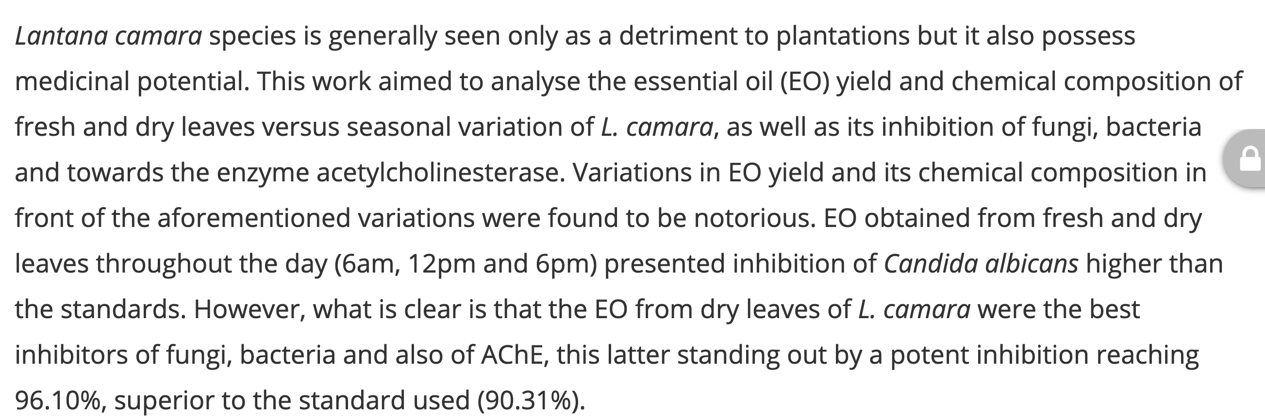

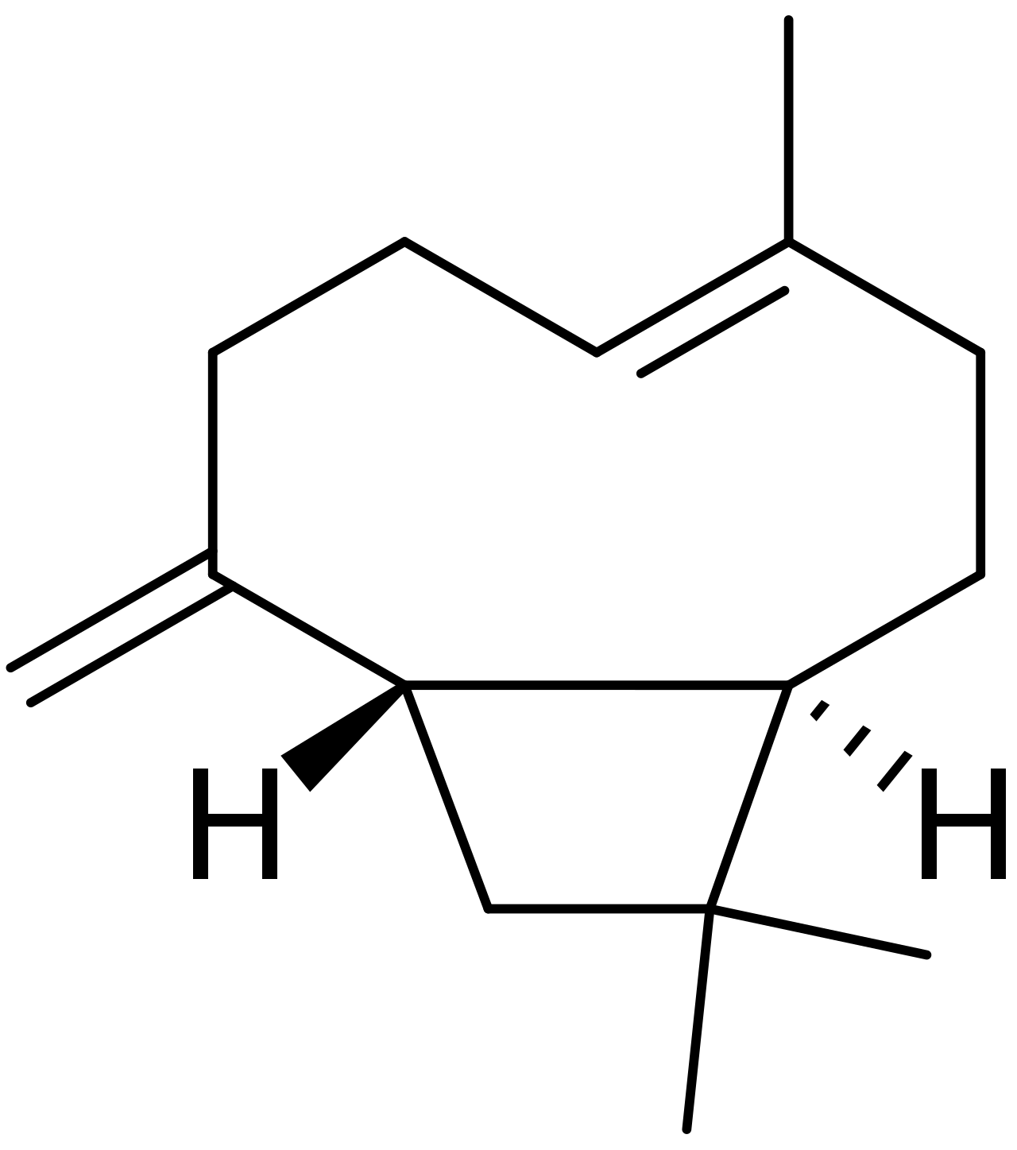
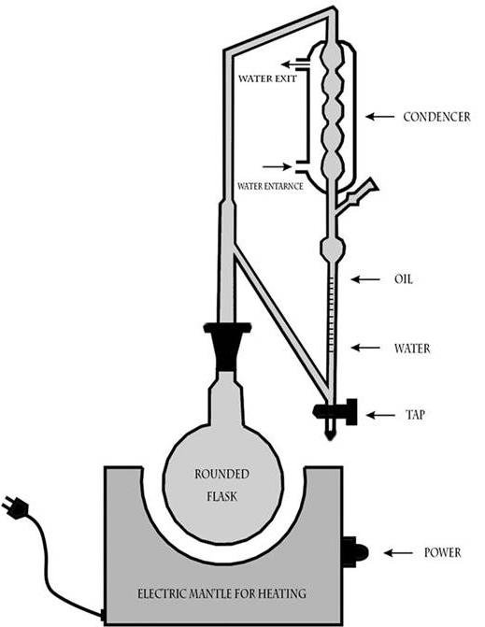
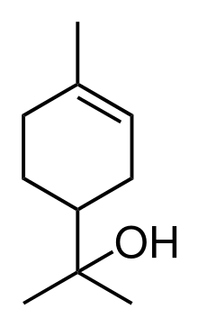
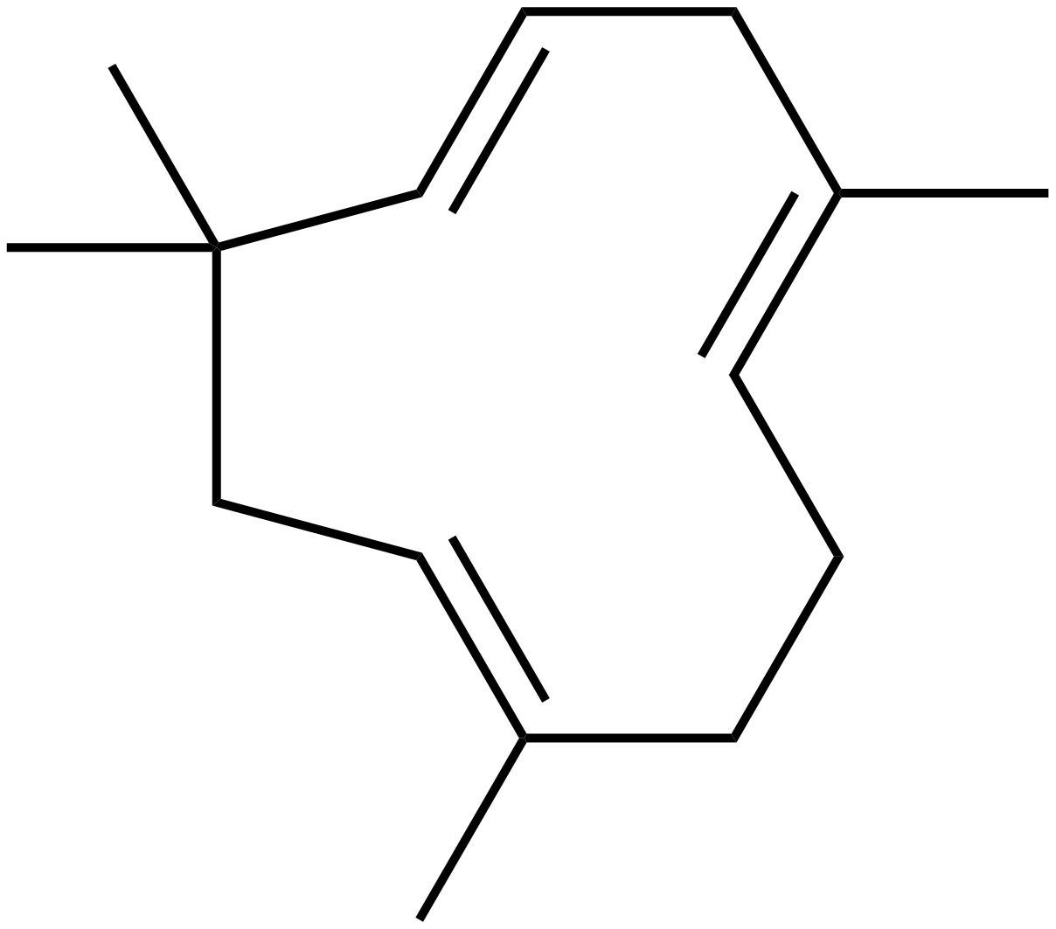

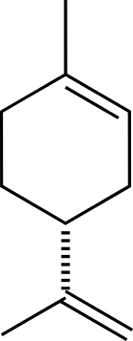
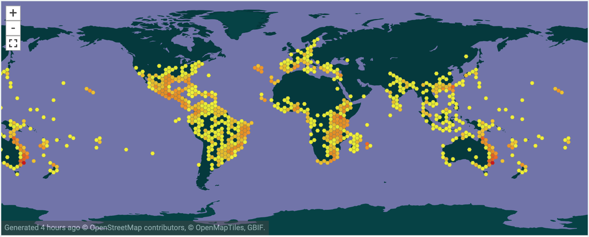
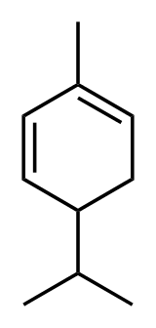
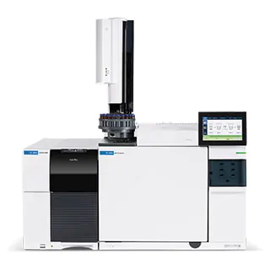
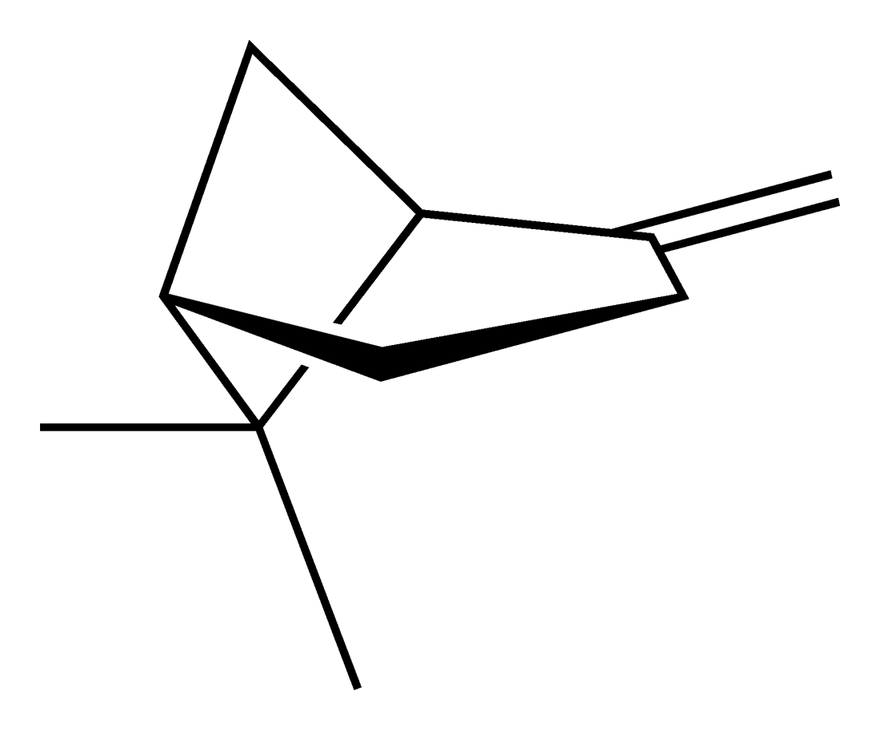
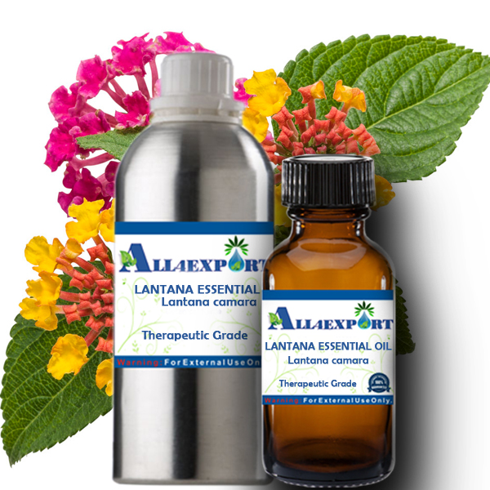
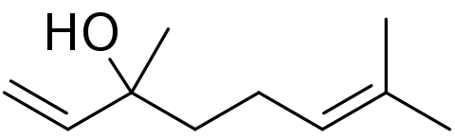
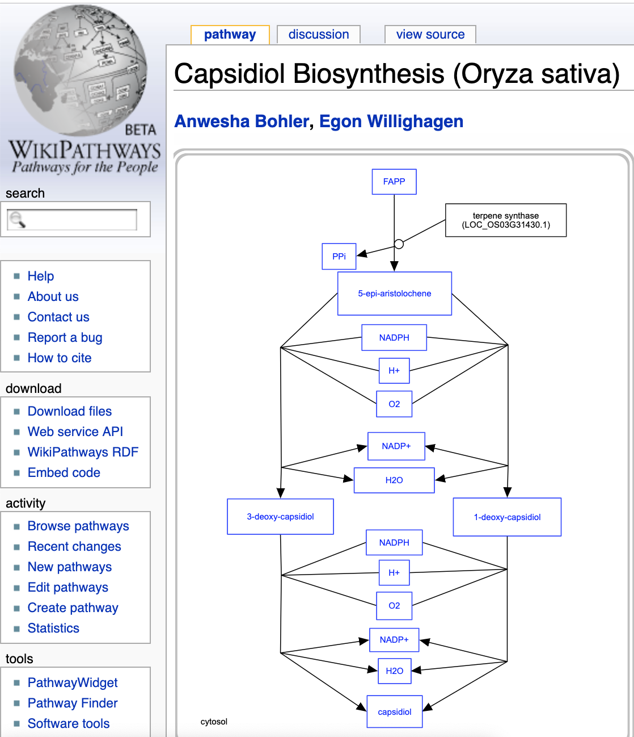
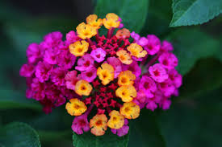
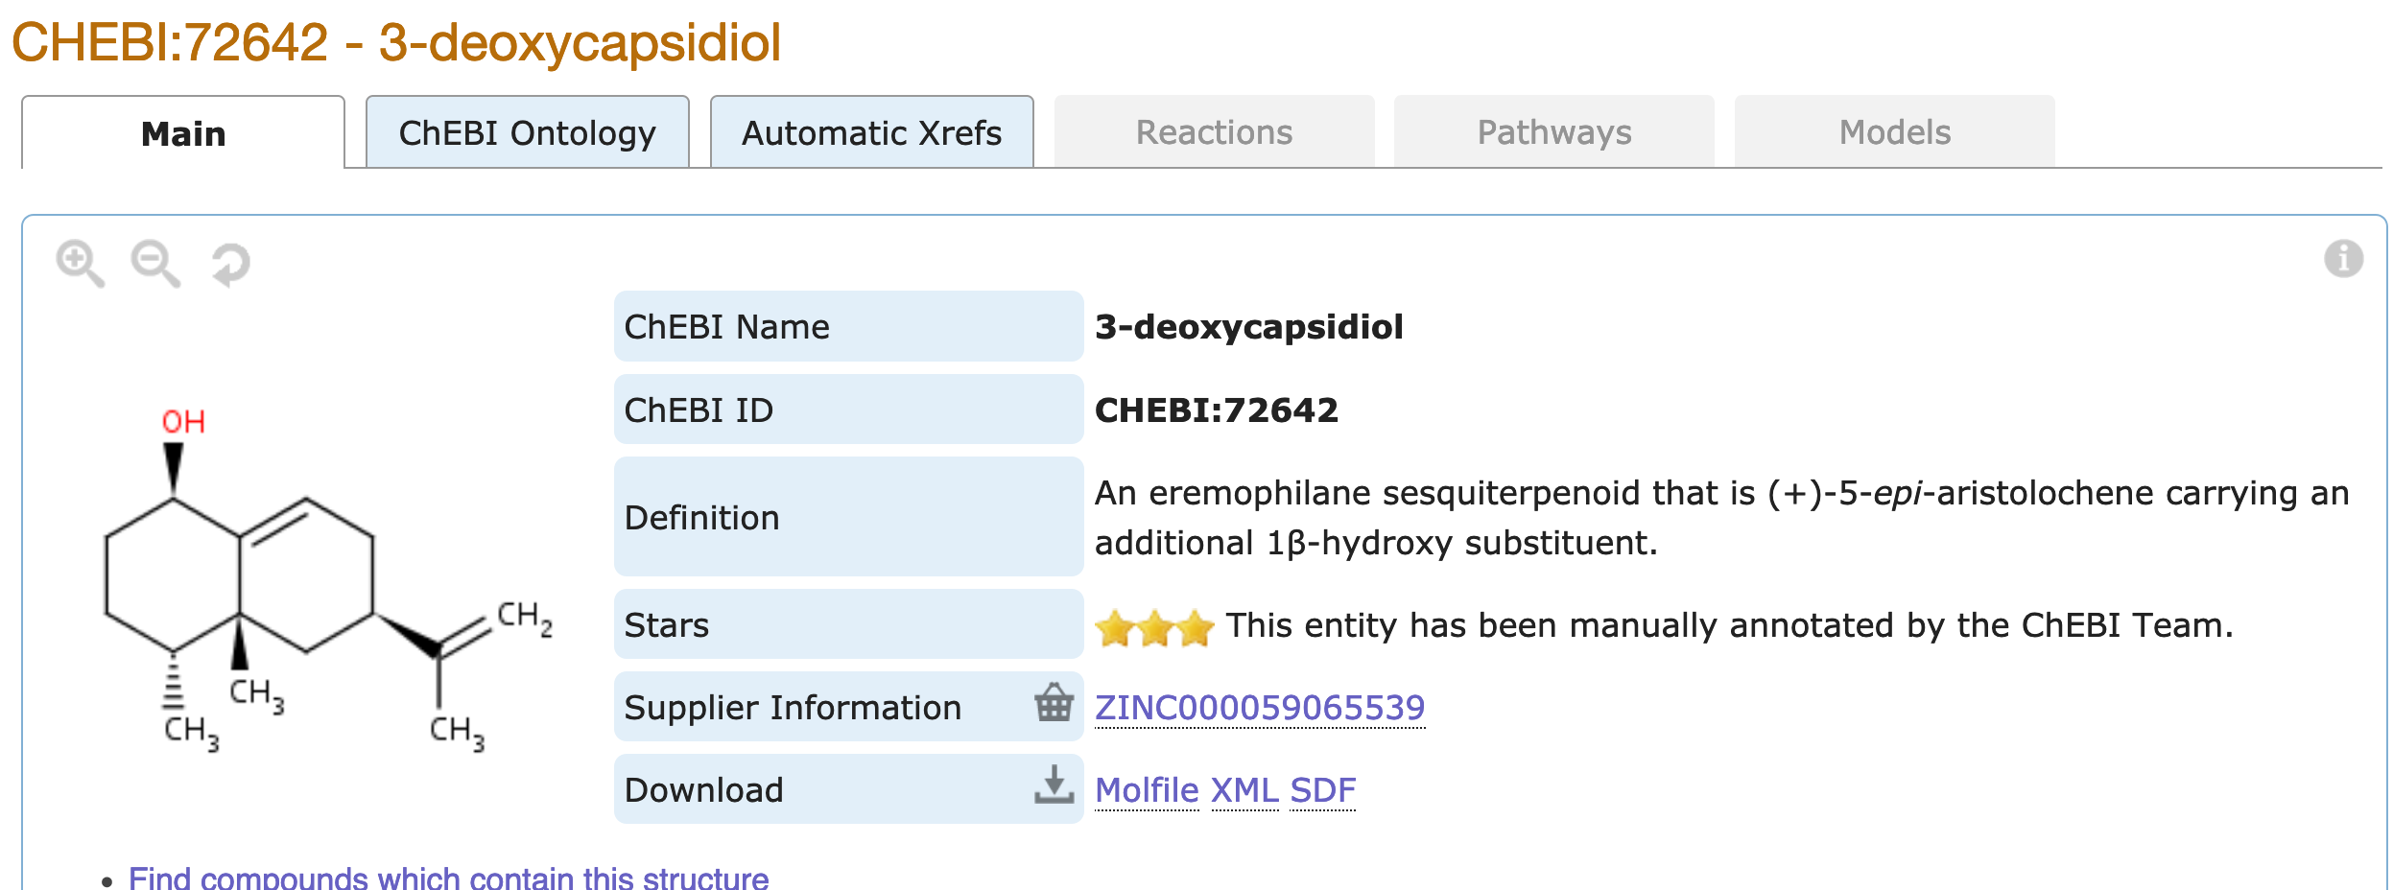
EssoilDB: A semantic phytochemical knowledgebase
Vinita Lamba, Shruthi M¹, Manish Kumar¹, Ambarish Kumar¹, Gitanjali Yadav^{1,2}, Peter Murray-Rust^{2,3}
¹ National Institute of Plant Genome Research, New Delhi, IN; ² University of Cambridge, UK; ³ ContentMine Ltd, Cambridge, UK
For 13 years EssoilDB in NIPGR has captured the plant literature on terpenes; now it’s being upgraded to use new technologies:
TextAndDataMining (TDM) and semantic ontology (Wikidata)
Papers are searched with EssoilDB 2.0/WikiFactMine dictionaries, extracted to enhance EssoilDB 2.0, and progressively indexed
ingestion + annotation of current articles
Check semantics
EssoilDB 2.0
Bibliography (1600)
Independent
variables
Crossref Unpaywall
bibliography
disambiguate
Location (500)
profile (????)
extraction
plant
plantpart
terpene
agriculture
microorganism
normalize
plant (1860)
Compounds emitted in single experiment
measurement
GBIF
plantpart
compound (7500)
date-time
Pubchem OPSIN
enzyme
datetime
nonplant species
populate
conditions
freetext mined data linked to
EssoilDB 1.0
Syntax, spelling, semantics, disambiguate, link
Wikifactmine Dictionaries (20+)
crops, funders, government, habitat, invasive, pests, soiltypes, viruses…
Wikidata and WikiFactMine link all the components!
Lantana
plantpart
β-caryophyllene
Clevger Apparatus Hydrodistillation ^{[1]}
α-humulene
germacrene D
extraction
α-terpineol
limonene
compound
{Records: ca. 7157}
davanone
α-phellandrene
γ-curcumene
β-pinene
β-elemene
linalool
1,8-cineole
myrcene
1-octen-3-ol
sabinene
γ-cadinene
GBIF
measurement
Commonly used plantparts of Lantana
profile (????)
Compound
Wikipathways

