Slide 1



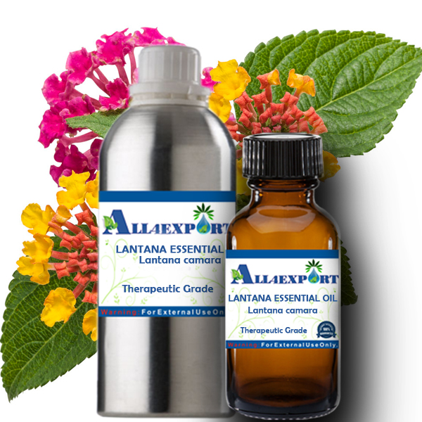
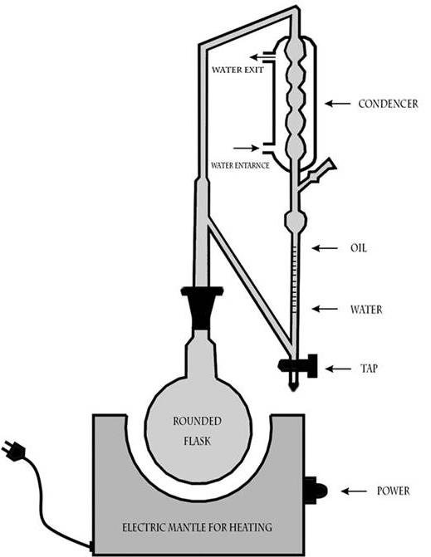

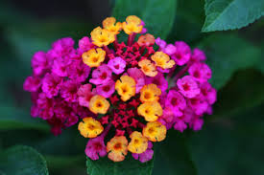
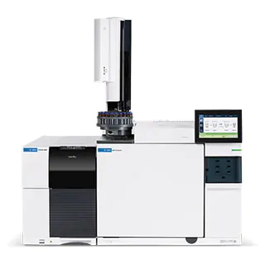
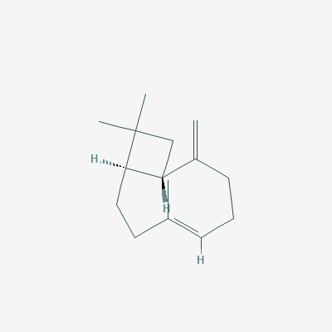
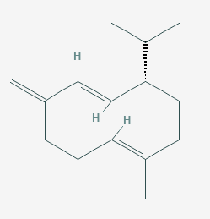
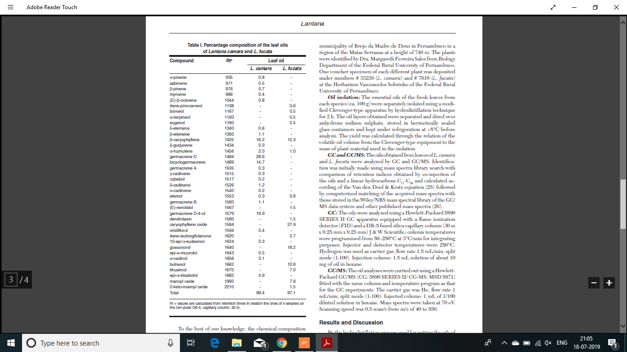
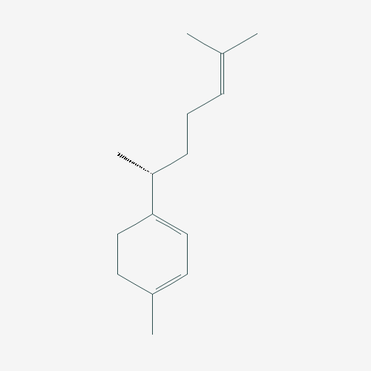
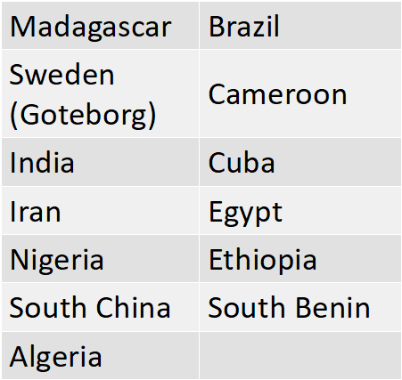
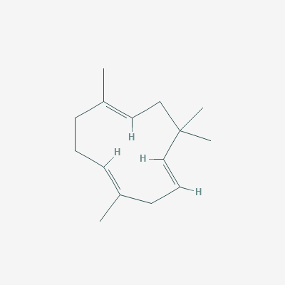
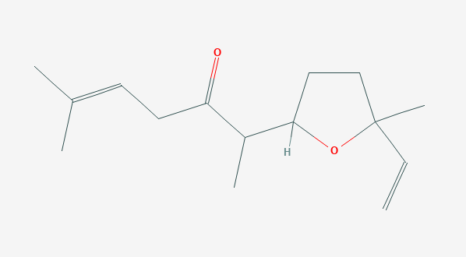
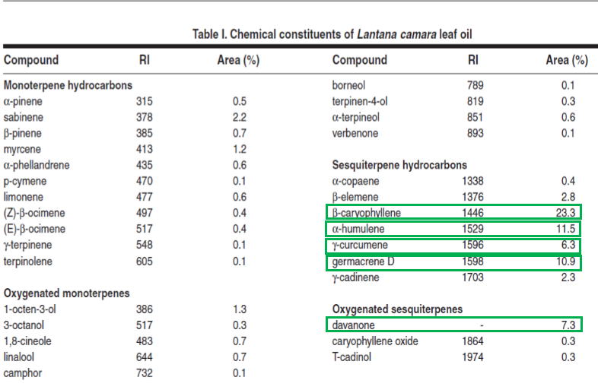
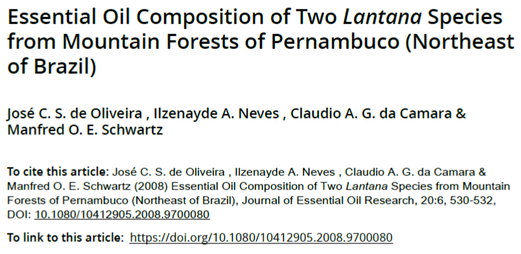
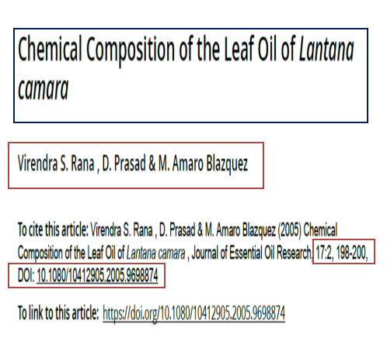
EssoilDB: A Semantic Knowledge base for Synthetic Phytochemistry
EssOilDB:
The EssOilDB (the ESSential OIL DataBase) is an organized collection of plant volatile emissions, containing experimental records of essential oil composition data, from published reports.
plant
{Records: ca 1800}
Benefits:
Potential preventive and therapeutic agents in pharmacology.
In aroma-therapy, for transdermal delivery of medicines.
plantpart
profile
Most commonly used parts of Lantana
Record of the experimental conditions and metadata.
Clevenger Apparatus Hydrodistillation ^{[1]}
extraction
Leaves
Clevenger Apparatus Hydrodistillation ^{[1]}
Fruits
Flowers
β-caryophyllene
Lantana Essential Oil ^{[4]}
α-humulene
germacrene D
Importance:
Context based scientific research, through a multitude of queries on volatile profiles of native, invasive, normal or stressed plants, across taxonomic clades, geographical locations and several other biotic and abiotic influences.
analyticaldata
α-terpineol
limonene
davanone
profiledata
α-phellandrene
compound
{Records: ca. 7157}
This is the chemical data associated with a profile
GC/MS Instrument – Agilent Technologies ^{[3]}
β-pinene
γ-curcumene
β-caryophyllene
Inferences:
The most prominent essential oil produced by a particular species
The part of the plant which yields maximum amount of the desired compound
The location at which a particular species produes maximum amount of terpenes
Seasonal changes in the production of essential oils
linalool
β-elemene
1,8-cineole
germacrene D
myrcene
1-octen-3-ol
γ-cadinene
sabinene
location
Conclusions:
Creation of EssOilDB is an attempt to provide a systematic compilation of essential oil profiles along with the details of their sources for the benefit of not only scientific community but also for the layman, entrepreneurs and farmers in exploring volatiles and their properties. As evident from the benchmarking analysis presented here, EssOilDB is the first and only database that enables a rigorous scientific assessment of plant essential oils in context of their surroundings and in a comparative manner.
γ-curcumene
α-humulene
Global distribution of lantana (2007)
Davanone
REFERENCES:
1. Ismaiel, Omnia & Abdelghani, Essam & Mousa, Heba & Eldahmy, Samih & Bayoumy, B.E.. (2016). Determination of Estragole in Pharmaceutical Products, Herbal Teas and Herbal Extracts Using GC-FID. Journal of Applied Pharmaceutical Science. 6. 144-150. 10.7324/JAPS.2016.601220.
2. Subhashni Taylor and Lalit Kumar, (2014). Impacts of climate change on invasive Lantana camara L. distribution in South Africa. African Journal of Environmental Science and Technology. Vol. 8(6), pp. 391-400, June 2014 DOI: 10.5897/AJEST2014.1705
3. https://www.agilent.com/en/products/gas-chromatography-mass-spectrometry-gc-ms/gc-ms-instruments
4. http://www.all4export.com/index.php?route=product/product&product_id=411
The outline of the flower was taken from http://clipartmag.com/images/sunflower-black-and-white-clipart-11.jpg . All the other images are taken from Wikimedia

