Slide 1
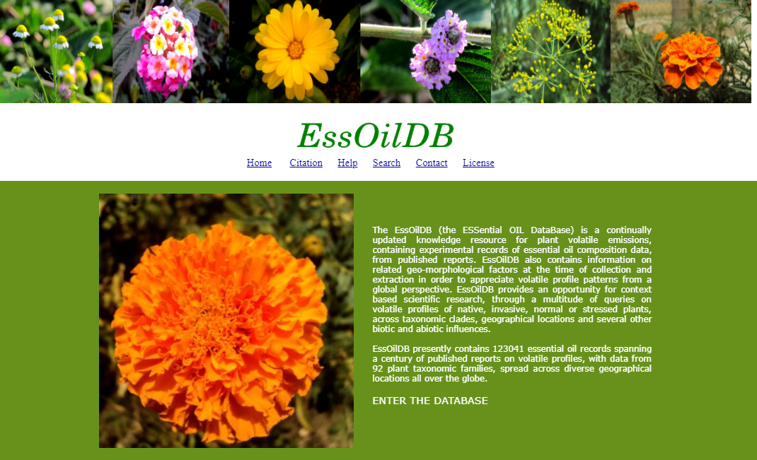
What is EssOilDB?
The EssOilDB (the ESSential OIL DataBase) is an organized collection of plant volatile emissions, containing experimental records of essential oil composition data, from published reports.
Why is it important?
EssOilDB provides an opportunity for context based scientific research, through a multitude of queries on volatile profiles of native, invasive, normal or stressed plants, across taxonomic clades, geographical locations and several other biotic and abiotic influences.
What can I infer?
The most prominent essential oil produced by a particular species
The part of the plant which yields maximum amount of the desired compound
The number of families that contribute to one particular terpene
The location at which a particular species produes maximum amount of terpenes
Seasonal changes in the production of essential oils

Slide 2
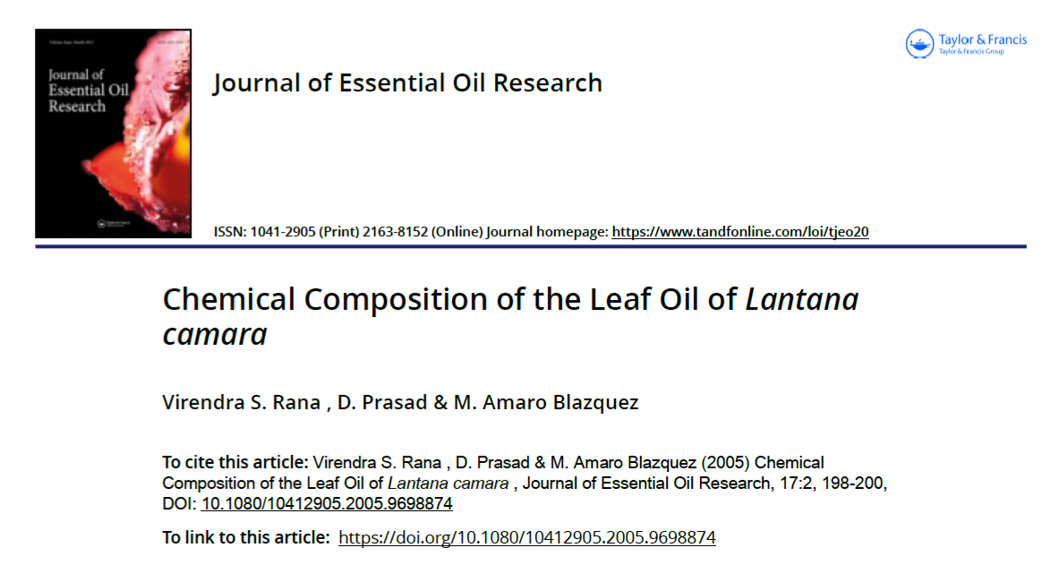
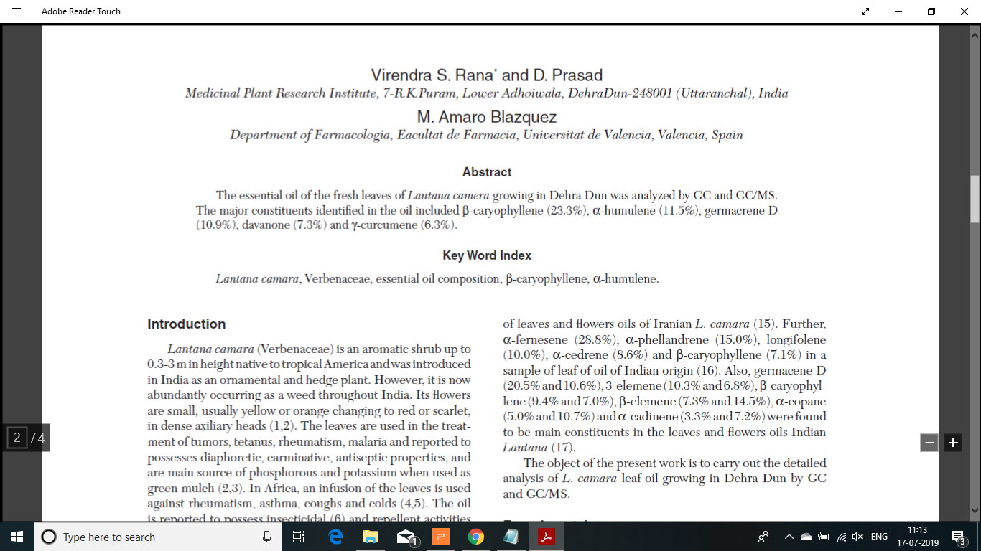
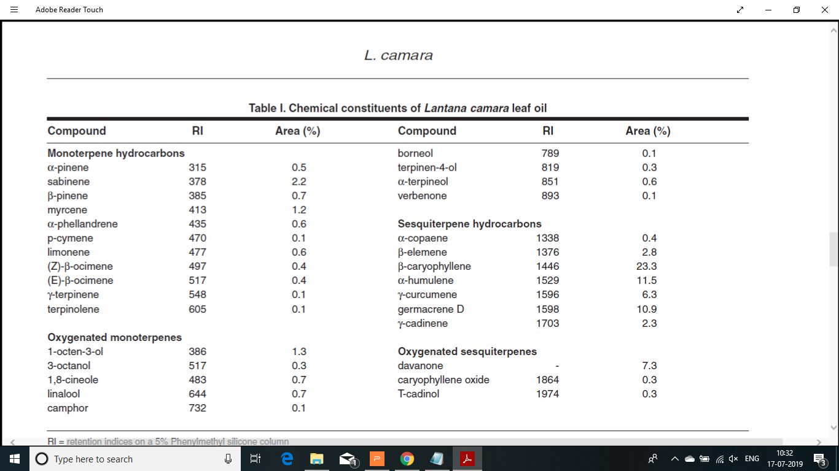

Slide 3

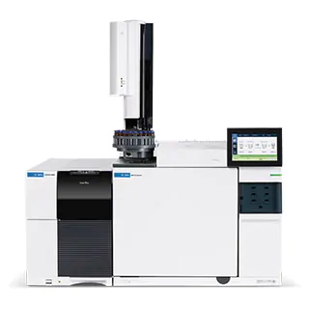
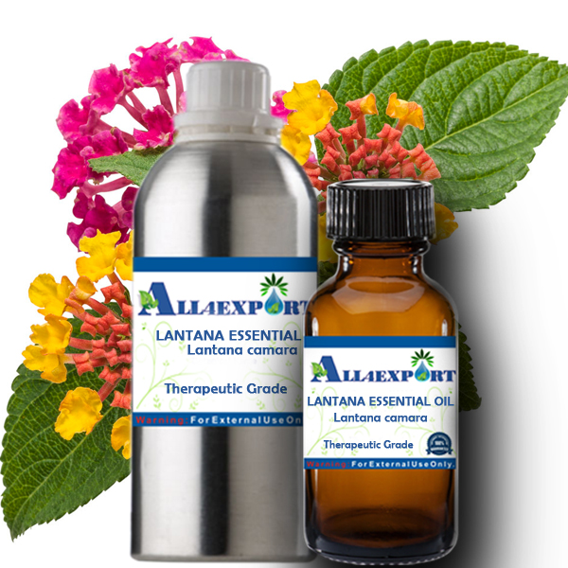
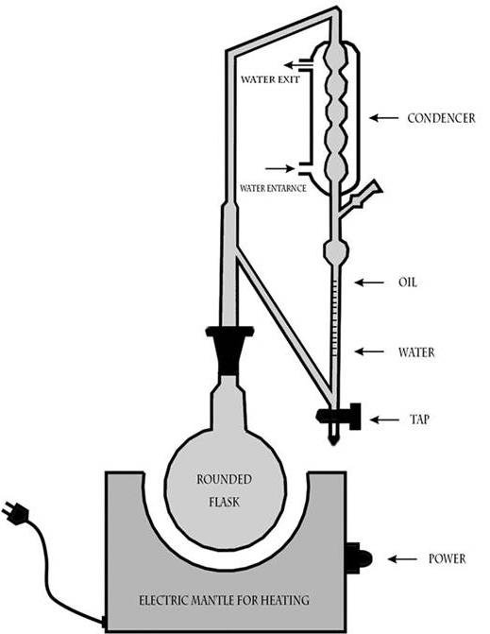
Profile
Lantana camara
Source: http://www.pioneeredge.in/e-portals-incursive-plants-invade-indian-soil/
Clevenger Apparatus Hydrodistillation
Source: Ismaiel, et al, 2016
GC/MS
Source: https://www.agilent.com/en/products/gas-chromatography-mass-spectrometry-gc-ms/gc-ms-instruments
Source: http://www.all4export.com/index.php?route=product/product&product_id=411
Notes:
Reference for the Levenger Apparatus: Ismaiel, Omnia & Abdelghani, Essam & Mousa, Heba & Eldahmy, Samih & Bayoumy, B.E.. (2016). Determination of Estragole in Pharmaceutical Products, Herbal Teas and Herbal Extracts Using GC-FID. Journal of Applied Pharmaceutical Science. 6. 144-150. 10.7324/JAPS.2016.601220.

