Slide 1
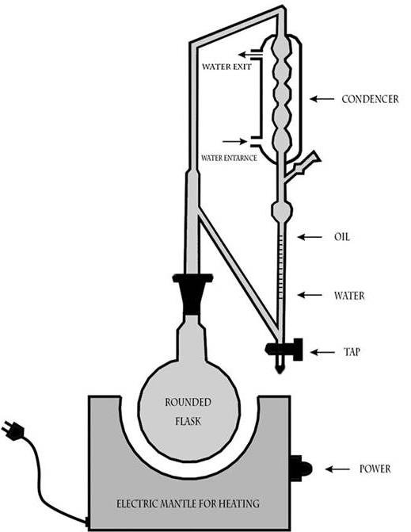
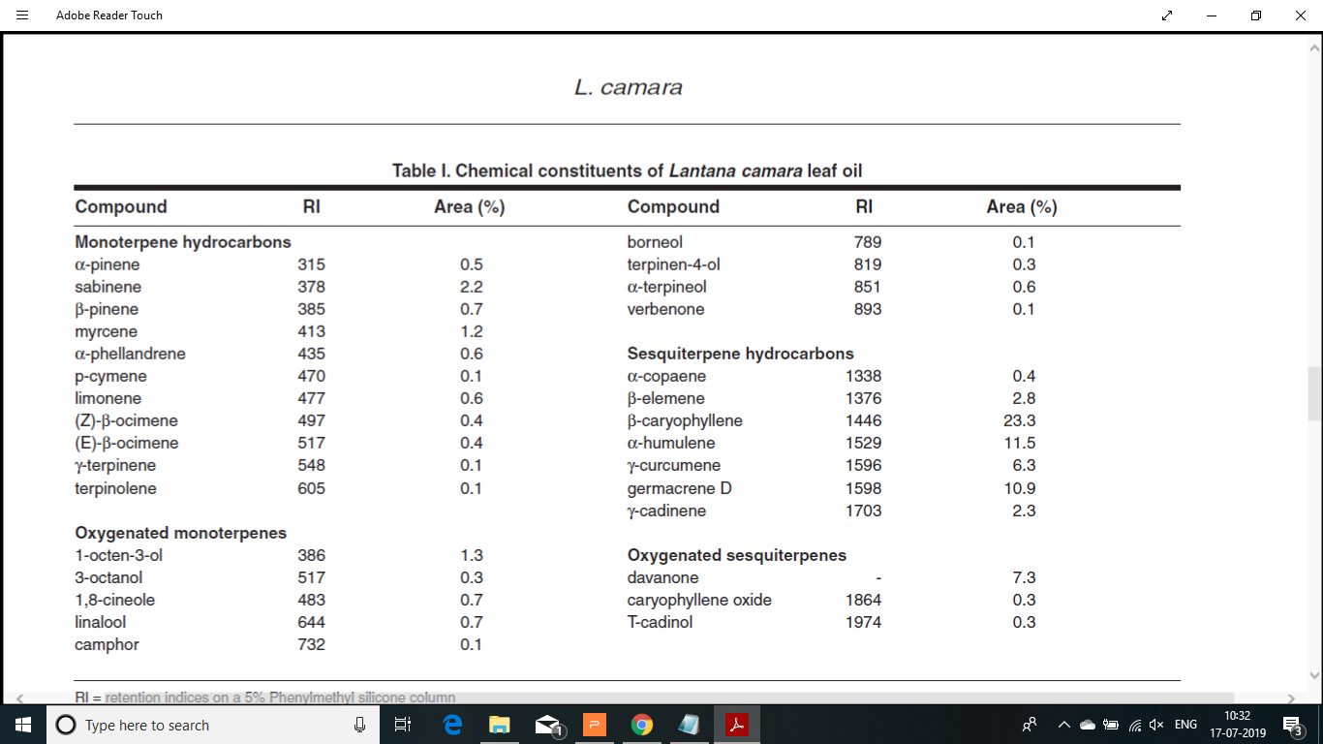
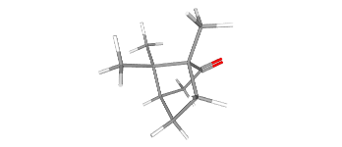

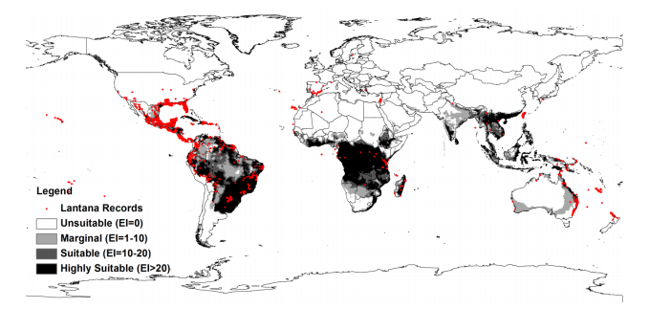

Extraction
{Records: }
Profile
{Records: }
Why is it important?
Context based scientific research, through a multitude of queries on volatile profiles of native, invasive, normal or stressed plants, across taxonomic clades, geographical locations and several other biotic and abiotic influences.
What is EssOilDB?
The EssOilDB (the ESSential OIL DataBase) is an organized collection of plant volatile emissions, containing experimental records of essential oil composition data, from published reports.
Clevenger Apparatus Hydrodistillation ^{[1]}
Plantpart
{Records: }
EssoilDB: A Semantic Knowledge base for Synthetic Phytochemistry
Profiledata
{Records: }
What can I infer?
The most prominent essential oil produced by a particular species
The part of the plant which yields maximum amount of the desired compound
The number of families that contribute to one particular terpene
The location at which a particular species produes maximum amount of terpenes
Seasonal changes in the production of essential oils
Camphor
Location
{Records: 878}
Analyticaldata
Global distribution of lantana based on records taken from the Global Biodiversity Information Facility
2007 together with the current potential global distribution of lantana modelled by CLIMEX for reference climate (averaging
period 1950-2000).⁽²⁾
CONCLUSIONS:
GC/MS Instrument – Agilent Technologies ^{[3]}
Beta-Caryophyllene
REFERENCES:
1. Ismaiel, Omnia & Abdelghani, Essam & Mousa, Heba & Eldahmy, Samih & Bayoumy, B.E.. (2016). Determination of Estragole in Pharmaceutical Products, Herbal Teas and Herbal Extracts Using GC-FID. Journal of Applied Pharmaceutical Science. 6. 144-150. 10.7324/JAPS.2016.601220.
2. Subhashni Taylor and Lalit Kumar, (2014). Impacts of climate change on invasive Lantana camara L. distribution in South Africa. African Journal of Environmental Science and Technology. Vol. 8(6), pp. 391-400, June 2014 DOI: 10.5897/AJEST2014.1705
3. https://www.agilent.com/en/products/gas-chromatography-mass-spectrometry-gc-ms/gc-ms-instruments

