Slide 1
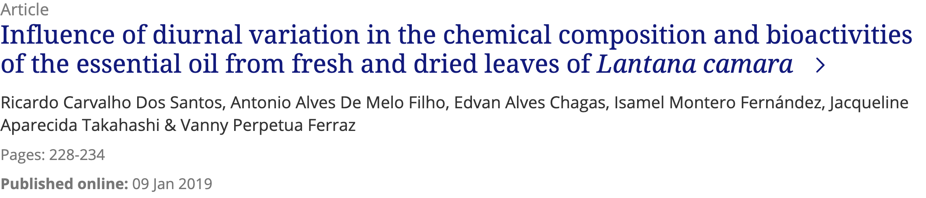

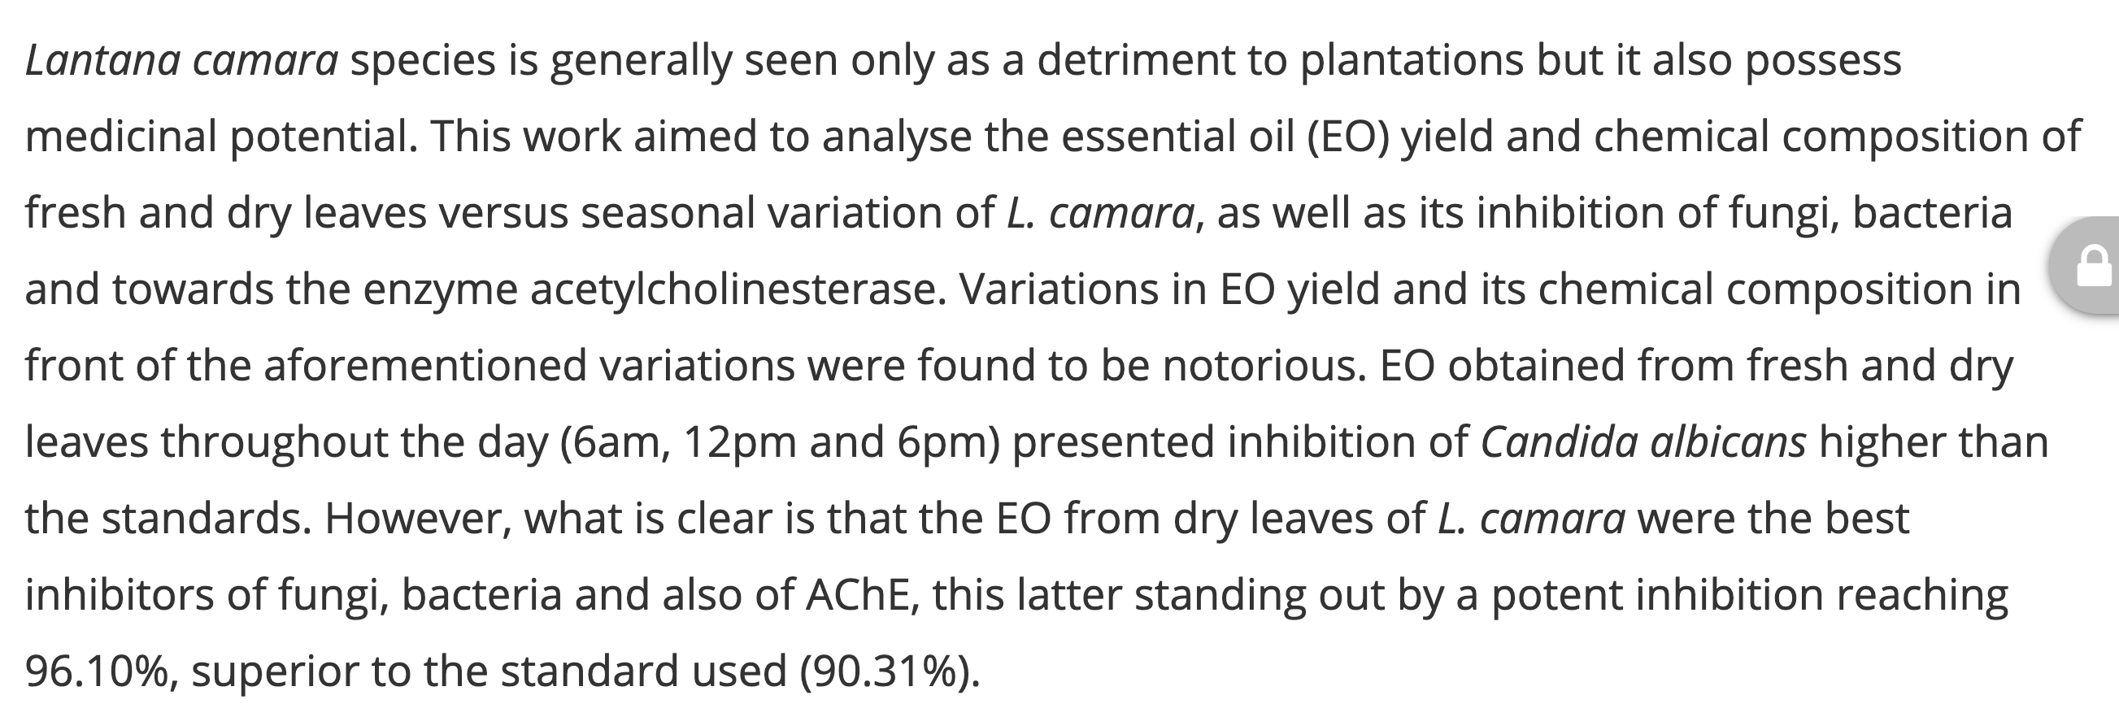

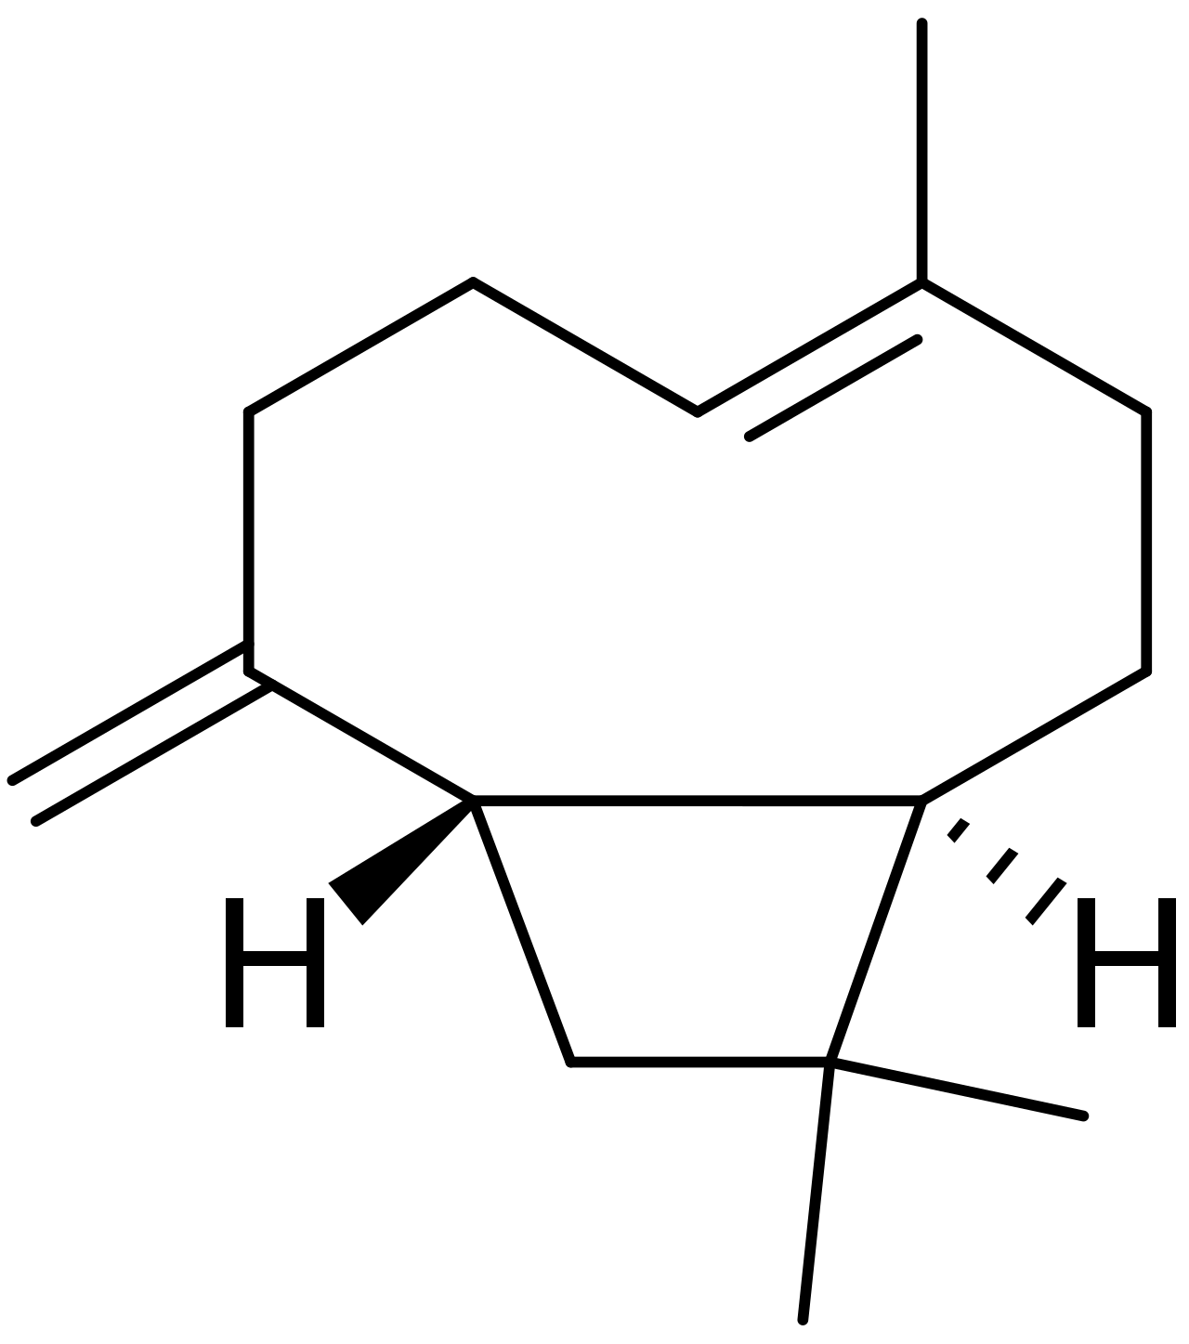
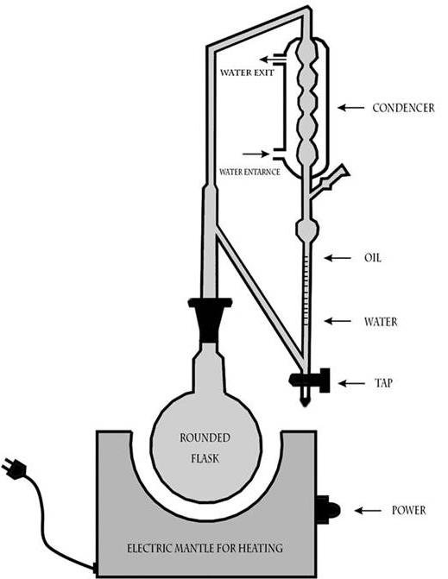
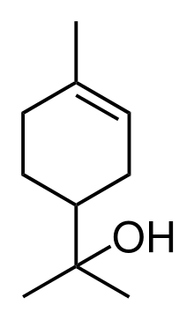
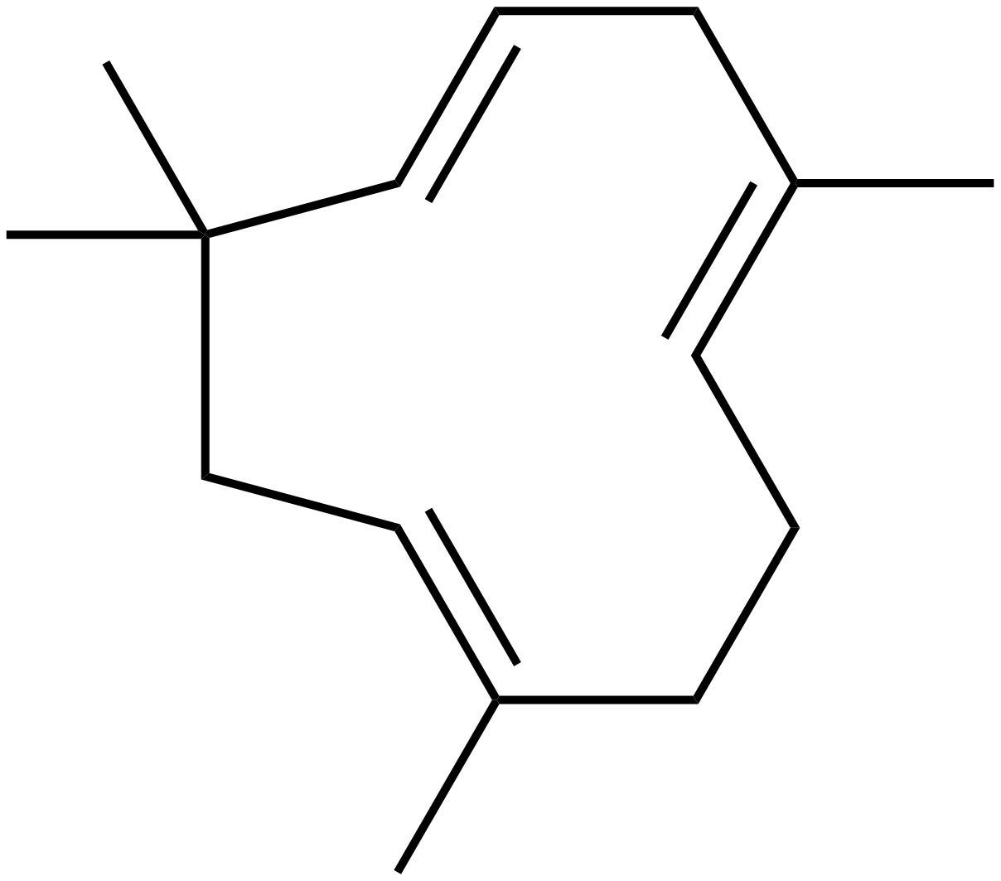
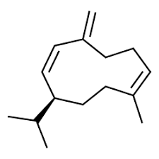

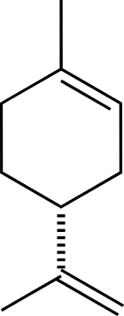
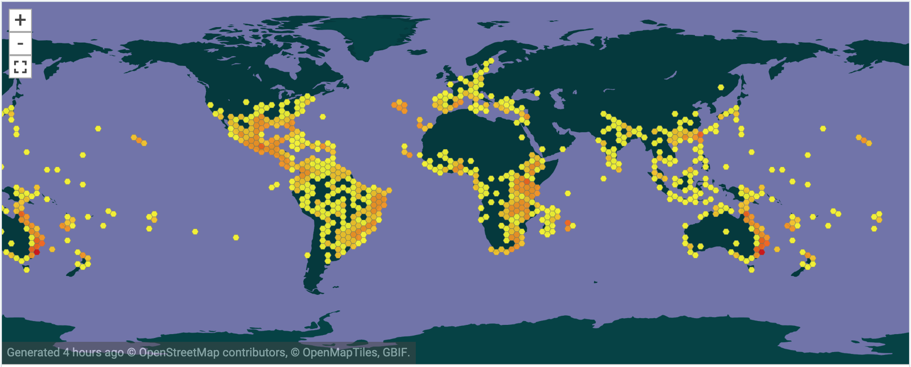
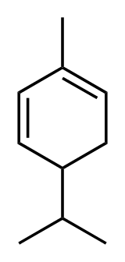
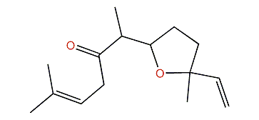
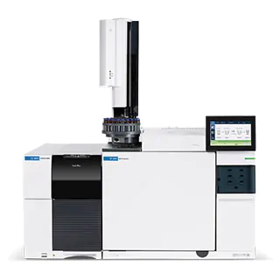
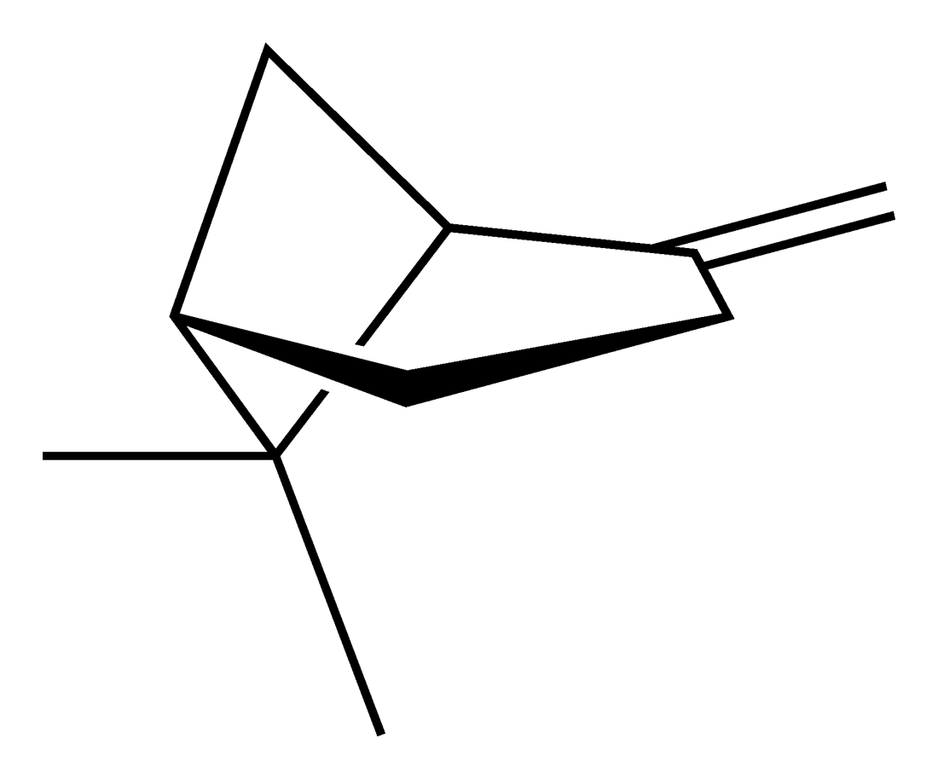
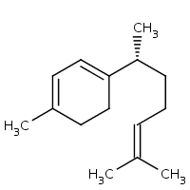
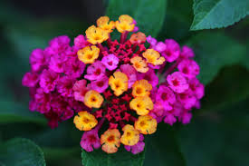
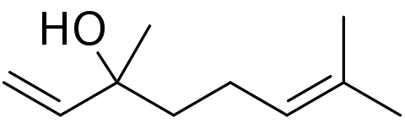
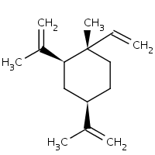
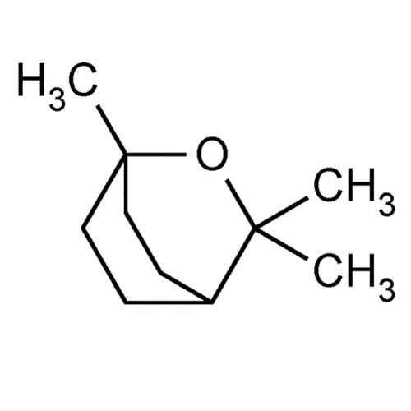

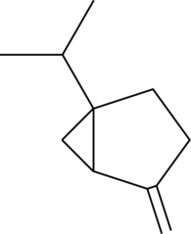
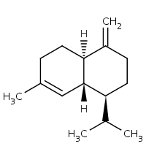
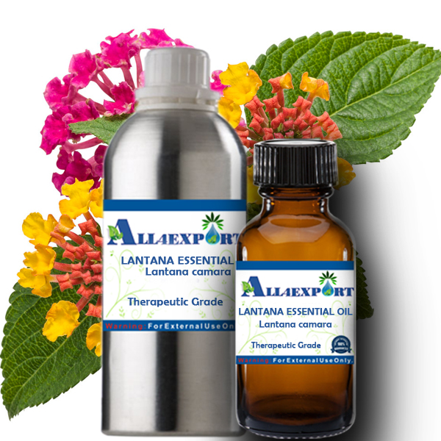
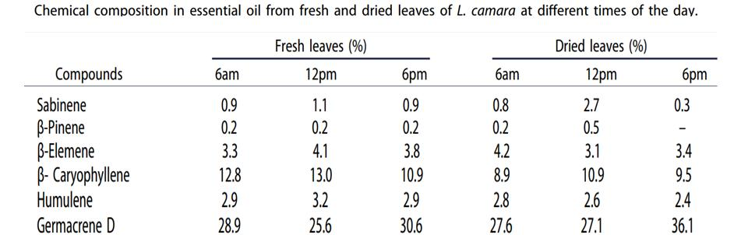
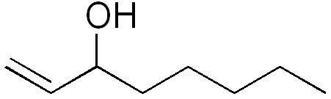
EssoilDB: A semantic phytochemical knowledgebase
Vinita Lamba, Shruthi M¹, Manish Kumar¹, Ambarish Kumar¹, Gitanjali Yadav^{1,2}, Peter Murray-Rust^{2,3}
¹ National Institute of Plant Genome Research, New Delhi, IN; ² University of Cambridge, UK; ³ ContentMine Ltd, Cambridge, UK
Plants are capable of generating a diverse spectrum of volatile organic compounds for maintaining communication and fruitful adaptive interaction with their environment. These are proven to be important protective and signaling molecules & constitute a platform for plant–plant interaction. For 13 years, EssoilDB in NIPGR, has captured the plant literature on terpenes (class of phytochemicals); now it’s being upgraded to use new technologies:
TextAndDataMining (TDM) and semantic ontology (Wikidata)
Papers are searched with EssoilDB 2.0/WikiFactMine dictionaries, extracted to enhance EssoilDB 2.0, and progressively indexed
ingestion + annotation of current articles
Check semantics
EssoilDB 2.0
Bibliography (1600)
disambiguate
Independent
variables
Crossref Unpaywall
bibliography
Location (500)
profile (????)
extraction
plant
plantpart
terpene
agriculture
microorganism
normalize
plant (1860)
Compounds emitted in single experiment
measurement
GBIF TRNS
plantpart
compound (7500)
date-time
Pubchem OPSIN
enzyme
datetime
nonplant species
populate
conditions
freetext mined data linked to
EssoilDB 1.0
Syntax, spelling, semantics, disambiguate, link
Wikifactmine Dictionaries (20+)
crops, funders, government, habitat, invasive species, organisms,, pests, soiltypes, viruses…mono-, di-, triterpens,
key
Table(count)
Wikidata and WikiFactMine link all the components!
Open lookup/disambiguation
Story about Lantana PMR
β-caryophyllene
Clevger Apparatus Hydrodistillation ^{[1]}
α-humulene
germacrene D
extraction
α-terpineol
limonene
compound
{Records: ca. 7157}
davanone
α-phellandrene
γ-curcumene
GBIF
β-pinene
β-elemene
linalool
1,8-cineole
myrcene
1-octen-3-ol
γ-cadinene
measurement
sabinene
Profile
Commonly used plant-parts of Lantana
Compound
***ADD PLANTS AND LINKS TO WIKIDATA** VL
***ADD EXAMPLES OF SEARCH ** PMR

