Slide 1



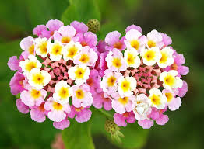
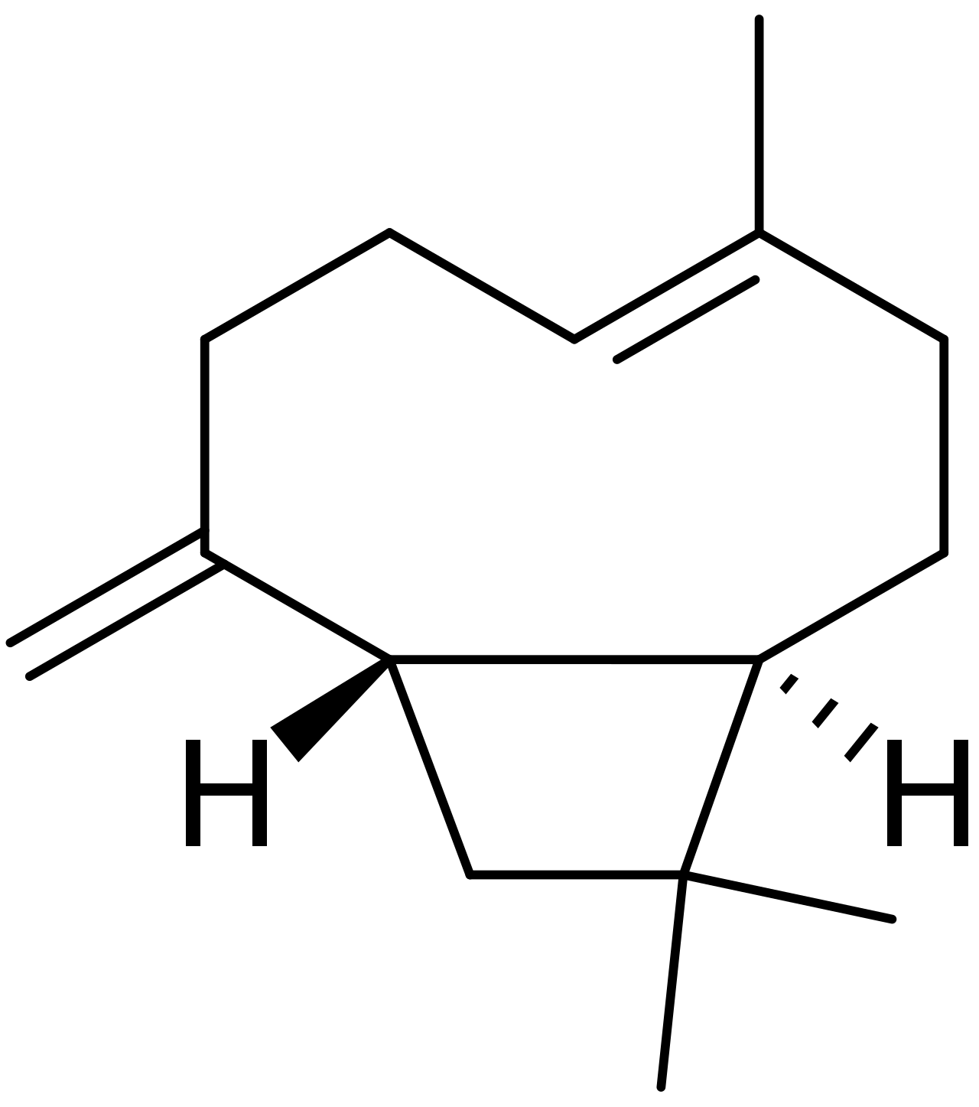
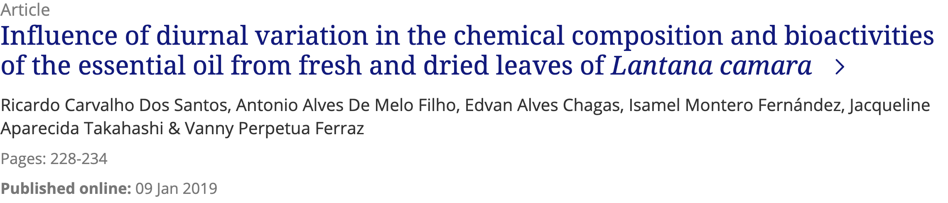

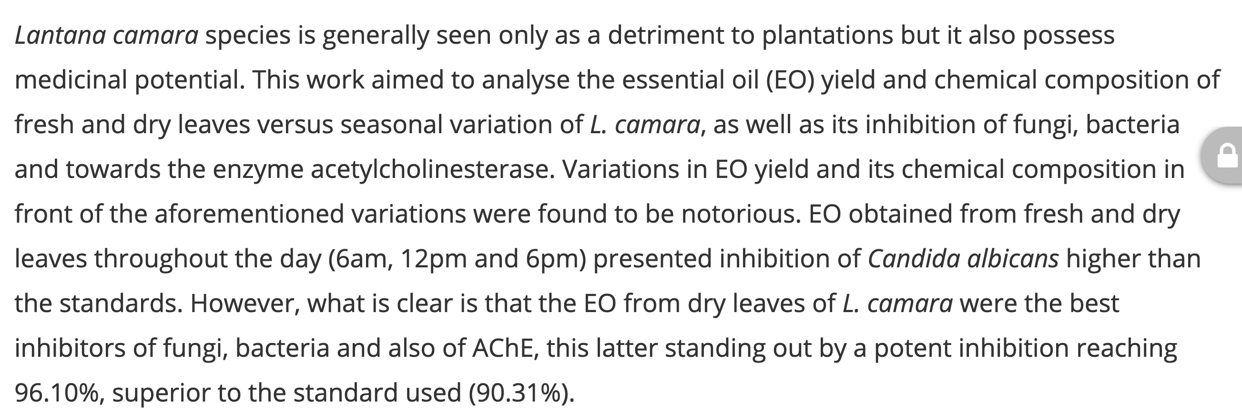

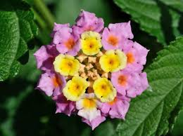
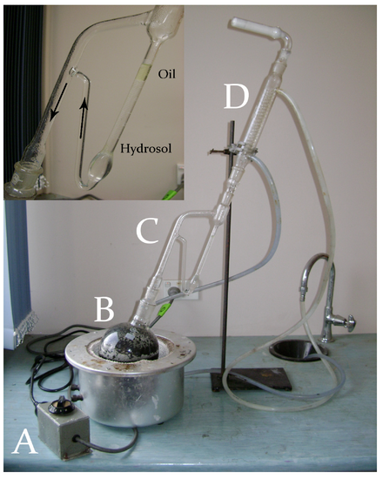
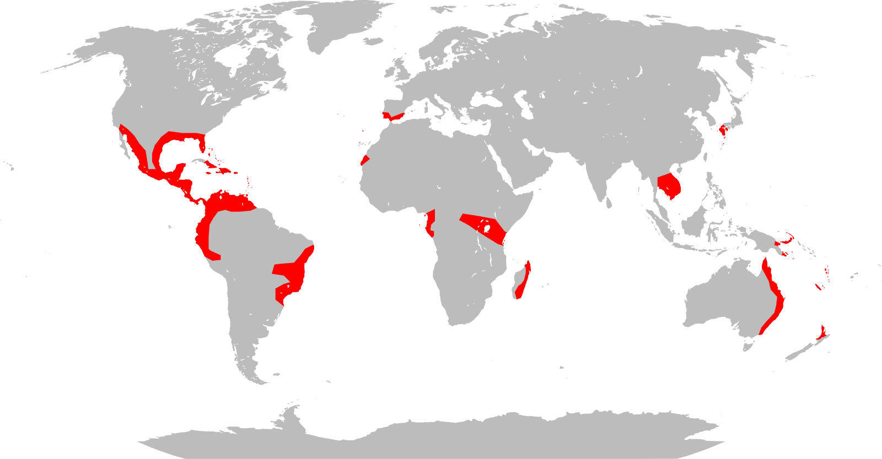
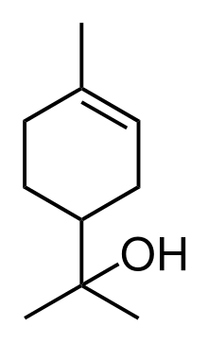
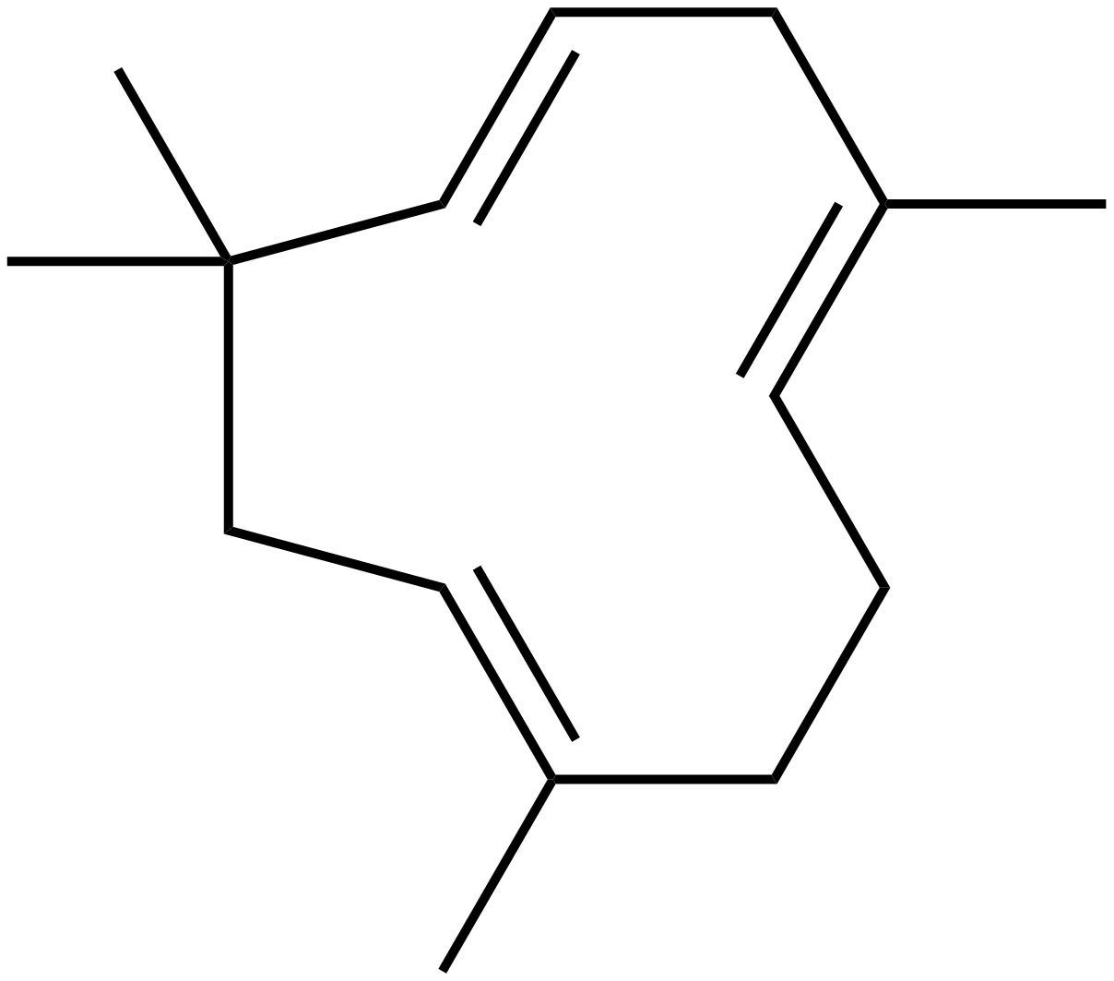
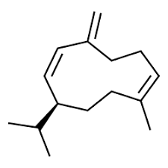

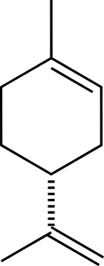
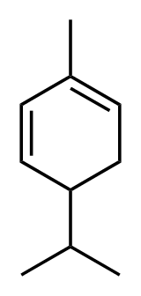
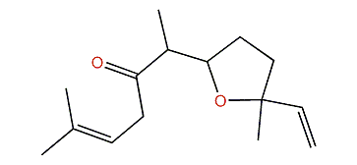
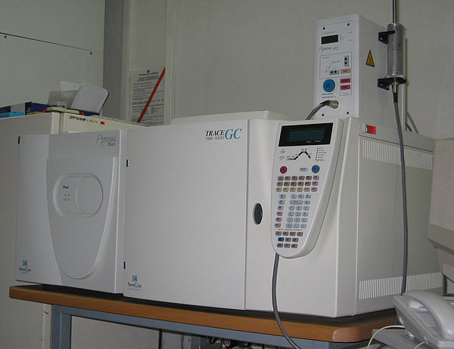
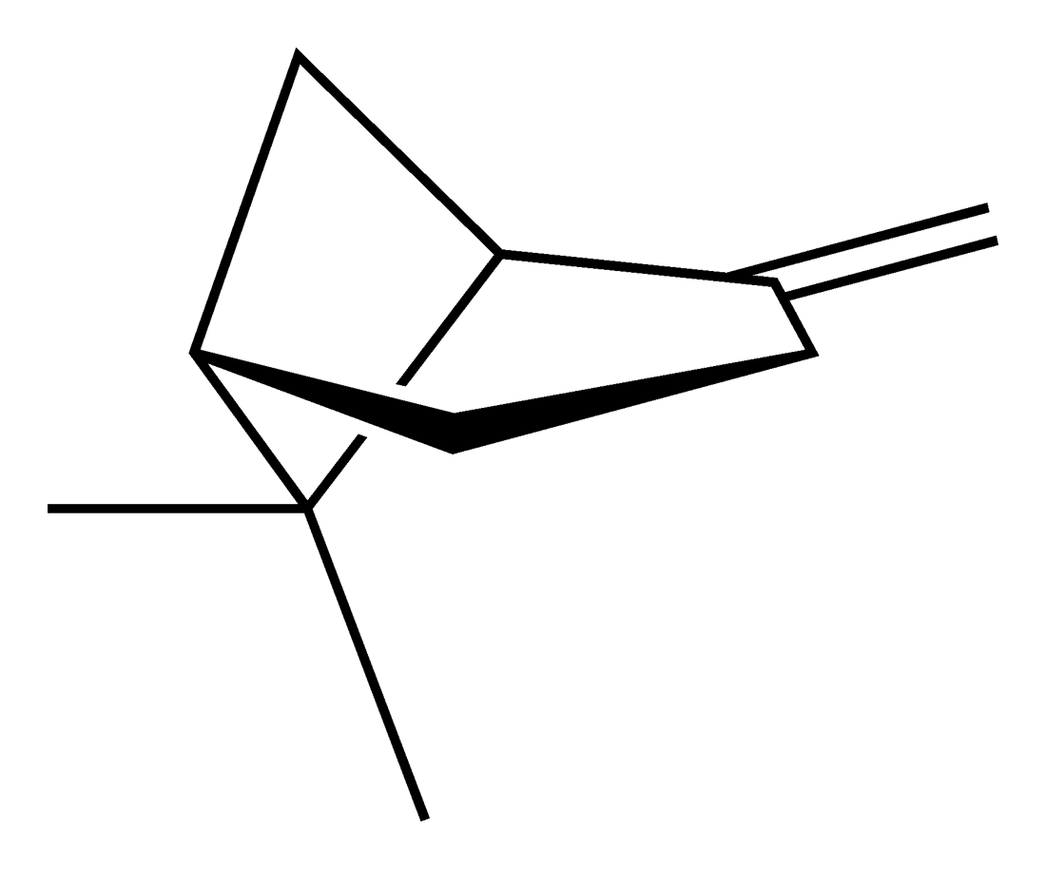
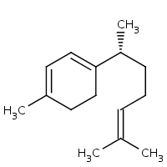
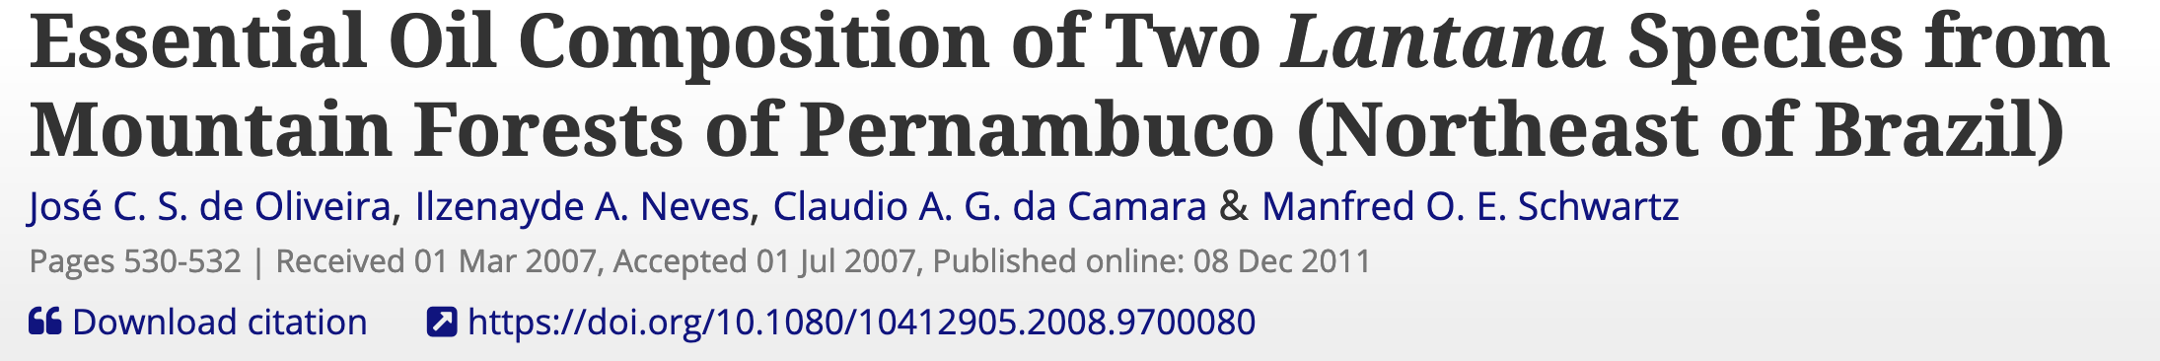
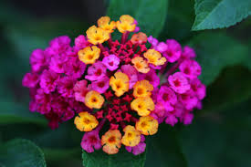
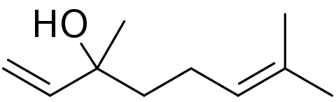
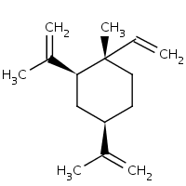
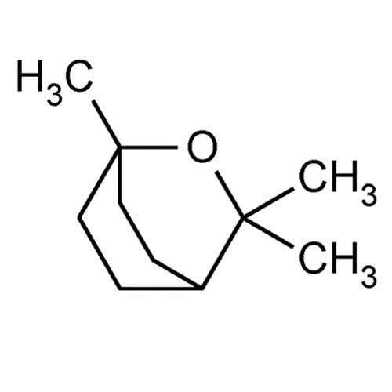
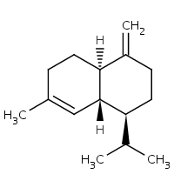
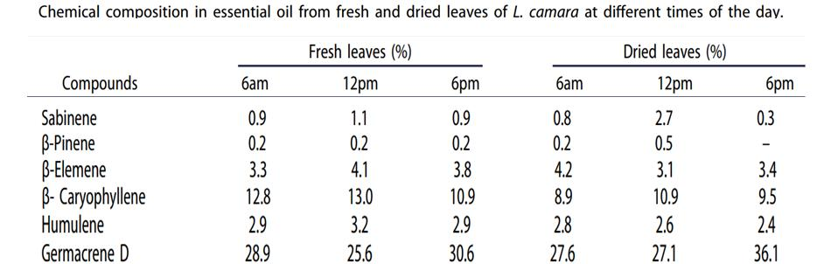
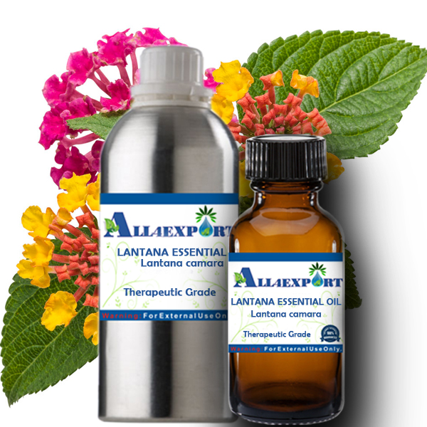

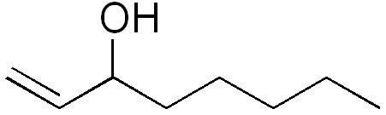
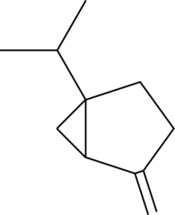
EssoilDB: A semantic phytochemical knowledgebase
Vinita Lamba¹, Shruthi M¹, Manish Kumar¹, Ambarish Kumar¹, Gitanjali Yadav^{1,2}, Peter Murray-Rust^{2,3, a}
¹ National Institute of Plant Genome Research, New Delhi, IN; ² University of Cambridge, UK; ³ ContentMine Ltd, Cambridge, UK
OVERVIEW. Plants are capable of generating a diverse spectrum of volatile organic compounds for maintaining communication and fruitful adaptive interaction with their environment. These are proven to be important protective and signalling molecules & constitute a platform for plant–plant interaction. For 13 years, EssoilDB in NIPGR, has captured the plant literature on terpenes (class of phytochemicals).
BACKGROUND: In 2019-02 [1] GY, VL, AK collaborated with ContentMine/PMR to run a TIGR²ESS workshop on mining the plant literature. We deployed Open text-mining tools (ContentMine’s getpapers,AMI) and used Wikipedia/Wikidata to create WikiFactMine dictionaries (e.g. pests, microorganisms, soiltypes, invasive species, spices…) and showed that Open semantic text-mining was robust and could be deployed in many areas of Plant Science.
Q332469
Q332469
SEMANTICS: Wikidata (a Wikimedia project) has over 50 million items of Open semantic knowledge. Items have unique identifiers (Q numbers) related by properties (P). Example: “ the invasive species Lantana camara produces beta-caryophyllene” is represented by the triples: Q332469 P5626 “56” (L. camara hasGISDId 56 – (GlobalInvasiveSpeciesDatabase))
Q421614 P1528 Q332469 (beta-caryophyllene isNaturalProductOf L. camara)
UPDATE: We are creating version 2.0 of EssoilDB with semantic objects linked to Wikidata, adding to the global knowledge graph.
We use EssoilDB2.0 to support text-mining … … and text-mining to populate EssoilDB2.0!
Q332469
ingestion + annotation of current articles
EssoilDB table
Check semantics
EssoilDB 2.0
Bibliography (1600)
dictionary
disambiguate
Independent
variables
Crossref Unpaywall
bibliography
Location (500)
Profile
extraction
plant
plantpart
terpene
agriculture
microorganism
normalize
plant (1860)
Compounds emitted in single experiment
measurement
GBIF TRNS
plantpart
compound (7500)
date-time
Pubchem OPSIN
enzyme
datetime
nonplant species
populate
conditions
Wikifactmine Dictionaries (20+)
Easily created by dataminers from selected Wikipedia/Wikidata entries, such as crops, funders, government, habitat, invasive species, organisms, pests, pollinators, soil types, viruses…mono-, di-, triterpenes,
EssoilDB 1.0
Syntax, spelling, semantics, disambiguate, link
Table(count)
key
Open lookup/disambiguation
Knowledge Components in EssoilDB 2.0 (illustrated by L. camara)
steam distillation (Q1164392)
Plantpart [Q20011319)]
Q421614
Global distribution of L. camara (Wikimedia)
Q27109437
Clevger Apparatus Hydrodistillation ^{[1]}
β-caryophyllene
Q27121615
Q27121451
extraction
Q278809
α-humulene
germacrene D
leaf Q33971
α-terpineol
Q58896121
location
GC-MS (Q873009)
Q25933668
limonene
Compound
[Q11173]
(7000+)
davanone
α-phellandrene
γ-curcumene
Q300928
β-pinene
β-elemene
Q27132733
Q40942
bibliography
linalool
fruit Q1364
1,8-cineole
myrcene
1-octen-3-ol
γ-cadinene
measurement
Q410932
sabinene
Q27132237
Profile
flower Q506
Q28138856
Q424577
Q161667
Q27132466
Common plant-parts Lantana
Compound Q11173
Q421278
Queries that EssoilDB2.0/Wikidata can support
Do invasive species produce Sesquiterpene toxins?
Can Chemical fingerprints be identified for Invasives across Habitats?
Who funds, or is likely to fund Terpene research?
What new Chemicals have been reported in 2019 preprints?
Identify plants that produce chemicals similar to known medicinal drugs
References and Acknowledgements
TIGR2ESS workshop : https://tigr2ess.globalfood.cam.ac.uk/news/adventures-r-reflections-tigr2ess-workshop-r-genomics-and-data-mining
ContentMine.org software: http://github.com/contentmine and : http://github.com/petermr/normami
https://www.wikidata.org/wiki/Wikidata:WikiFactMine
http://www.all4export.com/index.php?route=product/product&product_id=411
Images from Wikimedia Commons; Licence CC0 and CC BY-SA
GY, VL, AK, MK thank NIPGR for financial support.
GY Thanks the DBT-Cambridge program for Funding (University of Cambridge, Dept of Biotechnology, Govt of India)
[Wikidata] (ORCID): f: [Q908710] (0000-0003-3386-3972)
Notes:
=.

