Slide 1
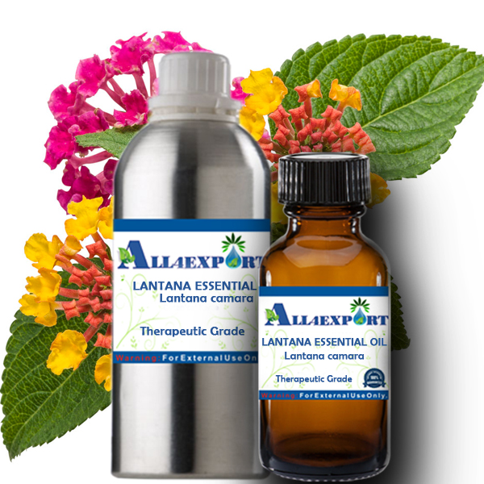
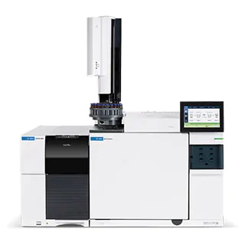
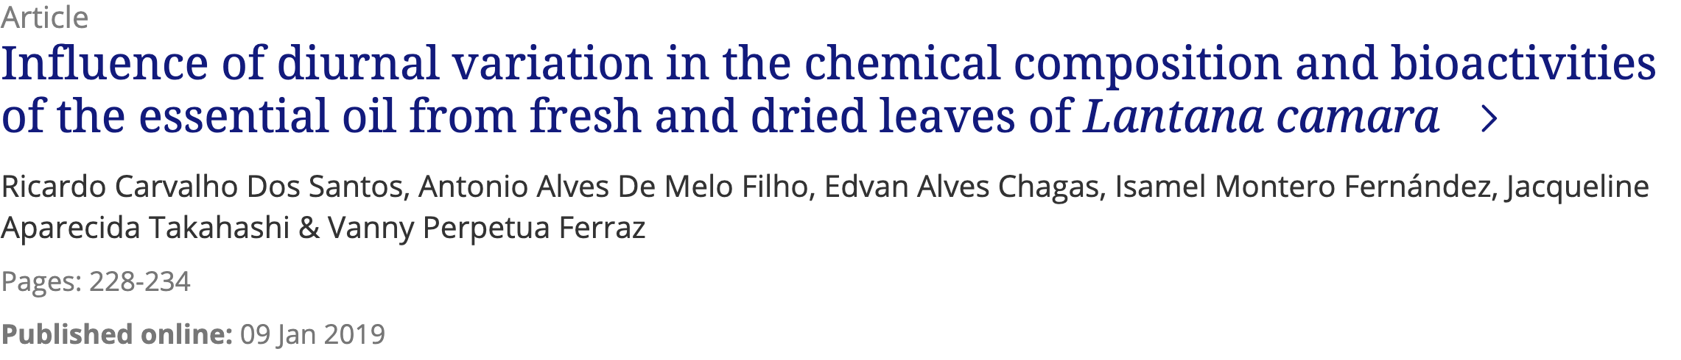

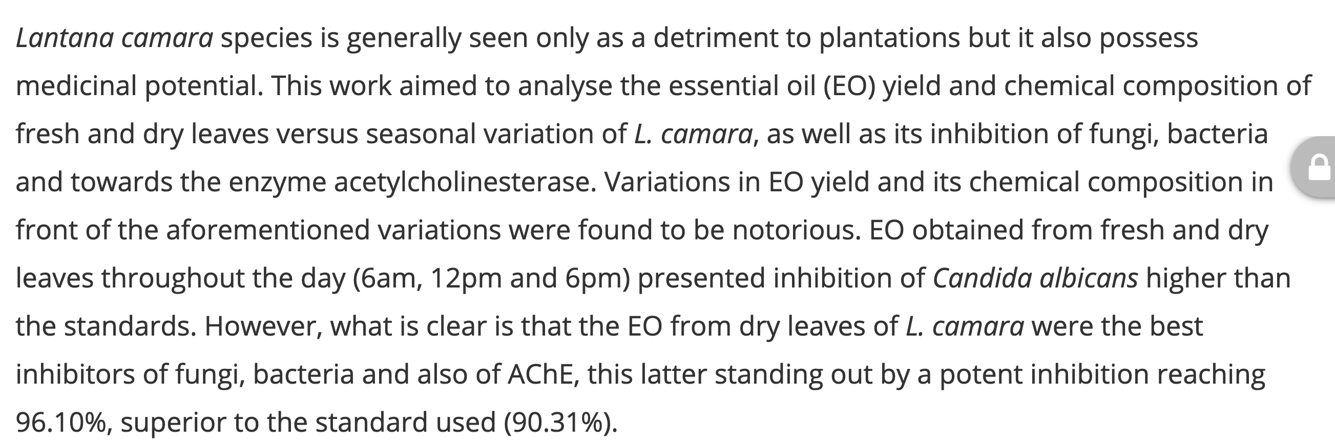

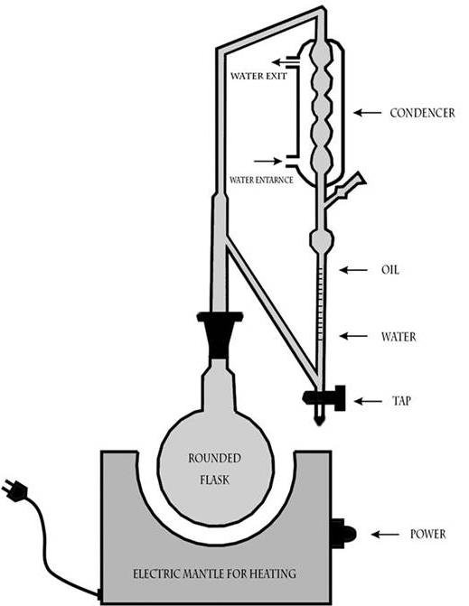

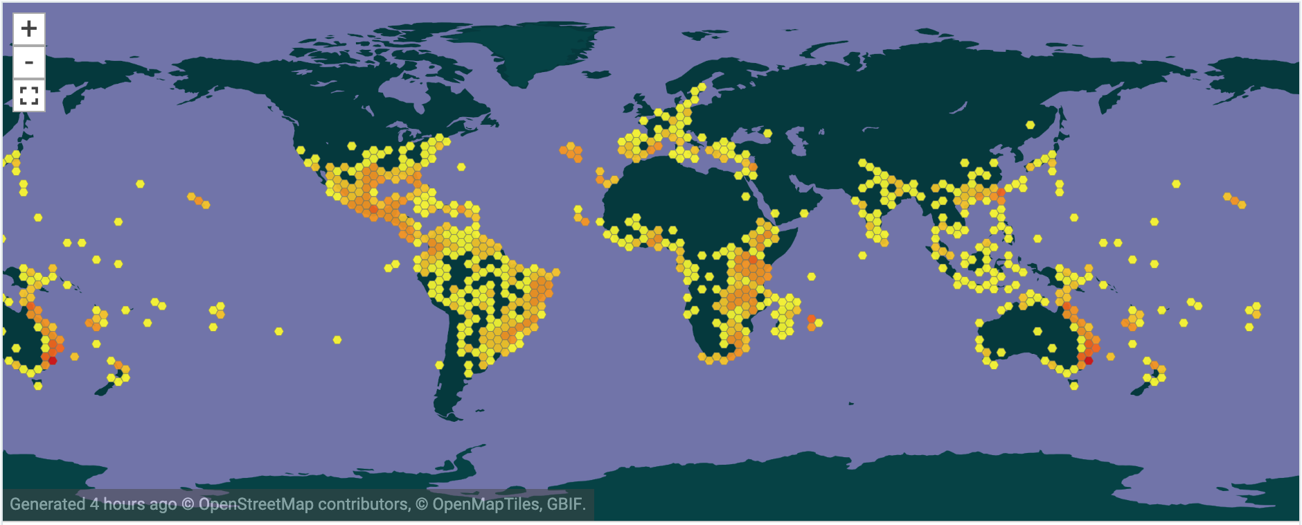
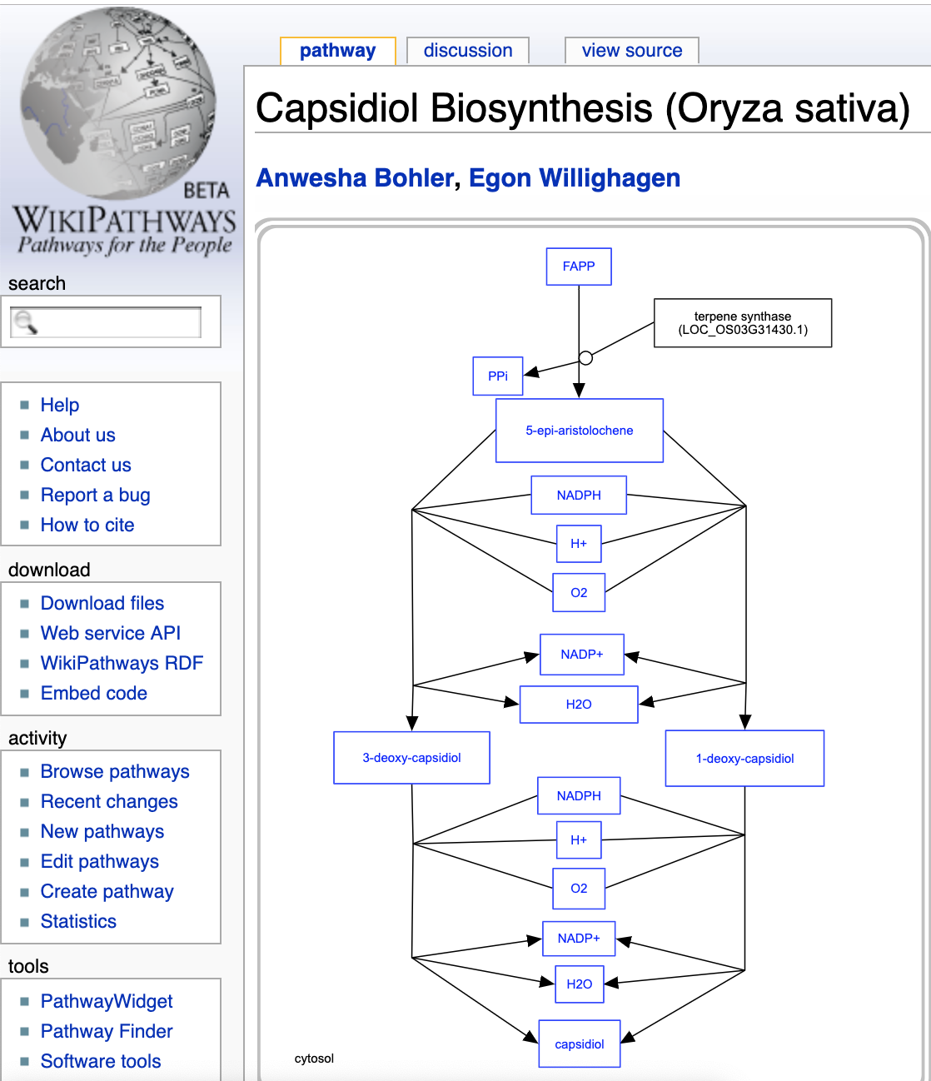
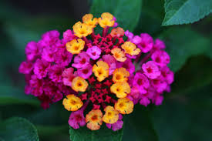
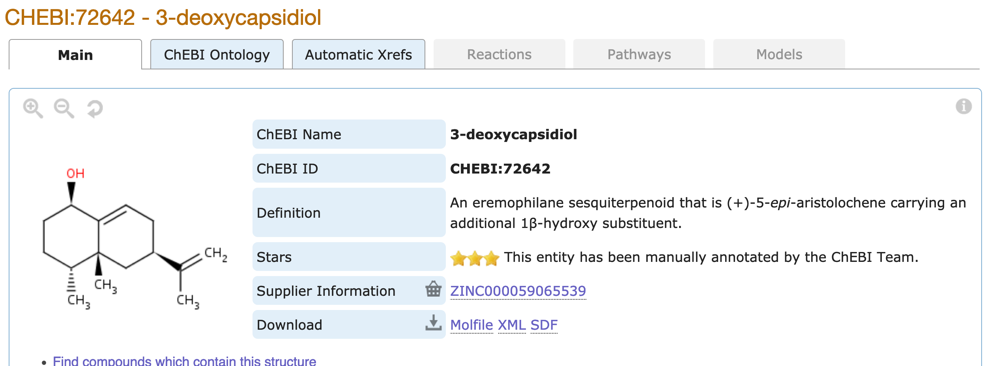
EssoilDB: A semantic phytochemical knowledgebase
Benefits:
Potential preventive and therapeutic agents in pharmacology.
In aroma-therapy, for transdermal delivery of medicines.
Vinita Mehlawat¹, Shruthi M¹, Manish Kumar¹, Ambarish Kumar¹, Gita Yadav^{1,2}, Peter Murray-Rust^{2,3}
¹ National Institute of Plant Genome Research, Delhi, IN; ² University of Cambridge, UK; ³ ContentMine Ltd, Cambridge, UK
Benefits:
Potential preventive and therapeutic agents in pharmacology.
In aroma-therapy, for transdermal delivery of medicines.
For 13 years EssoilDB in NIPGR has captured the plant literature on terpenes; now it’s being upgraded to use new technologies:
TextAndDataMining (TDM) and semantic ontology (Wikidata)
Lantana Essential Oil ^{[4]}
Lantana Essential Oil ^{[4]}
Papers are searched with EssoilDB 2.0 and WikiFactMine dictionaries, extracted to enhance EssoilDB 2.0, and progressively indexed
Lantana Essential Oil ^{[4]}
ingestion + annotation of current articles
Check semantics
EssoilDB 2.0
Bibliography (1600)
Independent
variables
Crossref Unpaywall
GC/MS Instrument – Agilent Technologies ^{[3]}
disambiguate
Location (500)
extraction
GC/MS Instrument – Agilent Technologies ^{[3]}
plant
plantpart
terpene
agriculture
bibliography
microorganism
normalize
plant (1860)
profile (????)
measurement
GC/MS Instrument – Agilent Technologies ^{[3]}
GBIF
Compounds emitted in single experiment
plantpart
compound (7500)
date-time
Pubchem OPSIN
enzyme
datetime
nonplant species
populate
conditions
freetext mined data linked to
EssoilDB 1.0
Syntax, spelling, semantics, disambiguate, link
Wikifactmine Dictionaries (20+)
crops, funders, government, habitat, invasive, pests, soiltypes, viruses…
Wikidata and WikiFactMine link all the components!
plantpart
β-caryophyllene
Clevger Apparatus Hydrodistillation ^{[1]}
extraction
α-humulene
germacrene D
α-terpineol
limonene
compound
{Records: ca. 7157}
davanone
α-phellandrene
γ-curcumene
measurement
β-pinene
linalool
β-elemene
profile (????)
Most commonly used parts of Lantana
1,8-cineole
myrcene
1-octen-3-ol
sabinene
γ-cadinene
GBIF
Compound
Wikipathways

