Slide 1

JCW HR Data Analytics
Purva Raut

Slide 2
AGENDA
Project Brief
Goal
Analysis
Data Insights
Conclusions
Recommendations
Recommendation Summary

Slide 3
Project Brief
A large company named JWC, employs, at any given point of time, around 4000 employees
However, every year, some of its employees leave the company for various reasons and need to be replaced with the talent pool available in the job market
The management believes that this level of attrition is bad for the company
Hence, the management wants to understand what JWC can do to stop and minimise attrition as much as possible

Slide 4
Goal
Help JCW company to reduce the attrition rate of their employees by:
Highlighting the most important variable/s which need to be addressed right away
Highlighting other features which are indicators of attrition
Providing recommendations for the changes that could be made to the workplace, in order to get most of the employees to stay

Slide 5
Analysis
There are 4410 observations with 25 characteristics of employees (Features) and 1 target variable (Attrition)
The features used for the analysis are:
[1.WorkLifeBalance, 2.EnvironmentSatisfaction, 3.JobSatisfaction, 4.BusinessTravel, 5.Department, 6.Education, 7.EducationField, 8.Gender, 9.JobLevel, 10.JobRole, 11.MaritalStatus, 12.NumCompaniesWorked, 13.PercentSalaryHike, 14.StockOptionLevel, 15.TotalWorkingYears, 16.TrainingTimesLastYear, 17.YearsAtCompany, 18.YearsSinceLastPromotion, 19.YearsWithCurrManager, 20.JobInvolvement, 21.PerformanceRating, 22.Age, 23.DistanceFromHome, 24.MonthlyIncome, 25.OverWorked]

Slide 6
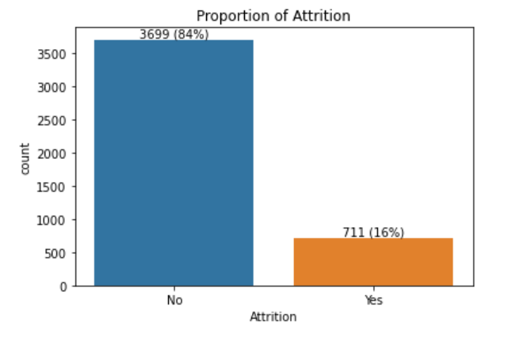
Data Insights
Attrition rate for the dataset is 16%
Class is imbalanced
As the class is imbalanced, it will be difficult to compare and draw conclusions based on the absolute values alone hence, I calculated the attrition rate for each class of the features and then compared them.

Slide 7
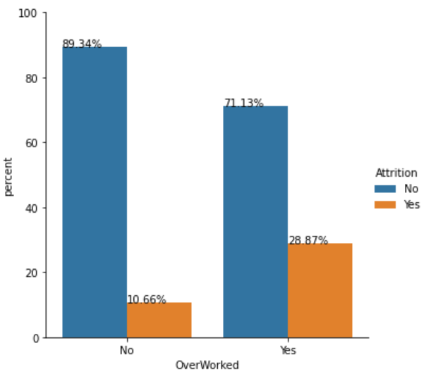
Data Insights Feature- OverWorked
Employees working overtime could be a key factor leading to attrition

Slide 8
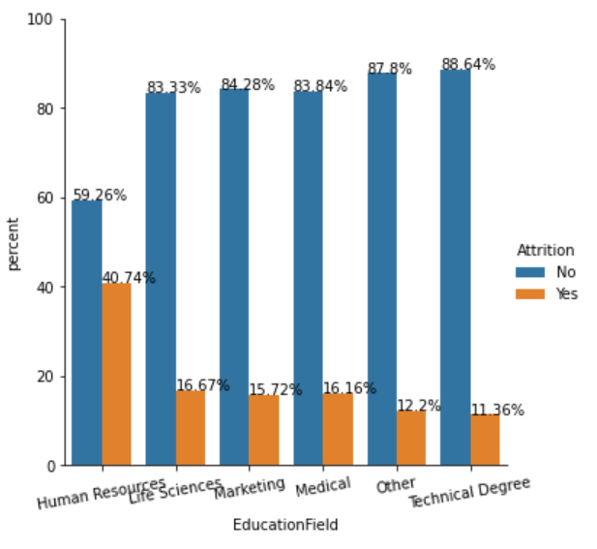
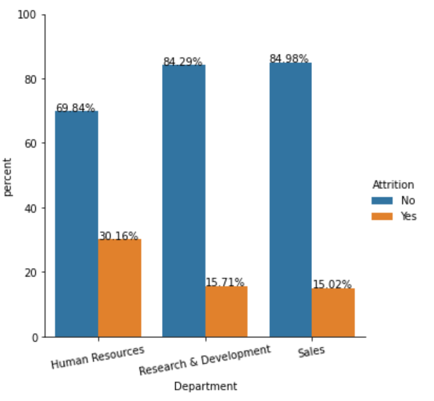
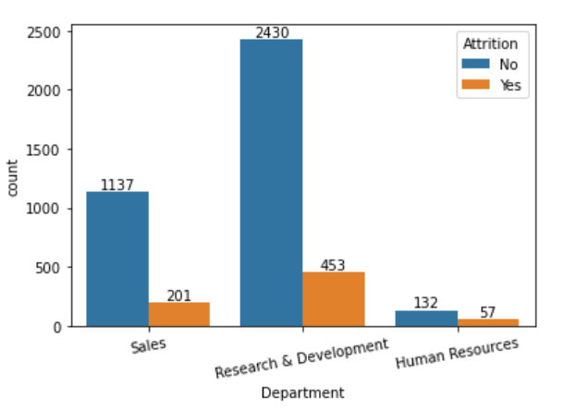
Data Insights Feature- Department, EducationField
A very small team of the HR department
Employees working in the Human Resources department show a high attrition rate
This might be due to fewer people in this department

Slide 9
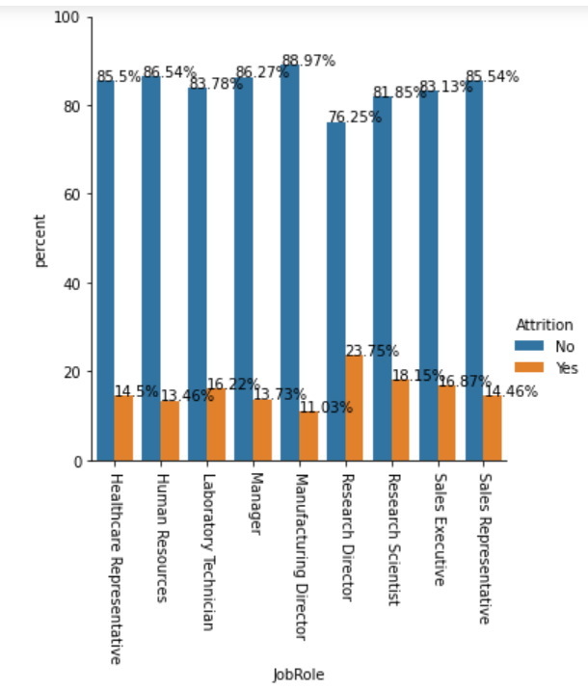
Data Insights Feature- JobRole
Employees in the role of research show a high attrition rate

Slide 10
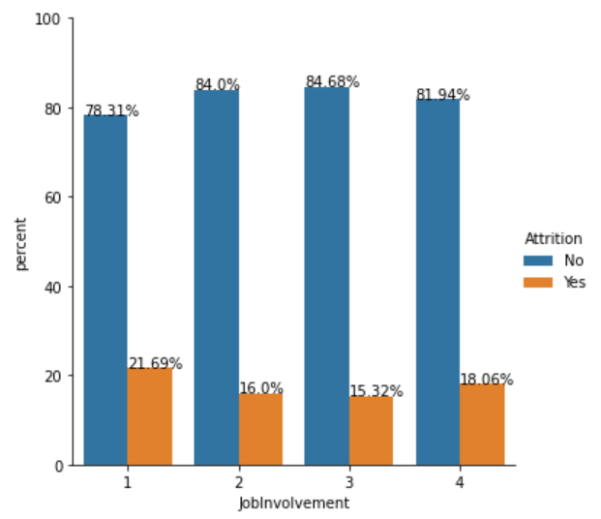
Data Insights Feature- JobInvolement
Employees with very low and very high job involvement show a high attrition rate

Slide 11
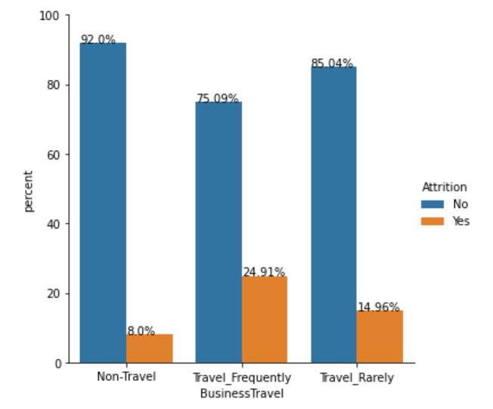
Data Insights Feature- BusinessTravel
Employees that travel frequently for business purposes show a high attrition rate

Slide 12
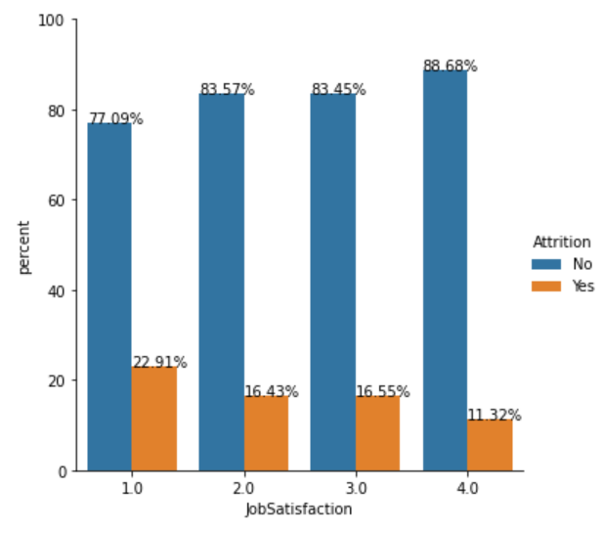
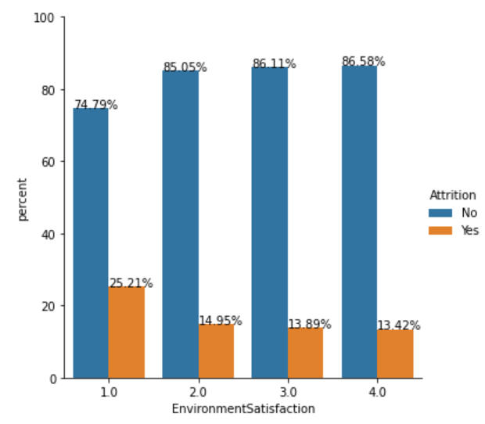
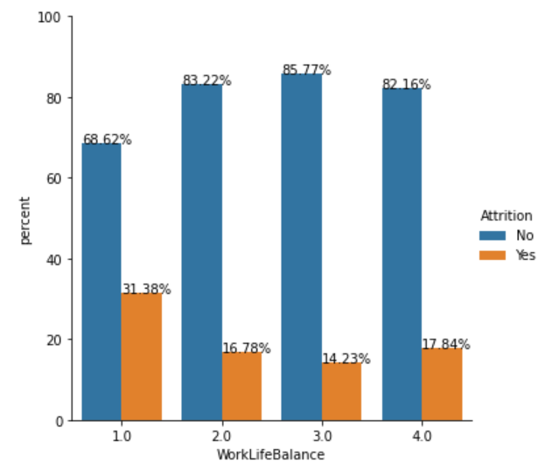
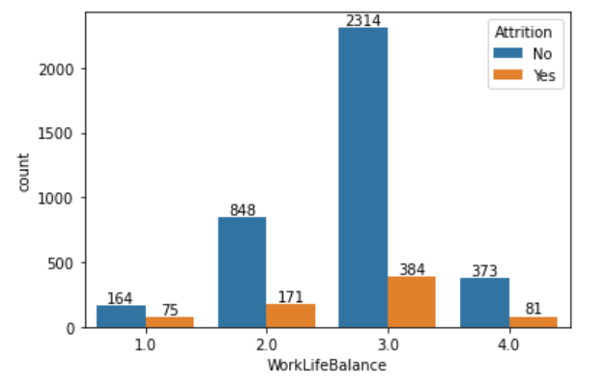
Data Insights Feature- EnvironmentSatisfaction, JobSatisfaction , WorkLifeBalance
Employees that feel Job satisfaction and Environment Satisfaction are low have a higher attrition rate
Employees that feel that their Work-life balance is low also have a higher attrition rate
However, employees voting for Work-life balance low were very less, so this is a moderate indicator contributing to attrition

Slide 13
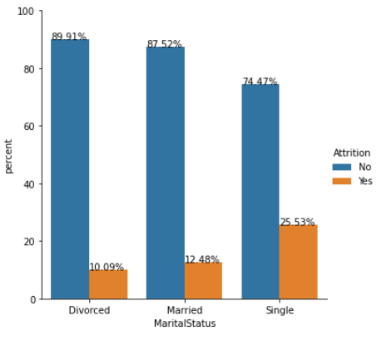
Data Insights
Other Features that typically show higher attrition are:
Marital status single
Employees worked in 1 or more than 5 companies
Total working years 0-2
Years at current company 0-2
Less than a year of experience working with the current manager
Age 18-21

Slide 14
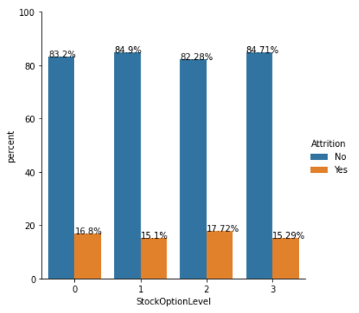
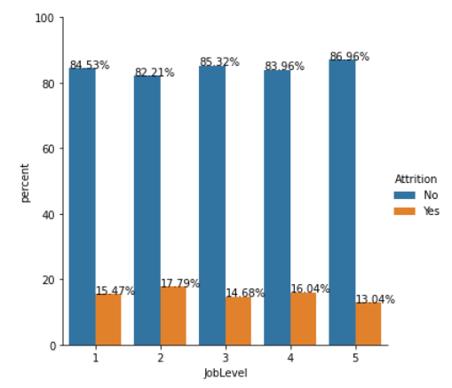
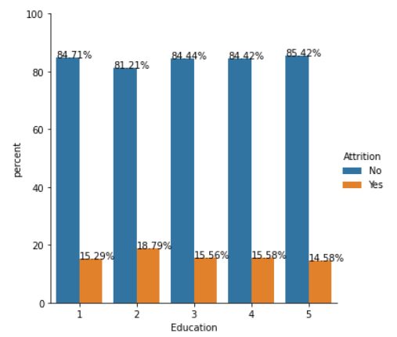
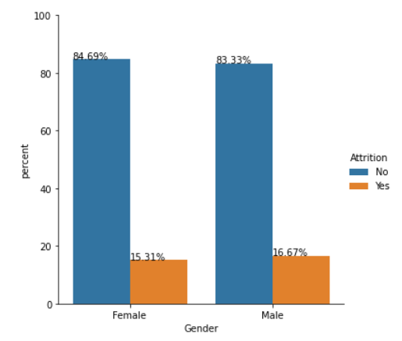
Data Insights
Below features did not show any trend that could contribute to a higher attrition rate
Stock Option Level
Job Level
Education
Gender

Slide 15
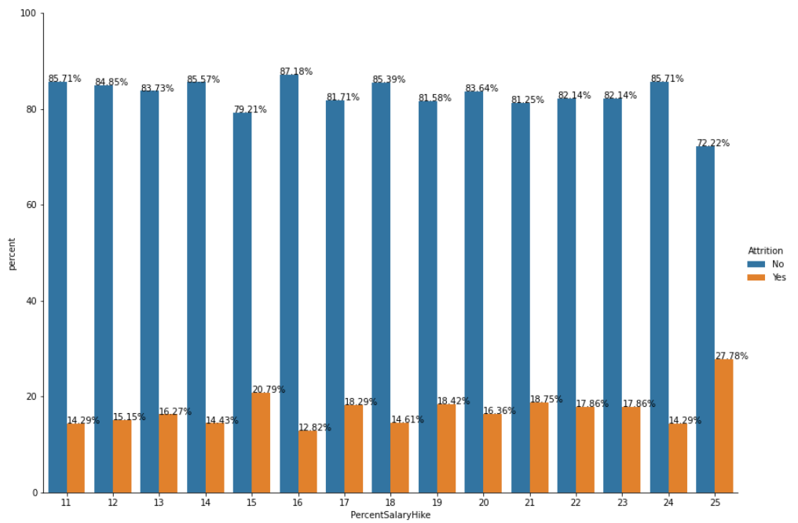
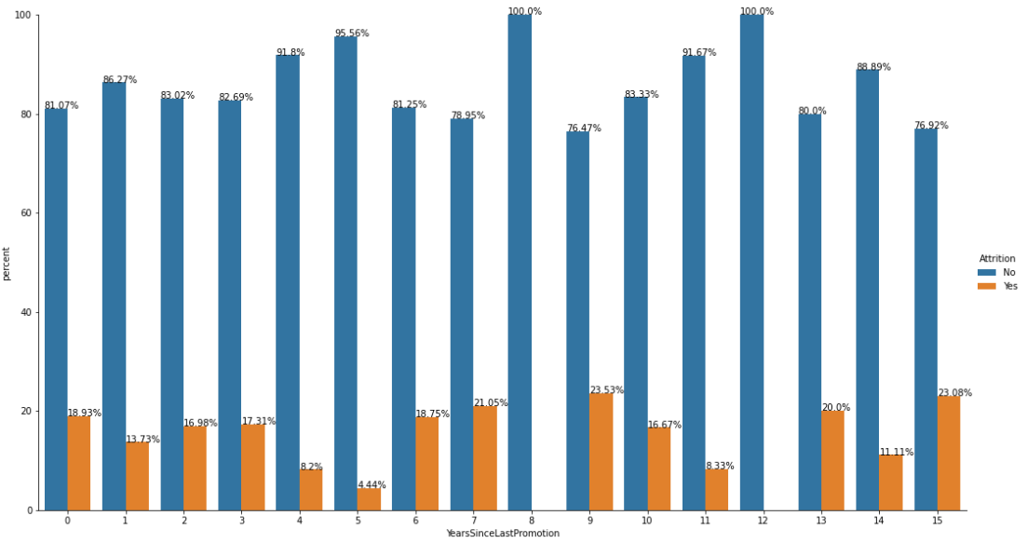
Data Insights
Below features did not show any trend that could contribute to a higher attrition rate
Percent Salary Hike
Years Since Last Promotion
(PercentSalaryHike of 25% seems to be slightly higher however, people belonging to this category are fairly less)

Slide 16
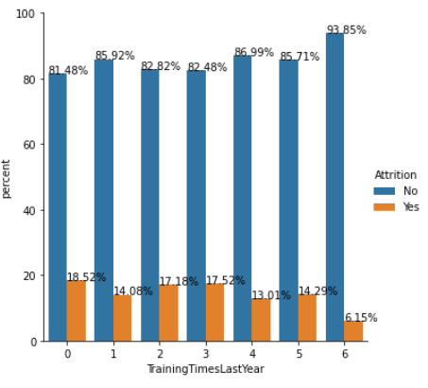
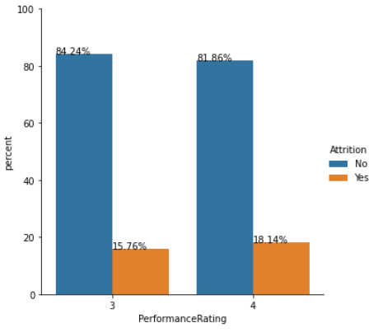
Data Insights
Below features did not show any trend that could contribute to a higher attrition rate
Training Times Last Year
Performance Rating

Slide 17
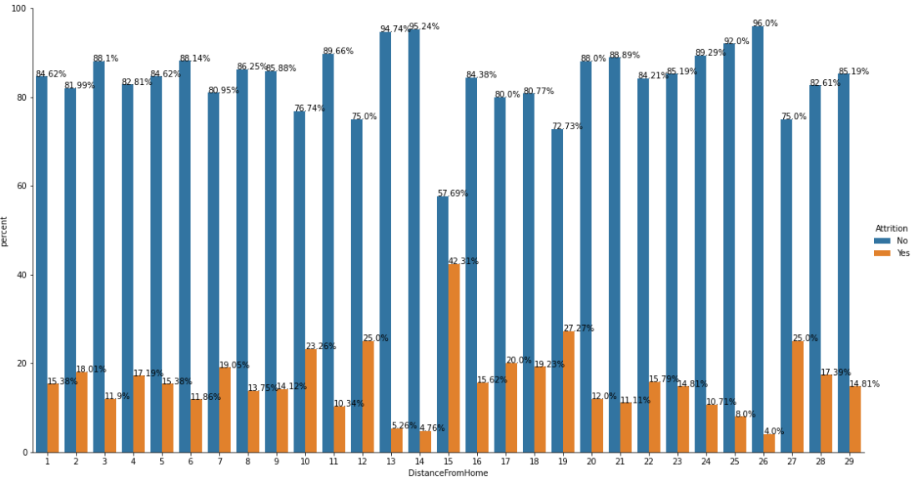
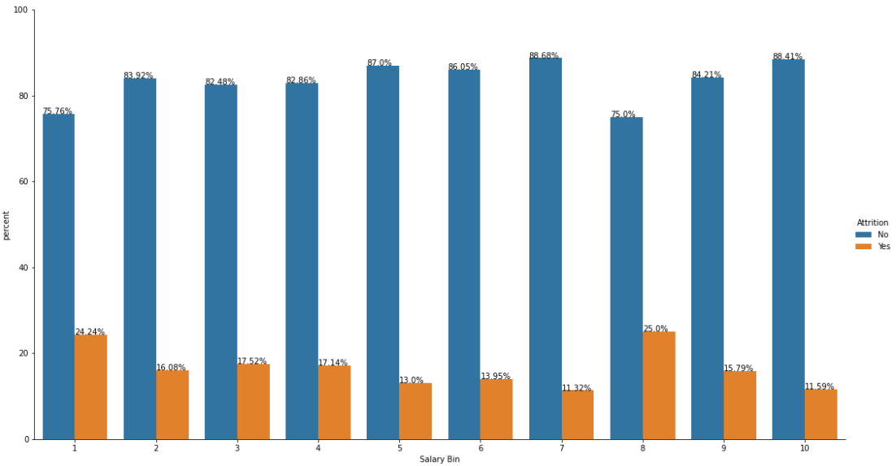
Data Insights
Below features did not show any particular trends that could contribute to a higher attrition rate
Distance From Home
Monthly Income
(A slightly higher attrition rate is observed for people with low salaries in the range of 0-20000 rupees -Bin1 however, people belonging to this category are very less.
The monthly income range of 160000-180000-Bin 8 also shows a slightly higher attrition rate which needs to be investigated further)
(A spike is observed at 15 km distance from home which can be investigated further)

Slide 18
Conclusion
The top reasons that point to the higher attrition rate are
Employees working overtime for more than 8 hours.
Employees working in the Human Resources department which might be due to fewer people in the team.
Employees particularly in the role of Research Directors and Research Scientists.
Employees with very low and very high job involvement.
Employees that travel frequently for business purposes.
Employees that feel Environment Satisfaction and Job satisfaction are low.

Slide 19
Recommendation
Find out reasons why the employees are working overtime and work towards minimising it.
Set up meetings with the employees of the HR department to find out if they are overworking.
Set up meetings with employees in the role of Research and find out if they face any difficulties.
Plan moderate job involvement for the employees.
Plan moderate business travel for employees.
A more detailed survey to find out why employees are less satisfied with the environment and their job.

Slide 20
Conclusion
Other characteristics that typically show higher attrition are
Marital status single
Employees worked in 1 or more than 5 companies
Total working years 0-2
Years at current company 0-2
Less than a year of experience working with current manager
Age 18-21

Slide 21
Recommendation
These observations should be used for study purposes only and not to make decisions for the recruitment of employees as to maintain an unbiased recruitment process.

Slide 22
Conclusion
Moderate indicators:
Employees voting for Work-life balance low were very less, so this is a moderate indicator contributing to attrition.

Slide 23
Conclusion
Weak or no indicators
Below features did not show any trends, in particular, that could contribute to a higher attrition rate
Education
Gender
Job Level
Percent Salary Hike
Stock Option Level
Training Times Last Year
Years Since Last Promotion
Performance Rating
Distance From Home
Monthly Income

Slide 24
Recommendation Summary The recommendation for the variables that need immediate attention in order to minimize attrition are:
Reduce overtime working
Analysing issues for the employees in the Human Resources department and Research role
Lowering frequent business travel
Providing equal Job Involvement to the employees
Providing maximum support for employee environment and job satisfaction.

Slide 25
Thank You Purva Raut purva.raut@xandertalent.com

