Slide 1
GRID RUNNER
Kostiantyn Makrasnov, Rudyjay Keopuhiwa, Niklas Roberts, Stephen Haugland

Slide 2
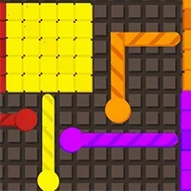
Project Description
Goal was to recreate Splix.io
Multiplayer game
Players capture area on the board
Players lose if they hit the edge of the board or run into one another
Capture territory by running over grid points
Notes:
nik

Slide 3
What were our main challenges
Getting assembler to work with C++ networking code
Properly tracking all the players and their path/territory
Could only access local variables from C++ in inline assembler
Notes:
Rudy

Slide 4
Coordinate System
X increments right
Y increments down
Data structures used
0,0 | 1,0 | 2,0
0,1 | 1,1 | 2,1
0,2 | 1,2 | 2,2
Notes:
Kostia

Slide 5
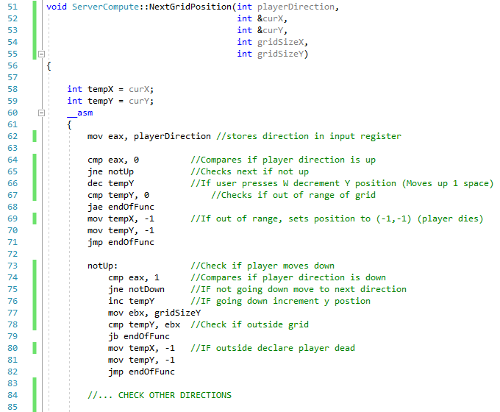
Movement Code
Function inputs
Temp variables
Conditional jumps
Inc, dec
Notes:
Stephen

Slide 6
Some Assembler Dependent Functions
DrawGrid(): Iterating over a 2d datastructure
SetDrawColor(): formulates color id based on r,g,b, and intensity properties of a grid point
Notes:
Kostia

Slide 7
Things we learned
Lowest-level coding
Inline assembler
Notes:
All

Slide 8
Demo Time!

Slide 9
THANKS!
Any questions?
Template Credits: Slides Carnival

Slide 10
References
Here you have a list of items
And some text
But remember not to overload your slides with content

