Slide 1
GRID RUNNER
Kostiantyn Makrasnov, Rudyjay Keopuhiwa, Niklas Roberts, Stephen Haugland

Slide 2
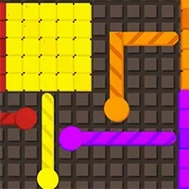
Project Description
Explain project idea

Slide 3
What were our main challenges
Here you have a list of items
And some text
But remember not to overload your slides with content
Your audience will listen to you or read the content, but won’t do both.

Slide 4
How we overcame challenges

Slide 5
Things we were proud of
Here you have a list of items
And some text
But remember not to overload your slides with content
Your audience will listen to you or read the content, but won’t do both.

Slide 6
Demo Time!

Slide 7
THANKS!
Any questions?

Slide 8
References
Here you have a list of items
And some text
But remember not to overload your slides with content

