Slide 1
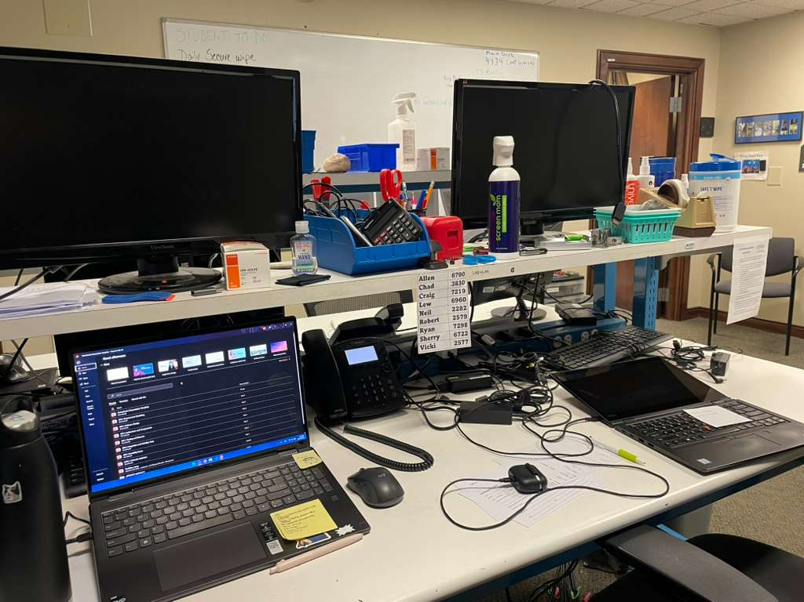
IT Internship
Name: Ethan Le
Internship Site: Messiah University’s IT Department (Old Main)
How you found it: Through a friend’s referral
Schedule: I worked up to 20 hours per week
Onboarding/Training: Learned by shadowing other workers

Slide 2
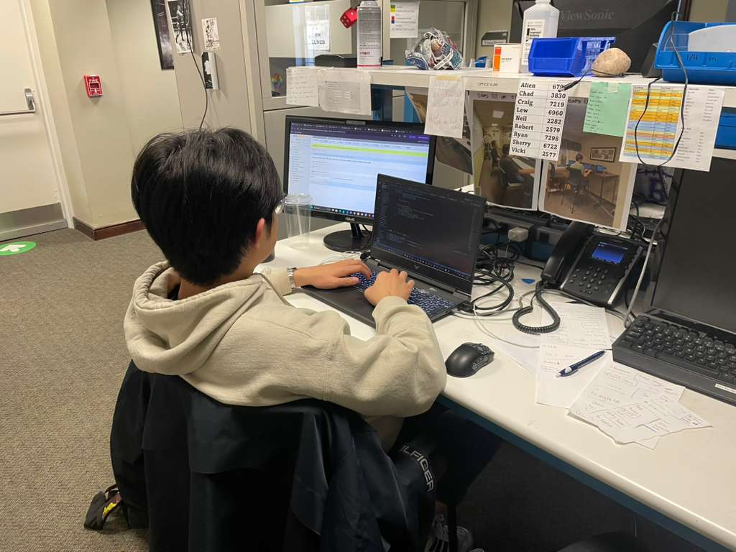
Role / Responsibilities
Assisted with troubleshooting hardware and software issues.
Managed help desk tickets and responded to tech support requests
Reimaged laptops and installed software
Set up and update new systems
Conduct maintenance and inventory on existing technology

Slide 3
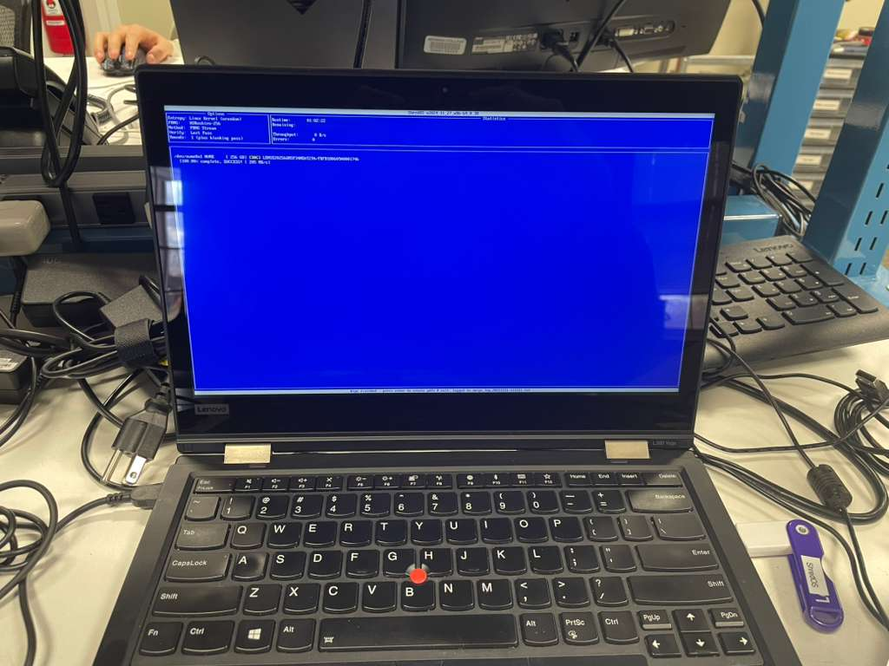
Transferrable Skills/ What Did You Learn
Gained hardware troubleshooting, software installation, and basic networking skills
Improved understanding of how IT infrastructure operates
Improved in explaining technical issues in simple terms
Developed my customer service skills and my ability to work professionally in a team

Slide 4
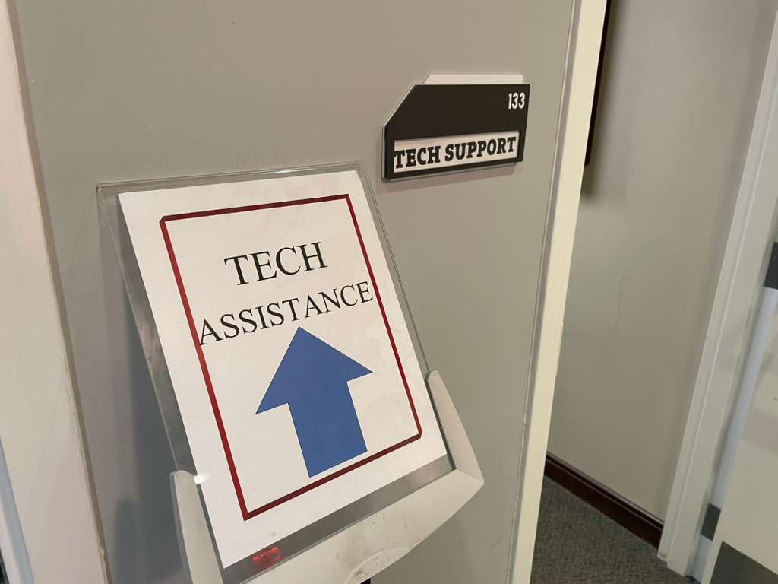
Conclusion
Helped me apply classroom knowledge to real-world IT problems
Improved my technical problem-solving skills
Gave me confidence working in a professional technical environment
Confirmed my interest in a career in technology

