Slide 1
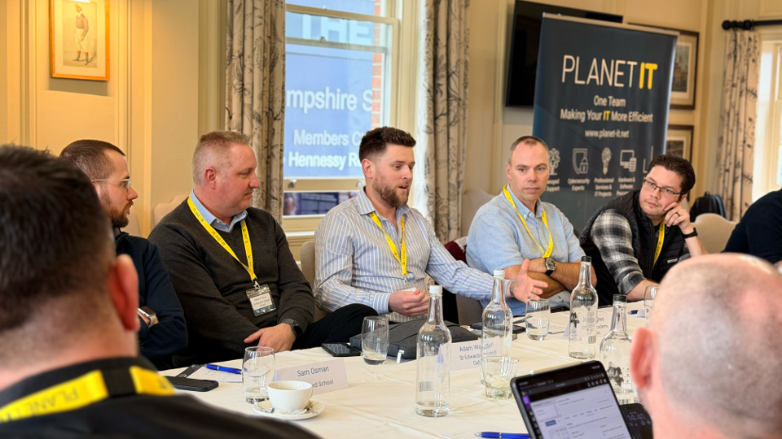










{{ Client }}
Cybersecurity Tabletop Scenario
DD MM YYYY
Notes:
APPLICATION_DIRECTIVE: STATIC_INCLUDE_ALWAYS
STATIC_KEY: PLANET_FRONT_PAGE
STATIC_PLACEMENT: FIRST
STATIC_TAG: STATIC_01_PLANET_FRONT_PAGE
MUTATION_POLICY: PRESERVE_VISIBLE_CONTENT_AND_GEOMETRY
SECONDARY_TEXT: Cybersecurity Tabletop Scenario
TABLETOP_TEMPLATE_DECK: planet_it_tabletop_template.pptx
TABLETOP_PRESENTATION_PROFILE: standard
TEMPLATE_SCOPE: TABLETOP_ONLY
PROFILE_CONTROL: ENV_ONLY
DETAILED_OVERFLOW_POLICY: STRICT
DETAILED_MAX_BULLETS_PER_SECTION: 3
STANDARD_PROFILE: INJECT=NARRATIVE_PLUS_KEY_QUESTIONS;PROBES=NOTES_ONLY
DETAILED_PROFILE: COMPACT_PROBES_WHEN_FIT;FULL_DETAIL=NOTES
FOOTER_TEXT: Confidential – Planet IT
THEME_FONT: Calibri (Segoe UI-compatible fallback)
THEME_COLORS: NAVY=23506A;BODY=323232;LIGHT=ECEFF1;AMBER=FB8C00;RED=C62828;GREEN=2E7D32
LAYOUT_MAP: 0=Title;1=Title & Content;2=Section Header;3=Two Content;4=Blank;5=Maturity Overview;6=Scenario Title;7=Inject;8=Priority Actions
STATIC_UNIQUENESS: EXACTLY_ONE_FRONT_AND_ONE_WRAP
FORMAT_CONTRACT: PLANET_IT_TABLETOP_V2
FORMAT_SCOPE: GENERATED_SLIDES_ONLY
RULE: Remove the initial empty paragraph before writing any placeholder content.
RULE: Never prefix paragraph text with a literal bullet glyph. Apply bullet properties separately.
RULE: Set fonts and paragraph formatting explicitly; do not rely on python-pptx inherited values.
TITLE: Calibri Bold, 36 pt, #23506A; allow two lines; do not shrink below 30 pt.
BODY: Calibri, 14 pt, #323232; 1.15 line spacing; 6 pt space after.
SECTION_LABEL: Calibri Bold, 15 pt, #23506A; no bullet; 10 pt before and 4 pt after.
AGENDA: follow DYNAMIC_AGENDA_CONTRACT; never place unrestricted LLM prose into the Content placeholder.
SCENARIO_TITLE: layout=6 Scenario Title;Title=Scenario {1-based ordinal};Subtitle={scenario.title};one slide before the first inject of every scenario.
INJECT: follow DYNAMIC_INJECT_PAIR_CONTRACT; generate one A evidence slide and one B questions slide for every included logical inject.
PRIORITY_ACTIONS: each action is 14 pt; owner/timing/evidence is 12.5 pt; maximum 6 actions.
DETAILED: maximum 3 bullets per probing section; strict overflow failure remains mandatory.
FOOTER: Explicitly enable/populate Confidential – Planet IT and the slide number on every generated slide.
PROFILE: standard keeps all probes in notes; detailed adds compact probes only when the strict fit check passes.
STATIC_MANIFEST_ENTRY: PLANET_RULES_OF_ENGAGEMENT
STATIC_TAG: STATIC_02_PLANET_RULES_OF_ENGAGEMENT
STATIC_PLACEMENT: AFTER_FRONT_PAGE
STATIC_REQUIREMENT: EXACTLY_ONE_COPY
STATIC_MANIFEST_ENTRY: PLANET_WHO_WE_ARE
STATIC_TAG: STATIC_PLANET_WHO_WE_ARE
STATIC_PLACEMENT: AFTER_FRONT_PAGE_BEFORE_RULES
STATIC_REQUIREMENT: EXACTLY_ONE_COPY
LAYOUT_STYLE_CONTRACT: PLANET_IT_EDITORIAL_V1
STYLE_SCOPE: ALL_NINE_GENERATION_LAYOUTS
STYLE_FURNITURE: NAVY_LEFT_RAIL;AMBER_EYEBROW;LIGHT_GREY_RULES;FIXED_CONFIDENTIAL_FOOTER
STYLE_TYPOGRAPHY: TITLE=CALIBRI_BOLD_34_TO_44_NAVY;BODY=CALIBRI_14_DARK;LABEL=CALIBRI_BOLD_15_NAVY;EYEBROW=CALIBRI_BOLD_11_AMBER
STYLE_BACKGROUNDS: TITLE=WHITE;TITLE_CONTENT=WHITE;SECTION=LIGHT_GREY;TWO_CONTENT=WHITE;BLANK=WHITE;MATURITY=WHITE;SCENARIO=LIGHT_GREY;INJECT=WHITE;PRIORITY=WHITE
GENERATOR_RULE: Preserve all PIGEN_* layout furniture and never cover the left rail, header rule, or footer zone.
GENERATOR_RULE: The confidentiality label is fixed layout furniture; do not create a duplicate footer text shape.
GENERATOR_RULE: Populate the existing slide-number placeholder at the right footer position.
GENERATOR_RULE: Apply semantic paragraph styling from FORMAT_CONTRACT: PLANET_IT_TABLETOP_V2; layout defaults are fallback formatting only.
GENERATOR_RULE: Keep content above y=6.80 inches and within the named placeholder geometry.
GENERATOR_RULE: Blank remains available for custom compositions but retains the rail and footer brand furniture.
STATIC_WORKFLOW_CONTRACT: PLANET_IT_STATIC_V2
STATIC_SOURCE_ORDER: PLANET_FRONT_PAGE;PLANET_WHO_WE_ARE;PLANET_RULES_OF_ENGAGEMENT;PLANET_ROLES_RESPONSIBILITIES;PLANET_HOW_EXERCISE_WORKS;PLANET_HOTWASH;PLANET_FOLLOW_UP_PROCESS;PLANET_WRAP_UP
PRE_GENERATED_SEQUENCE: PLANET_FRONT_PAGE;PLANET_WHO_WE_ARE;PLANET_RULES_OF_ENGAGEMENT;PLANET_ROLES_RESPONSIBILITIES;PLANET_HOW_EXERCISE_WORKS
POST_GENERATED_SEQUENCE: PLANET_HOTWASH;GENERATED_ACTION_REGISTER;PLANET_FOLLOW_UP_PROCESS;PLANET_WRAP_UP
STATIC_UNIQUENESS: EXACTLY_ONE_COPY_OF_EACH_STATIC_KEY
STATIC_TAG: STATIC_04_PLANET_ROLES_RESPONSIBILITIES
STATIC_TAG: STATIC_05_PLANET_HOW_EXERCISE_WORKS
STATIC_TAG: STATIC_06_PLANET_HOTWASH
STATIC_TAG: STATIC_07_PLANET_FOLLOW_UP_PROCESS
PAGE_NUMBER_POLICY: APPLICATION_RENUMBER_STATIC_AND_GENERATED_SLIDES_AFTER_ASSEMBLY
DYNAMIC_AGENDA_CONTRACT: PLANET_IT_AGENDA_V2
DYNAMIC_SLIDE_TYPE: AGENDA
LAYOUT_INDEX: 1
LAYOUT_NAME: Title & Content
FIELD_MAP: Title=Agenda;Content=participant-facing agenda labels only
CONTENT_POLICY: Build from the final included exercise sequence after reserve filtering. List fixed bookends and scenario titles only. Never include objectives prose, scenario summaries, inject titles, inject descriptions, timings, facilitator instructions, speaker-note content or hidden scenario detail.
SCENARIO_ITEM_FORMAT: Scenario {scenario_ordinal} — {participant-safe scenario title}
BOOKEND_ITEMS: Briefing and objectives;Hotwash and priority actions
WORD_LIMIT: Maximum 12 words or 72 characters per agenda item; shorten semantically before layout.
CAPACITY: Maximum 8 agenda items per slide, excluding an optional single SECTION_LABEL. Maximum 9 visible paragraphs total.
OVERFLOW_POLICY: If more than 8 items remain, generate consecutive continuation slides using the same layout. Title the first slide Agenda and later slides Agenda (continued). Repeat no items and preserve source order.
TYPOGRAPHY: Optional SECTION_LABEL uses Calibri Bold 15 pt #23506A with no bullet. Agenda items use Calibri 13.5 pt #323232 with real bullet properties, 1.15 line spacing and 6 pt after. Never use literal bullet glyphs.
GEOMETRY: Use the named Content placeholder at x=1.00,y=2.00,w=11.30,h=4.80 inches. Keep all content above y=6.80 inches.
FIT_CHECK: Measure or render every populated agenda slide before export. Overflow, clipping, font size below 12 pt or content outside the placeholder is a hard failure. Resolve by shortening labels or adding a continuation slide; never solve overflow by shrinking below 12 pt.
LLM_BOUNDARY: The LLM may propose labels only. Application code must enforce the word limit, capacity, continuation split, paragraph styling and fit check deterministically.
VALIDATION: Agenda slides use layout 1; every visible agenda item maps to one included sequence item; no agenda slide exceeds capacity; no hidden or facilitator-only information appears.
ASSEMBLY_PIPELINE_CONTRACT: PLANET_IT_ASSEMBLY_V3
ROUTING_KEY: Use STATIC_KEY plus ASSEMBLY_STAGE; never infer output order from physical source-slide order or copy every static slide in one pass.
STAGE_1_PRE_DYNAMIC: PLANET_FRONT_PAGE;PLANET_WHO_WE_ARE;PLANET_RULES_OF_ENGAGEMENT;PLANET_ROLES_RESPONSIBILITIES;PLANET_HOW_EXERCISE_WORKS
STAGE_2_DYNAMIC: GENERATED_AGENDA_AND_OBJECTIVES;FOR_EACH_INCLUDED_SCENARIO=[SCENARIO_TITLE;INJECT_PAIRS_IN_SOURCE_ORDER]
STAGE_3_POST_DYNAMIC: PLANET_HOTWASH;GENERATED_ACTION_REGISTER;PLANET_FOLLOW_UP_PROCESS
STAGE_4_FINAL: PLANET_WRAP_UP
INSERTION_ANCHOR: Insert all dynamic opening, scenario and inject slides after PLANET_HOW_EXERCISE_WORKS and before PLANET_HOTWASH.
POST_DYNAMIC_RULE: Do not materialise PLANET_HOTWASH or PLANET_FOLLOW_UP_PROCESS during the pre-dynamic static-copy pass.
WRAP_RULE: PLANET_WRAP_UP is materialised only after all post-dynamic content and remains last.
ORDER_VALIDATION: index(PLANET_HOW_EXERCISE_WORKS) < first(dynamic agenda/scenario/inject) < last(dynamic scenario/inject) < index(PLANET_HOTWASH) < index(GENERATED_ACTION_REGISTER) < index(PLANET_FOLLOW_UP_PROCESS) < index(PLANET_WRAP_UP).
FAILURE_POLICY: Missing anchors, duplicate static keys or any ordering violation are hard generation failures; never fall back to source-deck order.
DYNAMIC_INJECT_PAIR_CONTRACT: PLANET_IT_INJECT_PAIR_V1
DYNAMIC_SLIDE_TYPE: INJECT_EVIDENCE_A;INJECT_QUESTIONS_B
LAYOUT_INDEX: 7
LAYOUT_NAME: Inject
PAIR_POLICY: Every included logical inject produces exactly two adjacent slides in this order: {n}a then {n}b. Do not generate a single combined inject slide.
NUMBERING_POLICY: Number logical injects contiguously from 1 within each scenario after reserve filtering. Both pair members share the same integer and use lowercase suffixes a and b.
TITLE_A: Inject {inject_ordinal}a — {participant-safe inject title}
TITLE_B: Inject {inject_ordinal}b — Questions for the room
PLACEMENT_POLICY: After each Scenario Title, emit Inject 1a, Inject 1b, Inject 2a, Inject 2b and so on in source order before the next Scenario Title.
FIELD_MAP: Title=formatted pair title;Content=evidence on A or questions on B
A_CONTENT_POLICY: Show exactly one high-level participant-facing evidence object. Allowed evidence types are LOG_ENTRY, MOCK_EMAIL or IMPACTED_SYSTEM_IMAGE. Do not include room questions on A.
A_LOG_LIMIT: Maximum 10 visible lines; maximum 80 characters per line; use Consolas 13–14 pt for evidence text; retain fuller technical detail in speaker notes.
A_EMAIL_LIMIT: Maximum three header lines (From, To, Subject) plus a participant-safe body excerpt of no more than 90 words; body uses Calibri 14 pt.
A_IMAGE_POLICY: Insert exactly one approved or generated image within the Content placeholder bounds x=1.00,y=2.00,w=11.30,h=4.80 inches. Preserve aspect ratio, crop to fit rather than stretch, and provide descriptive alt text. Do not overlay body copy on the image.
B_CONTENT_POLICY: Show 3–5 concise decision-focused questions only; maximum 20 words per question; use real bullet properties at Calibri 13.5 pt with 1.15 line spacing and 6 pt after. Do not repeat the evidence narrative on B.
NOTES_POLICY: Facilitator context, expected discussion, escalation cues, answer guidance, technical artefact detail and additional probes remain in speaker notes and never appear on A or B participant content.
OVERFLOW_POLICY: Shorten participant-facing evidence or questions before layout. Move excess detail to notes. Never add a 1c slide, never combine A and B, and never shrink body text below 12 pt.
FIT_CHECK: Measure or render both pair members before export. Overflow, clipping, content outside the named Content bounds, title below 30 pt or body below 12 pt is a hard failure.
VALIDATION: Every included logical inject has one and only one A/B pair; A immediately precedes B; both use layout 7; no questions appear on A; no evidence is repeated on B; numbering is contiguous within each scenario.
DYNAMIC_SCENARIO_START_CONTRACT: PLANET_IT_SCENARIO_START_V1
DYNAMIC_SLIDE_TYPE: SCENARIO_START
LAYOUT_INDEX: 6
LAYOUT_NAME: Scenario Title
FIELD_MAP: Title=Scenario {scenario_ordinal};Subtitle={scenario.title}
NUMBERING_POLICY: Use the scenario array position after reserve filtering; 1-based; contiguous; never reuse or skip a number.
PLACEMENT_POLICY: Generate exactly one Scenario Title slide immediately before the first participant-facing slide of each scenario.
MULTI_SCENARIO_POLICY: Repeat Scenario Title for every included scenario; do not generate it for reserve-only scenarios.
CONTENT_POLICY: Show only scenario number and participant-safe scenario title; do not disclose theme, initial vector, root cause, attacker information or facilitator context.
STATIC_CLASSIFICATION: DYNAMIC_REPEATABLE_LAYOUT_NOT_STATIC
SOURCE_SLIDE_POLICY: No scenario-start specimen slide remains in the template; generate from layout 6 only.
VALIDATION: Every included scenario begins with exactly one layout-6 Scenario Title slide and is followed by at least one scenario-content slide.
ASSEMBLY_STAGE: PRE_DYNAMIC

Slide 2
MEET YOUR FACILITATOR
Who we are
A temporary profile — replace the fields below with your approved biography.
{{ Your name }}
Profile at a glance
{{ Role / title }}
EXPERIENCE
{{ Years / sectors / leadership scope }}
{{ Add a 40–60 word biography covering your relevant experience, your role at Planet IT and the perspective you bring to cybersecurity tabletop exercises. }}
CORE EXPERTISE
{{ Cyber response • governance • resilience }}
CREDENTIALS
{{ Relevant certifications or memberships }}
CONTACT
{{ email@planet-it.net }} • {{ LinkedIn / phone }}
SESSION ROLE
Facilitator • challenge partner • action owner
Confidential – Planet IT
2
Notes:
APPLICATION_DIRECTIVE: STATIC_INCLUDE_ALWAYS
STATIC_KEY: PLANET_WHO_WE_ARE
STATIC_PLACEMENT: AFTER_FRONT_PAGE_BEFORE_RULES
STATIC_ORDER: 2
STATIC_TAG: STATIC_PLANET_WHO_WE_ARE
MUTATION_POLICY: REPLACE_PLACEHOLDER_TEXT_ONLY
REQUIREMENT: EXACTLY_ONE_COPY
CONTENT_POLICY: Do not invent personal facts. Replace every {{ ... }} field only with approved profile information.
APPLICATION_ROUTING: Copy this static slide after PLANET_FRONT_PAGE and before PLANET_RULES_OF_ENGAGEMENT.
ASSEMBLY_STAGE: PRE_DYNAMIC

Slide 3
Rules of engagement
A no-fault, decision-focused simulation — learn how the system responds today.
01
02
03
How we play
Session boundaries
What success looks like
Treat this as no-fault learning: test the system, not individuals.
Respond using current roles, capabilities, tools and authority.
State assumptions and information gaps as they arise.
Accept the scenario as presented; do not fight the premise.
Identify gaps during play; do not pause to solve them.
Injects may be incomplete, delayed or deliberately ambiguous.
Take no production action and send no live customer communications.
Decisions are timeboxed: explain what you would do today.
Validate roles, escalation paths and response playbooks.
Surface missing authority, information and dependencies.
Capture strengths, gaps, risks and prioritised actions.
The goal: better decisions, clearer ownership and evidence-led improvements.
Confidential – Planet IT
3
Notes:
APPLICATION_DIRECTIVE: STATIC_INCLUDE_ALWAYS
STATIC_KEY: PLANET_RULES_OF_ENGAGEMENT
STATIC_PLACEMENT: AFTER_WHO_WE_ARE_BEFORE_ROLES
STATIC_ORDER: 3
STATIC_TAG: STATIC_02_PLANET_RULES_OF_ENGAGEMENT
MUTATION_POLICY: PRESERVE_VISIBLE_CONTENT_AND_GEOMETRY
REQUIREMENT: EXACTLY_ONE_COPY
SECONDARY_TEXT: No-fault learning, current capabilities, assumptions, scenario boundaries, gap capture and session goals
APPLICATION_ROUTING: Copy after PLANET_WHO_WE_ARE and before PLANET_ROLES_RESPONSIBILITIES.
ASSEMBLY_STAGE: PRE_DYNAMIC

Slide 4
EXERCISE BRIEFING
Roles & responsibilities
Know who leads, advises, records and decides before the first inject arrives.
Facilitator
Legal / privacy
Controls pace, releases injects and keeps discussion focused on decisions.
Advises on legal duties, privacy impact, privilege and notification thresholds.
Scribe
Communications
Records decisions, strengths, gaps, risks and agreed actions.
Coordinates internal and external messages, approvals and stakeholders.
Incident lead
Business operations
Directs the response, sets priorities and coordinates the team.
Represents service impact, continuity priorities and business trade-offs.
Technical / security leads
Executive decision-maker
Assess evidence, response options, dependencies and operational impact.
Resolves material risk, resource and authority decisions.
Confidential – Planet IT
4
Notes:
APPLICATION_DIRECTIVE: STATIC_INCLUDE_ALWAYS
STATIC_KEY: PLANET_ROLES_RESPONSIBILITIES
STATIC_PLACEMENT: AFTER_RULES_BEFORE_HOW_IT_WORKS
STATIC_ORDER: 4
STATIC_TAG: STATIC_04_PLANET_ROLES_RESPONSIBILITIES
MUTATION_POLICY: PRESERVE_VISIBLE_CONTENT_AND_GEOMETRY
REQUIREMENT: EXACTLY_ONE_COPY
APPLICATION_ROUTING: Copy after PLANET_RULES_OF_ENGAGEMENT and before PLANET_HOW_EXERCISE_WORKS.
ASSEMBLY_STAGE: PRE_DYNAMIC

Slide 5
EXERCISE BRIEFING
How the exercise works
A facilitated sequence of information, discussion, decisions and recorded learning.
01
Receive the next inject
Injects are released sequentially; use only the information available at that point.
02
Respond as you operate today
Discuss actions using current roles, processes, tools, authority and dependencies.
03
Make timeboxed decisions
State the decision, owner, rationale, required information and escalation path.
04
Keep the exercise simulated
Do not change production systems, contact real stakeholders or trigger live processes.
05
Record learning as it emerges
Capture decisions, strengths, gaps, risks and actions without stopping play to fix them.
Confidential – Planet IT
5
Notes:
APPLICATION_DIRECTIVE: STATIC_INCLUDE_ALWAYS
STATIC_KEY: PLANET_HOW_EXERCISE_WORKS
STATIC_PLACEMENT: LAST_BRIEFING_SLIDE_BEFORE_GENERATED_CONTENT
STATIC_ORDER: 5
STATIC_TAG: STATIC_05_PLANET_HOW_EXERCISE_WORKS
MUTATION_POLICY: PRESERVE_VISIBLE_CONTENT_AND_GEOMETRY
REQUIREMENT: EXACTLY_ONE_COPY
APPLICATION_ROUTING: Copy after PLANET_ROLES_RESPONSIBILITIES and immediately before the first generated scenario or inject slide.
ASSEMBLY_STAGE: PRE_DYNAMIC

Slide 6
AFTER THE EXERCISE
Hotwash
Reflect while the decisions, constraints and moments of friction are still fresh.
01
What worked?
Name the decisions, behaviours, information and capabilities that helped.
02
Where did decisions stall?
Identify hand-offs, uncertainty, dependencies or competing priorities.
03
What authority or information was missing?
Separate unclear ownership from unavailable evidence or access.
04
What should change first?
Prioritise the smallest practical improvements with the greatest readiness impact.
Keep observations specific enough to convert into a finding or action.
Confidential – Planet IT
6
Notes:
APPLICATION_DIRECTIVE: STATIC_INCLUDE_ALWAYS
STATIC_KEY: PLANET_HOTWASH
STATIC_PLACEMENT: AFTER_GENERATED_EXERCISE_CONTENT_BEFORE_ACTION_REGISTER
STATIC_ORDER: POST_EXERCISE_1
STATIC_TAG: STATIC_06_PLANET_HOTWASH
MUTATION_POLICY: PRESERVE_VISIBLE_CONTENT_AND_GEOMETRY
REQUIREMENT: EXACTLY_ONE_COPY
APPLICATION_ROUTING: Copy after the final generated inject or scenario content and before the generated Action Register / Priority Actions slide.
ASSEMBLY_STAGE: POST_DYNAMIC

Slide 7
AFTER THE EXERCISE
Follow-up process
Turn exercise learning into governed remediation, evidence and retesting.
01
After-action report owner
Name the accountable owner before close; agree the drafting and distribution timetable.
02
Issue-validation date
Confirm each finding, classification and evidence with the relevant accountable teams.
03
Remediation review
Review owners, priority, progress, barriers, residual risk and required decisions.
04
Retest date
Schedule validation of completed actions and close findings only when evidence is accepted.
Close the loop: every action needs an owner, date and completion evidence.
Confidential – Planet IT
7
Notes:
APPLICATION_DIRECTIVE: STATIC_INCLUDE_ALWAYS
STATIC_KEY: PLANET_FOLLOW_UP_PROCESS
STATIC_PLACEMENT: AFTER_ACTION_REGISTER_BEFORE_WRAP_UP
STATIC_ORDER: POST_EXERCISE_2
STATIC_TAG: STATIC_07_PLANET_FOLLOW_UP_PROCESS
MUTATION_POLICY: PRESERVE_VISIBLE_CONTENT_AND_GEOMETRY
REQUIREMENT: EXACTLY_ONE_COPY
APPLICATION_ROUTING: Copy after the generated Action Register / Priority Actions slide and immediately before PLANET_WRAP_UP.
ASSEMBLY_STAGE: POST_DYNAMIC

Slide 8
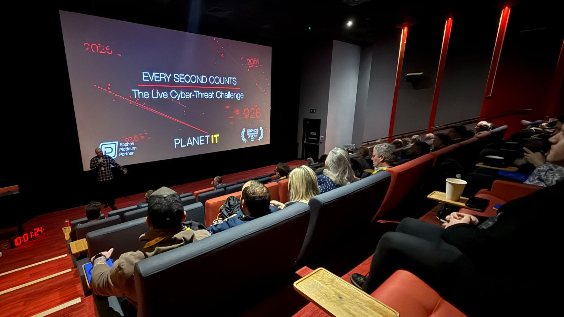
ONE TEAM
MAKING YOUR IT MORE EFFICIENT
www.planet-it.net
Notes:
APPLICATION_DIRECTIVE: STATIC_INCLUDE_ALWAYS
STATIC_KEY: PLANET_WRAP_UP
STATIC_PLACEMENT: LAST
STATIC_TAG: STATIC_03_PLANET_WRAP_UP
MUTATION_POLICY: PRESERVE_VISIBLE_CONTENT_AND_GEOMETRY
SECONDARY_TEXT: ONE TEAM MAKING YOUR IT MORE EFFICIENT
REQUIREMENT: NO_CONTENT_AFTER_THIS_SLIDE
ASSEMBLY_STAGE: FINAL

