Slide 1

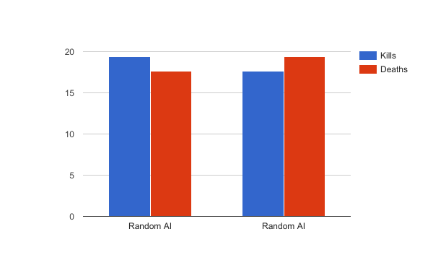
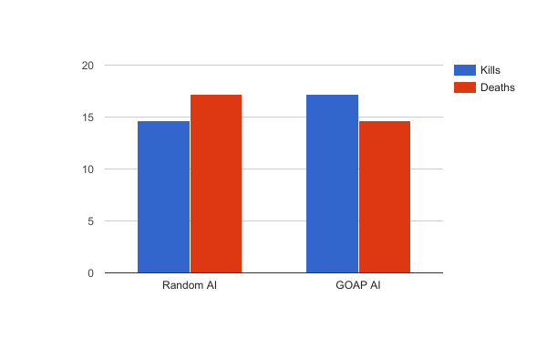
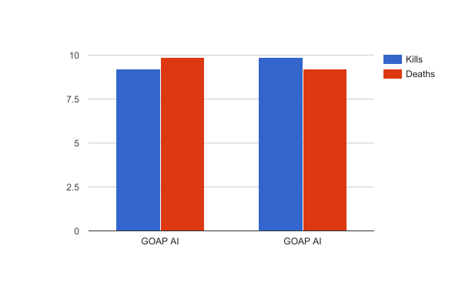
How does a more tactically aware Artificial Intelligence implemented using a planning architecture (GOAP) perform in comparison to the random selection of decisions.
Stephen Ennis
Institute of Technology Carlow
Introduction
Aims
Results
Conclusions
The purpose of this research is to implement tactically aware Artificial Intelligence. The way the AI behaves can really influence the enjoyment a player gets from a game. If the AI is perceived to be smart enough to move in real-life squad formations then the game is likely to be of a higher quality. Many AI in existing games following simple scripted behaviour such as “follow and attack”. I aim to implement an AI such that they will respond to changing tactical situations. This means they will behave with mainly two objectives. First they must ensure the elimination of enemies and second they should aim to keep casualties taken to a minimum.
I will be using a simplified STRIPS like planning architecture called Goal Oriented Action Planning (Goap) to accomplish this. This allows a set of actions to be specified and then a plan can be formulated by creating a tree graph of all possible action combinations to reach the desired goal state when given a specific world state followed by comparing the costs of all the solution leaves in the graph to find the best. Traversing in reverse through the actions that came before the cheapest leave will give the best path of actions applicable to completing the goal.
Investigate if the use of a planning architecture such as GOAP for an AI will cause it to perform better than an AI using the random selection of targets
Investigate if the use of such a technique will appear to a spectator to be more realistic
2 different types of AI.
Randomly choose target locations
GOAP: Have a set of actions that can be undertaken to reach a goal. This goal is chosen based on what is currently the most required state to be in. Using this, target locations will be chosen.
TI did 3 different comparisons:
Random AI vs Random AI
Random AI vs GOAP AI
GOAP AI vs GOAP AI
Random AI randomly selects nodes to pathfind to and cover locations to move to. GOAP AI uses a plan to help it decide.For each one of these comparisons I got the average number of Kills, Deaths, Shots and over 100 times. Each test was a sped up simulation of 5 minutes of play. Even when both AI are the same, there are still differences in results due to its random nature. As expected the GOAP AI outperforms the random AI. GOAP allows it to prioritise getting ammo if it is low so it's always ready to shoot. As it stays in cover longer, it also heals more in order to outlast the damage it takes. It runs away from enemies if they get too close so they helps it dodge bullets.Finally GOAP vs GOAP is a lower kill/death match up. This is due to GOAP AI runing to cover that will protect it from enemy fire if they get within range.
I believe the project was successful in proving that GOAP AI can perform much better than an inferior AI. In individual tests the degree to which the GOAP AI beats the random AI can vary. This is due to the random nature putting the random AI into precarious situations which the other AI will try to avoid. It can also happen that the random AI will win which is to be expected as again it might get “lucky” with with its random locations. Both comparisons that compared the same AI with other turned out as expected with little real differences.
If i was to start this project again I would choose a different situation in order to test out the performance of GOAP. I would have liked to have many more options for the planner to check so there are a lot of different ways to reach the same goal. Using Tiled to create the tile map was a great help as it really simplified the process. RapidJson is a great library to parse the JSON from the map editor so in combination it worked well. There were a lot of features I had to drop as it would have taken too long to do in SFML. I enjoyed SFML but a different approach I would have taken would have to use Unity. Unity would have been a good choice as it takes away a lot of the build up and would have let me focus on the algorithms more.I think it would be interesting to has many different goals and actions shared among different types of AI. I am curious to see the modularity of GOAP put to use.
Methods
The project will be a battle arena where two teams of units are pitted against each other. There are walls surrounding the arena and also within it. These walls block the line of sight of units and provide protection from attacks. Team A and Team B will consist of 4 units each. Units have ammo and can fire at each other. A set of actions are available for use by the units. These actions will change the state of the world. Actions may require preconditions to be met before they can be accomplished. In order to determine the best set of actions to take to reach a certain state, each action also has a cost. The lowest cost path is chosen to complete the goal. A tree is built up with all the leave nodes containing solutions. Each node contains the action to get to that state and the action applied previously. This can be traversed in reverse to get back to the first action. The AI will automatically face and fire at nearby enemies. They will prioritise the closest enemy. The GOAP AI will use these actions in such a way to ensure it always has good cover from the enemy and enough ammo. The random AI will random select target nodes to move to and occasionally go to cover. Being in cover will provide a small amount of healing which is another action the GOAP AI takes into account. The determination of what goal for the GOAP AI to take will be decided with the use of a Finite State Machine (FSM). The FSM will only contain 4 states. One state is for the normal random AI and not the advanced GOAP AI. The 3 states are Idle in which a goal is selected, MoveTo and PerformAction. Actions may require the unit to be in range and the state will keep switching to MoveTo until you are. A* is used extensively for pathfinding between a list of nodes. Each node has information defining its location and connecting nodes. A* will traverse along the lowest cost path between connecting nodes to teach an end destination. Cover nodes are also implemented in this graph so they can be reached.
In order to compare which is performing better. I will record the following data over the same time frame.
Total kills for each team
Total deaths for each team
Total shots fired for each team
Test 1
Background
The goal is to make the AI behave in response to its current situation and plan accordingly. There are many examples of tactical behaving AI out there. Many games implement some form of Finite State Machine in order to bring their AI to live. Some games are for educational, realistic simulations such as those used by the American army. An example of this is “America’s Army” whose purpose is to show the realistic side of battle and squad tactics. The purpose of these games are for military training.
Generally the defining feature of a squad in a military situation is their ability to work as a cohesive entity. Rather than each soldier being given direct instructions on how to behave, the squad leader is tasked with planning the entire squads next move. The units within the squad will move as commanded but in a way in which they support each other to limit casualties. The effectiveness of this type of AI varies depending on a number of factors for example; should cover be sacrificed in order to help a teammate or should a longer path be taken to ensure a safer route.
An AI that can be seen to behave more human like in battle scenarios causes the player to be more interested with the gameplay. I believe in pursuing the area of research I will produce an AI capable of of responding to its surroundings appropriately. This AI will appear to behave a lot more sensible when compared to AI that does not plan out it’s actions.
First I will discuss existing research into the area of militaristic AI for use in games and then from here outline the aims and procedure of this project. The project will test which type of AI performs better and which behaves more realistically.
Bibliography
Test 2
[1] Svenson, P. and Sidenbladh, H. (2003). Determining possible avenues of approach using ANTS [Online].
[2] Kamphuis, A. (unknown). Tactical Path Finding in Urban Environments
[3] Darken, C.J., McCue, D. and Guerrero M. (unknown). Realistic Fireteam Movement in Urban Environments
[4] Balla, R. and Fern, A. (2009). UCT for Tactical Assault Planning in Real-Time Strategy Games
[5] Shi, Y. and Crawfis, R. (2014). Group Tactics Utilizing Suppression and Shelter [Online].
[6] Orkin, J. Three States and a Plan: The A.I. of F.E.A.R.
Test 3

