Slide 1
TALKIES
A Full-Stack Real-Time Messaging & Calling Platform
Project Defense Presentation

Slide 2
Project Motivation & Objective
Limitations of Commercial Solutions:
Centralized data ownership (privacy concerns on WhatsApp/Telegram metadata).
Severe bloat in consumer chat networks (ads, markets, noise).
No option for enterprise private self-hosting.
Core Project Objectives:
Build a fully self-hosted, secure, and developer-owned chat network.
Implement real-time full-duplex messaging and peer-to-peer WebRTC calling.
Create a modern, animated, and highly responsive user interface.

Slide 3
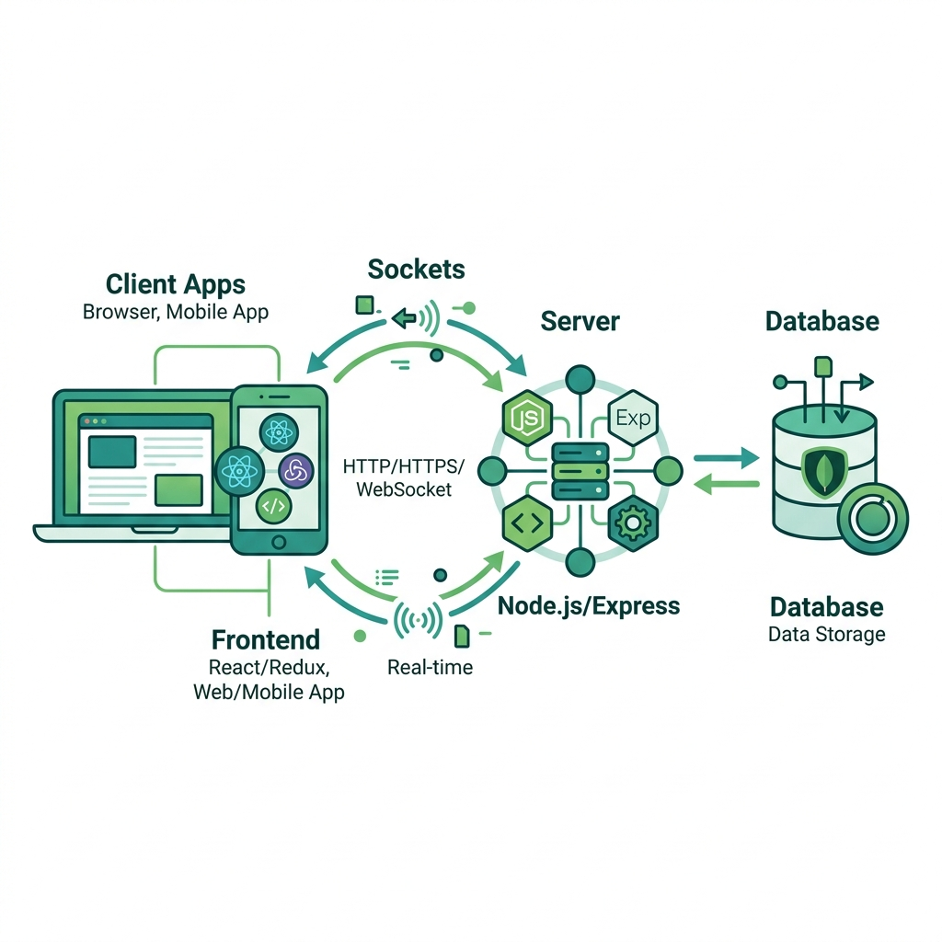
Technical Stack & Architecture
Frontend Engineering:
React.js & TailwindCSS for responsive layouts.
Zustand for lightweight client state management.
Framer Motion for premium UI transitions.
Backend & Real-Time signaling:
Node.js & Express.js for REST API routes.
Socket.io for WebSocket bidirectional messaging.
WebRTC for browser-to-browser media streaming.
Database & Media Storage:
MongoDB for structured collections.
Cloudinary for scalable cloud media hosting.

Slide 4
Authentication & Onboarding
Secure Sign-in & Authentication Flow:
User verification utilizing suffix checks and email authentication.
Stateless user authentication utilizing JSON Web Tokens (JWT).
JWT tokens secured inside HttpOnly cookies to shield from XSS attacks.
Profile Customization Onboarding:
Interactive profile setup: Username validation, avatar upload, and user bio.
Persistent profile storage in MongoDB with real-time socket updates for active contacts.

Slide 5
Real-Time Messaging & Voice Notes
Asynchronous Messaging Pipe:
Full WebSocket communication layer powered by Socket.io.
Optimistic UI updates: client appends sent messages immediately, eliminating latency lag.
Integrated Voice Notes (Voice Messaging):
Capture audio dynamically from the user's microphone using MediaRecorder API.
Upload captured audio as a WebM file to Cloudinary cloud storage.
Native browser audio rendering inside custom-styled message bubble players.

Slide 6
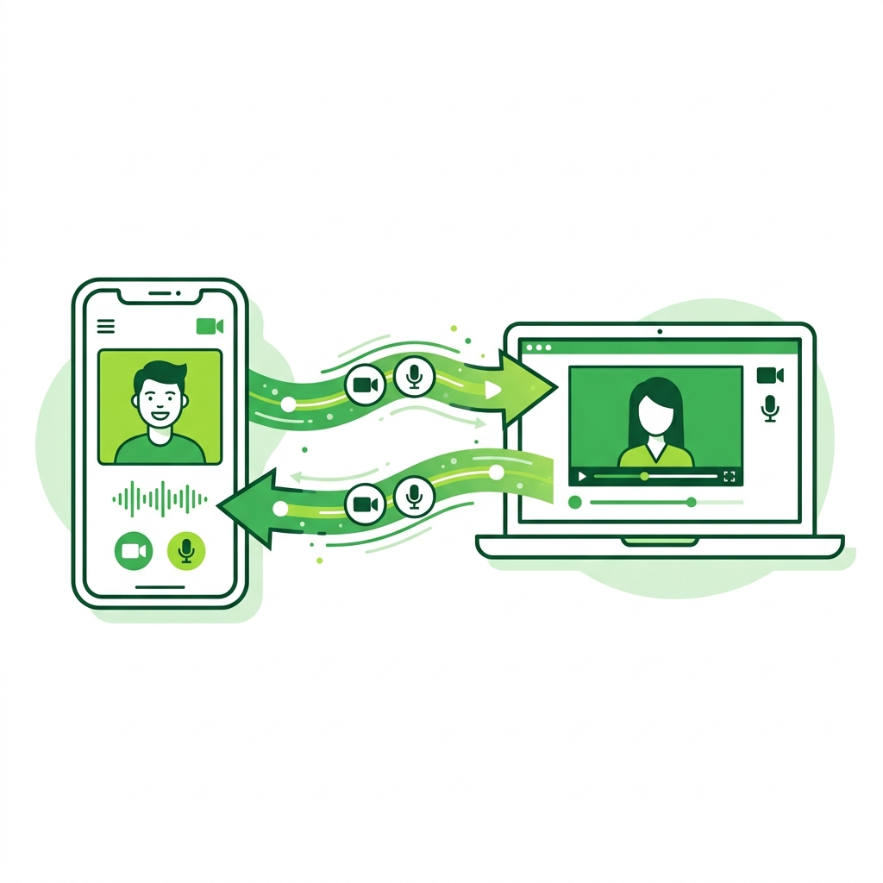
Peer-to-Peer Video & Voice Calling
High-Performance WebRTC Media Streaming:
Bypasses server bandwidth: video and audio stream directly between browsers.
Server acts only as a WebSocket signaling controller to exchange connection tokens.
Interactive UI Integration:
In-app call manager handles call status: Initiating, Ringing, Connected, and Disconnected.
Dynamic hardware controls: client-side toggle for camera, microphone mute, and hang-up.
Global overlay alert to receive or reject calls from any screen.

Slide 7
Real-Time Indicators & Sync
Message Status Ticks:
Single gray tick (Sent to server), double gray tick (Delivered to contact).
Double blue tick (Read by recipient).
Bulk read receipt updates in database and sockets to reduce network chatter.
Typing Indicators:
Typing status triggers socket events to display 'Typing...' under chat contact name.
Deterministic Room IDs (using User IDs) handle typing status for new conversations before database creation.

Slide 8
Social Features & Friend Requests
Friend Onboarding Management:
Split tab panel layout: Search stranger list / View pending friend requests.
Restricts random contacts: users can only chat if they are verified friends or active contacts.
Automated Safety Mechanisms:
Mutual friendship checks and automatic auto-repair loops to ensure database sync.
Prevent self-selection, and block illegal DB states.
Socket triggers alert immediately when a request is sent, accepted, or rejected.

Slide 9

Customization & Support Channels
Personalized Theme Engine:
Toggle between a sleek, battery-saving Dark Mode and clean Light Mode.
Theme configuration is persisted locally using local storage for consistent session state.
Interactive Chat Wallpapers:
Customize background for each conversation using solid color themes or personal images.
Direct Support Channel:
Integrated Help settings card containing a 'Chat with us' support router.
Supports customer queries with a verified green checkmark badge, bypassing friend requests.

Slide 10
Status Stories & Conclusion
Ephemeral Story Sharing (WhatsApp Style):
Upload image/video updates visible to friends for exactly 24 hours.
Dynamic story slider with automatic progress bar transitions.
Conclusion and Achievements:
Delivered a complete, secure, and production-grade MERN messaging system.
Mastered real-time WebSocket state management, WebRTC signaling, and cookie auth.
Future Scope:
Implementing End-to-End Encryption (E2EE) using Web Crypto API.
Developing group chat channels and collaborative document sharing.

