Slide 1
An Interpreted Scheme Dialect with a Reflective Tower
Stephen Barnes, stbarnes@stanford.edu

Slide 2
x = 2

Slide 3

x = 2
x = 2

Slide 4

x = 2
x = 2
locals()[‘x’] = 2

Slide 5
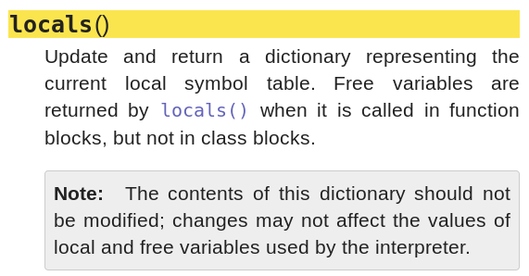
x = 2
x = 2
locals()[‘x’] = 2

Slide 6

x = 2
x = 2
locals()[‘x’] = 2
locals()[‘x’] = 2
mem_file = open("/proc/self/mem", 'r', 0)
...
Program
CPython

Slide 7

x = 2
locals()[‘x’] = 2
mem_file = open("/proc/self/mem", 'r', 0)
...
Program
CPython
Reflective Tower
(this project)
5:20

Slide 8
What is a Reflective Tower?

Slide 9

Client code
Interpreter

Slide 10
Client code
Interpreter

Slide 11
Client code
Interpreter
Interpreter

Slide 12

Client code
Interpreter
Interpreter
.
.
.
∞

Slide 13


Client code
Demiurge

Slide 14
Client code
Interpreter
Demiurge

Slide 15
Client code
Interpreter
Interpreter
Demiurge

Slide 16

Implementation
4:40

Slide 17
12 ↦ 12
“string” ↦ “string”
#t ↦ True
Literals:

Slide 18
12 ↦ 12
“string” ↦ “string”
#t ↦ True
Literals:
(fn a b) ↦ fn(a, b)
(+ 1 (+ 2 3)) ↦ 6
S-expressions:

Slide 19
12 ↦ 12
“string” ↦ “string”
#t ↦ True
Literals:
(fn a b) ↦ fn(a, b)
(+ 1 (+ 2 3)) ↦ 6
S-expressions:
Lambda-functions:
((lambda (a b) (+ a b)) 1 2) ↦ 3
(set x 12) → x ↦ 12
(if #t 1 2) ↦ 1
Assignment:
Branching:

Slide 20
(+ (+ 1 2) 3)
Eval
Tokenize
→ [‘(‘, ‘+‘, ‘(‘, ‘+’ ‘1’, ‘2’, ...]
Parse
→ [‘+’, [‘+’, ‘1’, ‘2’], ‘3’]
Eval_AST
→ 6

Slide 21
(+ (+ 1 2) 3)
Eval
Tokenize
→ [‘(‘, ‘+‘, ‘(‘, ‘+’ ‘1’, ‘2’, ...]
Parse
→ [‘+’, [‘+’, ‘1’, ‘2’], ‘3’]
Eval_AST
→ 6
Eval_AST
[‘+’, ‘1’, ‘2’] → 3

Slide 22
(+ (+ 1 2) 3)
Eval
Tokenize
→ [‘(‘, ‘+‘, ‘(‘, ‘+’ ‘1’, ‘2’, ...]
Parse
→ [‘+’, [‘+’, ‘1’, ‘2’], ‘3’]
Eval_AST
→ 6
Eval_AST
[‘+’, ‘1’, ‘2’] → 3
Eval_AST
‘+’ → <function object>

Slide 23
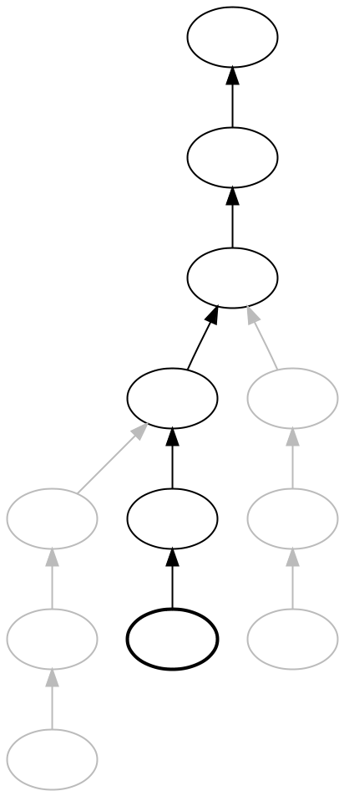
Contexts
4:00

Slide 24
Contexts
Globals
((lambda (a b) (+ a b)) 1 2)

Slide 25
Contexts
Globals
((lambda (a b) (+ a b)) 1 2)
{‘a’: 1,
‘b’: 2,
‘recurse’: <func>}

Slide 26
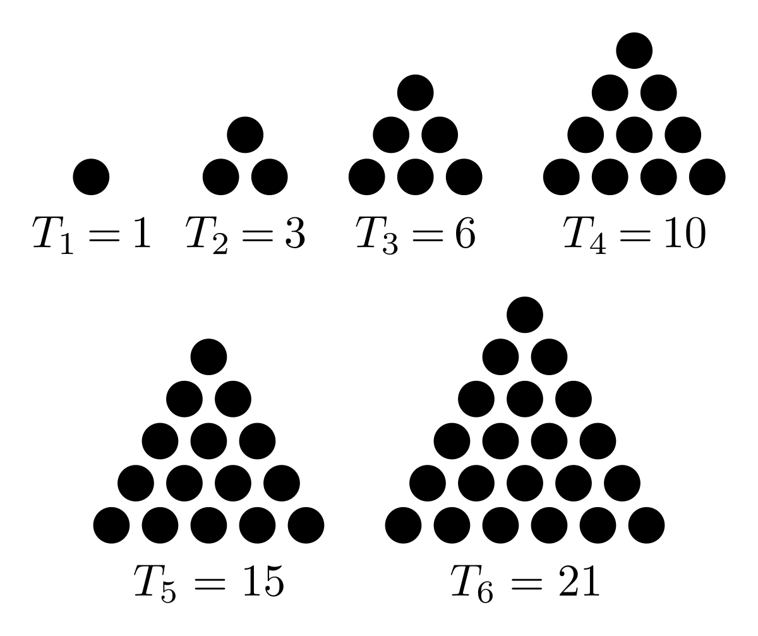
T_{n} = n + T_{n-1} T₀ = 0
(set f (lambda (i accum)
(if (= 0 i)
accum
(f (- x 1)
(+ accum i)))))
(f 10 0) ↦ 1 + 2 + … + 10

Slide 27
Globals with
{‘f’ : <func>}
T_{n} = n + T_{n-1} T₀ = 0
{‘i’: 10,
‘accum’: 0,
‘recurse’: <func>}
(set f (lambda (i accum)
(if (= 0 i)
accum
(f (- x 1)
(+ accum i)))))
(f 10 0) ↦ 1 + 2 + … + 10
Contexts can change after capture

Slide 28
Universals
Client code
Interpreter
Globals
Interpreter
Globals
Interpreter
Globals

Slide 29
Universals
+, map, eval
Client code
Interpreter
Globals
“depth”: 0
Interpreter
Globals
“depth”: 1
Interpreter
Globals
“depth”: 2

Slide 30
Universals
+, map, eval
depth ↦ 0
Client code
depth ↦ 1
Interpreter
Globals
“depth”: 0
Interpreter
Globals
“depth”: 1
depth ↦ 2
Interpreter
Globals
“depth”: 2

Slide 31
Universals
+, map, eval
+ ↦ <+ func>
Client code
+ ↦ <+ func>
Interpreter
Globals
“depth”: 0
+ ↦ <+ func>
Interpreter
Globals
“depth”: 1
Interpreter
Globals
“depth”: 2

Slide 32
Universals
+, map, eval
(set x 2)
x ↦ 2
Client code
x ↦ undefined
Interpreter
Globals
“x”: 2
Interpreter
Globals
x ↦ undefined
x ↦ undefined
Interpreter
Globals

Slide 33
Universals
+, map, eval
+ ↦ <+ func>
Client code
+ ↦ <+ func>
Interpreter
Globals
“depth”: 0
+ ↦ <+ func>
Interpreter
Globals
“depth”: 1
+ ↦ ???
Interpreter
Globals
“depth”: 2
???

Slide 34
Universals
+, map, eval
+ ↦ <+ func>
Client code
+ ↦ <+ func>
Interpreter
Globals
“depth”: 0
+ ↦ <+ func>
Interpreter
Globals
“depth”: 1
+ ↦ <+ func>
Interpreter
Globals
“depth”: 2

Slide 35
Universals
+, map, eval
(set eval (lambda ...))
eval ↦ new func
Client code
Interpreter
Globals
“eval”: new func
Interpreter
Globals
“depth”: 1
Interpreter
Globals
“depth”: 2
2:50

Slide 36
joots
“Jump out of the system”
Evaluate code as if executed by the layer interpreting this

Slide 37
Universals
+, map, eval
x ↦ <undefined>
Client code
x ↦ 2
Interpreter
Globals
Interpreter
Globals
“x”: 2
x ↦ <undefined>
x ↦ <undefined>
Interpreter
Globals
(joots (set x 2))

Slide 38
Universals
+, map, eval
Client code
Interpreter
Globals
Interpreter
Globals
Interpreter
Globals
(joots (set eval_literal
(lambda args "Malkovich")))

Slide 39
Universals
+, map, eval
Client code
eval_literal
↦ new func
Interpreter
Globals
Interpreter
Globals
“eval_lit”: ...
Interpreter
Globals
(joots (set eval_literal
(lambda args "Malkovich")))
(+ 1 1) ↦ “MalkovichMalkovich”

Slide 40
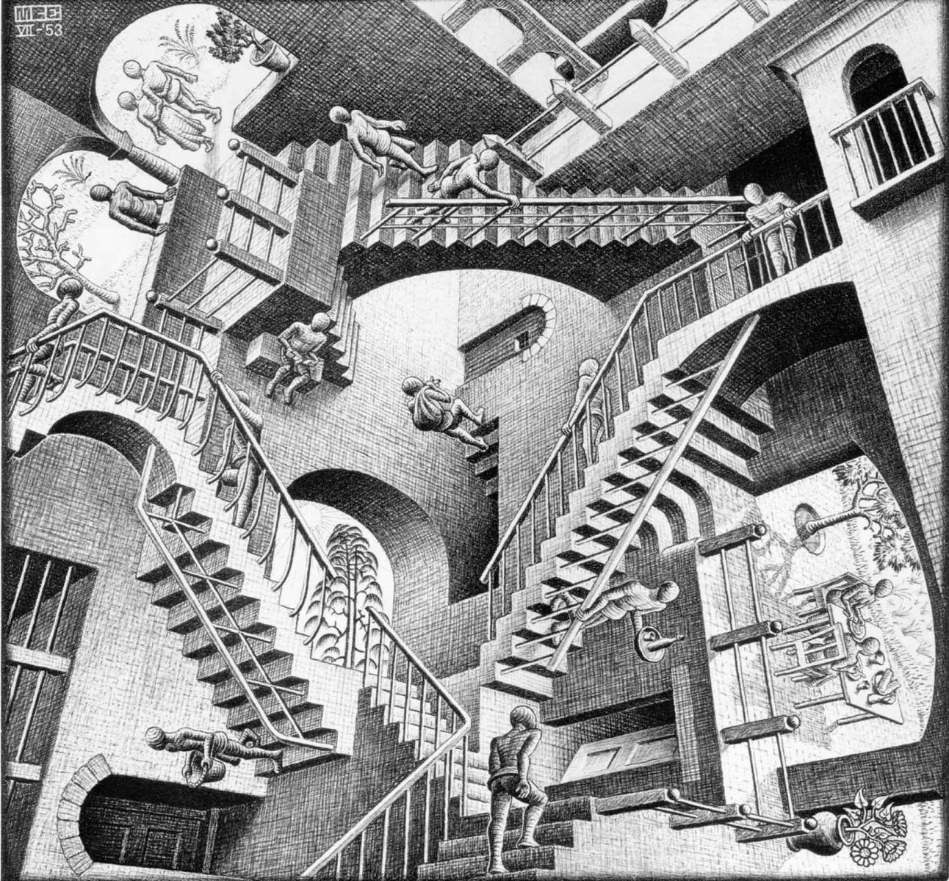
Code Examples
2:00

Slide 41
(set_index (get_current_context) "x" 10)
x ↦ 10
Analogous to:
locals()[‘x’] = 10

Slide 42
(begin
(set curriedplus
(lambda (x)
(lambda (y)
(lambda (z)
(+ x y z)))))
(set plus2 (curriedplus 2))
(set plus5 (plus2 3))
(plus5 10))
Universals
Globals
{‘x’: 2}
{‘y’: 3}
{‘z’: 10}
(+ x y z)

Slide 43
(set i 0)
(set inc (lambda ()
(begin
(set_global i (+ i 1))
(print i))))
(inc) ; prints 1
(inc) ; prints 2

Slide 44
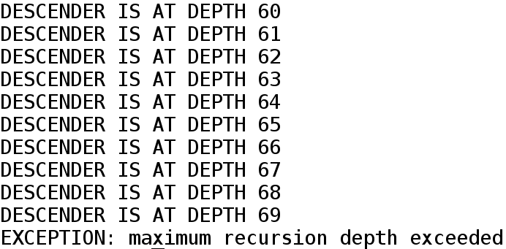
(set_universal descender
(floatinglambda ()
(begin
(print "DESCENDER IS AT DEPTH" DEPTH)
(joots (descender)))))
(descender)

Slide 45
(set_universal new_tokenize
(lambda (s interpreter) (begin
; first remove comments
(set s
(remove_comments s INTERPRETER))
; then parse into tokens
(set tokens
(regex_findall (+ "\{|\}|[^\'{}\s]+|\'[^\']*\'") s))
; then replace the [] with (), to plug into parse_tokens properly
(set tokens
(map
(lambda (x) (if
(= x "{")
"("
(if (= x "}")
")"
x)))
tokens))
(` tokens #f))))
(joots (set tokenize new_tokenize))
;FINISH-BEFORE
{print {+ 1 {* 2 3}}}

Slide 46
Q & A

