Slide 1
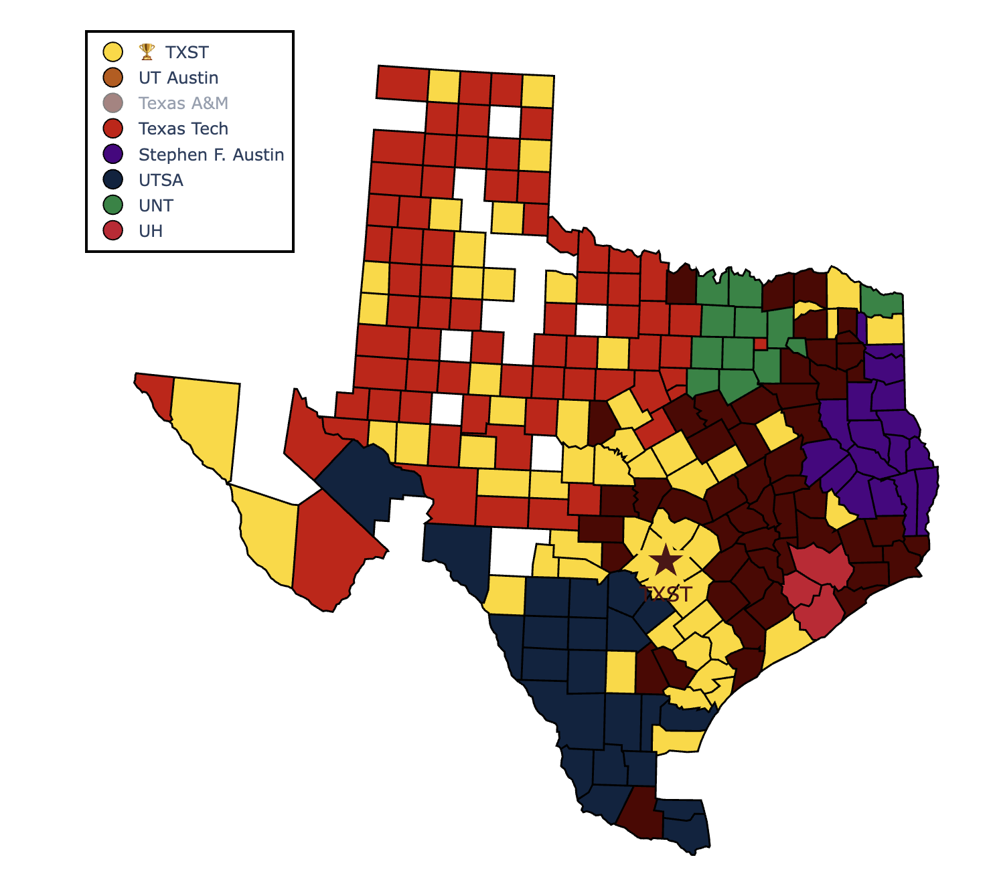
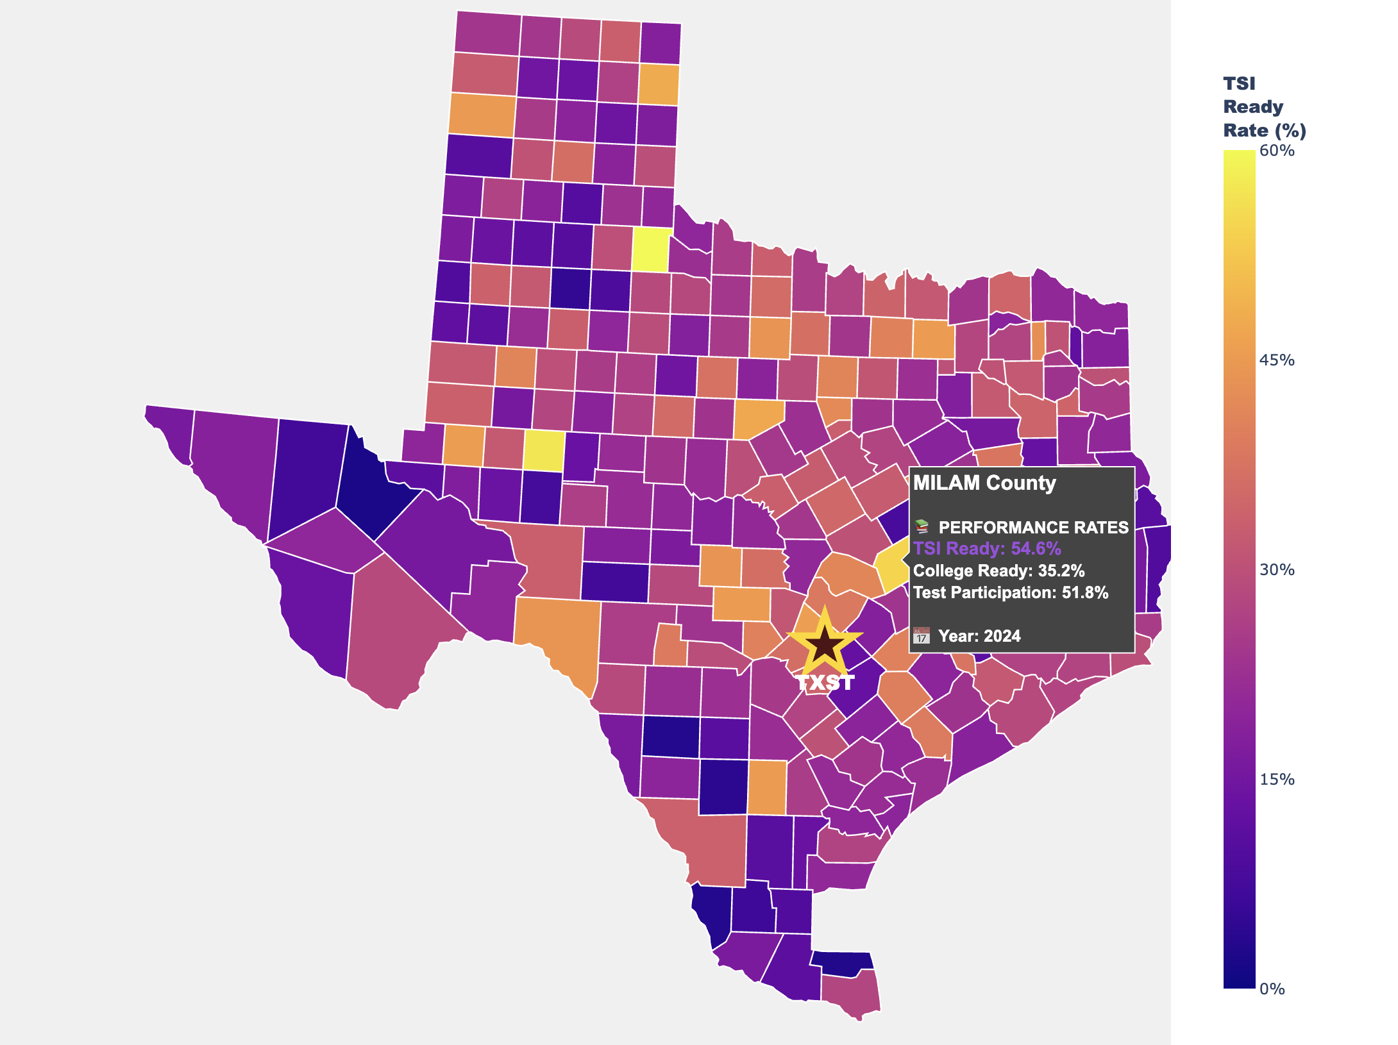
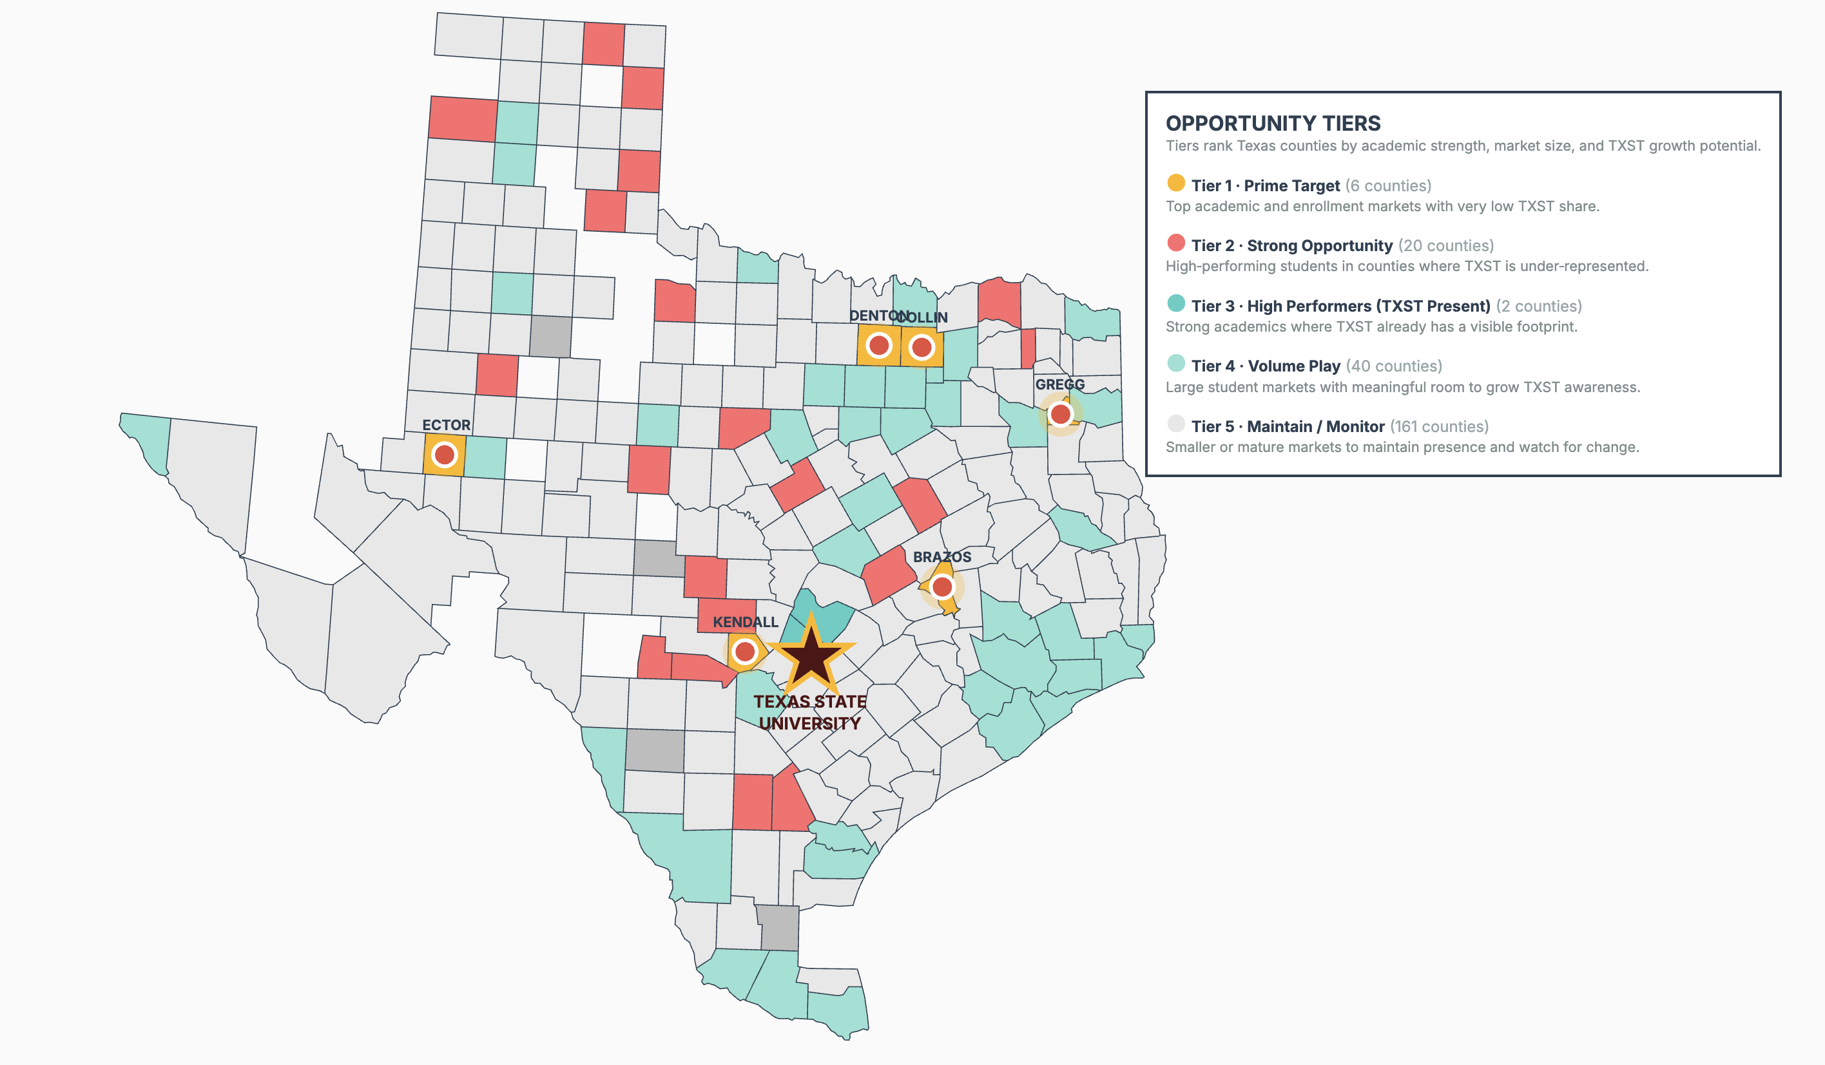
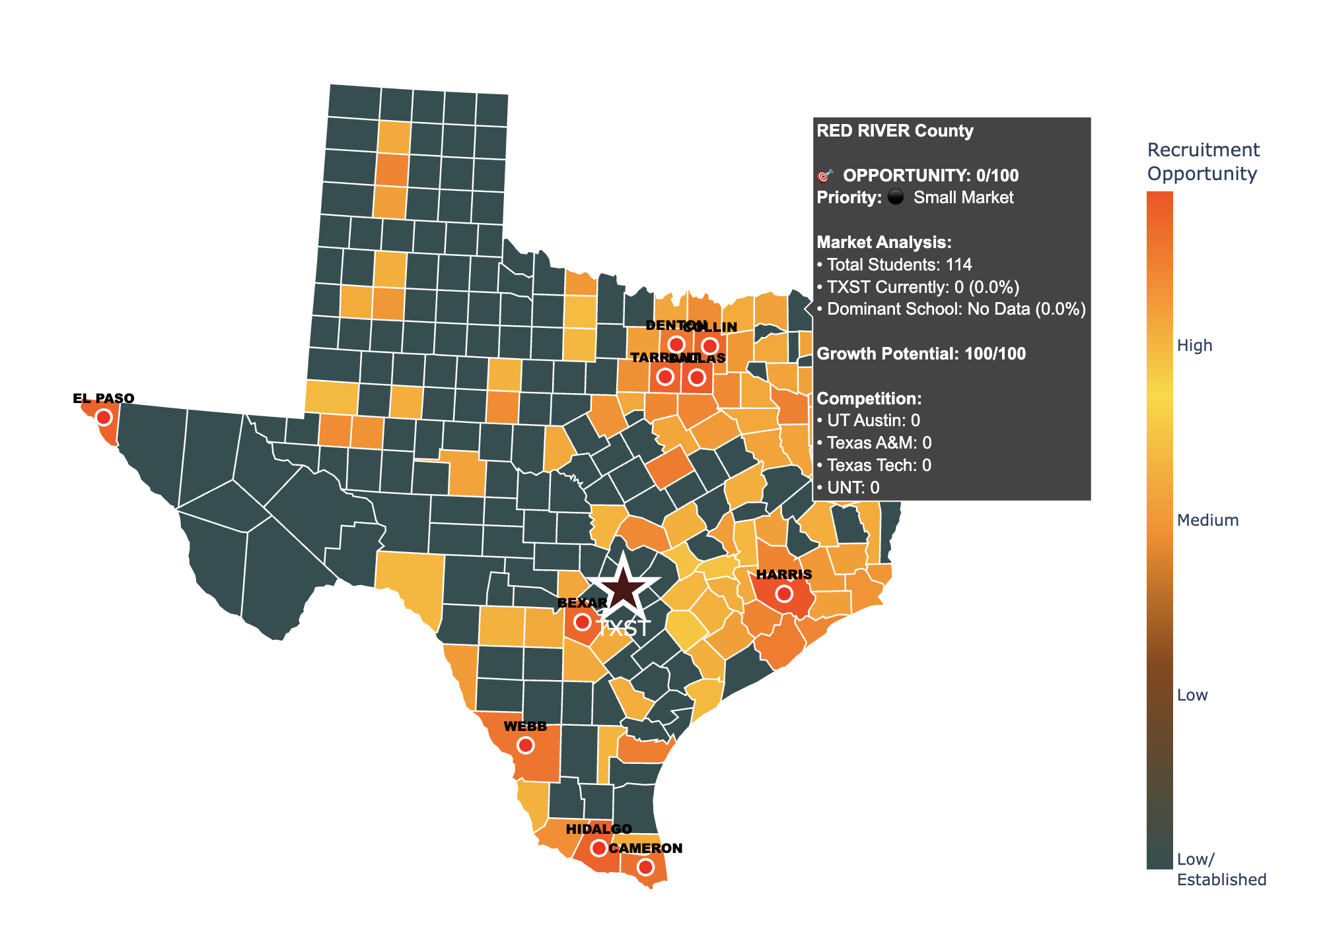
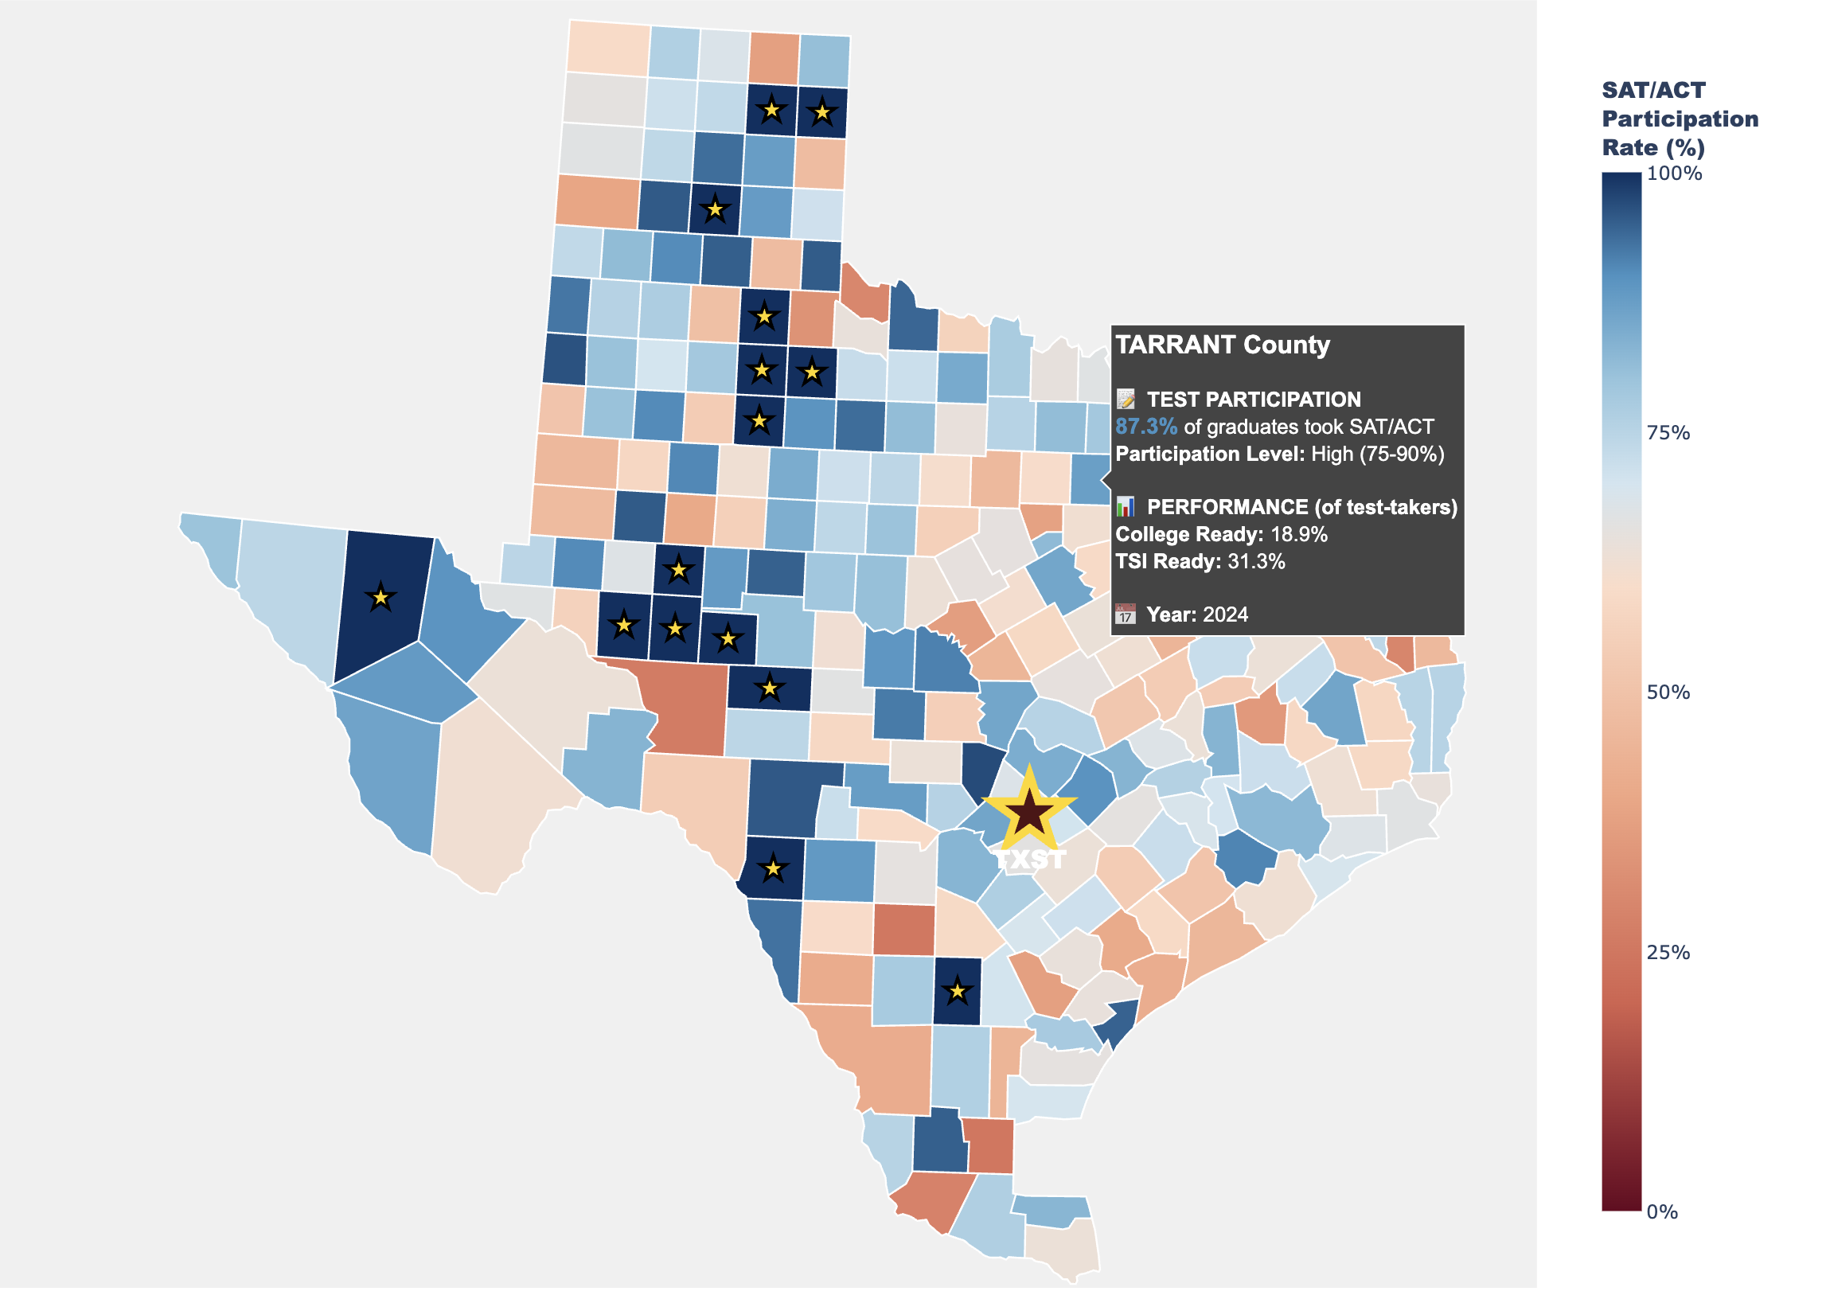
Identifying High-Performing Texas Counties for Strategic Enrollment Growth
Chloe Jones, Stephen Cox, Vaishnavi Sharma
Department of Computer Science, College Science and Engineering, Texas State University
Problem Statement
As Texas State University pursues Research 1 (R1) classification and works to elevate its academic prestige, attracting high-performing students becomes increasingly critical to institutional advancement. TXST faces intensifying competition from established peer institutions such as UT Austin, Texas A&M, and Texas Tech for top-tier students across Texas. This project analyzes the spatial distribution of college-ready students using county-level SAT/ACT data to identify strategic recruitment opportunities. By mapping TXST's competitive positioning and market share across Texas regions, we reveal high-opportunity counties with strong student performance but limited TXST presence, providing data-driven recommendations to support strategic enrollment growth.
Research Statement
What is the spatial distribution of college ready students across Texas, and which counties represent the highest-opportunity markets for TXST recruitment given competitive enrollment patterns?
Methods
Data Processing
Cleaned and standardized county names across THECB enrollment and TEA SAT/ACT datasets
Removed non-college categories from enrollment data
Aggregated district-level SAT/ACT data to county level using mean performance rates
Calculated market share for TXST and seven competitor institutions per county
Merged enrollment and academic performance data on county
Opportunity Scoring Two composite scoring approaches developed:
Enrollment-Only: Market Size (50%), Growth Potential to 17% target (30%), Breakable Market (20%)
Combined Academic + Enrollment: Academic Performance (40%), Market Size (30%), TXST Gap (20%), Test Participation (10%)
All components normalized to 0-100 scale
Tier Classification Counties classified into five strategic tiers based on:
High Academic Performance (College Ready ≥25%)
Large Market (>2,000 students)
Low TXST Presence (<10% share)
Tier 1 (Prime): All three criteria met Tier 2: High academics + Low TXST Tier 3: High academics (TXST present) Tier 4: Large market + Low TXST Tier 5: Maintain/Monitor
Visualization
Interactive choropleth maps created using Plotly and Census TIGER/Line 2020 shapefiles, displaying county-level academic performance, enrollment patterns, and strategic recruitment priorities.
Findings
TXST currently has strong representation in Central Texas but remains underrepresented in several high-performing, high-volume counties across North and West Texas.
Prime and strong-opportunity counties demonstrate significantly higher college readiness rates than TXST-dominant regions, suggesting missed recruitment potential among academically prepared students.
Large suburban counties such as Collin and Denton contain substantial student markets with low TXST market share, representing the greatest potential enrollment growth.
Many high-readiness counties with low TXST presence are currently dominated by competing institutions, indicating strong but penetrable recruitment pipelines.
Rural counties with smaller markets but high readiness rates provide targeted niche recruitment opportunities with relatively low competition.
Overall, recruitment opportunities are not evenly distributed, with the highest-impact gains concentrated in a small number of strategically important counties.
Results
THECB enrollment data and SAT/ACT readiness data were merged to create a combined dataset covering 265 Texas counties, with 229 counties containing both enrollment and academic readiness metrics.
Counties were classified into five strategic recruitment tiers based on college readiness, total student market, and Texas State (TXST) market share.
6 Tier 1 (prime target) and 20 Tier 2 (strong opportunity) counties were identified as high-growth regions where academic performance is strong but TXST presence is low.
Tier 1 counties alone represent a potential market of 85,560 students, with projected growth of +11,017 TXST students if market share increased to 15%.
Prime target counties show significantly higher academic readiness (~29.9%) compared to the statewide average (15.6%), indicating strong recruitment alignment.
Overall, results highlight geographically concentrated regions where targeted recruitment could substantially increase TXST enrollment.
Data Sources
THECB High School Graduate Enrollment Data
County-level enrollment data from the Texas Higher Education Coordinating Board tracking where 36,175 rows containing 951,423 Texas high school graduates enrolled across 325+ institutions and from 2019-2024. Includes enrollment counts by county, district, and institution.
TEA College Readiness Data
2024 district-level academic performance data from the Texas Education Agency tracking SAT/ACT outcomes across 1,058 school districts in 252 Texas counties. Metrics include test participation rates (70.3% average), college readiness benchmarks (16.5% average achieving critical scores), and TSI dual-subject readiness (26.7% average meeting standards in both Math and Reading/Writing).
Implications
Targeted recruitment in Tier 1 counties could significantly increase TXST applications/ enrollment quality, with potential growth of over 11,000 students if market share improves.
Expanding outreach in high-readiness counties may improve academic profile and incoming student preparedness.
Increased presence in large suburban counties (e.g., Collin, Denton) could strengthen TXST’s competitiveness against dominant institutions.
Data-driven geographic targeting allows recruitment resources to be focused on high-impact regions rather than evenly distributed statewide.
Strengthening pipelines in underrepresented but high-performing counties may support long-term enrollment growth and institutional visibility.
Component | Weight | Formula
Academic Score | 40% | (College Ready Rate ÷ 50) × 100
Market Score | 30% | [In(1 + Total Students) = In (1 + Max Students)] × 100
TXST Gap Score | 20% | 100 - TXST Market Share
Participation Score | 10% | SAT/ACT Participation Rate
FINAL SCORE | 100% | (Academic × 0.40) + (Market × 0.30) + (Gap × 0.20) + (Participation × 0.10)
TSI Readiness Performance by County - Percentage of graduates meeting Texas Success Initiative standards in both Math and Reading/Writing. Higher rates indicate students ready for college-level coursework without remediation.
Component | Weight | Formula
Market Size Score | 50% | [In(1 + Total Students) = In (1 + Max Students)] × 100
Growth Potential | 30% | [(max(0, 17% - TXST Share)) + 17%] × 100
Breakable Market | 20% | 100 - Dominant School Share
FINAL SCORE | 100% | (Market × 0.50) + (Growth × 0.30) + (Breakable × 0.20)
Texas County Dominance by University" Shows which university enrolls the most graduates from each county. Colors represent different institutions and reveal geographic recruitment territories across Texas.
Reference/Data Cite
Texas Higher Education Coordinating Board. "High School Graduate College Enrollment Data, 2019-2024." Dataset. Accessed February 2025. https://www.highered.texas.gov/.
Texas Education Agency. "District-Level SAT/ACT Performance Data, 2019-2024." Dataset. Accessed February 2025. https://tea.texas.gov/.
AI Disclosure: Poster content and analysis code developed with assistance from Claude (Anthropic). All outputs validated by authors.
SAT/ACT Test Participation Rates by County - Percentage of graduates taking college entrance exams. Blue counties show high college-going culture; red counties indicate lower test-taking engagement. Hover view shows college readiness metrics.
Recruitment opportunity map, recruitment opportunity score based off of Opportunity_Score = (Market_Size_Score × 0.50) + (Growth_Potential × 0.30) + (Breakable_Market × 0.20)
Market_Size_Score is the number of students that have graduated from that county from 2019-2024, Growth_Potential Gap between TXST's current share and a target share of 17%, Breakable_Market is the total market percentage minus the dominant school.
Counties classified into recruitment priority tiers based on a composite opportunity score combining academic performance (College Readiness and TSI Ready rates), market size (total graduates), current TXST market share, and test participation rates. Tier 1 (Gold) = highest priority targets with strong academics, large markets, and low TXST presence. Lower tiers indicate smaller markets or areas where TXST already has strong enrollment.

