Slide 1
Final presentation
Author: Zihan Xia, Zhaofeng Cao, Guang Zeng, Zizhao Cao

Slide 2
Libraries:
1. C++ standard library
2. Pthread library
3. Openmp Library
4. PPL Library
5. Dlib
Notes:
For every libraries, we stand from the views of features, usage and implementation to introduce them., And then use some algorithm to compare the performance of them in specific algorithm.

Slide 3
Basic information

Slide 4
C++ Standard Library Thread
Its features include:
1. Thread creation and management: The Thread library provides a class called 'thread' that allows developers to create and manage threads. Developers can create new threads, start and stop them, and check their running status.
2. Synchronization: The Thread library provides several synchronization mechanisms such as mutexes, condition variables, and barriers that allow developers to coordinate access to shared resources between threads.
3. Futures and promises: The Thread library provides a mechanism called 'futures' and 'promises' that allow developers to communicate data between threads. Futures and promises are objects that represent a value that will be computed in the future by a thread.
4. Atomic variables: The Thread library provides support for atomic variables that allow multiple threads to read and write to a shared memory location without the need for synchronization mechanisms.

Slide 5
C++ Standard Library usage:
The Thread library is useful for developing multi-threaded applications that can take advantage of modern multi-core processors. It is widely used in applications such as video encoding, web servers, and games.

Slide 6
C++ Standard Library Implementation:
The C++ standard library threads rely on the operating system's thread support, which is typically implemented using a combination of kernel-level and user-level code. The library provides a wrapper around the operating system's thread API, making it easier to create and manage threads from C++ code. When a thread is created, the library allocates a new stack for the thread and sets up a thread context that is managed by the operating system. The thread context includes things like the thread's register state and program counter, which are saved and restored as the thread is scheduled by the operating system.

Slide 7
OpenMP
OpenMP (Open Multi-Processing) is a widely used API (application programming interface) for shared-memory multi-processing in C, C++. It is a standard that defines a set of compiler directives, library routines, and environment variables that enable multi-threaded programming on shared-memory architectures.
Its features include:
1. Parallel Loops: The library provides a simple yet powerful construct for parallelizing loops called 'parallel for'. This construct makes it easy to parallelize loops, with only a few lines of code change, resulting in significant performance gains.
2. Parallel Regions: Parallel regions are a construct of OpenMP that allow developers to parallelize a block of code. The library provides directives that allow developers to specify a set of instructions that should be executed in parallel.
3. Work Sharing: OpenMP allows developers to divide a large task into smaller pieces and assign these to different threads. The work-sharing constructs of OpenMP—'sections,' 'single,' 'master,' and 'critical'—allow developers to define critical sections of code that should be executed by only one thread at a time.
4. Synchronization: Synchronization constructs, like 'critical,' 'barrier,' 'atomic,' 'flush,' and 'ordered' are key components for achieving correctness and consistency of the program's behavior.

Slide 8
Openmp usage:
The OpenMP library is useful in parallelizing applications for shared-memory architectures, making them run fast on modern multi-core processors. Some examples of where OpenMP can be used effectively are scientific simulations, computer vision, financial algorithms, and any applications that require iterative, independent work.

Slide 9
Openmp implementation
OpenMP relies on the operating system's support for thread-level parallelism, which is typically implemented using shared memory multiprocessing. When OpenMP directives are used in a program, the compiler generates code that creates multiple threads to execute the parallel portion of the program. These threads share access to the same memory space, which can result in contention and synchronization issues if not handled properly. OpenMP provides constructs for thread synchronization and data sharing, which can be used to eliminate contention and ensure correct program behavior.

Slide 10
POSIX Threads
POSIX Threads, often abbreviated as Pthreads, is a library consisting of a set of C programming language API (Application Programming Interface) and interfaces with which a programmer can access services of the Operating System to create and manage threads. It is a standard for thread creation and management on Unix-like systems, including Linux.
Its features include:
1. Thread creation and management: The library provides a set of functions for creating, starting, stopping, and managing threads. The functions can create threads with specific attributes, such as priority, stack size, and scheduling policy.
2. Thread synchronization: POSIX Threads provides a range of synchronization mechanisms such as mutexes, condition variables, read-write locks, and barriers that can be used to synchronize access to shared data between threads.
3. Thread stack management: The library provides functions for managing stack allocation, including setting the stack size, stack address, and stack overflow handling.
4. Thread cancellation: Pthreads supports thread cancellation, allowing one thread to terminate another thread. The thread being canceled can perform cleanup operations before being terminated.

Slide 11
POSIX Thread Usage:
Pthreads are useful for multithreaded programming on Unix-like systems. They allow a program to perform multiple tasks concurrently, taking advantage of multi-core processors or multiple CPUs.

Slide 12
POSIX Thread Implementation:
POSIX Threads also rely on the operating system's thread support, which is typically implemented using kernel-level and user-level code. When a thread is created using the pthread_create() function, the library allocates a new stack for the thread and sets up a thread context that is managed by the operating system. Like C++ Standard Library Threads, the thread context includes things like the thread's register state and program counter, which are saved and restored as the thread is scheduled by the operating system. POSIX Threads provide a low-level interface to thread management, which can be used to create and manage threads with fine-grained control.

Slide 13
Parallel Pattern Library(PPL)
Advantage: PPL is a high-level library that simplifies the process of writing parallel code. It provides a collection of parallel algorithms and data structures that can be used to distribute work across multiple threads or cores safely.
Disadvantage: PPL is only available on Windows platforms, which limits its portability to other operating systems.
Usage: PPL is often used in high-performance computing environments to speed up computationally-intensive tasks such as numerical simulations and data analysis.

Slide 14
Dlib
Advantage: dlib is a versatile library that provides a wide range of machine learning algorithms and tools, including image processing, face recognition, and object detection.
Disadvantage: dlib has a steeper learning curve than some other machine learning libraries due to its complex architecture and large number of features.
Usage: dlib is well known for its high accuracy in scenarios such as face recognition and often used in computer vision and image processing applications, as well as in natural language processing and other machine learning tasks. It is also commonly used in research and academic environments due to its flexibility and scalability.

Slide 15
Experiment:

Slide 16
Application: Image processing
Reason:
computationally intensive (separated regions in multiple threads)
helpful with real-time applications (large & multiple images)
Comparison:
3 different libraries (C++ standard lib, Pthread, OpenMP)
Image warp
Sobel edge detection

Slide 17
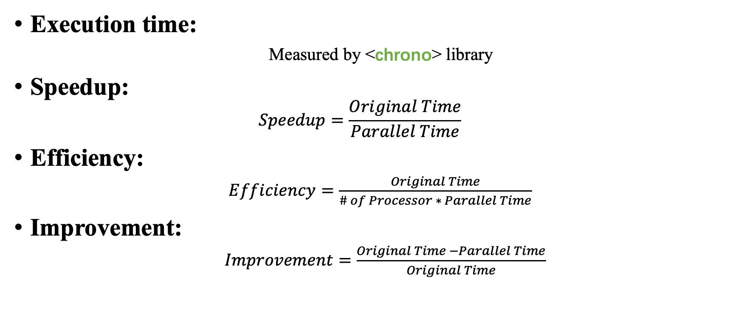
Performance metrices
Execution time:
Measured by <chrono> library
Speedup:
$$Speedup=\frac{Original Time}{Parallel Time}$$
Efficiency:
$Efficiency=\frac{Original Time}{\# of Processor ∗ Parallel Time}$
Improvement:
$Improvement=\frac{Original Time −Parallel Time}{Original Time}$

Slide 18
Hardware & Software Specifications
Apple M1 Pro
10-core M1 processor (8 performance and 2 efficiency)
16GB RAM
2.5 GHz - 3.2 GHz
Operation system: macOS 13.2.1
Compiler: Clang
IDE: CLion

Slide 19
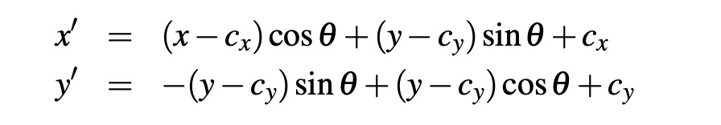


Image warp
Spatial transformation of an image is a popular process in both photo-editing software and registration algorithms
Mathematical expression:
Demo:
Reference code: https://github.com/cxcxcxcx/imgwarp-opencv

Slide 20
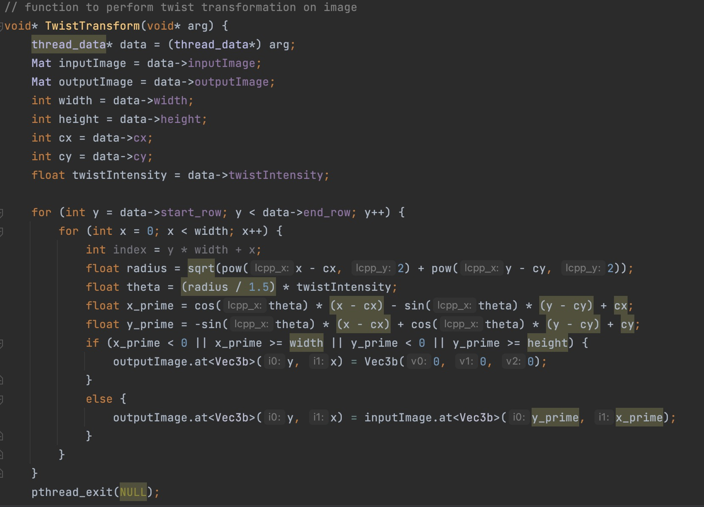
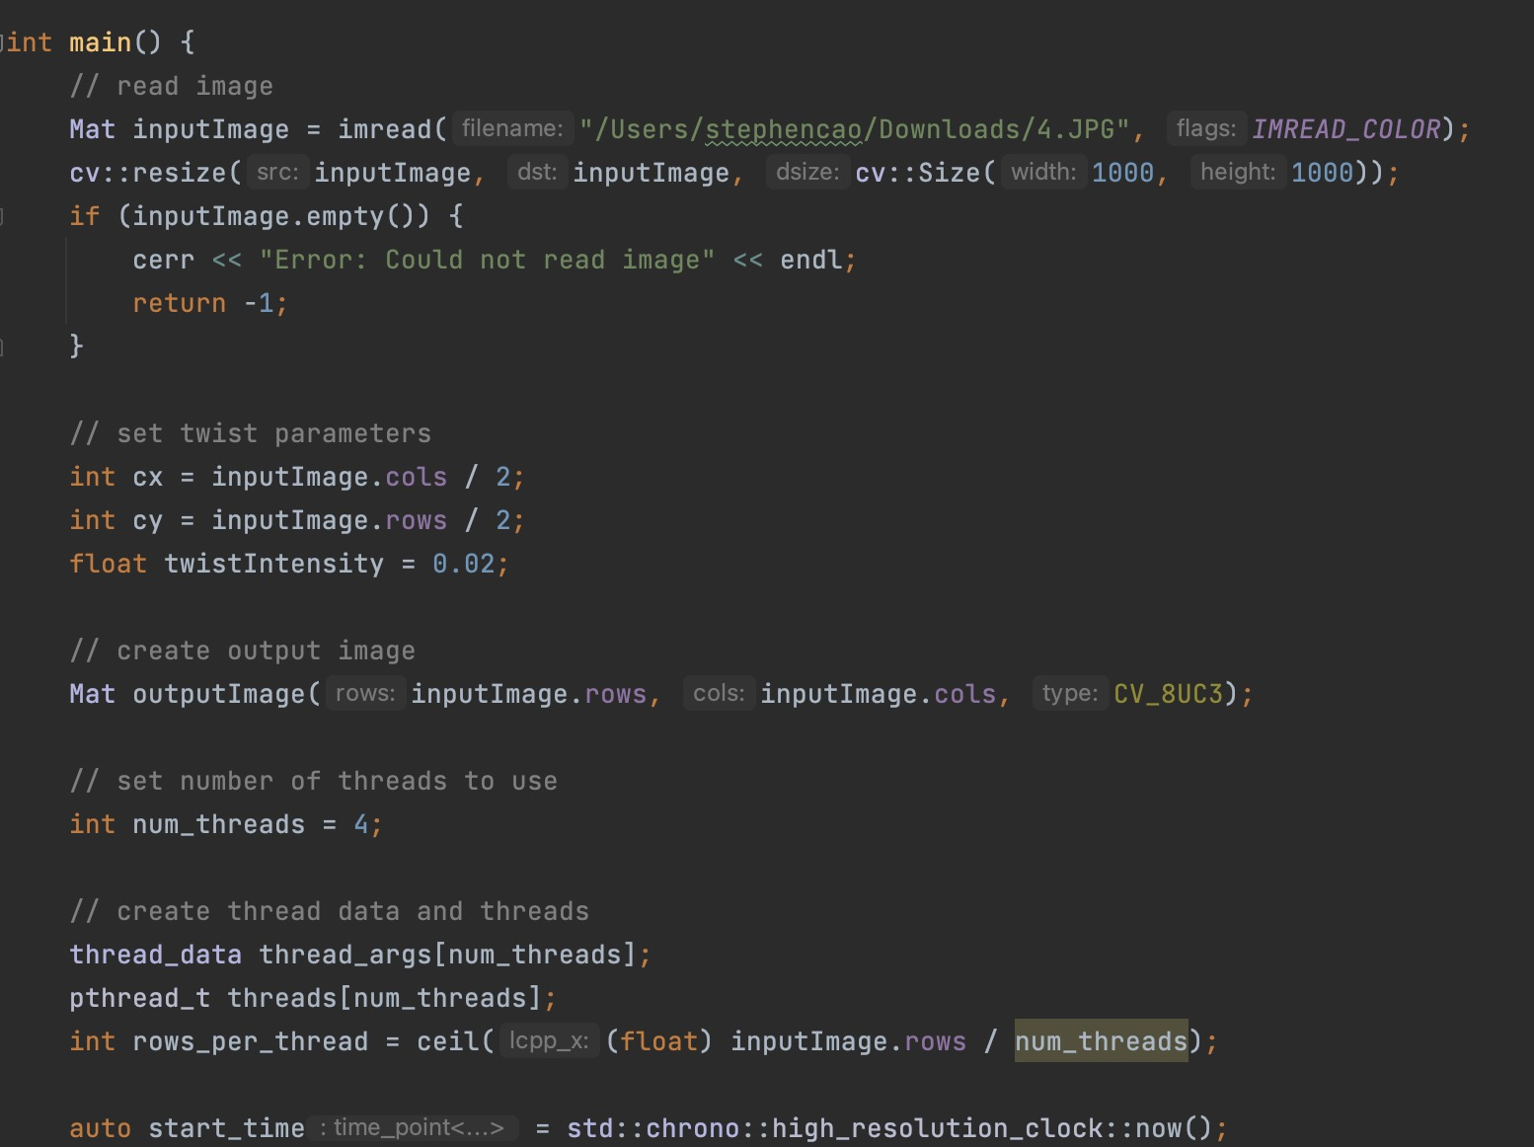
Code example:
Read the image
Change pixel
Math process of
image data
Separated image regions

Slide 21
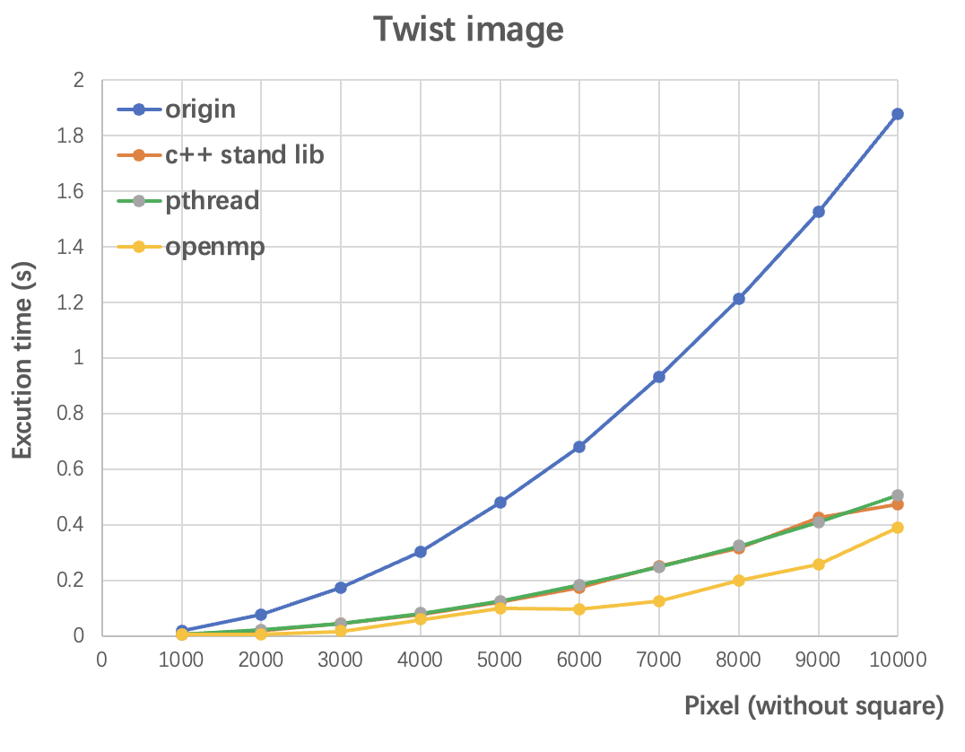
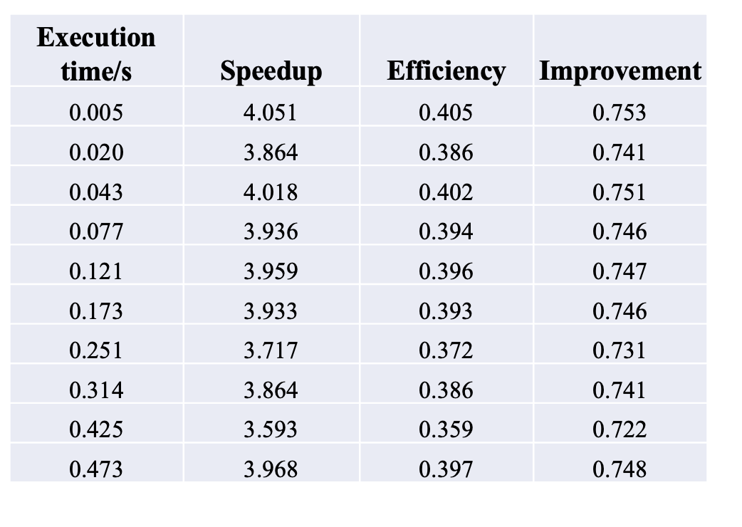
Result 1
Table. Example of performance matrices of C++ standard Library

Slide 22
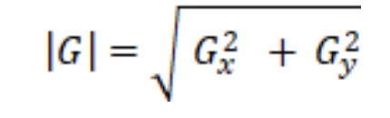



Sobel Edge Detection
Algorithm:
Input image
Load the image into a 2D array
Split the image into 4 sub-regions
Process 4 sub-regions using 4 threads
Join threads
Combine 4 sub-region results to get the final output image
Output image
Demo:
Reference: https://github.com/lukas783/CUDA-Sobel-Filter
Threshold value is determined by Euclidean distance formula:
Compromising with the Manhattan distance formula (improvement):

Slide 23
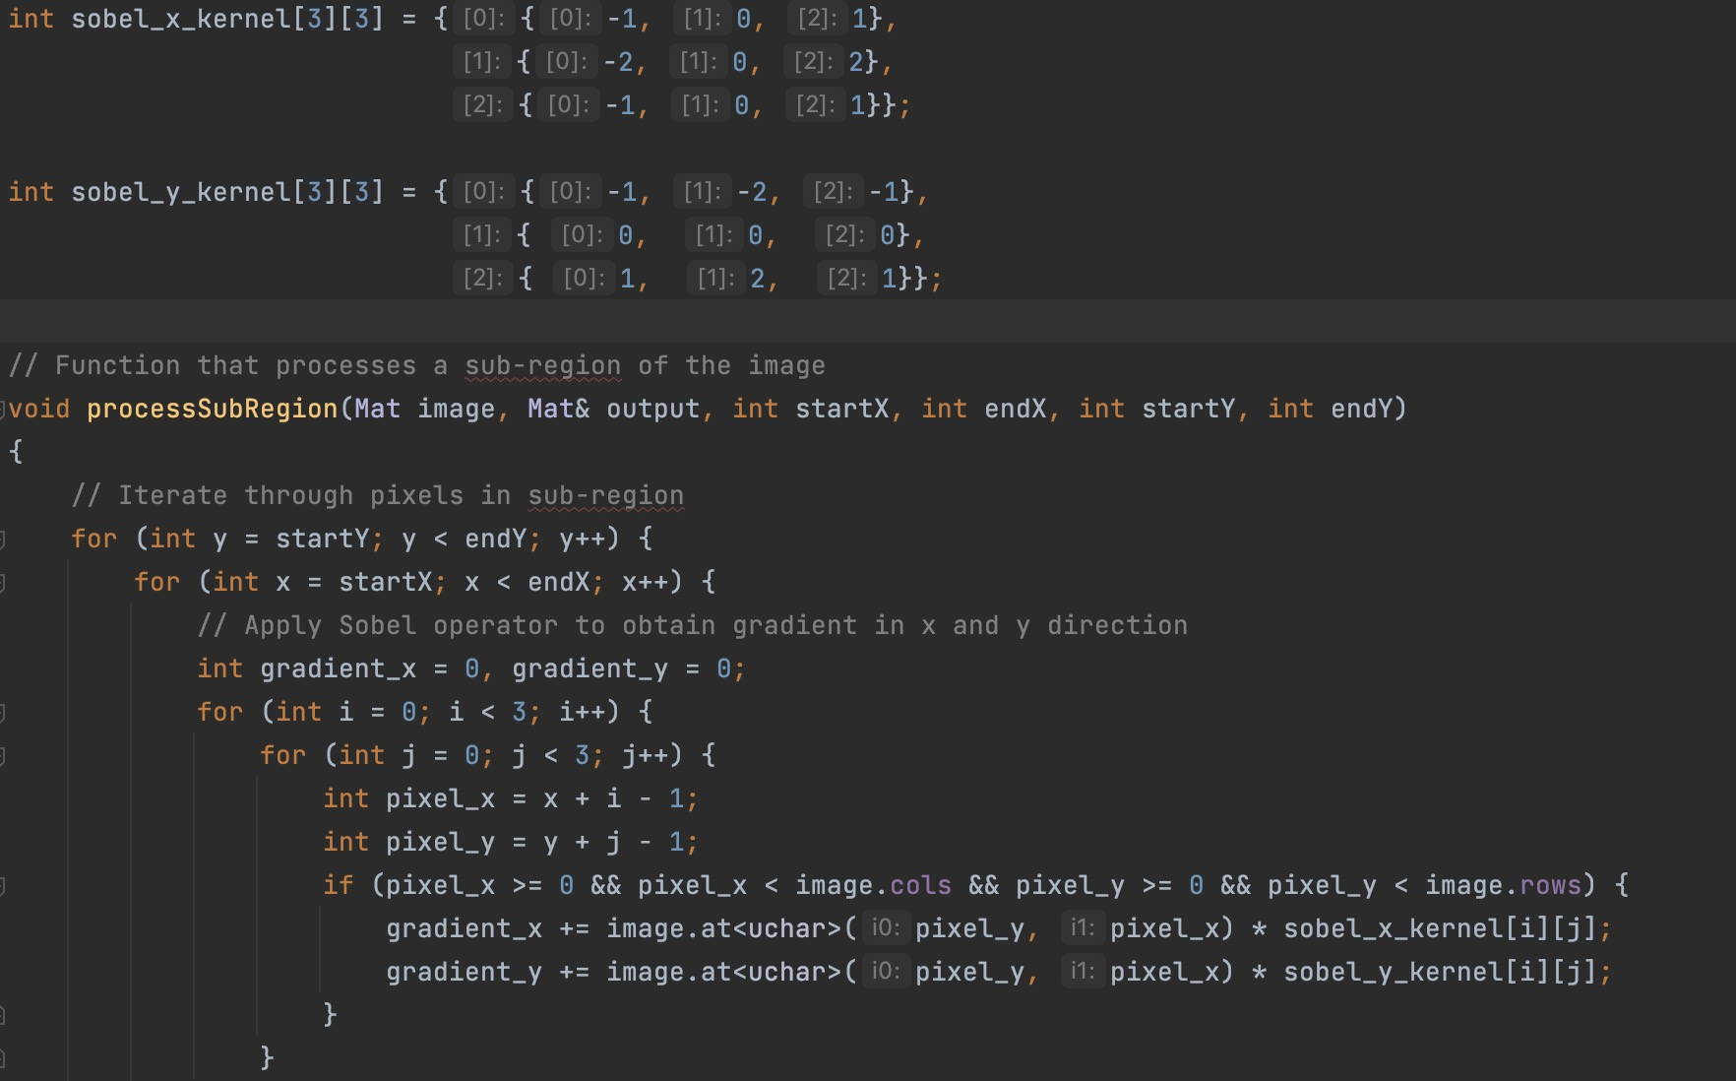
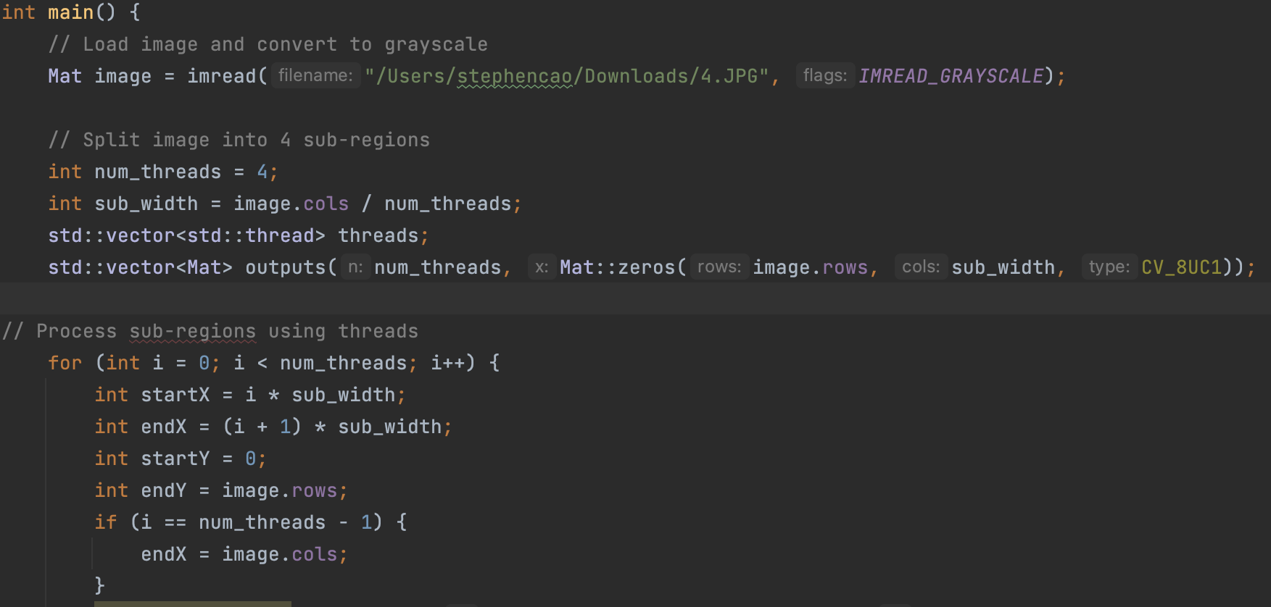
Code sample:
Sobel kernel for detecting edges in x and y direction

Slide 24
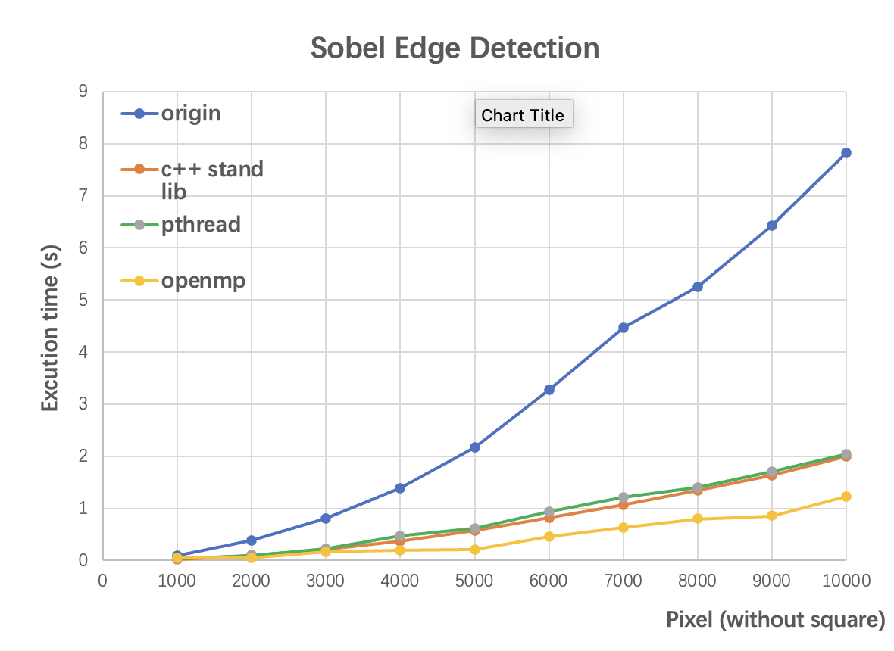
Result 2
Conclusion:
Pthread and C++ standard library has similar performance
OpenMP will has a better performance in large pixel image processing

Slide 25
Question:
The performance of Pthread and Openmp in parallelization quicksort.

Slide 26
Method
1. implement the quicksort with C standard library(sequential program), pthread library(parallel program) and openmp (parallel program).
Record the running time with sample number of 100000, 500000 and 1000000 by using the 5 threads.
Running 20 times for each size of sample.
Time measurement: using clock() function
Recording the clocks of cpu running to do the sort and then divide by CLOCKS_PER_SEC to get the running time in second.

Slide 27
Code:
Pthread:
Based on https://github.com/ChristianMagnerfelt/ParallelQuicksort
Openmp and C standard library:
https://github.com/xiazi21/threeWayQuickSort/tree/master

Slide 28
Test environment
CPU: 10 cores(1 thread per core); i7-12700k
RAM: 32770MB
Ubantu OS in virtual machine
The experiment use software solution to limit the running thread number.
All experiment based on 5 thread.
For pthread library, using thread counter to limit.
For Openmp library, using “OMP_NUM_THREADS=5” to limit thread number
For sequential program, have only use one thread

Slide 29
dataSample |  | 100000 |  |  |  |  |  | 500000 |  |  |  |  |  | 1000000
 |  | thread num = 5 | times | C std library (not parallel) | pthread | openmp |  | thread num = 5 | times | C std library (not parallel) | pthread | openmp |  | thread num = 5 | times | C std library (not parallel) | pthread | openmp
 |  |  | 1 | 0.029647 | 0.00217 | 0.136339 |  |  | 1 | 0.642153 | 0.014545 | 1.178072 |  |  | 1 | 2.537552 | 0.023788 | 3.936516
 |  |  | 2 | 0.030784 | 0.003054 | 0.135984 |  |  | 2 | 0.641584 | 0.014601 | 1.167178 |  |  | 2 | 2.54511 | 0.023043 | 3.911854
 |  |  | 3 | 0.030051 | 0.017999 | 0.136334 |  |  | 3 | 0.646187 | 0.013731 | 1.168978 |  |  | 3 | 2.546774 | 0.022836 | 3.862097
 |  |  | 4 | 0.030963 | 0.002458 | 0.135502 |  |  | 4 | 0.648564 | 0.016222 | 1.174986 |  |  | 4 | 2.573123 | 0.022924 | 3.931822
 |  |  | 5 | 0.029874 | 0.002411 | 0.13555 |  |  | 5 | 0.645535 | 0.014168 | 1.175138 |  |  | 5 | 2.543543 | 0.023803 | 3.9122
 |  |  | 6 | 0.03003 | 0.002202 | 0.133699 |  |  | 6 | 0.642148 | 0.014529 | 1.169445 |  |  | 6 | 2.595967 | 0.023211 | 3.895254
 |  |  | 7 | 0.030591 | 0.002732 | 0.136004 |  |  | 7 | 0.642956 | 0.015982 | 1.177061 |  |  | 7 | 2.508598 | 0.02304 | 3.825096
 |  |  | 8 | 0.030535 | 0.002211 | 0.16788 |  |  | 8 | 0.645142 | 0.013581 | 1.16588 |  |  | 8 | 2.506492 | 0.022359 | 3.801075
 |  |  | 9 | 0.0301 | 0.002128 | 0.135519 |  |  | 9 | 0.662332 | 0.016968 | 1.237556 |  |  | 9 | 2.507361 | 0.023835 | 3.829338
 |  |  | 10 | 0.03121 | 0.002299 | 0.135109 |  |  | 10 | 0.648349 | 0.014183 | 1.176487 |  |  | 10 | 2.507232 | 0.02355 | 3.85233
 |  |  | 11 | 0.030329 | 0.002846 | 0.136193 |  |  | 11 | 0.641229 | 0.015861 | 1.185558 |  |  | 11 | 2.535603 | 0.02441 | 3.803511
 |  |  | 12 | 0.02978 | 0.00302 | 0.13562 |  |  | 12 | 0.645569 | 0.01637 | 1.162396 |  |  | 12 | 2.497732 | 0.033213 | 3.79625
 |  |  | 13 | 0.030397 | 0.002128 | 0.133907 |  |  | 13 | 0.640198 | 0.015644 | 1.181594 |  |  | 13 | 2.500158 | 0.028936 | 3.843484
 |  |  | 14 | 0.033586 | 0.002779 | 0.145959 |  |  | 14 | 0.642168 | 0.013613 | 1.177219 |  |  | 14 | 2.500024 | 0.026335 | 3.808598
 |  |  | 15 | 0.031504 | 0.002209 | 0.134819 |  |  | 15 | 0.660529 | 0.015886 | 1.174343 |  |  | 15 | 2.506824 | 0.022628 | 3.82546
 |  |  | 16 | 0.029844 | 0.002806 | 0.137046 |  |  | 16 | 0.646752 | 0.017264 | 1.176226 |  |  | 16 | 2.521142 | 0.023418 | 3.810844
 |  |  | 17 | 0.03017 | 0.002155 | 0.137046 |  |  | 17 | 0.645853 | 0.01577 | 1.17345 |  |  | 17 | 2.516034 | 0.023747 | 3.810493
 |  |  | 18 | 0.029937 | 0.014731 | 0.138076 |  |  | 18 | 0.654219 | 0.014108 | 1.197438 |  |  | 18 | 2.555882 | 0.02429 | 3.868366
 |  |  | 19 | 0.032172 | 0.002173 | 0.136038 |  |  | 19 | 0.659569 | 0.018145 | 1.200062 |  |  | 19 | 2.576217 | 0.02444 | 3.957533
 |  |  | 20 | 0.030222 | 0.002846 | 0.13695 |  |  | 20 | 0.653058 | 0.013331 | 1.216045 |  |  | 20 | 2.551947 | 0.025694 | 3.848815
 |  |  | Average | 0.030586 | 0.003868 | 0.137979 |  |  | Average | 0.647705 | 0.015225 | 1.179951 |  |  | Average | 2.531666 | 0.024475 | 3.856547
 |  |  | Median | 0.030276 | 0.002435 | 0.136021 |  |  | Median | 0.645711 | 0.015123 | 1.176357 |  |  | Median | 2.528373 | 0.023768 | 3.84615
 |  |  | Standard deviation | 0.000951 | 0.004319 | 0.007461 |  |  | Standard deviation | 0.006746 | 0.001373 | 0.018306 |  |  | Standard deviation | 0.028935 | 0.002552 | 0.050816

Slide 30
100000
thread num = 5 | times | C std library (not parallel) | pthread | openmp
 | 1 | 0.029647 | 0.00217 | 0.136339
 | 2 | 0.030784 | 0.003054 | 0.135984
 | 3 | 0.030051 | 0.017999 | 0.136334
 | 4 | 0.030963 | 0.002458 | 0.135502
 | 5 | 0.029874 | 0.002411 | 0.13555
 | 6 | 0.03003 | 0.002202 | 0.133699
 | 7 | 0.030591 | 0.002732 | 0.136004
 | 8 | 0.030535 | 0.002211 | 0.16788
 | 9 | 0.0301 | 0.002128 | 0.135519
 | 10 | 0.03121 | 0.002299 | 0.135109
 | 11 | 0.030329 | 0.002846 | 0.136193
 | 12 | 0.02978 | 0.00302 | 0.13562
 | 13 | 0.030397 | 0.002128 | 0.133907
 | 14 | 0.033586 | 0.002779 | 0.145959
 | 15 | 0.031504 | 0.002209 | 0.134819
 | 16 | 0.029844 | 0.002806 | 0.137046
 | 17 | 0.03017 | 0.002155 | 0.137046
 | 18 | 0.029937 | 0.014731 | 0.138076
 | 19 | 0.032172 | 0.002173 | 0.136038
 | 20 | 0.030222 | 0.002846 | 0.13695
 | Average | 0.030586 | 0.003868 | 0.137979
 | Median | 0.030276 | 0.002435 | 0.136021
 | Standard deviation | 0.000951 | 0.004319 | 0.007461

Slide 31
500000
thread num = 5 | times | C std library (not parallel) | pthread | openmp
 | 1 | 0.642153 | 0.014545 | 1.178072
 | 2 | 0.641584 | 0.014601 | 1.167178
 | 3 | 0.646187 | 0.013731 | 1.168978
 | 4 | 0.648564 | 0.016222 | 1.174986
 | 5 | 0.645535 | 0.014168 | 1.175138
 | 6 | 0.642148 | 0.014529 | 1.169445
 | 7 | 0.642956 | 0.015982 | 1.177061
 | 8 | 0.645142 | 0.013581 | 1.16588
 | 9 | 0.662332 | 0.016968 | 1.237556
 | 10 | 0.648349 | 0.014183 | 1.176487
 | 11 | 0.641229 | 0.015861 | 1.185558
 | 12 | 0.645569 | 0.01637 | 1.162396
 | 13 | 0.640198 | 0.015644 | 1.181594
 | 14 | 0.642168 | 0.013613 | 1.177219
 | 15 | 0.660529 | 0.015886 | 1.174343
 | 16 | 0.646752 | 0.017264 | 1.176226
 | 17 | 0.645853 | 0.01577 | 1.17345
 | 18 | 0.654219 | 0.014108 | 1.197438
 | 19 | 0.659569 | 0.018145 | 1.200062
 | 20 | 0.653058 | 0.013331 | 1.216045
 | Average | 0.647705 | 0.015225 | 1.179951
 | Median | 0.645711 | 0.015123 | 1.176357
 | Standard deviation | 0.006746 | 0.001373 | 0.018306

Slide 32
1000000
thread num = 5 | times | C std library (not parallel) | pthread | openmp
 | 1 | 2.537552 | 0.023788 | 3.936516
 | 2 | 2.54511 | 0.023043 | 3.911854
 | 3 | 2.546774 | 0.022836 | 3.862097
 | 4 | 2.573123 | 0.022924 | 3.931822
 | 5 | 2.543543 | 0.023803 | 3.9122
 | 6 | 2.595967 | 0.023211 | 3.895254
 | 7 | 2.508598 | 0.02304 | 3.825096
 | 8 | 2.506492 | 0.022359 | 3.801075
 | 9 | 2.507361 | 0.023835 | 3.829338
 | 10 | 2.507232 | 0.02355 | 3.85233
 | 11 | 2.535603 | 0.02441 | 3.803511
 | 12 | 2.497732 | 0.033213 | 3.79625
 | 13 | 2.500158 | 0.028936 | 3.843484
 | 14 | 2.500024 | 0.026335 | 3.808598
 | 15 | 2.506824 | 0.022628 | 3.82546
 | 16 | 2.521142 | 0.023418 | 3.810844
 | 17 | 2.516034 | 0.023747 | 3.810493
 | 18 | 2.555882 | 0.02429 | 3.868366
 | 19 | 2.576217 | 0.02444 | 3.957533
 | 20 | 2.551947 | 0.025694 | 3.848815
 | Average | 2.531666 | 0.024475 | 3.856547
 | Median | 2.528373 | 0.023768 | 3.84615
 | Standard deviation | 0.028935 | 0.002552 | 0.050816

Slide 33

Result:
With the sample size increasing, the runtime become long.
With the same size of sample, the runtime of openmp>C standard library > pthread.

Slide 34
Analysis - openmp:
For openmp, it is not a good choice for parallelize the quick sort algorithm. Openmp, take a lot of time in creating thread. And openmp have less support in recursion using which is needed for divide & conquer algorithm.
The runtime difference enlarge with the increase of the sample size which are 0.1 s for 100000, 0.5s for 500000 and 1.3s for 1000000.

Slide 35
Analysis - pthread:
Pthread have a good performance in parallelization of quicksort. Based on the algorithm of quicksort, pthread can handle each divided part’s sort. Which is dependent on the feature of pthread that, it provide low level control for user.
Moreover, the increase in running time of quicksort with pthread with the increase of the sample size is relatively slow than standard library and the openmp. For example, from 100000 to 1000000, the pthread one increase 0.020607, the C standard library increase 2.50108s, and the openmp one increase 3.718568

Slide 36
Analysis - pthread: (cont.)
The reason why increase of running time is smaller than others, maybe is the better performance in implementation. Otherwise, with the larger sample size, the advantage can be expanded, because the cost of context switch can be minimal in processing of larger size data.
All in all, with the enlarge of the data sample, the benefit in using pthread in quicksort can be upsteped. s

Slide 37

Topic:
1. The performance of PPL and dlib in parallelized matrix multiplication.
2. The performance of dlib in parallelized matrix multiplication with different numbers of threads.

Slide 38
Method
For part 1, Implement serial/PPL/dlib versions of matrix multiplication. In the parallel part, we use the parallel_for to optimize the for loop.
In each test, we will generate 3 random matrix with size 10*10, 100*100 and 1000*1000.
We will run 20 tests in total.
To measure the execution time, we use the high_resolution_clock() and duration_cast() in the chrono library.
For part 2, we use the dlib versions of matrix multiplication with thread_pool to set the maximum of threads from 1 to 8.
In each test, we will generate 3 random matrices with sizes 100*100, 1000*1000, and 1200*1200.
For threads number 1 to 8, we will run 10 tests for each of them. And we still use the chrono library to measure the execution time.

Slide 39
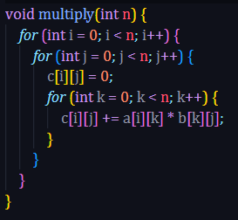
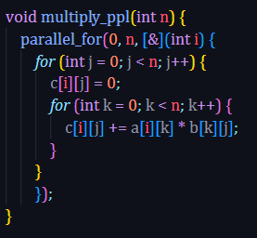
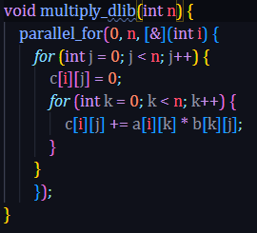
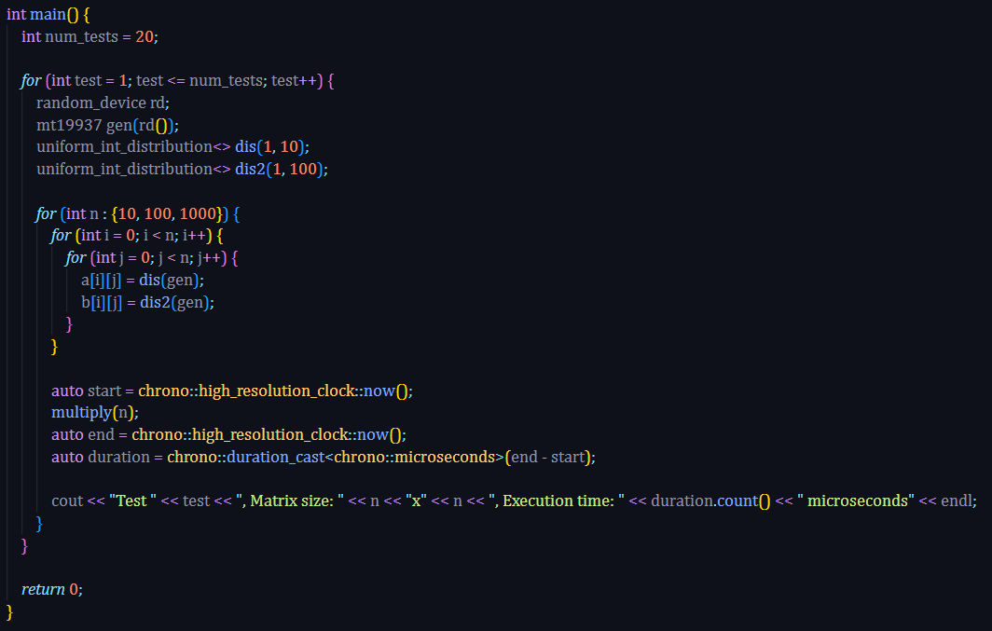
Code(part 1)

Slide 40
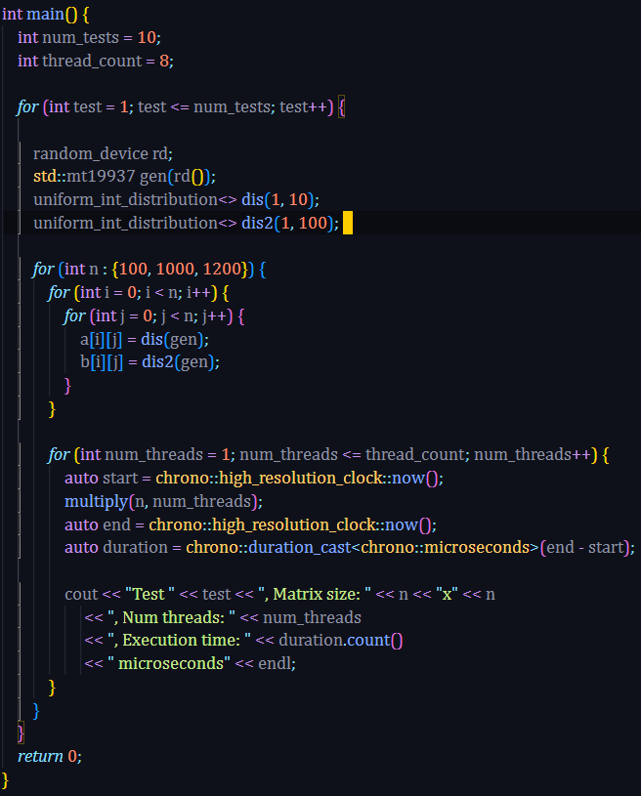
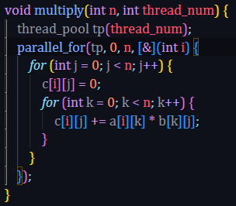
Code(part 2):

Slide 41
Test environment
CPU: Intel(R) Core(TM) i5-9300H CPU @ 2.40GHz 2.40 GHz
4 cores, 8 threads
RAM: 7.81 GB
Windows 10 21H2
In this experiment, use instructions to limit maximum thread numbers
Part 1 is based on 8 threads for PPL and dlib
In PPL, we use CurrentScheduler class to set the thread numbers
In dlib libaray, we use thread_pool class to set the thread numbers
Part 2 is based from 1 to 8 threads for dlib.

Slide 42
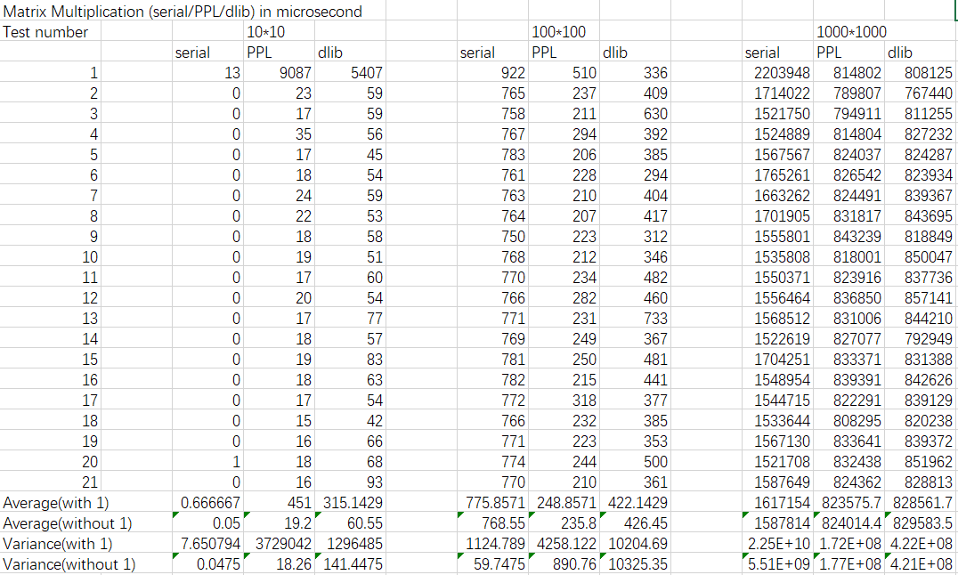
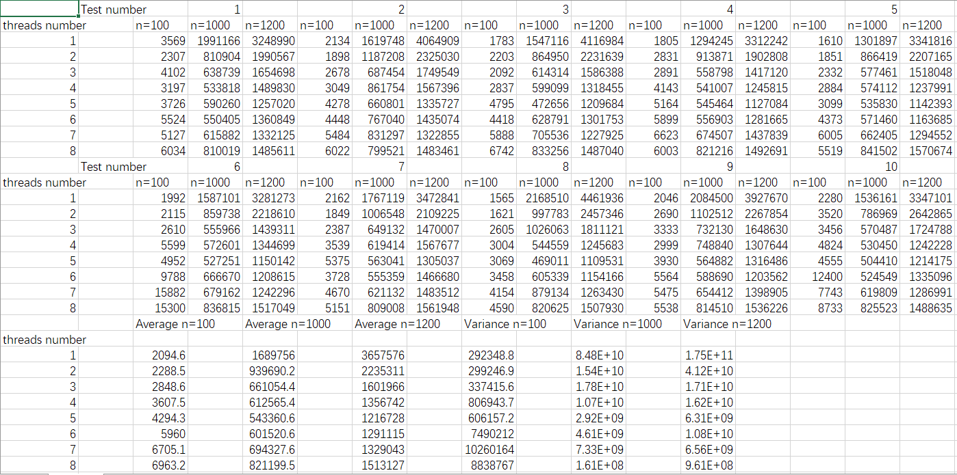
Data for part 1
Data for part 2

Slide 43
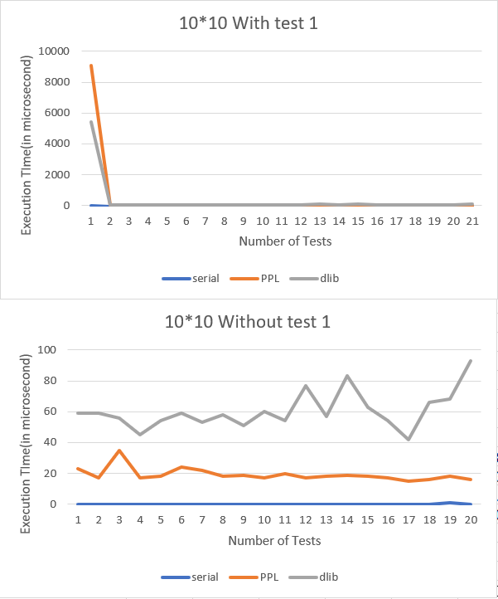
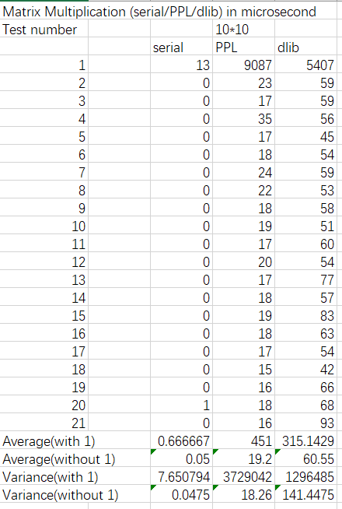

Slide 44
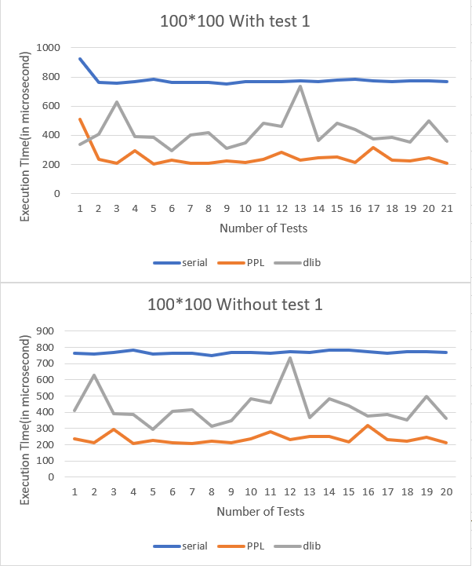
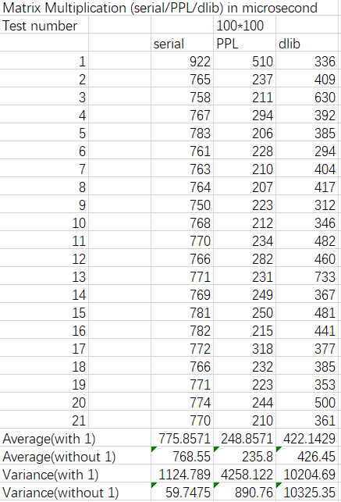

Slide 45
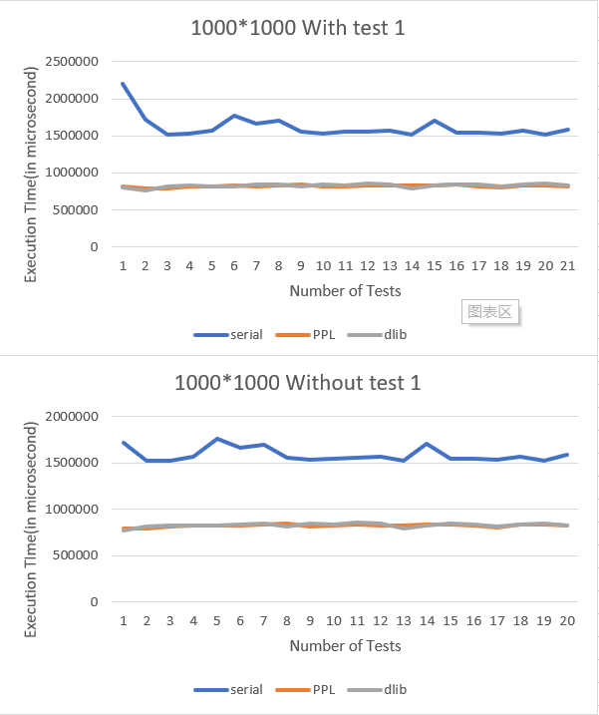
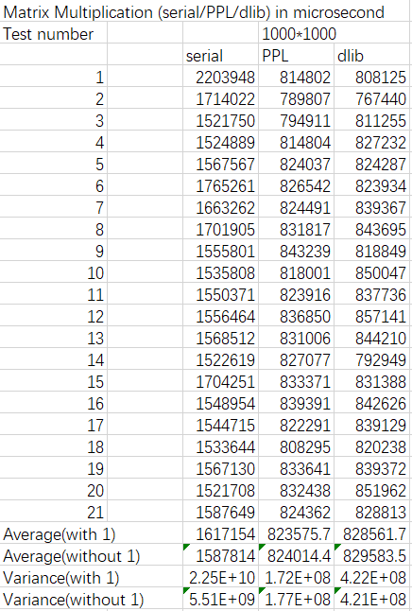

Slide 46
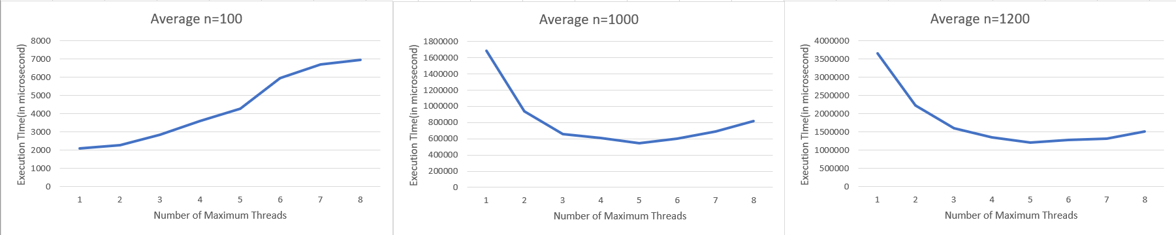
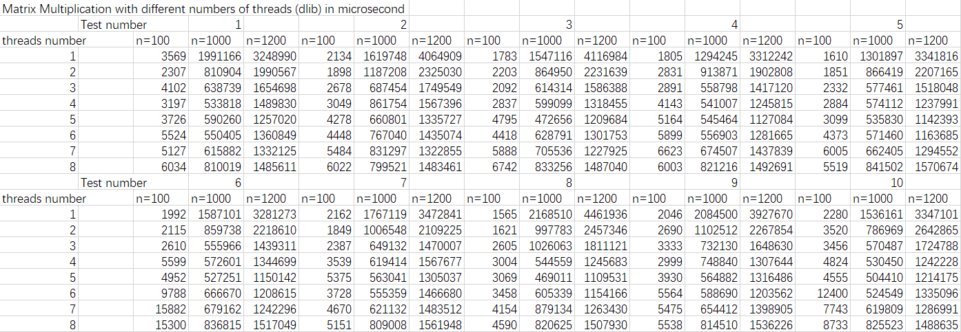
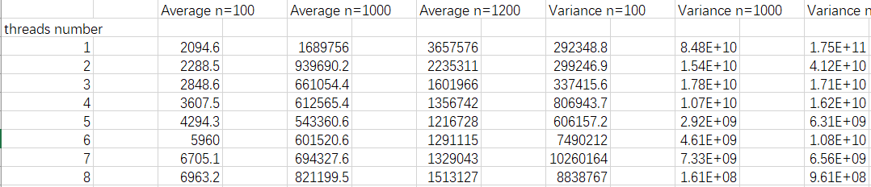

Slide 47
Conclusion:
Part 1: The serial program takes the shortest time when the data size is small, and when the data size is medium, the advantages of the parallel program start to manifest and PPL shows a stronger performance. When the data size is large, PPL and dlib both show similar and better performance than the serial program.
Part 2:For smaller or medium data sizes, the runtime increases equally as the number of threads increases. When the data size is large, the average runtime reaches a minimum of around 4 or 5 threads based on my environment with 4 cores and 8 threads.

Slide 48
Analysis – Part 1
In part 1, we notice that it takes far longer time to execute the first test, especially for the serial program. I assume the possible reasons for this unusual time are memory allocation or cache miss. The program needs to allocate memory for the matrices and load the matrices into the cache. So it will cost extra time on memory location and cost more time on calculation because there is less or no cache for it to use for the first execution.
For small sizes of data, because it only needs a small number of calculations, so the extra time spent by parallelizing is longer than the time it can save. So the serial program has the best performance.
For medium sizes of data, the reason why PPL performs best is likely to be that dlib implements more optimization for large sizes of data which does not improve efficiency for medium sizes of data. So PPL performs best on a 100*100 matrix.
For large sizes of data, we can admit that both libraries have almost the same performance which saves about 47.75% time compared with serial program.
Notes:
There are several possible reasons why a parallel matrix multiplication program might perform best with 4 threads instead of 8 on a computer with 4 cores and 8 threads:
Thread overhead: Each thread in a parallel program incurs some overhead due to the need to create, synchronize, and communicate with other threads. With 8 threads, the overhead may become significant, especially if the workload for each thread is relatively small. With 4 threads, there may be less overhead per thread, allowing each thread to execute more efficiently.
Cache contention: When multiple threads access the same data in memory, there is a risk of cache contention, where one thread's access to a cache line evicts another thread's data from the same cache line. With 8 threads, there is a higher risk of cache contention, which can slow down the program. With 4 threads, there may be less contention and more efficient use of the cache.
Memory bandwidth: The memory bandwidth of the computer can limit the performance of a parallel program, especially if multiple threads are competing for access to memory. With 8 threads, there may be more competition for memory bandwidth, which can slow down the program. With 4 threads, there may be less competition and more efficient use of memory bandwidth.
Load balancing: If the workload is not evenly distributed among the threads, some threads may finish their work early and have to wait for other threads to finish. With 8 threads, load balancing may be more difficult, leading to idle threads and reduced performance. With 4 threads, load balancing may be easier and more efficient.
Overall, the reasons why a parallel matrix multiplication program might perform best with 4 threads instead of 8 on a computer with 4 cores and 8 threads are likely to be a combination of factors related to thread overhead, cache contention, memory bandwidth, and load balancing. The optimal number of threads for a given program will depend on the specifics of the program, the hardware, and the workload.

Slide 49
Analysis – Part 2:
As we can notice, the best performance does not match the maximum thread number 8. Considering my environment, I have an assumption that it performs better when the thread number is close to the physical core number for this size of data. Since my computer has 4 cores and the data is not too large, 4 threads might have the advantage of minimizing contention for resources and maximizing throughput. When adding more threads, the increased contention for resources may cause it to perform worse.
For smaller size of data. I assume that the time cost on creating and managing threads is longer than the time it can save using multi threads. So it means more time is consumed on creating threads, balancing workloads, and cache contention which leads to longer execution time.
Notes:
There are several possible reasons why increasing the number of threads for a parallel matrix multiplication program could lead to worse performance for small sizes of data:
Overhead: Creating and managing threads incurs some overhead, which can become a significant fraction of the total execution time for small sizes of data. With more threads, the overhead can become more significant, leading to slower execution times.
Load balancing: If the workload is not evenly distributed among the threads, some threads may finish their work early and have to wait for other threads to finish. With more threads, load balancing can become more difficult, leading to idle threads and reduced performance.
Cache utilization: For small sizes of data, the matrices may fit entirely in the cache, allowing for very fast access. With more threads, there may be more contention for cache resources, leading to increased cache misses and slower execution times.
Memory bandwidth: For small sizes of data, the memory bandwidth required to read and write the matrices may not be enough to fully saturate all the available threads. With more threads, the available memory bandwidth may become a limiting factor, leading to slower execution times.
Overall, the reasons why increasing the number of threads for a parallel matrix multiplication program could lead to worse performance for small sizes of data are likely to be a combination of factors related to thread overhead, load balancing, cache utilization, and memory bandwidth. The optimal number of threads for a given program will depend on the specifics of the program, the hardware, and the workload, and may vary depending on the size of the data being processed. It is important to experiment with different thread counts and data sizes to determine the optimal configuration for your particular case.

Slide 50

The performance of C++ standard library thread,Pthread and Openmp in matrix multiplication

Slide 51
Method
Test the performance of multi-threaded matrix multiplication using the C++ standard library thread, pthread library and openmp
Sample : Randomly generated matrix containing integers from 1 to 100.
Test the matrix multiplication with the sizes of 8*8, 64*64, 512*512, 1000*1000,10000*10000

Slide 52
Environment
Ubuntu20.04 virtual machine based on vmware
Physical Machine : 10th Generation Intel® Core™ i7, 8 cores, 16threads, 2.3GHz~5.10GHz
Virtual Machine : 8 cores, 8 threads, 2.3GHz
The matrix multiplication program uses 8 threads for the three parallel implementations and only one thread for the sequential implementation

Slide 53
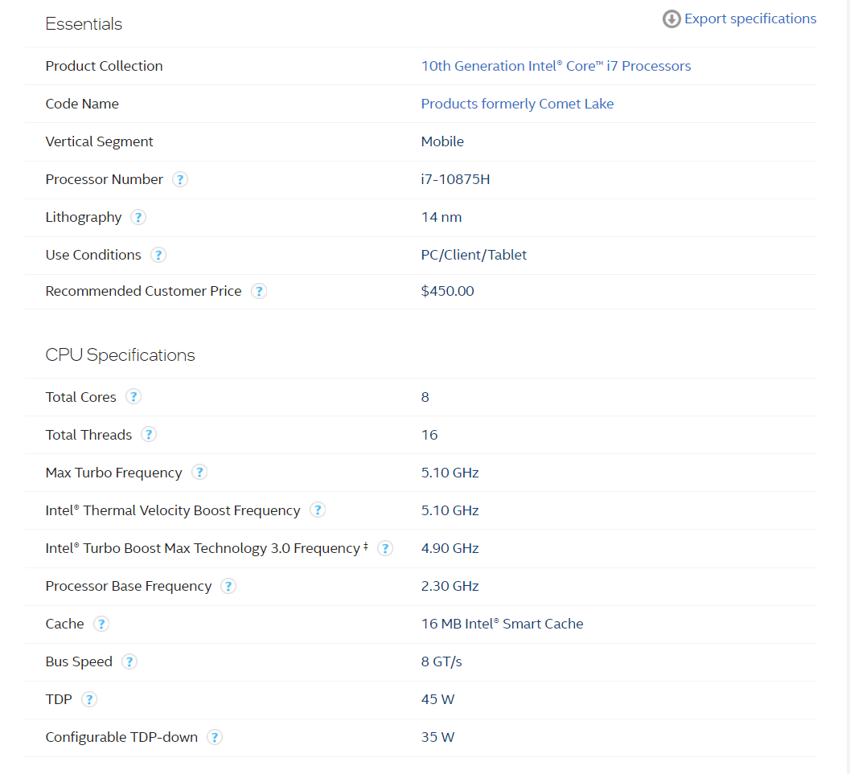
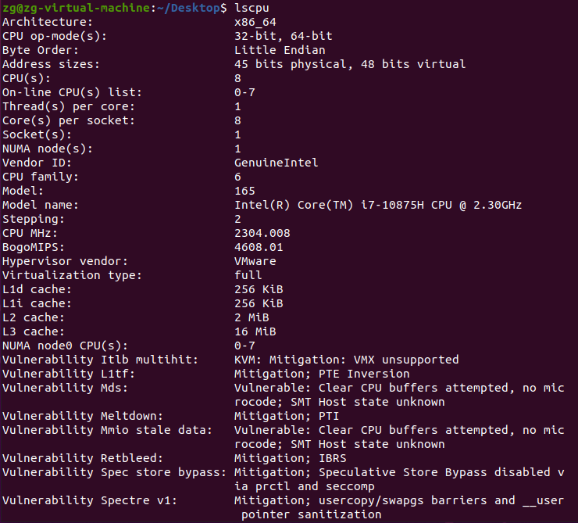
Environment
Physical Machine
Virtual Machine

Slide 54
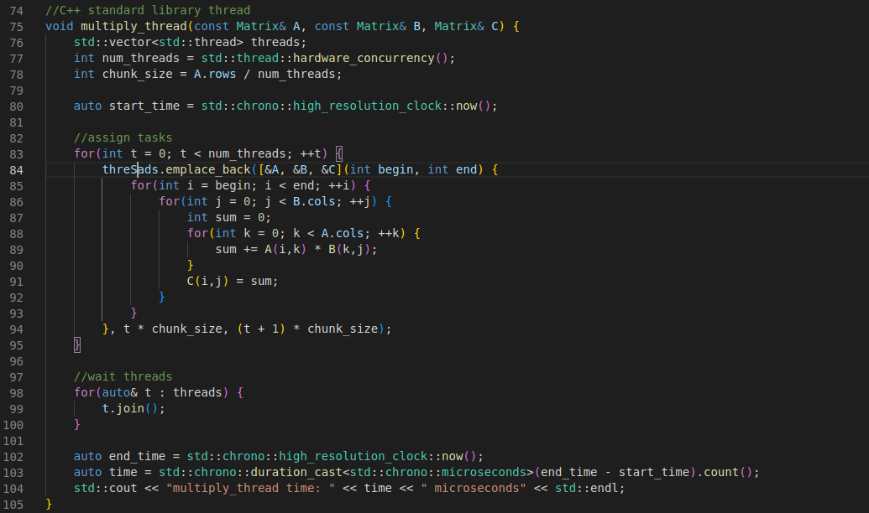
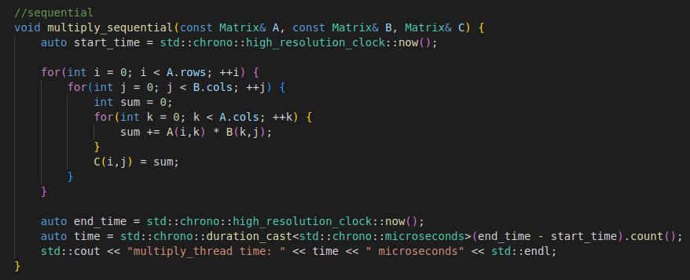
Code

Slide 55
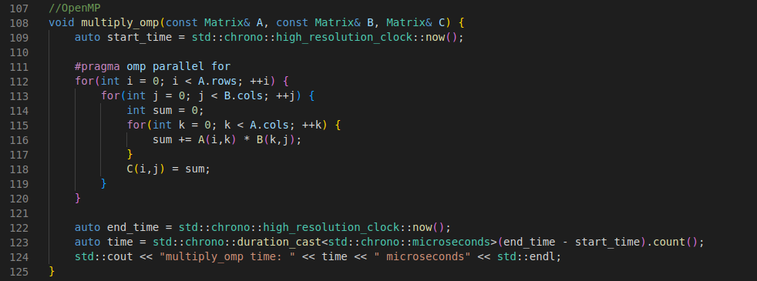
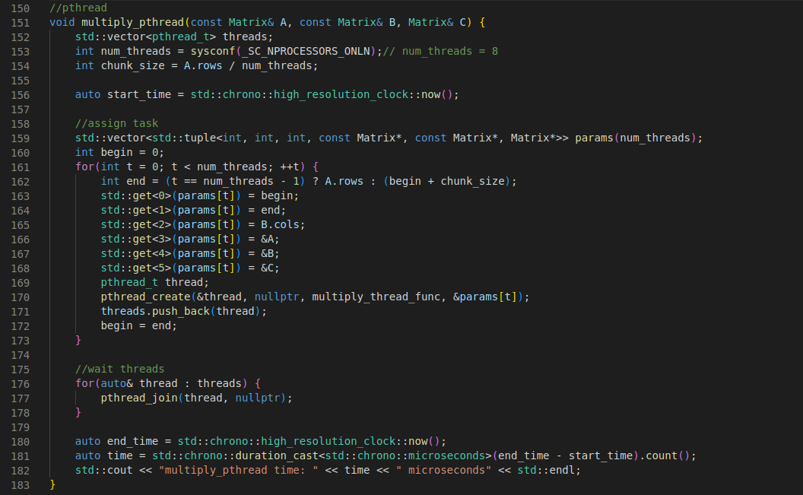
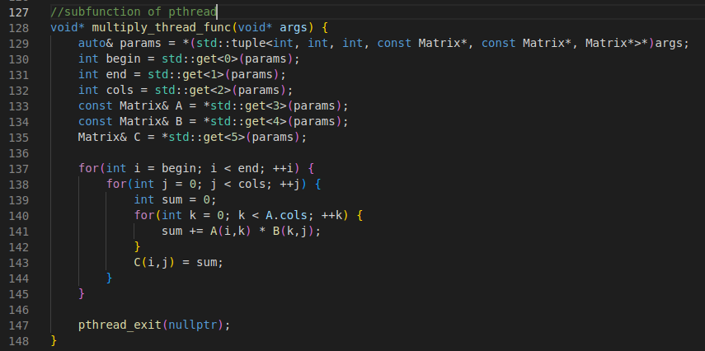
Code

Slide 56
 | 8*8 |  |  |  |  | 64*64
 | id | sequential | C++ standard library thread | omp | pthread | id | sequential | C++ standard library thread | omp | pthread
 | 1 | 0.002509 | 0.001127 | 0.005123 | 1628 | 1 | 0.002367 | 0.001738 | 0.003351 | 0.002042
 | 2 | 0.002339 | 0.001156 | 0.001994 | 2987 | 2 | 0.002335 | 0.002106 | 0.001772 | 0.002668
 | 3 | 0.002333 | 0.001048 | 0.002139 | 2861 | 3 | 0.002677 | 0.001136 | 0.001215 | 0.002486
 | 4 | 0.002234 | 0.001045 | 0.004386 | 2138 | 4 | 0.002645 | 0.001117 | 0.003932 | 0.002226
 | 5 | 0.002235 | 0.001837 | 0.004121 | 3065 | 5 | 0.002655 | 0.001759 | 0.001095 | 0.002004
 | 6 | 0.002412 | 0.001395 | 0.004277 | 3052 | 6 | 0.002552 | 0.001227 | 0.003905 | 0.002095
 | 7 | 0.002509 | 0.001127 | 0.005123 | 1628 | 7 | 0.002671 | 0.001127 | 0.004159 | 0.002643
 | 8 | 0.002551 | 0.002064 | 0.002279 | 2751 | 8 | 0.002274 | 0.001449 | 0.002223 | 0.002311
 | 9 | 0.002827 | 0.001517 | 0.004668 | 2662 | 9 | 0.002551 | 0.002064 | 0.002279 | 0.002751
 | 10 | 0.002274 | 0.001449 | 0.002223 | 2311 | 10 | 0.002827 | 0.001517 | 0.004668 | 0.002662
 | 512*512 |  |  |  |  | 1000*1000
 | id | sequential | C++ standard library thread | omp | pthread | id | sequential | C++ standard library thread | omp | pthread
 | 1 | 1.434652 | 0.418637 | 0.448498 | 0.455809 | 1 | 10.703265 | 3.710563 | 3.724862 | 3.182528
 | 2 | 1.457725 | 0.442775 | 0.456269 | 0.418498 | 2 | 9.562082 | 3.074842 | 3.681217 | 3.392889
 | 3 | 1.432656 | 0.391301 | 0.428031 | 0.362278 | 3 | 9.510102 | 2.807471 | 2.839931 | 2.651059
 | 4 | 1.441042 | 0.465321 | 0.428292 | 0.401554 | 4 | 11.380552 | 3.463981 | 3.727171 | 3.404745
 | 5 | 1.434545 | 0.468713 | 0.056838 | 0.527446 | 5 | 9.437902 | 2.754851 | 2.777702 | 3.128573
 | 6 | 1.549775 | 0.546134 | 0.563831 | 0.506041 | 6 | 11.429838 | 3.542461 | 3.660551 | 3.598273
 | 7 | 1.456408 | 0.492614 | 0.533824 | 0.488126 | 7 | 13.167594 | 3.896179 | 3.643106 | 3.431486
 | 8 | 1.468212 | 0.478113 | 0.053636 | 0.493552 | 8 | 12.415739 | 3.538182 | 3.650153 | 3.169309
 | 9 | 1.521948 | 0.498147 | 0.623507 | 0.489205 | 9 | 10.115033 | 3.240047 | 3.563349 | 3.388692
 | 10 | 1.417067 | 0.462208 | 0.446872 | 0.411557 | 10 | 10.363328 | 3.401318 | 3.352144 | 3.641534
 | 10000*10000 | C++ standard library thread | omp | pthread
 |  | 5808.558858 | 4961.146563 | 4607.186980

Slide 57
When the matrix is small, the difference in performance between parallel and sequential execution is small, C++ standard library is stable and optimal, while openmp is the least stable and the worst, and pthread is in between

Slide 58
When the matrix is slightly larger, the performance of the different implementations still exhibits the same characteristics as before

Slide 59
For larger matrices, parallelism shows clear advantages, but the differences between the three parallel libraries are not significant, except that openmp remains unstable

Slide 60
For larger matrices, the advantage of parallel over sequential execution continues to grow, with sequential execution taking about four times as long as parallel

Slide 61
The difference between parallel libraries is not significant

Slide 62

For the very large matrix,10000*10000, I only tested it once, because the execution time is too long, and the performance of the three libraries is sorted by C++ standard library thread<openmp<pthread
10000*10000 | C++ standard library thread | omp | pthread
Time | 5808.558858 s | 4961.146563 s | 4607.18698 s
 | 96.8 min | 82 min | 76 min

Slide 63
Some conclusion
1. For smaill matrix(8*8,64*64) multiplication, parallelism does improve the speed significantly.
2. The difference in performance between the three libraries is not very large. When the matrix is small(8*8,64*64), the C++ standard library performs best, but for larger matrices(512*512,1000*1000), their performance is very similar.
3. For very large matrices (10000*10000), the performance ranking is pthread>openmp>C++ standard library,but This conclusion may need more verification.
4.openmp is less stable compared to the other two libraries

Slide 64
Analysis
Parallel computing requires additional overhead to coordinate and manage communication and synchronization between threads, and for smaller matrices, these additional overheads can be more expensive than the computation itself, resulting in faster serialization.For larger matrices, on the other hand, the time cost of the computation itself is much higher than the overhead of coordinating and managing threads, so parallel computation can make more efficient use of the power of multiple processor cores, resulting in faster computation.
The reason why C++ standard library thread performs better for smaller matrices may be due to its implementation using lightweight threads that can create and destroy threads faster, avoiding excessive thread management overhead, while pthread and openmp implementations may require more management overhead, resulting in less performance than C++ standard library thread.
And for very large matrices, pthread performs best probably because the way pthread implements threads is closer to the kernel capabilities(test on a linux virtual machine), and its operations for multi-thread management, communication and synchronization are more finely controlled, while being better supported in hardware and OS optimizations.
Compared to the other two libraries, the implementation of matrix multiplication with openmp does not distribute tasks finely(just add a“#pragma omp parallel for”), resulting in a less balanced thread load when computing smaller matrices, with some threads having a higher workload while others are idle. This results in a relatively unstable performance of OpenMP.

Slide 65
Conclusion:
The different libraries have the different features
The different libraries have the different usage field

Slide 66

Thank You!

