Slide 1


Coding For Business Problems
30/04/2025
EMPLOYEE PERFORMANCE ANALYSER
Turning Employee Data Into Performance Metrics
SYNDICATE GROUP 8
PRESENTED BY: GISELA VANIA ALINE, ZIMING ZHAO, JIAJIE LIAO, SHEK MING CHU, SHUANG YE

Slide 2
OUTLINE
PROGRAM STRUCTURE
BASIC FEATURES
ADDITIONAL FEATURES

Slide 3
Program Structure

Slide 4
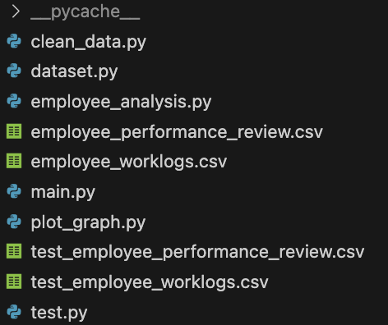
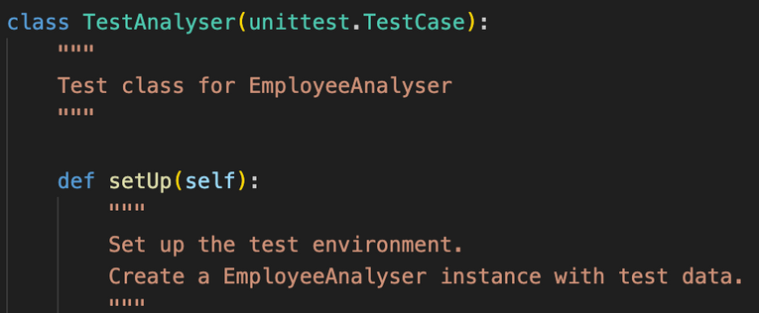


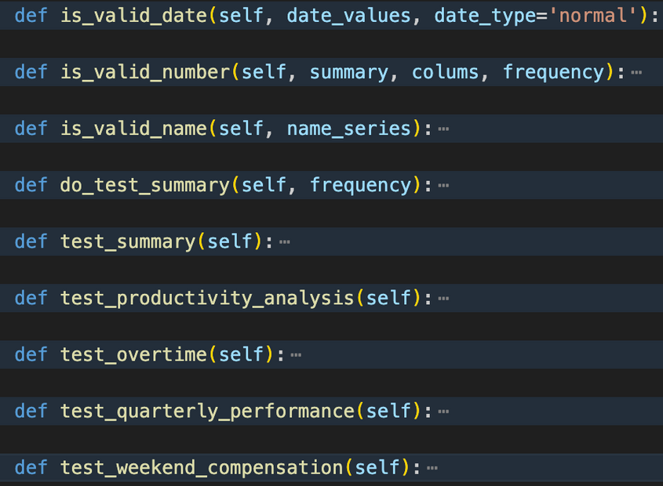
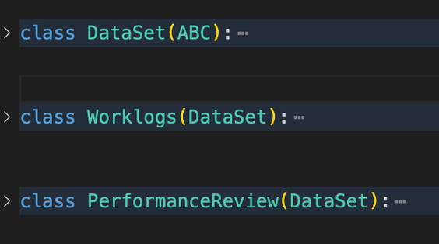
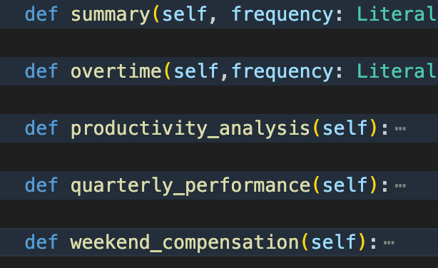
Program Structure | Object Oriented Program (OOP)
Three main Object
Test
Dataset
Analyser

Slide 5









Program Structure | Dependency Relationship Across Object
dataset.py
ABC (abstract base class)
Dependency Inversion
clean_data.py
class DataSet(ABC)
class DataCleaner
class Worklogs(DataSet)
Too complex
Do not need to resue
No long-term maintenance
class PerformanceReview(DataSet)
Pipeline structure
Connect a series of processing steps
Single Responsibility
employee_analysis.py
plot_graph.py
class EmployeeAnalyser
class Plotter
Object encapsulation
e.g.
test.py
class TestAnalyser(unittest.TestCase)
main.py
@Staticmethod in Plotter class:
No need to instance a object to call the method
if __name__ == '__main__':

Slide 6
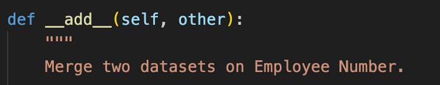
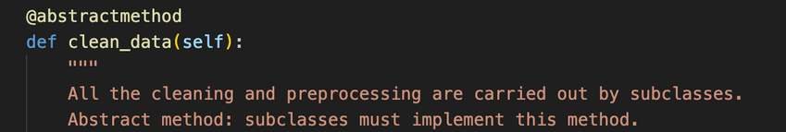
Program Structure | Advantages of OOP
Advantages of object encapsulation:
Modular design： easier to manage and debug
Clearer Interface：directly use the object instance, no need to focus on how the function work
Data Protection：prevents data be modified accidentally
Scalability：easier to extend the program (e.g., adding new types of dataset)
Easier Method Usage：
@staticmethod
magic method
No need to instance a object to call the method
Allow operator overloading
(customize built-in operators like +)
e.g.
e.g.
private method
@abstractmethod
not accessible from outside the class
e.g.
e.g.

Slide 7
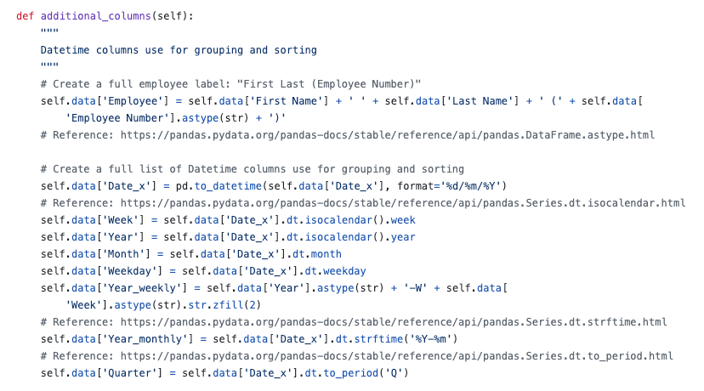
Program Structure | Code Review
.isocalendar()
It return the date according to ISO standard
e.g. 30/12/2024 → 2025-W01
.zfill(2)
It fill the number with zeros
2 means 2 digits
1 → 01; 12 → 12
It is used to format Year_week
e.g. 2025-W02
.strftime(2)
Since isocalendar is different
String formatted time
%Y → Year; %m → Month

Slide 8
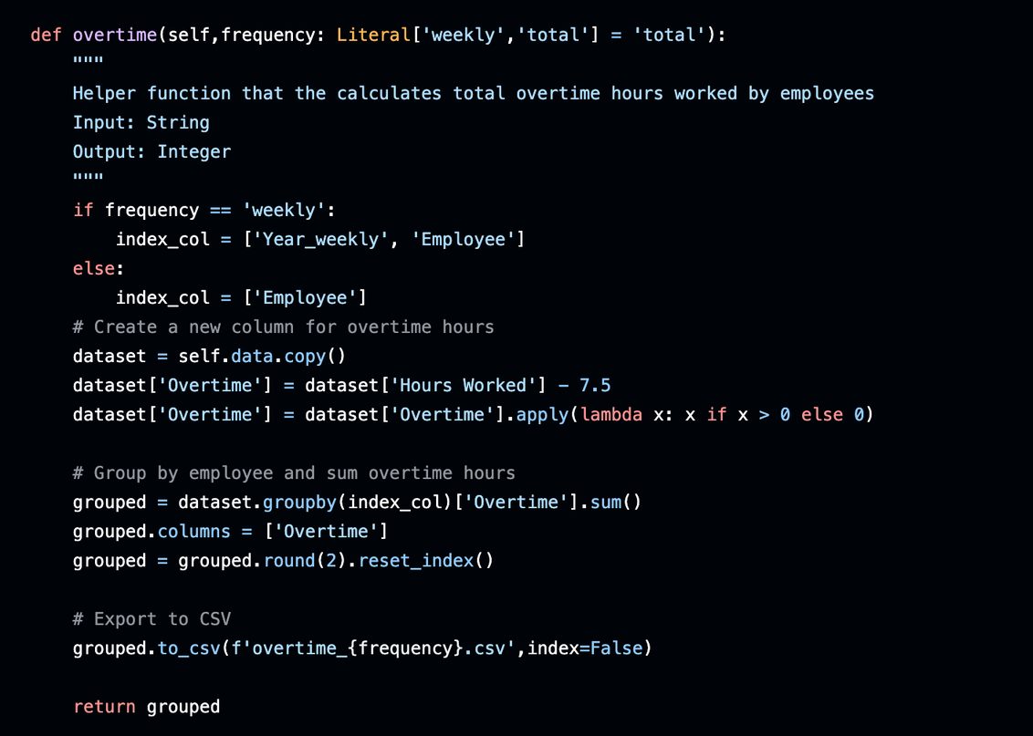
Program Structure | Code Review
Method example:
Program Output:

Slide 9
Basic Features

Slide 10
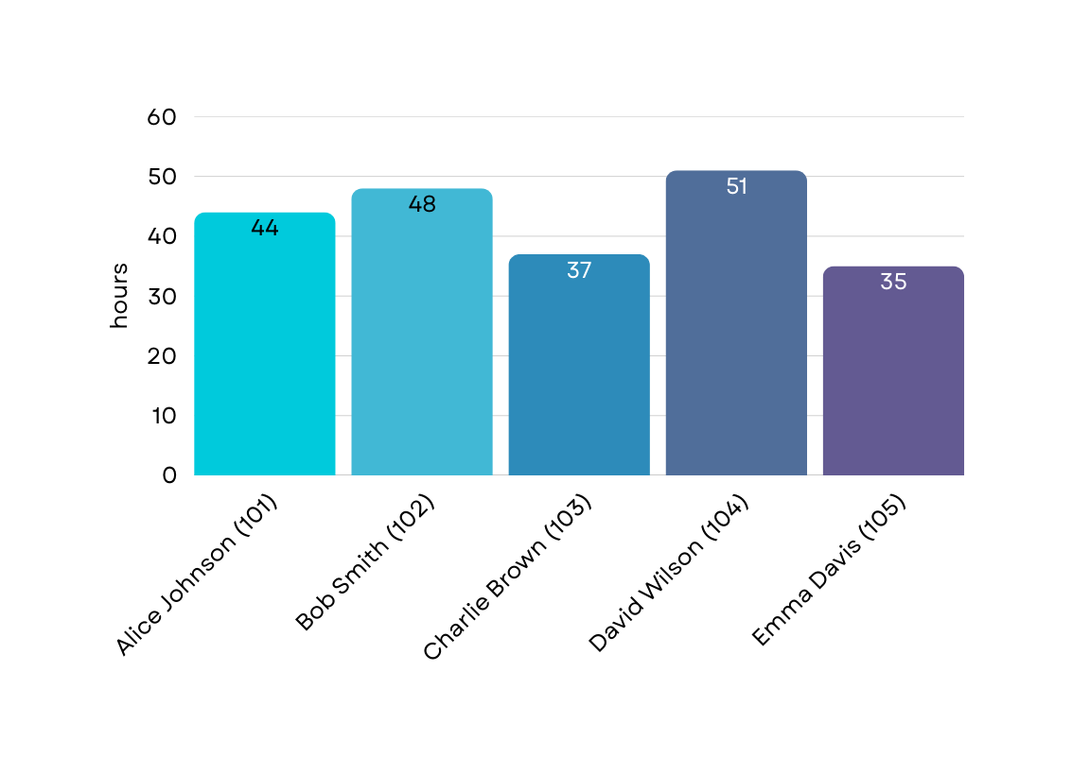
Basic Features | Overtime vs Performance
Business insights from total overtime for each employee
Total Overtime for Each Employee
Employee Performance Review
Alice Johnson (101) : 3 - Satisfactory
Bob Smith (102) : 4 - Meeting Expectations
Charlie Brown (103) : 5 - Exceeding Expectations
David Wilson (104) : 4 - Meeting Expectations
Emma Davis (105) : 3 - Satisfactory

Slide 11
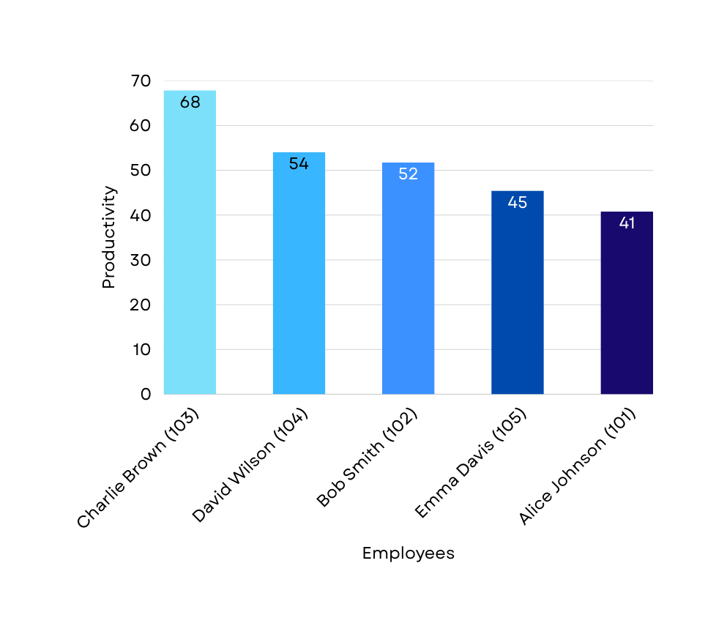
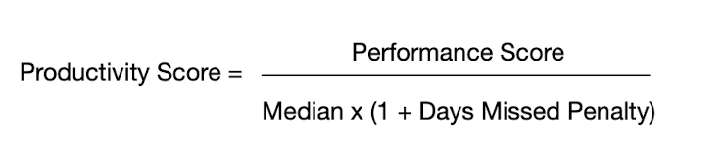
Basic Features | Productivity Analysis
Three attributes:
Performance score
Workhour (median)
Days Missed Penalty
Employee Productivity Score
Productivity Ranking Formula
Performance Score, numeric rating extracted from review (1-5)
Median Hours, median “Hours Worked” per entry for employee
Days Missed, number of scheduled weekdays with no time-log entries
Days Missed Penalty, the difference between the maximum days of the employees worked and each employees worked days, divided by the maximum days.

Slide 12
Additional Features

Slide 13
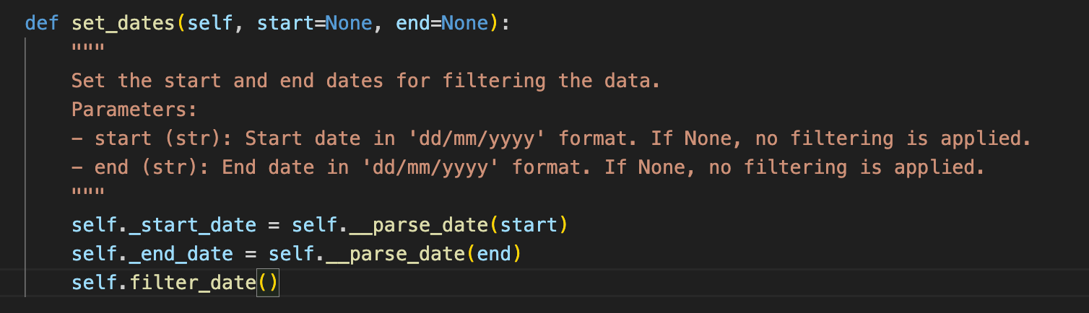
Additional Features | Date Filter
Enables customized reports for audits, team reviews, or business cycles without modifying the dataset.
How to use：

Slide 14
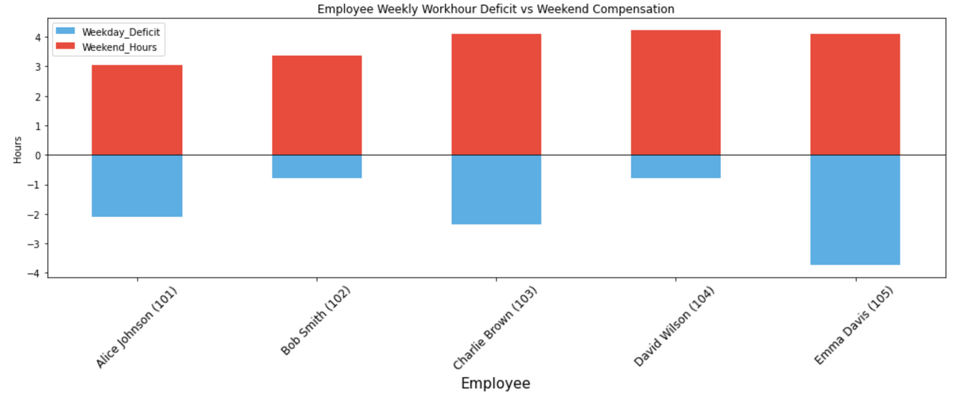
Additional Features | Weekday vs Weekend
Detect employees who rely heavily on weekend work
Proactively catch signs of overcompensation that might indicate understaffing, unrealistic targets, or operational issues.
Weekday Deficit vs Weekend Compensation

Slide 15
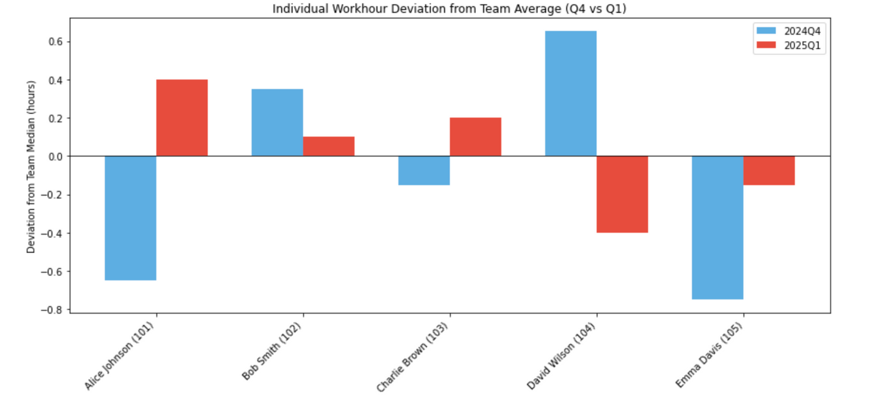
Additional Features | Quarterly Review: Individual vs Team Workhour
Captures the workhour deviation of each employee to their group peers
Identify highly deviated employee, an insight for managers in doing individual development discussions and / or coaching
Individual Workhour Deviation from Team

Slide 16
Appendices

Slide 17
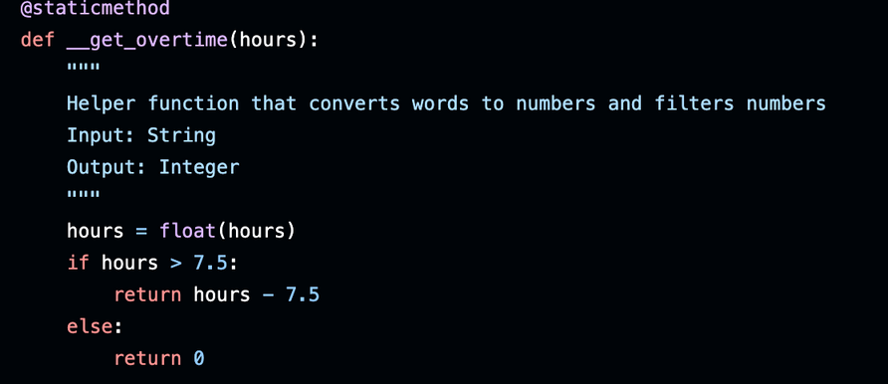
Appendix - Basic Feature: Overtime

Slide 18
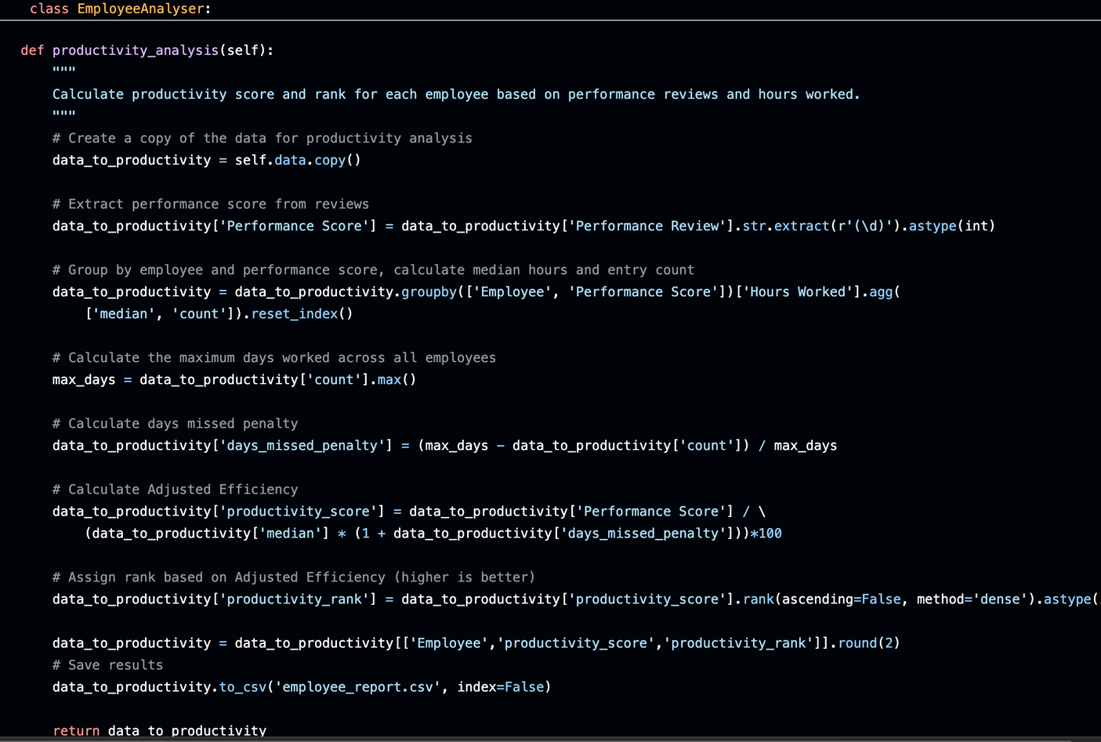
Appendix - Basic Feature: Productivity

Slide 19
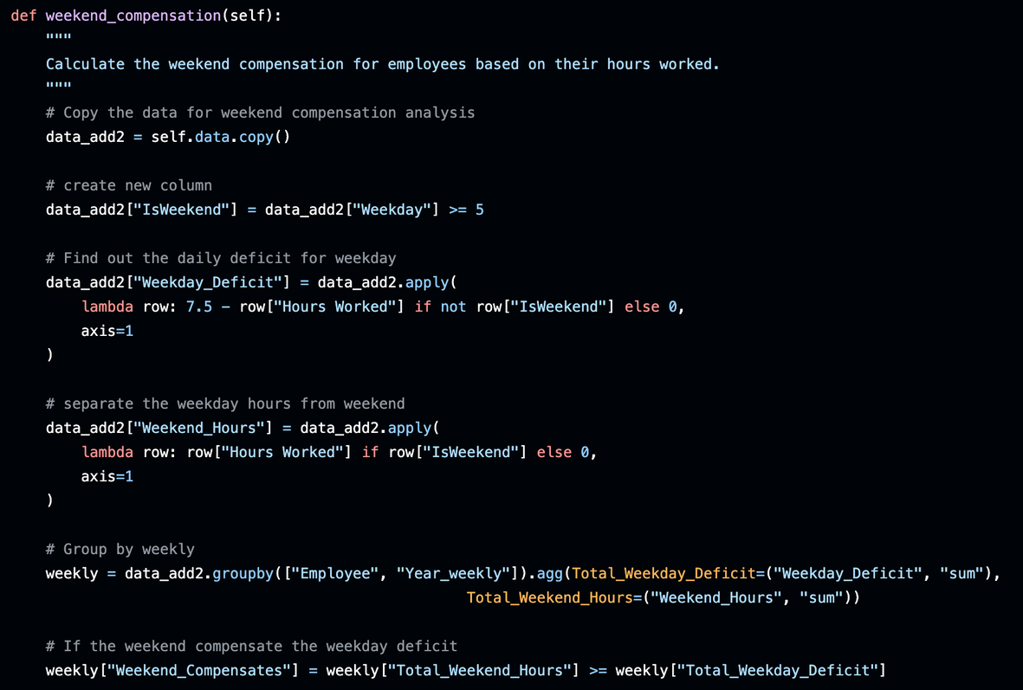
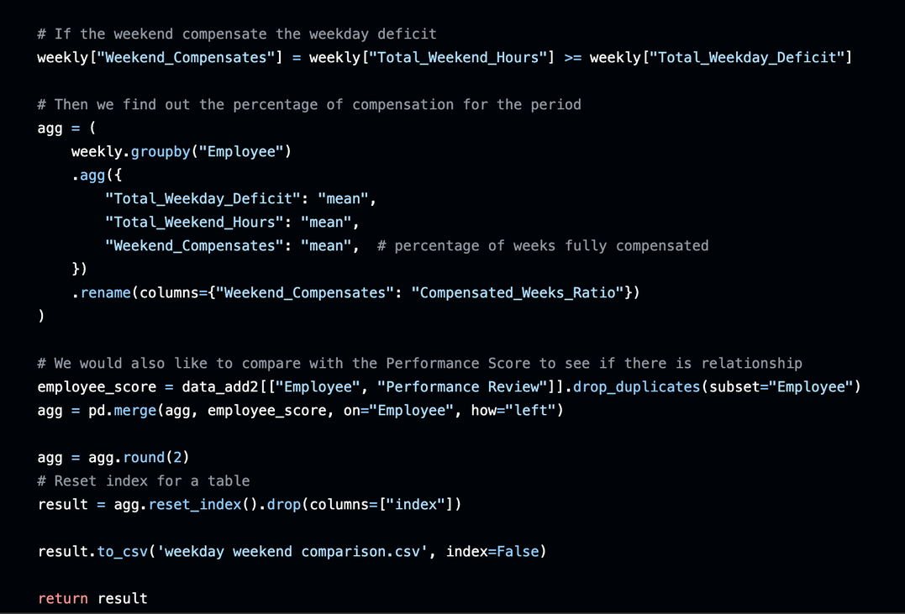
Appendix - Additional Feature: Weekday vs Weekend

Slide 20
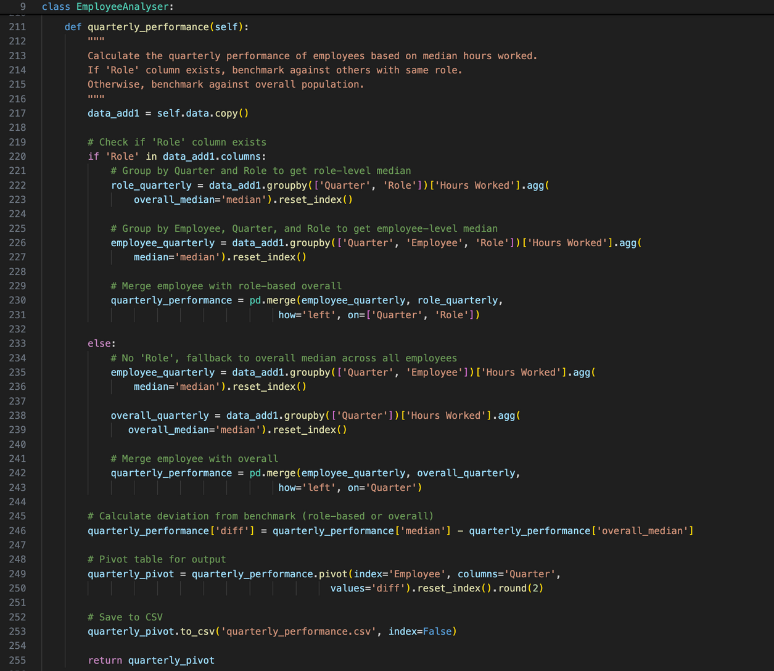
Appendix - Additional Feature: Quarterly Review

Slide 21
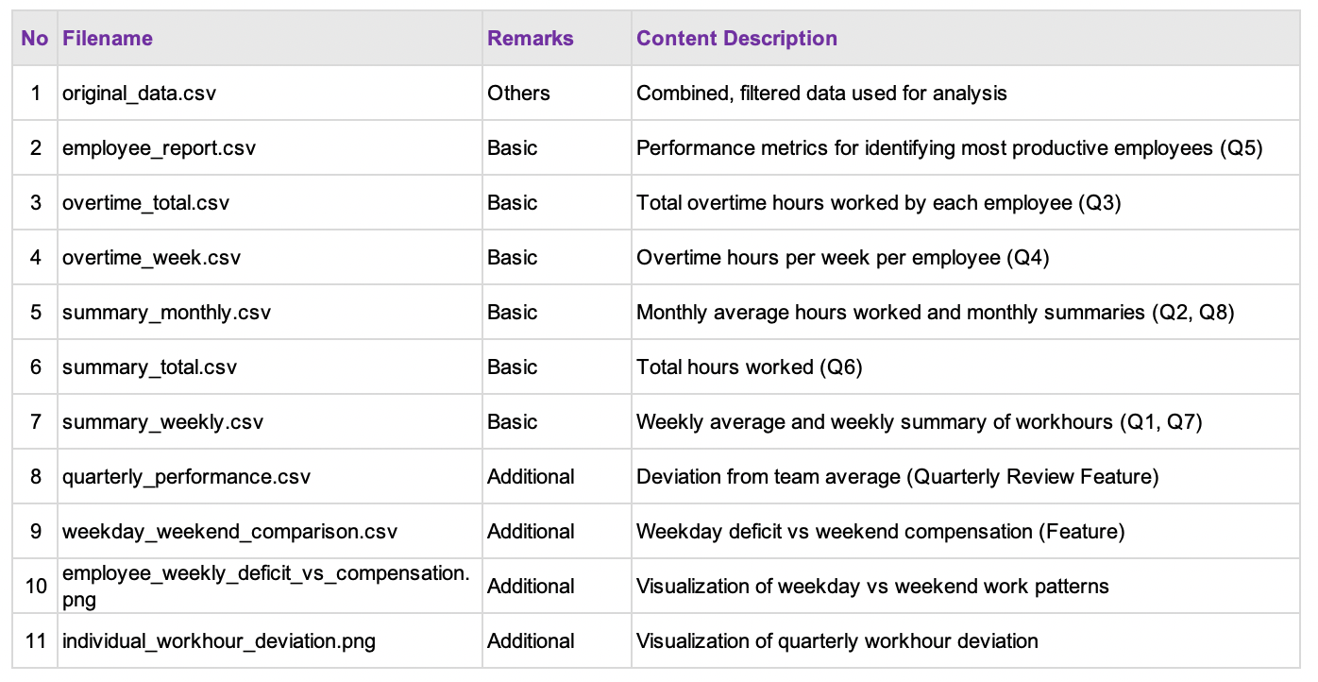
Appendix - Program Output Files

