Slide 1
The Automation of Infrastructure Orchestration and Application Deployment using Ansible and Docker Swarm
Stephen Coady
Cloud Technologies

Slide 2
Ansible
Provisioning and configuring servers
Agentless
SSH
Utilises:
Playbooks
Roles
Inventory

Slide 3
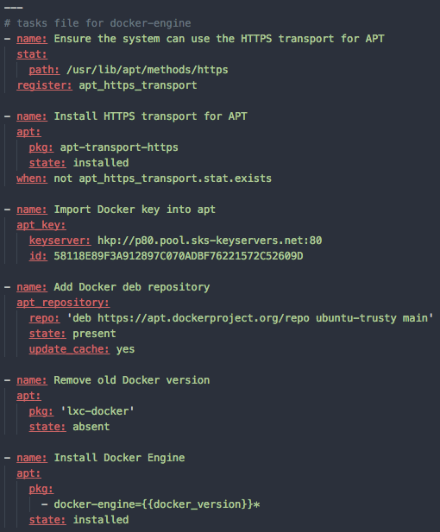
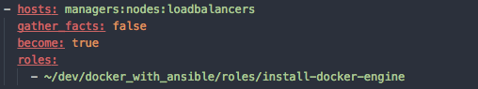
Playbook + Role

Slide 4
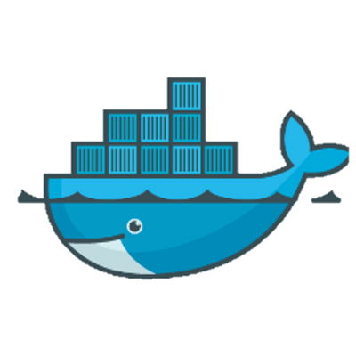

Problems With Orchestrating Docker Services

Slide 5
Solution
Lots of management of individual nodes – not ideal
Solution:
Introduce automation of management
Reduce the interface to as few nodes as possible (manager node)

Slide 6
Docker Swarm
Logically groups several Docker Engines into one Docker Engine
Uses a Manager
Everything else is a worker node
Services are split across all nodes in the swarm

Slide 7
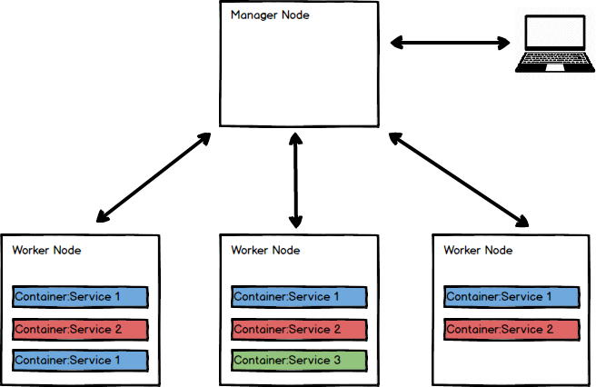

Slide 8
So Combining Ansible and Swarm We Can:
Provision Infrastructure
Configure that Infrastructure
Created a Docker Swarm
Deployed an Application to that Swarm
Load balance traffic to that Swarm

