Slide 1
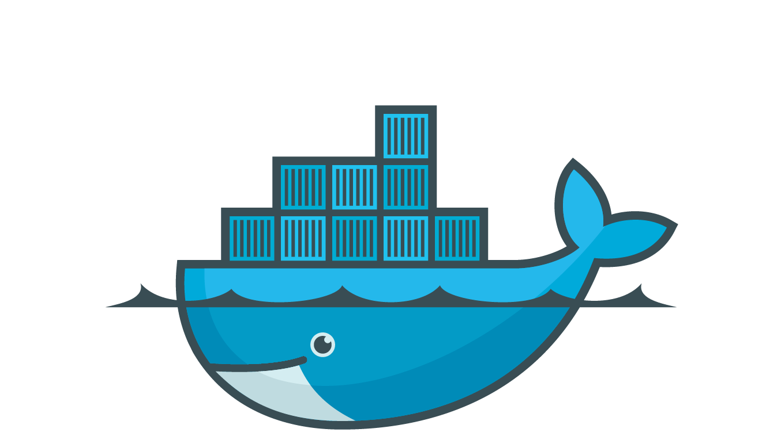
Docker Security
Stephen coady - Network Security

Slide 2
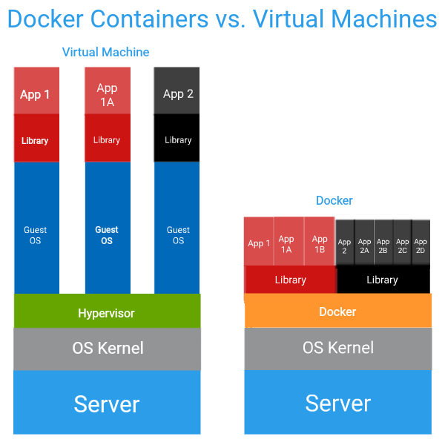
Credit: http://www.netuitive.com/

Slide 3
Security Considerations
Docker Daemon runs directly on the Linux Kernel
To do this it must have root privileges – very dangerous
Docker has built in precautions against this

Slide 4
How Does Docker Protect the Host?
Short Answer: Namespaces
Mount
User
Network
Process
etc
1
2
4
6
3
7
8, 1
9, 2
10, 3
New PID Namespace

Slide 5
However...
Useless if not used correctly
Any user in control of the Docker Daemon is essentially root

Slide 6
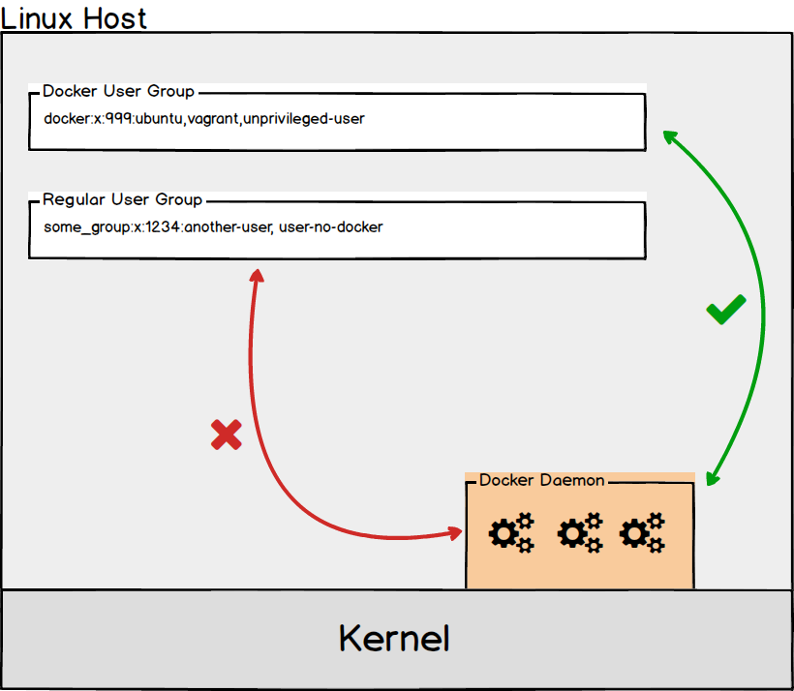

Slide 7
Questions?

