Slide 1
Lifecycle Management For Docker UI
Stephen Coady
20064122

Slide 2
What is Docker?
A way to package and run applications
Completely self-sufficient ‘containers’
Portability of containers
Lightweight alternative to virtual machines

Slide 3
Traditional Approach to Running Applications
VM 1
VM 2
VM 3
Computationally
Expensive

Slide 4
Using Docker to run Applications
Container 1
Container 2
Container 3

Slide 5
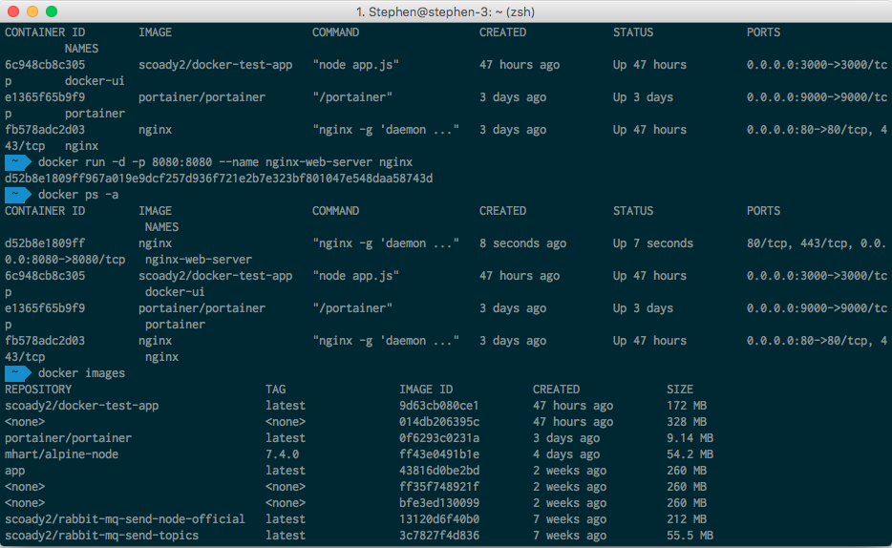
The Problem With Managing Docker

Slide 6
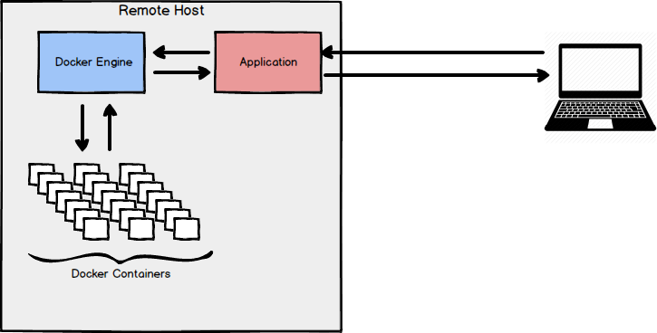

Application Flow
Kill Container A, B, C

Slide 7
Work Completed So Far
Full Continuous Integration Pipeline Built
Prototype Server Application Built
Prototype Front-End Application Built
Work Completed Since Report Submission:

Slide 8
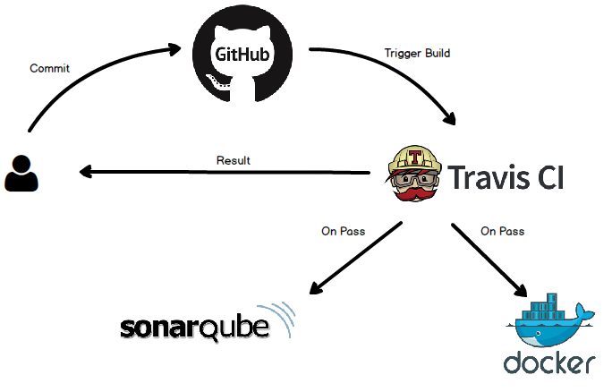
Continuous Integration Pipeline
Notes:
docker run -d -p 3000:3000 --name docker-ui -v /var/run/docker.sock:/var/run/docker.sock scoady2/docker-test-app

Slide 9
Project Direction
Documentation tools will be implemented
Database development
More complete server side application
Front-end development

Slide 10
Questions?

