Slide 1

Advanced security – lab 4
By c18490924 Stephen Darcy

Slide 2
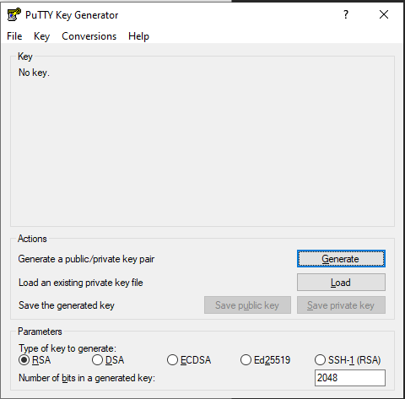
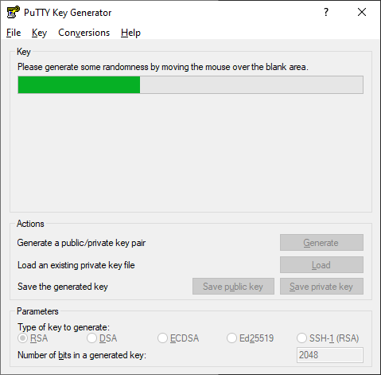

Part a – key generation with putty key Generator

Slide 3
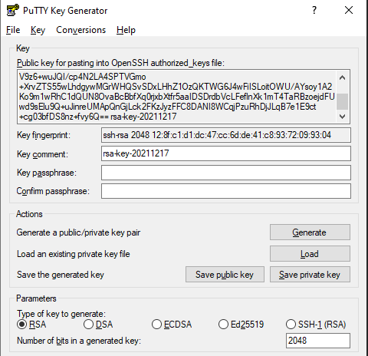

Part a – key generation with putty key Generator

Slide 4
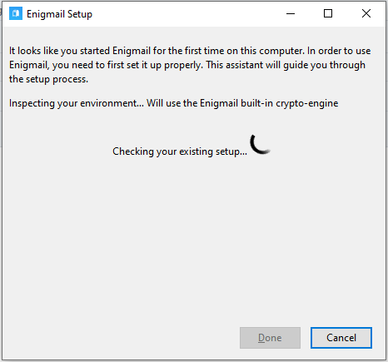
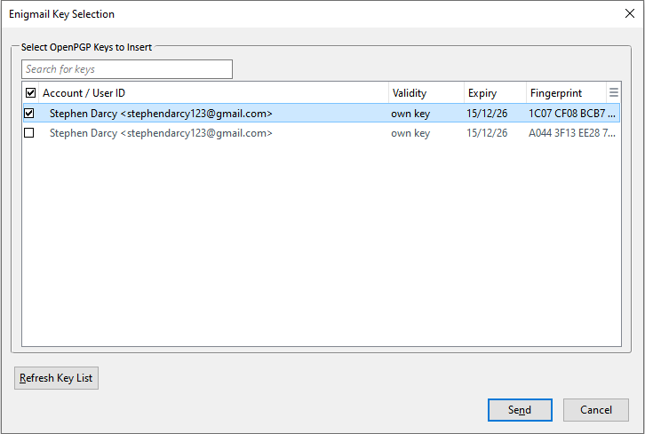
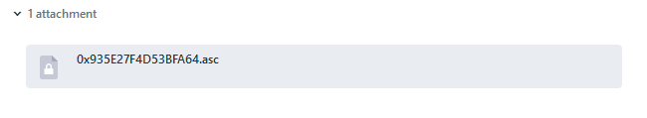
Part B – Sending an Encrypted EMAIL

Slide 5
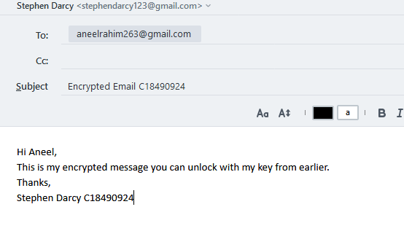

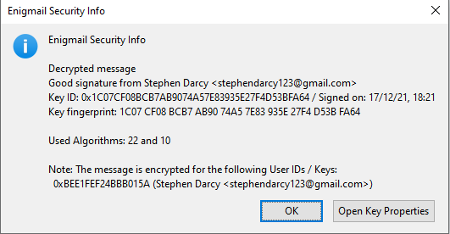
Part B – Sending an Encrypted EMAIL

Slide 6
Part C - cryptographic uses for a clock NTP and PTP
NTP is older and was designed for public systems and WANs.
PTP is newer with PTP V2 launching in 2008 and is designed for WANs and LANs
With NTP there is one master server pinging the time to the client machines.
Whereas with PTP there is multiple servers for the client to ping
NTP is also software based and prone to non-deterministic delays
PTP is hardware based and has APTS (Assisted partial timing support)

Slide 7
Part C - cryptographic uses for a clock Attacks against systems with a clock
Time synchronisation attacks against clocks can cause issues such as:
Interrupting automated tasks
Backups and processes not being able to complete
Incorrect time stamps
Financial costs and errors
Database system errors

Slide 8



Part D – RSA Encryption & decryption
random = new Random(); BigInteger p = BigInteger.probablePrime(length, random); BigInteger q = BigInteger.probablePrime(length, random);
privateKey = publicKey.modInverse(t);
n = p.multiply(q);
(new BigInteger(plaintextBytes).modPow(publicKey, n)).toByteArray();
public static BigInteger calculateTotient(BigInteger p, BigInteger q) { return (p.subtract(BigInteger.valueOf(1)).multiply(q.subtract(BigInteger.valueOf(1)))); }
BigInteger e = BigInteger.probablePrime(length / 2, random); while (t.gcd(e).compareTo(BigInteger.valueOf(1)) > 0 && e.compareTo(t) < 0) { e.add(BigInteger.valueOf(1)); } return e;
(new BigInteger(encrypted).modPow(privateKey, n)).toByteArray()

Slide 9
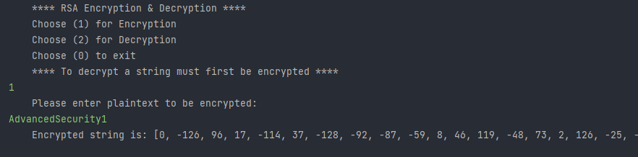
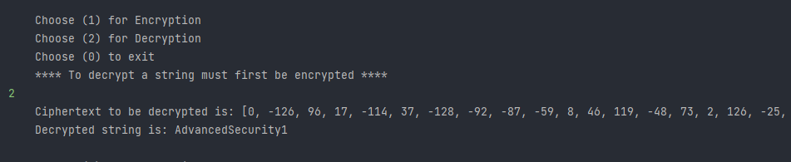
Part D – RSA Encryption & decryption

Slide 10

Thank You
Stephen Darcy c18490924

