Slide 1

3D Animation and Visual Effects
-Stephen Delicata

Slide 2

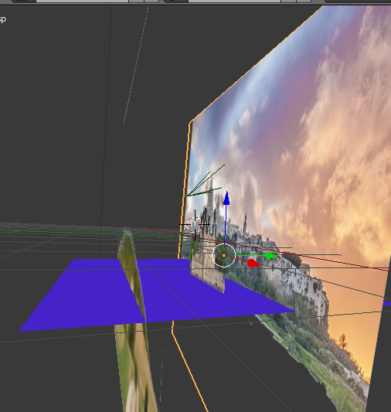
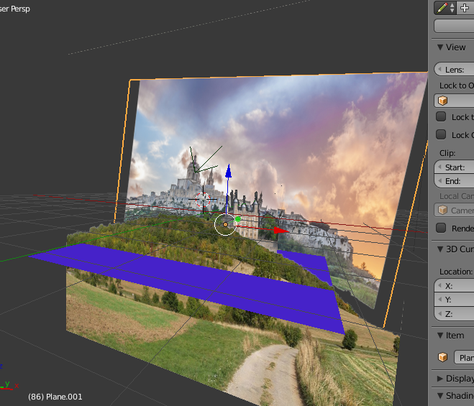
Matte Painting
Photoshop
Blender

Slide 3
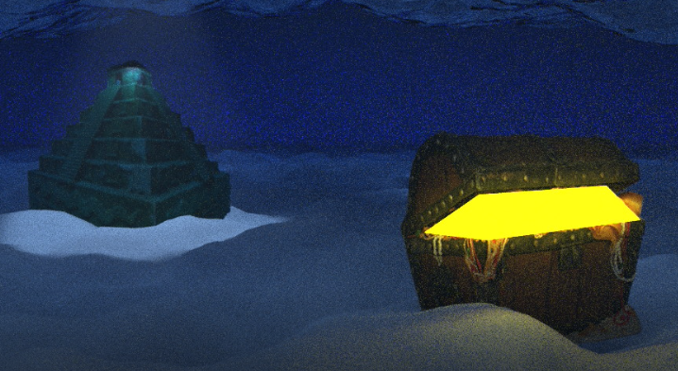
Under The Sea - Lighting

Slide 4
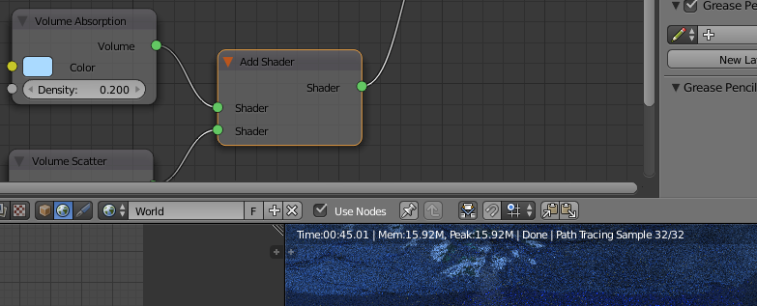

Setting up the scene
RBG Curves
In order to give it the more realistic look, I used RBG curves to change the lighting appearance.
Blender – cc2
Volume Absorption
In order to give it the colour of the Sea, I placed a volume Absorption attached to a shader.
Blender – Oceon
Transparent BSDF
In order to remove the background off my images, I used a Transparent BSDF to remove the black.
Blender - Oceon
Emission
I used an Emission to make the treasure glow.
Blender - Oceon

Slide 5
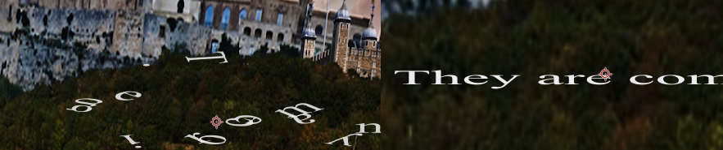

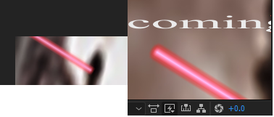
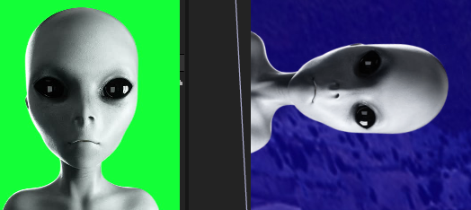
VFX Before After
Animating Text
After an Alien looks around, the texts starts to turn and appear with
The phrase in the end.
Distorting Objects with ‘Puppet’ tool
The Beginning shows an alien looking around, the puppet tool gave that appearance.
Effects
A laser was shown blasting at the building before ending the scene.
Advanced Keying
I used a keylight to remove the aliens background.

