Slide 1

CSCI E-108 Data Mining, Exploration and Discovery Learning to Rank and Recommender Algorithms
Steve Elston
Copyright 2020,2021, 2022, 2023, 2024, 2025, Stephen F Elston. All rights reserved.

Slide 2
Why Recommender Systems?
Catalogs of user choices are growing
Users need recommendations to navigate these vast choices
Many areas require recommendations
Physical products
Social media
Hospitality – Hotels, restaurants,…
Books
News articles
Music
Movies and TV shows
App stores
Matching people with required job skills
…
Economic impact of recommenders is massive!

Slide 3
Why Recommender Systems?
Catalogs of user choices are growing
In the physical world user choice is limited to small number of items
Items on the shelves of a store
News articles printed on paper
Books in a book store
Music in a music store
People submitting paper resumes for a job
Movies at a theater
…
But, in the online word the choices are nearly limitless
Choice is no longer limited by physical constraints
Most of the choices are rarely purchased
Users will rarely find these choices on their own
This is known as the long tail

Slide 4
Why Recommender Systems?
With large catalogs there are many items which are obscure and rarely purchased
Users unlikely to find rarely purchased items without recommender
Probability of Finding Item
Items commonly purchased
Items rarely purchased
Frequency of purchase

Slide 5
Overview of Recommender Algorithms

Slide 6
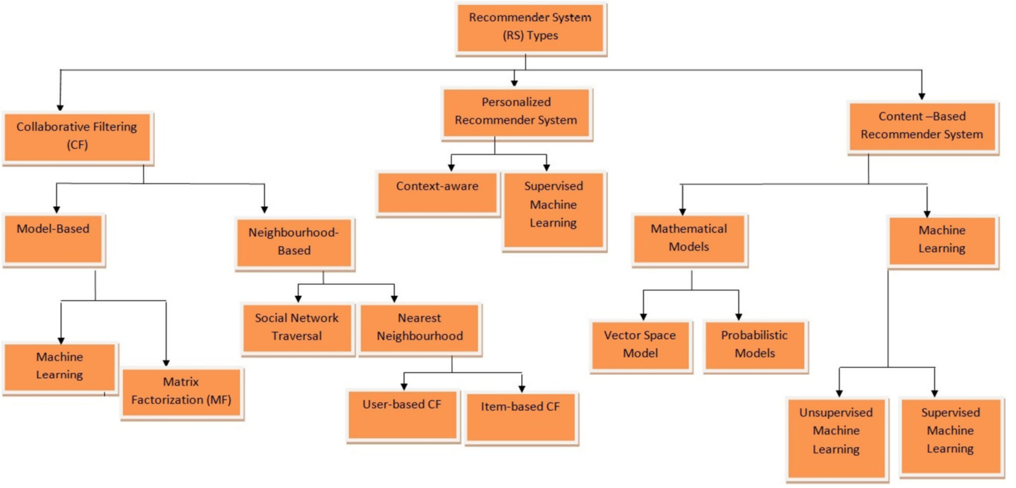
Recommender Systems
Ibrahim, et. al, 2025, propose a taxonomy to organize recommender algorithms

Slide 7
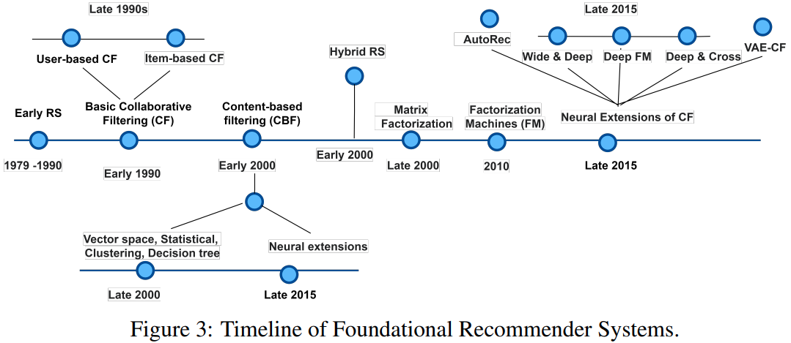
Recommender Systems
Recommendation algorithms have evolved with time
Figure from A Comprehensive Review of Recommender Systems: Transitioning From Theory to Practice, Raza, et.al., 2024

Slide 8
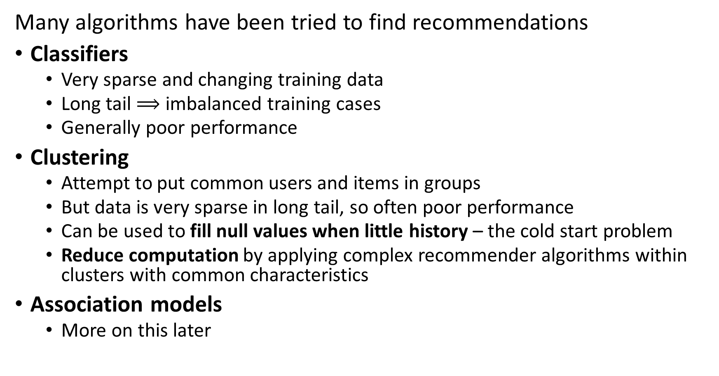
Recommender Systems
Many algorithms have been tried to find recommendations
Classifiers
Very sparse and changing training data
Long tail $⟹$ imbalanced training cases
Generally poor performance
Clustering
Attempt to put common users and items in groups
But data is very sparse in long tail, so often poor performance
Can be used to fill null values when little history – the cold start problem
Reduce computation by applying complex recommender algorithms within clusters with common characteristics
Association models
More on this later

Slide 9
Recommender Systems
Many algorithms have been tried to find recommendations
Algorithms based on similarity search dominate
Content based systems
Find items with common properties by similarity search
Uses unsupervised learning algorithms
Related to frequent item set algorithms – Last lesson of course
Collaborative filtering
Based on similarity between behavior or engagement between items or between users
Widely used algorithm
Unsupervised and supervised (ML) algorithms applied
Has cold-start problem

Slide 10
Recommender Systems
References for recommender systems
Revisiting Recommender Systems: An Investigative Survey. Ibrahim, et. al, 2025
A Comprehensive Review of Recommender Systems: Transitioning From Theory to Practice, Raza, et.al., 2024
Systematic Literature Review on Recommender System: Approach, Problem, Evaluation Techniques, Datasets, Saifudin and Widiyaningtyas, 2023

Slide 11
Recommender Systems
Resources for massively scalable recommenders
For examples of using graph recommender models at massive scale with Neo4j, see Graph Powered Machine Learning, Alessandro Negro, Manning, 2021
For an example of building scalable collaborative filtering and neural collaborative filtering recommenders in Keras, see this example by Siddhartha Banerjee
The Torch Rec system from Meta supports building massive scale recommenders using sharding and embedding algorithms
Twitter’s recommender uses a complex combination of NLP, social graph analysis and recommendation generation
A Grahm Jensen’s list of recommender system software can be found here

Slide 12
Datasets and Software
There is a growing list of recommender datasets
GitHub site with links to multiple other sites
Page with recommender dataset on Papers with Code
List of recommender datasets on Kagel
Grahm Jensen curates a directory of recommender software packages

Slide 13
Generating Recommendations is Hard!

Slide 14
Why is Making a Good Recommender Hard?
Creating a good recommender algorithm for the real-world is hard!
We do not have purchase information on new users or new items –
The cold-start problem!
Human users have variable behavior
Naïve solutions do not address long-tail
Negative sampling bias – Never collect samples when user does not take action
Position bias – Users typically only see top few items on recommendation list
These biases are strongly interdependent!

Slide 15
Why is Making a Good Recommender Hard?
Cold start problems limit predictions from recommenders
Cold start problem for new or rarely purchased items
New items are constantly added to digital catalogs
No reviews
No purchase history
Must rely on item similarity
Cold start problem for new users
No or few reviews or purchases
Similarity measures can be limited – little or no profile information
Must rely on other approaches – frequent item set search

Slide 16
Why is Making a Good Recommender Hard?
User behavior limits recommender predictions
People have complex behavior
Have variable taste – may change mind what they are looking for
May have multiple interests – e.g. user may want both classic country and baroque music
More than one person accessing user account – e.g. a family
User ratings are not constant with time
Average rating of movies increases with time from release
Game ratings decline with time from release
Fad products come and go quickly over time
…
Data quality often limits recommender performance more than algorithm choice!

Slide 17
Why is Making a Good Recommender Hard?
Good recommendations depend on user context
Example: the music the user wants to hear depends on time of day
Example: Travel recommendations depend on the nature of the trip, business, vacation, etc.
Context can be ambiguous
Example: video choice can depend on time of day, but depends on if a child is present
Example: recommendations can be location dependent, but dependent on users purpose
Analysis of context leads to a cold start problem

Slide 18
Why is Making a Good Recommender Hard?
Recommender systems are subject to adversarial and poisoning attacks
Actors may wish to boost or depress ratings for various reasons
Commercial, to gain unfair advantage in the market place
Political and cultural, to boost or suppress certain points of view
Adversarial attacks aim to manipulate input data to temporarily deceive the system into producing inaccurate real-time inferences or predictions
More commonly, poisoning attacks aim to inject carefully crafted data into the model’s training data to fundamentally change the results
Real-world recommenders need to employ countermeasures

Slide 19
Why is Making a Good Recommender Hard?
Recommender data suffers from bias
We can only sample when user takes positive action, negative sampling bias
Click through
Purchase
…
Many selections in a massive catalog are rarely or never selected by any user because of position bias
New items are constantly added to digital catalogs
Rarely purchased items have positions far down recommendation lists
Position bias leads to negative sampling bias and vice versa

Slide 20
Representation for Recommenders

Slide 21
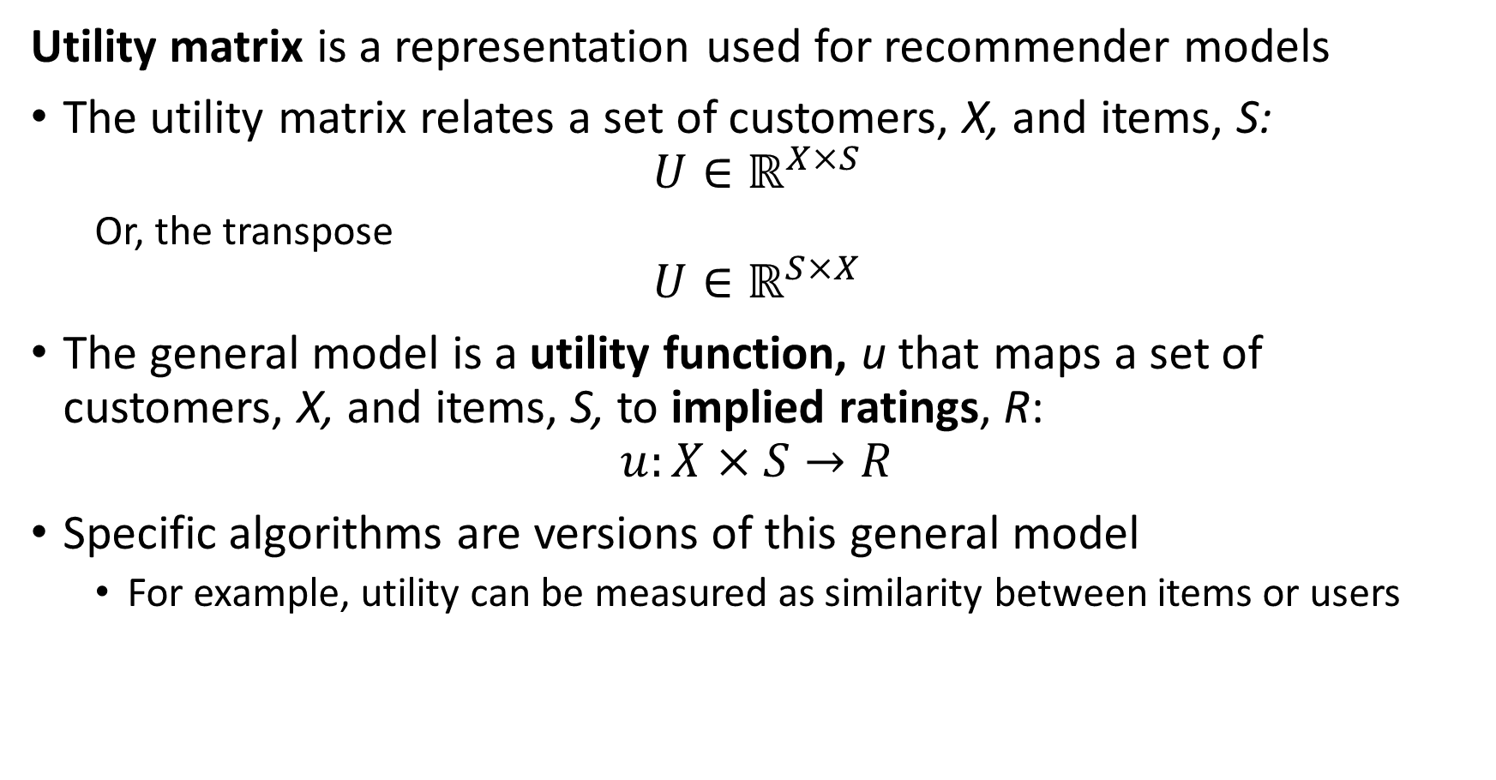
General Recommender Model
Utility matrix is a representation used for recommender models
The utility matrix relates a set of customers, X, and items, S:
$$U∈ℝ^{X×S}$$
Or, the transpose
$$U∈ℝ^{S×X}$$
The general model is a utility function, u that maps a set of customers, X, and items, S, to implied ratings, R:
$$u:X×S→R$$
Specific algorithms are versions of this general model
For example, utility can be measured as similarity between items or users

Slide 22
Representation for Recommender Algorithms
What representation can we use for recommender algorithms?
A utility matrix
Users in the rows, item ratings or purchases in the columns
Or the transpose
We can create a similar data structure using feature or user embeddings
 | Star Wars | The Matrix | Green Book | Frozen | Lady Bird | Jurassic Park | Schindler’s List | My Neighbor Totoro
Mary |  |  | 4 |  | 5 |  | 4 | 5
Bob | 4 | 5 |  |  | 1
Raj |  |  | 4 |  |  |  | 5
Maria | 3 | 4 |  | 5 | 4 |  | 3 | 5
Kevin |  |  | 5 |  |  | 2 | 5
Janell | 5 | 4 |  |  |  |  |  | 2

Slide 23
Representation for Recommender Algorithms
What representation can we use for recommender algorithms?
Notice that most users have watched only a few movies
There is only limited similarity information between users
 | Star Wars | The Matrix | Green Book | Frozen | Lady Bird | Jurassic Park | Schindler’s List | My Neighbor Totoro
Mary |  |  | 4 |  | 5 |  | 4 | 5
Bob | 4 | 5 |  |  | 1
Raj |  |  | 4 |  |  |  | 5
Maria | 3 | 4 |  | 5 | 4 |  | 3 | 5
Kevin |  |  | 5 |  |  | 2 | 5
Janell | 5 | 4 |  |  |  |  |  | 2

Slide 24
Representation for Recommender Algorithms
What representation can we use for recommender algorithms?
Do we always have ratings from users?
No! Many people will buy, watch, or listen without ever rating
Click-throughs are inherently binary
Often, only have binary response
 | Star Wars | The Matrix | Green Book | Frozen | Lady Bird | Jurassic Park | Schindler’s List | My Neighbor Totoro
Mary |  |  | 4 |  | 5 |  | 4 | 5
Bob | 4 | 5 |  |  | 1
Raj |  |  | ✔ |  |  |  | ✔
Maria | ✔ | ✔ |  | ✔ | ✔ |  | ✔ | ✔
Kevin |  |  | ✔ |  |  | ✔ | ✔
Janell | 5 | 4 |  |  |  |  |  | 2

Slide 25
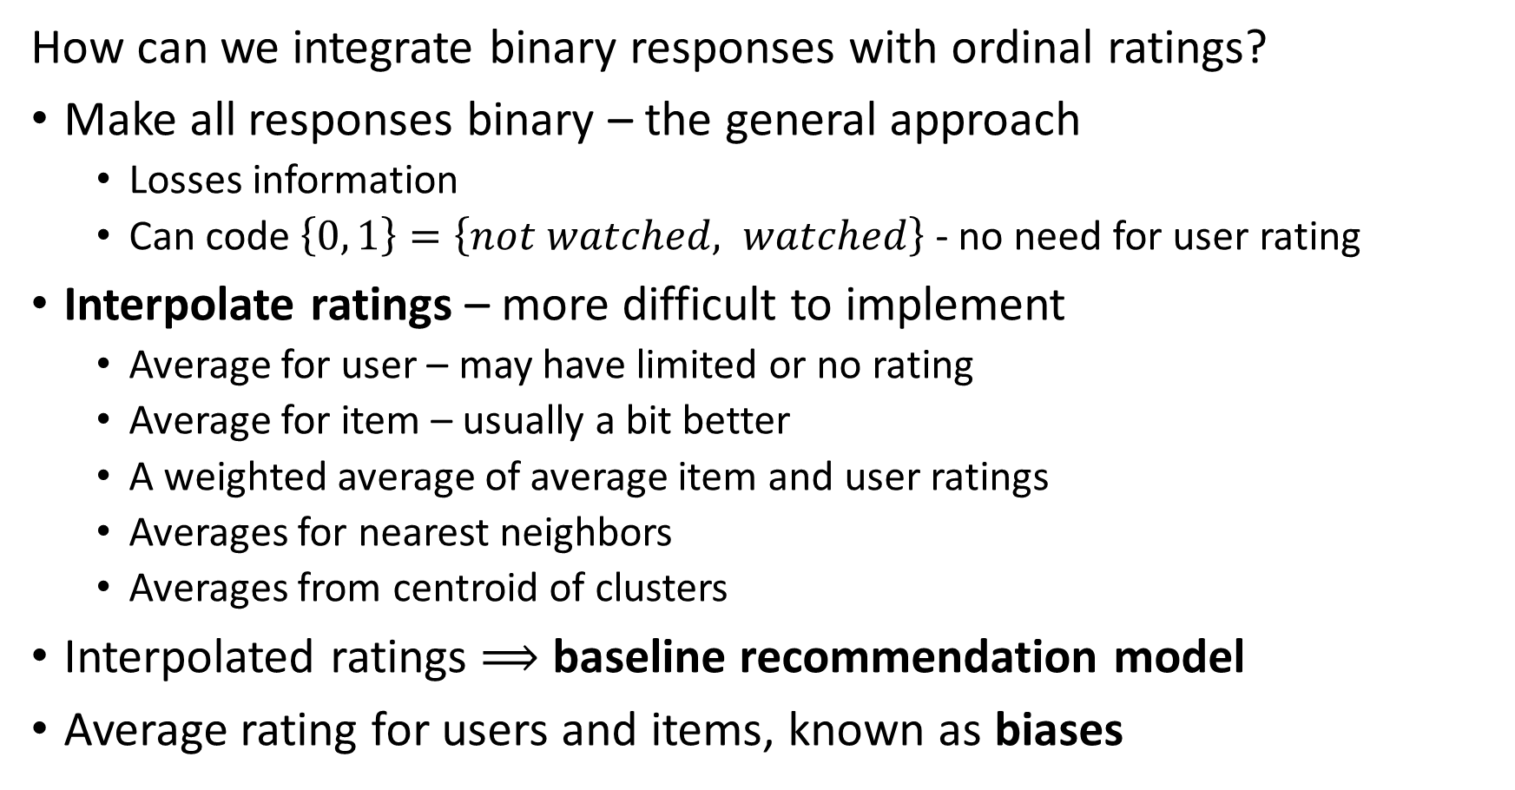
Representation for Recommender Algorithms
How can we integrate binary responses with ordinal ratings?
Make all responses binary – the general approach
Losses information
Can code $\left\{0, 1\right\}=\left\{not watched, watched\right\}$ - no need for user rating
Interpolate ratings – more difficult to implement
Average for user – may have limited or no rating
Average for item – usually a bit better
A weighted average of average item and user ratings
Averages for nearest neighbors
Averages from centroid of clusters
Interpolated ratings $⟹$ baseline recommendation model
Average rating for users and items, known as biases

Slide 26
Representation for Recommender Algorithms
What representation can we use for recommender algorithms?
Do we always have ratings from users?
Often, only have binary response
 | Star Wars | The Matrix | Green Book | Frozen | Lady Bird | Jurassic Park | Schindler’s List | My Neighbor Totoro
Mary |  |  | 1 |  | 1 |  | 1 | 1
Bob | 1 | 1 |  |  | 1
Raj |  |  | 1 |  |  |  | 1
Maria | 1 | 1 |  | 1 | 1 |  | 1 | 1
Kevin |  |  | 1 |  |  | 1 | 1
Janell | 1 | 1 |  |  |  |  |  | 1

Slide 27
Representation for Recommender Algorithms
Is Maria only one person?
Maybe not – multiple people share accounts
Perhaps the Maria account represents several people in a household?
 | Star Wars | The Matrix | Green Book | Frozen | Lady Bird | Jurassic Park | Schindler’s List | My Neighbor Totoro
Mary |  |  | 4 |  | 5 |  | 4 | 5
Bob | 4 | 5 |  |  | 1
Raj |  |  | 4 |  |  |  | 5
Maria | 3 | 4 |  | 5 | 4 |  | 3 | 5
Kevin |  |  | 5 |  |  | 2 | 5
Janell | 5 | 4 |  |  |  |  |  | 2

Slide 28








Representation for Recommender Algorithms
Graph representation of utility matrix
One type of node represents users
One type of node represents items
Weighted edges associate users and items – e.g. item ratings or similarity
Is a bipartite graph
Graph representation is inherently sparse
Many state of the art recommender algorithms are graph-based
$$U_{1}$$
$$I_{1}$$
$$U_{2}$$
$$I_{2}$$
$$U_{3}$$
$$I_{3}$$
…
…
$$U_{n}$$
$$I_{n}$$

Slide 29
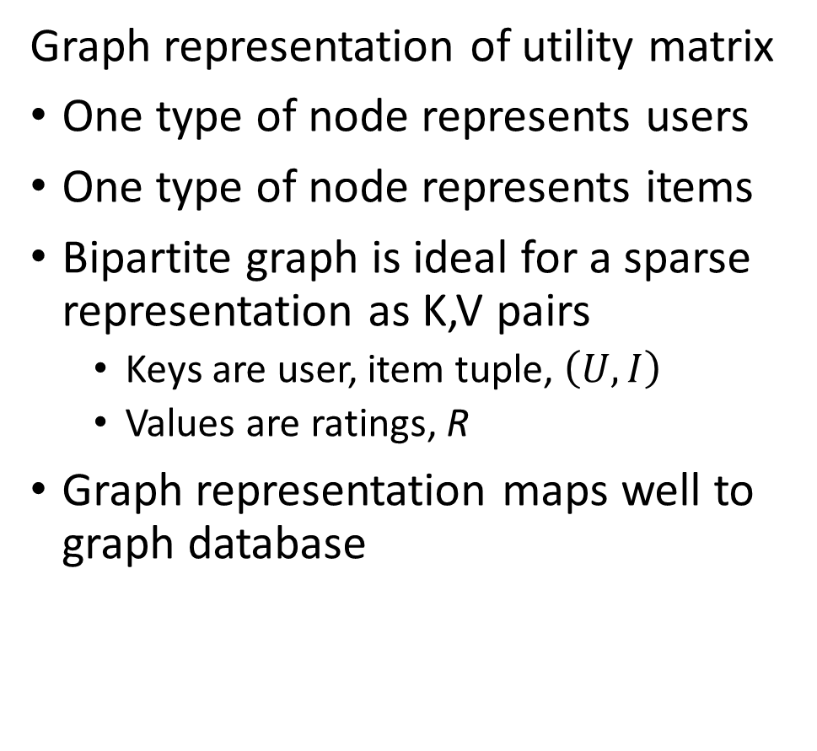
Representation for Recommender Algorithms
Graph representation of utility matrix
One type of node represents users
One type of node represents items
Bipartite graph is ideal for a sparse representation as K,V pairs
Keys are user, item tuple, $\left(U,I\right)$
Values are ratings, R
Graph representation maps well to graph database
$$U_{1}$$
$$I_{1}$$
$$U_{2}$$
$$I_{2}$$
$$U_{3}$$
$$I_{3}$$
…
…
$$U_{n}$$
$$I_{n}$$

Slide 30
Extending the Representation

Slide 31
Recommender Systems
Context-aware recommender for improved personalization
Figure from Revisiting Recommender Systems: An Investigative Survey. Ibrahim, et. al, 2025

Slide 32
Extending the Representation
How can we add context to the representation to improve personalization?
Extend the utility matrix
Add context dimensions to utility matrix
Example: for each rating or interaction
Time of day
Location
Pages visited
Reliability metrics
Etc.

Slide 33
Extending the Representation
How can we add context to the representation?
Context representation is difficult
High dimensional: many possible contexts
Sparse: only limited context for specific situation
Cold start problem
Few contexts encountered per user
No context for new user
Need to embed sparse high dimensional vector space

Slide 34
Content Based Recommenders

Slide 35
Content Based Recommenders
How can we build a content-based recommender?
Based on similarity of item profiles
Is an unsupervised similarity search
Can use most any similarity metric, with default of cosine
Goal: Recommend related items to user
Example: recommend movie
Find movies with similar actors, director, writers, etc. to user profile

Slide 36
Recommender Systems
Vector nearest neighbor search algorithm for content-based recommender
Figure from Revisiting Recommender Systems: An Investigative Survey. Ibrahim, et. al, 2025

Slide 37
Content Based Recommenders
How can we build a content-based recommender?
Item profiles (characteristics)
Acquired from item descriptions
No item cold-start problem
Feature map from embedding
Amazon uses mini-hashing, Luo, 2022, for large scale Item similarity search

Slide 38





Content Based Recommenders
How can we build a content-based recommender?
User profile of searchers, purchases and ratings of bicycle water bottles
Present recommended
items
Many possible similar items from item descriptions (choices)
Filter on k highest similarity between user and item profiles

Slide 39
Content Based Recommenders
How can we build a content-based recommender?
Extracting consistent item characteristics can be difficult
Descriptions often inconsistent, incomplete or missing
Different sources code and format characteristics differently
Integrate categorical and numerical characteristics
Categorical features
Use dense embedding
Unstructured text descriptions
Use neural embedding of natural language
Use embedding space for similarity search

Slide 40
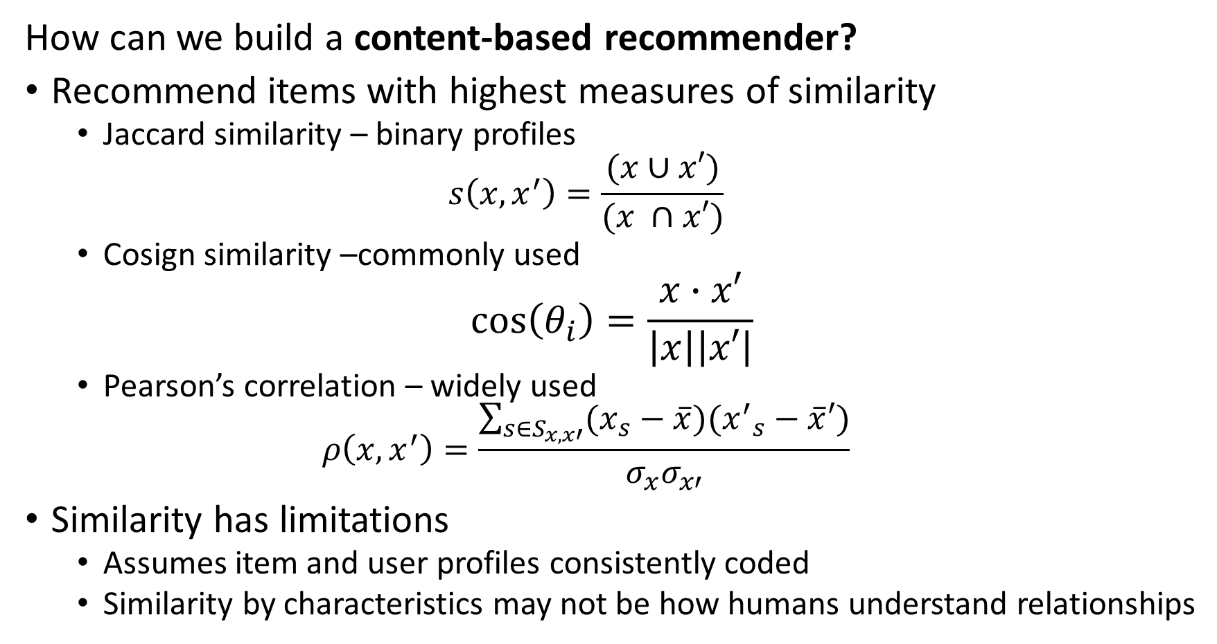
Content Based Recommenders
How can we build a content-based recommender?
Recommend items with highest measures of similarity
Jaccard similarity – binary profiles
$$s\left(x,x^{′}\right)=\frac{(x∪x′)}{(x ∩x′)}$$
Cosign similarity –commonly used
$$\cos\left(θ_{i}\right)=\frac{x∙x′}{\left|x\right|\left|x′\right|}$$
Pearson’s correlation – widely used
$$ρ\left(x,x^{′}\right)=\frac{\sum_{s∈S_{x,x′}}^{ }{(x_{s}−\overline{x})({x^{′}}_{s}−\overline{x}′)}}{σ_{x}σ_{x′}}$$
Similarity has limitations
Assumes item and user profiles consistently coded
Similarity by characteristics may not be how humans understand relationships

Slide 41
Content Based Recommenders
Advantages of content-based recommenders
No need for data on other item characteristics, e.g. ratings
Recommend new and unpopular item by profile alone
No cold start problem for items
Works for users with unusual tastes
No first-rater problem
Outcome is explainable
Easy to understand ranking by similarity

Slide 42
Content Based Recommenders
Disadvantages of content-based recommenders
Finding features for profile is hard
Inconsistent descriptions
Information in unstructured data; text, images
Cold start problem for new user with no profile
Can give over-specialized recommendations
Will never find item without similarity to user search
Does not account for user with multiple interests
Does not use information from other users; e.g. ratings

Slide 43
Collaborative Filtering

Slide 44
Recommender Systems
Collaborative filtering with k-nearest neighbor algorithm
Figure from Revisiting Recommender Systems: An Investigative Survey. Ibrahim, et. al, 2025

Slide 45
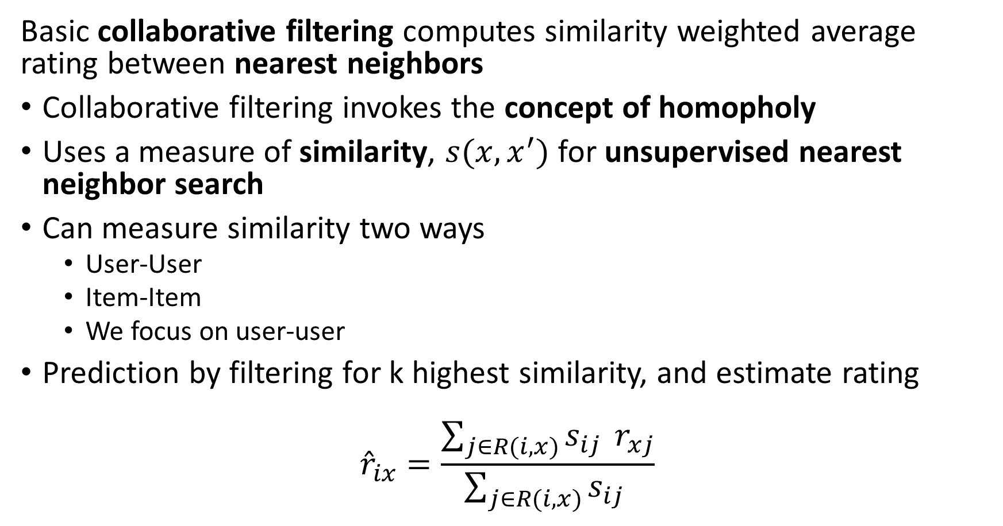
Collaborative Filter Recommenders
Basic collaborative filtering computes similarity weighted average rating between nearest neighbors
Collaborative filtering invokes the concept of homopholy
Uses a measure of similarity, $s(x,x^{′})$ for unsupervised nearest neighbor search
Can measure similarity two ways
User-User
Item-Item
We focus on user-user
Prediction by filtering for k highest similarity, and estimate rating
$${\hat{r}}_{ix}=\frac{\sum_{j∈R(i,x)}^{ }{s_{ij } r_{xj}}}{\sum_{j∈R(i,x)}^{ }{s_{ij} }}$$

Slide 46
Collaborative Filter Recommenders
Example of collaborative filtering
Start with a utility matrix
Here we use ratings, but can use feature embeddings with same basic algorithm
Users
 | 1 | 2 | 3 | 4 | 5 | 6 | 7 | 8 | 9 | 10 | 11
1 | 4 |  | 5 |  |  | 5 | ? |  | 3 |  | 1
2 | 1 | 2 |  |  | 4 |  |  | 4 | 5
3 | 5 | 3 | 4 |  | 3 |  | 2 | 1 |  | 4 | 2
4 | 2 |  |  | 4 |  |  | 5 |  | 4 | 2
5 | 2 |  |  |  |  | 2 | 4 | 3 | 4
6 | 4 |  |  | 2 |  |  | 3 |  | 3 |  | 1
Items

Slide 47
Collaborative Filter Recommenders
Example of collaborative filtering
Want to predict implied rating for user 7 of item 1
Compute the mean and Variance of the item ratings
Subtract mean rating from item rating
Users
 | 1 | 2 | 3 | 4 | 5 | 6 | 7 | 8 | 9 | 10 | 11 | Mean Rating | Variance
1 | 4 |  | 5 |  |  | 5 | ? |  | 3 |  | 1 | 3.60 | 2.80
2 | 1 | 2 |  |  | 4 |  |  | 4 | 5 |  |  | 3.20 | 2.7
3 | 5 | 3 | 4 |  | 3 |  | 2 | 1 |  | 4 | 2 | 3.00 | 1.71
4 | 2 |  |  | 4 |  |  | 5 |  | 4 | 2 |  | 3.40 | 1.8
5 | 2 |  |  |  |  | 2 | 4 | 3 | 4 |  |  | 3.00 | 1.00
6 | 4 |  |  | 2 |  |  | 3 |  | 3 |  | 1 | 2.60 | 1.30
Items

Slide 48
Collaborative Filter Recommenders
Example of collaborative filtering
Compute Pearson’s Correlation between item 1 ratings and other items
Two items have high correlation similarity
Users
 | 1 | 2 | 3 | 4 | 5 | 6 | 7 | 8 | 9 | 10 | 11 | Pearson Correlation | Jaccard Similarity
1 | 4 |  | 5 |  |  | 5 | ? |  | 3 |  | 1
2 | 1 | 2 |  |  | 4 |  |  | 4 | 5 |  |  | -1.0 | 0.18
3 | 5 | 3 | 4 |  | 3 |  | 2 | 1 |  | 4 | 2 | 0.84 | 0.27
4 | 2 |  |  | 4 |  |  | 5 |  | 4 | 2 |  | -1.0 | 0.18
5 | 2 |  |  |  |  | 2 | 4 | 3 | 4 |  |  | -0.87 | 0.27
6 | 4 |  |  | 2 |  |  | 3 |  | 3 |  | 1 | 1.0 | 0.27
Items

Slide 49
Collaborative Filter Recommenders
Example of collaborative filtering
Compute weighted rating = (0.84*2 + 1.0*3)/(0.84+1.0) = 2.54
Users
 | 1 | 2 | 3 | 4 | 5 | 6 | 7 | 8 | 9 | 10 | 11 | Pearson Correlation | Jaccard Similarity
1 | 4 |  | 5 |  |  | 5 | 3 |  | 3 |  | 1
2 | 1 | 2 |  |  | 4 |  |  | 4 | 5 |  |  | -1.0 | 0.18
3 | 5 | 3 | 4 |  | 3 |  | 2 | 1 |  | 4 | 2 | 0.84 | 0.27
4 | 2 |  |  | 4 |  |  | 5 |  | 4 | 2 |  | -1.0 | 0.18
5 | 2 |  |  |  |  | 2 | 4 | 3 | 4 |  |  | -0.87 | 0.27
6 | 4 |  |  | 2 |  |  | 3 |  | 3 |  | 1 | 1.0 | 0.27
Items

Slide 50
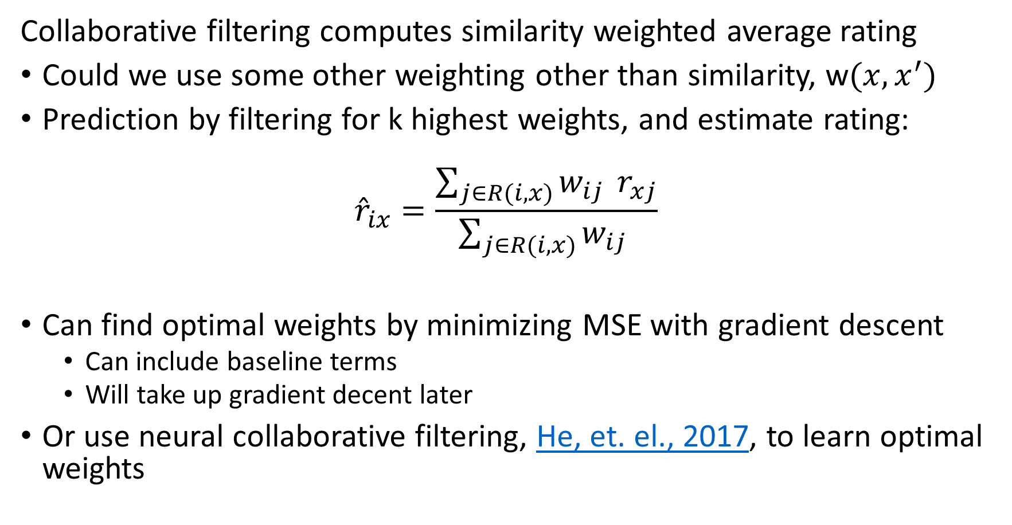
Collaborative Filter Recommenders
Collaborative filtering computes similarity weighted average rating
Could we use some other weighting other than similarity, w$(x,x^{′})$
Prediction by filtering for k highest weights, and estimate rating:
$${\hat{r}}_{ix}=\frac{\sum_{j∈R(i,x)}^{ }{w_{ij } r_{xj}}}{\sum_{j∈R(i,x)}^{ }{w_{ij} }}$$
Can find optimal weights by minimizing MSE with gradient descent
Can include baseline terms
Will take up gradient decent later
Or use neural collaborative filtering, He, et. el., 2017, to learn optimal weights

Slide 51
Evaluating Recommenders

Slide 52
Evaluating Recommenders
How do we objectively evaluate IR algorithms?
There are three dimensions of performance
Many possible recommendation performance metrics
Memory use can be the biggest constraint for massive data sets
Speed can be important for many applications
Users will only pay attention to promptly displayed recommendations
Low Memory -Scalable
Low Computational Complexity-Scalable
Retrieval Performance

Slide 53
Evaluating Recommenders
Jadon Patil 2024 provide a exhaustive, perhaps exhausting☺, review of four aspects of recommender system performance evaluation
Similarity metrics measure the similarity of recommendations to user queries
We have addressed these metrics previously
Candidate generation metrics evaluate the how broad and relevant the recommendations are
Predictive metrics evaluate how well the recommender system predicts the ratings of users
Business metrics how well the recommender system improves business performance

Slide 54
Evaluating Recommenders
Jadon Patil 2024 review a large number of candidate generation metrics
Ranking metrics for either candidate generation or business evaluation
Precision@k, Recall@k, average Precision@k, average Recall@k
Normalized cumulative discounted gain
Mean reciprocal rank
…
Candidate generation metrics
Novelty
Diversity
Serendipity
Catalog coverage
Distributional coverage

Slide 55
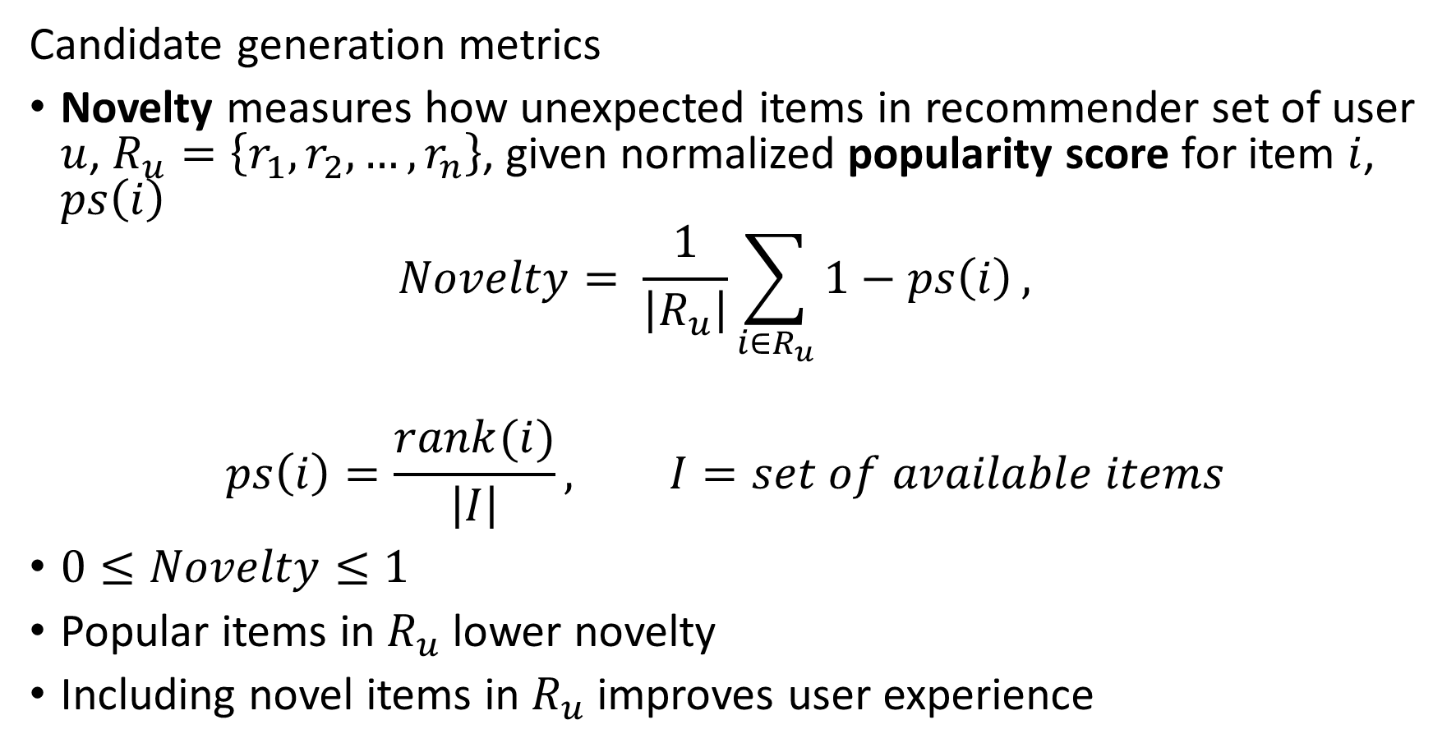
Evaluating Recommenders
Candidate generation metrics
Novelty measures how unexpected items in recommender set of user $u$, $R_{u}=\left\{r_{1},r_{2},…,r_{n}\right\}$, given normalized popularity score for item $i$, $ps\left(i\right)$
$$Novelty= \frac{1}{\left|R_{u}\right|}\sum_{i∈R_{u}}{1−ps\left(i\right)},$$
$$ps\left(i\right)=\frac{rank(i)}{\left|I\right|}, I=set of available items$$
$0≤Novelty≤1$
Popular items in $R_{u}$ lower novelty
Including novel items in $R_{u}$ improves user experience

Slide 56
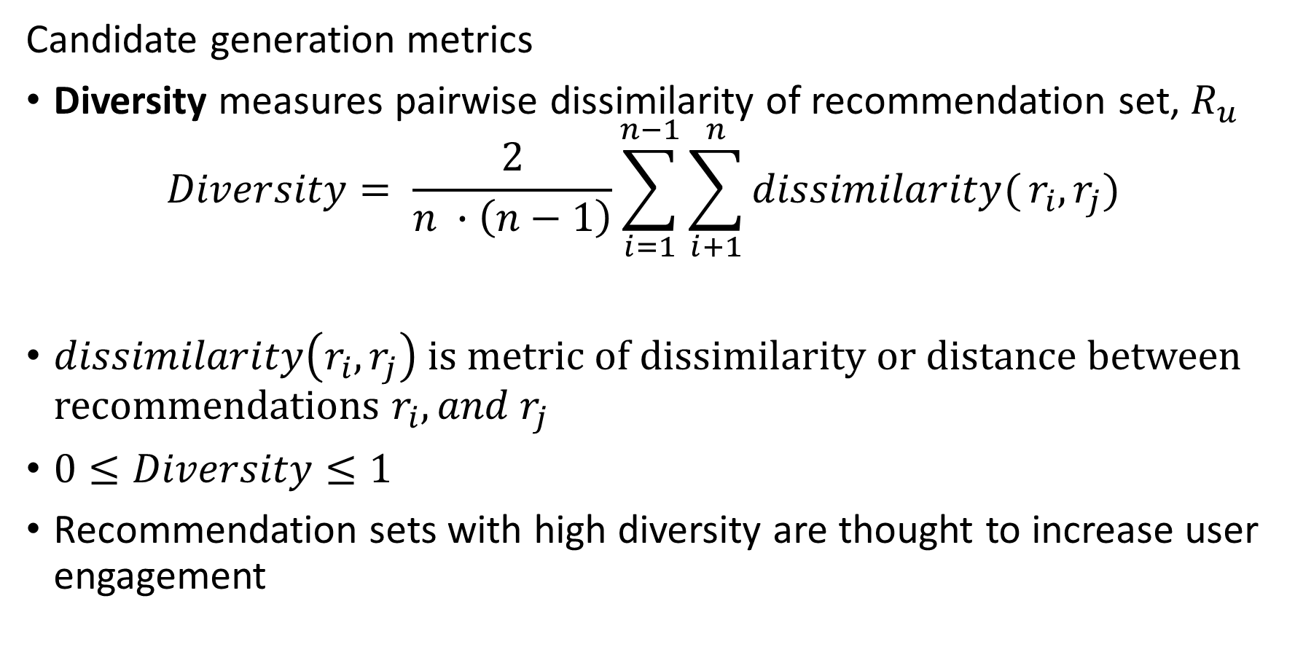
Evaluating Recommenders
Candidate generation metrics
Diversity measures pairwise dissimilarity of recommendation set, $R_{u}$
$$Diversity= \frac{2}{n ∙\left(n−1\right)}\sum_{i=1}^{n−1}{\sum_{i+1}^{n}{dissimilarity(}}r_{i},r_{j})$$
$dissimilarity\left(r_{i},r_{j}\right)$ is metric of dissimilarity or distance between recommendations $r_{i},{and r}_{j}$
$0≤Diversity≤1$
Recommendation sets with high diversity are thought to increase user engagement

Slide 57
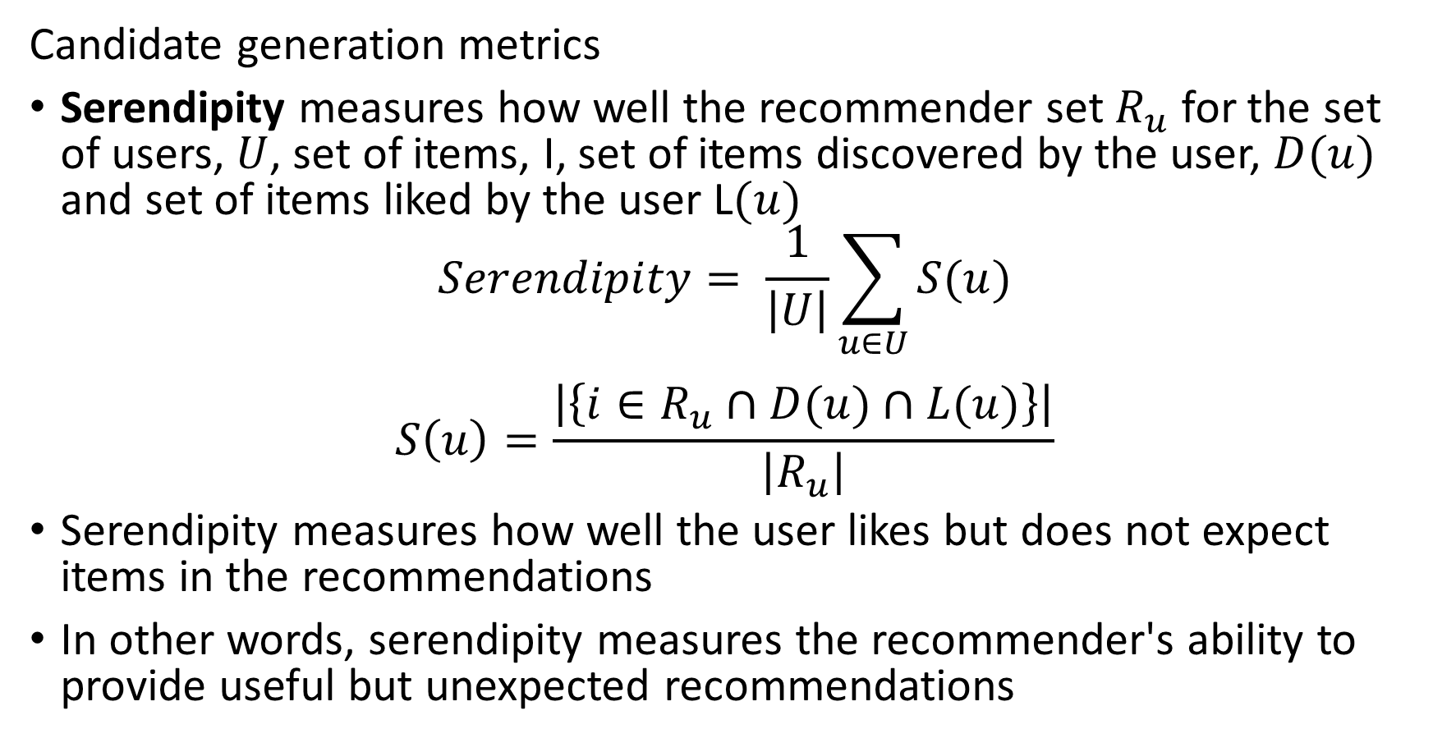
Evaluating Recommenders
Candidate generation metrics
Serendipity measures how well the recommender set $R_{u}$ for the set of users, $U$, set of items, I, set of items discovered by the user, $D(u)$ and set of items liked by the user L$(u)$
$$Serendipity= \frac{1}{\left|U\right|}\sum_{u∈U}{S(u)}$$
$$S\left(u\right)=\frac{\left|\left\{i∈R_{u}∩D(u)∩L(u)\right\}\right|}{\left|R_{u}\right|}$$
Serendipity measures how well the user likes but does not expect items in the recommendations
In other words, serendipity measures the recommender's ability to provide useful but unexpected recommendations

Slide 58
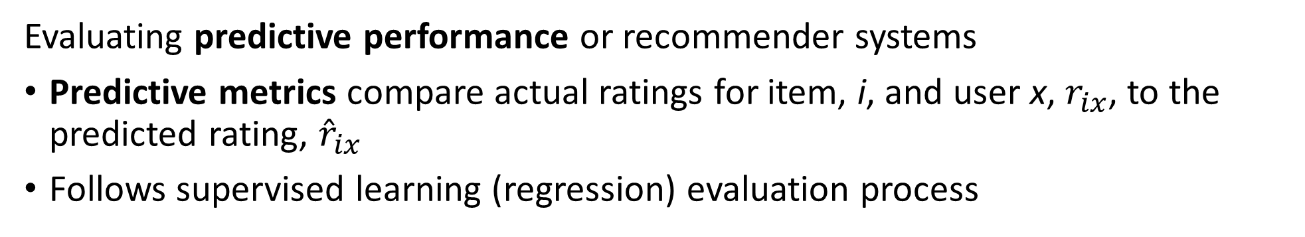
Evaluating Recommenders
Evaluating predictive performance or recommender systems
Predictive metrics compare actual ratings for item, i, and user x, $r_{ix}$, to the predicted rating, ${\hat{r}}_{ix}$
Follows supervised learning (regression) evaluation process
Users
Compare estimated rating to actual ratings
Choose evaluation metrics
Start with full data sample
Hold back Bernoulli sampled fraction of data
Train model
Evaluate using metric
4 |  | 3 |  |  | 2
 | 5 | 4 |  | 2 |  | 1
2 |  |  | 5 |  | 5
 | 3 | 3 |  | 2 | 4
5 |  | 5 | 3 |  |  | 4 | 1
 | 3 |  | 5 |  | 5 |  | 5
2 | 4 | 5 |  |  | 1
 | 3 |  | 4 |  | 3 |  | 2
4 |  | 3 |  |  | 2
 | 5 | 4 |  | 2 |  | 1
2 |  |  | 5 |  | 5
 | 3 | 3 |  | 2 | 4
5 |  | 5 | 3 |  |  | 4 | 1
 | 3 |  | 5 |  | 5 |  | 5
2 | 4 | 5 |  |  | 1
 | 3 |  | 4 |  | 3 |  | 2
Items

Slide 59
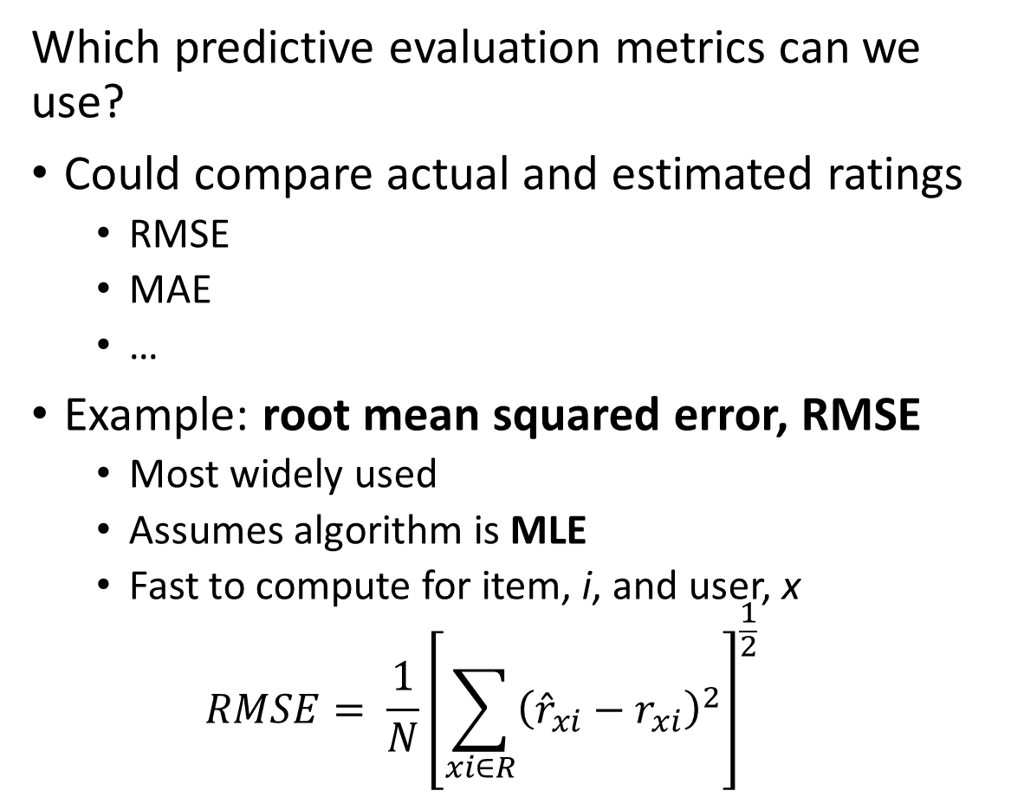
Evaluating Recommenders
Which predictive evaluation metrics can we use?
Could compare actual and estimated ratings
RMSE
MAE
…
Example: root mean squared error, RMSE
Most widely used
Assumes algorithm is MLE
Fast to compute for item, i, and user, x
$$RMSE= \frac{1}{N}{\left[\sum_{xi∈R}^{ }{{\left({\hat{r}}_{xi}−r_{xi}\right)}^{2}}\right]}^{\frac{1}{2}}$$
Users
4 |  | 3 |  |  | 2
 | 5 | 4 |  | 2 |  | 1
2 |  |  | 5 |  | 5
 | 3 | 3 |  | 2 | 4
5 |  | 5 | 3 |  |  | 4 | 1
 | 3 |  | 5 |  | 5 |  | 5
2 | 4 | 5 |  |  | 1
 | 3 |  | 4 |  | 3 |  | 2
Items

Slide 60
Evaluating Recommenders
Can we apply cross validation to recommender algorithms?
Yes! Use K-fold CV method
Randomly sample data into K-folds (subsets)
Round robin hold back one fold for evaluation and train model on K-1 folds
Base evaluation on mean and variance of K performance metric sets
CV is an effective tool for comparing performance of models
In theory, can use nested CV for hyperparameter search
But computation can be prohibitive – data can be massive
Can limit folds and number of hyperparameter values

Slide 61
Latent Variable Models

Slide 62
Recommender Systems
Collaborative filtering by unsupervised matrix factorization
Figure from Revisiting Recommender Systems: An Investigative Survey. Ibrahim, et. al, 2025

Slide 63
Latent Factor Recommenders
Latent factor recommenders are powerful machine learning models
Latent variables are low-dimensional and dense embedding of the spare response data
Unsupervised
Supervised
Data values can be dense or sparse
Example, numeric features are typically dense
Categorical features with high dimensionality are sparsely coded
Negative sampling bias results in few positive responses
Imbalanced training cases
An embedding space used to overcome these problems
Embedding spaces contain latent factors
Latent factors that are not observable

Slide 64
Latent Factor Recommenders
Latent factor recommenders are powerful models
Here we focus on unsupervised non-negative matrix decomposition of the utility matrix
Compute missing ratings from matrix decomposition
But, need a trick!
Utility matrix is not square: wide, n users by m items
Typically, m << n, or sometimes n < m
Many missing values, negative sample bias
Standard SVD biased by 0 filling

Slide 65
Latent Factor Recommenders
Latent factor recommenders are powerful models
What are factor models?
Statistical factor models attempt to explain data
Factors define a low-dimensional embedding space
Embeddings are explanatory factors
Algorithm learns factor weights
Unobservable factors are called latent factors
Latent since these factors cannot be observed
Factors weights learned from observed data

Slide 66
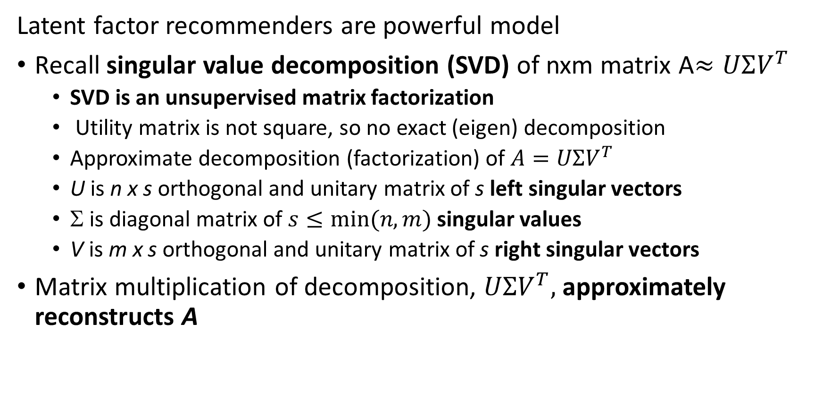
Latent Factor Recommenders
Latent factor recommenders are powerful model
Recall singular value decomposition (SVD) of nxm matrix A$≈UΣV^{T}$
SVD is an unsupervised matrix factorization
Utility matrix is not square, so no exact (eigen) decomposition
Approximate decomposition (factorization) of $A=UΣV^{T}$
U is n x s orthogonal and unitary matrix of s left singular vectors
Σ is diagonal matrix of $s≤min⁡(n,m)$ singular values
V is m x s orthogonal and unitary matrix of s right singular vectors
Matrix multiplication of decomposition, $UΣV^{T},$ approximately reconstructs A

Slide 67







Latent Factor Recommenders
Can we perform SVD decomposition the on utility matrix, A$≈UΣV^{T}$
Problem, SVD biased by missing values and produces negative ratings
Reconstruction of utility matrix is biased
Users
$$U$$
$$∑$$
$$VT$$
4 |  | 3 |  |  | 2
 | 5 | 4 |  | 2 |  | 1
2 |  |  | 5 |  | 5
 | 3 | 3
5 |  | 5
 | 3 |  | 5
2 | 4
 | 3 |  | 4
$$×$$
$$×$$
$$≈$$
Items

Slide 68



Latent Factor Recommenders
Perform non-negative factorization of utility matrix, A$≈PQ^{T}$
Wait! Don’t need SVD, A$≈UΣV^{T}$
Use non-negative matrix factorization, $A≈PQ^{T}$
Where,$QT≈ΣV^{T},P≈U$
Users
Factors
Users
4 |  | 3 |  |  | 2
 | 5 | 4 |  | 2 |  | 1
2 |  |  | 5 |  | 5
 | 3 | 3
5 |  | 5
 | 3 |  | 5
2 | 4
 | 3 |  | 4
$$≈$$
$$×$$
Factors
Items
Items

Slide 69



Latent Factor Recommenders
Can we perform decomposition on the utility matrix, A
How can we interpret this $A≈PQ^{T}$ decomposition?
Different factors for items and users
Vectors of explanatory factors for the values of the utility matrix
Inner product of Factor weights predicts the rating values
Users
Factors
Users
4 |  | 3 |  |  | 2
 | 5 | 4 |  | 2 |  | 1
2 |  |  | 5 |  | 5
 | 3 | 3
5 |  | 5
 | 3 |  | 5
2 | 4
 | 3 |  | 4
$$≈$$
$$×$$
Factors
Items
Items

Slide 70

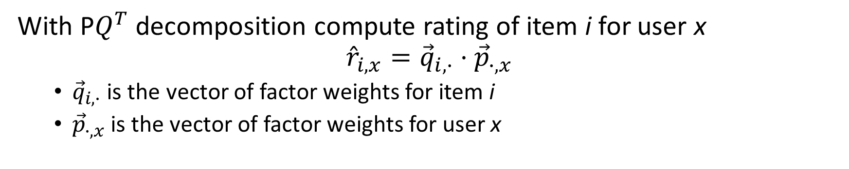



Latent Factor Recommenders
With P$Q^{T}$ decomposition compute rating of item i for user x
$${\hat{r}}_{i,x}={\vec{q}}_{i,∙}⋅{\vec{p}}_{∙,x}$$
${\vec{q}}_{i,∙}$ is the vector of factor weights for item i
${\vec{p}}_{∙,x}$is the vector of factor weights for user x
Users
Factors
Users
4 |  | 3 |  |  | 2
 | 5 | 4 |  | 2 |  | 1
2 |  |  | 5 |  | 5
 | 3 | 3 |  | ?
5 |  | 5
 | 3 |  | 5
2 | 4
 | 3 |  | 4
$$≈$$
$$×$$
Factors
$${\vec{q}}_{i,∙}$$
Items
Items
$${\vec{p}}_{∙,x}$$

Slide 71
Solving For Factor Weights

Slide 72
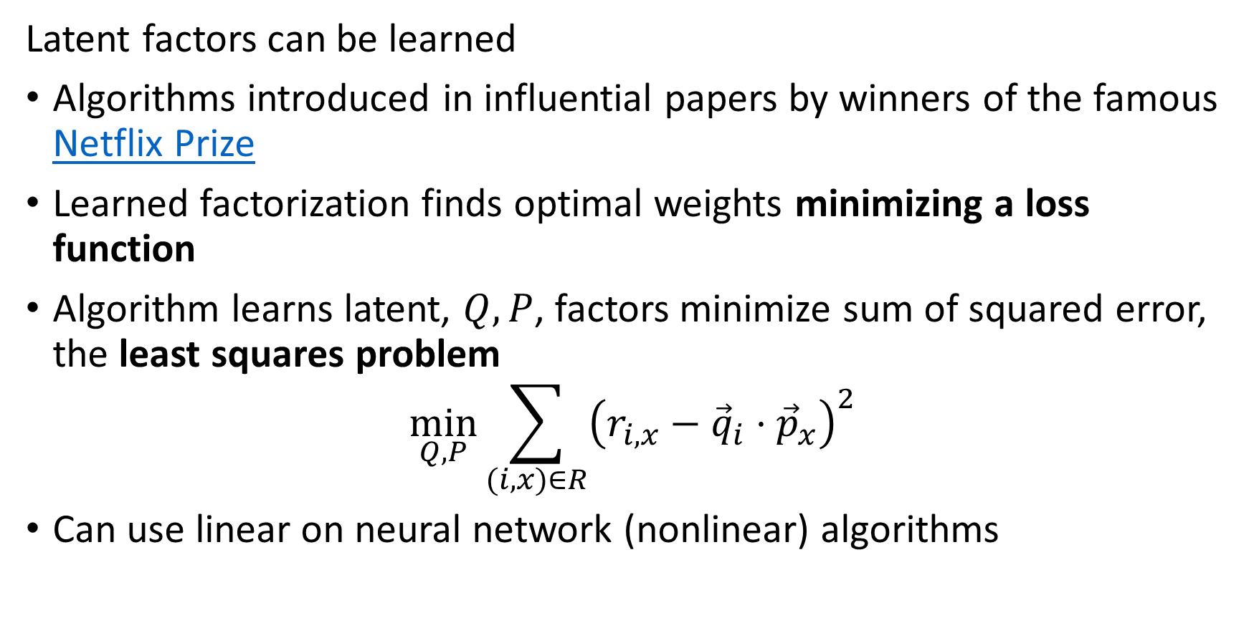
Latent Factor Recommenders
Latent factors can be learned
Algorithms introduced in influential papers by winners of the famous Netflix Prize
Learned factorization finds optimal weights minimizing a loss function
Algorithm learns latent, $Q, P$, factors minimize sum of squared error, the least squares problem
$$\min_{Q, P}{\sum_{(i,x)∈R}^{ }{{\left(r_{i,x}−{\vec{q}}_{i}⋅{\vec{p}}_{x}\right)}^{2}}}$$
Can use linear on neural network (nonlinear) algorithms

Slide 73
Recommender Systems
Collaborative filtering by machine learning
Figure from Revisiting Recommender Systems: An Investigative Survey. Ibrahim, et. al, 2025

Slide 74
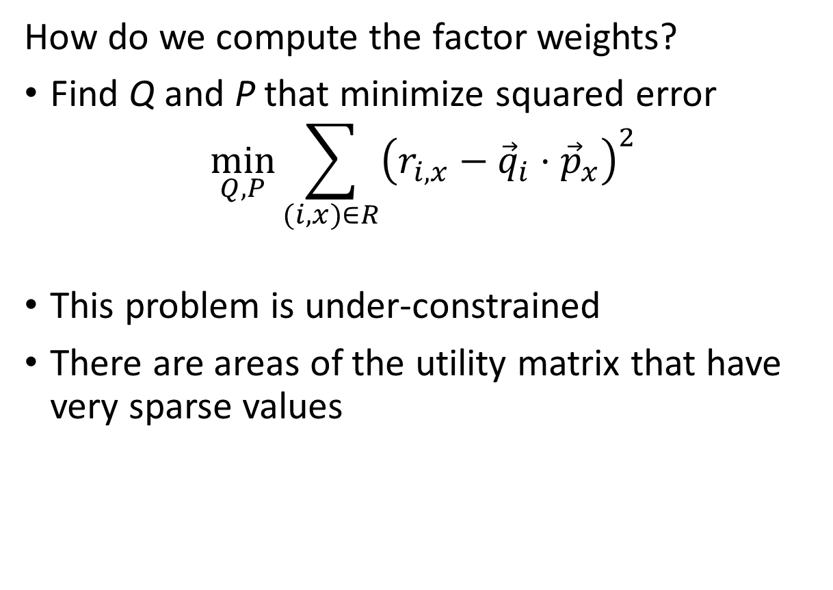
Latent Factor Recommenders
How do we compute the factor weights?
Find Q and P that minimize squared error
$$\min_{Q, P}{\sum_{(i,x)∈R}^{ }{{\left(r_{i,x}−{\vec{q}}_{i}⋅{\vec{p}}_{x}\right)}^{2}}}$$
This problem is under-constrained
There are areas of the utility matrix that have very sparse values
4 |  | 3 |  |  | 2
 | 5 | 4 |  | 2 |  | 1
2 |  |  | 5 |  | 5
 | 3 | 3
5 |  | 5
 | 3 |  | 5
2 | 4
 | 3 |  | 4
4 |  | 3 |  |  | 2
 | 5 | 4 |  | 2 |  | 1
2 |  |  | 5 |  | 5
 | 3 | 3
5 |  | 5
 | 3 |  | 5
2 | 4
 | 3 |  | 4

Slide 75
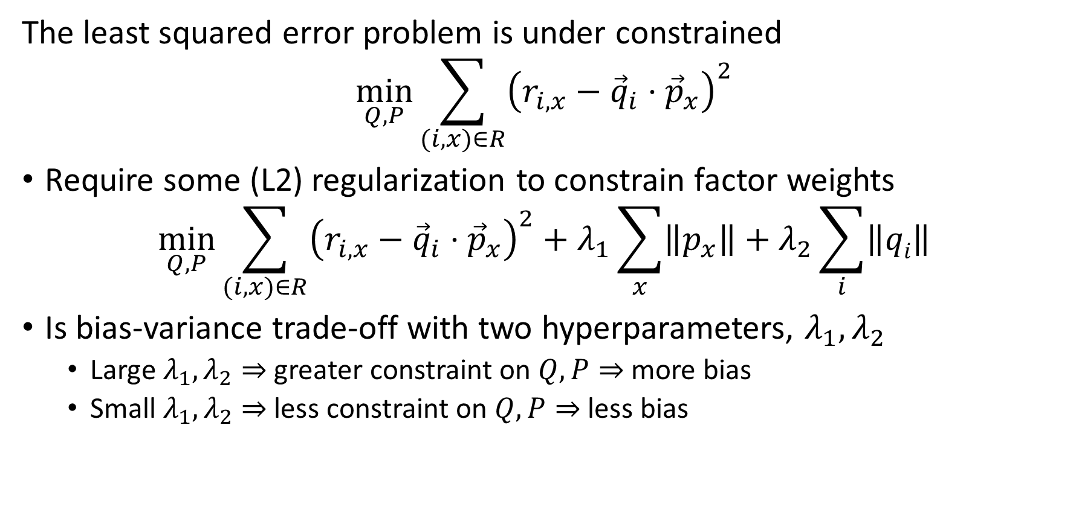
Latent Factor Recommenders
The least squared error problem is under constrained
$$\min_{Q, P}{\sum_{(i,x)∈R}^{ }{{\left(r_{i,x}−{\vec{q}}_{i}⋅{\vec{p}}_{x}\right)}^{2}}}$$
Require some (L2) regularization to constrain factor weights
$$\min_{Q, P}{\sum_{(i,x)∈R}^{ }{{\left(r_{i,x}−{\vec{q}}_{i}⋅{\vec{p}}_{x}\right)}^{2}+λ_{1}\sum_{x}{\left\|p_{x}\right\|}+λ_{2}\sum_{i}{\left\|qi\right\|}}}$$
Is bias-variance trade-off with two hyperparameters, $λ_{1},λ_{2}$
Large $λ_{1},λ_{2}⇒$ greater constraint on $Q,P⇒$ more bias
Small $λ_{1},λ_{2}⇒$ less constraint on $Q,P⇒$ less bias

Slide 76
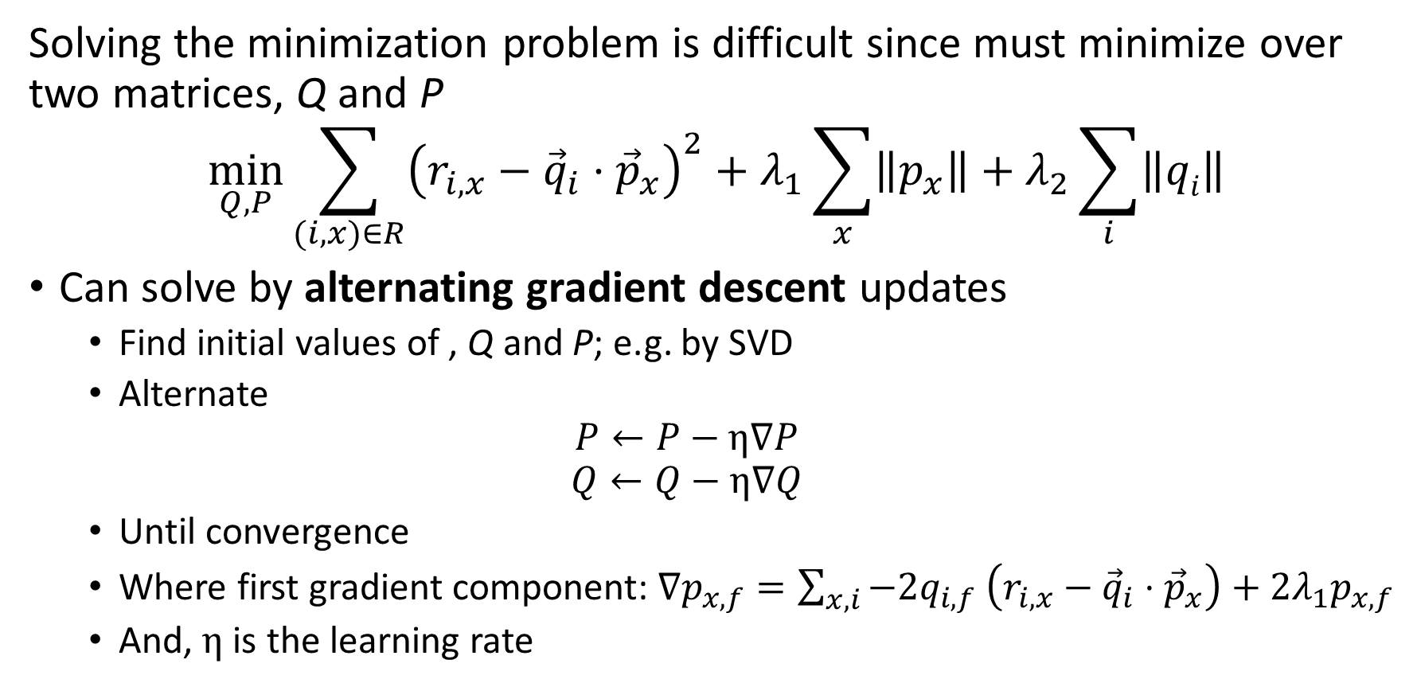
Latent Factor Recommenders
Solving the minimization problem is difficult since must minimize over two matrices, Q and P
$$\min_{Q, P}{\sum_{(i,x)∈R}^{ }{{\left(r_{i,x}−{\vec{q}}_{i}⋅{\vec{p}}_{x}\right)}^{2}+λ_{1}\sum_{x}{\left\|p_{x}\right\|}+λ_{2}\sum_{i}{\left\|qi\right\|}}}$$
Can solve by alternating gradient descent updates
Find initial values of , Q and P; e.g. by SVD
Alternate
$$P←P−η∇P$$
$$Q←Q−η∇Q$$
Until convergence
Where first gradient component: $∇p_{x,f}=\sum_{x,i}^{ }{−2q_{i,f}}$ $\left(r_{i,x}−{\vec{q}}_{i}⋅{\vec{p}}_{x}\right)+{2λ}_{1}p_{x,f}$
And, $η$ is the learning rate

Slide 77
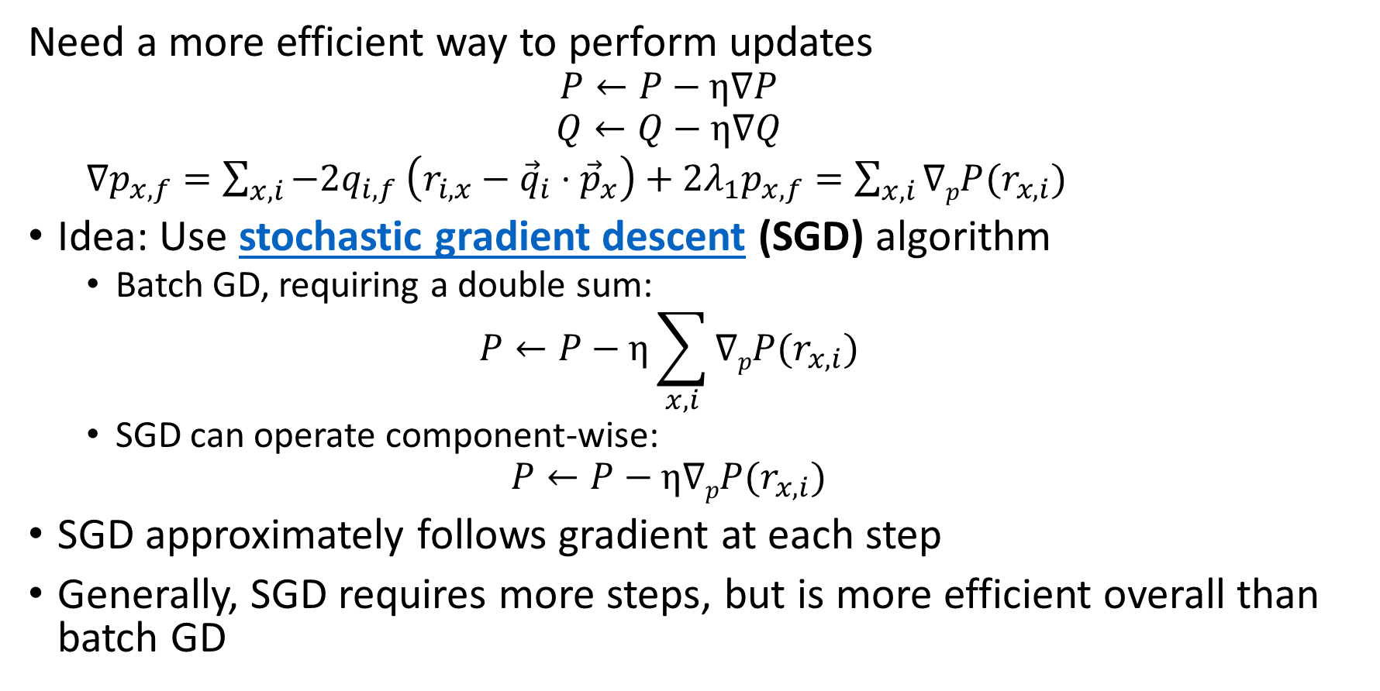
Latent Factor Recommenders
Need a more efficient way to perform updates
$$P←P−η∇P$$
$$Q←Q−η∇Q$$
$∇p_{x,f}=\sum_{x,i}^{ }{−2q_{i,f}}$ $\left(r_{i,x}−{\vec{q}}_{i}⋅{\vec{p}}_{x}\right)+{2λ}_{1}p_{x,f}=\sum_{x,i}^{ }{∇pP(r_{x,i})}$
Idea: Use stochastic gradient descent (SGD) algorithm
Batch GD, requiring a double sum:
$$P←P−η\sum_{x,i}^{ }{∇pP(r_{x,i})}$$
SGD can operate component-wise:
$$P←P−η∇pP(r_{x,i})$$
SGD approximately follows gradient at each step
Generally, SGD requires more steps, but is more efficient overall than batch GD

Slide 78
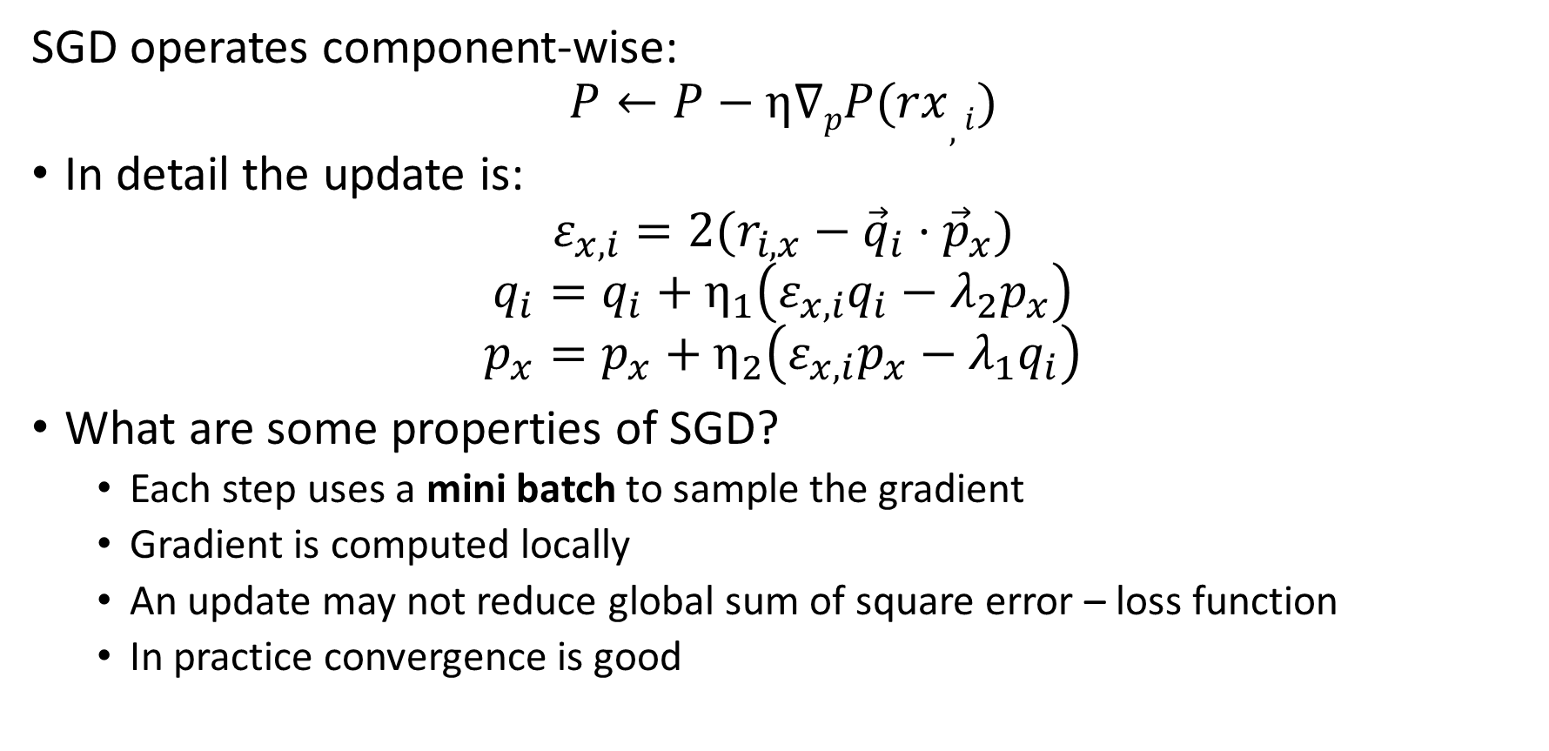
Latent Factor Recommenders
SGD operates component-wise:
$$P←P−η∇pP(rx,i)$$
In detail the update is:
$$ε_{x,i}=2(r_{i,x}−{\vec{q}}_{i}⋅{\vec{p}}_{x})$$
$$q_{i}=q_{i}+η_{1}\left(ε_{x,i}q_{i}−λ_{2}p_{x}\right)$$
$$p_{x}=p_{x}+η_{2}\left(ε_{x,i}p_{x}−λ_{1}q_{i}\right)$$
What are some properties of SGD?
Each step uses a mini batch to sample the gradient
Gradient is computed locally
An update may not reduce global sum of square error – loss function
In practice convergence is good

Slide 79
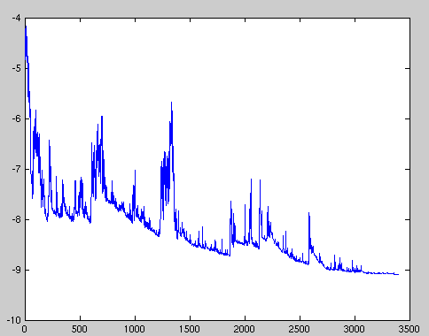
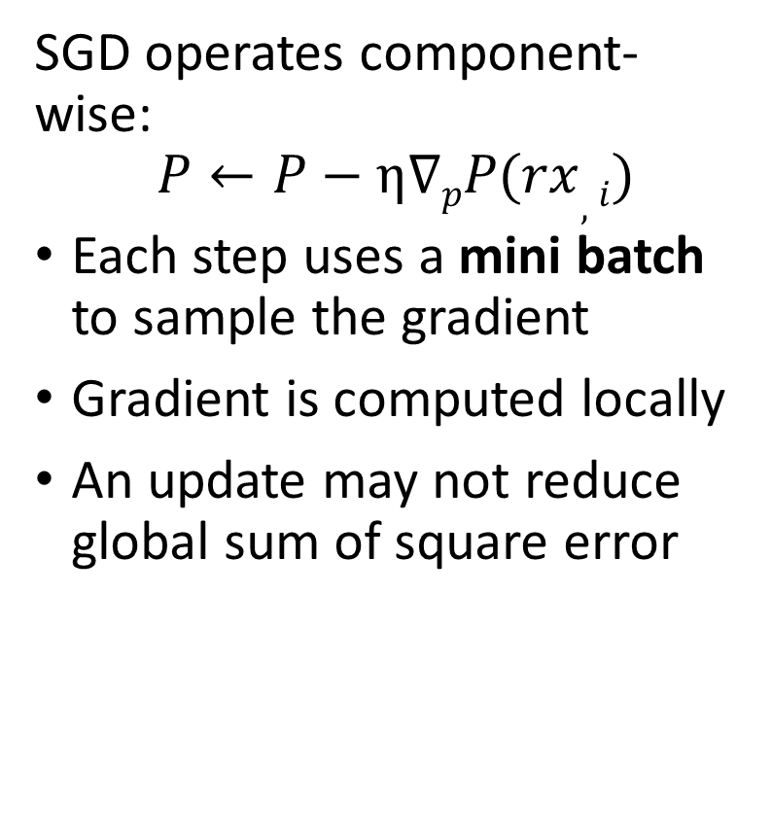
Latent Factor Recommenders
SGD operates component-wise:
$$P←P−η∇pP(rx,i)$$
Each step uses a mini batch to sample the gradient
Gradient is computed locally
An update may not reduce global sum of square error
Sum of Square Loss
Update steps – iterations
Credit: Wiki Commons

Slide 80
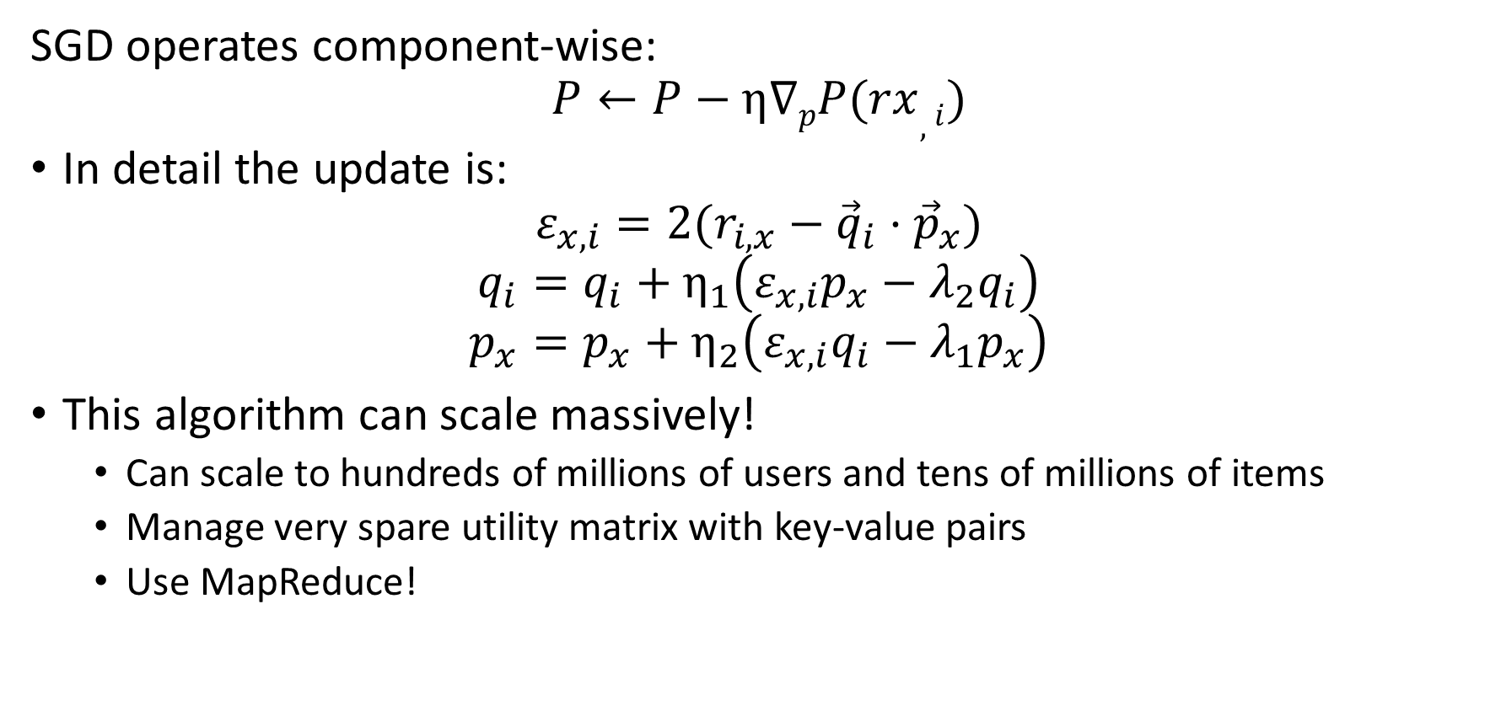
Latent Factor Recommenders
SGD operates component-wise:
$$P←P−η∇pP(rx,i)$$
In detail the update is:
$$ε_{x,i}=2(r_{i,x}−{\vec{q}}_{i}⋅{\vec{p}}_{x})$$
$$q_{i}=q_{i}+η_{1}\left(ε_{x,i}p_{x}−λ_{2}q_{i}\right)$$
$$p_{x}=p_{x}+η_{2}\left(ε_{x,i}q_{i}−λ_{1}p_{x}\right)$$
This algorithm can scale massively!
Can scale to hundreds of millions of users and tens of millions of items
Manage very spare utility matrix with key-value pairs
Use MapReduce!

Slide 81
Latent Factor Models with Baseline

Slide 82
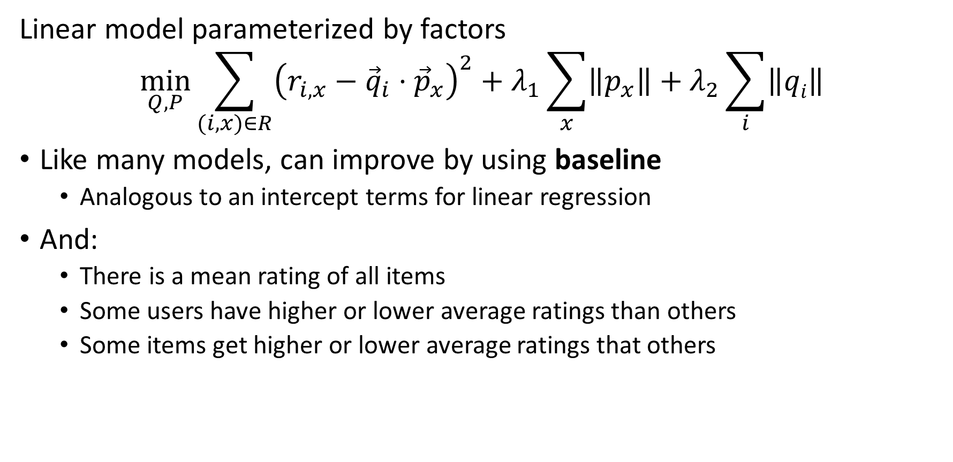
Latent Factor Recommenders
Linear model parameterized by factors
$$\min_{Q, P}{\sum_{(i,x)∈R}^{ }{{\left(r_{i,x}−{\vec{q}}_{i}⋅{\vec{p}}_{x}\right)}^{2}+λ_{1}\sum_{x}{\left\|p_{x}\right\|}+λ_{2}\sum_{i}{\left\|qi\right\|}}}$$
Like many models, can improve by using baseline
Analogous to an intercept terms for linear regression
And:
There is a mean rating of all items
Some users have higher or lower average ratings than others
Some items get higher or lower average ratings that others

Slide 83
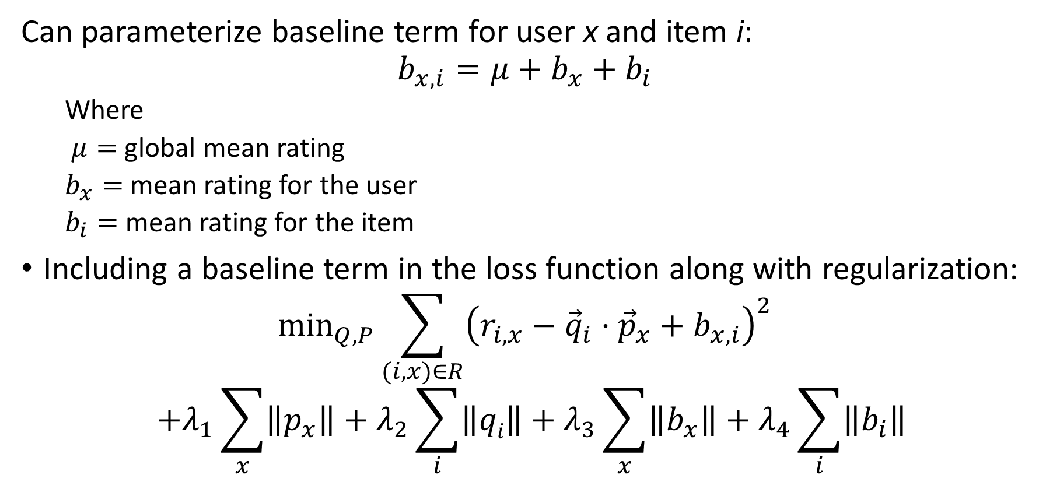
Latent Factor Recommenders
Can parameterize baseline term for user x and item i:
$$b_{x,i}={μ+b}_{x}+b_{i}$$
Where
$μ=$ global mean rating
$b_{x}=$ mean rating for the user
$b_{i}=$ mean rating for the item
Including a baseline term in the loss function along with regularization:
$$\min_{Q, P}{\sum_{(i,x)∈R}^{ }{{\left(r_{i,x}−{\vec{q}}_{i}⋅{\vec{p}}_{x}+b_{x,i}\right)}^{2}}}$$
$${+λ_{1}\sum_{x}{\left\|p_{x}\right\|}+λ_{2}\sum_{i}{\left\|qi\right\|}+λ_{3}\sum_{x}^{ }{\left\|b_{x}\right\|+λ_{4}\sum_{i}^{ }{\left\|b_{i}\right\|}}}$$

Slide 84
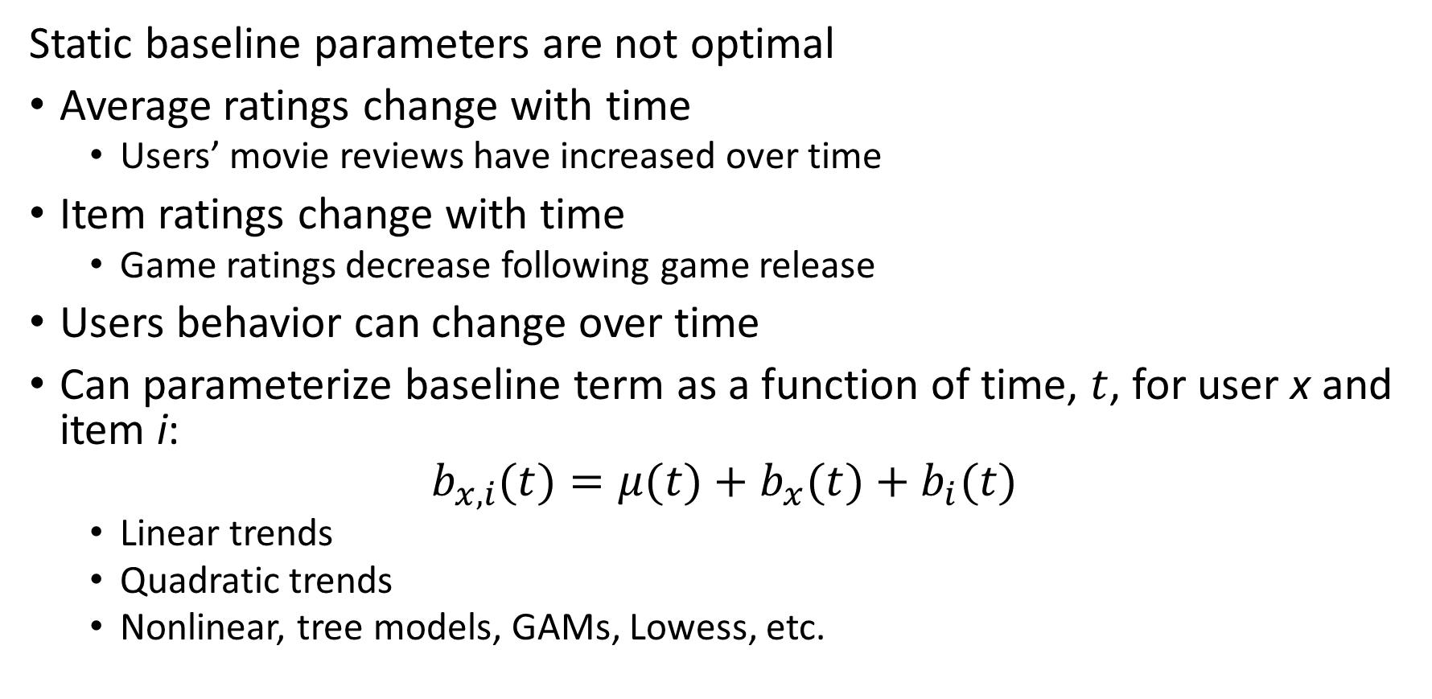
Latent Factor Recommenders
Static baseline parameters are not optimal
Average ratings change with time
Users’ movie reviews have increased over time
Item ratings change with time
Game ratings decrease following game release
Users behavior can change over time
Can parameterize baseline term as a function of time, $t$, for user x and item i:
$$b_{x,i}(t)={μ(t)+b}_{x}(t)+b_{i}(t)$$
Linear trends
Quadratic trends
Nonlinear, tree models, GAMs, Lowess, etc.

Slide 85
Latent Factor Recommenders
State of the art recommenders require additional baseline terms for context
Peoples’ opinions and tastes differ in many systematic ways
Regional differences
Product category differences
…
Can add baseline terms for observable context factors
Selection of factors is solution specific
May be time dependent
Neural recommender models have an advantage in dealing with the interactions

Slide 86
Embedding for Recommenders

Slide 87
Recommender Systems
Effective embeddings are essential for recommendations
Algorithms typically operate on features in an embedding space
Often use hash sketches
Learned embedding spaces
Good embeddings must have several properties
Uniqueness for each category embedded
Equal similarity between classes, to prevent bias
Reduction of high dimensionality, to reduce computation and memory use
High Shannon entropy, ensuring all dimensions of the embedding contain information

Slide 88
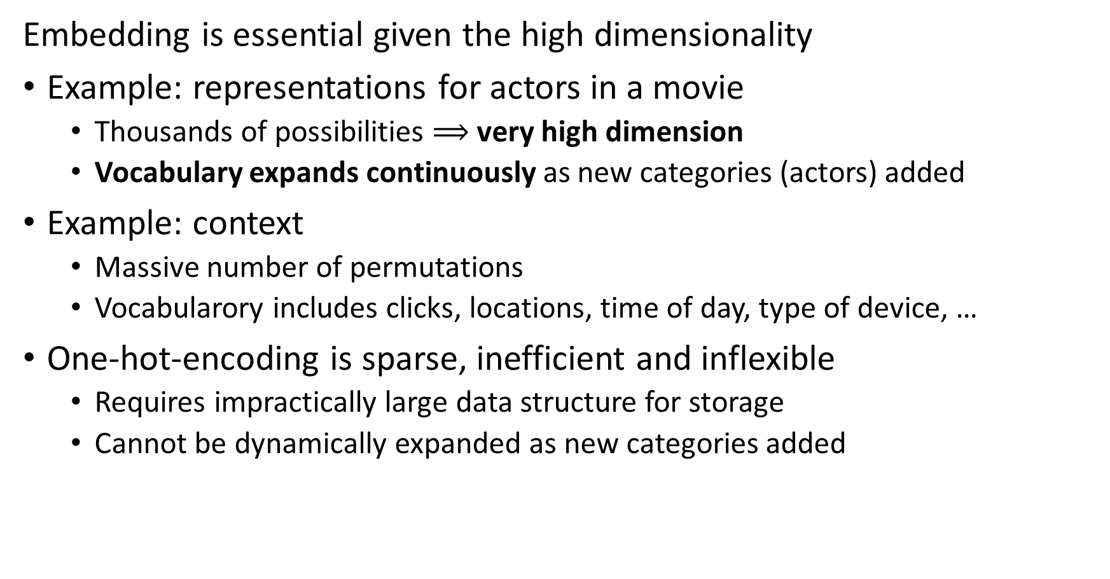
Embedding is Essential for Recommender Algorithms
Embedding is essential given the high dimensionality
Example: representations for actors in a movie
Thousands of possibilities $⟹$ very high dimension
Vocabulary expands continuously as new categories (actors) added
Example: context
Massive number of permutations
Vocabularory includes clicks, locations, time of day, type of device, …
One-hot-encoding is sparse, inefficient and inflexible
Requires impractically large data structure for storage
Cannot be dynamically expanded as new categories added

Slide 89
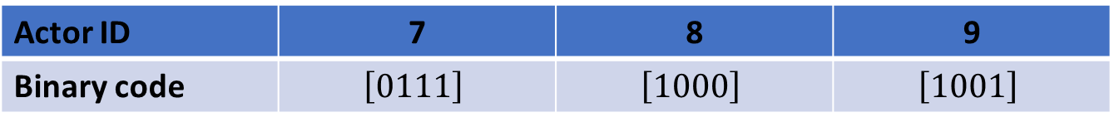
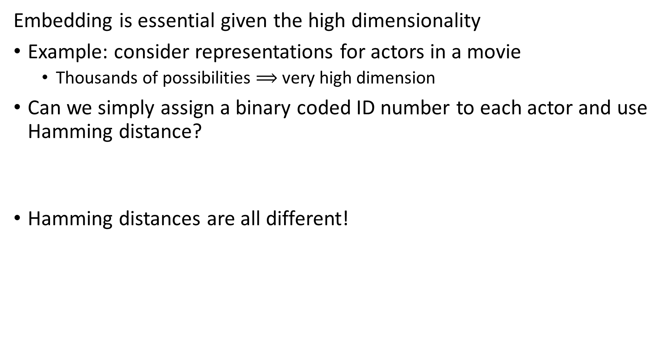
Embedding is Essential for Recommender Algorithms
Embedding is essential given the high dimensionality
Example: consider representations for actors in a movie
Thousands of possibilities $⟹$ very high dimension
Can we simply assign a binary coded ID number to each actor and use Hamming distance?
Hamming distances are all different!
Actor ID | 7 | 8 | 9
Binary code | $$\left[0111\right]$$ | $$\left[1000\right]$$ | $$\left[1001\right]$$
Actor ID | 7 | 8 | 9
7
8 | 4
9 | 3 | 1

Slide 90
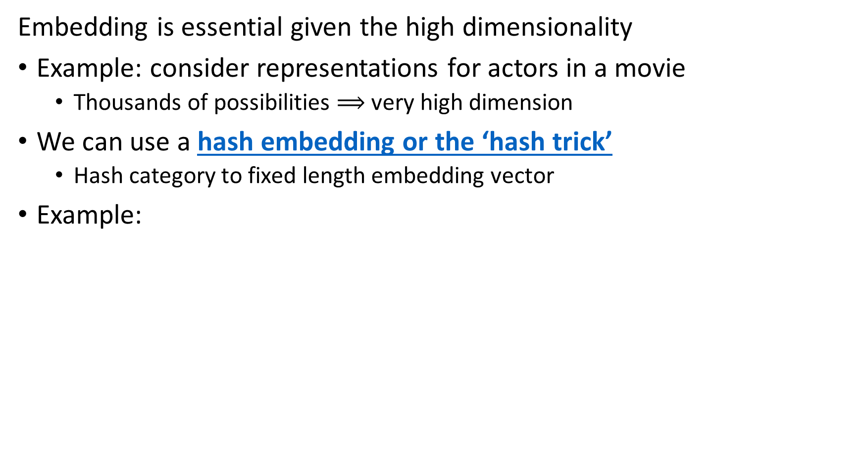

Embedding is Essential for Recommender Algorithms
Embedding is essential given the high dimensionality
Example: consider representations for actors in a movie
Thousands of possibilities $⟹$ very high dimension
We can use a hash embedding or the ‘hash trick’
Hash category to fixed length embedding vector
Example:
Category
Cat
Dog
Parrot
Gold Fish
Hamster
Category
Cat | 0 | 1 | 1 | 0 | 0
Dog | 1 | 0 | 0 | 1 | 1
Parrot | 1 | 1 | 1 | 0 | 1
Gold Fish | 0 | 1 | 1 | 1 | 0
Hamster | 0 | 0 | 1 | 1 | 1
Binary Hash Function h$\left(x\right)$

Slide 91
Embedding is Essential for Recommender Algorithms
Embedding is essential given the high dimensionality
We can use a hash embedding or the ‘hash trick’
Hash category to fixed length embedding vector
Hash collisions create non-uniqueness in coding features
How can we reduce hash collisions?
Use longer hash word
Use multiple hash functions
Randomize hash words by using binary sign hash multiplier – inner products become zero-centered
Feature hashing is well supported in many machine learninging packages including, Scikit-learn and TensorFlow (Keras)

Slide 92
Embedding is Essential for Recommender Algorithms
Embedding is essential given the high dimensionality
Hash trick has several limitations
Hash collisions reduce uniqueness
Hash values do not maintain high entropy, e.g. the information content of the hash word is low
To overcome these deficiencies, Zang, et. al., 2020, proposed deep hash embedding (DHE)

Slide 93
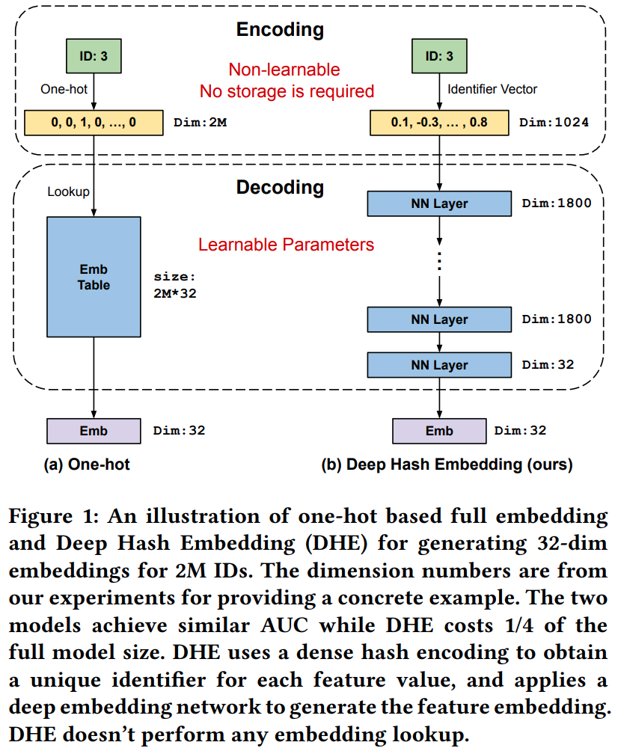
Embedding is Essential for Recommender Algorithms
Embedding is essential given the high dimensionality
Zang, et. al., 2020, proposed deep hash embedding (DHE)
DHE uses a deep neural network to learn optimal embeddings

Slide 94
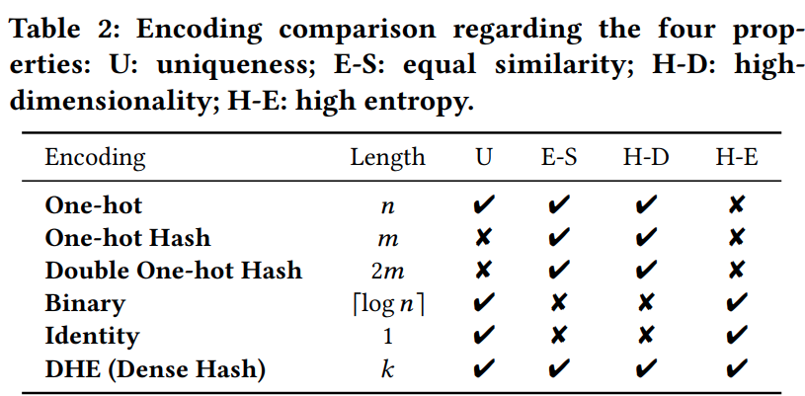
Embedding is Essential for Recommender Algorithms
Embedding is essential given the high dimensionality
Zang, et. al., 2020, proposed deep hash embedding (DHE)
DHE uses a deep neural network to learn optimal embeddings
DHE exhibits each of the optimal properties for feature hashing

Slide 95
Neural Collaborative Filtering

Slide 96
Neural Network Recommenders
Deep neural networks are having a significant impact on recommenders
Deep neural network algorithms compute complex embedding spaces
Interactions are common in recommender data
Example: user likes romantic comedy genre movies and with a specific actor
Example: a workman searches for a specific type of tool and favors a specific brand
Linear models cannot account for numerous interaction terms
Deep neural networks can learn complex feature interactions
Too many potential interaction for linear factor model

Slide 97
Recommender Systems
Neural network algorithms widely used for supervised collaborative filtering
Figure from Revisiting Recommender Systems: An Investigative Survey. Ibrahim, et. al, 2025

Slide 98
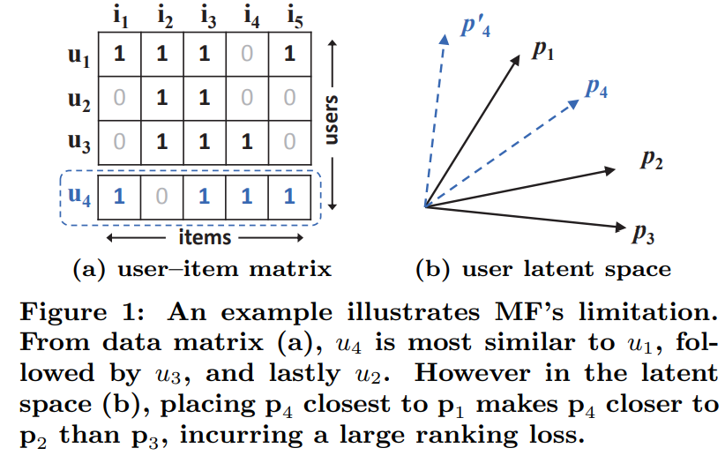
Neural Collaborative Filtering
Neural collaborative filtering, He et.al., 2017, uses a multi-layer perceptron to compute recommendation ranks
Why do we need non-linear collaborative filtering?
Interaction terms are inherently nonlinear
He, et. al., provide an example where binary coding of user features leads to misleading similarity, compared to Jaccard similarity
Correct ranking requires learning a nonlinear interaction with a neural network
From He, et. al., 2016

Slide 99
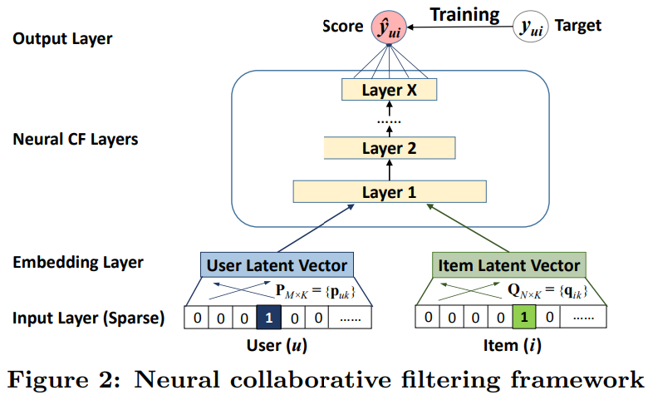
Neural Collaborative Filtering
Neural collaborative filtering, He et.al., 2017, uses a multi-layer perceptron to compute similarity and rank recommendations
Error (score) is minimized in training
Recommendation ranks computed with NN layers, including nonlinear interaction terms
User and item dense latent embedding vectors are computed
Inputs are sparse user and item identification vectors
From He, et. al., 2016

Slide 100
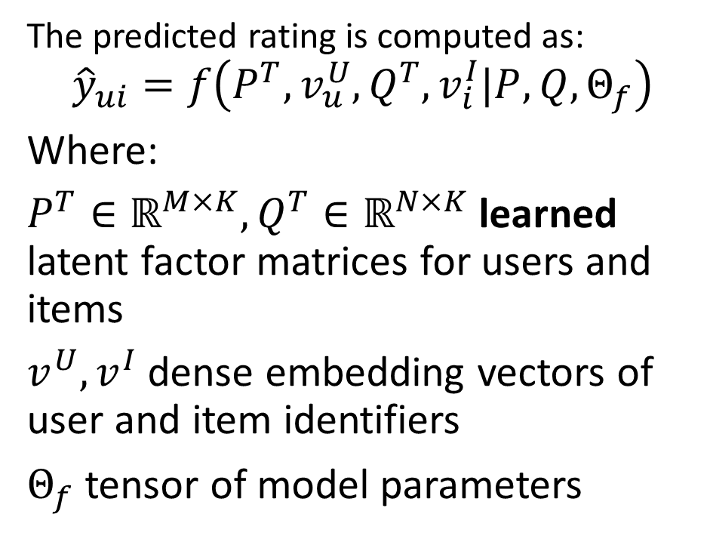
Neural Collaborative Filtering
Neural collaborative filtering, He et.al., 2016, uses a multi-layer perceptron to compute similarity and rank recommendations
The predicted rating is computed as:
$${\hat{y}}_{ui}=f\left(P^{T},v_{u}^{U},Q^{T},v_{i}^{I}|P,Q,Θ_{f}\right)$$
Where:
$P^{T}∈ℝ^{M×K},Q^{T}∈ℝ^{N×K}$ learned latent factor matrices for users and items
$v_{ }^{U}, v_{ }^{I}$ dense embedding vectors of user and item identifiers
$Θ_{f}$ tensor of model parameters
From He, et. al., 2016

Slide 101
Hybrid Models

Slide 102
Hybrid Recommenders
Can combine methods content-based and collaborative filtering methods
May improve performance if errors are reasonably uncorrelated
Possibly overcome cold start problem
Different models can help with cold start problem
Baseline estimates
Use clustering methods to find similar users and items
Early approach starts with semi-supervised (content-based) systems
Used by winners of the famous Netflix Prize
Initially use item profiles
Combine with matrix factorization results as more data acquired

Slide 103
Hybrid Recommenders
Improve recommender performance with hybrid collaborative filtering and content-based algorithms
Figure from Revisiting Recommender Systems: An Investigative Survey. Ibrahim, et. al, 2025

Slide 104
Hybrid Recommenders
Many hybrid recommender architectures proposed
Run independent recommenders and rank weighted sum of scores
An ensemble model
Recommender algorithms using both user or item collaborative and content information
Collaborative information (e.g. ratings) and context embedded
Content information embedded
Rank results of similarity search on joint (concatenated embeddings)

Slide 105






Hybrid Recommenders
Example: extending the utility matrix to include context and content information embeddings
Rating
User Profile
Context
Content Attributes
$$∙∙∙$$
$$∙∙∙$$
$$∙∙∙$$
Items
Rating
User Profile
Context
Content Attributes
Rating
User Profile
Context
Content Attributes
Rating
User Profile
Context
Content Attributes
Users
$$∙∙∙$$
$$∙∙∙$$
$$∙∙∙$$
Rating
User Profile
Context
Content Attributes
Rating
User Profile
Context
Content Attributes

Slide 106
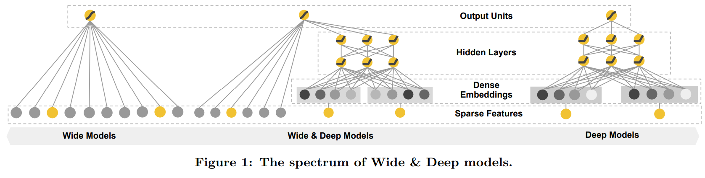
Wide and Deep Architectures
Wide and deep architecture, Chang, et. al., 2016, is a hybrid model combine neural encoding with linear matrix factorization
Linear model with wide sparse latent space and matrix factorization
Hybrid model uses linear matrix factorization for sparse latent features and neural network for dense latent feature
Nonlinear model with dense latent space and neural network
From Chang et. al., 2016

Slide 107
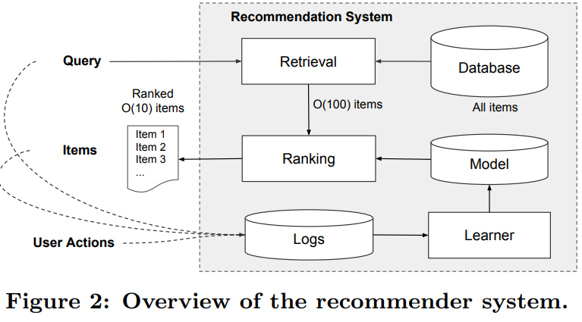
Wide and Deep Architectures
Wide and deep architecture, Chang, et. al., 2016, has 2 stages
Retrieval stage uses a hybrid of similarity search on query algorithms to generate candidates
Ranking stage assigns positions (ranks) to items for presentation to user
From Chang et. al., 2016

Slide 108
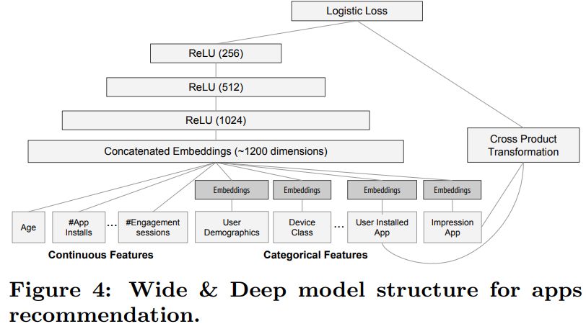
Wide and Deep Architectures
Wide and deep architecture, Chang, et. al., 2016 accommodates both sparse categorical and dense numeric features
Concatenated emedding encodes all features
Sparse features (e.g. categorical) require dense embedding, or hashing
Dense features (e.g. numeric) features require no embedding
From Chang et. al., 2016

Slide 109
Adversarial and Poisoning Attacks

Slide 110
Attacks on Recommenders Attempt to Bias Results
Recommender systems are subject to adversarial and poisoning attacks
Actors may wish to boost or depress ratings for various reasons
Commercial, to gain unfair advantage in the market place
Political and cultural, to boost or suppress certain points of view
Adversarial attacks aim to manipulate input data to temporarily deceive the system into producing inaccurate real-time inferences or predictions
More commonly, poisoning attacks aim to inject carefully crafted data into the model’s training data to fundamentally change the results
Real-world recommenders need to employ countermeasures

Slide 111
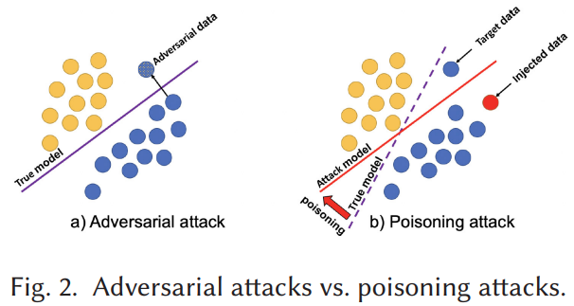
Attacks on Recommenders Attempt to Bias Results
Many complex paths for recommender poison attacks
Adversarial attacks temporarily manipulates input data to temporarily deceive the system
Poisoning attacks inject carefully crafted data into the model’s training data to fundamentally change the model results
Illustration from Nguyen, et. al., 2024

Slide 112
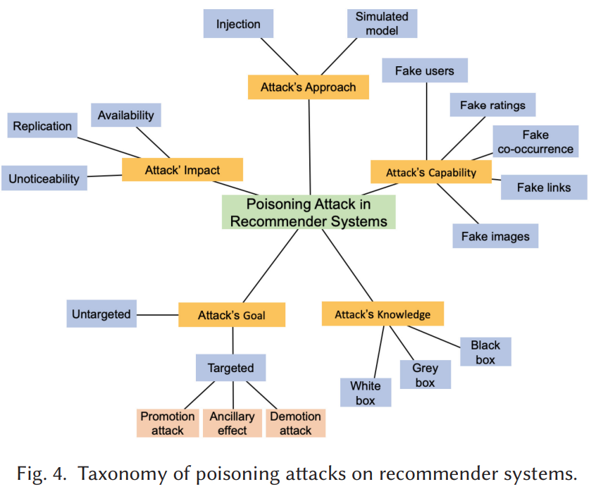
Attacks on Recommenders Attempt to Bias Results
Many complex paths for recommender poison attacks
Nguyen, et. al., 2024 have created a classification and nomenclature for poisoning attacks with dimensions
Attacker’s approach
Attacker’s capability
Attacker’s impact
Attacker’s goal
Attacker’s knowledge

Slide 113
Growing Literature on Recommender Attacks
Recent review papers focus on poisoning attacks
Manipulating Recommender Systems: A Survey of Poisoning Attacks and Countermeasures, Nguyen, et. al., 2024
Poisoning Attacks against Recommender Systems: A Survey, Wang, et. al., 2024

Slide 114
Advanced Neural Recommender Architectures

Slide 115
Advanced Neural Recommender Architectures
Recently recommender system researchers have tried many paths
The introduction of neural recommenders has led to many improvements
The two-tower model is now fairly standard
Query tower embeds the user queries
Item tower embeds item features
Methods like mixed negative sampling reduce inherent negative sampling bias
Ensemble recommenders attempt to average out errors and reduce position bias using multiple approaches

Slide 116
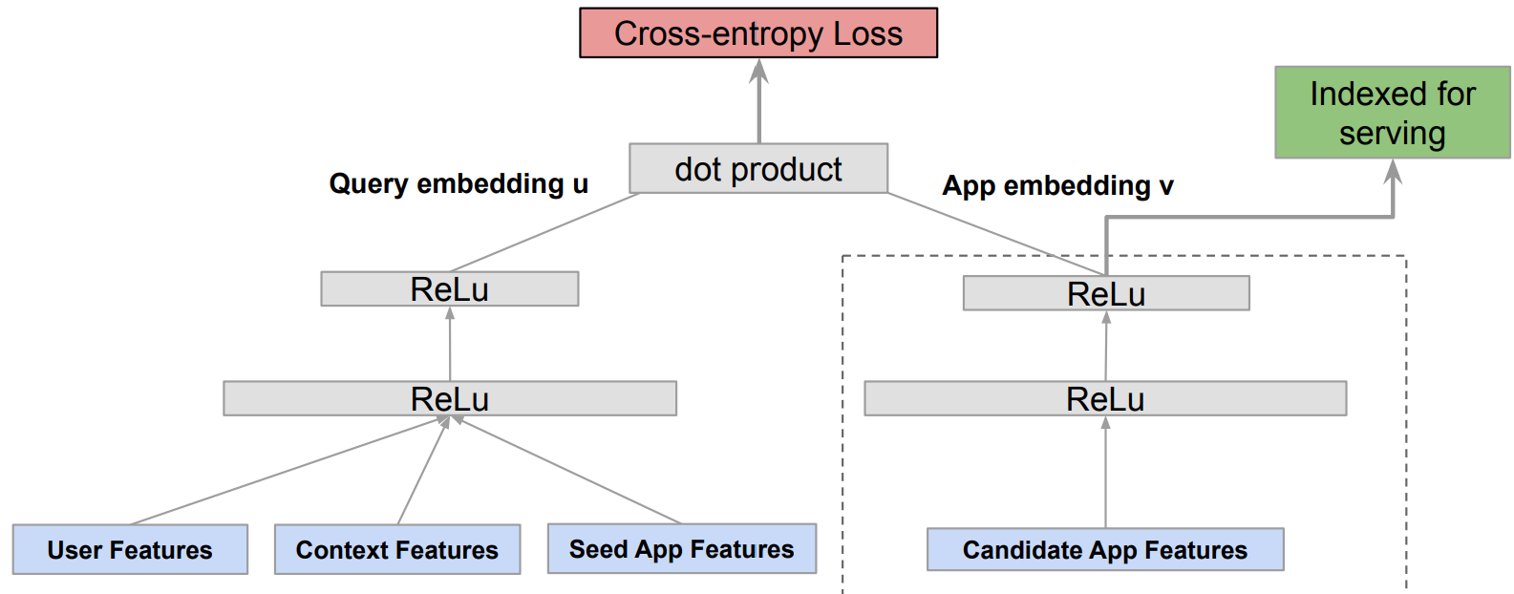
Two-Tower Architectures
Two-tower architectures are a prevalent in modern production recommenders
User query embedding
Item feature embedding
Architecture introduced by Zhao, et. al, 2019, for Google Play
Example, proposed by Yang et. al., 2020 of Google Research
Query tower
Item tower
From Yang et. al., 2020

Slide 117
Negative Sampling Bias Affects Recommender Training
Recommender data suffers from negative sampling bias
We only get feedback about actions users take
Never know why users do not take action
Only have positive results (clicks)
Example: consider a model with only binary response for an app store:
Value is 1 if user downloaded an app
Value is 0 if user did not download the app
If 1, we do not know if the user liked the app or not
If 0, we do not know if user did not want the app or never knew of its existence
Position bias arises from negative sampling bias

Slide 118
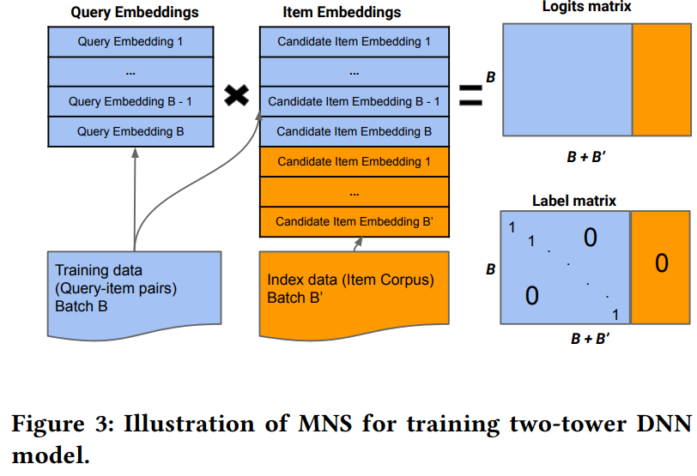
Mixed Negative Sampling
Yang, et. al., 2020 introduced mixed negative sampling (MNS) for dealing with the negative sampling bias
MNS adds a uniformly sampled stream of negative samples from the entire catalog (corpus)
Embeddings of additional negative samples are appended to item embeddings
Adding negative sample of size 2-3 x positive samples reduces negative sampling bias
From Yang et. al., 2020

Slide 119
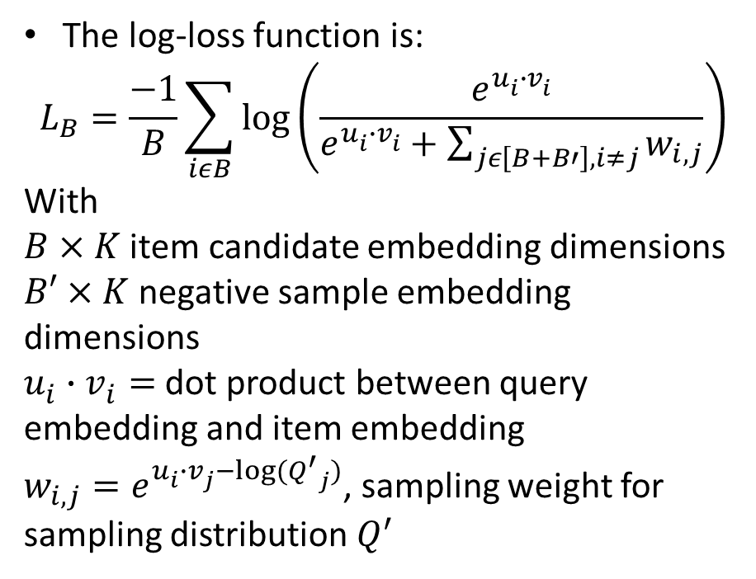
Mixed Negative Sampling
Yang, et. al., 2020 introduced mixed negative sampling (NMS) for dealing with the negative sampling bias
The log-loss function is:
$$L_{B}=\frac{−1}{B}\sum_{iεB}{\log\left(\frac{e^{u_{i}^{ }∙v_{i}^{ }}}{e^{u_{i}^{ }∙v_{i}^{ }}+\sum_{jε\left[B+B′\right], i≠j}{w_{i,j}}}\right)}$$
With
$B×K$ item candidate embedding dimensions
$B′×K$ negative sample embedding dimensions
$u_{i}^{ }∙v_{i}^{ }=$ dot product between query embedding and item embedding
$w_{i,j}=e^{u_{i}^{ }∙v_{j}^{ }−log⁡({Q^{′}}_{j})}$, sampling weight for sampling distribution $Q^{′}$
From Yang et. al., 2020

Slide 120
Position Bias Reduces Recommender Effectiveness
Click probability depends on the position in the search results
Items in the tail suffer position bias
Users typically do not see choices far down the list
We never know the probability of click through for some items
Popularity of the top items in the list is biased upward by frequent clicks
Bias propagates to new recommendation lists, increasing subsequent bias
Position bias leads to negative sampling bias

Slide 121
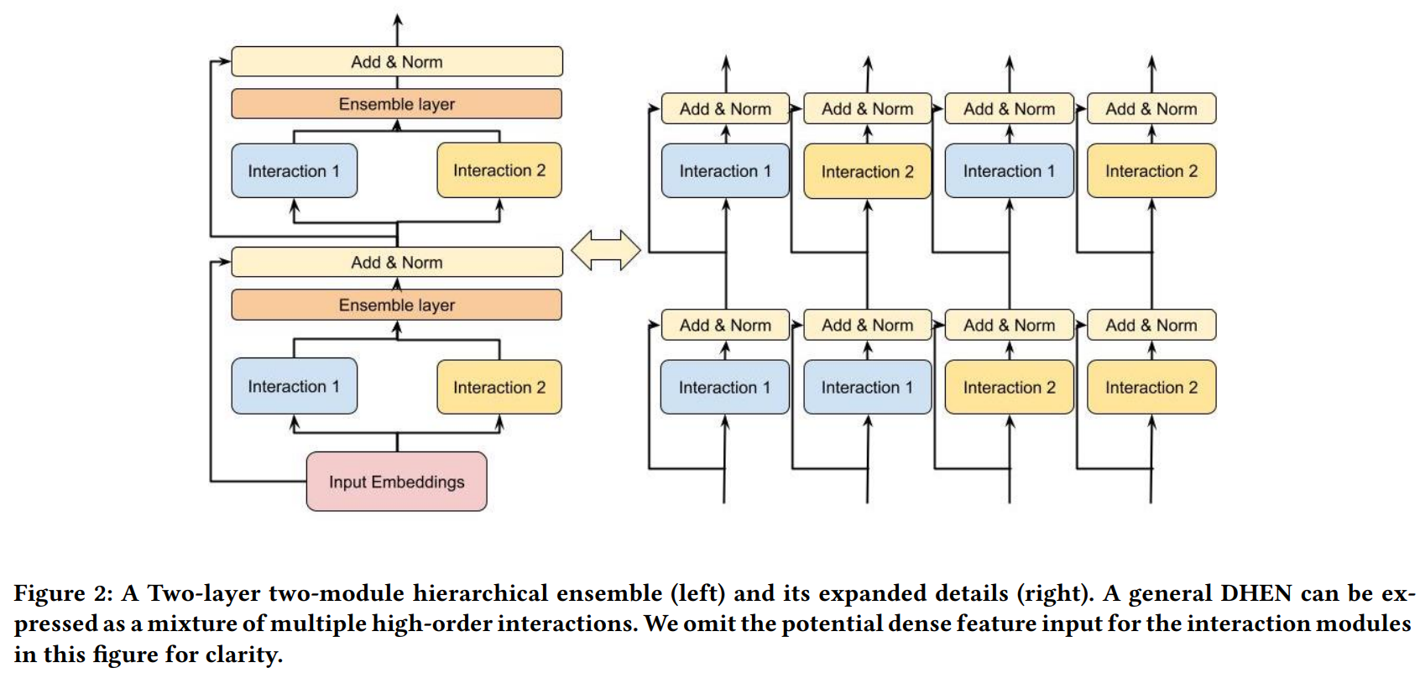
DHEN, Deep and Hierarchical Ensemble Recommender
Meta’s DHEN deep and hierarchical ensemble recommender, Zhang, et, al,2022, uses multiple similarity search algorithms in a two-stage, two-tower, architecture
DEHN architecture uses a hierarchy of several models for interactions for features in an embedding space
An NVIDIA team of Schifferer, et. al,. 2022 use a similar apprach
From Zhang et. al., 2022

Slide 122

DHEN, Deep and Hierarchical Ensemble Recommender
Zang, et. al., 2022, explore the causal relationship between the position tower and the relevance tower
Relevance tower performs similarity search on items and/or users
Observation tower computes position bias adjustment
Uses log information on user behavior and context
Adjusts ranking to limit position bias
From Zang et. al., 2022

Slide 123

DHEN, Deep and Hierarchical Ensemble Recommender
Zang, et. al., 2022, explore the causal relationship between the position tower and the relevance tower
Relevance tower performs similarity search on items and/or users assuming independence
But user actions are not independent of position with a causal relationship!
From Zang et. al., 2022

Slide 124


DHEN, Deep and Hierarchical Ensemble Recommender
Zang, et. al., 2022, explore the causal relationship between the position tower and the relevance tower
Zang, et. al., propose adding an adversarial label to the model
The reverse gradient is backpropagated into the position adjustment of the observation tower
$η$ is a learning rate hyperparameter
Provides unbiased learning to rank (ULTR) algorithm
From Zang et. al., 2022

Slide 125
Summary

Slide 126
Summary
Economic impact of recommenders is massive!
Online catalogs have a long tail
Many rarely purchased and reviewed items
Users will not find items in the tail without a recommender
Recommender algorithms connect users with items
Creating a good recommender algorithm for the real-world is hard!
People have complex and variable behavior
User ratings are not constant with time
Biases from position and negative sampling
Attacks on recommenders a growing problem
Cold start problem for new items
Cold start problem for new users

Slide 127
Summary
Many algorithms have been tried to find recommendations
Content based systems
Similarity search to find items with common properties
Related to frequent item set algorithms
Collaborative filtering
Based on similarity between items and between users
Widely used algorithms
Can be unsupervised or supervised
Linear and nonlinear (neural) algorithms widely employed
Has cold-start problem

Slide 128

Summary
Latent factor methods are powerful models
Decompose utility matrix into item and user latent factors, PQ^{T}
Efficiently learn factor weights with SGD
Predict missing ratings by product PQ^{T}
Improve with baseline functions
Average rating
Average user rating
Average item rating
Evaluate recommenders
RMSE
${Recall}_{@K}$, ${Precision}_{@K}$
Can perform cross validation

