Slide 1

CSCI E-108
Data Mining, Exploration and
Discovery
Learning to Rank and Recommender Algorithms
Steve Elston
Copyright 2020, 2021, 2022, 2023, 2024, 2025, 2026, Stephen F Elston. All rights reserved.

Slide 2
Main topics in this course
The main topics in this course are interconnected and build on each other
1. Hashing and K-V pair management
2. Distance and Similarity Metrics
3. Graph Algorithms
Foundations
Core Algorithms
2. Dimensionality Reduction
5. Similarity Search and NN Algorithms
4. Online Algorithms
3. Social Network Analysis
6. Web/Document ranking and search
7. Recommender Algorithms
8. Clustering Algorithms
Taks Speific Algorithms

Slide 3
Why Recommender Systems?
Catalogs of user choices are growing
Users need recommendations to navigate these vast choices
Many areas require recommendations
  Physical products
  Social media
  Hospitality – Hotels, restaurants,…
  Books
  News articles
  Music
  Movies and TV shows
  App stores
  Matching people with required job skills
  …
Economic impact of recommenders is massive!

Slide 4
Why Recommender Systems?
Catalogs of user choices are growing
In the physical world user choice is limited to small number of items
  Items on the shelves of a store
  News articles printed on paper
  Books in a book store
  Music in a music store
  People submitting paper resumes for a job
  Movies at a theater
  …
But, in the online word the choices are nearly limitless
  Choice is no longer limited by physical constraints
  Most of the choices are rarely purchased
  Users will rarely find these choices on their own
  This is known as the long tail

Slide 5
Why Recommender Systems?
With large catalogs there are many items which are obscure and rarely purchased
Users unlikely to find rarely purchased items without recommender
Probability of Finding Item
Items commonly purchased
Items rarely purchased
Frequency of purchase

Slide 6
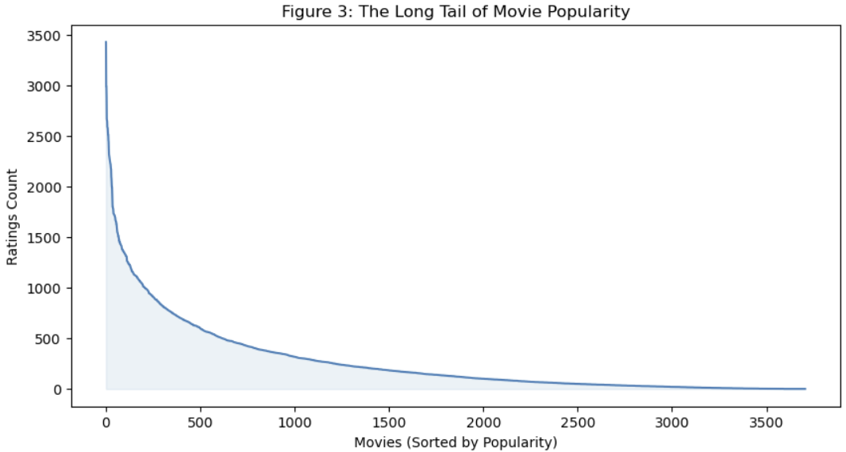
Why Recommender Systems?
Example of long tail from MovieLens 1M
Figure provided by Humphry Lim.

Slide 7
Latent Variable Models

Slide 8
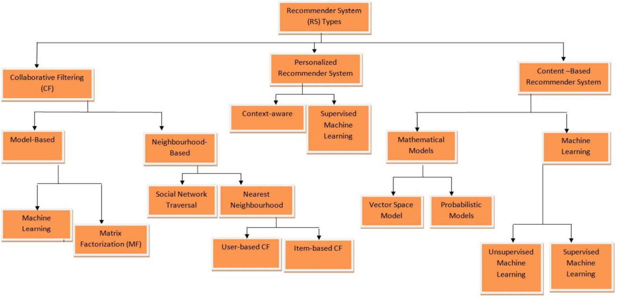
Recommender Systems
Collaborative filtering by unsupervised matrix factorization
Figure from Revisiting Recommender Systems: An Investigative Survey. Ibrahim, et. al, 2025

Slide 9
Latent Factor Recommenders
Latent factor recommenders are powerful machine learning models
Latent variables are low-dimensional and dense embedding of the spare response data
  Unsupervised
  Supervised
Data values can be dense or sparse
  Example, numeric features and vectors are typically dense
  Categorical features with high dimensionality are sparsely coded
Negative sampling bias results in few negative responses
  Imbalanced training cases
An embedding space used to overcome these problems
  Embedding spaces contain latent factors
  Latent factors that are not observable

Slide 10
Latent Factor Recommenders
Latent factor recommenders are powerful models
Here we focus on unsupervised non-negative matrix decomposition of the utility matrix
Compute missing ratings from matrix decomposition
But, need a trick!
  Utility matrix is not square: e.g. n users wide by m items tall
  Typically, m < n, or sometimes n < m
  Many missing values, negative sample bias
  Standard SVD biased by 0 filling

Slide 11
Latent Factor Recommenders
Latent factor recommenders are powerful models
What are factor models?
Statistical factor models attempt to explain data
  Factors define a low-dimensional embedding space
  Embeddings are explanatory factors
  Algorithm learns factor weights
Unobservable factors are called latent factors
  Latent since these factors cannot be observed
  Factors weights learned from observed data

Slide 12
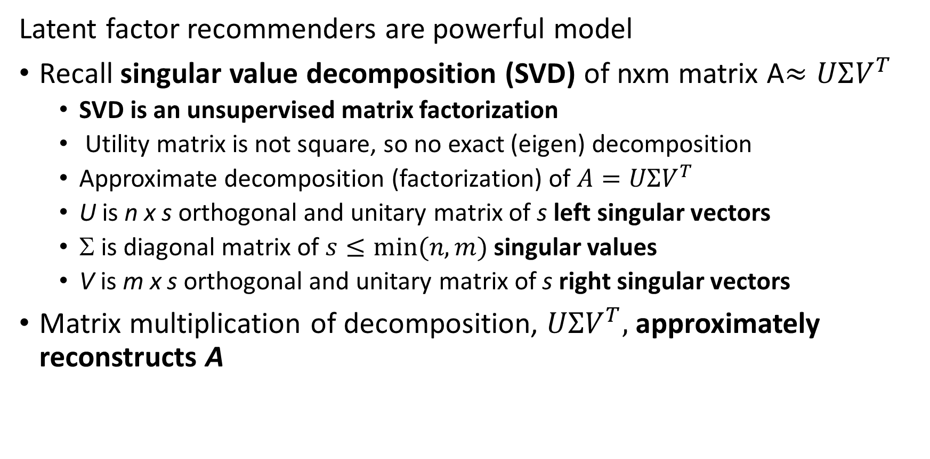
Latent Factor Recommenders
Latent factor recommenders are powerful model
Recall singular value decomposition (SVD) of nxm matrix A$≈UΣV^{T}$
  SVD is an unsupervised matrix factorization
  Utility matrix is not square, so no exact (eigen) decomposition
  Approximate decomposition (factorization) of $A=UΣV^{T}$
  U is n x s orthogonal and unitary matrix of s left singular vectors
  Σ is diagonal matrix of $s≤min⁡(n,m)$ singular values
  V is m x s orthogonal and unitary matrix of s right singular vectors
Matrix multiplication of decomposition, $UΣV^{T},$ approximately reconstructs A

Slide 13



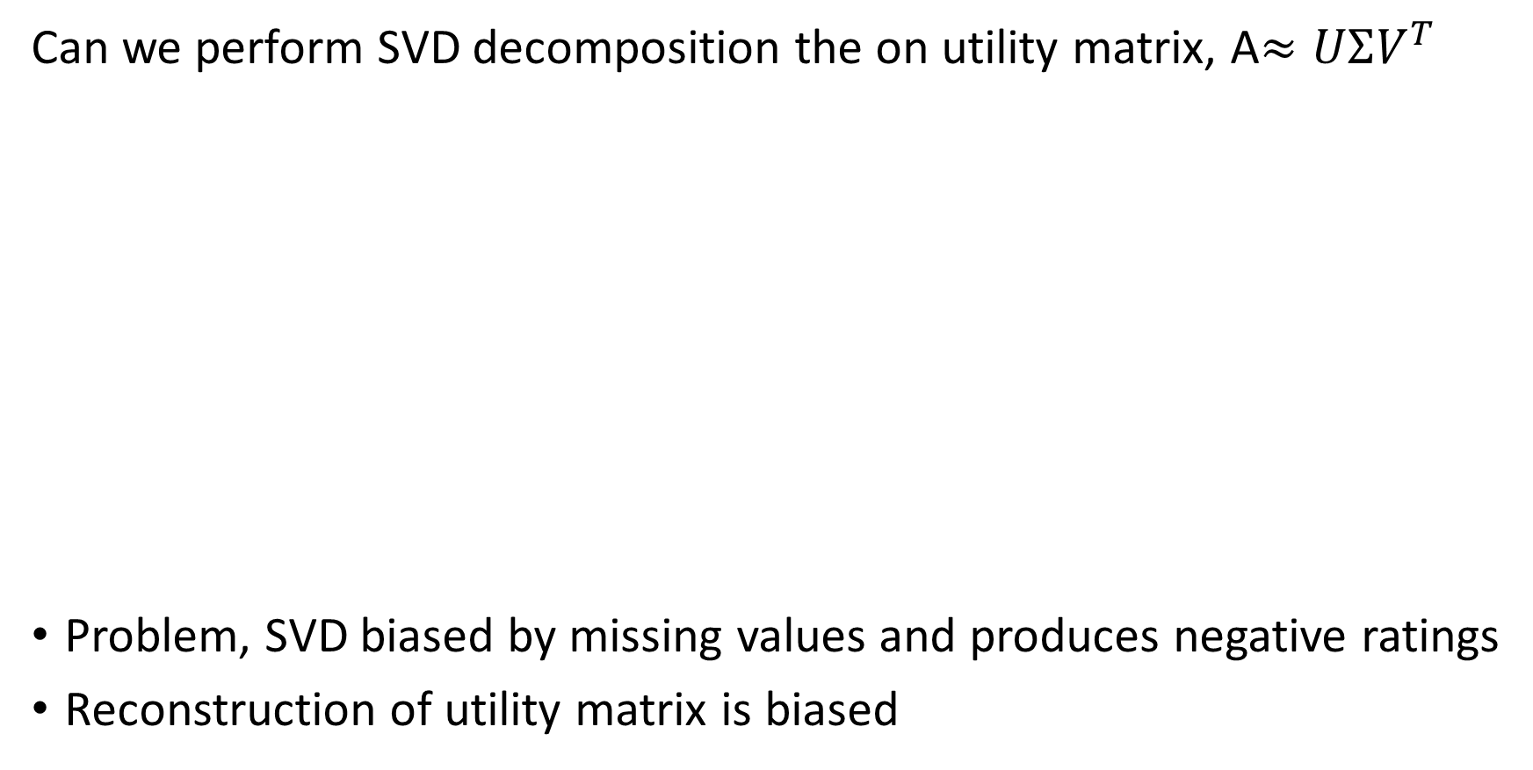



Latent Factor Recommenders
Can we perform SVD decomposition the on utility matrix, A$≈UΣV^{T}$
Problem, SVD biased by missing values and produces negative ratings
Reconstruction of utility matrix is biased
Users
$$U$$
$$∑$$
$$VT$$
4 |  | 3 |  |  | 2
 | 5 | 4 |  | 2 |  | 1
2 |  |  | 5 |  | 5
 | 3 | 3
5 |  | 5
 | 3 |  | 5
2 | 4
 | 3 |  | 4
$$×$$
$$×$$
$$≈$$
Items

Slide 14

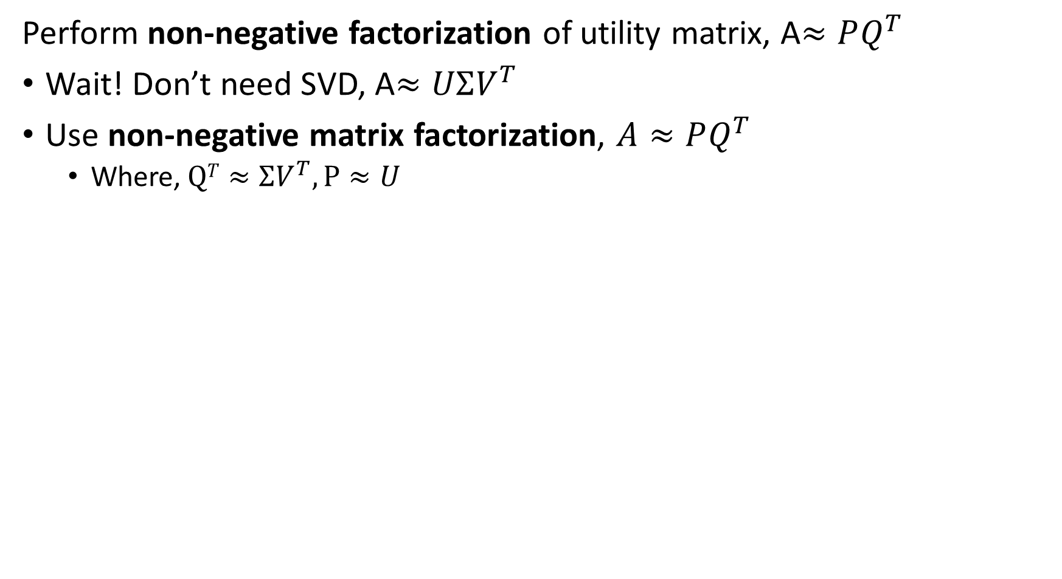

Latent Factor Recommenders
Perform non-negative factorization of utility matrix, A$≈PQ^{T}$
Wait! Don’t need SVD, A$≈UΣV^{T}$
Use non-negative matrix factorization, $A≈PQ^{T}$
  Where,$QT≈ΣV^{T},P≈U$
Users
Factors
Users
4 |  | 3 |  |  | 2
 | 5 | 4 |  | 2 |  | 1
2 |  |  | 5 |  | 5
 | 3 | 3
5 |  | 5
 | 3 |  | 5
2 | 4
 | 3 |  | 4
$$≈$$
$$×$$
Factors
Items
Items

Slide 15

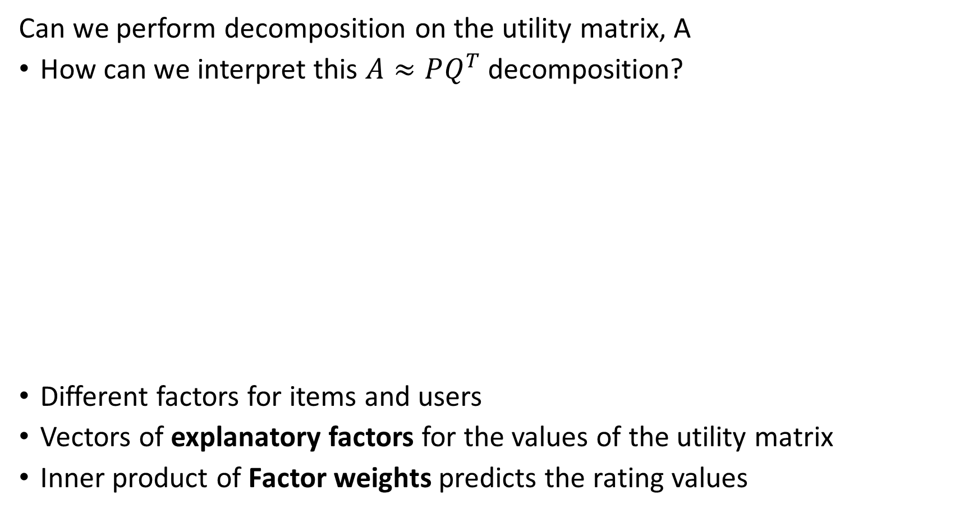

Latent Factor Recommenders
Can we perform decomposition on the utility matrix, A
How can we interpret this $A≈PQ^{T}$ decomposition?
Different factors for items and users
Vectors of explanatory factors for the values of the utility matrix
Inner product of Factor weights predicts the rating values
Users
Factors
Users
4 |  | 3 |  |  | 2
 | 5 | 4 |  | 2 |  | 1
2 |  |  | 5 |  | 5
 | 3 | 3
5 |  | 5
 | 3 |  | 5
2 | 4
 | 3 |  | 4
$$≈$$
$$×$$
Factors
Items
Items

Slide 16

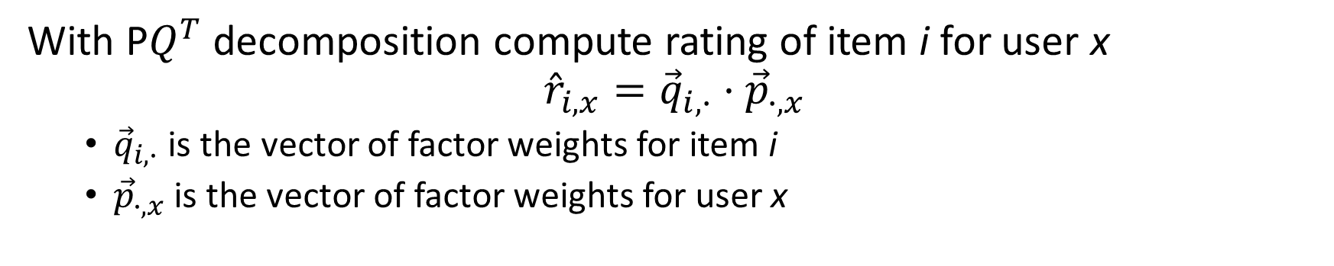



Latent Factor Recommenders
With P$Q^{T}$ decomposition compute rating of item i for user x
$${\hat{r}}_{i,x}={\vec{q}}_{i,∙}⋅{\vec{p}}_{∙,x}$$
  ${\vec{q}}_{i,∙}$ is the vector of factor weights for item i
  ${\vec{p}}_{∙,x}$is the vector of factor weights for user x
Users
Factors
Users
4 |  | 3 |  |  | 2
 | 5 | 4 |  | 2 |  | 1
2 |  |  | 5 |  | 5
 | 3 | 3 |  | ?
5 |  | 5
 | 3 |  | 5
2 | 4
 | 3 |  | 4
$$≈$$
$$×$$
Factors
$${\vec{q}}_{i,∙}$$
Items
Items
$${\vec{p}}_{∙,x}$$

Slide 17
Solving For Factor Weights

Slide 18
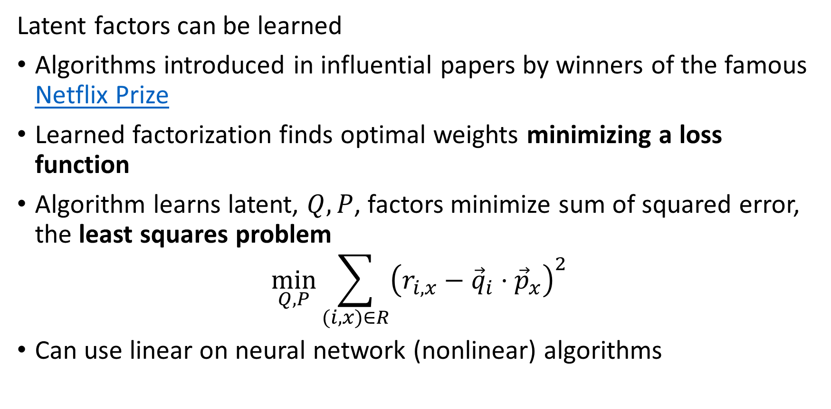
Latent Factor Recommenders
Latent factors can be learned
Algorithms introduced in influential papers by winners of the famous Netflix Prize
Learned factorization finds optimal weights minimizing a loss function
Algorithm learns latent, $Q, P$, factors minimize sum of squared error, the least squares problem
$$\min_{Q, P}{\sum_{(i,x)∈R}^{ }{{\left(r_{i,x}−{\vec{q}}_{i}⋅{\vec{p}}_{x}\right)}^{2}}}$$
Can use linear on neural network (nonlinear) algorithms

Slide 19
Recommender Systems
Collaborative filtering by machine learning
Figure from Revisiting Recommender Systems: An Investigative Survey. Ibrahim, et. al, 2025

Slide 20
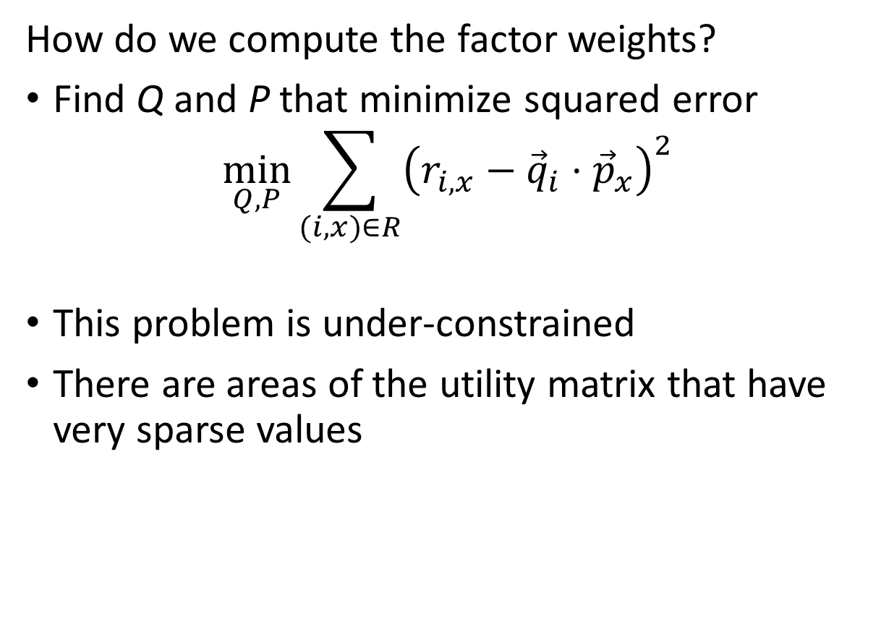
Latent Factor Recommenders
How do we compute the factor weights?
Find Q and P that minimize squared error
$$\min_{Q, P}{\sum_{(i,x)∈R}^{ }{{\left(r_{i,x}−{\vec{q}}_{i}⋅{\vec{p}}_{x}\right)}^{2}}}$$
This problem is under-constrained
There are areas of the utility matrix that have very sparse values
4 |  | 3 |  |  | 2
 | 5 | 4 |  | 2 |  | 1
2 |  |  | 5 |  | 5
 | 3 | 3
5 |  | 5
 | 3 |  | 5
2 | 4
 | 3 |  | 4
4 |  | 3 |  |  | 2
 | 5 | 4 |  | 2 |  | 1
2 |  |  | 5 |  | 5
 | 3 | 3
5 |  | 5
 | 3 |  | 5
2 | 4
 | 3 |  | 4

Slide 21
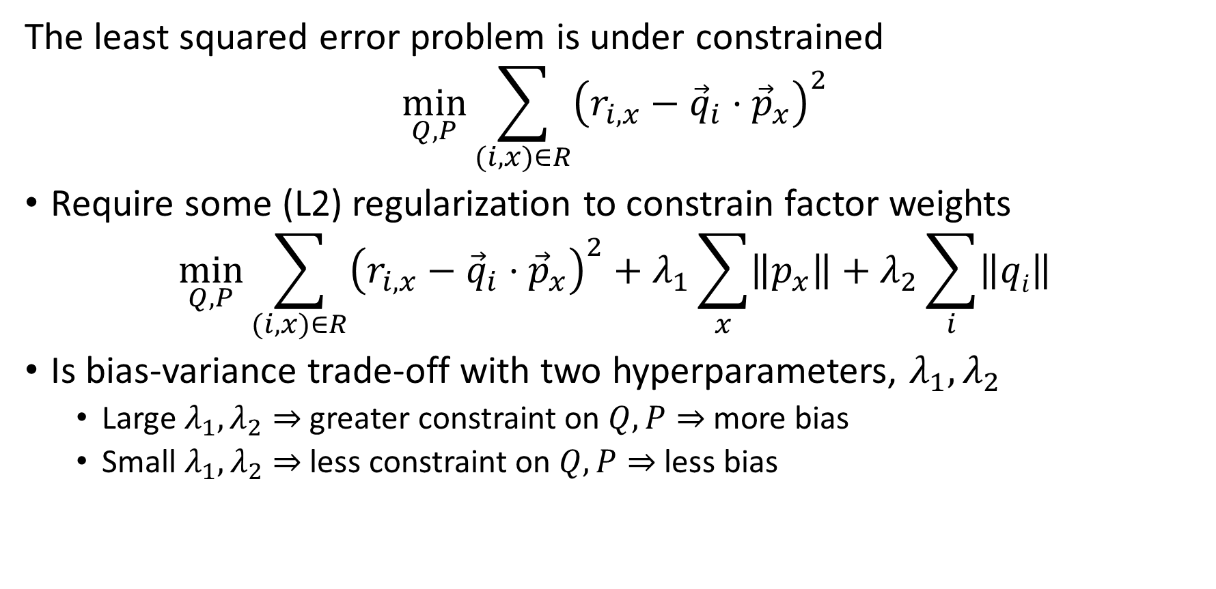
Latent Factor Recommenders
The least squared error problem is under constrained
$$\min_{Q, P}{\sum_{(i,x)∈R}^{ }{{\left(r_{i,x}−{\vec{q}}_{i}⋅{\vec{p}}_{x}\right)}^{2}}}$$
Require some (L2) regularization to constrain factor weights
$$\min_{Q, P}{\sum_{(i,x)∈R}^{ }{{\left(r_{i,x}−{\vec{q}}_{i}⋅{\vec{p}}_{x}\right)}^{2}+λ_{1}\sum_{x}{\left\|p_{x}\right\|}+λ_{2}\sum_{i}{\left\|qi\right\|}}}$$
Is bias-variance trade-off with two hyperparameters, $λ_{1},λ_{2}$
  Large $λ_{1},λ_{2}⇒$ greater constraint on $Q,P⇒$ more bias
  Small $λ_{1},λ_{2}⇒$ less constraint on $Q,P⇒$ less bias

Slide 22
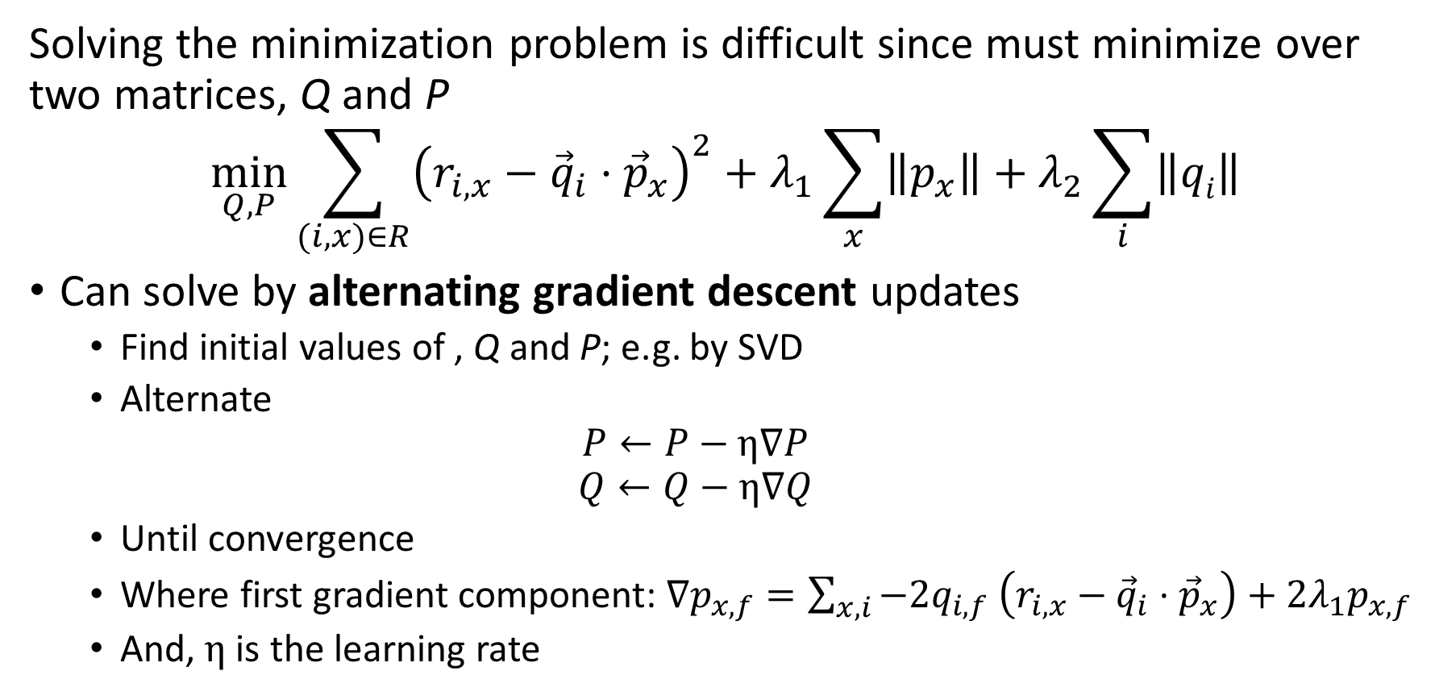
Latent Factor Recommenders
Solving the minimization problem is difficult since must minimize over two matrices, Q and P
$$\min_{Q, P}{\sum_{(i,x)∈R}^{ }{{\left(r_{i,x}−{\vec{q}}_{i}⋅{\vec{p}}_{x}\right)}^{2}+λ_{1}\sum_{x}{\left\|p_{x}\right\|}+λ_{2}\sum_{i}{\left\|qi\right\|}}}$$
Can solve by alternating gradient descent updates
  Find initial values of , Q and P; e.g. by SVD
  Alternate
  $$P←P−η∇P$$
  $$Q←Q−η∇Q$$
  Until convergence
  Where first gradient component: $∇p_{x,f}=\sum_{x,i}^{ }{−2q_{i,f}}$ $\left(r_{i,x}−{\vec{q}}_{i}⋅{\vec{p}}_{x}\right)+{2λ}_{1}p_{x,f}$
  And, $η$ is the learning rate

Slide 23
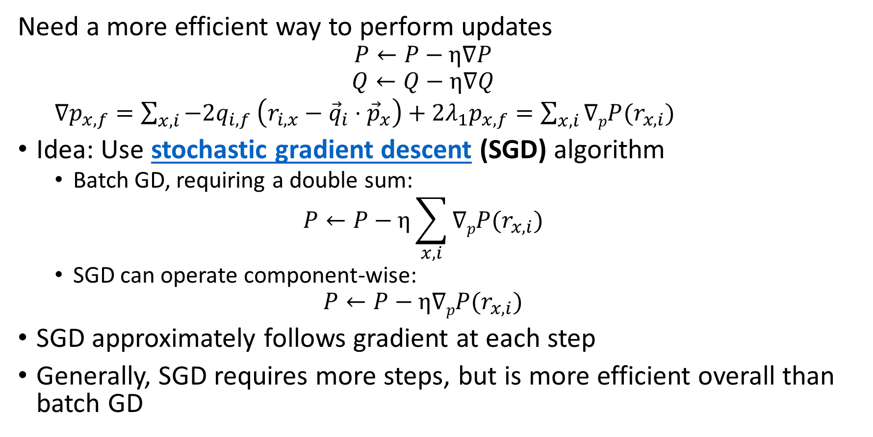
Latent Factor Recommenders
Need a more efficient way to perform updates
  $$P←P−η∇P$$
  $$Q←Q−η∇Q$$
  $∇p_{x,f}=\sum_{x,i}^{ }{−2q_{i,f}}$ $\left(r_{i,x}−{\vec{q}}_{i}⋅{\vec{p}}_{x}\right)+{2λ}_{1}p_{x,f}=\sum_{x,i}^{ }{∇pP(r_{x,i})}$
Idea: Use stochastic gradient descent (SGD) algorithm
  Batch GD, requiring a double sum:
  $$P←P−η\sum_{x,i}^{ }{∇pP(r_{x,i})}$$
  SGD can operate component-wise:
  $$P←P−η∇pP(r_{x,i})$$
SGD approximately follows gradient at each step
Generally, SGD requires more steps, but is more efficient overall than batch GD

Slide 24
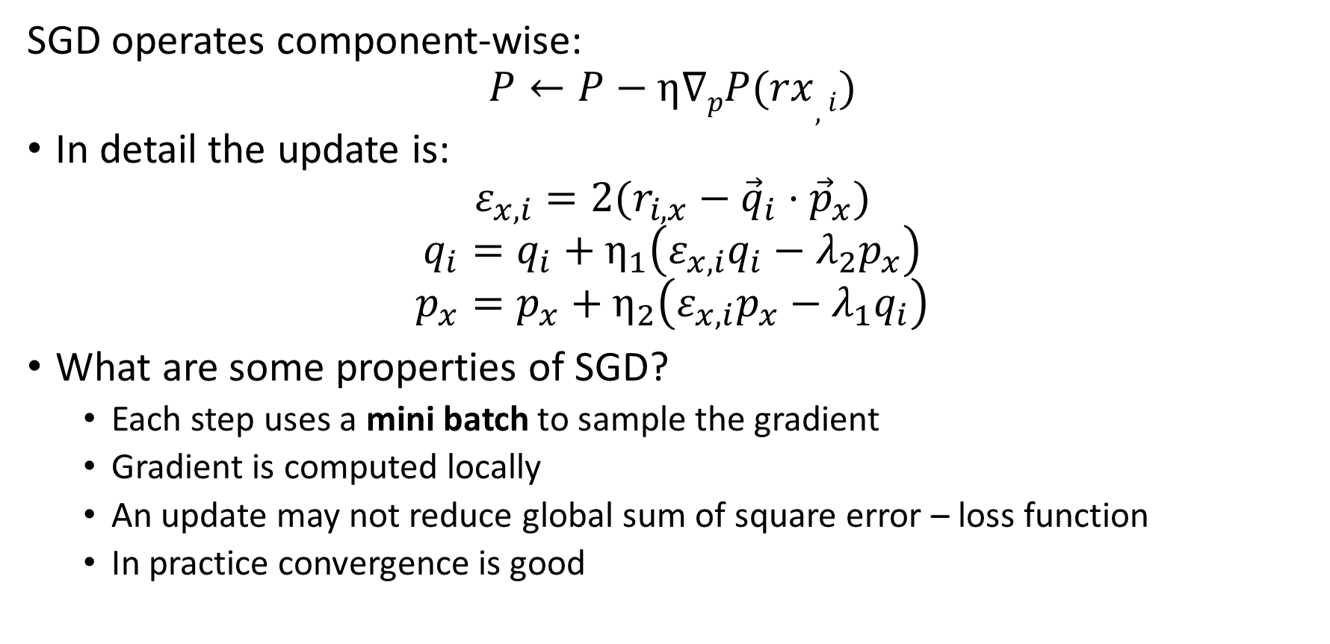
Latent Factor Recommenders
SGD operates component-wise:
$$P←P−η∇pP(rx,i)$$
In detail the update is:
$$ε_{x,i}=2(r_{i,x}−{\vec{q}}_{i}⋅{\vec{p}}_{x})$$
$$q_{i}=q_{i}+η_{1}\left(ε_{x,i}q_{i}−λ_{2}p_{x}\right)$$
$$p_{x}=p_{x}+η_{2}\left(ε_{x,i}p_{x}−λ_{1}q_{i}\right)$$
What are some properties of SGD?
  Each step uses a mini batch to sample the gradient
  Gradient is computed locally
  An update may not reduce global sum of square error – loss function
  In practice convergence is good

Slide 25
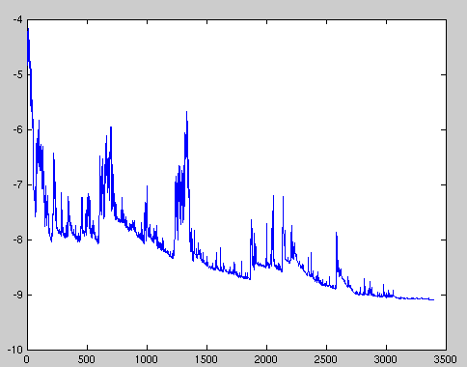
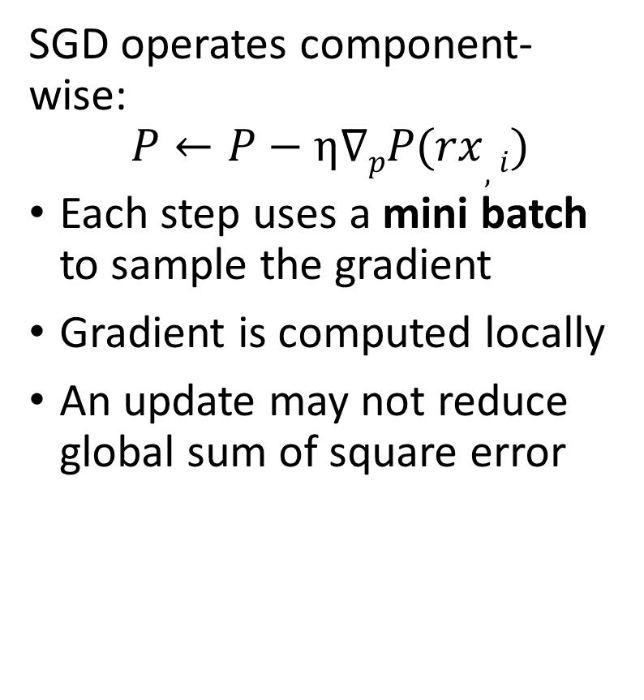
Latent Factor Recommenders
SGD operates component-wise:
$$P←P−η∇pP(rx,i)$$
Each step uses a mini batch to sample the gradient
Gradient is computed locally
An update may not reduce global sum of square error
Sum of Square Loss
Update steps – iterations
Credit: Wiki Commons

Slide 26
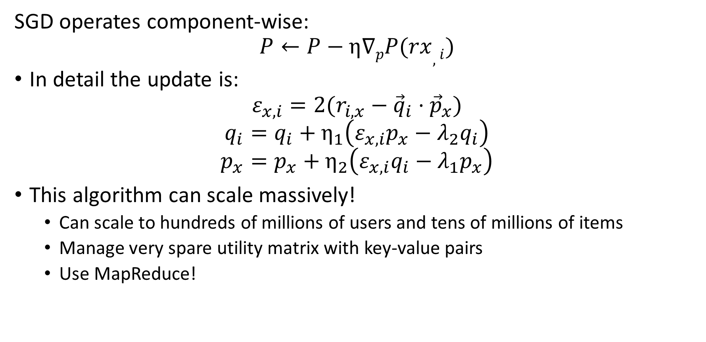
Latent Factor Recommenders
SGD operates component-wise:
$$P←P−η∇pP(rx,i)$$
In detail the update is:
$$ε_{x,i}=2(r_{i,x}−{\vec{q}}_{i}⋅{\vec{p}}_{x})$$
$$q_{i}=q_{i}+η_{1}\left(ε_{x,i}p_{x}−λ_{2}q_{i}\right)$$
$$p_{x}=p_{x}+η_{2}\left(ε_{x,i}q_{i}−λ_{1}p_{x}\right)$$
This algorithm can scale massively!
  Can scale to hundreds of millions of users and tens of millions of items
  Manage very spare utility matrix with key-value pairs
  Use MapReduce!

Slide 27
Latent Factor Models with Baseline

Slide 28
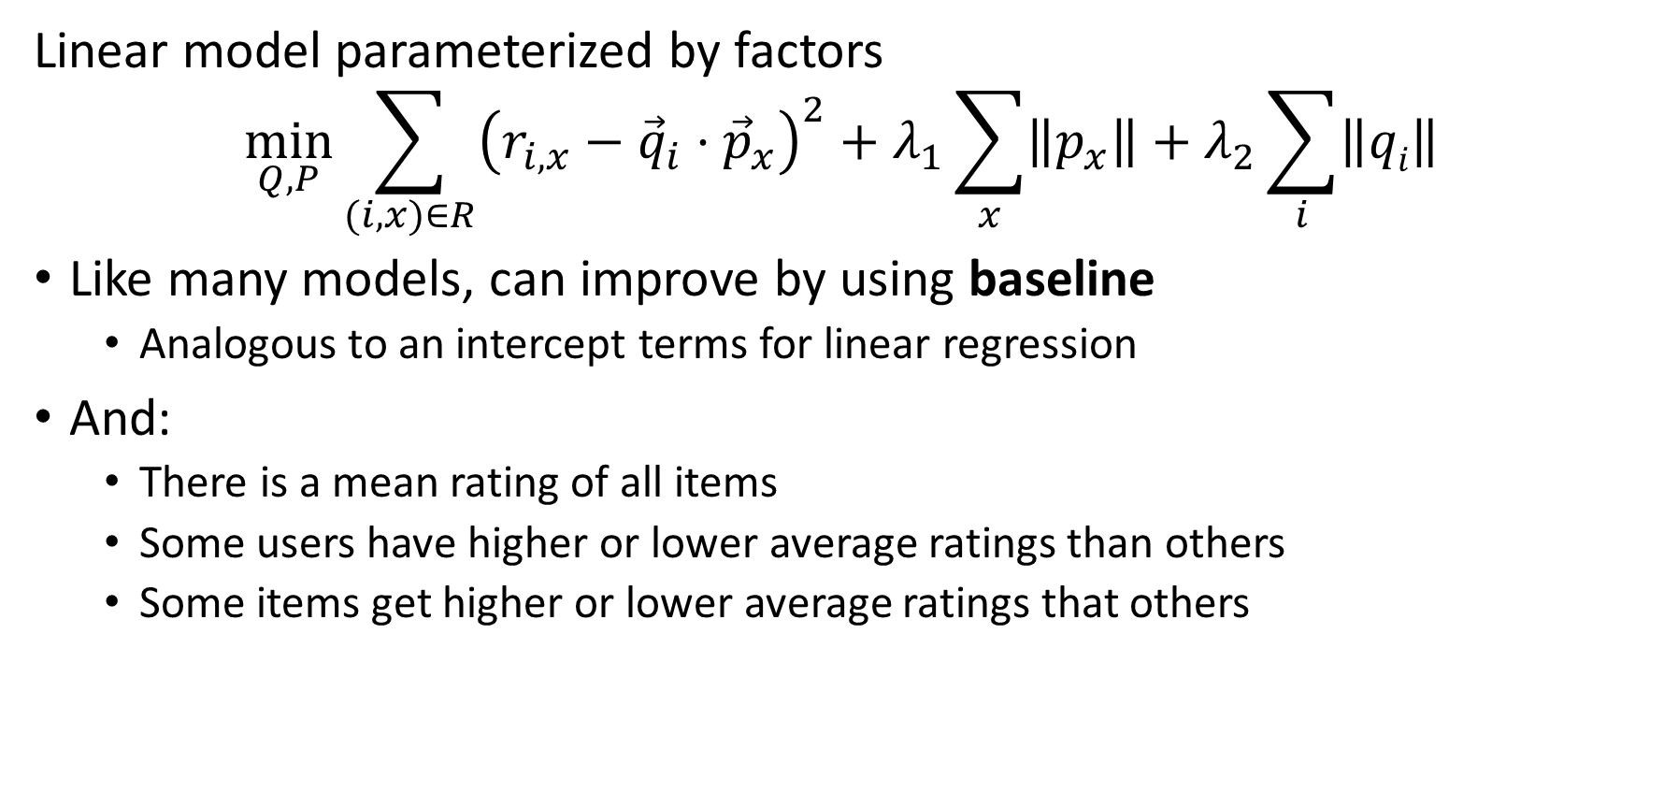
Latent Factor Recommenders
Linear model parameterized by factors
$$\min_{Q, P}{\sum_{(i,x)∈R}^{ }{{\left(r_{i,x}−{\vec{q}}_{i}⋅{\vec{p}}_{x}\right)}^{2}+λ_{1}\sum_{x}{\left\|p_{x}\right\|}+λ_{2}\sum_{i}{\left\|qi\right\|}}}$$
Like many models, can improve by using baseline
  Analogous to an intercept terms for linear regression
And:
  There is a mean rating of all items
  Some users have higher or lower average ratings than others
  Some items get higher or lower average ratings that others

Slide 29
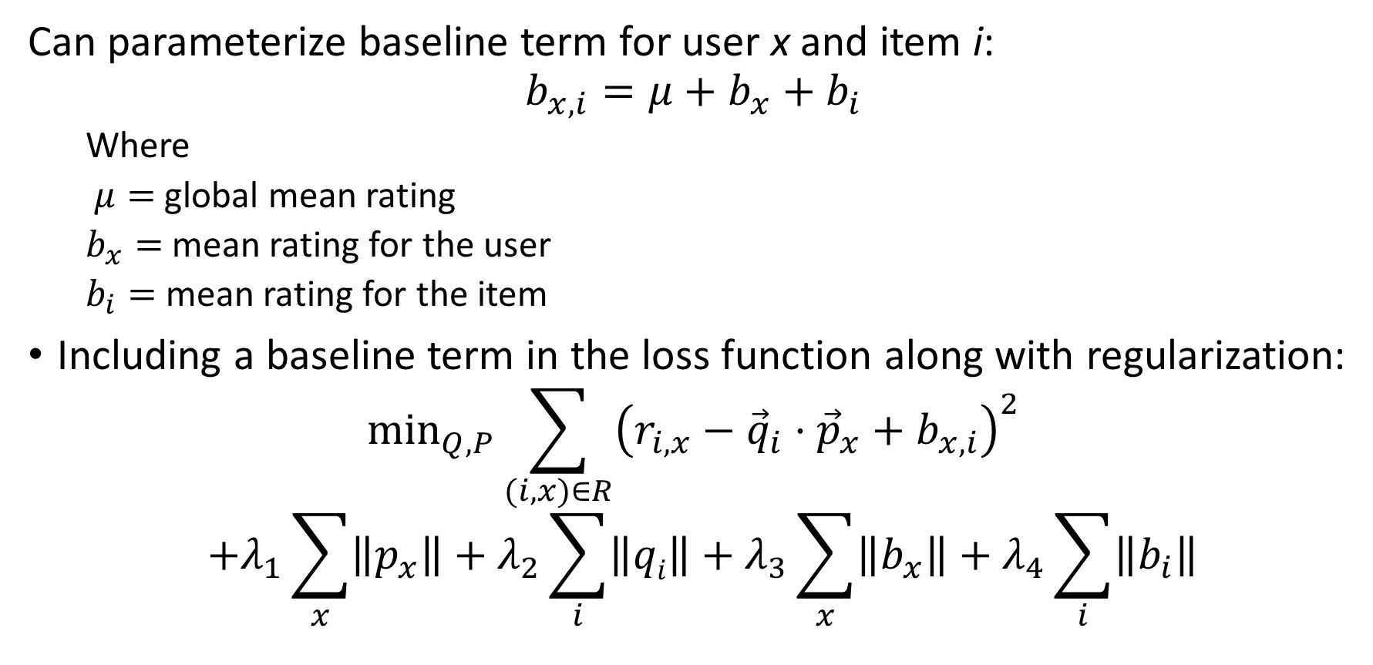
Latent Factor Recommenders
Can parameterize baseline term for user x and item i:
$$b_{x,i}={μ+b}_{x}+b_{i}$$
  Where
  $μ=$ global mean rating
  $b_{x}=$ mean rating for the user
  $b_{i}=$ mean rating for the item
Including a baseline term in the loss function along with regularization:
$$\min_{Q, P}{\sum_{(i,x)∈R}^{ }{{\left(r_{i,x}−{\vec{q}}_{i}⋅{\vec{p}}_{x}+b_{x,i}\right)}^{2}}}$$
$${+λ_{1}\sum_{x}{\left\|p_{x}\right\|}+λ_{2}\sum_{i}{\left\|qi\right\|}+λ_{3}\sum_{x}^{ }{\left\|b_{x}\right\|+λ_{4}\sum_{i}^{ }{\left\|b_{i}\right\|}}}$$

Slide 30
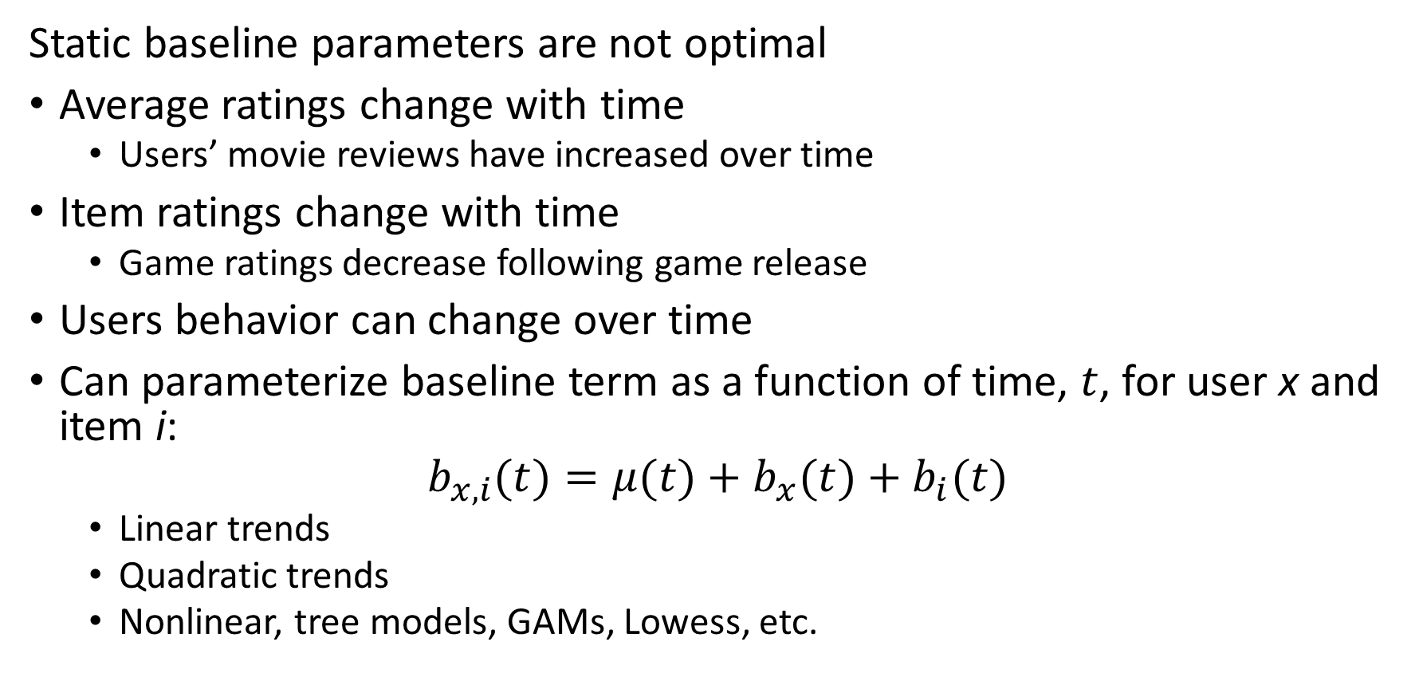
Latent Factor Recommenders
Static baseline parameters are not optimal
Average ratings change with time
  Users’ movie reviews have increased over time
Item ratings change with time
  Game ratings decrease following game release
Users behavior can change over time
Can parameterize baseline term as a function of time, $t$, for user x and item i:
$$b_{x,i}(t)={μ(t)+b}_{x}(t)+b_{i}(t)$$
  Linear trends
  Quadratic trends
  Nonlinear, tree models, GAMs, Lowess, etc.

Slide 31
Latent Factor Recommenders
State of the art recommenders require additional baseline terms for context
Peoples’ opinions and tastes differ in many systematic ways
  Regional differences
  Product category differences
  …
Can add baseline terms for observable context factors
  Selection of factors is solution specific
  May be time dependent
Neural recommender models have an advantage in dealing with the interactions

Slide 32
Embedding for Recommenders

Slide 33
Embeddings for Recommender Systems
Effective embeddings are essential for recommendations
Algorithms typically operate on features in an embedding space
  Hash sketches
  Learned embedding spaces
Good embeddings must have several properties
  Uniqueness for each category embedded
  Equal similarity between classes, to prevent bias
  Reduction of high dimensionality, to reduce computation and memory use
  High Shannon entropy, ensuring all dimensions of the embedding contain information

Slide 34
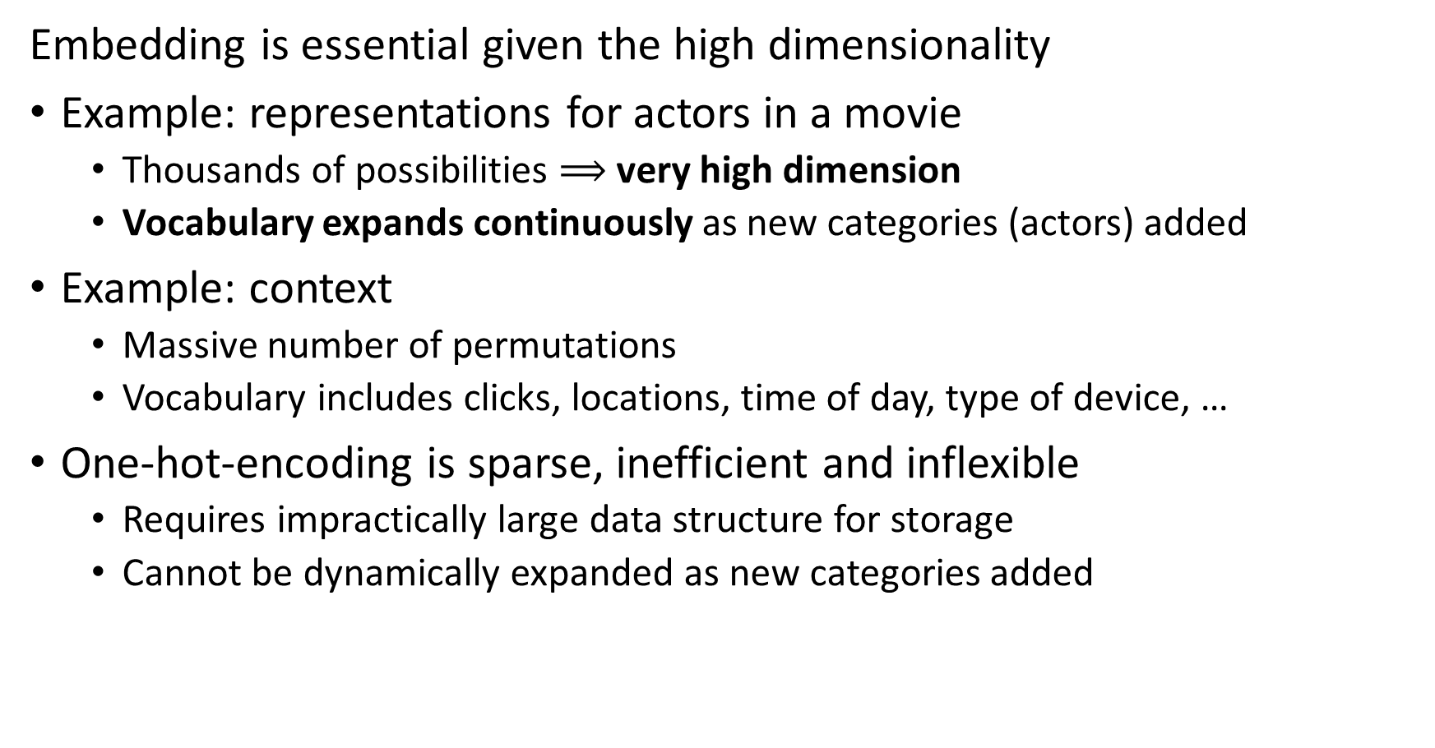
Embedding is Essential for Recommender Algorithms
Embedding is essential given the high dimensionality
Example: representations for actors in a movie
  Thousands of possibilities $⟹$ very high dimension
  Vocabulary expands continuously as new categories (actors) added
Example: context
  Massive number of permutations
  Vocabulary includes clicks, locations, time of day, type of device, …
One-hot-encoding is sparse, inefficient and inflexible
  Requires impractically large data structure for storage
  Cannot be dynamically expanded as new categories added

Slide 35
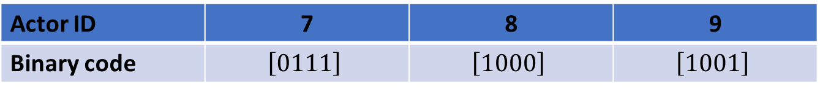
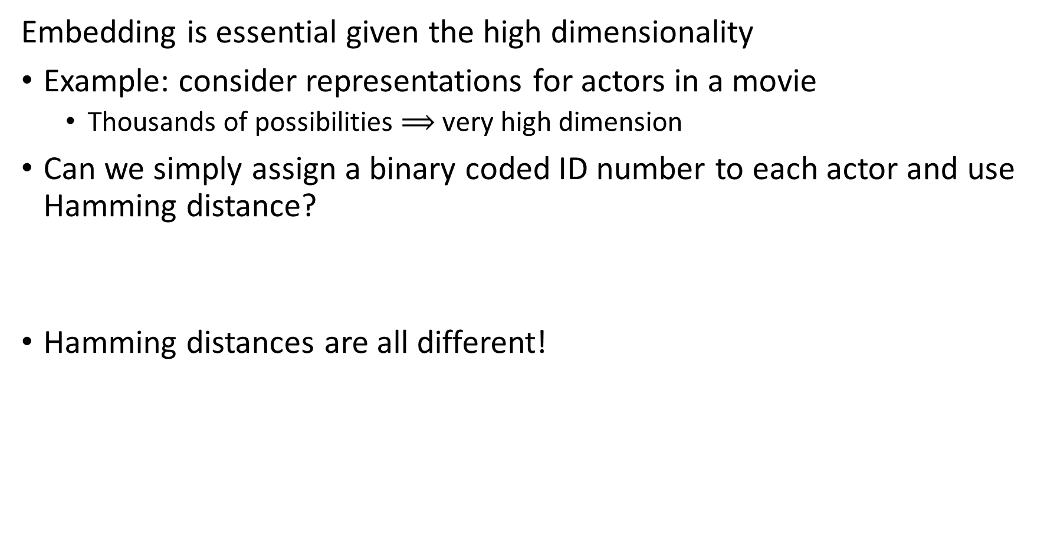
Embedding is Essential for Recommender Algorithms
Embedding is essential given the high dimensionality
Example: consider representations for actors in a movie
  Thousands of possibilities $⟹$ very high dimension
Can we simply assign a binary coded ID number to each actor and use Hamming distance?
Hamming distances are all different!
Actor ID | 7 | 8 | 9
Binary code | $$\left[0111\right]$$ | $$\left[1000\right]$$ | $$\left[1001\right]$$
Actor ID | 7 | 8 | 9
7
8 | 4
9 | 3 | 1

Slide 36
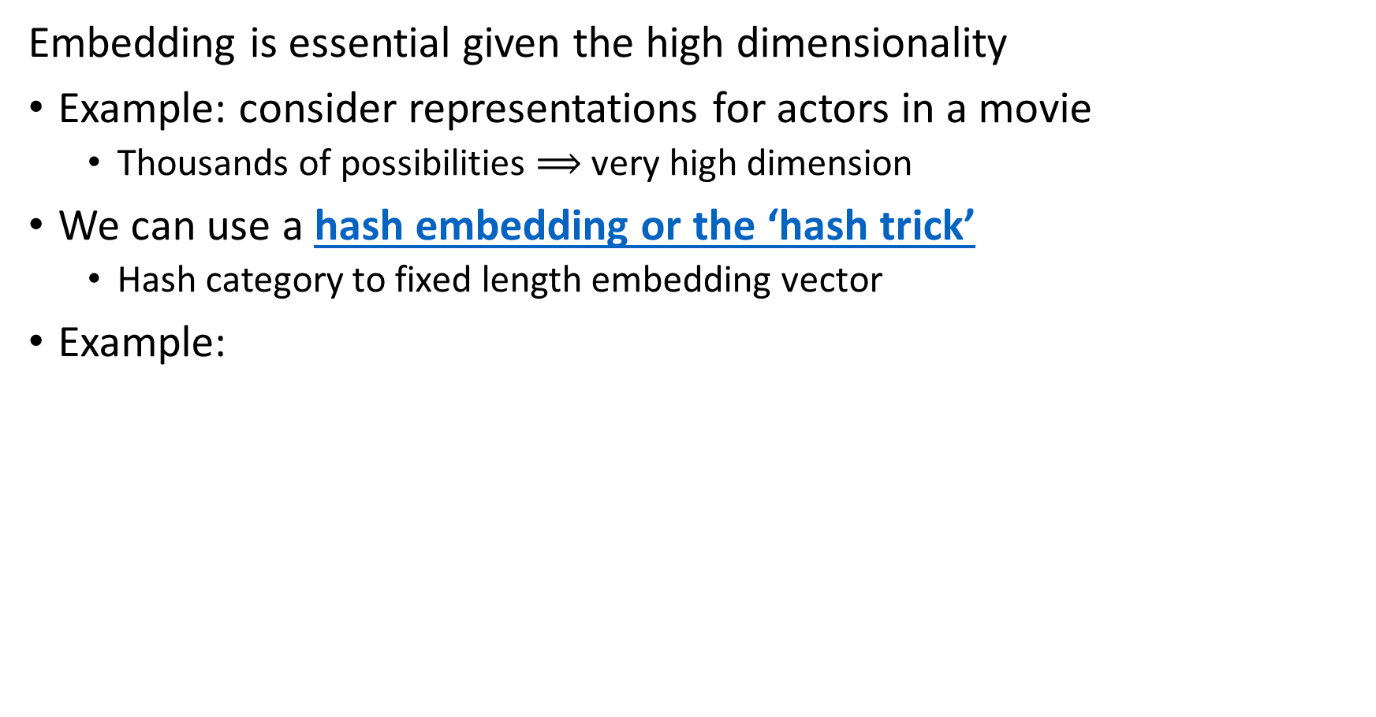
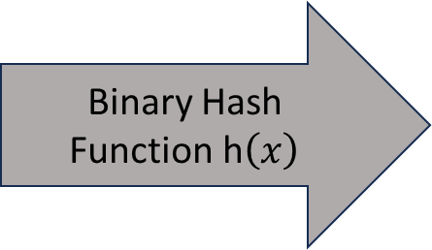
Embedding is Essential for Recommender Algorithms
Embedding is essential given the high dimensionality
Example: consider representations for actors in a movie
  Thousands of possibilities $⟹$ very high dimension
We can use a hash embedding or the ‘hash trick’
  Hash category to fixed length embedding vector
Example:
Category
Cat
Dog
Parrot
Gold Fish
Hamster
Category
Cat | 0 | 1 | 1 | 0 | 0
Dog | 1 | 0 | 0 | 1 | 1
Parrot | 1 | 1 | 1 | 0 | 1
Gold Fish | 0 | 1 | 1 | 1 | 0
Hamster | 0 | 0 | 1 | 1 | 1
Binary Hash Function h$\left(x\right)$

Slide 37
Embedding is Essential for Recommender Algorithms
Embedding is essential given the high dimensionality
We can use a hash embedding or the ‘hash trick’
  Hash category to fixed length embedding vector
Hash collisions create non-uniqueness in coding features
How can we reduce hash collisions?
  Use longer hash word
  Use multiple hash functions
  Randomize hash words by using binary sign hash multiplier – inner products become zero-centered
  Feature hashing is well supported in many machine learninging packages including, Scikit-learn and TensorFlow (Keras)

Slide 38
Embedding is Essential for Recommender Algorithms
Embedding is essential given the high dimensionality
Hash trick has several limitations
  Hash collisions reduce uniqueness
  Hash values do not maintain high entropy, e.g. the information content of the hash word is low
To overcome these deficiencies, Zang, et. al., 2020, proposed deep hash embedding (DHE)

Slide 39
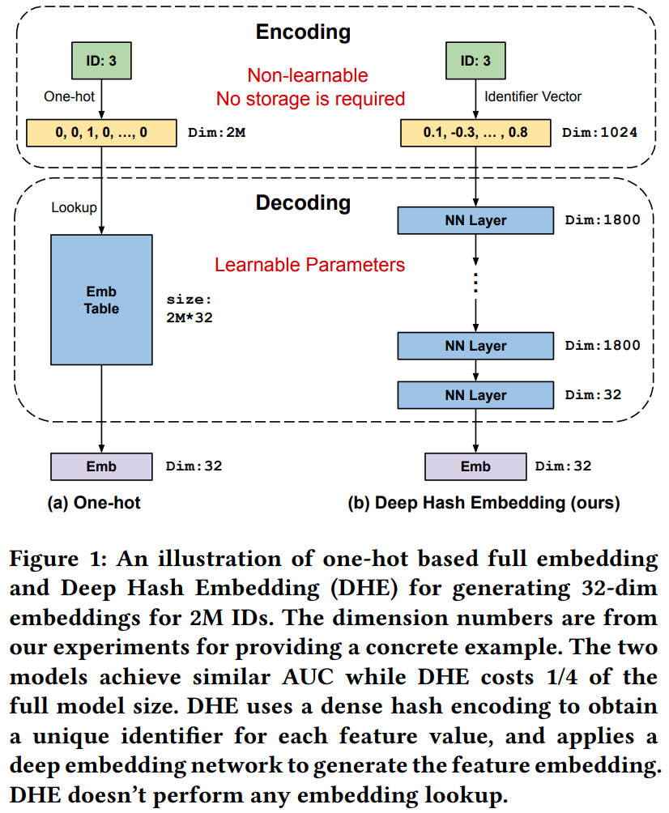
Embedding is Essential for Recommender Algorithms
Embedding is essential given the high dimensionality
Zang, et. al., 2020, proposed deep hash embedding (DHE)
DHE uses a deep neural network to learn optimal embeddings

Slide 40
Embedding is Essential for Recommender Algorithms
Clasical hash embedding has fixed vocabulary
One-hot encoding to very high dimensional sparse vector
Decoder is fixed table look-up
Embedding is fixed-length binary hash word

Slide 41
Embedding is Essential for Recommender Algorithms
Zang, et. al., 2020, use an asymmetric encoder-decoder architecture
Shallow encoder computes fixed-length vector
Decoder learns parameters to optimize embedding
Embedding is fixed-length binary hash word

Slide 42
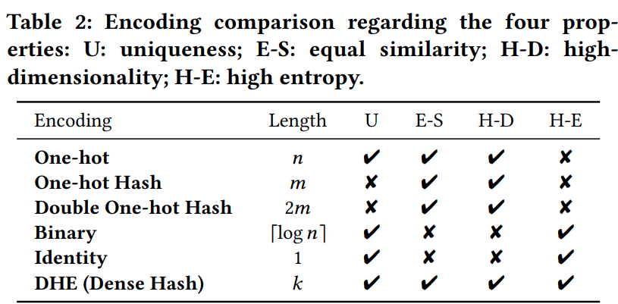
Embedding is Essential for Recommender Algorithms
Embedding is essential given the high dimensionality
Zang, et. al., 2020, proposed deep hash embedding (DHE)
DHE uses a deep neural network to learn optimal embeddings
DHE exhibits each of the optimal properties for feature hashing

Slide 43
Neural Collaborative Filtering

Slide 44
Neural Network Recommenders
Deep neural networks are having a significant impact on recommenders
Deep neural network algorithms compute complex embedding spaces
Interactions are common in recommender data
  Example: user likes romantic comedy genre movies and with a specific actor
  Example: a workman searches for a specific type of tool and favors a specific brand
Linear models cannot account for numerous interaction terms
Deep neural networks can learn complex feature interactions
  Too many potential interaction for linear factor model

Slide 45
Recommender Systems
Neural network algorithms widely used for supervised collaborative filtering
Figure from Revisiting Recommender Systems: An Investigative Survey. Ibrahim, et. al, 2025

Slide 46
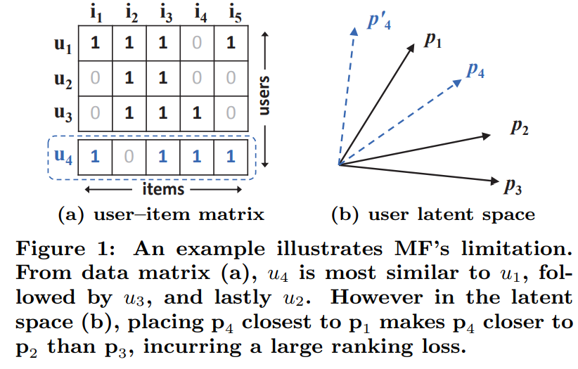
Neural Collaborative Filtering
Neural collaborative filtering, He et.al., 2017, uses a multi-layer perceptron to compute recommendation ranks
Why do we need non-linear collaborative filtering?
Interaction terms are inherently nonlinear
He, et. al., provide an example where binary coding of user features leads to misleading similarity, compared to Jaccard similarity
Correct ranking requires learning a nonlinear interaction with a neural network
From He, et. al., 2016

Slide 47
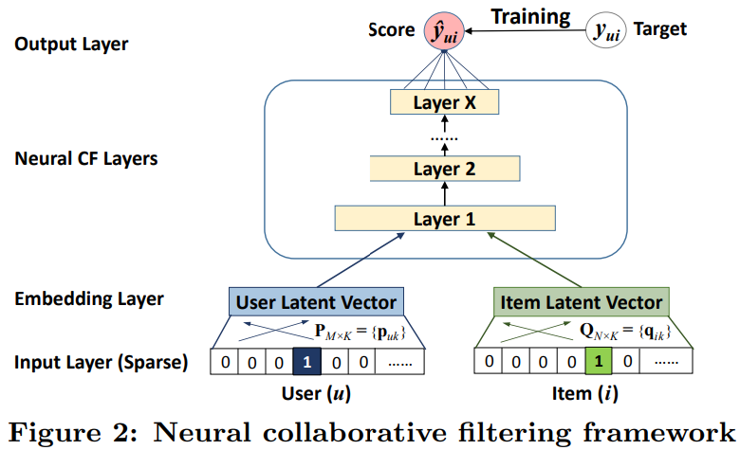
Neural Collaborative Filtering
Neural collaborative filtering, He et.al., 2017, uses a multi-layer perceptron to compute similarity and rank recommendations
Error (score) is minimized in training
Recommendation ranks computed with NN layers, including nonlinear interaction terms
User and item dense latent embedding vectors are computed
Inputs are sparse user and item identification vectors
From He, et. al., 2016

Slide 48
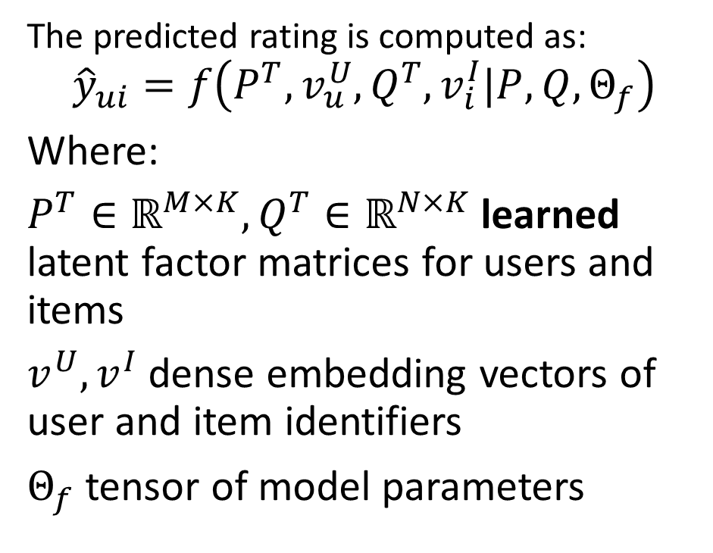
Neural Collaborative Filtering
Neural collaborative filtering, He et.al., 2016, uses a multi-layer perceptron to compute similarity and rank recommendations
The predicted rating is computed as:
$${\hat{y}}_{ui}=f\left(P^{T},v_{u}^{U},Q^{T},v_{i}^{I}|P,Q,Θ_{f}\right)$$
Where:
$P^{T}∈ℝ^{M×K},Q^{T}∈ℝ^{N×K}$ learned latent factor matrices for users and items
$v_{ }^{U}, v_{ }^{I}$ dense embedding vectors of user and item identifiers
$Θ_{f}$ tensor of model parameters
From He, et. al., 2016

Slide 49
Hybrid Models

Slide 50
Hybrid Recommenders
Can combine methods content-based and collaborative filtering methods
May improve performance if errors are reasonably uncorrelated
Possibly overcome cold start problem
Different models can help with cold start problem
  Baseline estimates
  Use clustering methods to find similar users and items
Early approach starts with semi-supervised (content-based) systems
  Used by winners of the famous Netflix Prize
  Initially use item profiles
  Combine with matrix factorization results as more data acquired

Slide 51
Hybrid Recommenders
Improve recommender performance with hybrid collaborative filtering and content-based algorithms
Figure from Revisiting Recommender Systems: An Investigative Survey. Ibrahim, et. al, 2025

Slide 52
Hybrid Recommenders
Many hybrid recommender architectures proposed
Run independent recommenders and rank weighted sum of scores
  An ensemble model
Recommender algorithms using both user or item collaborative and content information
  Collaborative information (e.g. ratings) and context embedded
  Content information embedded
  Rank results of similarity search on joint (concatenated embeddings)

Slide 53






Hybrid Recommenders
Example: extending the utility matrix to include context and content information embeddings
Rating
User Profile
Context
Content Attributes
$$∙∙∙$$
$$∙∙∙$$
$$∙∙∙$$
Items
Rating
User Profile
Context
Content Attributes
Rating
User Profile
Context
Content Attributes
Rating
User Profile
Context
Content Attributes
Users
$$∙∙∙$$
$$∙∙∙$$
$$∙∙∙$$
Rating
User Profile
Context
Content Attributes
Rating
User Profile
Context
Content Attributes

Slide 54
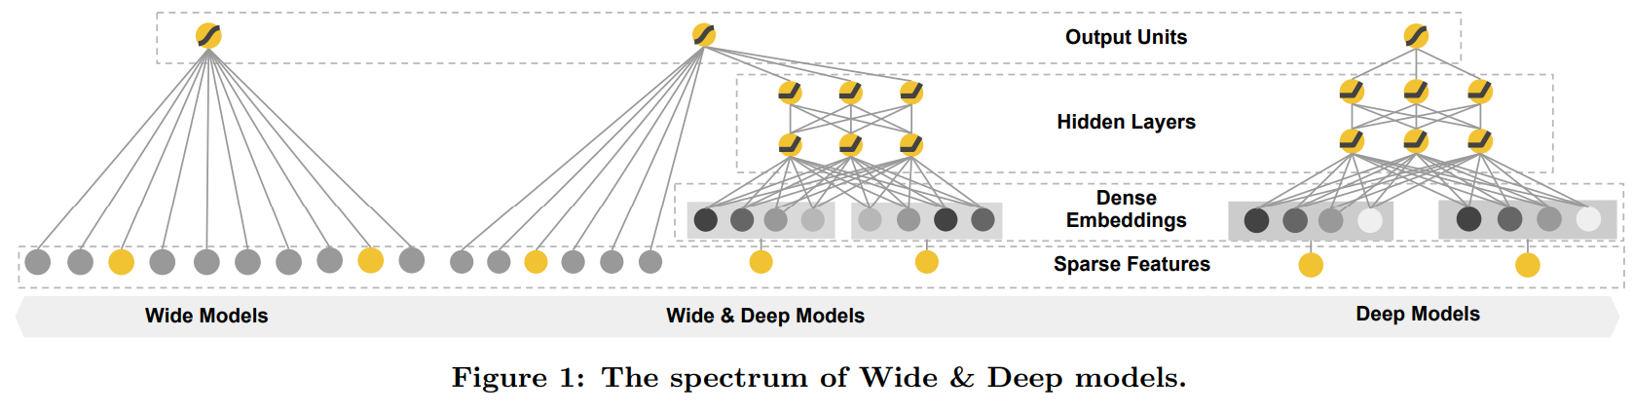
Wide and Deep Architectures
Wide and deep architecture, Chang, et. al., 2016, is a hybrid model combine neural encoding with linear matrix factorization
Linear model with wide sparse latent space and matrix factorization
Hybrid model uses linear matrix factorization for sparse latent features and neural network for dense latent feature
Nonlinear model with dense latent space and neural network
From Chang et. al., 2016

Slide 55
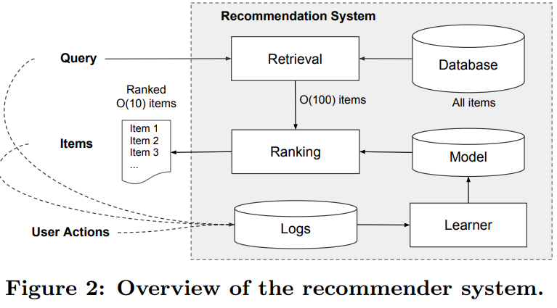
Wide and Deep Architectures
Wide and deep architecture, Chang, et. al., 2016, has 2 stages
Retrieval stage uses a hybrid of similarity search on query algorithms to generate candidates
Ranking stage assigns positions (ranks) to items for presentation to user
From Chang et. al., 2016

Slide 56
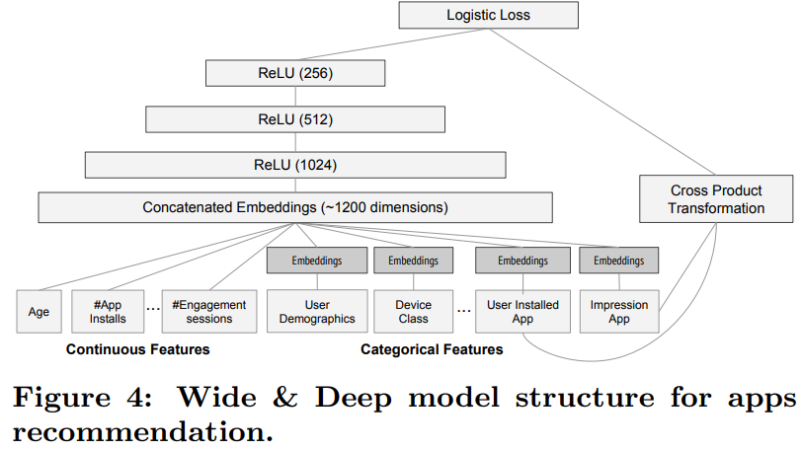
Wide and Deep Architectures
Wide and deep architecture, Chang, et. al., 2016 accommodates both sparse categorical and dense numeric features
Concatenated emedding encodes all features
Sparse features (e.g. categorical) require dense embedding, or hashing
Dense features (e.g. numeric) features require no embedding
From Chang et. al., 2016

Slide 57
Adversarial and Poisoning Attacks

Slide 58
Attacks on Recommenders Attempt to Bias Results
Recommender systems are subject to adversarial and poisoning attacks
Actors may wish to boost or depress ratings for various reasons
  Commercial, to gain unfair advantage in the market place
  Political and cultural, to boost or suppress certain points of view
Adversarial attacks aim to manipulate input data to temporarily deceive the system into producing inaccurate real-time inferences or predictions
More commonly, poisoning attacks aim to inject carefully crafted data into the model’s training data to fundamentally change the results
Real-world recommenders need to employ countermeasures

Slide 59
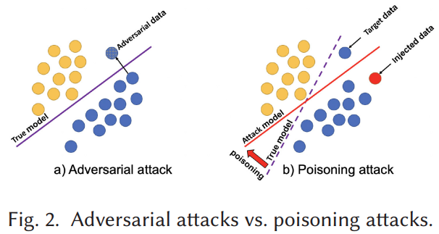
Attacks on Recommenders Attempt to Bias Results
Many complex paths for recommender poison attacks
Adversarial attacks temporarily manipulates input data to temporarily deceive the system
Poisoning attacks inject carefully crafted data into the model’s training data to fundamentally change the model results
Illustration from Nguyen, et. al., 2024

Slide 60
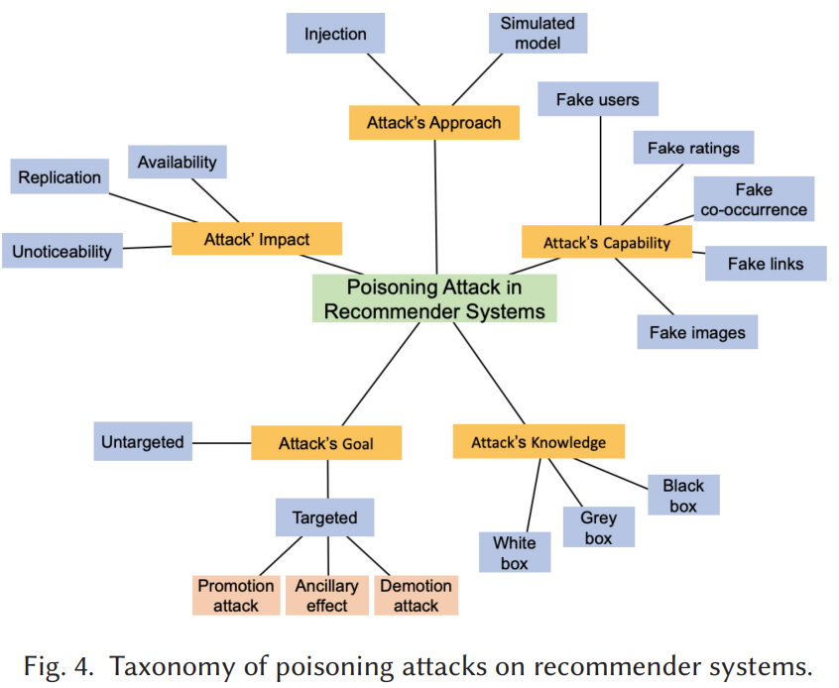
Attacks on Recommenders Attempt to Bias Results
Many complex paths for recommender poison attacks
Nguyen, et. al., 2024 have created a classification and nomenclature for poisoning attacks with dimensions
  Attacker’s approach
  Attacker’s capability
  Attacker’s impact
  Attacker’s goal
  Attacker’s knowledge

Slide 61
Growing Literature on Recommender Attacks
Recent review papers focus on poisoning attacks
Manipulating Recommender Systems: A Survey of Poisoning Attacks and Countermeasures, Nguyen, et. al., 2024
Poisoning Attacks against Recommender Systems: A Survey, Wang, et. al., 2024

Slide 62
Advanced Neural Recommender Architectures

Slide 63
Advanced Neural Recommender Architectures
Recently recommender system researchers have tried many paths
The introduction of neural recommenders has led to many improvements
The two-tower model is now fairly standard
  Query tower embeds the user queries
  Item tower embeds item features
Methods like mixed negative sampling reduce inherent negative sampling bias
Ensemble recommenders attempt to average out errors and reduce position bias using multiple approaches

Slide 64
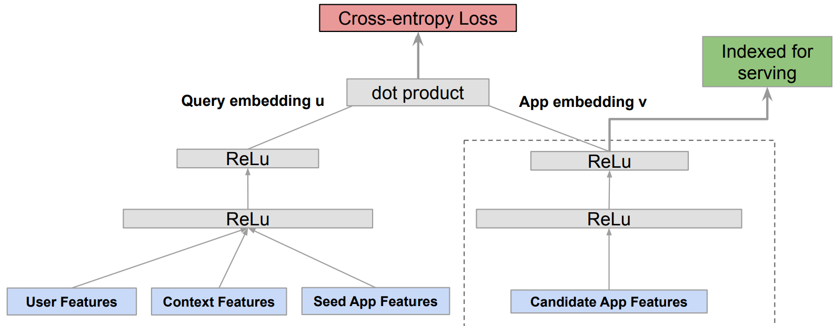
Two-Tower Architectures
Two-tower architectures are a prevalent in modern production recommenders
User query embedding
Item feature embedding
Architecture introduced by Zhao, et. al, 2019, for Google Play
Example, proposed by Yang et. al., 2020 of Google Research
Query tower
Item tower
From Yang et. al., 2020

Slide 65
Negative Sampling Bias Affects Recommender Training
Recommender data suffers from negative sampling bias
We only get feedback about actions users take
  Never know why users do not take action
  Only have positive results (clicks)
Example: consider a model with only binary response for an app store:
  Value is 1 if user downloaded an app
  Value is 0 if user did not download the app
  If 1, we do not know if the user liked the app or not
  If 0, we do not know if user did not want the app or never knew of its existence
Position bias arises from negative sampling bias

Slide 66
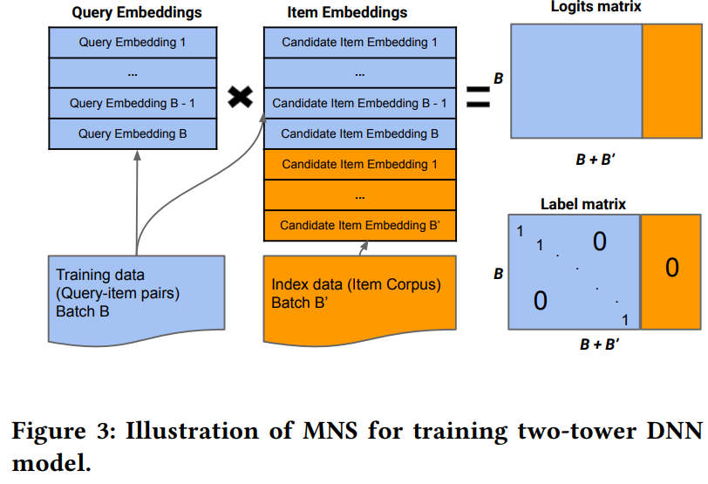
Mixed Negative Sampling
Yang, et. al., 2020 introduced mixed negative sampling (MNS) for dealing with the negative sampling bias
MNS adds a uniformly sampled stream of negative samples from the entire catalog (corpus)
Embeddings of additional negative samples are appended to item embeddings
Adding negative sample of size 2-3 x positive samples reduces negative sampling bias
From Yang et. al., 2020

Slide 67
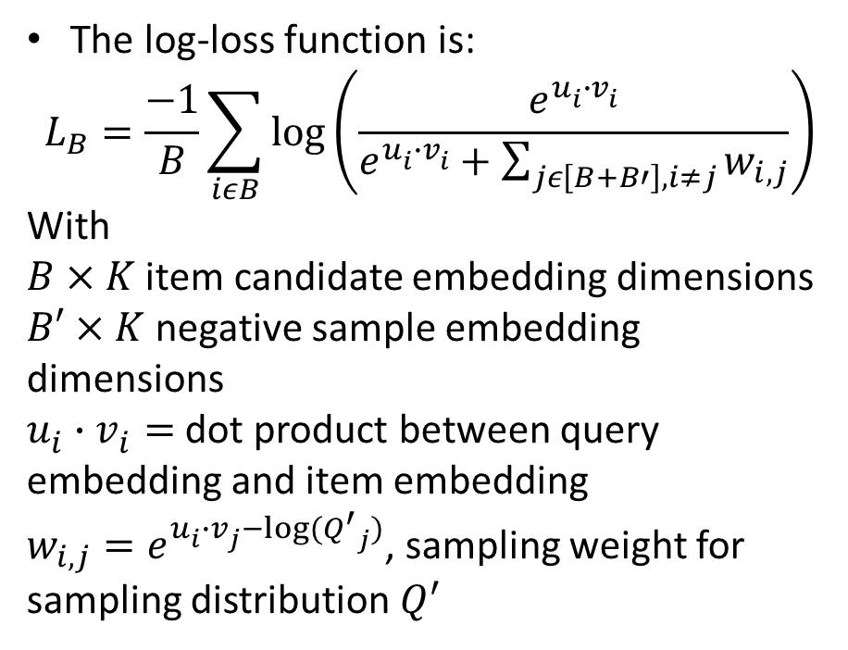
Mixed Negative Sampling
Yang, et. al., 2020 introduced mixed negative sampling (NMS) for dealing with the negative sampling bias
The log-loss function is:
$$L_{B}=\frac{−1}{B}\sum_{iεB}{\log\left(\frac{e^{u_{i}^{ }∙v_{i}^{ }}}{e^{u_{i}^{ }∙v_{i}^{ }}+\sum_{jε\left[B+B′\right], i≠j}{w_{i,j}}}\right)}$$
With
$B×K$ item candidate embedding dimensions
$B′×K$ negative sample embedding dimensions
$u_{i}^{ }∙v_{i}^{ }=$ dot product between query embedding and item embedding
$w_{i,j}=e^{u_{i}^{ }∙v_{j}^{ }−log⁡({Q^{′}}_{j})}$, sampling weight for sampling distribution $Q^{′}$
From Yang et. al., 2020

Slide 68
Position Bias Reduces Recommender Effectiveness
Click probability depends on the position in the search results
Items in the tail suffer position bias
  Users typically do not see choices far down the list
  We never know the probability of click through for some items
Popularity of the top items in the list is biased upward by frequent clicks
  Bias propagates to new recommendation lists, increasing subsequent bias
Position bias leads to negative sampling bias

Slide 69
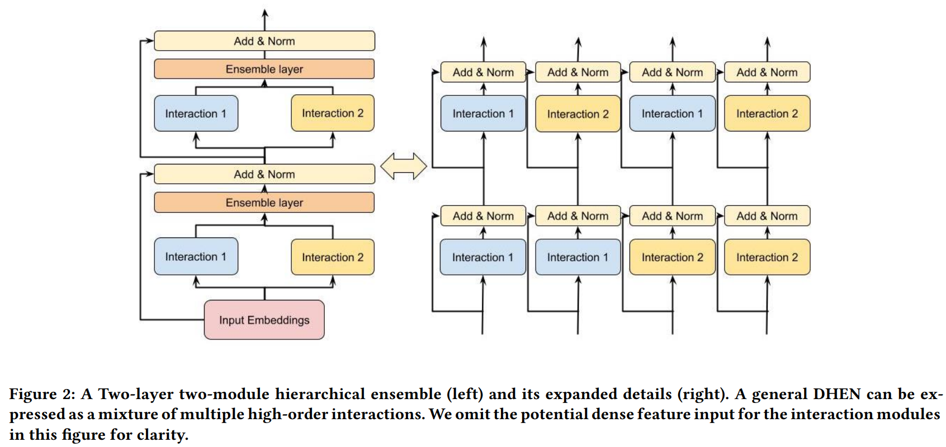
DHEN, Deep and Hierarchical Ensemble Recommender
Meta’s DHEN deep and hierarchical ensemble recommender, Zhang, et, al,2022, uses multiple similarity search algorithms in a two-stage, two-tower, architecture
DEHN architecture uses a hierarchy of several models for interactions for features in an embedding space
An NVIDIA team of Schifferer, et. al,. 2022 use a similar apprach
From Zhang et. al., 2022

Slide 70
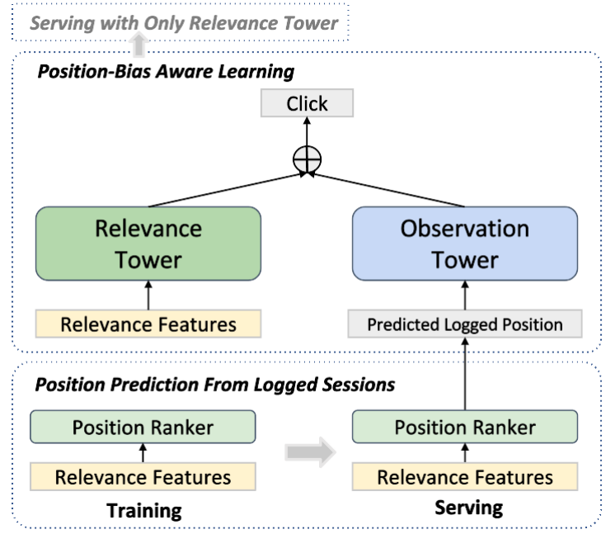
DHEN, Deep and Hierarchical Ensemble Recommender
Zang, et. al., 2022, explore the causal relationship between the position tower and the relevance tower
Relevance tower performs similarity search on items and/or users
Observation tower computes position bias adjustment
  Uses log information on user behavior and context
  Adjusts ranking to limit position bias
From Zang et. al., 2022

Slide 71
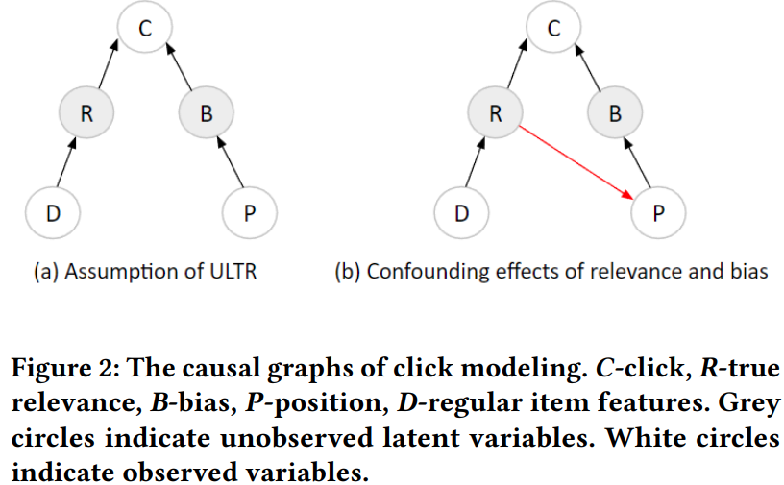
DHEN, Deep and Hierarchical Ensemble Recommender
Zang, et. al., 2022, explore the causal relationship between the position tower and the relevance tower
Relevance tower performs similarity search on items and/or users assuming independence
But user actions are not independent of position with a causal relationship!
From Zang et. al., 2022

Slide 72
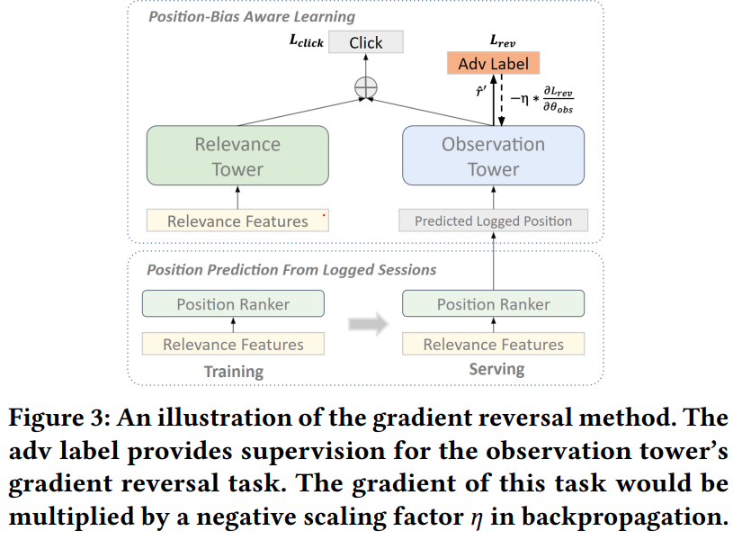
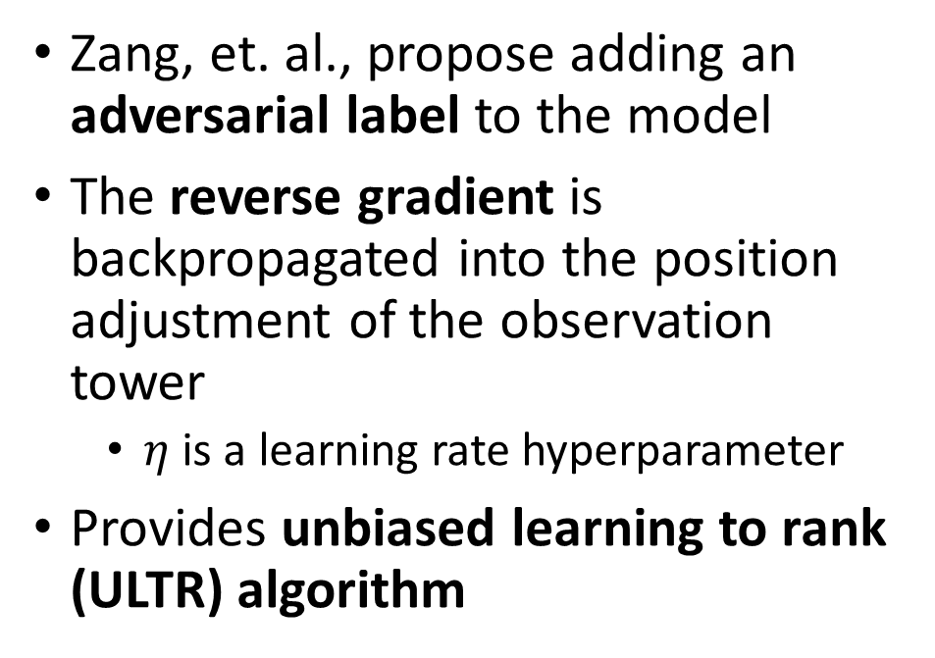
DHEN, Deep and Hierarchical Ensemble Recommender
Zang, et. al., 2022, explore the causal relationship between the position tower and the relevance tower
Zang, et. al., propose adding an adversarial label to the model
The reverse gradient is backpropagated into the position adjustment of the observation tower
  $η$ is a learning rate hyperparameter
Provides unbiased learning to rank (ULTR) algorithm
From Zang et. al., 2022

Slide 73
Summary

Slide 74
Summary
Economic impact of recommenders is massive!
Online catalogs have a long tail
  Many rarely purchased and reviewed items
  Users will not find items in the tail without a recommender
Recommender algorithms connect users with items
Creating a good recommender algorithm for the real-world is hard!
  People have complex and variable behavior
  User ratings are not constant with time
  Biases from position and negative sampling
  Attacks on recommenders a growing problem
  Cold start problem for new items
  Cold start problem for new users

Slide 75
Summary
Many algorithms have been tried to find recommendations
Commonly used algorithms are based on similarity search
Content based systems
  Similarity search to find items with common properties
  Related to frequent item set algorithms
Collaborative filtering
  Based on similarity between items and between users
  Widely used algorithms
  Can be unsupervised or supervised
  Linear and nonlinear (neural) algorithms widely employed
  Has cold-start problem

Slide 76
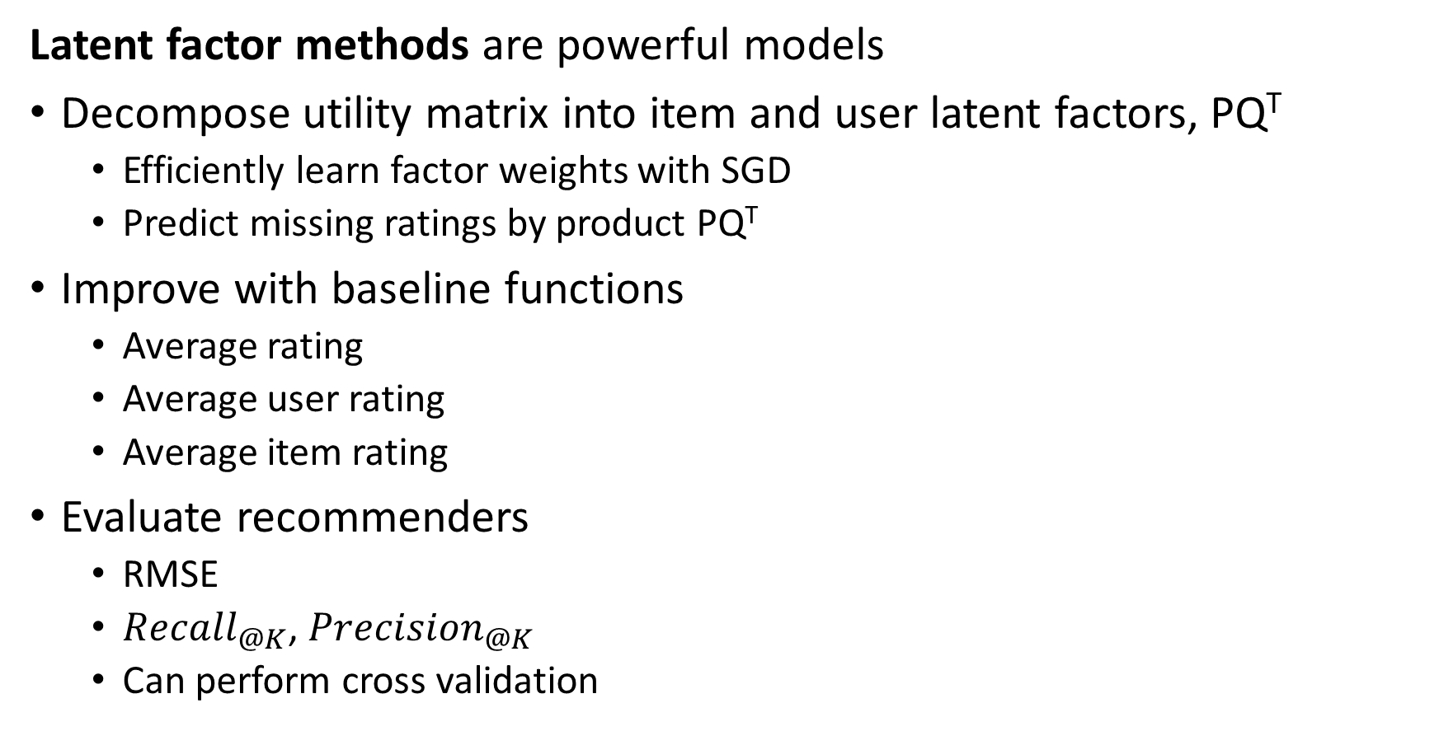
Summary
Latent factor methods are powerful models
Decompose utility matrix into item and user latent factors, PQ^{T}
  Efficiently learn factor weights with SGD
  Predict missing ratings by product PQ^{T}
Improve with baseline functions
  Average rating
  Average user rating
  Average item rating
Evaluate recommenders
  RMSE
  ${Recall}_{@K}$, ${Precision}_{@K}$
  Can perform cross validation

