Slide 1

CSCI E-96
Data Mining, Discovery and Exploration
Efficient Similarity Search
Steve Elston
Copyright 2021, 2022, 2023, 2024, 2025, 2026, Stephen F Elston. All rights reserved.

Slide 2
Main topics in this course
The main topics in this course are interconnected and build on each other
1. Hashing and K-V pair management
2. Distance and Similarity Metrics
3. Graph Algorithms
Foundations
Core Algorithms
2. Dimensionality Reduction
5. Similarity Search and NN Algorithms
4. Online Algorithms
3. Social Network Analysis
6. Web/Document ranking and search
7. Recommender Algorithms
8. Clustering Algorithms
Taks Speific Algorithms

Slide 3
Similarity Search at Scale
Need an efficient method for high-dimensional similarity joins at massive scale
Constructing nearest-neighbor graphs
  Cluster models
  Dimensionality reduction
  Network analysis
Find similar products and for recommendation
Information retrival and document search
  Web search
  Document search
  Deduplication
  Plagiarism detection
  …
Search for similar images
Retrieval Augmented Generation (RAG) models for generative AI
  For a review of RAG including the similarity search problem see Gao, et. al., 2024

Slide 4
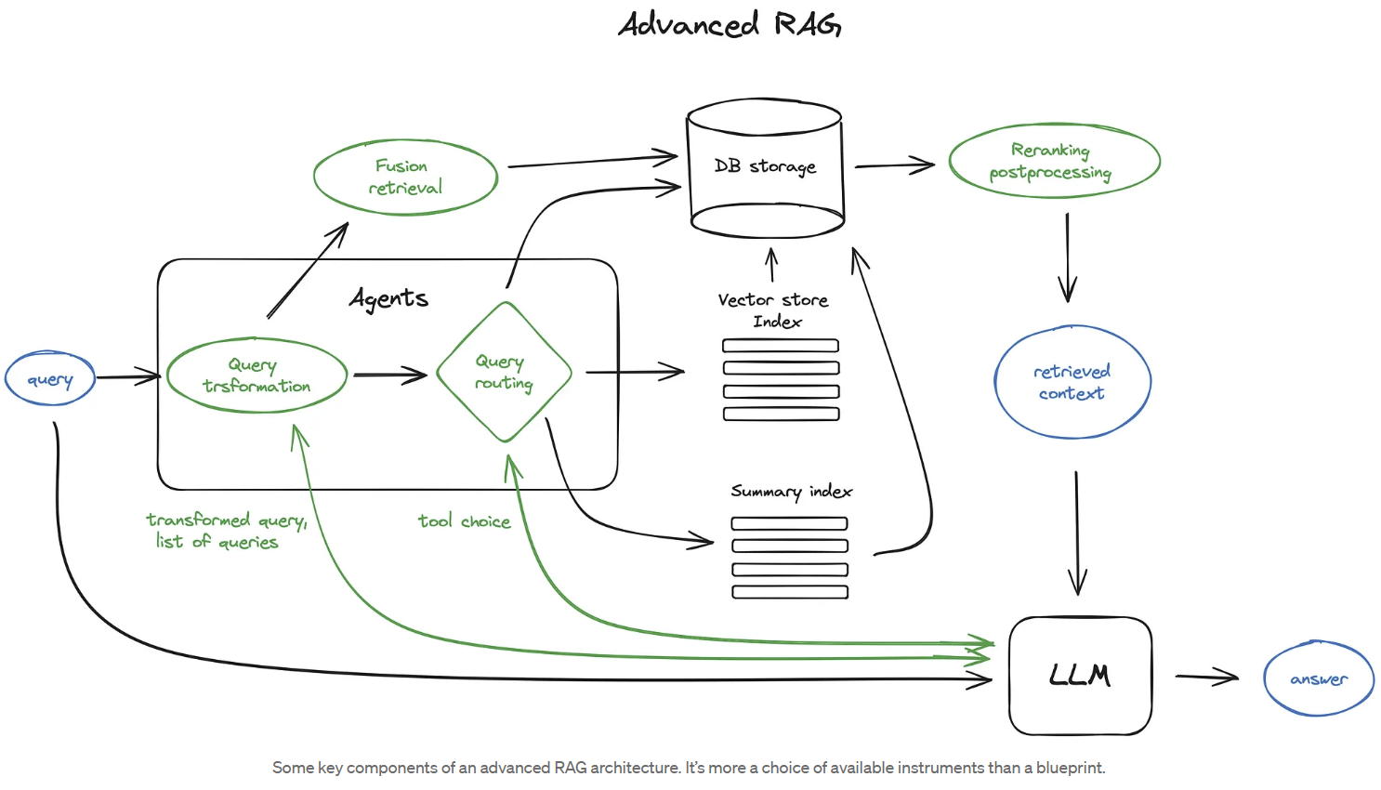
Similarity Search at Scale
Example of massive similarity search for retrieval augmented generation (RAG)
Ranking typically uses cosine similarity
We are focused on massive index and search problem
Diagram from blog post by Ivan Ilin

Slide 5
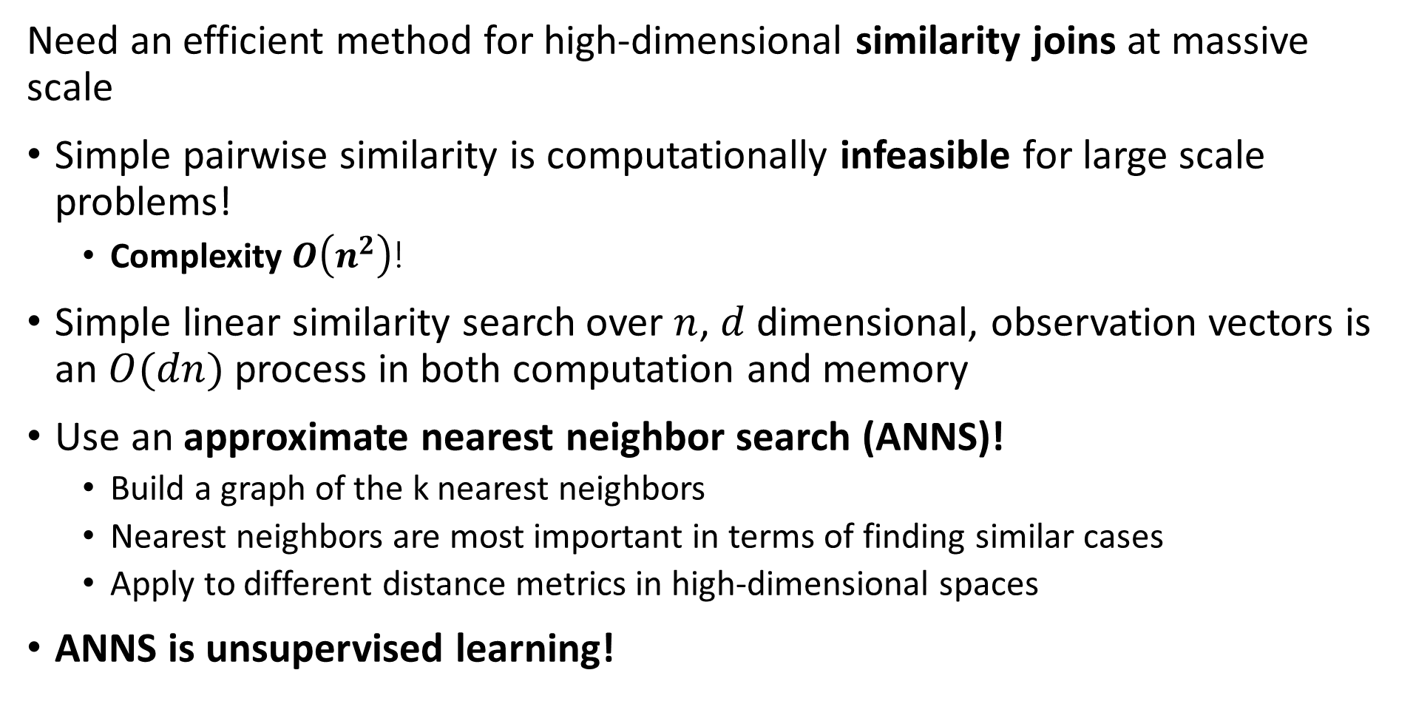
Similarity Search at Scale
Need an efficient method for high-dimensional similarity joins at massive scale
Simple pairwise similarity is computationally infeasible for large scale problems!
  Complexity $O\left(n^{2}\right)$!
Simple linear similarity search over $n$, $d$ dimensional, observation vectors is an $O(dn)$ process in both computation and memory
Use an approximate nearest neighbor search (ANNS)!
  Build a graph of the k nearest neighbors
  Nearest neighbors are most important in terms of finding similar cases
  Apply to different distance metrics in high-dimensional spaces
ANNS is unsupervised learning!

Slide 6
Similarity Search at Scale
Massive scale similarity search is at the core of many analytics and AI platforms
There is wide landscape of technologies available for the similarity search problem
Vector databases incorporate massive scale similarity search,
  Pinecone includes FAISS
  Milvus from Zilli
  Chroma
  Weaviate
  And many more…
Cloud platforms often include massive scale document similarity search,
  AWS ElasticSearch
  Azure AI Search
  And others….

Slide 7
Similarity Search at Scale
Massive scale similarity search is at the core of many analytics and AI platforms
There are several vector similarity search platforms for recommender systems, document search and web search,
  Approximate Nearest Neighbor Search Oh Yeah (Annoy) from Spotify
  Qdrant
  Vearch-Gamma
  Vespa
  OpenSearch
  And others…
We will focus on Facebook AI Similarity Search (FAISS)
  FAISS is widely used as a basis for many similarity search platforms
We will explore specific solutions using these algorithms in subsequent lessons

Slide 8
Similarity Search at Scale
We need an efficient way to (approximately) perform similarity joins at massive scale
Need an efficient method for large-scale and high-dimensional similarity joins!
Broadly, there are four classes of ANNS algorithms
  Tree search
  Hash-based search – today!
  Quantization-based search
  Graph search – today!
Apply appropriate distance metrics in high-dimensional spaces

Slide 9
Similarity Search at Scale
Pipeline for similarity joins at massive scale
Our goal is to rapidly find approximate nearest neighbors with high recall
No one method can achieve this goal
In practice use a pipeline concatenating several methods – Composite index
Distance (Similarity) Metric
Dimensionality Reduction (Embedding)
Create D dimensional numeric embedding vectors
PCA
Neural Embedding
Etc.
Coarse Quantization
Reduce scope for ANN search
Inverted file - IVF
IVF Product quantization (IVF-PQ)
Inverted Multi-Index (IMI)
IVF Hierarchical Navigable Small Worlds (HNSW)
Etc…
Fine Quantizaton
Further reduce search scope and improve recall
Exhaustive search – Flat
Residual PQ
Locally Sensitive Hashing (LSH)
Search Refinemnet
Increase recall for NN search
Flat
Residual PQ algorithm
Neural reranking

Slide 10
Similarity Search at Scale
Dimensionality reduction often applied to similarity serarch
It is easier to search in a lower-dimensional space
Many possible transformations to lower-dimensional embedding space
  Some algorithms start with a nearest neighbor similarity search!
  Can use a neural network to find an embedding space, but computationally expensive
Ideally want an orthogonal embedding space
More on embedding and dimensionality reduction in next lesson

Slide 11
Hierarchical Navigable Small World (HNSW) Graphs

Slide 12
Hierarchical Navigable Small World Graphs
Hierarchical Navigable small world (HNSW) graphs for ANNS where first proposed for ANNS by Malkov and Yashunin, 2016
A HNSW graph performs an ANNS on a hierarchy of graphs in two greedy search steps
  Search through hierarchy from top to bottom with increasing detail, ‘zooming in’
  Search at most detailed level, ‘zooming out’
HNSW graphs incorporate several concepts
  Proximity graphs
  Probabilistic hierarchical search
  Navigable small world graphs

Slide 13
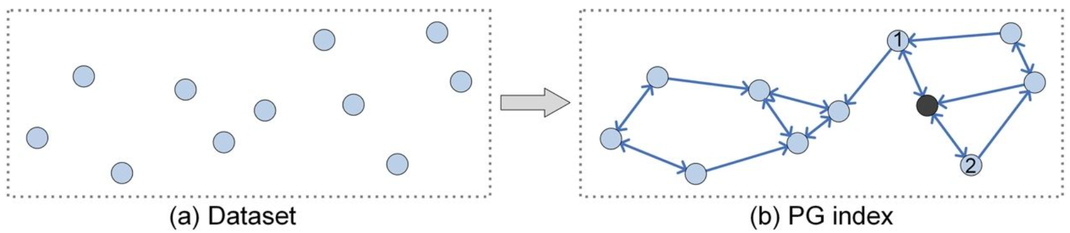
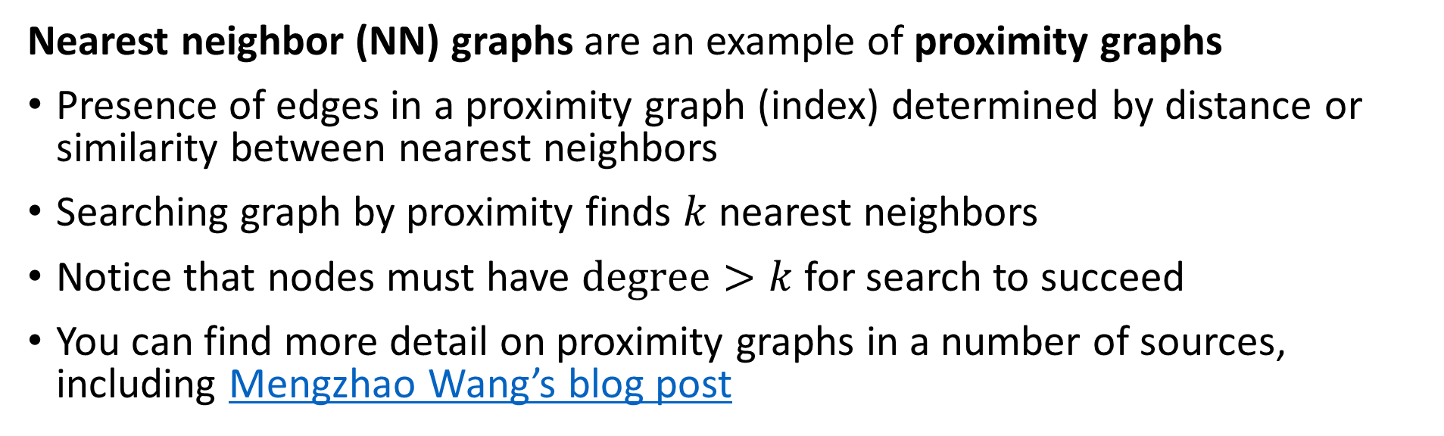
Proximity Graphs
Nearest neighbor (NN) graphs are an example of proximity graphs
Presence of edges in a proximity graph (index) determined by distance or similarity between nearest neighbors
Searching graph by proximity finds $k$ nearest neighbors
Notice that nodes must have $degree>k$ for search to succeed
You can find more detail on proximity graphs in a number of sources, including Mengzhao Wang’s blog post
Diagram credit, Mengzhao Wang

Slide 14
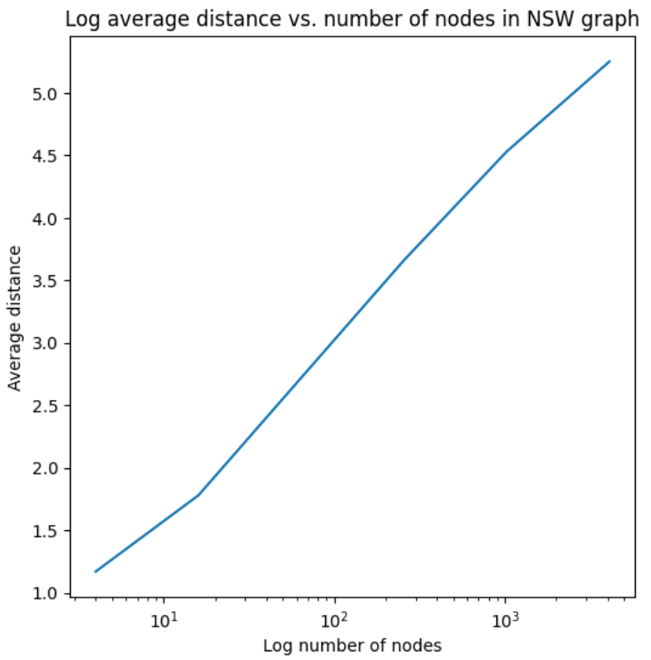
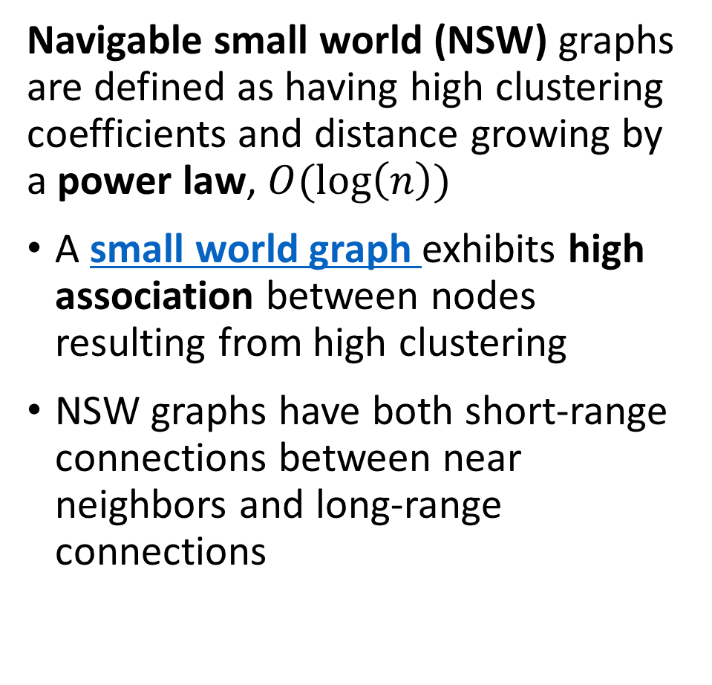
Navigable Small World Graphs
Navigable small world (NSW) graphs are defined as having high clustering coefficients and distance growing by a power law, $O(\log\left(n\right))$
A small world graph exhibits high association between nodes resulting from high clustering
NSW graphs have both short-range connections between near neighbors and long-range connections

Slide 15
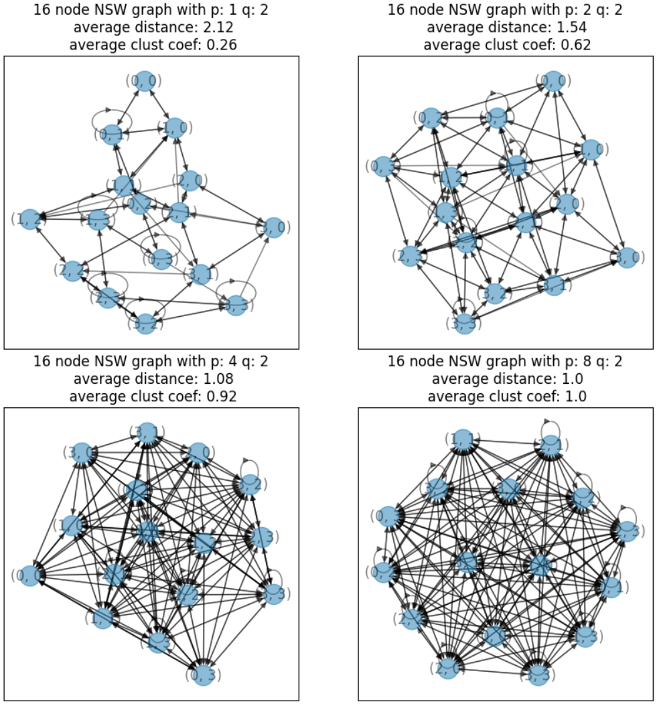
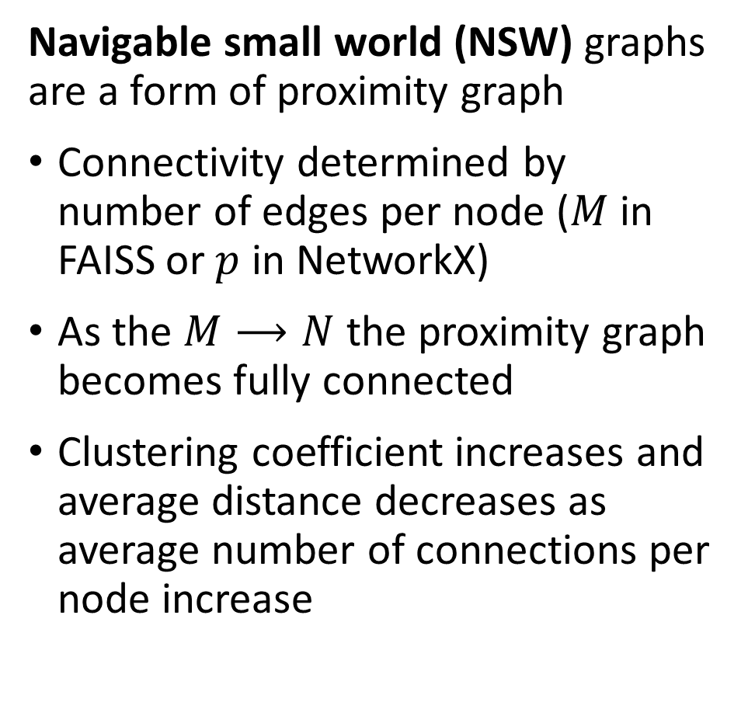
Navigable Small World Graphs
Navigable small world (NSW) graphs are a form of proximity graph
Connectivity determined by number of edges per node ($M$ in FAISS or $p$ in NetworkX)
As the $M⟶N$ the proximity graph becomes fully connected
Clustering coefficient increases and average distance decreases as average number of connections per node increase

Slide 16
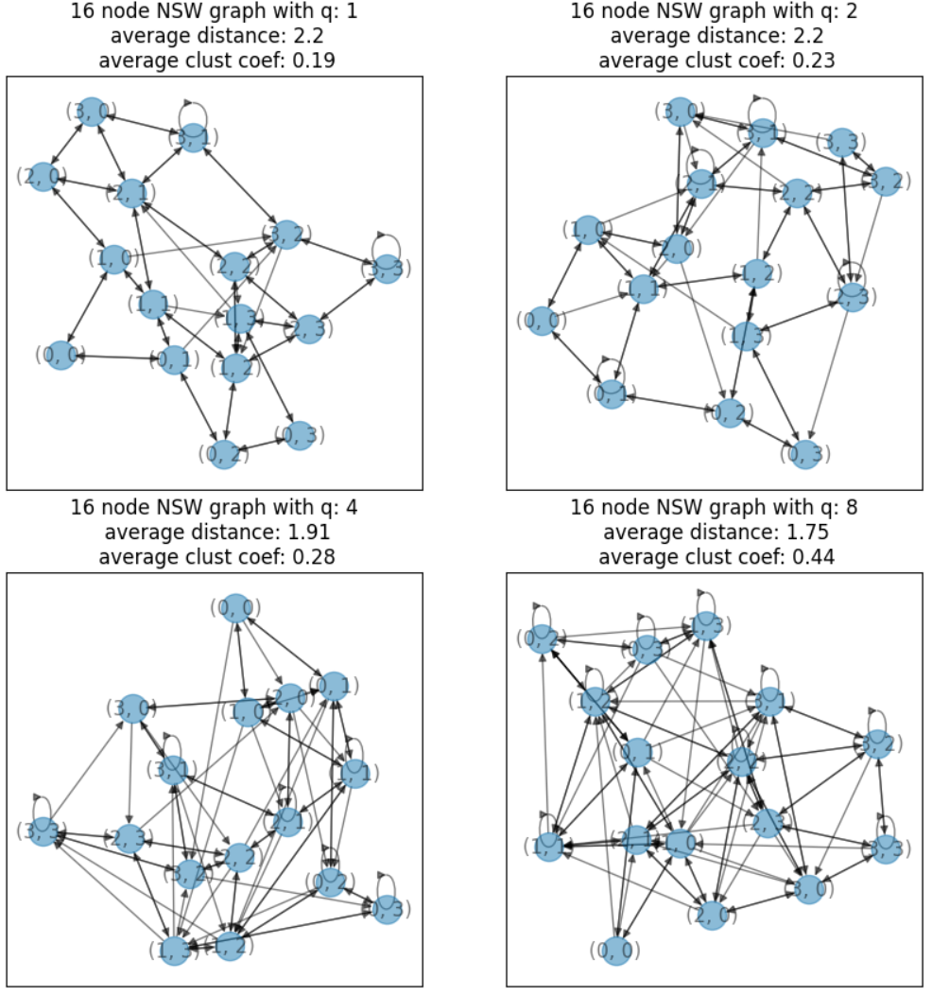
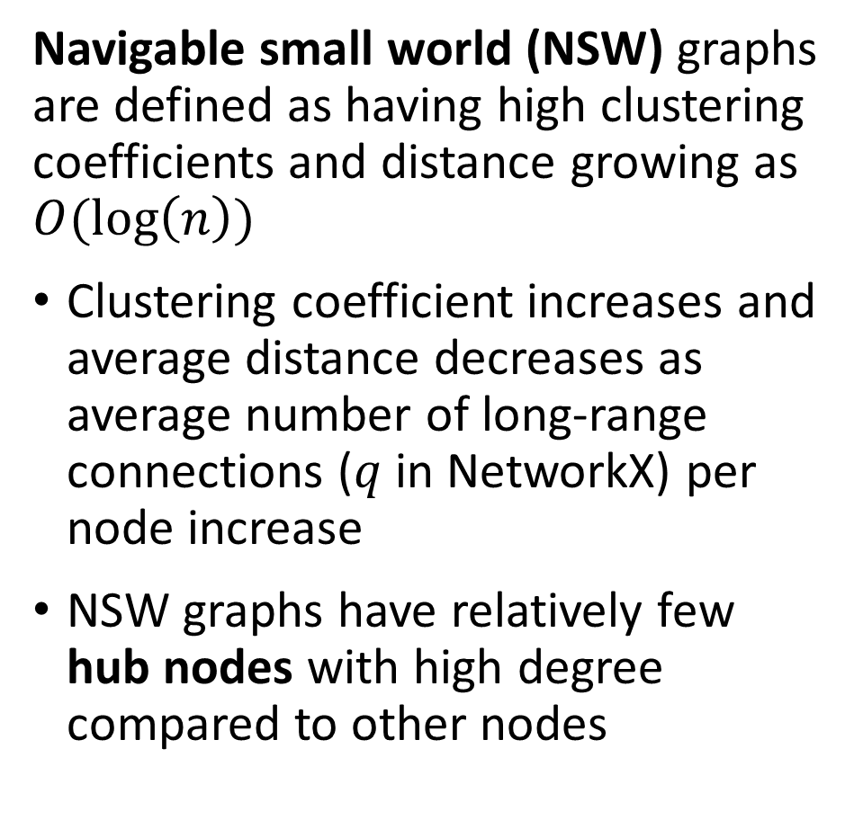
Navigable Small World Graphs
Navigable small world (NSW) graphs are defined as having high clustering coefficients and distance growing as $O(\log\left(n\right))$
Clustering coefficient increases and average distance decreases as average number of long-range connections ($q$ in NetworkX) per node increase
NSW graphs have relatively few hub nodes with high degree compared to other nodes

Slide 17
Hierarchical Navigable Small World Graphs
Hierarchical Navigable small world (HNSW) graphs enable efficient and scalable ANNS
Malkov, et. al., 2014 applied NSW graphs to the ANNS problem
  In some cases, a greedy search on a NSW effectively finds the NNs
  If the graph exhibits considerable clustering only a sub-optimal local solution will be found
  In other cases, the search path can be excessively long
Using a hierarchy of NSW graphs is more robust and helps to overcome these problems

Slide 18
Hierarchical Navigable Small World Graphs
Hierarchical navigable small world (HNSW) graphs for ANNS where first proposed for ANNS by Malkov and Yashunin, 2016
Select entry point node in top layer
Greedy search for nearest neighbor to the query vector
Zoom In
Use nearest neighbor from previous layer as entry point
Greedy search next layer for nearest neighbor
Use nearest neighbor from previous layer as entry point
Zoom Out
Search bottom layer for nearest neighbor
Nearest neighbor search on HNSW graph

Slide 19
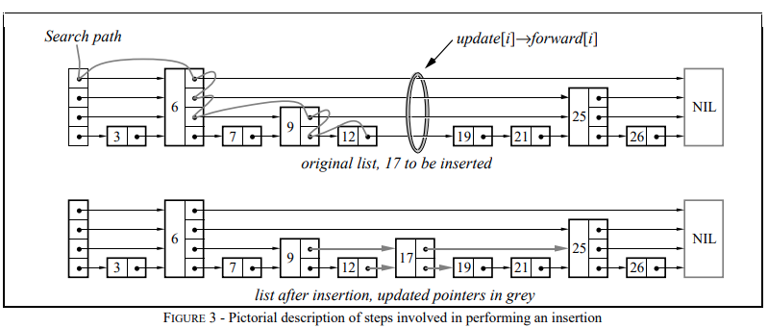
Hierarchical Navigable Small World Graphs
Hierarchical Navigable small world (HNSW) graphs enable efficient and scalable ANNS
The hierarchy of NSW graphs creates a skip list
Skip-list search was introduced by Pugh, 1990, as a fast search algorithm
A skip-list is a form of linked list using a hierarchy of long-range and short-range links
Links connecting observations are sampled probabilistically
Diagram credit, Pugh, 1990

Slide 20
Hierarchical Navigable Small World Graphs
Hierarchical Navigable small world (HNSW) graph has layers comprised of NSW graphs of increasing resolution
The highest level of the hierarchy has the longest-range edges
The search proceeds to increasingly finer detail levels
The lowest level contains all nodes and the most detail
query
Level 2
query
Level 1
query
Level 0

Slide 21
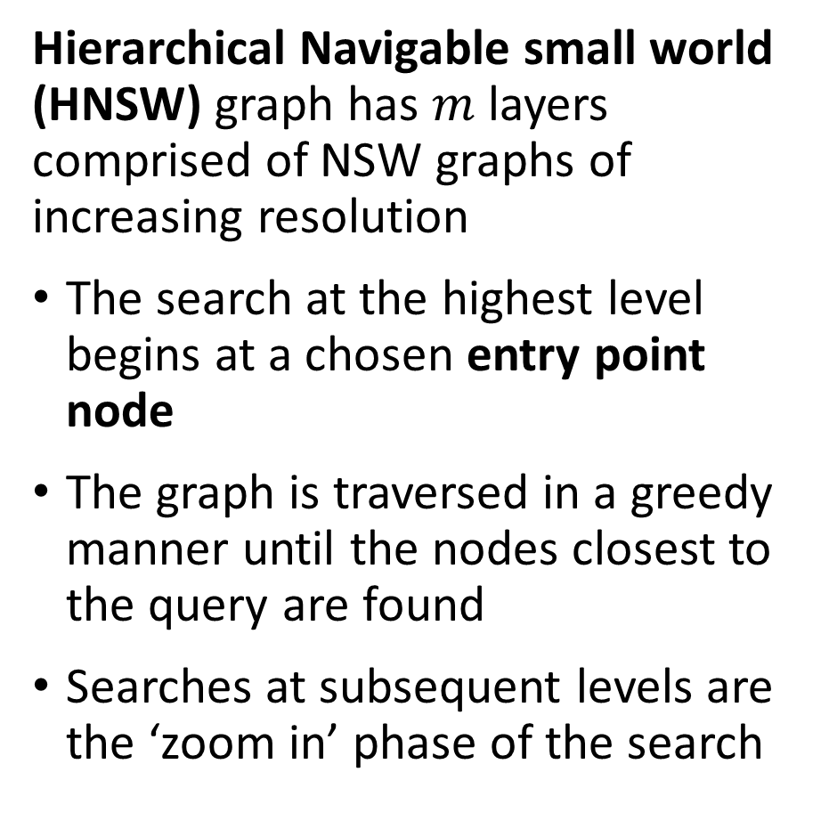
Hierarchical Navigable Small World Graphs
Hierarchical Navigable small world (HNSW) graph has $m$ layers comprised of NSW graphs of increasing resolution
The search at the highest level begins at a chosen entry point node
The graph is traversed in a greedy manner until the nodes closest to the query are found
Searches at subsequent levels are the ‘zoom in’ phase of the search
query
Level 2

Slide 22
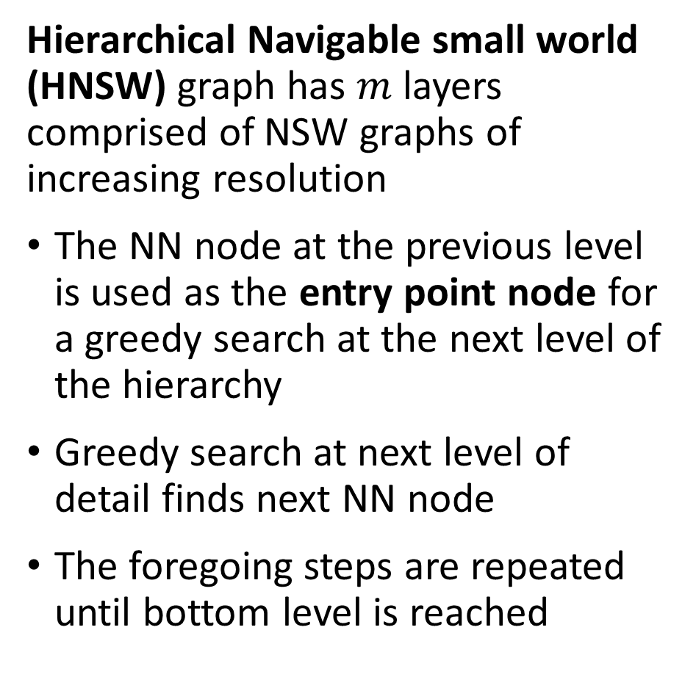
Hierarchical Navigable Small World Graphs
Hierarchical Navigable small world (HNSW) graph has $m$ layers comprised of NSW graphs of increasing resolution
The NN node at the previous level is used as the entry point node for a greedy search at the next level of the hierarchy
Greedy search at next level of detail finds next NN node
The foregoing steps are repeated until bottom level is reached
query
Level 2
query
Level 1

Slide 23
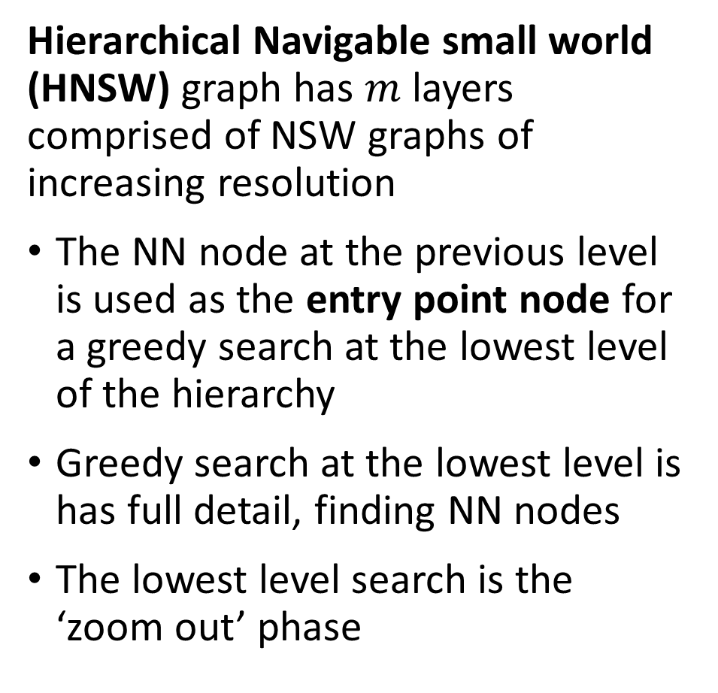
Hierarchical Navigable Small World Graphs
Hierarchical Navigable small world (HNSW) graph has $m$ layers comprised of NSW graphs of increasing resolution
The NN node at the previous level is used as the entry point node for a greedy search at the lowest level of the hierarchy
Greedy search at the lowest level is has full detail, finding NN nodes
The lowest level search is the ‘zoom out’ phase
query
Level 2
query
Level 1
query

Slide 24
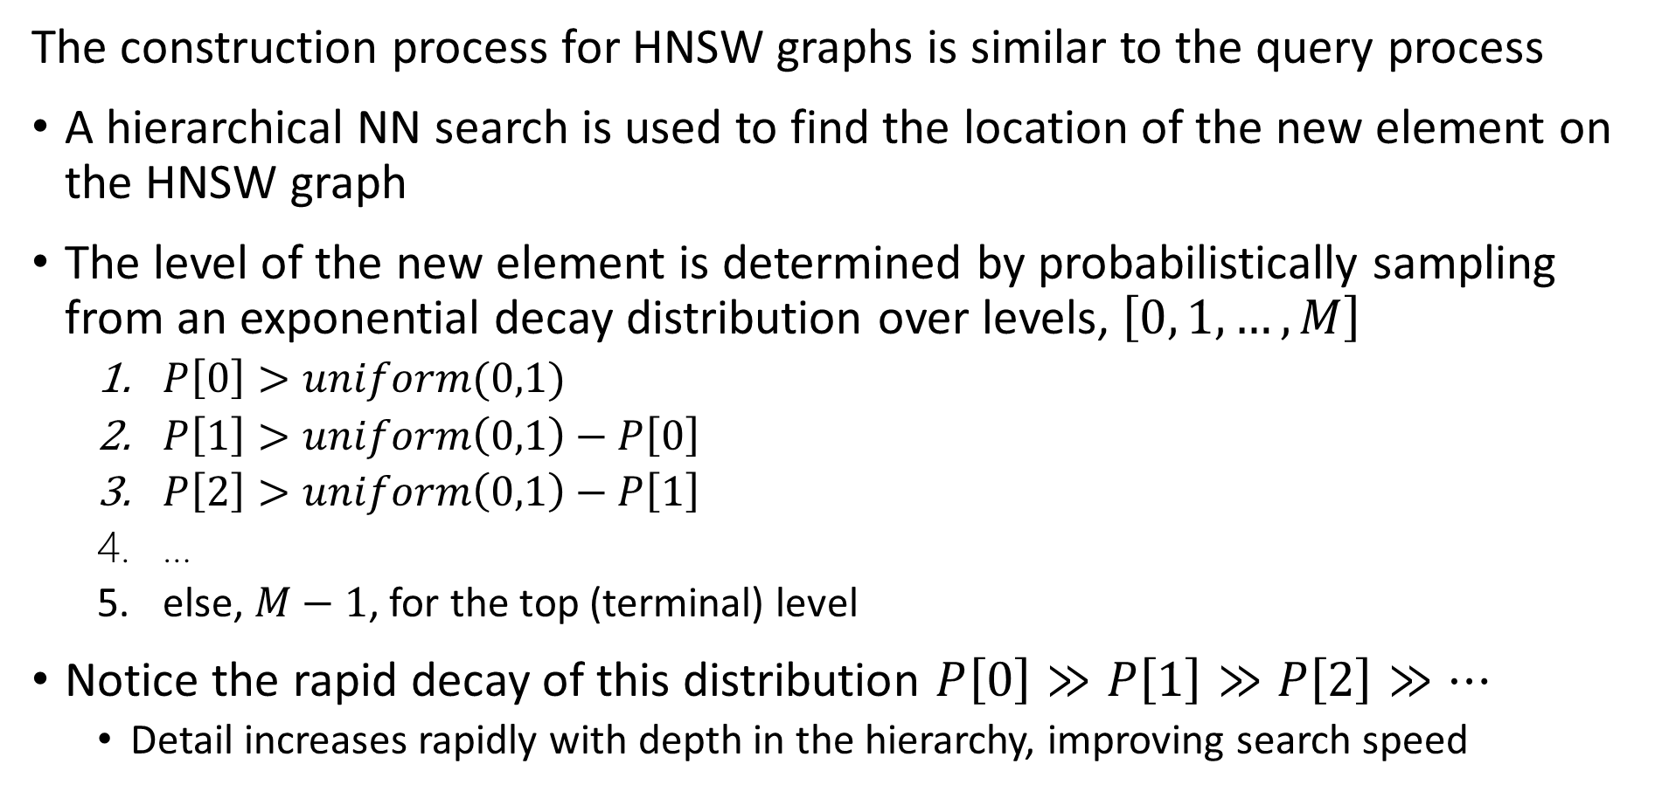
Constructing NSW Graphs
The construction process for HNSW graphs is similar to the query process
A hierarchical NN search is used to find the location of the new element on the HNSW graph
The level of the new element is determined by probabilistically sampling from an exponential decay distribution over levels, $\left[0, 1,…, M\right]$
  $P\left[0\right]>uniform(0,1)$
  $P\left[1\right]>uniform\left(0,1\right)−P\left[0\right]$
  $P\left[2\right]>uniform\left(0,1\right)−P\left[1\right]$
  …
  else, $M−1$, for the top (terminal) level
Notice the rapid decay of this distribution $P\left[0\right]≫P\left[1\right]≫P\left[2\right]≫…$
  Detail increases rapidly with depth in the hierarchy, improving search speed

Slide 25
Optimizing HNSW graph
The HNSW ANNS has several hyperparameters that affect performance
M, the number of levels, determines the number of edges each node in the graph has.
  Limits are set by M_max and M_max0 limit the number of edges in the layers and in the bottom layer, 0, with defaults M_max = M and M_max0 = 2*M
efConstruction sets the number of entry point nodes used when building the index
efSearch sets the number of entry point nodes used for the NN search

Slide 26
Optimizing HNSW ANNS
Low Memory -Scalable
The HNSW ANNS has several hyperparameters that affect performance
M determines the number of edges each node in the graph has.
  Limits are set by M_max and M_max0 limit the number of edges in the layers and in the bottom layer, 0, with defaults M_max = M and M_max0 = 2*M
efConstruction sets the number of entry points used when building the index
efSearch sets the number of entry points used for the NN search
Increasing M
Increasing M and ef’s
Low Computational Complexity-Scalable
High Recall -Accuracy

Slide 27
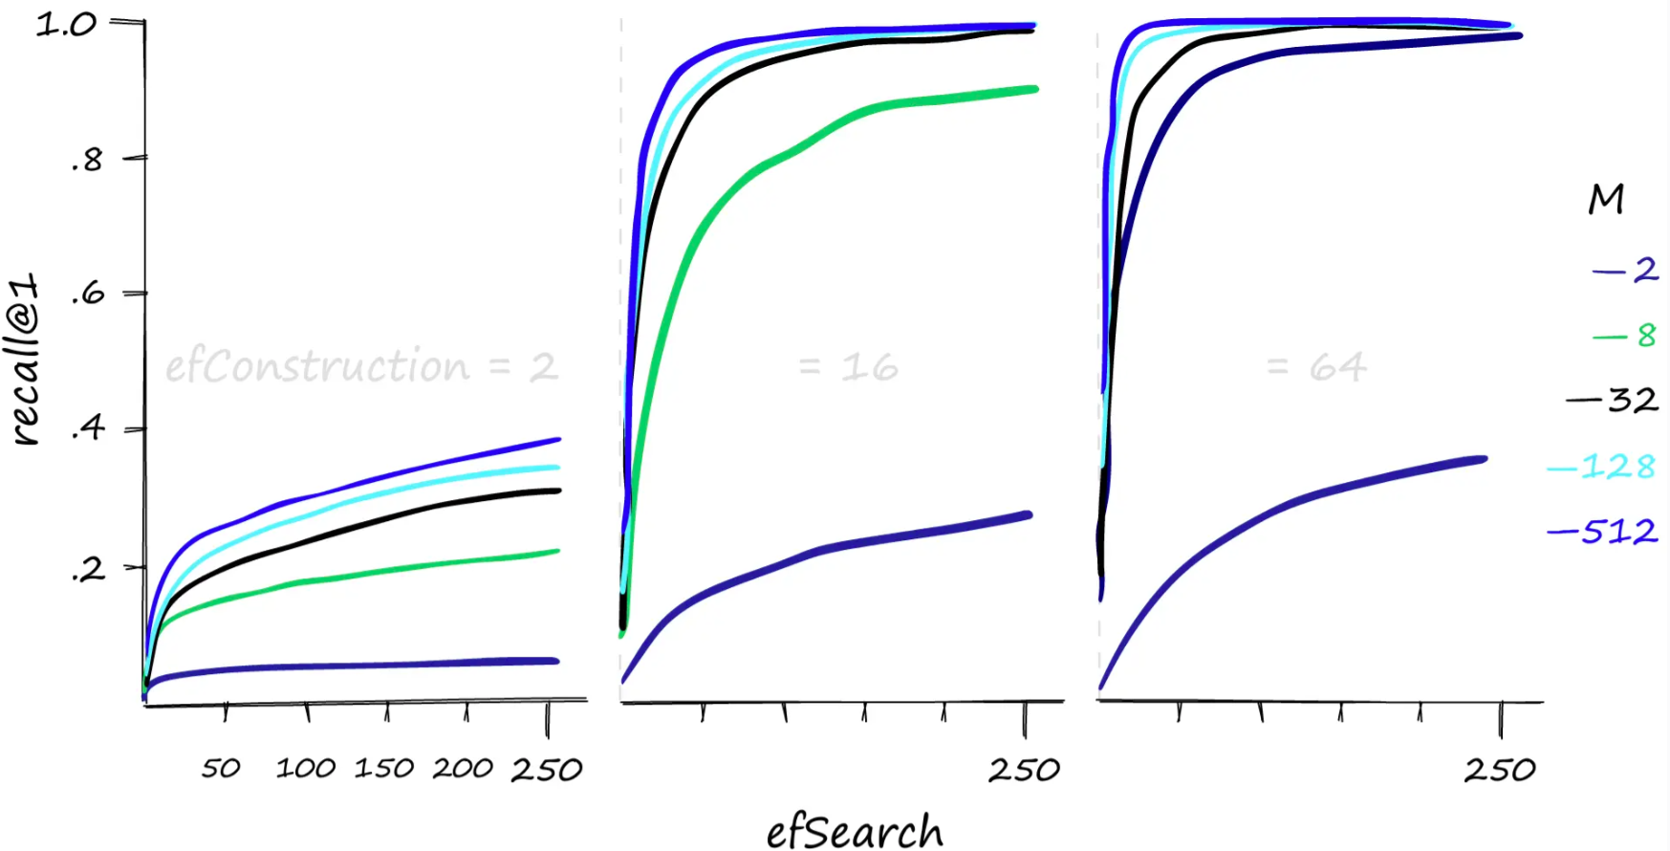
Optimizing HNSW graph
The HNSW ANNS has several hyperparameters that affect performance
ANNS with HNSW can achieve high recall but at a price
Illustration from FAISS the Missing Manual, Pinecone

Slide 28
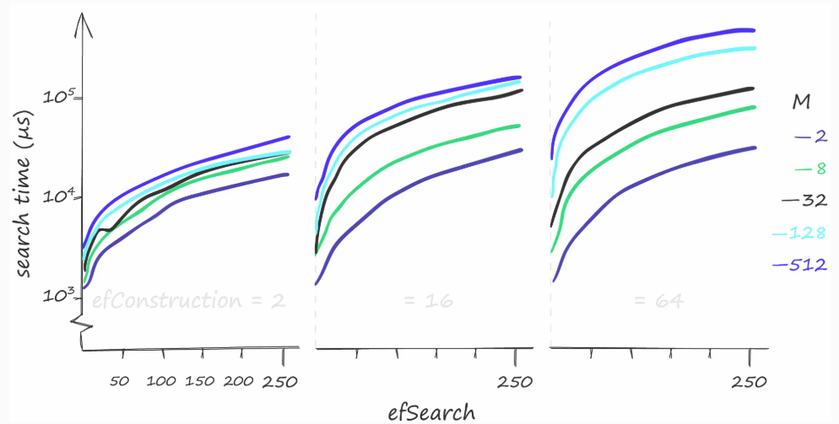
Optimizing HNSW graph
The HNSW ANNS has several hyperparameters that affect performance
Achieving higher recall with HNSW ANNS increases search time significantly
Illustration from FAISS the Missing Manual, Pinecone

Slide 29
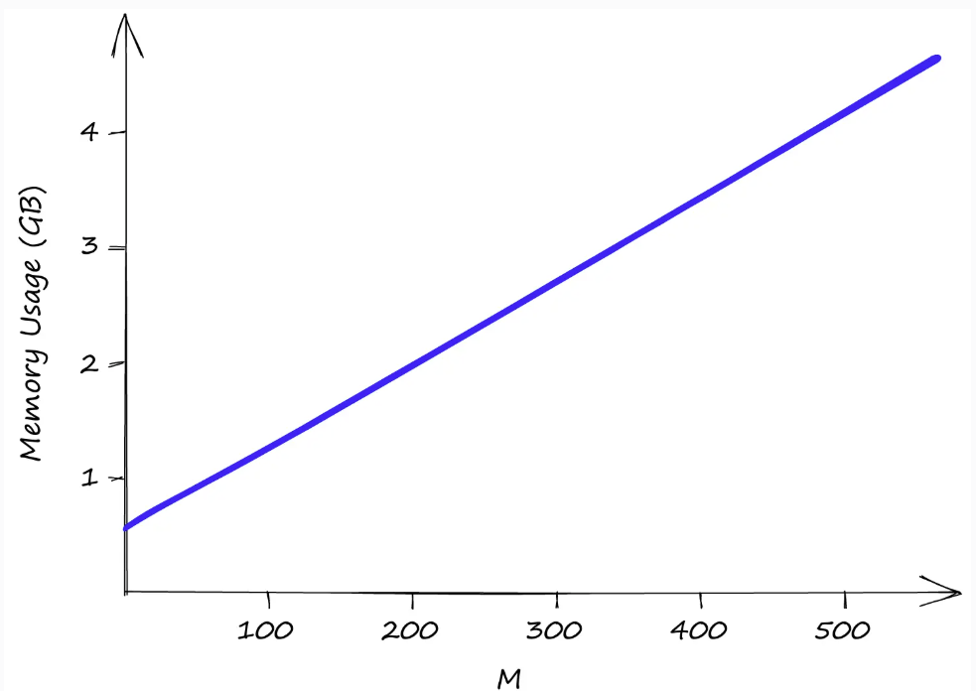
Optimizing HNSW graph
The HNSW ANNS has several hyperparameters that affect performance
Achieving higher recall by increasing M in HNSW ANNS increases memory consumption linearly
Illustration from FAISS the Missing Manual, Pinecone

Slide 30
Composite Indices

Slide 31
Composite Indices
For optimal ANNS performance a composite is created from multiple indices
While single indices can achieve good recall, it is unreasonable to expect optimal performance on all three dimensions
Optimal performance is obtained with composite indices
Distance (Similarity) Metric
Dimensionality Reduction (Embedding)
Create D dimensional numeric embedding vectors
PCA
Neural Embedding
Etc.
Coarse Quantization
Reduce scope for ANN search
Inverted file - IVF
IVF Product quantization (IVF-PQ)
Inverted Multi-Index (IMI)
IVF Hierarchical Navigable Small Worlds (HNSW)
Etc…
Fine Quantizaton
Further reduce search scope and improve recall
Exhaustive search – Flat
Residual PQ
Locally Sensitive Hashing (LSH)
Search Refinemnet
Increase recall for NN search
Flat
Residual PQ algorithm

Slide 32
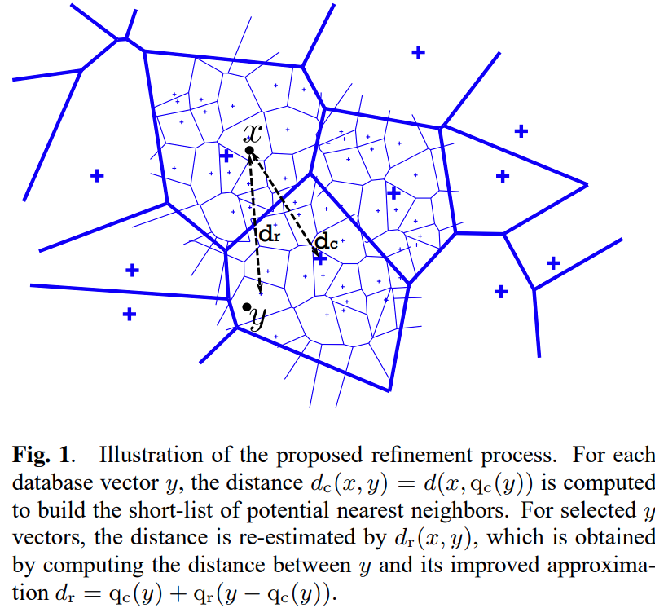
Product Quantization as a Refinement
The PQ algorithm can be used to refine searches following coarse quantization
Idea introduced by Jegou, et. al., 2011
Coarse quantization is efficient in memory and computation
PQ compresses the observation vectors
PQ is applied only to cells being probed
Concatenating these algorithms provides improved recall with low memory use and computational complexity
Figure from Jegou, et. al., 2011

Slide 33
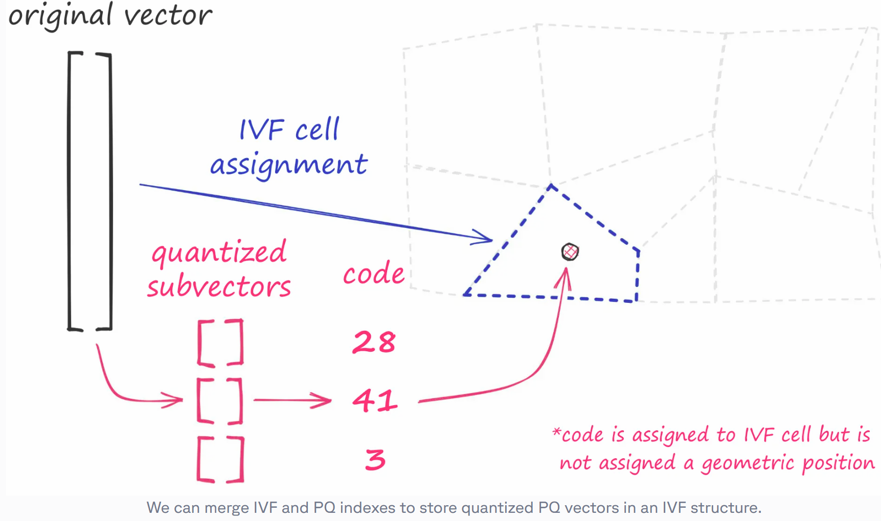
Composite Indices
For optimal ANNS performance multiple indices are concatenated
Example: concatenate IVF and PQ
  IVF quantizes vector into coarse Voronoi cells
  Vector-valued observations mapped by coarse code book
  Code maps to cell centroid
Illustration From Part 6 of FAISS the Missing Manual

Slide 34
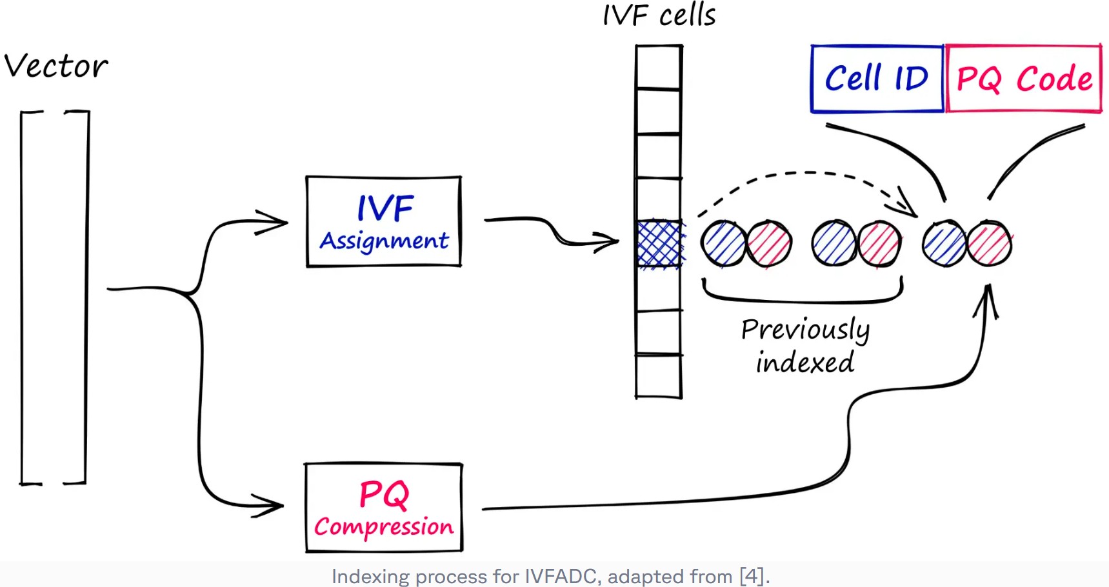
Composite Indices
For optimal ANNS performance multiple indices are concatenated
Example: query IVF and PQ
  IVF assignment determines coarse cell and code book
  PQ ASD code book compresses subvectors using code book for the coarse cell
  Subvector fine-quantize to the Voronoi regions within cell
Illustration From Part 6 of FAISS the Missing Manual

Slide 35
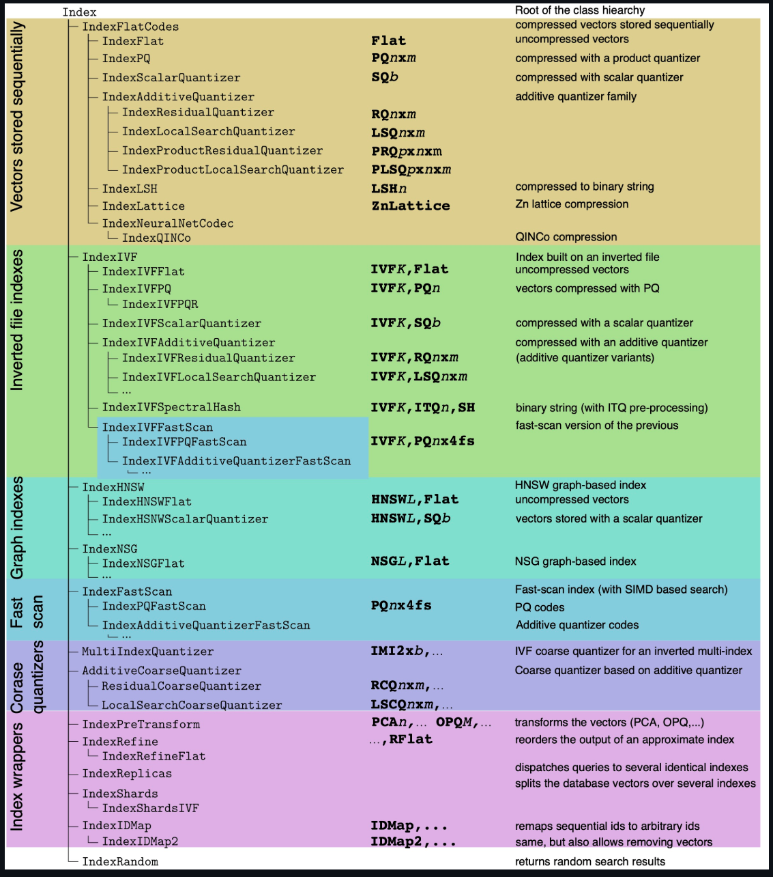
Composite Indices
For optimal ANNS performance multiple indices are concatenated
The FAISS index factory simplifies creation of Composite indices
FAISS allows a complex set of choices for Composite indices

Slide 36
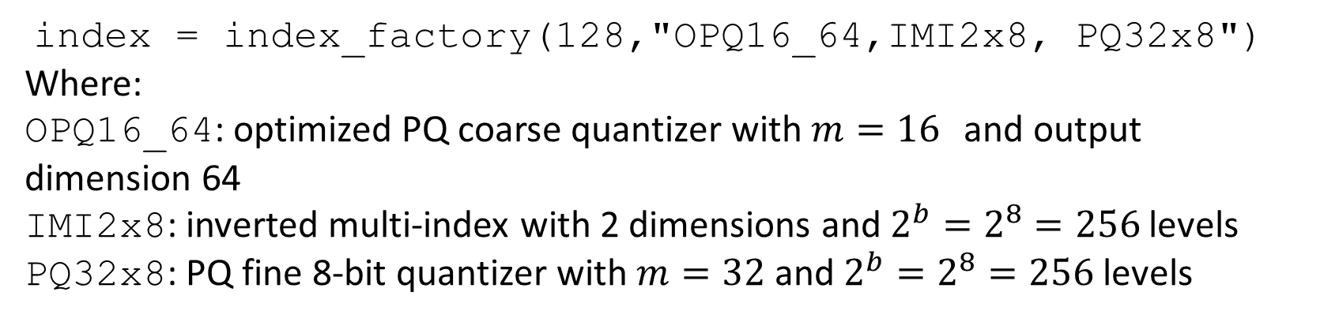
Composite Indices
How can we construct effective Composite indices?
Be careful! Order maters for Composite indicies!
  Many orderings do not make sense, actually reducing performance
  Concatenated indices must work from coarse to fine
Example of using FAISS index factory
Dimension of input vector
String specifying concatenated indexes
index = index_factory(128,"OPQ16_64,IMI2x8, PQ32x8")
Where:
OPQ16_64: optimized PQ coarse quantizer with $m=16$ and output dimension 64
IMI2x8: inverted multi-index with 2 dimensions and $2^{b}=2^{8}=256$ levels
PQ32x8: PQ fine 8-bit quantizer with $m=32$ and $2^{b}=2^{8}=256$ levels

Slide 37
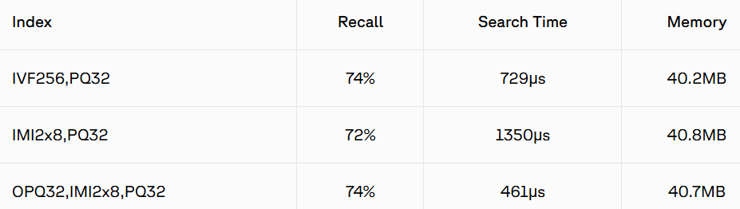
Composite Indices
Different quantization sequences result in different recall, search time and memory use
Example: The three quantization sequences all use nearly identical recall and memory use
Notice how orthogonalization (rotation) preprocessing reduces query time at no penalty in memory or recall
Table From Part 6 of FAISS the Missing Manual

Slide 38
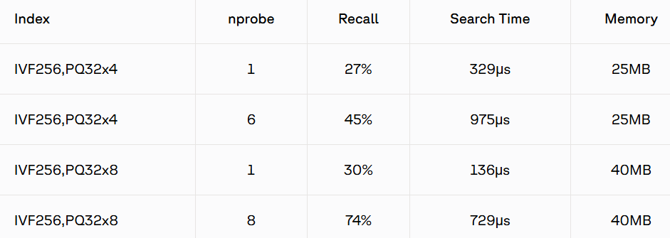
Composite Indices
Example: Hyperparameter choice affect recalls, search time and memory use
Increasing nprobe gives higher recall, but slower queries, at no change in memory
Increasing PQ subvectors quantization increases memory use but greatly boosts recall
Table From Part 6 of FAISS the Missing Manual

Slide 39
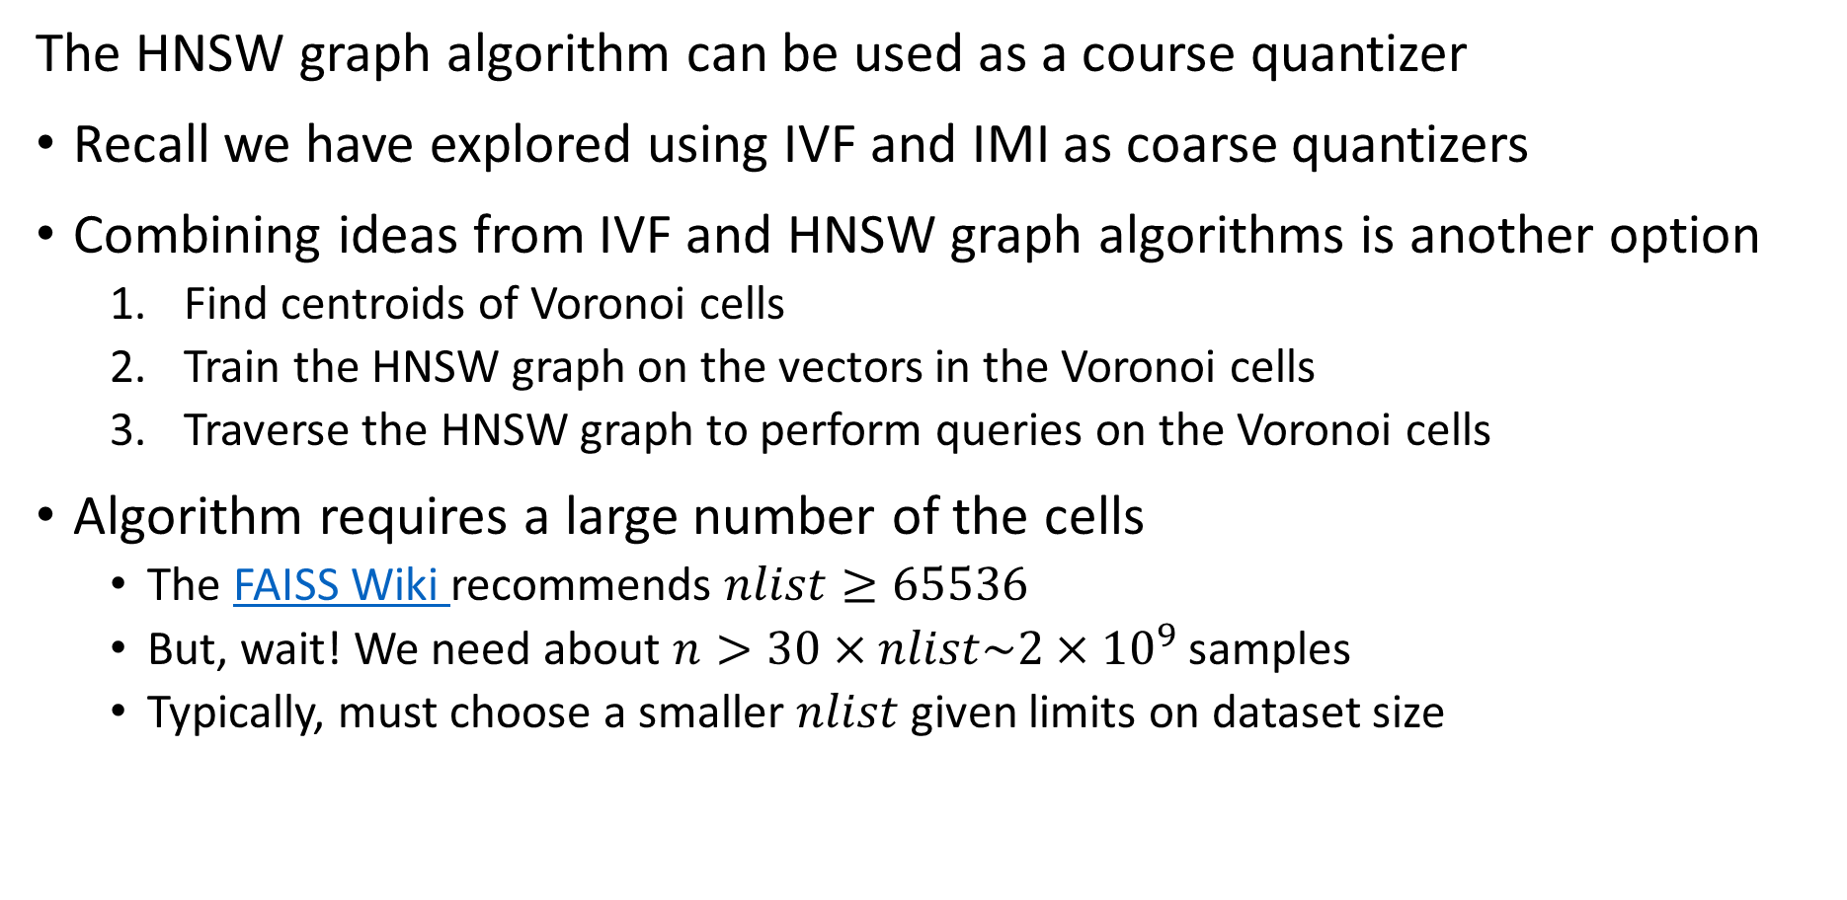
Composite Indices
The HNSW graph algorithm can be used as a course quantizer
Recall we have explored using IVF and IMI as coarse quantizers
Combining ideas from IVF and HNSW graph algorithms is another option
  Find centroids of Voronoi cells
  Train the HNSW graph on the vectors in the Voronoi cells
  Traverse the HNSW graph to perform queries on the Voronoi cells
Algorithm requires a large number of the cells
  The FAISS Wiki recommends $nlist≥65536$
  But, wait! We need about $n>30×nlist\sim 2{×10}^{9}$ samples
  Typically, must choose a smaller $nlist$ given limits on dataset size

Slide 40
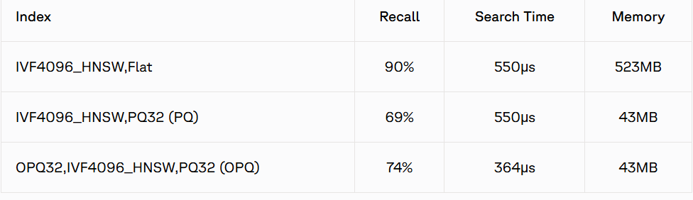
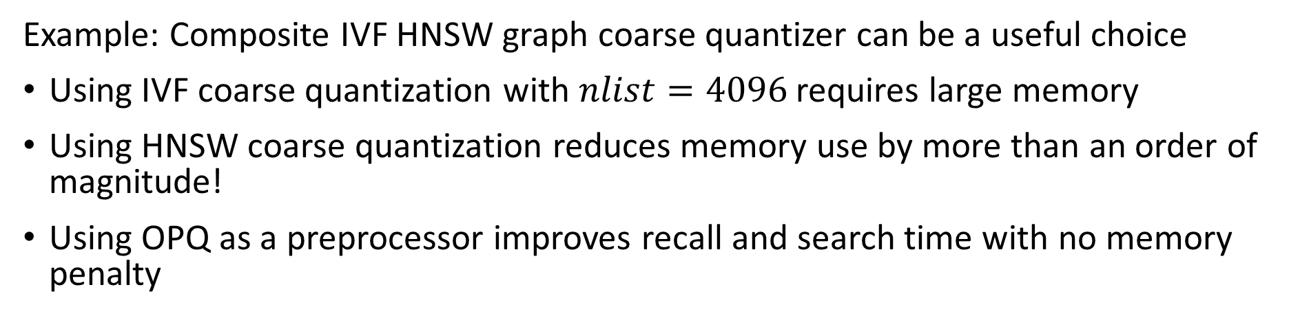
Composite Indices
Example: Composite IVF HNSW graph coarse quantizer can be a useful choice
Using IVF coarse quantization with $nlist=4096$ requires large memory
Using HNSW coarse quantization reduces memory use by more than an order of magnitude!
Using OPQ as a preprocessor improves recall and search time with no memory penalty
Table From Part 6 of FAISS the Missing Manual

Slide 41
LSH for Cosine Distance

Slide 42
Mini-Hashing Numeric Variables
How can mini-hashing be applied to numeric variables?
Can create hashes to estimate cosine distance
Cosine distances computed with numeric (real) variables
Uses computationally efficient dot products as hashes
Apply LSH to find cosine distance estimates

Slide 43

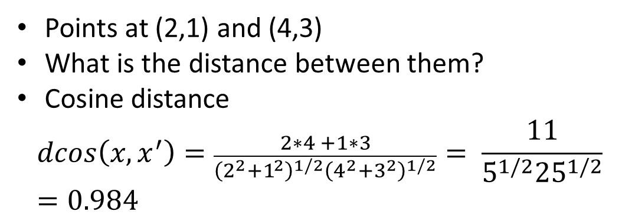
Mini-Hashing Numeric Variables
Review Cosine Similarity
$$d\left(x,x^{′}\right)=cos\left(θ_{i}\right)=\frac{x∙x′}{\left|x\right|\left|x′\right|}$$
Points at (2,1) and (4,3)
What is the distance between them?
Cosine distance
$$dcos\left(x,x^{′}\right)=\frac{2∗4 +1∗3}{{\left(2^{2}+1^{2}\right)}^{1/2}{\left(4^{2}+3^{2}\right)}^{1/2}}= \frac{11}{5^{1/2}{25}^{1/2}}=0.984$$
(4,3)
X₂
θ
(2,1)
X₁

Slide 44
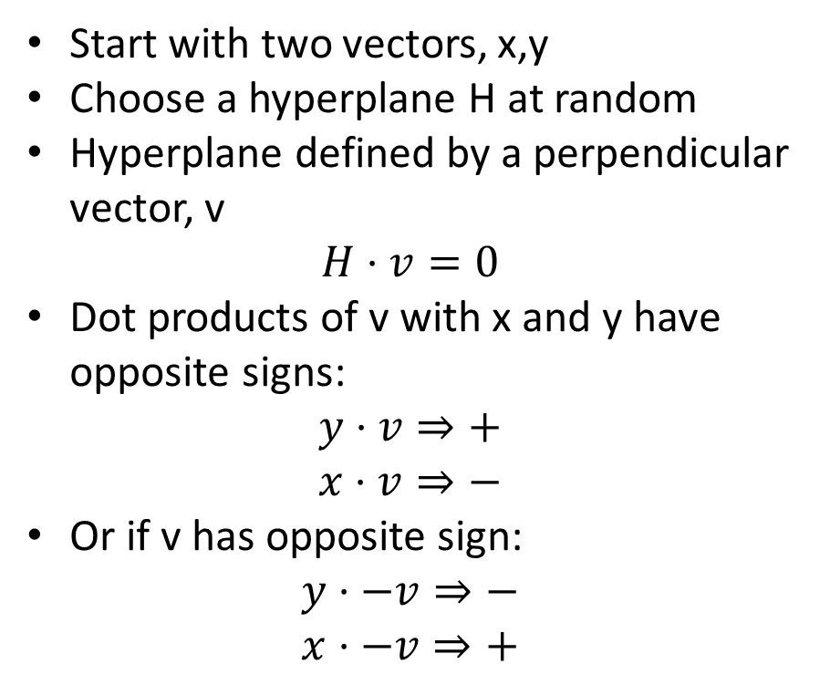
Mini-Hashing Numeric Variables
Create hashes with random hyperplanes
Start with two vectors, x,y
Choose a hyperplane H at random
Hyperplane defined by a perpendicular vector, v
$$H⋅v=0$$
Dot products of v with x and y have opposite signs:
$$y⋅v⇒+$$
$$x⋅v⇒−$$
Or if v has opposite sign:
$$y⋅−v⇒−$$
$$x⋅−v⇒+$$
y
v
θ
x
H

Slide 45
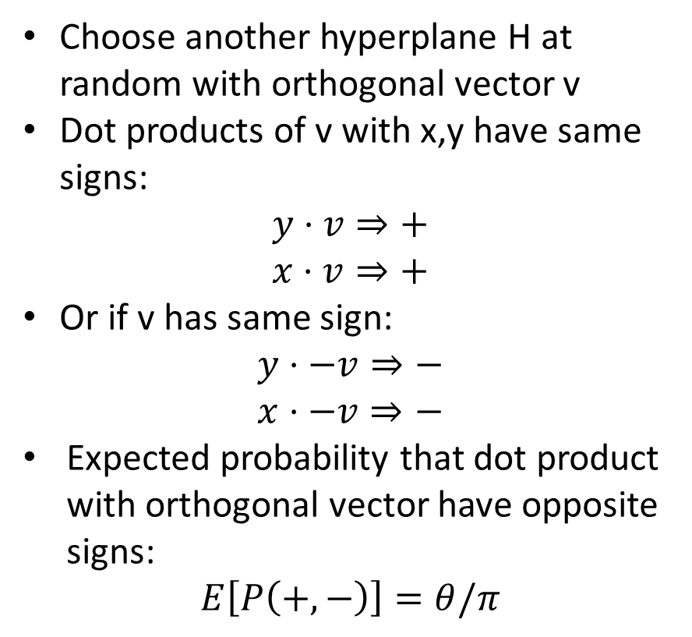
Mini-Hashing Numeric Variables
Create hashes with random hyperplanes
Choose another hyperplane H at random with orthogonal vector v
Dot products of v with x,y have same signs:
$$y⋅v⇒+$$
$$x⋅v⇒+$$
Or if v has same sign:
$$y⋅−v⇒−$$
$$x⋅−v⇒−$$
Expected probability that dot product with orthogonal vector have opposite signs:
$$E\left[P\left(+,−\right)\right]=θ/π$$
y
v
θ
x
H

Slide 46
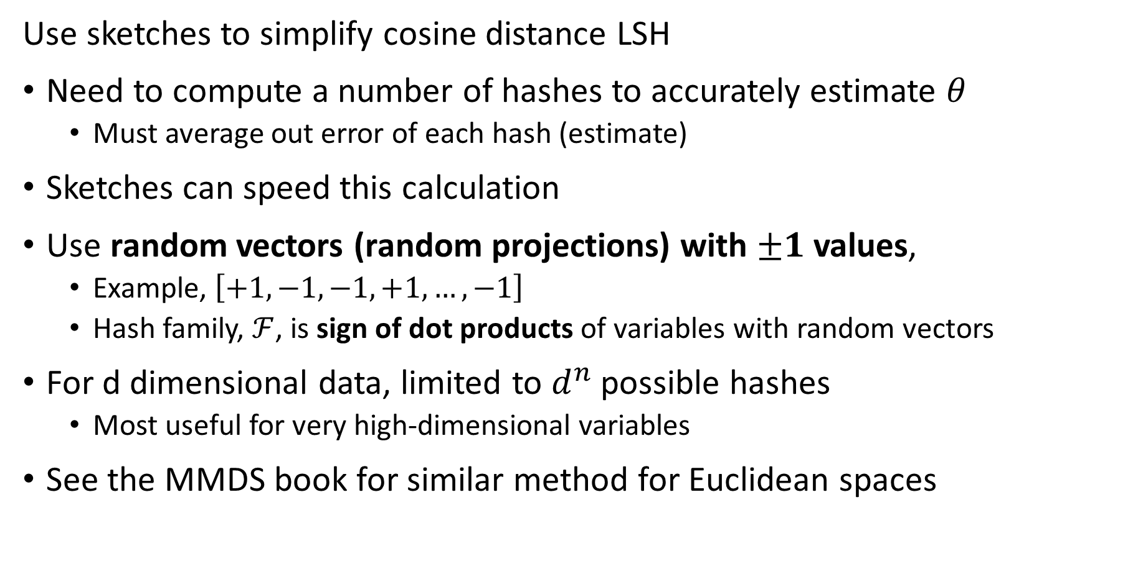
LSH for Numeric Variables
Use sketches to simplify cosine distance LSH
Need to compute a number of hashes to accurately estimate $θ$
  Must average out error of each hash (estimate)
Sketches can speed this calculation
Use random vectors (random projections) with $±1$ values,
  Example, $\left[+1,−1,−1,+1,…,−1\right]$
  Hash family, $ℱ$, is sign of dot products of variables with random vectors
For d dimensional data, limited to $d^{n}$ possible hashes
  Most useful for very high-dimensional variables
See the MMDS book for similar method for Euclidean spaces

Slide 47
Locally Sensitive Hashing

Slide 48
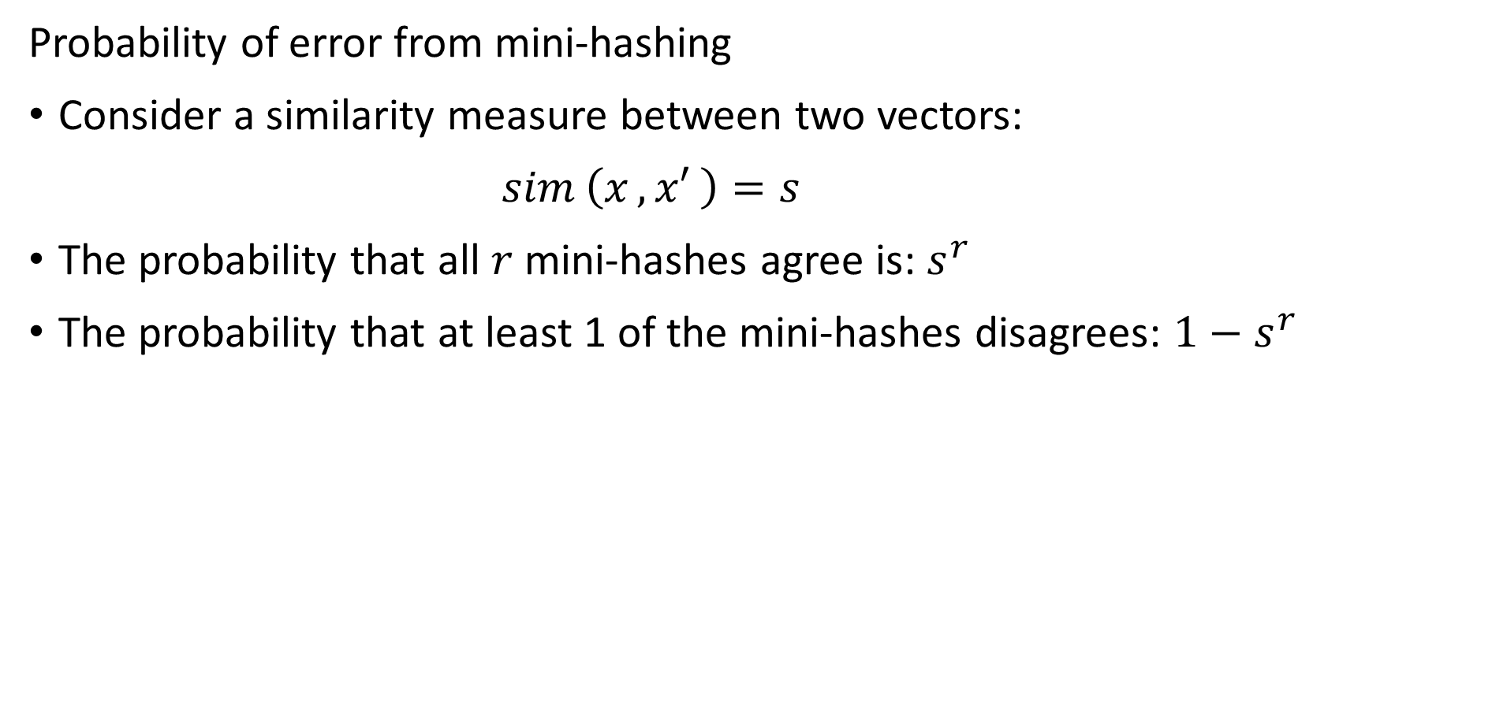
Locally Sensitive Hashing
Probability of error from mini-hashing
Consider a similarity measure between two vectors:
${sim}_{ }\left(x_{ },{x′}_{ }\right)=s$
The probability that all $r$ mini-hashes agree is: $s^{r}$
The probability that at least 1 of the mini-hashes disagrees: $1−s^{r}$

Slide 49
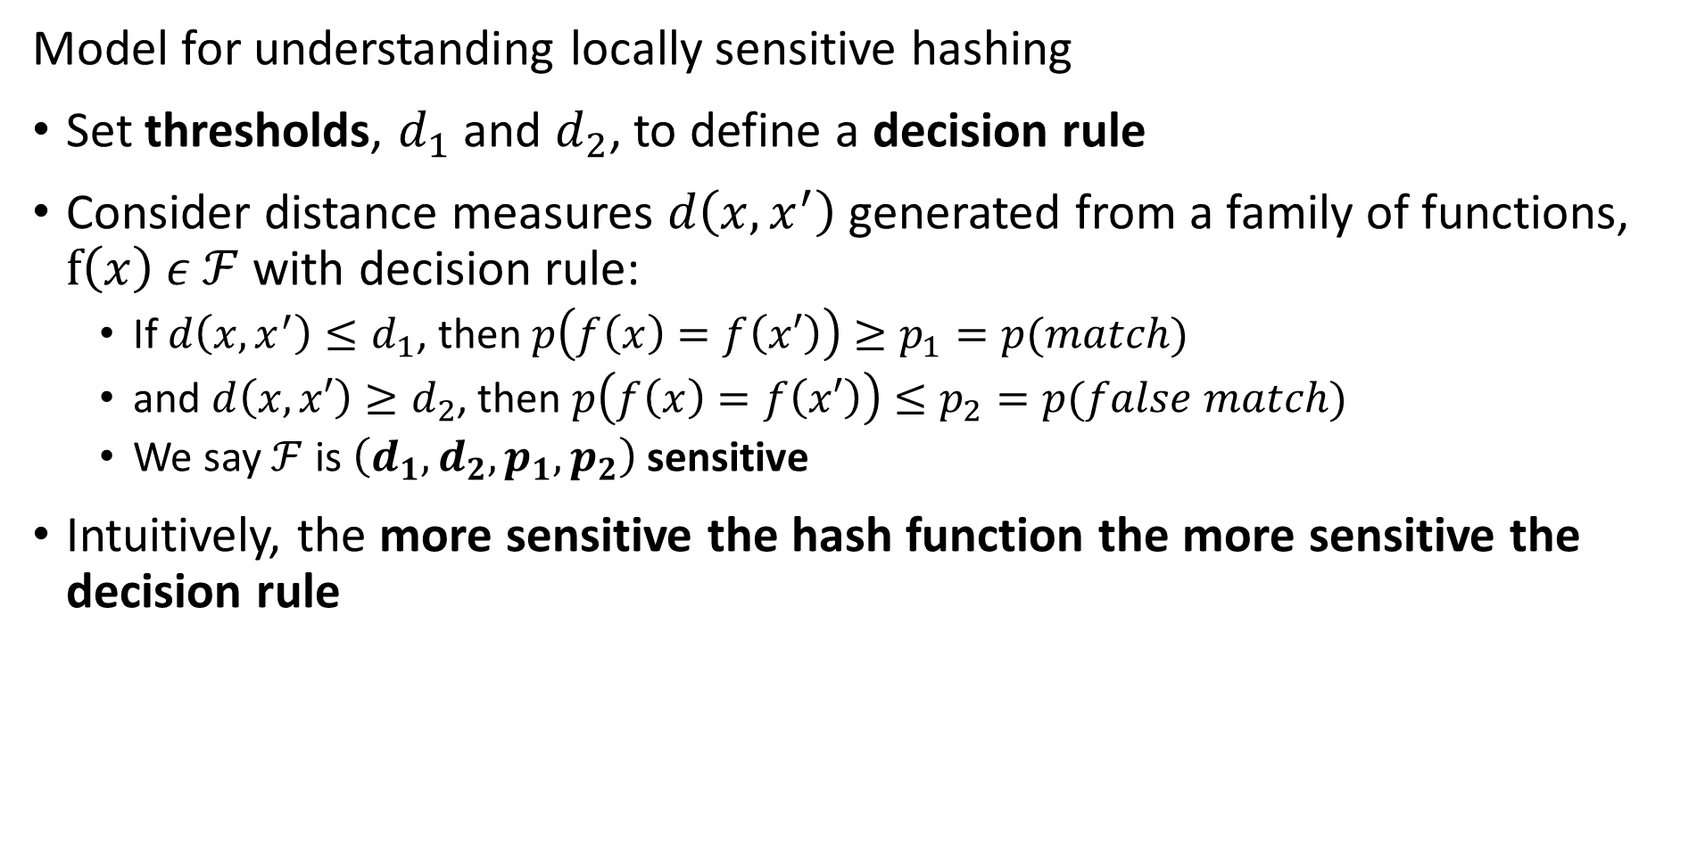
Locally Sensitive Functions
Model for understanding locally sensitive hashing
Set thresholds, $d_{1}$ and $d_{2}$, to define a decision rule
Consider distance measures $d\left(x, x^{′}\right)$ generated from a family of functions, $f\left(x\right) ε ℱ$ with decision rule:
  If $d\left(x,x^{′}\right)≤d_{1}$, then $p\left(f\left(x\right)=f\left(x′\right)\right)≥p_{1}=p(match)$
  and $d\left(x,x′\right)≥d_{2}$, then $p\left(f\left(x\right)=f\left(x′\right)\right)≤p_{2}=p(false match)$
  We say $ℱ$ is $\left(d_{1},d_{2},p_{1},p_{2}\right)$ sensitive
Intuitively, the more sensitive the hash function the more sensitive the decision rule

Slide 50
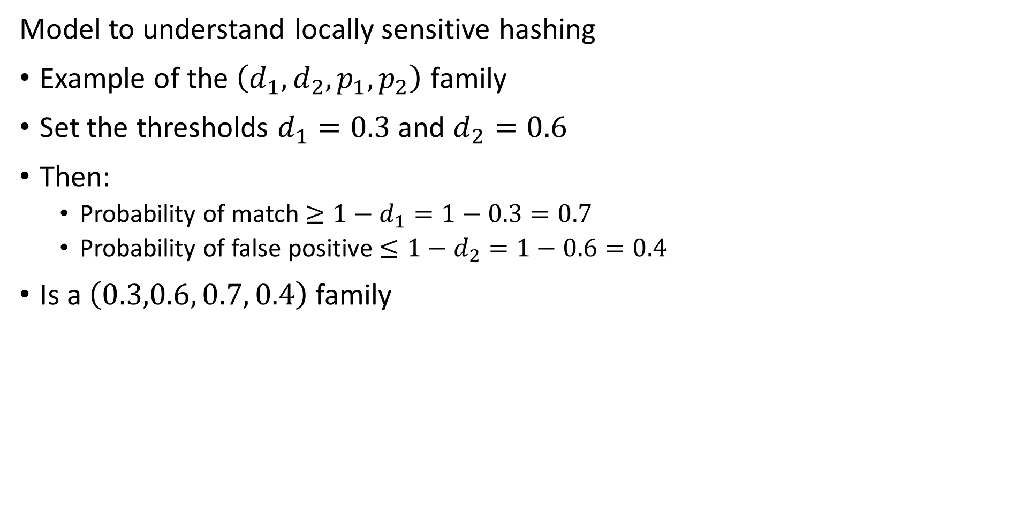
Locally Sensitive Functions
Model to understand locally sensitive hashing
Example of the $\left(d_{1},d_{2}, p_{1}, p_{2}\right)$ family
Set the thresholds $d_{1}=0.3$ and $d_{2}=0.6$
Then:
  Probability of match $≥1−d_{1}=1−0.3=0.7$
  Probability of false positive $≤1−d_{2}=1−0.6=0.4$
Is a $\left(0.3,0.6, 0.7, 0.4\right)$ family

Slide 51
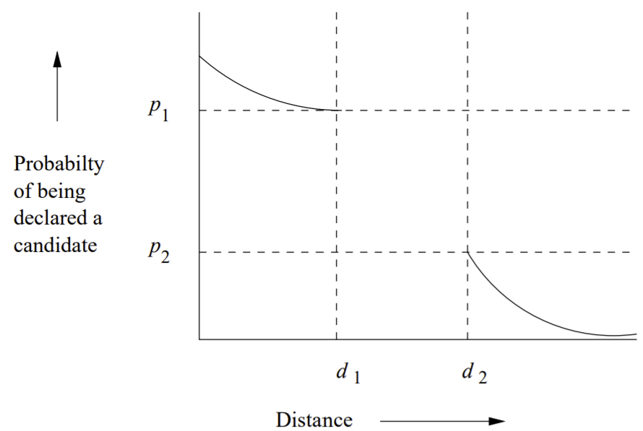
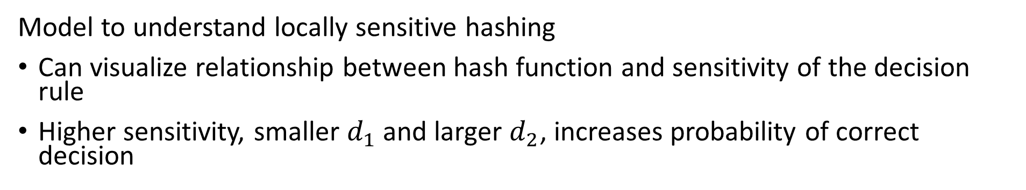
Locally Sensitive Functions
Model to understand locally sensitive hashing
Can visualize relationship between hash function and sensitivity of the decision rule
Higher sensitivity, smaller $d_{1}$ and larger $d_{2}$, increases probability of correct decision
False Negative
False Positive
Credit; Leskovec et.al. 2020

Slide 52
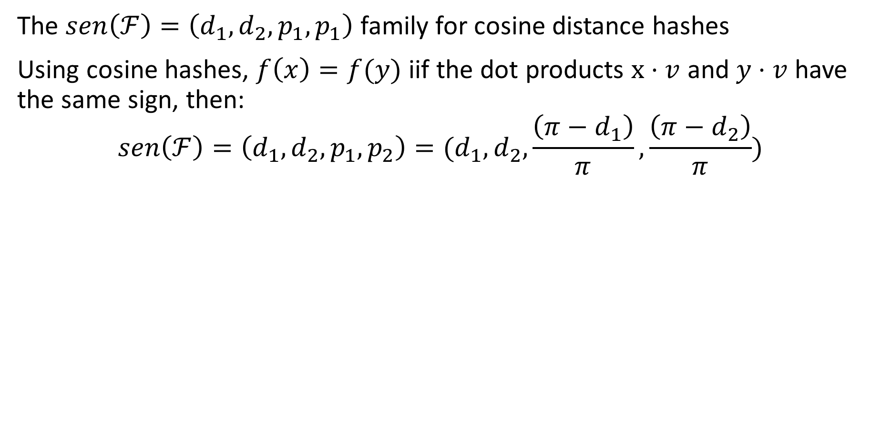
LSH for Cosine Similarity
The $sen\left(ℱ\right)=\left(d_{1},d_{2},p_{1},p_{1}\right)$ family for cosine distance hashes
Using cosine hashes, $f\left(x\right)=f(y)$ iif the dot products $x⋅v$ and $y⋅v$ have the same sign, then:
$$sen\left(ℱ\right)=\left(d_{1},d_{2},p_{1},p_{2}\right)=(d_{1},d_{2},\frac{\left(π−d_{1}\right)}{π},\frac{\left(π−d_{2}\right)}{π})$$

Slide 53
Improving LSH

Slide 54
Locally Sensitive Hashing
Probability of error from mini-hashing
Single mini-hash yields low sensitivity to positive cases
How can we improve on local sensitivity?
We employ b bands of r mini-hashes per band
Signature 1
Band 1
Signature 2
…
Signature r
Signature 1
Band 2
Signature 2
…
Signature r
…
Signature 1
Band b
Signature 2
…
Signature r

Slide 55
Improving Locally Sensitive Functions
How can we improve local sensitivity of a family of functions $ℱ$?
Start with $sen\left(ℱ\right)=\left(d_{1},d_{2},p_{1},p_{2}\right)$
Construct a new family from $ℱ$, called $ℱ′$ by AND-construction
Construct family from $r$ distance function: $ℱ^{′}=\left\{f_{1},f_{2},…,f_{r}\right\}$
Assuming independence of the distance functions:
$$sen\left(ℱ^{′}\right)=\left(d_{1},d_{2},{( p_{1}^{ })}^{r},{(p_{2})}^{r}\right)$$
AND-construction uses agreement – logical AND
AND-construction decreases both decision thresholds, since $p_{1}^{ },p_{2}^{ }<1$

Slide 56
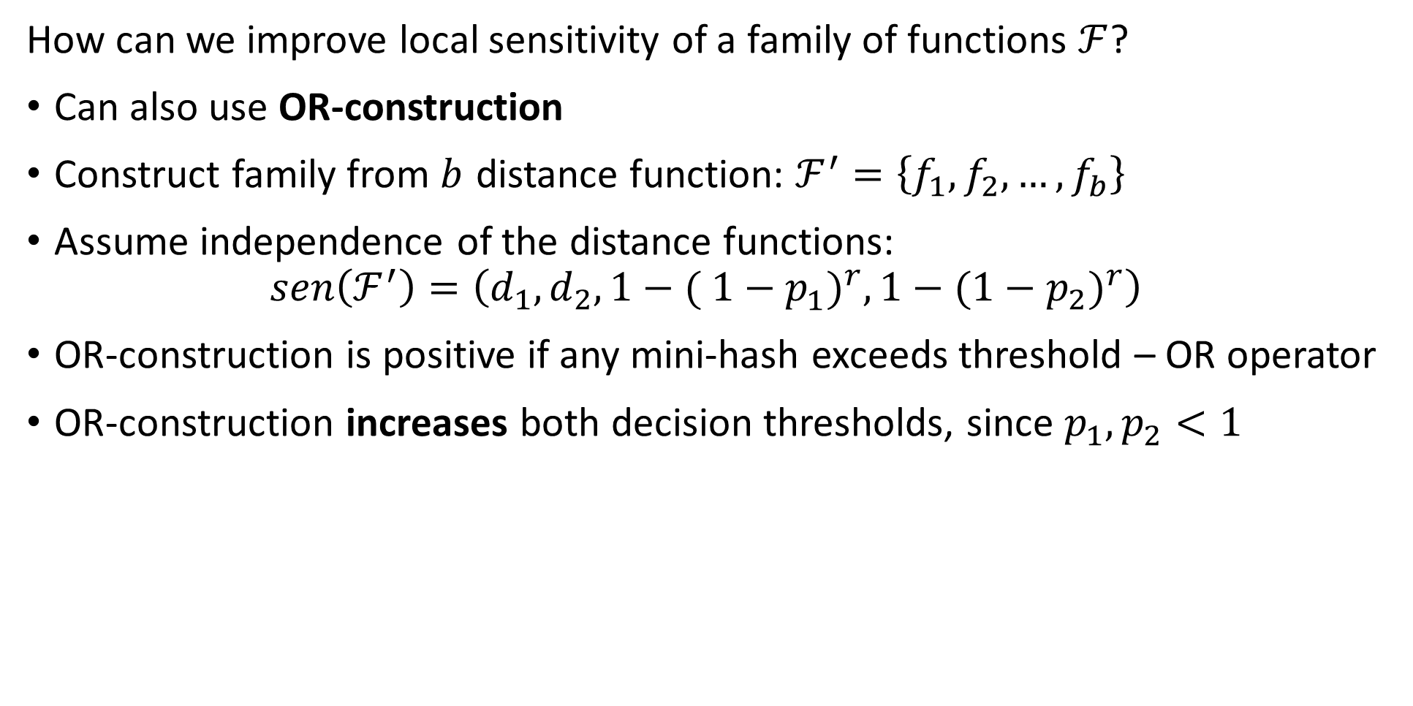
Improving Locally Sensitive Functions
How can we improve local sensitivity of a family of functions $ℱ$?
Can also use OR-construction
Construct family from $b$ distance function: $ℱ^{′}=\left\{f_{1},f_{2},…,f_{b}\right\}$
Assume independence of the distance functions:
$$sen\left(ℱ^{′}\right)=\left(d_{1},d_{2},{1−( 1−p_{1}^{ })}^{r},{1−({1−p}_{2})}^{r}\right)$$
OR-construction is positive if any mini-hash exceeds threshold – OR operator
OR-construction increases both decision thresholds, since $p_{1}^{ },p_{2}^{ }<1$

Slide 57
Improving Locally Sensitive Functions
How can we improve local sensitivity of a family of functions $ℱ$?
Can get the best of both by combining AND-construction and OR-construction
  r hashes per band
  d bands
Option 1: AND-OR-Construction – apply AND-Construction first then apply OR-Construction, giving sensitivity:
$$1−{\left(1−p^{r}\right)}^{b}$$
Option 2: OR-AND-Construction – apply OR-Construction first then apply AND-Construction, giving sensitivity:
$${\left(1−{\left(1−p\right)}^{b}\right)}^{r}$$

Slide 58
Improving Locally Sensitive Functions
How can we improve local sensitivity of a family of functions $ℱ$?
Example: $d=4$ and $r=4$
Increased sensitivity for both constructions
  AND-OR-Construction slightly biased to negative cases
  OR-AND-Construction slightly biased to positive cases
p | AND-OR-Construction | OR-AND-Construction
0.1 | 3.9994E-04 | 1.3987E-02
0.2 | 6.3847E-03 | 1.2150E-01
0.3 | 3.2008E-02 | 3.3345E-01
0.4 | 9.8535E-02 | 5.7395E-01
0.5 | 2.2752E-01 | 7.7248E-01
0.6 | 4.2605E-01 | 9.0147E-01
0.7 | 6.6655E-01 | 9.6799E-01
0.8 | 8.7850E-01 | 9.9362E-01
0.9 | 9.8601E-01 | 9.9960E-01

Slide 59
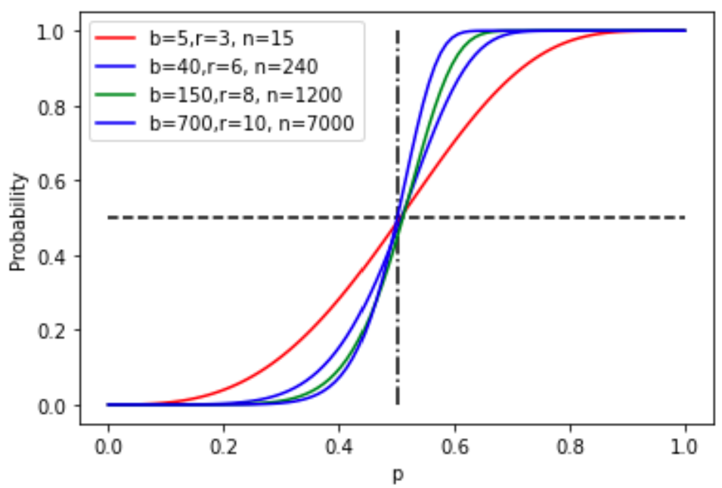
Improving Locally Sensitive Functions
How can we improve local sensitivity of a family of functions $ℱ$?
Example: AND-OR construction of LSH decision function
Optimal choice of $b,r$ given $n$
Notice, slope of decision function increases with $n$

Slide 60
Efficient LSH

Slide 61
Efficient LSH
What is an efficient algorithm for LSH?
Pairwise comparison is inefficient
  $\frac{n(n−1)}{2}$ pairs
  Computational complexity $O\left(n^{2}\right)$
  Or $O\left(k n\log{n}\right)$ for KD-tree
Use hash buckets to find candidate pairs
  Band of signature matrix hash to bucket
  More than one hash in bucket is candidate pair
  Hashing algorithm with computational complexity $O\left(n^{ }\right)$!

Slide 62
Efficient LSH
Candidate 1 1
Candidate 2
Hash Table
Signature 1
Signature 1
Hash 1
Efficient algorithm for LSH uses hash table
Start with hash table
Signatures arranged in bands
Hash signatures in bands to hash buckets
Match hash to same bucket indicates high similarity
Band 1
Signature 2
Signature 2
Hash 2
…
…
Hash 3
Signature r
Signature r
Hash 4
Signature 1
Signature 1
Hash 5
Band 2
Signature 2
Signature 2
Hash 6
…
…
Hash 7
Signature r
Signature r
Hash 8
…
…
…
Signature 1
Signature 1
Hash n-2
Band b
Signature 2
Signature 2
Hash 2 n-1
…
…
Hash n
Signature r
Signature r

Slide 63
Summary

Slide 64
Summary
Summary of algorithms discussed: See also this page in the FAISS Wiki
Algorithm | Dataset Size | Recall | Memory | Query Speed | Metrics Typically Used
KD Tree | Small to medium, low-dimensional | Exact | Low | Fast | Minkowski, also see Sklean docs
Flat | Small stand-alone – typically combined with other algorithms | Exact | High | Slow | Default L2, also see FAISS Wiki
IVF | Massive | Low | Low | Fast | Default L2, also see FAISS Wiki
IMI | Massive | Low - higher than IVF | Low - higher than IVF | Fast | Default L2, also see FAISS Wiki
LSH | Medium size and very high dimensions | Low | Medium | Fast | Jaccard, Hamming, Cosine
PQ, RPQ, OPQ | Medium to Massive if combined with IVF-IMI | Medium | Low – high compression | Fast to medium | Default L2, also see FAISS Wiki
HNSW | Medium to large if combined with IVF-IMI | High | High | Medium to slow | Default L2, also see FAISS Wiki

Slide 65
Summary
Key points for this lesson
Exact nearest neighbor search is not scalable to massive dataset
Broadly, there are four classes of ANNS algorithms
  Tree search
  Hash-based search
  Quantization-based search
  Graph search
ANNS on massive datasets requires trade-offs between performance characteristics
  Recall
  Memory
  Query speed
Can apply different distance metrics to ANNS
Composite index can achieve greater performance

