Slide 1

CSCI E-96
Data Mining, Exploration and Discovery
Information Retrieval and Search Algorithms
Steve Elston
Copyright 2021, 2022, 2023, 2024, 2025, 2026 Stephen F Elston. All rights reserved.

Slide 2
Main topics in this course
The main topics in this course are interconnected and build on each other
1. Hashing and K-V pair management
2. Distance and Similarity Metrics
3. Graph Algorithms
Foundations
Core Algorithms
2. Dimensionality Reduction
5. Similarity Search and NN Algorithms
4. Online Algorithms
3. Social Network Analysis
6. Web/Document ranking and search
7. Recommender Algorithms
8. Clustering Algorithms
Taks Speific Algorithms

Slide 3
Lesson Overview
Information retrieval is a foundation of many data mining tasks
Vector search is core to information retrieval
Vector search requires embedding
  Dense embedding BERT family of models
  Sparse text embedding models, e.g. BM25
Sparse-dense information retrieval pipelines improve performance
  Efficient search for large number of potential results
Reranking improves overall results
SPLADE models for improve sparse embedding
CLIP models for embedding images and multimodal (text) embedding

Slide 4
Information Retrieval
Web search is a subset of the general information retrieval problem
Search of documents, medical, legal, technical, etc.
Web search
Product similarity for recommendations
Question and response systems
Retrieval augmented generation (RAG)
Conversational assistance
De-duplicate document databases
Genomics research
Etc.

Slide 5
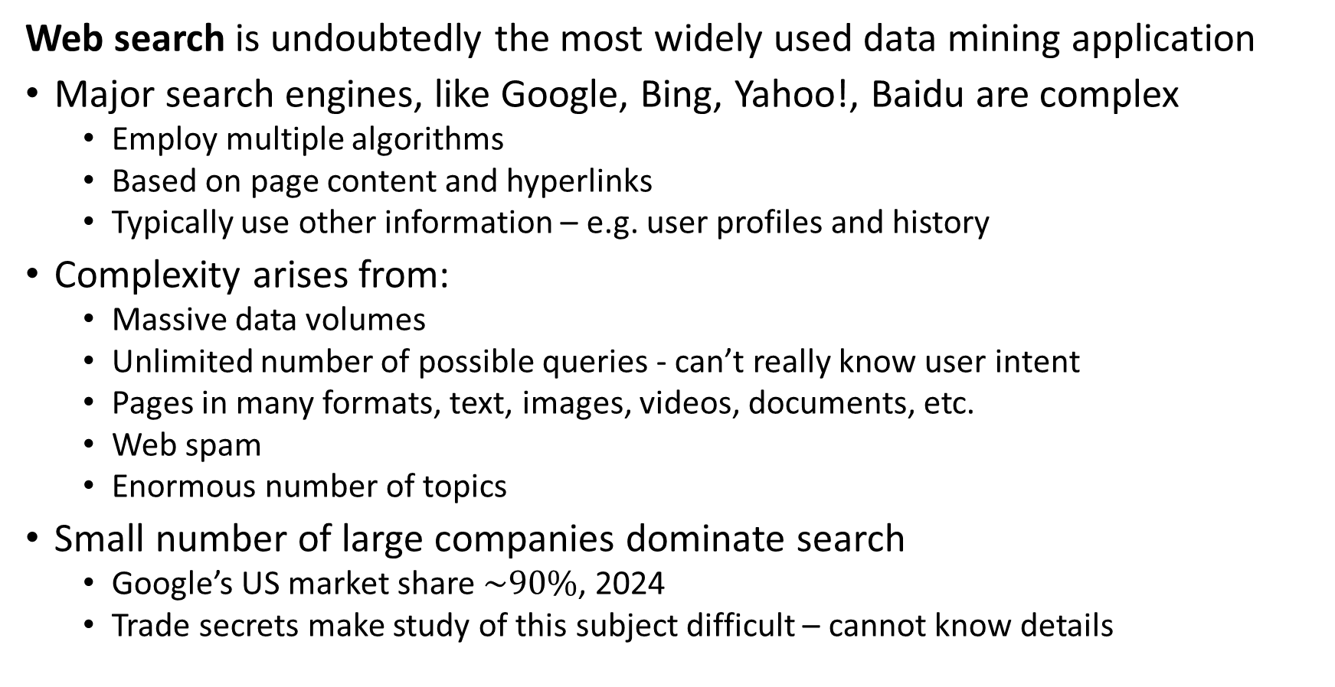
Introduction to Web Searching
Web search is undoubtedly the most widely used data mining application
Major search engines, like Google, Bing, Yahoo!, Baidu are complex
  Employ multiple algorithms
  Based on page content and hyperlinks
  Typically use other information – e.g. user profiles and history
Complexity arises from:
  Massive data volumes
  Unlimited number of possible queries - can’t really know user intent
  Pages in many formats, text, images, videos, documents, etc.
  Web spam
  Enormous number of topics
Small number of large companies dominate search
  Google’s US market share $\sim 90\%$, 2024
  Trade secrets make study of this subject difficult – cannot know details

Slide 6
Introduction to Web Searching
Many pitfalls in text search
Limited length query may not contain complete semantics or context
Natural language used for query is often ambiguous
  Example: Query for ‘Jaguar numbers’ could refer to an endangered large cat, an automobile, a sports team, or maybe something else??
Keywords are not unique to a topic
  Example: ‘Bank’ can refer to a financial institution, the edge of river, or the an aircraft maneuver, or …
Keywords have synonyms
  Example of two queries with different key words but identical semantics
  “What was the loss of farm land in the US in 2024”
  “How many cultivated acers were lost in the US during 2024”

Slide 7
Introduction to Web Searching
What about the role of LLMs in search?
LLMs create a summary of documents discovered with a high similarity to a query
LLMs require an efficient search of documents as basis of summary
Web search and ranking are key to effective summarization by LLMs through RAG algorithms
The economics of using LLMs as a primary information retrieval tool is not favorable given the high cost per token and slow response times!

Slide 8
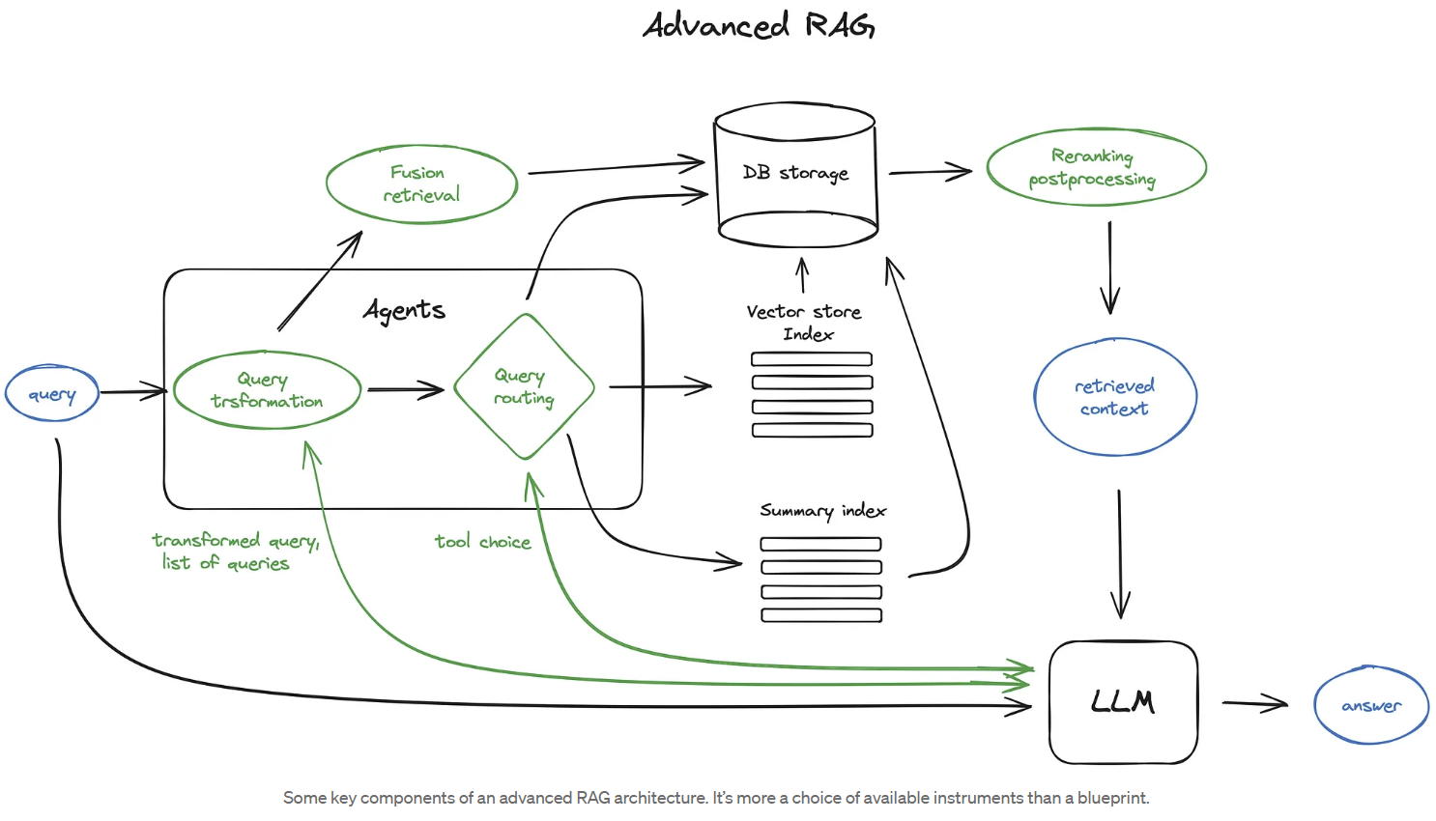
Similarity Search at Scale
Example of massive similarity search for retrieval augmented generation (RAG)
Ranking typically uses cosine similarity
We are focused on massive index and search problem
Diagram from blog post by Ivan Ilin

Slide 9
Components of Document Similarity Search Systems

Slide 10
Steps for Document Search
Document search pipelines have a number of key steps
Documents are sharded into smaller chunks that can be processed
  Performance of embedding models degrades for long text strings
Transform shards to embedding vectors
Store embedding vectors in database as key-value pairs
  Metadata tags indicate the original passage the shard came from
Embed queries
Perform vector similarity search for responses to query
Rank responses
Rerank top k responses to improve recall
  Can use a more computationally intensive algorithm

Slide 11


Document Vector Similarity Search
Document Shard
Vector
Document Shard
Vector
Embedding
Document Shard
Vector
Documents
Vector
$$⋮$$
$$⋮$$
Document Shard
Vector Database
Reranker
Ranked List
Embedding
Query Vector
Vector Search
Query

Slide 12
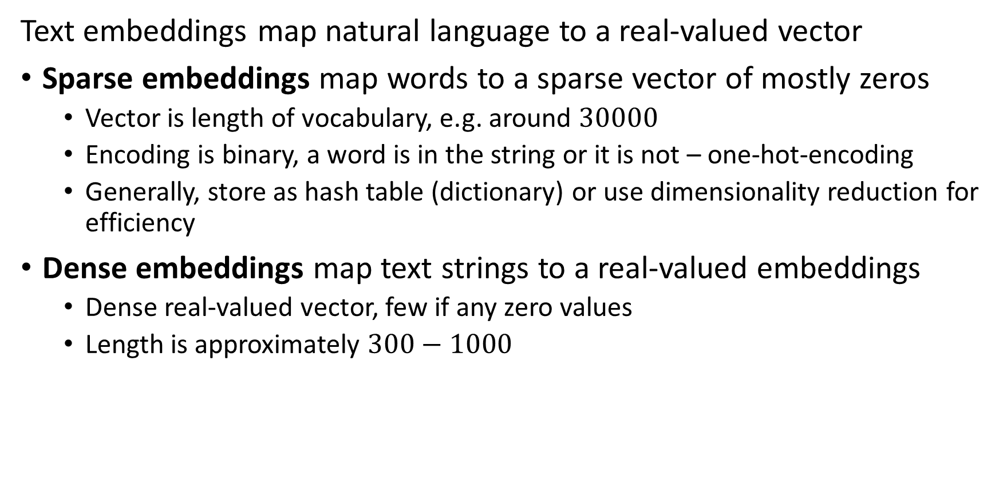
Text embeddings
Text embeddings map natural language to a real-valued vector
Sparse embeddings map words to a sparse vector of mostly zeros
  Vector is length of vocabulary, e.g. around $30000$
  Encoding is binary, a word is in the string or it is not – one-hot-encoding
  Generally, store as hash table (dictionary) or use dimensionality reduction for efficiency
Dense embeddings map text strings to a real-valued embeddings
  Dense real-valued vector, few if any zero values
  Length is approximately $300−1000$

Slide 13

Improving Document Vector Similarity Search at Massive Scale
Embedding vectors of documents
Vector
Vector
Fast approximate NN search results in large number of matches
Vector
ANN search results reranked by more exact, possibly slower, search algorithm
Vector
$$⋮$$
Embedding vector from query
Vector Database
ANN Vector Search
Reranker
Ranked List
Query Vector

Slide 14
Information Retrieval and Web Searching
Google uses multiple algorithms to rank search results
Dense semantic search using embedding vectors from BERT family of algorithms
  Search vector similarity between query and page embeddings
Sparse exact match search for key words
  A sparse search over a fixed vocabulary with algorithms like BM25 or SPLADE
  Don’t use TF-IDF! – you will lose points
Vector search for duplicate pages
Freshness metrics to prioritize up to date information
Ranking algorithms
  Multiple algorithms, including the venerable and famous PageRank algorithm
These algorithms are common to the general information retrieval problem

Slide 15
Evaluation for Information Retrieval

Slide 16
Evaluation of Retrieval
How do we objectively evaluate IR algorithms?
There are three dimensions of performance
Many possible retrieval performance metrics
  Recall measures the fraction of true NNs found by the algorithm
  Precision measures the fraction of NNs found by algorithm that are true positives
  F-scores weight precision and recall
  Discounted cumulative gain (DCG) measures relative rankings of relevant passages found
  Mean reciprocal rank (MRR) measures the ranking of the first relevant passage found
  …
Memory use can be the biggest constraint for massive data sets
Speed can be important for many applications
Low Memory -Scalable
Low Computational Complexity-Scalable
Retrieval Performance

Slide 17
Evaluation of Retrieval
How do we objectively evaluate IR algorithms
Retrieval performance evaluation is challenging
  Metrics rely on ground truth, difficult to establish
Often need human evaluators
  Slow
  Subjective
  Often use multiple evaluators
Machine (e.g. LLM) evaluation is biased by algorithms
  Often compare results from multiple LLMs
  May not agree with human evaluation

Slide 18
Evaluation of Retrieval
How do we objectively evaluate IR algorithms
Benchmark data sets are limited
  Limited size
  Limited range of topics
  Limited language coverage
BIER dataset example of benchmarking dataset
  pronounced ‘beer’
  English language only
Numerous TERC datasets cover many areas of IR
  Most dataset cover specific domains
MS MARCO is a query response IR benchmark
…..

Slide 19
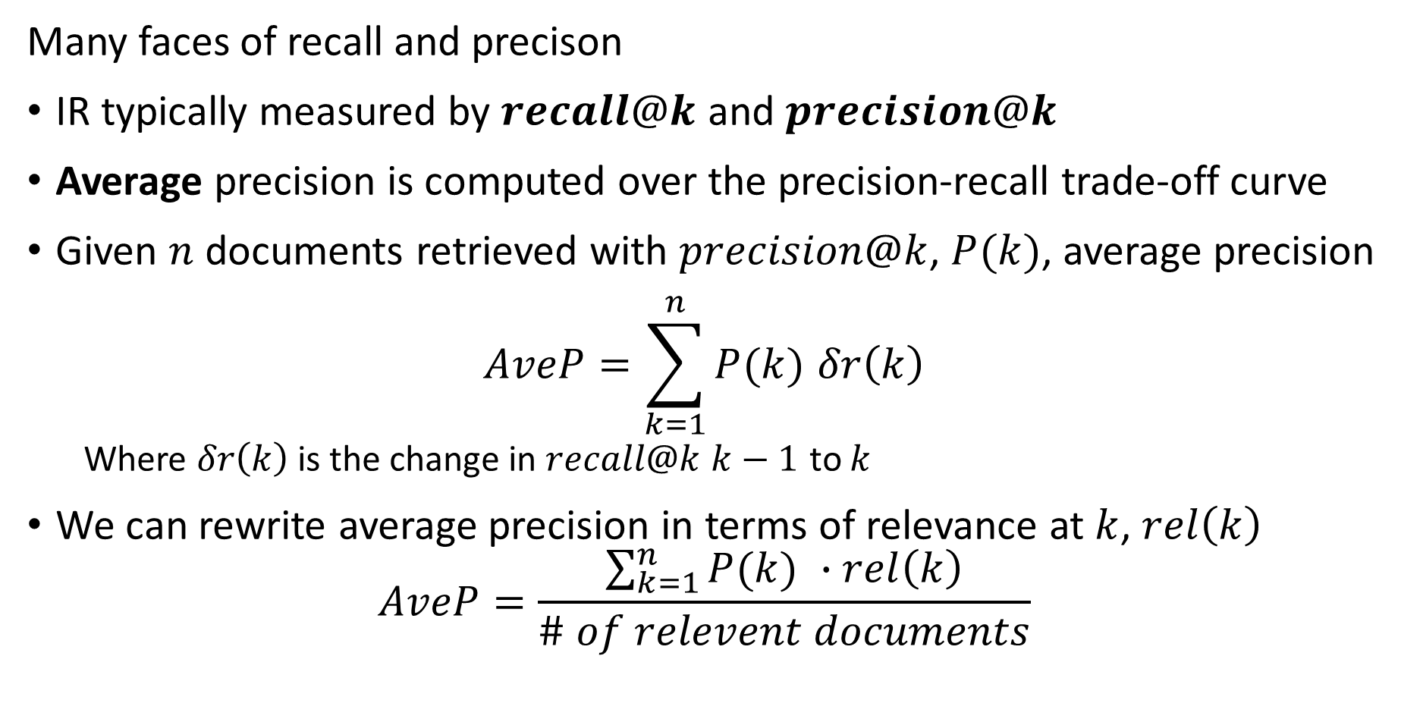
Evaluation of Retrieval
Many faces of recall and precison
IR typically measured by $recall@k$ and $precision@k$
Average precision is computed over the precision-recall trade-off curve
Given $n$ documents retrieved with $precision@k$, $P(k)$, average precision
$$AveP=\sum_{k=1}^{n}{P(k) δr\left(k\right)}$$
  Where $δr\left(k\right)$ is the change in $recall@k$ $k−1$ to $k$
We can rewrite average precision in terms of relevance at $k$, $rel\left(k\right)$
$$AveP=\frac{\sum_{k=1}^{n}{P(k) ∙rel\left(k\right)}}{\# of relevent documents}$$

Slide 20
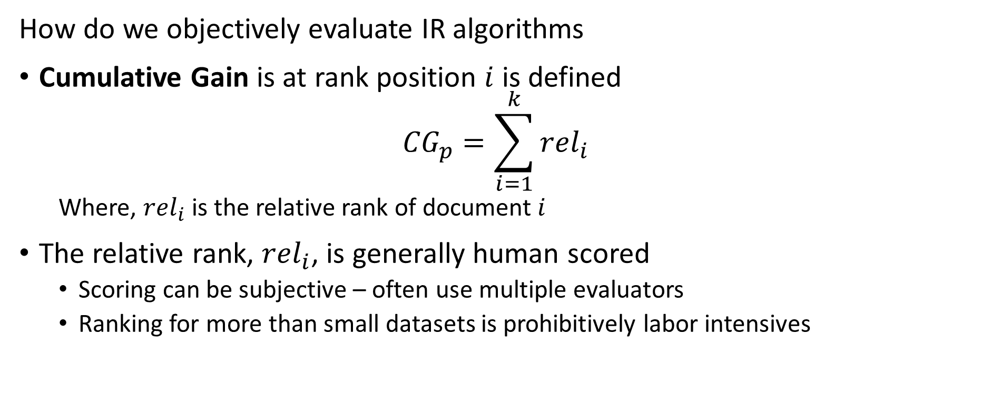
Evaluation of Retrival
How do we objectively evaluate IR algorithms
Cumulative Gain is at rank position $i$ is defined
$${CG}_{p}=\sum_{i=1}^{k}{{rel}_{i}}$$
  Where, ${rel}_{i}$ is the relative rank of document $i$
The relative rank, ${rel}_{i}$, is generally human scored
  Scoring can be subjective – often use multiple evaluators
  Ranking for more than small datasets is prohibitively labor intensives

Slide 21
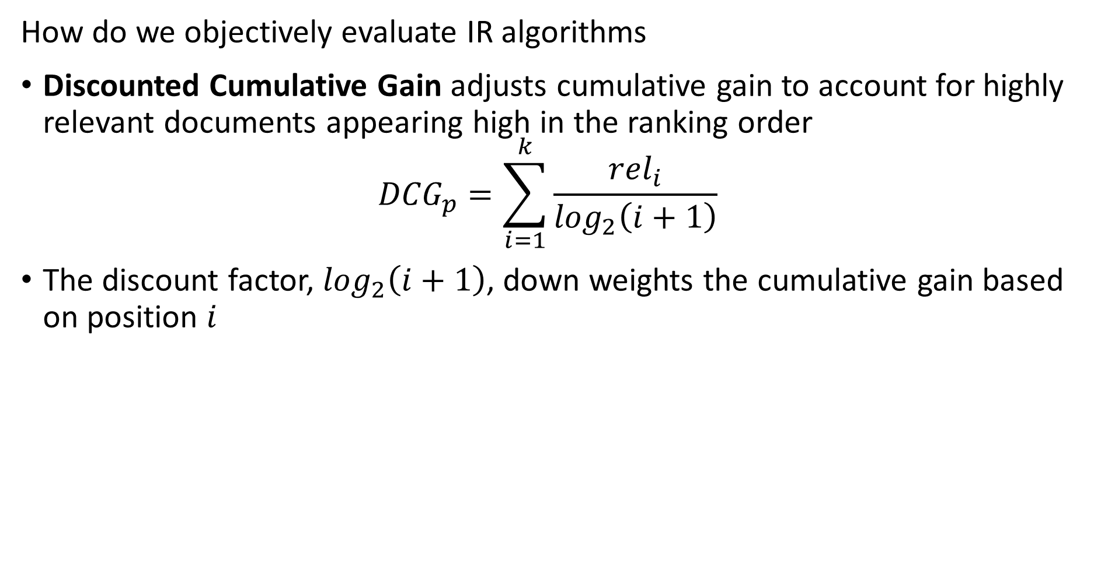
Evaluation of Retrieval
How do we objectively evaluate IR algorithms
Discounted Cumulative Gain adjusts cumulative gain to account for highly relevant documents appearing high in the ranking order
$${DCG}_{p}=\sum_{i=1}^{k}{\frac{{rel}_{i}}{\log_{2}\left(i+1\right)}}$$
The discount factor, $\log_{2}\left(i+1\right)$, down weights the cumulative gain based on position $i$

Slide 22
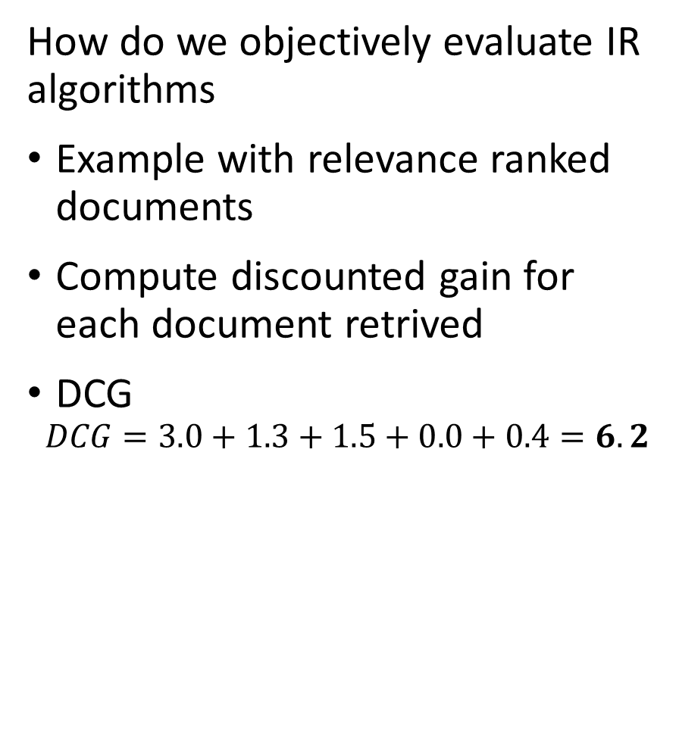
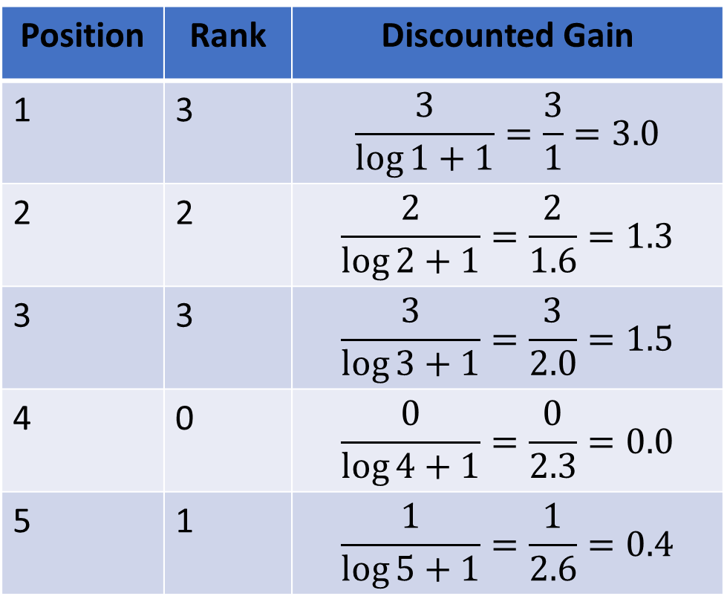
Evaluation of Retrieval
How do we objectively evaluate IR algorithms
Example with relevance ranked documents
Compute discounted gain for each document retrived
DCG
$$DCG=3.0+1.3+1.5+0.0+0.4=6.2$$
Position | Rank | Discounted Gain
1 | 3 | $$\frac{3}{\log{1+1}}=\frac{3}{1}=3.0$$
2 | 2 | $$\frac{2}{\log{2+1}}=\frac{2}{1.6}=1.3$$
3 | 3 | $$\frac{3}{\log{3+1}}=\frac{3}{2.0}=1.5$$
4 | 0 | $$\frac{0}{\log{4+1}}=\frac{0}{2.3}=0.0$$
5 | 1 | $$\frac{1}{\log{5+1}}=\frac{1}{2.6}=0.4$$

Slide 23
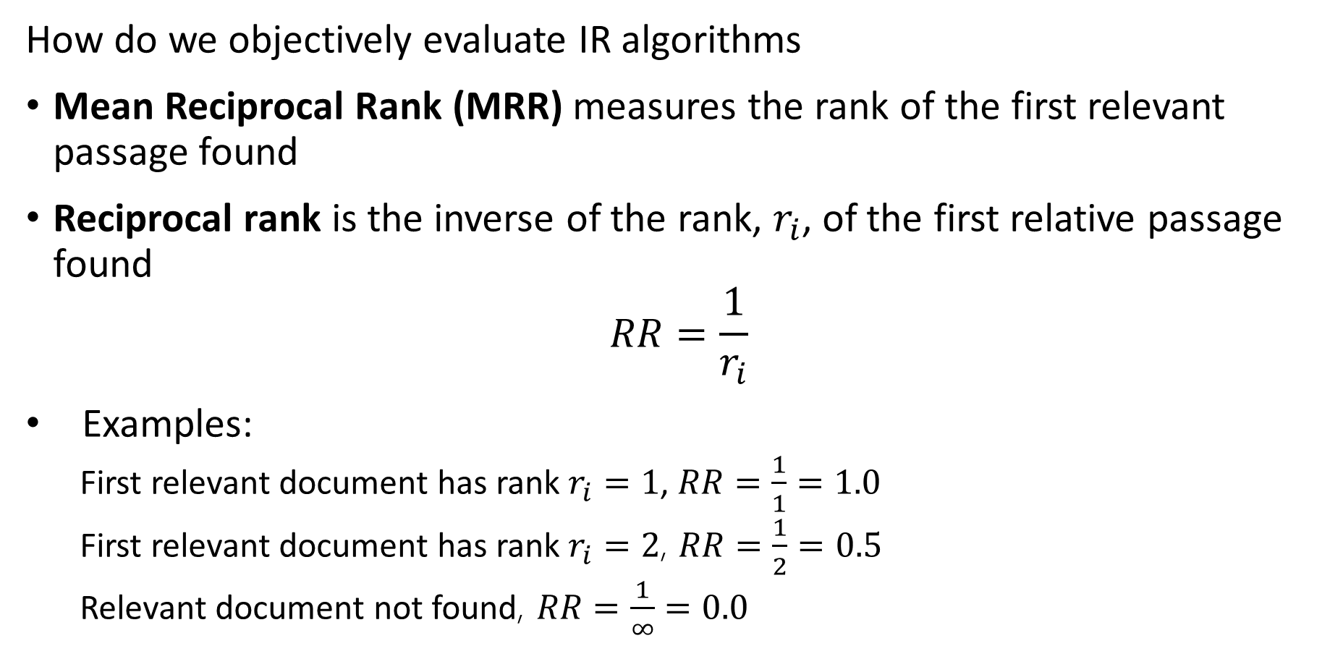
Evaluation of Retrieval
How do we objectively evaluate IR algorithms
Mean Reciprocal Rank (MRR) measures the rank of the first relevant passage found
Reciprocal rank is the inverse of the rank, $r_{i}$, of the first relative passage found
$$RR=\frac{1}{r_{i}}$$
Examples:
  First relevant document has rank $r_{i}=1$, $RR=\frac{1}{1}=1.0$
  First relevant document has rank $r_{i}=2$, $RR=\frac{1}{2}=0.5$
  Relevant document not found, $RR=\frac{1}{∞}=0.0$

Slide 24
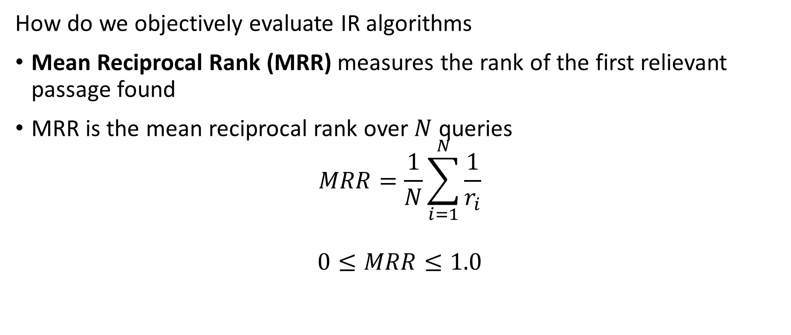
Evaluation of Retrieval
How do we objectively evaluate IR algorithms
Mean Reciprocal Rank (MRR) measures the rank of the first relievant passage found
MRR is the mean reciprocal rank over $N$ queries
$$MRR=\frac{1}{N}\sum_{i=1}^{N}{\frac{1}{r_{i}}}$$
$$0≤MRR≤1.0$$

Slide 25
Sparse Text Embedding

Slide 26

Overview of Sparse Encoding
Spare text embedding has a long history
Spare encoders produce long embedding vectors of mostly 0 values
  Length of vector = length of vocabulary
  Each vocabulary word encoded by position in the encoding vector
  Any given document has only a fraction of total vocabulary
Embedding example using word-level tokenization:
  “A dog ran in from the street”
1
0
0
1
0
1
0
0
0
0
1
0
1
0
0
$$⋯$$
a
dog
this
in
these
both
at
half
from
the
who
road
street
alley
wind

Slide 27
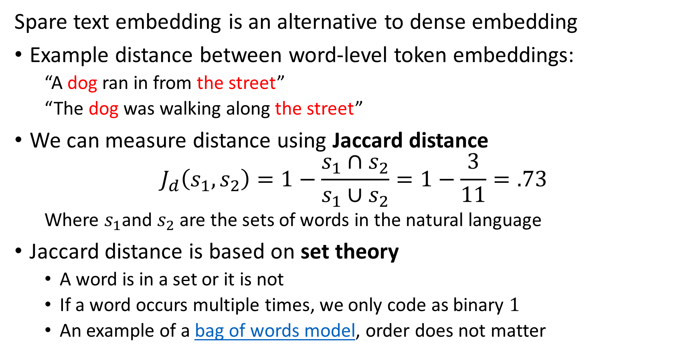
Overview of Sparse Encoding
Spare text embedding is an alternative to dense embedding
Example distance between word-level token embeddings:
  “A dog ran in from the street”
  “The dog was walking along the street”
We can measure distance using Jaccard distance
$$J_{d}\left(s_{1},s_{2}\right)=1−\frac{s_{1}∩s_{2}}{s_{1}∪s_{2}}=1−\frac{3}{11}=.73$$
  Where $s_{1}$and $s_{2}$ are the sets of words in the natural language
Jaccard distance is based on set theory
  A word is in a set or it is not
  If a word occurs multiple times, we only code as binary $1$
  An example of a bag of words model, order does not matter

Slide 28
The TF-IDF model
Simple TF-IDF normalizes sparse similarity vectors
Simple Jaccard metrics suffer from several deficiencies
  Cannot account for a more relevant document using a key term multiple times
  Does not account for the rarity of a key term in the entire corpus
TF-IDF computes weight to adjust for the foregoing
  Term frequency is the frequency that a term or word appears in a document
  Inverse document frequency is the log of the ratio of number of documents to the number of documents where the term occurs.
TF-IDF is an example of a bag of words model
  Word order does not matter!
  No sensitivity to semantics

Slide 29
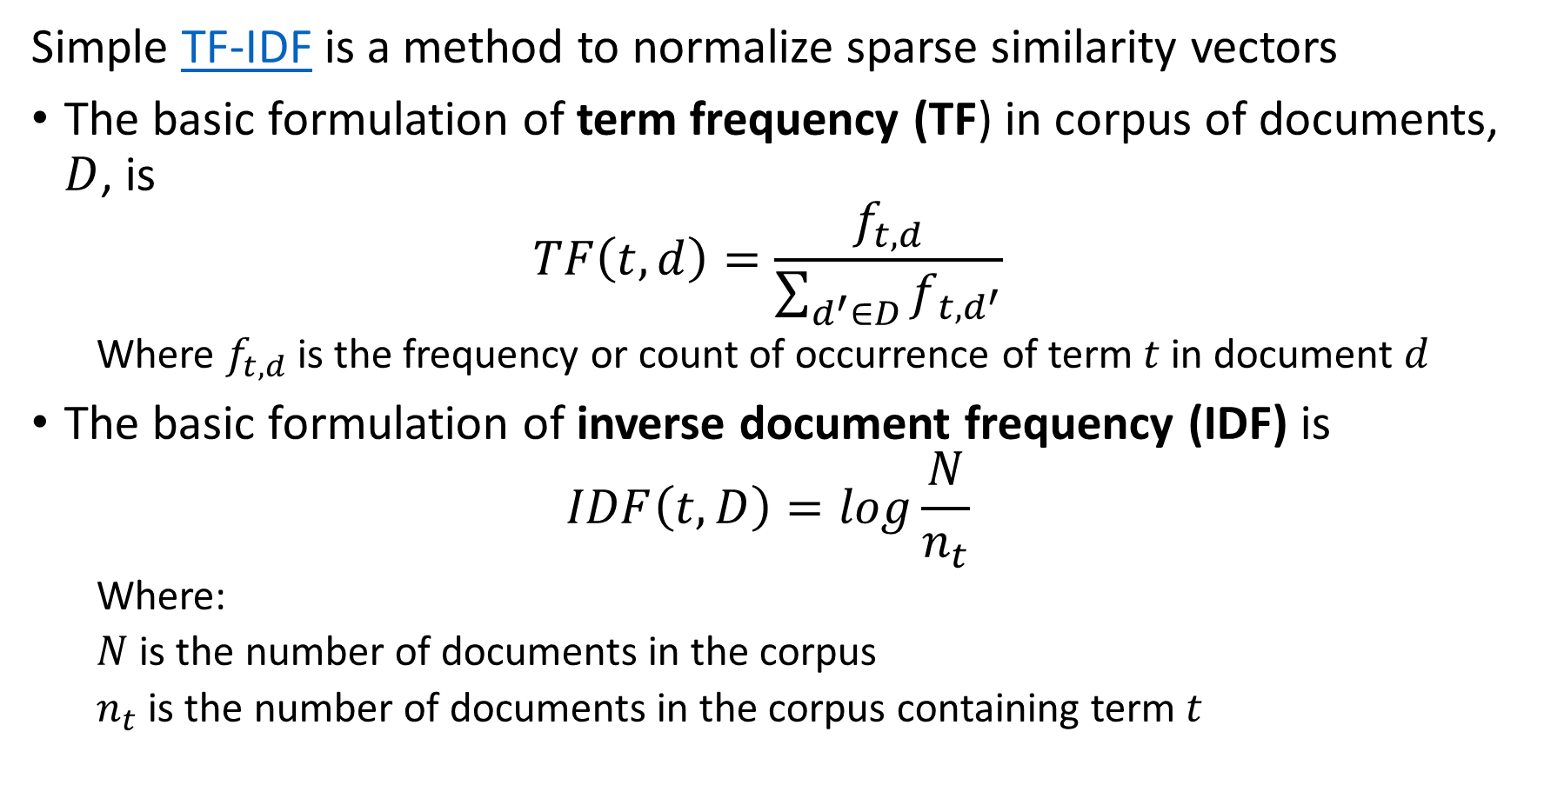
The TF-IDF model
Simple TF-IDF is a method to normalize sparse similarity vectors
The basic formulation of term frequency (TF) in corpus of documents, $D$, is
$$TF\left(t,d\right)=\frac{f_{t,d}}{\sum_{d^{′}∈D}{f_{t,d^{′}}}}$$
  Where $f_{t,d}$ is the frequency or count of occurrence of term $t$ in document $d$
The basic formulation of inverse document frequency (IDF) is
$$IDF\left(t,D\right)=log\frac{N}{n_{t}}$$
  Where:
  $N$ is the number of documents in the corpus
  $n_{t}$ is the number of documents in the corpus containing term $t$

Slide 30
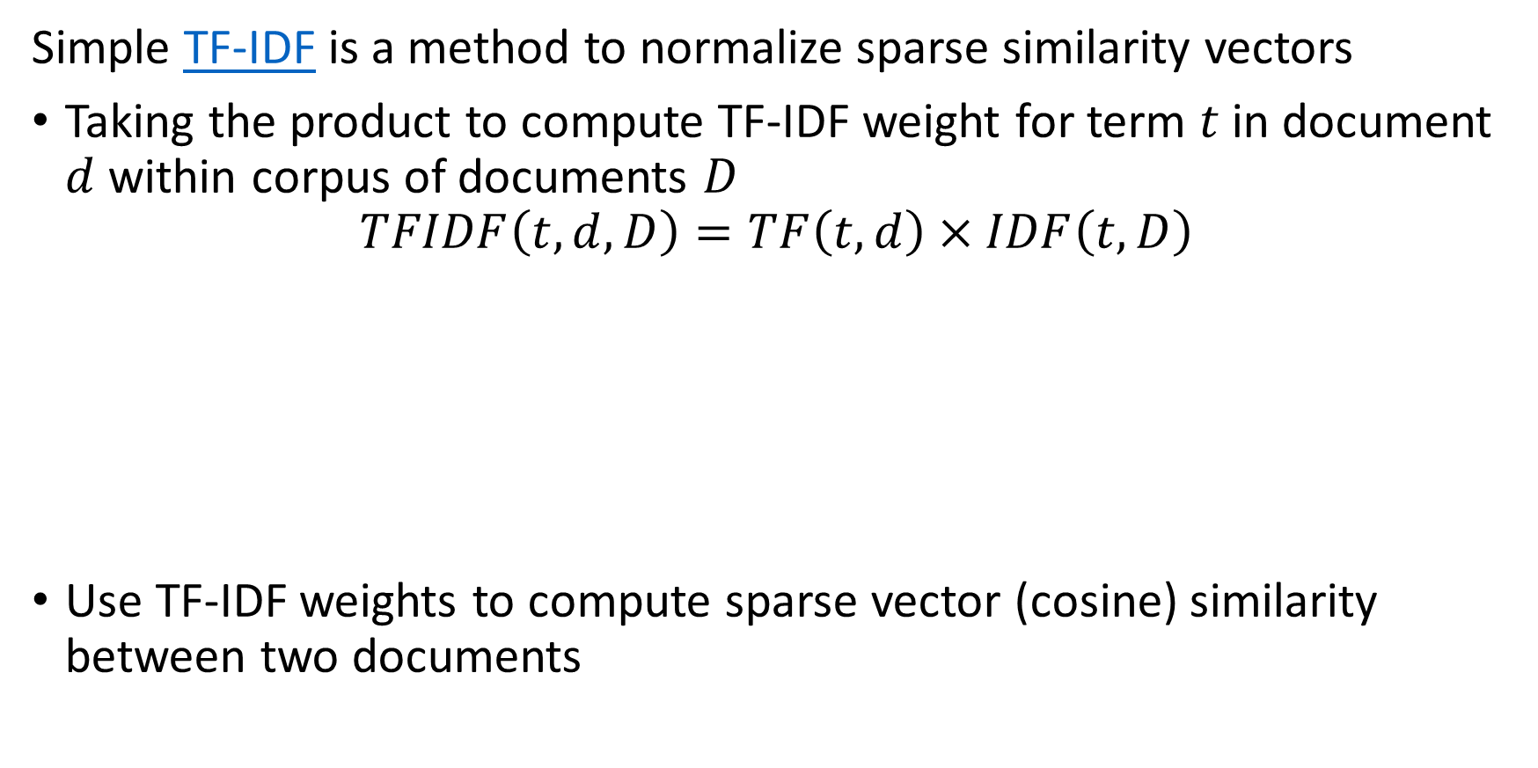
The TF-IDF model
Simple TF-IDF is a method to normalize sparse similarity vectors
Taking the product to compute TF-IDF weight for term $t$ in document $d$ within corpus of documents $D$
$$TFIDF\left(t,d,D\right)=TF\left(t,d\right)×IDF\left(t,D\right)$$
Use TF-IDF weights to compute sparse vector (cosine) similarity between two documents
Term frequency weight increases as number of occurrences increase in a document
Inverse document frequency increases as the log of rarity of the term increases

Slide 31
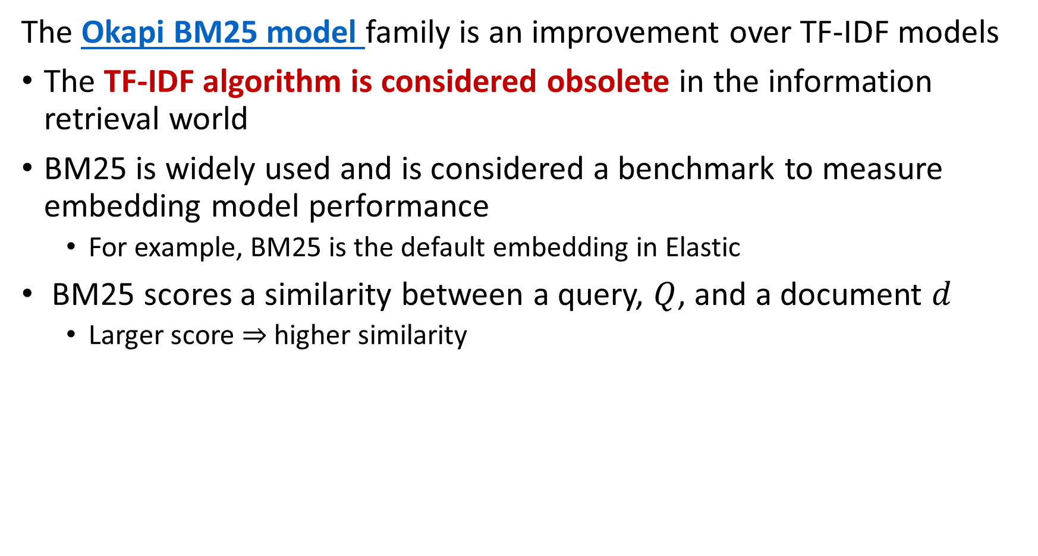
The BM25 model
The Okapi BM25 model family is an improvement over TF-IDF models
The TF-IDF algorithm is considered obsolete in the information retrieval world
BM25 is widely used and is considered a benchmark to measure embedding model performance
  For example, BM25 is the default embedding in Elastic
BM25 scores a similarity between a query, $Q$, and a document $d$
  Larger score $⇒$ higher similarity

Slide 32
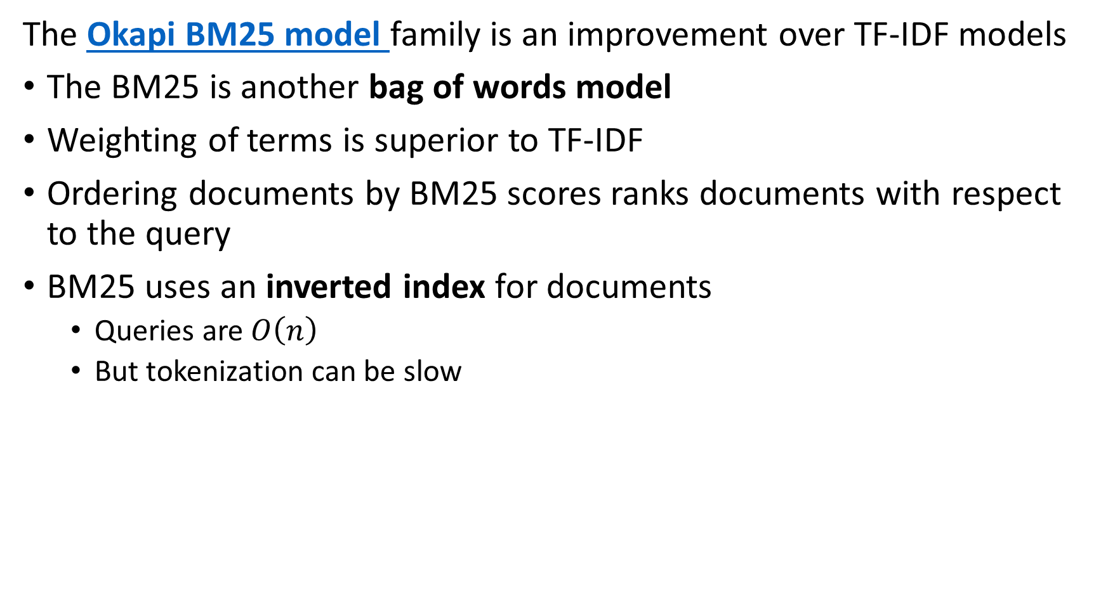
The BM25 model
The Okapi BM25 model family is an improvement over TF-IDF models
The BM25 is another bag of words model
Weighting of terms is superior to TF-IDF
Ordering documents by BM25 scores ranks documents with respect to the query
BM25 uses an inverted index for documents
  Queries are $O\left(n\right)$
  But tokenization can be slow

Slide 33
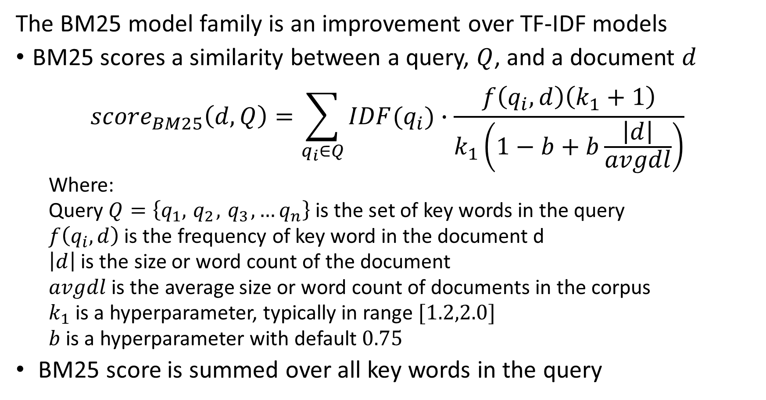
The BM25 model
The BM25 model family is an improvement over TF-IDF models
BM25 scores a similarity between a query, $Q$, and a document $d$
$${score}_{BM25}\left(d,Q\right)=\sum_{q_{i}∈Q}{IDF(q_{i})}∙\frac{f\left(q_{i},d\right)\left(k_{1}+1\right)}{k_{1}\left(1−b+b\frac{\left|d\right|}{avgdl}\right)}$$
  Where:
  Query $Q=\left\{q_{1},{ q}_{2},{ q}_{3},…q_{n}\right\}$ is the set of key words in the query
  $f\left(q_{i},d\right)$ is the frequency of key word in the document d
  $\left|d\right|$ is the size or word count of the document
  $avgdl$ is the average size or word count of documents in the corpus
  $k_{1}$ is a hyperparameter, typically in range $[1.2,2.0]$
  $b$ is a hyperparameter with default $0.75$
BM25 score is summed over all key words in the query

Slide 34
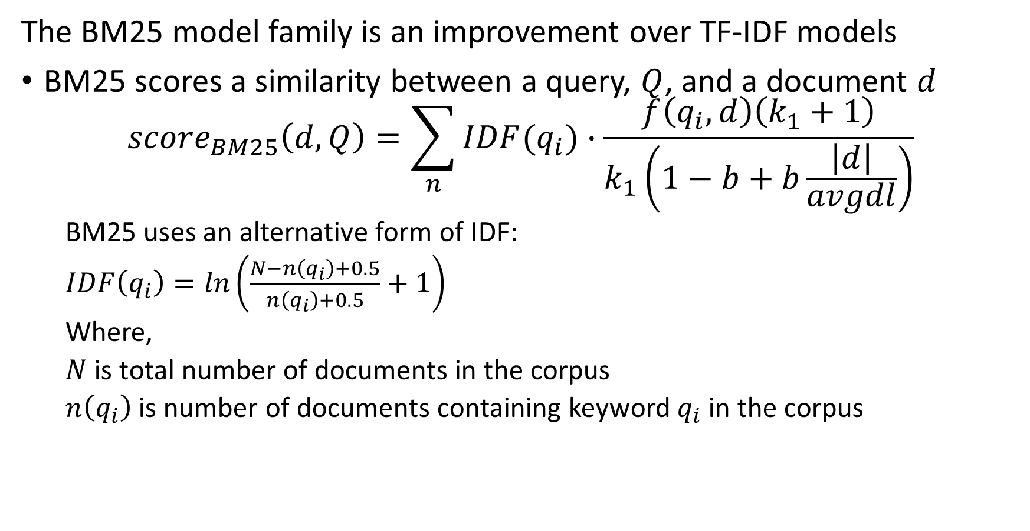
The BM25 model
The BM25 model family is an improvement over TF-IDF models
BM25 scores a similarity between a query, $Q$, and a document $d$
$${score}_{BM25}\left(d,Q\right)=\sum_{n}{IDF(q_{i})}∙\frac{f\left(q_{i},d\right)\left(k_{1}+1\right)}{k_{1}\left(1−b+b\frac{\left|d\right|}{avgdl}\right)}$$
  BM25 uses an alternative form of IDF:
  $IDF\left(q_{i}\right)=ln\left(\frac{N−n\left(q_{i}\right)+0.5}{n\left(q_{i}\right)+0.5}+1\right)$
  Where,
  $N$ is total number of documents in the corpus
  $n\left(q_{i}\right)$ is number of documents containing keyword $q_{i}$ in the corpus

Slide 35
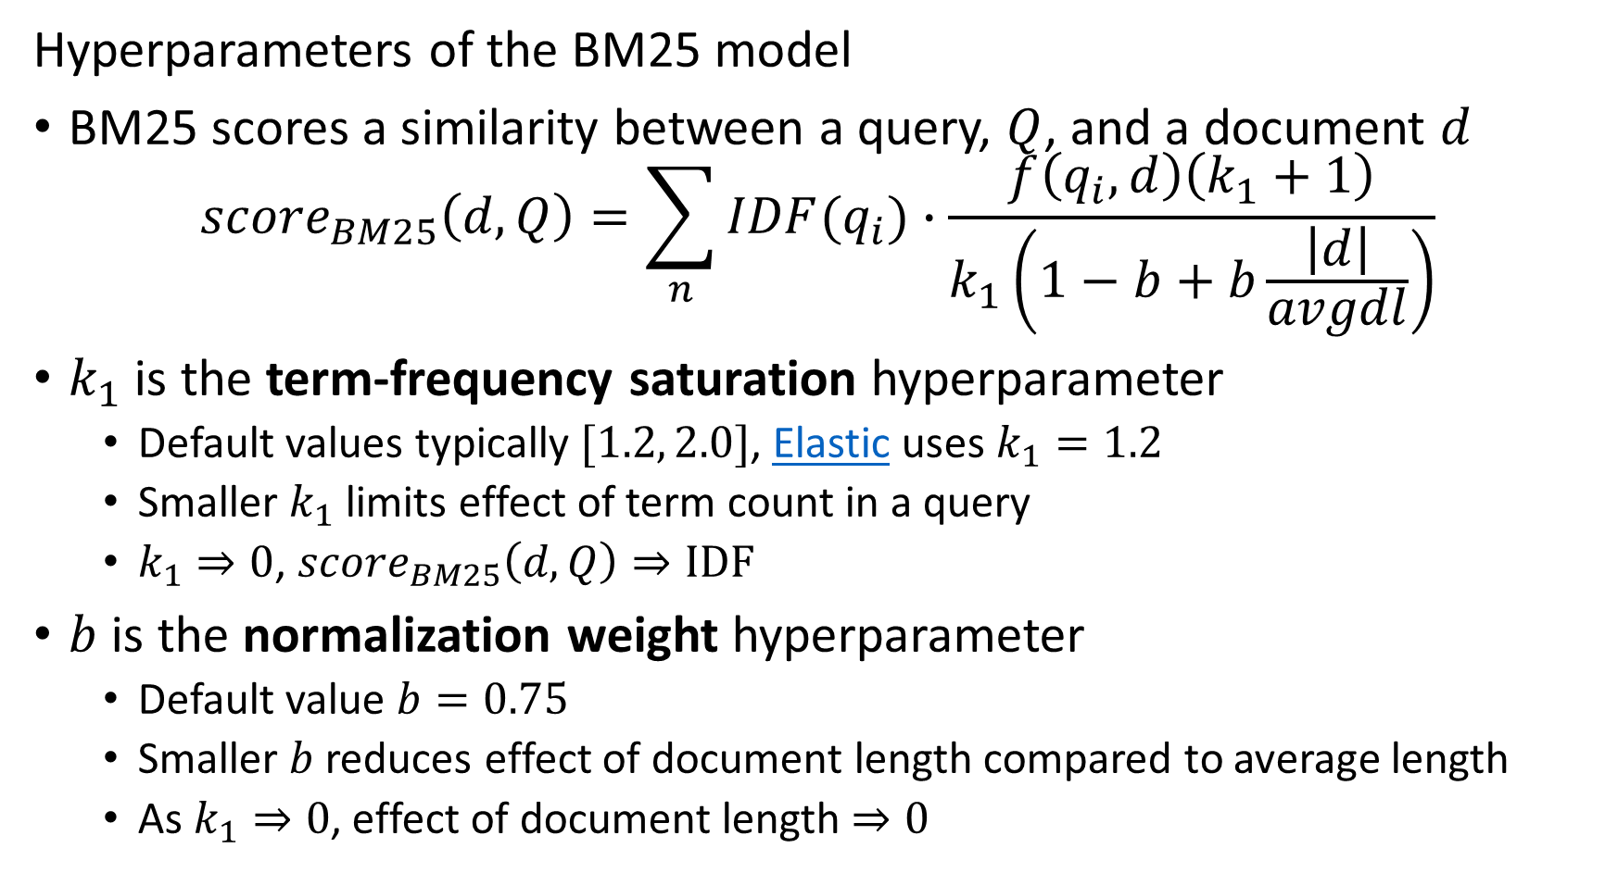
The BM25 model
Hyperparameters of the BM25 model
BM25 scores a similarity between a query, $Q$, and a document $d$
$${score}_{BM25}\left(d,Q\right)=\sum_{n}{IDF(q_{i})}∙\frac{f\left(q_{i},d\right)\left(k_{1}+1\right)}{k_{1}\left(1−b+b\frac{\left|d\right|}{avgdl}\right)}$$
$k_{1}$ is the term-frequency saturation hyperparameter
  Default values typically $[1.2, 2.0]$, Elastic uses $k_{1}=1.2$
  Smaller $k_{1}$ limits effect of term count in a query
  $k_{1}⇒0$, ${score}_{BM25}\left(d,Q\right)⇒IDF$
$b$ is the normalization weight hyperparameter
  Default value $b=0.75$
  Smaller $b$ reduces effect of document length compared to average length
  As $k_{1}⇒0$, effect of document length $⇒0$

Slide 36
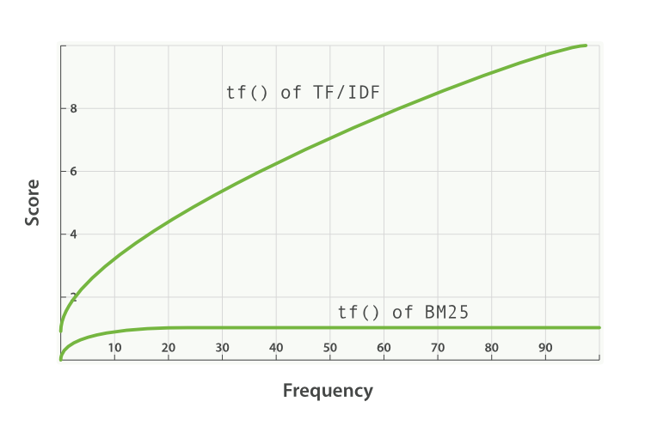
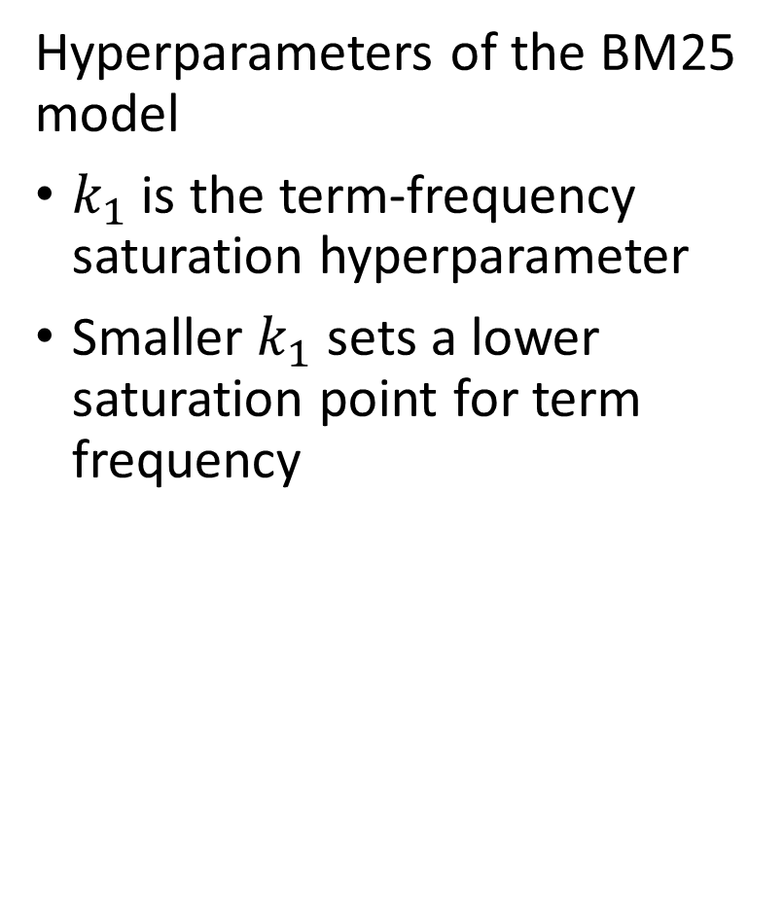
The BM25 model
Hyperparameters of the BM25 model
$k_{1}$ is the term-frequency saturation hyperparameter
Smaller $k_{1}$ sets a lower saturation point for term frequency
Plot from Elastic documentation

Slide 37
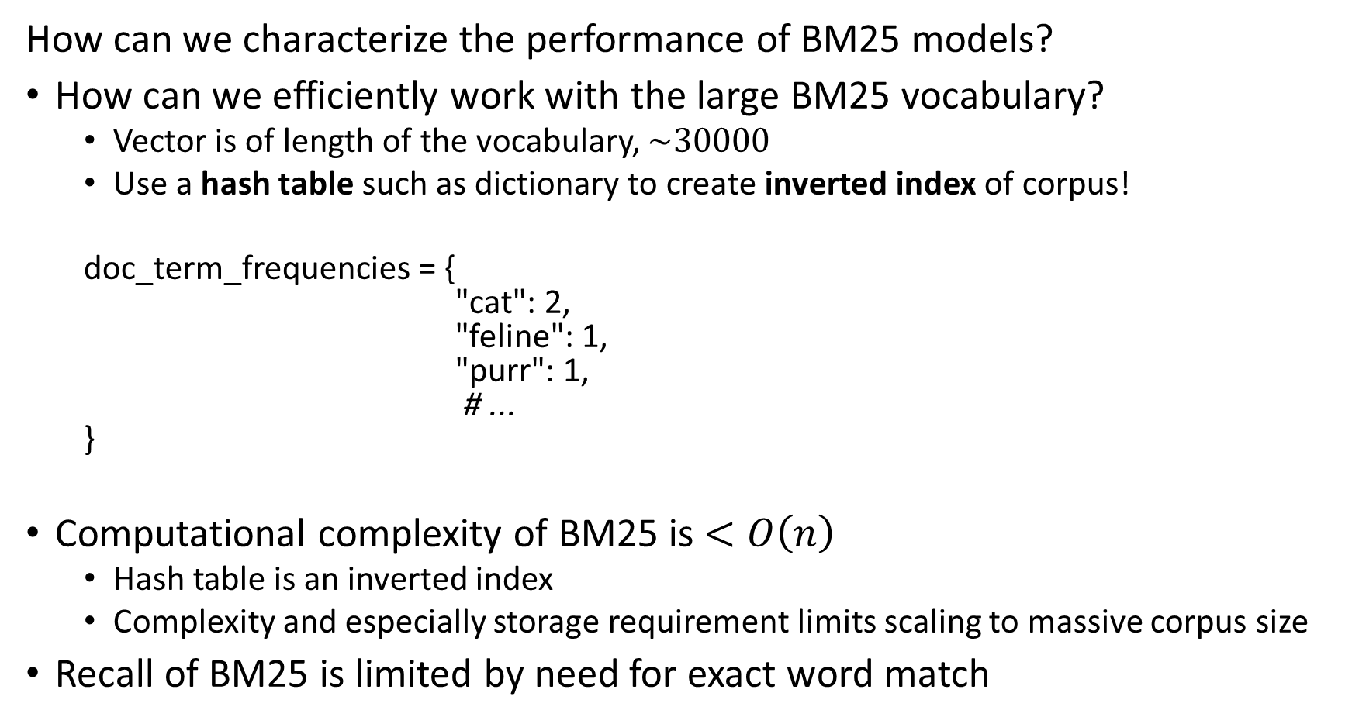
The BM25 model
How can we characterize the performance of BM25 models?
How can we efficiently work with the large BM25 vocabulary?
  Vector is of length of the vocabulary, $\sim 30000$
  Use a hash table such as dictionary to create inverted index of corpus!
  doc_term_frequencies = {
  "cat": 2,
  "feline": 1,
  "purr": 1,
  # ...
  }
Computational complexity of BM25 is $<O\left(n\right)$
  Hash table is an inverted index
  Complexity and especially storage requirement limits scaling to massive corpus size
Recall of BM25 is limited by need for exact word match

Slide 38
The BM25 model
Many improvements proposed to BM25 models
Many packages support versions of BM25
  Rank-BM25
  BM25s
  Elastic
  HuggingFace
  LangChain
  …
Trotman, Puurula and Burgess, 2014, review many variations on the basic BM25 algorithm finding limited differences
Newer work uses learned weights to improve performance
  Algorithms include DeepImpact and COIL
  See review by Lin and Ma, 2021

Slide 39
Short Introduction to BERT Models for Dense Text Embedding

Slide 40
Overview of BERT models
Bidirectional encoder representation from transformer (BERT) models are a family of dense text embedding models
The original BERT model was introduced by Devlin, et. al., 2019
There is a large and growing family of fast, efficient and effective BERT models
  DistilBERT, Sanh, et. al., 2019, a faster and lighter distillation of BERT
  XlmROBERTa, Conneau, et. al., 2019, a larger mulit-language embedding model
  LegalBERT, Chalkidis, et. al., 2020, trained on legal documents
  FinBERT, Araci, 2019, trained on financial statements
  ModernBERT, Warner, et. al., 2024, uses improved self-supervised learning.
  And, many others…

Slide 41
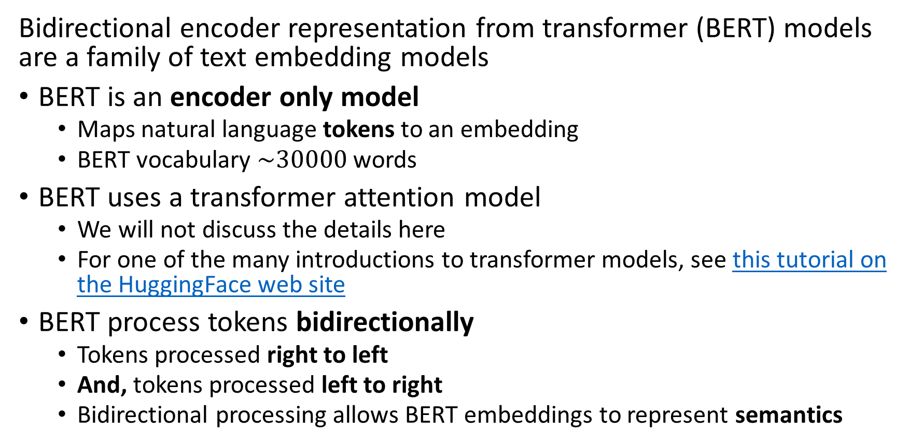
Overview of BERT models
Bidirectional encoder representation from transformer (BERT) models are a family of text embedding models
BERT is an encoder only model
  Maps natural language tokens to an embedding
  BERT vocabulary $\sim 30000$ words
BERT uses a transformer attention model
  We will not discuss the details here
  For one of the many introductions to transformer models, see this tutorial on the HuggingFace web site
BERT process tokens bidirectionally
  Tokens processed right to left
  And, tokens processed left to right
  Bidirectional processing allows BERT embeddings to represent semantics

Slide 42
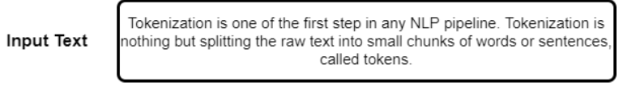
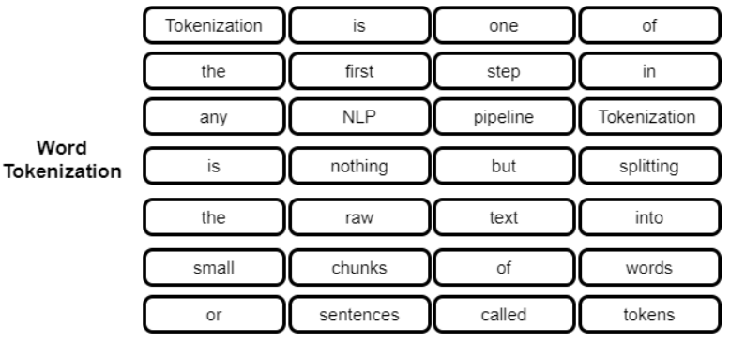
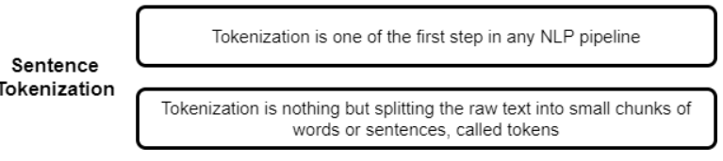
Overview of BERT models
(BERT) models process tokenized text
Natural language text processed by BERT must first be tokenized
Tokenization can be done at the word level
Tokenization can be done at the sentence or phrase level
Example from Kagel example notebook

Slide 43
Overview of BERT models
Tokenization can be performed at many levels
Models like BERT do not simply use tokenized words and sentences
Sub-word tokenization is used.
Example of the result shows both words, parts of words and other general tokes
['[PAD]', '[UNK]', '[START]', '[END]', '!', '#', '$', '%', '&', “’”]
['as', 'all', 'at', 'one’, ‘people', 're', 'like', 'if', 'our', 'from’]
['choose', 'consider', 'extraordinary', 'focus', 'generation’, ‘killed’,
'patterns', 'putting', 'scientific', 'wait’]
['##_', '##`', '##ย', '##ร', '##อ', '##–', '##—', '##’', '##♪', '##♫']
Example from TensorFlow Subword Tokenizer Documentation

Slide 44

Overview of BERT models
BERT token embedding has three components
Input strings with separators
Text token embedding
Positional embeddings
Segment embeddings
To capture semantics, BERT processes tokes both left to right and right to left
Image credit, Wikipedia Commons

Slide 45
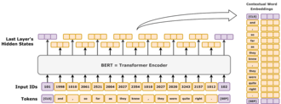
Overview of BERT models
BERT models output embedding vectors from input text
The final hidden state is the full token embeddings
Embedding vector for input text is created from the final hidden state
BERT encoder processes tokens in multiple transformer layers
Input IDs (keys) and embedded tokens (values) are bidirectionally processed by the BERT algorithm
Image credit, Wikipedia Commons

Slide 46
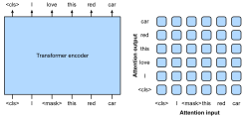
Overview of BERT models
BERT transformer layers use bidirectional attention to compute embeddings
Embedding hidden state is based on attention
Transformers compute bidirectional cross attention between input tokens to capture semantics
Token embeddings are input to transformer encoder layers
Image credit, Wikipedia Commons

Slide 47
Overview of BERT models
BERT uses self-supervised learning with two simultaneous steps
Masked language model (MLM) learns to predict masked (missing) tokens
  A randomly sampled fraction of tokens are masked at the input
  The loss function measures how well the model predicts the missing tokens
  To ensure diversity, random tokens are used to compute the loss function about 10% of the time
Next sentence prediction learns to generate next sentence in a sequence
  Loss function based on prediction if next sentence is the correct one
  Random sentences are substituted to create the negative cases

Slide 48
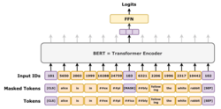
Overview of BERT models
BERT uses MLM as self-supervised learning
Embedding vector is used to predict missing tokens
Random input tokens are masked
Start with the full input sequence of tokens
Image credit, Wikipedia Commons

Slide 49
Reranking

Slide 50
Reranking Can Greatly Improve Information Retrieval
Using ANNS on embeddings produces only approximate rankings
Reranking aims to improve approximate rankings
Reranking is performed on a reduced number of approximately ranked items
Reranking uses slower more accurate algorithms
  Cross-encoders for dense embedding
  LLMs
  …

Slide 51
Reranking Can Greatly Improve Information Retrieval
Cross encoding improves ranking
Dense embeddings of single text string do not account for similarity with any other strings
Cross-encoders score similarity between specific pairs of text strings
  Cross-encoding uses attention (context) from both strings
  More accurate result

Slide 52
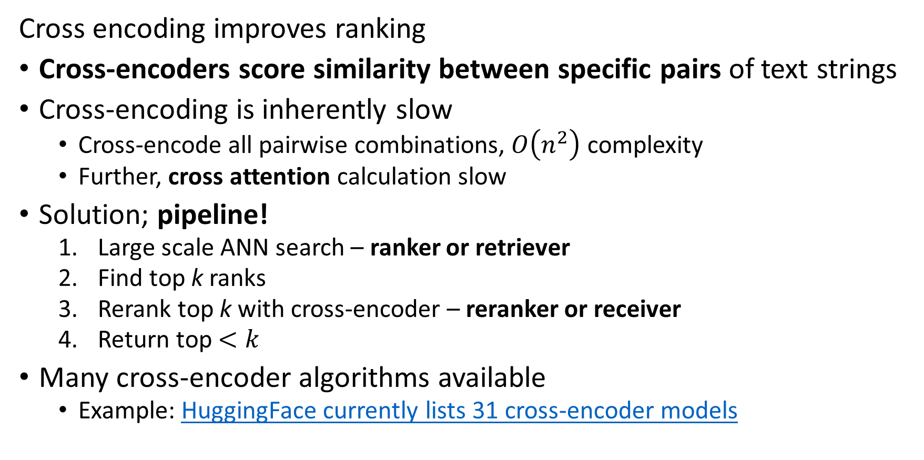
Reranking Can Greatly Improve Information Retrieval
Cross encoding improves ranking
Cross-encoders score similarity between specific pairs of text strings
Cross-encoding is inherently slow
  Cross-encode all pairwise combinations, $O\left(n^{2}\right)$ complexity
  Further, cross attention calculation slow
Solution; pipeline!
  Large scale ANN search – ranker or retriever
  Find top k ranks
  Rerank top k with cross-encoder – reranker or receiver
  Return top $<k$
Many cross-encoder algorithms available
  Example: HuggingFace currently lists 31 cross-encoder models

Slide 53
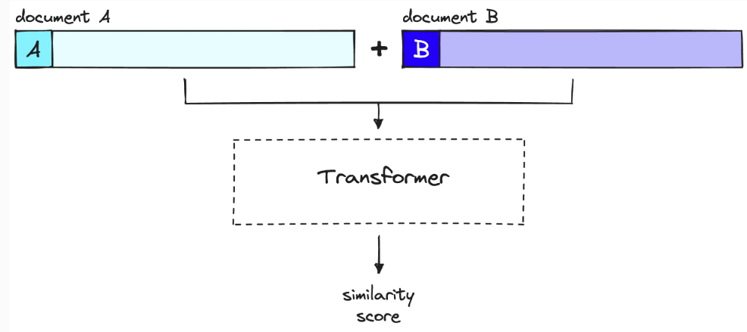
Reranking with Sentence BERT
Example: Sentence BERT accurately score similarity between text strings
Inputs are query and candidate document
Transformer layers process both documents bi-directionally and simultaneously
Cross-attention Similarity score
Image credit, Pincone Rerankers and Two-Stage Retrieval

Slide 54
Sparse-Dense Hybrid and Retriever Receiver Pipelines

Slide 55
Hybrid Retriever
Can use sparse and dense models in parallel to improve reranking
Sparse and dense receivers are used in parallel
Dense and sparse scores are integrated to optimize results
  Integrate by simple weighted sum
  Recall improves if error are independent
Weighting of the sum between semantic (dense) and keyword (sparse) retrievers is task-specific
Ranks from dense ranker
Sparse embedding Receiver
Dense embedding Receiver
Integrate scores

Slide 56
Sparse-Dense Pipelines
Generally, we can improve performance of vector search concatenating sparse and dense searches
Known as retriever (ranker) receiver (reranker) model
Retriever finds candidate list of near neighbors
Receiver performs an high-accuracy search to improve ranking
Choice of retriever and receiver algorithms on different operating points in the trade-off space
You can find an overview of retriever receiver model in this post
Low Memory -Scalable
Low Computational Complexity-Scalable
High Recall -Accuracy

Slide 57
Improving Document Vector Similarity Search at Massive Scale
Embedding vectors of documents
Vector
Vector
Retriever crease list of candidates
Vector
Ranker improves result
Vector
$$⋮$$
Embedding vector from query
Vector Database
Retriever
Receiver
Ranked List
Query Vector

Slide 58
Sparse-Dense Pipelines
There are several possibilities to create retriever-ranker pipelines
Sparse vector retriever followed by cross encoder transformer model
  Sparse retriever creates filtered set of candidate documents based on keywords
  Reranker performs exhaustive pairwise search between candidate documents and query
Dense vector retriever followed by sparse vector receiver
  Efficient ANNS used to find candidate document set
  Sparse vector receiver filters and reranks candidate documents
Dense vector retriever followed by cross encoder transformer model
  Efficient ANNS used to find candidate document set
  Reranker performs exhaustive pairwise search between candidate documents and query
Etc…

Slide 59
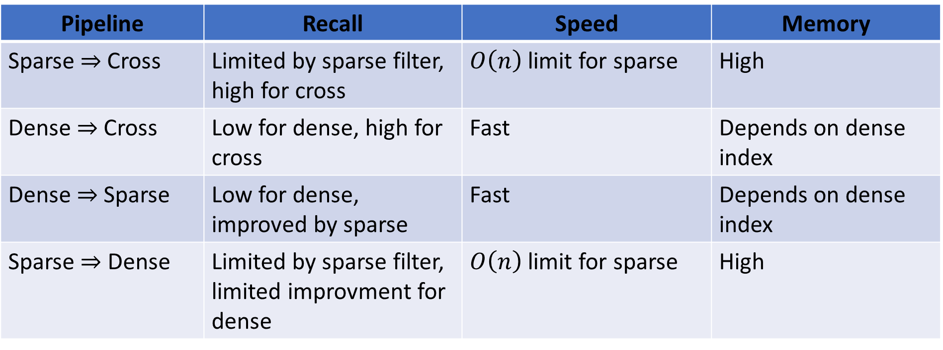
Sparse-Dense Pipelines
Comparing retriever-ranker pipelines
Pipeline | Recall | Speed | Memory
Sparse$⇒$ Cross | Limited by sparse filter, high for cross | $O\left(n\right)$ limit for sparse | High
Dense$⇒$ Cross | Low for dense, high for cross | Fast | Depends on dense index
Dense$⇒$ Sparse | Low for dense, improved by sparse | Fast | Depends on dense index
Sparse $⇒$ Dense | Limited by sparse filter, limited improvment for dense | $O\left(n\right)$ limit for sparse | High

Slide 60
The Sparse Lexical and Expansion (SPLADE) model

Slide 61
The Sparse Lexical and Expansion (SPLADE) mode
SPLADE models are a modern approach to sparse natural language embedding
Older sparse embedding methods, TF-IDF and BM25, require exact word matches
SPLADE models perform sparse embedding using term expansion
  Learn synonyms to terms in vocabulary
  Match terms or synonyms
SPLADE models use term expansion to create single stage receiver with good recall for reranking
The seminal papers on SPLADE algorithms are Formal, Piwowarski, and Clinchant, 2021 and Formal, Lassance, Piwowarski, and Clinchant, 2021

Slide 62
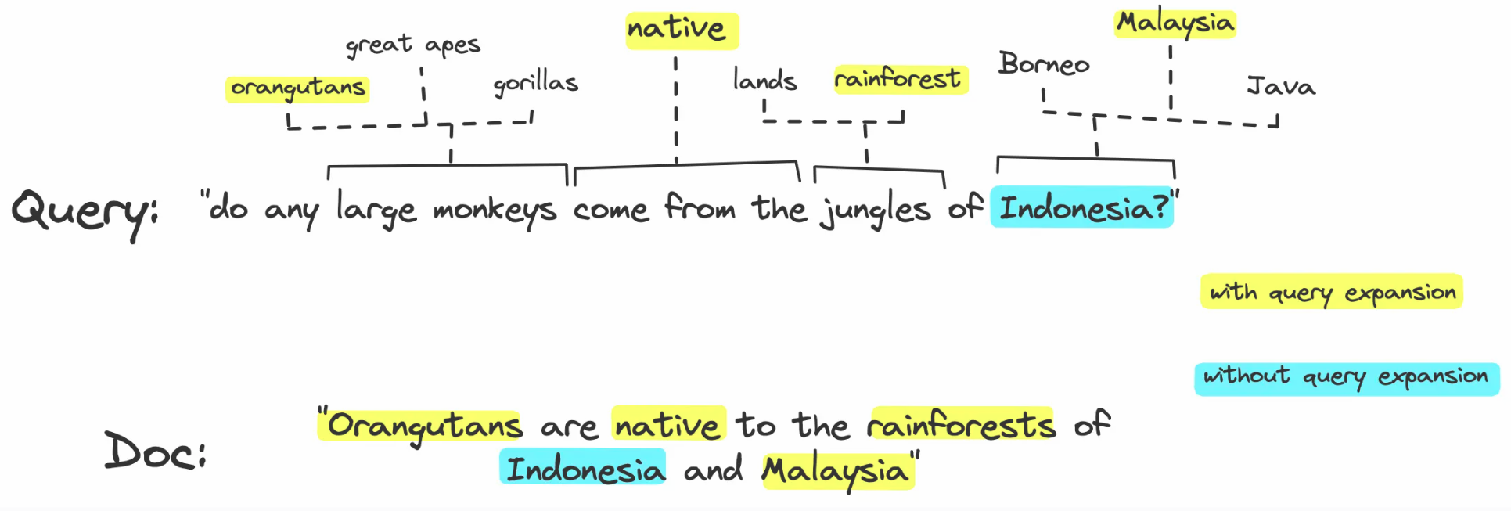
The Sparse Lexical and Expansion (SPLADE) mode
SPLADE models are a modern approach to sparse natural language embedding
SPLADE models perform term expansion so exact term match is not required
Drawing from post by James Briggs of Pinecone

Slide 63
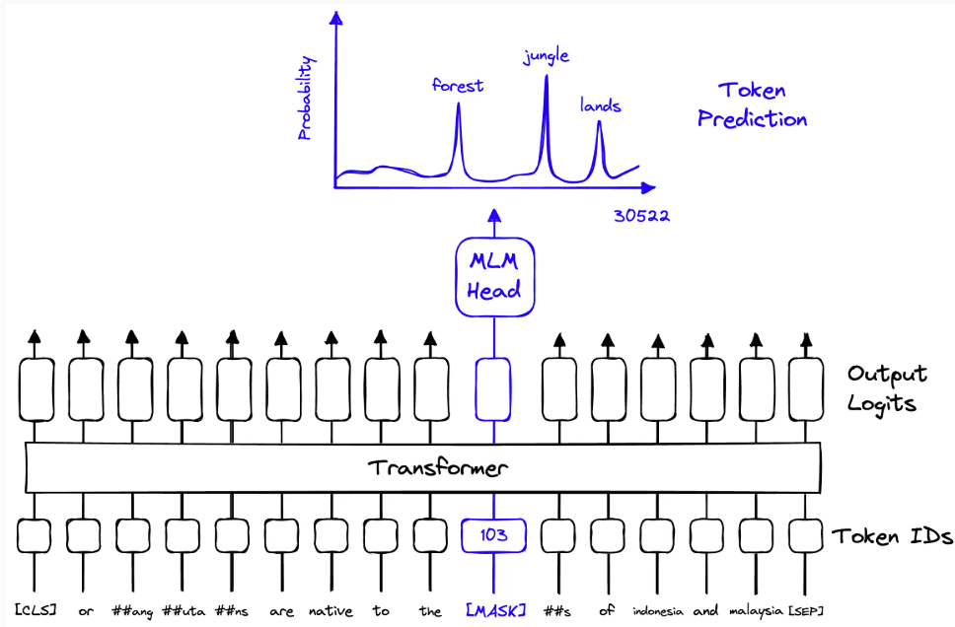
The Sparse Lexical and Expansion (SPLADE) mode
SPLADE models are a modern approach to sparse natural language embedding
SPLADE uses BERT with contrastive learning to find probabilities of alternative terms
Drawing from post by James Briggs of Pinecone

Slide 64
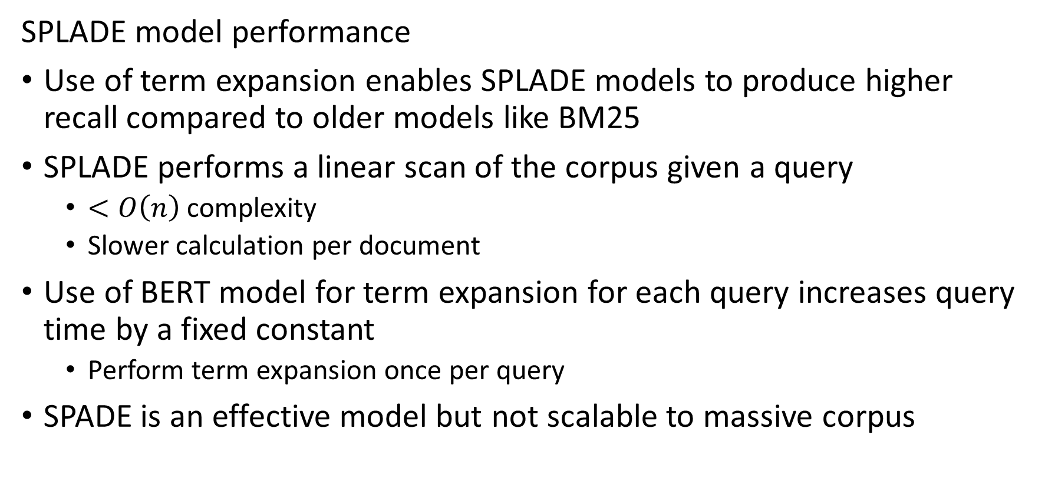
The Sparse Lexical and Expansion (SPLADE) mode
SPLADE model performance
Use of term expansion enables SPLADE models to produce higher recall compared to older models like BM25
SPLADE performs a linear scan of the corpus given a query
  $<O\left(n\right)$ complexity
  Slower calculation per document
Use of BERT model for term expansion for each query increases query time by a fixed constant
  Perform term expansion once per query
SPADE is an effective model but not scalable to massive corpus

Slide 65
Models for Image Embedding

Slide 66
Image embeddings
How can we do similarity search on images?
Vector embeddings can be found for other data, not just natural language
Similar methods are used for videos, audio tracks, etc.
There are two commonly used methods to create embeddings for images

Slide 67
Image embeddings
There are two commonly used methods to create embeddings for images
Using feature maps from convolutional neural networks or transformer networks
  Network pretrained
  Flatten multi-dimensional feature map is embedding
Contrastive language-image pre-training (CLIP) models
  Multi-modal model has both a text encoder and an image encoder
  Contrastive learning used to find embeddings for similarity between text query and image

Slide 68
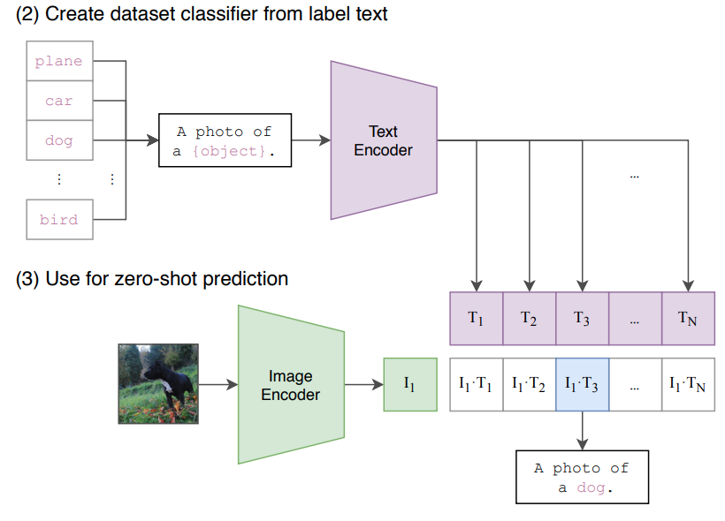
Image embeddings
How can we do similarity search on images?
Embedded text queries
Embedded images from database
Similarity scores computed between text and image embeddings
Drawing from Radford, et. al., 2021

Slide 69
Image embeddings
How can we do similarity search on images?
The CLIP model was introduced by Radford, et. al., 2021
You can find an example of using the HuggingFace CLIP models here
You can find another example of image embeddings on the HuggingFace web site here
You can find a post and video discussing semantic image search on the Ultralytics web site

Slide 70
Summary

Slide 71
Lesson Summary
Overview of graph theory and web search
Vector search is used for the general information retrieval problem
BERT family of models provide efficient and effective dense text embeddings
Sparse text embedding models require exact term matches
Reranking uses retriever-receiver model
Dense-sparse, or sparse-dense, retriever-receiver, information retrieval pipelines improve recall
SPLADE models enable single stage reciver
CLIP models used for embedding text queries and image databases

