Slide 1

CSCI E-108
Data Mining, Exploration and
Discovery
Learning to Rank and Recommender Algorithms
Steve Elston
Copyright 2020, 2021, 2022, 2023, 2024, 2025, 2026, Stephen F Elston. All rights reserved.

Slide 2
Main topics in this course
The main topics in this course are interconnected and build on each other
1. Hashing and K-V pair management
2. Distance and Similarity Metrics
3. Graph Algorithms
Foundations
Core Algorithms
2. Dimensionality Reduction
5. Similarity Search and NN Algorithms
4. Online Algorithms
3. Social Network Analysis
6. Web/Document ranking and search
7. Recommender Algorithms
8. Clustering Algorithms
Taks Speific Algorithms

Slide 3
Why Recommender Systems?
Catalogs of user choices are growing
Users need recommendations to navigate these vast choices
Many areas require recommendations
  Physical products
  Social media
  Hospitality – Hotels, restaurants,…
  Books
  News articles
  Music
  Movies and TV shows
  App stores
  Matching people with required job skills
  …
Economic impact of recommenders is massive!

Slide 4
Why Recommender Systems?
Catalogs of user choices are growing
In the physical world user choice is limited to small number of items
  Items on the shelves of a store
  News articles printed on paper
  Books in a book store
  Music in a music store
  People submitting paper resumes for a job
  Movies at a theater
  …
But, in the online word the choices are nearly limitless
  Choice is no longer limited by physical constraints
  Most of the choices are rarely purchased
  Users will rarely find these choices on their own
  This is known as the long tail

Slide 5
Why Recommender Systems?
With large catalogs there are many items which are obscure and rarely purchased
Users unlikely to find rarely purchased items without recommender
Probability of Finding Item
Items commonly purchased
Items rarely purchased
Frequency of purchase

Slide 6
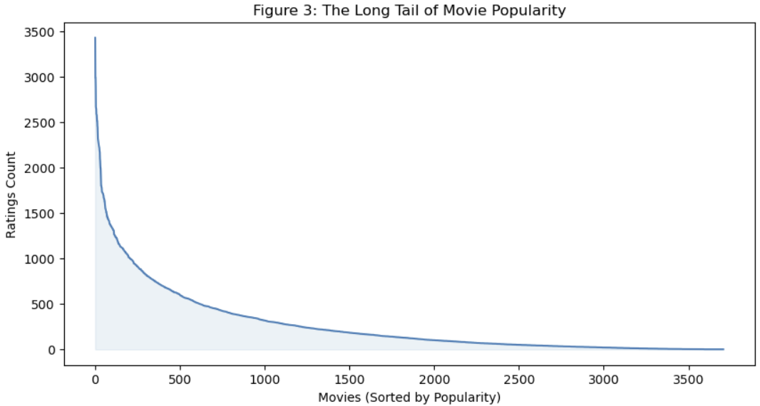
Why Recommender Systems?
Example of long tail from MovieLens 1M
Figure provided by Humphry Lim.

Slide 7
Overview of Recommender Algorithms

Slide 8
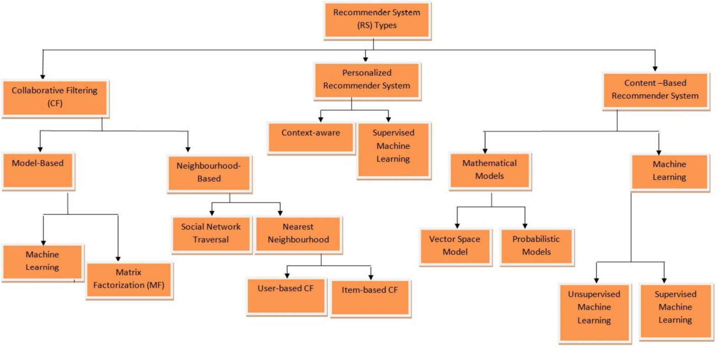
Recommender Systems
Ibrahim, et. al, 2025, propose a taxonomy to organize recommender algorithms

Slide 9
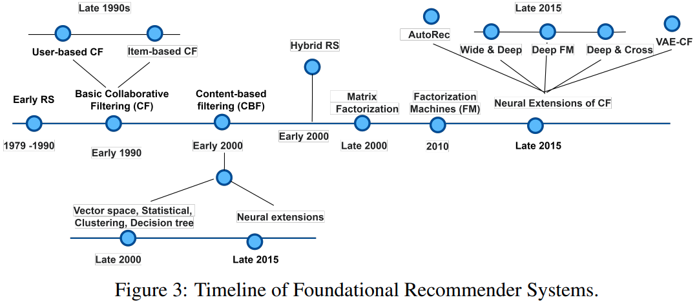
Recommender Systems
Recommendation algorithms have evolved with time
Figure from A Comprehensive Review of Recommender Systems: Transitioning From Theory to Practice, Raza, et.al., 2024

Slide 10
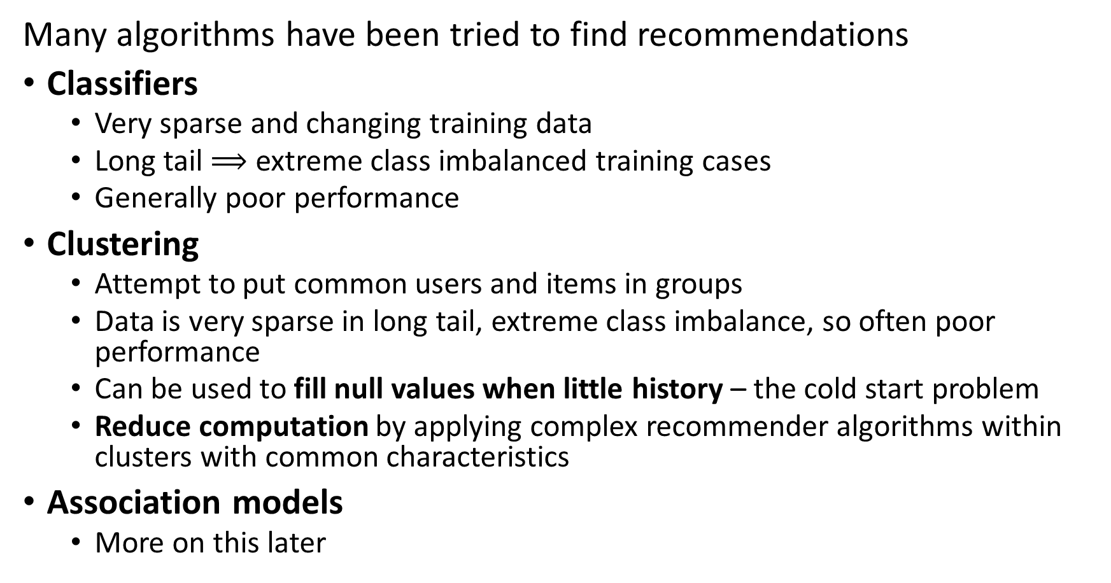
Recommender Systems
Many algorithms have been tried to find recommendations
Classifiers
  Very sparse and changing training data
  Long tail $⟹$ extreme class imbalanced training cases
  Generally poor performance
Clustering
  Attempt to put common users and items in groups
  Data is very sparse in long tail, extreme class imbalance, so often poor performance
  Can be used to fill null values when little history – the cold start problem
  Reduce computation by applying complex recommender algorithms within clusters with common characteristics
Association models
  More on this later

Slide 11
Recommender Systems
Many algorithms have been tried to find recommendations
Algorithms based on similarity search dominate
Content based systems
  Find items with common properties by similarity search
  Uses unsupervised learning algorithms
  Related to frequent item set algorithms – Last lesson of course
Collaborative filtering
  Based on similarity between behavior or engagement between items or between users
  Widely used algorithm
  Unsupervised and supervised (ML) algorithms applied
  Has cold-start problem

Slide 12
Recommender Systems
References for recommender systems
Revisiting Recommender Systems: An Investigative Survey. Ibrahim, et. al, 2025
A Comprehensive Review of Recommender Systems: Transitioning From Theory to Practice, Raza, et.al., 2024
Systematic Literature Review on Recommender System: Approach, Problem, Evaluation Techniques, Datasets, Saifudin and Widiyaningtyas, 2023

Slide 13
Recommender Systems
Resources for massively scalable recommenders
For examples of using graph recommender models at massive scale with Neo4j, see Graph Powered Machine Learning, Alessandro Negro, Manning, 2021
For an example of building scalable collaborative filtering and neural collaborative filtering recommenders in Keras, see this example by Siddhartha Banerjee
The Torch Rec system from Meta supports building massive scale recommenders using sharding and embedding algorithms
Twitter’s recommender uses a complex combination of NLP, social graph analysis and recommendation generation
Grahm Jensen’s list of recommender system software can be found here

Slide 14
Datasets and Software
There is a growing list of recommender datasets
GitHub site with links to multiple other sites
Page with recommender dataset on Papers with Code
List of recommender datasets on Kagel

Slide 15
Generating Recommendations is Hard!

Slide 16
Why is Making a Good Recommender Hard?
Creating a good recommender algorithm for the real-world is hard!
We do not have purchase information on new users or new items –
  The cold-start problem!
Human users have variable behavior
Naïve solutions do not address long-tail
  Data are very sparse – users only interact with a small fraction of the catelog
  Negative sampling bias – No samples when user does not take action
  Position bias – Users typically only see top few items on recommendation list
  These biases are strongly interdependent!

Slide 17
Why is Making a Good Recommender Hard?
Cold start problems limit predictions from recommenders
Cold start problem for new or rarely purchased items
  New items are constantly added to digital catalogs
  No reviews
  No purchase history
  Must rely on item similarity
Cold start problem for new users
  No or few reviews or purchases
  Similarity measures can be limited – little or no profile information
  Must rely on other approaches – frequent item set search

Slide 18
Why is Making a Good Recommender Hard?
User behavior limits recommender predictions
People have complex behavior
  Have variable taste – may change mind what they are looking for
  May have multiple interests – e.g. user may want both classic country and baroque music
  More than one person accessing user account – e.g. a family
User ratings are not constant with time
  Average rating of movies increases with time from release
  Game ratings decline with time from release
  Fad products come and go quickly over time
  …
Data quality often limits recommender performance more than algorithm choice!

Slide 19
Why is Making a Good Recommender Hard?
Good recommendations depend on user context
Examples:
  The music the user wants to hear depends on time of day
  Travel recommendations depend on the nature of the trip, business, vacation, etc., budget, and intended destination
Context can be ambiguous
  Example: video choice can depend on time of day, but also on if a child is present
  Example: recommendations can be location dependent, but dependent on users’ purpose
Analysis of context leads to a cold start problem

Slide 20
Why is Making a Good Recommender Hard?
Recommender data suffers from bias
We can only sample when user takes positive action, negative sampling bias
  User did not click through
  User did not purchase
  …
Many selections in a massive catalog are rarely or never selected by any user because of position bias
  New items are constantly added to digital catalogs
  Rarely purchased items have positions far down recommendation lists
Position bias leads to negative sampling bias and vice versa

Slide 21
Why is Making a Good Recommender Hard?
Recommender systems are subject to adversarial and poisoning attacks
Actors may wish to boost or depress ratings for various reasons
  Commercial, to gain unfair advantage in the market place
  Political and cultural, to boost or suppress certain points of view
Adversarial attacks aim to manipulate input data to temporarily deceive the system into producing inaccurate real-time inferences or predictions
More commonly, poisoning attacks aim to inject carefully crafted data into the model’s training data to fundamentally change the results
Real-world recommenders need to employ countermeasures

Slide 22
Representation for Recommenders

Slide 23
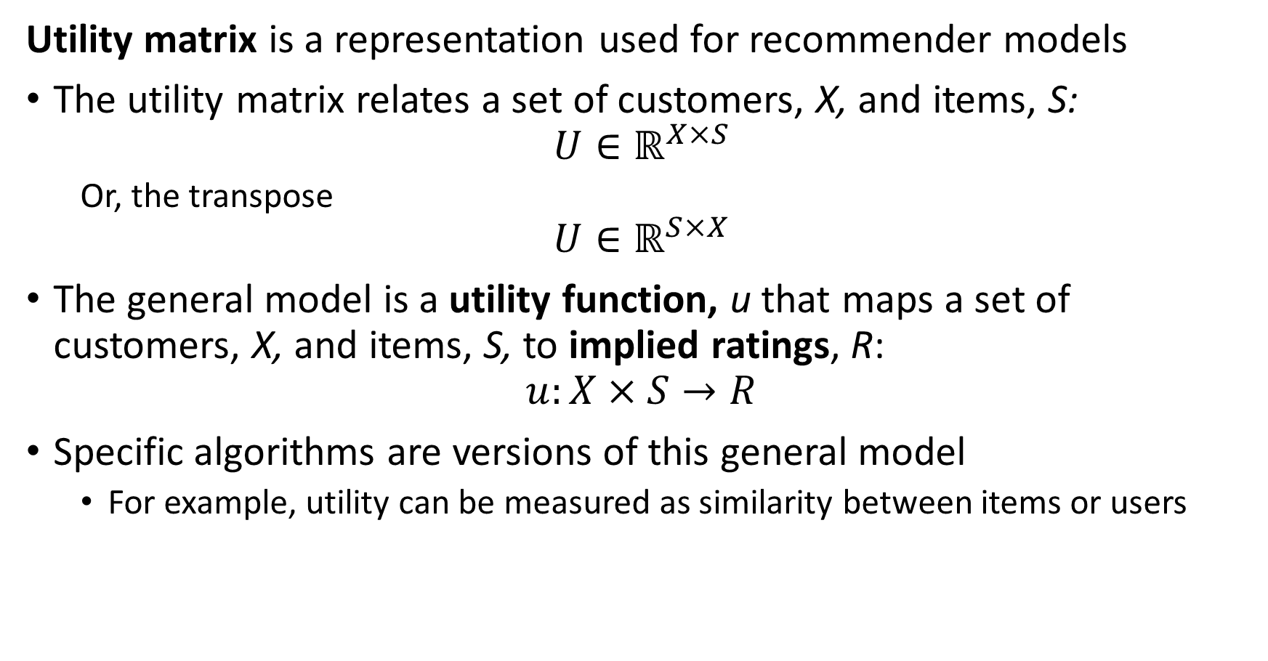
General Recommender Model
Utility matrix is a representation used for recommender models
The utility matrix relates a set of customers, X, and items, S:
$$U∈ℝ^{X×S}$$
  Or, the transpose
$$U∈ℝ^{S×X}$$
The general model is a utility function, u that maps a set of customers, X, and items, S, to implied ratings, R:
$$u:X×S→R$$
Specific algorithms are versions of this general model
  For example, utility can be measured as similarity between items or users

Slide 24
Representation for Recommender Algorithms
What representation can we use for recommender algorithms?
A utility matrix
  Users in the rows, item ratings or purchases in the columns
  Or the transpose
We can create a similar data structure using feature or user embeddings
 | Star Wars | The Matrix | Green Book | Frozen | Lady Bird | Jurassic Park | Schindler’s List | My Neighbor Totoro
Mary |  |  | 4 |  | 5 |  | 4 | 5
Bob | 4 | 5 |  |  | 1
Raj |  |  | 4 |  |  |  | 5
Maria | 3 | 4 |  | 5 | 4 |  | 3 | 5
Kevin |  |  | 5 |  |  | 2 | 5
Janell | 5 | 4 |  |  |  |  |  | 2

Slide 25
Representation for Recommender Algorithms
What representation can we use for recommender algorithms?
Notice that most users have watched only a few movies
There is only limited similarity information between users
 | Star Wars | The Matrix | Green Book | Frozen | Lady Bird | Jurassic Park | Schindler’s List | My Neighbor Totoro
Mary |  |  | 4 |  | 5 |  | 4 | 5
Bob | 4 | 5 |  |  | 1
Raj |  |  | 4 |  |  |  | 5
Maria | 3 | 4 |  | 5 | 4 |  | 3 | 5
Kevin |  |  | 5 |  |  | 2 | 5
Janell | 5 | 4 |  |  |  |  |  | 2

Slide 26
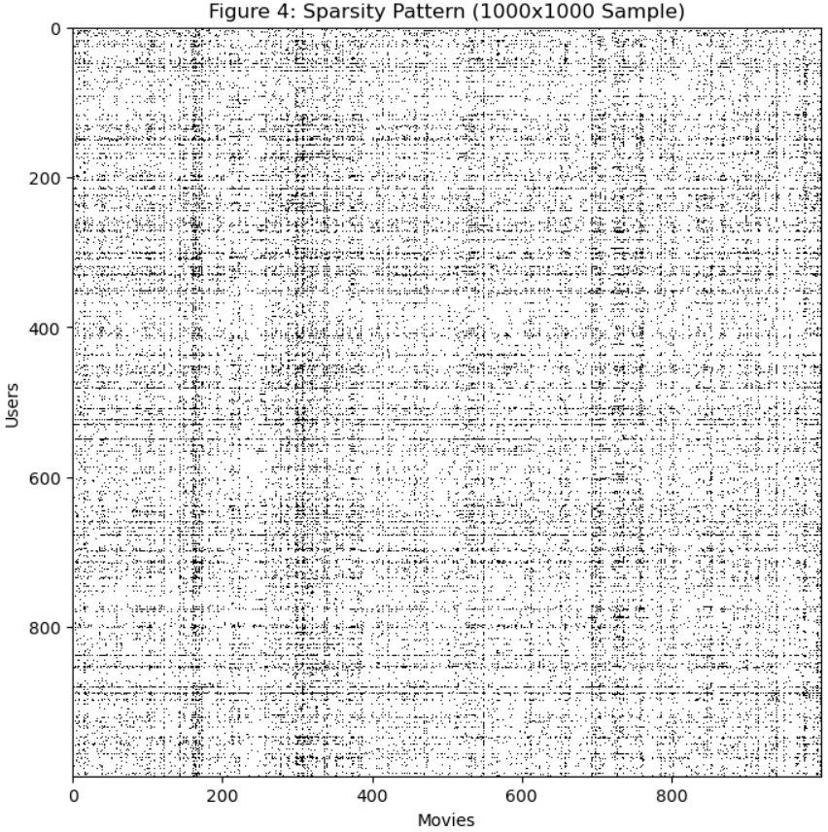
Representation for Recommender Algorithms
Example of sparse utility matrix from MovieLens 1M
Figure provided by Humphry Lim.

Slide 27
Representation for Recommender Algorithms
What representation can we use for recommender algorithms?
Do we always have ratings from users?
No! Many people will buy, watch, or listen without ever rating
  Click-throughs are inherently binary
Often, only have binary response
 | Star Wars | The Matrix | Green Book | Frozen | Lady Bird | Jurassic Park | Schindler’s List | My Neighbor Totoro
Mary |  |  | 4 |  | 5 |  | 4 | 5
Bob | 4 | 5 |  |  | 1
Raj |  |  | ✔ |  |  |  | ✔
Maria | ✔ | ✔ |  | ✔ | ✔ |  | ✔ | ✔
Kevin |  |  | ✔ |  |  | ✔ | ✔
Janell | 5 | 4 |  |  |  |  |  | 2

Slide 28
Representation for Recommender Algorithms
What representation can we use for recommender algorithms?
Do we always have ratings from users?
Often, only have binary response
 | Star Wars | The Matrix | Green Book | Frozen | Lady Bird | Jurassic Park | Schindler’s List | My Neighbor Totoro
Mary |  |  | 1 |  | 1 |  | 1 | 1
Bob | 1 | 1 |  |  | 1
Raj |  |  | 1 |  |  |  | 1
Maria | 1 | 1 |  | 1 | 1 |  | 1 | 1
Kevin |  |  | 1 |  |  | 1 | 1
Janell | 1 | 1 |  |  |  |  |  | 1

Slide 29
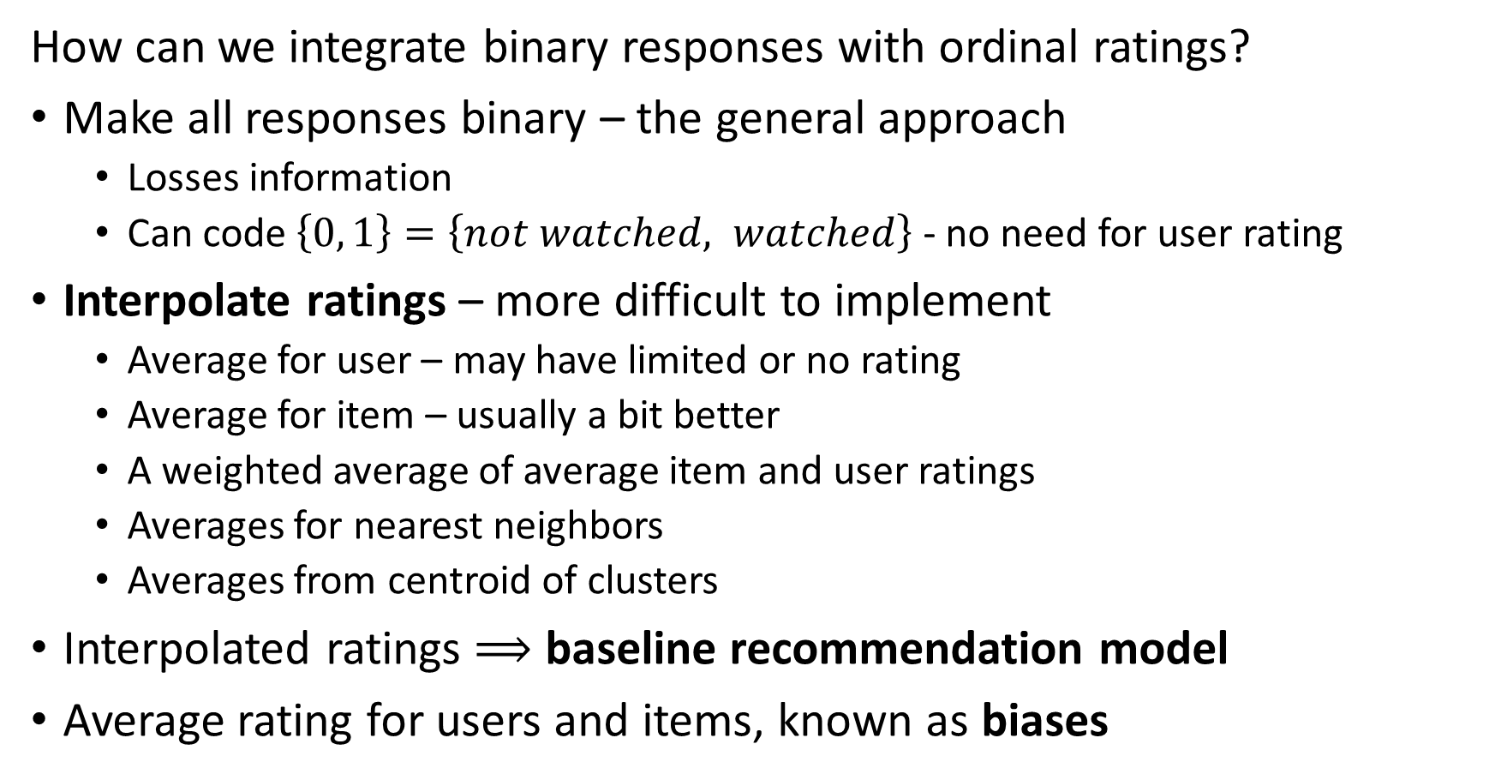
Representation for Recommender Algorithms
How can we integrate binary responses with ordinal ratings?
Make all responses binary – the general approach
  Losses information
  Can code $\left\{0, 1\right\}=\left\{not watched, watched\right\}$ - no need for user rating
Interpolate ratings – more difficult to implement
  Average for user – may have limited or no rating
  Average for item – usually a bit better
  A weighted average of average item and user ratings
  Averages for nearest neighbors
  Averages from centroid of clusters
Interpolated ratings $⟹$ baseline recommendation model
Average rating for users and items, known as biases

Slide 30
Representation for Recommender Algorithms
Is Maria only one person?
Maybe not – multiple people share accounts
Perhaps the Maria account represents several people in a household?
 | Star Wars | The Matrix | Green Book | Frozen | Lady Bird | Jurassic Park | Schindler’s List | My Neighbor Totoro
Mary |  |  | 4 |  | 5 |  | 4 | 5
Bob | 4 | 5 |  |  | 1
Raj |  |  | 4 |  |  |  | 5
Maria | 3 | 4 |  | 5 | 4 |  | 3 | 5
Kevin |  |  | 5 |  |  | 2 | 5
Janell | 5 | 4 |  |  |  |  |  | 2

Slide 31








Representation for Recommender Algorithms
Graph representation of utility matrix
One type of node represents users
One type of node represents items
Weighted edges associate users and items – e.g. item ratings or similarity
Is a bipartite graph
Graph representation is inherently sparse
Many state of the art recommender algorithms are graph-based
$$U_{1}$$
$$I_{1}$$
$$U_{2}$$
$$I_{2}$$
$$U_{3}$$
$$I_{3}$$
…
…
$$U_{n}$$
$$I_{n}$$

Slide 32
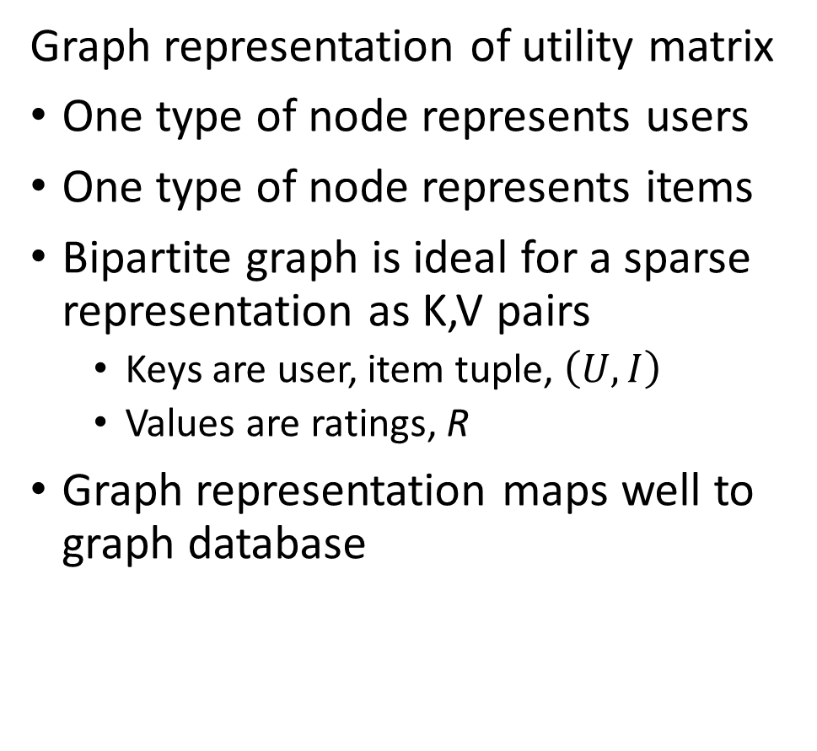
Representation for Recommender Algorithms
Graph representation of utility matrix
One type of node represents users
One type of node represents items
Bipartite graph is ideal for a sparse representation as K,V pairs
  Keys are user, item tuple, $\left(U,I\right)$
  Values are ratings, R
Graph representation maps well to graph database
$$U_{1}$$
$$I_{1}$$
$$U_{2}$$
$$I_{2}$$
$$U_{3}$$
$$I_{3}$$
…
…
$$U_{n}$$
$$I_{n}$$

Slide 33
Extending the Representation

Slide 34
Recommender Systems
Context-aware recommender for improved personalization
Figure from Revisiting Recommender Systems: An Investigative Survey. Ibrahim, et. al, 2025

Slide 35
Extending the Representation
How can we add context to the representation to improve personalization?
Extend the utility matrix
Add context dimensions to utility matrix
Example: for each rating or interaction
  Time of day
  Location
  Pages visited
  Reliability metrics
  Etc.

Slide 36
Extending the Representation
How can we add context to the representation?
Context representation is difficult
High dimensional: many possible contexts
Sparse: only limited context for specific situation
Cold start problem
  Few contexts encountered per user
  No context for new user
Need to embed sparse high dimensional vector space

Slide 37






Extending the representation
Example: extending the utility matrix to include context and content information embeddings
Rating
User Profile
Context
Content Attributes
$$∙∙∙$$
$$∙∙∙$$
$$∙∙∙$$
Items
Rating
User Profile
Context
Content Attributes
Rating
User Profile
Context
Content Attributes
Rating
User Profile
Context
Content Attributes
Users
$$∙∙∙$$
$$∙∙∙$$
$$∙∙∙$$
Rating
User Profile
Context
Content Attributes
Rating
User Profile
Context
Content Attributes

Slide 38
Content Based Recommenders

Slide 39
Content Based Recommenders
How can we build a content-based recommender?
Based on similarity of item profiles
Is an unsupervised similarity search
Can use most any similarity metric, with default of cosine
Goal: Recommend related items to user
Example: recommend movie
  Find movies with similar actors, director, writers, etc. to user profile

Slide 40
Recommender Systems
Vector nearest neighbor search algorithm for content-based recommender
Figure from Revisiting Recommender Systems: An Investigative Survey. Ibrahim, et. al, 2025

Slide 41
Content Based Recommenders
How can we build a content-based recommender?
Item profiles (characteristics)
  Acquired from item descriptions
  No item cold-start problem
  Feature map from embedding
Amazon uses mini-hashing LSH, Luo, 2022, for large scale Item similarity search

Slide 42

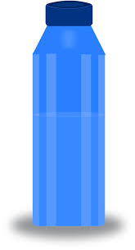



Content Based Recommenders
How can we build a content-based recommender?
User profile of searchers, purchases and ratings of bicycle water bottles
Present recommended
items
Many possible similar items from item descriptions (choices)
Filter on k highest similarity between user and item profiles

Slide 43
Content Based Recommenders
How can we build a content-based recommender?
Extracting consistent item characteristics can be difficult
Descriptions often inconsistent, incomplete or missing
  Different sources code and format characteristics differently
  Integrate categorical and numerical characteristics
Categorical features
  Feature hashing – hashing trick
  Dense semantic embedding
Unstructured text and image descriptions
  Use neural embedding
Use embedding space for similarity search

Slide 44
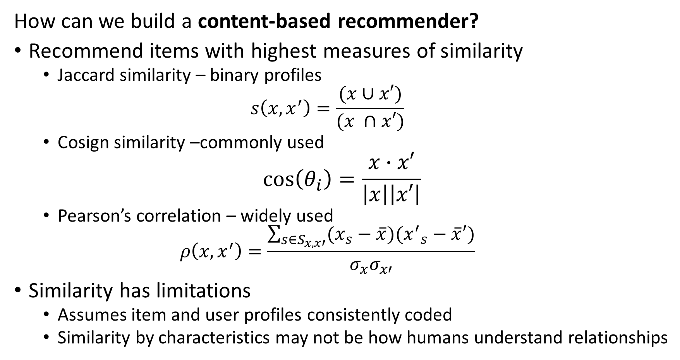
Content Based Recommenders
How can we build a content-based recommender?
Recommend items with highest measures of similarity
  Jaccard similarity – binary profiles
  $$s\left(x,x^{′}\right)=\frac{(x∪x′)}{(x ∩x′)}$$
  Cosign similarity –commonly used
$$\cos\left(θ_{i}\right)=\frac{x∙x′}{\left|x\right|\left|x′\right|}$$
  Pearson’s correlation – widely used
  $$ρ\left(x,x^{′}\right)=\frac{\sum_{s∈S_{x,x′}}^{ }{(x_{s}−\overline{x})({x^{′}}_{s}−\overline{x}′)}}{σ_{x}σ_{x′}}$$
Similarity has limitations
  Assumes item and user profiles consistently coded
  Similarity by characteristics may not be how humans understand relationships

Slide 45
Content Based Recommenders
Advantages of content-based recommenders
No need for data on other item characteristics, e.g. ratings
Recommend new and unpopular item by profile alone
  No cold start problem for items
Works for users with unusual tastes
  No first-rater problem
Outcome is explainable
  Easy to understand ranking by similarity

Slide 46
Content Based Recommenders
Disadvantages of content-based recommenders
Finding features for profile is hard
  Inconsistent descriptions
  Information in unstructured data; text, images
Cold start problem for new user with no profile
Can give over-specialized recommendations
  Will never find item without similarity to user search
  Does not account for user with multiple interests
  Does not use information from other users; e.g. ratings

Slide 47
Collaborative Filtering

Slide 48
Recommender Systems
Collaborative filtering with k-nearest neighbor algorithm
Figure from Revisiting Recommender Systems: An Investigative Survey. Ibrahim, et. al, 2025

Slide 49
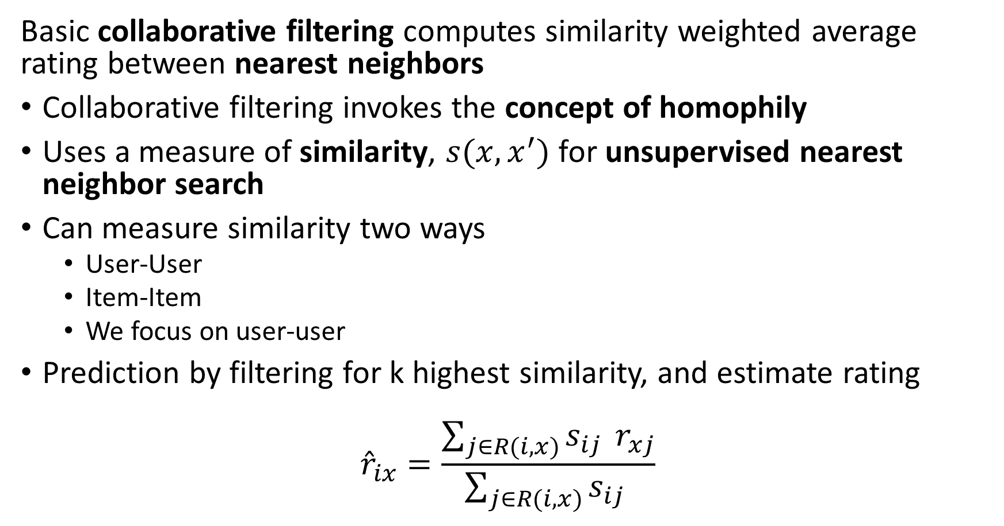
Collaborative Filter Recommenders
Basic collaborative filtering computes similarity weighted average rating between nearest neighbors
Collaborative filtering invokes the concept of homophily
Uses a measure of similarity, $s(x,x^{′})$ for unsupervised nearest neighbor search
Can measure similarity two ways
  User-User
  Item-Item
  We focus on user-user
Prediction by filtering for k highest similarity, and estimate rating
$${\hat{r}}_{ix}=\frac{\sum_{j∈R(i,x)}^{ }{s_{ij } r_{xj}}}{\sum_{j∈R(i,x)}^{ }{s_{ij} }}$$

Slide 50
Collaborative Filter Recommenders
Example of unsupervised collaborative filtering
Start with a utility matrix
Here we use ratings, but can use feature embeddings with same basic algorithm
Users
 | 1 | 2 | 3 | 4 | 5 | 6 | 7 | 8 | 9 | 10 | 11
1 | 4 |  | 5 |  |  | 5 | ? |  | 3 |  | 1
2 | 1 | 2 |  |  | 4 |  |  | 4 | 5
3 | 5 | 3 | 4 |  | 3 |  | 2 | 1 |  | 4 | 2
4 | 2 |  |  | 4 |  |  | 5 |  | 4 | 2
5 | 2 |  |  |  |  | 2 | 4 | 3 | 4
6 | 4 |  |  | 2 |  |  | 3 |  | 3 |  | 1
Items

Slide 51
Collaborative Filter Recommenders
Example of unsupervised collaborative filtering
Want to predict implied rating for user 7 of item 1
Compute the mean and Variance of the item ratings
Subtract mean rating from item rating
Users
 | 1 | 2 | 3 | 4 | 5 | 6 | 7 | 8 | 9 | 10 | 11 | Mean Rating | Variance
1 | 4 |  | 5 |  |  | 5 | ? |  | 3 |  | 1 | 3.60 | 2.80
2 | 1 | 2 |  |  | 4 |  |  | 4 | 5 |  |  | 3.20 | 2.7
3 | 5 | 3 | 4 |  | 3 |  | 2 | 1 |  | 4 | 2 | 3.00 | 1.71
4 | 2 |  |  | 4 |  |  | 5 |  | 4 | 2 |  | 3.40 | 1.8
5 | 2 |  |  |  |  | 2 | 4 | 3 | 4 |  |  | 3.00 | 1.00
6 | 4 |  |  | 2 |  |  | 3 |  | 3 |  | 1 | 2.60 | 1.30
Items

Slide 52
Collaborative Filter Recommenders
Example of unsupervised collaborative filtering
Compute Pearson’s Correlation between item 1 ratings and other items
Two items have high correlation similarity
Users
 | 1 | 2 | 3 | 4 | 5 | 6 | 7 | 8 | 9 | 10 | 11 | Pearson Correlation | Jaccard Similarity
1 | 4 |  | 5 |  |  | 5 | ? |  | 3 |  | 1
2 | 1 | 2 |  |  | 4 |  |  | 4 | 5 |  |  | -1.0 | 0.18
3 | 5 | 3 | 4 |  | 3 |  | 2 | 1 |  | 4 | 2 | 0.84 | 0.27
4 | 2 |  |  | 4 |  |  | 5 |  | 4 | 2 |  | -1.0 | 0.18
5 | 2 |  |  |  |  | 2 | 4 | 3 | 4 |  |  | -0.87 | 0.27
6 | 4 |  |  | 2 |  |  | 3 |  | 3 |  | 1 | 1.0 | 0.27
Items

Slide 53
Collaborative Filter Recommenders
Example of unsupervised collaborative filtering
Compute weighted rating = (0.84*2 + 1.0*3)/(0.84+1.0) = 2.54
Users
 | 1 | 2 | 3 | 4 | 5 | 6 | 7 | 8 | 9 | 10 | 11 | Pearson Correlation | Jaccard Similarity
1 | 4 |  | 5 |  |  | 5 | 3 |  | 3 |  | 1
2 | 1 | 2 |  |  | 4 |  |  | 4 | 5 |  |  | -1.0 | 0.18
3 | 5 | 3 | 4 |  | 3 |  | 2 | 1 |  | 4 | 2 | 0.84 | 0.27
4 | 2 |  |  | 4 |  |  | 5 |  | 4 | 2 |  | -1.0 | 0.18
5 | 2 |  |  |  |  | 2 | 4 | 3 | 4 |  |  | -0.87 | 0.27
6 | 4 |  |  | 2 |  |  | 3 |  | 3 |  | 1 | 1.0 | 0.27
Items

Slide 54
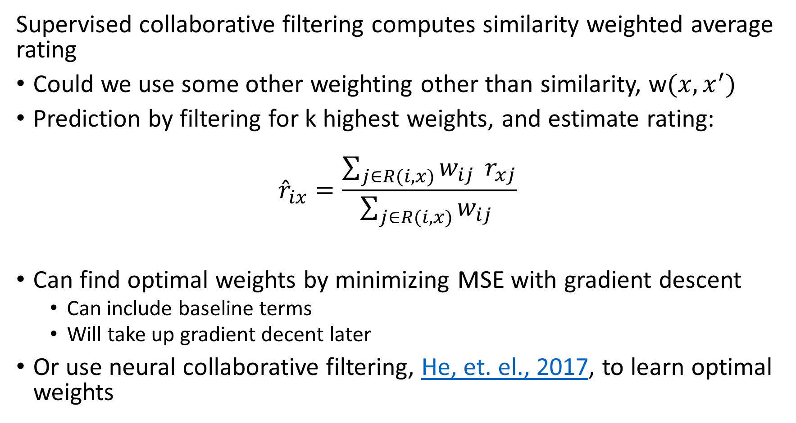
Collaborative Filter Recommenders
Supervised collaborative filtering computes similarity weighted average rating
Could we use some other weighting other than similarity, w$(x,x^{′})$
Prediction by filtering for k highest weights, and estimate rating:
$${\hat{r}}_{ix}=\frac{\sum_{j∈R(i,x)}^{ }{w_{ij } r_{xj}}}{\sum_{j∈R(i,x)}^{ }{w_{ij} }}$$
Can find optimal weights by minimizing MSE with gradient descent
  Can include baseline terms
  Will take up gradient decent later
Or use neural collaborative filtering, He, et. el., 2017, to learn optimal weights

Slide 55
Evaluating Recommenders

Slide 56
Evaluating Recommenders
How do we objectively evaluate IR algorithms?
There are three dimensions of performance
Many possible recommendation performance metrics
Memory use can be the biggest constraint for massive data sets
Speed can be important for many applications
  Users will only pay attention to promptly displayed recommendations
Low Memory -Scalable
Low Computational Complexity-Scalable
Retrieval Performance

Slide 57
Evaluating Recommenders
Jadon Patil 2024 provide a exhaustive, perhaps exhausting☺, review of four aspects of recommender system performance evaluation
Similarity metrics measure the similarity of recommendations to user queries
  We have addressed these metrics previously
Candidate generation metrics evaluate the how broad and relevant the recommendations are
Predictive metrics evaluate how well the recommender system predicts the ratings of users
Business metrics how well the recommender system improves business performance

Slide 58
Evaluating Recommenders
Jadon Patil 2024 review a large number of candidate generation metrics
Ranking metrics for either candidate generation or business evaluation
  Precision@k, Recall@k, average Precision@k, average Recall@k
  Normalized cumulative discounted gain
  Mean reciprocal rank
  …
Candidate generation metrics
  Novelty
  Diversity
  Serendipity
  Catalog coverage
  Distributional coverage

Slide 59
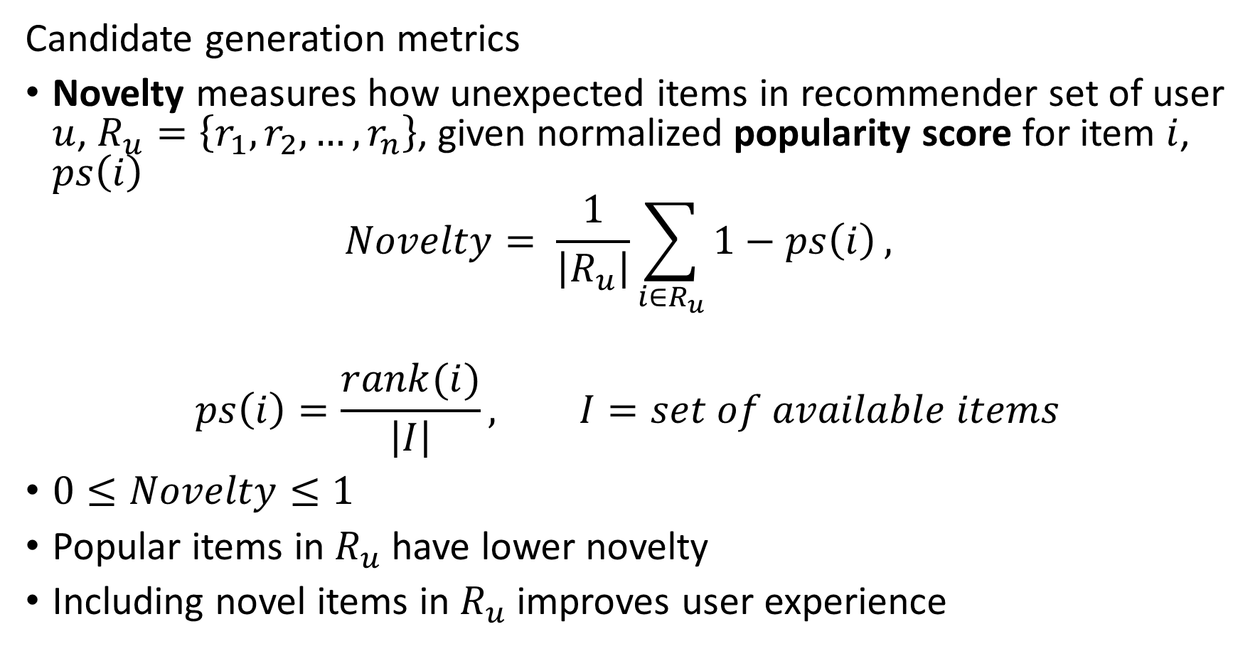
Evaluating Recommenders
Candidate generation metrics
Novelty measures how unexpected items in recommender set of user $u$, $R_{u}=\left\{r_{1},r_{2},…,r_{n}\right\}$, given normalized popularity score for item $i$, $ps\left(i\right)$
$$Novelty= \frac{1}{\left|R_{u}\right|}\sum_{i∈R_{u}}{1−ps\left(i\right)},$$
$$ps\left(i\right)=\frac{rank(i)}{\left|I\right|}, I=set of available items$$
$0≤Novelty≤1$
Popular items in $R_{u}$ have lower novelty
Including novel items in $R_{u}$ improves user experience

Slide 60
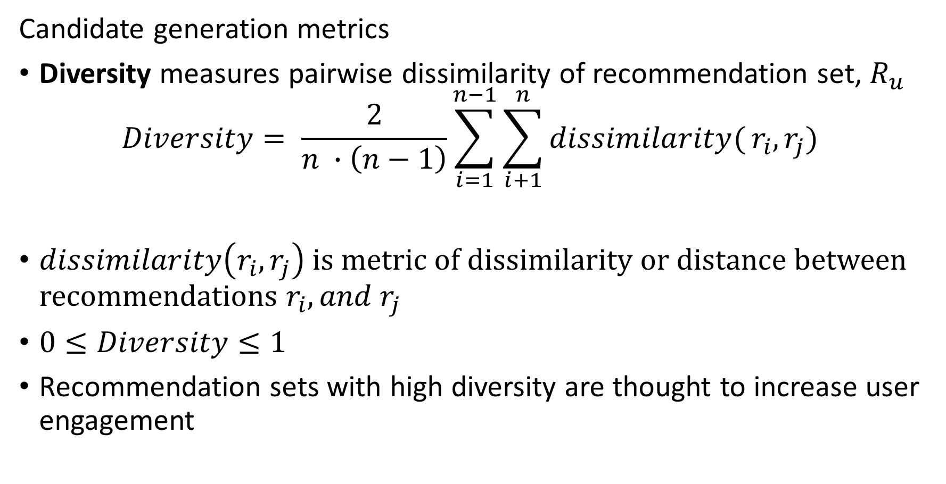
Evaluating Recommenders
Candidate generation metrics
Diversity measures pairwise dissimilarity of recommendation set, $R_{u}$
$$Diversity= \frac{2}{n ∙\left(n−1\right)}\sum_{i=1}^{n−1}{\sum_{i+1}^{n}{dissimilarity(}}r_{i},r_{j})$$
$dissimilarity\left(r_{i},r_{j}\right)$ is metric of dissimilarity or distance between recommendations $r_{i},{and r}_{j}$
$0≤Diversity≤1$
Recommendation sets with high diversity are thought to increase user engagement

Slide 61
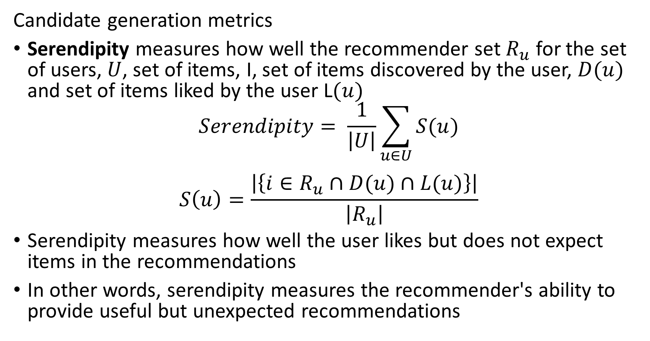
Evaluating Recommenders
Candidate generation metrics
Serendipity measures how well the recommender set $R_{u}$ for the set of users, $U$, set of items, I, set of items discovered by the user, $D(u)$ and set of items liked by the user L$(u)$
$$Serendipity= \frac{1}{\left|U\right|}\sum_{u∈U}{S(u)}$$
$$S\left(u\right)=\frac{\left|\left\{i∈R_{u}∩D(u)∩L(u)\right\}\right|}{\left|R_{u}\right|}$$
Serendipity measures how well the user likes but does not expect items in the recommendations
In other words, serendipity measures the recommender's ability to provide useful but unexpected recommendations

Slide 62
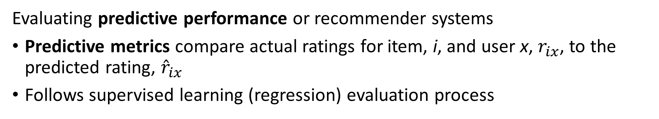
Evaluating Recommenders
Evaluating predictive performance or recommender systems
Predictive metrics compare actual ratings for item, i, and user x, $r_{ix}$, to the predicted rating, ${\hat{r}}_{ix}$
Follows supervised learning (regression) evaluation process
Users
Compare estimated rating to actual ratings
Choose evaluation metrics
Start with full data sample
Hold back Bernoulli sampled fraction of data
Train model
Evaluate using metric
4 |  | 3 |  |  | 2
 | 5 | 4 |  | 2 |  | 1
2 |  |  | 5 |  | 5
 | 3 | 3 |  | 2 | 4
5 |  | 5 | 3 |  |  | 4 | 1
 | 3 |  | 5 |  | 5 |  | 5
2 | 4 | 5 |  |  | 1
 | 3 |  | 4 |  | 3 |  | 2
4 |  | 3 |  |  | 2
 | 5 | 4 |  | 2 |  | 1
2 |  |  | 5 |  | 5
 | 3 | 3 |  | 2 | 4
5 |  | 5 | 3 |  |  | 4 | 1
 | 3 |  | 5 |  | 5 |  | 5
2 | 4 | 5 |  |  | 1
 | 3 |  | 4 |  | 3 |  | 2
Items

Slide 63
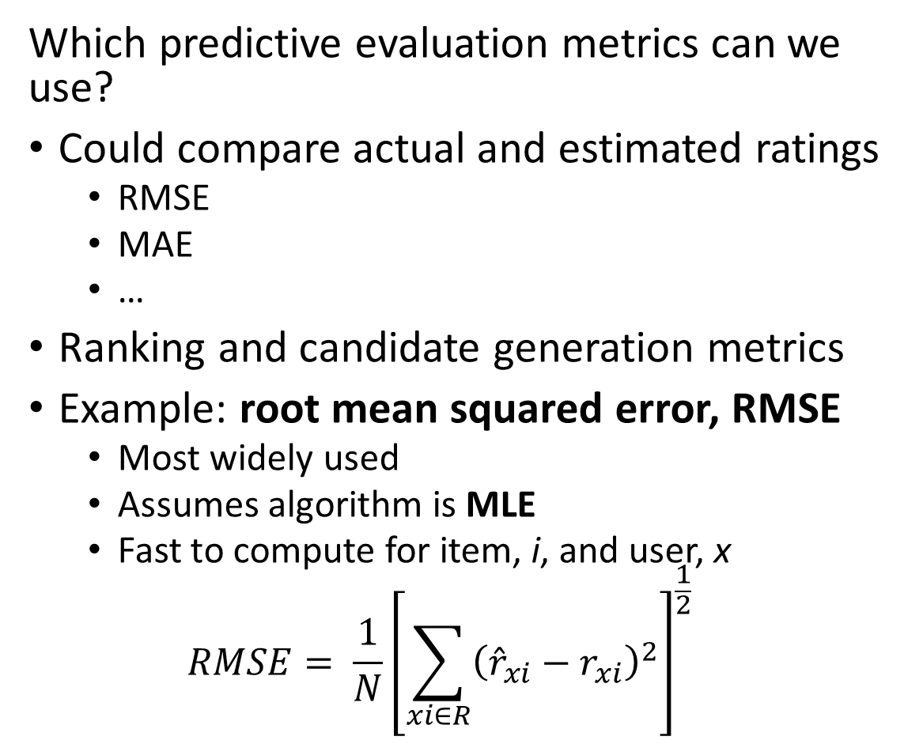
Evaluating Recommenders
Which predictive evaluation metrics can we use?
Could compare actual and estimated ratings
  RMSE
  MAE
  …
Ranking and candidate generation metrics
Example: root mean squared error, RMSE
  Most widely used
  Assumes algorithm is MLE
  Fast to compute for item, i, and user, x
  $$RMSE= \frac{1}{N}{\left[\sum_{xi∈R}^{ }{{\left({\hat{r}}_{xi}−r_{xi}\right)}^{2}}\right]}^{\frac{1}{2}}$$
Users
4 |  | 3 |  |  | 2
 | 5 | 4 |  | 2 |  | 1
2 |  |  | 5 |  | 5
 | 3 | 3 |  | 2 | 4
5 |  | 5 | 3 |  |  | 4 | 1
 | 3 |  | 5 |  | 5 |  | 5
2 | 4 | 5 |  |  | 1
 | 3 |  | 4 |  | 3 |  | 2
Items

Slide 64
Evaluating Recommenders
Can we apply cross validation to recommender algorithms?
Yes! Use K-fold CV method
  Randomly sample data into K-folds (subsets)
  Round robin hold back one fold for evaluation and train model on K-1 folds
  Base evaluation on mean and variance of K performance metric sets
CV is an effective tool for comparing performance of models
In theory, can use nested CV for hyperparameter search
  But computation can be prohibitive – data can be massive
  Can limit folds and number of hyperparameter values

Slide 65
Summary

Slide 66
Summary
Economic impact of recommenders is massive!
Online catalogs have a long tail
  Many rarely purchased and reviewed items
  Users will not find items in the tail without a recommender
Recommender algorithms connect users with items
Creating a good recommender algorithm for the real-world is hard!
  People have complex and variable behavior
  User ratings are not constant with time
  Biases from position and negative sampling
  Attacks on recommenders a growing problem
  Cold start problem for new items
  Cold start problem for new users

Slide 67
Summary
Many algorithms have been tried to find recommendations
Commonly used algorithms are based on similarity search
Content based systems
  Similarity search to find items with common properties
  Related to frequent item set algorithms
Collaborative filtering
  Based on similarity between items and between users
  Widely used algorithms
  Can be unsupervised or supervised
  Linear and nonlinear (neural) algorithms widely employed
  Has cold-start problem

Slide 68
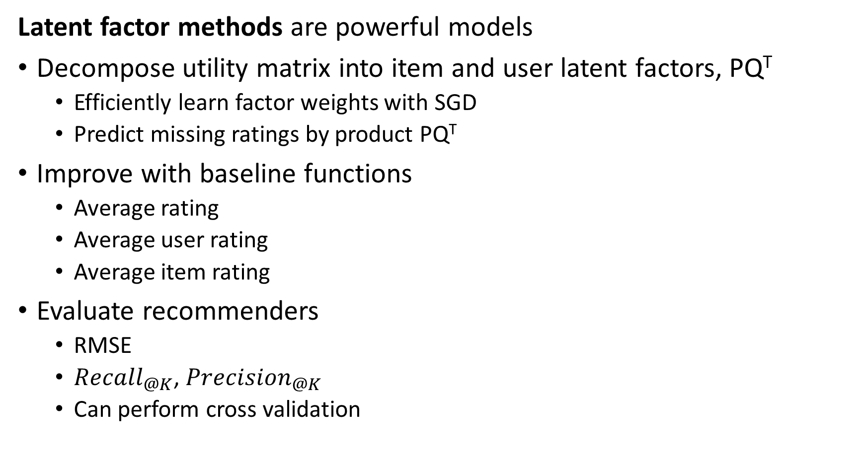
Summary
Latent factor methods are powerful models
Decompose utility matrix into item and user latent factors, PQ^{T}
  Efficiently learn factor weights with SGD
  Predict missing ratings by product PQ^{T}
Improve with baseline functions
  Average rating
  Average user rating
  Average item rating
Evaluate recommenders
  RMSE
  ${Recall}_{@K}$, ${Precision}_{@K}$
  Can perform cross validation

