Slide 1

CSCI E-96 Data Mining, Exploration and Discovery Social Network Analysis
Steve Elston
Copyright 2021, 2022, 2023, 2024, 2025, Stephen F Elston. All rights reserved.

Slide 2
Introduction to Social Network Analysis
Social networks appear in many forms
Online social media
Networks of collaborating people
People in clubs
Political and business organizations
Organisms in an ecosystem
Citations in research papers
Many more …

Slide 3
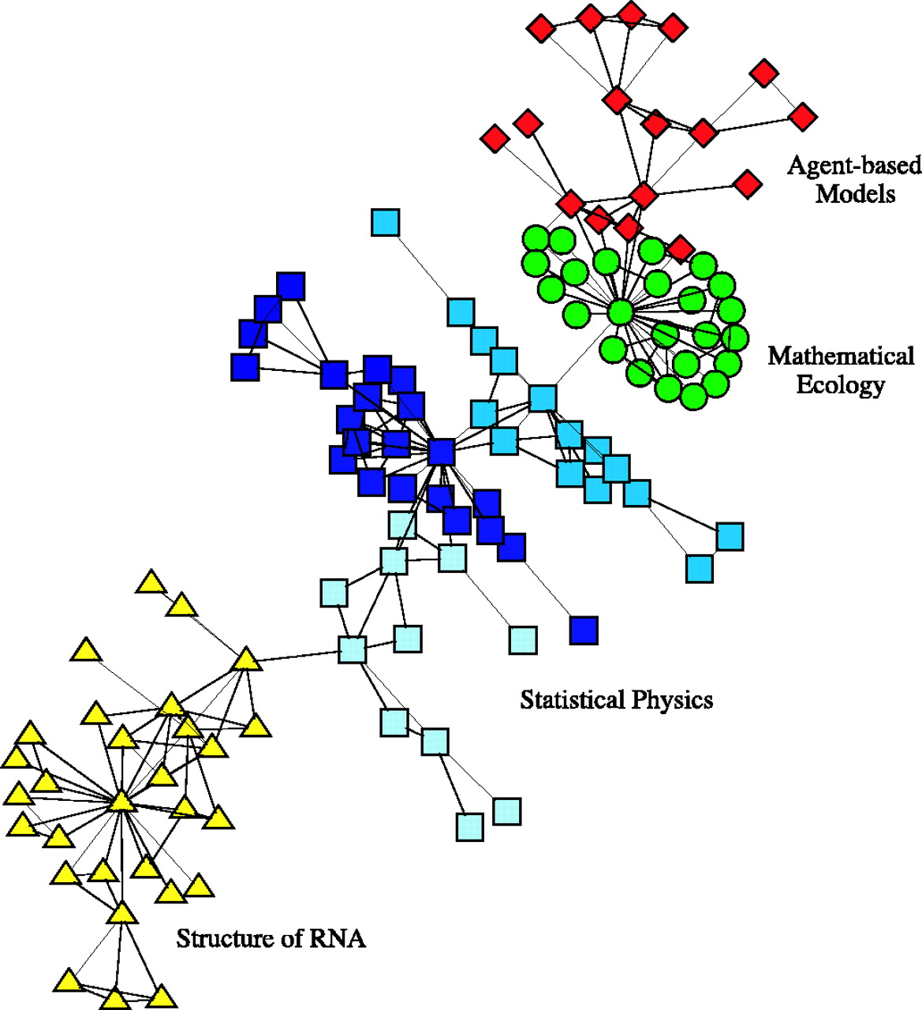
Introduction to Social Network Analysis
Social networks appear in many forms
Example: small network of co-authorship of scientific papers
Relationships represented by undirected graph
Relationship communities organize along discipline lines
Some community members are strongly connected
Strongly connected members are said to be influential
Few connections between communities
Credit: Neman, 2004, Proceedings of the National Academy of Sciences

Slide 4
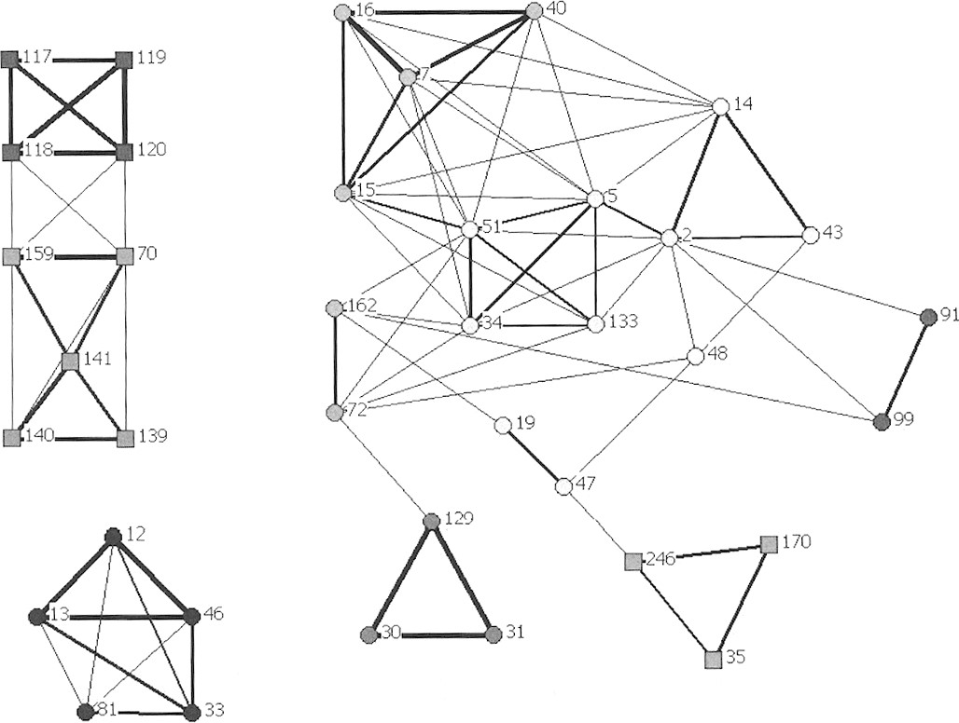
Introduction to Social Network Analysis
Social networks appear in many forms
Example: Association network of Bottlenose Dolphins at Port Stephens NSW Australia
Square = western population
Circle = eastern population
Credit: Wiszniewksi, Brown and Moller, Journal of Mammalogy, 2012

Slide 5
Introduction to Social Network Analysis
Social networks appear in many forms
Undirected weighted graph represents relationships between dolphins
Strength of relationship represented by edge weights
Communities in isolated graph components
Some sub-components within communities are weekly connected
Credit: Wiszniewksi, Brown and Moller, Journal of Mammalogy, 2012

Slide 6
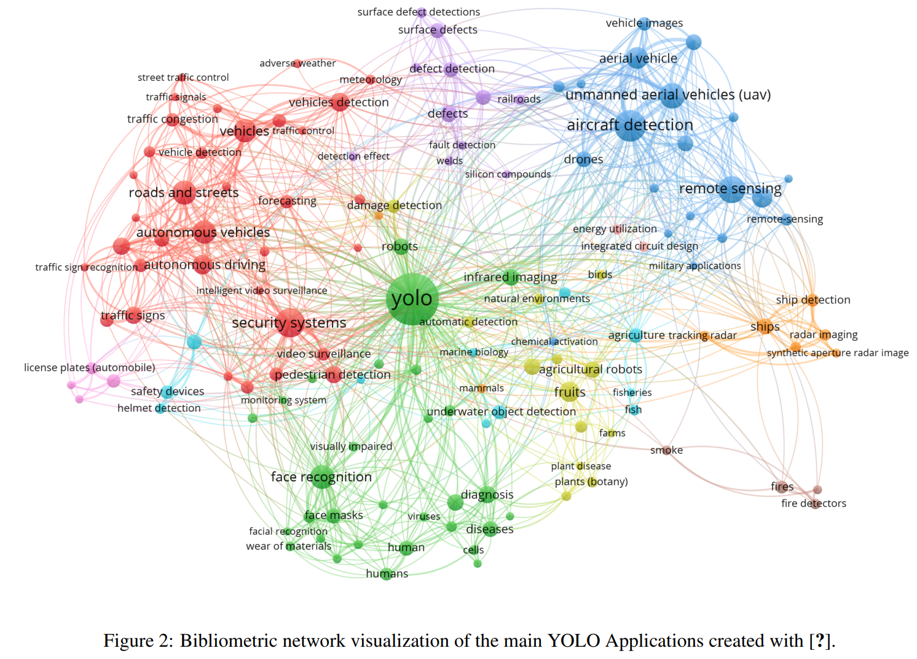
Example of Network of Published Research Literature
Continued advances in the YOLO family of real-time object detectors has created a tangle of models and published literature!
Citation network created with Scopus
Only a few papers are highly influential
From YOLO Architecture review paper, Terven and Cordova-Esparza, 2024

Slide 7
Introduction to Social Network Analysis
Analysis to determine community structure in networks
Discover regions of dense connections in the network, cores
Discover and partition distinct communities within the networks
Find highly influential nodes in the network
Community analysis is largely unsupervised learning
Rarely know ground truth
Often requires some judgement or domain knowledge
Different models can provide different views and insights

Slide 8
Introduction to Social Network Analysis
Some properties of social networks
Social networks can be partitioned into communities
Communities are assortative
Homophily is tendency of similar entries to interact in a social network
Homophily leads to stronger connections within communities
Communities have stronger (denser) connections between nodes
Weaker (fewer) connections between nodes of different communities
Nodes in the core components of communities have strongest connection

Slide 9
Introduction to Social Network Analysis
Some properties of social networks
Most social networks are undirected
Friends know each other
Work colleagues know each other
Members of a small club have a high number of mutual connections
But, some social networks are directed
I can follow someone on X, but they need not follow me
Organisms in an environment have asymmetric relationship, e.g. predator-prey
We focus on undirected social networks here

Slide 10
Introduction to Social Network Analysis
Many methods to find communities in social networks
Communities defined by high connectivity
Can find communities by the centrality or influence of nodes:
Kratz centrality
Closeness centrality
K-Cores
Triangle density and clustering
Partition communities by betweenness
Find communities by modularity of groups of nodes
Greedy algorithms
Spectral modularity decomposition

Slide 11
Pitfalls in Social Network Analysis
Unsupervised learning of community structure has pitfalls
No hard definitions or thresholds
How can you define dense connections?
How dense is a core?
How many communities are there?
Communities may have subcommunities
Communities may overlap – not independent or unique
Example: members of two clubs
Example: people in occupations and members of political parties
Effect of criminal network on victims
Evaluation is never fully objective

Slide 12
Introduction to Graph Theory

Slide 13
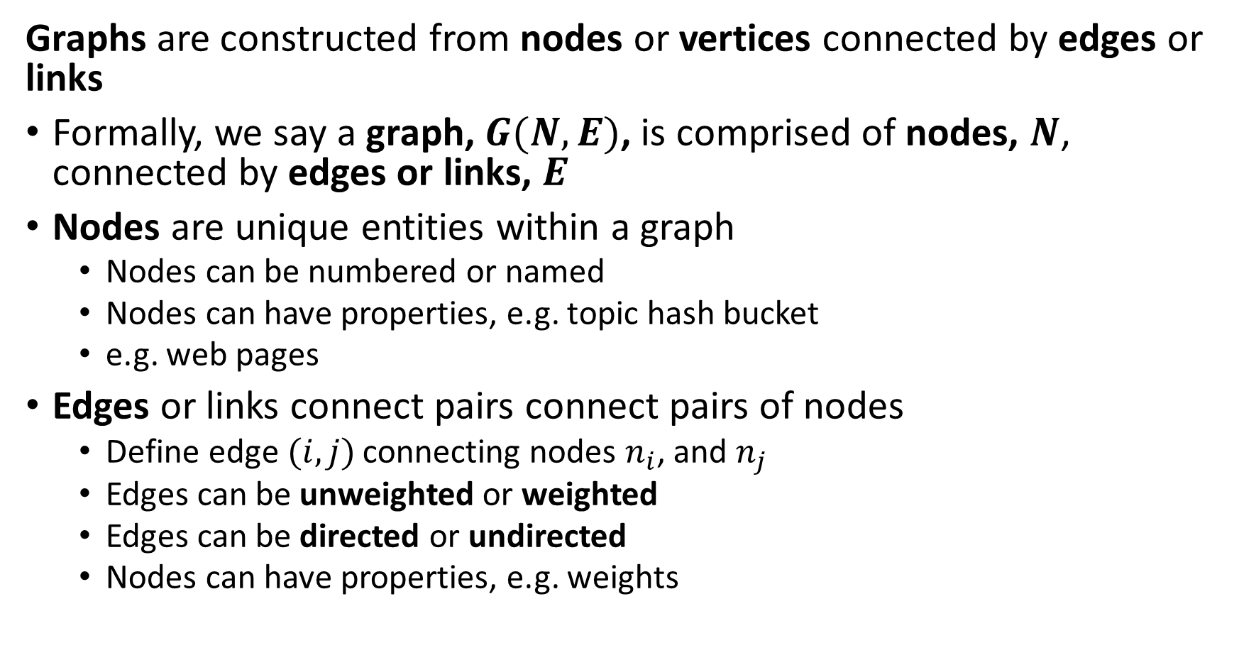
Introduction to Graph Theory Terminology
Graphs are constructed from nodes or vertices connected by edges or links
Formally, we say a graph, $G(N,E)$, is comprised of nodes, $N$, connected by edges or links, $E$
Nodes are unique entities within a graph
Nodes can be numbered or named
Nodes can have properties, e.g. topic hash bucket
e.g. web pages
Edges or links connect pairs connect pairs of nodes
Define edge$(i,j)$ connecting nodes $n_{i}$, and $n_{j}$
Edges can be unweighted or weighted
Edges can be directed or undirected
Nodes can have properties, e.g. weights

Slide 14

Introduction to Graph Theory Terminology
Undirected graphs are constructed from nodes or vertices connected by undirected edges
An undirected edge, $l\left(i,j\right)$, connects nodes $n_{i}$ and $n_{j}$ bidirectionally
Example: Facebook friends is a symmetric relationship
Example: A highway network allows travel in both directions

Slide 15
Introduction to Graph Theory Terminology
Undirected graphs are constructed from nodes or vertices connected by undirected edges
Example: Undirected graph between people in a social media network
Nodes are the people
Property is name
Edges are the connections between nodes
Weights can represent connection strength
Undirected edges are symmetric or bidirectional; e.g. Bob knows Gigi and Gigi knows Bob
Raj
Bob
Gigi
Asan
Mary

Slide 16
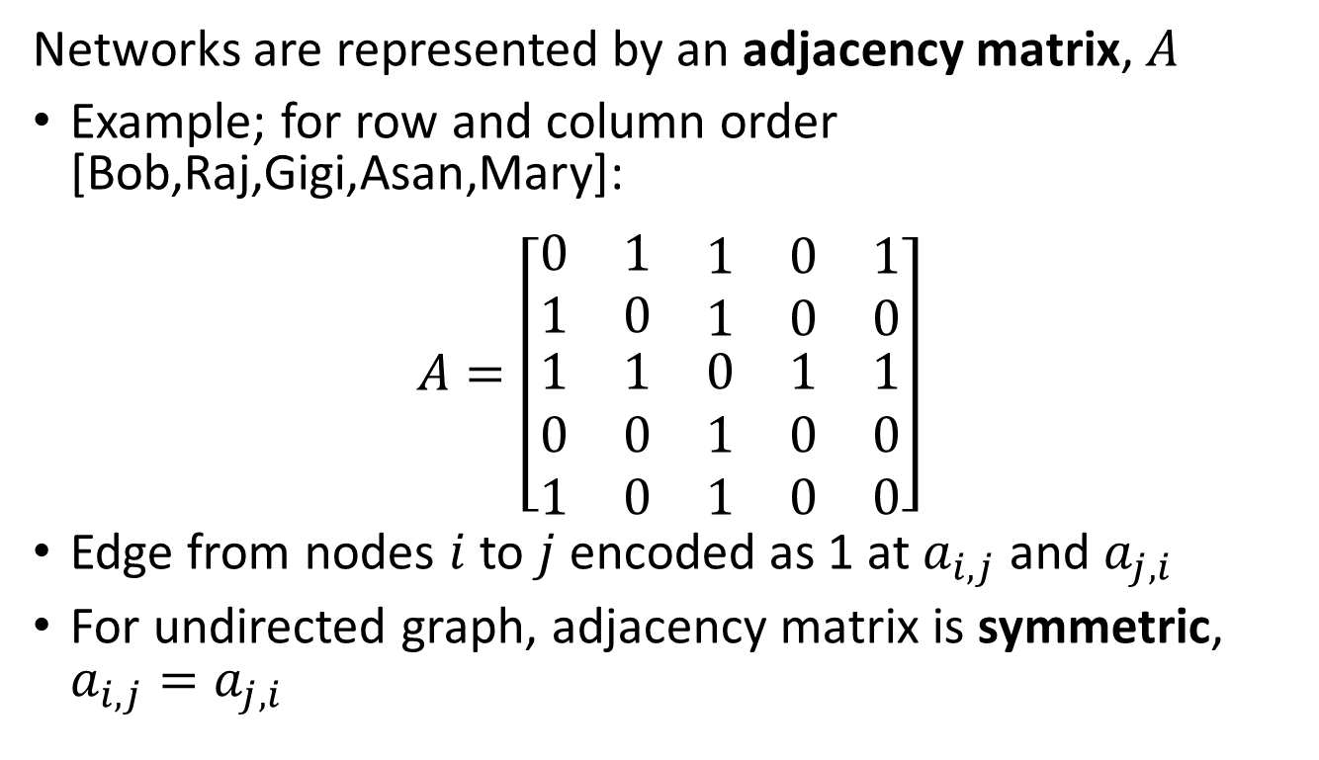
Introduction to Graph Theory
Undirected graphs are constructed from nodes or vertices connected by undirected edges
Networks are represented by an adjacency matrix, $A$
Example; for row and column order [Bob,Raj,Gigi,Asan,Mary]:
$$A=\left[\begin{matrix}0 & 1 & \begin{matrix}1 & 0 & 1\end{matrix} \\ 1 & 0 & \begin{matrix}1 & 0 & 0\end{matrix} \\ \begin{matrix}1 \\ 0 \\ 1\end{matrix} & \begin{matrix}1 \\ 0 \\ 0\end{matrix} & \begin{matrix}0 & 1 & 1 \\ 1 & 0 & 0 \\ 1 & 0 & 0\end{matrix}\end{matrix}\right]$$
Edge from nodes $i$ to $j$ encoded as 1 at $a_{i,j}$ and $a_{j,i}$
For undirected graph, adjacency matrix is symmetric, $a_{i,j}=a_{j,i}$
Raj
Bob
Gigi
Mary
Asan

Slide 17
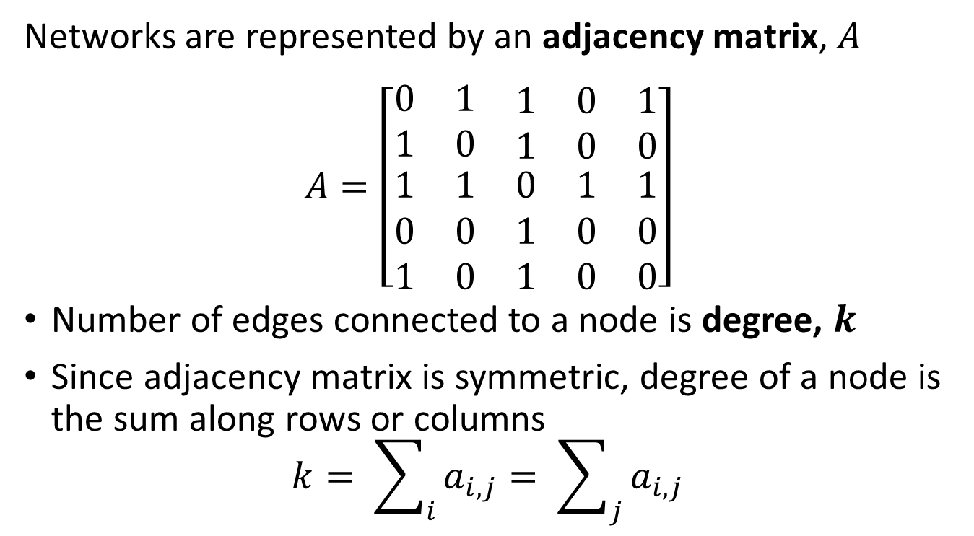
Introduction to Graph Theory
Undirected graphs are constructed from nodes or vertices connected by undirected edges
Networks are represented by an adjacency matrix, $A$
$$A=\left[\begin{matrix}0 & 1 & \begin{matrix}1 & 0 & 1\end{matrix} \\ 1 & 0 & \begin{matrix}1 & 0 & 0\end{matrix} \\ \begin{matrix}1 \\ 0 \\ 1\end{matrix} & \begin{matrix}1 \\ 0 \\ 0\end{matrix} & \begin{matrix}0 & 1 & 1 \\ 1 & 0 & 0 \\ 1 & 0 & 0\end{matrix}\end{matrix}\right]$$
Number of edges connected to a node is degree, $k$
Since adjacency matrix is symmetric, degree of a node is the sum along rows or columns
$$k= \sum_{i}{a_{i,j}}= \sum_{j}{a_{i,j}}$$
Raj
Bob
Gigi
Mary
Asan

Slide 18
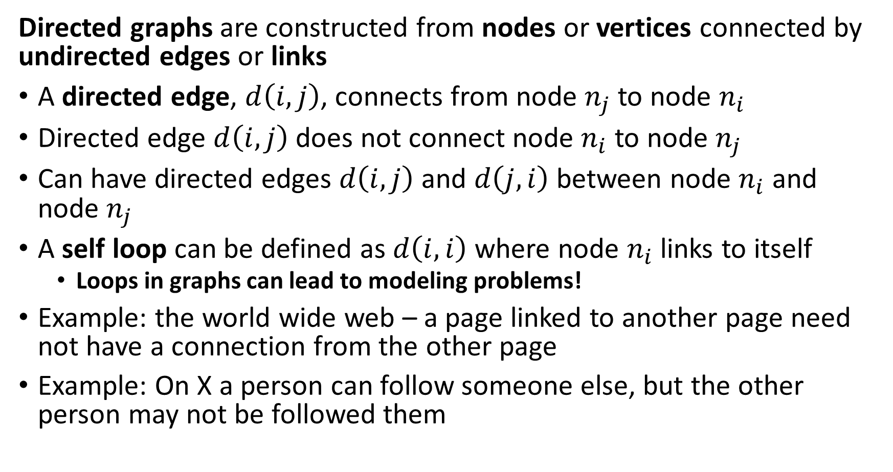
Introduction to Graph Theory Terminology
Directed graphs are constructed from nodes or vertices connected by undirected edges or links
A directed edge, $d\left(i,j\right)$, connects from node $n_{j}$ to node $n_{i}$
Directed edge $d\left(i,j\right)$ does not connect node $n_{i}$ to node $n_{j}$
Can have directed edges $d\left(i,j\right)$ and $d\left(j,i\right)$ between node $n_{i}$ and node $n_{j}$
A self loop can be defined as $d\left(i,i\right)$ where node $n_{i}$ links to itself
Loops in graphs can lead to modeling problems!
Example: the world wide web – a page linked to another page need not have a connection from the other page
Example: On X a person can follow someone else, but the other person may not be followed them

Slide 19
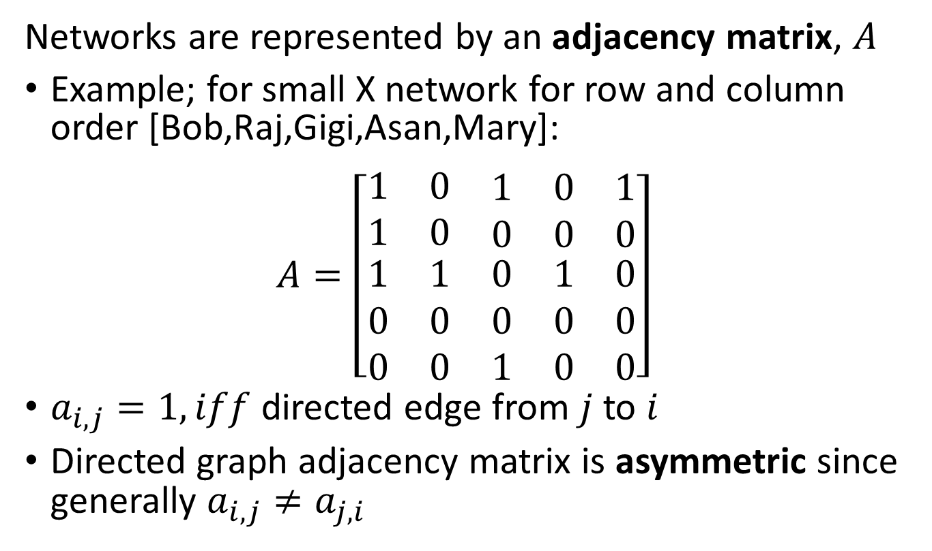
Introduction to Graph Theory
Directed graphs are constructed from nodes or vertices connected by directed edges
Networks are represented by an adjacency matrix, $A$
Example; for small X network for row and column order [Bob,Raj,Gigi,Asan,Mary]:
$$A=\left[\begin{matrix}1 & 0 & \begin{matrix}1 & 0 & 1\end{matrix} \\ 1 & 0 & \begin{matrix}0 & 0 & 0\end{matrix} \\ \begin{matrix}1 \\ 0 \\ 0\end{matrix} & \begin{matrix}1 \\ 0 \\ 0\end{matrix} & \begin{matrix}0 & 1 & 0 \\ 0 & 0 & 0 \\ 1 & 0 & 0\end{matrix}\end{matrix}\right]$$
$a_{i,j}=1, iff$ directed edge from $j$ to $i$
Directed graph adjacency matrix is asymmetric since generally $a_{i,j}≠a_{j,i}$
Raj
Bob
Gigi
Mary
Asan

Slide 20
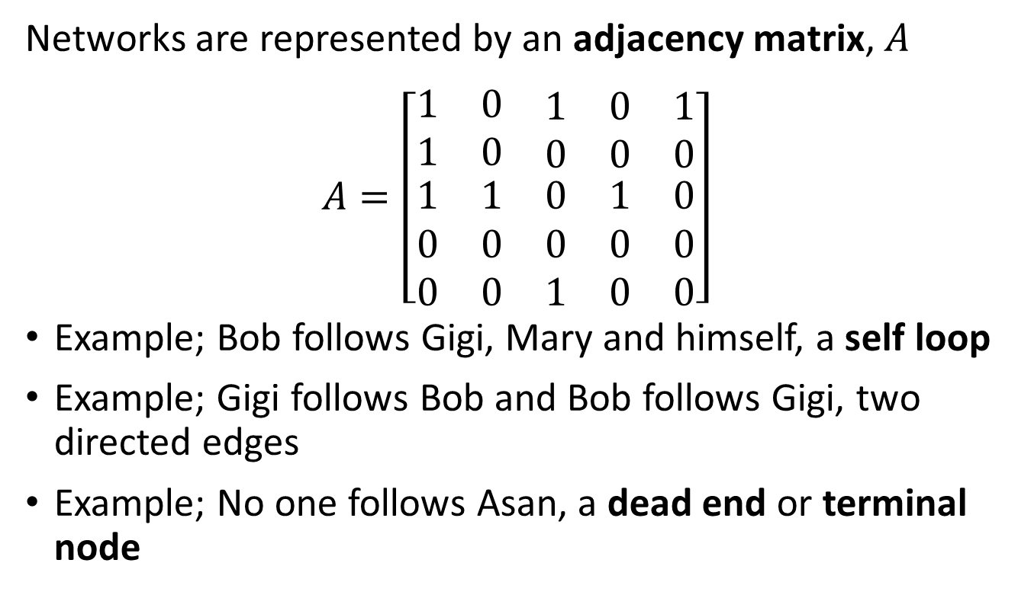
Introduction to Graph Theory
Directed graphs are constructed from nodes or vertices connected by directed edges
Networks are represented by an adjacency matrix, $A$
$$A=\left[\begin{matrix}1 & 0 & \begin{matrix}1 & 0 & 1\end{matrix} \\ 1 & 0 & \begin{matrix}0 & 0 & 0\end{matrix} \\ \begin{matrix}1 \\ 0 \\ 0\end{matrix} & \begin{matrix}1 \\ 0 \\ 0\end{matrix} & \begin{matrix}0 & 1 & 0 \\ 0 & 0 & 0 \\ 1 & 0 & 0\end{matrix}\end{matrix}\right]$$
Example; Bob follows Gigi, Mary and himself, a self loop
Example; Gigi follows Bob and Bob follows Gigi, two directed edges
Example; No one follows Asan, a dead end or terminal node
Raj
Bob
Gigi
Mary
Asan

Slide 21
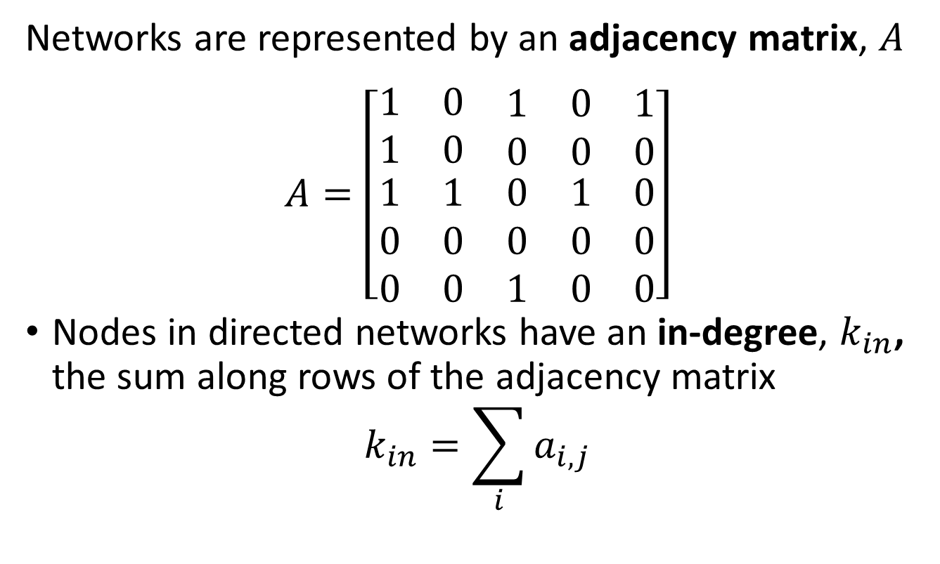
Introduction to Graph Theory
Directed graphs are constructed from nodes or vertices connected by directed edges
Networks are represented by an adjacency matrix, $A$
$$A=\left[\begin{matrix}1 & 0 & \begin{matrix}1 & 0 & 1\end{matrix} \\ 1 & 0 & \begin{matrix}0 & 0 & 0\end{matrix} \\ \begin{matrix}1 \\ 0 \\ 0\end{matrix} & \begin{matrix}1 \\ 0 \\ 0\end{matrix} & \begin{matrix}0 & 1 & 0 \\ 0 & 0 & 0 \\ 1 & 0 & 0\end{matrix}\end{matrix}\right]$$
Nodes in directed networks have an in-degree, $k_{in}$, the sum along rows of the adjacency matrix
$$k_{in}=\sum_{i}{a_{i,j}}$$
Raj
Bob
Gigi
Mary
Asan

Slide 22
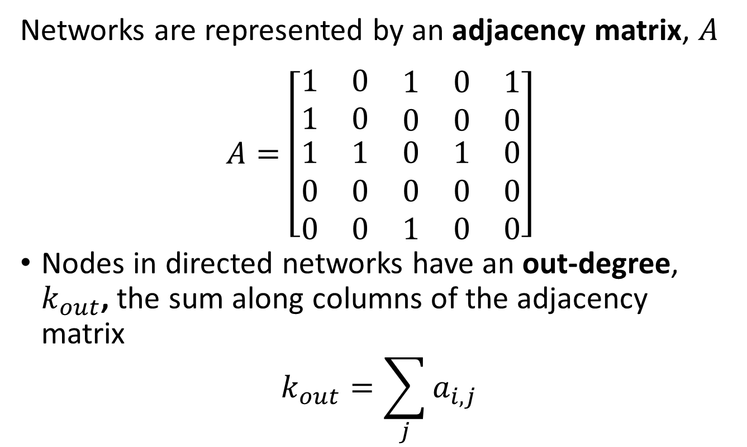
Introduction to Graph Theory
Directed graphs are constructed from nodes or vertices connected by directed edges
Networks are represented by an adjacency matrix, $A$
$$A=\left[\begin{matrix}1 & 0 & \begin{matrix}1 & 0 & 1\end{matrix} \\ 1 & 0 & \begin{matrix}0 & 0 & 0\end{matrix} \\ \begin{matrix}1 \\ 0 \\ 0\end{matrix} & \begin{matrix}1 \\ 0 \\ 0\end{matrix} & \begin{matrix}0 & 1 & 0 \\ 0 & 0 & 0 \\ 1 & 0 & 0\end{matrix}\end{matrix}\right]$$
Nodes in directed networks have an out-degree, $k_{out}$, the sum along columns of the adjacency matrix
$$k_{out}=\sum_{j}{a_{i,j}}$$
Raj
Bob
Gigi
Mary
Asan

Slide 23

Introduction to Graph Theory
Directed graphs are constructed from nodes or vertices connected by directed edges
Nodes in directed networks have an in-degree, $k_{in}$, and out-degree, $k_{out}$,
Example; for Gigi $k_{in}=3$, $k_{out}=2$
Example; for Asan $k_{in}=0$, $k_{out}=1$
Raj
Bob
Gigi
Mary
Asan

Slide 24
Random Graphs

Slide 25
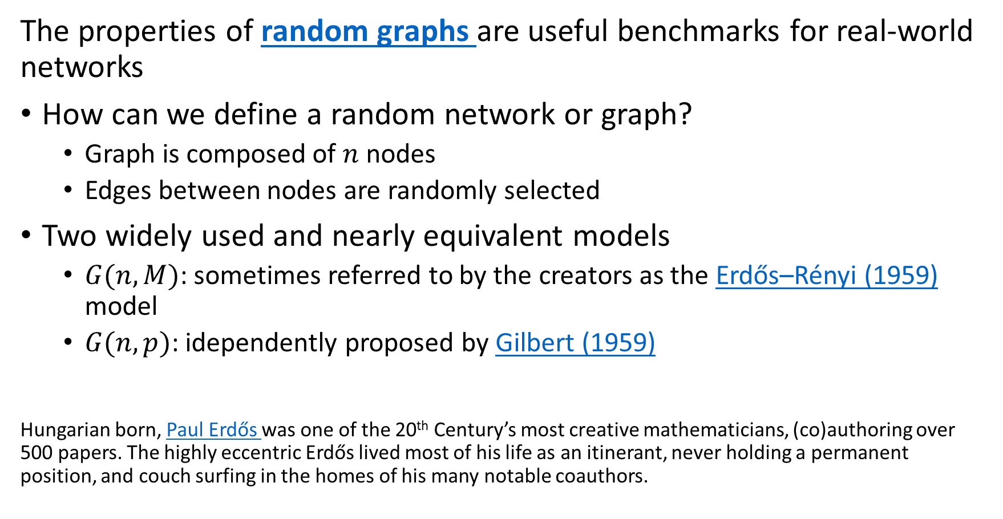
Random Graphs
The properties of random graphs are useful benchmarks for real-world networks
How can we define a random network or graph?
Graph is composed of $n$ nodes
Edges between nodes are randomly selected
Two widely used and nearly equivalent models
$G(n,M)$: sometimes referred to by the creators as the Erdős–Rényi (1959) model
$G(n,p)$: idependently proposed by Gilbert (1959)
Hungarian born, Paul Erdős was one of the 20th Century’s most creative mathematicians, (co)authoring over 500 papers. The highly eccentric Erdős lived most of his life as an itinerant, never holding a permanent position, and couch surfing in the homes of his many notable coauthors.

Slide 26
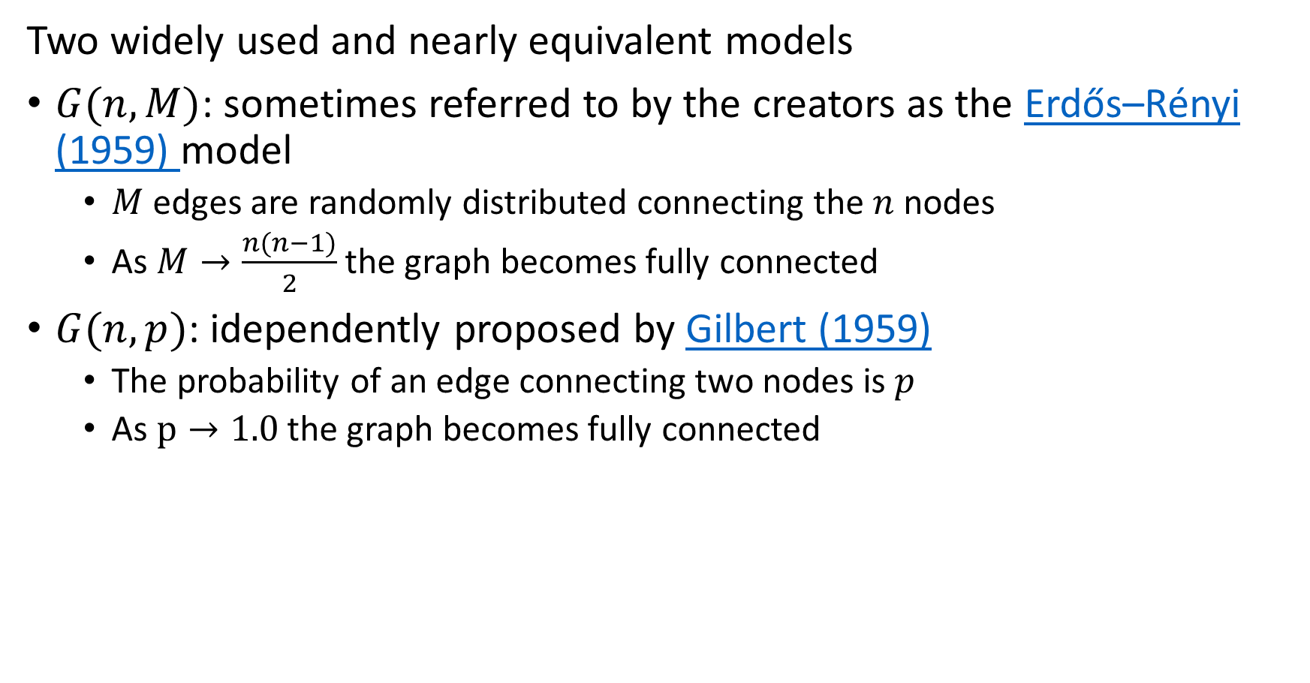
Random Graphs
Two widely used and nearly equivalent models
$G(n,M)$: sometimes referred to by the creators as the Erdős–Rényi (1959) model
$M$ edges are randomly distributed connecting the $n$ nodes
As $M→\frac{n(n−1)}{2}$ the graph becomes fully connected
$G(n,p)$: idependently proposed by Gilbert (1959)
The probability of an edge connecting two nodes is $p$
As $p→1.0$ the graph becomes fully connected

Slide 27
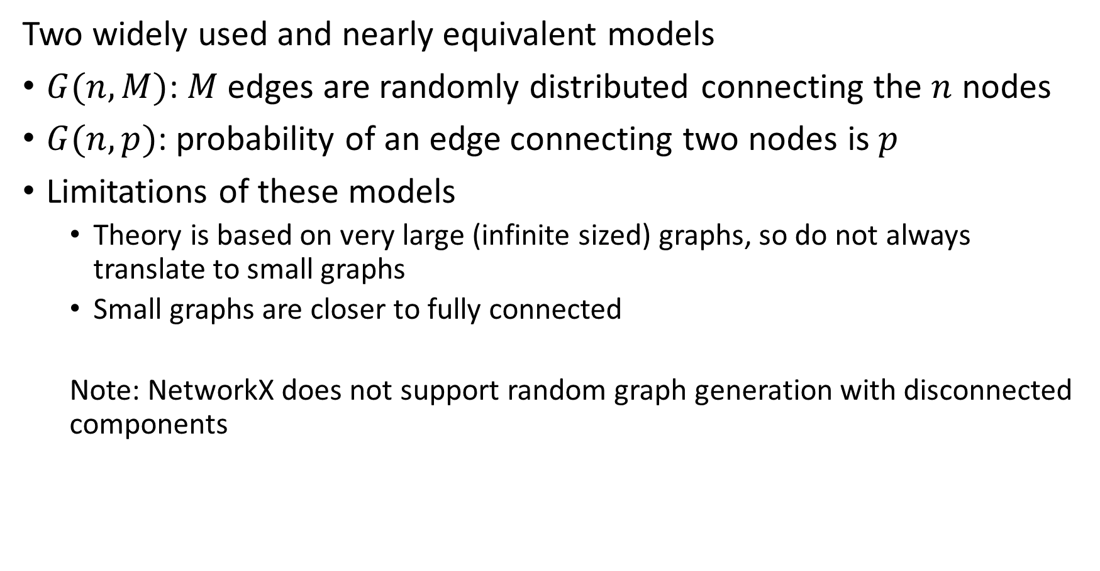
Random Graphs
Two widely used and nearly equivalent models
$G(n,M)$: $M$ edges are randomly distributed connecting the $n$ nodes
$G(n,p)$: probability of an edge connecting two nodes is $p$
Limitations of these models
Theory is based on very large (infinite sized) graphs, so do not always translate to small graphs
Small graphs are closer to fully connected
Note: NetworkX does not support random graph generation with disconnected components

Slide 28
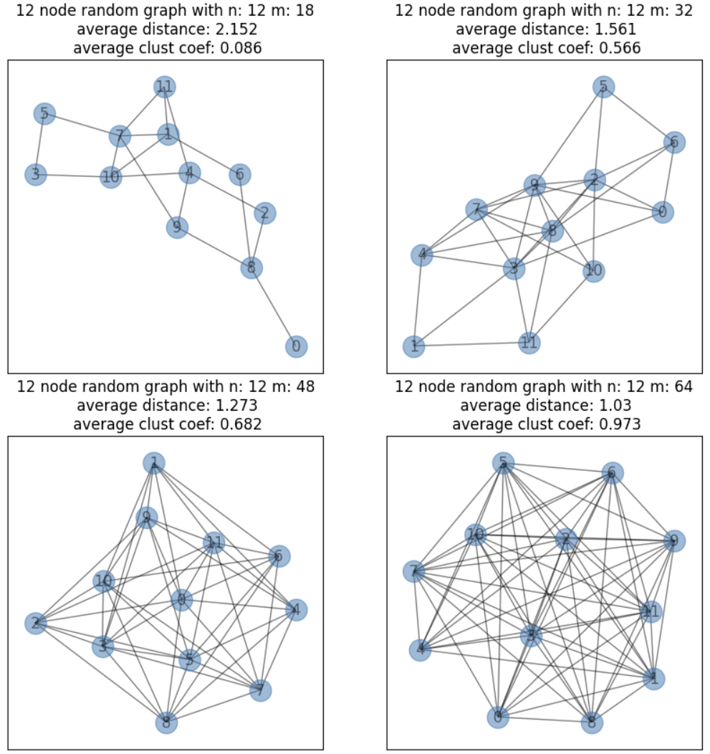
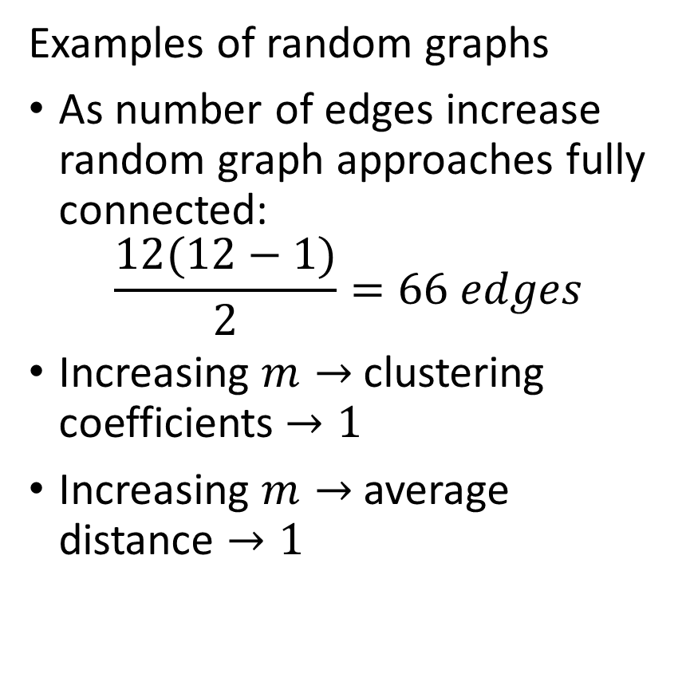
Random Graphs
Examples of random graphs
As number of edges increase random graph approaches fully connected:
$$\frac{12(12−1)}{2}=66 edges$$
Increasing $m→$ clustering coefficients $→1$
Increasing $m→$ average distance $→1$

Slide 29
Communities in Networks

Slide 30
Finding Communities in Networks
Social networks are organized in communities
Communities are strongly connected
A random graph has uniform distribution of the edges
A graph of communities has regions of dense connections
Few connections between communities
Core nodes are said to exhibit high clustering
Communities are built around highly influential nodes
High centrality nodes at the core of communities
Can use several measures of centrality
Example; K-cores represent nodes at center of communities

Slide 31
Centrality in Communities
Find highly connected nodes at center or core of communities
These highly connected nodes are influential in the community
Consider the spread of information in a social network
Messages with the information travel from node to node
Nodes with stronger connections to the community disseminate messages more effectively
These strongly connected nodes are considered influential
We measure a node’s influence in a social network by its centrality

Slide 32
Centrality in Communities
Centrality is the ability of a node to exert influence on the network
Cores are densely connected groups of nodes
Core nodes have high centrality
Kratz centrality is an example of a centrally metric
Kratz centrality is equivalent to the probability of visiting a node during a random walk on the graph
Kratz centrality is applicable to directed or undirected graphs
Closeness centrality is the average inverse distance from a node to all other nodes in a graph component
Different centrality measures are sensitive to different aspects of the network!

Slide 33
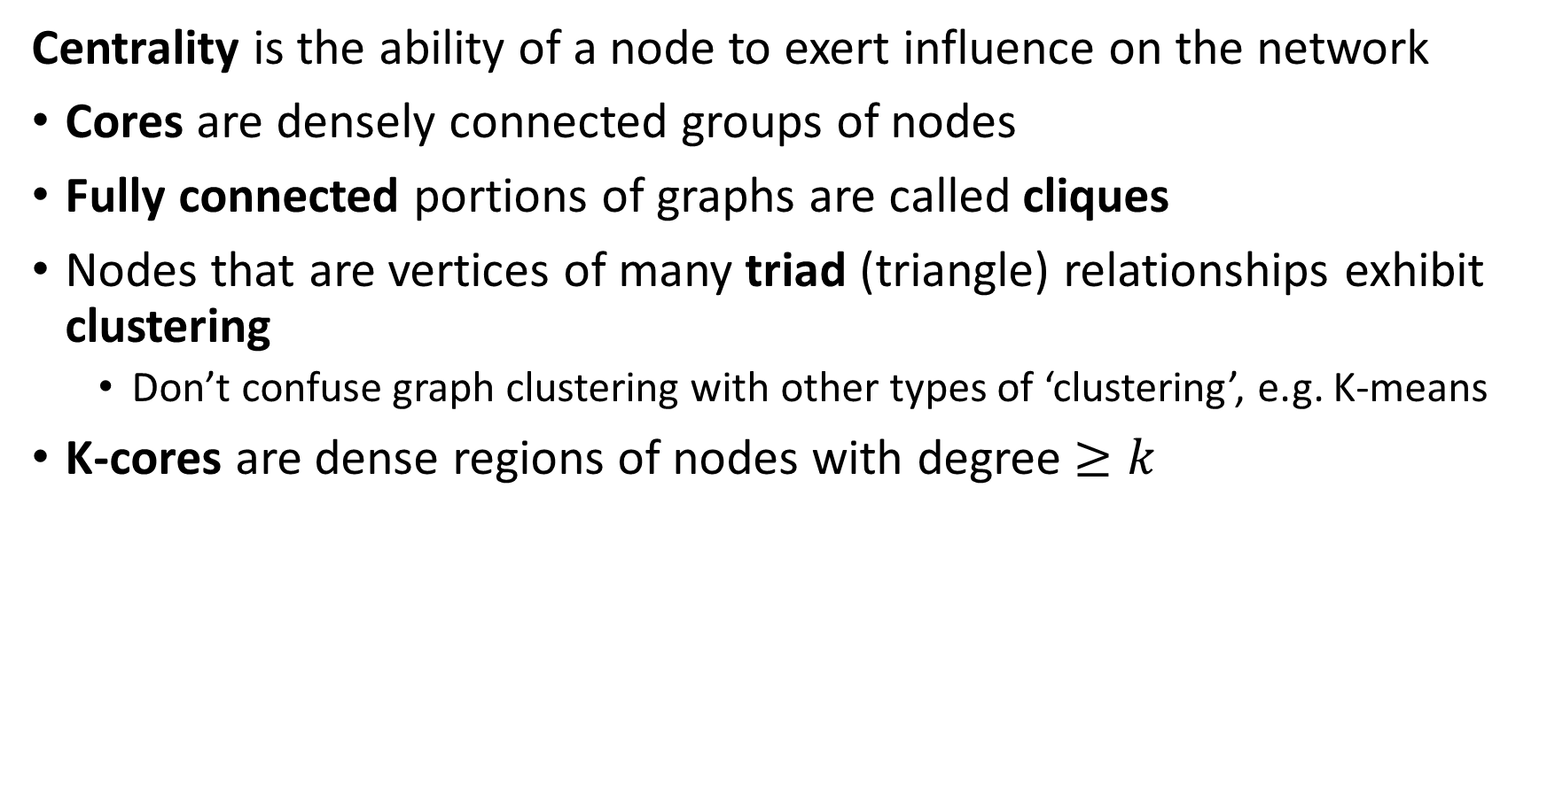
Centrality in Communities
Centrality is the ability of a node to exert influence on the network
Cores are densely connected groups of nodes
Fully connected portions of graphs are called cliques
Nodes that are vertices of many triad (triangle) relationships exhibit clustering
Don’t confuse graph clustering with other types of ‘clustering’, e.g. K-means
K-cores are dense regions of nodes with degree $≥k$

Slide 34
Finding Communities in Networks
Social networks are organized in communities
Betweenness and modularity used to partition graphs into community components
Betweenness measures the extent certain nodes and edges are on path between other nodes
Betweenness is low within highly connected communities
Betweenness is high between communities
Modularity measures the weights (density) of edges compared to random graph
Communities have high modularity
Use modularity to search for communities

Slide 35
Kratz Centrality

Slide 36
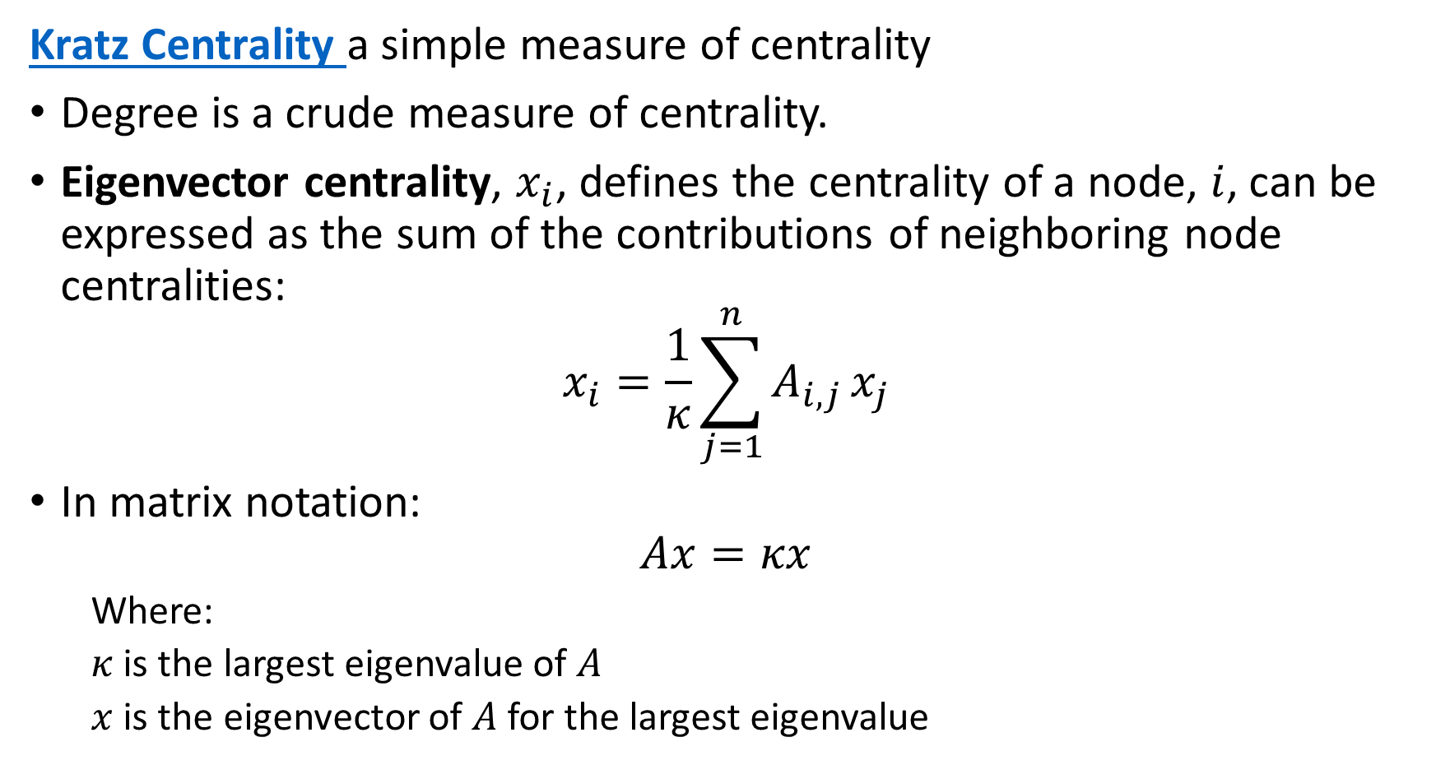
Kratz Centrality in Communities
Kratz Centrality a simple measure of centrality
Degree is a crude measure of centrality.
Eigenvector centrality, $x_{i}$, defines the centrality of a node, $i$, can be expressed as the sum of the contributions of neighboring node centralities:
$$x_{i}=\frac{1}{κ}\sum_{j=1}^{n}{A_{i,j}}x_{j}$$
In matrix notation:
$$Ax=κx$$
Where:
$κ$ is the largest eigenvalue of $A$
$x$ is the eigenvector of $A$ for the largest eigenvalue

Slide 37
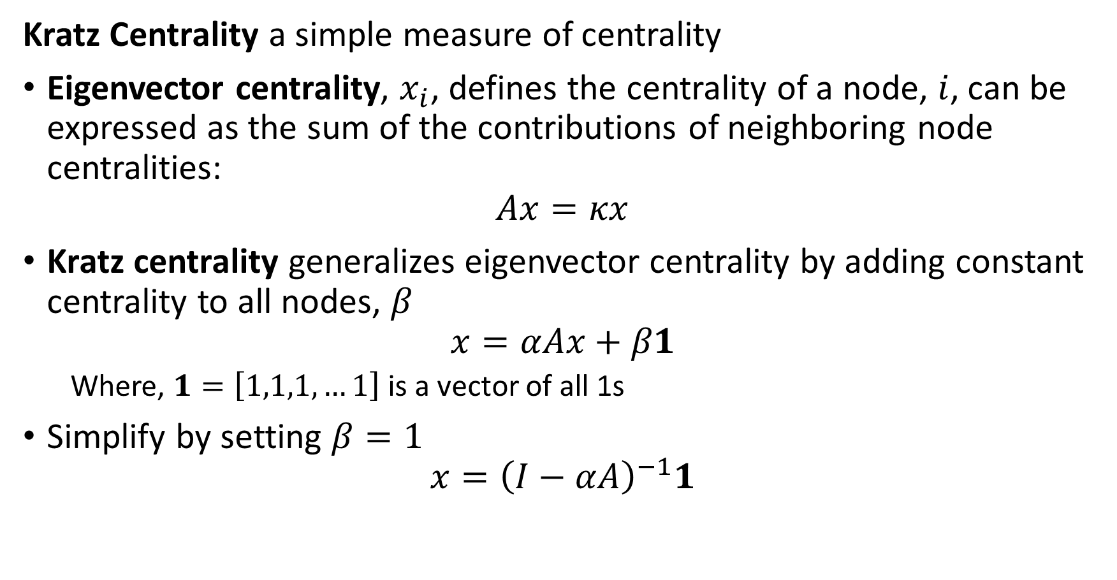
Kratz Centrality in Communities
Kratz Centrality a simple measure of centrality
Eigenvector centrality, $x_{i}$, defines the centrality of a node, $i$, can be expressed as the sum of the contributions of neighboring node centralities:
$$Ax=κx$$
Kratz centrality generalizes eigenvector centrality by adding constant centrality to all nodes, $β$
$$x=αAx+β1$$
Where, $1=\left[1,1,1,…1\right]$ is a vector of all 1s
Simplify by setting $β=1$
$$x={\left(I−αA\right)}^{−1}1$$

Slide 38
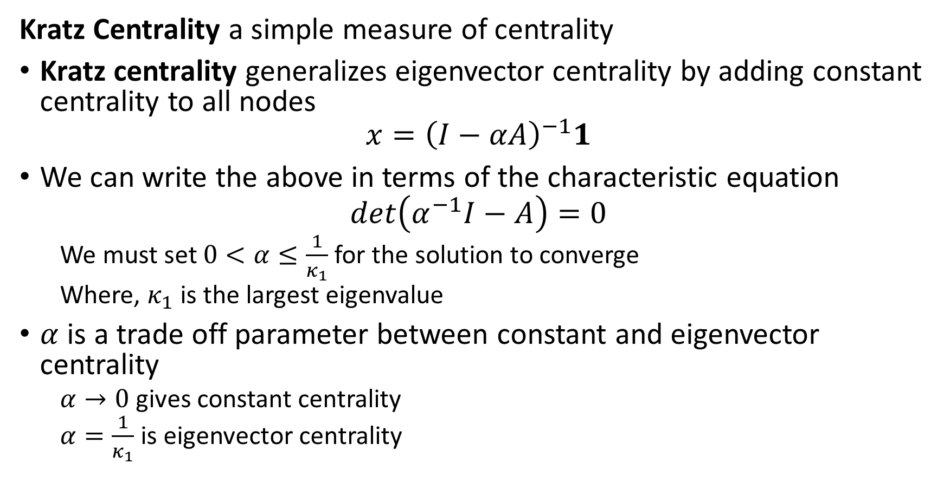
Kratz Centrality in Communities
Kratz Centrality a simple measure of centrality
Kratz centrality generalizes eigenvector centrality by adding constant centrality to all nodes
$$x={\left(I−αA\right)}^{−1}1$$
We can write the above in terms of the characteristic equation
$$det\left(α^{−1}I−A\right)=0$$
We must set $0<α≤\frac{1}{κ_{1}}$ for the solution to converge
Where, $κ_{1}$ is the largest eigenvalue
$α$ is a trade off parameter between constant and eigenvector centrality
$α→0$ gives constant centrality
$α=\frac{1}{κ_{1}}$ is eigenvector centrality

Slide 39
Breath-First Search and Distance-Based Centrality

Slide 40
Distance-Based Centrality
Measures of distance are natural and intuitive centrality metrics
Closeness centrality measures average closeness of a node to other nodes in a network
Closeness measured by inverse distance on shortest path
Betweenness centrality measures the number of shortest paths between nodes in a network
Can measure betweenness at nodes or on edges
Both metrics based on algorithms to find shorted paths and compute distances between nodes in a graph
Generally, use breath first search algorithms

Slide 41
Finding Shortest Paths in Networks
Finding shortest paths in networks requires a search
Path search is computationally intensive for large graphs!
Two general approaches to path search
Depth first
Breath first
Path search analogous to database searching algorithm
e.g. B-tree search
Searching graphs
Find distances
Distance can be edge weight
Compute shortest paths
Discover connectivity

Slide 42
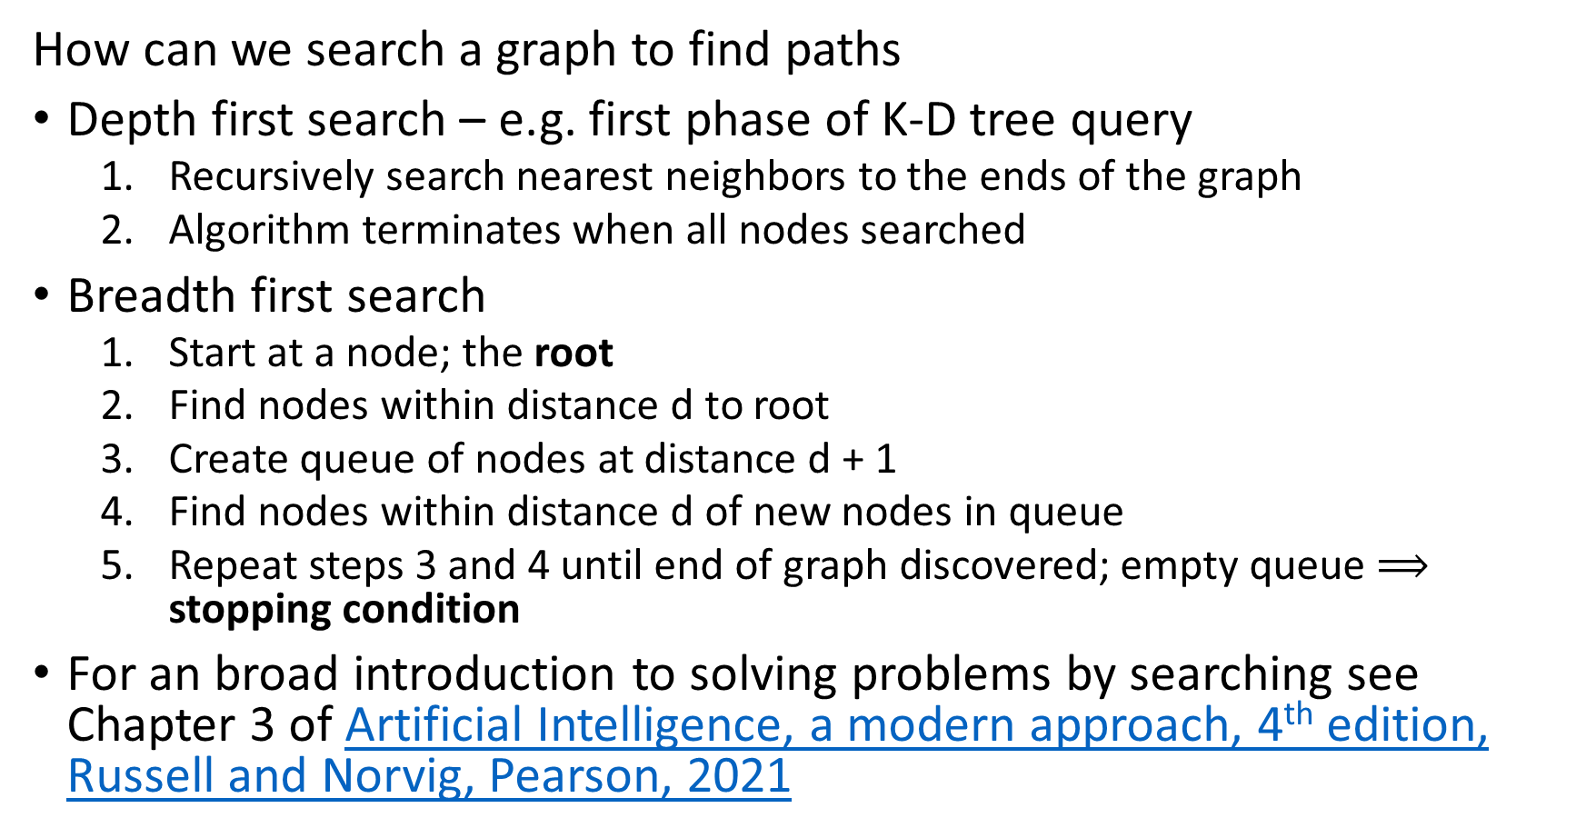
Breadth First Search Algorithm
How can we search a graph to find paths
Depth first search – e.g. first phase of K-D tree query
Recursively search nearest neighbors to the ends of the graph
Algorithm terminates when all nodes searched
Breadth first search
Start at a node; the root
Find nodes within distance d to root
Create queue of nodes at distance d + 1
Find nodes within distance d of new nodes in queue
Repeat steps 3 and 4 until end of graph discovered; empty queue $⟹$ stopping condition
For an broad introduction to solving problems by searching see Chapter 3 of Artificial Intelligence, a modern approach, 4th edition, Russell and Norvig, Pearson, 2021

Slide 43
Breadth First Search Algorithm
Basic breadth first search algorithm
Start with root node on graph at distance 0
Find nodes at distance d from the root
Find nodes at distance d = 1
Find nodes at distance d = 2
Continue until the termination condition is reached
0
D=1
D=2

Slide 44
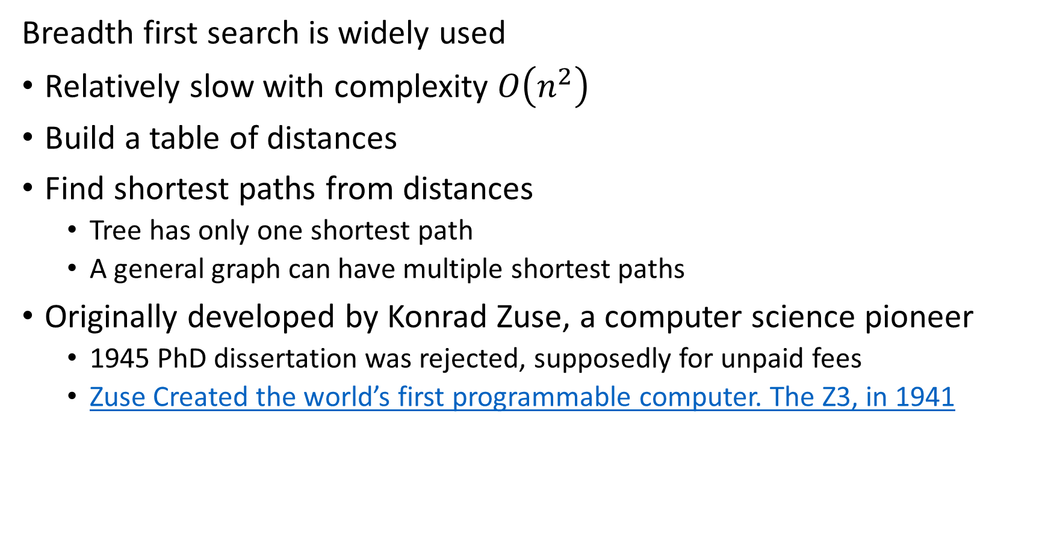
Breadth First Search Algorithm
Breadth first search is widely used
Relatively slow with complexity $O\left(n^{2}\right)$
Build a table of distances
Find shortest paths from distances
Tree has only one shortest path
A general graph can have multiple shortest paths
Originally developed by Konrad Zuse, a computer science pioneer
1945 PhD dissertation was rejected, supposedly for unpaid fees
Zuse Created the world’s first programmable computer. The Z3, in 1941

Slide 45
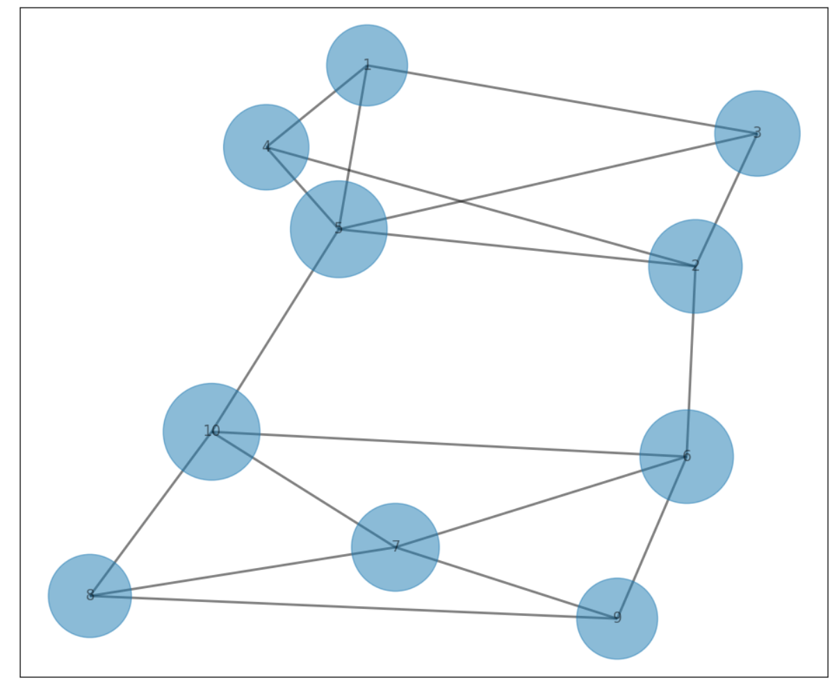
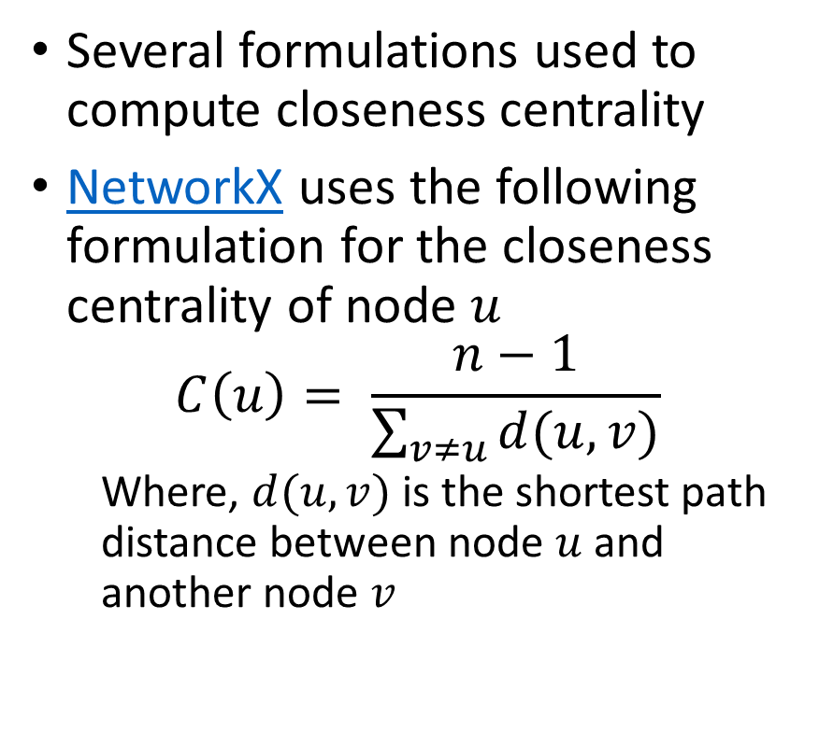
Closeness Centrality
Closeness centrality measures average closeness of a node to other nodes in a network
Several formulations used to compute closeness centrality
NetworkX uses the following formulation for the closeness centrality of node $u$
$$C\left(u\right)= \frac{n−1}{\sum_{v≠u}{d(u,v)}}$$
Where, $d(u,v)$ is the shortest path distance between node $u$ and another node $v$

Slide 46
Betweenness of Social Network Communities
Betweenness measures the number of paths between parts of a graph
Betweenness is the number of pairwise shortest paths passing though part of a graph
Expect high betweenness between communities – few possible paths
Node betweenness is the number of pairwise shortest paths passing through a given node in the graph
Edge betweenness is the number of pairwise shortest paths passing through a given edge in the graph

Slide 47
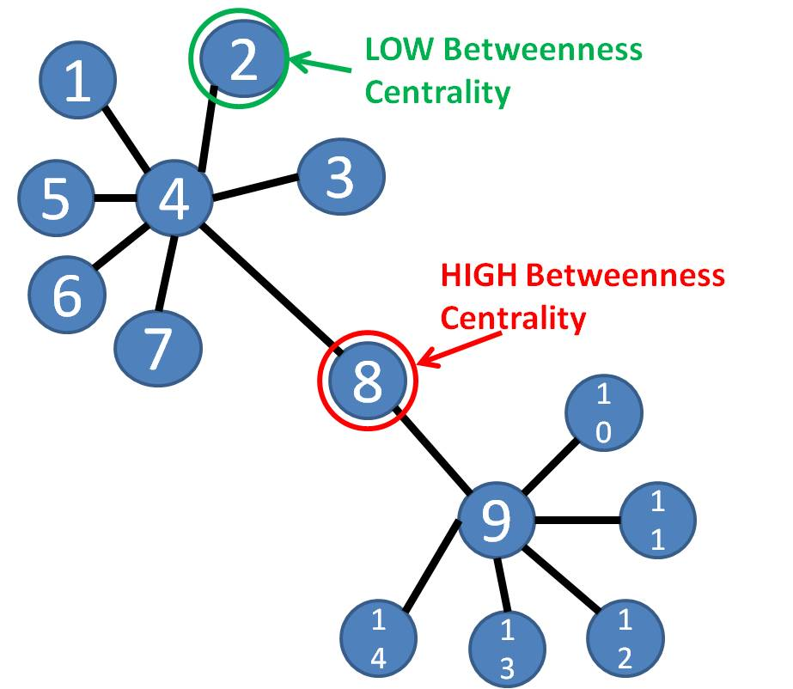
Betweenness Social Network Communities
Betweenness measures the number of paths between parts of a graph
Example: a single node is on path between members of two communities
Can use betweenness to separate communities
Source: bsmithactivity3

Slide 48
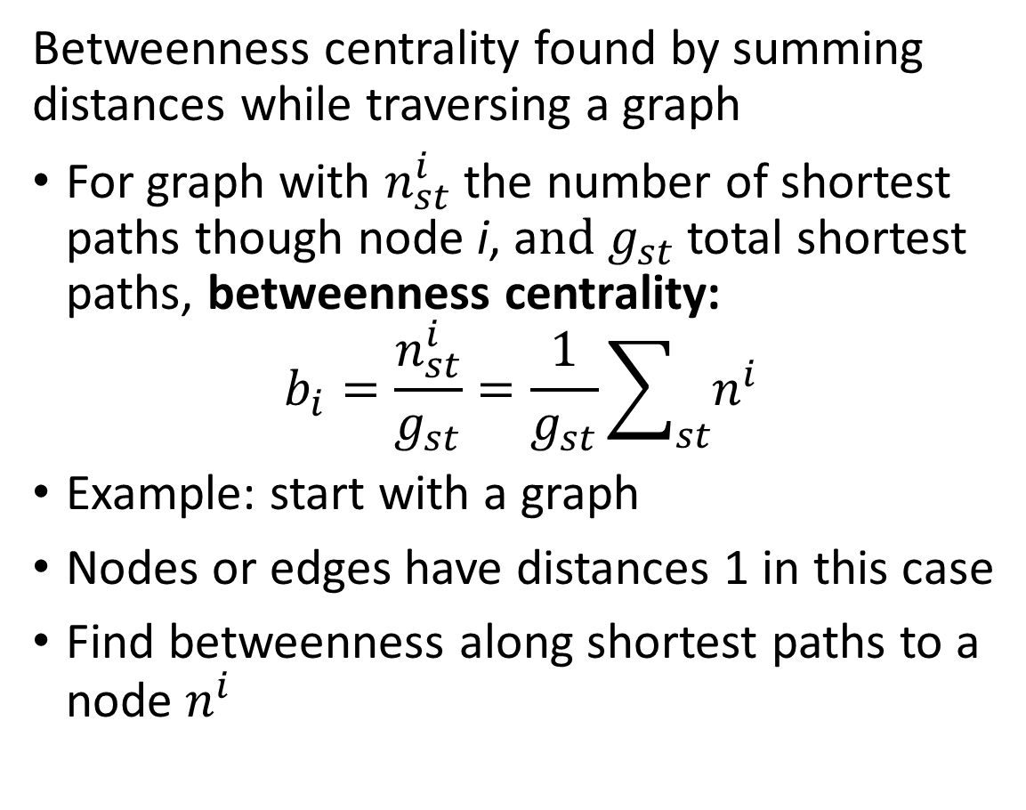
Betweenness of Social Networks
s
Betweenness centrality found by summing distances while traversing a graph
For graph with $n_{st}^{i}$ the number of shortest paths though node i, a$nd g_{st}$total shortest paths, betweenness centrality:
$$b_{i}=\frac{n_{st}^{i}}{g_{st}}=\frac{1}{g_{st}}\sum_{st}{n_{ }^{i}}$$
Example: start with a graph
Nodes or edges have distances 1 in this case
Find betweenness along shortest paths to a node $n_{ }^{i}$
1
1
1
1
1
1

Slide 49




Betweenness of Social Networks
s
Betweenness centrality found by summing distances while traversing a graph
Starting with the most distant nodes
Sum distances
If multiple paths, divide distance (weight) between paths
Continue summing until reaching s
$$\frac{5}{2}$$
$$\frac{7}{2}$$
1
1
$$\frac{3}{2}$$
$$\frac{5}{2}$$
1
1
1
1

Slide 50
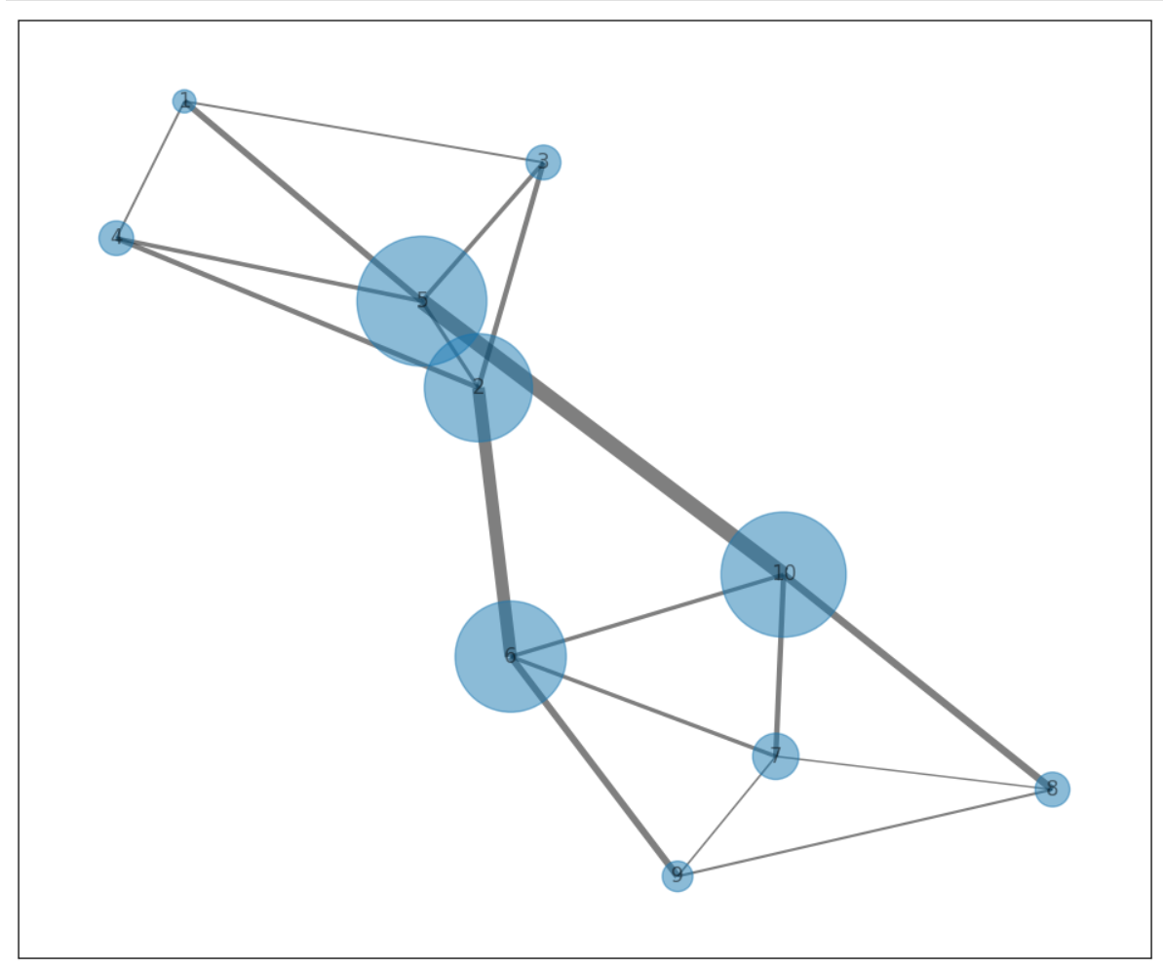
Betweenness of Social Networks
Betweenness centrality found by summing distances while traversing a graph
Betweenness can be computed for both nodes and edges
High betweenness nodes and edges lie between communities

Slide 51
Cliques and K-Cores

Slide 52
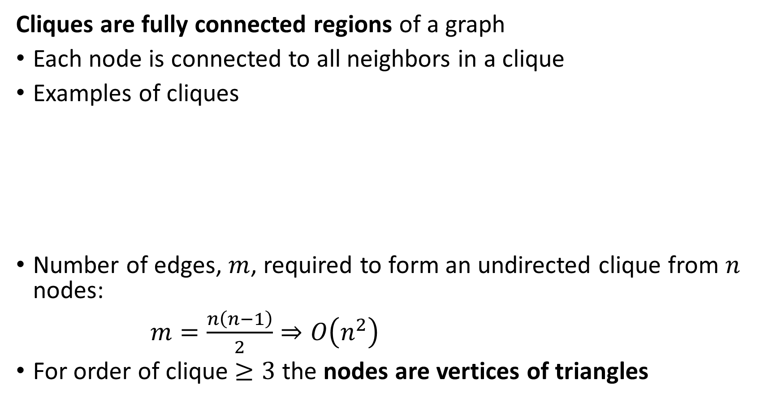
Cliques and K-Cores
Cliques are fully connected regions of a graph
Each node is connected to all neighbors in a clique
Examples of cliques
Number of edges, $m$, required to form an undirected clique from $n$ nodes:
$m=\frac{n\left(n−1\right)}{2}⇒O\left(n^{2}\right)$
For order of clique $≥3$ the nodes are vertices of triangles
2-Clique
3-Clique
4-Clique
5-Clique

Slide 53
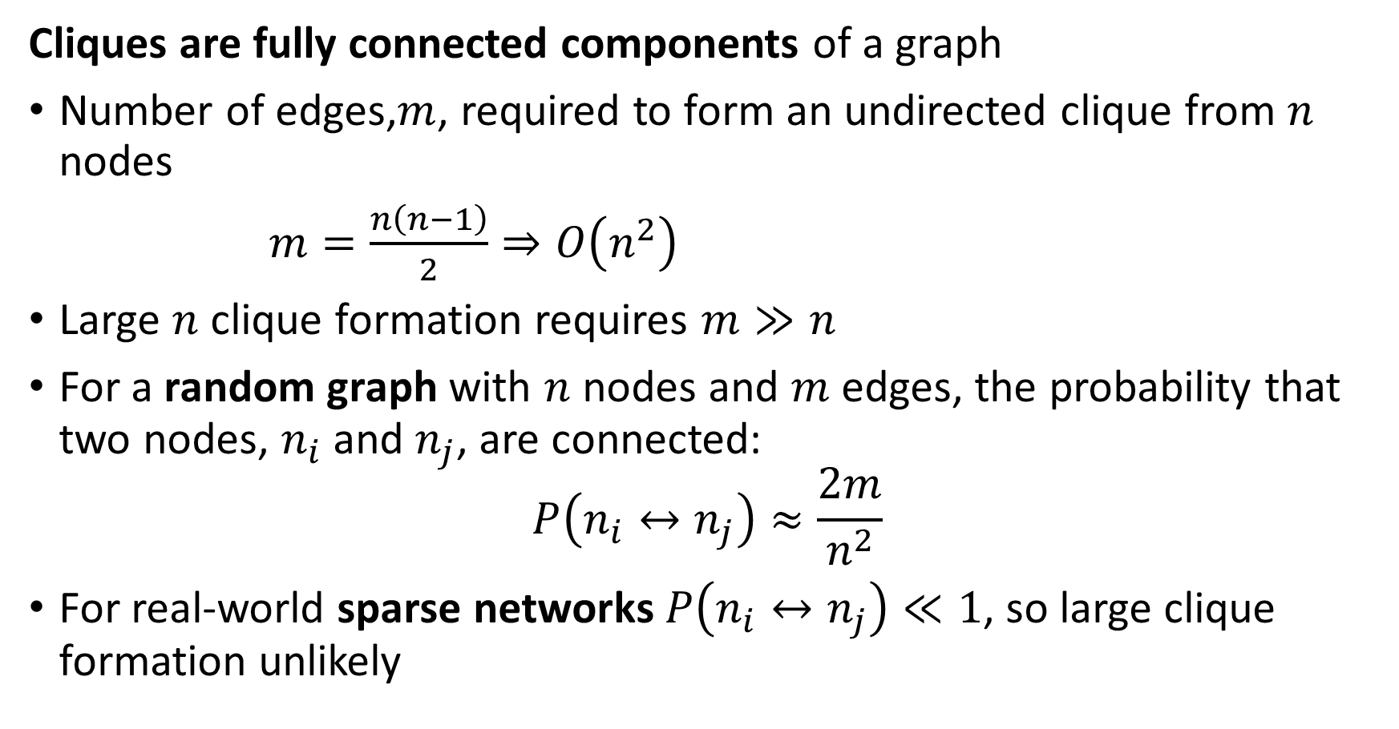
Cliques and K-Cores
Cliques are fully connected components of a graph
Number of edges,$m$, required to form an undirected clique from $n$ nodes
$m=\frac{n\left(n−1\right)}{2}⇒O\left(n^{2}\right)$
Large $n$ clique formation requires $m≫n$
For a random graph with $n$ nodes and $m$ edges, the probability that two nodes, $n_{i}$ and $n_{j}$, are connected:
$$P\left(n_{i}↔n_{j}\right)≈\frac{2m}{n^{2}}$$
For real-world sparse networks$P\left(n_{i}↔n_{j}\right)≪1$, so large clique formation unlikely

Slide 54
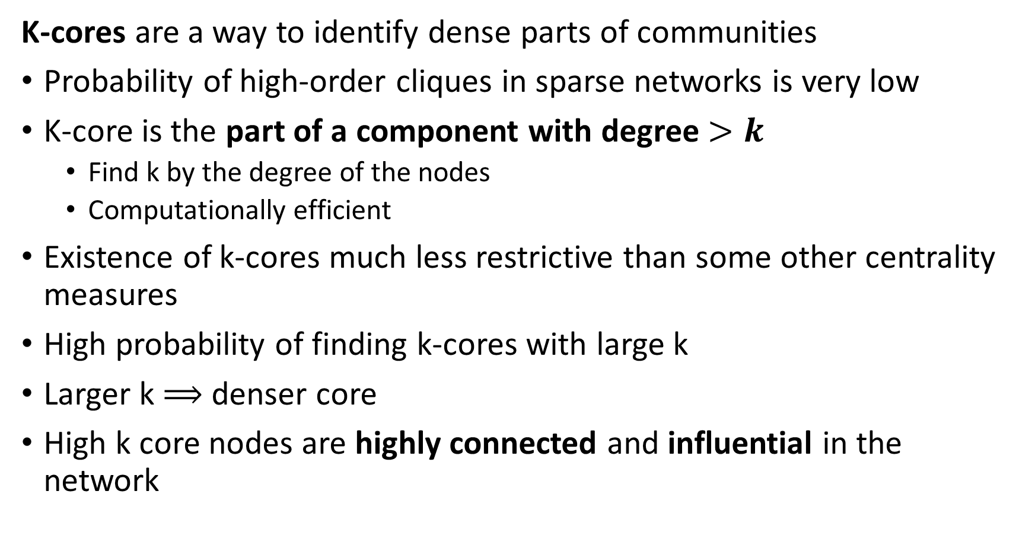
Cliques and K-Cores
K-cores are a way to identify dense parts of communities
Probability of high-order cliques in sparse networks is very low
K-core is the part of a component with degree $>k$
Find k by the degree of the nodes
Computationally efficient
Existence of k-cores much less restrictive than some other centrality measures
High probability of finding k-cores with large k
Larger k $⟹$ denser core
High k core nodes are highly connected and influential in the network

Slide 55
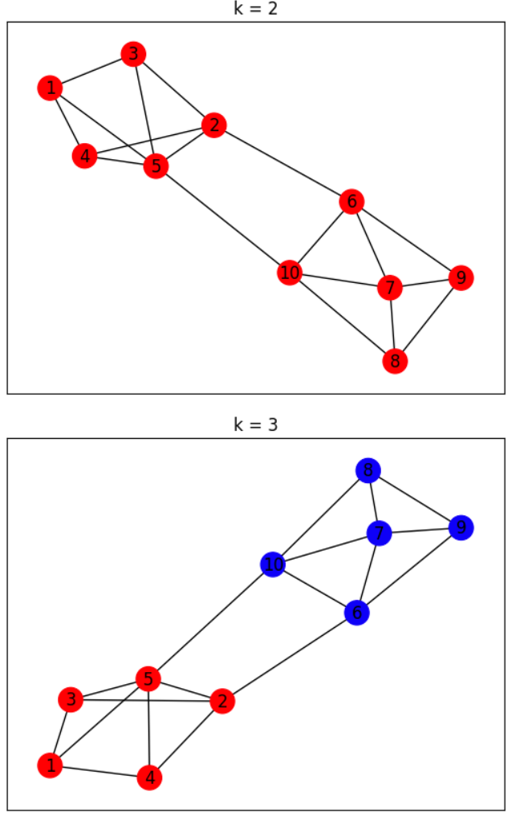
Cliques and K-Cores
K-cores are a way to identify dense parts of communities
Example: k-cores of a simple network
Higher values of k correspond to nodes with higher centrality
Subcommunities each can have a k-core

Slide 56
Communities and Triangle Density

Slide 57
Communities and Triangle Density
Density of triangles is an indicator or community cores
Empirically, we expect when a person is connected to 2 other people, the other people are more likely to be connected to each other
In a random graph, two people connected to a common individual will only be connected to each other by random coincidence:
In a community there is a high probability of completing the triangle of relationships or creating a triad:
Low probability of completing triangle in random graph
High probability of completing triangle in community

Slide 58
Communities and Triangle Density
Density of triangles is an indicator or community cores
A relationship in a graph: if u is connected to w and v is connected to w the relationship is transitive if u is connected to v:
The human version of transitivity: the friend of my friend is my friend
Density of triangle in a social graph is a measure of density
u
v
w

Slide 59
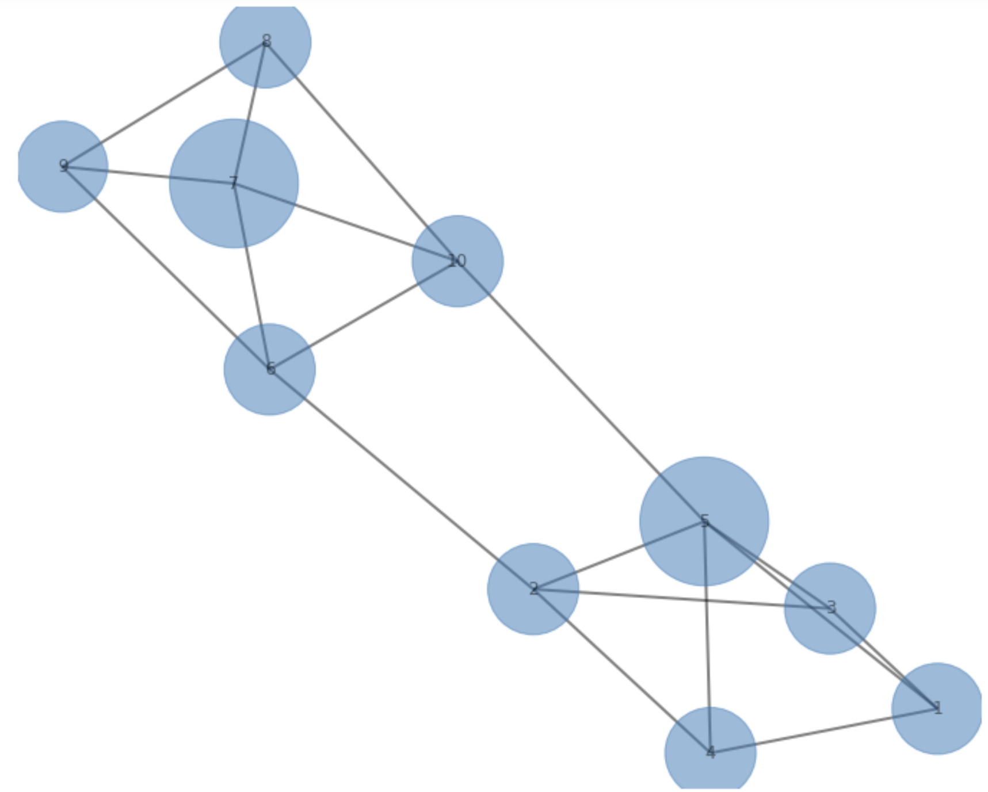
Communities and Triangle Density
Example: Density of triangles is an indicator of community cores, or influential nodes

Slide 60
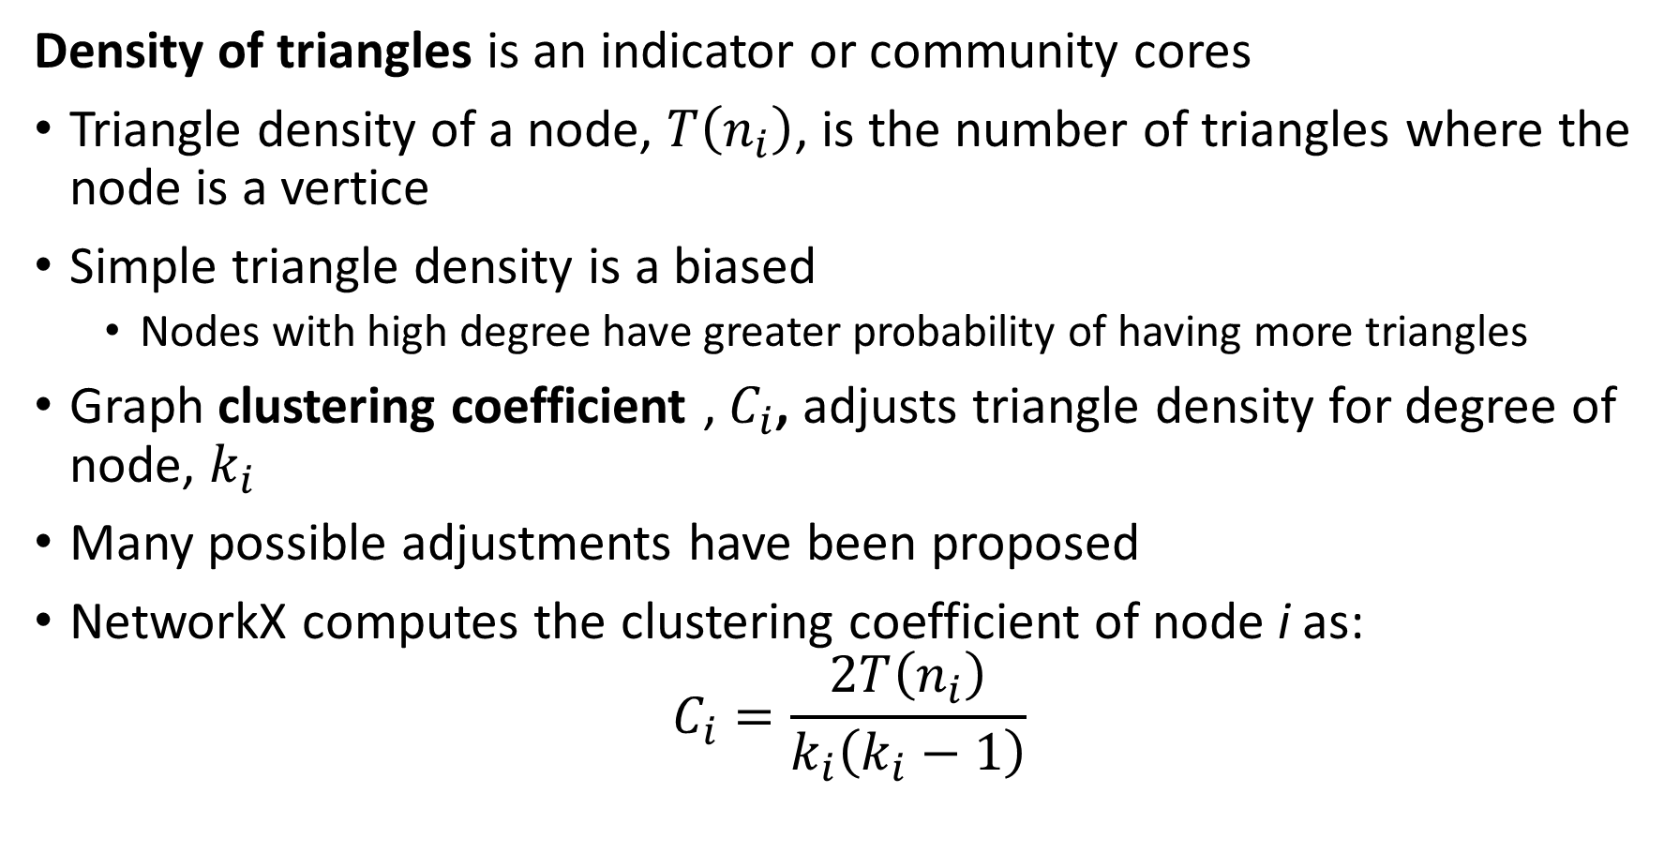
Communities and Triangle Density
Density of triangles is an indicator or community cores
Triangle density of a node, $T\left(n_{i}\right)$, is the number of triangles where the node is a vertice
Simple triangle density is a biased
Nodes with high degree have greater probability of having more triangles
Graph clustering coefficient , $C_{i}$, adjusts triangle density for degree of node, $k_{i}$
Many possible adjustments have been proposed
NetworkX computes the clustering coefficient of node i as:
$$C_{i}=\frac{2T\left(n_{i}\right)}{k_{i}\left(k_{i}−1\right)}$$

Slide 61
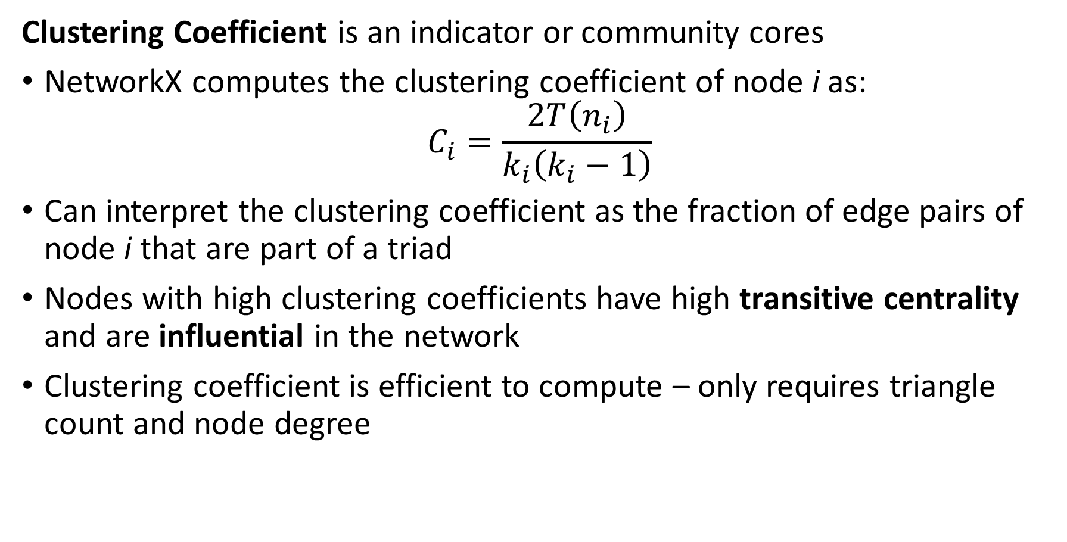
Communities and Triangle Density
Clustering Coefficient is an indicator or community cores
NetworkX computes the clustering coefficient of node i as:
$$C_{i}=\frac{2T\left(n_{i}\right)}{k_{i}\left(k_{i}−1\right)}$$
Can interpret the clustering coefficient as the fraction of edge pairs of node i that are part of a triad
Nodes with high clustering coefficients have high transitive centrality and are influential in the network
Clustering coefficient is efficient to compute – only requires triangle count and node degree

Slide 62
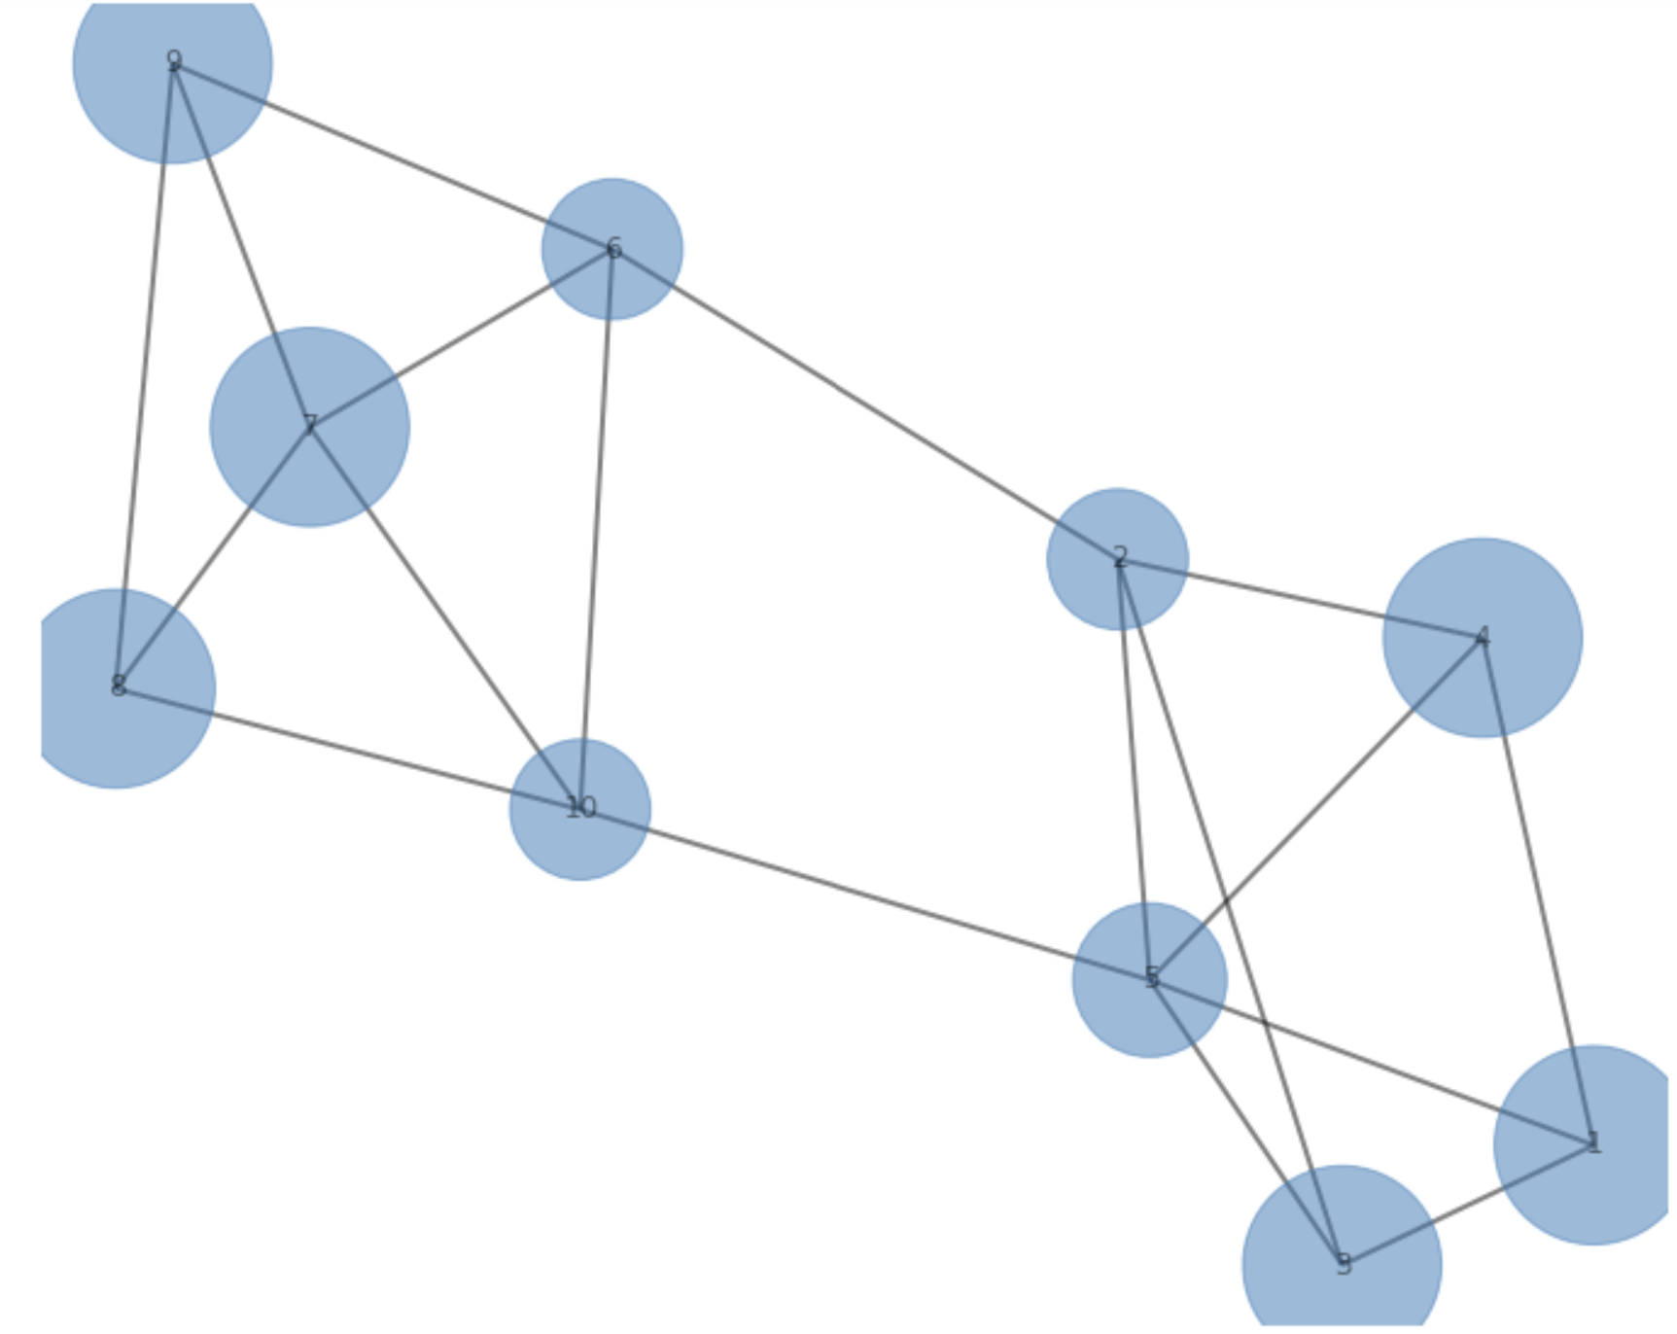
Communities and Triangle Density
Example: Clustering Coefficient as an indicator of community cores or node influence

Slide 63
Modularity in Communities

Slide 64
Modularity of Communities
Modularity estimates the extent that edges concentrate in communities
Communities are groups of nodes with some common characteristics
Examples:
Members of an organization
Work collaborators
Animals in an ecosystem
…….
Empirically, the density of edges within communities is higher than a random graph
Modularity is a metric to compare the connection in a community to a random network.

Slide 65
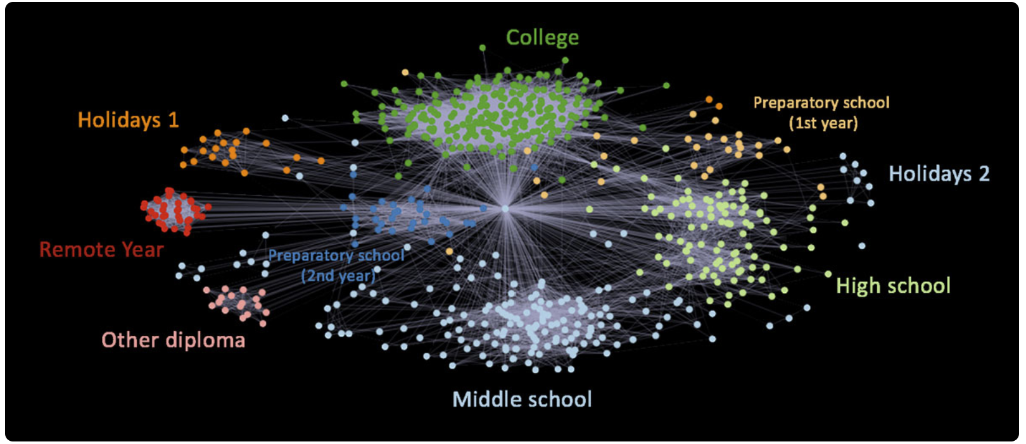
Modularity of Communities
Modularity estimates the extent that edges concentrate in communities
Example from Elliot Anders blog post on visualization of Facebook friends

Slide 66
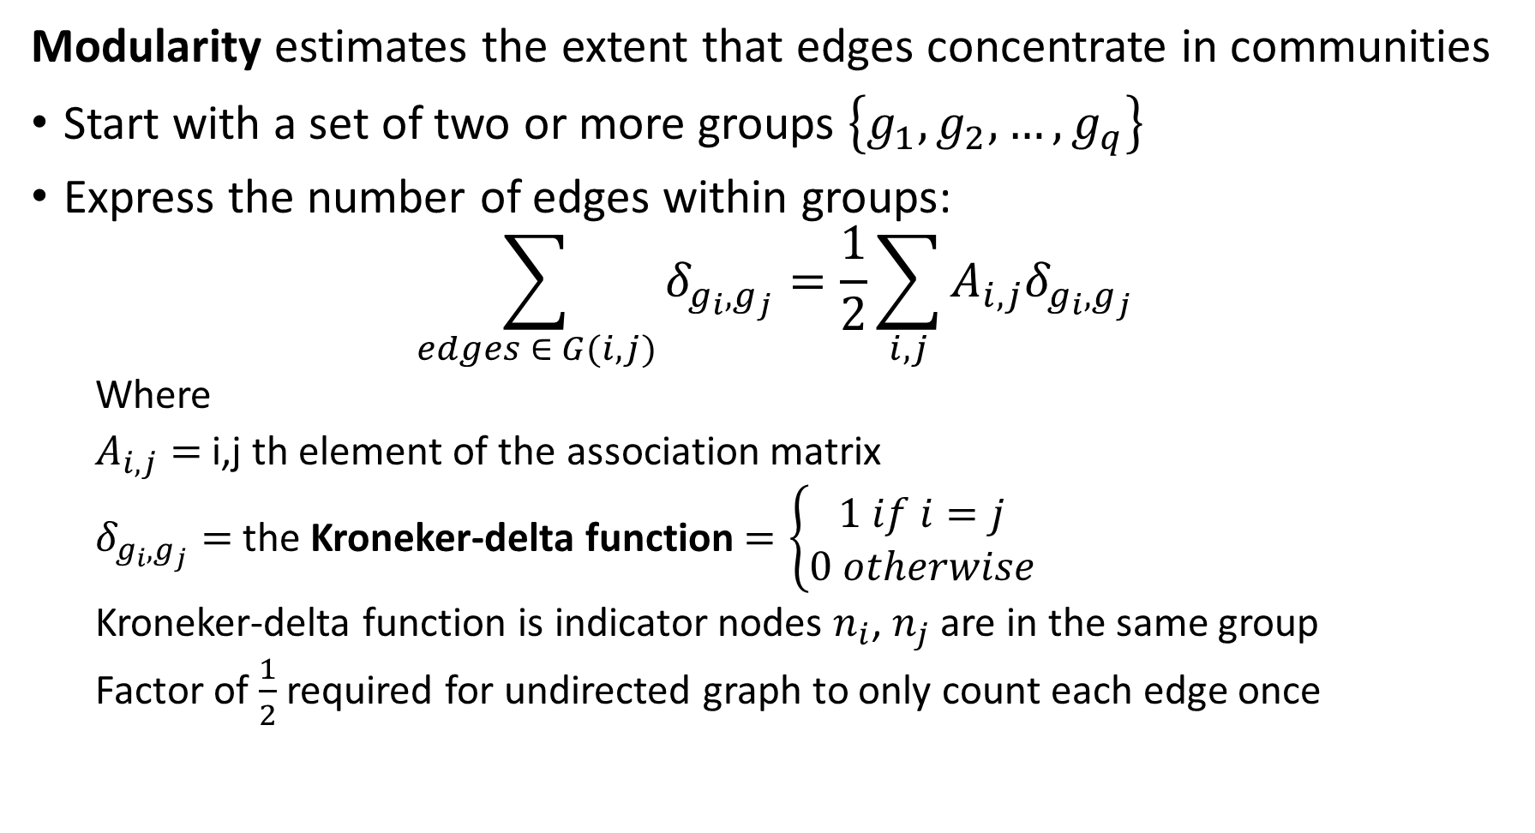
Modularity of Communities
Modularity estimates the extent that edges concentrate in communities
Start with a set of two or more groups $\left\{g_{1},g_{2},…,g_{q}\right\}$
Express the number of edges within groups:
$$\sum_{edges ∈ G(i,j)}{δ_{g_{i},g_{j}}=\frac{1}{2}}\sum_{i,j}{A_{i,j}δ_{g_{i},g_{j}}}$$
Where
$A_{i,j}=$ i,j th element of the association matrix
$δ_{g_{i},g_{j}}=$ the Kroneker-delta function $=\left\{\begin{aligned}1 if i=j \\ 0 otherwise\end{aligned}\right.$
Kroneker-delta function is indicator nodes $n_{i}$, $n_{j}$ are in the same group
Factor of $\frac{1}{2}$ required for undirected graph to only count each edge once

Slide 67
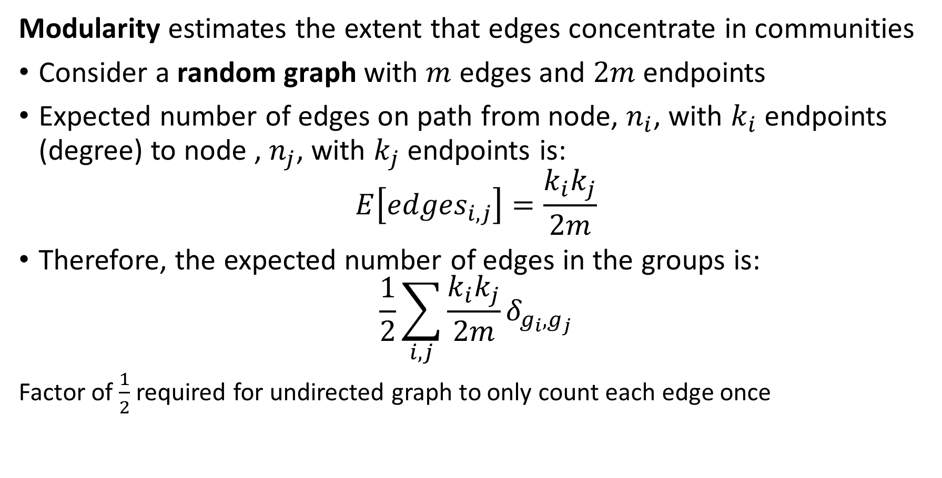
Modularity of Communities
Modularity estimates the extent that edges concentrate in communities
Consider a random graph with $m$ edges and $2m$ endpoints
Expected number of edges on path from node, $n_{i}$, with $k_{i}$ endpoints (degree) to node , $n_{j}$, with $k_{j}$ endpoints is:
$$E\left[{edges}_{i,j}\right]=\frac{k_{i}k_{j}}{2m}$$
Therefore, the expected number of edges in the groups is:
$$\frac{1}{2}\sum_{i,j}{\frac{k_{i}k_{j}}{2m}δ_{g_{i},g_{j}}}$$
Factor of $\frac{1}{2}$ required for undirected graph to only count each edge once

Slide 68
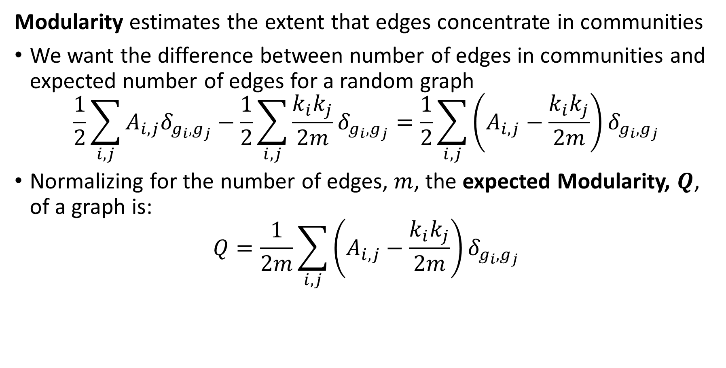
Modularity of Communities
Modularity estimates the extent that edges concentrate in communities
We want the difference between number of edges in communities and expected number of edges for a random graph
$$\frac{1}{2}\sum_{i,j}{A_{i,j}δ_{g_{i},g_{j}}}−\frac{1}{2}\sum_{i,j}{\frac{k_{i}k_{j}}{2m}δ_{g_{i},g_{j}}}=\frac{1}{2}\sum_{i,j}{\left(A_{i,j}−\frac{k_{i}k_{j}}{2m}\right)δ_{g_{i},g_{j}}}$$
Normalizing for the number of edges, $m$, the expected Modularity, $Q$, of a graph is:
$$Q=\frac{1}{2m}\sum_{i,j}{\left(A_{i,j}−\frac{k_{i}k_{j}}{2m}\right)δ_{g_{i},g_{j}}}$$

Slide 69
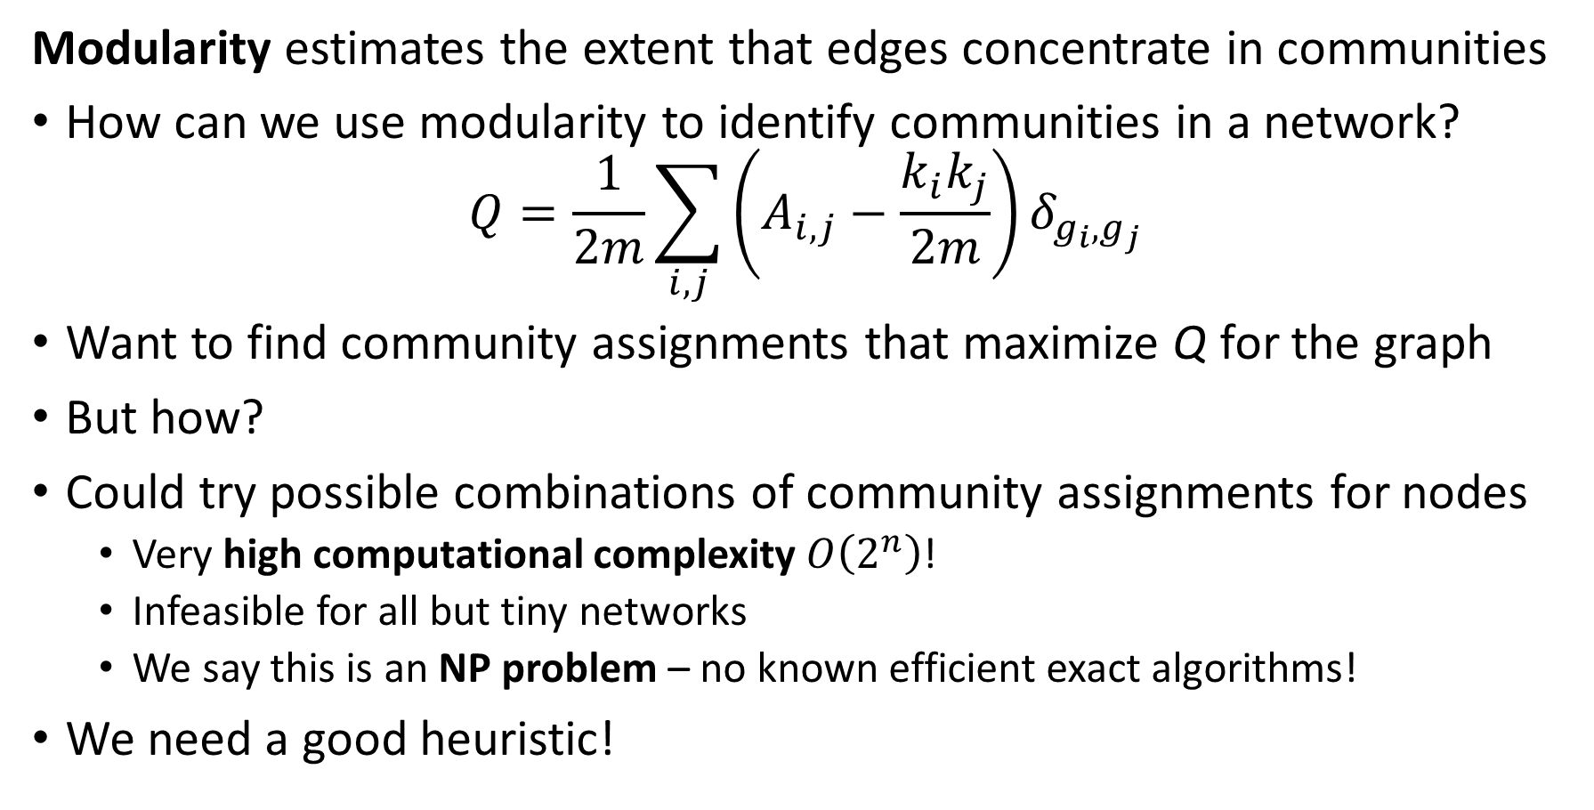
Modularity of Communities
Modularity estimates the extent that edges concentrate in communities
How can we use modularity to identify communities in a network?
$$Q=\frac{1}{2m}\sum_{i,j}{\left(A_{i,j}−\frac{k_{i}k_{j}}{2m}\right)δ_{g_{i},g_{j}}}$$
Want to find community assignments that maximize Q for the graph
But how?
Could try possible combinations of community assignments for nodes
Very high computational complexity $O\left(2^{n}\right)$!
Infeasible for all but tiny networks
We say this is an NP problem – no known efficient exact algorithms!
We need a good heuristic!

Slide 70
Modularity of Communities
Many heuristics for community search to maximize modularity
Methods that sample possible community assignments
Simulated annealing
Genetic algorithms
Generally, require significant computational power
Optimization algorithms
Information theoretic loss function
Maximum likelihood methods
Greedy reallocation of community assignments
Spectral Modularity Maximization

Slide 71
Greedy Modularity Search

Slide 72
Greedy Modularity Search for Communities
Greedy reallocation of community assignments
Greedy algorithm may never find optimal solution
Accept any allocation that improves modularity - greedy
No backtracking – all assignments depend on current state of community assignments
Dependent on initial partition of network

Slide 73
Greedy Modularity Search for Communities
Greedy reallocation of community assignments
Procedure Division(Network):
C1, C2 <- equal_division (Network) # start with equal random division
Network <- community_assignments(C1, C2) # initial community assignments
M <- modularity(Network) # initial modularity
for n steps:
node <- random_sample(Network) # sample node at random
node_temp <- switch_community(node) # change assignment of node
M_temp <- modularity(Network, node_temp) # measure modularity of assignment
If M_temp > M: # greedy update of network
Network <- community_assignments(M_temp)
M = M_temp
return(network)

Slide 74
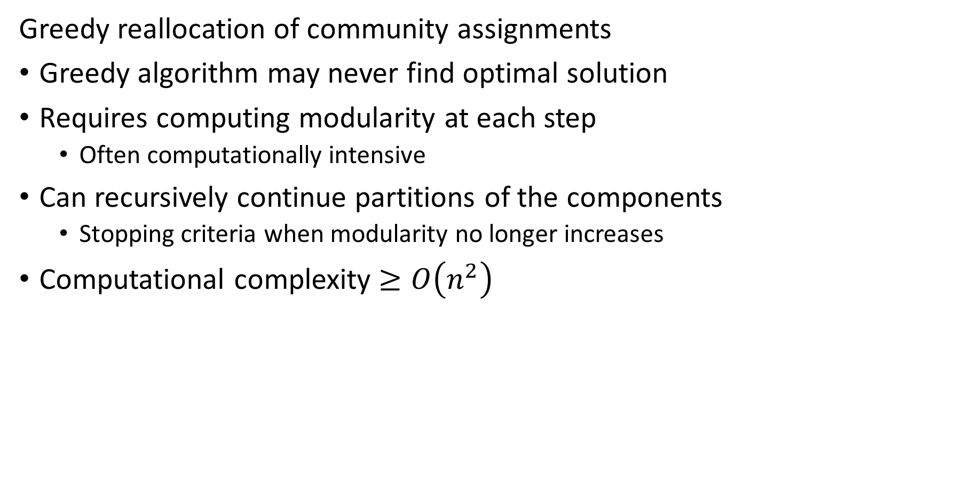
Greedy Modularity Search for Communities
Greedy reallocation of community assignments
Greedy algorithm may never find optimal solution
Requires computing modularity at each step
Often computationally intensive
Can recursively continue partitions of the components
Stopping criteria when modularity no longer increases
Computational complexity $≥O\left(n^{2}\right)$

Slide 75
Community Search with Spectral Maximization

Slide 76
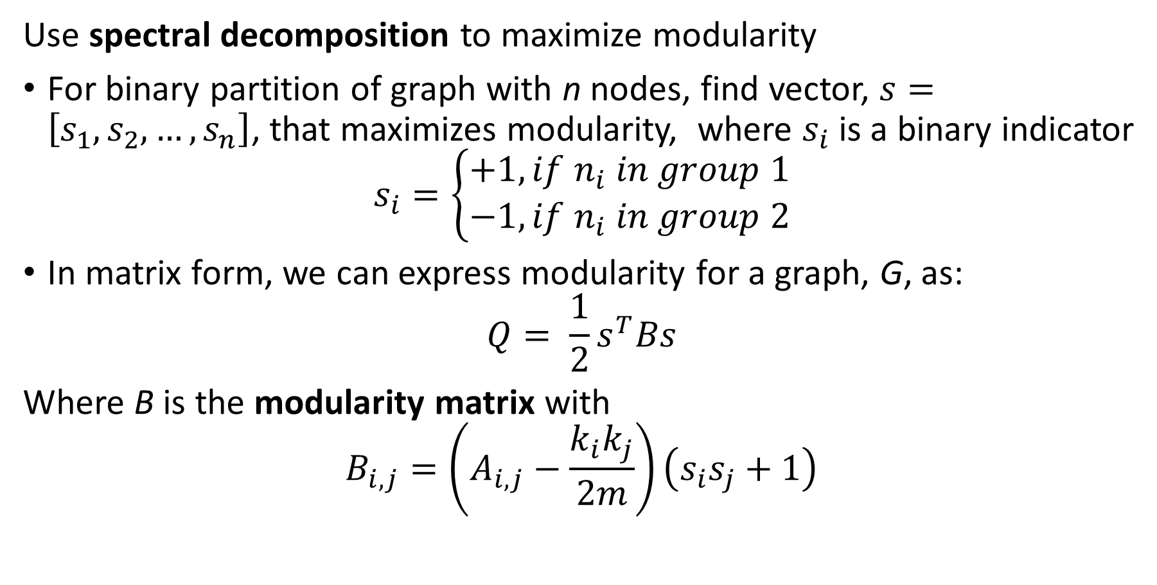
Spectral Modularity Maximization
Use spectral decomposition to maximize modularity
For binary partition of graph with n nodes, find vector, $s=\left[s_{1},s_{2},…, s_{n}\right]$, that maximizes modularity, where $s_{i}$ is a binary indicator
$$s_{i}=\left\{\begin{aligned}+1, if n_{i} in group 1 \\ −1, if n_{i} in group 2\end{aligned}\right.$$
In matrix form, we can express modularity for a graph, G, as:
$$Q= \frac{1}{2}s^{T}Bs$$
Where B is the modularity matrix with
$$B_{i,j}=\left(A_{i,j}−\frac{k_{i}k_{j}}{2m}\right)\left(s_{i}s_{j}+1\right)$$

Slide 77
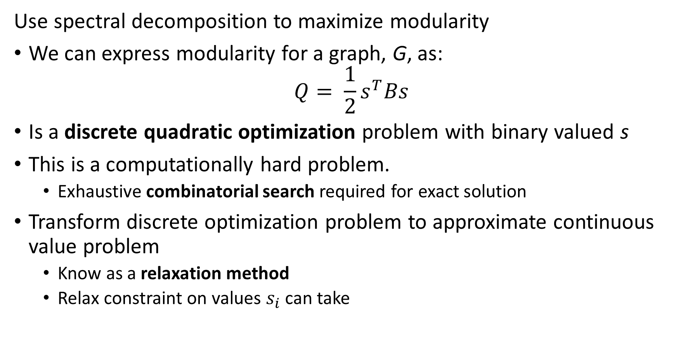
Spectral Modularity Maximization
Use spectral decomposition to maximize modularity
We can express modularity for a graph, G, as:
$$Q= \frac{1}{2}s^{T}Bs$$
Is a discrete quadratic optimization problem with binary valued s
This is a computationally hard problem.
Exhaustive combinatorial search required for exact solution
Transform discrete optimization problem to approximate continuous value problem
Know as a relaxation method
Relax constraint on values $s_{i}$ can take

Slide 78
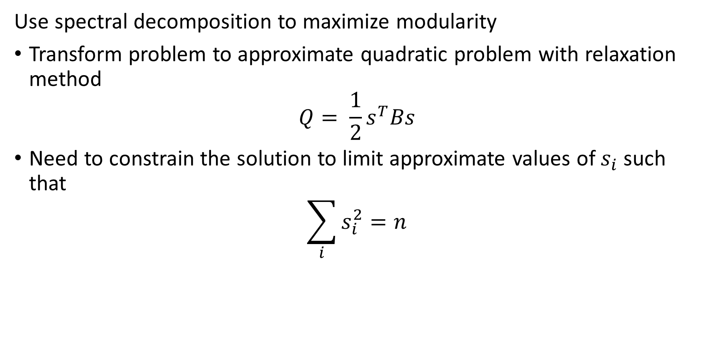
Spectral Modularity Maximization
Use spectral decomposition to maximize modularity
Transform problem to approximate quadratic problem with relaxation method
$$Q= \frac{1}{2}s^{T}Bs$$
Need to constrain the solution to limit approximate values of $s_{i}$ such that
$$\sum_{i}{s_{i}^{2}=n}$$

Slide 79
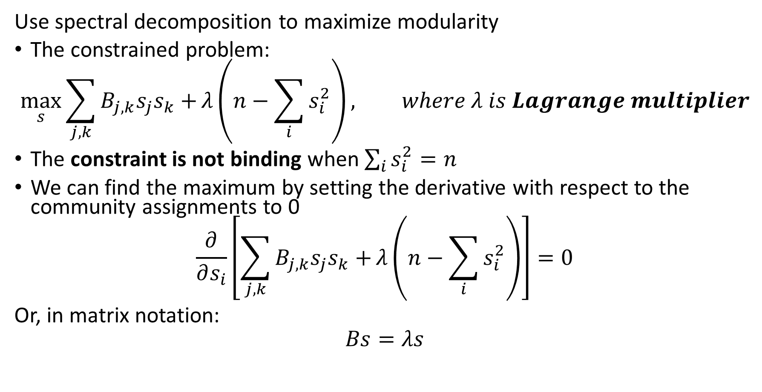
Spectral Modularity Maximization
Use spectral decomposition to maximize modularity
The constrained problem:
$$\max_{s}{\sum_{j,k}{B_{j,k}s_{j}s_{k}+}λ\left(n−\sum_{i}{s_{i}^{2}}\right)}, where λ is Lagrange multiplier$$
The constraint is not binding when $\sum_{i}{s_{i}^{2}=n}$
We can find the maximum by setting the derivative with respect to the community assignments to 0
$$\frac{∂}{∂s_{i}}\left[\sum_{j,k}{B_{j,k}s_{j}s_{k}+}λ\left(n−\sum_{i}{s_{i}^{2}}\right)\right]=0$$
Or, in matrix notation:
$$Bs=λs$$

Slide 80
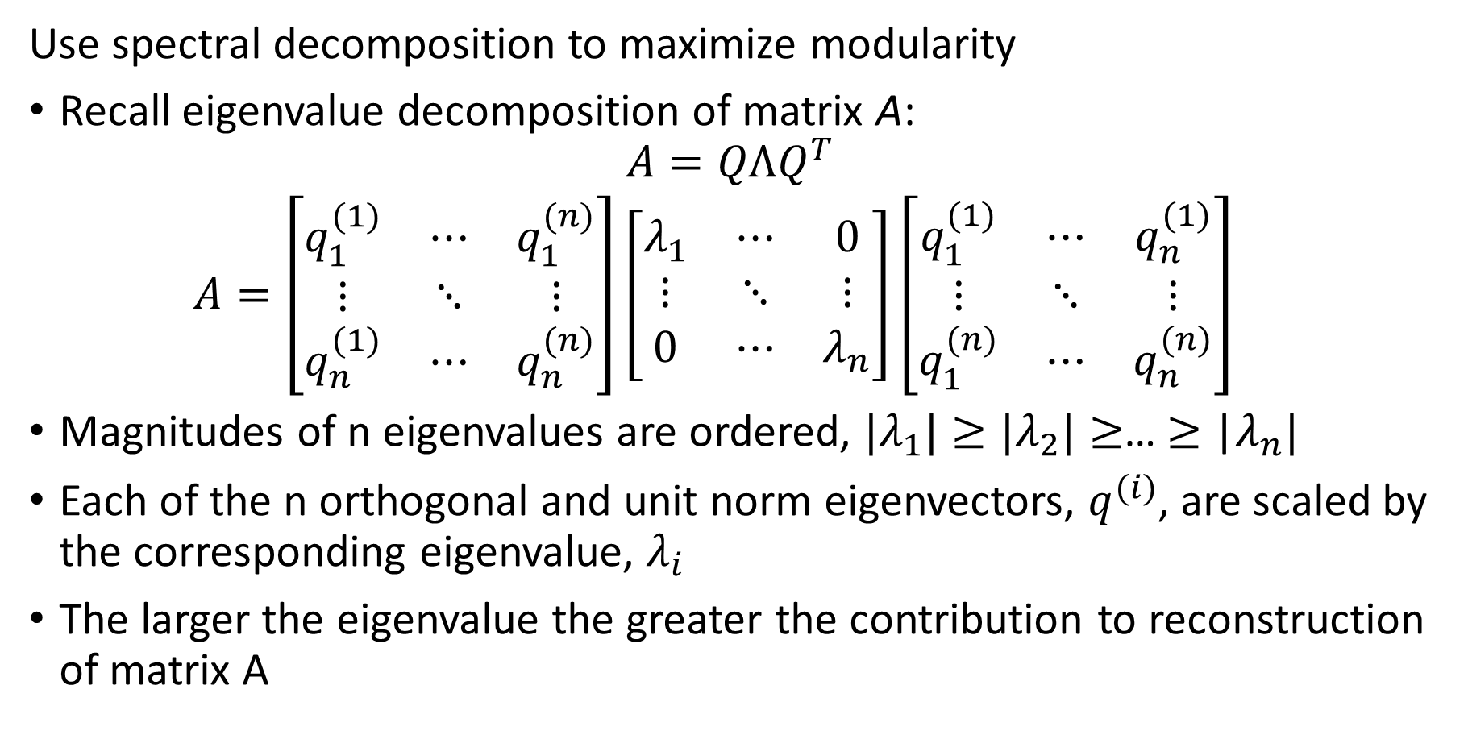
Spectral Modularity Maximization
Use spectral decomposition to maximize modularity
Recall eigenvalue decomposition of matrix A:
$$A=QΛQ^{T}$$
$$A=\left[\begin{matrix}q_{1}^{(1)} & ⋯ & q_{1}^{(n)} \\ ⋮ & ⋱ & ⋮ \\ q_{n}^{(1)} & ⋯ & q_{n}^{(n)}\end{matrix}\right]\left[\begin{matrix}λ_{1} & ⋯ & 0 \\ ⋮ & ⋱ & ⋮ \\ 0 & ⋯ & λ_{n}\end{matrix}\right]{\left[\begin{matrix}q_{1}^{(1)} & ⋯ & q_{n}^{(1)} \\ ⋮ & ⋱ & ⋮ \\ q_{1}^{(n)} & ⋯ & q_{n}^{(n)}\end{matrix}\right]}^{}$$
Magnitudes of n eigenvalues are ordered, ${|λ}_{1}|≥{|λ}_{2}|≥$… $≥$ |$λ_{n}|$
Each of the n orthogonal and unit norm eigenvectors, $q_{ }^{(i)}$, are scaled by the corresponding eigenvalue, $λ_{i}$
The larger the eigenvalue the greater the contribution to reconstruction of matrix A

Slide 81
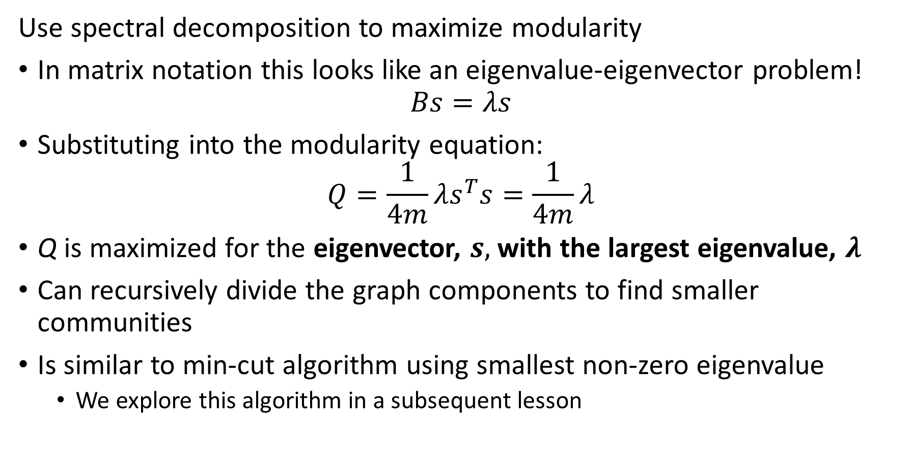
Spectral Modularity Maximization
Use spectral decomposition to maximize modularity
In matrix notation this looks like an eigenvalue-eigenvector problem!
$$Bs=λs$$
Substituting into the modularity equation:
$$Q=\frac{1}{4m}λs^{T}s=\frac{1}{4m}λ$$
Q is maximized for the eigenvector, $s,$ with the largest eigenvalue, $λ$
Can recursively divide the graph components to find smaller communities
Is similar to min-cut algorithm using smallest non-zero eigenvalue
We explore this algorithm in a subsequent lesson

Slide 82
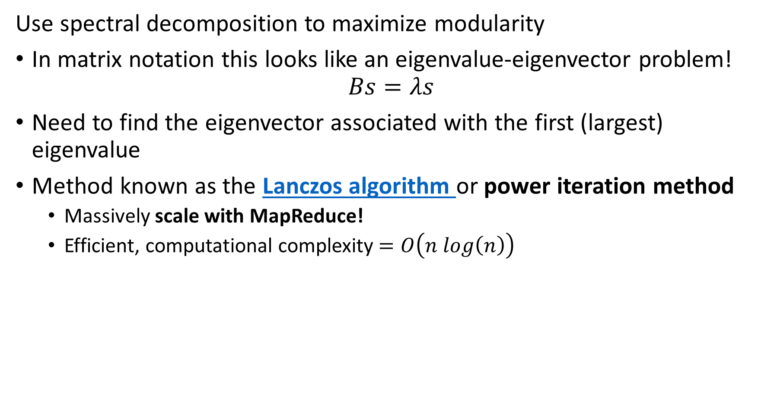
Spectral Modularity Maximization
Use spectral decomposition to maximize modularity
In matrix notation this looks like an eigenvalue-eigenvector problem!
$$Bs=λs$$
Need to find the eigenvector associated with the first (largest) eigenvalue
Method known as the Lanczos algorithm or power iteration method
Massively scale with MapReduce!
Efficient, computational complexity $=O\left(n log\left(n\right)\right)$

Slide 83
Small World Networks

Slide 84
Small World Networks
Small world networks (SWNs) are a class of graph with low distances between nodes
Small world networks have low degree of separation between nodes
Small world networks comprise two types of edges
Edges between near neighbors of a lattice network
A small number of edges between distant nodes
Small world networks have relatively few highly connected nodes or hubs

Slide 85
Small World Networks
Examples of small world networks (SWNs)
Structure of the Internet
Airlines with hub and spoke network
Similarity of documents and images
People in affiliated social groups
Wildlife in ecosystem food webs
Neurons in the human brain
Regulation of genetic transcription networks
Etc…..

Slide 86

Small World Networks
Properties of small world networks
The average distances between nodes in a SWN, $L$, follows a power law with respect to the number of nodes, $n$
$$L∝\log{n}$$
SWNs have lower average distances between nodes compared to equivalent random graphs
SWNs have higher clustering coefficient compared to equivalent random graphs

Slide 87

Small World Networks
Three metrics commonly used to evaluate small world networks
Small world coefficient, $σ$, compares the SWN to a random graph
$$σ=\frac{\frac{C}{C_{r}}}{\frac{L}{L_{r}}}$$
Where,
$$C_{ }=clustering coefficient of SWN$$
$$C_{r}=clustering coefficient of random network$$
$$L_{ }=average path length of SWN$$
$$L_{r}=average path length of random network$$
If $σ>1$ is SWN when $C>C_{r}$ and $L\sim L_{r}$
$σ$ is biased by network size

Slide 88

Small World Networks
Three metrics commonly used to evaluate small world networks
Small world measure, $ω$, compares the SWN to a random graph
$$ω=\frac{L}{L_{r}}−\frac{C}{C_{l}}$$
Where, $C_{l}$ is the clustering coefficient of a random lattice network
$-1≤ω≤1$, larger magnitude indicates greater SWN characteristics compared to equivelent random networks
Small world index (SWI) compares the SWN to a random graph
$$SWI=\frac{L−L_{l}}{L_{r}−L_{l}}×\frac{C−C_{r}}{C_{l}−C_{r}}$$
$0≤SWI≤1$, larger indicates greater SWN characteristics compared to comparable random networks

Slide 89


Small World Networks
Examples of SWNs
$p=1$, diameter of short-range connections
$q$ = number of long-range connections per node
SWG approaches fully connected graph as $q$ increases

Slide 90


Small World Networks
Examples of SWNs
Examples of SWNs
q$=2$, number of long-range
$p$ diameter of short-range connections
SWG approaches fully connected graph as $p$ increases

Slide 91


Small World Networks
Examples of SWNs
The average distances between nodes in a SWN, $L$, follows a power law with respect to the number of nodes, $n$
$$L∝\log{n}$$

Slide 92
Summary
Many methods to find communities in social networks
Communities defined by high connectivity
Can find communities by the centrality or influence of nodes:
Kratz centrality
Closeness centrality
K-Cores
Triangle density and clustering
Partition communities by betweenness
Find communities by modularity of groups of nodes
Greedy algorithms
Spectral decomposition modularity
Many real-world networks are SWNs

