Slide 1

CSCI E-96 Data Mining, Discovery and Exploration Efficient Similarity Search
Steve Elston
Copyright 2021, 2022, 2023, 2024, 2025, Stephen F Elston. All rights reserved.

Slide 2
Similarity Search at Scale
Need an efficient method for high-dimensional similarity joins at massive scale
Constructing nearest-neighbor graphs
Cluster models
Dimensionality reduction
Find similar products and for recommendation
Find similar documents
Web search
Document search
Deduplication
Plagiarism detection
Search for similar images
Retrieval Augmented Generation (RAG) models for generative AI
For a review of RAG including the similarity search problem see Gao, et. al., 2024

Slide 3
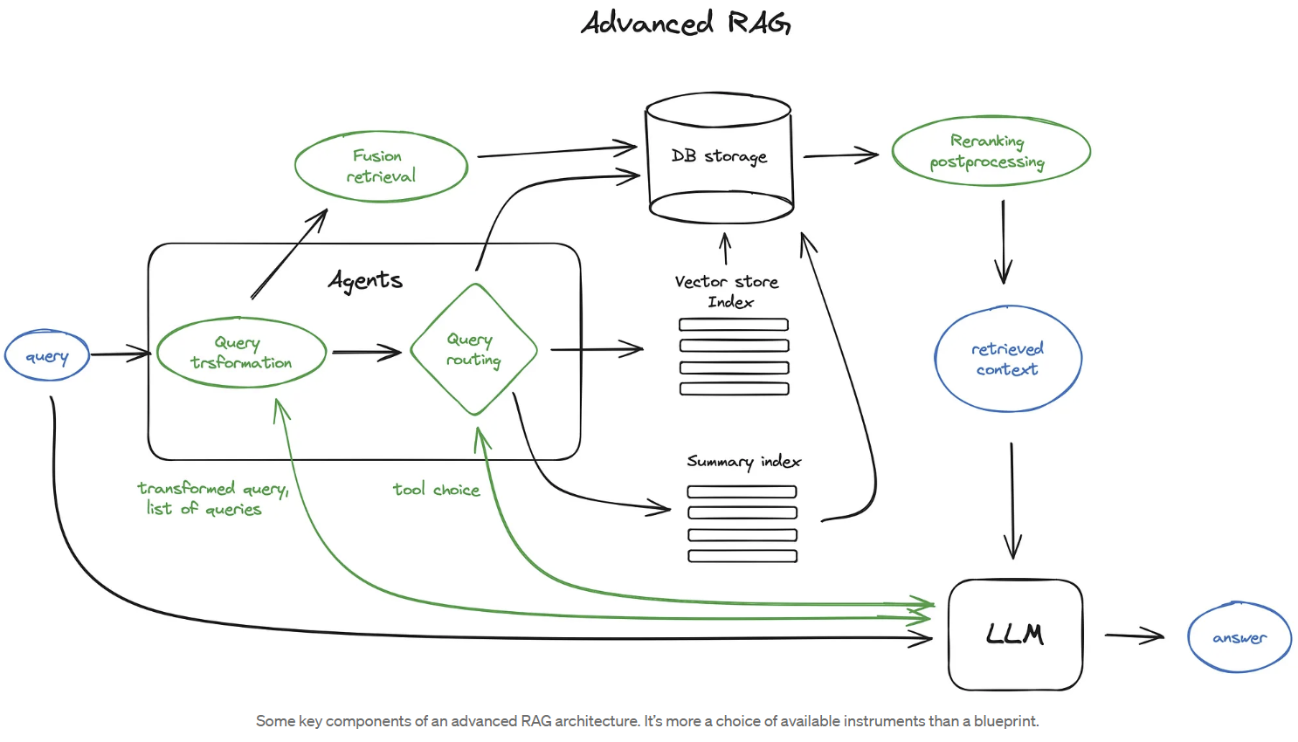
Similarity Search at Scale
Example of massive similarity search for retrieval augmented generation (RAG)
Ranking typically uses cosine similarity
We are focused on massive index and search problem
Diagram from blog post by Ivan Ilin

Slide 4
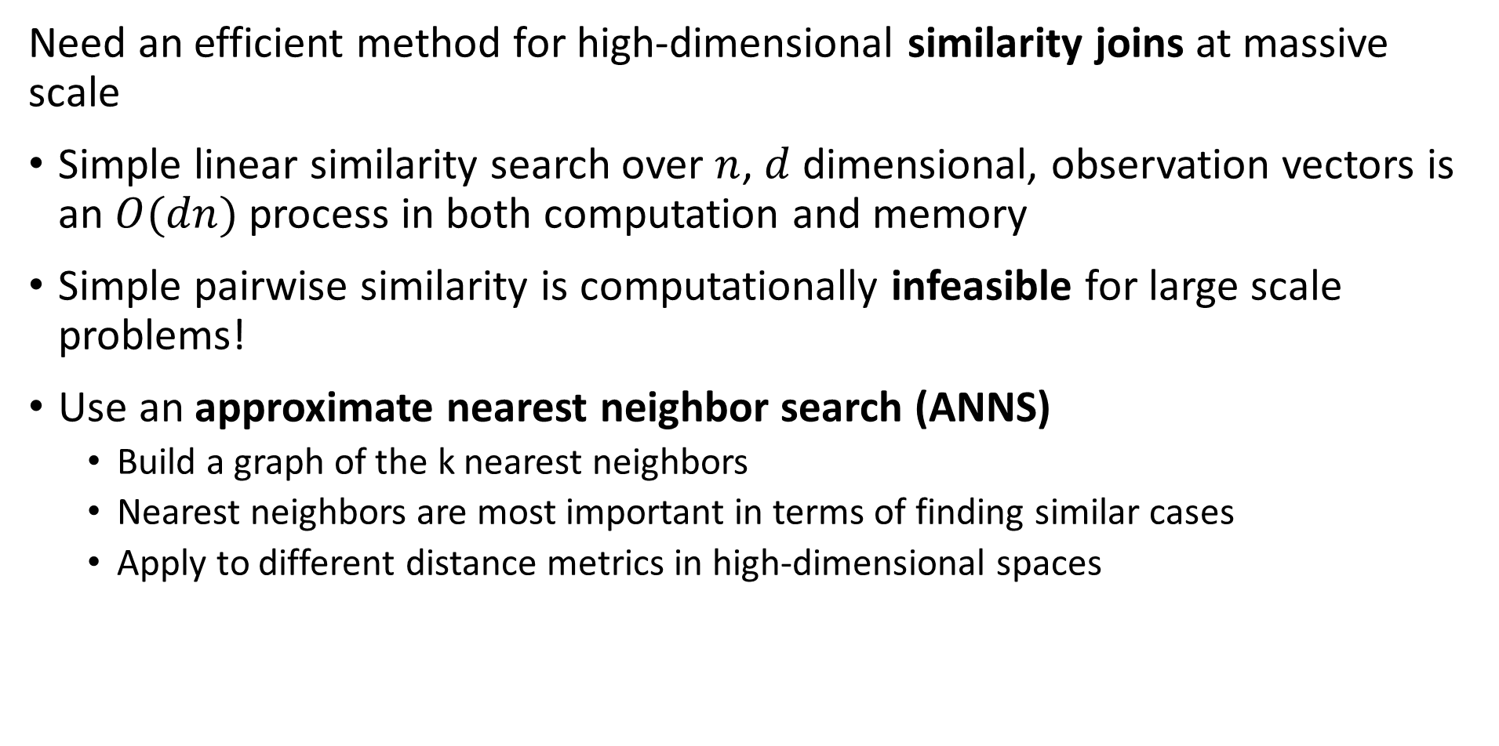
Similarity Search at Scale
Need an efficient method for high-dimensional similarity joins at massive scale
Simple linear similarity search over $n$, $d$ dimensional, observation vectors is an $O(dn)$ process in both computation and memory
Simple pairwise similarity is computationally infeasible for large scale problems!
Use an approximate nearest neighbor search (ANNS)
Build a graph of the k nearest neighbors
Nearest neighbors are most important in terms of finding similar cases
Apply to different distance metrics in high-dimensional spaces

Slide 5
Similarity Search at Scale
Massive scale similarity search is at the core of many analytics and AI platforms
There is wide landscape of technologies available for the similarity search problem
Vector databases incorporate massive scale similarity search,
Pinecone includes FAISS
Milvus from Zilli
Chroma
Weaviate
And many more…
Cloud platforms often include massive scale document similarity search,
AWS ElasticSearch
Azure AI Search
And others….

Slide 6
Similarity Search at Scale
Massive scale similarity search is at the core of many analytics and AI platforms
There are several vector similarity search platforms for recommender systems, document search and web search,
Approximate Nearest Neighbor Search Oh Yeah (Annoy) from Spotify
Qdrant
Vearch-Gamma
Vespa
OpenSearch
And others…
We will focus on Facebook AI Similarity Search (FAISS)
FAISS is widely used as a basis for many similarity search platforms
We will explore specific solutions using these algorithms in subsequent lessons

Slide 7
Similarity Search at Scale
We need an efficient way to (approximately) perform similarity joins at massive scale
Need an efficient method for large-scale and high-dimensional similarity joins!
Broadly, there are four classes of ANNS algorithms
Tree search
Hash-based search
Quantization-based search
Graph search
Apply to appropriate distance metrics in high-dimensional spaces

Slide 8
Similarity Search at Scale
Pipeline for similarity joins at massive scale
Our goal is to find rapidly approximate nearest neighbors with high recall
No one method can achieve this goal
In practice use a pipeline which concatenates several methods
Distance (Similarity) Metric
Dimensionality Reduction (Embedding)
Create D dimensional numeric embedding vectors
PCA
Neural Embedding
Etc.
Coarse Quantization
Reduce scope for ANN search
Inverted file - IVF
IVF Product quantization (IVF-PQ)
Inverted Multi-Index (IMI)
IVF Hierarchical Navigable Small Worlds (HNSW)
Etc…
Fine Quantizaton
Further reduce search scope and improve recall
Exhaustive search – Flat
Residual PQ
Locally Sensitive Hashing (LSH)
Search Refinemnet
Increase recall for NN search
Flat
Residual PQ algorithm
Neural reranking

Slide 9
Similarity Search at Scale
Dimensionality reduction often applied to similarity serarch
It is easier to search in a lower-dimensional space
Many possible transformations to lower-dimensional embedding space
Some algorithms start with a nearest neighbor similarity search!
Can use a neural network to find an embedding space, but computationally intensive
Ideally want an orthogonal embedding space
More on embedding and dimensionality reduction in other lessons

Slide 10
Flat Similarity Search

Slide 11
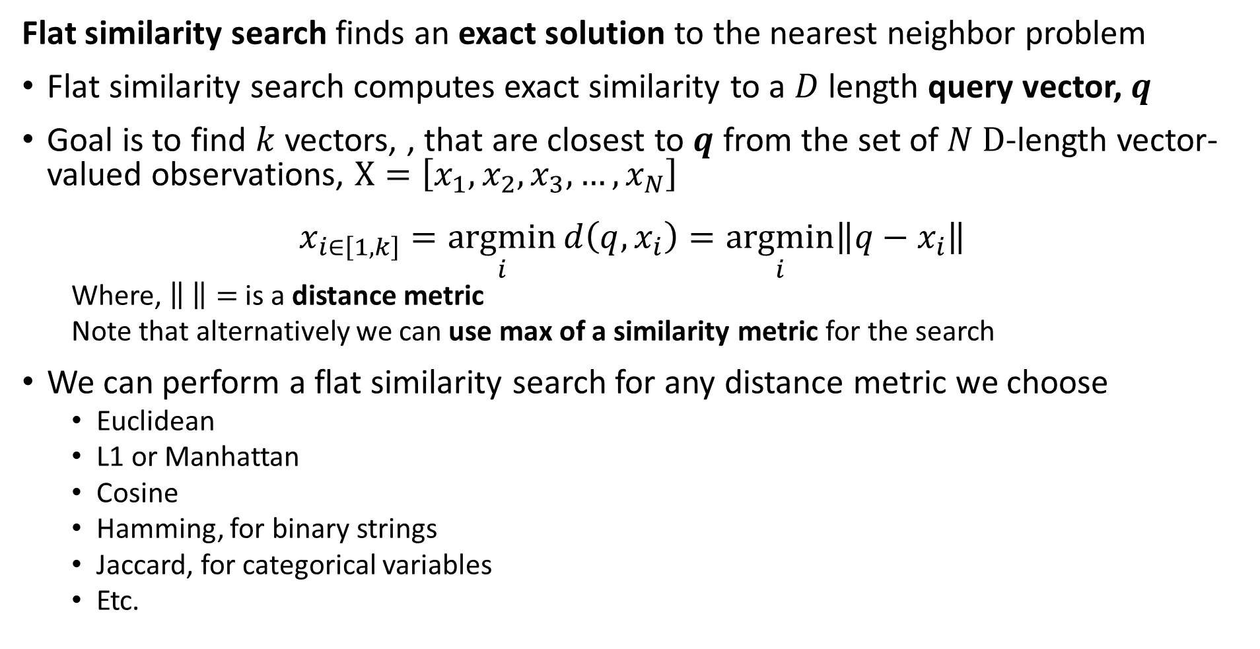
Flat similarity search finds exact solution
Flat similarity search finds an exact solution to the nearest neighbor problem
Flat similarity search computes exact similarity to a $D$ length query vector, $q$
Goal is to find $k$ vectors, , that are closest to $q$ from the set of $N D$-length vector-valued observations, $X=\left[x_{1},x_{2},x_{3},…,x_{N}\right]$
$$x_{i∈\left[1,k\right]}=\underset{i}{argmin}{d\left(q, x_{i}\right)}=\underset{i}{argmin}{{\left\|q−x_{i}\right\|}^{ }}$$
Where, $\left\| \right\|=$ is a distance metric
Note that alternatively we can use max of a similarity metric for the search
We can perform a flat similarity search for any distance metric we choose
Euclidean
L1 or Manhattan
Cosine
Hamming, for binary strings
Jaccard, for categorical variables
Etc.

Slide 12
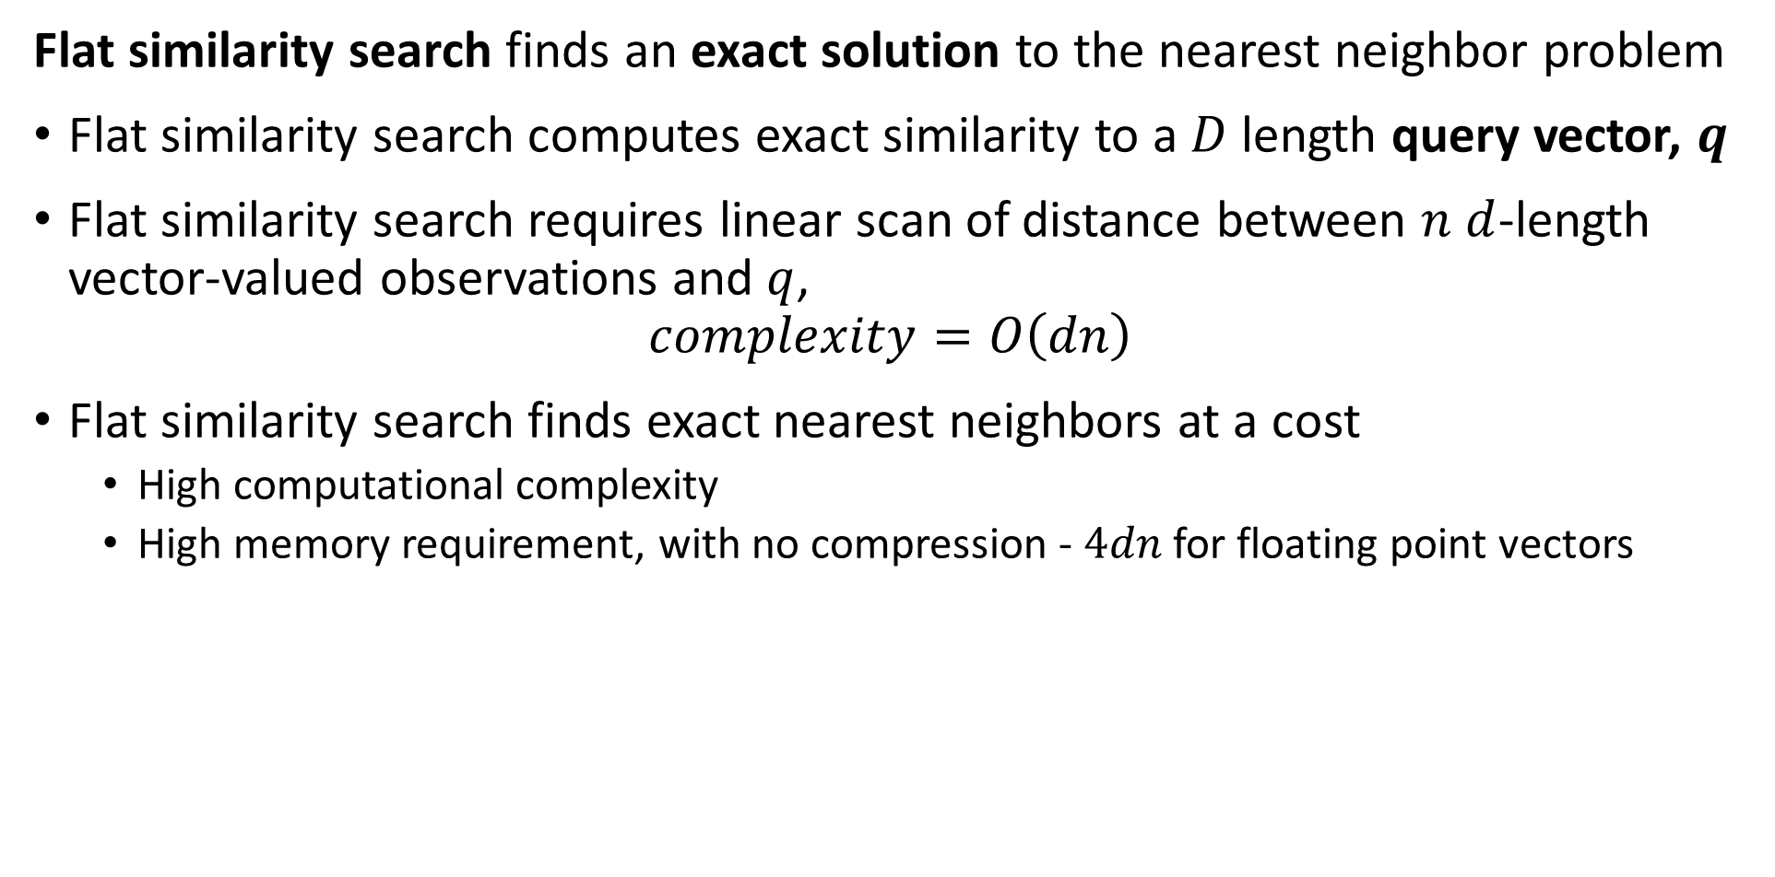
Flat similarity search finds exact solution
Flat similarity search finds an exact solution to the nearest neighbor problem
Flat similarity search computes exact similarity to a $D$ length query vector, $q$
Flat similarity search requires linear scan of distance between $n$ $d$-length vector-valued observations and $q$,
$$complexity=O\left(dn\right)$$
Flat similarity search finds exact nearest neighbors at a cost
High computational complexity
High memory requirement, with no compression - $4dn$ for floating point vectors

Slide 13
Flat similarity search finds exact solution
But, is any similarity search truly exact?
Unlikely!
Distance is dependent on the distance metric used
Dimensionality reduction (embedding) provides only an approximate representation of original vector
Vector valued observations are subject to noise
In reality we only need an NN similarity search good enough for our task

Slide 14
Evaluation of ANNS

Slide 15
Evaluation of ANNS
How do we objectively evaluate ANNS algorithms
There are three dimensions of performance
Recall measures the fraction of true NNs found by the algorithm
Memory use can be the biggest constraint for massive data sets
Speed can be important for many applications
Low Memory -Scalable
Low Computational Complexity-Scalable
High Recall -Accuracy

Slide 16
Evaluation of ANNS
How do we objectively evaluate ANNS algorithms
Is an invariable trade off between these three dimensions
Example, we can have high recall if we have sufficient memory and computational capacity
Generally, we must pick two of three dimensions and accept the value of the third
For a theoretical analysis of this tradeoff, including bounds on performance, can be found in Andoni, et.al, 2018
Low Memory -Scalable
?
Low Computational Complexity-Scalable
High Recall -Accuracy

Slide 17
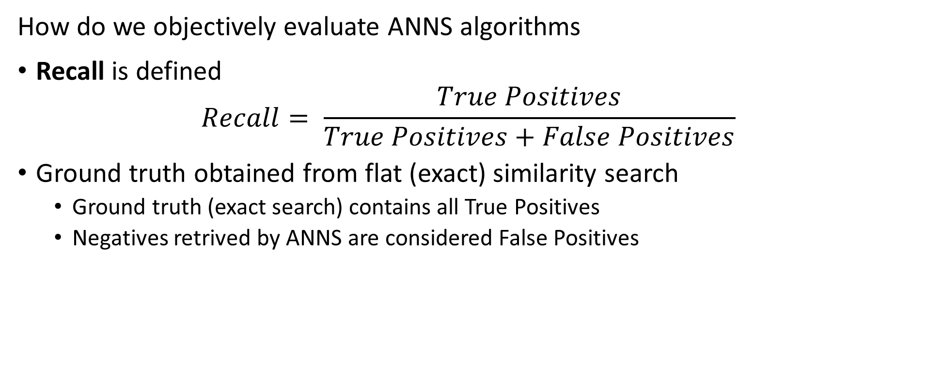
Evaluation of ANNS
How do we objectively evaluate ANNS algorithms
Recall is defined
$$Recall= \frac{True Positives}{True Positives+False Positives}$$
Ground truth obtained from flat (exact) similarity search
Ground truth (exact search) contains all True Positives
Negatives retrived by ANNS are considered False Positives

Slide 18
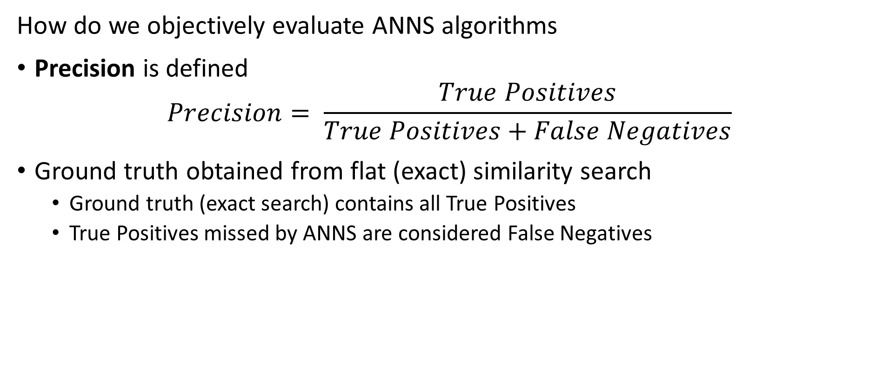
Evaluation of ANNS
How do we objectively evaluate ANNS algorithms
Precision is defined
$$Precision= \frac{True Positives}{True Positives+False Negatives}$$
Ground truth obtained from flat (exact) similarity search
Ground truth (exact search) contains all True Positives
True Positives missed by ANNS are considered False Negatives

Slide 19
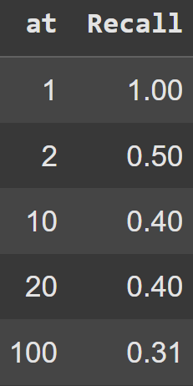
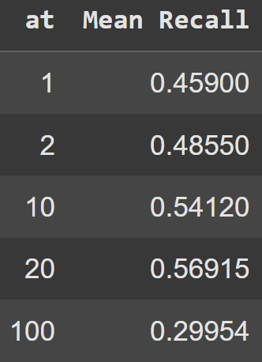
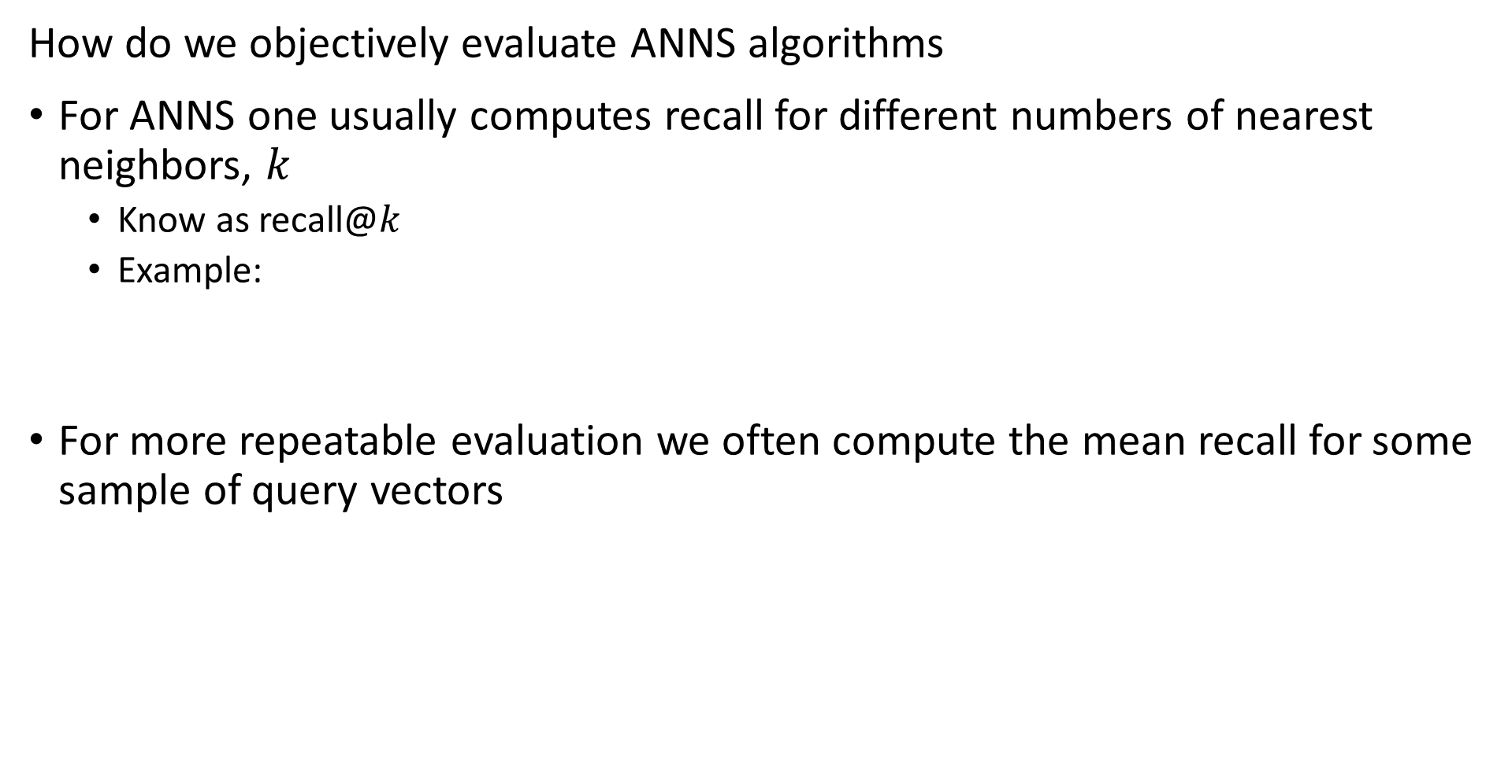
Evaluation of ANNS
How do we objectively evaluate ANNS algorithms
For ANNS one usually computes recall for different numbers of nearest neighbors, $k$
Know as recall@$k$
Example:
For more repeatable evaluation we often compute the mean recall for some sample of query vectors

Slide 20
Inverted File Systems

Slide 21
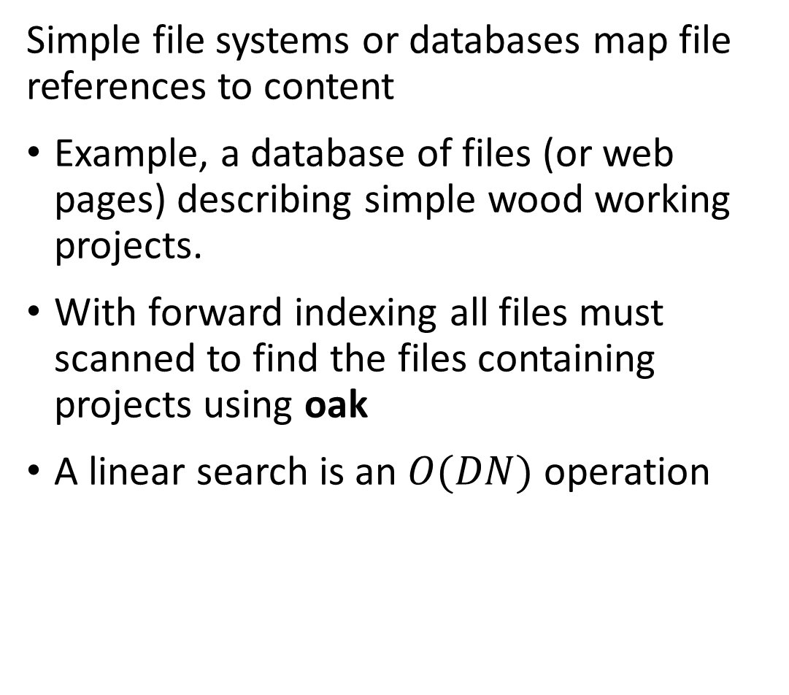
Inverted file systems enable look-up by value
Simple file systems or databases map file references to content
Example, a database of files (or web pages) describing simple wood working projects.
With forward indexing all files must scanned to find the files containing projects using oak
A linear search is an $O(DN)$ operation
File ID
101
102
103
104
105
106
107
108
109
110
111
112
113
114
115
Wood type
Oak
Pine
Oak
Maple
Fir
Maple
Fir
Oak
Maple
Fir
Maple
Pine
Maple
Oak
Oak

Slide 22
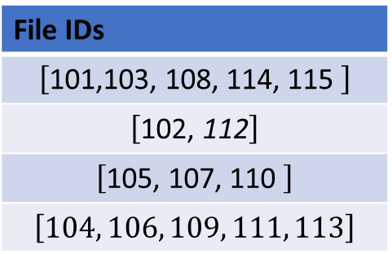
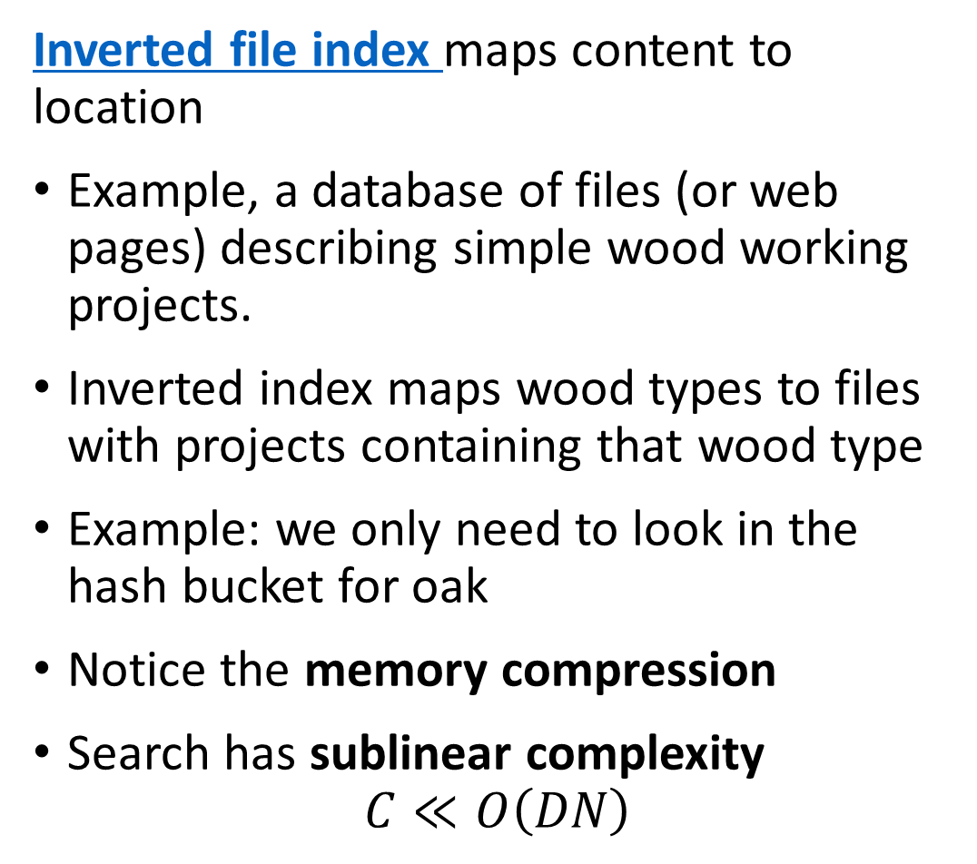
Inverted file systems enable look-up by value
Inverted file index maps content to location
Example, a database of files (or web pages) describing simple wood working projects.
Inverted index maps wood types to files with projects containing that wood type
Example: we only need to look in the hash bucket for oak
Notice the memory compression
Search has sublinear complexity
$$C≪O\left(DN\right)$$
Wood type
Oak
Pine
Fir
Maple
File IDs
$$\left[\text{101,}\text{103, }\text{108, 114, 115 }\right]$$
$$\left[\text{10}\text{2}\text{,}\text{ 112}\right]$$
$$\left[\text{10}\text{5}\text{, 107, 110 }\right]$$
$$\left[104, 106, 109, 111, 113\right]$$

Slide 23
Building KD-Trees

Slide 24
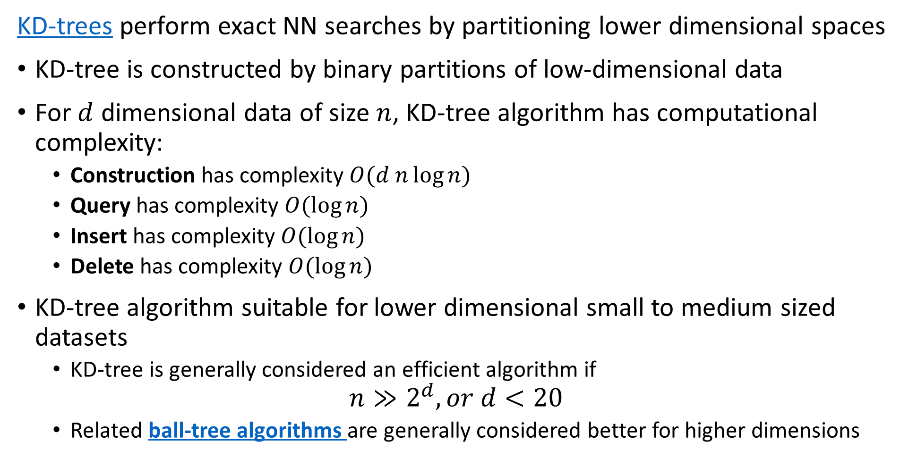
KD-Trees
KD-trees perform exact NN searches by partitioning lower dimensional spaces
KD-tree is constructed by binary partitions of low-dimensional data
For $d$ dimensional data of size $n$, KD-tree algorithm has computational complexity:
Construction has complexity $O(d n\log{n})$
Query has complexity $O(\log{n})$
Insert has complexity $O(\log{n})$
Delete has complexity $O(\log{n})$
KD-tree algorithm suitable for lower dimensional small to medium sized datasets
KD-tree is generally considered an efficient algorithm if
$$n≫2^{d}, or d<20$$
Related ball-tree algorithms are generally considered better for higher dimensions

Slide 25
KD-Trees
A KD-tree is constructed by binary partitions through these steps
Start with the set of observations
Number of observations per leaf is defined – a hyperparameter
Splits are along the axes of the data space
Axes are sampled round-robin or randomly
On each axis split point is determined
Split is on observation closest to median, mean or other measure
Splitting hyperplane is perpendicular to the axis selected
Observations in region split are partitioned left and right of hyperplane
Repeat steps 2-6 until leaf has less than required number of observations
The termination condition

Slide 26
KD-Trees
Many sources discussing details of KD-tree algorithms, their limitations and the pitfalls, with a few suggestions
Chapter from Andrew Moore’s PhD dissertation
Chapters 8, 9, 10, 11 of Advanced Algorithms and Data Structures, Marcello La Rocca, Manning, 2021
Wikipedia article

Slide 27
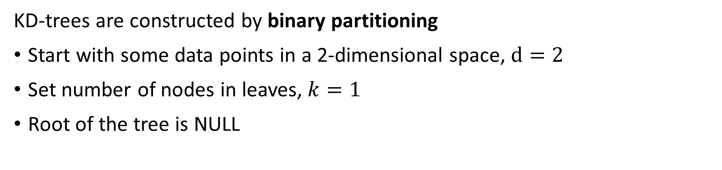


KD-Trees
KD-trees are constructed by binary partitioning
Start with some data points in a 2-dimensional space, $d=2$
Set number of nodes in leaves, $k=1$
Root of the tree is NULL
$$x_{2}$$
A
B
C
J
J
D
E
G
F
I
H
$$x_{1}$$

Slide 28
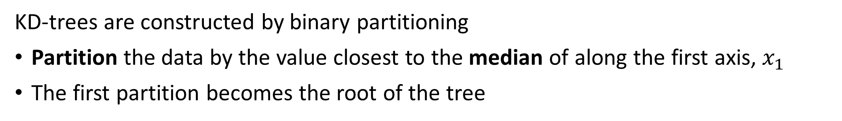
KD-Trees
KD-trees are constructed by binary partitioning
Partition the data by the value closest to the median of along the first axis, $x_{1}$
The first partition becomes the root of the tree
E
$$x_{2}$$
A
B
C
J
J
D
E
G
F
I
H
$$x_{1}$$

Slide 29
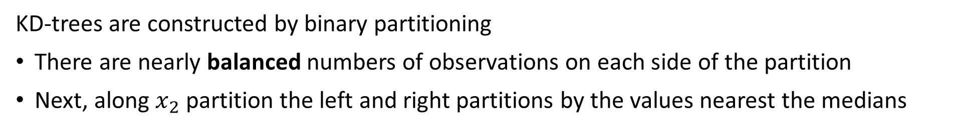
KD-Trees
KD-trees are constructed by binary partitioning
There are nearly balanced numbers of observations on each side of the partition
Next, along $x_{2}$ partition the left and right partitions by the values nearest the medians
E
$$x_{2}$$
A
B
D
G
C
J
J
D
E
G
F
I
H
K
$$x_{1}$$

Slide 30
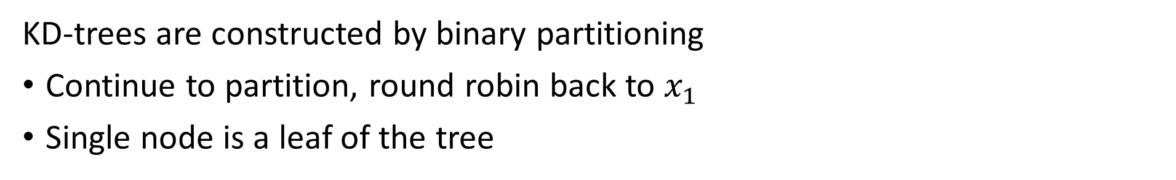
KD-Trees
KD-trees are constructed by binary partitioning
Continue to partition, round robin back to $x_{1}$
Single node is a leaf of the tree
E
$$x_{2}$$
A
B
D
G
C
J
J
J
H
C
K
D
E
G
F
I
H
K
$$x_{1}$$

Slide 31
KD-Trees
KD-trees are constructed by binary partitioning
Now there are only leaves to add to the tree
E
$$x_{2}$$
A
B
D
C
G
J
J
J
H
C
K
D
E
G
A
B
J
F
I
F
I
H
K
$$x_{1}$$

Slide 32
Similarity Queries on KD-Trees

Slide 33
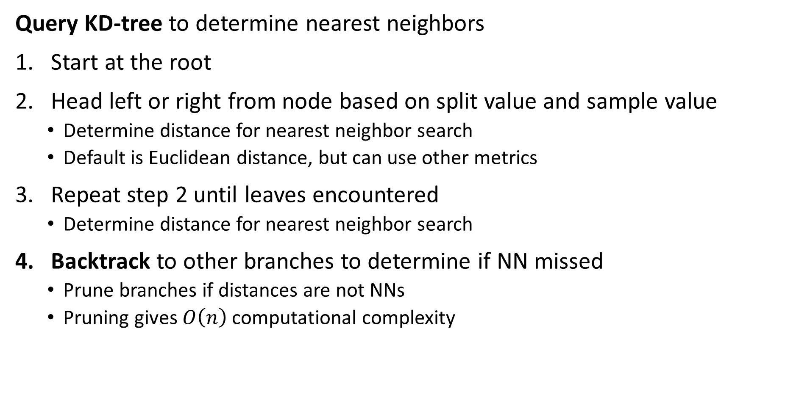
KD-Trees
Query KD-tree to determine nearest neighbors
Start at the root
Head left or right from node based on split value and sample value
Determine distance for nearest neighbor search
Default is Euclidean distance, but can use other metrics
Repeat step 2 until leaves encountered
Determine distance for nearest neighbor search
Backtrack to other branches to determine if NN missed
Prune branches if distances are not NNs
Pruning gives $O\left(n\right)$ computational complexity

Slide 34
KD-Trees
Can rapidly perform 3-nearest neighbor query a KD-Tree by following the node splits
Start with a new observation, Z
E
$$x_{2}$$
A
B
D
C
G
J
J
J
H
C
K
D
E
G
A
B
J
F
I
F
Z
I
H
K
$$x_{1}$$

Slide 35
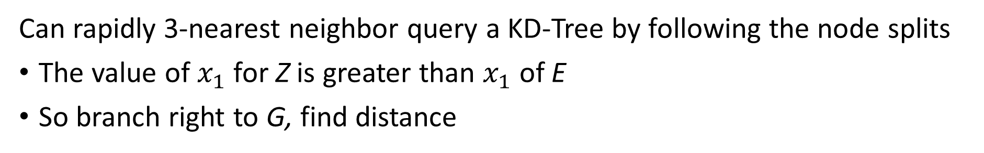
KD-Trees
Can rapidly 3-nearest neighbor query a KD-Tree by following the node splits
The value of $x_{1}$ for Z is greater than $x_{1}$ of E
So branch right to G, find distance
E
$$x_{2}$$
A
B
D
C
G
J
J
J
H
C
K
D
E
G
A
B
J
F
I
F
Z
I
H
K
$$x_{1}$$

Slide 36
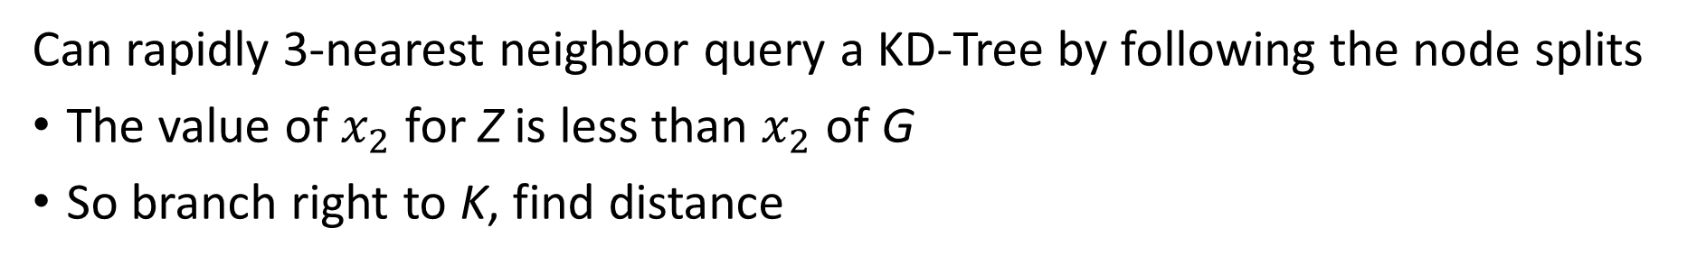
KD-Trees
Can rapidly 3-nearest neighbor query a KD-Tree by following the node splits
The value of $x_{2}$ for Z is less than $x_{2}$ of G
So branch right to K, find distance
E
$$x_{2}$$
A
B
D
C
G
J
J
J
H
C
K
D
E
G
A
B
J
F
I
F
Z
I
H
K
$$x_{1}$$

Slide 37
KD-Trees
Can rapidly 3-nearest neighbor query a KD-Tree by following the node splits
Z has nearest neighbors on graph I, G, K
But is there a nearer neighbor on the graph?
E
$$x_{2}$$
A
B
D
C
G
J
J
J
H
C
K
D
E
G
A
B
J
F
I
F
Z
I
H
K
$$x_{1}$$

Slide 38
KD-Trees
Can rapidly 3-nearest neighbor query a KD-Tree by following the node splits
We need to backtrack to determine if there is a nearer neighbor on another branch
Backtracking to K then to branch with F, finding a nearer neighbor than K
E
$$x_{2}$$
A
B
D
C
G
J
J
J
H
C
K
D
E
G
A
B
J
F
I
F
Z
I
H
K
$$x_{1}$$

Slide 39
KD-Trees
Can rapidly 3-nearest neighbor query a KD-Tree by following the node splits
Continue backtracking to K then to branch to C and J, but no nearer neighbor
We can prune the branch with C and J from the search
E
$$x_{2}$$
A
B
D
C
G
J
J
J
H
C
K
D
E
G
A
B
J
F
I
F
Z
I
H
K
$$x_{1}$$

Slide 40
KD-Trees
Can rapidly query a KD-Tree by following the video splits
The backtrack arrives at the root, terminating the algorithm
E
$$x_{2}$$
A
B
D
C
G
J
J
J
H
C
K
D
E
G
A
B
J
F
I
F
Z
I
H
K
$$x_{1}$$

Slide 41
Coarse Quantization

Slide 42
Coarse quantization divides the search region
Coarse quantization speeds NN search by reducing scope
To speed NN search by orders of magnitude limit scope of search
Coarse coding divides the search scope into small cells
Similar vectors are within the cells
Can use the cell IDs in an inverted index for fast lookup of similar vectors

Slide 43
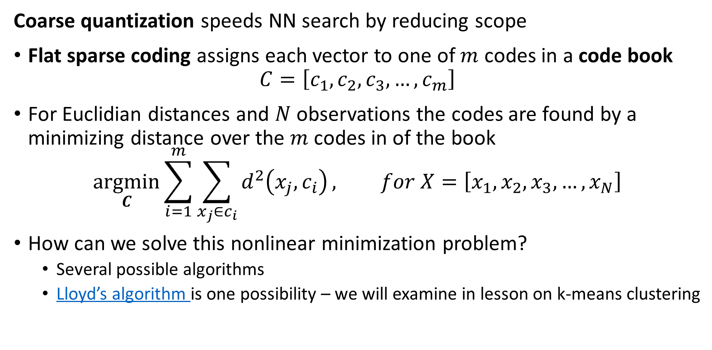
Coarse quantization divides the search region
Coarse quantization speeds NN search by reducing scope
Flat sparse coding assigns each vector to one of $m$ codes in a code book
$$C=\left[c_{1},c_{2},c_{3},…,c_{m}\right]$$
For Euclidian distances and $N$ observations the codes are found by a minimizing distance over the $m$ codes in of the book
$$\underset{C}{argmin}{\sum_{i=1}^{m}{\sum_{x_{j}∈c_{i}}^{ }{d^{2}\left(x_{j},c_{i}\right)}}}, for X=\left[x_{1},x_{2},x_{3},…,x_{N}\right]$$
How can we solve this nonlinear minimization problem?
Several possible algorithms
Lloyd’s algorithm is one possibility – we will examine in lesson on k-means clustering

Slide 44
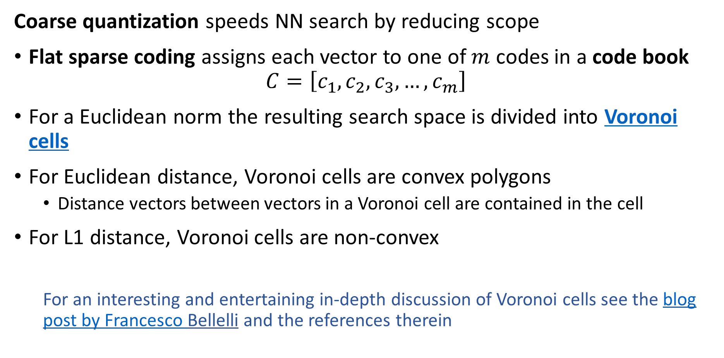
Coarse quantization divides the search region
Coarse quantization speeds NN search by reducing scope
Flat sparse coding assigns each vector to one of $m$ codes in a code book
$$C=\left[c_{1},c_{2},c_{3},…,c_{m}\right]$$
For a Euclidean norm the resulting search space is divided into Voronoi cells
For Euclidean distance, Voronoi cells are convex polygons
Distance vectors between vectors in a Voronoi cell are contained in the cell
For L1 distance, Voronoi cells are non-convex
For an interesting and entertaining in-depth discussion of Voronoi cells see the blog post by Francesco Bellelli and the references therein

Slide 45

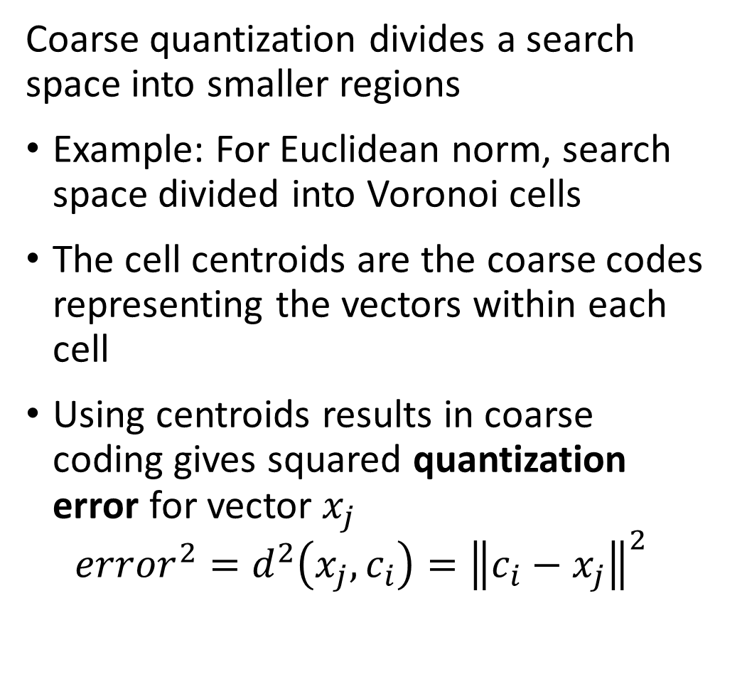







Coarse quantization divides the search region
Coarse quantization divides a search space into smaller regions
Example: For Euclidean norm, search space divided into Voronoi cells
The cell centroids are the coarse codes representing the vectors within each cell
Using centroids results in coarse coding gives squared quantization error for vector $x_{j}$
$${error}^{2}=d^{2}\left(x_{j},c_{i}\right)={\left\|c_{i}−x_{j}\right\|}^{2}$$
$$c_{3}$$
$$c_{2}$$
$$c_{7}$$
$$c_{1}$$
$$c_{4}$$
$$c_{8}$$
$$c_{6}$$
$$c_{5}$$

Slide 46

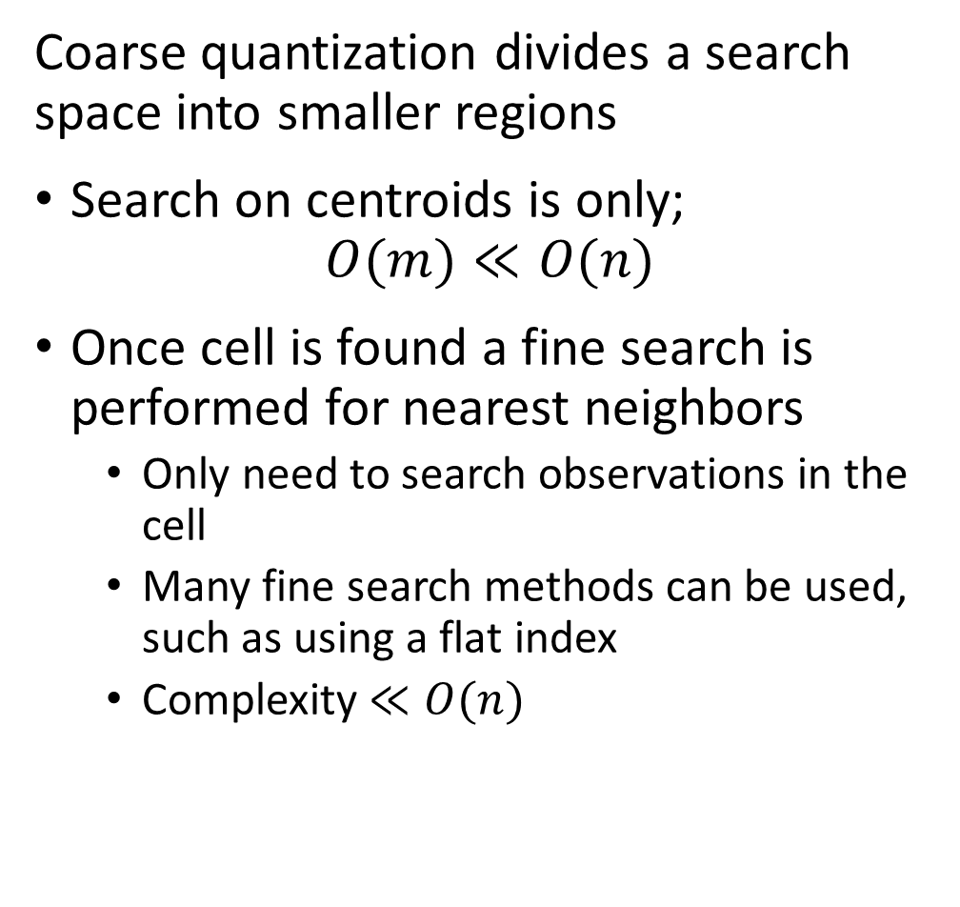







Coarse quantization divides the search region
Coarse quantization divides a search space into smaller regions
Search on centroids is only;
$$O(m)≪O(n)$$
Once cell is found a fine search is performed for nearest neighbors
Only need to search observations in the cell
Many fine search methods can be used, such as using a flat index
Complexity $≪O(n)$
$$c_{3}$$
$$c_{2}$$
$$c_{7}$$
$$c_{1}$$
$$c_{4}$$
$$c_{8}$$
$$c_{6}$$
$$c_{5}$$

Slide 47
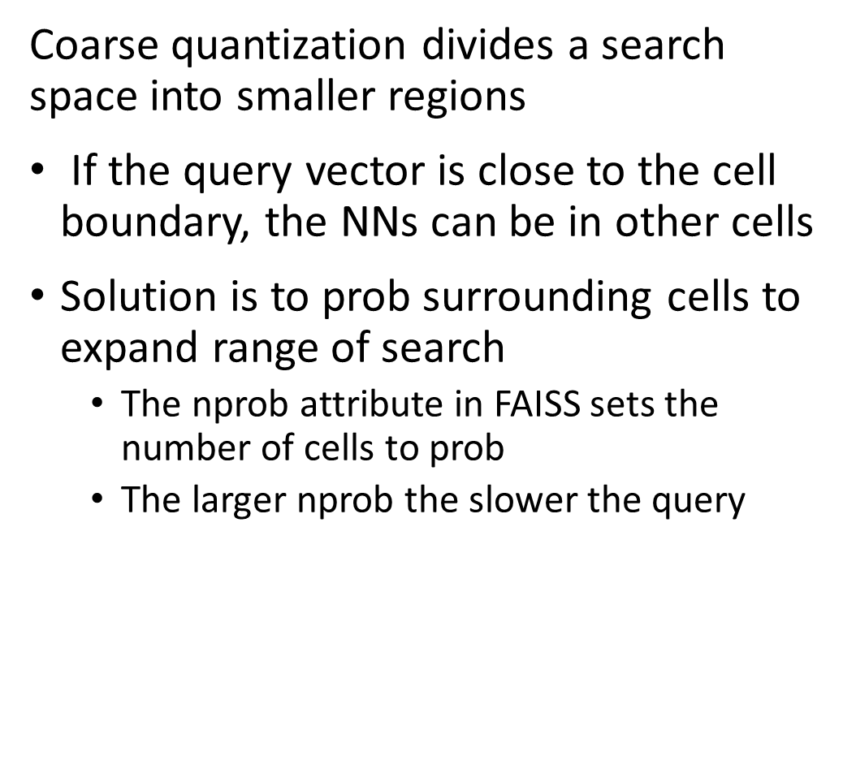
Coarse quantization divides the search region
Coarse quantization divides a search space into smaller regions
If the query vector is close to the cell boundary, the NNs can be in other cells
Solution is to prob surrounding cells to expand range of search
The nprob attribute in FAISS sets the number of cells to prob
The larger nprob the slower the query
$$c_{3}$$
$$c_{2}$$
query
$$c_{7}$$
$$c_{1}$$
$$c_{4}$$
$$c_{8}$$
$$c_{6}$$
$$c_{5}$$

Slide 48
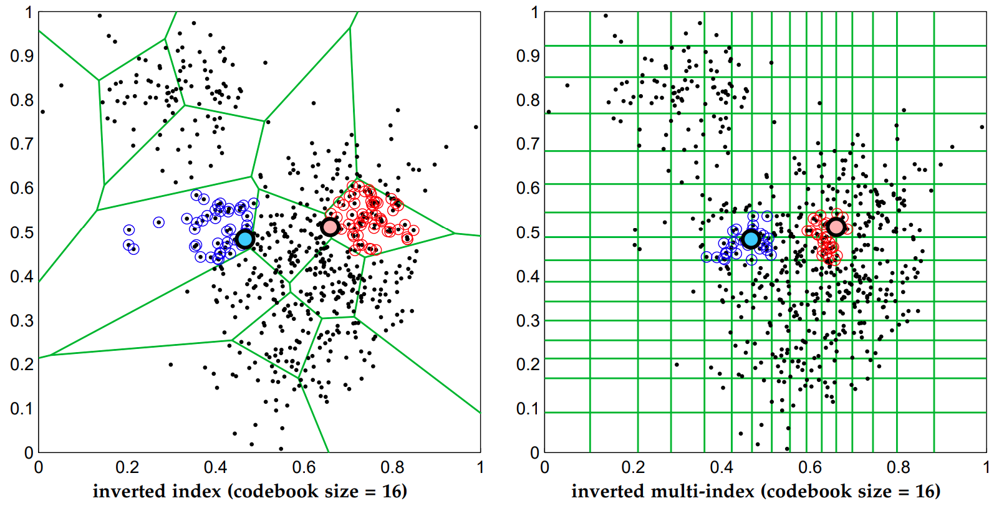
Coarse quantization divides the search region
Voronoi cells are not the only way to perform coarse quantization
Babenko, et. al., 2012, proposed using a multi-dimensional inverted multi-index
The multi-index is quantized along the axes of a grid rather than Voronoi cells
Result is a better constrained search region

Slide 49
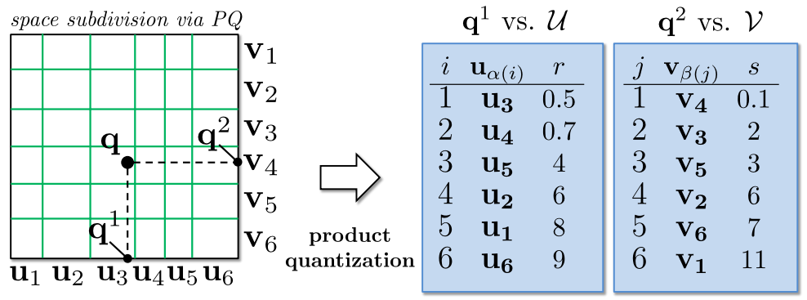
Coarse quantization divides the search region
Babenko, et. al., 2012, proposed using a multi-dimensional inverted multi-index
Grid is quantized along axes
Distances from the query vector are measured along the axes

Slide 50
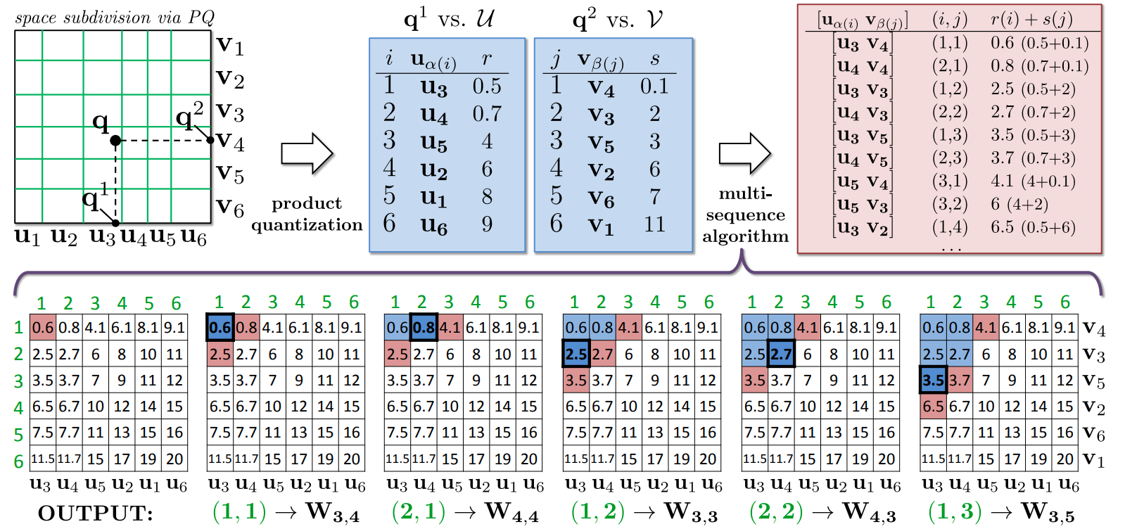
Coarse quantization divides the search region
Babenko, et. al., 2012, proposed using a multi-dimensional inverted multi-index
Total distances are the sum of distances along the axes
The query proceeds stepwise until required NNs found

Slide 51
Product Quantization

Slide 52
Product Quantization
Product Quantization (PQ) for ANNS was first proposed by Jégou, Douze, and Schmid, 2011
Factor observation vectors into subvectors
Factor query vectors into subvectors
Learn codes (centroids) by K-means clustering subvectors
Build asymmetric distance tables between subvector centroids and query subvectors
Encode observation subvectors by cluster centroids
Use distance table for NN search for query subvectors
compute distances by summing subvector distances
Database construction
a.k.a. model training
NN search for query

Slide 53
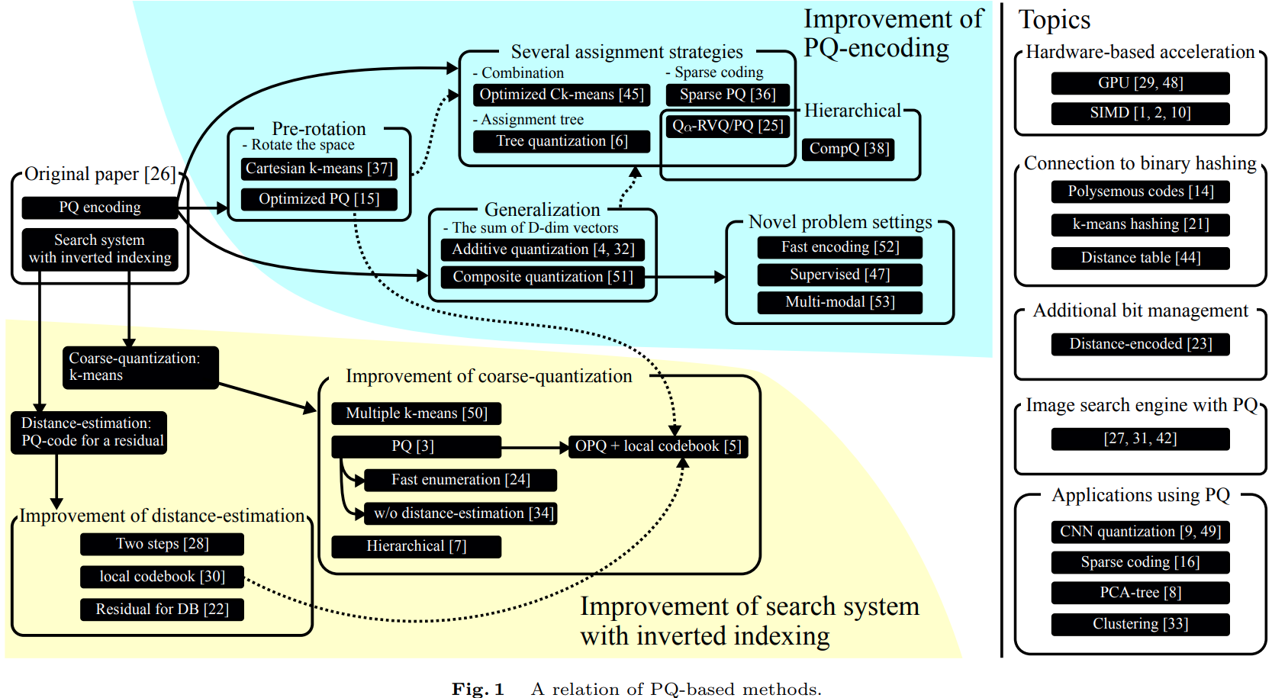
Product Quantization
The review paper by Matsui, et. al., 2018, includes a diagram showing the evolution of PQ algorithms
We will only discuss a few of these many algorithms and applications in our lesson

Slide 54
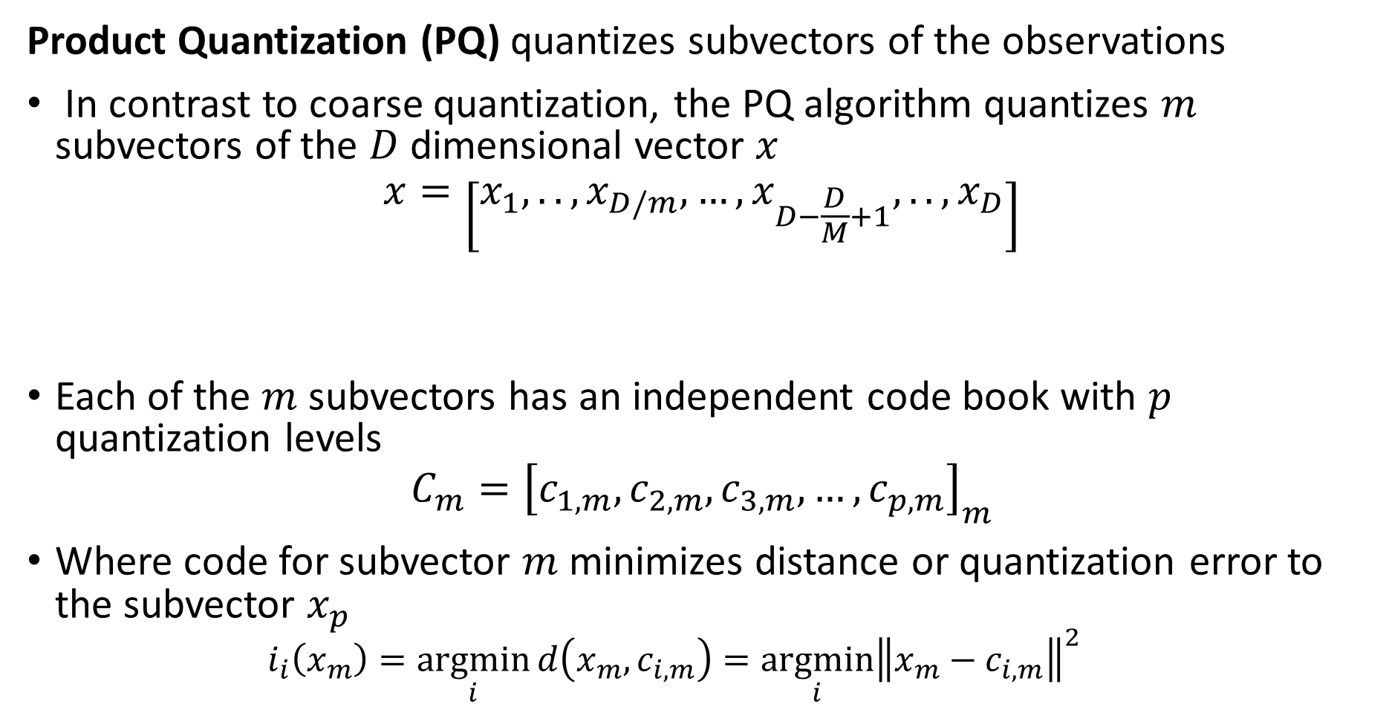
Product Quantization
Product Quantization (PQ) quantizes subvectors of the observations
In contrast to coarse quantization, the PQ algorithm quantizes $m$ subvectors of the $D$ dimensional vector $x$
$$x=\left[x_{1},..,x_{D/m},…,x_{D−\frac{D}{M}+1},..,x_{D}\right]$$
Each of the $m$ subvectors has an independent code book with $p$ quantization levels
$$C_{m}={\left[c_{1,m},c_{2,m},c_{3,m},…,c_{p,m}\right]}_{m}$$
Where code for subvector $m$ minimizes distance or quantization error to the subvector $x_{p}$
$$i_{i}\left(x_{m}\right)=\underset{i}{argmin}{d\left(x_{m}, c_{i,m}\right)}=\underset{i}{argmin}{{\left\|x_{m}−c_{i,m}\right\|}^{2}}$$
Subvector 1
Subvector m

Slide 55
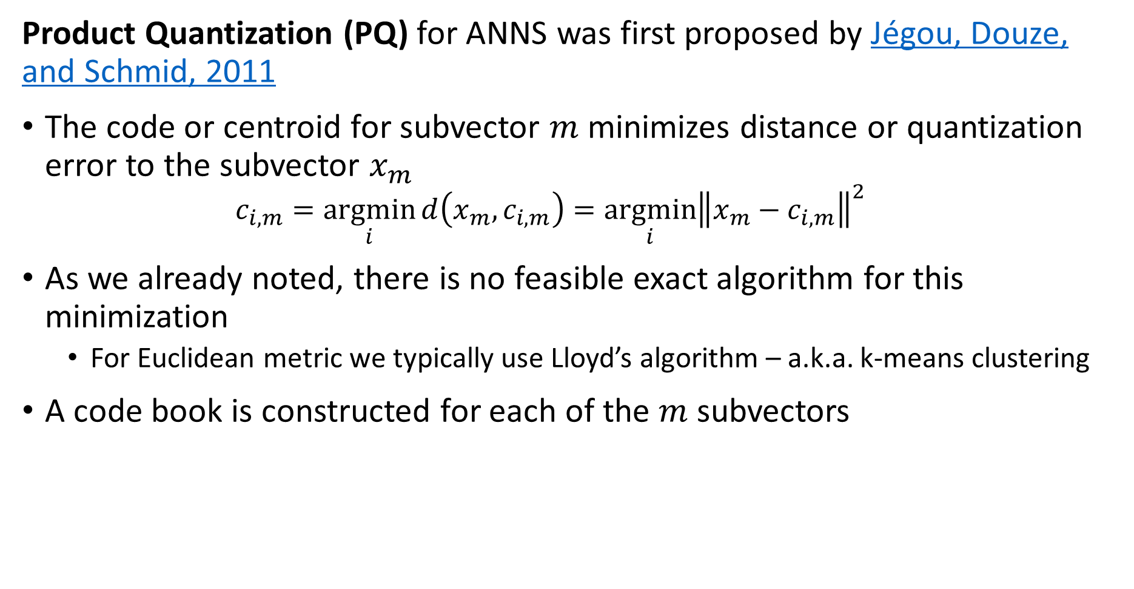
Product Quantization
Product Quantization (PQ) for ANNS was first proposed by Jégou, Douze, and Schmid, 2011
The code or centroid for subvector $m$ minimizes distance or quantization error to the subvector $x_{m}$
$$c_{i,m}=\underset{i}{argmin}{d\left(x_{m}, c_{i,m}\right)}=\underset{i}{argmin}{{\left\|x_{m}−c_{i,m}\right\|}^{2}}$$
As we already noted, there is no feasible exact algorithm for this minimization
For Euclidean metric we typically use Lloyd’s algorithm – a.k.a. k-means clustering
A code book is constructed for each of the $m$ subvectors

Slide 56
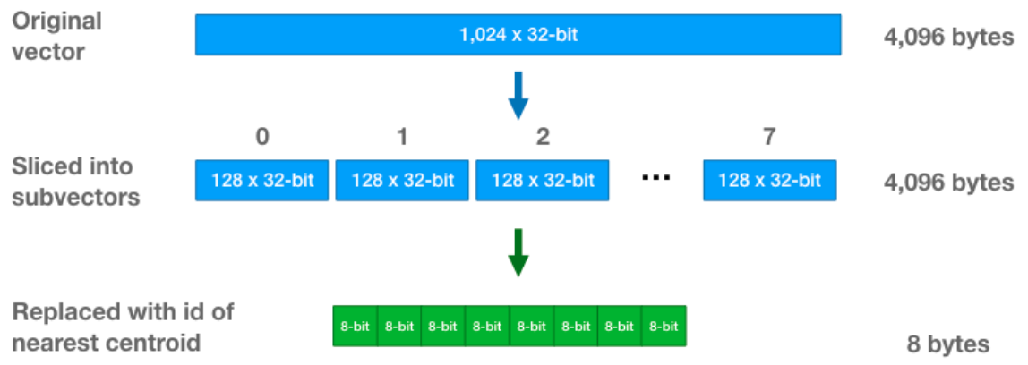

Product Quantization
Product Quantization (PQ) quantizes subvectors of the observations
Each of the $m$ subvectors have an independent code book with $p$ quantization levels
$$C_{m}={\left[c_{1,m},c_{2,m},c_{3,m},…,c_{p,m}\right]}_{m}$$
Example from Chris McCormick’s blog post on the PQ algorithm

Slide 57
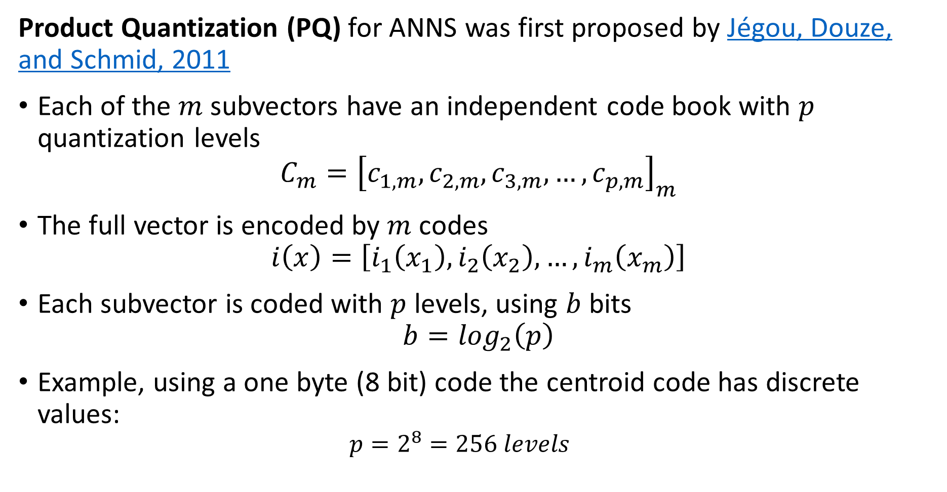
Product Quantization
Product Quantization (PQ) for ANNS was first proposed by Jégou, Douze, and Schmid, 2011
Each of the $m$ subvectors have an independent code book with $p$ quantization levels
$$C_{m}={\left[c_{1,m},c_{2,m},c_{3,m},…,c_{p,m}\right]}_{m}$$
The full vector is encoded by $m$ codes
$$i\left(x\right)=\left[i_{1}\left(x_{1}\right),i_{2}\left(x_{2}\right),…,i_{m}\left(x_{m}\right)\right]$$
Each subvector is coded with $p$ levels, using $b$ bits
$$b=\log_{2}\left(p\right)$$
Example, using a one byte (8 bit) code the centroid code has discrete values:
$$p=2^{8}=256 levels$$

Slide 58
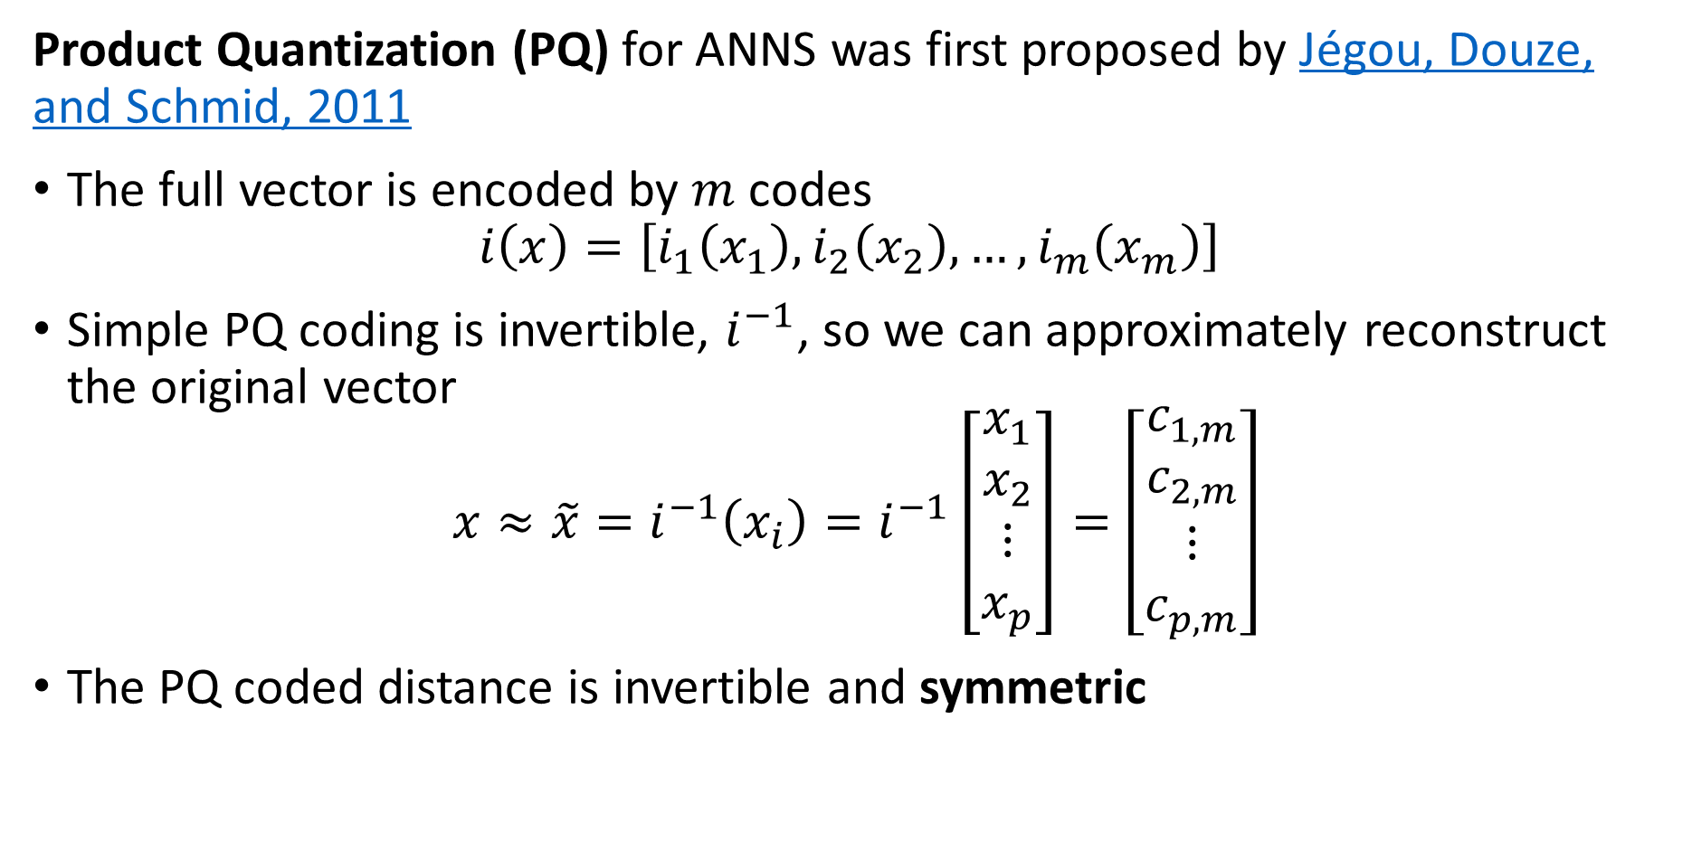
Product Quantization
Product Quantization (PQ) for ANNS was first proposed by Jégou, Douze, and Schmid, 2011
The full vector is encoded by $m$ codes
$$i\left(x\right)=\left[i_{1}\left(x_{1}\right),i_{2}\left(x_{2}\right),…,i_{m}\left(x_{m}\right)\right]$$
Simple PQ coding is invertible, $i^{−1}$, so we can approximately reconstruct the original vector
$$x≈\tilde{x}=i^{−1}\left(x_{i}\right)=i^{−1}\left[\begin{matrix}x_{1} \\ x_{2} \\ \begin{matrix}⋮ \\ x_{p}\end{matrix}\end{matrix}\right]=\left[\begin{matrix}c_{1,m} \\ c_{2,m} \\ \begin{matrix}⋮ \\ c_{p,m}\end{matrix}\end{matrix}\right]$$
The PQ coded distance is invertible and symmetric

Slide 59
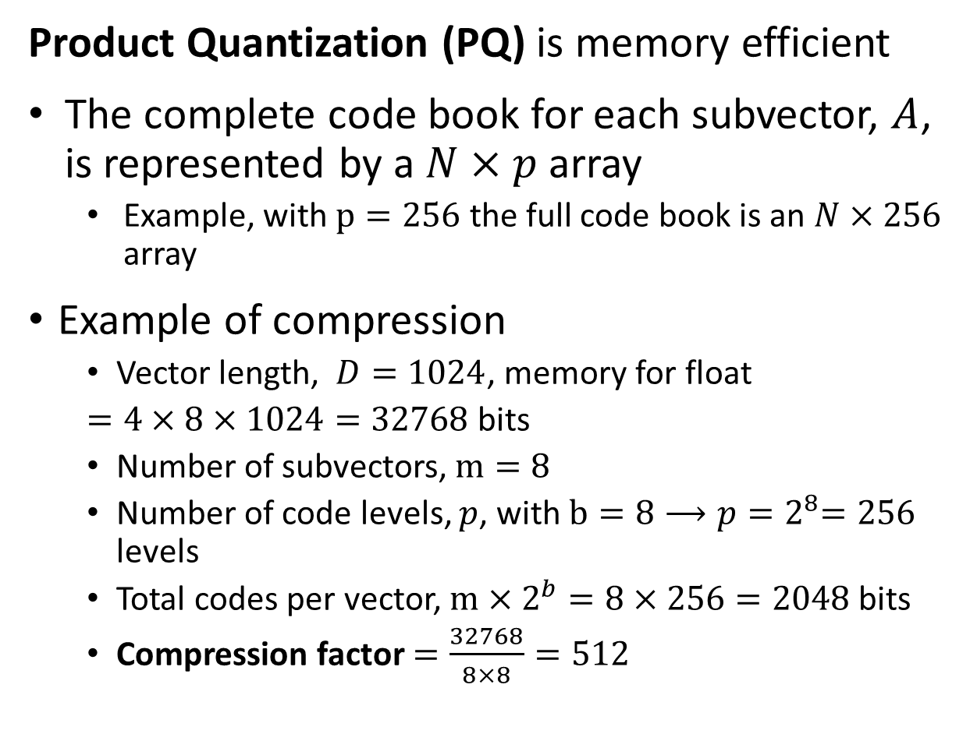


Product Quantization
Product Quantization (PQ) is memory efficient
The complete code book for each subvector, $A$, is represented by a $N×p$ array
Example, with $p=256$ the full code book is an $N×256$ array
Example of compression
Vector length, $D=1024$, memory for float
$=4×8×1024=32768$ bits
Number of subvectors, $m=8$
Number of code levels, $p$, with $b=8{⟶p=2}^{8}=256$ levels
Total codes per vector, $m×2^{b}=8×256=2048$ bits
Compression factor $=\frac{32768}{8×8}=512$
$$p$$
0 ,0
0 ,1
. . .
0 ,k-1
1 ,0
1 ,1
. . .
1 ,k-1
2 ,0
2 ,1
. . .
2 ,k-1
3 ,0
3 ,1
. . .
3 ,k-1
$$N$$
.
.
.
.
.
.
.
.
.
N-2 ,0
N-2 ,1
. . .
N-2 ,k-1
N-1,0
N-1,1
. . .
N-1,k-1

Slide 60
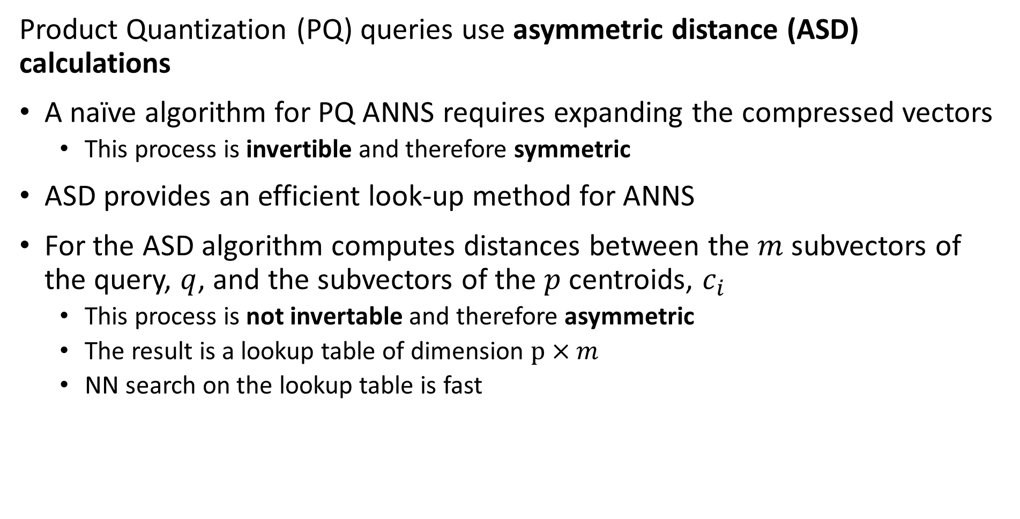


Product Quantization
Product Quantization (PQ) queries use asymmetric distance (ASD) calculations
A naïve algorithm for PQ ANNS requires expanding the compressed vectors
This process is invertible and therefore symmetric
ASD provides an efficient look-up method for ANNS
For the ASD algorithm computes distances between the $m$ subvectors of the query, $q$, and the subvectors of the $p$ centroids, $c_{i}$
This process is not invertable and therefore asymmetric
The result is a lookup table of dimension $p×m$
NN search on the lookup table is fast
$$m$$
0 ,0
0 ,1
. . .
0 ,-1
1 ,0
1 ,1
. . .
1 ,m-1
2 ,0
2 ,1
. . .
2 ,m-1
$$p$$
3 ,0
3 ,1
. . .
3 ,m-1
.
.
.
.
.
.
.
.
.
k-2 ,0
N-2 ,1
. . .
k-2 ,m-1
k-1,0
N-1,1
. . .
k-1,k-1

Slide 61
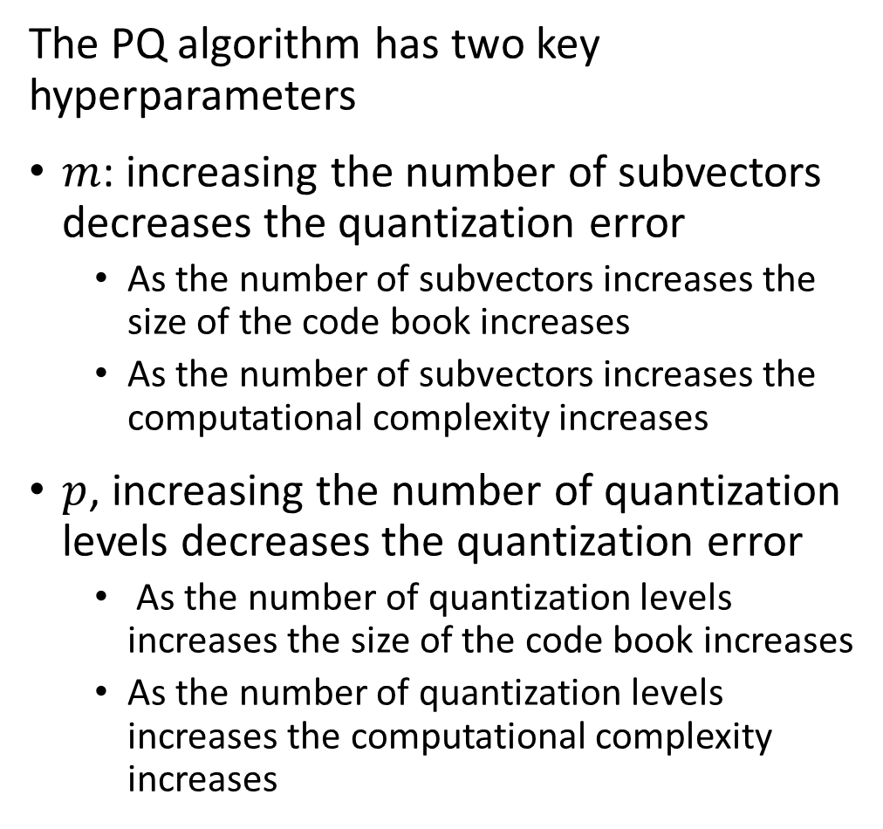
Performance of the PQ algorithm
The PQ algorithm has two key hyperparameters
$m$: increasing the number of subvectors decreases the quantization error
As the number of subvectors increases the size of the code book increases
As the number of subvectors increases the computational complexity increases
$p$, increasing the number of quantization levels decreases the quantization error
As the number of quantization levels increases the size of the code book increases
As the number of quantization levels increases the computational complexity increases
Low Memory -Scalable
Increasing p and m
Increasing p and m
Low Computational Complexity-Scalable
High Recall -Accuracy

Slide 62
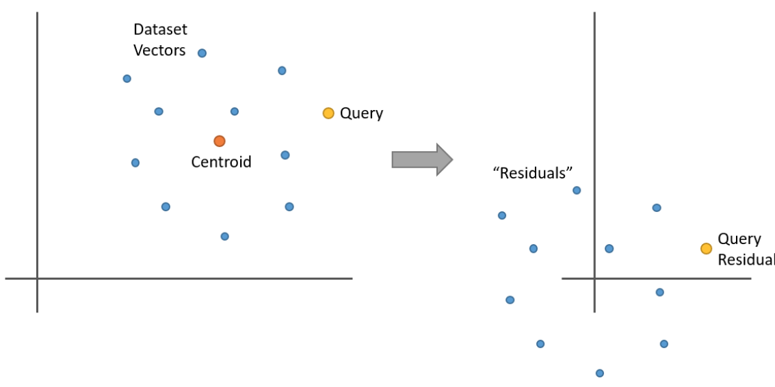
Improving Basic Quantization
Quantization algorithms can be formulated in terms residuals, RPQ
We can perform similarity search using differences or residuals with respect to the centroid
Idea proposed by Schicong, et.al., 2015, and others
Example from Chris McCormick’s blog post on the PQ algorithm

Slide 63
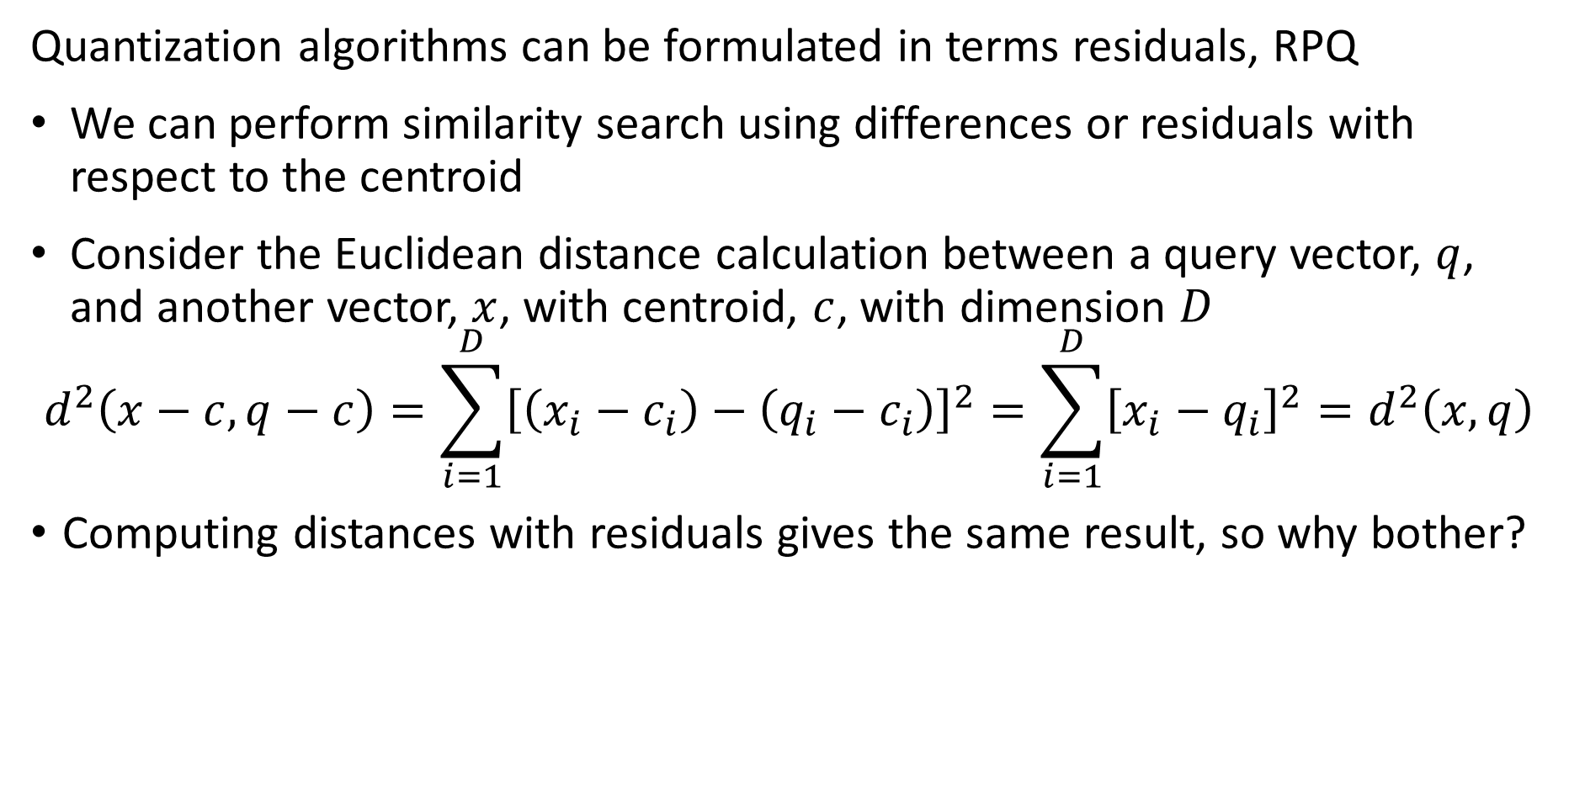
Improving Basic Quantization
Quantization algorithms can be formulated in terms residuals, RPQ
We can perform similarity search using differences or residuals with respect to the centroid
Consider the Euclidean distance calculation between a query vector, $q$, and another vector, $x$, with centroid, $c$, with dimension $D$
$$d^{2}\left(x−c,q−c\right)=\sum_{i=1}^{D}{{\left[\left(x_{i}−c_{i}\right)−\left(q_{i}−c_{i}\right)\right]}^{2}=\sum_{i=1}^{D}{{\left[x_{i}−q_{i}\right]}^{2}}=d^{2}\left(x,q\right)}$$
Computing distances with residuals gives the same result, so why bother?

Slide 64
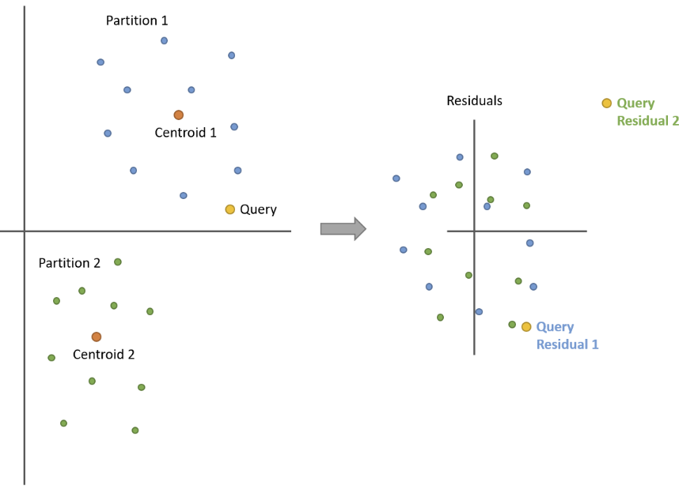
Improvements Basic Product Quantization
Quantization algorithms can be formulated in terms residuals
What is the advantage of using residuals, since we get the same result either way?
The variance of the residuals, and therefore the error of distance estimates is reduced!
Using residuals, distance estimates are zero-centered, analogous to zero-centering variables for machine learning
Example from Chris McCormick’s blog post on the PQ algorithm

Slide 65
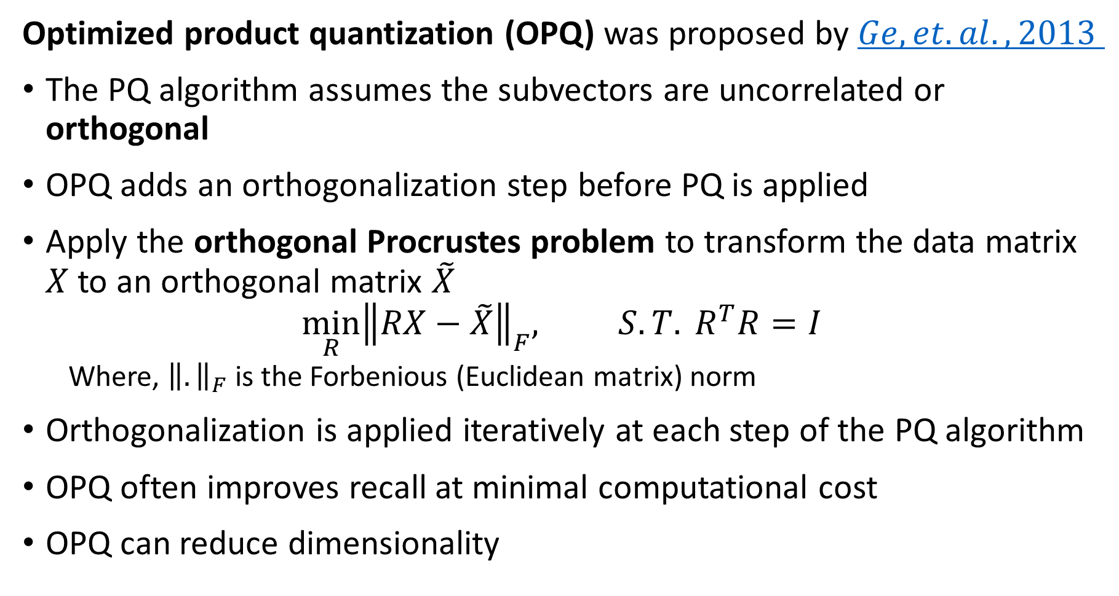
Improvements Basic Product Quantization
Optimized product quantization (OPQ) was proposed by $Ge, et. al., 2013$
The PQ algorithm assumes the subvectors are uncorrelated or orthogonal
OPQ adds an orthogonalization step before PQ is applied
Apply the orthogonal Procrustes problem to transform the data matrix $X$ to an orthogonal matrix $\tilde{X}$
$$\min_{R}{{\left\|RX−\tilde{X}\right\|}_{F}, S.T. R^{T}R=I }$$
Where, ${\left\|.\right\|}_{F}$ is the Forbenious (Euclidean matrix) norm
Orthogonalization is applied iteratively at each step of the PQ algorithm
OPQ often improves recall at minimal computational cost
OPQ can reduce dimensionality

Slide 66
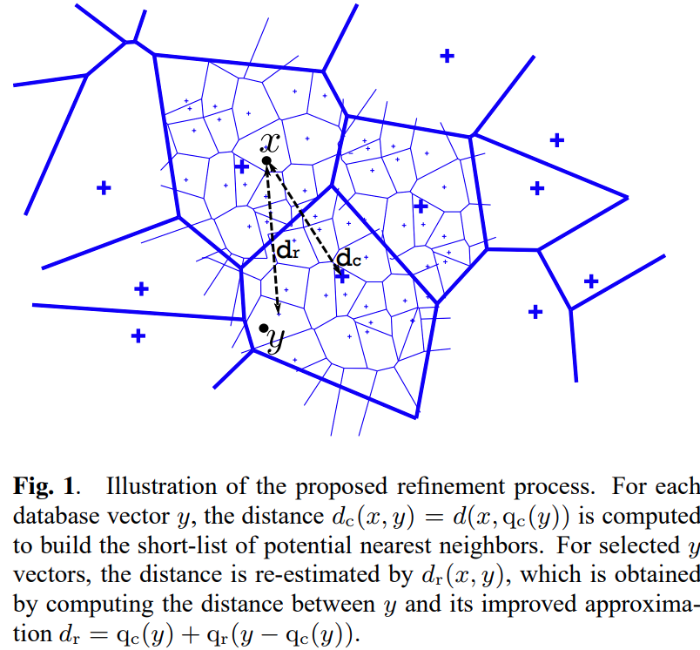
Product Quantization as a Refinement
The PQ algorithm can be used to refine searches following coarse quantization
Idea introduced by Jegou, et. al., 2011
Coarse quantization is efficient in memory and computation
PQ compresses the observation vectors
PQ is applied only to cells being probed
Concatenating these algorithms provides improved recall with low memory use and computational complexity
Figure from Jegou, et. al., 2011

Slide 67
Hierarchical Navigable Small World (HNSW) Graphs

Slide 68
Hierarchical Navigable Small World Graphs
Hierarchical Navigable small world (HNSW) graphs for ANNS where first proposed for ANNS by Malkov and Yashunin, 2016
A HNSW graph performs an ANNS on a hierarchy of graphs in two greedy search steps
Search through hierarchy from top to bottom with increasing detail, ‘zooming in’
Search at most detailed level, ‘zooming out’
HNSW graphs incorporate several concepts
Proximity graphs
Probabilistic hierarchical search
Navigable small world graphs

Slide 69
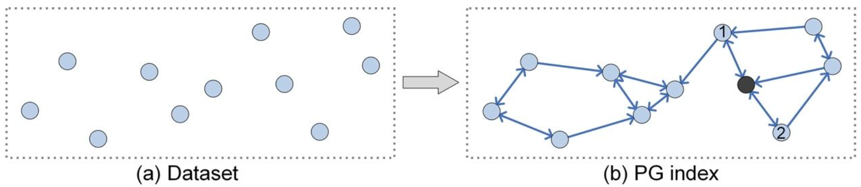
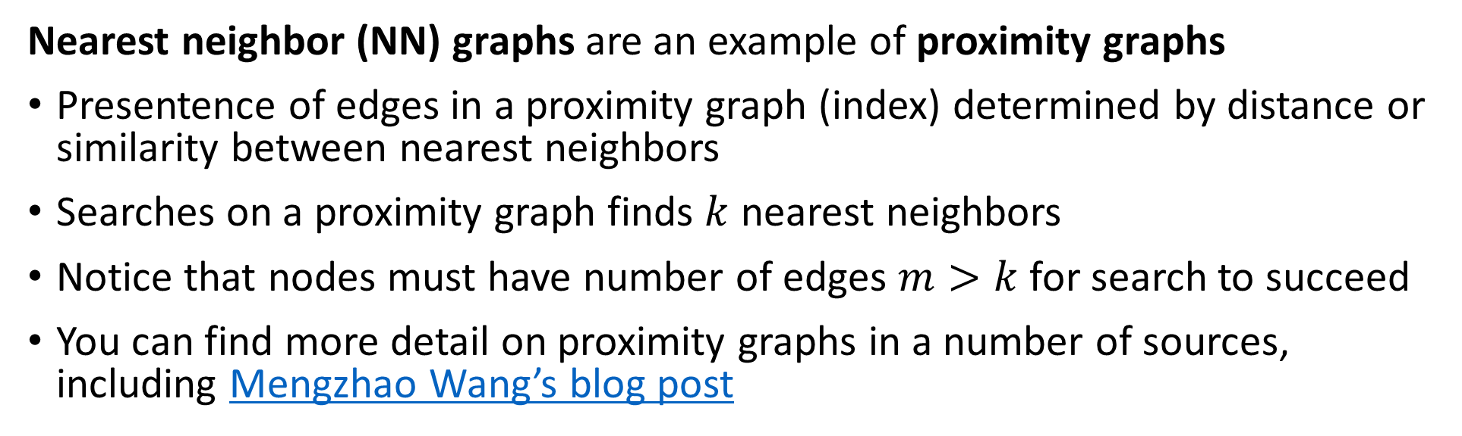
Proximity Graphs
Nearest neighbor (NN) graphs are an example of proximity graphs
Presentence of edges in a proximity graph (index) determined by distance or similarity between nearest neighbors
Searches on a proximity graph finds $k$ nearest neighbors
Notice that nodes must have number of edges $m>k$ for search to succeed
You can find more detail on proximity graphs in a number of sources, including Mengzhao Wang’s blog post
Diagram credit, Mengzhao Wang

Slide 70
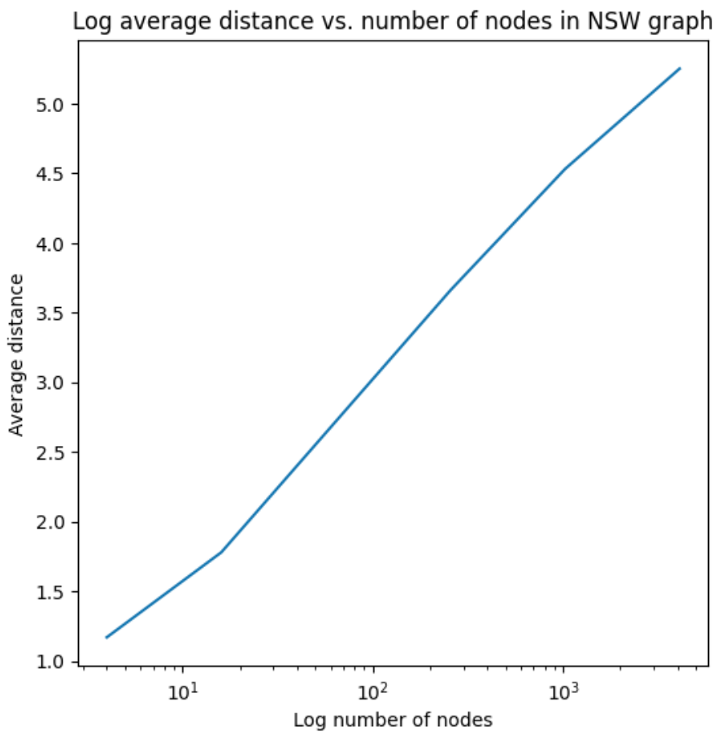
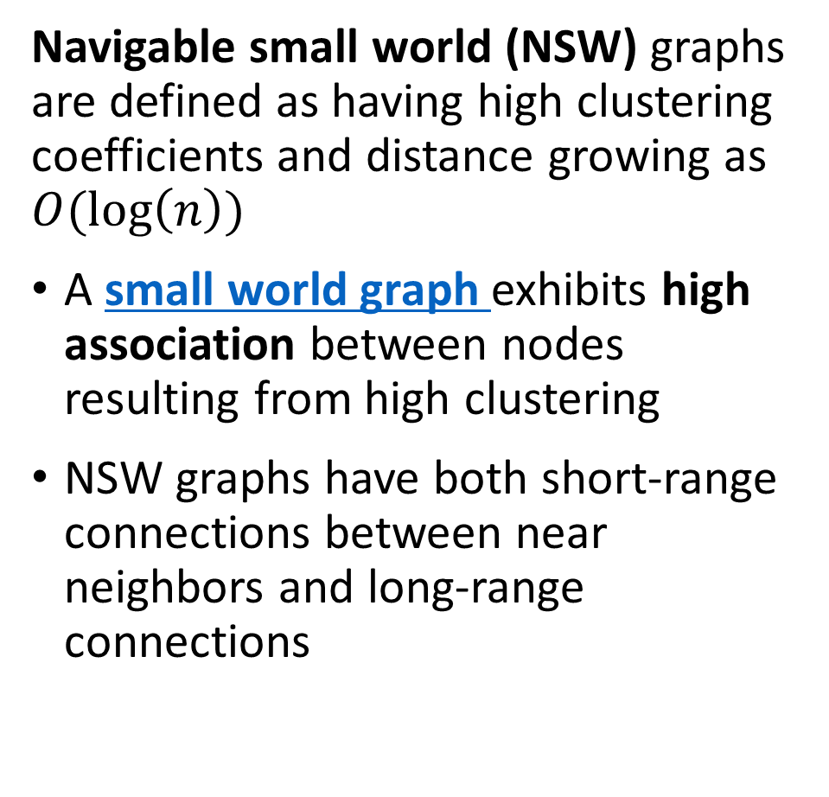
Navigable Small World Graphs
Navigable small world (NSW) graphs are defined as having high clustering coefficients and distance growing as $O(\log\left(n\right))$
A small world graph exhibits high association between nodes resulting from high clustering
NSW graphs have both short-range connections between near neighbors and long-range connections

Slide 71
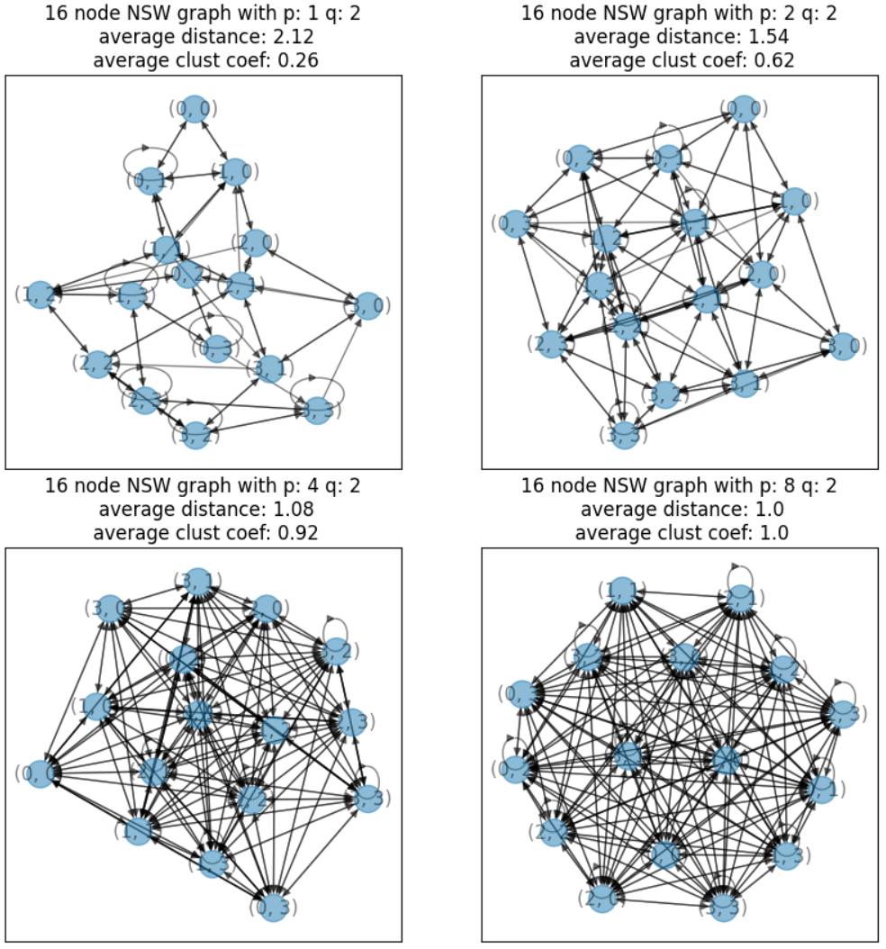
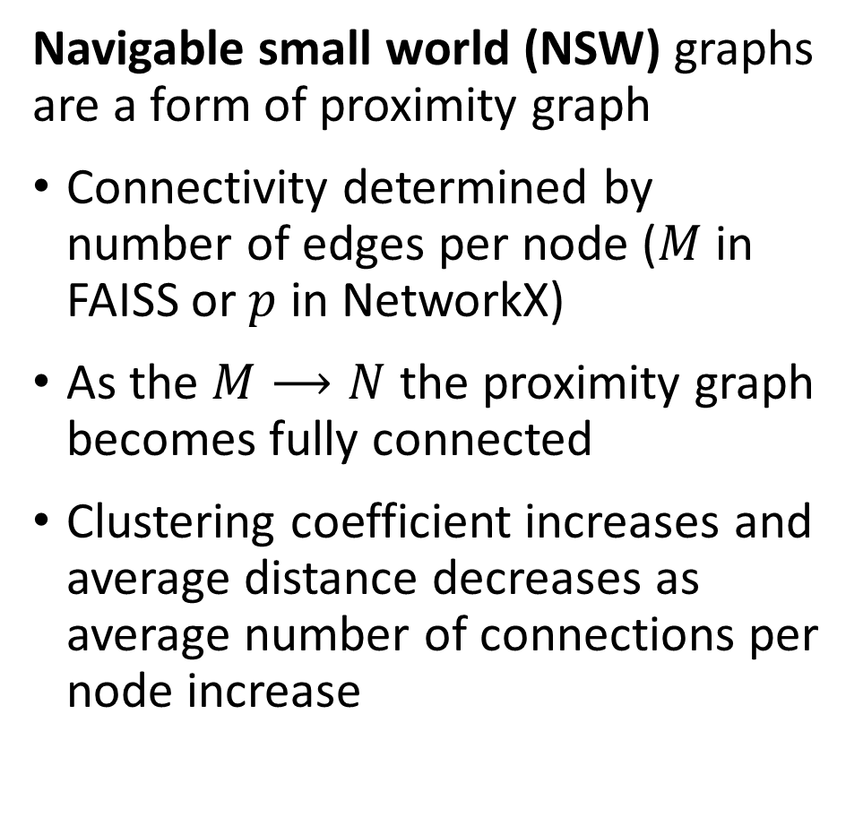
Navigable Small World Graphs
Navigable small world (NSW) graphs are a form of proximity graph
Connectivity determined by number of edges per node ($M$ in FAISS or $p$ in NetworkX)
As the $M⟶N$ the proximity graph becomes fully connected
Clustering coefficient increases and average distance decreases as average number of connections per node increase

Slide 72
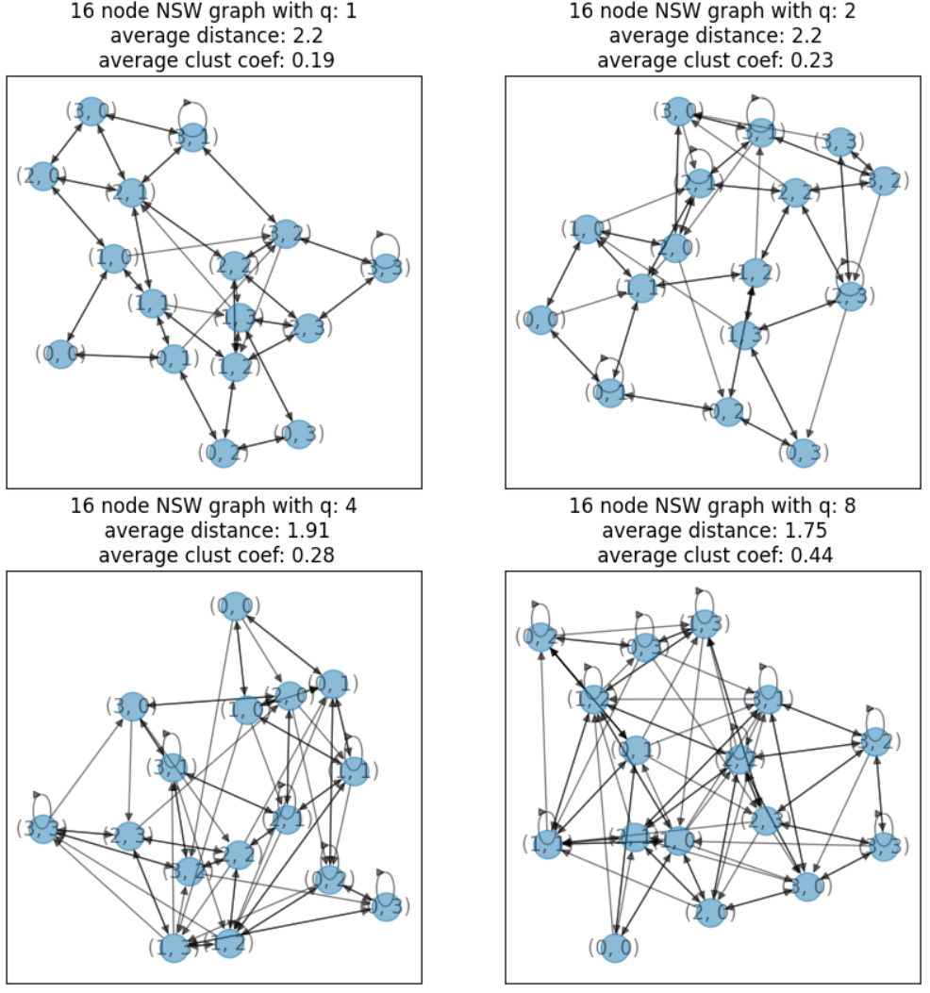

Navigable Small World Graphs
Navigable small world (NSW) graphs are defined as having high clustering coefficients and distance growing as $O(\log\left(n\right))$
Clustering coefficient increases and average distance decreases as average number of long-range connections ($q$ in NetworkX) per node increase
NSW graphs have relatively few hub nodes with high degree compared to other nodes

Slide 73
Hierarchical Navigable Small World Graphs
Hierarchical Navigable small world (HNSW) graphs enable efficient and scalable ANNS
Malkov, et. al., 2014 applied NSW graphs to the ANNS problem
In some cases, a greedy search on a NSW effectively finds the NNs
If the graph exhibits considerable clustering only a sub-optimal local solution will be found
In other cases, the search path can be excessively long
Using a hierarchy of NSW graphs is more robust and helps to overcome these problems

Slide 74
Hierarchical Navigable Small World Graphs
Hierarchical navigable small world (HNSW) graphs for ANNS where first proposed for ANNS by Malkov and Yashunin, 2011
Select entry point node in top layer
Greedy search for nearest neighbor to the query vector
Zoom In
Use nearest neighbor from previous layer as entry point
Greedy search next layer for nearest neighbor
Use nearest neighbor from previous layer as entry point
Zoom Out
Search bottom layer for nearest neighbor
Nearest neighbor search on HNSW graph

Slide 75

Hierarchical Navigable Small World Graphs
Hierarchical Navigable small world (HNSW) graphs enable efficient and scalable ANNS
The hierarchy of NSW graphs creates a skip list
Skip-list search was introduced by Pugh, 1990, as a fast search algorithm
A skip-list is a form of linked list using a hierarchy of long-range and short-range links
Links connecting observations are sampled probabilistically
Diagram credit, Pugh, 1990

Slide 76
Hierarchical Navigable Small World Graphs
Hierarchical Navigable small world (HNSW) graph has layers comprised of NSW graphs of increasing resolution
The highest level of the hierarchy has the longest-range edges
The search proceeds to increasingly finer detail levels
The lowest level contains all nodes and the most detail
query
Level 2
query
Level 1
query
Level 0

Slide 77

Hierarchical Navigable Small World Graphs
Hierarchical Navigable small world (HNSW) graph has $m$ layers comprised of NSW graphs of increasing resolution
The search at the highest level begins at a chosen entry point node
The graph is traversed in a greedy manner until the node closest to the query is found
Searches at subsequent levels are the ‘zoom in’ phase of the search
query
Level 2

Slide 78

Hierarchical Navigable Small World Graphs
Hierarchical Navigable small world (HNSW) graph has $m$ layers comprised of NSW graphs of increasing resolution
The NN node at the previous level is used as the entry point node for a greedy search at the next level of the hierarchy
Greedy search at next level of detail finds next NN node
The foregoing steps are repeated until bottom level is reached
query
Level 2
query
Level 1

Slide 79

Hierarchical Navigable Small World Graphs
Hierarchical Navigable small world (HNSW) graph has $m$ layers comprised of NSW graphs of increasing resolution
The NN node at the previous level is used as the entry point node for a greedy search at the lowest level of the hierarchy
Greedy search at the lowest level is has full detail, finding NN nodes
The lowest level search is the ‘zoom out’ phase
query
Level 2
query
Level 1
query

Slide 80

Constructing NSW Graphs
The construction process for HNSW graphs is similar to the query process
A hierarchical NN search is used to find the location of the new element on the HNSW graph
The level of the new element is determined by probabilistically sampling from an exponential decay distribution over levels, $\left[0, 1,…, M\right]$
$P\left[0\right]>uniform(0,1)$
$P\left[1\right]>uniform\left(0,1\right)−P\left[0\right]$
$P\left[2\right]>uniform\left(0,1\right)−P\left[1\right]$
…
else, $M−1$, for the top (terminal) level
Notice the rapid decay of this distribution $P\left[0\right]≫P\left[1\right]≫P\left[2\right]≫…$
Detail increases rapidly with depth in the hierarchy, improving search speed

Slide 81
Optimizing HNSW graph
The HNSW ANNS has several hyperparameters that affect performance
M, the number of levels, determines the number of edges each node in the graph has.
Limits are set by M_max and M_max0 limit the number of edges in the layers and in the bottom layer, 0, with defaults M_max = M and M_max0 = 2*M
efConstruction sets the number of entry point nodes used when building the index
efSearch sets the number of entry point nodes used for the NN search

Slide 82
Optimizing HNSW ANNS
Low Memory -Scalable
The HNSW ANNS has several hyperparameters that affect performance
M determines the number of edges each node in the graph has.
Limits are set by M_max and M_max0 limit the number of edges in the layers and in the bottom layer, 0, with defaults M_max = M and M_max0 = 2*M
efConstruction sets the number of entry points used when building the index
efSearch sets the number of entry points used for the NN search
Increasing M
Increasing M and ef’s
Low Computational Complexity-Scalable
High Recall -Accuracy

Slide 83

Optimizing HNSW graph
The HNSW ANNS has several hyperparameters that affect performance
ANNS with HNSW can achieve high recall but at a price
Illustration from FAISS the Missing Manual, Pinecone

Slide 84

Optimizing HNSW graph
The HNSW ANNS has several hyperparameters that affect performance
Achieving higher recall with HNSW ANNS increases search time significantly
Illustration from FAISS the Missing Manual, Pinecone

Slide 85

Optimizing HNSW graph
The HNSW ANNS has several hyperparameters that affect performance
Achieving higher recall by increasing M in HNSW ANNS increases memory consumption linearly
Illustration from FAISS the Missing Manual, Pinecone

Slide 86
Composite Indices

Slide 87
Composite Indices
For optimal ANNS performance a composite is created from multiple indices
While single indices can achieve good recall, it is unreasonable to expect optimal performance on all three dimensions
Optimal performance is obtained with composite indices
Distance (Similarity) Metric
Dimensionality Reduction (Embedding)
Create D dimensional numeric embedding vectors
PCA
Neural Embedding
Etc.
Coarse Quantization
Reduce scope for ANN search
Inverted file - IVF
IVF Product quantization (IVF-PQ)
Inverted Multi-Index (IMI)
IVF Hierarchical Navigable Small Worlds (HNSW)
Etc…
Fine Quantizaton
Further reduce search scope and improve recall
Exhaustive search – Flat
Residual PQ
Locally Sensitive Hashing (LSH)
Search Refinemnet
Increase recall for NN search
Flat
Residual PQ algorithm

Slide 88

Composite Indices
For optimal ANNS performance multiple indices are concatenated
Example: concatenate IVF and PQ
IVF quantizes into Voronoi cells
Vector-valued observations partitioned into subvectors
Subvectors are quantized
Quantized subvectors are used within Voronoi cells
Illustration From Part 6 of FAISS the Missing Manual

Slide 89

Compound Indices
For optimal ANNS performance multiple indices are concatenated
Example: query IVF and PQ
Each subvector is coded per the code book
PQ ASD code book compresses the subvectors
Subvector is assigned to the Voronoi region per the code
Illustration From Part 6 of FAISS the Missing Manual

Slide 90

Compound Indices
For optimal ANNS performance multiple indices are concatenated
The FAISS index factory simplifies creation of compound indices
FAISS allows a complex set of choices for compound indices

Slide 91

Compound Indices
How can we construct effective compound indices?
Be careful! Order maters for compound indicies!
Many orderings do not make sense, actually reducing performance
Concatenated indices must work from coarse to fine
Example of using FAISS index factory
Dimension of input vector
String specifying concatenated indexes
index = index_factory(128,"OPQ16_64,IMI2x8, PQ32x8")
Where:
OPQ16_64: optimized PQ coarse quantizer with $m=16$ and output dimension 64
IMI2x8: inverted multi-index with 2 dimensions and $2^{b}=2^{8}=256$ levels
PQ32x8: PQ fine quantizer with $m=32$ and $2^{b}=2^{8}=256$ levels

Slide 92

Compound Indices
Different quantization sequences result in different recall, search time and memory use
Example: The three quantization sequences all use nearly identical recall and memory use
Notice how orthogonalization (rotation) preprocessing reduces query time at no penalty in memory or recall
Table From Part 6 of FAISS the Missing Manual

Slide 93

Compound Indices
Example: Hyperparameter choice affect recalls, search time and memory use
Increasing nprobe gives higher recall, but slower queries, at no change in memory
Increasing PQ subvectors increases memory use but greatly boosts recall
Table From Part 6 of FAISS the Missing Manual

Slide 94

Compound Indices
The HNSW graph algorithm can be used as a course quantizer
Recall we have explored using IVF and IMI as coarse quantizers
Combining ideas from IVF and HNSW graph algorithms is another option
Find centroids of Voronoi cells
Train the HNSW graph on the vectors in the Voronoi cells
Traverse the HNSW graph to perform queries on the Voronoi cells
Algorithm requires a large number of the cells
The FAISS Wiki recommends $nlist≥65536$
At the same time we need about $n>30×nlist\sim 2{×10}^{9}$ samples
Typically, must choose a smaller $nlist$ given limits on dataset size

Slide 95


Compound Indices
Example: Compound IVF HNSW graph coarse quantizer can be a useful choice
Using IVF coarse quantization with $nlist=4096$ requires large memory
Using HNSW coarse quantization reduces memory use by more than an order of magnitude!
Using OPQ as a preprocessor improves recall and search time with no memory penalty
Table From Part 6 of FAISS the Missing Manual

Slide 96
LSH for Cosine Distance

Slide 97
Mini-Hashing Numeric Variables
How can LSH be applied to numeric variables?
Can create hashes to estimate cosine distance
Cosine distances computed with numeric (real) variables
Uses computationally efficient dot products as hashes
Apply LSH to find cosine distance estimates

Slide 98


Mini-Hashing Numeric Variables
Review Cosine Similarity
$$d\left(x,x^{′}\right)=cos\left(θ_{i}\right)=\frac{x∙x′}{\left|x\right|\left|x′\right|}$$
Points at (2,1) and (4,3)
What is the distance between them?
Cosine distance
$$dcos\left(x,x^{′}\right)=\frac{2∗4 +1∗3}{{\left(2^{2}+1^{2}\right)}^{1/2}{\left(4^{2}+3^{2}\right)}^{1/2}}= \frac{11}{5^{1/2}{25}^{1/2}}=0.984$$
(4,3)
X₂
θ
(2,1)
X₁

Slide 99

Mini-Hashing Numeric Variables
Create hashes with random hyperplanes
Start with two vectors, x,y
Choose a hyperplane H at random
Hyperplane defined by a perpendicular vector, v
$$H⋅v=0$$
Dot products of v with x and y have opposite signs:
$$y⋅v⇒+$$
$$x⋅v⇒−$$
Or if v has opposite sign:
$$y⋅−v⇒−$$
$$x⋅−v⇒+$$
y
v
θ
x
H

Slide 100

Mini-Hashing Numeric Variables
Create hashes with random hyperplanes
Choose another hyperplane H at random with orthogonal vector v
Dot products of v with x,y have same signs:
$$y⋅v⇒+$$
$$x⋅v⇒+$$
Or if v has same sign:
$$y⋅−v⇒−$$
$$x⋅−v⇒−$$
Therefore, expected probability that dot product with orthogonal vector have opposite signs:
$$E\left[P\left(+,−\right)\right]=θ/π$$
y
v
θ
x
H

Slide 101

Locally Sensitive Hashing
Probability of error from mini-hashing
Consider a similarity measure between two vectors:
${sim}_{ }\left(x_{ },{x′}_{ }\right)=s$
The probability that all $r$ mini-hashes agree is: $s^{r}$
The probability that at least 1 of the mini-hashes disagrees: $1−s^{r}$

Slide 102
Locally Sensitive Hashing
Probability of error from mini-hashing
Single mini-hash yields low sensitivity to positive cases
How can we improve on local sensitivity?
We employ b bands of r mini-hashes per band
Signature 1
Band 1
Signature 2
…
Signature r
Signature 1
Band 2
Signature 2
…
Signature r
…
Signature 1
Band b
Signature 2
…
Signature r

Slide 103

Locally Sensitive Hashing
Probability of error from mini-hashing
With $b$bands of $r$ mini-hashes we can find the sensitivity of positives between two vectors
The probability for $b$ bands with $r$ mini-hashes agreeing is: ${\left(s^{r}\right)}^{b}$
The probability that at least 1 of the $r$ mini-hashes in the $b$ bands disagree:
$$1−{\left(1−s^{r}\right)}^{b}$$

Slide 104

Locally Sensitive Functions
Model for understanding locally sensitive hashing
Set thresholds, $d_{1}$ and $d_{2}$, to define a decision rule
Consider distance measures $d\left(x, x^{′}\right)$ generated from a family of functions, $f\left(x\right) ε ℱ$ with decision rule:
If $d\left(x,x^{′}\right)≤d_{1}$, then $p\left(f\left(x\right)=f\left(x′\right)\right)≥p_{1}=p(match)$
and $d\left(x,x′\right)≥d_{2}$, then $p\left(f\left(x\right)=f\left(x′\right)\right)≤p_{2}=p(false match)$
We say $ℱ$ is $\left(d_{1},d_{2},p_{1},p_{2}\right)$ sensitive
Intuitively, the more sensitive the hash function the more sensitive the decision rule

Slide 105


Locally Sensitive Functions
Model to understand locally sensitive hashing
Can visualize relationship between hash function and sensitivity of the decision rule
Higher sensitivity, smaller $d_{1}$ and larger $d_{2}$, increases probability of correct decision
False Negative
False Positive
Credit; Leskovec et.al. 2020

Slide 106

LSH for Cosine Similarity
The $sen\left(ℱ\right)=\left(d_{1},d_{2},p_{1},p_{1}\right)$ family for cosine distance hashes
Using cosine hashes, $f\left(x\right)=f(y)$ iif the dot products $x⋅v$ and $y⋅v$ have the same sign, then:
$$sen\left(ℱ\right)=\left(d_{1},d_{2},p_{1},p_{2}\right)=(d_{1},d_{2},\frac{\left(π−d_{1}\right)}{π},\frac{\left(π−d_{2}\right)}{π})$$

Slide 107

LSH for Numeric Variables
Use sketches to simplify cosine distance LSH
Need to compute a number of hashes to accurately estimate $θ$
Must average out error of each hash (estimate)
Sketches can speed this calculation
Use random vectors (random projections) with $±1$ values,
Example, $\left[+1,−1,−1,+1,…,−1\right]$
Hash family, $ℱ$, is sign of dot products of variables with random vectors
For d dimensional data, limited to $d^{n}$ possible hashes
Most useful for very high-dimensional variables
See the MMDS book for similar method for Euclidean spaces

Slide 108
Summary

Slide 109
Summary
Summary of algorithms discussed: See also this page in the FAISS Wiki
Algorithm | Dataset Size | Recall | Memory | Query Speed | Metrics Typically Used
KD Tree | Small to medium, low-dimensional | Exact | Low | Fast | Minkowski, also see Sklean docs
Flat | Small stand-alone – typically combined with other algorithms | Exact | High | Slow | Default L2, also see FAISS Wiki
IVF | Massive | Low | Low | Fast | Default L2, also see FAISS Wiki
IMI | Massive | Low - higher than IVF | Low - higher than IVF | Fast | Default L2, also see FAISS Wiki
LSH | Medium size and very high dimensions | Low | Medium | Fast | Jaccard, Hamming, Cosine
PQ, RPQ, OPQ | Medium to Massive if combined with IVF-IMI | Medium | Low – high compression | Fast to medium | Default L2, also see FAISS Wiki
HNSW | Medium to large if combined with IVF-IMI | High | High | Medium to slow | Default L2, also see FAISS Wiki

Slide 110
Summary
Key points for this lesson
Exact nearest neighbor search is not scalable to massive dataset
Broadly, there are four classes of ANNS algorithms
Tree search
Hash-based search
Quantization-based search
Graph search
ANNS on massive datasets requires trade-offs between performance characteristics
Recall
Memory
Query speed
Can apply different distance metrics to ANNS
Compound algorithms can achieve greater performance

