Slide 1

CSCI E-108 Data Mining, Discovery and Exploration Introduction and Pitfalls
Steve Elston
Copyright 2021, 2022, 2023 2024, 2025, 2026 Stephen F Elston. All rights reserved.

Slide 2
Overview of Today’s Lesson
What is data mining?
About this course
Data mining uses massive data sets
Manage massive data with key-values pairs
Efficient management of key-value pairs requires hashing
Hash functions provide direct addressing at a massive scale

Slide 3
What is data mining?
Data mining is the science of actionable knowledge discovery from inferences on massive datasets
Known as knowledge discovery and data mining (KDD)
Data mining is an iterative process of exploration
Most data mining is unsupervised
If we had known labels we could use supervised ML
Exploration is difficult
Iteratively apply many approaches
Only some attempts work
Try lots of ideas, fail fast, keep the ones that work!
Keep this in mind when doing your graduate project!

Slide 4
What is data mining?
Data mining (KDD) focuses on analytics at a massive scale
Dataset size has grown nearly exponentially
More importantly, dataset and problem complexity has grown
Data mining is at the intersection of several subjects
Statistics: What of significance can we learn from the data?
Mathematics: How do we represent a model of the data as, say, a graph?
Algorithms: How do we efficiently find important relationships in massive datasets?
Technology: How do we manage and process massive datasets?

Slide 5
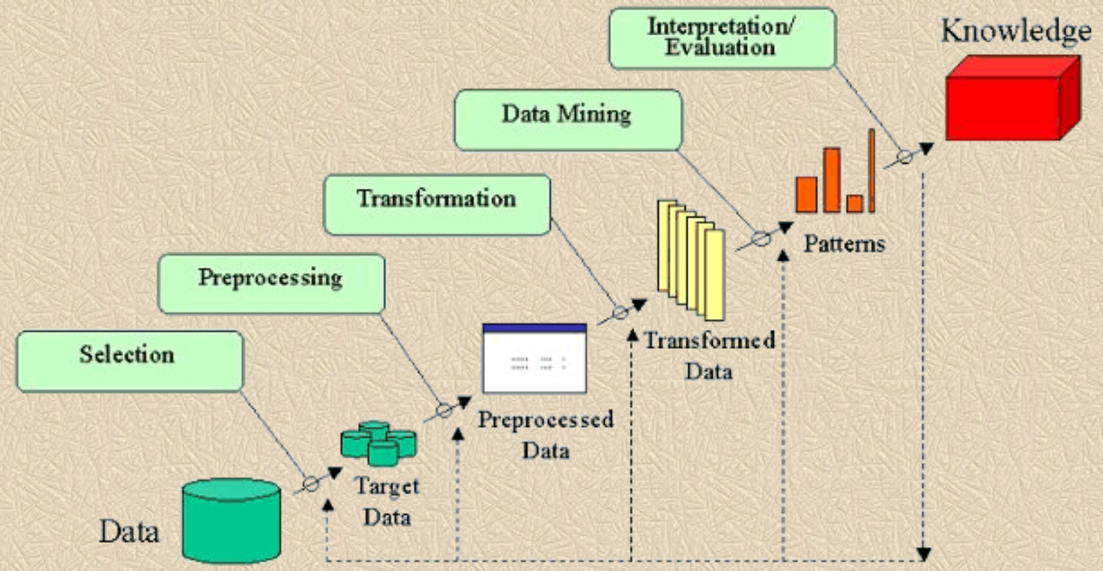
KDD process
What is the KDD process?
Is this old diagram representative? - e.g. Fayyad et.al. 1996

Slide 6
KDD process
What is the KDD process?
Is this diagram representative of today’s process?
Perhaps or perhaps not?
Must have a clear idea of goal!
Multiple complex data sources
Need to perform in-depth exploration of data and inferences at every step!!
Storage of intermediate results
Privacy and deidentification
KDD is an iterative process
The results of one step informs updates to previous steps
Process is a series of overlapping cycles

Slide 7
Dimensions of Data Mining
Scalability is a key consideration when dealing with massive datasets!
Scalability requires tradeoffs between three factors
Low memory use
Low computational complexity
Accuracy of results
Must accept approximate results for massive scalability, low memory and complexity
LLMs have low scalability
Slow
Expensive
High accuracy?? – hard to quantify
Low Memory -Scalable
Focus of Data Mining Algorithms
LLMs
Low Computational Complexity-Scalable
High Accuracy

Slide 8
About This Course

Slide 9

About your Instructor: Steve Elston
Instructor for Harvard since 2017
Data science consultant with several decades of experience
Led team that commercialized Bell Labs S, now opensource R
Company co-founder and held executive positions in several industries
Creator of multiple edX courses, author of books and articles
Inventor on 5 patents
BS, physics and math (minor), University of New Mexico
MS and PhD, geophysics, Princeton University – John von Neuman Supercomputing Fellow
I love anything to do with natural history and the outdoors

Slide 10
About your T.A.: Eric Trucksess
Registered Patent Attorney focused on the chemical arts, particularly pharmaceuticals, solid state devices and polymeric coatings
Founder/architect of HasHave, formerly an online bartering site which facilitated the exchange of goods and services amongst members
Counsel to RocketFuel an early-generation targeted marketing firm that applied ML principles in online marketing campaigns
Currently a consultant to several Defense Contractors and a Director in a Dubai-based betting syndicate with a focus on horse racing

Slide 11
About your TA: Hellen S. Momoh
Data Scientist and AI/ML Engineer developing applied machine learning and intelligent systems
Founder & CEO of Surna Technologies, building sovereign AI-powered systems and digital infrastructure
Applied AI experience across financial systems, maternal wellness, and public-sector technology
ALM in Data Science, Harvard University; BALS in Interdisciplinary Mathematics, Georgetown University
Professional experience spanning technology, engineering, and international public service
Passionate about translating data science and machine learning from theory into real-world systems

Slide 12
What can you gain from this course?
Our overarching objective is giving you a deep understand of the algorithms forming the backbone of todays massive scale analytics
Lean how to work with highly scalable analytic KDD methods and algorithms for massive datasets
Good algorithms have long staying power
Understand algorithm performance analysis
Good algorithms are the essential to scaling
Good algorithm can scale analysis by orders of magnitude
Better algorithms beats throwing hardware at the problem
Deliberately minimize data engineering required for course
Wide and constantly changing landscape of Big Data platforms
Other Harvard DCE courses explore big data engineering

Slide 13
What is the focus of this course?
Data mining is exploratory and is often Unsupervised
Use algorithms with massive scalability
Key-value management and hashing algorithms
Scalable approximate analytic algorithms
Focus on unsupervised learning
Approximate similarity search algorithms are massively scalable
Ranking for recommenders, web search, RAG algorithms, etc.
Clustering models for exploration of complex data sets
Algorithms for online and infinite or streaming data
Dimensionality reduction algorithms
Graphs models
How to apply efficient graph representations and algorithms?

Slide 14
What is the focus of this course?
Topics we (mostly) avoid in this course
Supervised machine learning
Data mining is focused on exploration and knowledge discovery, not prediction!
Some supervised machine learning is useful in data mining
Supervised machine learning covered in-depth in other DCE courses
Most deep learning
Promising deep NN data mining algorithms are emerging
In some cases, deep NN algorithm provide more accurate results
But, NN algorithms are generally much less scalable!
In practice, more and better data is usually more important!

Slide 15
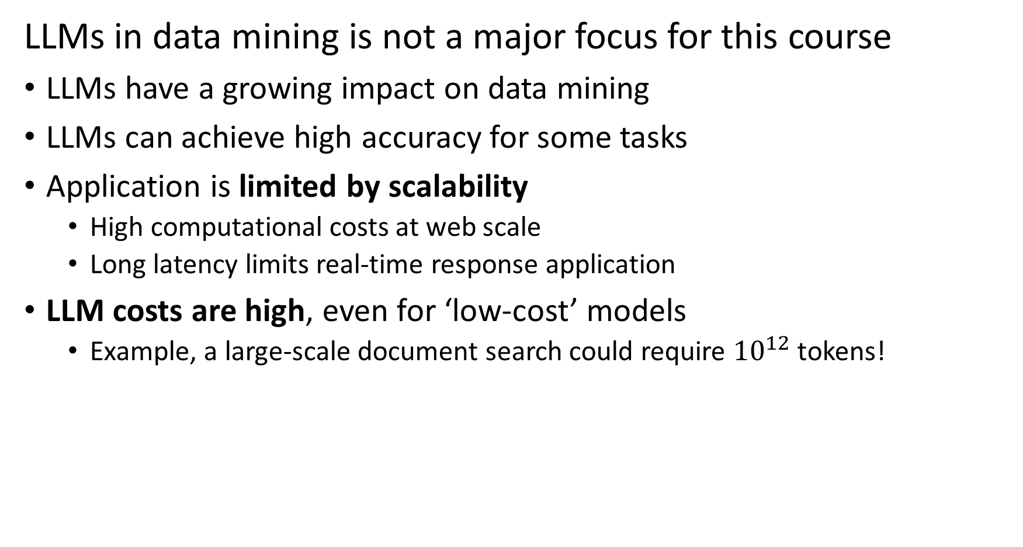
What is the focus of this course?
LLMs in data mining is not a major focus for this course
LLMs have a growing impact on data mining
LLMs can achieve high accuracy for some tasks
Application is limited by scalability
High computational costs at web scale
Long latency limits real-time response application
LLM costs are high, even for ‘low-cost’ models
Example, a large-scale document search could require ${10}^{12}$ tokens!

Slide 16
Dimensions of Data Mining
Scalability is a key consideration when dealing with massive datasets!
At massive scale we must consider the trade-off between
Computational complexity
Memory requirements
Accuracy of results
LLMs can achieve high accuracy at a high cost
At massive scale we trade-off accuracy for scalability
Low Memory -Scalable
Focus of Data Mining Algorithms
LLMs
Low Computational Complexity-Scalable
High Accuracy

Slide 17
What is the focus of this course?
Where do LLMs fit into data minning at massive scale?
LLM algorithms use retrieval augmented generation (RAG) to guide generation
RAG algorithms require massive scale similarity search, a core data mining topic
Often use highly scalable algorithms as filter then apply LLM
Example: in document search use massively scalable algorithm as filter, with LLM used as reranker for refinement
More efficient methods available

Slide 18
Main topics in this course
The main topics in this course are interconnected and build on each other
1. Hashing and K-V pair management
2. Distance and Similarity Metrics
3. Graph Algorithms
Foundations
Core Algorithms
2. Dimensionality Reduction
5. Similarity Search and NN Algorithms
4. Online Algorithms
3. Social Network Analysis
6. Web/Document ranking and search
8. Clustering Algorithms
7. Recommender Algorithms
Taks Speific Algorithms

Slide 19
Main topics in this course
Unsupervised learning dominates the topics in this course
1. Hashing and K-V pair management
2. Distance and Similarity Metrics
3. Graph Algorithms
Foundations
Core Algorithms
2. Dimensionality Reduction
5. Similarity Search and NN Algorithms
4. Online Algorithms
3. Social Network Analysis
6. Web/Document ranking and search
8. Clustering Algorithms
7. Recommender Algorithms
Taks Speific Algorithms

Slide 20
Schedule
Schedule for live class meetings
Wednesdays – Lectures focused on theoretical foundations – 6:00 to 8:00 pm US Eastern Time
Mondays – Section meeting to address your questions, review and background – starting at 6:00 pm US Eastern Time
All class meetings are recorded and available on-demand – See Class Recordings tab in Canvas

Slide 21
Schedule
Schedule for live class meetings during Summer School
Tuesdays and Thursdays – Lectures focused on theoretical foundations - 6:30-9:30 pm US Eastern Time
Most lessons less than 3 hours
Mondays and Wednesdays – Section meeting to address questions, discuss code, background review – starting at 6:30 pm US Eastern Time
One-on-one meetings can be held by arrangement
All class meetings are recorded and available on-demand – See Class Recordings tab in Canvas

Slide 22
Pace of this course
Harvard Summer School session is only 7 weeks!
Expect an intense pace!
Course moves at twice the rate of a regular semester
Lesson and assignments cover all material of the regular 15-week semester
Assignment deadlines are important
One or two assignments due every week!
Do not fall behind!!
Expect 8 assignments plus online discussion questions and projects for graduate credit
There is no time to ‘catch up’!

Slide 23
Undergraduate Credit Grading
Students enrolled for undergraduate credit are evaluated by the following weights:
10% Class Participation – Class participation in online discussions
90% Assignments – Hands-on assignments for most lessons
Expect 8 assignments

Slide 24
Graduate Credit Grading
Students enrolled for graduate credit are evaluated by the following weights:
10% Class Participation – Class participation in online discussions
65% Assignments – Hands-on assignments for most lessons
Expect 8 assignments
5% Project proposal – Proposal describing the problem you wish to address and methods you plan to apply. Based on your proposal, your instructor will approve your project as appropriate for the course.
20% Project – Independent data mining project report – More on this next class

Slide 25
Where can you find the course materials?
Read and understand the Syllabus!
Material specific to this course are in the Github repository
Slides
Notebooks for assignments
Data
Supplementary materials for review
Assignment due dates, submissions, and grading in Canvas
Class assignments
Graduate independent projects
Solutions and examples under Modules
Assignments are being revised!
Do not start assignments before they are posted in Canvas
Do a pull on the GitHub repository to get updated notebooks

Slide 26
Where can you find the course materials?
Recommended reading primarily from these texts:
Mining of Massive Datasets, 3rd Ed - .pdf download available
Networks, 2nd edition, Mark Newman Available through the Harvard Coop
Algorithms and data structures for massive datasets, Medjedovic, Dzejla, Tahirovic, Emin, Manning, 2022
Advanced algorithms and data structures, La Rocca, Marcello, Manning, 2021
Data Mining, Concepts and Techniques, 4th Edition, Jiawei Han, Jian Pei, Hanghang Tong, Morgan Kaufmann, 2022
Available as Library Reserves – See tab in Canvas

Slide 27
Assignments
Expect 8 assignments + project!
Assignments and projects are done in Jupyter Notebooks
Format discussion text using Jupyter Markdown
You will lose points for poor formatting of your discussion text, e.g. no section headings, text that does not wrap to page width, discussion only in code comments,…
If you are not familiar with Jupyter, you can find a basic tutorial here
Updated assignment Jupyter notebooks will be posted in the course GitHub repository
Clone the repository and do frequent pulls to get the latest material
Make sure to work in your own branch or copy to another directory
There are many good Git and GitHub tutorials online, including this one
Some assignment notebooks are tested using GPU support in in Google Colab
A paid subscription is recommended to limit you frustration!

Slide 28
Late Assignment Policy
Timely release of assignment solutions is an important part of the learning process
Harvard Summer School moves at an intense pace!!
Late assignment policy:
Up to one day late - no penalty
Up to 2 days late - less 20%
Up to 3 days late – less 40%
More than 3 days late - no credit
Make sure you turn in work on time!

Slide 29
Late Assignment Policy – For regular semester
Timely release of assignment solutions is an important part of the learning process
Do not fall behind! With 8 assignments and a project, there is very little time to “catch-up”
Late assignment policy:
Up to one day late - no penalty
Up to two days late - less 10%
Up to three days late - less 20%
Up to four days late - less 30%
Up to five days late - less 40%
More than five days late - no credit
Make sure you turn in work on time!

Slide 30
Communication
Ed Discussion is the primary means of communication for this course
Use Ed Discussion to get help with assignments and projects
It’s okay to post code for your question!
Post code and complete exception messages if you are dealing with code problem!
Graded online class discussions take place in Ed
Private communications regarding matters such as grades
Use private messages in Ed Discussion for fastest response
Or, Steve Elston: stephen_elston at g dot harvard dot edu, Hellen Siah Momoh: hem299 at g dot harvard dotedu, Eric Trucksess: ert713 at g dot harvard dot edu
Private one-on-one appointments on request
Do not use Canvas messages, unless you want a delayed response!

Slide 31
Using AI for this course
As AI (LLMs) is becoming a standard tool for professional data scientists, limited use is allowed for this course
Writing & Analysis: Your written reports, question responses and discussion post must be your own original work!
LLMs are quite helpful with research and learning
LLMs cannot think or reason
Understanding of which problems are worth solving, determining the best approaches for solutions and interpreting results are skills you need to develop!
Code Generation: You may use AI to generate discrete portions of code and to resolve exceptions
It’s the way we do things these days!
LLM generated code lets us test ideas quickly

Slide 32
Using AI for this course
As AI (LLMs) is becoming a standard tool for professional data scientists, limited use is allowed for this course
Validation of Results: You are responsible for validating the correctness, efficiency, and security of any AI-generated code.
LLMs have no way to evaluate if a algorithm actually solves a problem or exhibits undesirable behavior
You need to develop the skills to critically evaluate results
You must have the skills to determine approaches to improve results and correct undesirable behavior
Attribution & Integrity: Cite AI use per the Harvard Extension School Academic Integrity Policy!
See course syllabus in Canvas for additional policy details

Slide 33
Foundations of Large-Scale Data-Mining

Slide 34
Main topics in this course
Hashing and key-value pair management are foundations of working with massive datasets
1. Hashing and K-V pair management
2. Distance and Similarity Metrics
3. Graph Algorithms
Foundations
Core Algorithms
2. Dimensionality Reduction
5. Similarity Search and NN Algorithms
4. Online Algorithms
3. Social Network Analysis
6. Web/Document ranking and search
7. Recommender Algorithms
8. Clustering Algorithms
Taks Speific Algorithms

Slide 35
Foundations for Large-Scale Data Mining
Mastering tools for working with and performing inference on massive and complex of data is a core goal for this course
Massive size requires efficient storage and retrieval
Manage data with key-value pairs
Hash keys for efficient storage and retrieval
We apply hashing and ‘sketches’ in future lessons

Slide 36
Data Management with Key-Value Pairs

Slide 37
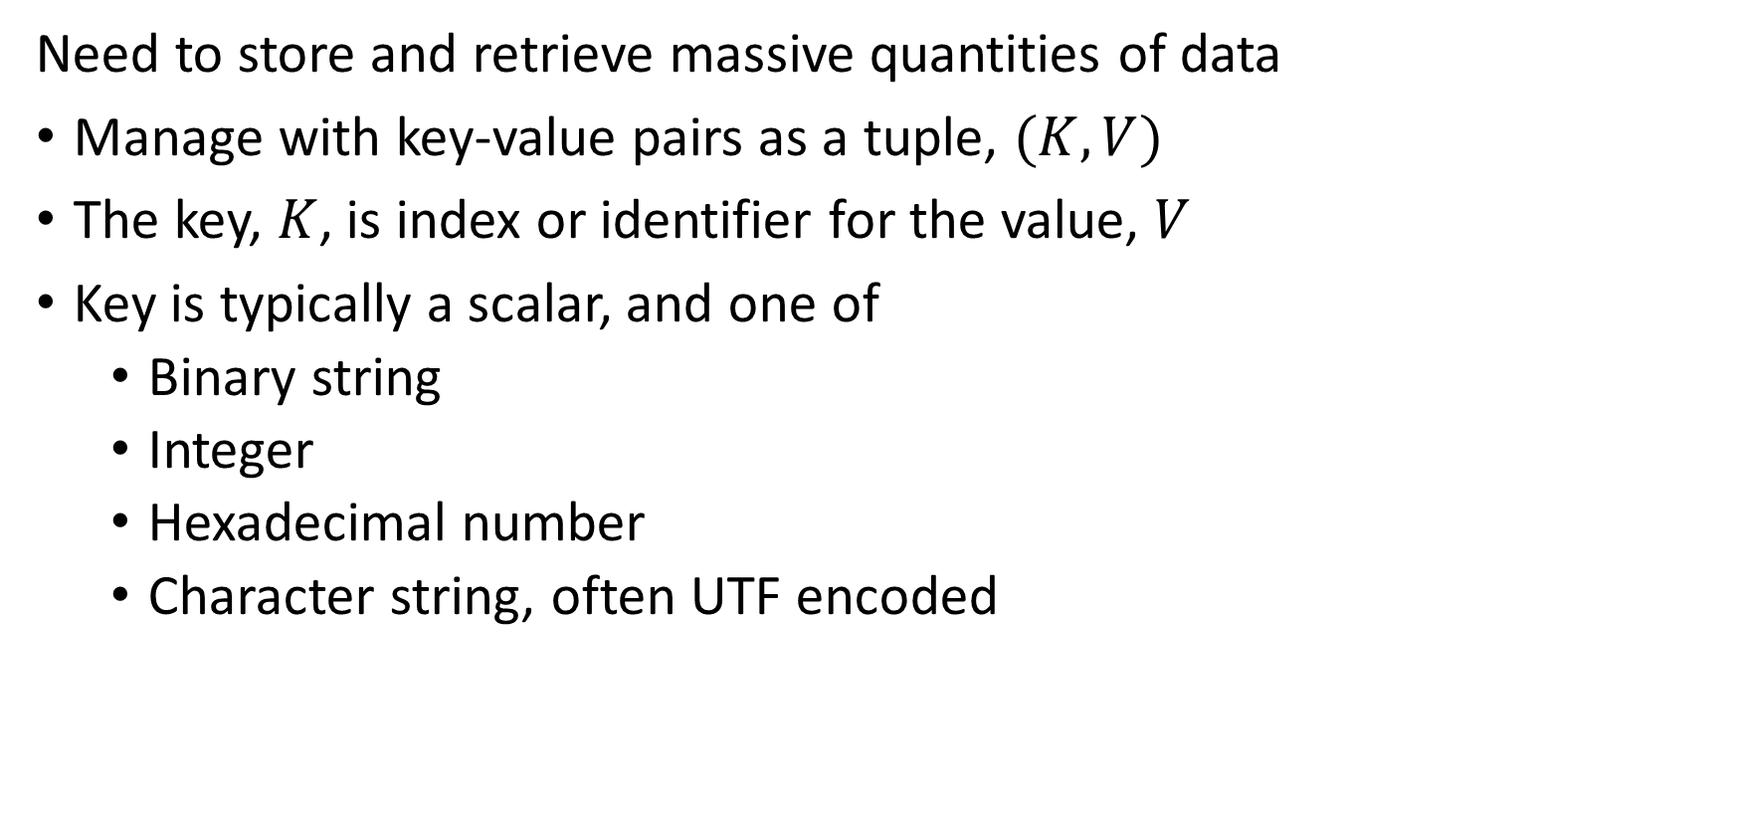
Introduction to key-value indexing
Need to store and retrieve massive quantities of data
Manage with key-value pairs as a tuple, $(K,V)$
The key, $K$, is index or identifier for the value, $V$
Key is typically a scalar, and one of
Binary string
Integer
Hexadecimal number
Character string, often UTF encoded

Slide 38
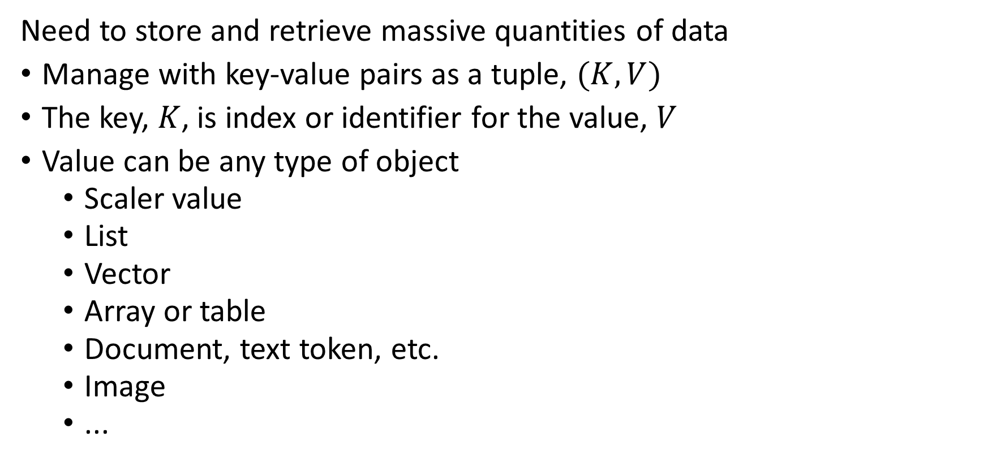
Introduction to key-value indexing
Need to store and retrieve massive quantities of data
Manage with key-value pairs as a tuple, $(K,V)$
The key, $K$, is index or identifier for the value, $V$
Value can be any type of object
Scaler value
List
Vector
Array or table
Document, text token, etc.
Image
...

Slide 39
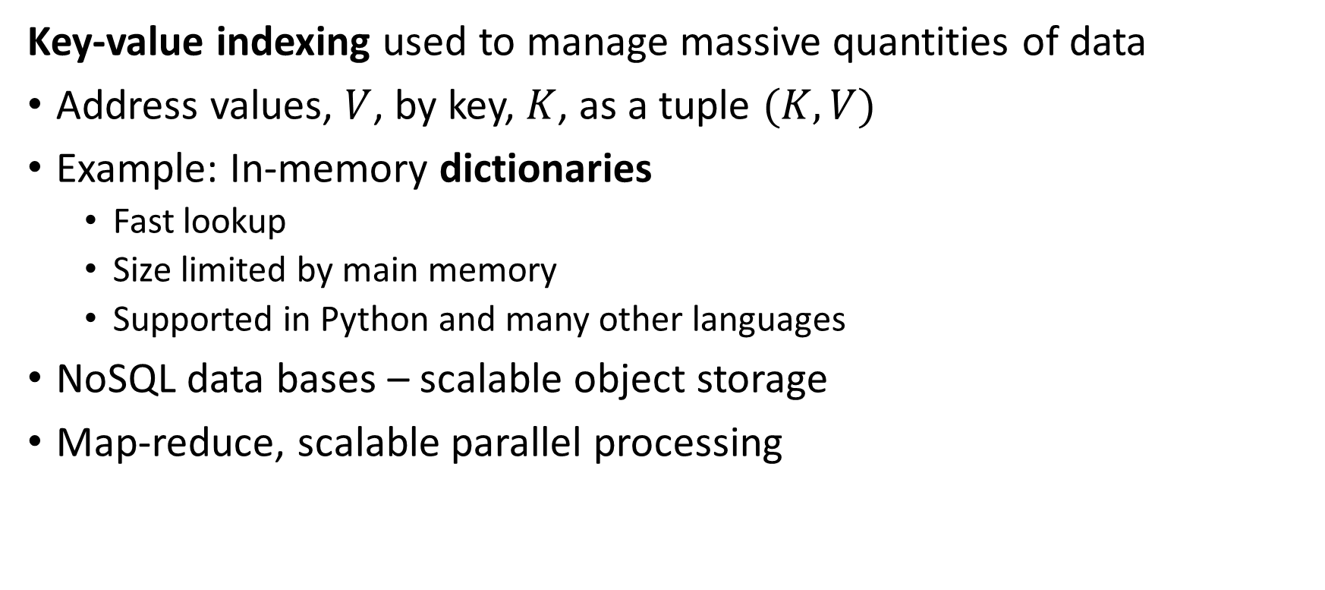
Introduction to key-value indexing
Key-value indexing used to manage massive quantities of data
Address values, $V$, by key, $K$, as a tuple $(K,V)$
Example: In-memory dictionaries
Fast lookup
Size limited by main memory
Supported in Python and many other languages
NoSQL data bases – scalable object storage
Map-reduce, scalable parallel processing

Slide 40
Introduction to key-value indexing
How can we do data management with key-value pairs?
Linear list
Sorted list
Linked list
Balanced trees (B-trees)
Hash tables
…

Slide 41
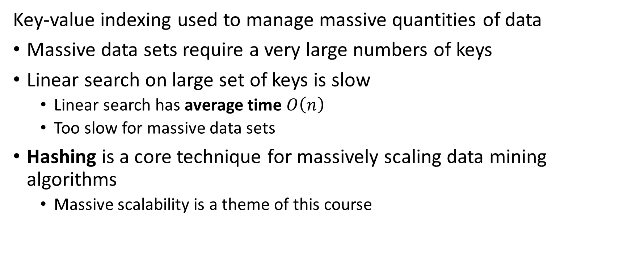
Introduction to key-value indexing
Key-value indexing used to manage massive quantities of data
Massive data sets require a very large numbers of keys
Linear search on large set of keys is slow
Linear search has average time $O\left(n\right)$
Too slow for massive data sets
Hashing is a core technique for massively scaling data mining algorithms
Massive scalability is a theme of this course

Slide 42
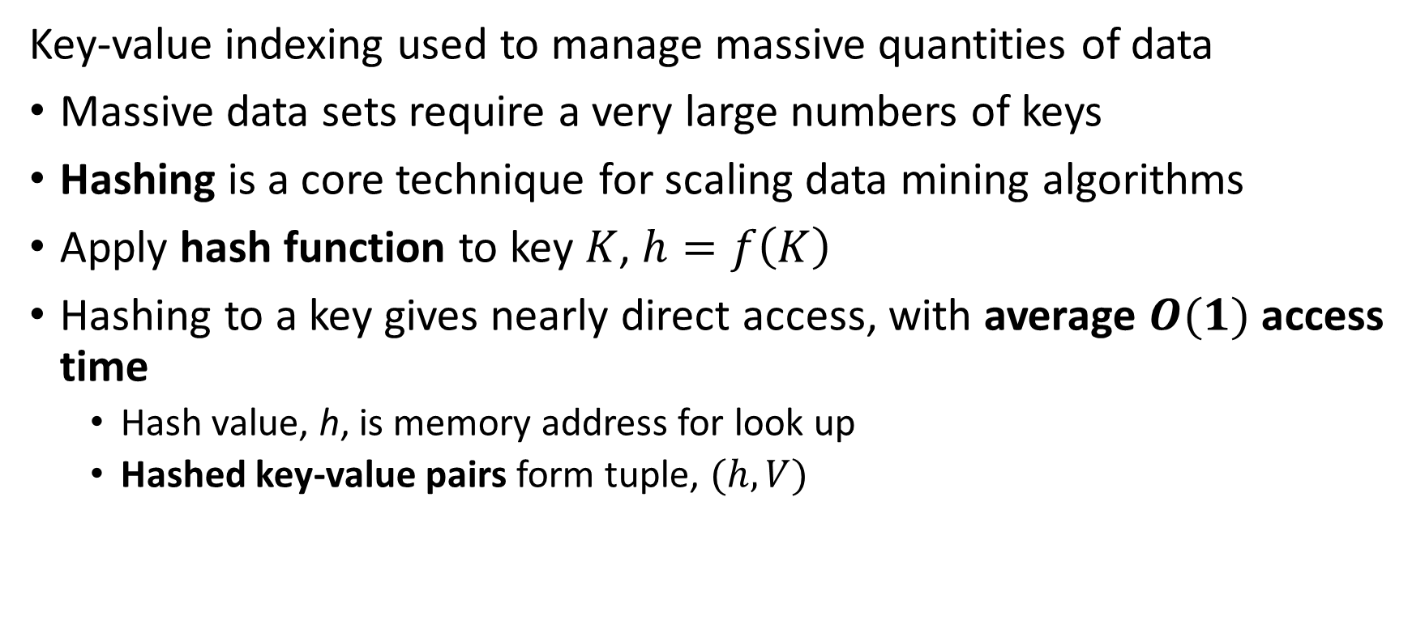
Introduction to key-value indexing
Key-value indexing used to manage massive quantities of data
Massive data sets require a very large numbers of keys
Hashing is a core technique for scaling data mining algorithms
Apply hash function to key $K$, $h=f\left(K\right)$
Hashing to a key gives nearly direct access, with average $O(1)$ access time
Hash value, h, is memory address for look up
Hashed key-value pairs form tuple, $(h,V)$

Slide 43
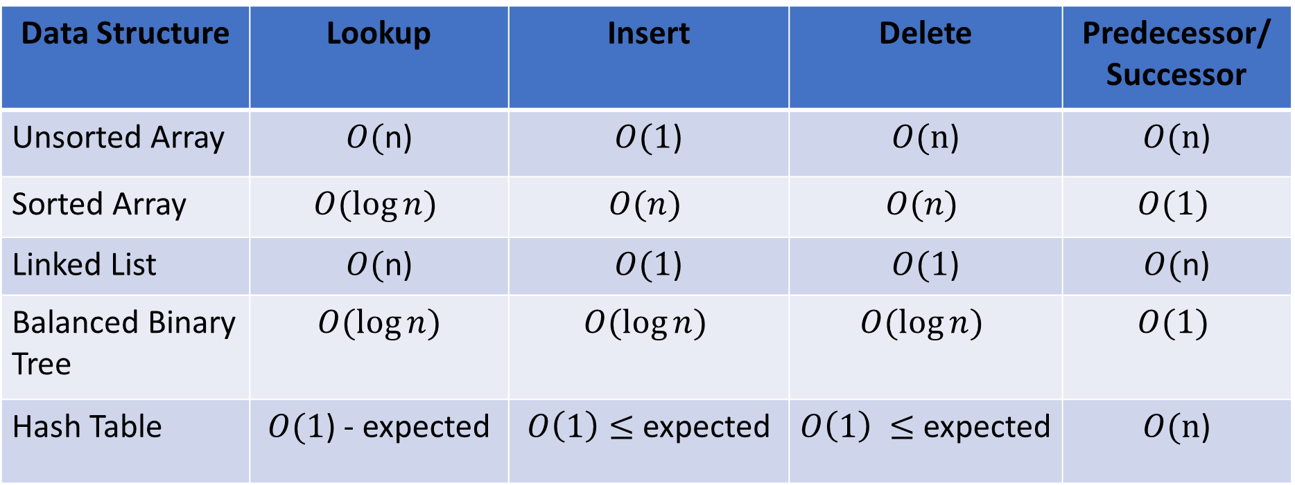
Introduction to key-value indexing
How can we compare data structure options for storage and retrieval of key-value pairs?
Data Structure | Lookup | Insert | Delete | Predecessor/ Successor
Unsorted Array | $O($n) | $O(1$) | $O(n$) | $O(n$)
Sorted Array | $$O(\log{n})$$ | $$O(n)$$ | $$O(n)$$ | $$O(1)$$
Linked List | $O($n) | $O(1$) | $O(1$) | $O($n)
Balanced Binary Tree | $$O(\log{n})$$ | $$O(\log{n})$$ | $$O(\log{n})$$ | $$O(1)$$
Hash Table | $O(1$) - expected | $O\left(1\right)≤$ expected | $O\left(1\right) ≤$ expected | $O(n$)

Slide 44
Introduction to Hashing

Slide 45
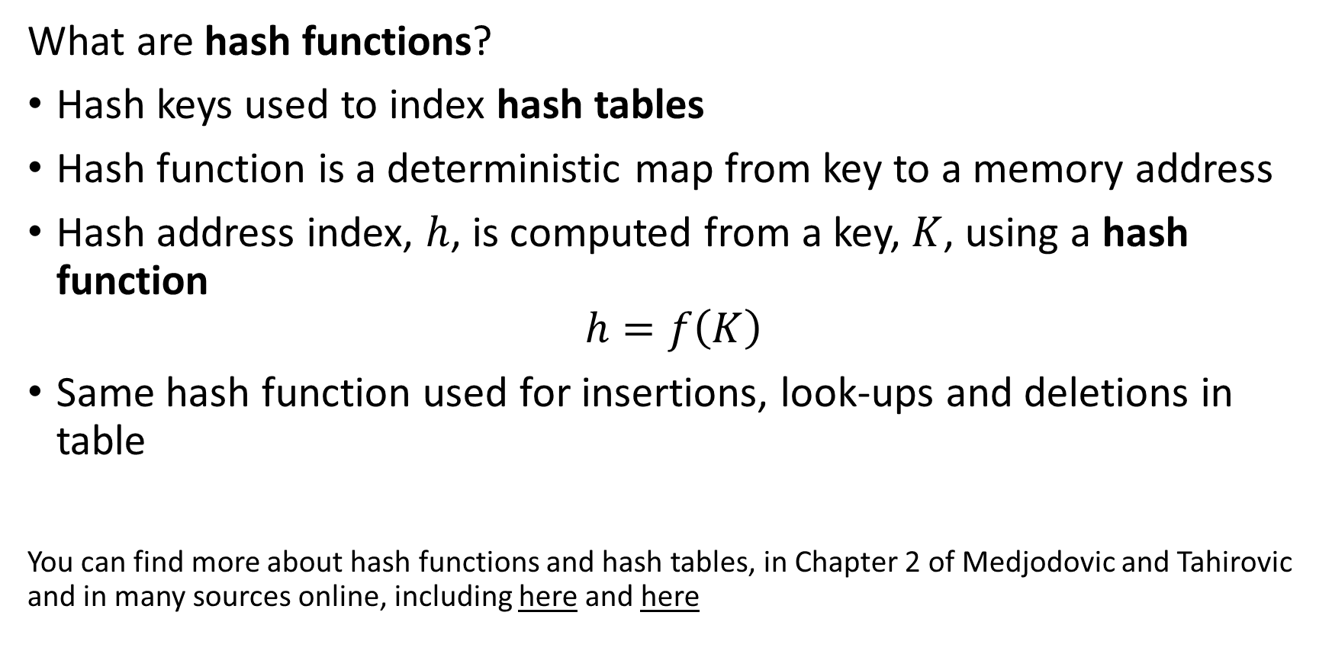
Introduction to Hashing
What are hash functions?
Hash keys used to index hash tables
Hash function is a deterministic map from key to a memory address
Hash address index, $h$, is computed from a key, $K$, using a hash function
$$h=f\left(K\right)$$
Same hash function used for insertions, look-ups and deletions in table
You can find more about hash functions and hash tables, in Chapter 2 of Medjodovic and Tahirovic and in many sources online, including here and here

Slide 46
Introduction to Hashing
Generally speaking, there are two major types of hash functions
Cryptographic hash functions are invertible encodings used to prevent unauthorized access
Not a data mining topic
Address hash functions compute a sequence of address values for access to buckets of data tables
There is no need for invertibility
There is a common body of theory underlying both types of hashes
For data mining we apply address hashes to manage massive datasets

Slide 47

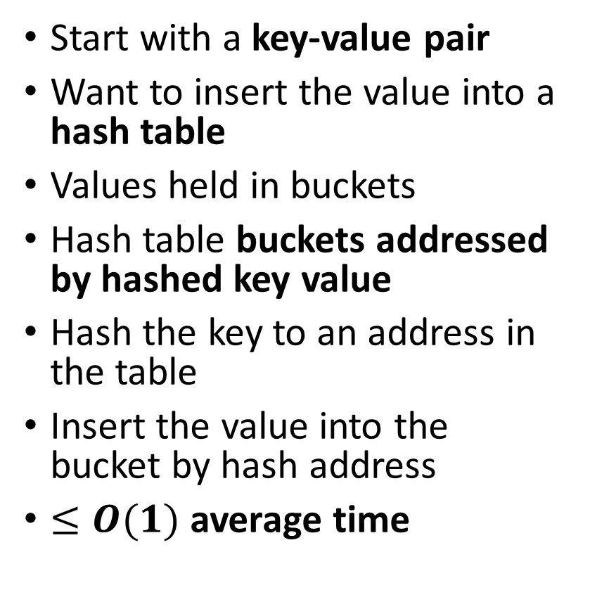
Introduction to Hashing
A hash table uses a hash of a key to index values
Start with a key-value pair
Want to insert the value into a hash table
Values held in buckets
Hash table buckets addressed by hashed key value
Hash the key to an address in the table
Insert the value into the bucket by hash address
$≤O(1)$ average time
Hash table
Key-value pair
h₁
v₁
key_{i}
v_{i}
h₂
v₂
h₃
v₃
$$h_{i}=f(key)$$
h_{i}
v_{i}
h_{n}
v_{n}

Slide 48

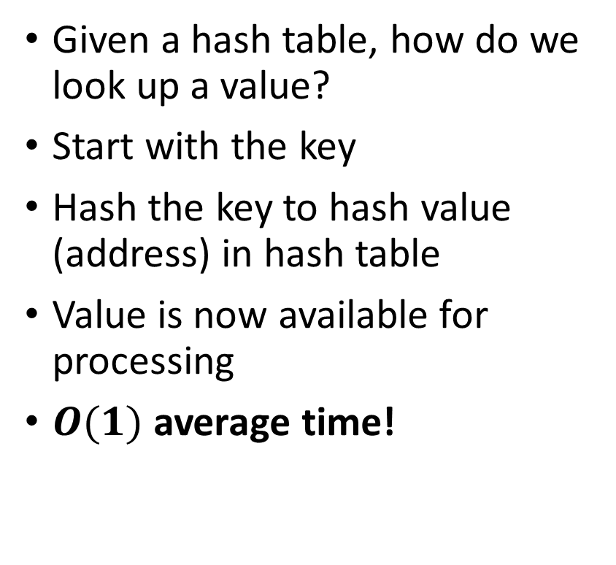
Introduction to Hashing
A hash table uses a hash of a key to index values
Hash table
Given a hash table, how do we look up a value?
Start with the key
Hash the key to hash value (address) in hash table
Value is now available for processing
$O(1)$ average time!
h₁
v₁
key_{i}
h₂
v₂
h₃
v₃
$$h_{i}=f(key)$$
h_{i}
v_{i}
v_{i}
h_{n}
v_{n}

Slide 49
Hash Functions

Slide 50
Introduction to Hashing
Commonly used hash functions
A great many hash functions are used in practice
Simple hash functions operate on numeric keys
Binary or integer
Binary representation of strings, e.g. ASCII or Unicode
Hash a binary or integer representation of a string

Slide 51
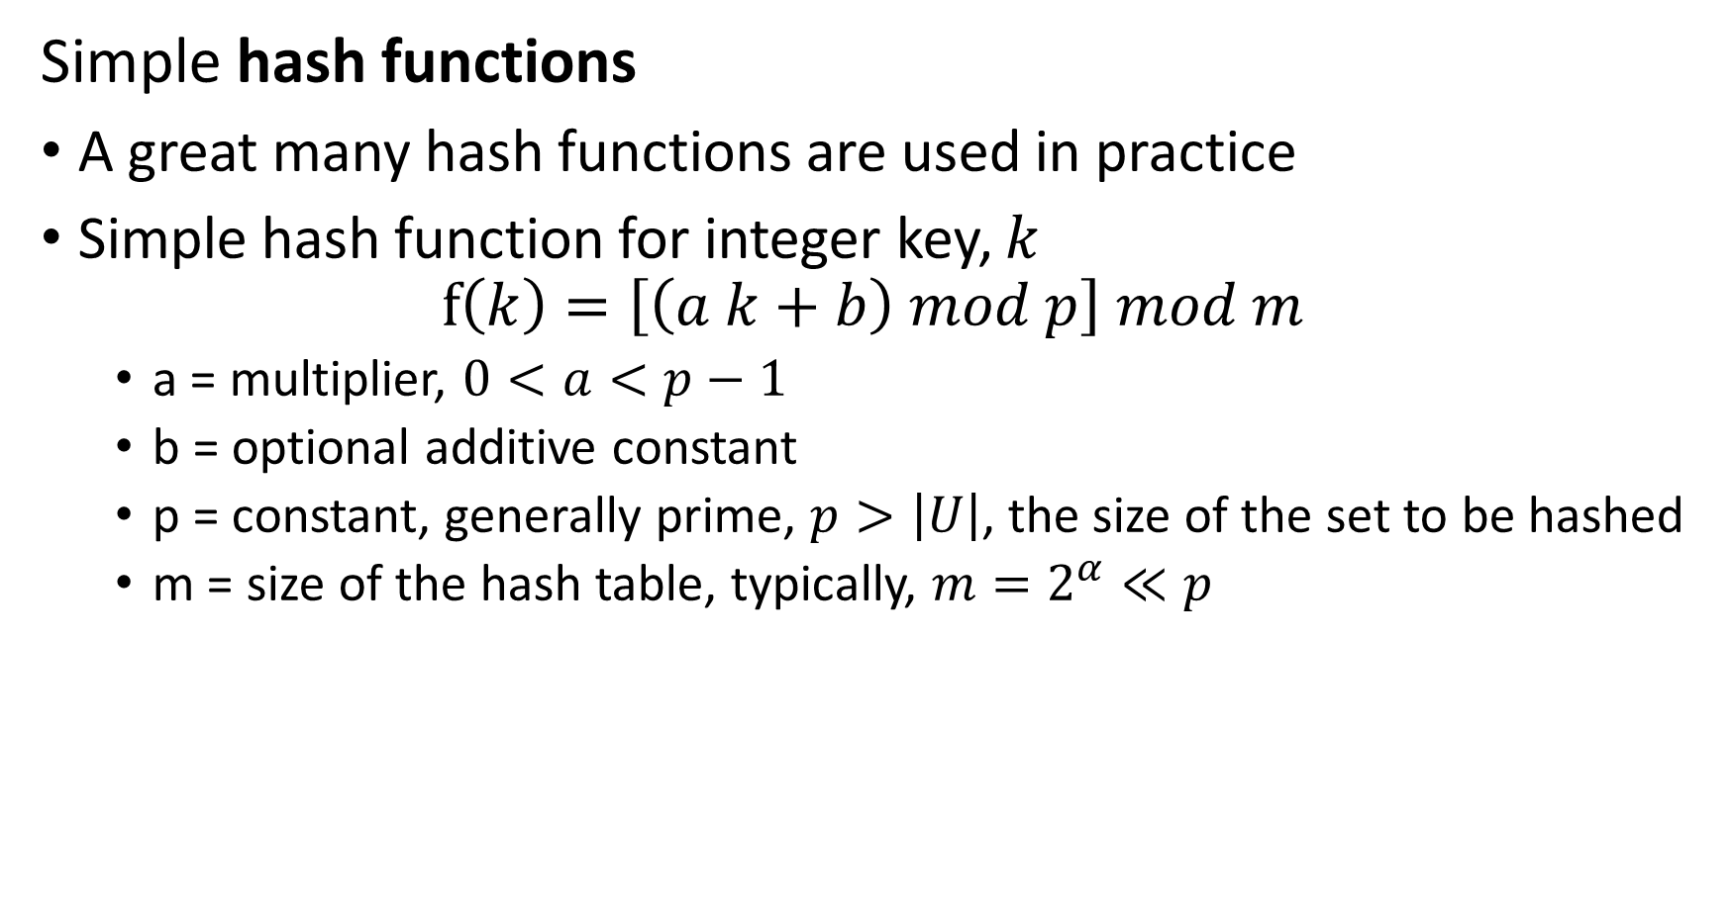
Introduction to Hashing
Simple hash functions
A great many hash functions are used in practice
Simple hash function for integer key, $k$
$$f\left(k\right)=\left[\left(a k+b\right) mod p\right] mod m$$
a = multiplier, $0<a<p−1$
b = optional additive constant
p = constant, generally prime, $p>\left|U\right|$, the size of the set to be hashed
m = size of the hash table, typically, $m=2^{α}≪p$

Slide 52
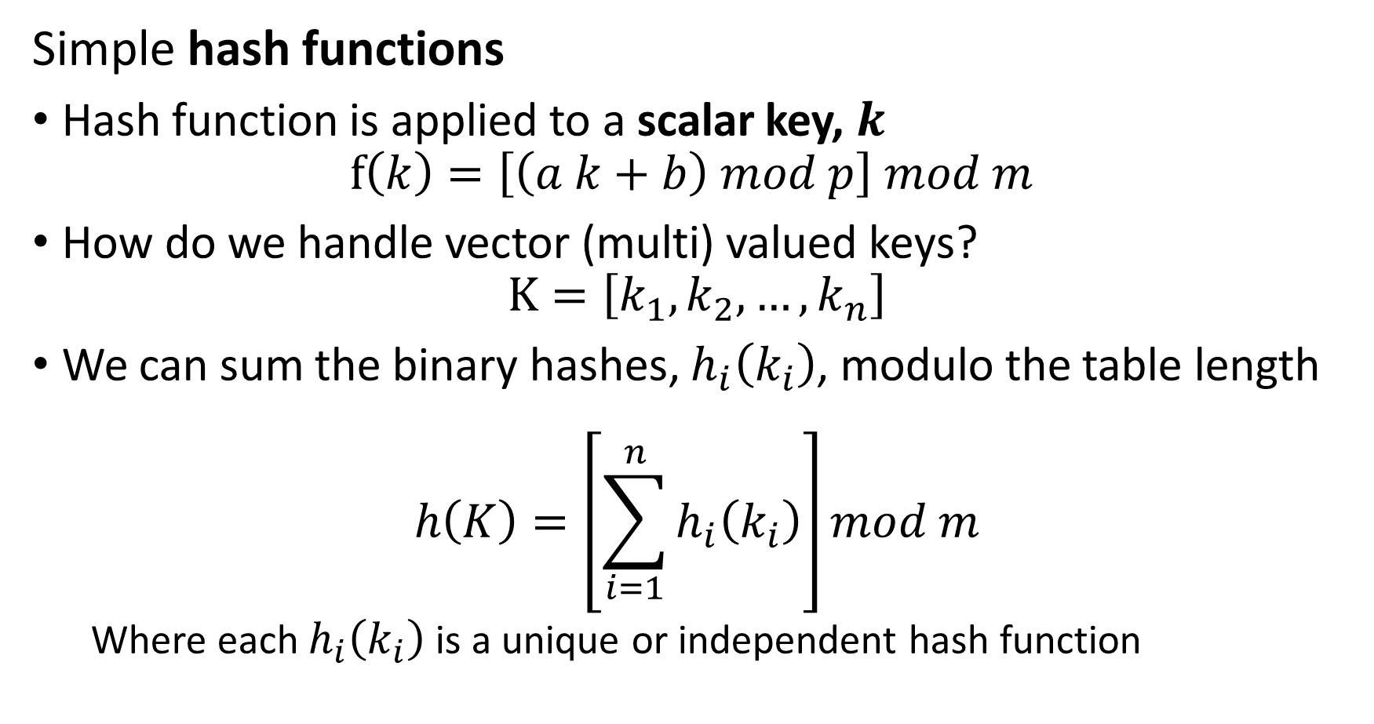
Introduction to Hashing
Simple hash functions
Hash function is applied to a scalar key, $k$
$$f\left(k\right)=\left[\left(a k+b\right) mod p\right] mod m$$
How do we handle vector (multi) valued keys?
$$K=\left[k_{1},k_{2},…,k_{n}\right]$$
We can sum the binary hashes, $h_{i}\left(k_{i}\right)$, modulo the table length
$$h\left(K\right)=\left[\sum_{i=1}^{n}{h_{i}\left(k_{i}\right)}\right]mod m$$
Where each $h_{i}\left(k_{i}\right)$ is a unique or independent hash function

Slide 53
Properties of Hash Functions and Hash Collisions

Slide 54
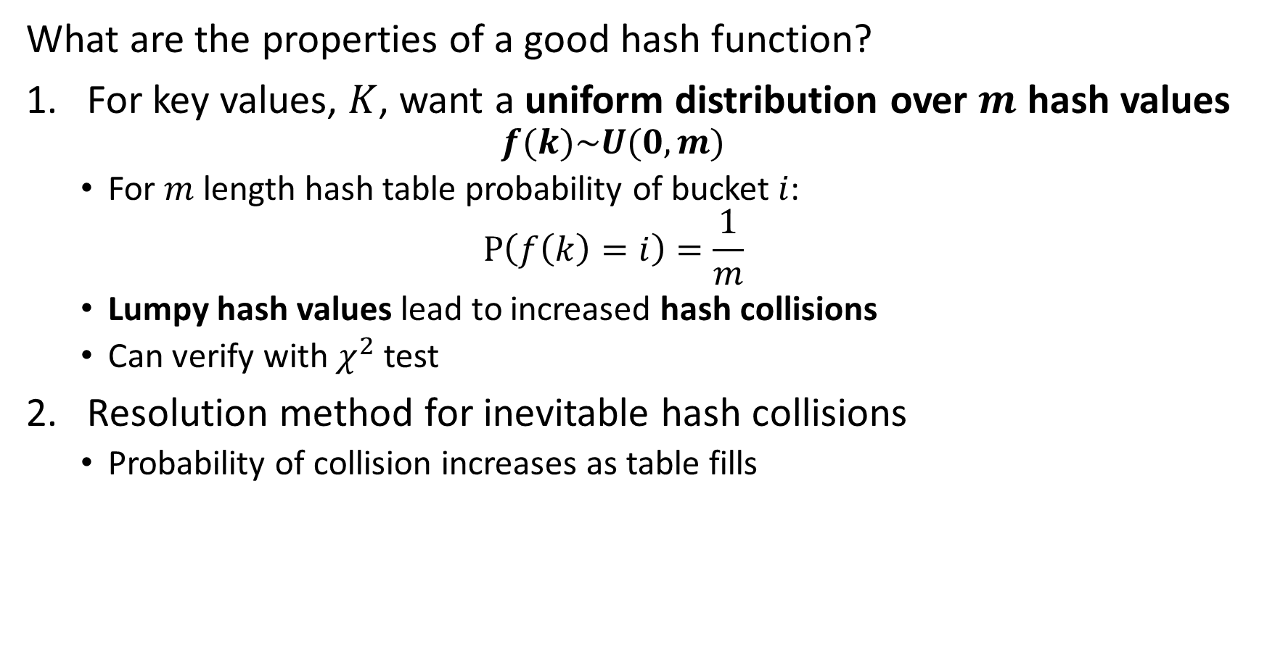
Introduction to Hashing
What are the properties of a good hash function?
For key values, $K$, want a uniform distribution over $m$ hash values
$$f(k)\sim U(0,m)$$
For $m$ length hash table probability of bucket $i$:
$$P\left(f\left(k\right)=i\right)=\frac{1}{m}$$
Lumpy hash values lead to increased hash collisions
Can verify with $χ^{2}$ test
Resolution method for inevitable hash collisions
Probability of collision increases as table fills

Slide 55
Introduction to Hashing
What are the properties of a good hash tables?
Appropriate table size
Hash functions produce limited range of hash values
Too large wastes space
Too small leads to collisions
Ideally make hash table resizable - Half or double as needed
Ability to merge hash tables
Enables parallel processing
Hash multiple data streams
More on this later in the course

Slide 56
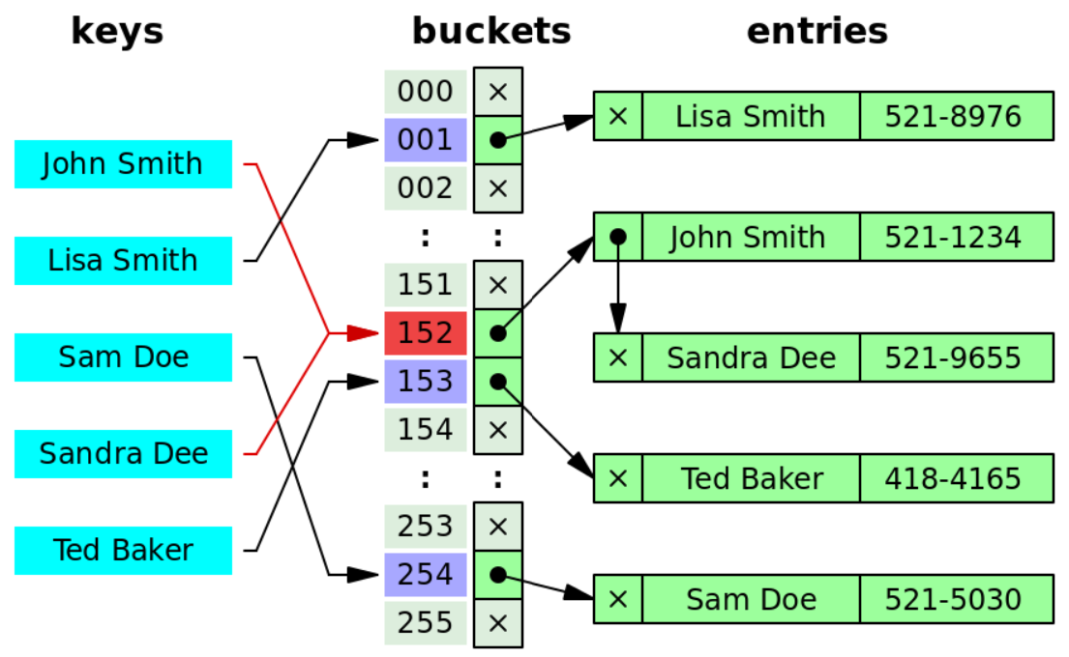
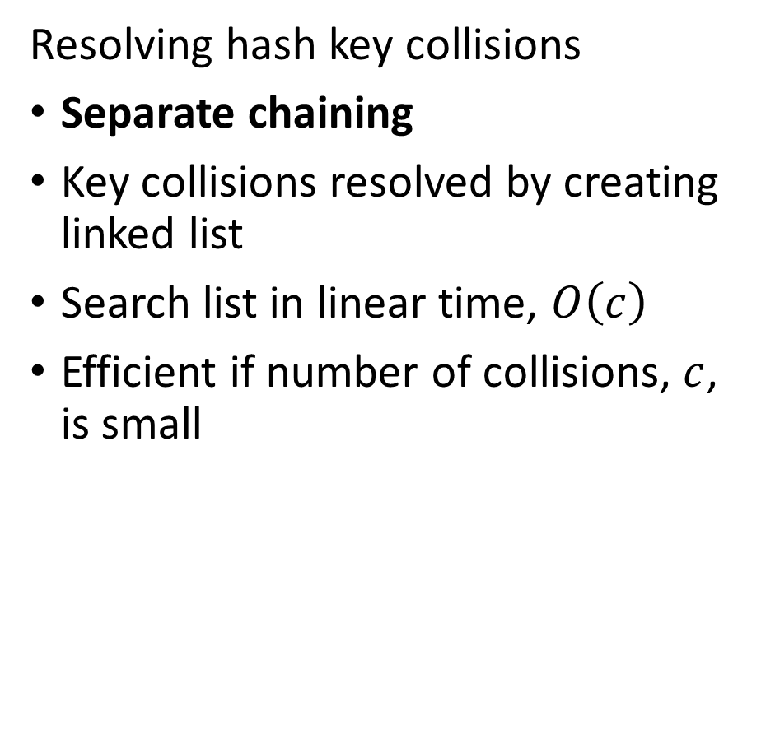
Introduction to Hashing
Resolving hash key collisions
Separate chaining
Key collisions resolved by creating linked list
Search list in linear time, $O\left(c\right)$
Efficient if number of collisions, $c$, is small
Credit: Wikipedia commons

Slide 57
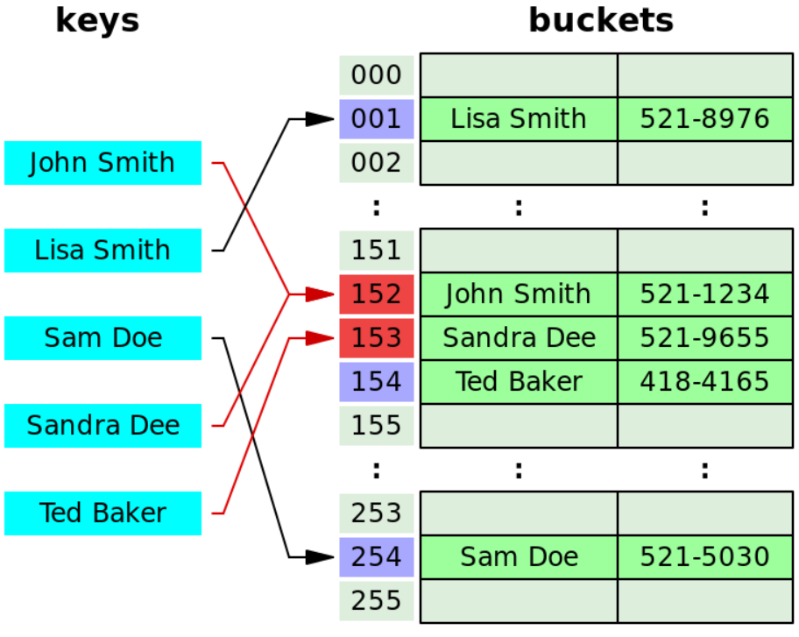
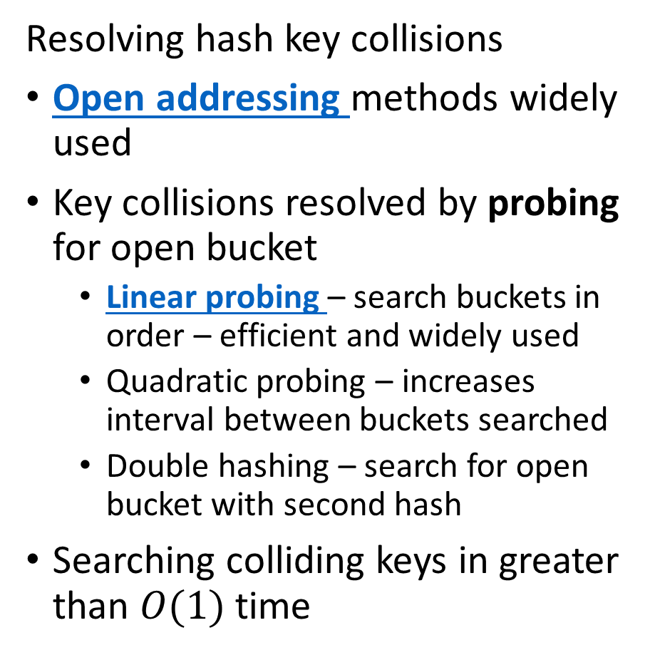
Introduction to Hashing
Resolving hash key collisions
Open addressing methods widely used
Key collisions resolved by probing for open bucket
Linear probing – search buckets in order – efficient and widely used
Quadratic probing – increases interval between buckets searched
Double hashing – search for open bucket with second hash
Searching colliding keys in greater than $O(1)$ time
Credit: Wikipedia commons

Slide 58
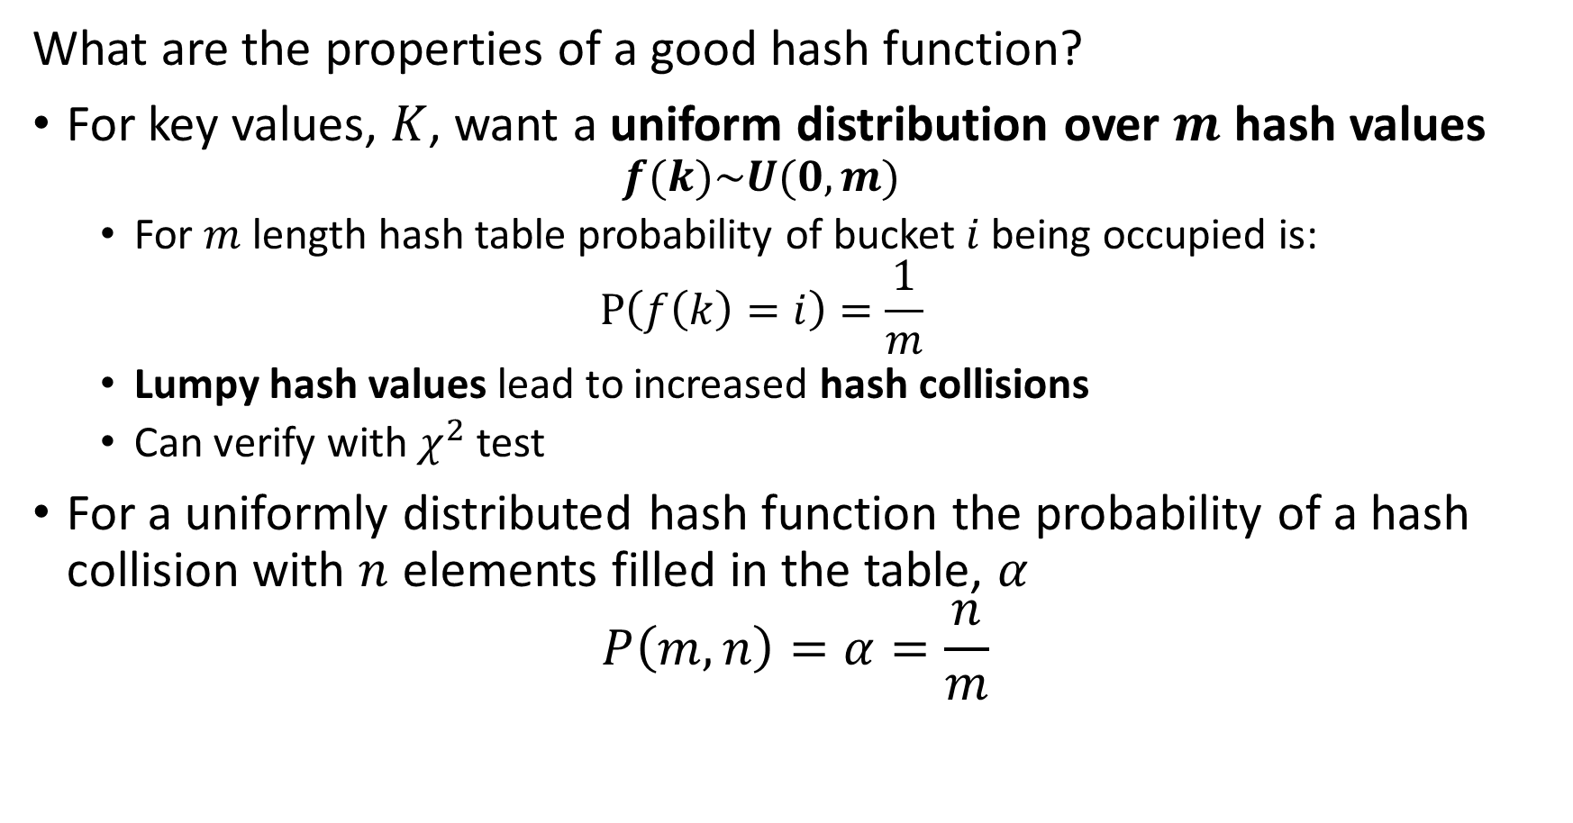
Introduction to Hashing
What are the properties of a good hash function?
For key values, $K$, want a uniform distribution over $m$ hash values
$$f(k)\sim U(0,m)$$
For $m$ length hash table probability of bucket $i$ being occupied is:
$$P\left(f\left(k\right)=i\right)=\frac{1}{m}$$
Lumpy hash values lead to increased hash collisions
Can verify with $χ^{2}$ test
For a uniformly distributed hash function the probability of a hash collision with $n$ elements filled in the table, $α$
$$P\left(m,n\right)=α=\frac{n}{m}$$

Slide 59
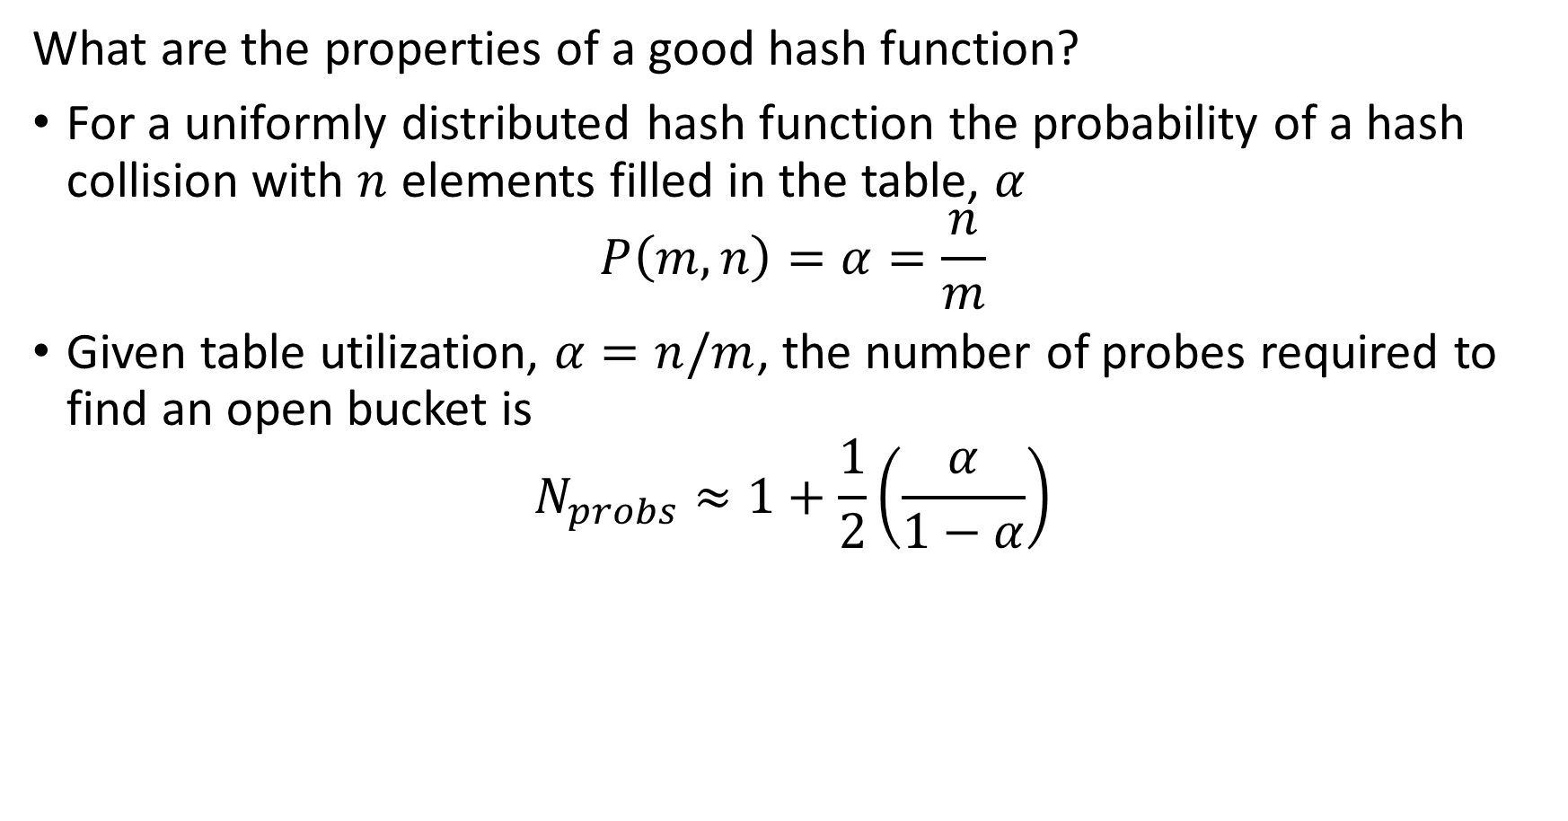
Introduction to Hashing
What are the properties of a good hash function?
For a uniformly distributed hash function the probability of a hash collision with $n$ elements filled in the table, $α$
$$P\left(m,n\right)=α=\frac{n}{m}$$
Given table utilization, $α=n/m$, the number of probes required to find an open bucket is
$$N_{probs}≈1+\frac{1}{2}\left(\frac{α}{1−α}\right)$$

Slide 60
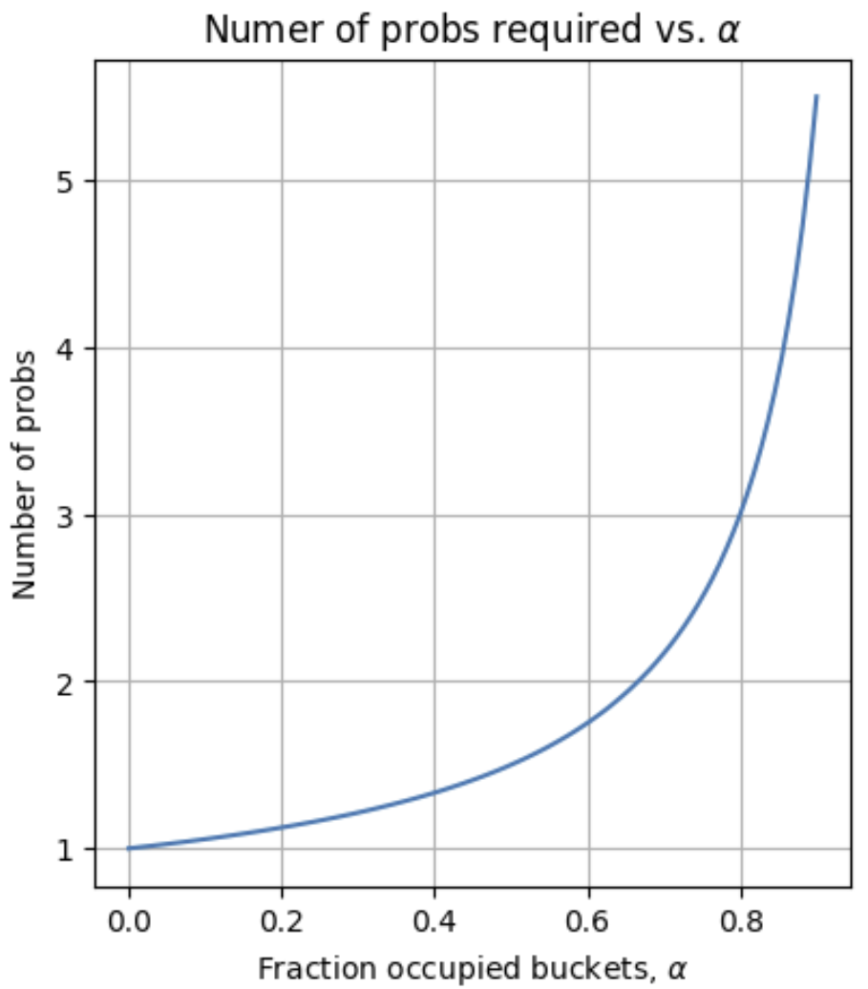
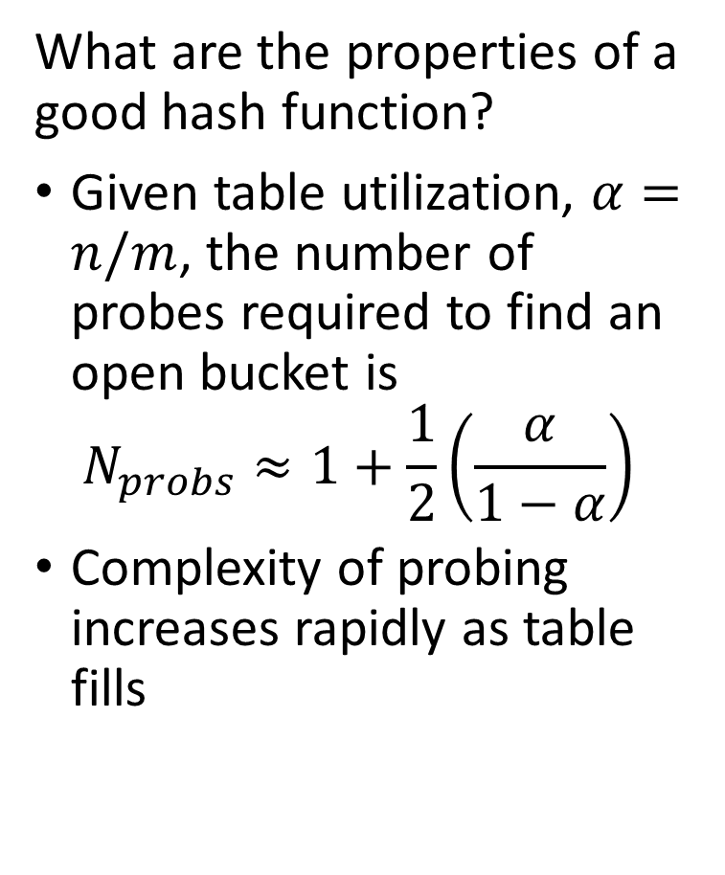
Introduction to Hashing
What are the properties of a good hash function?
Given table utilization, $α=n/m$, the number of probes required to find an open bucket is
$$N_{probs}≈1+\frac{1}{2}\left(\frac{α}{1−α}\right)$$
Complexity of probing increases rapidly as table fills

Slide 61
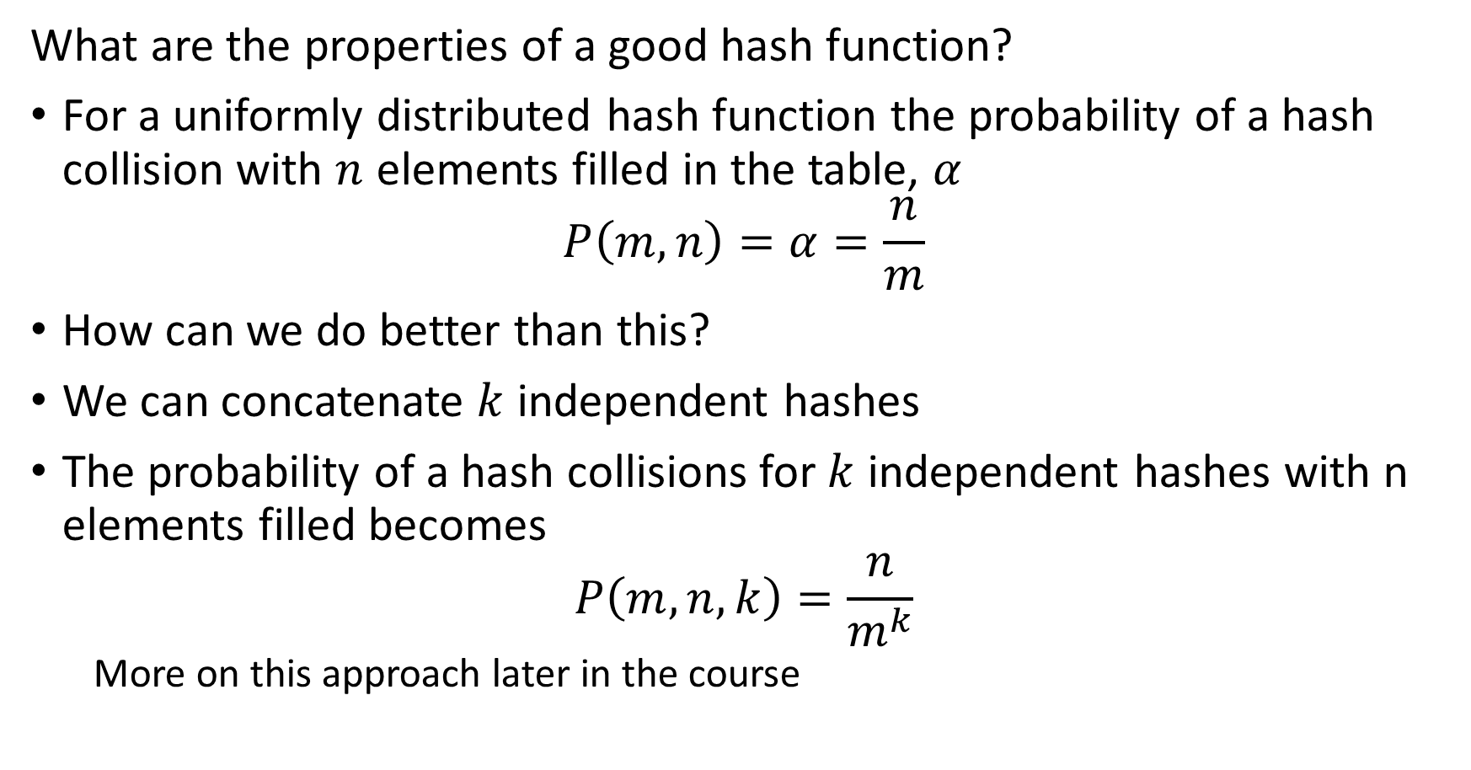
Introduction to Hashing
What are the properties of a good hash function?
For a uniformly distributed hash function the probability of a hash collision with $n$ elements filled in the table, $α$
$$P\left(m,n\right)=α=\frac{n}{m}$$
How can we do better than this?
We can concatenate $k$ independent hashes
The probability of a hash collisions for $k$ independent hashes with n elements filled becomes
$$P\left(m,n,k\right)=\frac{n}{m^{k}}$$
More on this approach later in the course

Slide 62
Summary

Slide 63
Key Points
Data mining is the science of knowledge discovery using data
Data mining uses massive data sets!
Manage massive data with key-values pairs
Hashing keys can reduce storge and retrieval times
Hash functions provide direct addressing at a massive scale
Ideal hash functions should have uniform distribution of hash values
Hash collisions are expected and must be managed
Hash tables require resizing algorithms
Merging is a key operation for hash tables.

