Slide 1

CSCI E-96
Data Mining, Exploration and
Discovery
Graph Theory and
Social Network Analysis
Steve Elston
Copyright 2021, 2022, 2023, 2024, 2025, 2026, Stephen F Elston. All rights reserved.

Slide 2
Main topics in this course
Graph algorithms are foundational for many data mining algorithms
1. Hashing and K-V pair management
2. Distance and Similarity Metrics
3. Graph Algorithms
Foundations
Core Algorithms
2. Dimensionality Reduction
5. Similarity Search and NN Algorithms
4. Online Algorithms
3. Social Network Analysis
6. Web/Document ranking and search
7. Recommender Algorithms
8. Clustering Algorithms
Taks Speific Algorithms

Slide 3
Introduction to Graph Theory

Slide 4
Graph algorithms are widely used for data mining
Graph algorithms can be efficient and highly scalable
Graphs are a natural choice of data structure in many cases
Applications include:
  Dimensionality reduction
  Social network analysis
  Approximate nearest neighbor search
  Recommender systems
  Clustering models
  Many more …

Slide 5
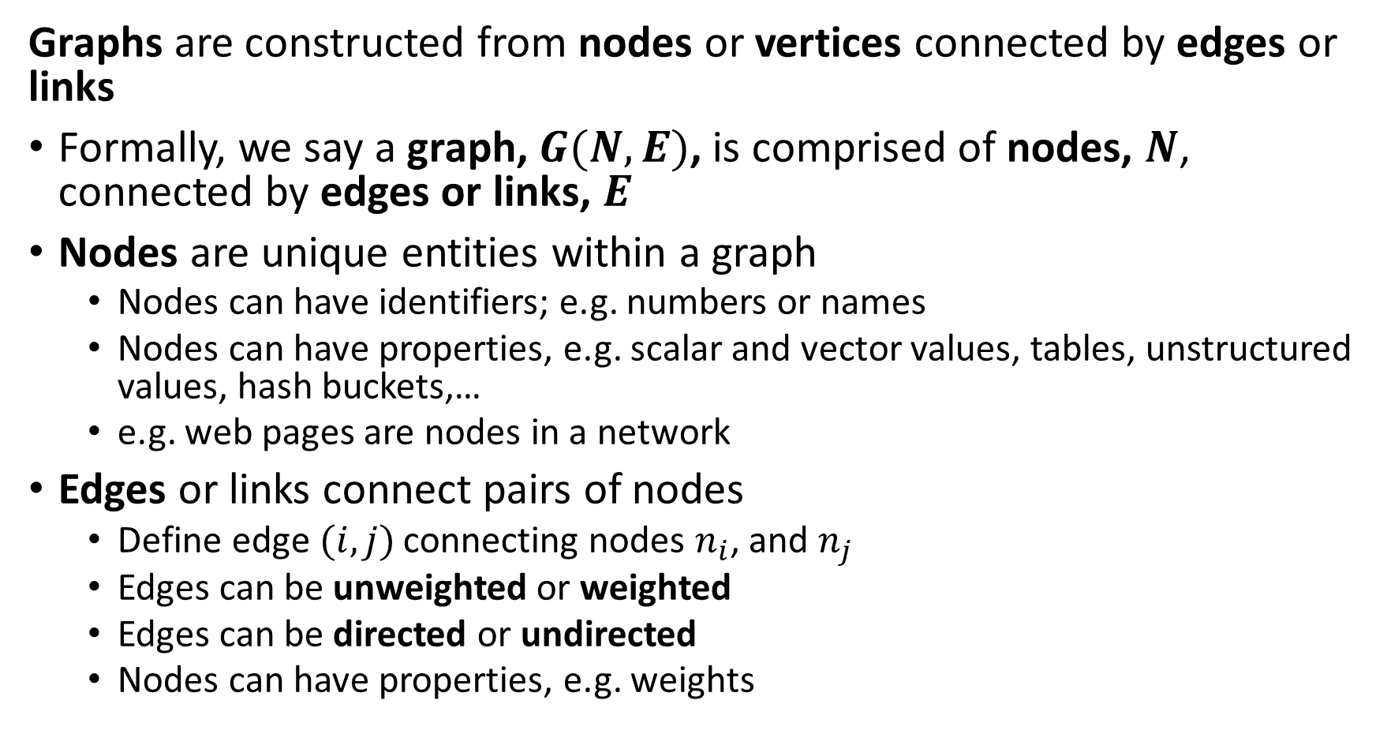
Introduction to Graph Theory Terminology
Graphs are constructed from nodes or vertices connected by edges or links
Formally, we say a graph, $G(N,E)$, is comprised of nodes, $N$, connected by edges or links, $E$
Nodes are unique entities within a graph
  Nodes can have identifiers; e.g. numbers or names
  Nodes can have properties, e.g. scalar and vector values, tables, unstructured values, hash buckets,…
  e.g. web pages are nodes in a network
Edges or links connect pairs of nodes
  Define edge$(i,j)$ connecting nodes $n_{i}$, and $n_{j}$
  Edges can be unweighted or weighted
  Edges can be directed or undirected
  Nodes can have properties, e.g. weights

Slide 6

Introduction to Graph Theory Terminology
Undirected graphs are constructed from nodes or vertices connected by undirected edges
An undirected edge, $l\left(i,j\right)$, connects nodes $n_{i}$ and $n_{j}$ bidirectionally
Example: Facebook friends is a symmetric relationship
Example: A highway network allows travel in both directions

Slide 7
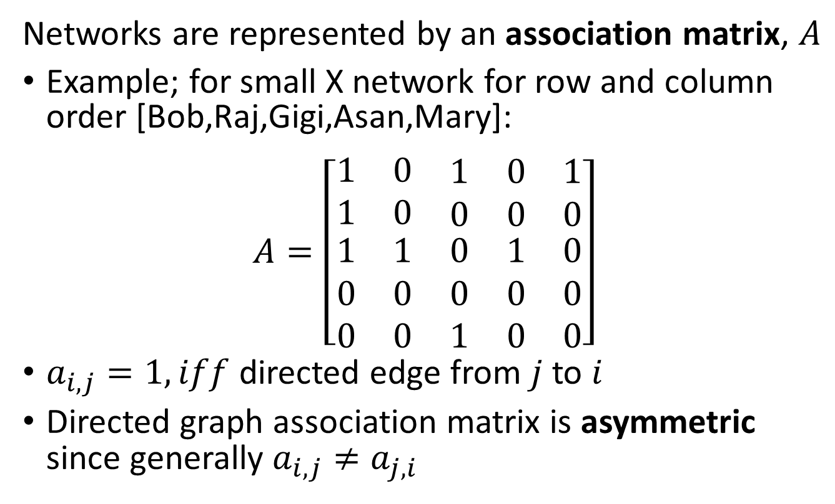
Introduction to Graph Theory
Directed graphs are constructed from nodes or vertices connected by directed edges
Networks are represented by an association matrix, $A$
Example; for small X network for row and column order [Bob,Raj,Gigi,Asan,Mary]:
$$A=\left[\begin{matrix}1 & 0 & \begin{matrix}1 & 0 & 1\end{matrix} \\ 1 & 0 & \begin{matrix}0 & 0 & 0\end{matrix} \\ \begin{matrix}1 \\ 0 \\ 0\end{matrix} & \begin{matrix}1 \\ 0 \\ 0\end{matrix} & \begin{matrix}0 & 1 & 0 \\ 0 & 0 & 0 \\ 1 & 0 & 0\end{matrix}\end{matrix}\right]$$
$a_{i,j}=1, iff$ directed edge from $j$ to $i$
Directed graph association matrix is asymmetric since generally $a_{i,j}≠a_{j,i}$
Raj
Bob
Gigi
Mary
Asan

Slide 8
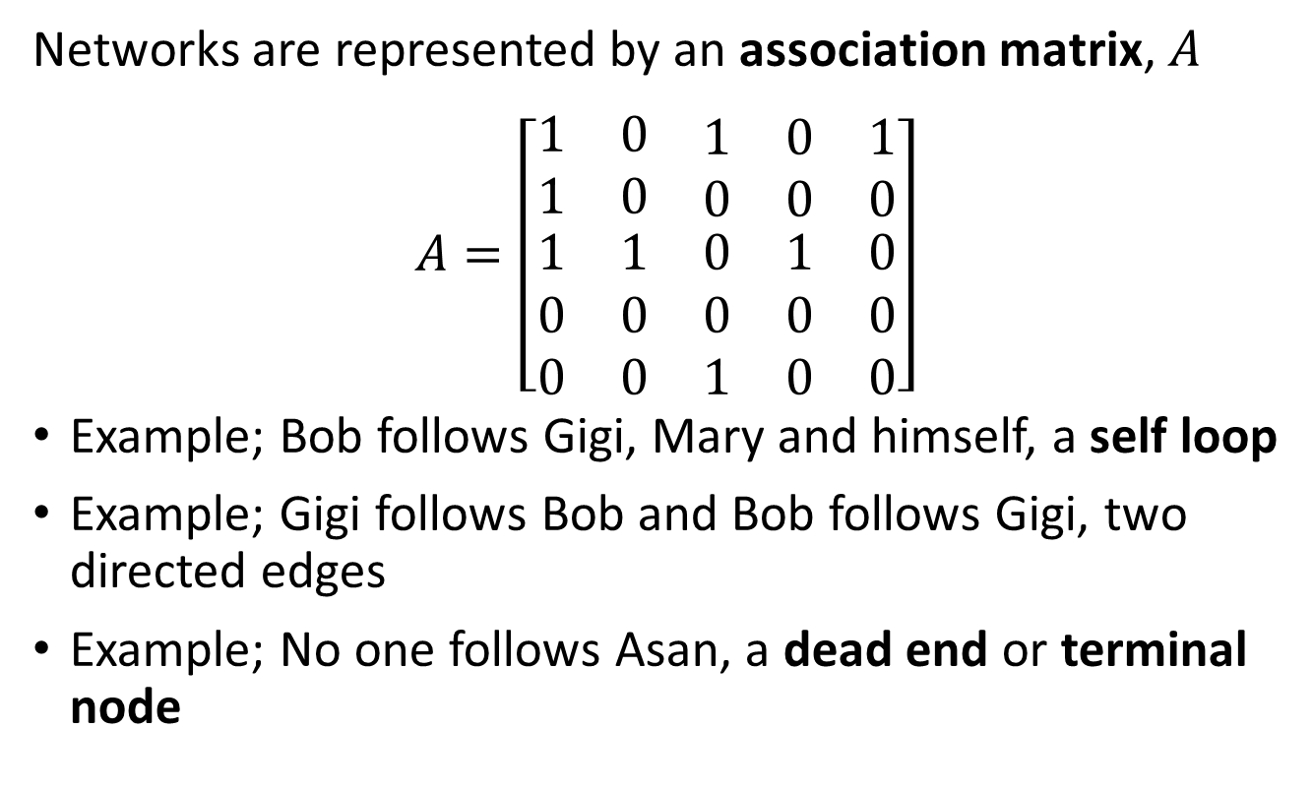
Introduction to Graph Theory
Directed graphs are constructed from nodes or vertices connected by directed edges
Networks are represented by an association matrix, $A$
$$A=\left[\begin{matrix}1 & 0 & \begin{matrix}1 & 0 & 1\end{matrix} \\ 1 & 0 & \begin{matrix}0 & 0 & 0\end{matrix} \\ \begin{matrix}1 \\ 0 \\ 0\end{matrix} & \begin{matrix}1 \\ 0 \\ 0\end{matrix} & \begin{matrix}0 & 1 & 0 \\ 0 & 0 & 0 \\ 1 & 0 & 0\end{matrix}\end{matrix}\right]$$
Example; Bob follows Gigi, Mary and himself, a self loop
Example; Gigi follows Bob and Bob follows Gigi, two directed edges
Example; No one follows Asan, a dead end or terminal node
Raj
Bob
Gigi
Mary
Asan

Slide 9
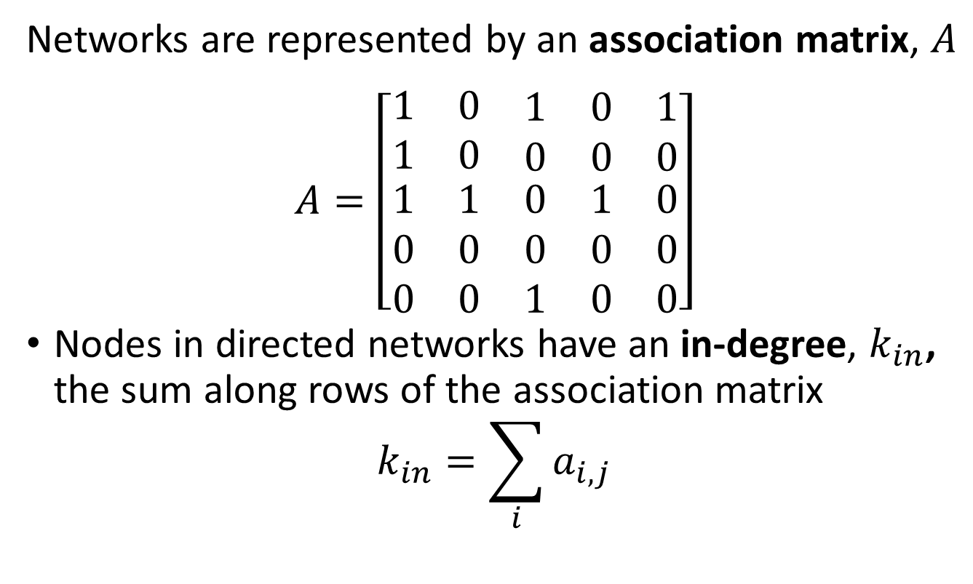
Introduction to Graph Theory
Directed graphs are constructed from nodes or vertices connected by directed edges
Networks are represented by an association matrix, $A$
$$A=\left[\begin{matrix}1 & 0 & \begin{matrix}1 & 0 & 1\end{matrix} \\ 1 & 0 & \begin{matrix}0 & 0 & 0\end{matrix} \\ \begin{matrix}1 \\ 0 \\ 0\end{matrix} & \begin{matrix}1 \\ 0 \\ 0\end{matrix} & \begin{matrix}0 & 1 & 0 \\ 0 & 0 & 0 \\ 1 & 0 & 0\end{matrix}\end{matrix}\right]$$
Nodes in directed networks have an in-degree, $k_{in}$, the sum along rows of the association matrix
$$k_{in}=\sum_{i}{a_{i,j}}$$
Raj
Bob
Gigi
Mary
Asan

Slide 10
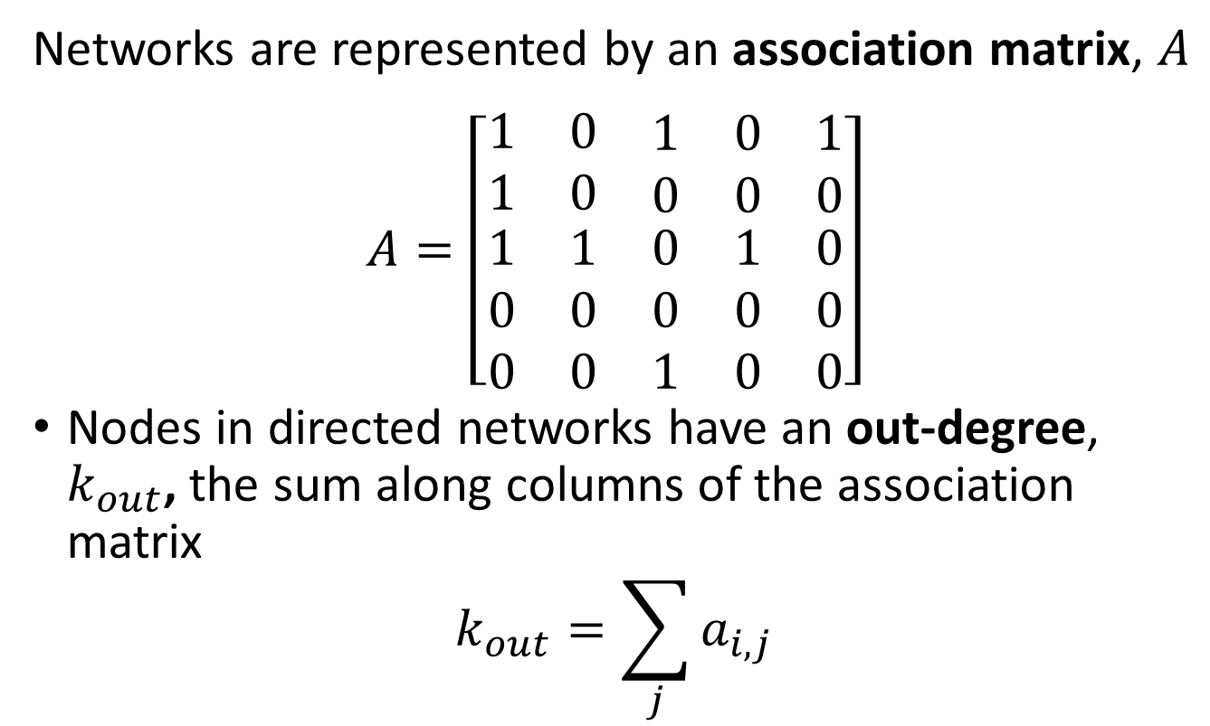
Introduction to Graph Theory
Directed graphs are constructed from nodes or vertices connected by directed edges
Networks are represented by an association matrix, $A$
$$A=\left[\begin{matrix}1 & 0 & \begin{matrix}1 & 0 & 1\end{matrix} \\ 1 & 0 & \begin{matrix}0 & 0 & 0\end{matrix} \\ \begin{matrix}1 \\ 0 \\ 0\end{matrix} & \begin{matrix}1 \\ 0 \\ 0\end{matrix} & \begin{matrix}0 & 1 & 0 \\ 0 & 0 & 0 \\ 1 & 0 & 0\end{matrix}\end{matrix}\right]$$
Nodes in directed networks have an out-degree, $k_{out}$, the sum along columns of the association matrix
$$k_{out}=\sum_{j}{a_{i,j}}$$
Raj
Bob
Gigi
Mary
Asan

Slide 11

Introduction to Graph Theory
Directed graphs are constructed from nodes or vertices connected by directed edges
Nodes in directed networks have an in-degree, $k_{in}$, and out-degree, $k_{out}$,
Example; for Gigi $k_{in}=3$, $k_{out}=2$
Example; for Asan $k_{in}=0$, $k_{out}=1$
Raj
Bob
Gigi
Mary
Asan

Slide 12
Random Graphs

Slide 13
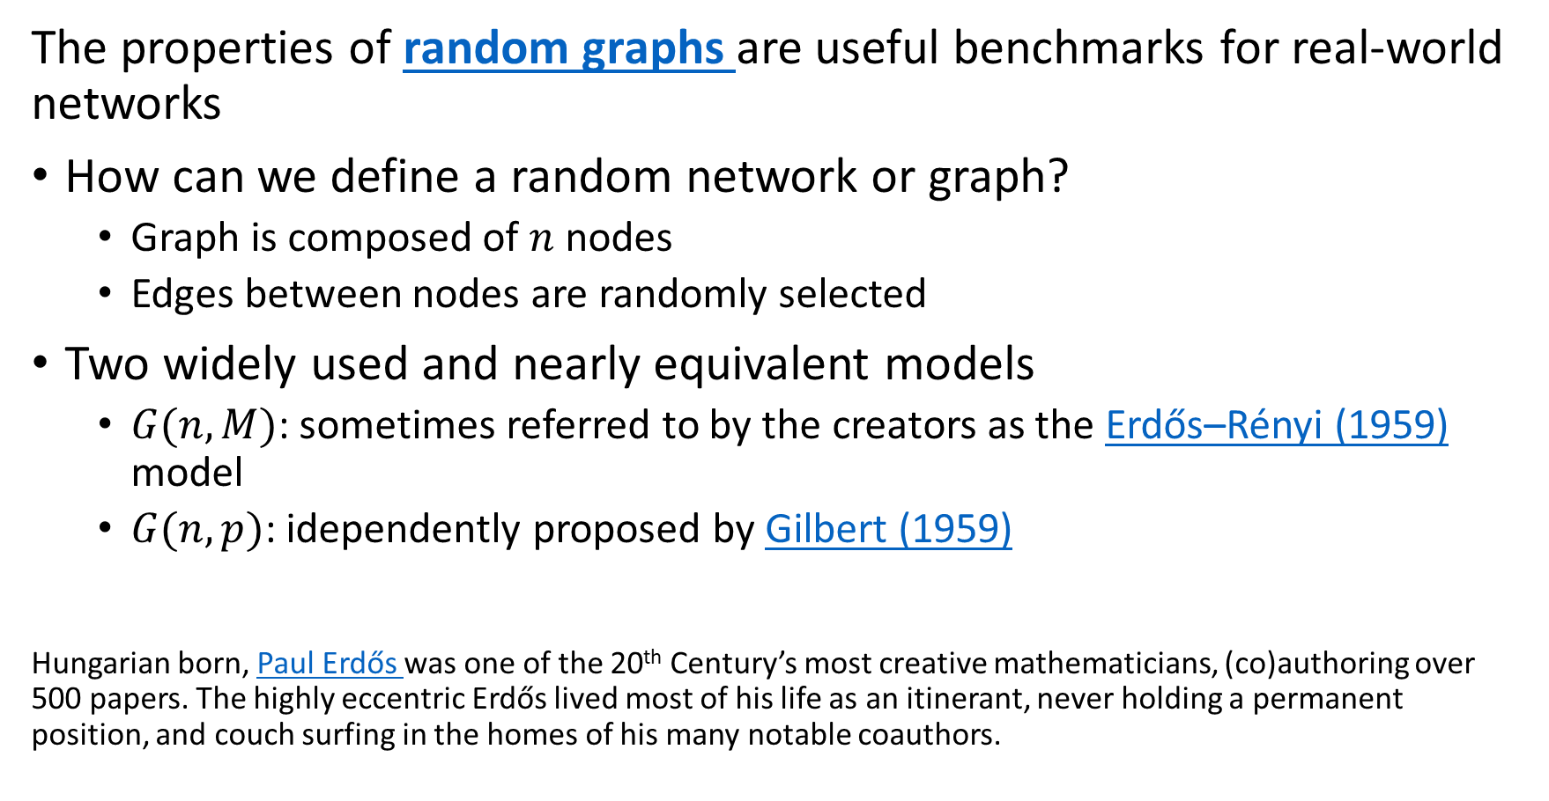
Random Graphs
The properties of random graphs are useful benchmarks for real-world networks
How can we define a random network or graph?
  Graph is composed of $n$ nodes
  Edges between nodes are randomly selected
Two widely used and nearly equivalent models
  $G(n,M)$: sometimes referred to by the creators as the Erdős–Rényi (1959) model
  $G(n,p)$: idependently proposed by Gilbert (1959)
Hungarian born, Paul Erdős was one of the 20th Century’s most creative mathematicians, (co)authoring over 500 papers. The highly eccentric Erdős lived most of his life as an itinerant, never holding a permanent position, and couch surfing in the homes of his many notable coauthors.

Slide 14
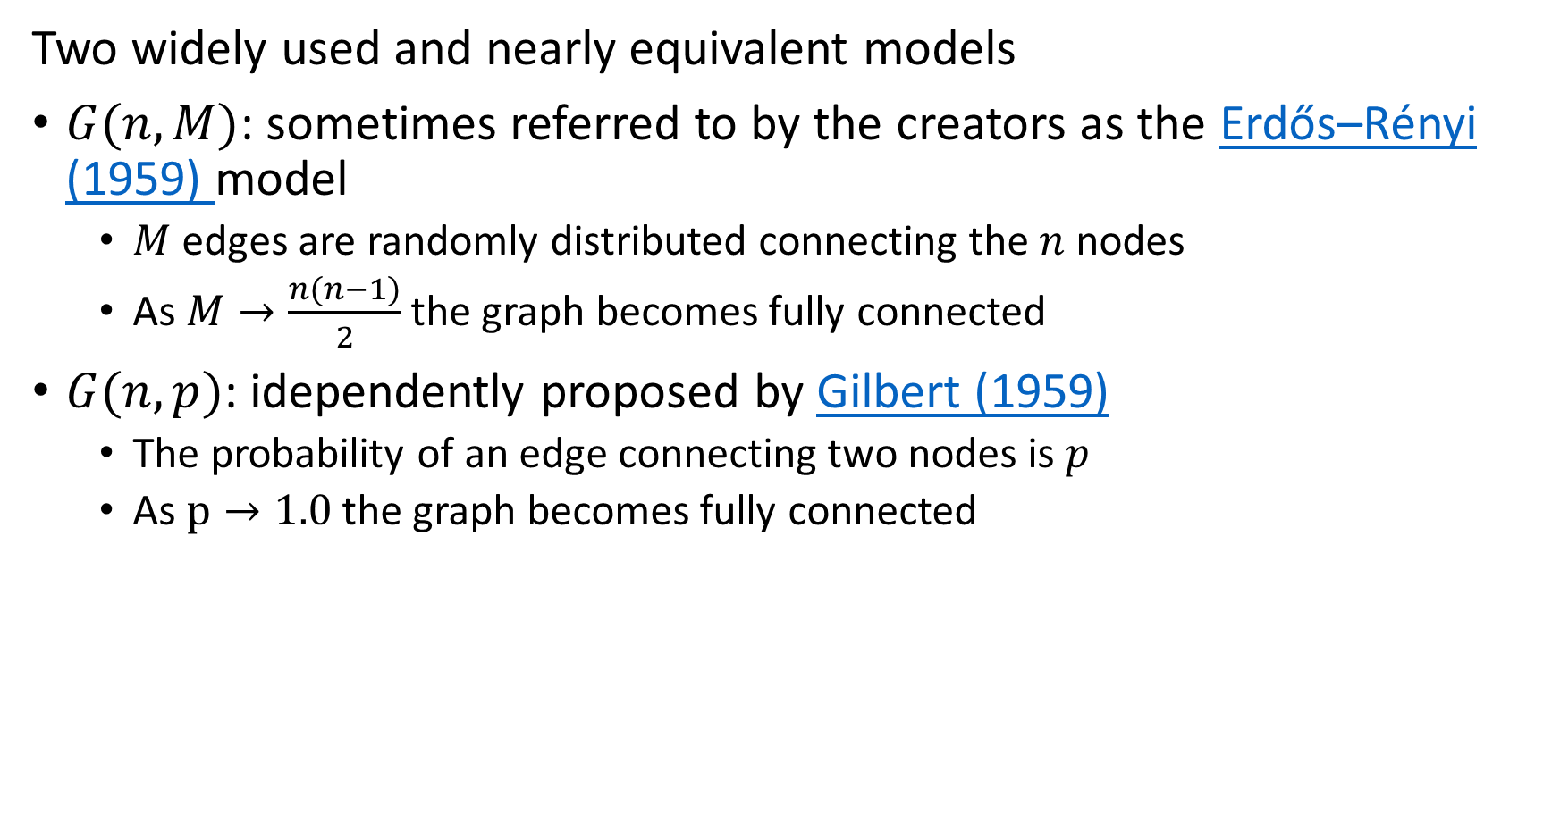
Random Graphs
Two widely used and nearly equivalent models
$G(n,M)$: sometimes referred to by the creators as the Erdős–Rényi (1959) model
  $M$ edges are randomly distributed connecting the $n$ nodes
  As $M→\frac{n(n−1)}{2}$ the graph becomes fully connected
$G(n,p)$: idependently proposed by Gilbert (1959)
  The probability of an edge connecting two nodes is $p$
  As $p→1.0$ the graph becomes fully connected

Slide 15
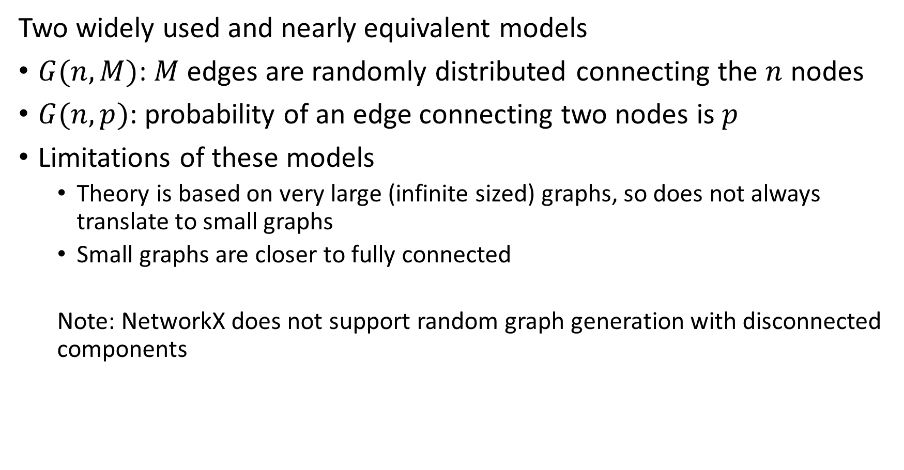
Random Graphs
Two widely used and nearly equivalent models
$G(n,M)$: $M$ edges are randomly distributed connecting the $n$ nodes
$G(n,p)$: probability of an edge connecting two nodes is $p$
Limitations of these models
  Theory is based on very large (infinite sized) graphs, so does not always translate to small graphs
  Small graphs are closer to fully connected
  Note: NetworkX does not support random graph generation with disconnected components

Slide 16
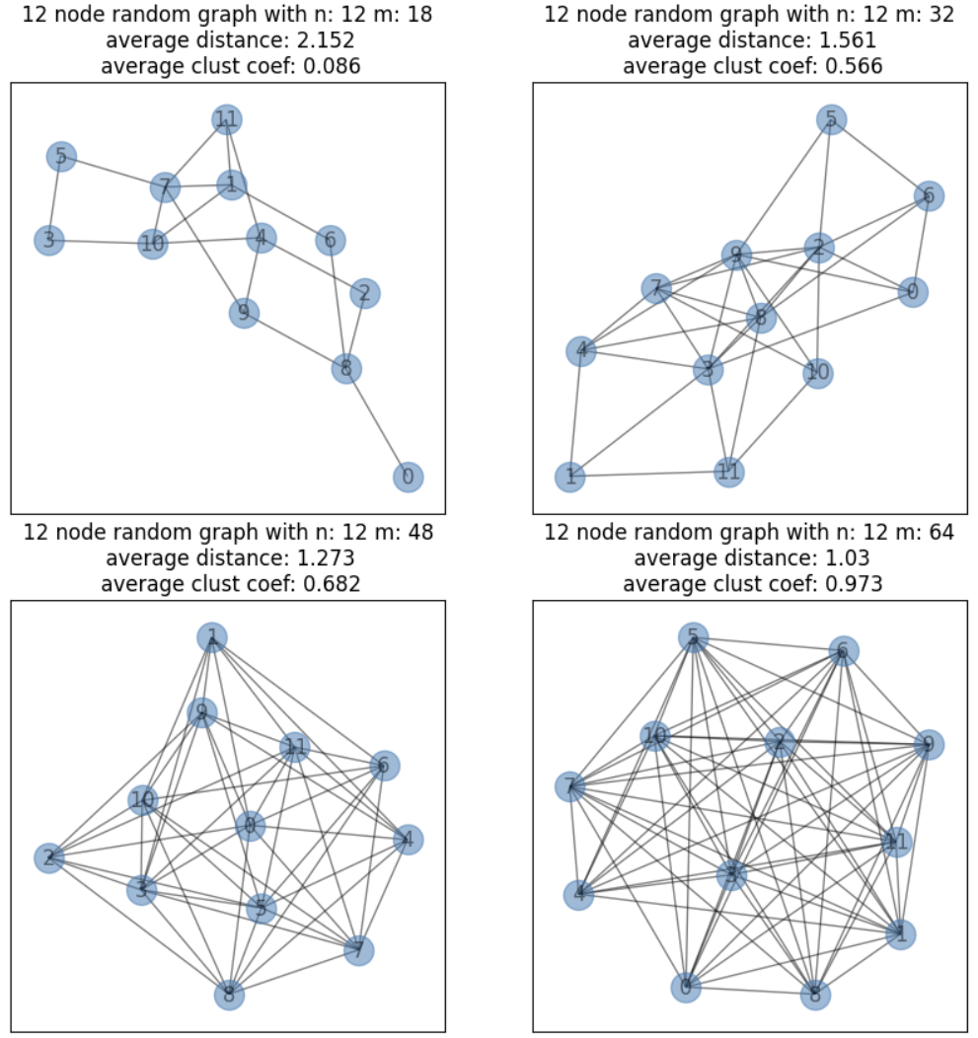
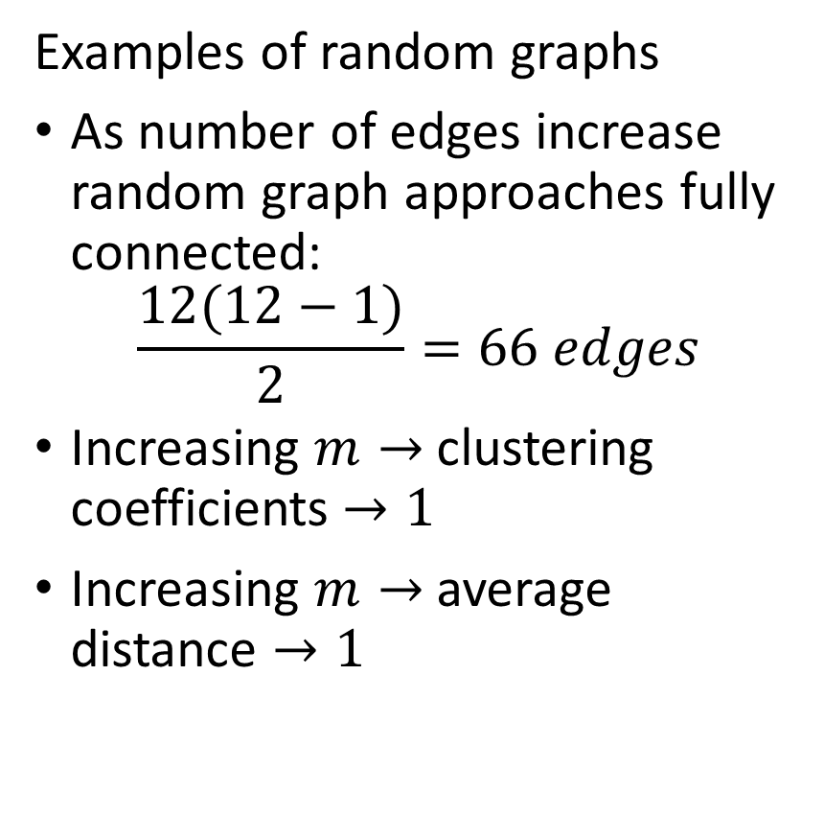
Random Graphs
Examples of random graphs
As number of edges increase random graph approaches fully connected:
$$\frac{12(12−1)}{2}=66 edges$$
Increasing $m→$ clustering coefficients $→1$
Increasing $m→$ average distance $→1$

Slide 17
Introduction to Social Networks

Slide 18
Introduction to Social Network Analysis
Social networks appear in many forms
Online social media
Networks of collaborating people
People in clubs
Political and business organizations
Organisms in an ecosystem
Citations in research papers
Many more …

Slide 19
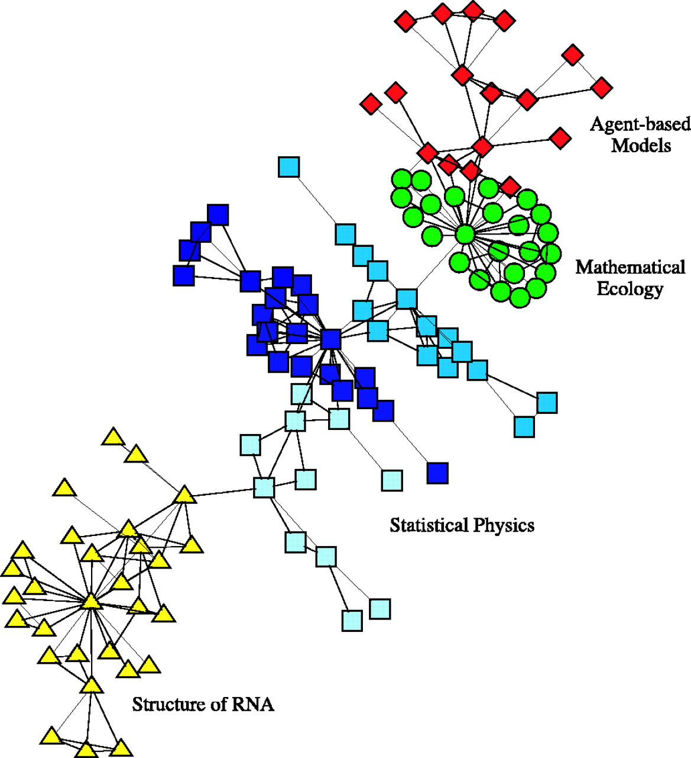
Introduction to Social Network Analysis
Social networks appear in many forms
Example: small network of co-authorship of scientific papers
Relationships represented by undirected graph
Relationship communities organize along discipline lines
  Some community members are strongly connected
  Strongly connected members are said to be influential
Few connections between communities
Credit: Neman, 2004, Proceedings of the National Academy of Sciences

Slide 20
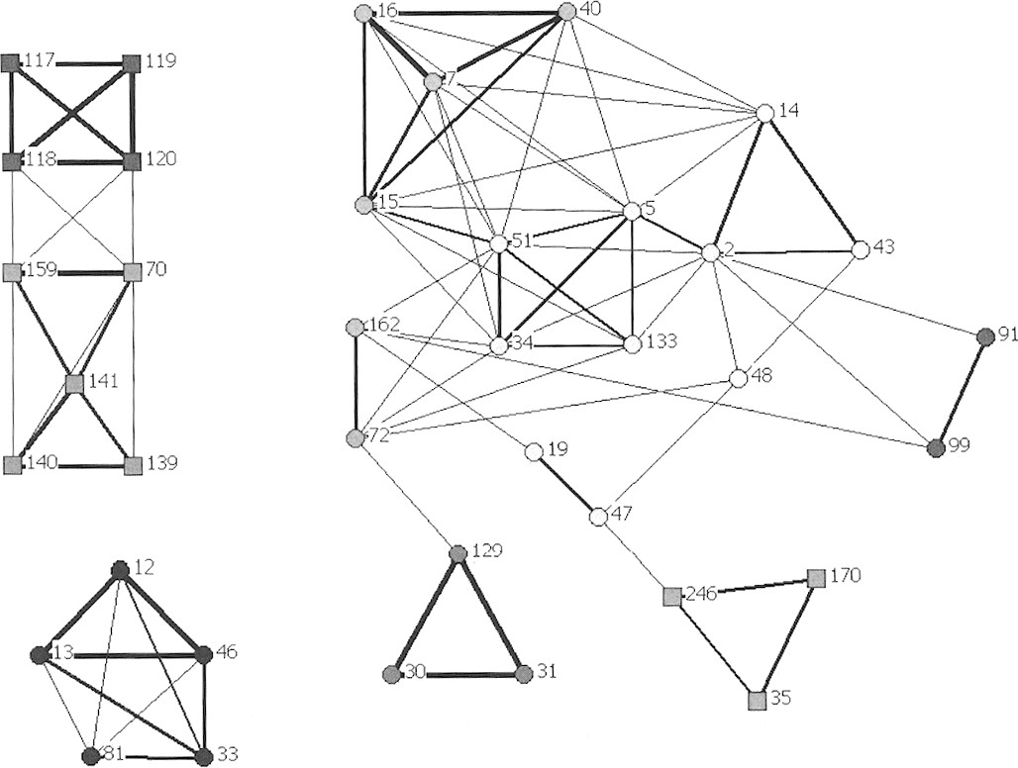
Introduction to Social Network Analysis
Social networks appear in many forms
Example: Association network of Bottlenose Dolphins at Port Stephens NSW Australia
  Square = western population
  Circle = eastern population
Credit: Wiszniewksi, Brown and Moller, Journal of Mammalogy, 2012

Slide 21
Introduction to Social Network Analysis
Social networks appear in many forms
Undirected weighted graph represents relationships between dolphins
  Strength of relationship represented by edge weights
Communities in isolated graph components
  Some sub-components within communities are weekly connected
Credit: Wiszniewksi, Brown and Moller, Journal of Mammalogy, 2012

Slide 22
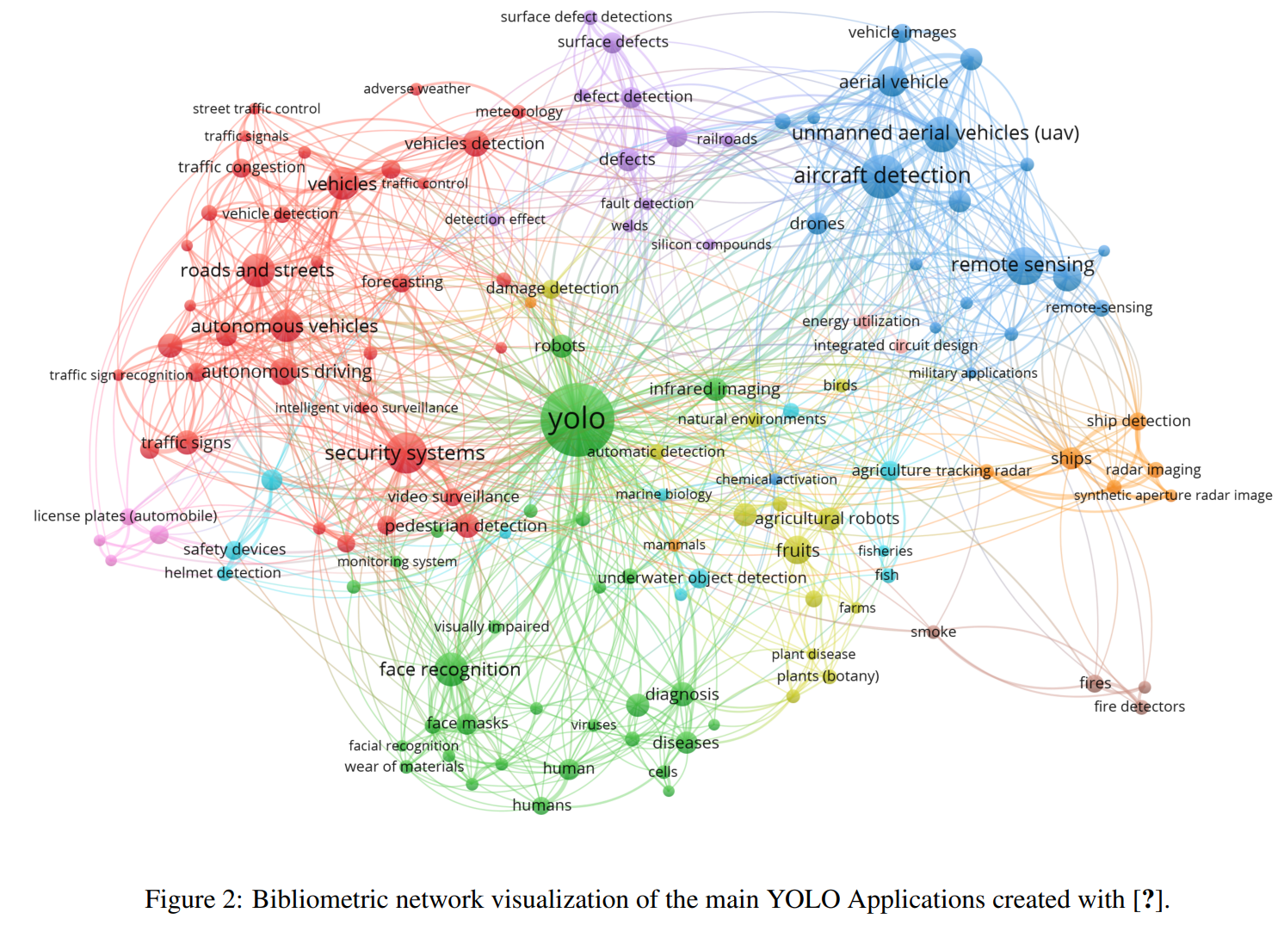
Example of Network of Published Research Literature
Continued advances in the YOLO family of real-time object detectors has created a tangle of models and published literature!
Citation network created with Scopus
Only a few papers are highly influential
From YOLO Architecture review paper, Terven and Cordova-Esparza, 2024

Slide 23
Introduction to Social Network Analysis
Analysis to determine community structure in networks
Discover regions of dense connections in the network, cores
Discover and partition distinct communities within the networks
Find highly influential nodes in the network
Community analysis is largely unsupervised learning
  Rarely know ground truth
  Often requires some judgement or domain knowledge
  Different models can provide different views and insights

Slide 24
Introduction to Social Network Analysis
Some properties of social networks
Social networks can be partitioned into communities
Communities are assortative
  Homophily is tendency of similar entries to interact in a social network
  Homophily leads to stronger connections within communities
Communities have stronger (denser) connections between nodes
  Weaker (fewer) connections between nodes of different communities
  Nodes in the core components of communities have strongest connection

Slide 25
Introduction to Social Network Analysis
Some properties of social networks
Most social networks are undirected
  Friends know each other
  Work colleagues know each other
  Members of a small club have a high number of mutual connections
But, some social networks are directed
  I can follow someone on X, but they need not follow me
  Organisms in an environment have asymmetric relationship, e.g. predator-prey
We focus on undirected social networks here

Slide 26
Introduction to Social Network Analysis
Many methods to find communities in social networks
Communities defined by high connectivity
Can find communities by the centrality or influence of nodes:
  Kratz centrality
  Closeness centrality
  K-Cores
  Triangle density and clustering
Partition communities by betweenness
Find communities by modularity of groups of nodes
  Greedy algorithms
  Spectral modularity decomposition

Slide 27
Pitfalls in Social Network Analysis
Unsupervised learning of community structure has pitfalls
No hard definitions or thresholds
  How can you define dense connections?
  How dense is a core?
How many communities are there?
  Communities may have subcommunities
Communities may overlap – not independent or unique
  Example: members of two clubs
  Example: people in occupations and members of political parties
  Effect of criminal network on victims
Evaluation is never fully objective

Slide 28
Communities in Networks

Slide 29
Finding Communities in Networks
Social networks are organized in communities
Communities are strongly connected
  A random graph has uniform distribution of the edges
  A graph of communities has regions of dense connections
  Few connections between communities
  Core nodes are said to exhibit high clustering
Communities are built around highly influential nodes
  High centrality nodes at the core of communities
  Can use several measures of centrality
  Example; K-cores represent nodes at center of communities

Slide 30
Centrality in Communities
Find highly connected nodes at center or core of communities
These highly connected nodes are influential in the community
Consider the spread of information in a social network
  Messages with the information travel from node to node
  Nodes with stronger connections to the community disseminate messages more effectively
  These strongly connected nodes are considered influential
We measure a node’s influence in a social network by its centrality

Slide 31
Centrality in Communities
Centrality is the ability of a node to exert influence on the network
Cores are densely connected groups of nodes
Core nodes have high centrality
Kratz centrality is an example of a centrally metric
  Kratz centrality is equivalent to the probability of visiting a node during a random walk on the graph
  Kratz centrality is applicable to directed or undirected graphs
Closeness centrality is the average inverse distance from a node to all other nodes in a graph component
Different centrality measures are sensitive to different aspects of the network!

Slide 32
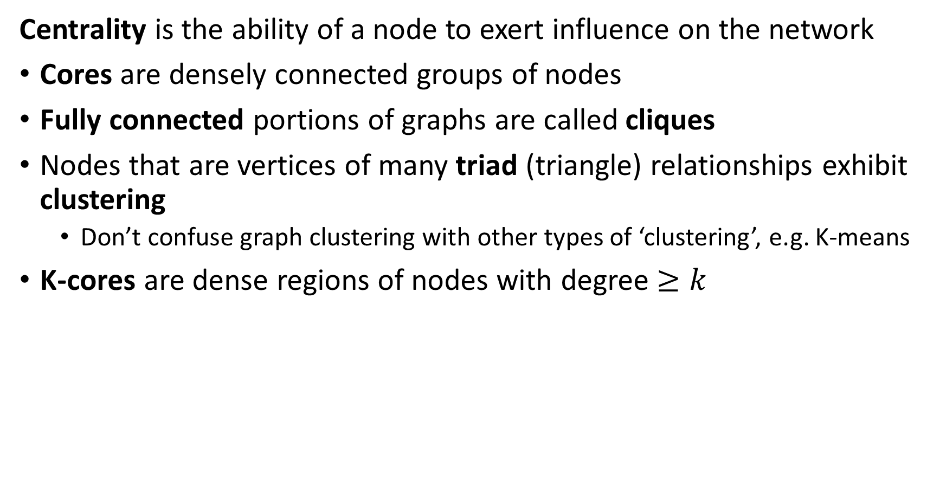
Centrality in Communities
Centrality is the ability of a node to exert influence on the network
Cores are densely connected groups of nodes
Fully connected portions of graphs are called cliques
Nodes that are vertices of many triad (triangle) relationships exhibit clustering
  Don’t confuse graph clustering with other types of ‘clustering’, e.g. K-means
K-cores are dense regions of nodes with degree $≥k$

Slide 33
Finding Communities in Networks
Social networks are organized in communities
Betweenness and modularity used to partition graphs into community components
Betweenness measures the extent certain nodes and edges are on path between other nodes
  Betweenness is low within highly connected communities
  Betweenness is high between communities
Modularity measures the weights (density) of edges compared to random graph
  Communities have high modularity
  Use modularity to search for communities

Slide 34
Kratz Centrality

Slide 35
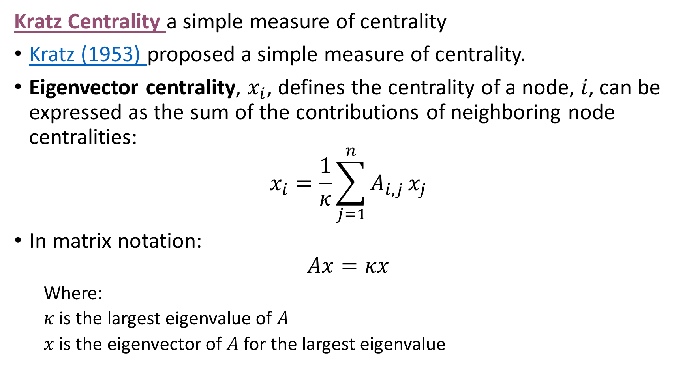
Kratz Centrality in Communities
Kratz Centrality a simple measure of centrality
Kratz (1953) proposed a simple measure of centrality.
Eigenvector centrality, $x_{i}$, defines the centrality of a node, $i$, can be expressed as the sum of the contributions of neighboring node centralities:
$$x_{i}=\frac{1}{κ}\sum_{j=1}^{n}{A_{i,j}}x_{j}$$
In matrix notation:
$$Ax=κx$$
  Where:
  $κ$ is the largest eigenvalue of $A$
  $x$ is the eigenvector of $A$ for the largest eigenvalue

Slide 36
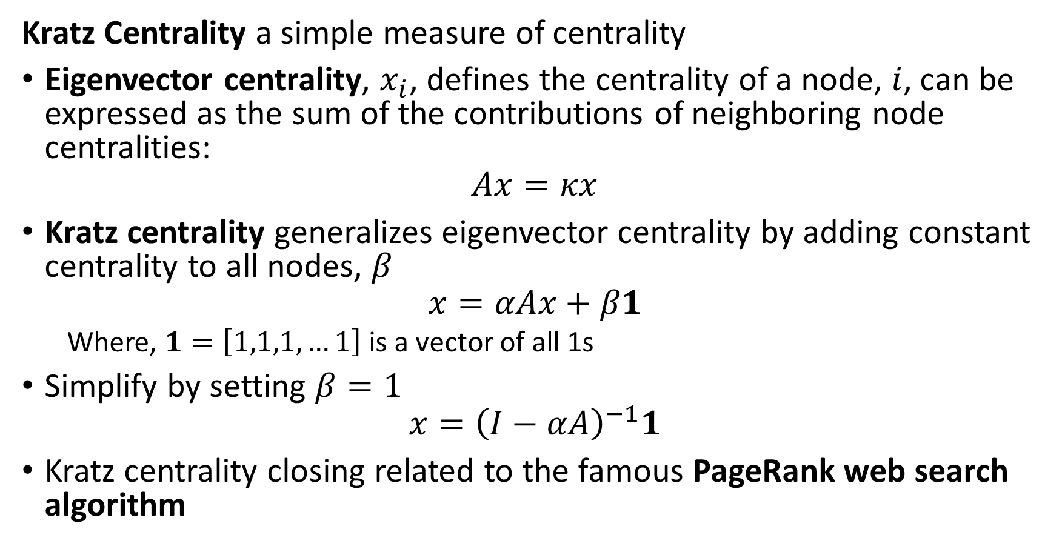
Kratz Centrality in Communities
Kratz Centrality a simple measure of centrality
Eigenvector centrality, $x_{i}$, defines the centrality of a node, $i$, can be expressed as the sum of the contributions of neighboring node centralities:
$$Ax=κx$$
Kratz centrality generalizes eigenvector centrality by adding constant centrality to all nodes, $β$
$$x=αAx+β1$$
  Where, $1=\left[1,1,1,…1\right]$ is a vector of all 1s
Simplify by setting $β=1$
$$x={\left(I−αA\right)}^{−1}1$$
Kratz centrality closing related to the famous PageRank web search algorithm

Slide 37
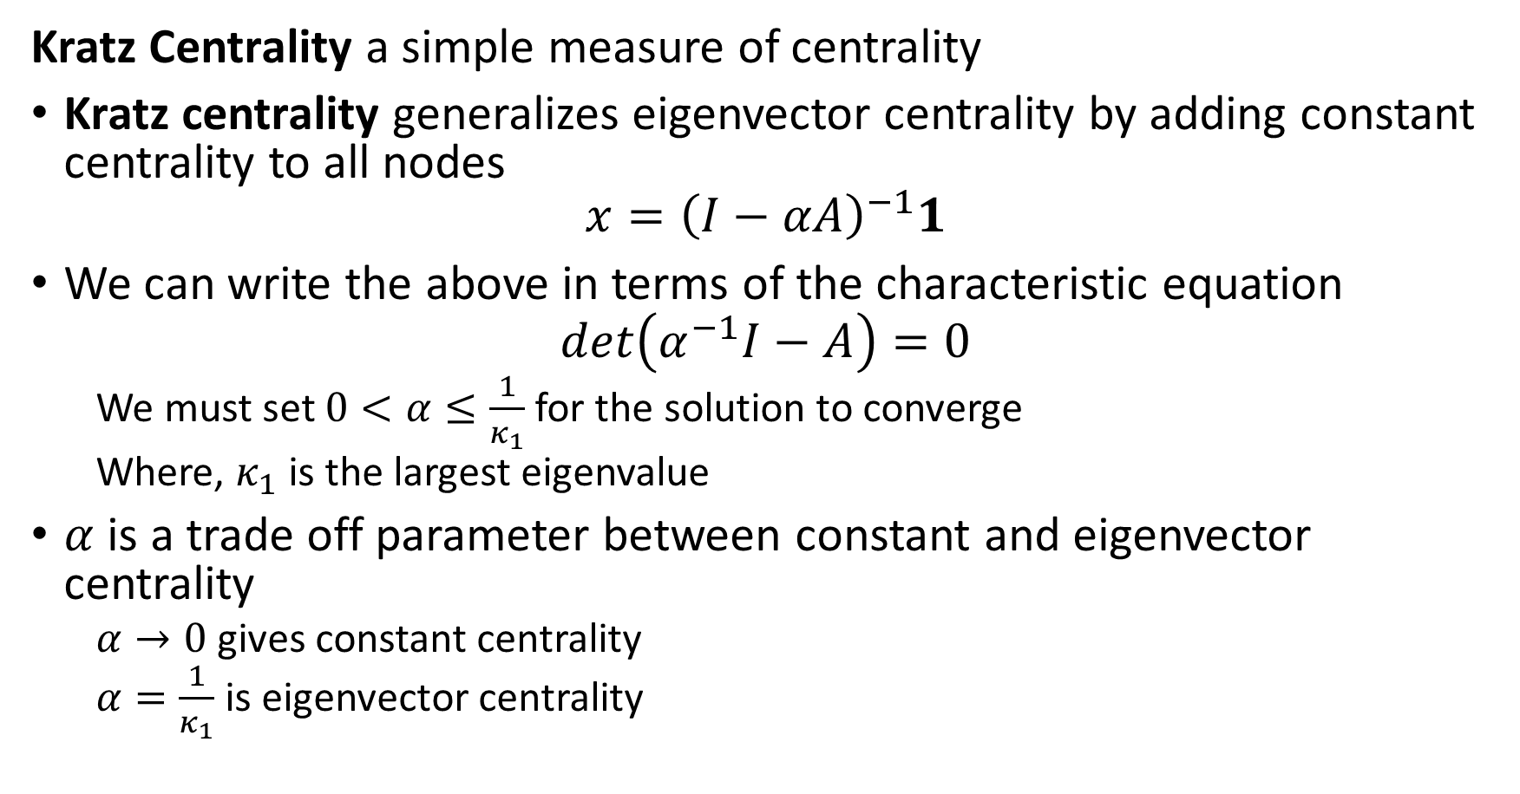
Kratz Centrality in Communities
Kratz Centrality a simple measure of centrality
Kratz centrality generalizes eigenvector centrality by adding constant centrality to all nodes
$$x={\left(I−αA\right)}^{−1}1$$
We can write the above in terms of the characteristic equation
$$det\left(α^{−1}I−A\right)=0$$
  We must set $0<α≤\frac{1}{κ_{1}}$ for the solution to converge
  Where, $κ_{1}$ is the largest eigenvalue
$α$ is a trade off parameter between constant and eigenvector centrality
  $α→0$ gives constant centrality
  $α=\frac{1}{κ_{1}}$ is eigenvector centrality

Slide 38
Breath-First Search and Distance-Based Centrality

Slide 39
Distance-Based Centrality
Measures of distance are natural and intuitive centrality metrics
Closeness centrality measures average closeness of a node to other nodes in a network
  Closeness measured by inverse distance on shortest path
Betweenness centrality measures the number of shortest paths between nodes in a network
  Can measure betweenness at nodes or on edges
Both metrics based on algorithms to find shorted paths and compute distances between nodes in a graph
  Generally, use breath first search algorithms

Slide 40
Finding Shortest Paths in Networks
Finding shortest paths in networks requires a search
Path search is computationally intensive for large graphs!
Two general approaches to path search
  Depth first
  Breath first
Path search analogous to database searching algorithm
  e.g. B-tree search
Searching graphs
  Find distances
  Distance can be edge weight
  Compute shortest paths
  Discover connectivity

Slide 41
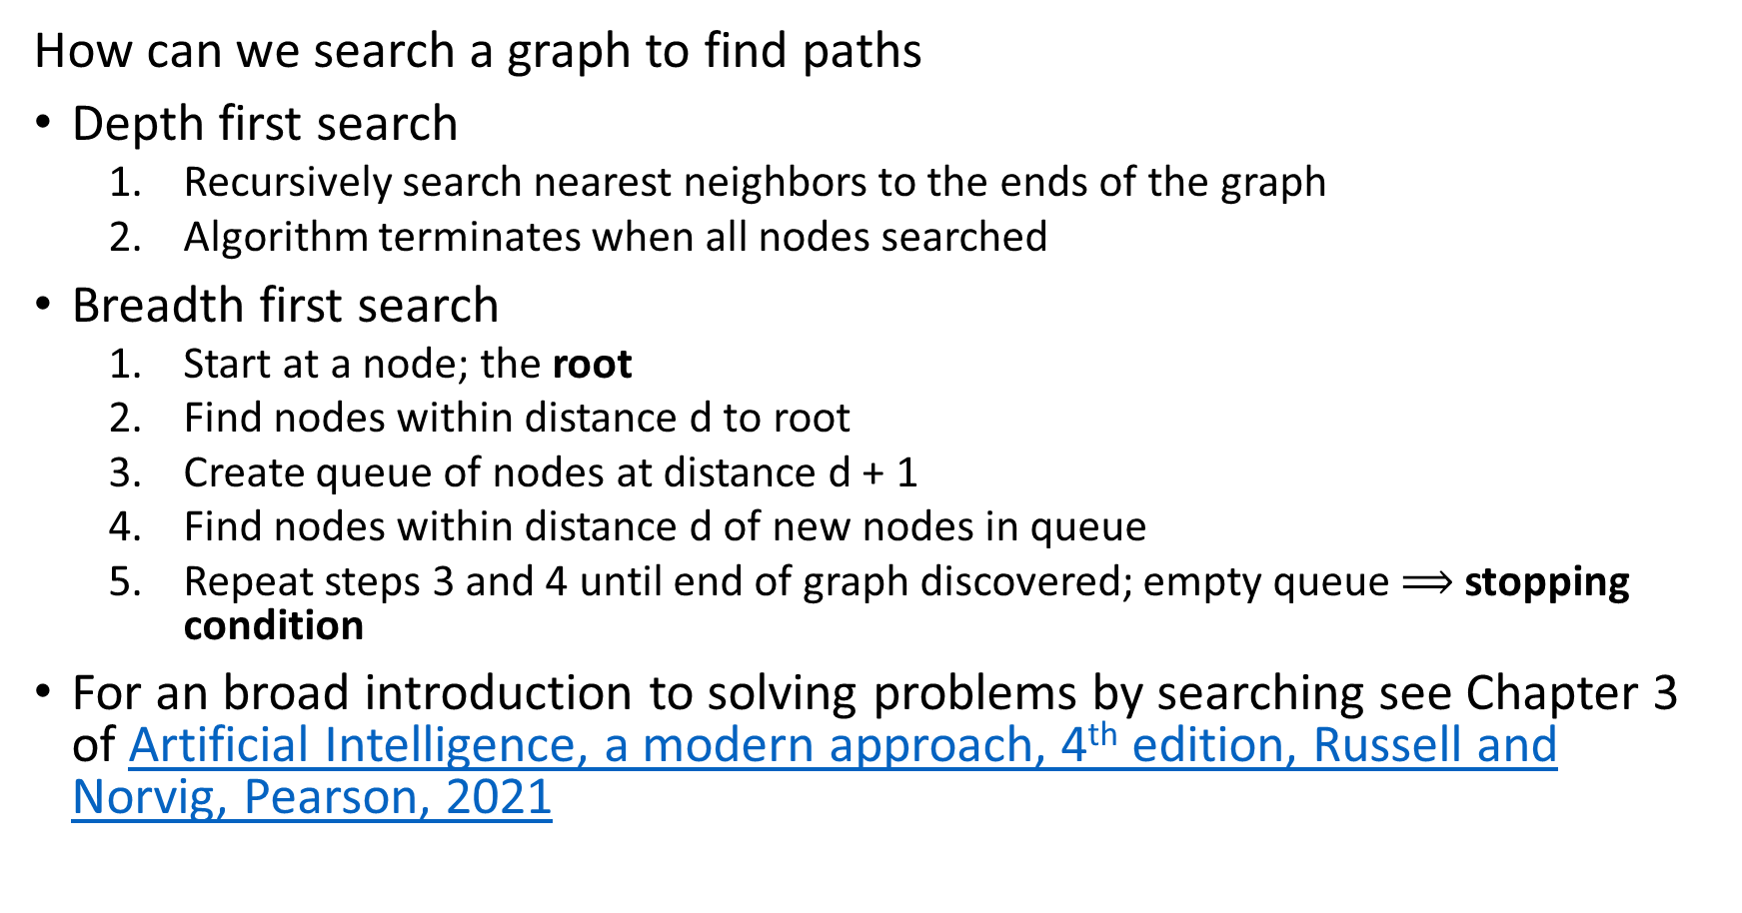
Breadth First Search Algorithm
How can we search a graph to find paths
Depth first search
  Recursively search nearest neighbors to the ends of the graph
  Algorithm terminates when all nodes searched
Breadth first search
  Start at a node; the root
  Find nodes within distance d to root
  Create queue of nodes at distance d + 1
  Find nodes within distance d of new nodes in queue
  Repeat steps 3 and 4 until end of graph discovered; empty queue $⟹$ stopping condition
For an broad introduction to solving problems by searching see Chapter 3 of Artificial Intelligence, a modern approach, 4th edition, Russell and Norvig, Pearson, 2021

Slide 42
Breadth First Search Algorithm
Basic breadth first search algorithm
Start with root node on graph at distance 0
Find nodes at distance d from the root
Find nodes at distance d = 1
Find nodes at distance d = 2
Continue until the termination condition is reached
  End nodes of the graph
  Maximum depth
0
D=1
D=2

Slide 43
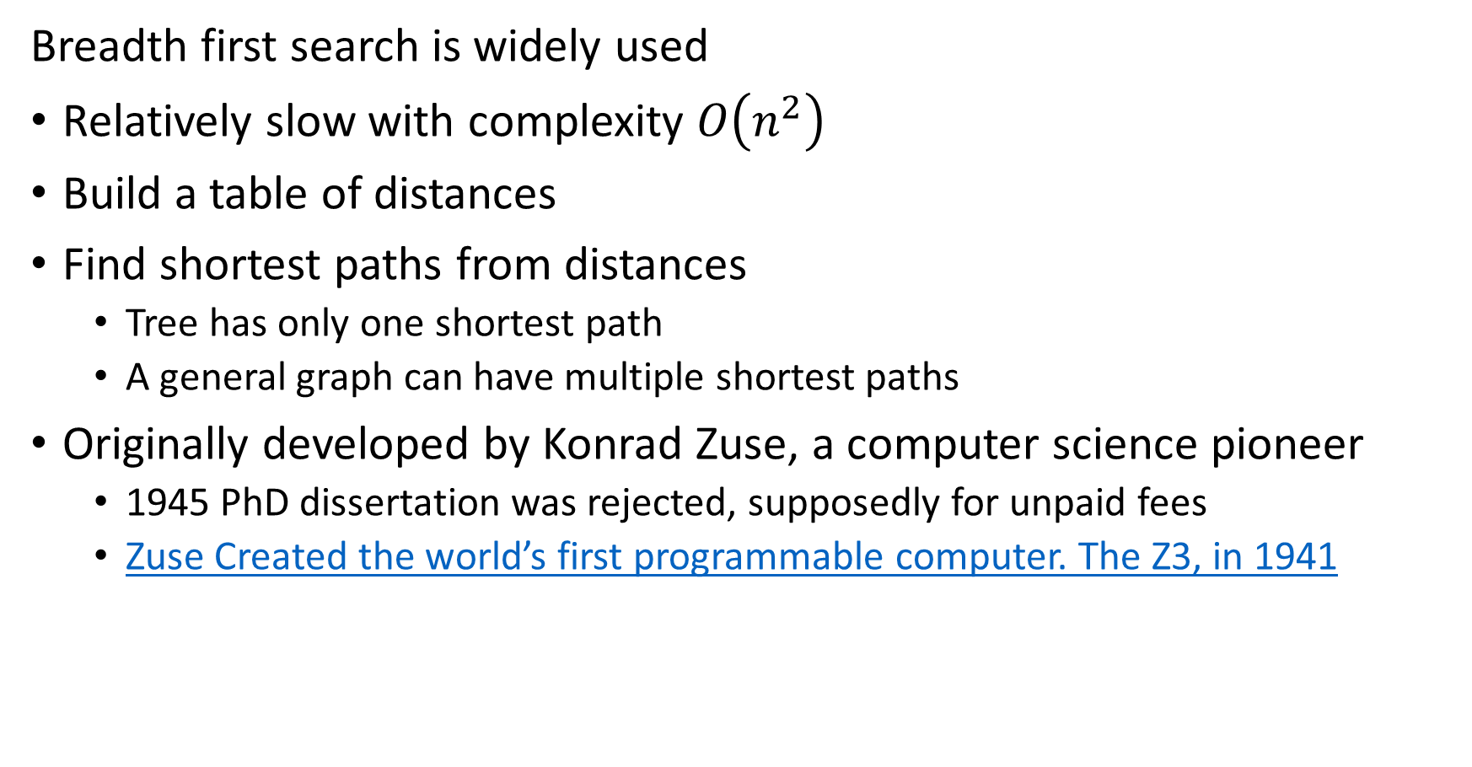
Breadth First Search Algorithm
Breadth first search is widely used
Relatively slow with complexity $O\left(n^{2}\right)$
Build a table of distances
Find shortest paths from distances
  Tree has only one shortest path
  A general graph can have multiple shortest paths
Originally developed by Konrad Zuse, a computer science pioneer
  1945 PhD dissertation was rejected, supposedly for unpaid fees
  Zuse Created the world’s first programmable computer. The Z3, in 1941

Slide 44
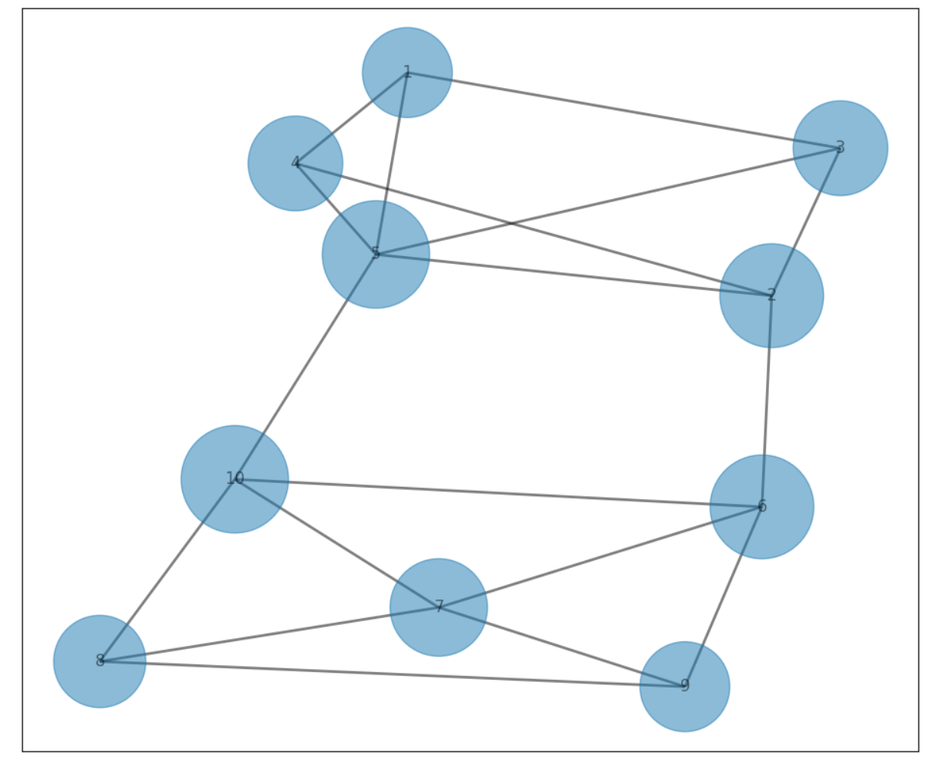
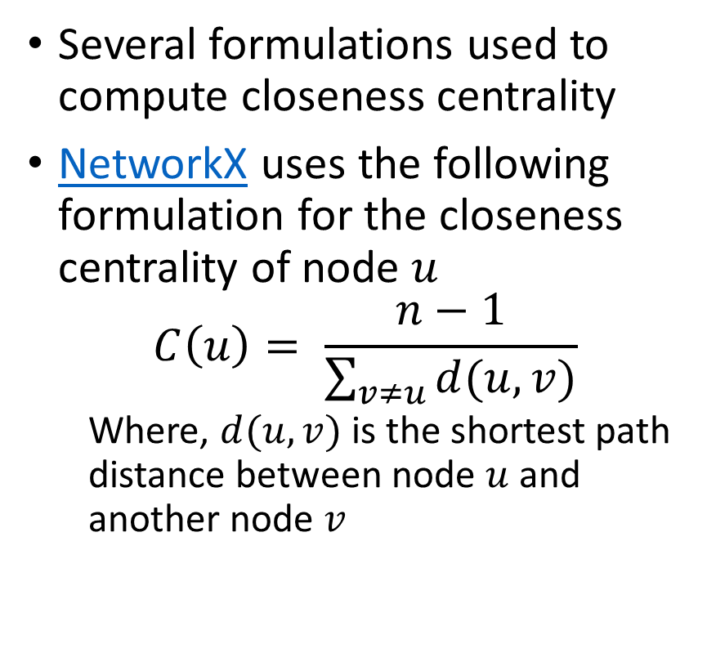
Closeness Centrality
Closeness centrality measures average closeness of a node to other nodes in a network
Several formulations used to compute closeness centrality
NetworkX uses the following formulation for the closeness centrality of node $u$
$$C\left(u\right)= \frac{n−1}{\sum_{v≠u}{d(u,v)}}$$
  Where, $d(u,v)$ is the shortest path distance between node $u$ and another node $v$

Slide 45
Betweenness of Social Network Communities
Betweenness measures the number of paths between parts of a graph
Betweenness is the number of pairwise shortest paths passing though part of a graph
Expect high betweenness between communities – few possible paths
Node betweenness is the number of pairwise shortest paths passing through a given node in the graph
Edge betweenness is the number of pairwise shortest paths passing through a given edge in the graph

Slide 46
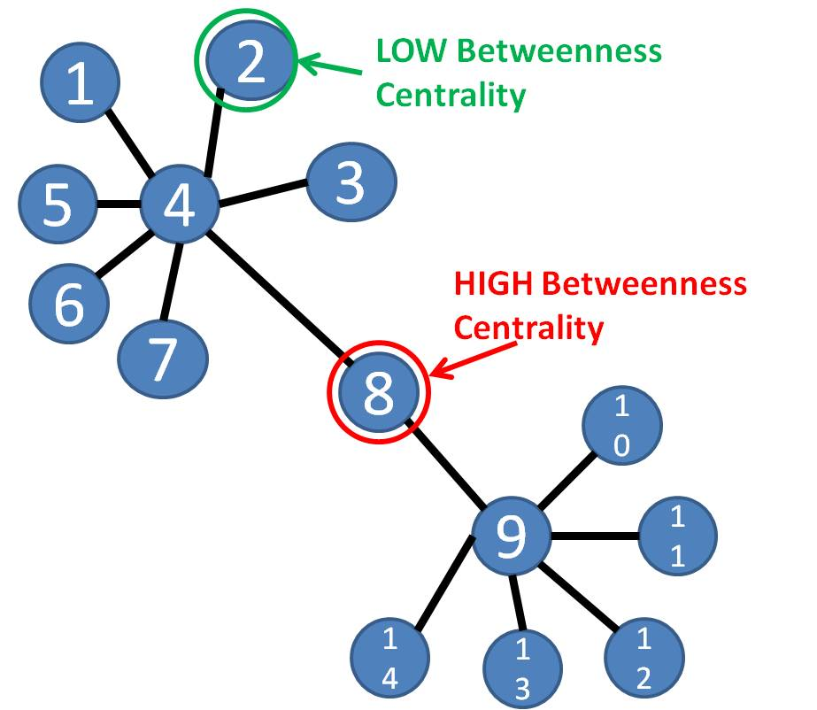
Betweenness Social Network Communities
Betweenness measures the number of paths between parts of a graph
Example: a single node is on path between members of two communities
Can use betweenness to separate communities
Source: bsmithactivity3

Slide 47
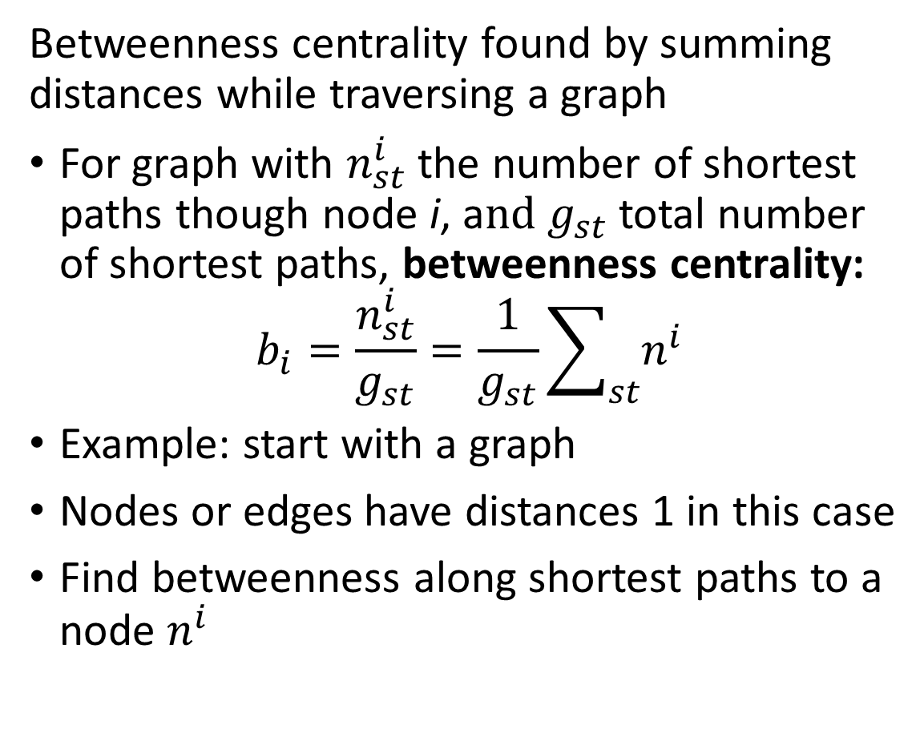
Betweenness of Social Networks
s
Betweenness centrality found by summing distances while traversing a graph
For graph with $n_{st}^{i}$ the number of shortest paths though node i, a$nd g_{st}$total number of shortest paths, betweenness centrality:
$$b_{i}=\frac{n_{st}^{i}}{g_{st}}=\frac{1}{g_{st}}\sum_{st}{n_{ }^{i}}$$
Example: start with a graph
Nodes or edges have distances 1 in this case
Find betweenness along shortest paths to a node $n_{ }^{i}$
1
1
1
1
1
1

Slide 48




Betweenness of Social Networks
s
Betweenness centrality found by summing distances while traversing a graph
Starting with the most distant nodes
Sum distances
If multiple paths, divide distance (weight) between paths
Continue summing until reaching s
$$\frac{5}{2}$$
$$\frac{7}{2}$$
1
1
$$\frac{3}{2}$$
$$\frac{5}{2}$$
1
1
1
1

Slide 49
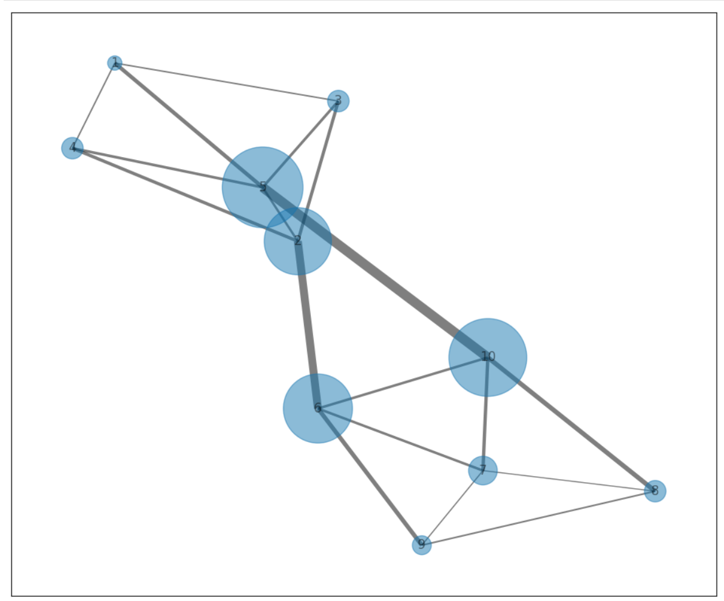
Betweenness of Social Networks
Betweenness centrality found by summing distances while traversing a graph
Betweenness can be computed for both nodes and edges
High betweenness nodes and edges lie between communities

Slide 50
Cliques and K-Cores

Slide 51
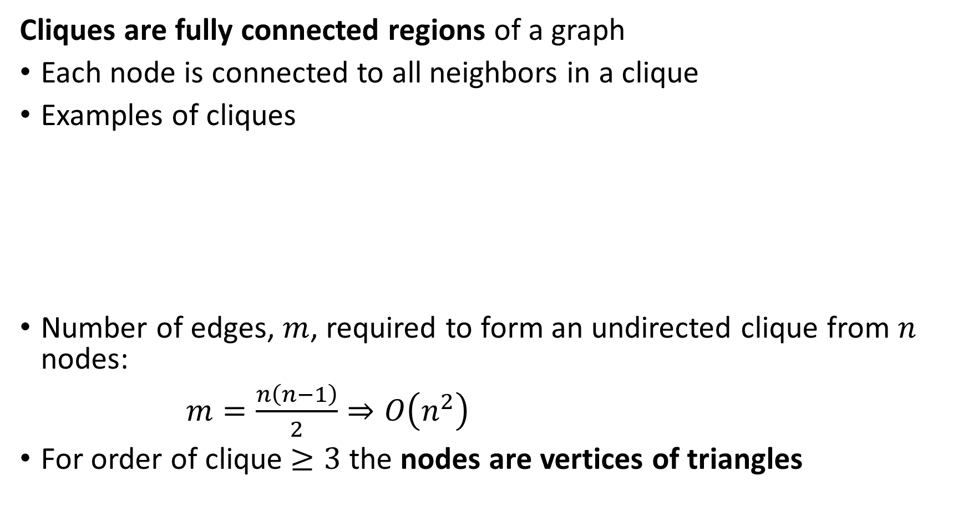
Cliques and K-Cores
Cliques are fully connected regions of a graph
Each node is connected to all neighbors in a clique
Examples of cliques
Number of edges, $m$, required to form an undirected clique from $n$ nodes:
$m=\frac{n\left(n−1\right)}{2}⇒O\left(n^{2}\right)$
For order of clique $≥3$ the nodes are vertices of triangles
2-Clique
3-Clique
4-Clique
5-Clique

Slide 52
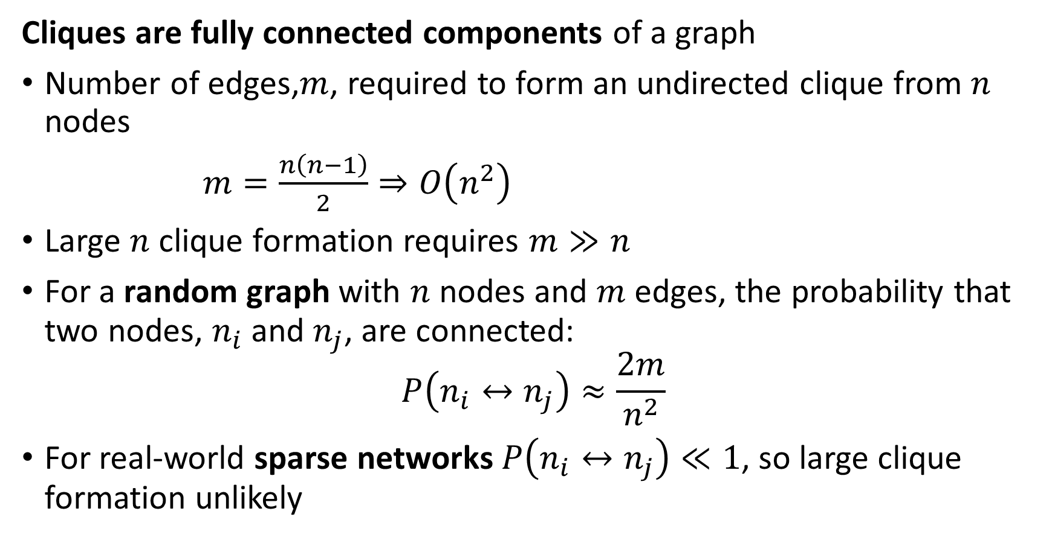
Cliques and K-Cores
Cliques are fully connected components of a graph
Number of edges,$m$, required to form an undirected clique from $n$ nodes
$m=\frac{n\left(n−1\right)}{2}⇒O\left(n^{2}\right)$
Large $n$ clique formation requires $m≫n$
For a random graph with $n$ nodes and $m$ edges, the probability that two nodes, $n_{i}$ and $n_{j}$, are connected:
$$P\left(n_{i}↔n_{j}\right)≈\frac{2m}{n^{2}}$$
For real-world sparse networks$P\left(n_{i}↔n_{j}\right)≪1$, so large clique formation unlikely

Slide 53
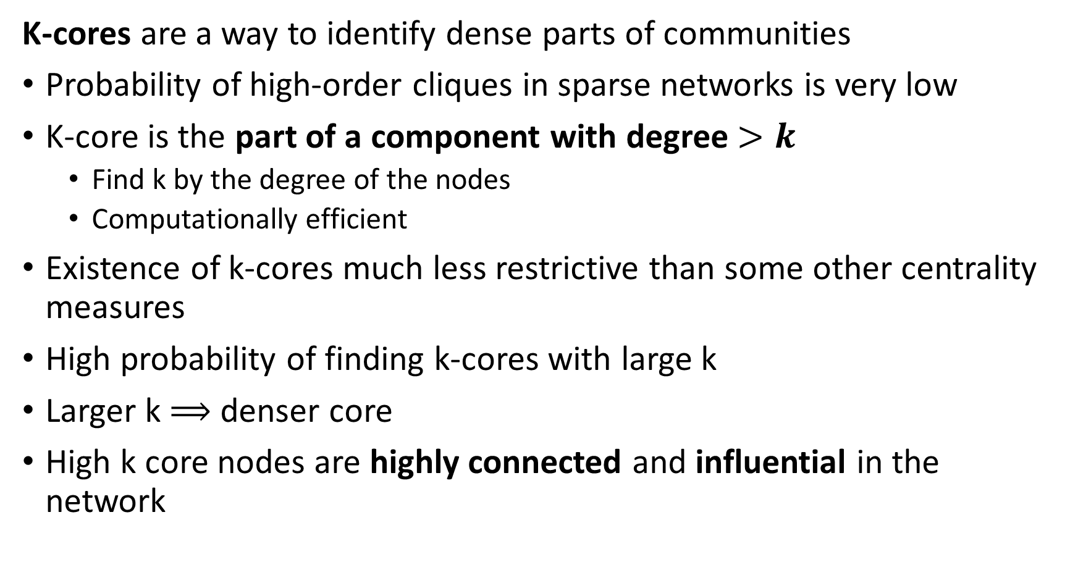
Cliques and K-Cores
K-cores are a way to identify dense parts of communities
Probability of high-order cliques in sparse networks is very low
K-core is the part of a component with degree $>k$
  Find k by the degree of the nodes
  Computationally efficient
Existence of k-cores much less restrictive than some other centrality measures
High probability of finding k-cores with large k
Larger k $⟹$ denser core
High k core nodes are highly connected and influential in the network

Slide 54
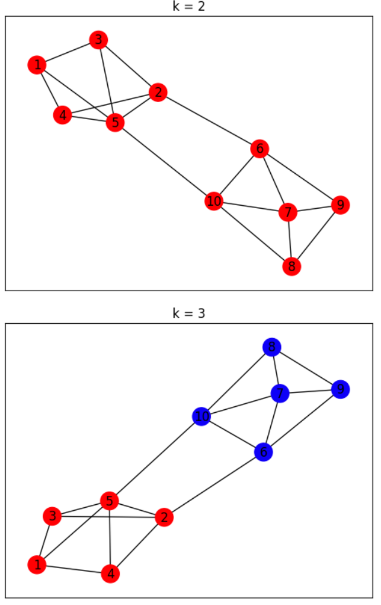
Cliques and K-Cores
K-cores are a way to identify dense parts of communities
Example: k-cores of a simple network
Higher values of k correspond to nodes with higher centrality
Subcommunities each can have a k-core

Slide 55
Communities and Triangle Density

Slide 56
Communities and Triangle Density
Density of triangles is an indicator of community cores
Empirically, we expect when a person is connected to 2 other people, the other people are more likely to be connected to each other
In a random graph, two people connected to a common individual will only be connected to each other by random coincidence:
In a community there is a high probability of completing the triangle of relationships or creating a triad:
Low probability of completing triangle in random graph
High probability of completing triangle in community

Slide 57
Communities and Triangle Density
Density of triangles is an indicator or community cores
A relationship in a graph: if u is connected to w and v is connected to w the relationship is transitive if u is connected to v:
The human version of transitivity: the friend of my friend is my friend
Density of triangle in a social graph is a measure of density
u
v
w

Slide 58
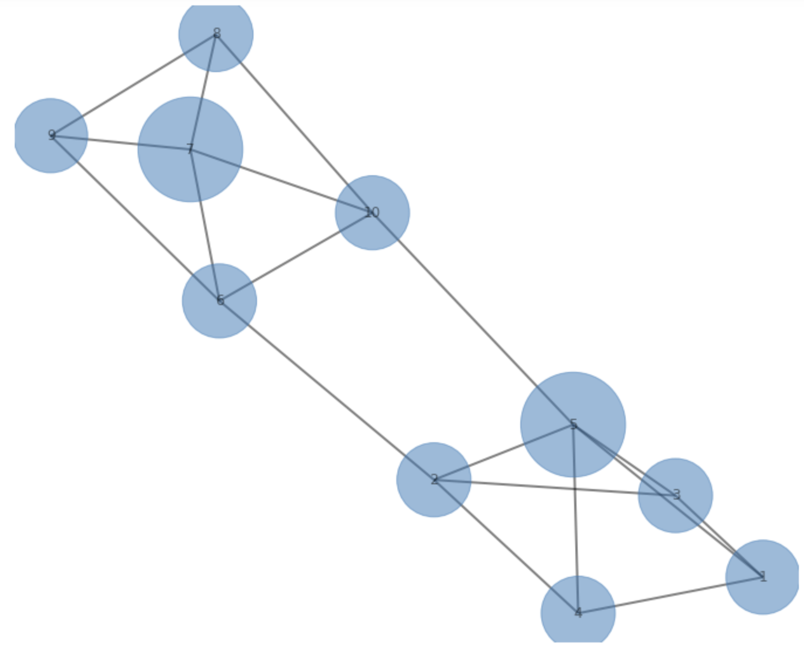
Communities and Triangle Density
Example: Density of triangles is an indicator of community cores, or influential nodes

Slide 59
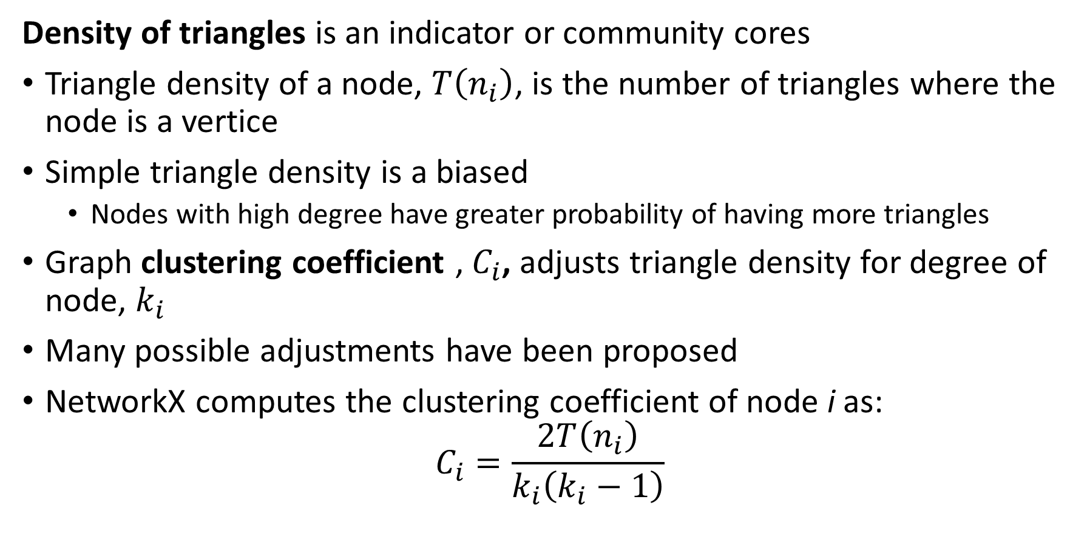
Communities and Triangle Density
Density of triangles is an indicator or community cores
Triangle density of a node, $T\left(n_{i}\right)$, is the number of triangles where the node is a vertice
Simple triangle density is a biased
  Nodes with high degree have greater probability of having more triangles
Graph clustering coefficient , $C_{i}$, adjusts triangle density for degree of node, $k_{i}$
Many possible adjustments have been proposed
NetworkX computes the clustering coefficient of node i as:
$$C_{i}=\frac{2T\left(n_{i}\right)}{k_{i}\left(k_{i}−1\right)}$$

Slide 60
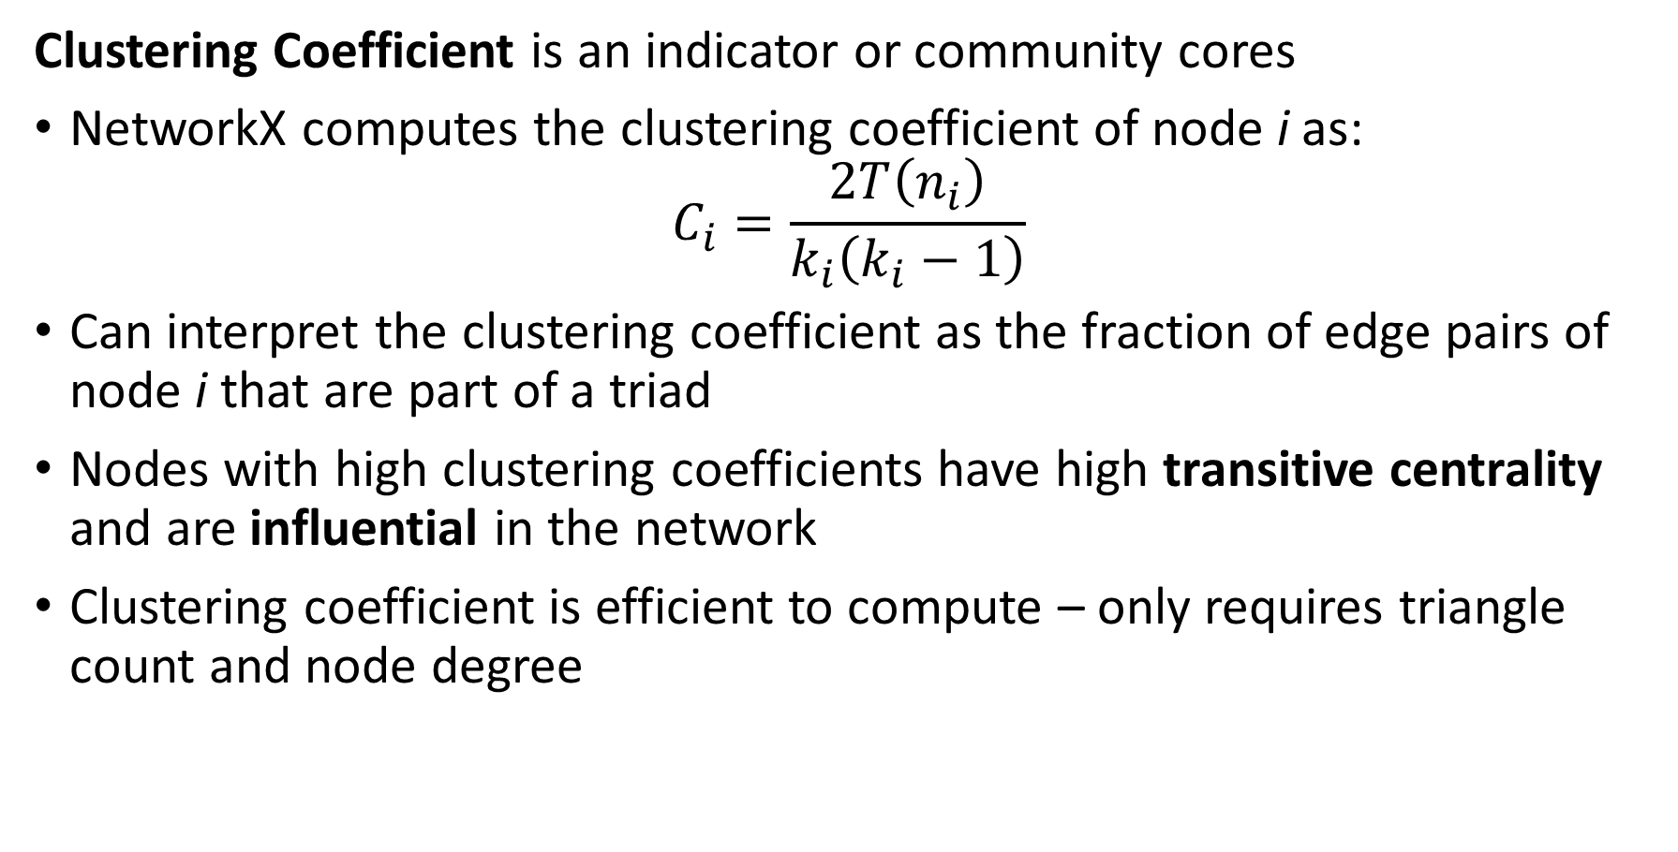
Communities and Triangle Density
Clustering Coefficient is an indicator or community cores
NetworkX computes the clustering coefficient of node i as:
$$C_{i}=\frac{2T\left(n_{i}\right)}{k_{i}\left(k_{i}−1\right)}$$
Can interpret the clustering coefficient as the fraction of edge pairs of node i that are part of a triad
Nodes with high clustering coefficients have high transitive centrality and are influential in the network
Clustering coefficient is efficient to compute – only requires triangle count and node degree

Slide 61
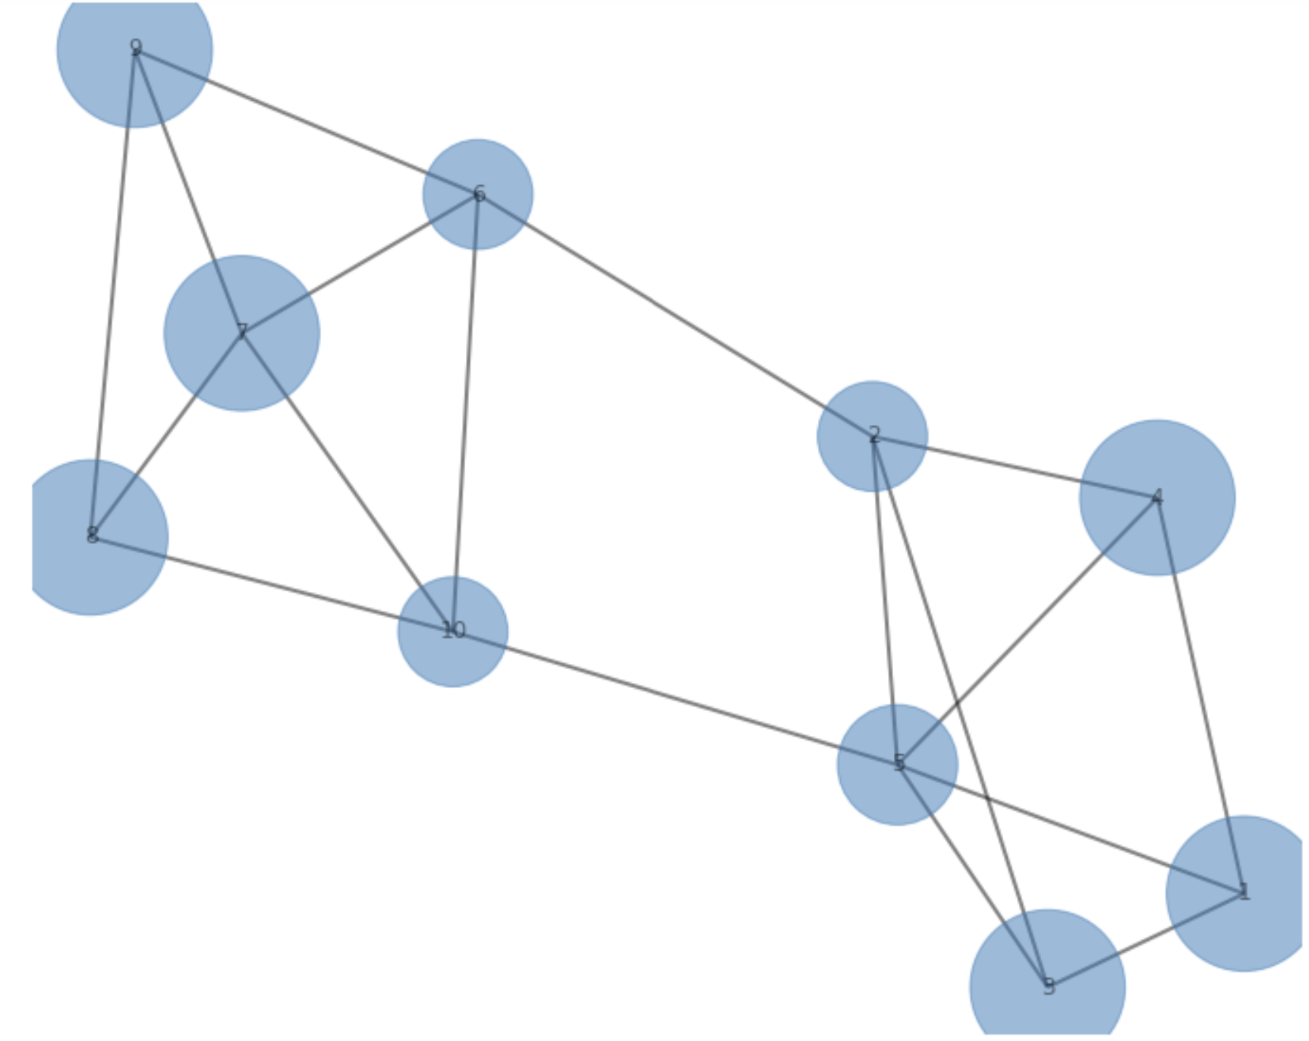
Communities and Triangle Density
Example: Clustering Coefficient as an indicator of community cores or node influence

Slide 62
Modularity in Communities

Slide 63
Modularity of Communities
Modularity estimates the extent that edges concentrate in communities
Communities are groups of nodes with some common characteristics
Examples:
  Members of an organization
  Work collaborators
  Animals in an ecosystem
  …….
Empirically, the density of edges within communities is higher than a random graph
Modularity is a metric to compare the connection in a community to a random network.

Slide 64
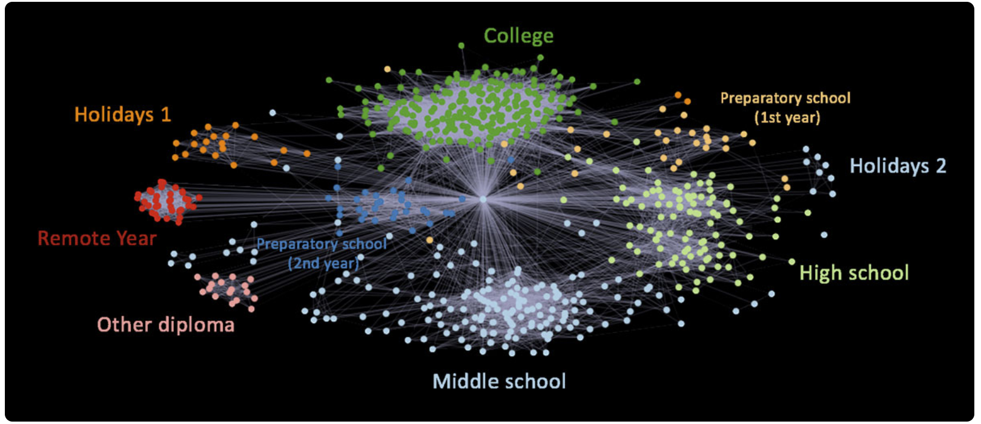
Modularity of Communities
Modularity estimates the extent that edges concentrate in communities
Example from Elliot Anders blog post on visualizing his Facebook friends

Slide 65
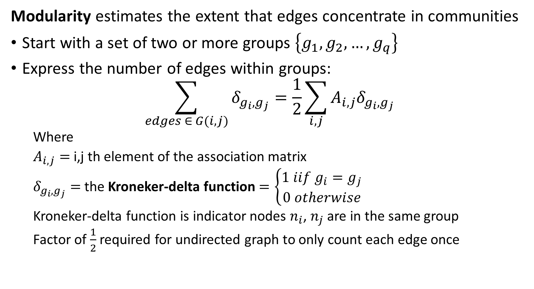
Modularity of Communities
Modularity estimates the extent that edges concentrate in communities
Start with a set of two or more groups $\left\{g_{1},g_{2},…,g_{q}\right\}$
Express the number of edges within groups:
$$\sum_{edges ∈ G(i,j)}{δ_{g_{i},g_{j}}=\frac{1}{2}}\sum_{i,j}{A_{i,j}δ_{g_{i},g_{j}}}$$
  Where
  $A_{i,j}=$ i,j th element of the association matrix
  $δ_{g_{i},g_{j}}=$ the Kroneker-delta function $=\left\{\begin{aligned}1 iif{ g}_{i}=g_{j} \\ 0 otherwise\end{aligned}\right.$
  Kroneker-delta function is indicator nodes $n_{i}$, $n_{j}$ are in the same group
  Factor of $\frac{1}{2}$ required for undirected graph to only count each edge once

Slide 66
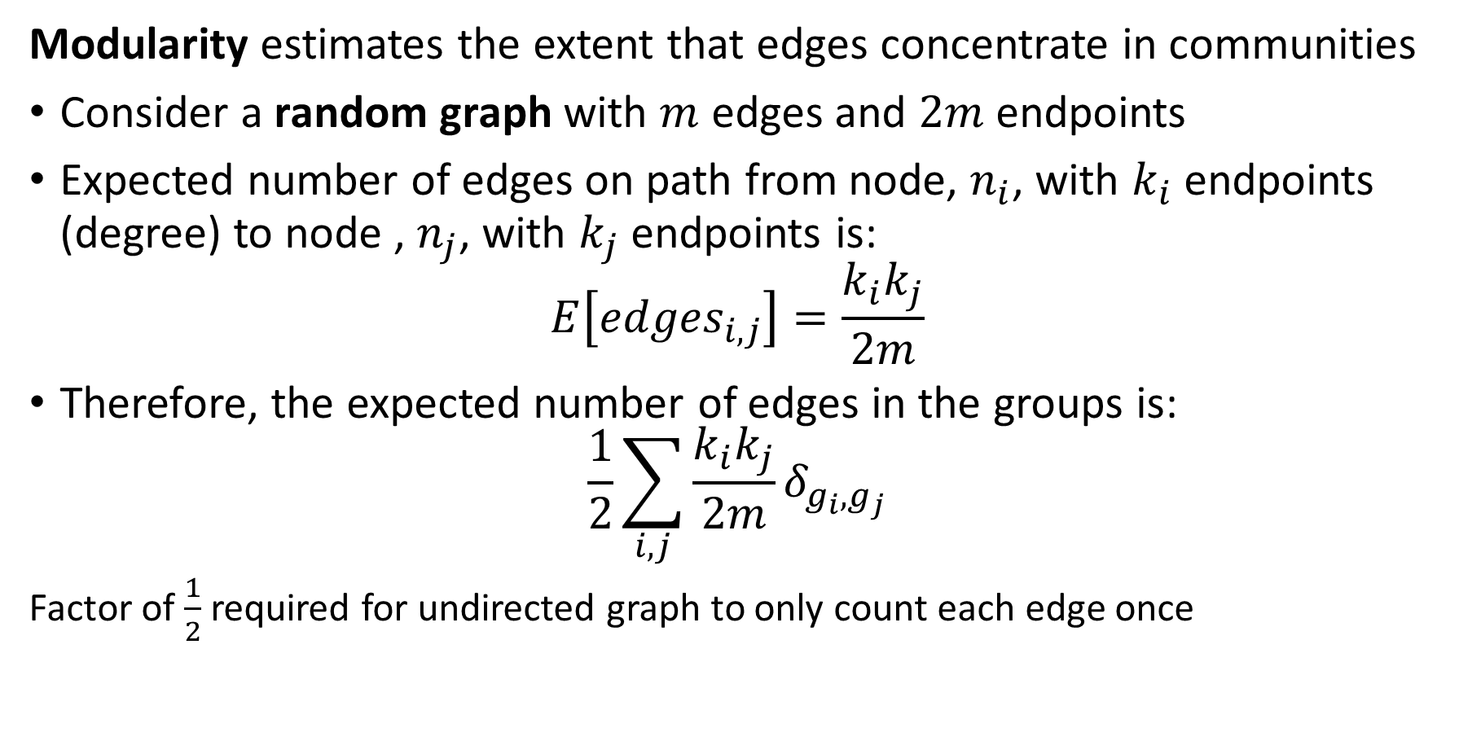
Modularity of Communities
Modularity estimates the extent that edges concentrate in communities
Consider a random graph with $m$ edges and $2m$ endpoints
Expected number of edges on path from node, $n_{i}$, with $k_{i}$ endpoints (degree) to node , $n_{j}$, with $k_{j}$ endpoints is:
$$E\left[{edges}_{i,j}\right]=\frac{k_{i}k_{j}}{2m}$$
Therefore, the expected number of edges in the groups is:
$$\frac{1}{2}\sum_{i,j}{\frac{k_{i}k_{j}}{2m}δ_{g_{i},g_{j}}}$$
Factor of $\frac{1}{2}$ required for undirected graph to only count each edge once

Slide 67
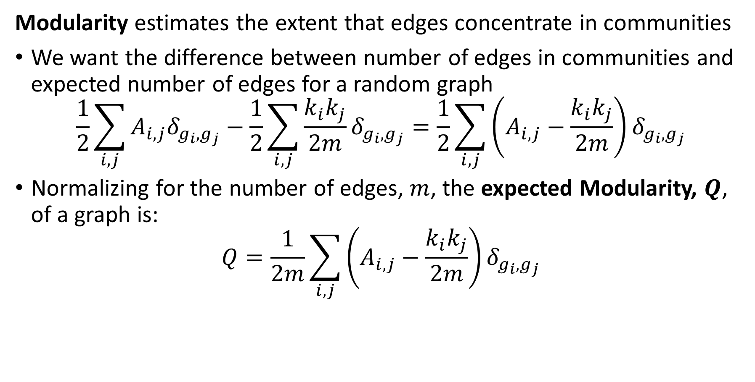
Modularity of Communities
Modularity estimates the extent that edges concentrate in communities
We want the difference between number of edges in communities and expected number of edges for a random graph
$$\frac{1}{2}\sum_{i,j}{A_{i,j}δ_{g_{i},g_{j}}}−\frac{1}{2}\sum_{i,j}{\frac{k_{i}k_{j}}{2m}δ_{g_{i},g_{j}}}=\frac{1}{2}\sum_{i,j}{\left(A_{i,j}−\frac{k_{i}k_{j}}{2m}\right)δ_{g_{i},g_{j}}}$$
Normalizing for the number of edges, $m$, the expected Modularity, $Q$, of a graph is:
$$Q=\frac{1}{2m}\sum_{i,j}{\left(A_{i,j}−\frac{k_{i}k_{j}}{2m}\right)δ_{g_{i},g_{j}}}$$

Slide 68
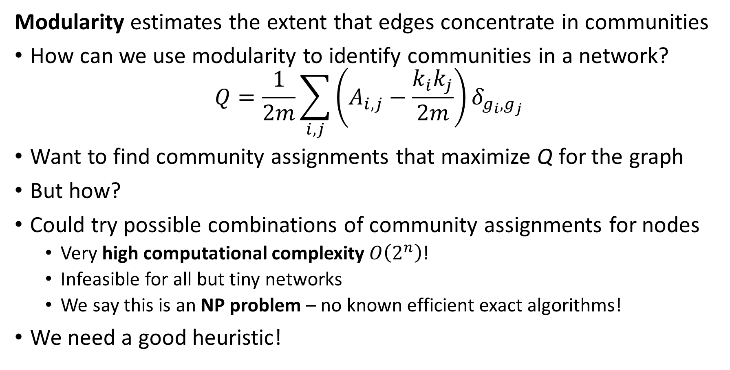
Modularity of Communities
Modularity estimates the extent that edges concentrate in communities
How can we use modularity to identify communities in a network?
$$Q=\frac{1}{2m}\sum_{i,j}{\left(A_{i,j}−\frac{k_{i}k_{j}}{2m}\right)δ_{g_{i},g_{j}}}$$
Want to find community assignments that maximize Q for the graph
But how?
Could try possible combinations of community assignments for nodes
  Very high computational complexity $O\left(2^{n}\right)$!
  Infeasible for all but tiny networks
  We say this is an NP problem – no known efficient exact algorithms!
We need a good heuristic!

Slide 69
Modularity of Communities
Many heuristics for community search to maximize modularity
Methods that sample possible community assignments
  Simulated annealing
  Genetic algorithms
  Generally, require significant computational power
Optimization algorithms
  Information theoretic loss function
  Maximum likelihood methods
Greedy reallocation of community assignments
Spectral Modularity Maximization

Slide 70
Greedy Modularity Search

Slide 71
Greedy Modularity Search for Communities
Greedy reallocation of community assignments
Greedy algorithm may never find optimal solution
Accept any allocation that improves modularity - greedy
No backtracking – all assignments depend on current state of community assignments
Dependent on initial partition of network

Slide 72
Greedy Modularity Search for Communities
Greedy reallocation of community assignments
Procedure Division(Network):
  C1, C2 <- equal_division (Network) # start with equal random division
  Network <- community_assignments(C1, C2) # initial community assignments
  M <- modularity(Network) # initial modularity
  for n steps:
    node <- random_sample(Network) # sample node at random
    node_temp <- switch_community(node) # change assignment of node
    M_temp <- modularity(Network, node_temp) # measure modularity of assignment
    If M_temp > M: # greedy update of network
    Network <- community_assignments(M_temp)
    M = M_temp
  return(network)

Slide 73
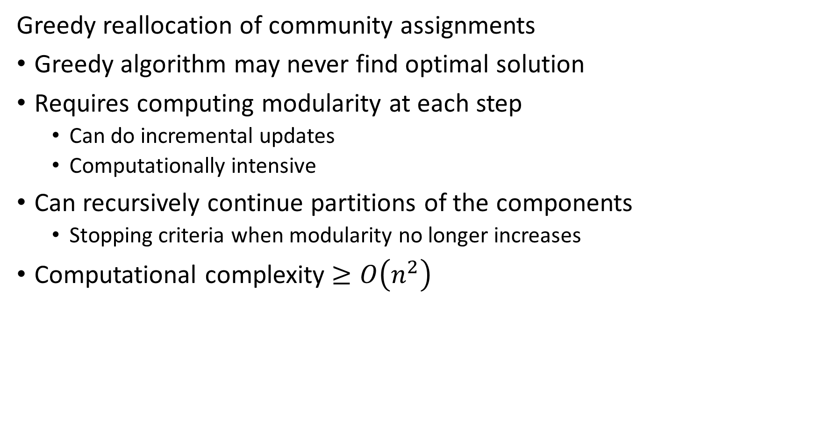
Greedy Modularity Search for Communities
Greedy reallocation of community assignments
Greedy algorithm may never find optimal solution
Requires computing modularity at each step
  Can do incremental updates
  Computationally intensive
Can recursively continue partitions of the components
  Stopping criteria when modularity no longer increases
Computational complexity $≥O\left(n^{2}\right)$

Slide 74
Community Search with Spectral Maximization

Slide 75
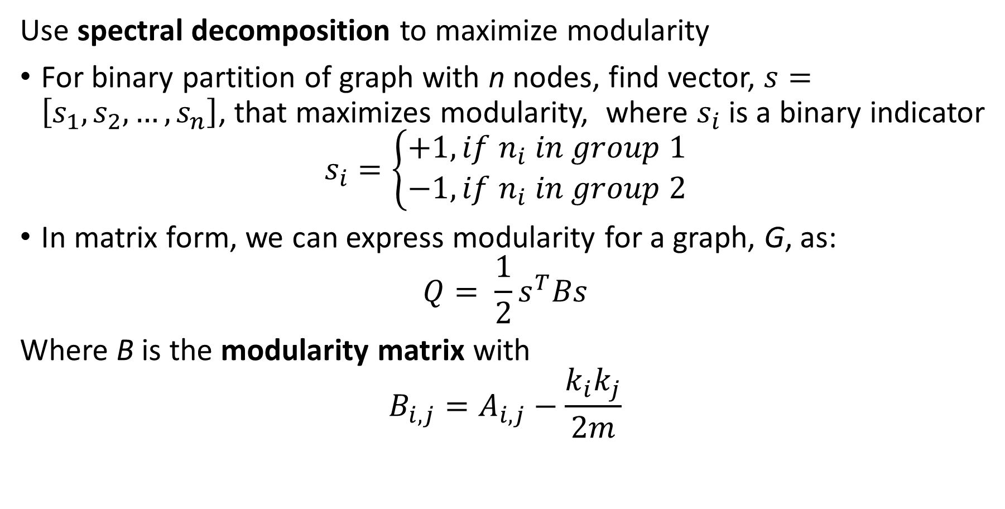
Spectral Modularity Maximization
Use spectral decomposition to maximize modularity
For binary partition of graph with n nodes, find vector, $s=\left[s_{1},s_{2},…, s_{n}\right]$, that maximizes modularity, where $s_{i}$ is a binary indicator
$$s_{i}=\left\{\begin{aligned}+1, if n_{i} in group 1 \\ −1, if n_{i} in group 2\end{aligned}\right.$$
In matrix form, we can express modularity for a graph, G, as:
$$Q= \frac{1}{2}s^{T}Bs$$
Where B is the modularity matrix with
$$B_{i,j}=A_{i,j}−\frac{k_{i}k_{j}}{2m}$$

Slide 76
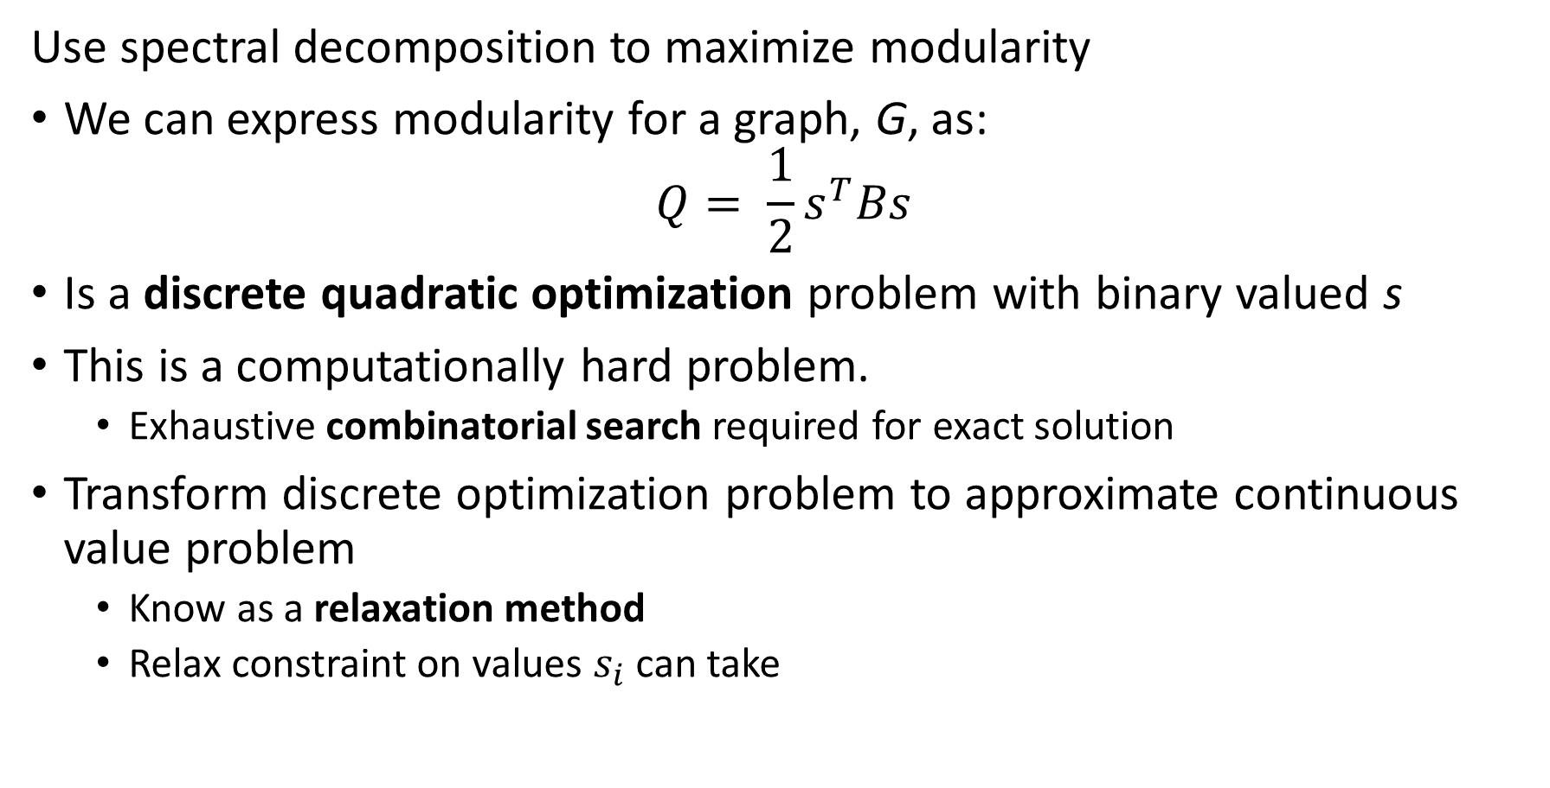
Spectral Modularity Maximization
Use spectral decomposition to maximize modularity
We can express modularity for a graph, G, as:
$$Q= \frac{1}{2}s^{T}Bs$$
Is a discrete quadratic optimization problem with binary valued s
This is a computationally hard problem.
  Exhaustive combinatorial search required for exact solution
Transform discrete optimization problem to approximate continuous value problem
  Know as a relaxation method
  Relax constraint on values $s_{i}$ can take

Slide 77
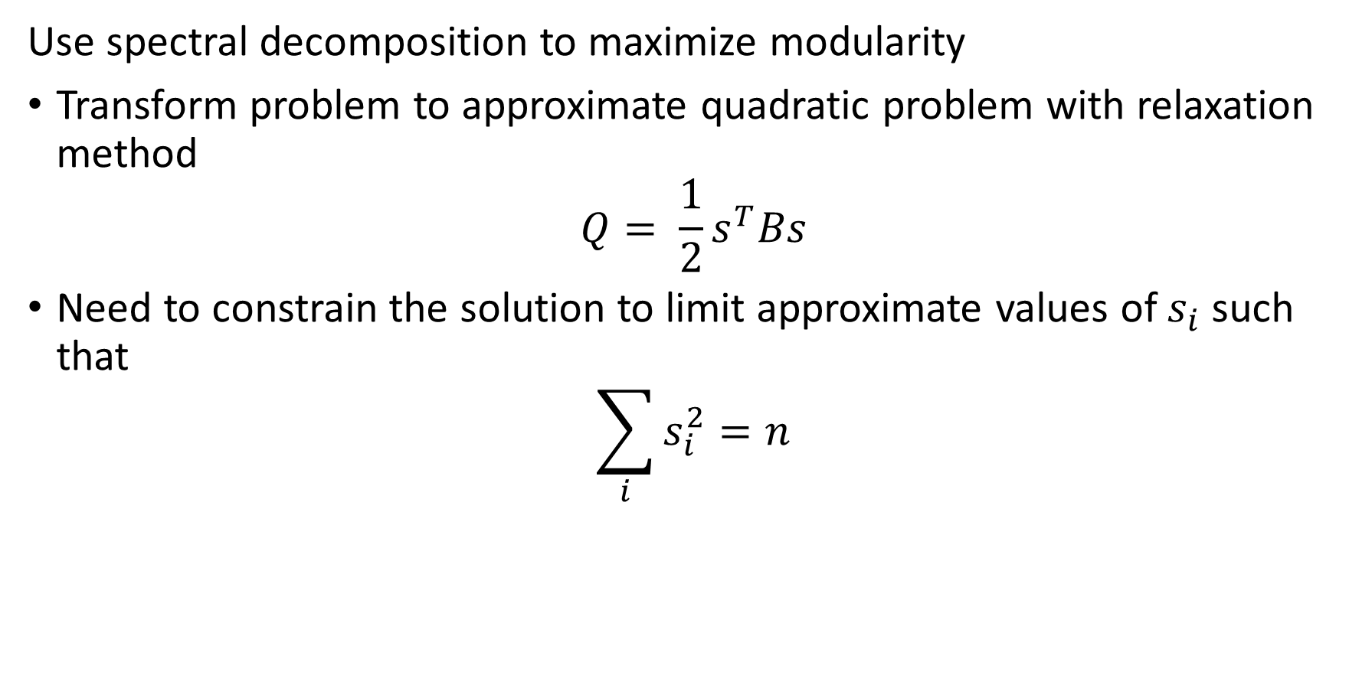
Spectral Modularity Maximization
Use spectral decomposition to maximize modularity
Transform problem to approximate quadratic problem with relaxation method
$$Q= \frac{1}{2}s^{T}Bs$$
Need to constrain the solution to limit approximate values of $s_{i}$ such that
$$\sum_{i}{s_{i}^{2}=n}$$

Slide 78
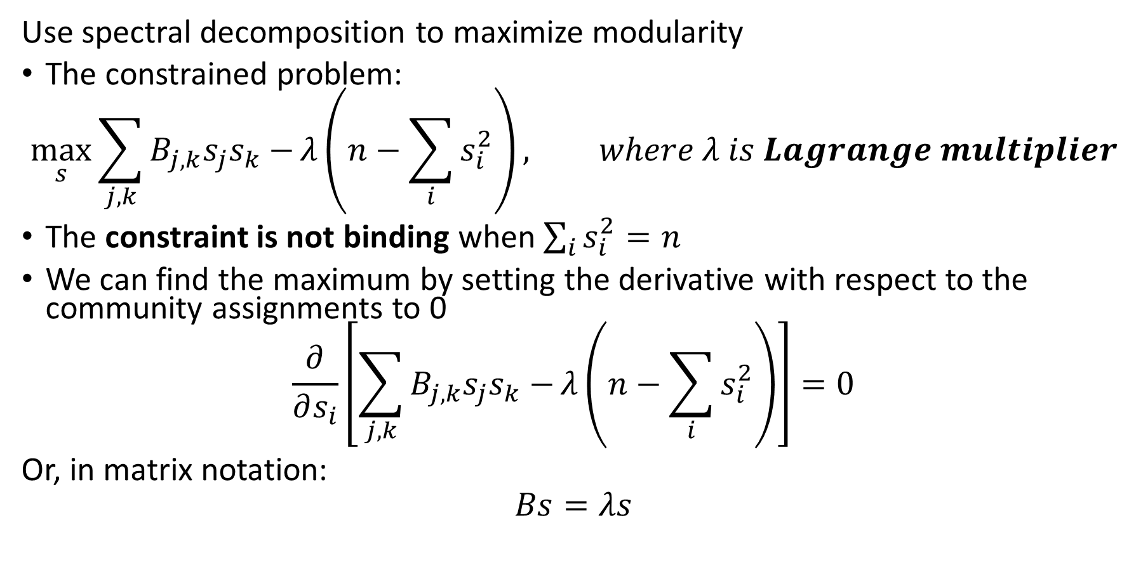
Spectral Modularity Maximization
Use spectral decomposition to maximize modularity
The constrained problem:
$$\max_{s}{\sum_{j,k}{B_{j,k}s_{j}s_{k}−}λ\left(n−\sum_{i}{s_{i}^{2}}\right)}, where λ is Lagrange multiplier$$
The constraint is not binding when $\sum_{i}{s_{i}^{2}=n}$
We can find the maximum by setting the derivative with respect to the community assignments to 0
$$\frac{∂}{∂s_{i}}\left[\sum_{j,k}{B_{j,k}s_{j}s_{k}−}λ\left(n−\sum_{i}{s_{i}^{2}}\right)\right]=0$$
Or, in matrix notation:
$$Bs=λs$$

Slide 79
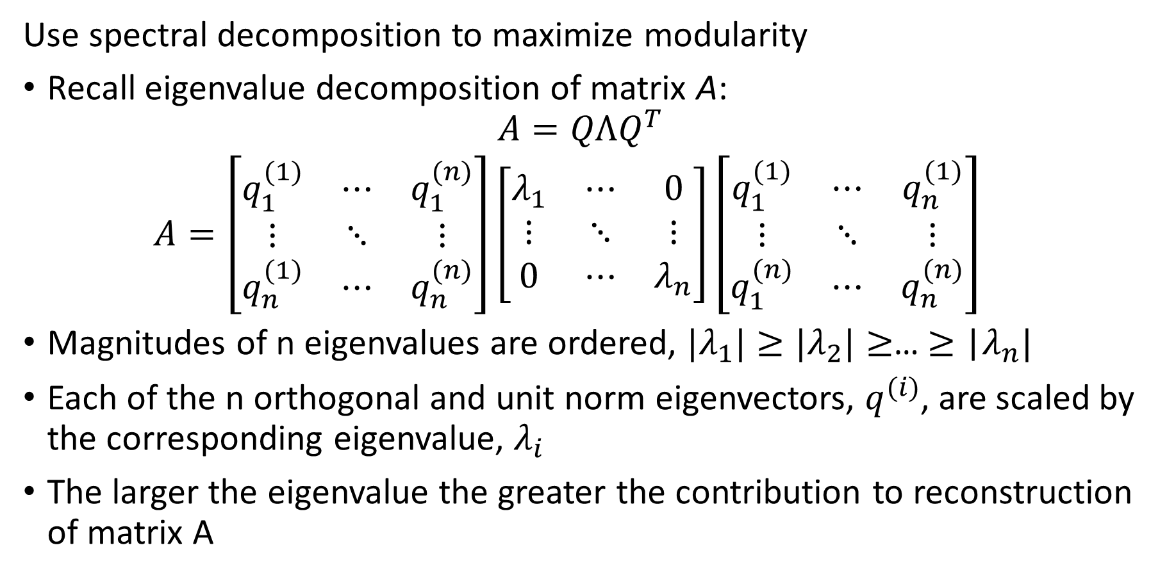
Spectral Modularity Maximization
Use spectral decomposition to maximize modularity
Recall eigenvalue decomposition of matrix A:
$$A=QΛQ^{T}$$
$$A=\left[\begin{matrix}q_{1}^{(1)} & ⋯ & q_{1}^{(n)} \\ ⋮ & ⋱ & ⋮ \\ q_{n}^{(1)} & ⋯ & q_{n}^{(n)}\end{matrix}\right]\left[\begin{matrix}λ_{1} & ⋯ & 0 \\ ⋮ & ⋱ & ⋮ \\ 0 & ⋯ & λ_{n}\end{matrix}\right]{\left[\begin{matrix}q_{1}^{(1)} & ⋯ & q_{n}^{(1)} \\ ⋮ & ⋱ & ⋮ \\ q_{1}^{(n)} & ⋯ & q_{n}^{(n)}\end{matrix}\right]}^{}$$
Magnitudes of n eigenvalues are ordered, ${|λ}_{1}|≥{|λ}_{2}|≥$… $≥$ |$λ_{n}|$
Each of the n orthogonal and unit norm eigenvectors, $q_{ }^{(i)}$, are scaled by the corresponding eigenvalue, $λ_{i}$
The larger the eigenvalue the greater the contribution to reconstruction of matrix A

Slide 80
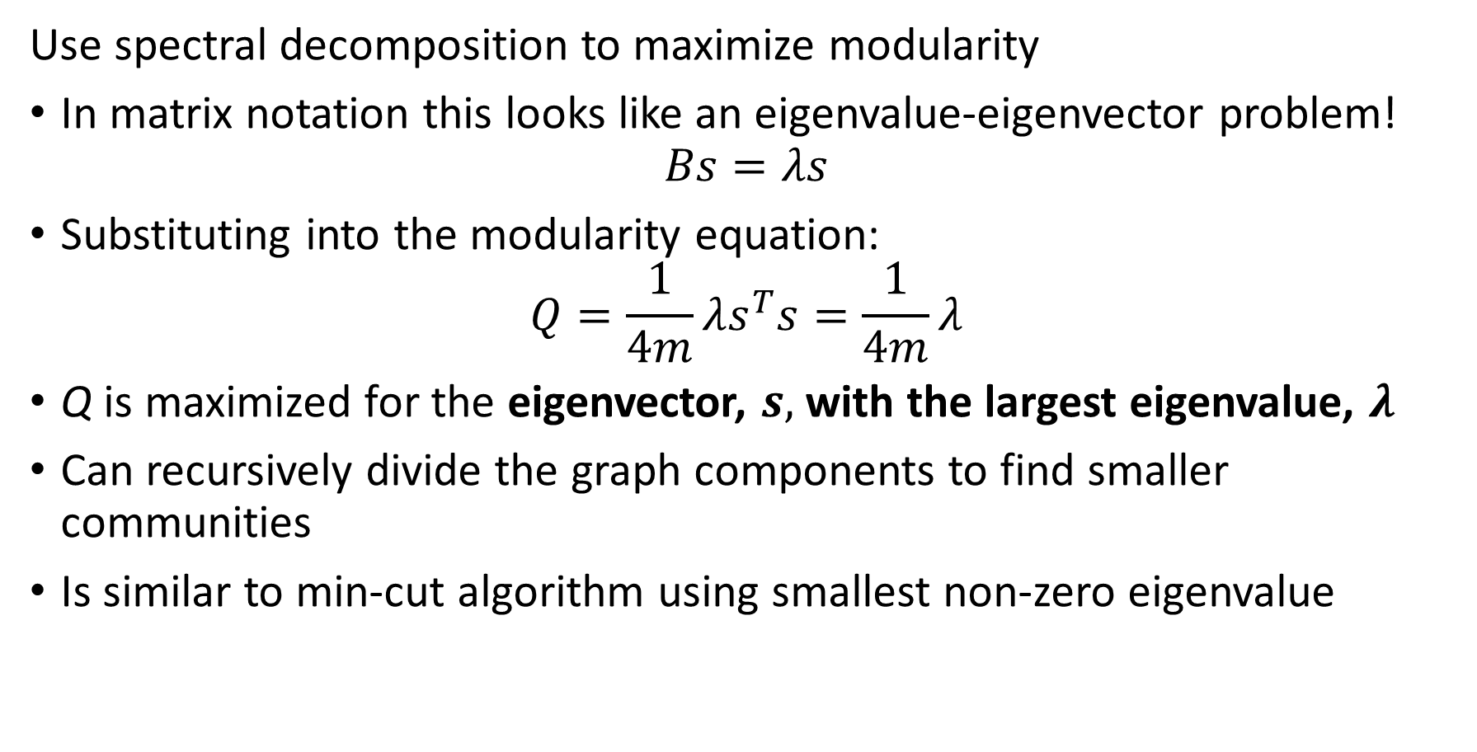
Spectral Modularity Maximization
Use spectral decomposition to maximize modularity
In matrix notation this looks like an eigenvalue-eigenvector problem!
$$Bs=λs$$
Substituting into the modularity equation:
$$Q=\frac{1}{4m}λs^{T}s=\frac{1}{4m}λ$$
Q is maximized for the eigenvector, $s,$ with the largest eigenvalue, $λ$
Can recursively divide the graph components to find smaller communities
Is similar to min-cut algorithm using smallest non-zero eigenvalue

Slide 81
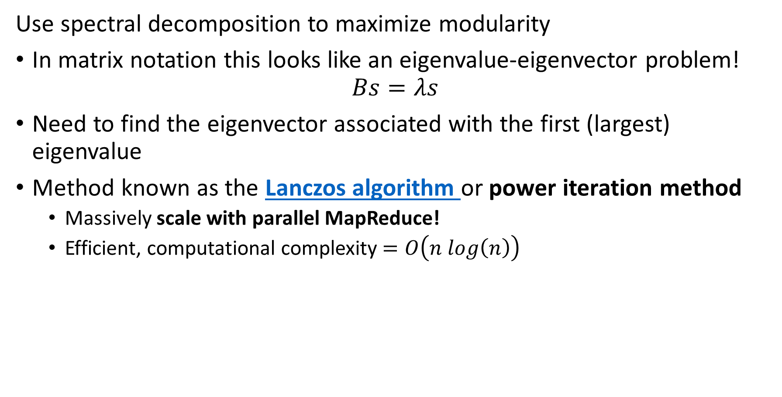
Spectral Modularity Maximization
Use spectral decomposition to maximize modularity
In matrix notation this looks like an eigenvalue-eigenvector problem!
$$Bs=λs$$
Need to find the eigenvector associated with the first (largest) eigenvalue
Method known as the Lanczos algorithm or power iteration method
  Massively scale with parallel MapReduce!
  Efficient, computational complexity $=O\left(n log\left(n\right)\right)$

Slide 82
Small World Networks

Slide 83
Small World Networks
Small world networks (SWNs) are a class of graph with unusually short distances between nodes
Small world networks have low degree of separation between nodes
Small world networks comprise two types of edges
  Edges between near neighbors of a lattice network
  A small number of edges between distant nodes
Small world networks have relatively few highly connected nodes or hubs

Slide 84
Small World Networks
Examples of small world networks (SWNs)
Structure of the Internet
Airlines with hub and spoke network
Similarity of documents and images
People in affiliated social groups
Wildlife in ecosystem food webs
Neurons in the human brain
Regulation of genetic transcription networks
Etc…..

Slide 85
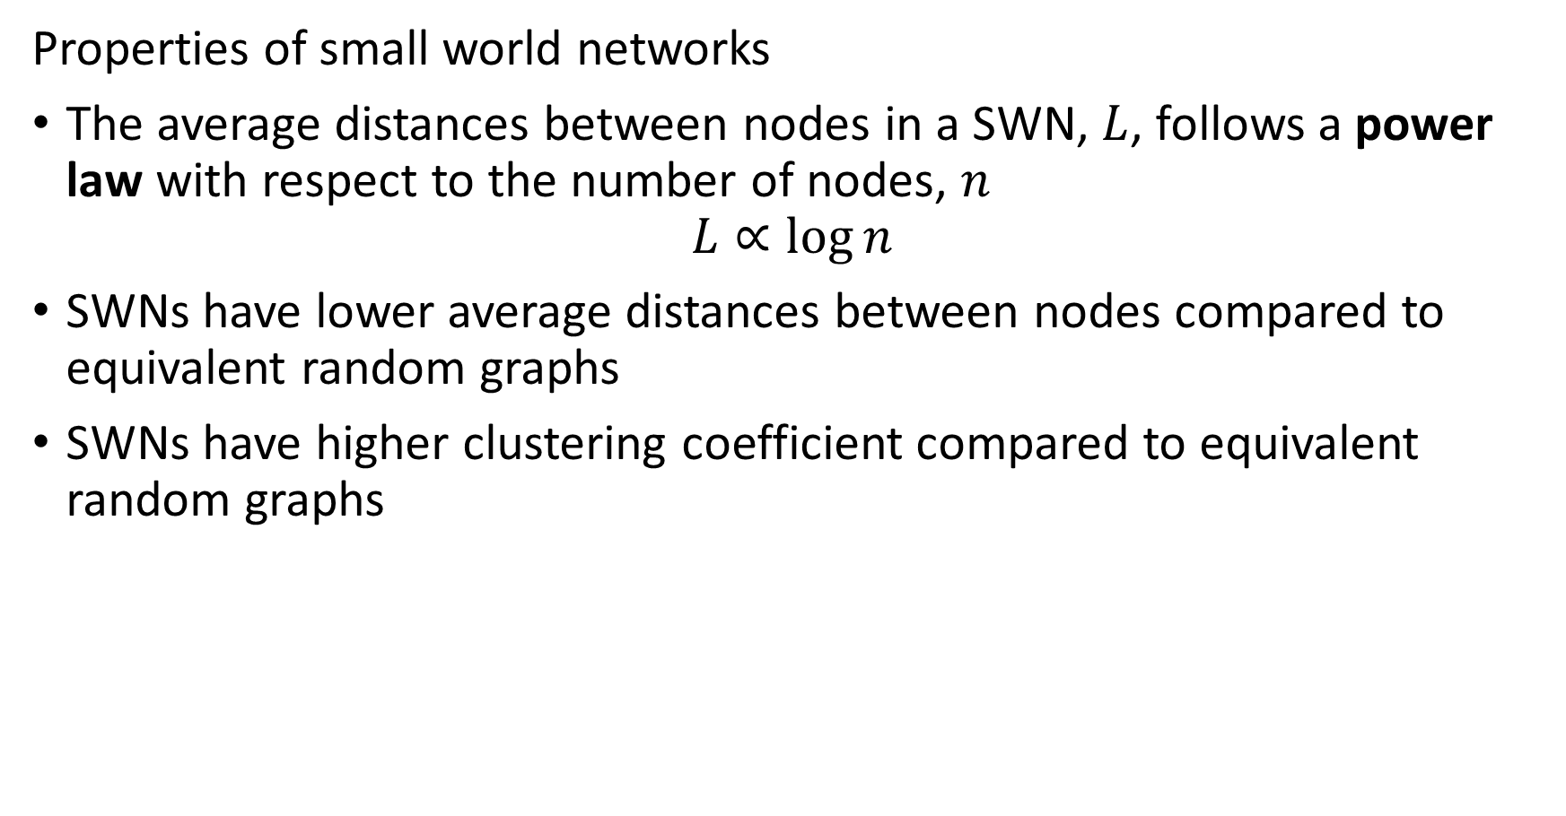
Small World Networks
Properties of small world networks
The average distances between nodes in a SWN, $L$, follows a power law with respect to the number of nodes, $n$
$$L∝\log{n}$$
SWNs have lower average distances between nodes compared to equivalent random graphs
SWNs have higher clustering coefficient compared to equivalent random graphs

Slide 86
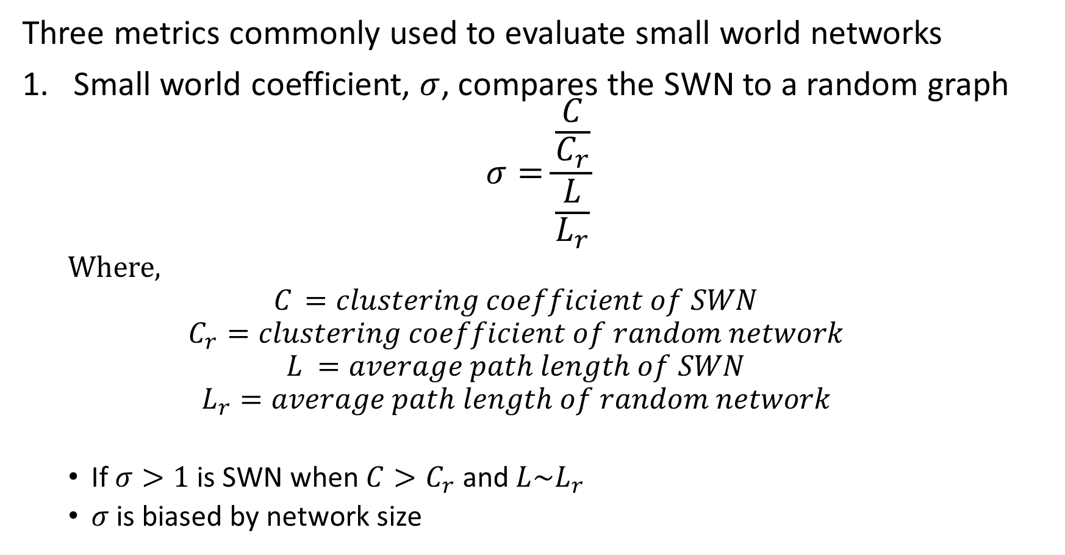
Small World Networks
Three metrics commonly used to evaluate small world networks
Small world coefficient, $σ$, compares the SWN to a random graph
$$σ=\frac{\frac{C}{C_{r}}}{\frac{L}{L_{r}}}$$
  Where,
  $$C_{ }=clustering coefficient of SWN$$
  $$C_{r}=clustering coefficient of random network$$
  $$L_{ }=average path length of SWN$$
  $$L_{r}=average path length of random network$$
  If $σ>1$ is SWN when $C>C_{r}$ and $L\sim L_{r}$
  $σ$ is biased by network size

Slide 87
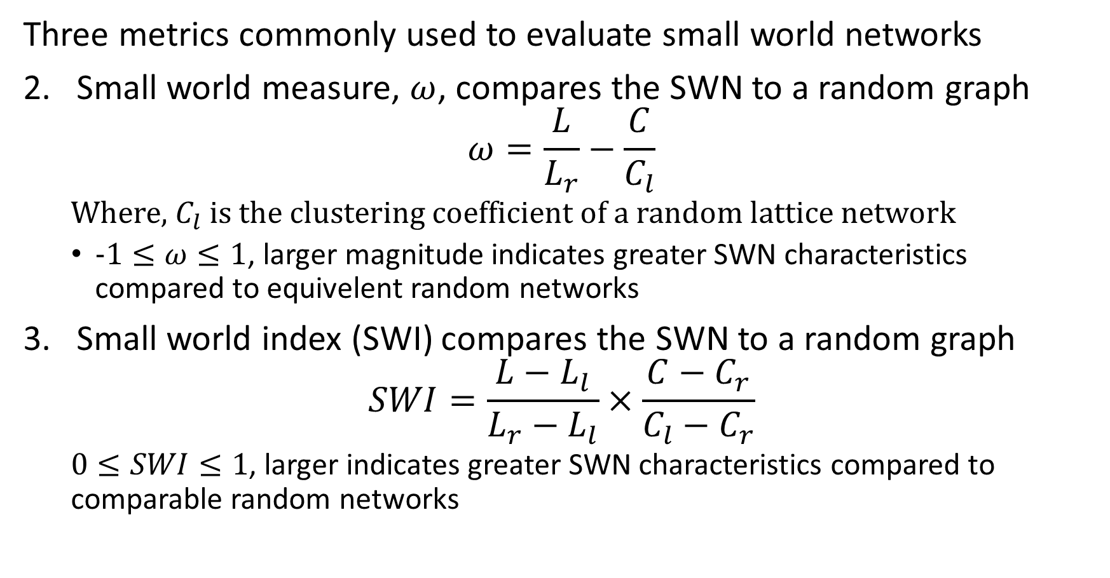
Small World Networks
Three metrics commonly used to evaluate small world networks
Small world measure, $ω$, compares the SWN to a random graph
$$ω=\frac{L}{L_{r}}−\frac{C}{C_{l}}$$
  Where, $C_{l}$ is the clustering coefficient of a random lattice network
  $−1≤ω≤1$, larger magnitude indicates greater SWN characteristics compared to equivelent random networks
Small world index (SWI) compares the SWN to a random graph
$$SWI=\frac{L−L_{l}}{L_{r}−L_{l}}×\frac{C−C_{r}}{C_{l}−C_{r}}$$
  $0≤SWI≤1$, larger indicates greater SWN characteristics compared to comparable random networks

Slide 88


Small World Networks
Examples of SWNs
$p=1$, diameter of short-range connections
$q$ = number of long-range connections per node
SWG approaches fully connected graph as $q$ increases

Slide 89


Small World Networks
Examples of SWNs
Examples of SWNs
q$=2$, number of long-range
$p$ diameter of short-range connections
SWG approaches fully connected graph as $p$ increases

Slide 90


Small World Networks
Examples of SWNs
The average distances between nodes in a SWN, $L$, follows a power law with respect to the number of nodes, $n$
$$L∝\log{n}$$

Slide 91
Summary

Slide 92
Summary
Many methods to find communities in social networks
Communities defined by high connectivity
Can find communities by the centrality or influence of nodes:
  Kratz centrality
  Closeness centrality
  K-Cores
  Triangle density and clustering
Partition communities by betweenness
Find communities by modularity of groups of nodes
  Greedy algorithms
  Spectral decomposition modularity
Many real-world networks are SWNs

