Slide 1

CSCI E-96
Data Mining, Discovery and Exploration
Online Algorithms and Steaming Analytics, Part 2
Steve Elston
Copyright 2021, 2022, 2023, 2024, 2025, 2026, Stephen F Elston. All rights reserved.

Slide 2
Main topics in this course
Online algorithms build on foundations
1. Hashing and K-V pair management
2. Distance and Similarity Metrics
3. Graph Algorithms
Foundations
Core Algorithms
2. Dimensionality Reduction
5. Similarity Search and NN Algorithms
4. Online Algorithms
3. Social Network Analysis
6. Web/Document ranking and search
7. Recommender Algorithms
8. Clustering Algorithms
Taks Speific Algorithms

Slide 3
Streaming Analytics
What are the key points to learn in this lesson?
Measures must be taken to reduce the massive volume of infinite stream data
Streams can be real-valued or discrete-valued
Stream data can be sampled and filtered to reduce volume
  Sampling methods used for filter real valued streams
  Hash methods used to filter discrete event streams
Sketches (hashes) are used to perform streaming analytics within computation and memory limits for both real valued and discrete streams

Slide 4
Counting Events - Cardinality

Slide 5
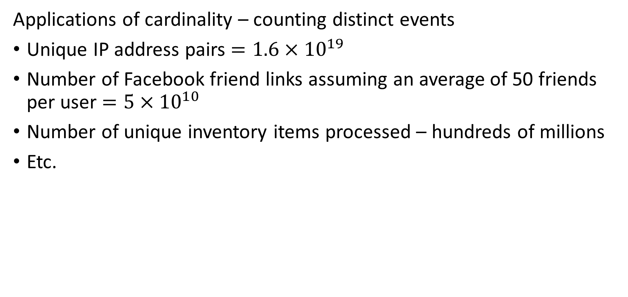
Counting Distinct Events – Cardinality
Applications of cardinality – counting distinct events
Unique IP address pairs $=1.6×{10}^{19}$
Number of Facebook friend links assuming an average of 50 friends per user $=5×{10}^{10}$
Number of unique inventory items processed – hundreds of millions
Etc.

Slide 6




Volume Reduction and Streaming Analytics
Event stream algorithms are both filters and analytics
Streams can be filtered and sampled near the source
Further filtering, sampling and sketching performed as preprocessing for analytics
Data Source
Filter/sample
Filter/sample/sketch
Stream analytic
Filter/sample/sketch
Stream analytic
Data Source
Filter/sample
$$⋮$$
$$⋮$$
$$⋮$$
$$⋮$$
Bandwidth limited network
Filter/sample/sketch
Stream analytic
Data Source
Filter/sample
Archival storage
Classical supervised and unsupervised ML
Server/Cloud
Minimum (filtered) data and analytics archived
Filtered streams and sketches used as input to classical ML

Slide 7
Counting Distinct Events – Cardinality
How to determine cardinality?
Maintain table of unique identifiers?
  Table can grow without bounds
  Need billions of entries for many applications
  Not scalable!
We need a better approach!
Accept approximate results using a sketch, or hash summary, of full data
Sketch algorithms are built on two concepts
  Probabilistic sampling
  Hash tables

Slide 8
Counting Distinct Events - Cardinality
Approximate counting algorithms used for streaming data
Sketch algorithms built on probability analysis of bit map hashes
Flajolet-Martin algorithm proposed 1985
  Improvement: LogLog algorithm, Durand and Flajolet, 2003
  Improvement: HyperLogLog algorithm more accurate, 2007
  Refinement: HyperLogLog++, Heule, et. al., 2013
Other state-of-the-art algorithms offer some improvements
  Theta sketch, Rimberg, 2019
  Compressed Probabilistic Counting, Ertl, 2024
For a review of many variations discrete events for large-scale streams see Chapter 5 of Algorithms and Structures for Massive Data Sets, Medjodovic, et al., 2022, Manning

Slide 9
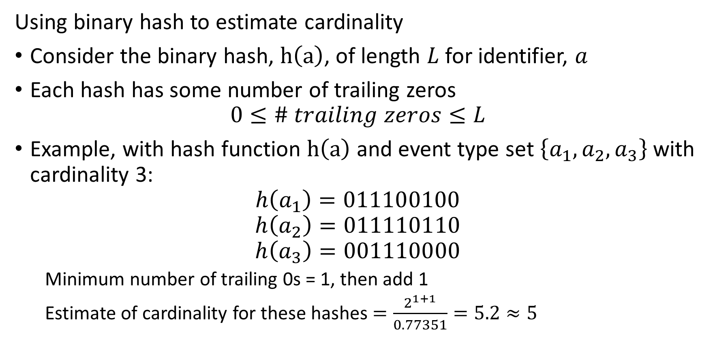
Counting Distinct Events – Cardinality
Using binary hash to estimate cardinality
Consider the binary hash, $h\left(a\right)$, of length $L$ for identifier, $a$
Each hash has some number of trailing zeros
$$0≤\# trailing zeros≤L$$
Example, with hash function $h\left(a\right)$ and event type set $\left\{a_{1},a_{2},a_{3}\right\}$ with cardinality 3:
$$h\left(a_{1}\right)=011100100$$
$$h\left(a_{2}\right)=011110110$$
$$h\left(a_{3}\right)=001110000$$
  Minimum number of trailing 0s = 1, then add 1
  Estimate of cardinality for these hashes $=\frac{2^{1+1}}{0.77351}=5.2≈5$

Slide 10
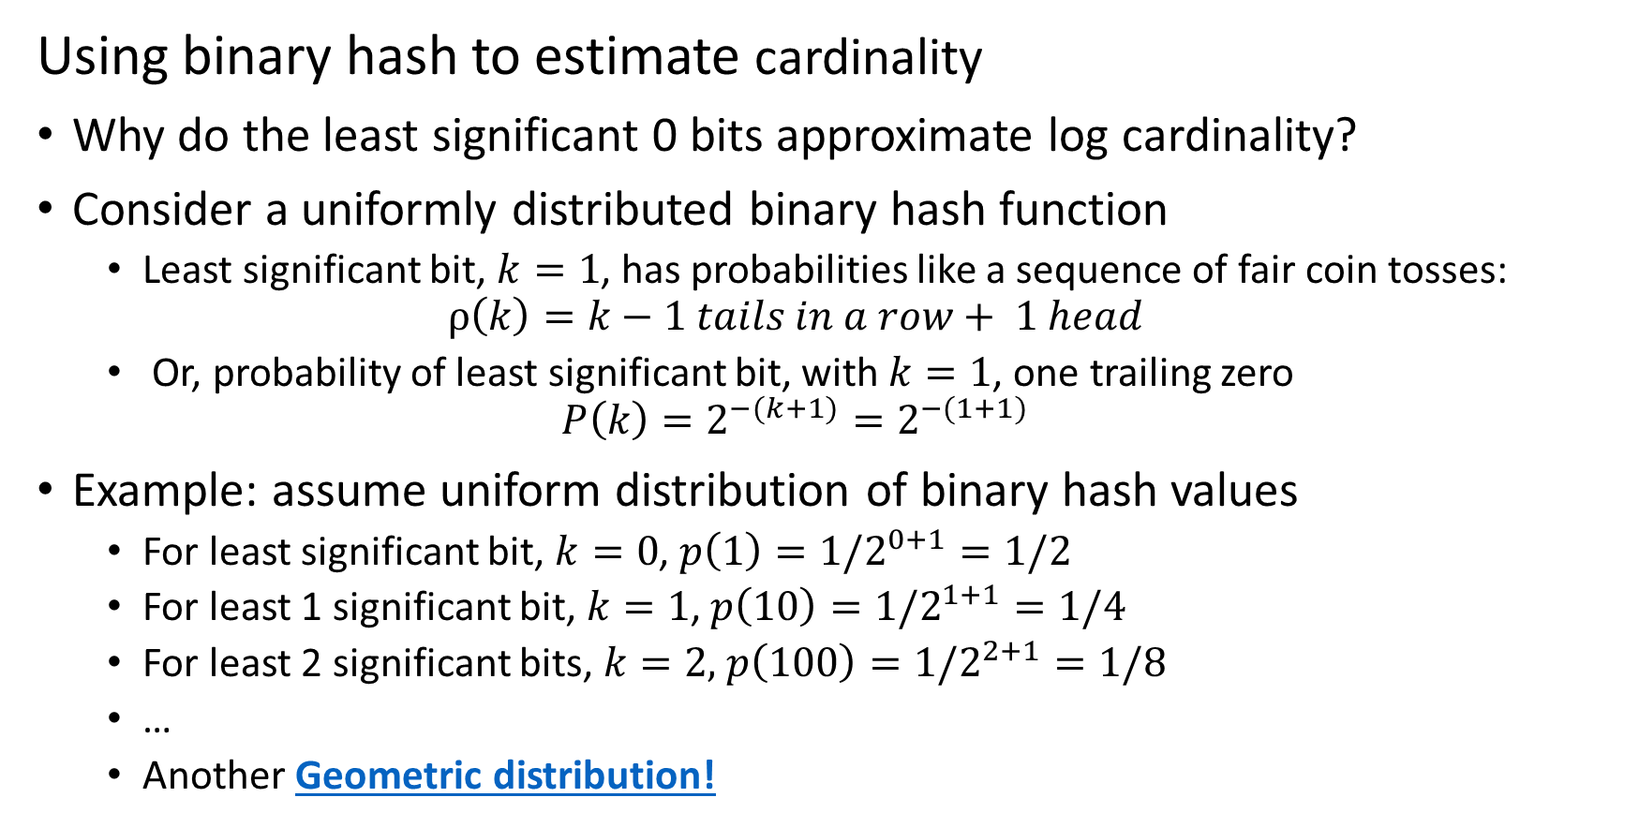
Counting Distinct Events – Cardinality
Using binary hash to estimate cardinality
Why do the least significant 0 bits approximate log cardinality?
Consider a uniformly distributed binary hash function
  Least significant bit, $k=1$, has probabilities like a sequence of fair coin tosses:
  $$ρ\left(k\right)=k−1 tails in a row+ 1 head$$
  Or, probability of least significant bit, with $k=1$, one trailing zero
  $$P\left(k\right)=2^{−(k+1)}=2^{−(1+1)}$$
Example: assume uniform distribution of binary hash values
  For least significant bit, $k=0$, $p\left(1\right)=1/2^{0+1}=1/2$
  For least 1 significant bit, $k=1$, $p\left(10\right)=1/2^{1+1}=1/4$
  For least 2 significant bits, $k=2,$ $p\left(100\right)=1/2^{2+1}=1/8$
  …
  Another Geometric distribution!

Slide 11
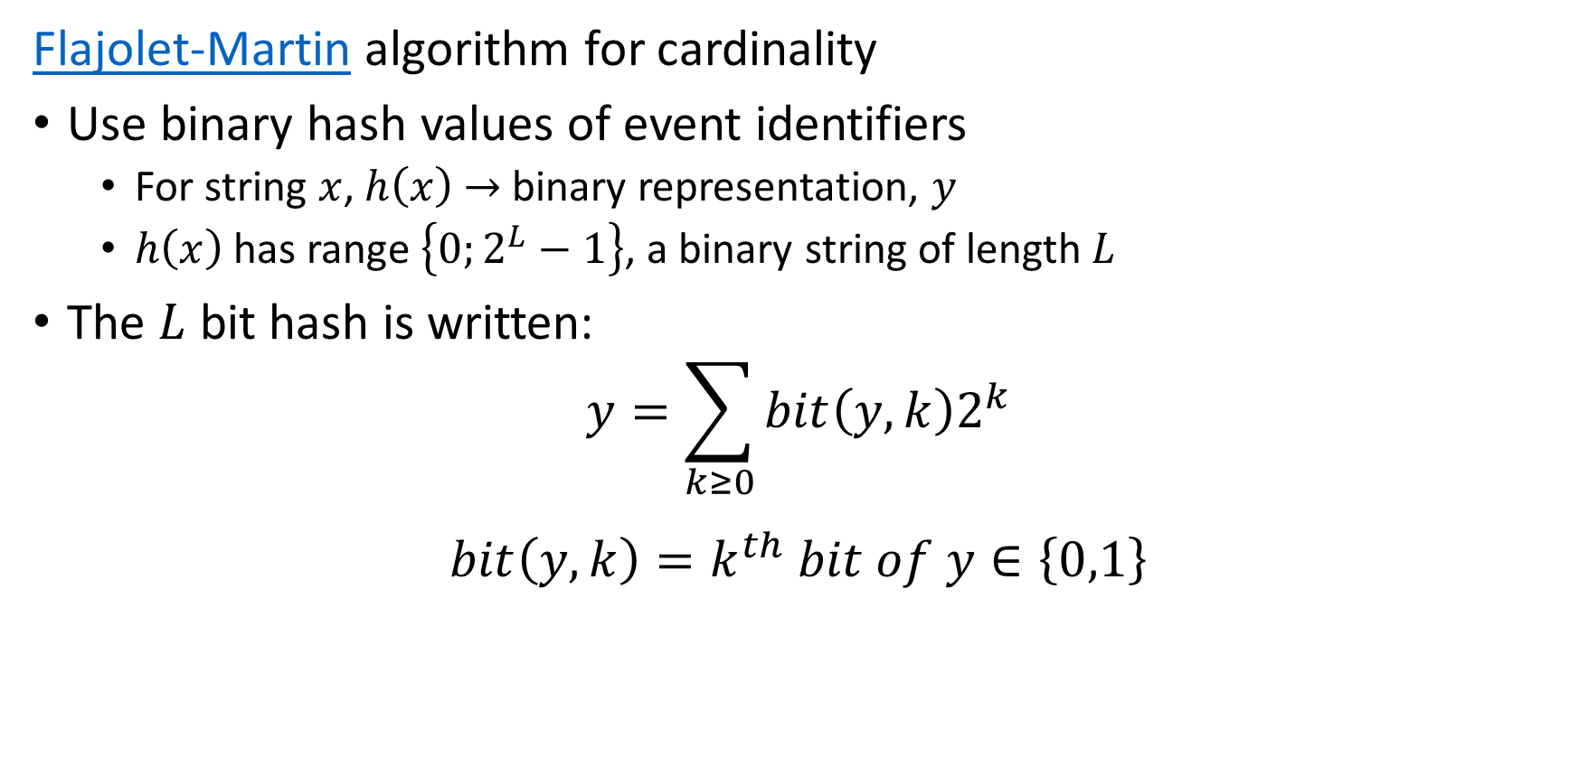
Counting Distinct Events – Cardinality
Flajolet-Martin algorithm for cardinality
Use binary hash values of event identifiers
  For string $x$, $h\left(x\right)$ $→$ binary representation, $y$
  $h\left(x\right)$ has range $\left\{0;2^{L}−1\right\}$, a binary string of length $L$
The $L$ bit hash is written:
$$y=\sum_{k≥0}^{ }{bit\left(y,k\right)2^{k}}$$
$$bit\left(y,k\right)=k^{th} bit of y∈\left\{0,1\right\}$$

Slide 12
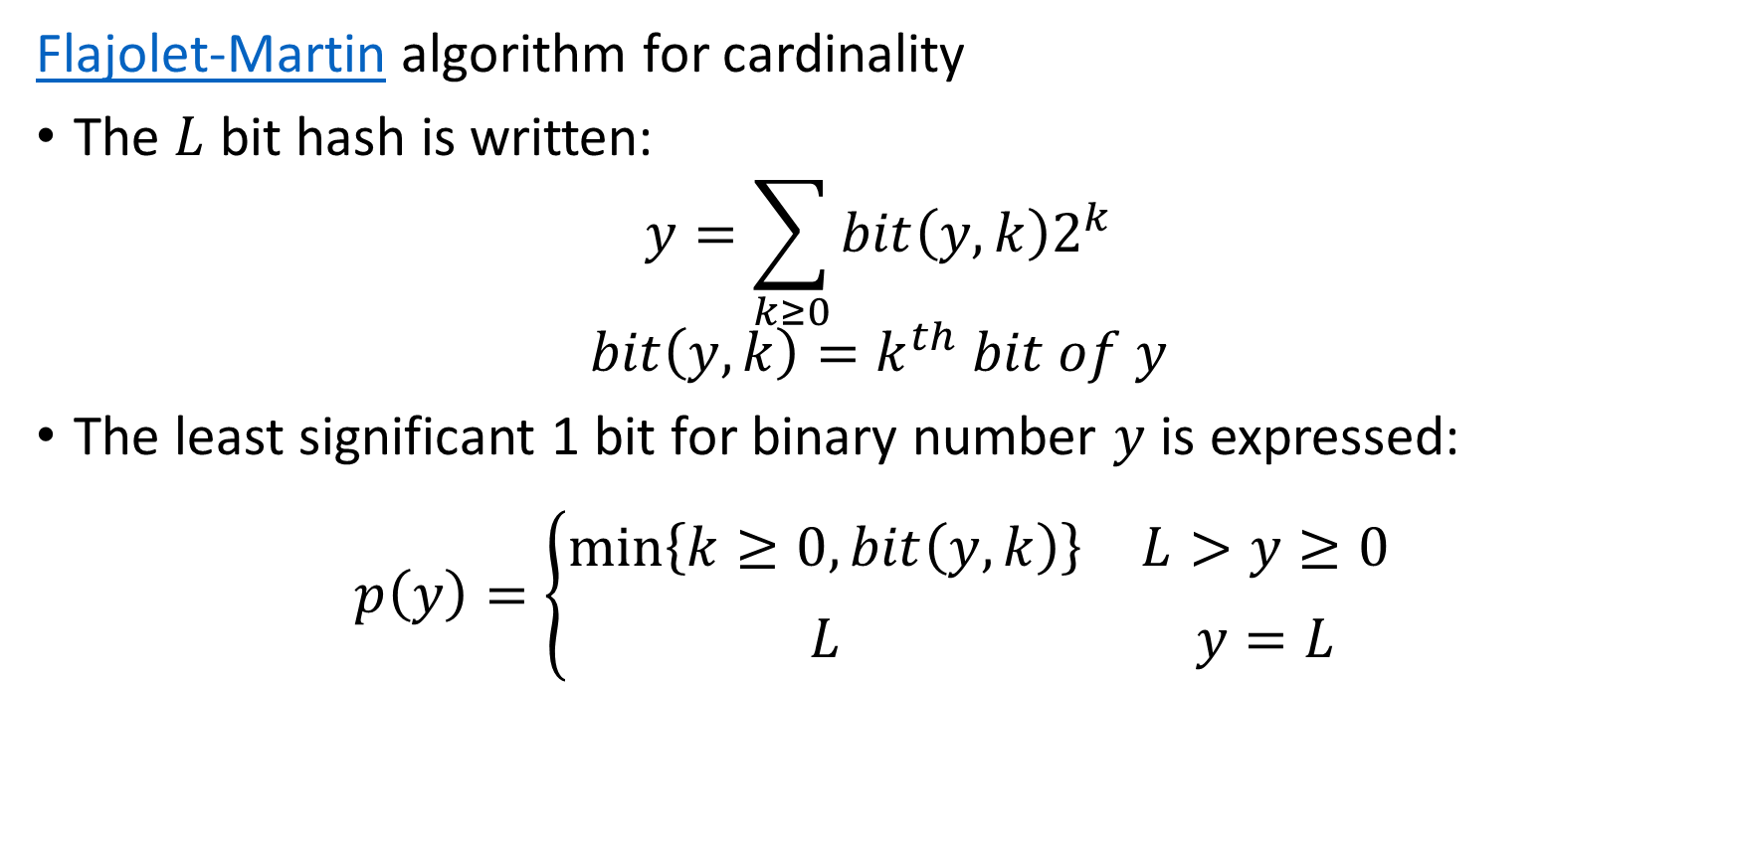
Counting Distinct Events – Cardinality
Flajolet-Martin algorithm for cardinality
The $L$ bit hash is written:
$$y=\sum_{k≥0}^{ }{bit\left(y,k\right)2^{k}}$$
$$bit\left(y,k\right)=k^{th} bit of y$$
The least significant 1 bit for binary number $y$ is expressed:
$$p\left(y\right)=\left\{\begin{matrix}\min_{ }\left\{k≥0, bit\left(y,k\right)\right\} & L>y≥0 \\ L & y=L\end{matrix}\begin{matrix} \\ \end{matrix}\right.$$

Slide 13

Counting Distinct Events – Cardinality
Flajolet-Martin algorithm for cardinality
The least significant 1 bit for binary number $y$ is expressed:
$$p\left(y\right)=\left\{\begin{matrix}\min_{ }\left\{k≥0, bit\left(y,k\right)\right\} & L>y≥0 \\ L & y=L\end{matrix}\begin{matrix} \\ \end{matrix}\right.$$
Uniform distribution of bits $→$ Geometric distribution of trailing $0s$
$$p\left(2^{k}\right)=2^{−\left(k+1\right)}=probability of k trialing 0s$$

Slide 14
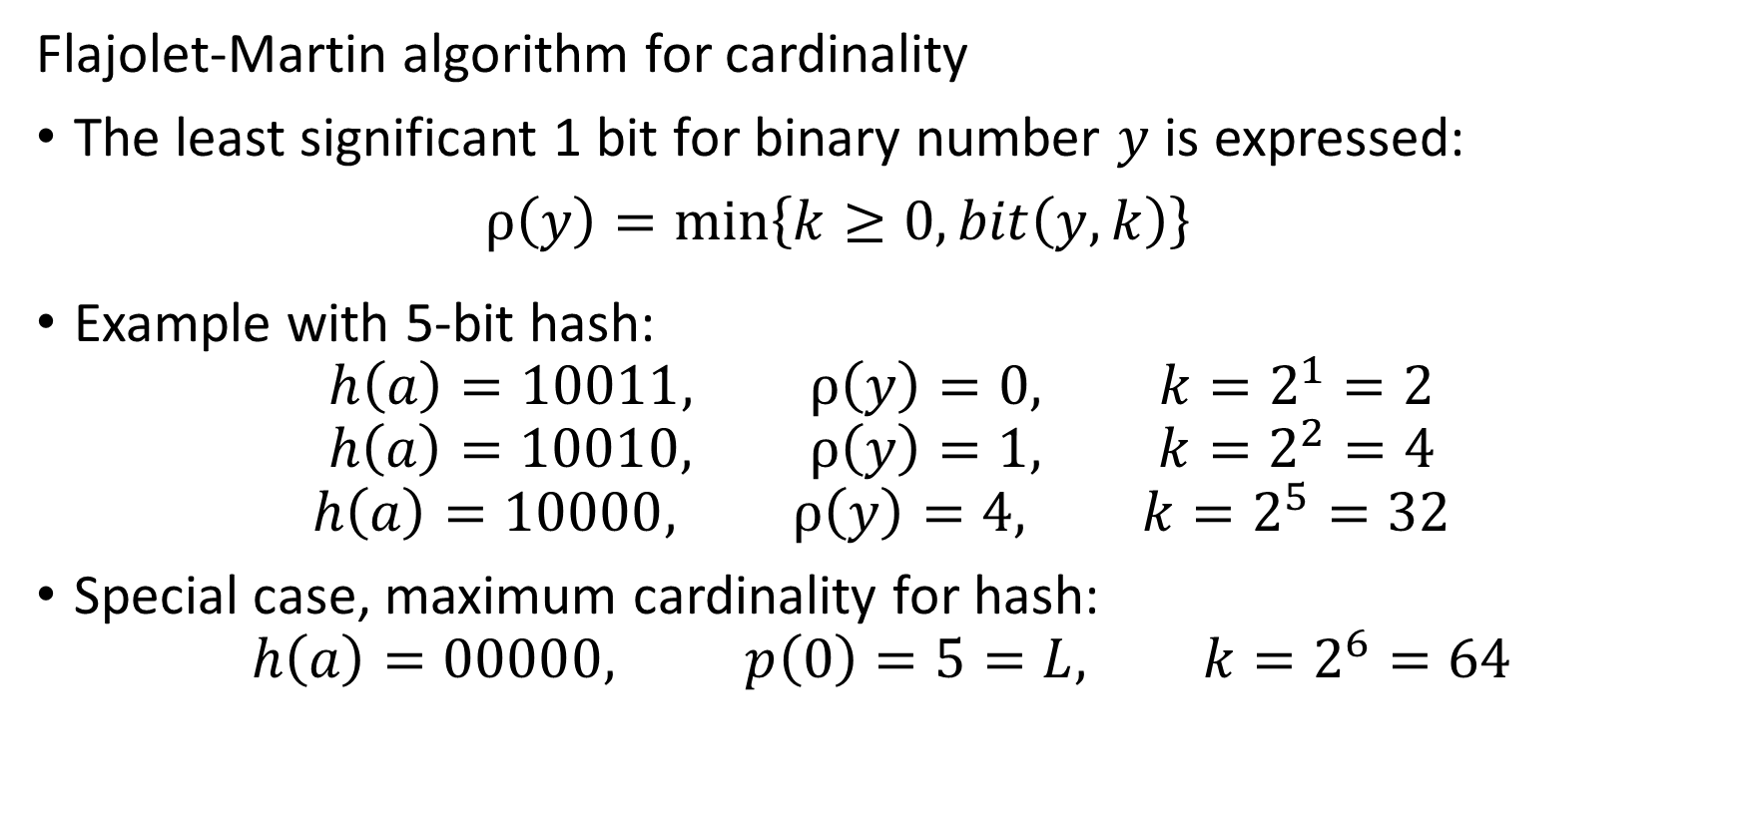
Counting Distinct Events – Cardinality
Flajolet-Martin algorithm for cardinality
The least significant 1 bit for binary number $y$ is expressed:
$ρ\left(y\right)=\min_{ }\left\{k≥0, bit\left(y,k\right)\right\}$
Example with 5-bit hash:
$$h\left(a\right)=10011, ρ\left(y\right)=0, k=2^{1}=2$$
$$h\left(a\right)=10010, ρ\left(y\right)=1, k=2^{2}=4$$
$$h\left(a\right)=10000, ρ\left(y\right)=4, k=2^{5}=32$$
Special case, maximum cardinality for hash:
$$h\left(a\right)=00000, p\left(0\right)=5=L, k=2^{6}=64$$

Slide 15
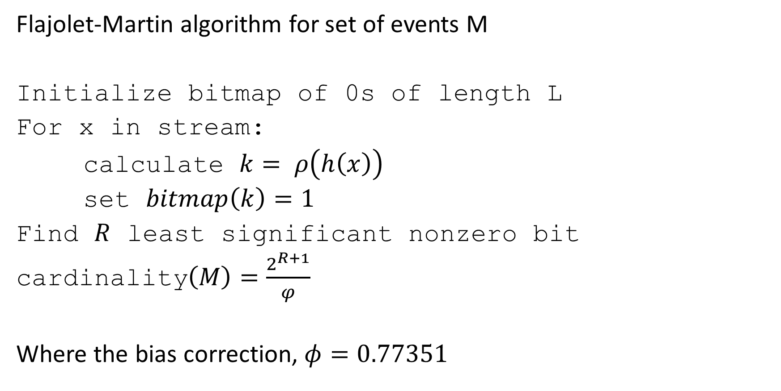
Counting Distinct Events – Cardinality
Flajolet-Martin algorithm for set of events M
Initialize bitmap of 0s of length L
For x in stream:
calculate $k= ρ\left(h\left(x\right)\right)$
set $bitmap\left(k\right)=1$
Find $R$ least significant nonzero bit
cardinality$\left(M\right)=\frac{2^{R+1}}{φ}$
Where the bias correction, $φ=0.77351$

Slide 16
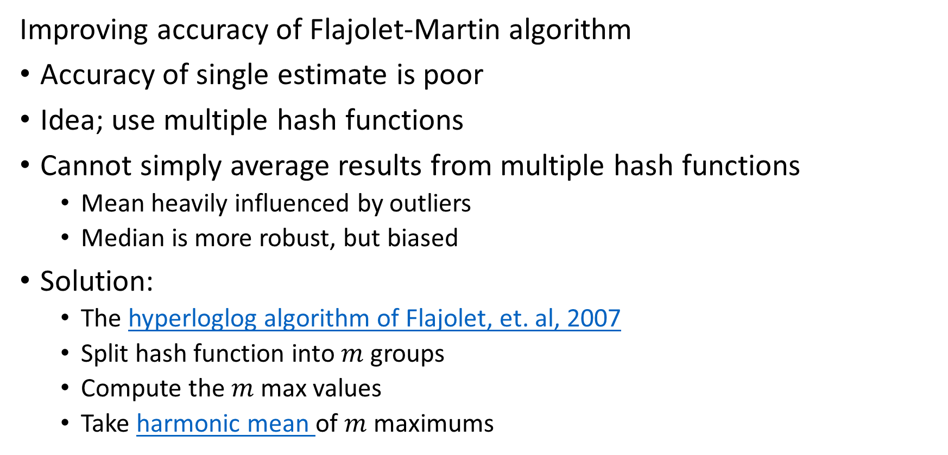
Counting Distinct Events – Cardinality
Improving accuracy of Flajolet-Martin algorithm
Accuracy of single estimate is poor
Idea; use multiple hash functions
Cannot simply average results from multiple hash functions
  Mean heavily influenced by outliers
  Median is more robust, but biased
Solution:
  The hyperloglog algorithm of Flajolet, et. al, 2007
  Split hash function into $m$ groups
  Compute the $m$ max values
  Take harmonic mean of $m$ maximums

Slide 17
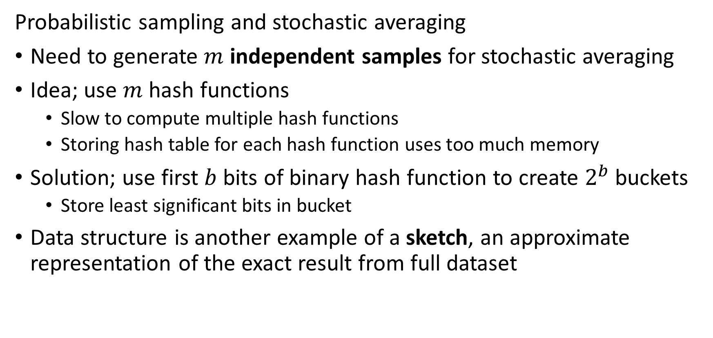
Counting Distinct Events – Cardinality
Probabilistic sampling and stochastic averaging
Need to generate $m$ independent samples for stochastic averaging
Idea; use $m$ hash functions
  Slow to compute multiple hash functions
  Storing hash table for each hash function uses too much memory
Solution; use first $b$ bits of binary hash function to create $2^{b}$ buckets
  Store least significant bits in bucket
Data structure is another example of a sketch, an approximate representation of the exact result from full dataset

Slide 18



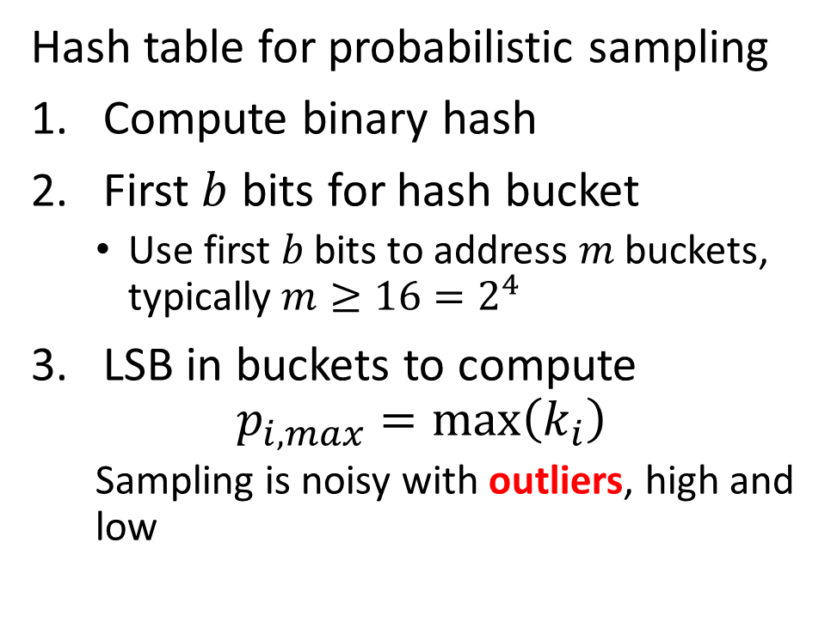












Filtering Event Data
Probabilistic sampling and stochastic averaging
Hash table for probabilistic sampling
Compute binary hash
First $b$ bits for hash bucket
  Use first 𝑏 bits to address 𝑚 buckets, typically $m≥16=2^{4}$
LSB in buckets to compute
$$p_{i,max}=max\left(k_{i}\right)$$
  Sampling is noisy with outliers, high and low
Bucket
LSB
$$h_{i}\left(x\right)=10010100⇒$$
$100$1
$$0100$$
$$h_{j}\left(x\right)=10100110⇒$$
$101$0
$$0110$$
$$h_{k}\left(x\right)=11011111⇒$$
$$1101$$
$$1111$$
$$h_{u}\left(x\right)=00000000⇒$$
$000$0
$$0000$$
$$h_{v}\left(x\right)=00111100⇒$$
$001$1
$$1100$$

Slide 19
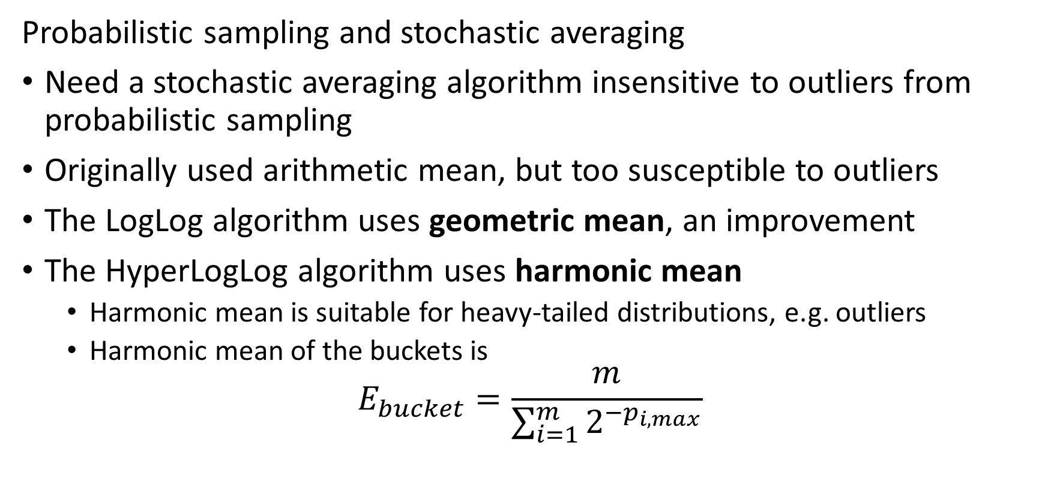
Counting Distinct Events – Cardinality
Probabilistic sampling and stochastic averaging
Need a stochastic averaging algorithm insensitive to outliers from probabilistic sampling
Originally used arithmetic mean, but too susceptible to outliers
The LogLog algorithm uses geometric mean, an improvement
The HyperLogLog algorithm uses harmonic mean
  Harmonic mean is suitable for heavy-tailed distributions, e.g. outliers
  Harmonic mean of the buckets is
$$E_{bucket}=\frac{m}{\sum_{i=1}^{m}{2^{−p_{i,max}}}}$$

Slide 20
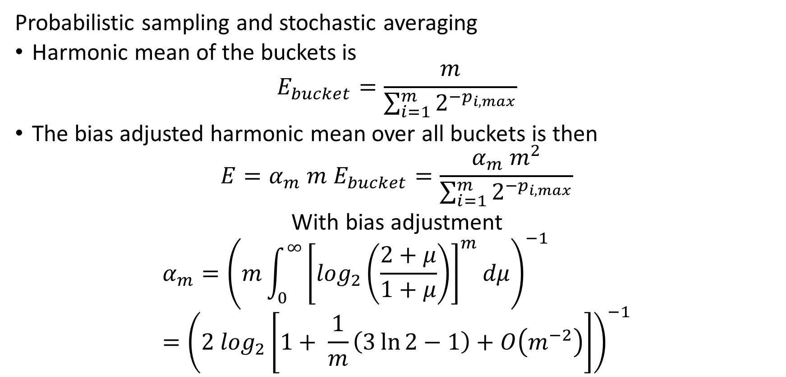
Counting Distinct Events – Cardinality
Probabilistic sampling and stochastic averaging
Harmonic mean of the buckets is
$$E_{bucket}=\frac{m}{\sum_{i=1}^{m}{2^{−p_{i,max}}}}$$
The bias adjusted harmonic mean over all buckets is then
$${E=α_{m} m E}_{bucket}=\frac{α_{m} m^{2}}{\sum_{i=1}^{m}{2^{−p_{i,max}}}}$$
With bias adjustment
$$α_{m}={\left(m\int_{0}^{∞}{{\left[\log_{2}\left(\frac{2+μ}{1+μ}\right)\right]}^{m}dμ}\right)}^{−1}={\left(2 \log_{2}\left[1+ \frac{1}{m}\left(3\ln{2}−1\right)+O\left(m^{−2}\right)\right]\right)}^{−1}$$

Slide 21
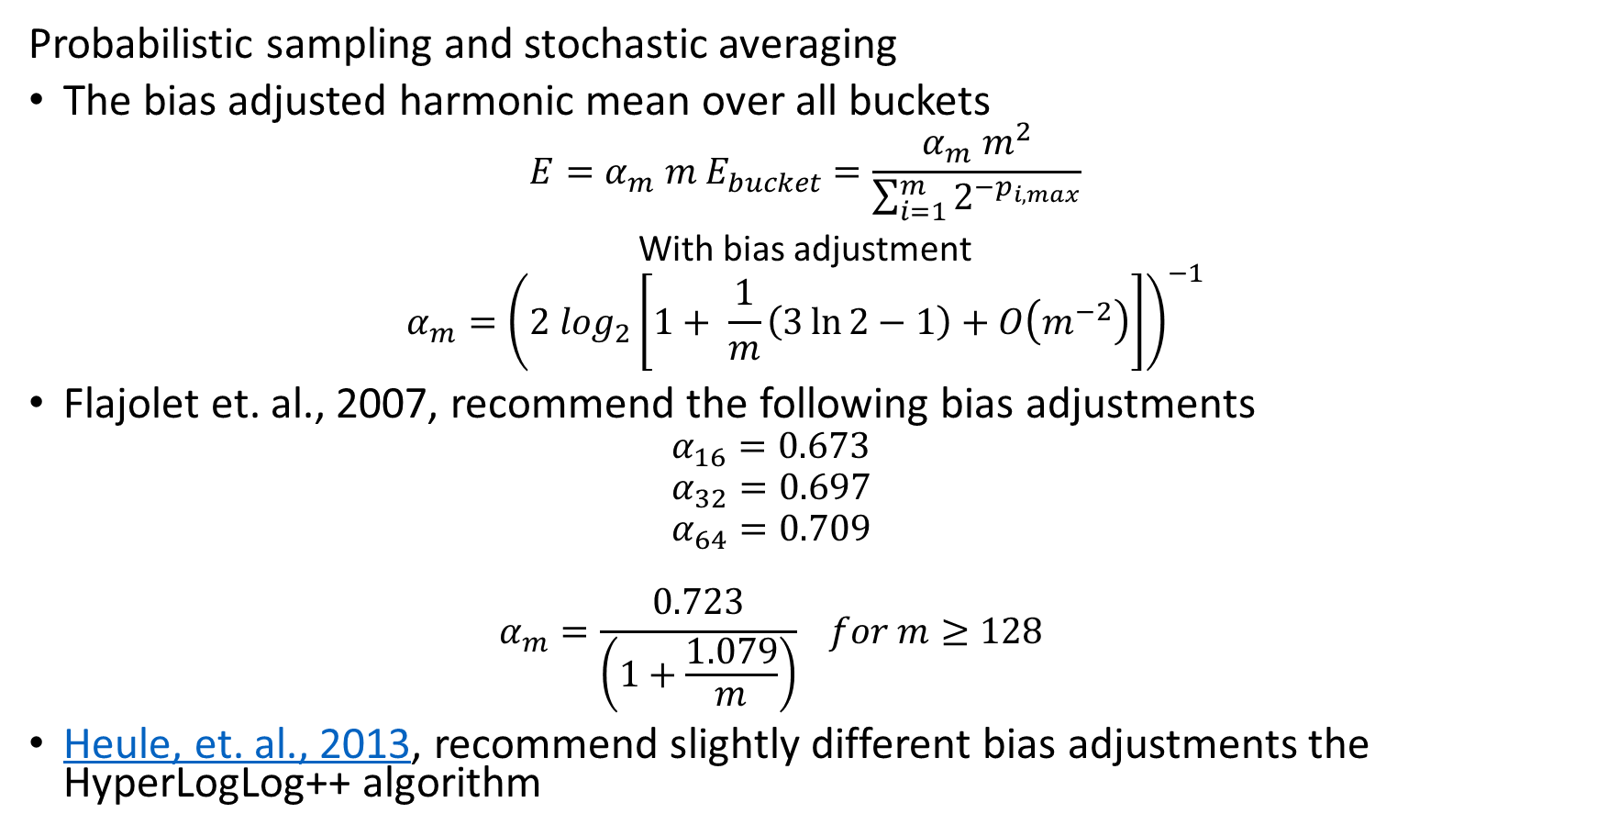
Counting Distinct Events – Cardinality
Probabilistic sampling and stochastic averaging
The bias adjusted harmonic mean over all buckets
$${E=α_{m} m E}_{bucket}=\frac{α_{m} m^{2}}{\sum_{i=1}^{m}{2^{−p_{i,max}}}}$$
With bias adjustment
$$α_{m}={\left(2 \log_{2}\left[1+ \frac{1}{m}\left(3\ln{2}−1\right)+O\left(m^{−2}\right)\right]\right)}^{−1}$$
Flajolet et. al., 2007, recommend the following bias adjustments
  $$α_{16}=0.673$$
  $$α_{32}=0.697$$
  $$α_{64}=0.709$$
  $$α_{m}=\frac{0.723}{\left(1+\frac{1.079}{m}\right)} for m≥128$$
Heule, et. al., 2013, recommend slightly different bias adjustments the HyperLogLog++ algorithm

Slide 22
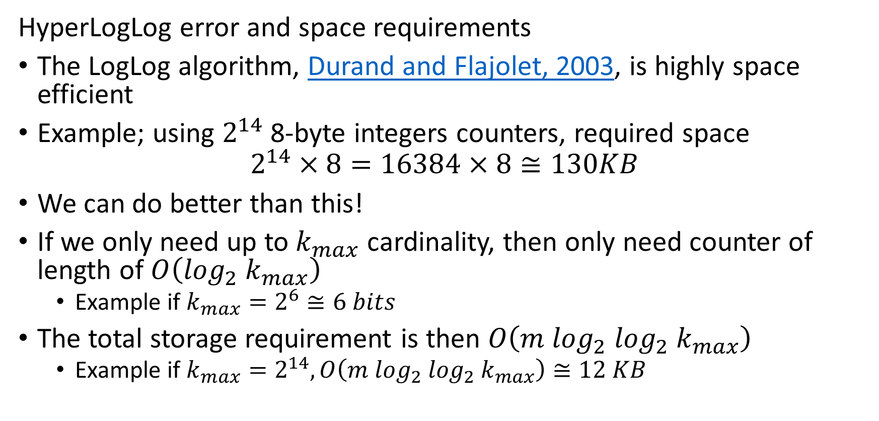
Counting Distinct Events – Cardinality
HyperLogLog error and space requirements
The LogLog algorithm, Durand and Flajolet, 2003, is highly space efficient
Example; using $2^{14}$ 8-byte integers counters, required space
$$2^{14}×8=16384×8≅130KB$$
We can do better than this!
If we only need up to $k_{max}$ cardinality, then only need counter of length of $O\left(\log_{2}{ k}_{max}\right)$
  Example if $k_{max}=2^{6}≅6 bits$
The total storage requirement is then $O\left(m {\log_{2} log}_{2}{ k}_{max}\right)$
  Example if $k_{max}=2^{14}, O\left(m {\log_{2} log}_{2}{ k}_{max}\right)≅12 KB$

Slide 23
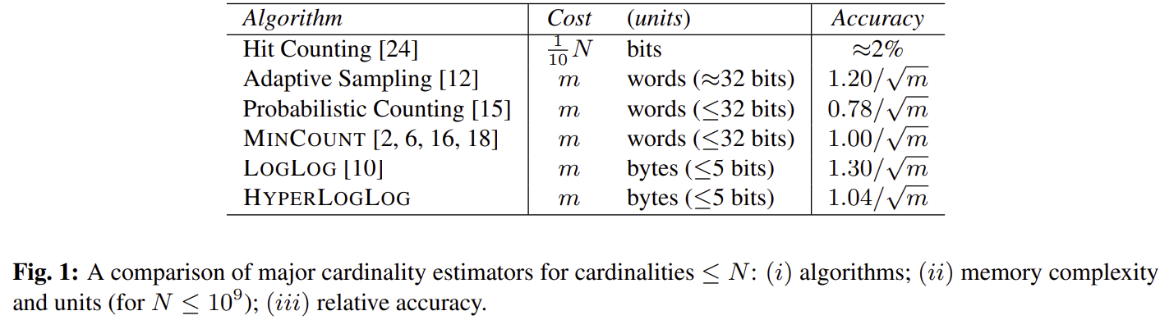
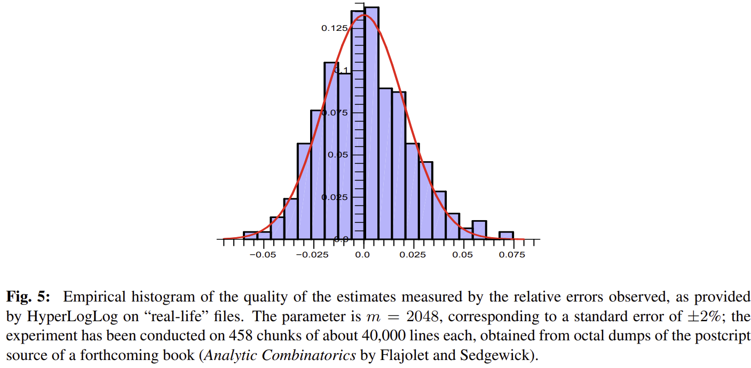
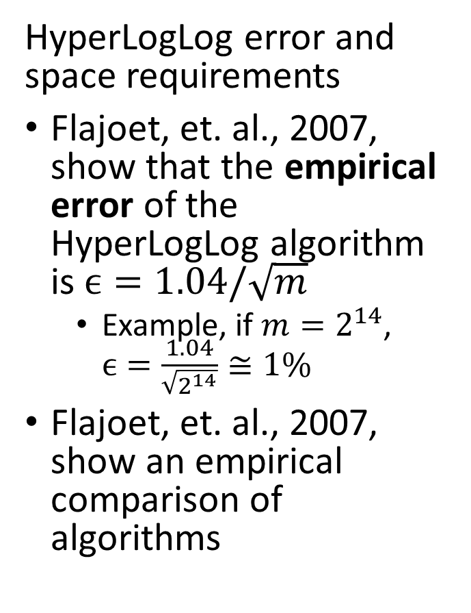
Counting Distinct Events – Cardinality
HyperLogLog error and space requirements
Flajoet, et. al., 2007, show that the empirical error of the HyperLogLog algorithm is $ϵ=1.04/\sqrt{m}$
  Example, if $m=2^{14}$, $ϵ=\frac{1.04}{\sqrt{2^{14}}}≅1\%$
Flajoet, et. al., 2007, show an empirical comparison of algorithms

Slide 24
Counting Distinct Events – Cardinality
Aggregating HyperLogLog counters
Aggregation is an important property of many sketches
HyperLogLog counters can be readily merged
  Example; counters by minute merged (aggregated) to counters by hour
  Example; counters by day merged to weekly or monthly
  Example; counters for different streams merged into single estimate
But we cannot just sum the total unique events over multiple periods!
  Example; A user who is active several days of the month is only counted once aggregating daily to monthly
  A simple sum will count the user multiple times
Must merge by union and then sum

Slide 25
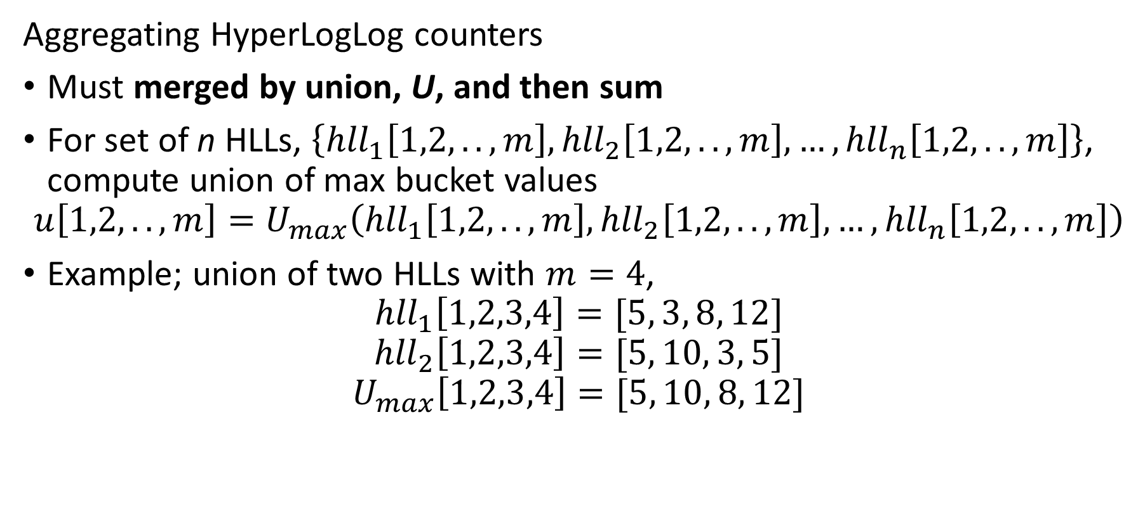
Counting Distinct Events – Cardinality
Aggregating HyperLogLog counters
Must merged by union, U, and then sum
For set of n HLLs, $\left\{{hll}_{1}\left[1,2,..,m\right],{hll}_{2}\left[1,2,..,m\right],…,{hll}_{n}\left[1,2,..,m\right]\right\}$, compute union of max bucket values
$$u\left[1,2,..,m\right]=U_{max}\left({hll}_{1}\left[1,2,..,m\right],{hll}_{2}\left[1,2,..,m\right],…,{hll}_{n}\left[1,2,..,m\right]\right)$$
Example; union of two HLLs with $m=4$,
$${hll}_{1}\left[1,2,3,4\right]=[5, 3, 8, 12]$$
$${hll}_{2}\left[1,2,3,4\right]=[5, 10, 3, 5]$$
$$U_{max}\left[1,2,3,4\right]=[5, 10, 8, 12]$$

Slide 26
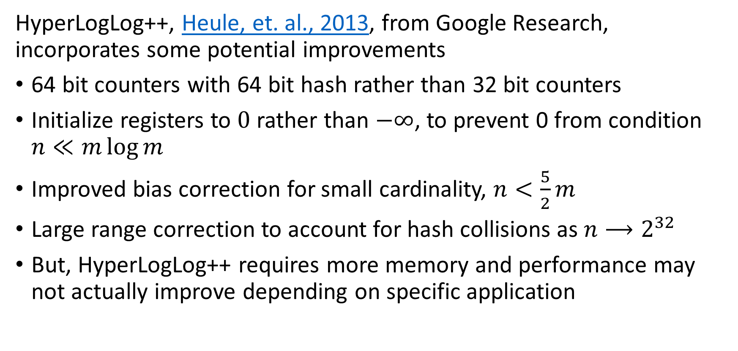
Counting Distinct Events – Cardinality
HyperLogLog++, Heule, et. al., 2013, from Google Research, incorporates some potential improvements
64 bit counters with 64 bit hash rather than 32 bit counters
Initialize registers to $0$ rather than $−∞$, to prevent 0 from condition $n≪m\log{m}$
Improved bias correction for small cardinality, $n<\frac{5}{2}m$
Large range correction to account for hash collisions as $n⟶2^{32}$
But, HyperLogLog++ requires more memory and performance may not actually improve depending on specific application

Slide 27
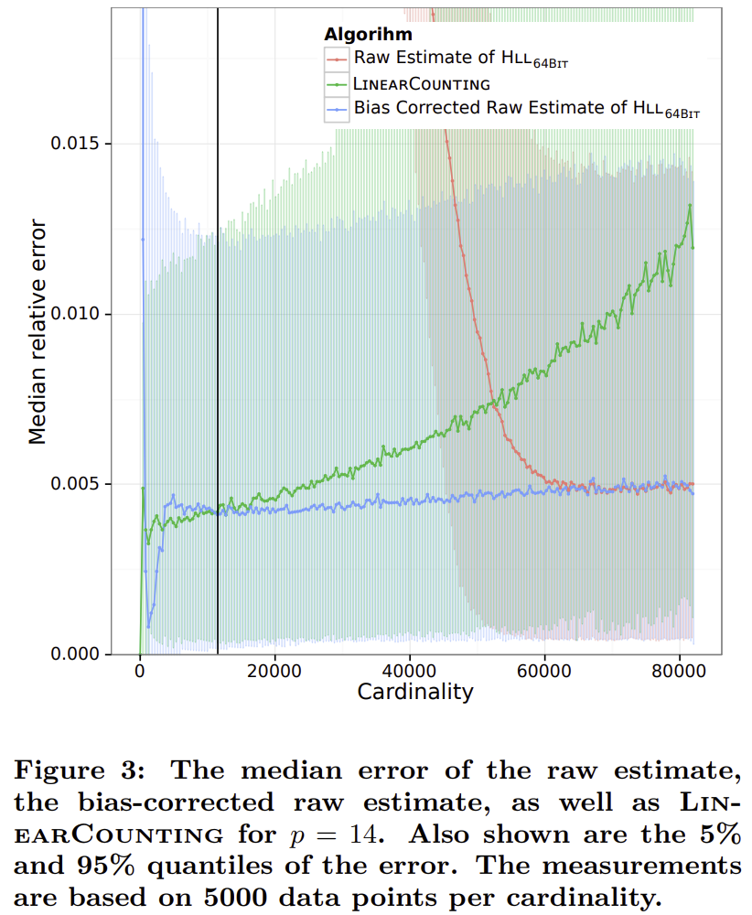
Counting Distinct Events – Cardinality
HyperLogLog++, Heule, et. al., 2013, from Google Research, incorporates some potential improvements
Comparison between algorithms shows HyperLogLog and HyperLogLog++ performance converge
Simple linear counting is best for small cardinality

Slide 28
Estimating Quantiles in Streams

Slide 29
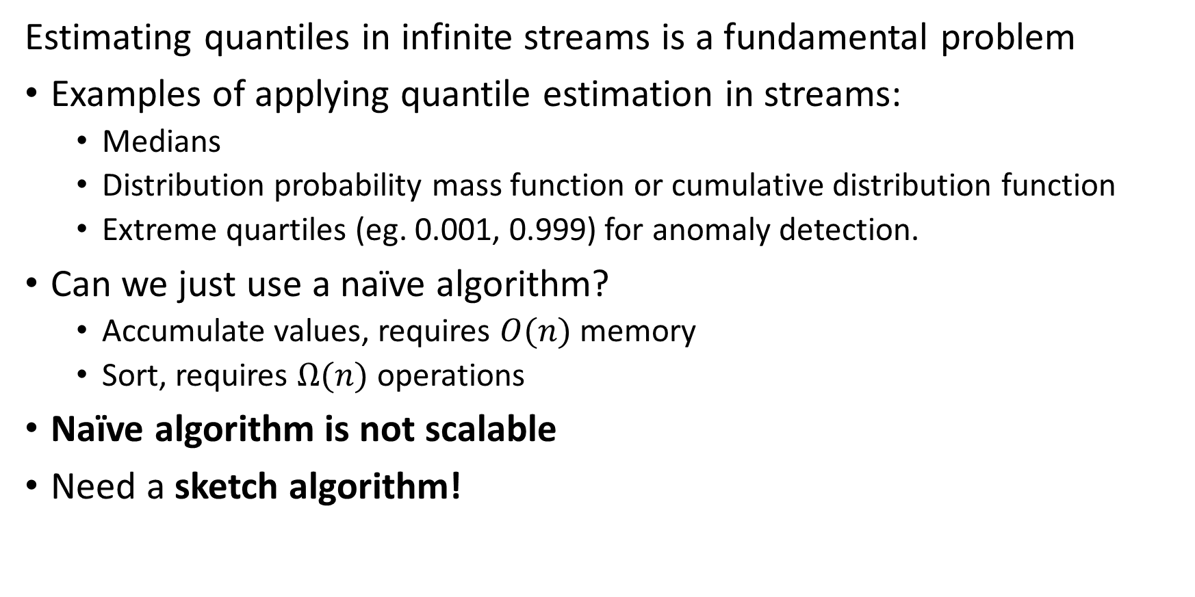
Estimating Quantiles in Streams
Estimating quantiles in infinite streams is a fundamental problem
Examples of applying quantile estimation in streams:
  Medians
  Distribution probability mass function or cumulative distribution function
  Extreme quartiles (eg. 0.001, 0.999) for anomaly detection.
Can we just use a naïve algorithm?
  Accumulate values, requires $O(n)$ memory
  Sort, requires $Ω(n)$ operations
Naïve algorithm is not scalable
Need a sketch algorithm!

Slide 30
Volume Reduction and Streaming Analytics
Event stream algorithms are both filters and analytics
Streams can be filtered and sampled near the source
Further filtering, sampling and sketching performed as preprocessing for analytics
Data Source
Filter/sample
Filter/sample/sketch
Stream analytic
Filter/sample/sketch
Stream analytic
Data Source
Filter/sample
$$⋮$$
$$⋮$$
$$⋮$$
$$⋮$$
Bandwidth limited network
Filter/sample/sketch
Stream analytic
Data Source
Filter/sample
Archival storage
Classical supervised and unsupervised ML
Server/Cloud
Minimum (filtered) data and analytics archived
Filtered streams and sketches used as input to classical ML

Slide 31
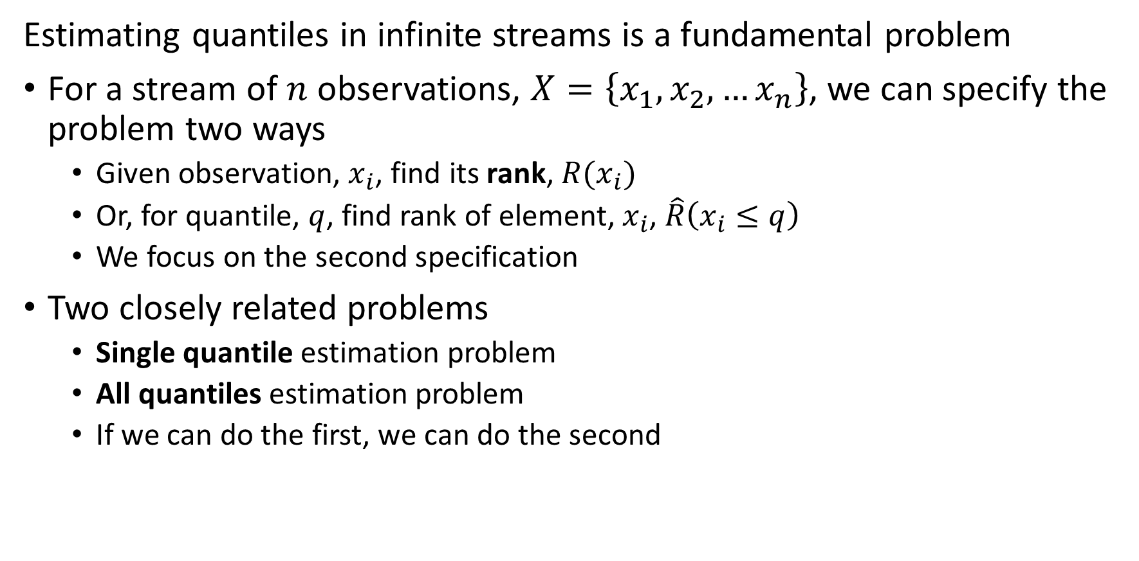
Estimating Quantiles in Streams
Estimating quantiles in infinite streams is a fundamental problem
For a stream of $n$ observations, $X=\left\{x_{1},x_{2},…x_{n}\right\}$, we can specify the problem two ways
  Given observation, $x_{i}$, find its rank, $R(x_{i})$
  Or, for quantile, $q$, find rank of element, $x_{i}$, $\hat{R}\left(x_{i}≤q\right)$
  We focus on the second specification
Two closely related problems
  Single quantile estimation problem
  All quantiles estimation problem
  If we can do the first, we can do the second

Slide 32
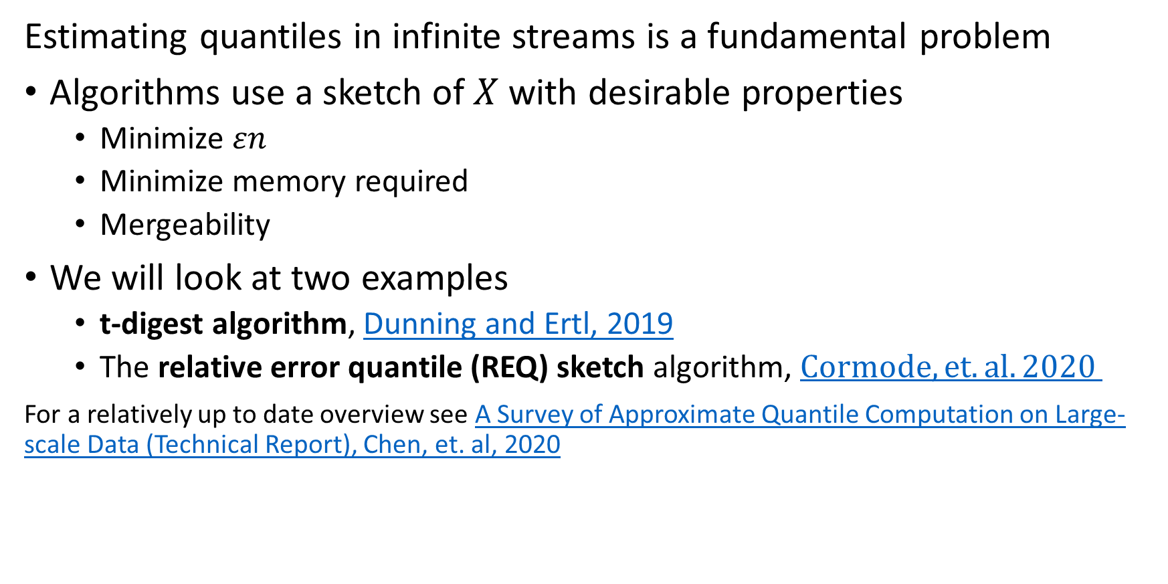
Estimating Quantiles in Streams
Estimating quantiles in infinite streams is a fundamental problem
Algorithms use a sketch of $X$ with desirable properties
  Minimize $εn$
  Minimize memory required
  Mergeability
We will look at two examples
  t-digest algorithm, Dunning and Ertl, 2019
  The relative error quantile (REQ) sketch algorithm, $Cormode, et. al. 2020$
For a relatively up to date overview see A Survey of Approximate Quantile Computation on Large-scale Data (Technical Report), Chen, et. al, 2020

Slide 33
T-Digest Algorithm

Slide 34
T-Digest Algorithm
The t-digest is an effective heuristic algorithm
The t-digest uses a unique sampling strategy that improves quantile estimates at extremes, e.g. distribution tails
  Accuracy improved by interpolation between samples
  Effective for anomaly detection and similar situations
Numerous implementations of the t-digest algorithm
  Apache DataSketches
  Fastdigest package
  Tdigest package
  Also see implementations in many languages in Ted Dunning’s reference implementation GitHub repository

Slide 35
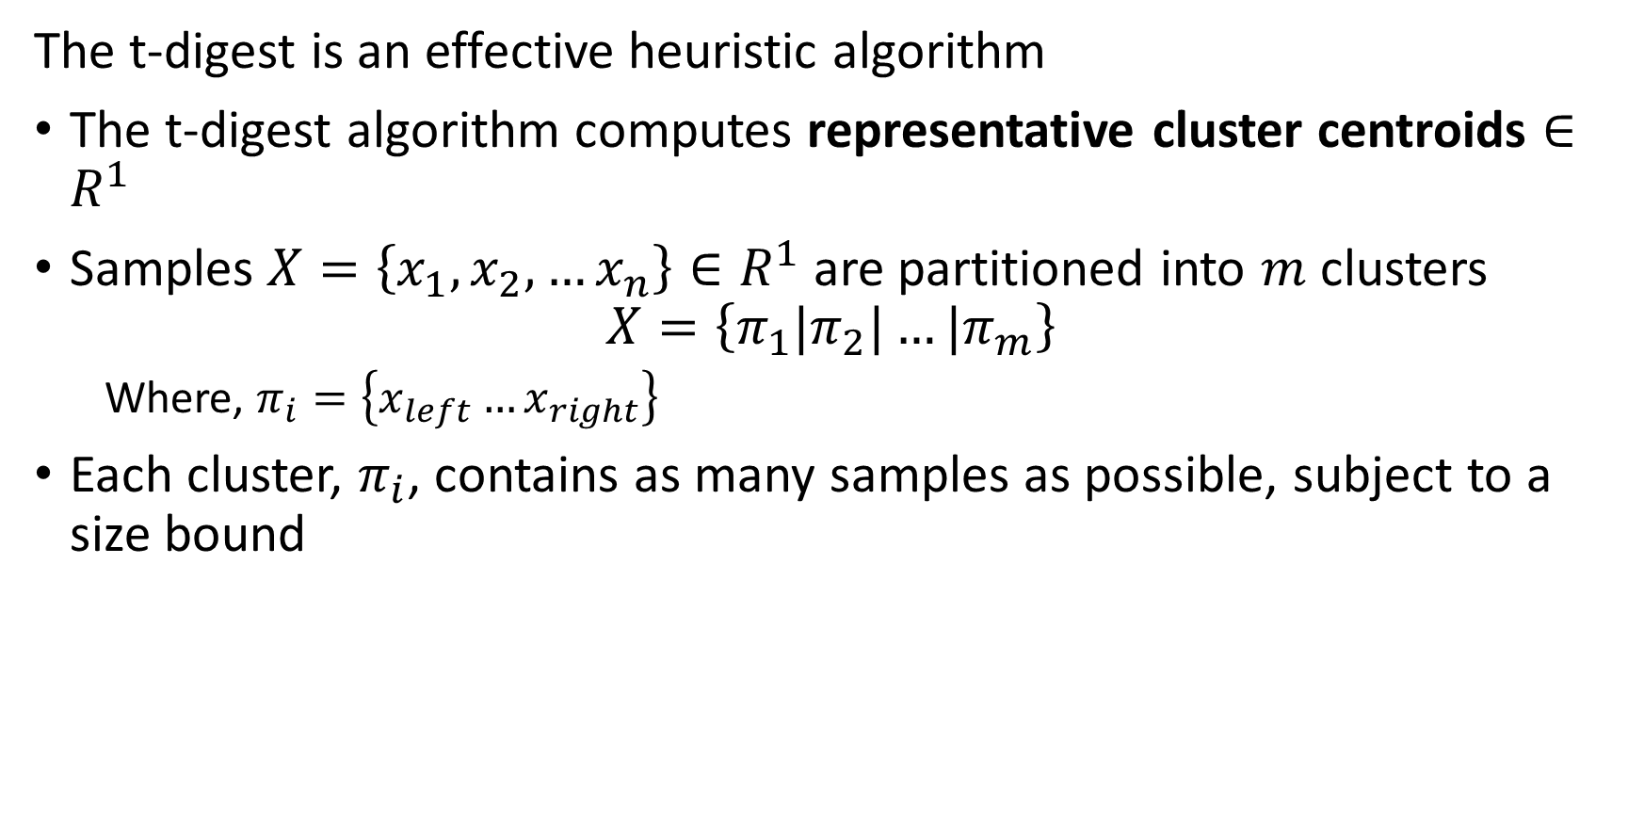
T-Digest Algorithm
The t-digest is an effective heuristic algorithm
The t-digest algorithm computes representative cluster centroids $∈R^{1}$
Samples $X=\left\{x_{1},x_{2},…x_{n}\right\}∈R^{1}$ are partitioned into $m$ clusters
$$X=\left\{π_{1}|π_{2}|…{|π}_{m}\right\}$$
  Where, $π_{i}=\left\{x_{left}…x_{right}\right\}$
Each cluster, $π_{i}$, contains as many samples as possible, subject to a size bound

Slide 36
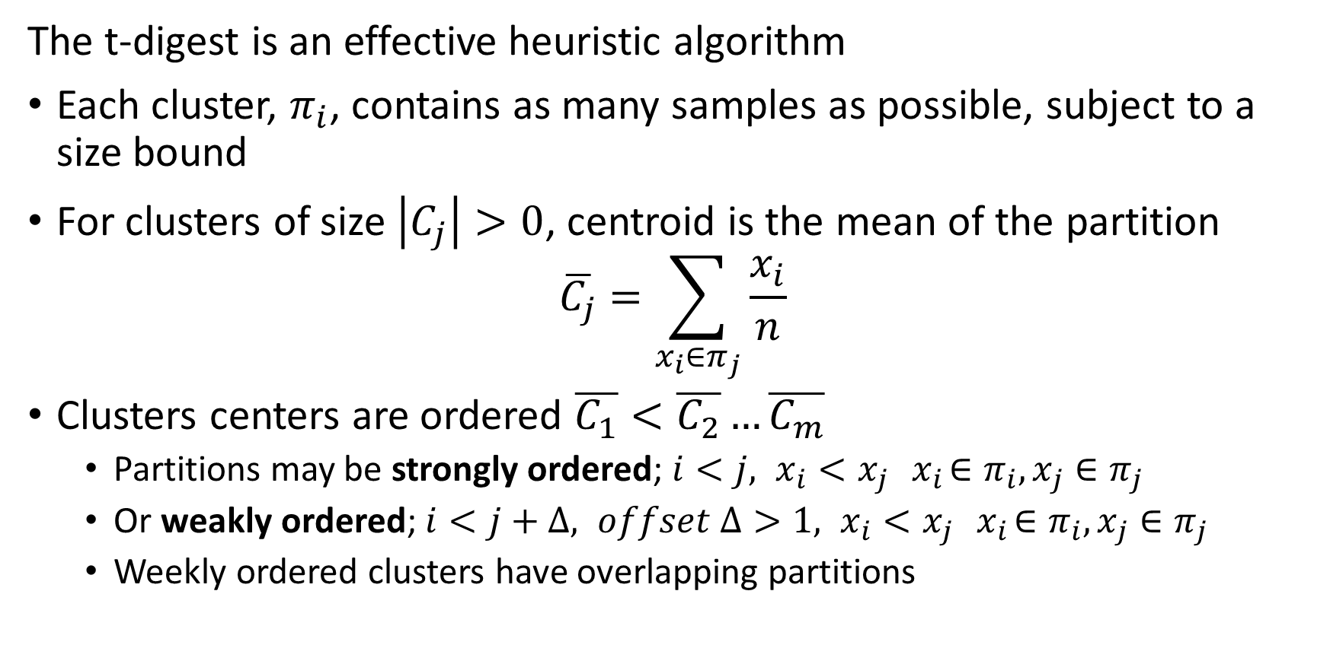
T-Digest Algorithm
The t-digest is an effective heuristic algorithm
Each cluster, $π_{i}$, contains as many samples as possible, subject to a size bound
For clusters of size $\left|C_{j}\right|>0$, centroid is the mean of the partition
$$\overline{C_{j}}=\sum_{x_{i}∈π_{j}}{\frac{x_{i}}{n}}$$
Clusters centers are ordered $\overline{C_{1}}<\overline{C_{2}}…\overline{C_{m}}$
  Partitions may be strongly ordered; ${i<j, x}_{i}<x_{j} { x}_{i}∈π_{i},x_{j}∈π_{j}$
  Or weakly ordered; ${i<j+Δ, offset Δ>1, x}_{i}<x_{j} { x}_{i}∈π_{i},x_{j}∈π_{j}$
  Weekly ordered clusters have overlapping partitions

Slide 37
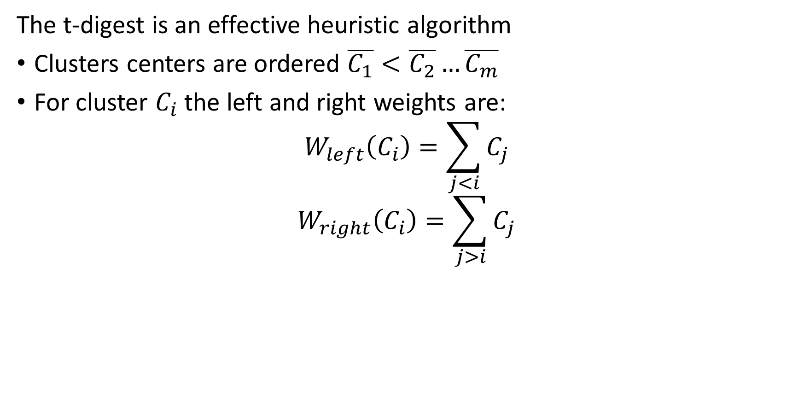
T-Digest Algorithm
The t-digest is an effective heuristic algorithm
Clusters centers are ordered $\overline{C_{1}}<\overline{C_{2}}…\overline{C_{m}}$
For cluster $C_{i}$ the left and right weights are:
$$W_{left}\left(C_{i}\right)=\sum_{j<i}{C_{j}}$$
$$W_{right}\left(C_{i}\right)=\sum_{j>i}{C_{j}}$$

Slide 38
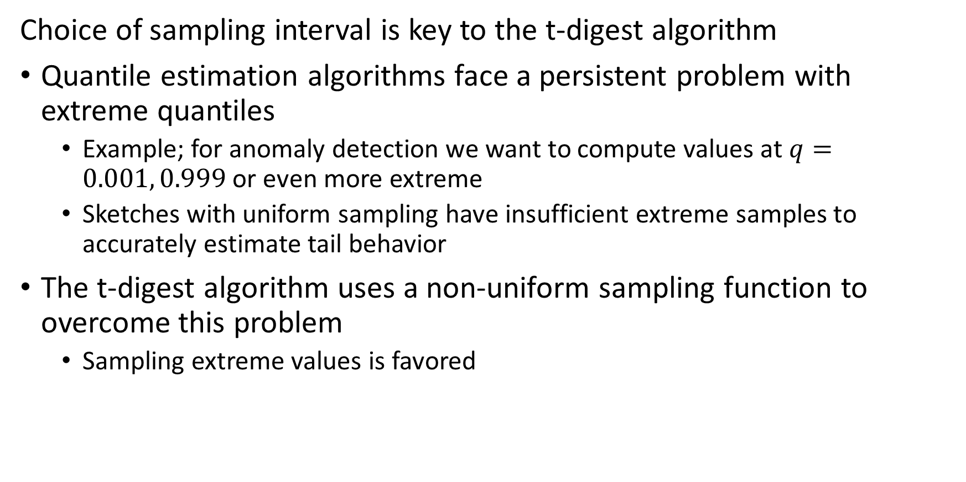
T-Digest Algorithm
Choice of sampling interval is key to the t-digest algorithm
Quantile estimation algorithms face a persistent problem with extreme quantiles
  Example; for anomaly detection we want to compute values at $q=0.001, 0.999$ or even more extreme
  Sketches with uniform sampling have insufficient extreme samples to accurately estimate tail behavior
The t-digest algorithm uses a non-uniform sampling function to overcome this problem
  Sampling extreme values is favored

Slide 39
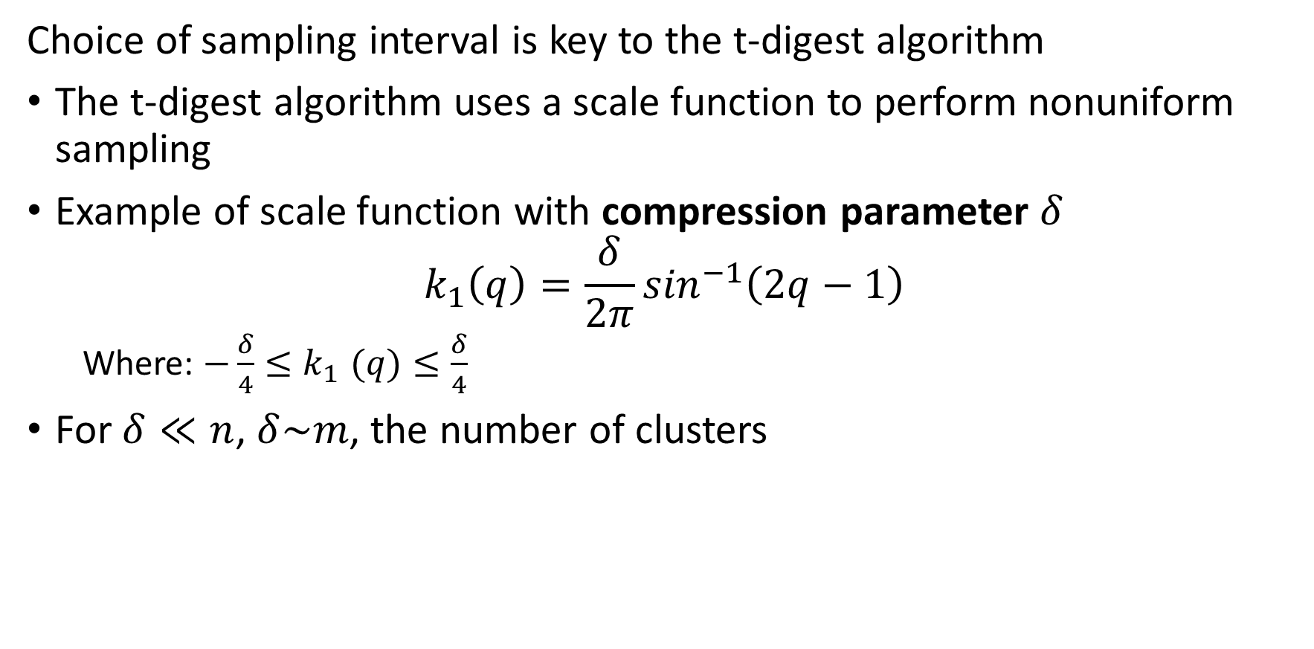
T-Digest Algorithm
Choice of sampling interval is key to the t-digest algorithm
The t-digest algorithm uses a scale function to perform nonuniform sampling
Example of scale function with compression parameter $δ$
$$k_{1}\left(q\right)=\frac{δ}{2π}\sin^{−1}\left(2q−1\right)$$
  Where: $−\frac{δ}{4}{≤k}_{1}(q)≤\frac{δ}{4}$
For $δ≪n$, $δ\sim m$, the number of clusters

Slide 40
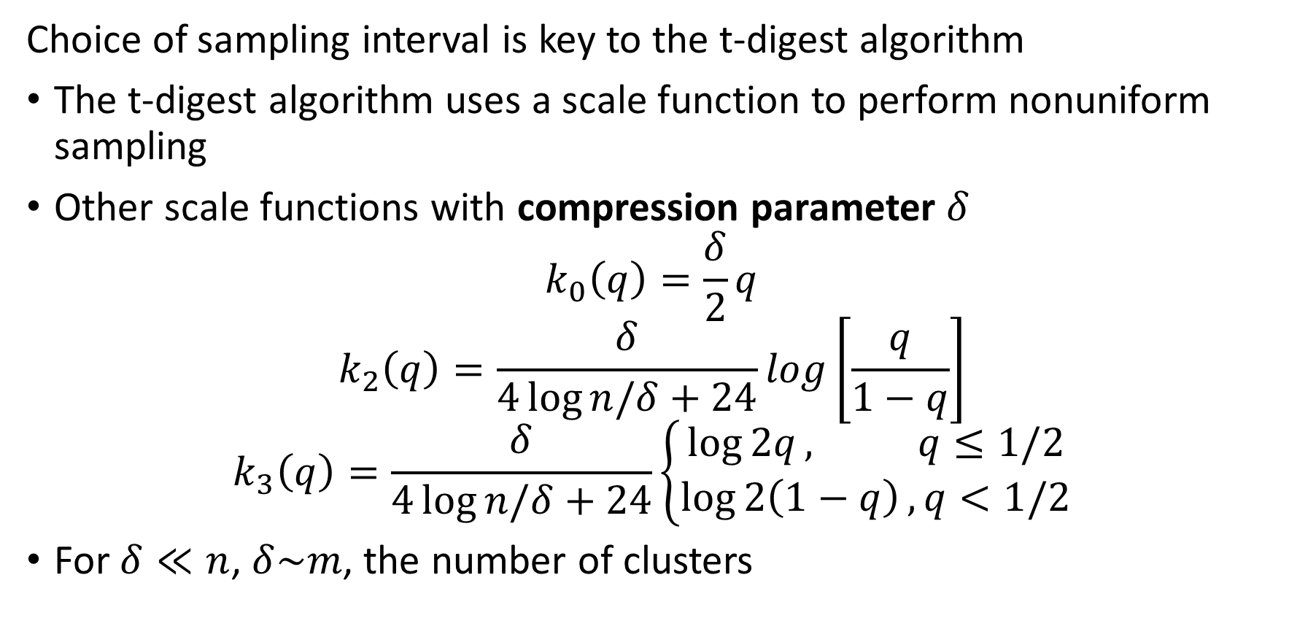
T-Digest Algorithm
Choice of sampling interval is key to the t-digest algorithm
The t-digest algorithm uses a scale function to perform nonuniform sampling
Other scale functions with compression parameter $δ$
$$k_{0}\left(q\right)=\frac{δ}{2}q$$
$$k_{2}\left(q\right)=\frac{δ}{4\log{n/δ}+24}log\left[\frac{q}{1−q}\right]$$
$$k_{3}\left(q\right)=\frac{δ}{4\log{n/δ}+24}\left\{\begin{aligned}\log{2q}, q≤1/2 \\ \log{2\left(1−q\right)}, q<1/2\end{aligned}\right.$$
For $δ≪n$, $δ\sim m$, the number of clusters

Slide 41
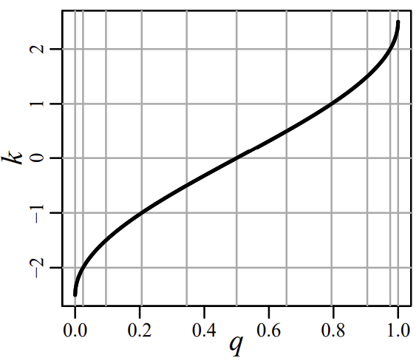
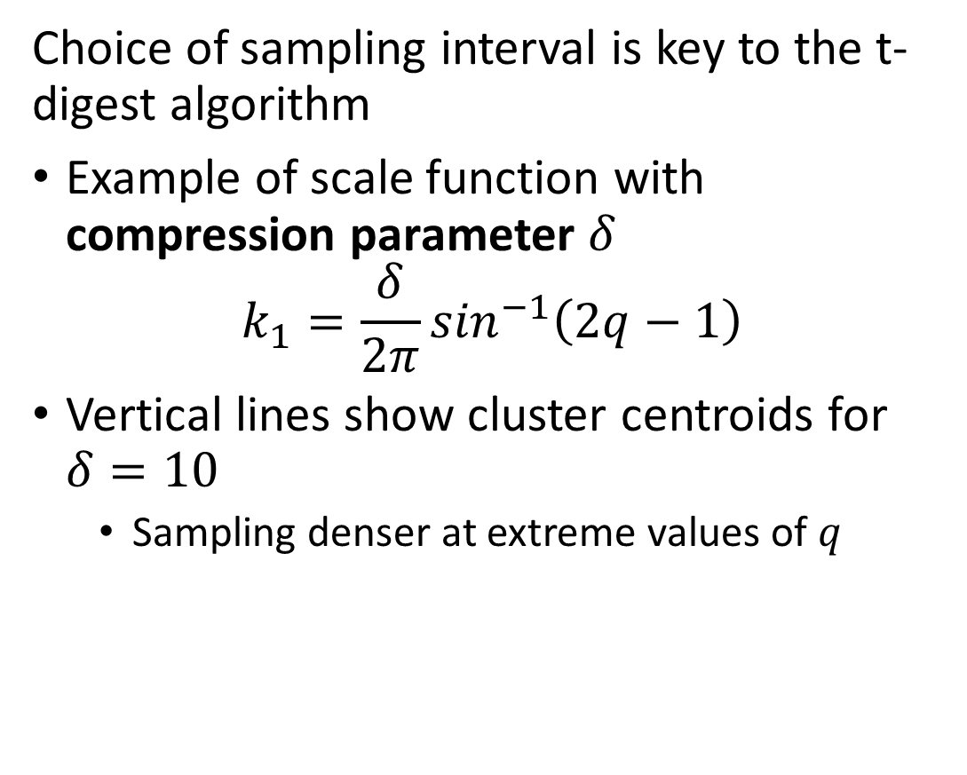
T-Digest Algorithm
Choice of sampling interval is key to the t-digest algorithm
Example of scale function with compression parameter $δ$
$$k_{1}=\frac{δ}{2π}\sin^{−1}\left(2q−1\right)$$
Vertical lines show cluster centroids for $δ=10$
  Sampling denser at extreme values of $q$
Figure from Dunning and Ertl, 2019

Slide 42
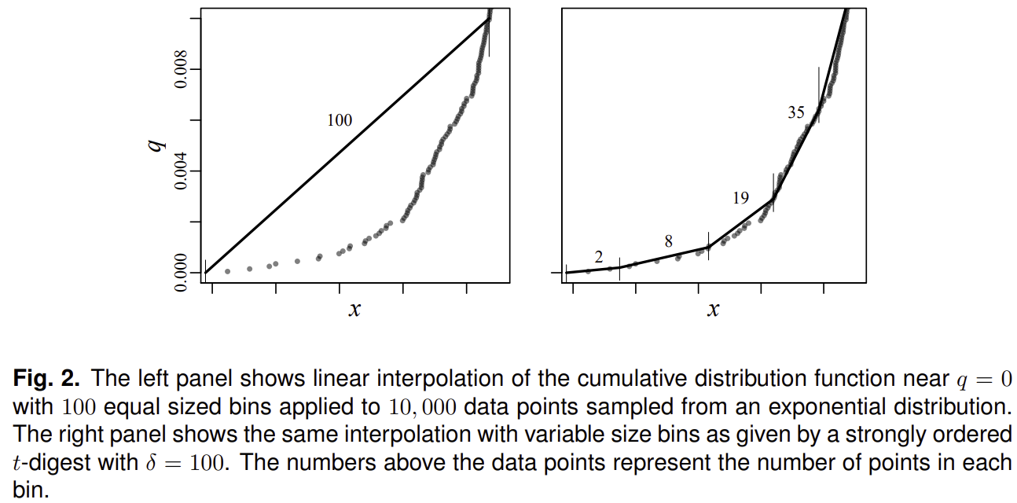
T-Digest Algorithm
Using a scale function improves interpolation of tail quantiles
Uniform bin-width random sampling results in limited samples for interpolation at extreme quantiles
Variable sized bins results non-uniform number of samples and greatly improved interpolation for extreme quantiles
Figure from Dunning and Ertl, 2019

Slide 43
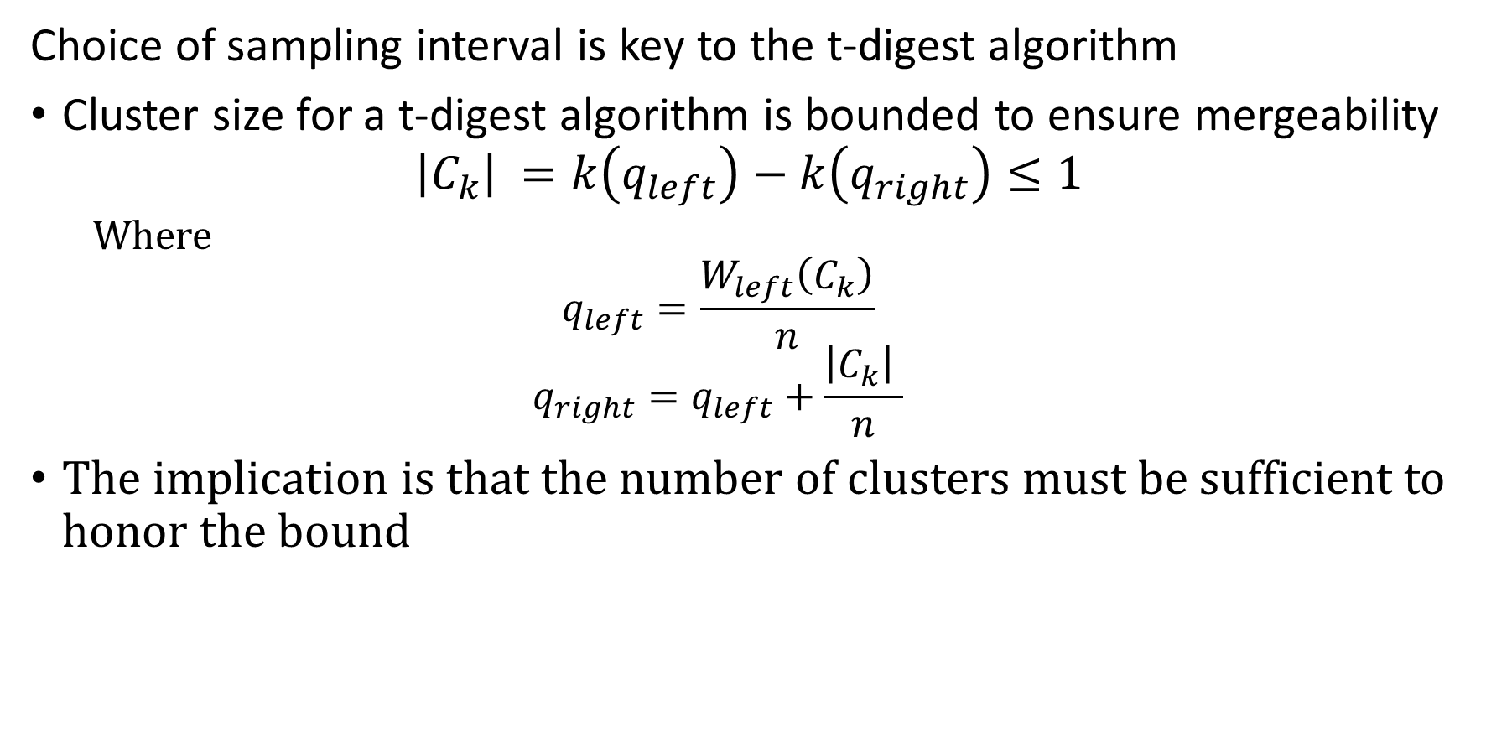
T-Digest Algorithm
Choice of sampling interval is key to the t-digest algorithm
Cluster size for a t-digest algorithm is bounded to ensure mergeability
$${\left|C_{k}\right|}_{ }=k\left(q_{left}\right)−k\left(q_{right}\right)≤1$$
  Where
  $$q_{left}=\frac{W_{left}\left(C_{k}\right)}{n}$$
  $$q_{right}=q_{left}+\frac{{\left|C_{k}\right|}_{ }}{n}$$
The implication is that the number of clusters must be sufficient to honor the bound

Slide 44
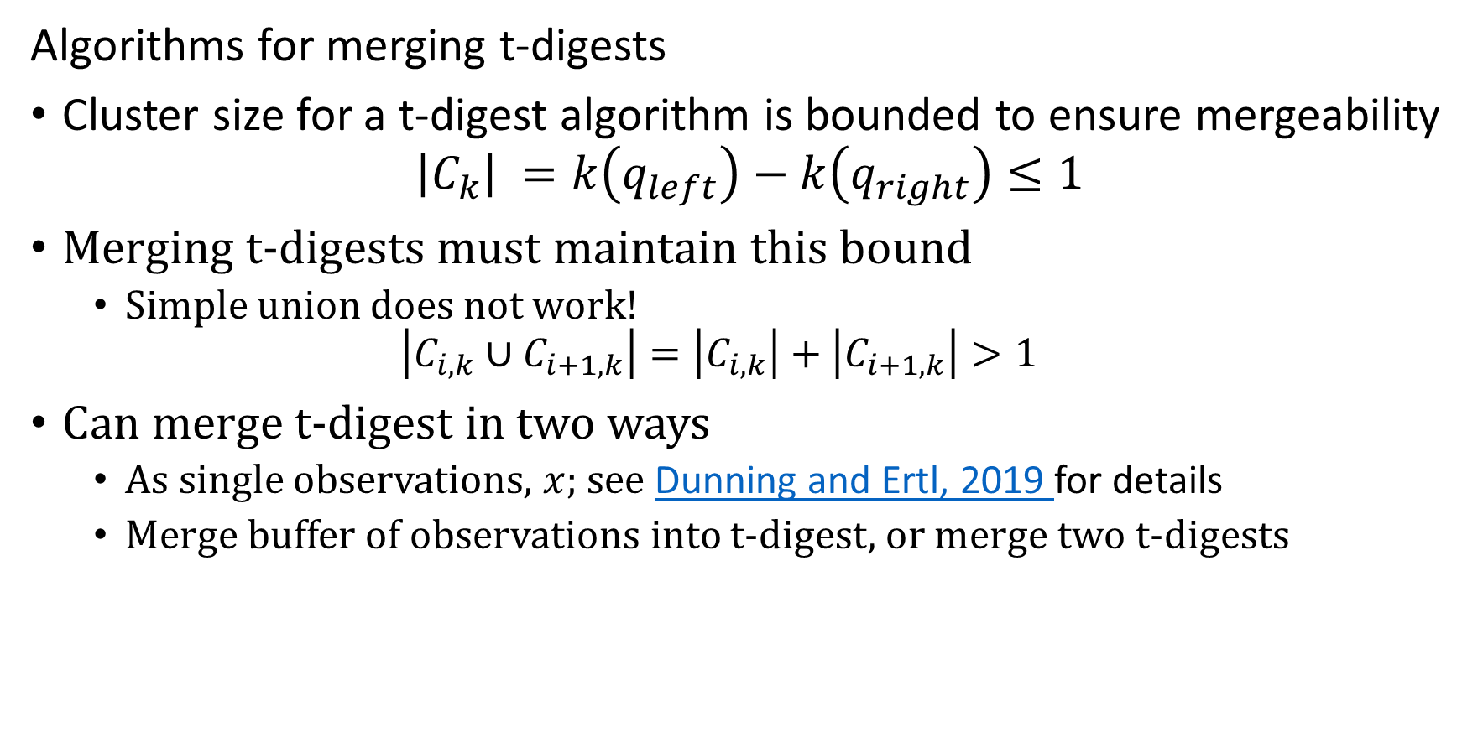
T-Digest Algorithm
Algorithms for merging t-digests
Cluster size for a t-digest algorithm is bounded to ensure mergeability
$${\left|C_{k}\right|}_{ }=k\left(q_{left}\right)−k\left(q_{right}\right)≤1$$
Merging t-digests must maintain this bound
  Simple union does not work!
  $$\left|C_{i,k}∪C_{i+1,k}\right|=\left|C_{i,k}\right|+\left|C_{i+1,k}\right|>1$$
Can merge t-digest in two ways
  As single observations, $x$; see Dunning and Ertl, 2019 for details
  Merge buffer of observations into t-digest, or merge two t-digests

Slide 45
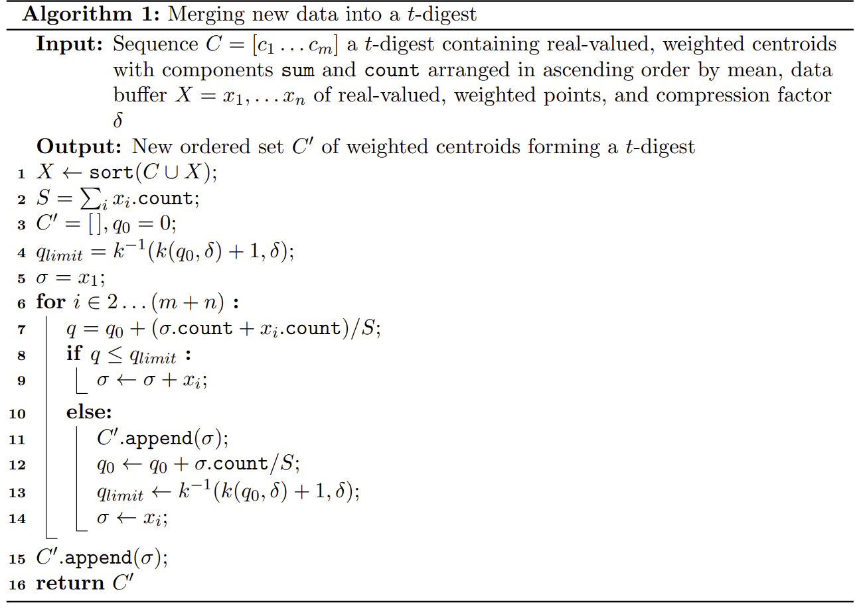
T-Digest Algorithm
Algorithm for merging t-digests
Order union of buffer and t-digest (or 2 digests)
Initialize new t-digest
Compute bound for cluster
Update counts (weights) in cluster
If, cluster bound not exceeded update cluster
Else, create new cluster and update bound
Figure from Dunning and Ertl, 2019

Slide 46
T-Digest Algorithm
T-digest uses complex interpolation algorithm to improve accuracy at extreme quantiles with 4 cases
Interpolate between two clusters with more than one sample
Interpolate between cluster with single member and cluster with more than one sample
Interpolate between two clusters with single sample
Interpolate for first or last cluster

Slide 47
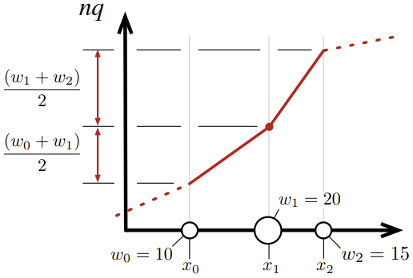
T-Digest Algorithm
T-digest uses interpolation to improve accuracy with 4 cases
Interpolate between clusters with more than one sample
  Half of centroid weight to left and half to right
  Assumes adjacent centroids have equal weight; true asymptotically
Figure from Dunning and Ertl, 2019

Slide 48
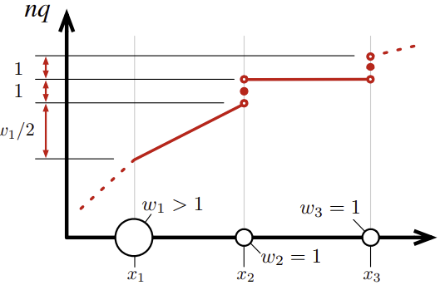
T-Digest Algorithm
T-digest uses interpolation to improve accuracy with 4 cases
Use same interpolation for case 2, one cluster with single sample to cluster with multiple samples
  Interpolation has jump of 1 at single sample centroid
Interpolate between two clusters with single sample
  Take advantage the single sample being the centroid
  Interpolation has jump of 1 at single sample centroid
Figure from Dunning and Ertl, 2019

Slide 49
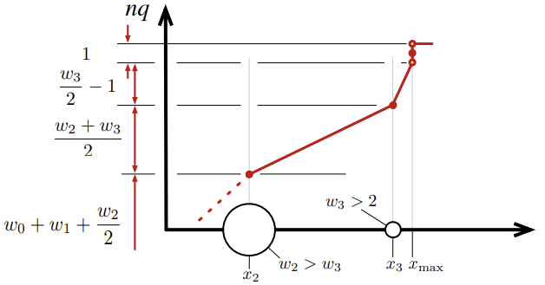
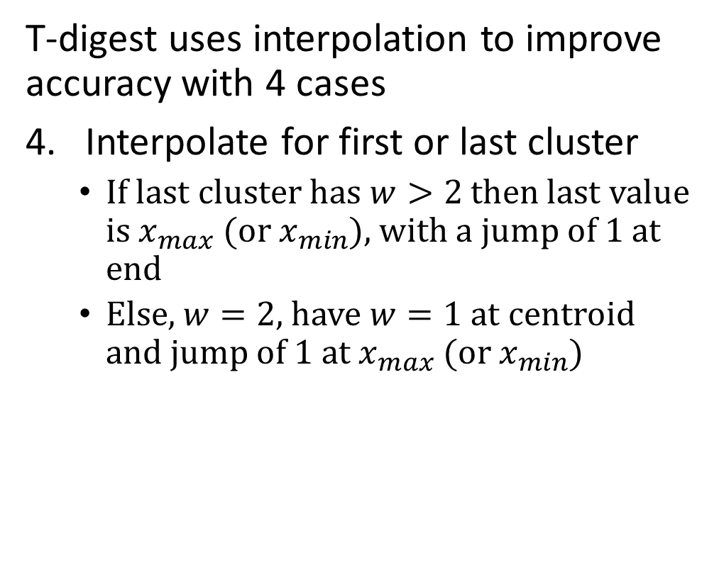
T-Digest Algorithm
T-digest uses interpolation to improve accuracy with 4 cases
Interpolate for first or last cluster
  If last cluster has $w>2$ then last value is $x_{max}$ (or $x_{min}$), with a jump of 1 at end
  Else, $w=2$, have $w=1$ at centroid and jump of 1 at $x_{max}$ (or $x_{min}$)
Figure from Dunning and Ertl, 2019

Slide 50
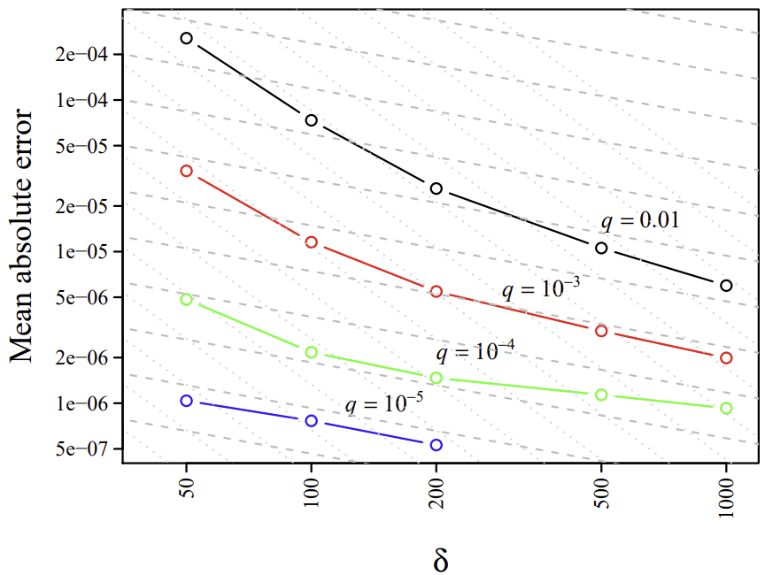
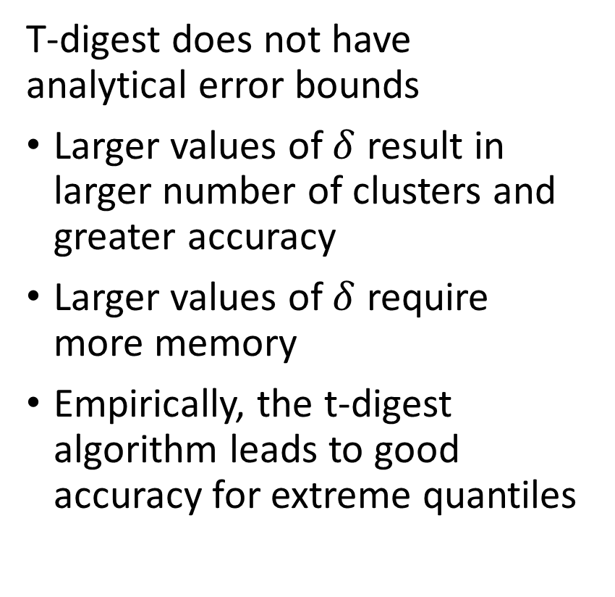
T-Digest Algorithm
T-digest does not have analytical error bounds
Larger values of $δ$ result in larger number of clusters and greater accuracy
Larger values of $δ$ require more memory
Empirically, the t-digest algorithm leads to good accuracy for extreme quantiles
Figure from Dunning and Ertl, 2019

Slide 51
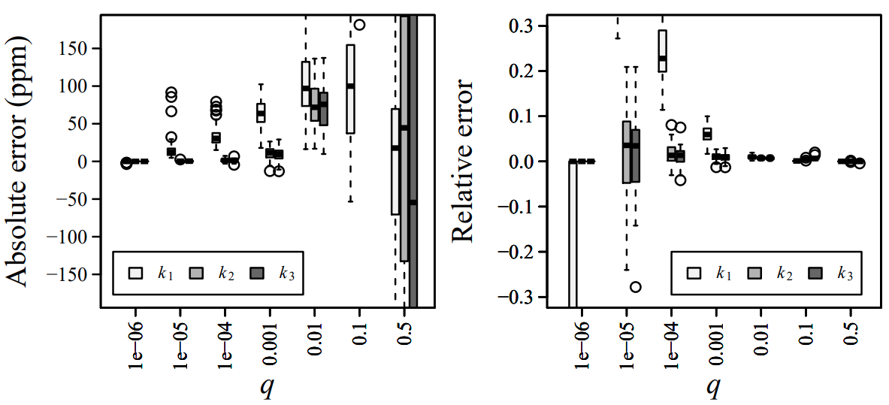
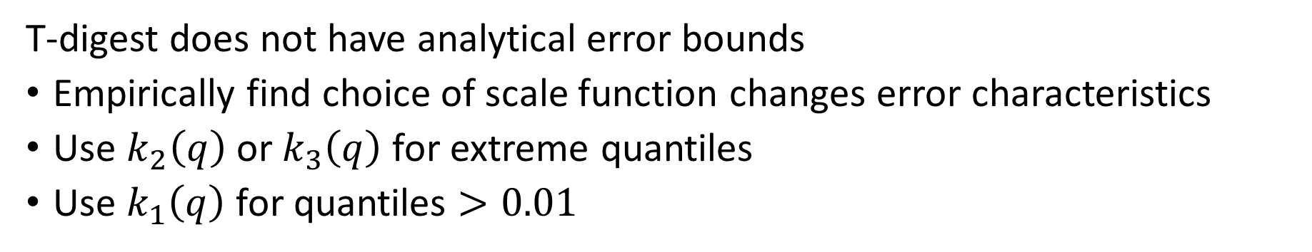
T-Digest Algorithm
T-digest does not have analytical error bounds
Empirically find choice of scale function changes error characteristics
Use $k_{2}\left(q\right)$ or $k_{3}\left(q\right)$ for extreme quantiles
Use $k_{1}\left(q\right)$ for quantiles $>0.01$
Figure from Dunning and Ertl, 2019

Slide 52
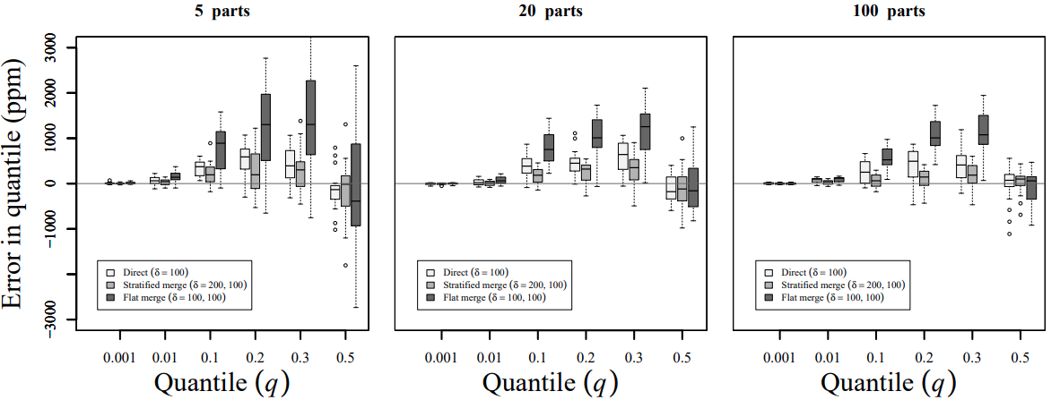
T-Digest Algorithm
T-digest does not have analytical error bounds
Empirically, stratified merging appears to reduce error
Example: merge seconds -> minutes -> hours, etc.
Figure from Dunning and Ertl, 2019

Slide 53
Relative Error Quantile (REQ) Algorithm

Slide 54
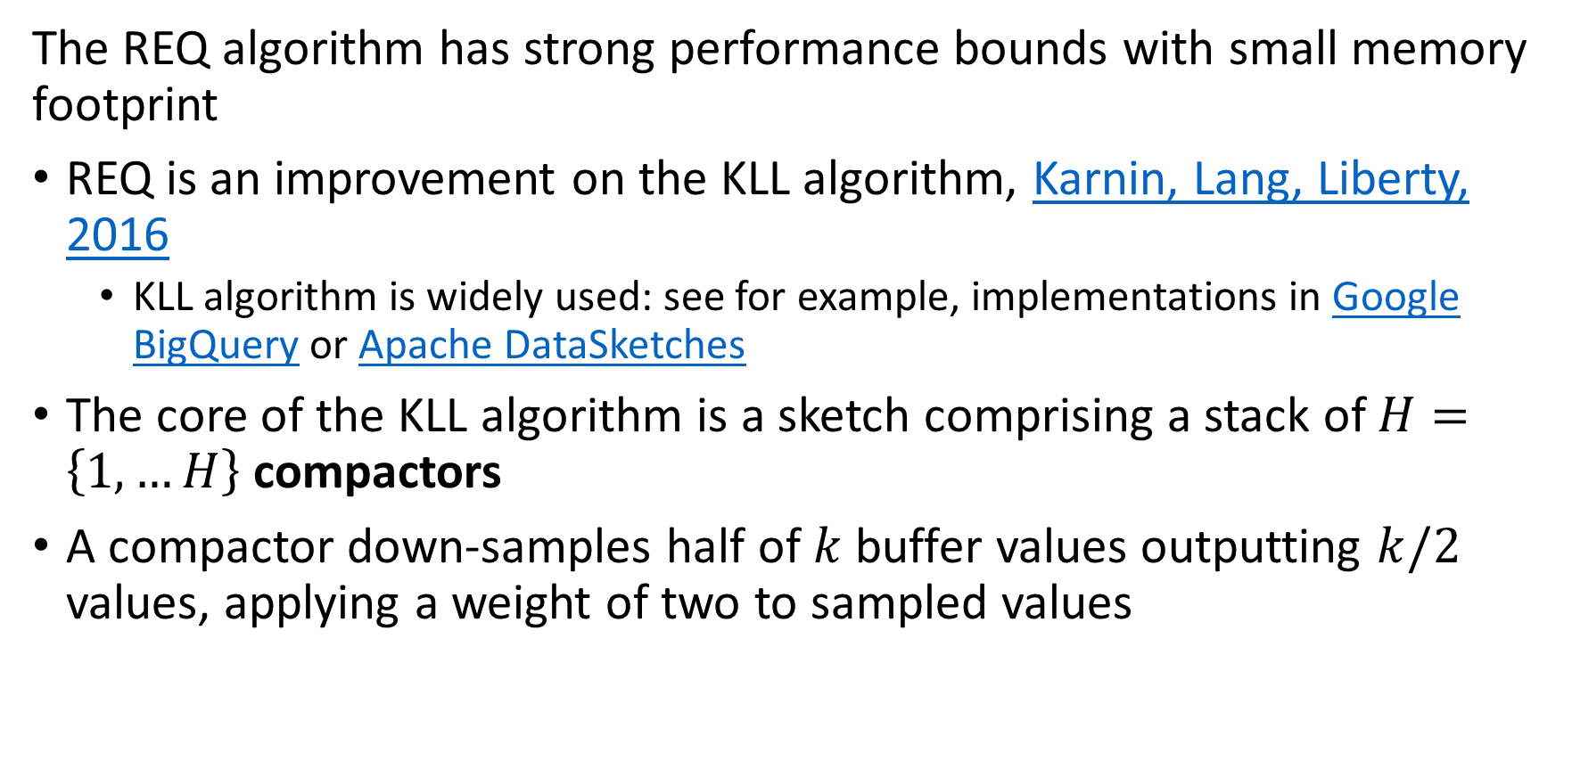
Relative Error Quantile in Sketch
The REQ algorithm has strong performance bounds with small memory footprint
REQ is an improvement on the KLL algorithm, Karnin, Lang, Liberty, 2016
  KLL algorithm is widely used: see for example, implementations in Google BigQuery or Apache DataSketches
The core of the KLL algorithm is a sketch comprising a stack of $H=\left\{1,…H\right\}$ compactors
A compactor down-samples half of $k$ buffer values outputting $k/2$ values, applying a weight of two to sampled values

Slide 55
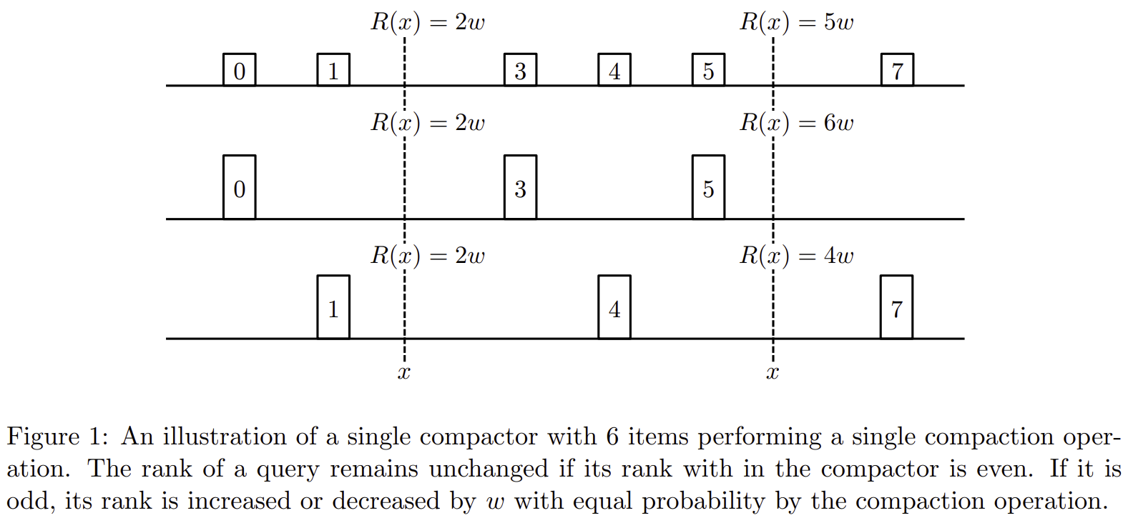
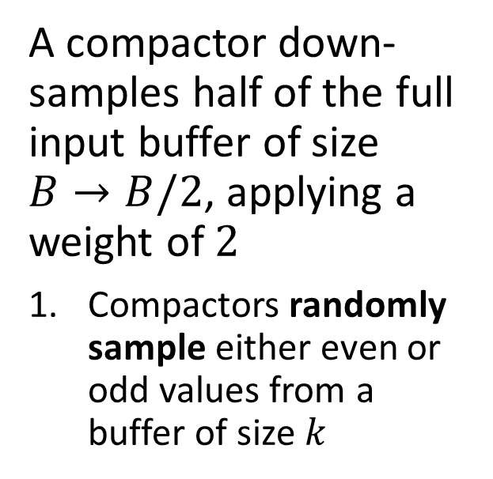
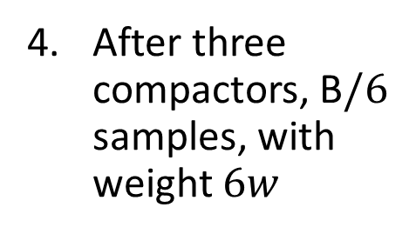
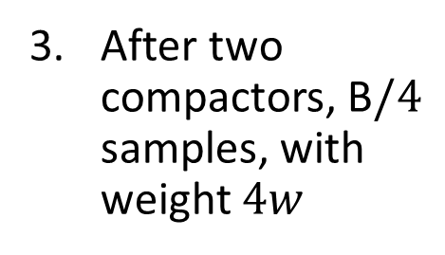
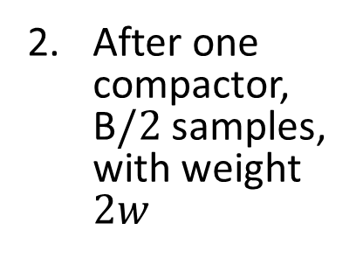
Relative Error Quantile in Sketch
After three compactors, B$/6$ samples, with weight $6w$
After one compactor, B$/2$ samples, with weight $2w$
After two compactors, B$/4$ samples, with weight $4w$
A compactor down-samples half of the full input buffer of size $B→B/2$, applying a weight of $2$
Compactors randomly sample either even or odd values from a buffer of size $k$
Figure from Karmin, Lang, Liberty, 2016

Slide 56





Relative Error Quantile in Sketch
Compactors of increasing capacity, emit 1$/2$ input samples, from buffer of capacity $m$
Stack of $H$ compactors down-samples input buffer values
For a stream of length $n$ the maximum height (number of compactors) is
$$H≤\log_{2}n$$
Rank computed by summing over last buffer
Smallest possible compactor with capacity of $B=2$ values
Use random sampler for low-capacity, $B=2$, compactors
Figure from Karmin, Lang, Liberty, 2016

Slide 57

Relative Error Quantile in Sketch
The REQ algorithm has strong performance bounds with small memory footprint
The KLL algorithm is not optimal in terms of error bound and memory use
$Cormode, et. al. 2020$ use a modified compactor for the REQ algorithm to improve error bound and memory use
  REQ algorithm minimizes relative error or multiplicative error, $ε$, with probability $δ$, not absolute error or additive error
  $$\left|\hat{R}\left(q\right)−R(q)\right|≤εR\left(q\right)$$
  $$Pr\left[\left|\hat{R}\left(q\right)−R(q)\right|>εR\left(q\right) \right]<δ$$
  REQ compactor does not down-sample extreme values

Slide 58

Relative Error Quantile in Sketch
REQ compactor does not down-sample extreme values
REQ algorithm is optimized for either extreme small or extreme large quantiles, but not both
REQ buffer always stores smallest (largest) $1/ε$ values to reduce error
Buffer size determined by error bound and stream size $n$
$$B=2k \log_{2} n/k$$
$$k=Θ\left(\frac{1}{ε\sqrt{log\left(ε n\right)}}\right)$$
For streaming data:
$$k=2\left[\frac{4}{ε} \sqrt{\frac{\ln{1/δ}}{\log_{2}\left(εn\right)}}\right]$$

Slide 59

Relative Error Quantile in Sketch
REQ compactor does not down-sample extreme values
Once buffer is full:
  Smallest (largest) $B/2$ values are not sampled
  Conversely, only largest (smallest) $B/2$ values are sampled
  Sampling is determined by least significant bits of a binary counter
Goal is to randomize the sample of largest (smallest) $B/2$ values following a geometric distribution
  Use a deterministic approximation for efficiency

Slide 60






Relative Error Quantile in Sketch
$k=\left[0,0,0,0,0,0,1\right]$, sample slot 1
REQ compactor does not down-sample extreme values
Goal is to randomize the sample of largest (smallest) $B/2$ values following a geometric distribution
  Use a deterministic approximation for efficiency
Example, use a 7-bit binary counter, $C$, to deterministically sample slots with $\frac{B}{k 2}$ samples
$k=\left[0,0,0,0,0,1,0\right]$, sample slot 2
$k=\left[0,0,0,0,0,1,1\right]$, sample slots 1 and 2
$k=\left[0,0,0,0,1,0,0\right]$, sample slot 3
Figure from $Cormode, et. al. 2020$

Slide 61



REQ Algorithm
Compactor algorithm for REQ
Parameter $k$ determines size of buffer
Initialize counter $C$
Compute sampling parameters
Set the pivot point in the buffer
Sort the buffer values from the pivot point
Randomly sample even or odd values
Figure from $Cormode, et. al. 2020$

Slide 62


REQ Algorithm
Algorithm for merging REQ sketch $S′′$ into sketch $S′$
Compactors of $S′′$ integrated sequentially
Buffers of each level $h$ are combined
Check if buffer at each level $h$ is full
If the buffer is full perform compaction operation
Figure from $Cormode, et. al. 2020$

Slide 63



Comparison of Quantile in Sketches
One can take advantage of the performance differences between the t-digest and REQ algorithms
The t-digest algorithm is known to have a bias at extreme quantiles that increases with sample size, $n$
The REQ algorithm is unbiased
Figure from DataSketches User Guide

Slide 64


Comparison of Quantile in Sketches
One can take advantage of the performance differences between the t-digest and REQ algorithms
The t-digest and REQ algorithms have different error characteristics with sample size
The memory foot print of a t-digest is constant, whereas the memory required for REQ increases with sample size
Both algorithms have tradeoff between memory and error
Figure from DataSketches User Guide

Slide 65
Case Study 2

Slide 66
Case Study 2: Real-time Depth of Book
Volume in a security order book are defined by the quantiles
Is a continuous auction market
Inside spread is difference between highest bid and lowest ask
Volume increases as spread increases
  Often de minimis volume at the inside spread
  Larger trades pay larger spread
Example: in US equities markets quantiles are measured in pennes, $0.01.
Stream analysis of order book provides vital trade execution information
See patent US 8,768,821, Elston, 2011

Slide 67
Case Study 2: Real-time Depth of Book
Volume in a security order book are defined by the quantiles
Order book constructed by accumulating open (bid/ask, price, volume) tuples
  Orders and trades arrive in high volume stream for each security
  Order book updates at sub-microsecond rate
  Storing history is infeasible
Quantiles of order book are the available volume at each spread
Securities traded on multiple exchanges
  Each exchange outputs high volume stream for each security
  Must integrate streams

Slide 68

Case Study 2: Real-time Depth of Book
  Depth of book, order lifetime and other statistics at several spreads

Slide 69
Case Study

Slide 70
Case Study 3: Capital Markets Risk
Goal: provide market and credit risk reports to management and regulators
Global bank with large holdings
  Trading on a 24/7 basis – global markets never sleep!
  Hold illiquid (rarely traded) assets
Regulators require snap shot reports every 4 hours and within 2 hours on demand
  Existing batch system required 12+ hours to update reports

Slide 71
Case Study 3: Capital Markets Risk
Model training
1000s of risk factors to calibrate
  Asset type
  Industry exposure
  Ratings
  FX exposure
  Interest rate exposure
  ….
Market conditions change rapidly
  Must down weight older data
  Impute valuations for illiquid assets

Slide 72
Case Study 3: Capital Markets Risk
Scaling
Initial calibration is computed in batch
  Not time critical
Running model in production
  Batch too slow
  Stream data and update asset holdings (positions)
  Incrementally update risk factors
  Upon demand perform aggregation to generate required reports – fast
Distribute streaming compute load by asset type on cluster
  Trades, prices and other data only go to node where required
Archive all raw data per regulatory required retention policy

Slide 73
Summary

Slide 74
Summary
Key points for this lesson
Streaming data often arrives at a massive scale
Down sample streams with real-number values
  Moving averages
  Delta coding
  Exponential weighting
  Reservoir sampling
  ….
Use probabilistic sketch algorithms for discrete event streams
  Uniqueness – have we seen this event type before?
  Counts – how many of these events in time interval?
  Cardinality – how many event types?
  Quantiles – what is the density of the distribution?
  …

