Slide 1

CSCI E-108
Review of Linear Algebra
Steve Elston
Copyright 2020, 2021, 2022, 2023. 2024, 2025, 2026 Stephen F Elston. All rights reserved.

Slide 2
Review of Linear Algebra
Linear algebra is at the core of nearly all machine learning algorithms
Linear algebra is the algebra of arrays
Understanding of linear algebra is essential to understanding machine learning
Linear algebra operations are building blocks of algorithms
Efficient linear algebra algorithms enable large scale machine learning and statistical analysis
We limit ourselves to linear algebra with real valued arrays

Slide 3
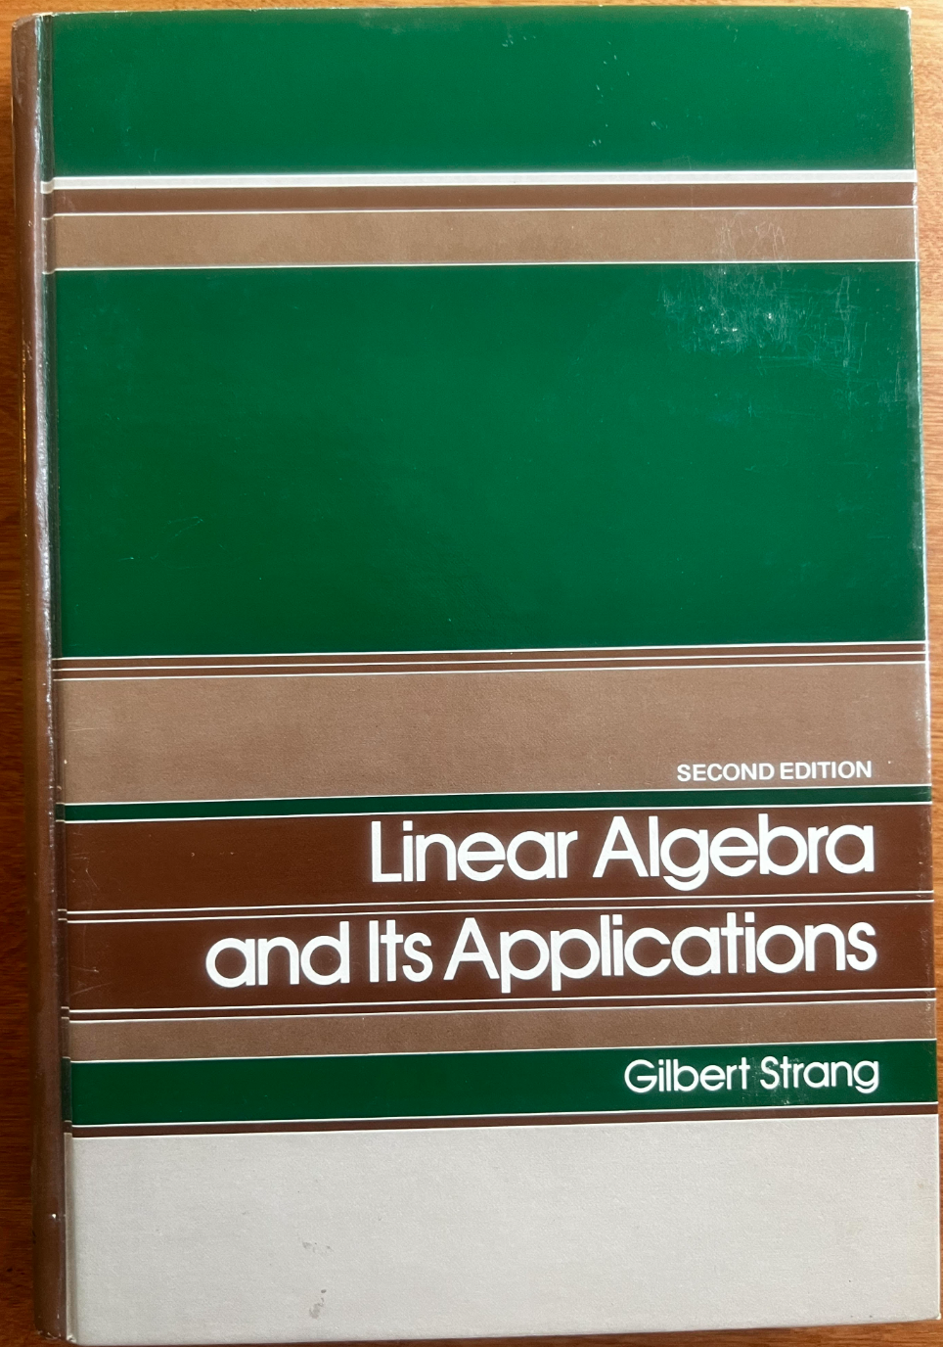
Review of Linear Algebra
There are a great many recourses for digging further into this subject
Gil Strang is the master and we are all his pupils
Book and lectures by Gilbert Strang are particularly good
Strang’s Introduction to Linear Algebra, now in 6th edition, is the classic text
Also see Strang’s lectures on YouTube and MIT Open Courseware
Your instructor’s well-warn copy from the 1970s

Slide 4
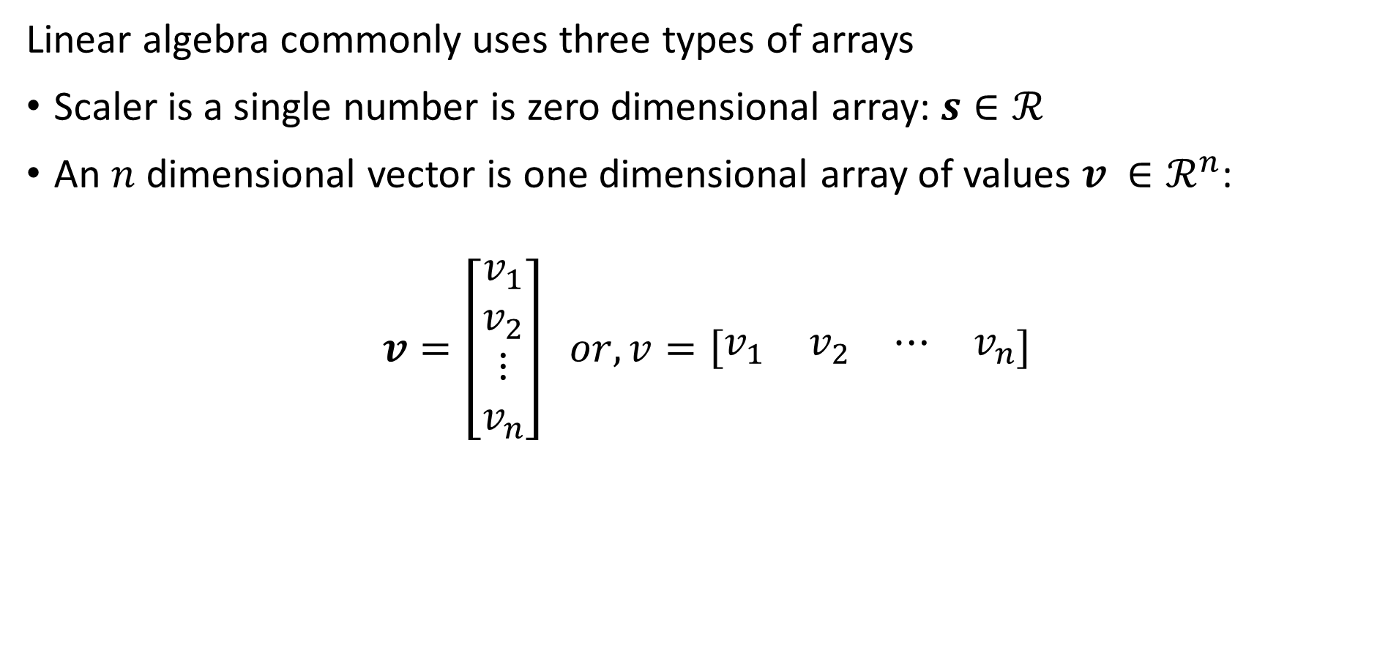
Types of Arrays
Linear algebra commonly uses three types of arrays
Scaler is a single number is zero dimensional array: $s∈ℛ$
An $n$ dimensional vector is one dimensional array of values $v_{ }∈ℛ^{n}$:
$$v=\left[\begin{matrix}\begin{matrix}v_{1} \\ v_{2}\end{matrix} \\ \begin{matrix}⋮ \\ v_{n}\end{matrix}\end{matrix}\right] or, v=\left[\begin{matrix}\begin{matrix}v_{1} & v_{2}\end{matrix} & \begin{matrix}⋯ & v_{n}\end{matrix}\end{matrix}\right]$$

Slide 5
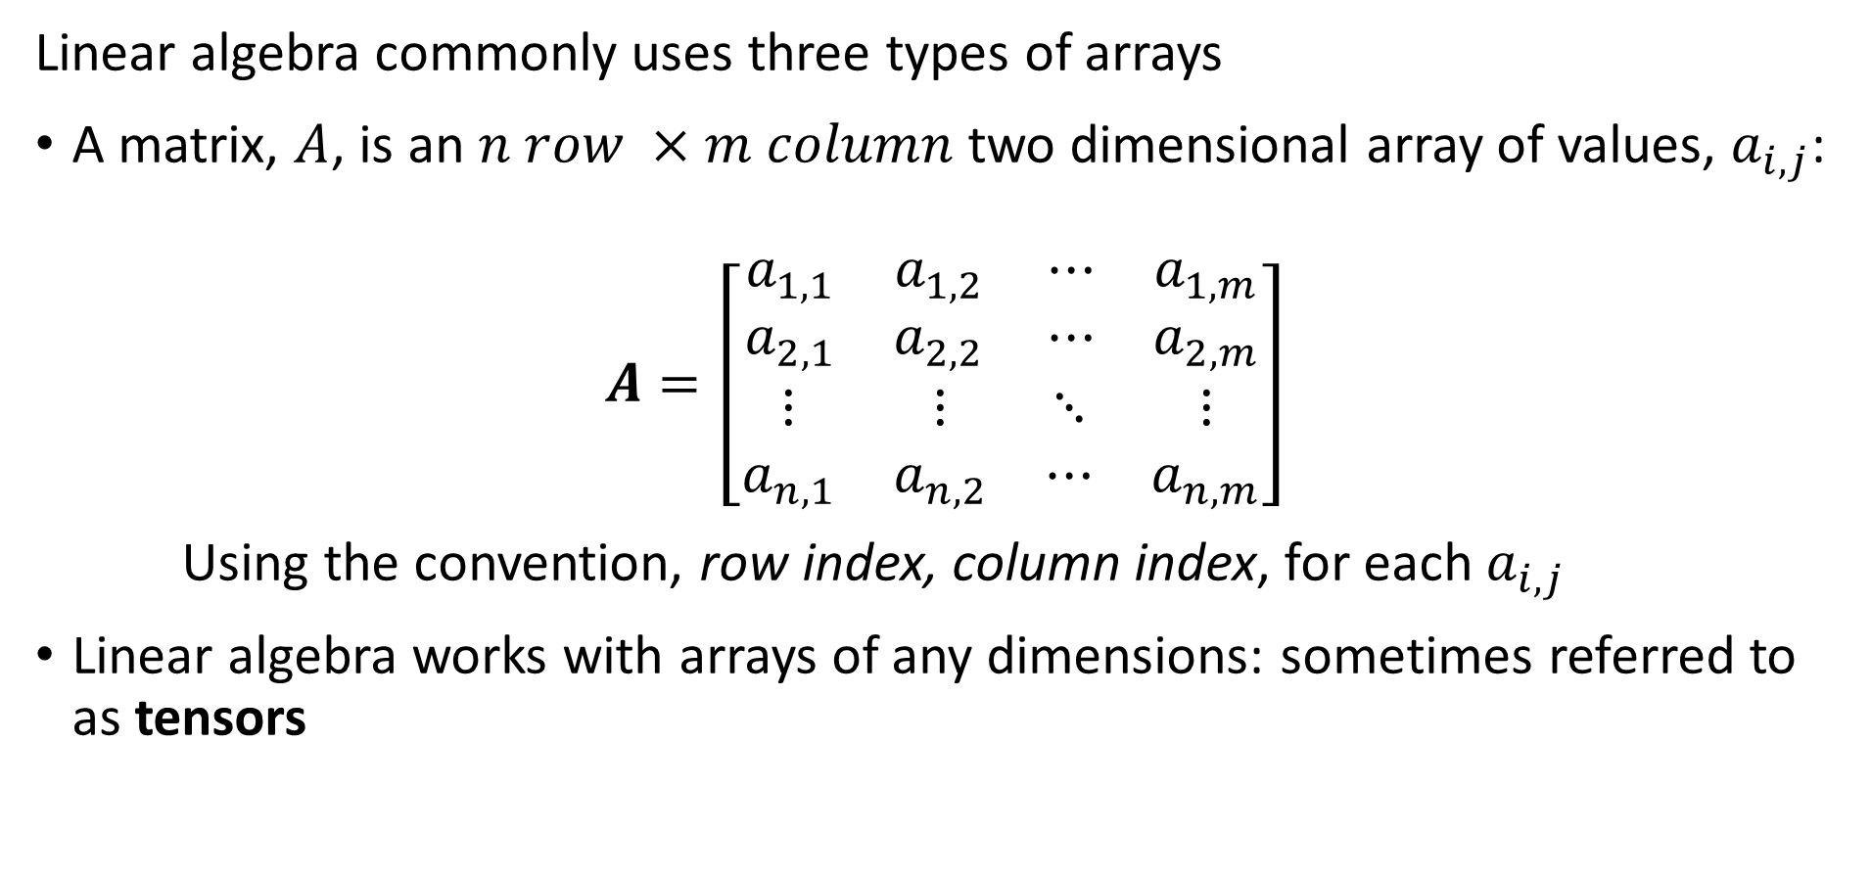
Types of Arrays
Linear algebra commonly uses three types of arrays
A matrix, $A$, is an $n row ×m column$ two dimensional array of values, $a_{i,j}$:
$$A=\left[\begin{matrix}\begin{matrix}a_{1,1} & a_{1,2} \\ a_{2,1} & a_{2,2}\end{matrix} & \begin{matrix}⋯ & a_{1,m} \\ ⋯ & a_{2,m}\end{matrix} \\ \begin{matrix}⋮ & ⋮ \\ a_{n,1} & a_{n,2}\end{matrix} & \begin{matrix}⋱ & ⋮ \\ ⋯ & a_{n,m}\end{matrix}\end{matrix}\right]$$
Using the convention, row index, column index, for each $a_{i,j}$
Linear algebra works with arrays of any dimensions: sometimes referred to as tensors

Slide 6

Basic Array Operations
Can add or multiply a scalar with a vector, a commutative operation
$$s+v=\left[\begin{matrix}\begin{matrix}s+v_{1} \\ {s+v}_{2}\end{matrix} \\ \begin{matrix}⋮ \\ {s+v}_{n}\end{matrix}\end{matrix}\right]$$
$$s∗v=\left[\begin{matrix}\begin{matrix}{s∗v}_{1} \\ {s∗v}_{2}\end{matrix} \\ \begin{matrix}⋮ \\ {s∗v}_{n}\end{matrix}\end{matrix}\right]$$

Slide 7
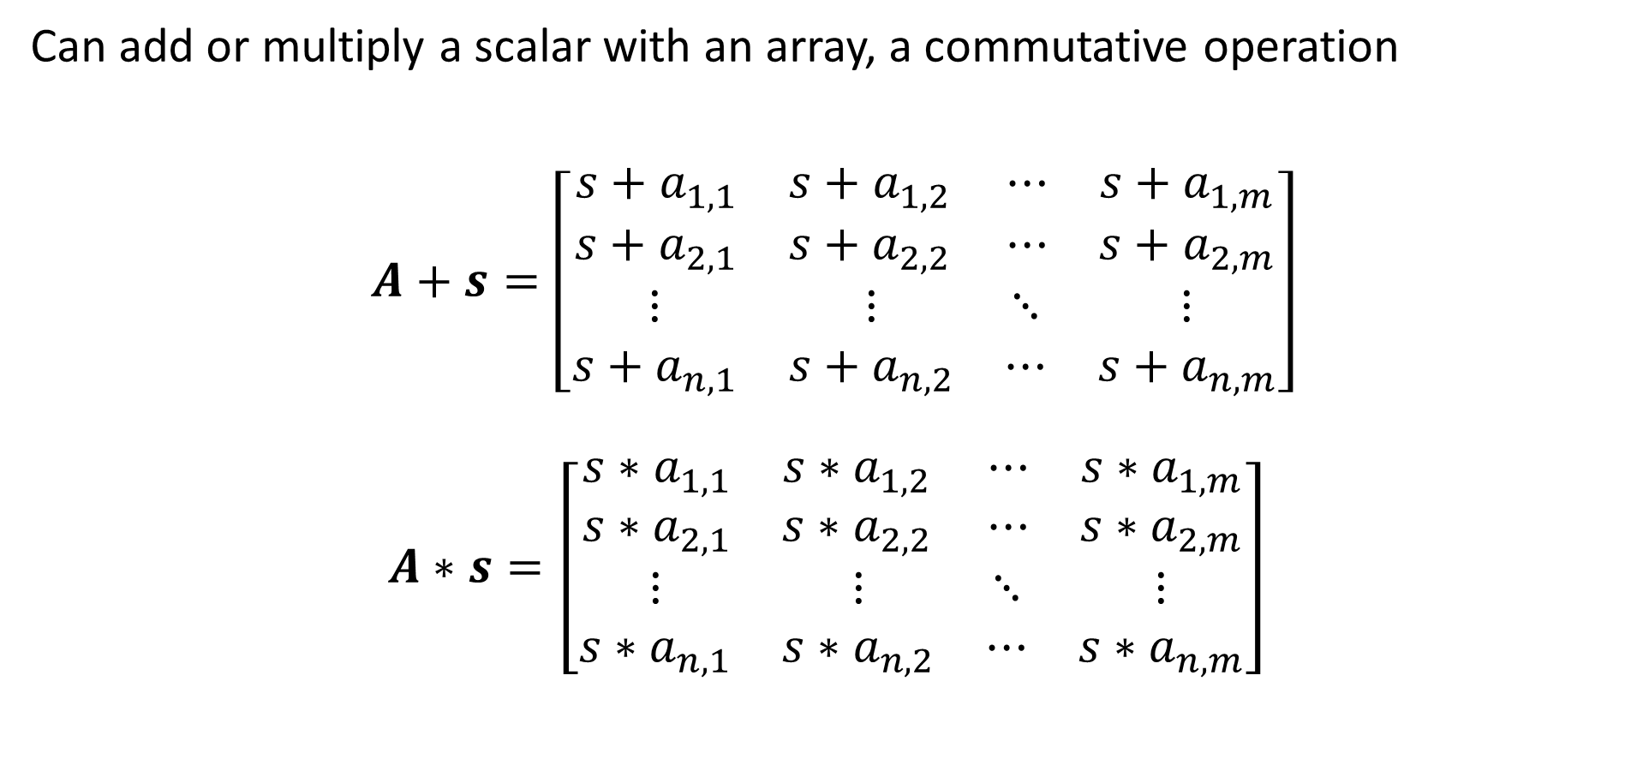
Basic Array Operations
Can add or multiply a scalar with an array, a commutative operation
$A+s=\left[\begin{matrix}\begin{matrix}{s+a}_{1,1} & s+a_{1,2} \\ {s+a}_{2,1} & {s+a}_{2,2}\end{matrix} & \begin{matrix}⋯ & {s+a}_{1,m} \\ ⋯ & {s+a}_{2,m}\end{matrix} \\ \begin{matrix}⋮ & ⋮ \\ {s+a}_{n,1} & s+a_{n,2}\end{matrix} & \begin{matrix}⋱ & ⋮ \\ ⋯ & {s+a}_{n,m}\end{matrix}\end{matrix}\right]$
$$A∗s=\left[\begin{matrix}\begin{matrix}{s∗a}_{1,1} & s∗a_{1,2} \\ {s∗a}_{2,1} & {s∗a}_{2,2}\end{matrix} & \begin{matrix}⋯ & {s∗a}_{1,m} \\ ⋯ & {s∗a}_{2,m}\end{matrix} \\ \begin{matrix}⋮ & ⋮ \\ {s∗a}_{n,1} & s∗a_{n,2}\end{matrix} & \begin{matrix}⋱ & ⋮ \\ ⋯ & {s∗a}_{n,m}\end{matrix}\end{matrix}\right]$$

Slide 8

Basic Array Operations
Perform element-wise operations on arrays, a commutative operation
$$u+v=\left[\begin{matrix}\begin{matrix}u_{1}{+v}_{1} \\ {u_{2}+v}_{2}\end{matrix} \\ \begin{matrix}⋮ \\ {u_{n}+v}_{n}\end{matrix}\end{matrix}\right]$$
$$u∗v=\left[\begin{matrix}\begin{matrix}{u_{1}∗v}_{1} \\ {u_{2}∗v}_{2}\end{matrix} \\ \begin{matrix}⋮ \\ {u_{n}∗v}_{n}\end{matrix}\end{matrix}\right]$$

Slide 9
Basic Numpy Operations
Perform basic linear algebra operations in Numpy, create some arrays
import numpy as np
import numpy.random as nr
import numpy.linalg as npla
y = np.array([2]*3)
print('Array y = {}, with type {}'.format(y,type(y)))
## Array y = [2 2 2], with type < class 'numpy.ndarray >
x = np.arange(1, 4)
print('Array x = {} with type {}'.format(x,type(x)))
## Array x = [1 2 3] with type < class 'numpy.ndarray >

Slide 10
Basic Numpy Operations
Perform basic linear algebra operations in Numpy
a_scalar = 1.0
print(a_scalar + y)
## [3. 3. 3.]
print(y - x)
## [ 1 0 -1]

Slide 11
Basic Numpy Operations
Create arrays using Numpy
A = np.full((4,3), 2.0)
print('A = \n{}'.format(A))
## A =
## [[2. 2. 2.]
## [2. 2. 2.]
## [2. 2. 2.]
## [2. 2. 2.]]

Slide 12
Basic Numpy Operations
Create arrays using Numpy
B = np.arange(1,13).reshape((4,3))
print('Matrix B with shape {} \n{}'.format(B.shape, B))
## Matrix B with shape (4, 3)
## [[ 1 2 3]
## [ 4 5 6]
## [ 7 8 9]
## [10 11 12]]

Slide 13
Basic Numpy Operations
Numpy scalar operation on an array
print('1.0 + A = \n{}'.format(a_scalar + A))
## 1.0 + A =
## [[3. 3. 3.]
## [3. 3. 3.]
## [3. 3. 3.]
## [3. 3. 3.]]

Slide 14
Basic Numpy Operations
Numpy element-wise operations on arrays
print('A + B = \n{}'.format(A + B))
## A + B =
## [[ 3. 4. 5.]
## [ 6. 7. 8.]
## [ 9. 10. 11.]
## [12. 13. 14.]]

Slide 15
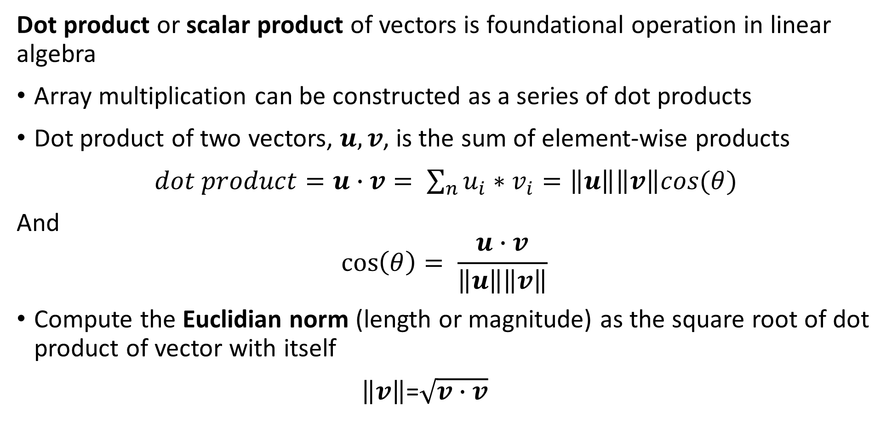
Review of Linear Algebra
Dot product or scalar product of vectors is foundational operation in linear algebra
Array multiplication can be constructed as a series of dot products
Dot product of two vectors, $u,v$, is the sum of element-wise products
$dot product=u∙v= \sum_{n}{u_{i}∗v_{i}}=\left\|u\right\|\left\|v\right\|cos(θ)$
And
$$\cos\left(θ\right)= \frac{u∙v}{\left\|u\right\|\left\|v\right\|}$$
Compute the Euclidian norm (length or magnitude) as the square root of dot product of vector with itself
$\left\|v\right\|$=$\sqrt{v∙v}$

Slide 16
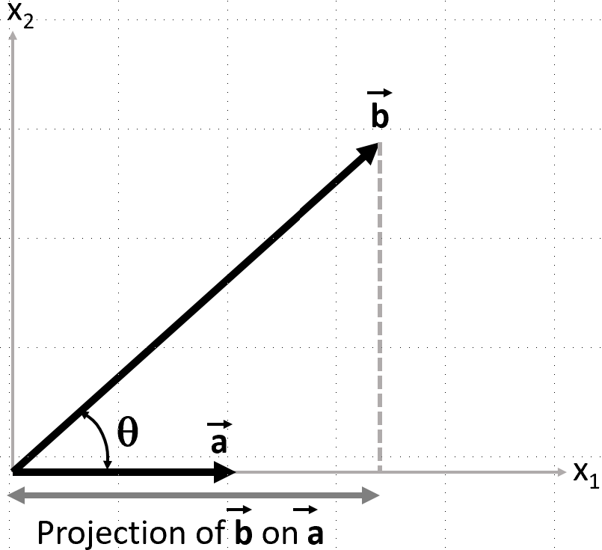
Review of Linear Algebra
Dot product of vectors is the product of a vector and the projection of another vector onto the first, or vice versa

Slide 17
Review of Linear Algebra
Dot product of vectors with Numpy
np.dot(x,y)
## 12
np.dot(y, y)
## 12
npla.norm(y)
## 3.4641016151377544

Slide 18
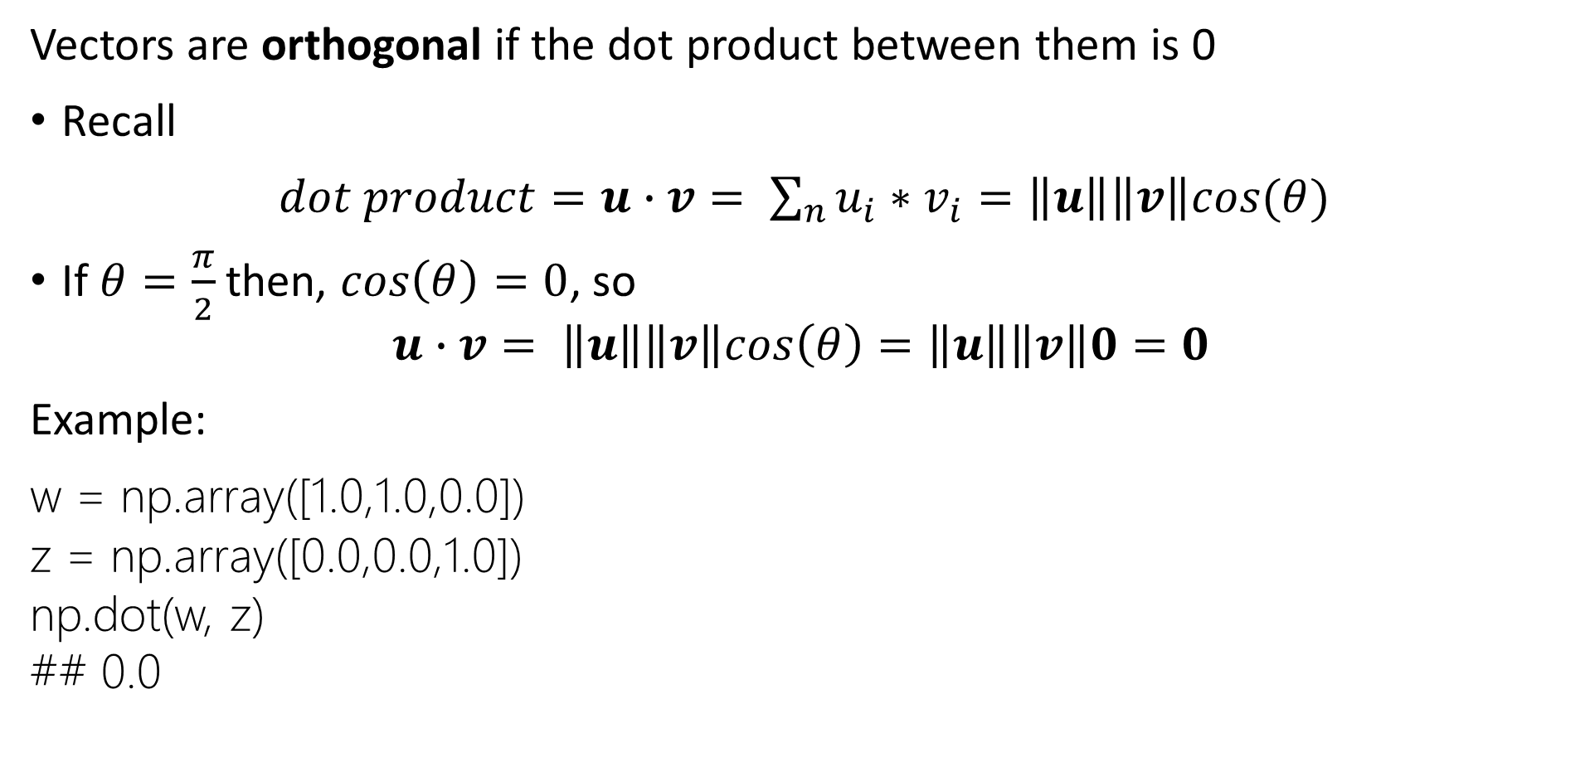
Review of Linear Algebra
Vectors are orthogonal if the dot product between them is 0
Recall
$dot product=u∙v= \sum_{n}{u_{i}∗v_{i}}=\left\|u\right\|\left\|v\right\|cos(θ)$
If $θ=\frac{π}{2}$ then, $cos\left(θ\right)=0$, so
$$u∙v= \left\|u\right\|\left\|v\right\|cos\left(θ\right)=\left\|u\right\|\left\|v\right\|0=0$$
Example:
w = np.array([1.0,1.0,0.0])
z = np.array([0.0,0.0,1.0])
np.dot(w, z)
## 0.0

Slide 19

Review of Linear Algebra
Matrix transpose of matrix, $B$, $B_{ }^{T}$, permutes the element indices
$$B_{i,j}=B_{j,i}^{T}$$
Transpose of $n×m$ matrix has dimension $m×n$
Example:
np.transpose(B)
## array([[ 1, 4, 7, 10],
## [ 2, 5, 8, 11],
## [ 3, 6, 9, 12]])

Slide 20
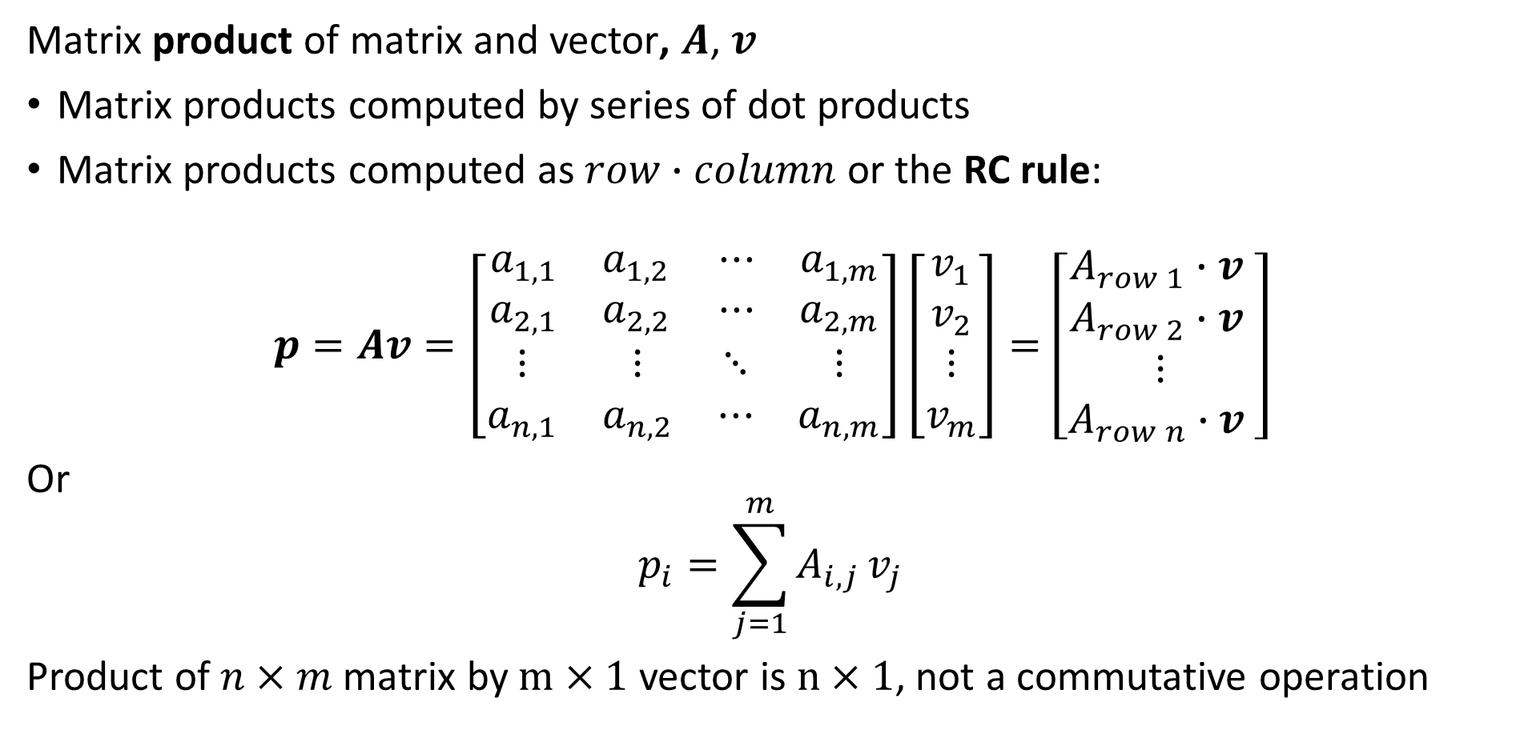
Review of Linear Algebra
Matrix product of matrix and vector, $A$, $v_{ }^{ }$
Matrix products computed by series of dot products
Matrix products computed as $row∙column$ or the RC rule:
$$p=Av=\left[\begin{matrix}\begin{matrix}a_{1,1} & a_{1,2} \\ a_{2,1} & a_{2,2}\end{matrix} & \begin{matrix}⋯ & a_{1,m} \\ ⋯ & a_{2,m}\end{matrix} \\ \begin{matrix}⋮ & ⋮ \\ a_{n,1} & a_{n,2}\end{matrix} & \begin{matrix}⋱ & ⋮ \\ ⋯ & a_{n,m}\end{matrix}\end{matrix}\right]\left[\begin{matrix}\begin{matrix}v_{1} \\ v_{2}\end{matrix} \\ \begin{matrix}⋮ \\ v_{m}\end{matrix}\end{matrix}\right]=\left[\begin{matrix}\begin{matrix}{A_{row 1}∙v}_{ } \\ {A_{row 2}∙v}_{ }\end{matrix} \\ \begin{matrix}⋮ \\ {A_{row n}∙v}_{ }\end{matrix}\end{matrix}\right]$$
Or
$$p_{i}=\sum_{j=1}^{m}{A_{i,j}}v_{j}$$
Product of $n×m$ matrix by $m×1$ vector is $n×1$, not a commutative operation

Slide 21




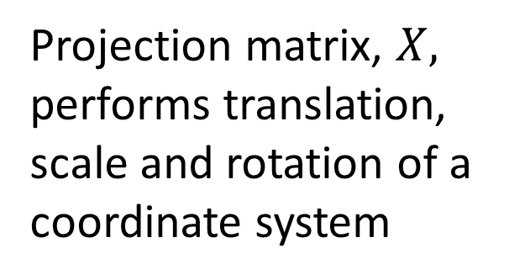




Review of Linear Algebra
The product of a matrix with a vector, $\vec{b}=X\vec{a}$, is a projection from a coordinate system $\left[x_{1},x_{2}\right]$ to another coordinate system, $\left[{x′}_{1},{x′}_{2}\right]$
$${x′}_{2}$$
$$x_{2}$$
$$\vec{b}$$
$${x′}_{1}$$
Projection matrix, $X,$ performs translation, scale and rotation of a coordinate system
$$X$$
$$\vec{a}$$
$$x_{1}$$

Slide 22

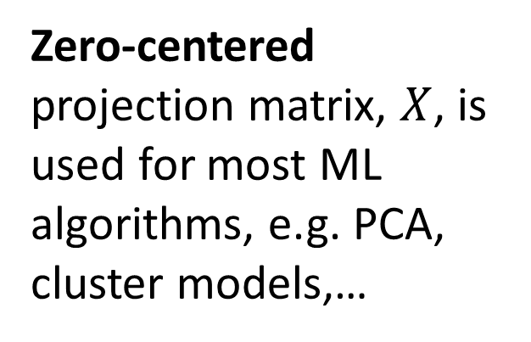

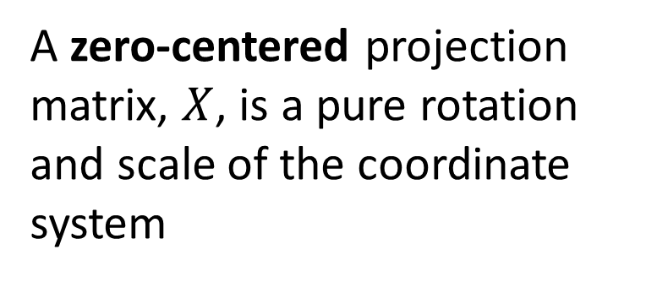


Review of Linear Algebra
The product of a matrix with a vector, $\vec{b}=X\vec{a}$, is a projection from a coordinate system $\left[x_{1},x_{2}\right]$ to another coordinate system, $\left[{x′}_{1},{x′}_{2}\right]$
A zero-centered projection matrix, $X$, is a pure rotation and scale of the coordinate system
$$x_{2}$$
$${x′}_{2}$$
$${x′}_{1}$$
Zero-centered projection matrix, $X$, is used for most ML algorithms, e.g. PCA, cluster models,…
$$X$$
$$\vec{a}$$
$$\vec{b}$$
$$x_{1}$$

Slide 23

Review of Linear Algebra
Matrix product of matrix and vector, $A$, $v_{ }^{ }$
Example:
np.dot(B, x)
## array([14, 32, 50, 68])

Slide 24
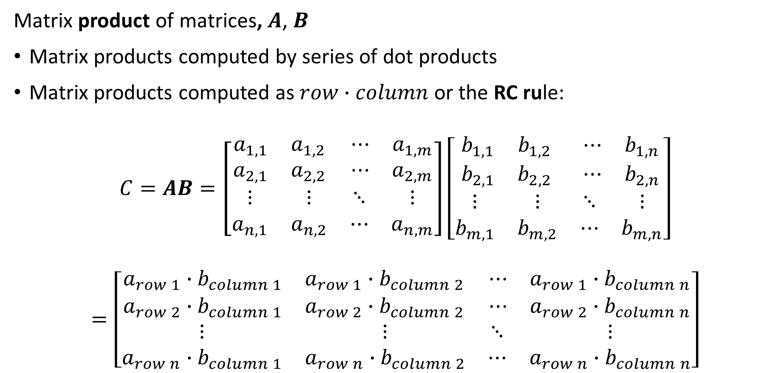
Review of Linear Algebra
Matrix product of matrices, $A$, $B$
Matrix products computed by series of dot products
Matrix products computed as $row∙column$ or the RC rule:
$$C=AB=\left[\begin{matrix}\begin{matrix}a_{1,1} & a_{1,2} \\ a_{2,1} & a_{2,2}\end{matrix} & \begin{matrix}⋯ & a_{1,m} \\ ⋯ & a_{2,m}\end{matrix} \\ \begin{matrix}⋮ & ⋮ \\ a_{n,1} & a_{n,2}\end{matrix} & \begin{matrix}⋱ & ⋮ \\ ⋯ & a_{n,m}\end{matrix}\end{matrix}\right]\left[\begin{matrix}\begin{matrix}b_{1,1} & b_{1,2} \\ b_{2,1} & b_{2,2}\end{matrix} & \begin{matrix}⋯ & b_{1,n} \\ ⋯ & b_{2,n}\end{matrix} \\ \begin{matrix}⋮ & ⋮ \\ b_{m,1} & b_{m,2}\end{matrix} & \begin{matrix}⋱ & ⋮ \\ ⋯ & b_{m,n}\end{matrix}\end{matrix}\right]$$
$$=\left[\begin{matrix}\begin{matrix}a_{row 1}∙b_{column 1} & a_{row 1}∙b_{column 2} \\ a_{row 2}∙b_{column 1} & a_{row 2}∙b_{column 2}\end{matrix} & \begin{matrix}⋯ & a_{row 1}∙b_{column n} \\ ⋯ & a_{row 2}∙b_{column n}\end{matrix} \\ \begin{matrix}⋮ & ⋮ \\ a_{row n}∙b_{column 1} & a_{row n}∙b_{column 2}\end{matrix} & \begin{matrix}⋱ & ⋮ \\ ⋯ & a_{row n}∙b_{column n}\end{matrix}\end{matrix}\right]$$

Slide 25
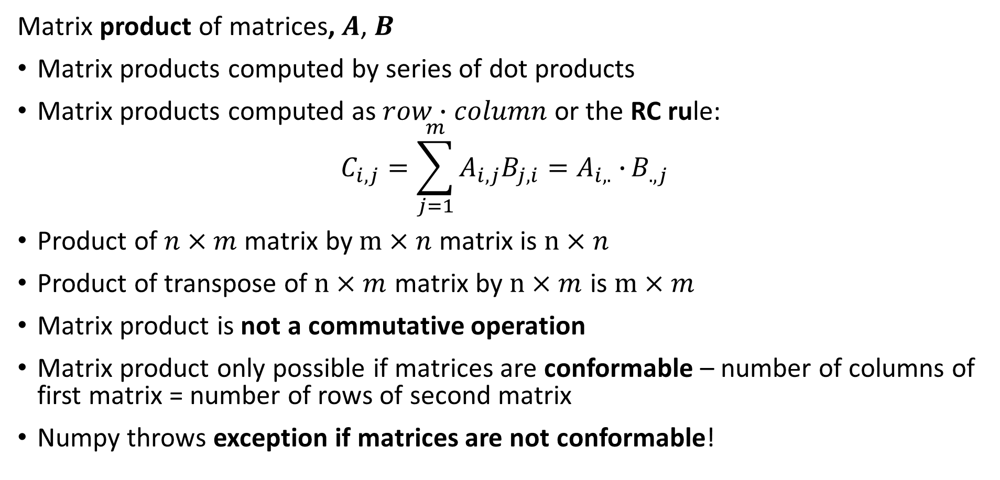
Review of Linear Algebra
Matrix product of matrices, $A$, $B$
Matrix products computed by series of dot products
Matrix products computed as $row∙column$ or the RC rule:
$$C_{i,j}=\sum_{j=1}^{m}{A_{i,j}B_{j,i}=A_{i, .}∙}B_{.,j}$$
Product of $n×m$ matrix by $m×n$ matrix is $n×n$
Product of transpose of $n×m$ matrix by $n×m$ is $m×m$
Matrix product is not a commutative operation
Matrix product only possible if matrices are conformable – number of columns of first matrix = number of rows of second matrix
Numpy throws exception if matrices are not conformable!

Slide 26

Review of Linear Algebra
Matrix product of matrices, $A$, $B$
Examples of conformable products:
np.dot(np.transpose(A) , B)
## array([[44., 52., 60.],
## [44., 52., 60.],
## [44., 52., 60.]])
np.dot(A, np.transpose(B))
## array([[12., 30., 48., 66.],
## [12., 30., 48., 66.],
## [12., 30., 48., 66.],
## [12., 30., 48., 66.]])

Slide 27
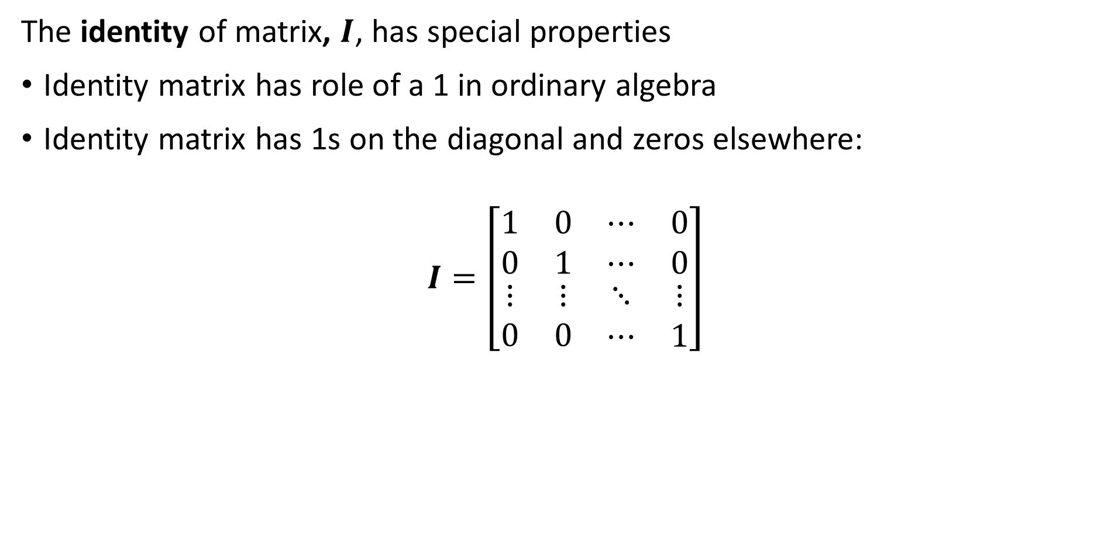
Review of Linear Algebra
The identity of matrix, $I$, has special properties
Identity matrix has role of a 1 in ordinary algebra
Identity matrix has 1s on the diagonal and zeros elsewhere:
$$I=\left[\begin{matrix}\begin{matrix}1 & 0 \\ 0 & 1\end{matrix} & \begin{matrix}⋯ & 0 \\ ⋯ & 0\end{matrix} \\ \begin{matrix}⋮ & ⋮ \\ 0 & 0\end{matrix} & \begin{matrix}⋱ & ⋮ \\ ⋯ & 1\end{matrix}\end{matrix}\right]$$

Slide 28

Review of Linear Algebra
Properties of the identity matrix
Products of a rectangular $n×n$ matrix and an identity matrix are the original matrix:
$$A=AI=IA=A$$
Define the inverse of a square matrix, $A^{−1}$:
$$AA^{−1}=A^{−1}A=I$$

Slide 29
Review of Linear Algebra
Examples of identity matrix and inverse:
I3 = np.eye(3)
I3
## array([[1., 0., 0.],
## [0., 1., 0.],
## [0., 0., 1.]])
C = np.array([[1,3,6], [2,2,1], [3,1,4]])
## array([[1, 3, 6],
## [2, 2, 1],
## [3, 1, 4]])

Slide 30
Review of Linear Algebra
Examples of identity matrix and inverse:
np.dot(C,I3)
## array([[1., 3., 6.],
## [2., 2., 1.],
## [3., 1., 4.]])
np.dot(I3,C)
## array([[1., 3., 6.],
## [2., 2., 1.],
## [3., 1., 4.]])

Slide 31
Review of Linear Algebra
Examples of identity matrix and inverse:
inv_C = npla.inv(C)
np.dot(inv_C,C)
## array([[ 1.00000000e+00, -1.11022302e-16, 2.22044605e-16],
## [ 1.66533454e-16, 1.00000000e+00, 2.22044605e-16],
## [-1.38777878e-17, 6.93889390e-17, 1.00000000e+00]])

Slide 32
Broadcasting in Numpy
Broadcasting ‘fills’ in values for Numpy calculations
Values from lower dimensional arrays are broadcast into higher dimensional arrays
Broadcasting simplifies syntax
Broadcasting used in many scientific languages
  Matlab
  R
  Numpy
  …..
Exact broadcasting rules vary from language to language

Slide 33

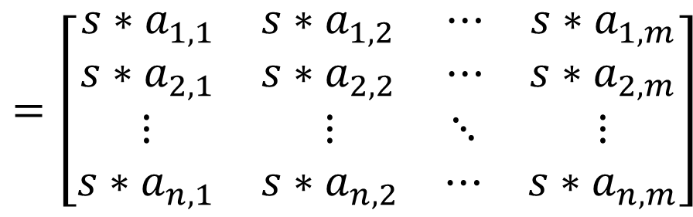

Broadcasting in Numpy
Broadcasting ‘fills’ in values for Numpy calculations
Example: Multiply array by scalar by broadcasting into the array
$$\left[\begin{matrix}\begin{matrix}a_{1,1} & a_{1,2} \\ a_{2,1} & a_{2,2}\end{matrix} & \begin{matrix}⋯ & a_{1,m} \\ ⋯ & a_{2,m}\end{matrix} \\ \begin{matrix}⋮ & ⋮ \\ a_{n,1} & a_{n,2}\end{matrix} & \begin{matrix}⋱ & ⋮ \\ ⋯ & a_{n,m}\end{matrix}\end{matrix}\right]×$$
$$=\left[\begin{matrix}\begin{matrix}{s∗a}_{1,1} & s∗a_{1,2} \\ {s∗a}_{2,1} & {s∗a}_{2,2}\end{matrix} & \begin{matrix}⋯ & {s∗a}_{1,m} \\ ⋯ & {s∗a}_{2,m}\end{matrix} \\ \begin{matrix}⋮ & ⋮ \\ {s∗a}_{n,1} & s∗a_{n,2}\end{matrix} & \begin{matrix}⋱ & ⋮ \\ ⋯ & {s∗a}_{n,m}\end{matrix}\end{matrix}\right]$$
$$s$$

Slide 34
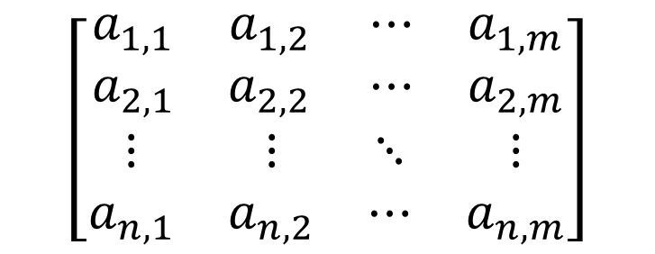
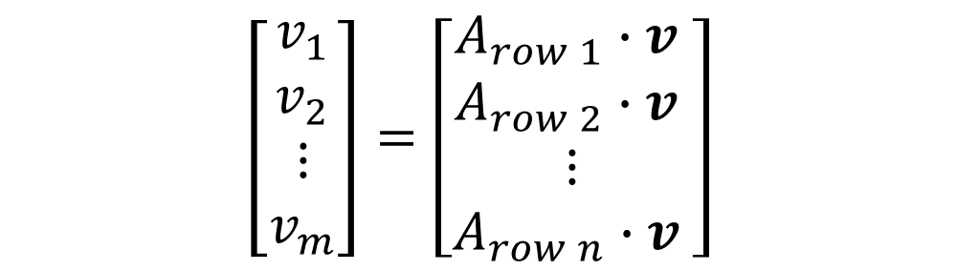
Broadcasting in Numpy
Broadcasting ‘fills’ in values for Numpy calculations
Example: Multiply array by vector by broadcasting into the array
$$\left[\begin{matrix}\begin{matrix}a_{1,1} & a_{1,2} \\ a_{2,1} & a_{2,2}\end{matrix} & \begin{matrix}⋯ & a_{1,m} \\ ⋯ & a_{2,m}\end{matrix} \\ \begin{matrix}⋮ & ⋮ \\ a_{n,1} & a_{n,2}\end{matrix} & \begin{matrix}⋱ & ⋮ \\ ⋯ & a_{n,m}\end{matrix}\end{matrix}\right]$$
$$\left[\begin{matrix}\begin{matrix}v_{1} \\ v_{2}\end{matrix} \\ \begin{matrix}⋮ \\ v_{m}\end{matrix}\end{matrix}\right]=\left[\begin{matrix}\begin{matrix}{A_{row 1}∙v}_{ } \\ {A_{row 2}∙v}_{ }\end{matrix} \\ \begin{matrix}⋮ \\ {A_{row n}∙v}_{ }\end{matrix}\end{matrix}\right]$$

Slide 35
Vectorization in Numpy
Vectorization of code greatly speeds execution
Numpy calculations performed in compiled code
  Mathematical operations performed at ‘C-speed’
  Numpy is a wrapper on optimized C and FORTRAN routines
Vectorized code operates on entire arrays with one call
  Limits slow function call context switching
  Context switching must push and pop from stack – expensive
Coding with for loops requires many context switches

Slide 36
Vectorization in Numpy
Example: use nested for loops to multiply matrix by vector
Perform calculation with nested for loops
  Each arithmetic operation is a function call with context switching
num_calculations = 1000
dim = 1000
Q = np.full((dim,dim), 2.0)
z = np.full((dim), 10.0)
def matrix_vector_product(A,x):
o = np.zeros(len(x))
for i in range(len(x)):
for j in range(len(x)):
o[j] =+ A[i,j]*x[j]
%time for _ in range(num_calculations): matrix_vector_product(Q,z)
CPU times: total: 14min 30s
Wall time: 14min 37s

Slide 37
Vectorization in Numpy
Example: use nested for loops to multiply matrix by vector
Vectorized calculation is much faster with Numpy
o = np.zeros((dim))
%time for _ in range(num_calculations): o = np.dot(Q, z)
CPU times: total: 2.27 s
Wall time: 503 ms
Vectorized code is about 380 times faster!!

Slide 38
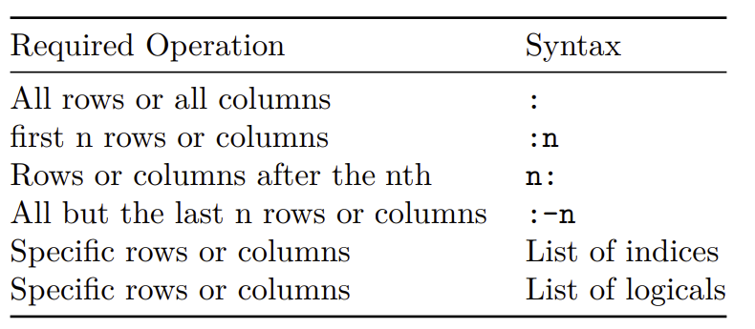
Working with Numpy Arrays
Subset or slice Numpy arrays
Common operations include:

Slide 39
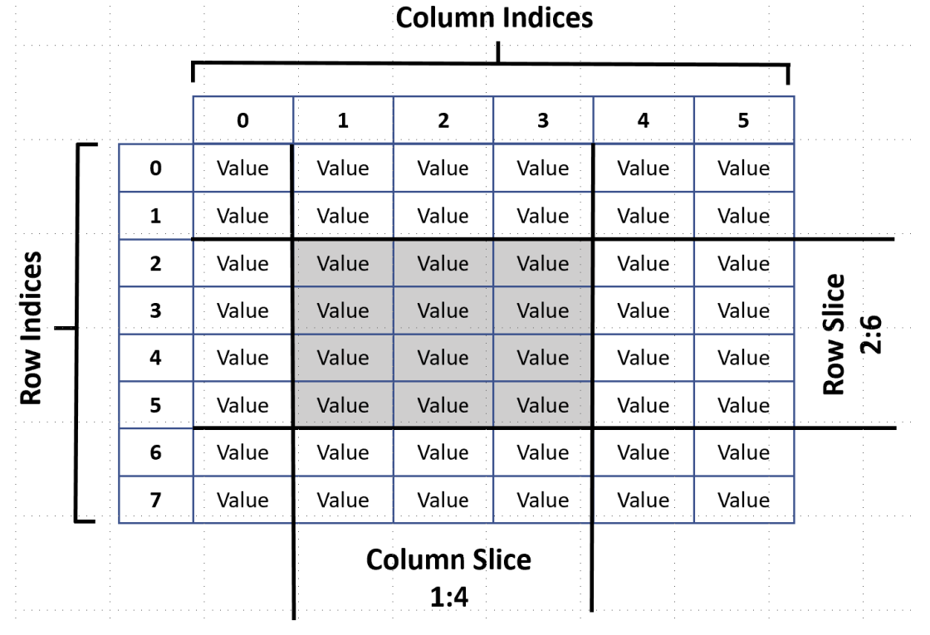
Working with Numpy Arrays
Subset or slice Numpy arrays
Numpy arrays use Python 0 indexing convention:

Slide 40
Working with Numpy Arrays
Subset or slice Numpy arrays
Example, select range of columns:
B[:, 1:3]
## array([[ 2, 3],
## [ 5, 6],
## [ 8, 9],
## [11, 12]])

Slide 41
Working with Numpy Arrays
Subset or slice Numpy arrays
Example, all but last column:
B[:, :-1]
## array([[ 1, 2],
## [ 4, 5],
## [ 7, 8],
## [10, 11]])

Slide 42
Working with Numpy Arrays
Subset or slice Numpy arrays
Example, select rows 0 and 2:
B[[0,2], :]
## array([[1, 2, 3],
## [7, 8, 9]])
B[[True,False,True,False], :]
## array([[1, 2, 3],
## [7, 8, 9]])

Slide 43
Working with Numpy Arrays
To create a copy of a Numpy array use the numpy.copy function;
Note: numpy.copy is not to be confused with the Python copy package, copy.deepcopy, which is less efficient for Numpy arrays
Example:
C = np.copy(B)
B = B + 1.0
print(B)
## [[ 2. 3. 4.]
## [ 5. 6. 7.]
## [ 8. 9. 10.]
## [11. 12. 13.]]
print(C)
## [[ 1 2 3]
## [ 4 5 6]
## [ 7 8 9]
## [10 11 12]]

Slide 44

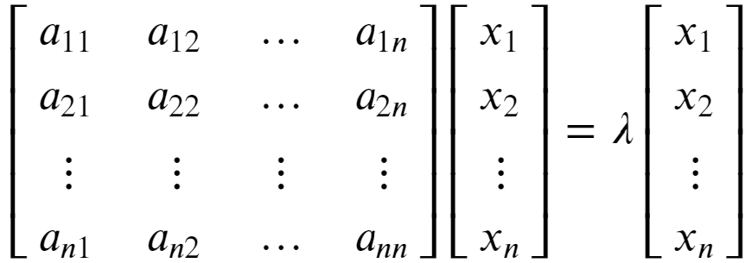


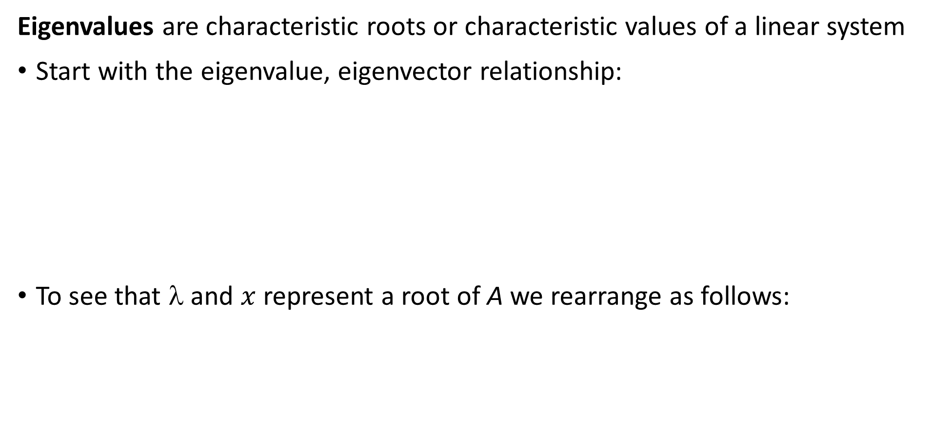
Review of Eigenvalues and Eigenvectors
Eigenvalues are characteristic roots or characteristic values of a linear system
Start with the eigenvalue, eigenvector relationship:
To see that λ and $x$ represent a root of A we rearrange as follows:

Slide 45
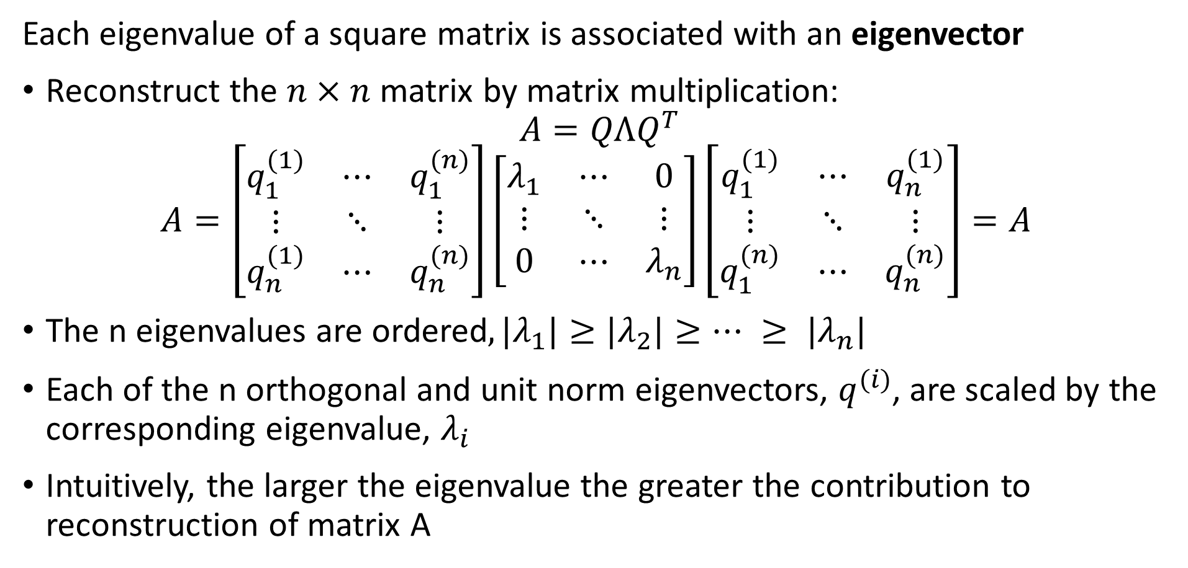
Review of Eigenvalues and Eigenvectors
Each eigenvalue of a square matrix is associated with an eigenvector
Reconstruct the $n×n$ matrix by matrix multiplication:
$$A=QΛQ^{T}$$
$$A=\left[\begin{matrix}q_{1}^{(1)} & ⋯ & q_{1}^{(n)} \\ ⋮ & ⋱ & ⋮ \\ q_{n}^{(1)} & ⋯ & q_{n}^{(n)}\end{matrix}\right]\left[\begin{matrix}λ_{1} & ⋯ & 0 \\ ⋮ & ⋱ & ⋮ \\ 0 & ⋯ & λ_{n}\end{matrix}\right]{\left[\begin{matrix}q_{1}^{(1)} & ⋯ & q_{n}^{(1)} \\ ⋮ & ⋱ & ⋮ \\ q_{1}^{(n)} & ⋯ & q_{n}^{(n)}\end{matrix}\right]=A}^{ }$$
The n eigenvalues are ordered$, {|λ}_{1}|≥{|λ}_{2}|≥… ≥ {|λ}_{n}|$
Each of the n orthogonal and unit norm eigenvectors, $q_{ }^{(i)}$, are scaled by the corresponding eigenvalue, $λ_{i}$
Intuitively, the larger the eigenvalue the greater the contribution to reconstruction of matrix A

Slide 46
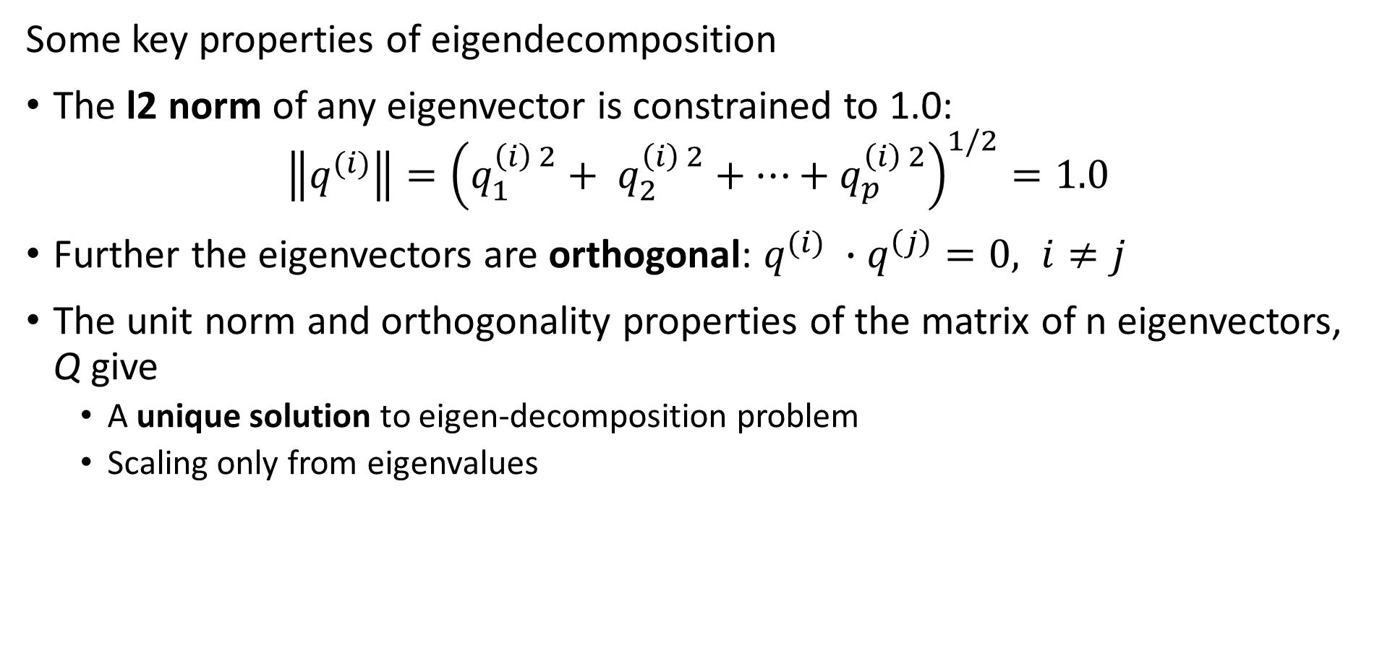
Review of Eigenvalues and Eigenvectors
Some key properties of eigendecomposition
The l2 norm of any eigenvector is constrained to 1.0:
$$\left\|q^{(i)}\right\|={\left(q_{1}^{\left(i\right) 2}+ q_{2}^{\left(i\right) 2}+…+q_{p}^{\left(i\right) 2}\right)}^{1/2}=1.0$$
Further the eigenvectors are orthogonal: $q^{(i)} ∙q^{\left(j\right)}=0, i≠j$
The unit norm and orthogonality properties of the matrix of n eigenvectors, Q give
  A unique solution to eigen-decomposition problem
  Scaling only from eigenvalues

Slide 47
Review of Eigenvalues and Eigenvectors
How can we interpret eigen-decomposition for 2-d example?
First eigenvector is along direction of fastest change – highest variance
First eigenvalue determine the scale of the first eigenvector
Other eigenvectors ordered by decreasing eigenvalue
direction of the fastest change
direction of the slowest change
(λ_{max})^{-1/2}
(λ_{min})^{-1/2}

Slide 48
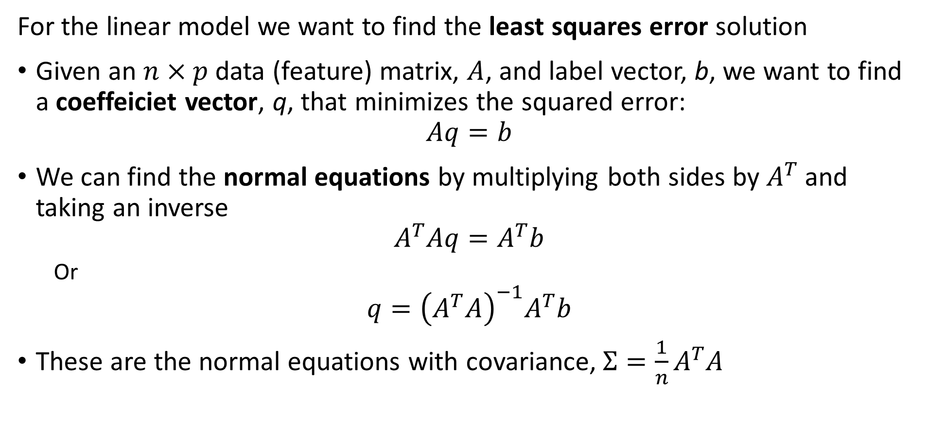
Least Squares for the linear model
For the linear model we want to find the least squares error solution
Given an $n×p$ data (feature) matrix, $A$, and label vector, b, we want to find a coeffeiciet vector, q, that minimizes the squared error:
$$Aq=b$$
We can find the normal equations by multiplying both sides by $A^{T}$ and taking an inverse
$$A^{T}Aq=A^{T}b$$
  Or
$$q={\left(A^{T}A\right)}^{−1}A^{T}b$$
These are the normal equations with covariance, $Σ=\frac{1}{n}A^{T}A$

Slide 49
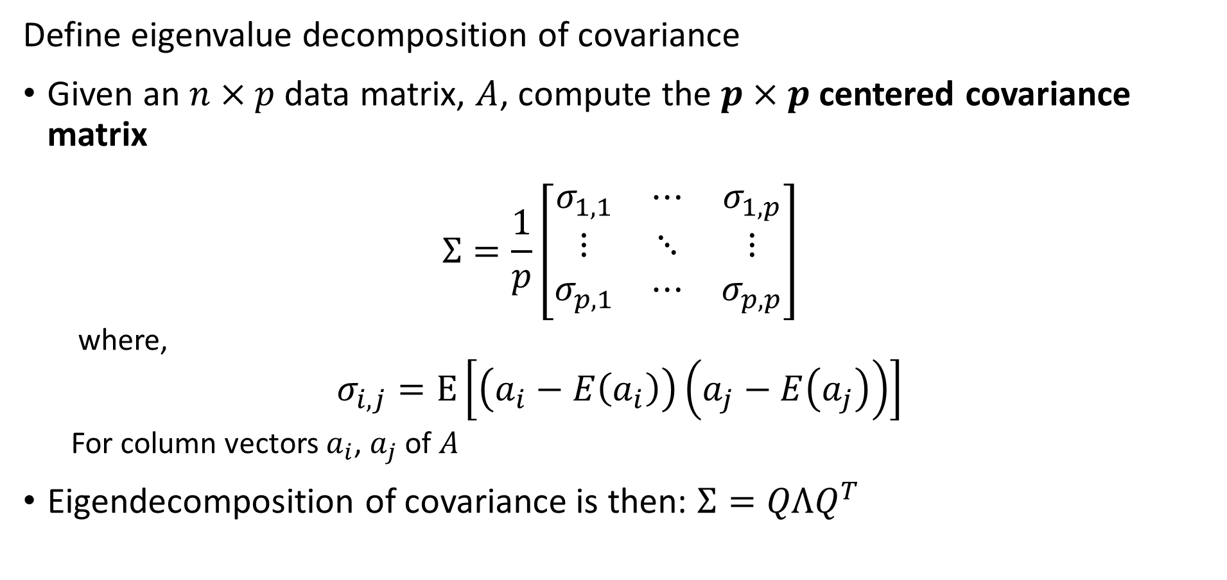
Least Squares for Linear Model
Define eigenvalue decomposition of covariance
Given an $n×p$ data matrix, $A$, compute the $p×p$centered covariance matrix
$$Σ=\frac{1}{p}\left[\begin{matrix}σ_{1,1} & ⋯ & σ_{1,p} \\ ⋮ & ⋱ & ⋮ \\ σ_{p,1} & ⋯ & σ_{p,p}\end{matrix}\right]$$
  where,
$$σ_{i,j}=E\left[\left(a_{i}−E\left(a_{i}\right)\right)\left(a_{j}−E\left(a_{j}\right)\right)\right]$$
  For column vectors $a_{i}$, $a_{j}$ of $A$
Eigendecomposition of covariance is then: $Σ=QΛQ^{T}$

Slide 50
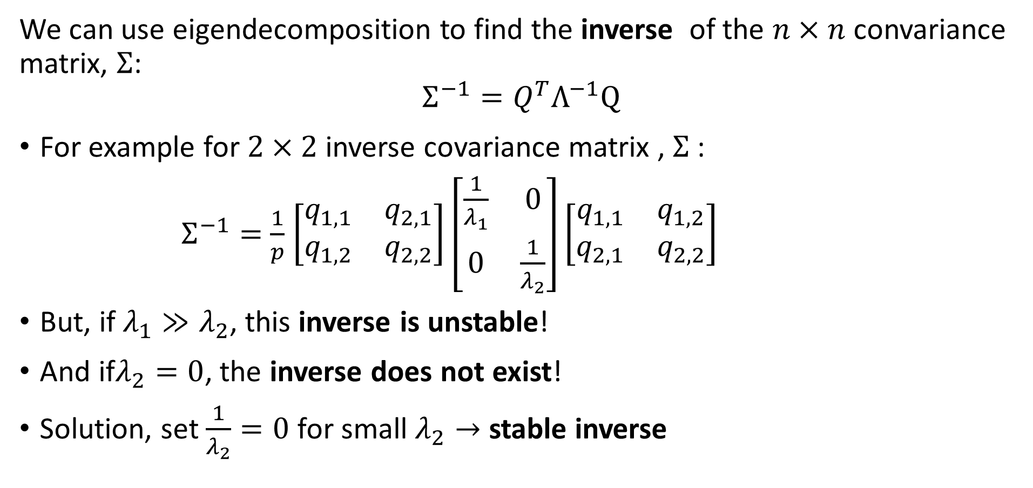
Least Squares for Linear Model
We can use eigendecomposition to find the inverse of the $n×n$ convariance matrix, $Σ$:
$$Σ^{−1}=Q^{T}Λ^{−1}Q$$
For example for $2×2$ inverse covariance matrix , $Σ$:
$Σ^{−1}=$ $\frac{1}{p}$ $\left[\begin{matrix}q_{1,1} & q_{2,1} \\ q_{1,2} & q_{2,2}\end{matrix}\right]\left[\begin{matrix}\frac{1}{λ_{1}} & 0 \\ 0 & \frac{1}{λ_{2}}\end{matrix}\right]\left[\begin{matrix}q_{1,1} & q_{1,2} \\ q_{2,1} & q_{2,2}\end{matrix}\right]$
But, if$λ_{1}≫λ_{2}$, this inverse is unstable!
And if$λ_{2}=0$, the inverse does not exist!
Solution, set $\frac{1}{λ_{2}}=0$ for small $λ_{2}→$ stable inverse

Slide 51
Examples of Eigenvalues and Eigenvectors
See the notebook!

Slide 52
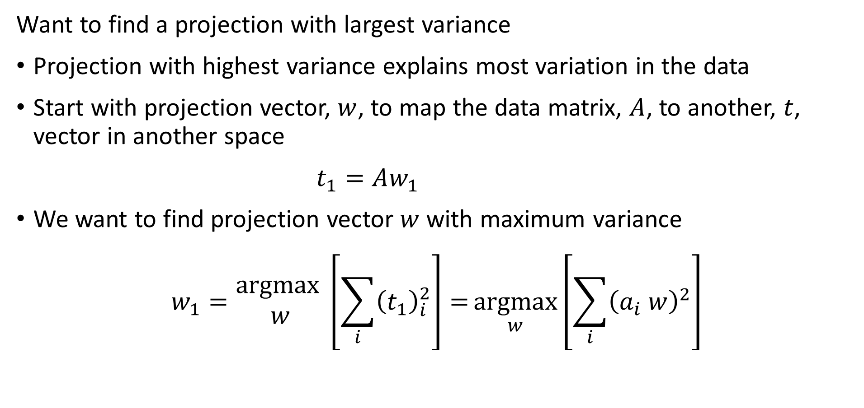
Principle Component Decomposition
Want to find a projection with largest variance
Projection with highest variance explains most variation in the data
Start with projection vector, $w$, to map the data matrix, $A$, to another, $t$, vector in another space
$t_{1}=Aw_{1}$
We want to find projection vector $w$ with maximum variance
$$w_{1}=\underset{ }{\begin{aligned}argmax \\ w\end{aligned}}\left[\sum_{i}{{\left(t_{1}\right)}_{i}^{2}}\right]={\underset{w}{argmax}\left[\sum_{i}{{\left(a_{i} w\right)}_{ }^{2}}\right]}$$

Slide 53
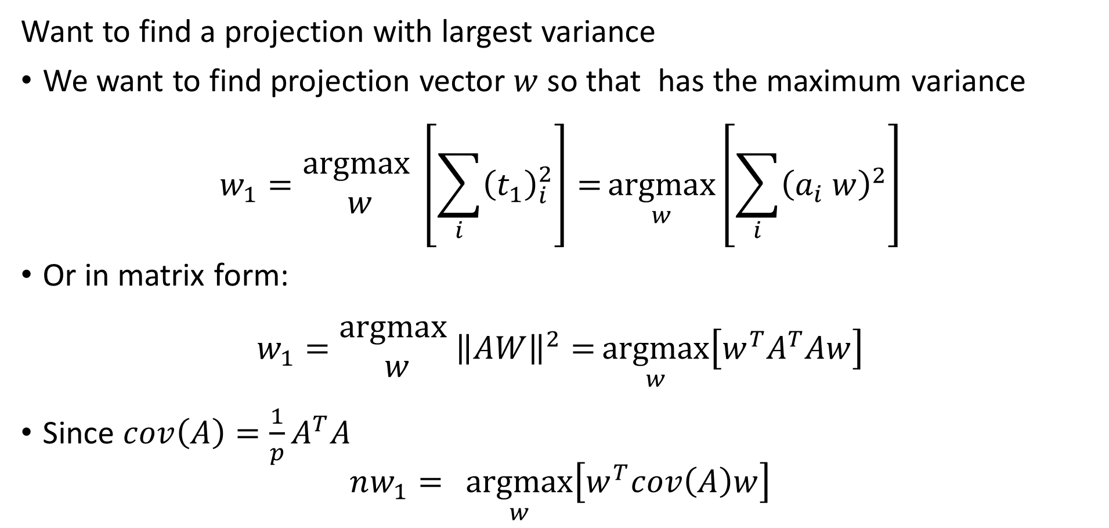
Principle Component Decomposition
Want to find a projection with largest variance
We want to find projection vector $w$ so that has the maximum variance
$$w_{1}=\underset{ }{\begin{aligned}argmax \\ w\end{aligned}}\left[\sum_{i}{{\left(t_{1}\right)}_{i}^{2}}\right]={\underset{w}{argmax}\left[\sum_{i}{{\left(a_{i} w\right)}_{ }^{2}}\right]}$$
Or in matrix form:
$$w_{1}=\underset{ }{\begin{aligned}argmax \\ w\end{aligned}}{\left\|AW\right\|}^{2}={\underset{w}{argmax}\left[w^{T}A^{T}Aw\right]}$$
Since $cov\left(A\right)={\frac{1}{p}A}^{T}A$
$$nw_{1}={\underset{w}{argmax}\left[w^{T}cov\left(A\right)w\right]}$$

Slide 54
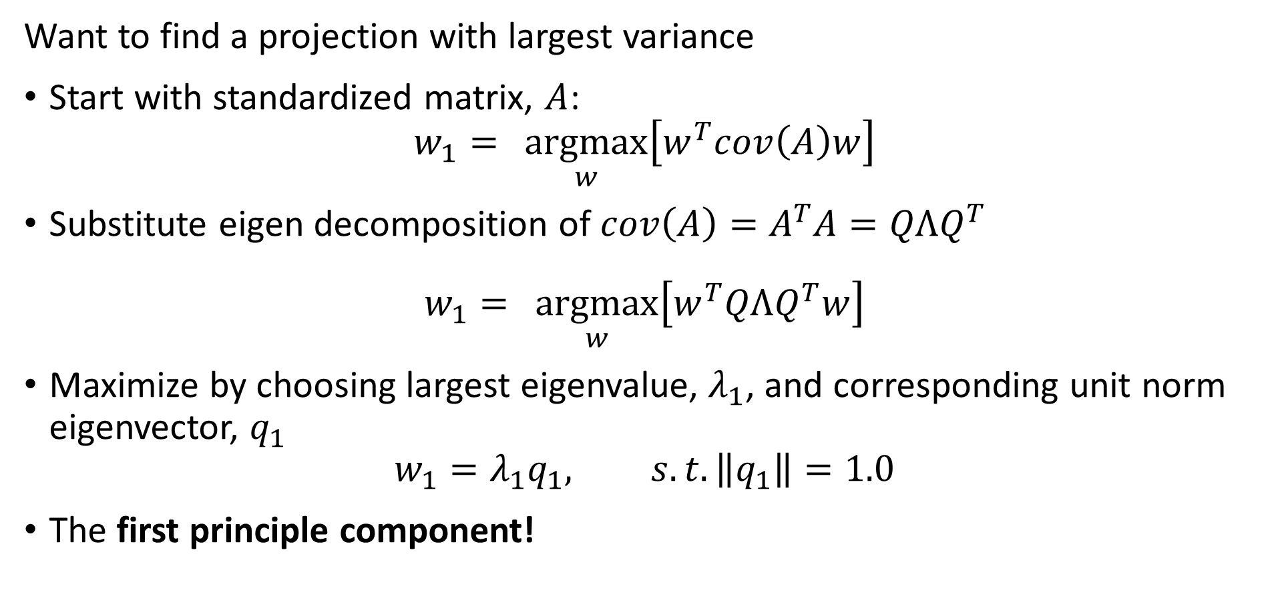
Principle Component Decomposition
Want to find a projection with largest variance
Start with standardized matrix, $A$:
$$w_{1}={\underset{w}{argmax}\left[w^{T}cov\left(A\right)w\right]}$$
Substitute eigen decomposition of $cov\left(A\right)=A^{T}A=QΛQ^{T}$
$$w_{1}={\underset{w}{argmax}\left[w^{T}QΛQ^{T}w\right]}$$
Maximize by choosing largest eigenvalue, $λ_{1}$, and corresponding unit norm eigenvector, $q_{1}$
$$w_{1}=λ_{1}q_{1}, s.t.\left\|q_{1}\right\|=1.0$$
The first principle component!

Slide 55
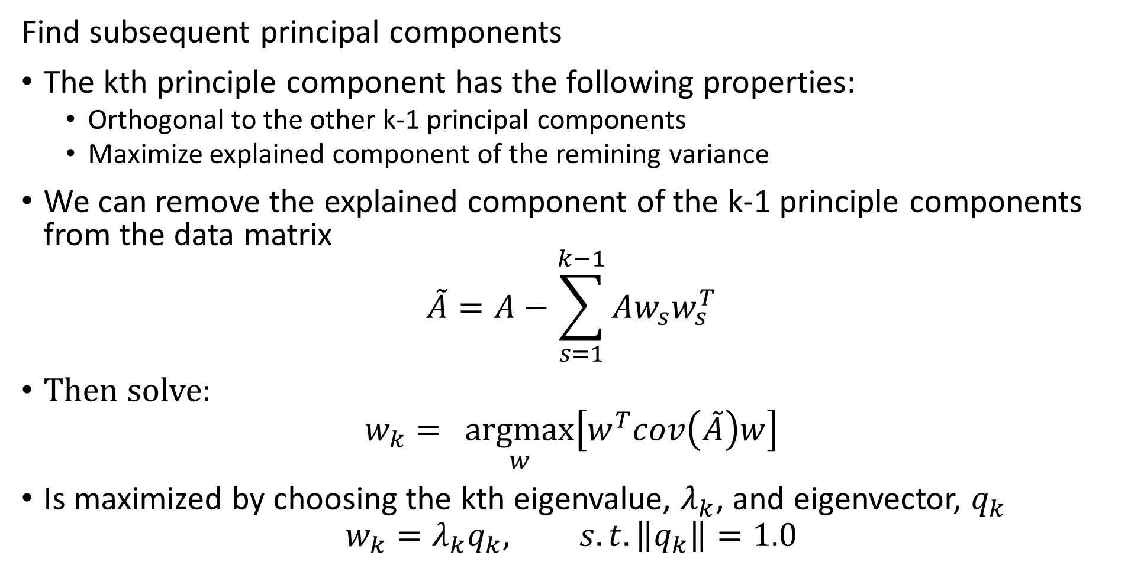
Principle Component Decomposition
Find subsequent principal components
The kth principle component has the following properties:
  Orthogonal to the other k-1 principal components
  Maximize explained component of the remining variance
We can remove the explained component of the k-1 principle components from the data matrix
$$\tilde{A}=A−\sum_{s=1}^{k−1}{Aw_{s}w_{s}^{T}}$$
Then solve:
$$w_{k}={\underset{w}{argmax}\left[w^{T}cov\left(\tilde{A}\right)w\right]}$$
Is maximized by choosing the kth eigenvalue, $λ_{k}$, and eigenvector, $q_{k}$
$$w_{k}=λ_{k}q_{k}, s.t.\left\|q_{k}\right\|=1.0$$

Slide 56
Principle Component Decomposition
Properties of principle components
The projection directions are determined by the unit norm eigenvectors
Each principle direction scaled by the eigenvalue
Each PC ordered by eigenvalues, having decreasing variance

Slide 57
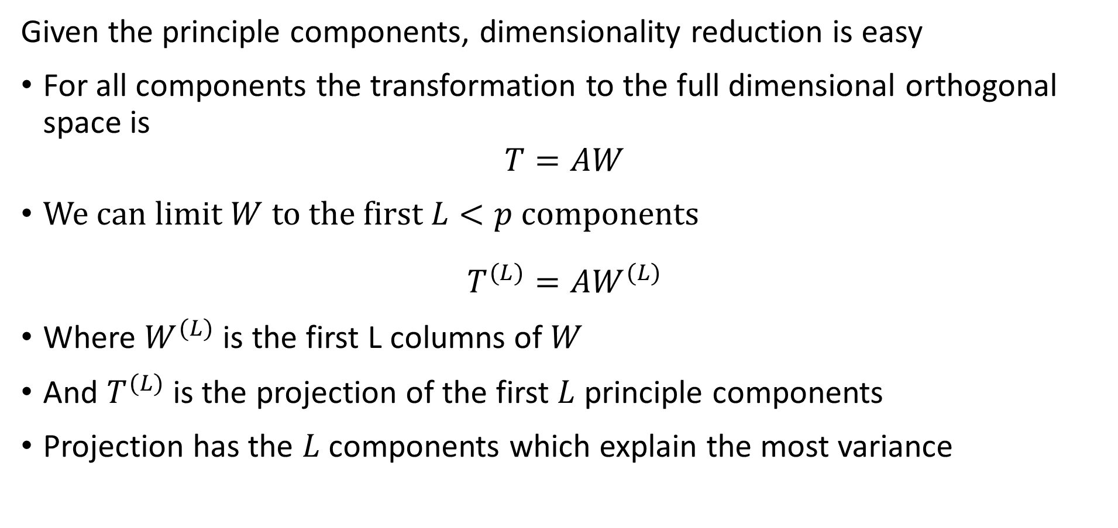
Principle Component Decomposition
Given the principle components, dimensionality reduction is easy
For all components the transformation to the full dimensional orthogonal space is
$$T=AW$$
We can limit $W$ to the first $L<p$ components
$$T^{(L)}=AW^{(L)}$$
Where $W^{(L)}$ is the first L columns of $W$
And $T^{(L)}$ is the projection of the first $L$ principle components
Projection has the $L$ components which explain the most variance

Slide 58
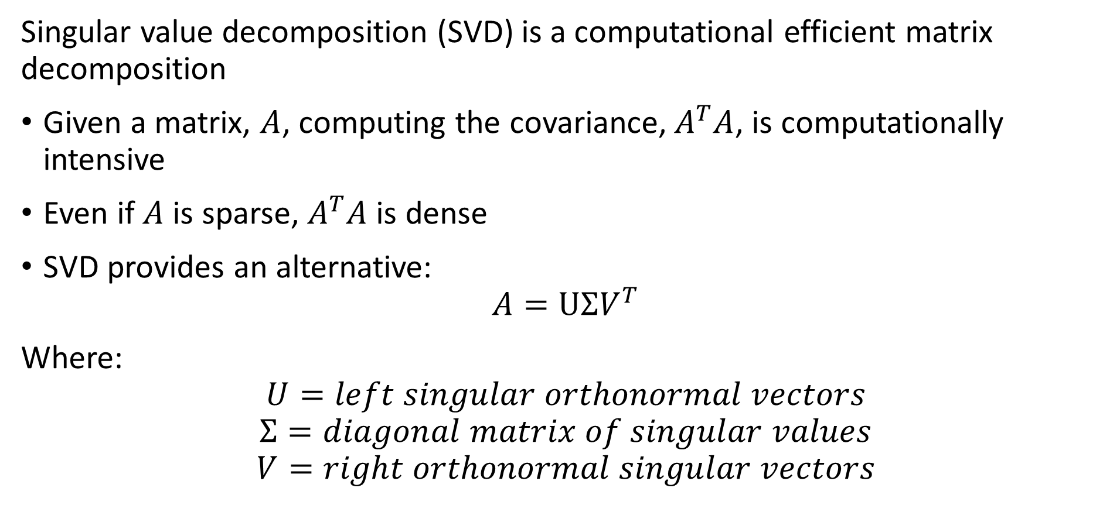
Singular Value Decomposition
Singular value decomposition (SVD) is a computational efficient matrix decomposition
Given a matrix, $A$, computing the covariance, $A^{T}A$, is computationally intensive
Even if $A$ is sparse, $A^{T}A$ is dense
SVD provides an alternative:
$$A=UΣV^{T}$$
Where:
$$U=left singular orthonormal vectors$$
$$Σ=diagonal matrix of singular values$$
$$V=right orthonormal singular vectors$$

Slide 59
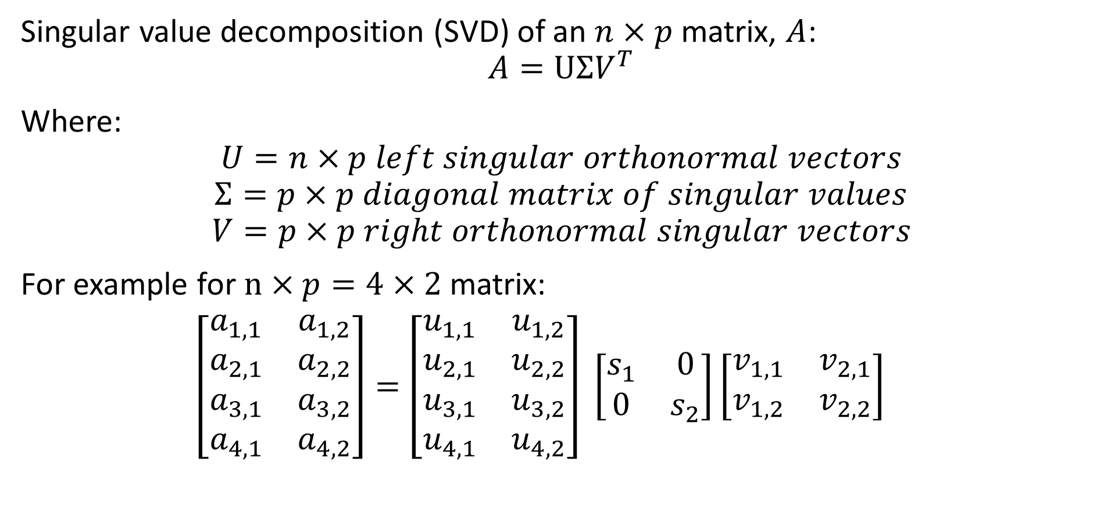
Singular Value Decomposition
Singular value decomposition (SVD) of an $n×p$ matrix, $A$:
$$A=UΣV^{T}$$
Where:
$$U=n×p left singular orthonormal vectors$$
$$Σ=p×p diagonal matrix of singular values$$
$$V=p×p right orthonormal singular vectors$$
For example for $n×p=4×2$ matrix:
$\left[\begin{matrix}a_{1,1} & a_{1,2} \\ a_{2,1} & a_{2,2} \\ a_{3,1} & a_{3,2} \\ a_{4,1} & a_{4,2}\end{matrix}\right]=$ $\left[\begin{matrix}u_{1,1} & u_{1,2} \\ u_{2,1} & u_{2,2} \\ u_{3,1} & u_{3,2} \\ u_{4,1} & u_{4,2}\end{matrix}\right] \left[\begin{matrix}s_{1} & 0 \\ 0 & s_{2}\end{matrix}\right]\left[\begin{matrix}v_{1,1} & v_{2,1} \\ v_{1,2} & v_{2,2}\end{matrix}\right]$

Slide 60
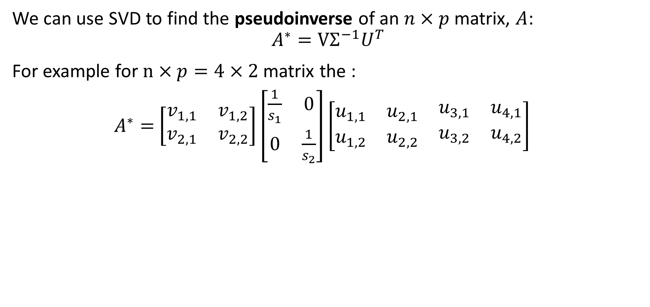
Singular Value Decomposition
We can use SVD to find the pseudoinverse of an $n×p$ matrix, $A$:
$$A^{∗}=VΣ^{−1}U^{T}$$
For example for $n×p=4×2$ matrix the :
$A^{∗}=$ $\left[\begin{matrix}v_{1,1} & v_{1,2} \\ v_{2,1} & v_{2,2}\end{matrix}\right]\left[\begin{matrix}\frac{1}{s_{1}} & 0 \\ 0 & \frac{1}{s_{2}}\end{matrix}\right]\left[\begin{matrix}u_{1,1} & u_{2,1} & \begin{matrix}u_{3,1} & u_{4,1}\end{matrix} \\ u_{1,2} & u_{2,2} & \begin{matrix}u_{3,2} & u_{4,2}\end{matrix}\end{matrix}\right]$

Slide 61
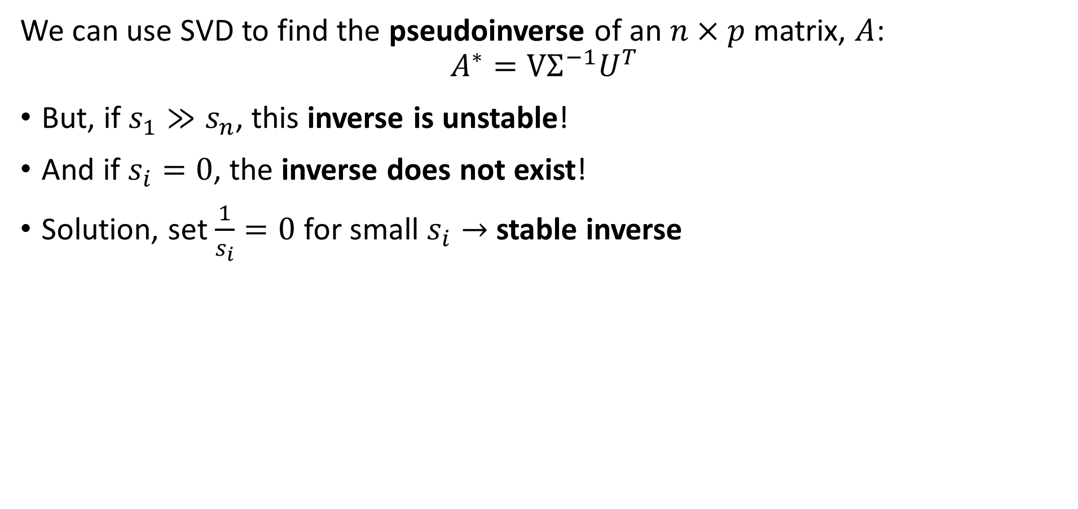
Singular Value Decomposition
We can use SVD to find the pseudoinverse of an $n×p$ matrix, $A$:
$$A^{∗}=VΣ^{−1}U^{T}$$
But, if$s_{1}≫s_{n}$, this inverse is unstable!
And if $s_{i}=0$, the inverse does not exist!
Solution, set $\frac{1}{s_{i}}=0$ for small $s_{i}→$ stable inverse

Slide 62
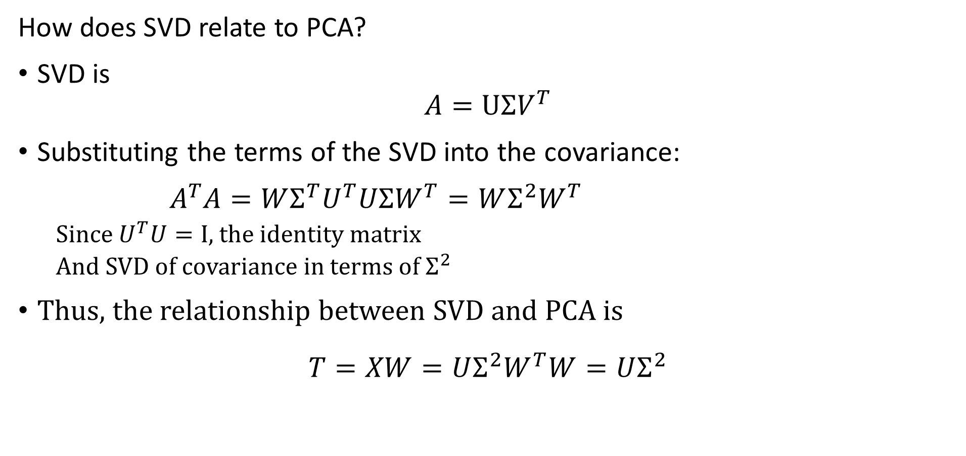
Singular Value Decomposition
How does SVD relate to PCA?
SVD is
$$A=UΣV^{T}$$
Substituting the terms of the SVD into the covariance:
$A^{T}A=WΣ^{T}U^{T}UΣW^{T}=WΣ^{2}W^{T}$
  Since $U^{T}U=I$, the identity matrix
  And SVD of covariance in terms of $Σ^{2}$
Thus, the relationship between SVD and PCA is
$$T=XW=UΣ^{2}W^{T}W=UΣ^{2}$$

Slide 63
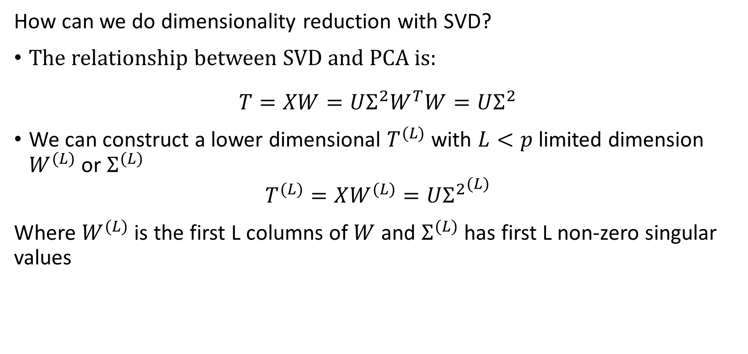
Singular Value Decomposition
How can we do dimensionality reduction with SVD?
The relationship between SVD and PCA is:
$$T=XW=UΣ^{2}W^{T}W=UΣ^{2}$$
We can construct a lower dimensional $T^{(L)}$ with $L<p$ limited dimension $W^{(L)}$ or $Σ^{(L)}$
$$T^{(L)}=XW^{(L)}=U{Σ^{2}}^{(L)}$$
Where $W^{(L)}$ is the first L columns of $W$ and $Σ^{(L)}$ has first L non-zero singular values

