Slide 1

CSCI E-96
Data Mining, Exploration and
Discovery
Introduction to Dimensionality Reduction
Steve Elston
Copyright 2020,2021, 2022, 2023, 2024, 2025, 2026, Stephen F Elston. All rights reserved.

Slide 2
Main topics in this course
Dimensionality reduction is a core algorithm for data mining massive high-dimensional datasets
1. Hashing and K-V pair management
2. Distance and Similarity Metrics
3. Graph Algorithms
Foundations
Core Algorithms
2. Dimensionality Reduction
5. Similarity Search and NN Algorithms
4. Online Algorithms
3. Social Network Analysis
6. Web/Document ranking and search
8. Clustering Algorithms
7. Recommender Algorithms
Taks Speific Algorithms

Slide 3
Introduction to Dimensionality Reduction
Dimensionality reduction is widely used in data mining
Human understanding of high dimensional spaces is poor at best
  For most people, perception of data relationships starts to diminish beyond 4 or 5 dimensions
  Exploration of complex spaces can be aided by projection into lower dimensional space
Most algorithms exhibit improved convergence in lower dimensional spaces
  High dimensional spaces can lead to over-fitting of data mining algorithms
  For example, clustering in high dimensional spaces can lead fragmentation of the data
  Dimensionality generally improves results

Slide 4
Introduction to Dimensionality Reduction
Why is dimensionality reduction possible?
Consider the information content of each feature
  Information of a feature is only unique if it is independent of all other features
  Dependent features have redundant information
Dependency implies effective dimensionality less than number of features
Dependent feature values lie on a low-dimensional manifold in a higher dimensional space
We want dimensionality reduction to be similarity (distance) preserving
  Embedding must minimize bias and error with respect to original high-dimensional space

Slide 5
Introduction to Dimensionality Reduction
Why is dimensionality reduction possible?
Dependency of features almost always the case in the real world
  Semantic dependence
  Linear dependency
  Nonlinear dependency
The metric used for dimensionality reduction must match the metric used for any subsequent model!
We examine some embedding algorithms, a form of dimensionality reduction, in the course
  Hash embeddings
  Neural embeddings
  Latent representations
  Methods used for similarity search

Slide 6
Lesson Overview
Dimensionality reduction is widely used in data mining
Curse of Dimensionality!
Introduction to dimensionality reduction
Principal component analysis (PCA)
Singular value decomposition (SVD)
Manifold Learning
Spectral Embedding
Uniform Manifold Approximation and Projection (UMAP)
Random projections – time permitting

Slide 7
Curse of Dimensionality!

Slide 8
What Could Possibly Go Wrong? Curse of Dimensionality!
Machine learing models scale poorly with dimensionality
Consider sampling required to maintain the same uniformly distributed sampling density in a hypercube:
An example of the Curse of Dimensionality!
Dimensions | Samples
1 | 10
2 | 100
3 | 1,000
5 | 10⁵
10 | 10¹⁰

Slide 9
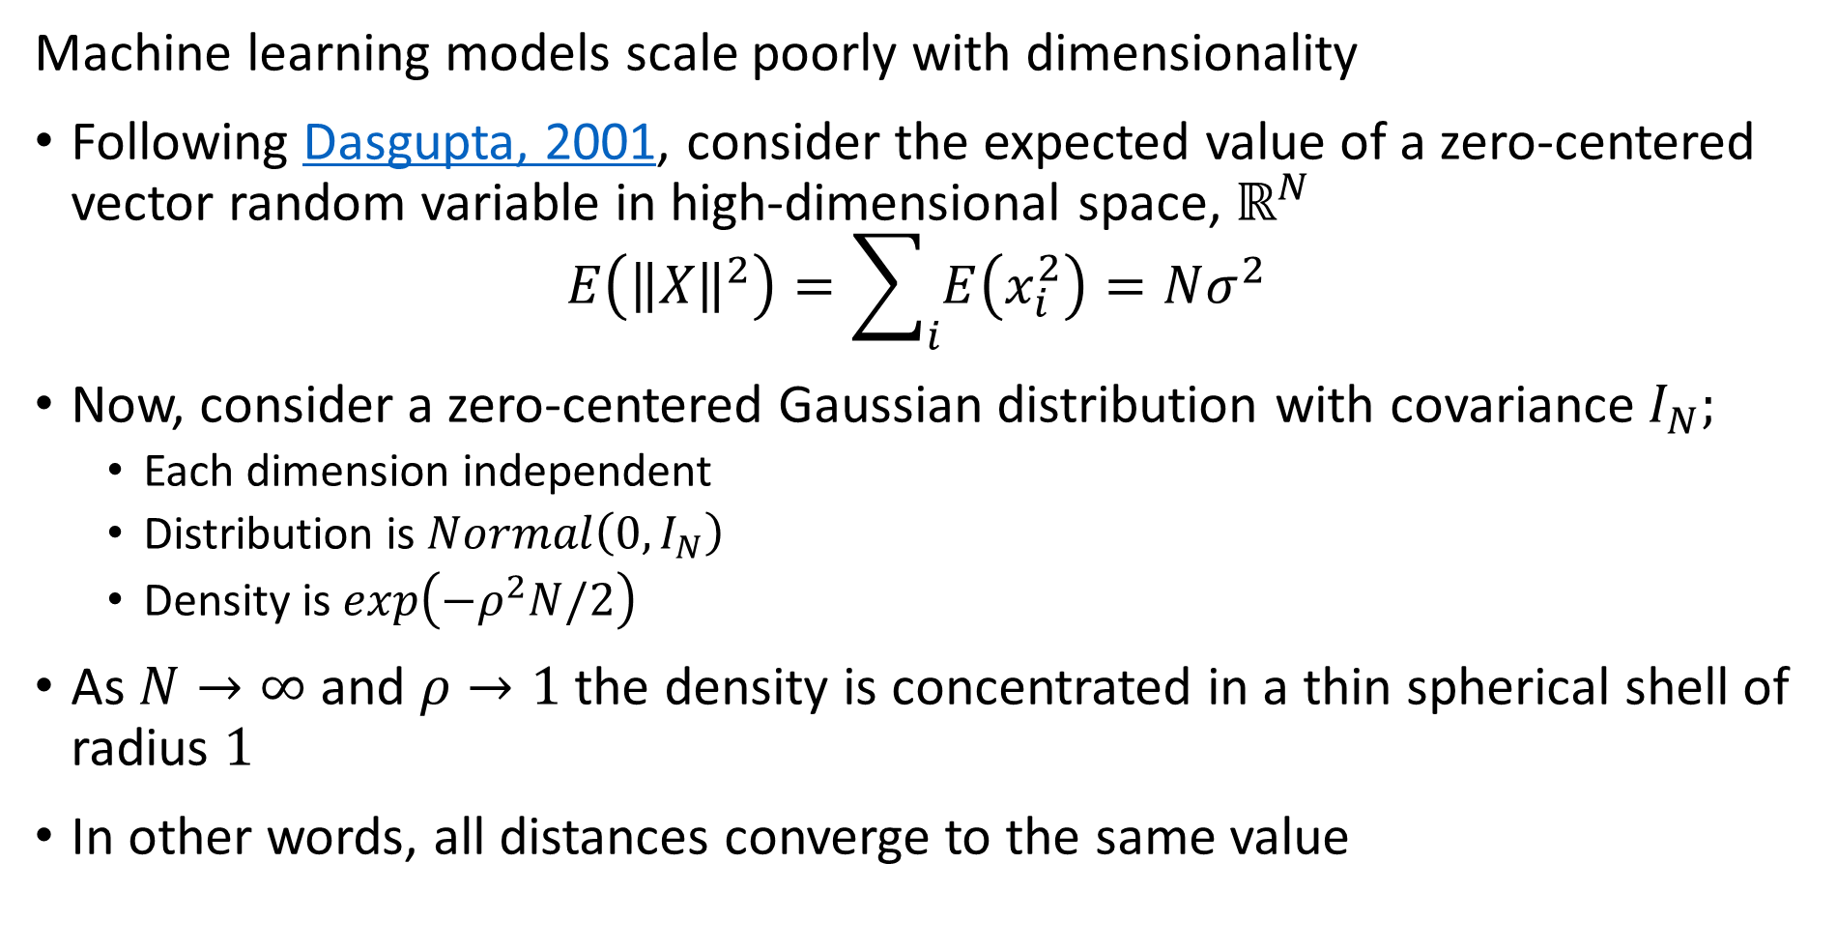
What Could Possibly Go Wrong? Curse of Dimensionality
Machine learning models scale poorly with dimensionality
Following Dasgupta, 2001, consider the expected value of a zero-centered vector random variable in high-dimensional space, $ℝ^{N}$
$$E\left({\left\|X\right\|}^{2}\right)=\sum_{i}{E\left(x_{i}^{2}\right)=Nσ^{2}}$$
Now, consider a zero-centered Gaussian distribution with covariance $I_{N};$
  Each dimension independent
  Distribution is$Normal\left(0,I_{N}\right)$
  Density is $exp\left(−ρ^{2}N/2\right)$
As $N→∞$ and $ρ→1$ the density is concentrated in a thin spherical shell of radius $1$
In other words, all distances converge to the same value

Slide 10
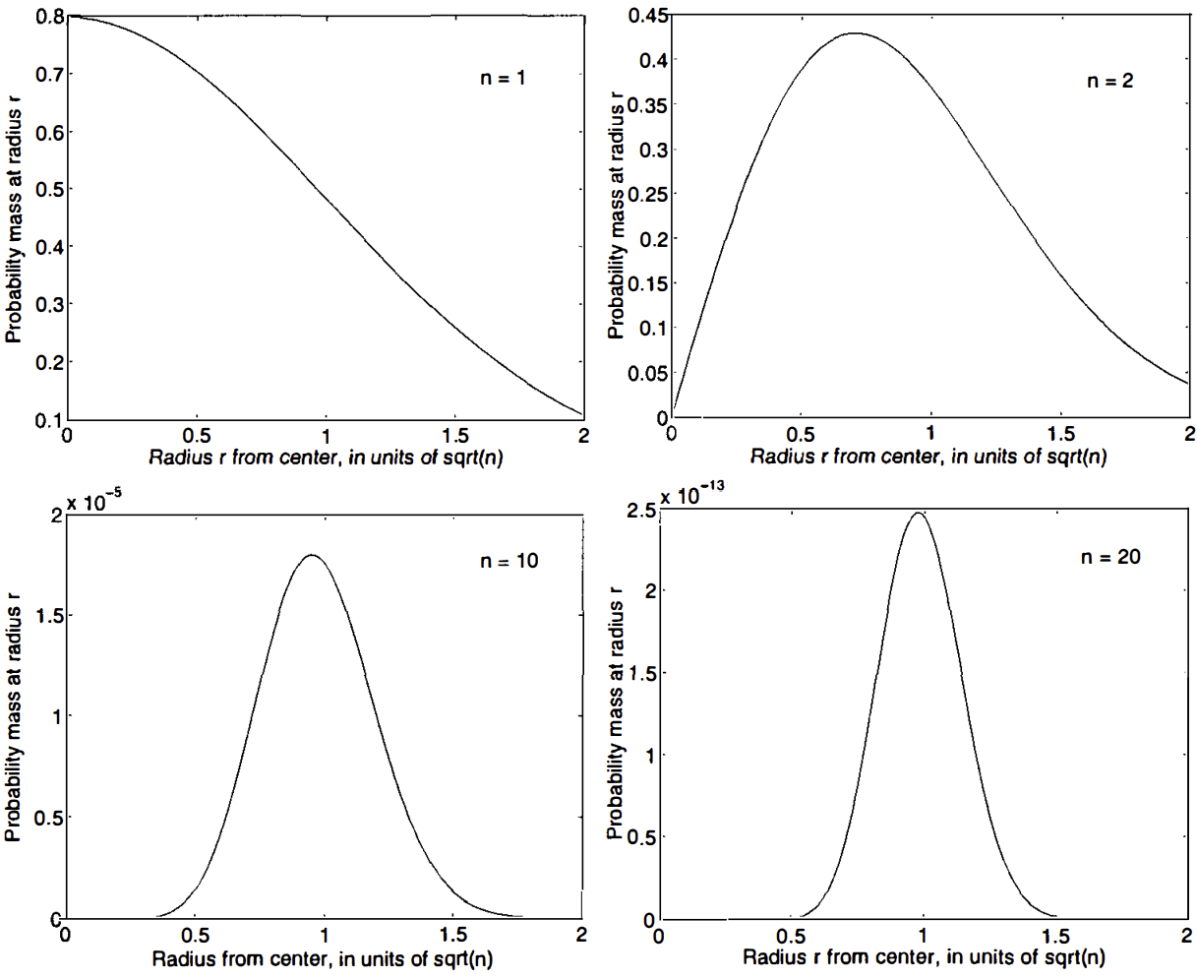
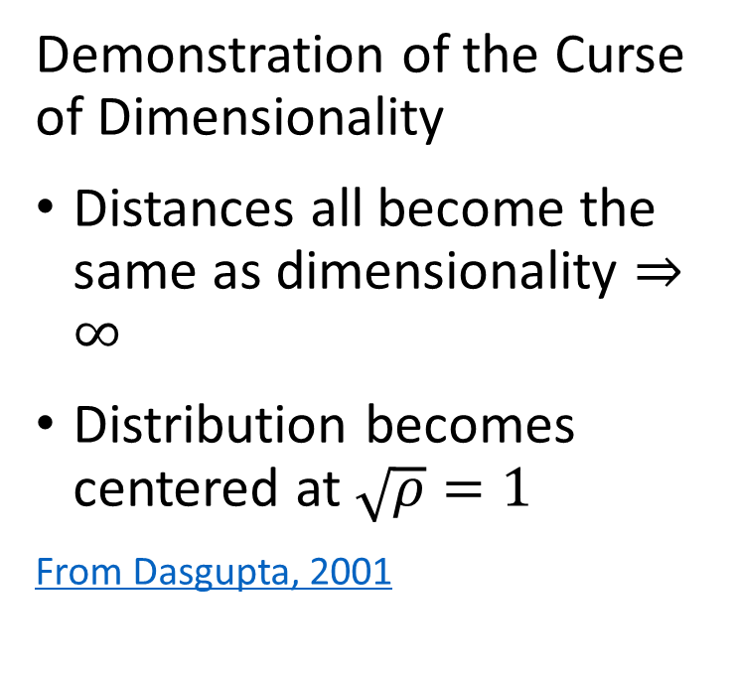
What Could Possibly Go Wrong? Curse of Dimensionality
Demonstration of the Curse of Dimensionality
Distances all become the same as dimensionality $⇒∞$
Distribution becomes centered at $\sqrt{ρ}=1$
From Dasgupta, 2001

Slide 11
What Could Possibly Go Wrong? Curse of Dimensionality
The curse of dimensionality means that all distances are the same in high dimensions
Sampling density decreases exponentially
Distances converge to the same length in a high dimensional space
The choice of metric does not help
  All distances are the same in high dimensions!
Implication is that high-dimensional ML models, such as cluster models, are easy to overfit!!

Slide 12
What Could Possibly Go Wrong? Curse of Dimensionality
How can we extend machine learning to higher dimensions?
Reducing dimensionality can help
Need to create a lower dimensional embedding
But how?
PCA and SVD are a linear projections
Manifold learning can be linear or nonlinear

Slide 13
Properties of Dimensionality Reduction

Slide 14
Properties of Dimensionality Reduction
What are the properties good dimensionality reduction algorithms?
Goal is to find a mapping to the lower dimensional manifold or embedding space
Embedding should minimize error with respect to the original data
  Ideally, reconstruct original data by inverse transformation
Embedding should preserve distances
  Distances or similarities should not be distorted by transformation
Embedding should have low bias
  Embedding should not produce systematic bias

Slide 15
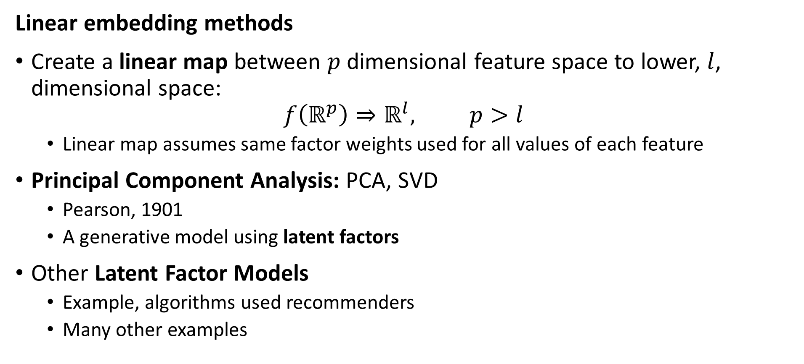
Properties of Dimensionality Reduction
Linear embedding methods
Create a linear map between $p$ dimensional feature space to lower, $l$, dimensional space:
$$f\left(ℝ^{p}\right)⇒ℝ^{l}, p>l$$
  Linear map assumes same factor weights used for all values of each feature
Principal Component Analysis: PCA, SVD
  Pearson, 1901
  A generative model using latent factors
Other Latent Factor Models
  Example, algorithms used recommenders
  Many other examples

Slide 16
Properties of Dimensionality Reduction
Nonlinear embedding methods
Manifold learning for visualization and dimensionality reduction
  Spectral embedding
  UMAP
  Etc……
Deep autoencoders, other NN-based embedding methods
  Discussed in a subsequent lesson
  For a well written tutorial on using VAEs as image generative models see this post by the amazing Lily Wang of NVIDIA, 2018

Slide 17
Linear Embedding with PCA

Slide 18
Linear Dimensionality Reduction - PCA
PCA applies a linear projection from sample space to an orthogonal space
Start with the original features of the model matrix in the p-dimensional sample space
Compute a linear transformation to an orthogonal latent space
  Principle (1st) axis with highest variance
  Each axis is orthogonal to the others, explaining maximum remaining variance
First l projection axes define orthogonal lower dimensional space, l < p

Slide 19
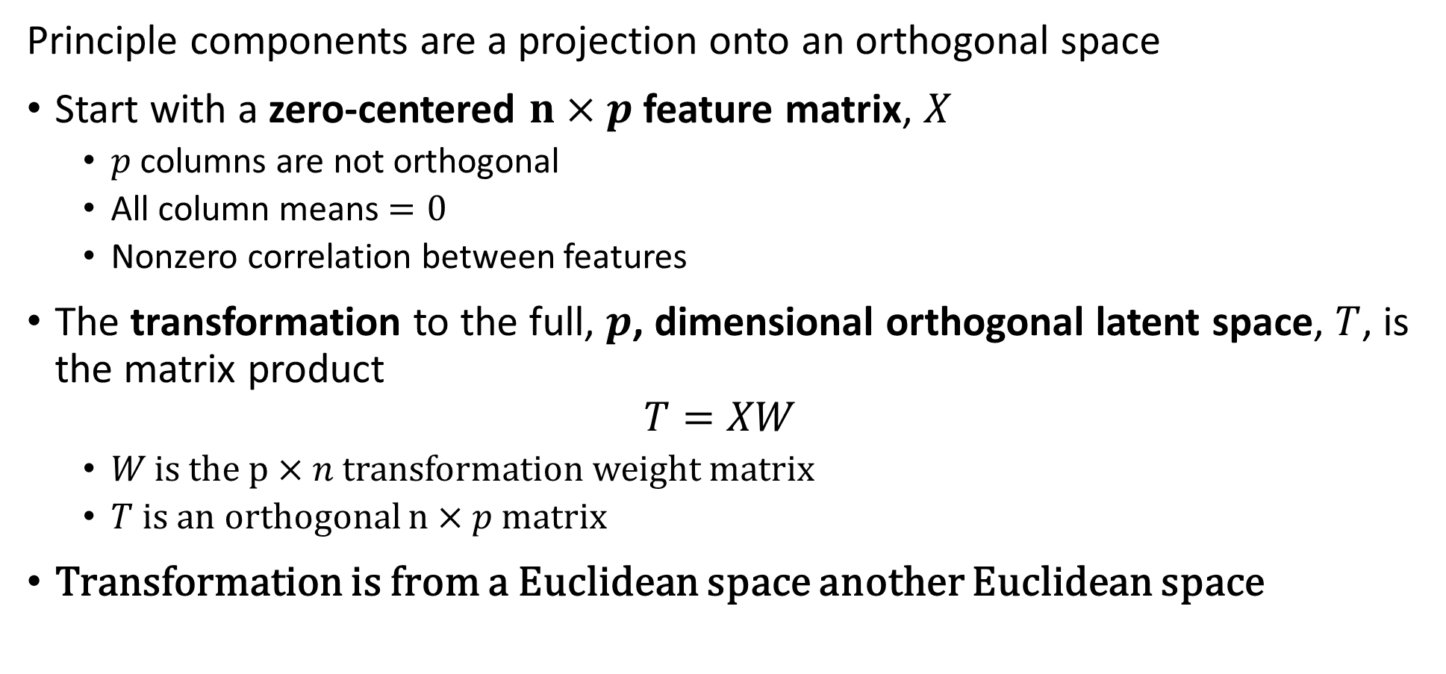
Principle Component Decomposition
Principle components are a projection onto an orthogonal space
Start with a zero-centered $n×p$ feature matrix, $X$
  $p$ columns are not orthogonal
  All column means $=0$
  Nonzero correlation between features
The transformation to the full, $p$, dimensional orthogonal latent space, $T$, is the matrix product
$$T=XW$$
  $W$is the $p×n$ transformation weight matrix
  $T$ is an orthogonal $n×p$ matrix
Transformation is from a Euclidean space another Euclidean space

Slide 20
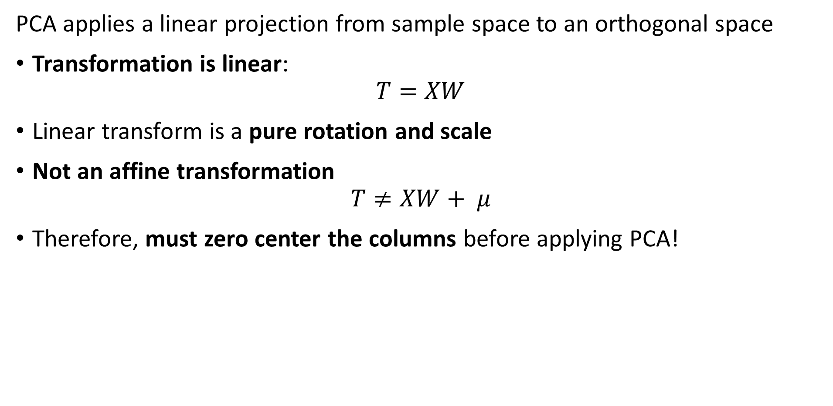
Linear Dimensionality Reduction - PCA
PCA applies a linear projection from sample space to an orthogonal space
Transformation is linear:
$$T=XW$$
Linear transform is a pure rotation and scale
Not an affine transformation
$$T≠XW+ μ$$
Therefore, must zero center the columns before applying PCA!

Slide 21
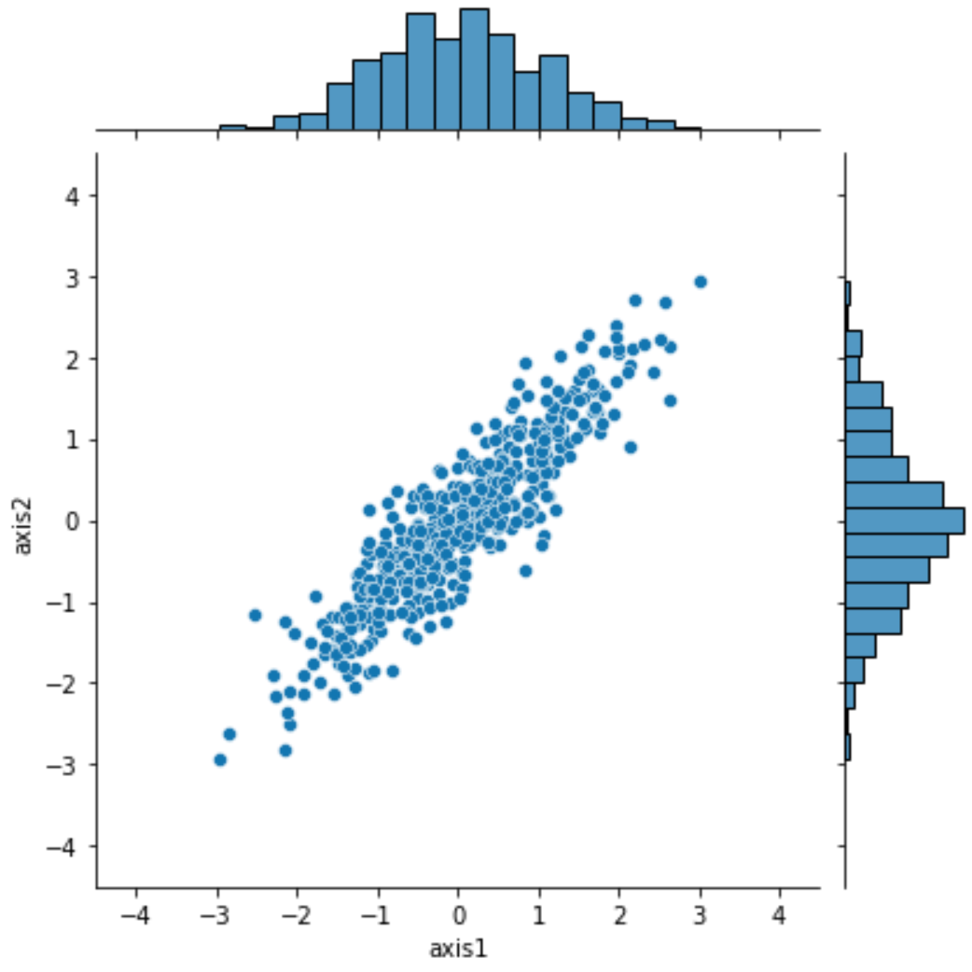
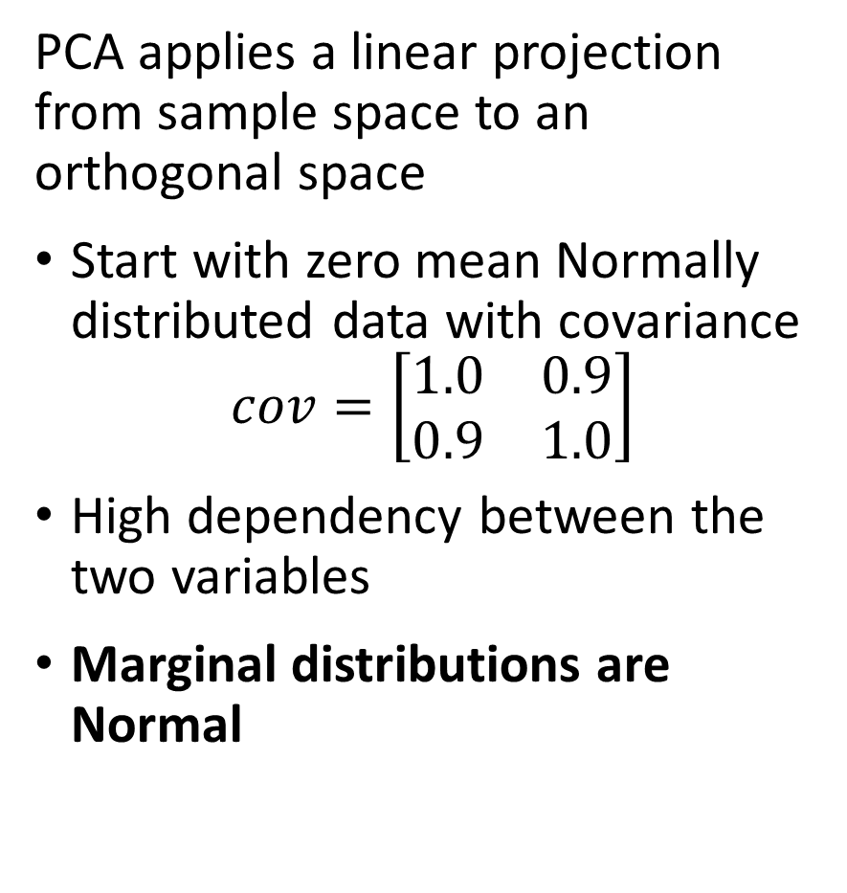
Linear Dimensionality Reduction - PCA
PCA applies a linear projection from sample space to an orthogonal space
Start with zero mean Normally distributed data with covariance
$$cov=\left[\begin{matrix}1.0 & 0.9 \\ 0.9 & 1.0\end{matrix}\right]$$
High dependency between the two variables
Marginal distributions are Normal

Slide 22
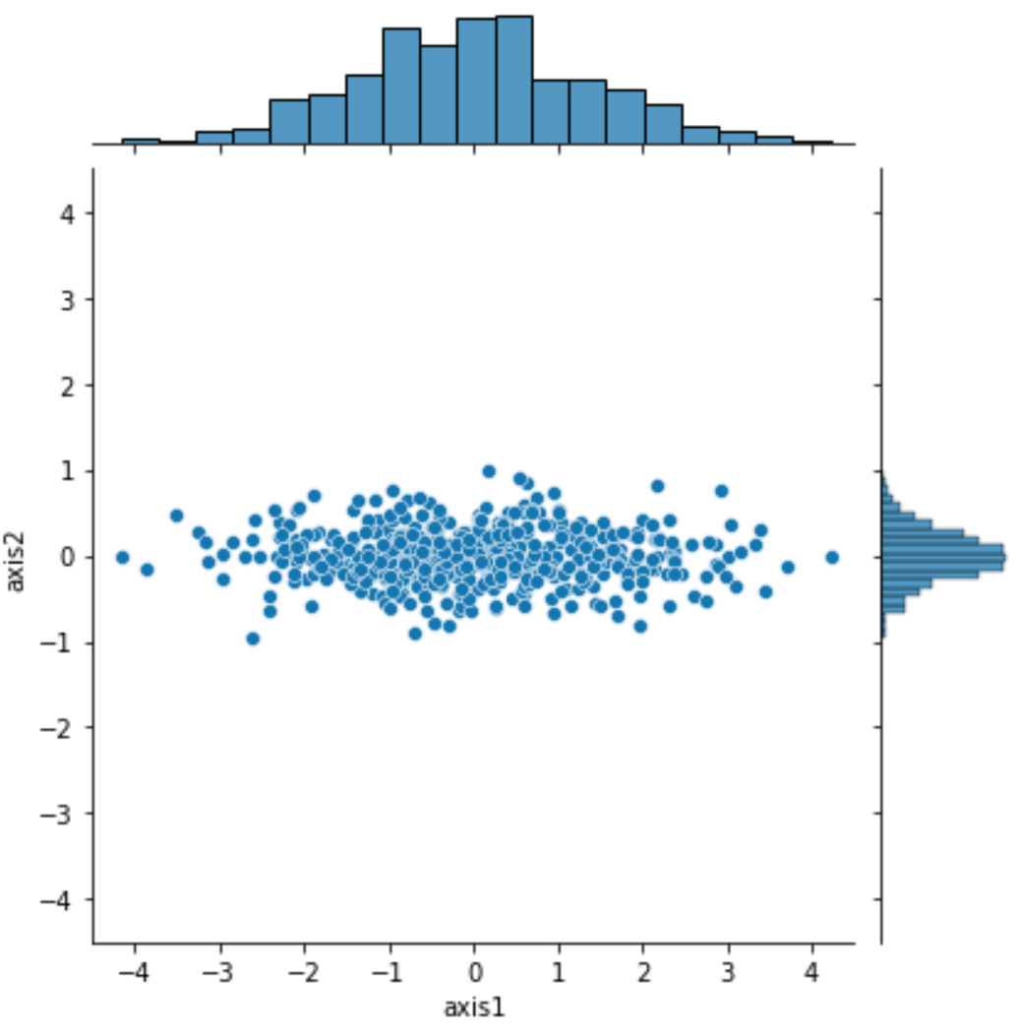
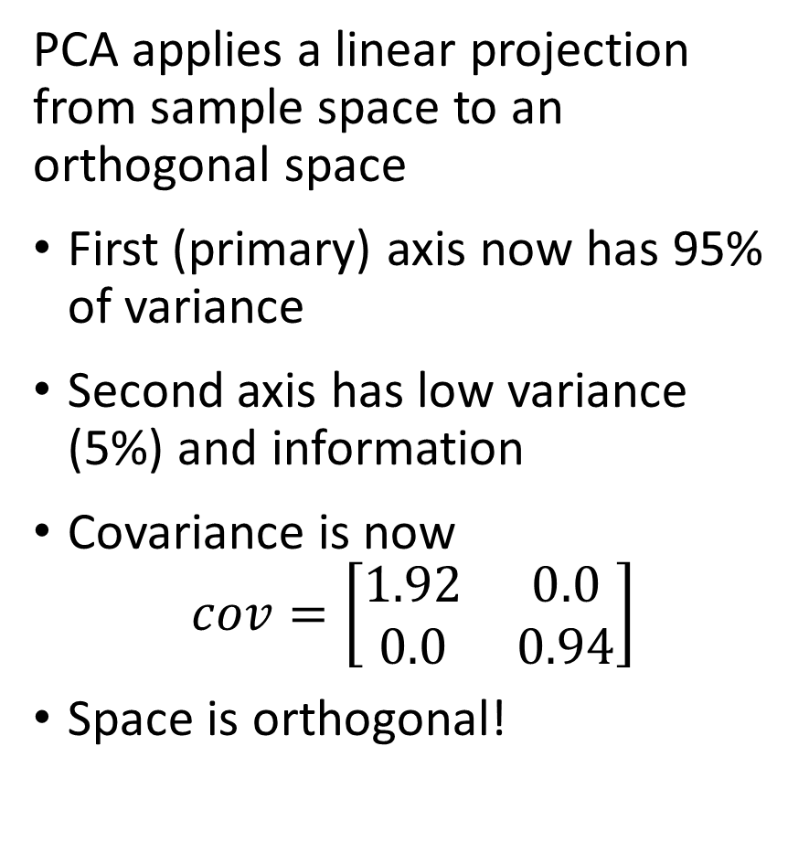
Linear Dimensionality Reduction - PCA
PCA applies a linear projection from sample space to an orthogonal space
First (primary) axis now has 95% of variance
Second axis has low variance (5%) and information
Covariance is now
$$cov=\left[\begin{matrix}1.92 & 0.0 \\ 0.0 & 0.94\end{matrix}\right]$$
Space is orthogonal!

Slide 23
Principal Component Dimensionality Reduction

Slide 24
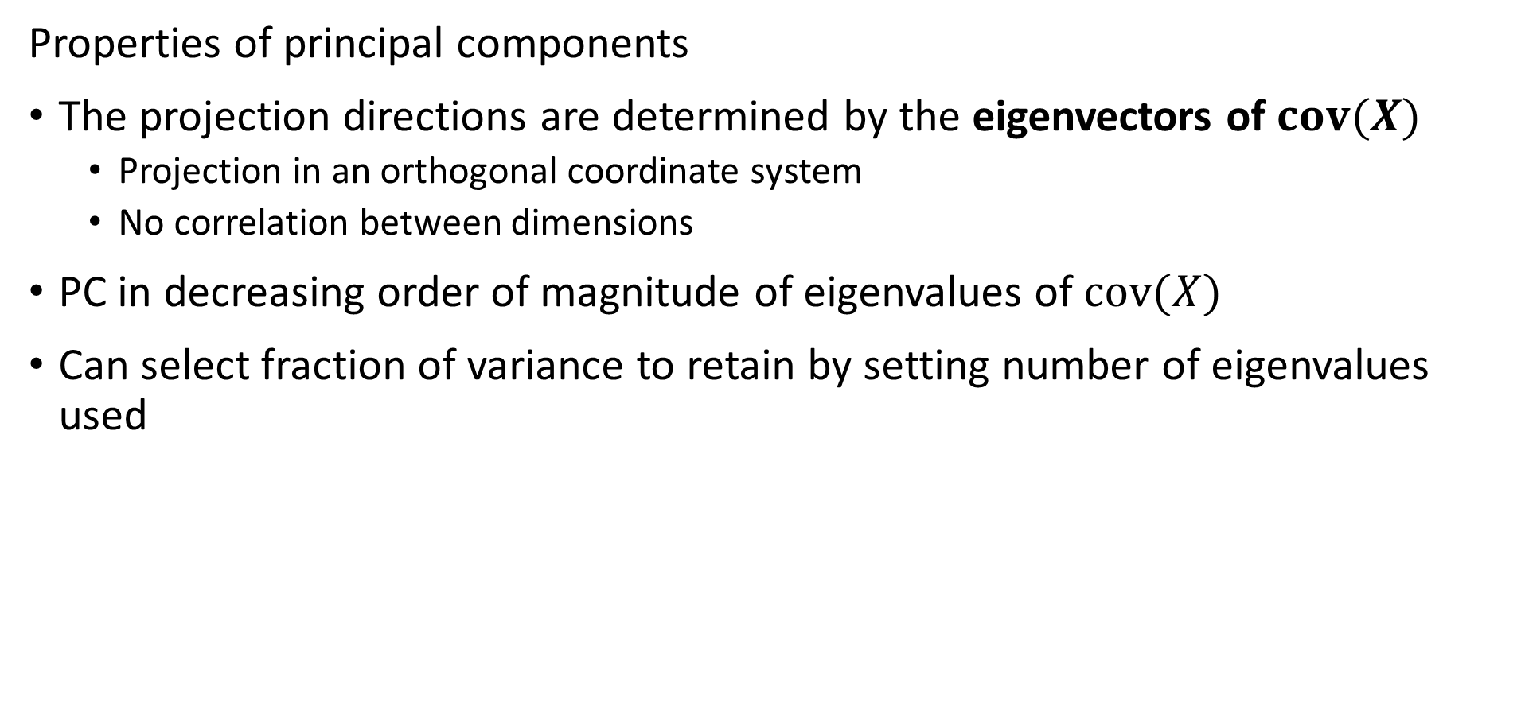
Principle Component Decomposition
Properties of principal components
The projection directions are determined by the eigenvectors of $cov(X)$
  Projection in an orthogonal coordinate system
  No correlation between dimensions
PC in decreasing order of magnitude of eigenvalues of $cov(X)$
Can select fraction of variance to retain by setting number of eigenvalues used

Slide 25
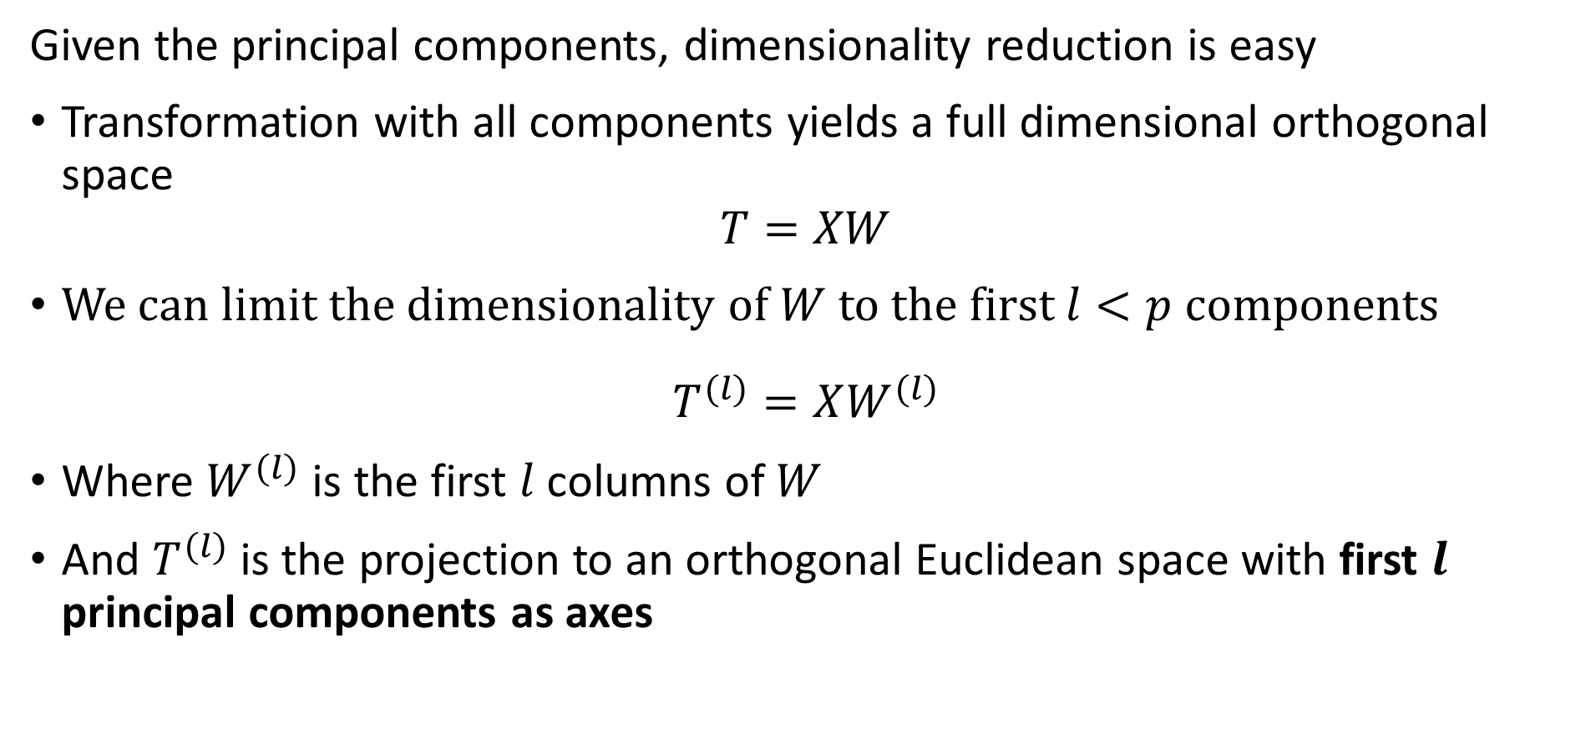
Principle Component Decomposition
Given the principal components, dimensionality reduction is easy
Transformation with all components yields a full dimensional orthogonal space
$$T=XW$$
We can limit the dimensionality of $W$ to the first $l<p$ components
$$T^{(l)}=XW^{(l)}$$
Where $W^{(l)}$ is the first $l$ columns of $W$
And $T^{(l)}$ is the projection to an orthogonal Euclidean space with first $l$ principal components as axes

Slide 26
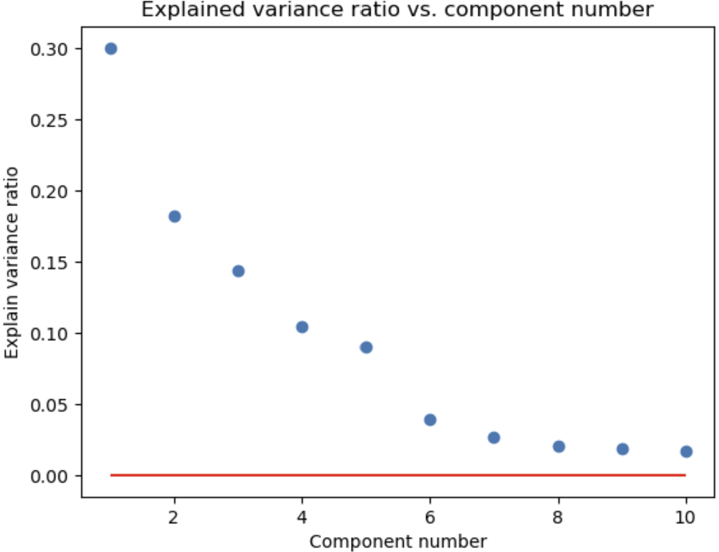
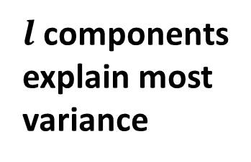
Principle Component Decomposition
How many components do you need?
Need to retain enough components to explain most of the variance
explained variance 1st component
explained variance 2nd component
$l$ components explain most variance
Apparent random variation – irreducible error

Slide 27
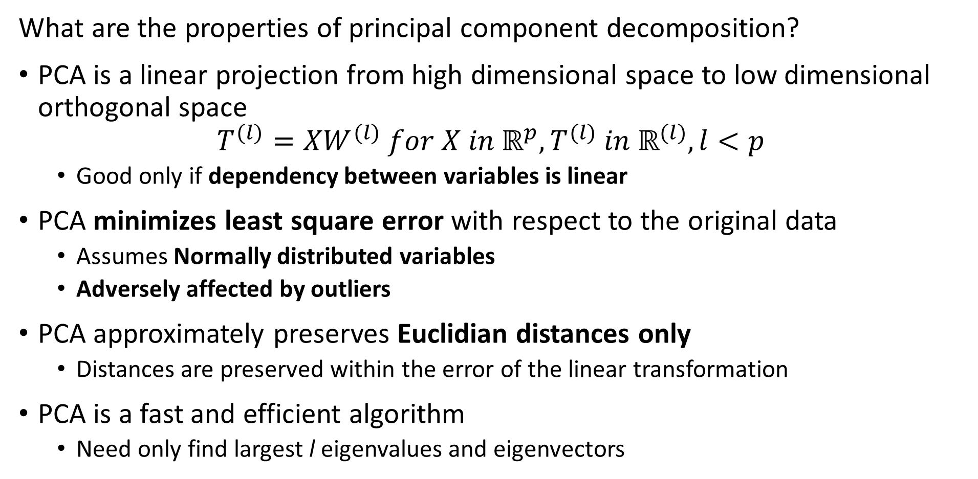
Principle Component Decomposition
What are the properties of principal component decomposition?
PCA is a linear projection from high dimensional space to low dimensional orthogonal space
$$T^{(l)}=XW^{(l)} for X in ℝ^{p},T^{(l)} in ℝ^{(l)}, l<p$$
  Good only if dependency between variables is linear
PCA minimizes least square error with respect to the original data
  Assumes Normally distributed variables
  Adversely affected by outliers
PCA approximately preserves Euclidian distances only
  Distances are preserved within the error of the linear transformation
PCA is a fast and efficient algorithm
  Need only find largest l eigenvalues and eigenvectors

Slide 28
Principle Component Decomposition
Data preparation for PCA
Treat outliers since PCA susceptible
  Details are problem dependent
  If outliers inherent in data, consider nonlinear method like spectral embedding
Demean the variables
  PCA is a linear transformation
  But not an affine transformation!
Transforming variables to unit variance can improve convergence
  Particularly important in high dimensions

Slide 29
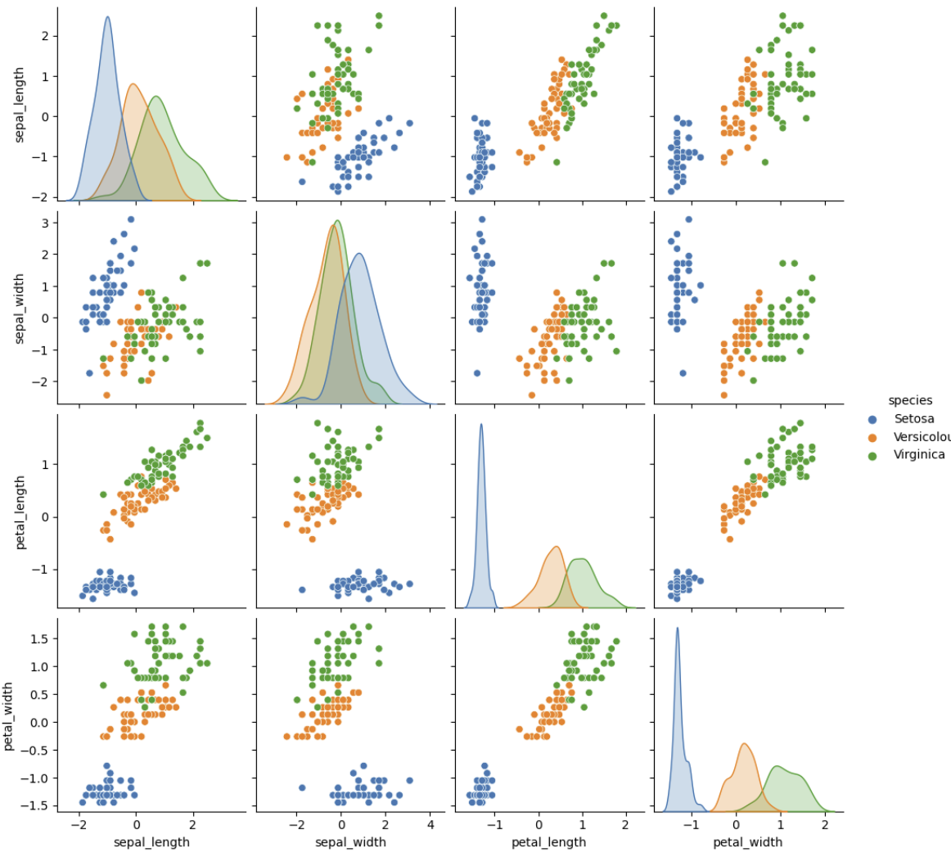
Principle Component Decomposition
Example, Iris dataset
3 spices of iris flowers
4 dimensions of measurements
1 species well separated
2 species overlap in all dimensions

Slide 30
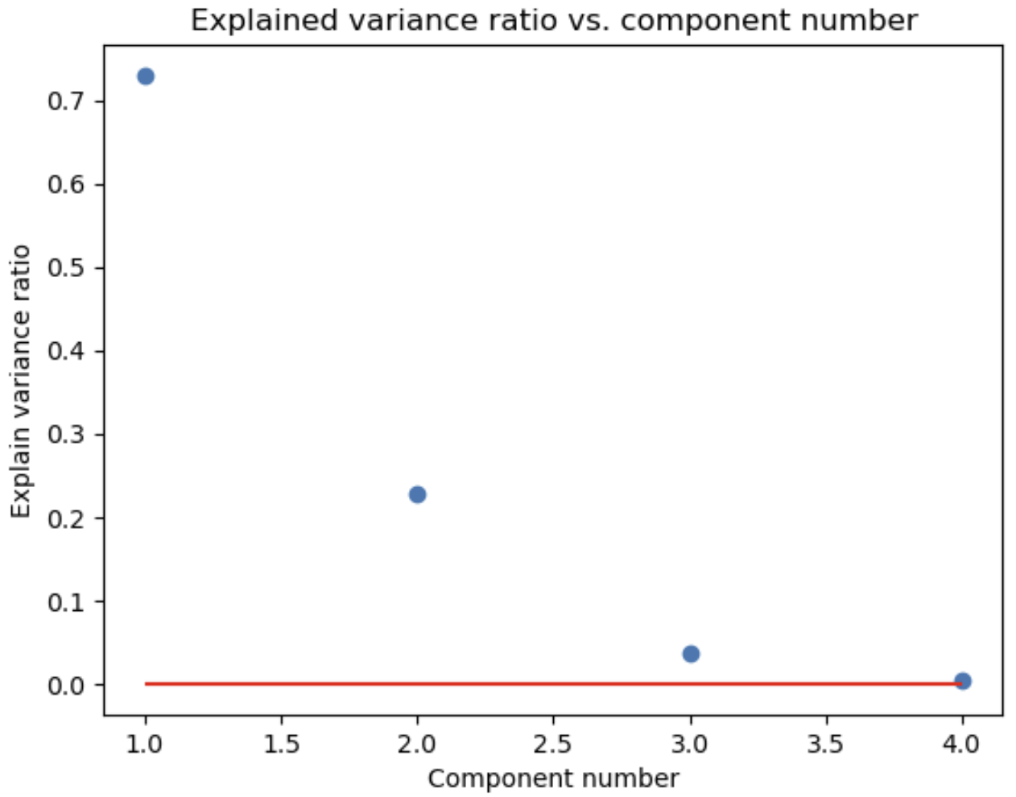
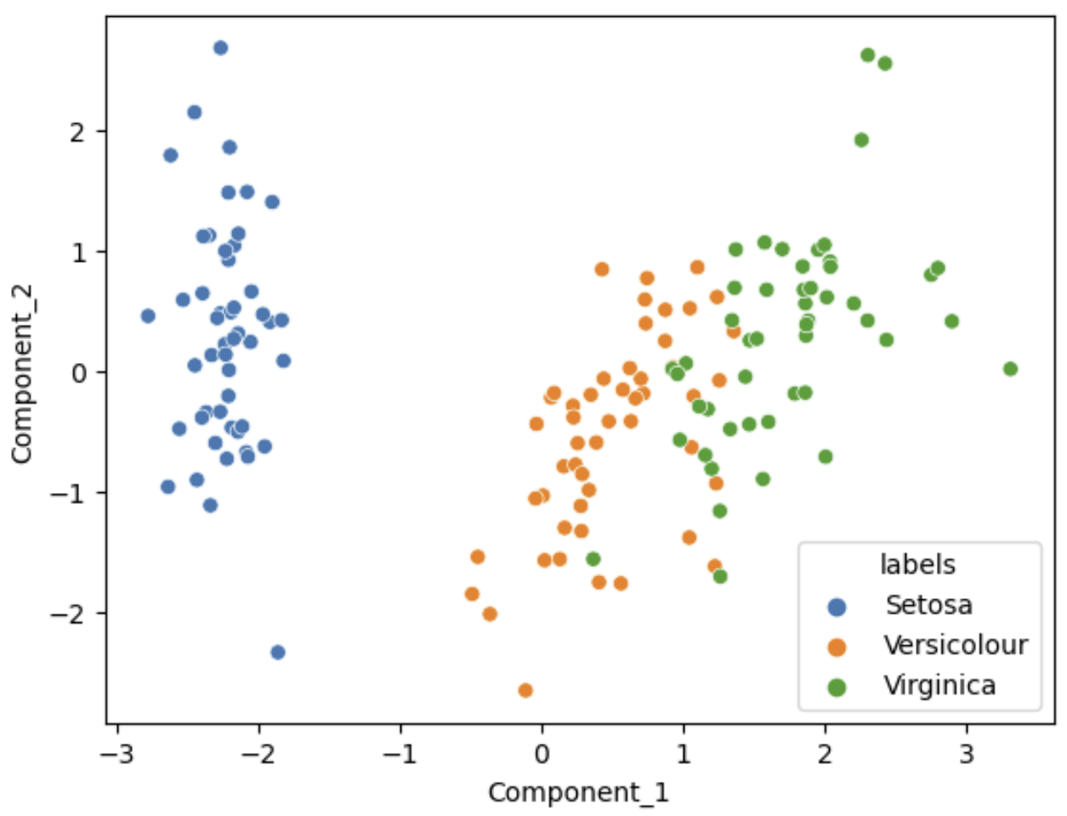
Principle Component Decomposition
Example, first 2 principal components explain about 95% of variance for Iris dataset
Variance ratio by PCA component
Scatterplot of first 2 PCA Components

Slide 31
Singular Value Decomposition

Slide 32
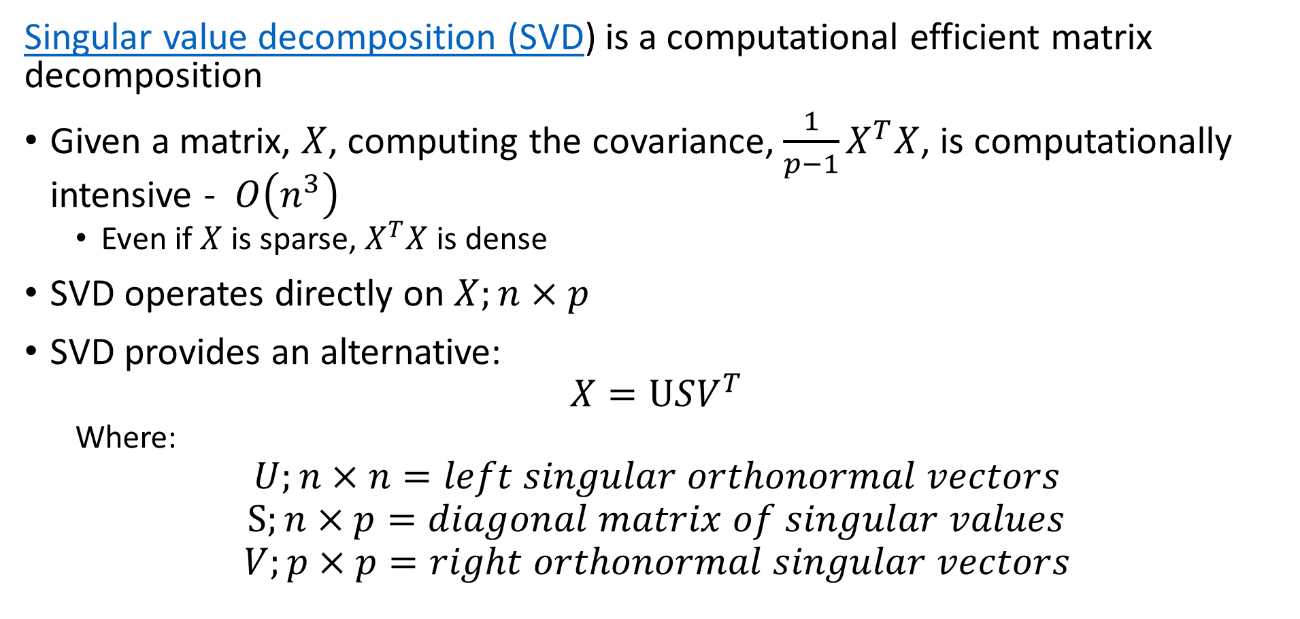
Singular Value Decomposition
Singular value decomposition (SVD) is a computational efficient matrix decomposition
Given a matrix, $X$, computing the covariance, ${\frac{1}{p−1}X}^{T}X$, is computationally intensive - $O\left(n^{3}\right)$
  Even if $X$ is sparse, $X^{T}X$ is dense
SVD operates directly on $X;n×p$
SVD provides an alternative:
$$X=USV^{T}$$
  Where:
$$U;n×n=left singular orthonormal vectors$$
$$S;n×p=diagonal matrix of singular values$$
$$V;p×p=right orthonormal singular vectors$$

Slide 33
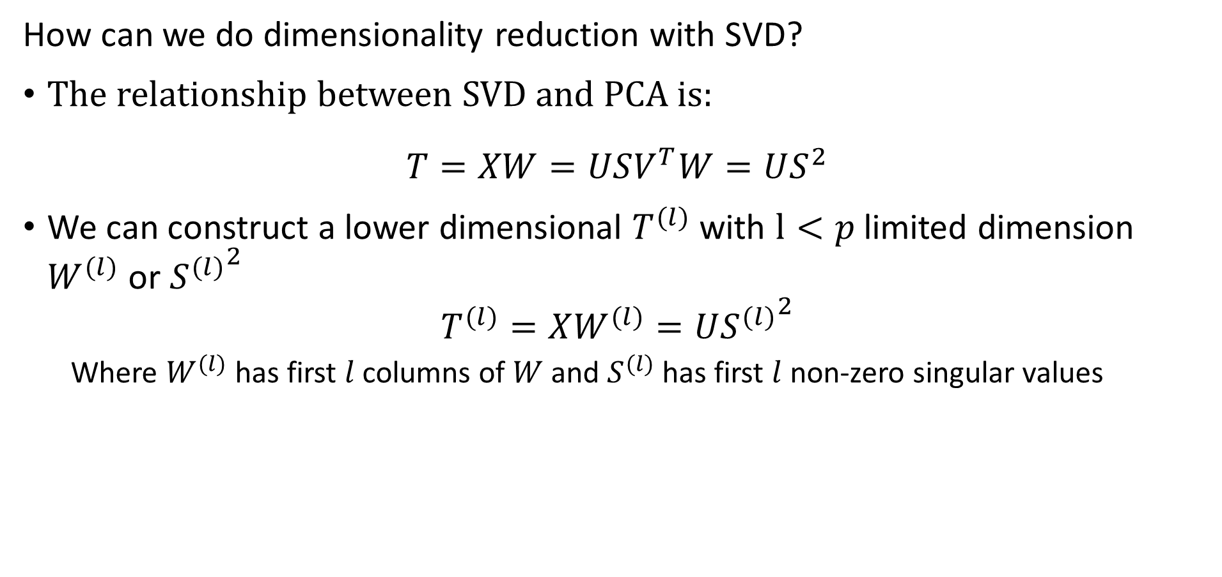
Singular Value Decomposition
How can we do dimensionality reduction with SVD?
The relationship between SVD and PCA is:
$$T=XW=USV^{T}W=US^{2}$$
We can construct a lower dimensional $T^{(l)}$ with $l<p$ limited dimension $W^{(l)}$ or ${S^{(l)}}^{2}$
$$T^{(l)}=XW^{(l)}=U{S^{(l)}}^{2}$$
  Where $W^{(l)}$ has first $l$ columns of $W$ and $S^{(l)}$ has first $l$ non-zero singular values

Slide 34
Feature Hashing

Slide 35
Feature Hashing
Why not just use one-hot-encoding?
Example: A used car shopping site lists thousands of (make, model, year) tuples
  One-hot-encoding the (make, model, year) tuple results in a very high dimensional vector
  Memory intensive and not highly scalable!
One hot encoding cannot manage dynamic situations
  Example: new (make, model, year) tuples are added constantly as new vehicle types become available
  There is no way to encode new (make, model, year) tuples in the fixed data structure!

Slide 36
Feature Hashing
Hash algorithms can be applied to high-cardinality categorical variables
Concatenate results from several hash functions to embed high-cardinality variable to lower-dimensional binary coded variable
This is known as the hashing trick
sklearn.feature_extraction.FeatureHasher uses the 32 bit Murmurhash3 to map text string categories to a binary hash
Example: A used car shopping site lists thousands of (make, model, year) tuples
  Hashing trick maps the (make, model, year) tuple to a compact binary hash
  Method is highly scalable!

Slide 37
Feature Hashing
Hash algorithms can be applied to high-cardinality categorical variables
The hashing trick maps a high-cardinality variable to lower-dimensional binary coded variable
Distance is not preserved
  For categorical variable the distances between categories is uniform
  Binary numbers do not have uniform distances
Cannot ensure unique coding because of hash collisions
  Improve uniqueness by concatenating multiple hashes
Semantic relationships are not preserved by binary hash
We will explore other embedding methods in this course

Slide 38
Manifold Learning

Slide 39
Manifold Learning
How can we visualize data from higher dimensions?
Reducing dimensionality can help
Need to create a lower dimensional embedding
But how?
Manifold Learning projects a high-dimensional space onto a low-dimensional manifold
Many commonly used unsupervised methods
  Spectral embedding
  Uniform Manifold Approximation and Projection (UMAP)
  t-distributed Stochastic Neighbor Embedding (t-SNE) – made obsolete by UMAP
  …..

Slide 40
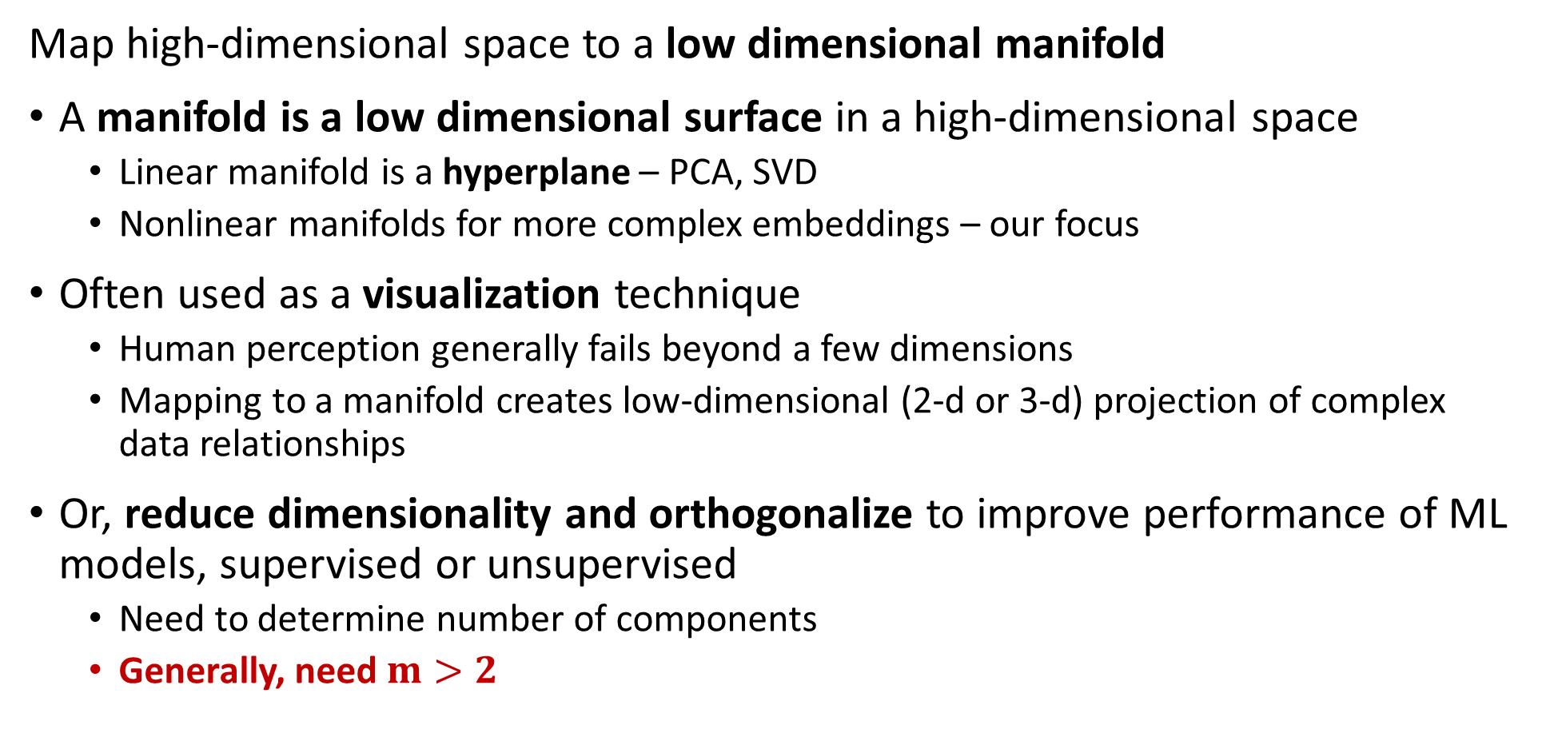
Manifold Learning
Map high-dimensional space to a low dimensional manifold
A manifold is a low dimensional surface in a high-dimensional space
  Linear manifold is a hyperplane – PCA, SVD
  Nonlinear manifolds for more complex embeddings – our focus
Often used as a visualization technique
  Human perception generally fails beyond a few dimensions
  Mapping to a manifold creates low-dimensional (2-d or 3-d) projection of complex data relationships
Or, reduce dimensionality and orthogonalize to improve performance of ML models, supervised or unsupervised
  Need to determine number of components
  Generally, need $m>2$

Slide 41
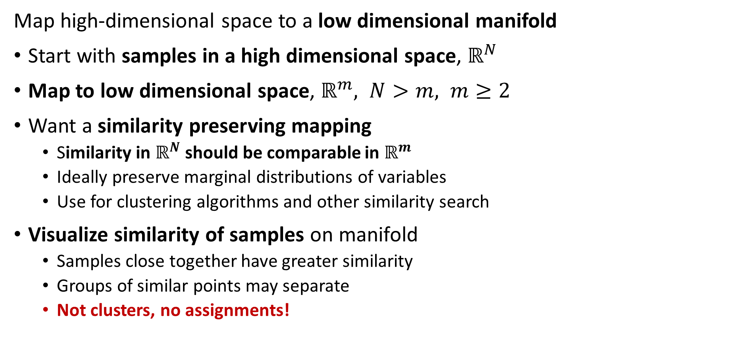
Manifold Learning
Map high-dimensional space to a low dimensional manifold
Start with samples in a high dimensional space, $ℝ^{N}$
Map to low dimensional space, $ℝ^{m}, N>m, m≥2$
Want a similarity preserving mapping
  Similarity in $ℝ^{N}$ should be comparable in $ℝ^{m}$
  Ideally preserve marginal distributions of variables
  Use for clustering algorithms and other similarity search
Visualize similarity of samples on manifold
  Samples close together have greater similarity
  Groups of similar points may separate
  Not clusters, no assignments!

Slide 42
Manifold Learning
Map high-dimensional space to a low dimensional manifold
Many algorithms have been developed
Scikit-Learn supports 8 algorithms + PCA
PCA finds projection of PCs is on a linear manifold or hyperplane
We will look at two nonlinear unsupervised algorithms in detail:
  Spectral embedding
  UMAP

Slide 43
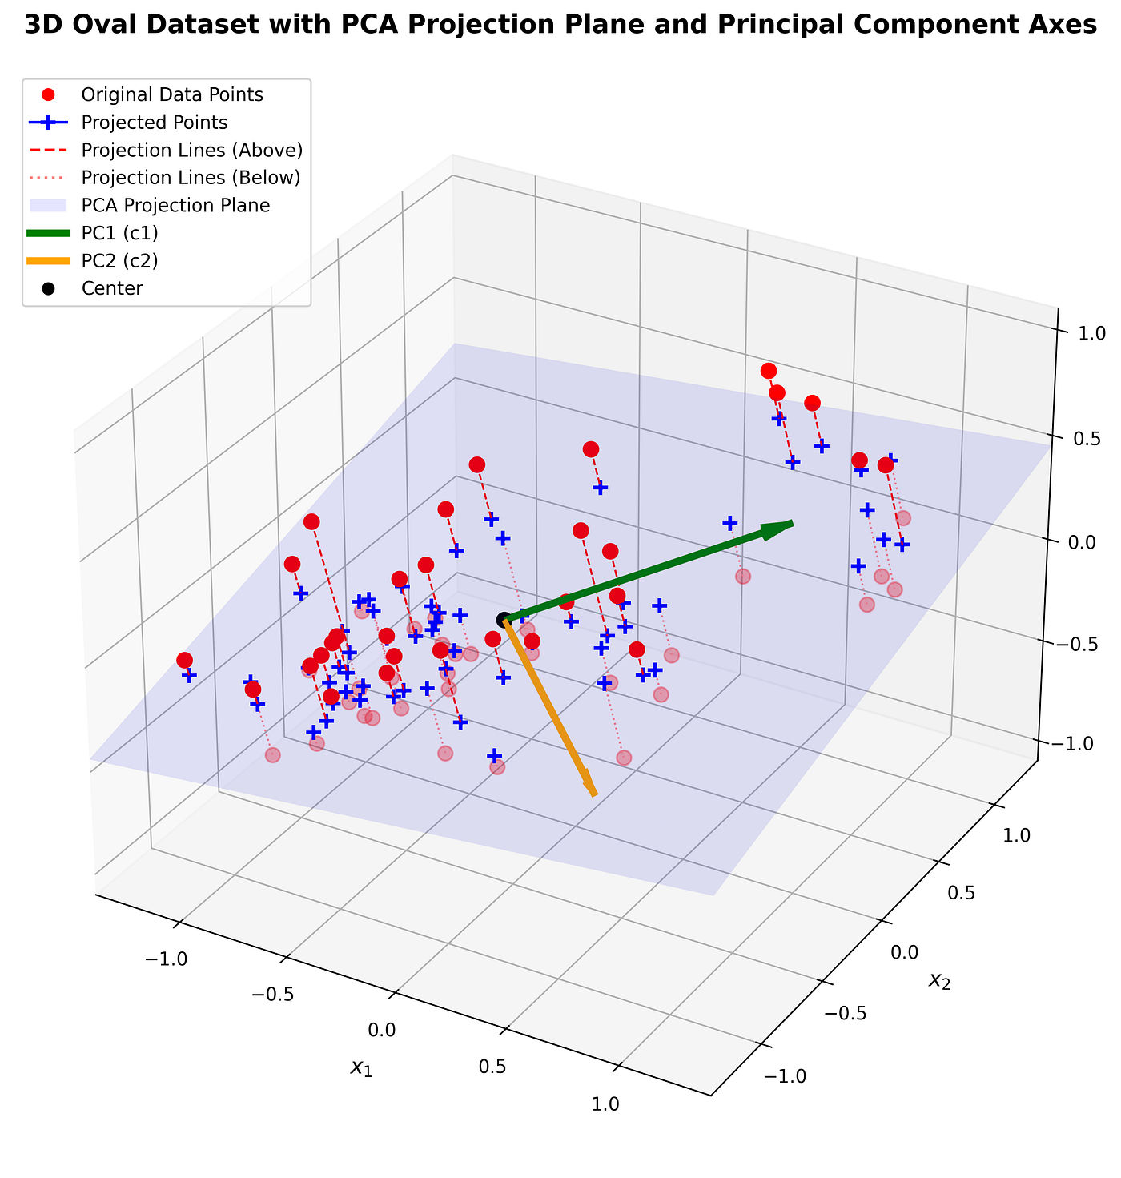
Manifold Learning
Example: PCA is linear mapping to hyperplane manifold
Observed values are shown as red dots
The observed values are mapped to the hyperplane, shown as blue +
The hyperplane represents the manifold
  Is lower-dimensional than original space
  Principle axes on the hyperplane
  Manifold represents the least squares loss projection
Image from blog post by Nguyen Ha Thai Son

Slide 44
Spectral Embedding

Slide 45
Spectral Embedding
Spectral embedding uses graph-based construction
Creates a low-dimensional map of high dimensional space
Closely related to spectral clustering algorithm
Uses eigendecomposition of graph Laplacian
Maps to nonlinear manifold from high-dimensional space
Preserves distances of most similar pairs on graph
A standard implementation in Scikit-Learn
Megaman package has a highly scalable implementation
  Based on SciPy sparse matrices
  Optimized eigen-decomposition
  Getting behind on maintenance
  For tutorial on spectral clustering, see van Luxburg, 2007

Slide 46
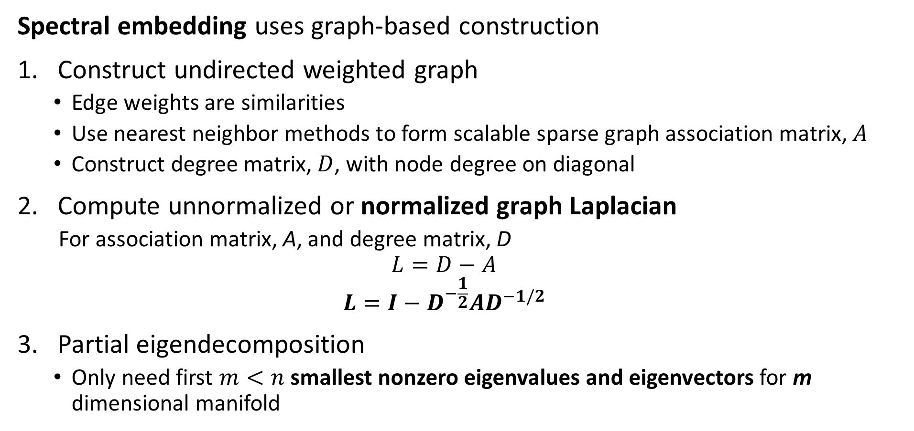
Spectral Embedding
Spectral embedding uses graph-based construction
Construct undirected weighted graph
  Edge weights are similarities
  Use nearest neighbor methods to form scalable sparse graph association matrix, $A$
  Construct degree matrix, $D$, with node degree on diagonal
Compute unnormalized or normalized graph Laplacian
  For association matrix, A, and degree matrix, D
  $$L=D−A$$
  $$L={I−D}^{−\frac{1}{2}}AD^{−1/2}$$
Partial eigendecomposition
  Only need first $m<n$ smallest nonzero eigenvalues and eigenvectors for m dimensional manifold

Slide 47
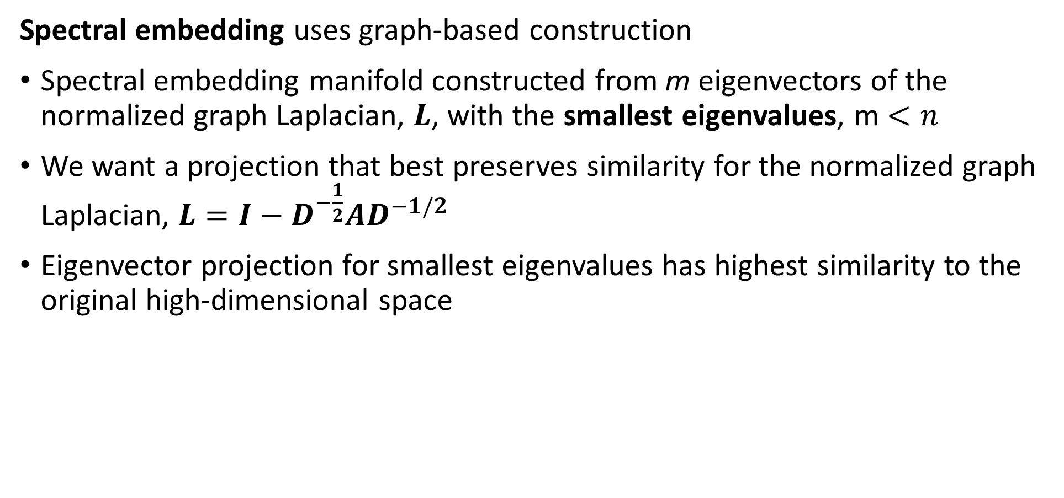
Spectral Embedding
Spectral embedding uses graph-based construction
Spectral embedding manifold constructed from m eigenvectors of the normalized graph Laplacian, $L$, with the smallest eigenvalues, m $<n$
We want a projection that best preserves similarity for the normalized graph Laplacian, $L={I−D}^{−\frac{1}{2}}AD^{−1/2}$
Eigenvector projection for smallest eigenvalues has highest similarity to the original high-dimensional space

Slide 48
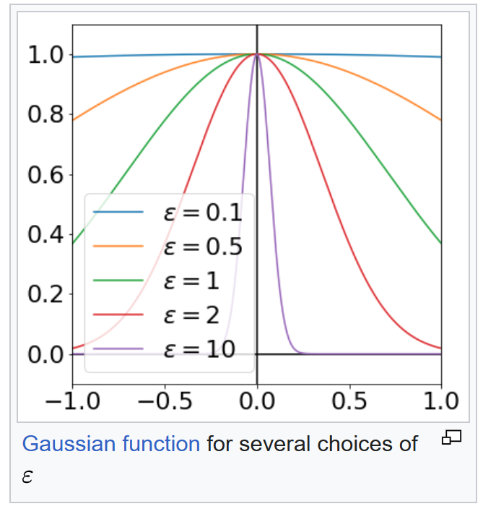
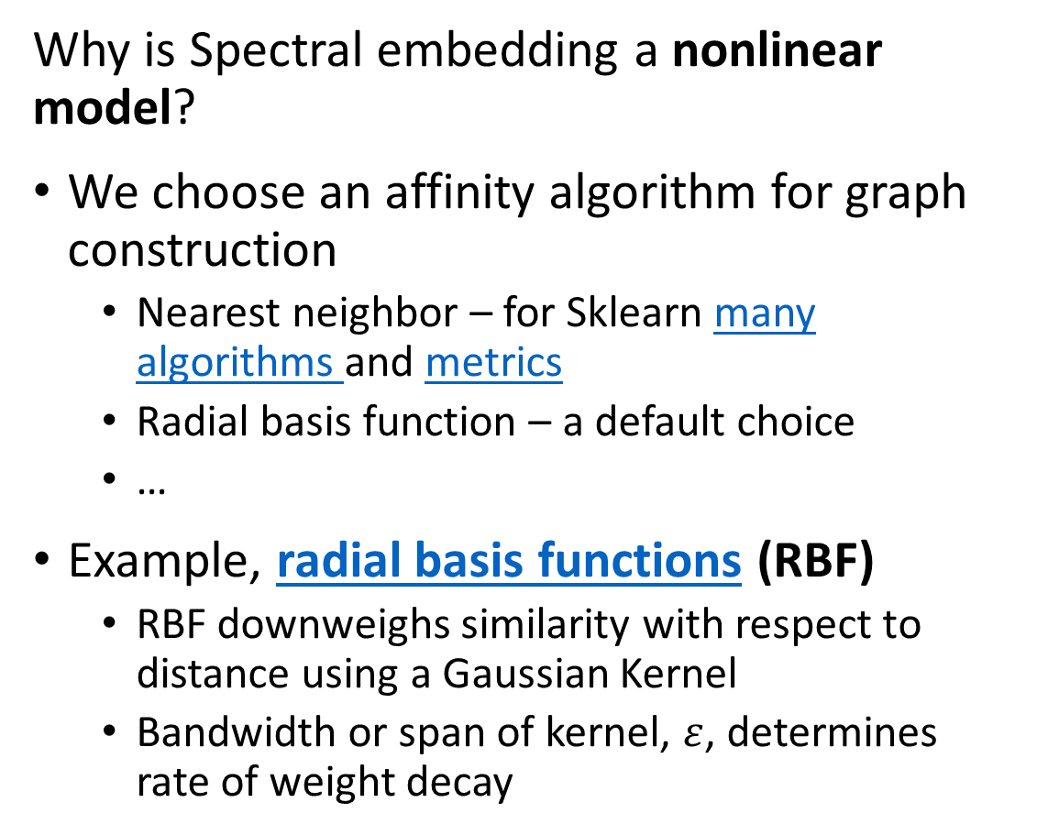
Spectral Embedding
Why is Spectral embedding a nonlinear model?
We choose an affinity algorithm for graph construction
  Nearest neighbor – for Sklearn many algorithms and metrics
  Radial basis function – a default choice
  …
Example, radial basis functions (RBF)
  RBF downweighs similarity with respect to distance using a Gaussian Kernel
  Bandwidth or span of kernel, $ε$, determines rate of weight decay
Illustration from Wikipedia Commons

Slide 49
Uniform Manifold Approximation and Projection (UMAP)

Slide 50
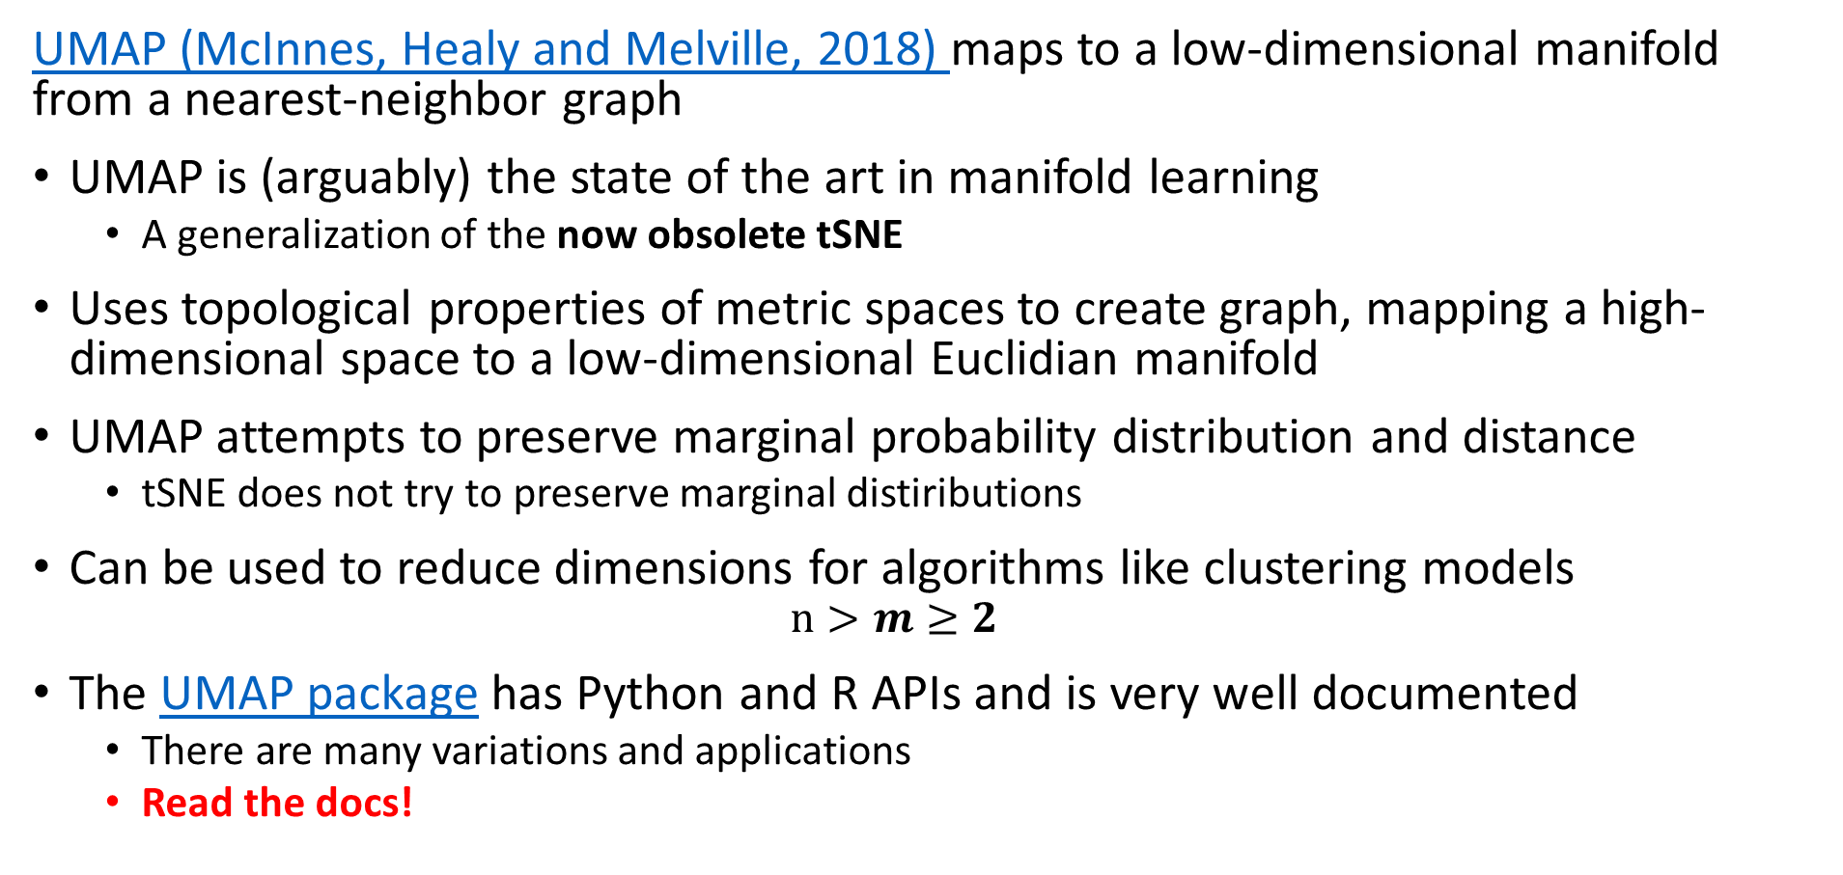
Uniform Manifold Approximation and Projection (UMAP)
UMAP (McInnes, Healy and Melville, 2018) maps to a low-dimensional manifold from a nearest-neighbor graph
UMAP is (arguably) the state of the art in manifold learning
  A generalization of the now obsolete tSNE
Uses topological properties of metric spaces to create graph, mapping a high-dimensional space to a low-dimensional Euclidian manifold
UMAP attempts to preserve marginal probability distribution and distance
  tSNE does not try to preserve marginal distiributions
Can be used to reduce dimensions for algorithms like clustering models
  $$n>m≥2$$
The UMAP package has Python and R APIs and is very well documented
  There are many variations and applications
  Read the docs!

Slide 51
Uniform Manifold Approximation and Projection (UMAP)
Key properties of UMAP
UMAP attempts to preserve probability distribution and distance
Assumes the observations on a manifold are locally connected and uniformly distributed
  High-dimensional manifold can use most any distance metric
  Low-dimensional manifold is Euclidean
Algorithm relies on properties of Reimann manifolds
  Reimann manifolds are locally smooth
  Reimann manifolds have continuous first derivatives

Slide 52
Uniform Manifold Approximation and Projection (UMAP)
Key properties of UMAP
Low-dimensional Euclidean Reimann manifold has desirable properties
Human perception of visualizations in Euclidean space is good
Euclidean space has advantages for machine learning
  Wide choice of possible algorithms
  Can compute sum of squares
  Clusters are elliptical or spherical

Slide 53
Uniform Manifold Approximation and Projection (UMAP)
How does the UMAP algorithm work?
Algorithm for mapping to low dimensional Euclidian space has 4 major steps:
Locally compute fuzzy weights
Build nearest-neighbor graph
Use spectral embedding to find good starting transformation
Minimize cross-entropy to optimize low-dimensional Euclidian manifold and preserve marginal distributions

Slide 54
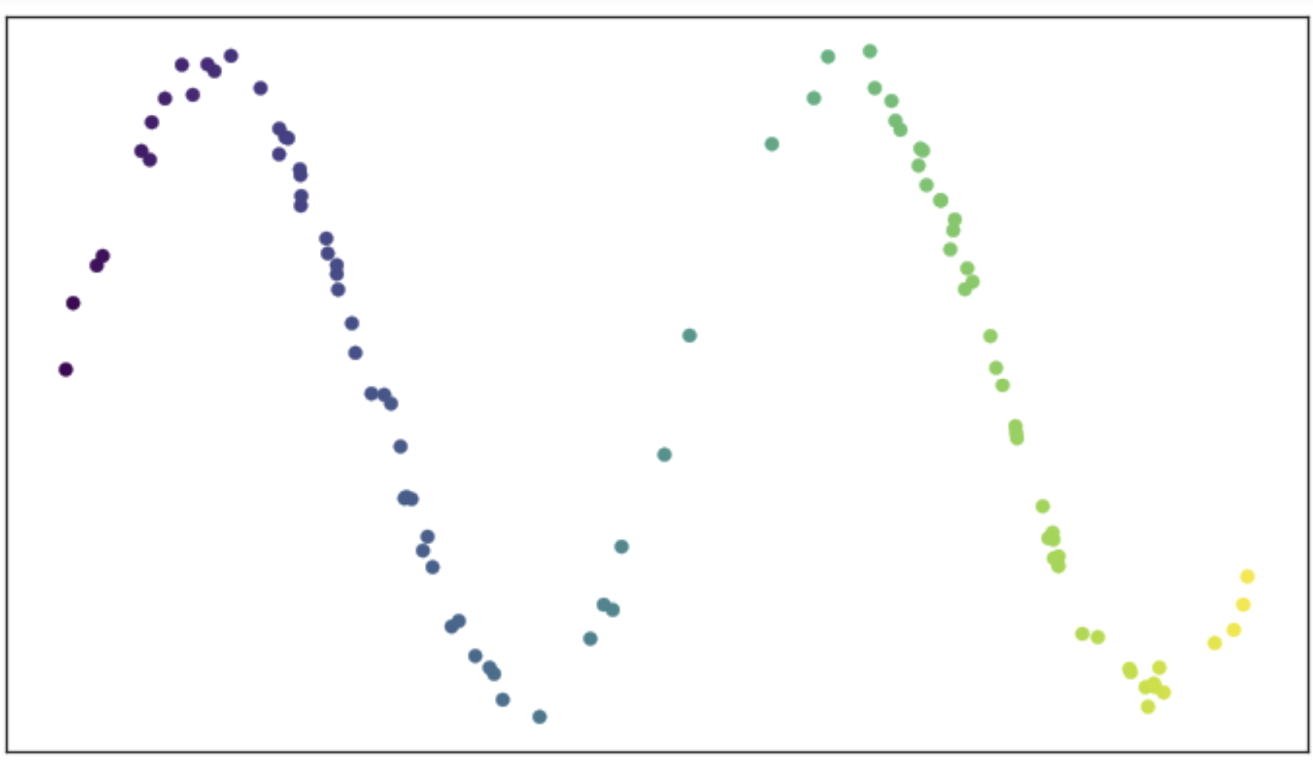
Uniform Manifold Approximation and Projection (UMAP)
How does the UMAP algorithm work?
Consider an example of data on a manifold
Is a two-dimensional space
Sample values are predominantly on a 1-dimensional smooth (Reimann) manifold
How do we construct the low-dimensional manifold?
From UMAP documentation, Leland McInnis, 2018

Slide 55
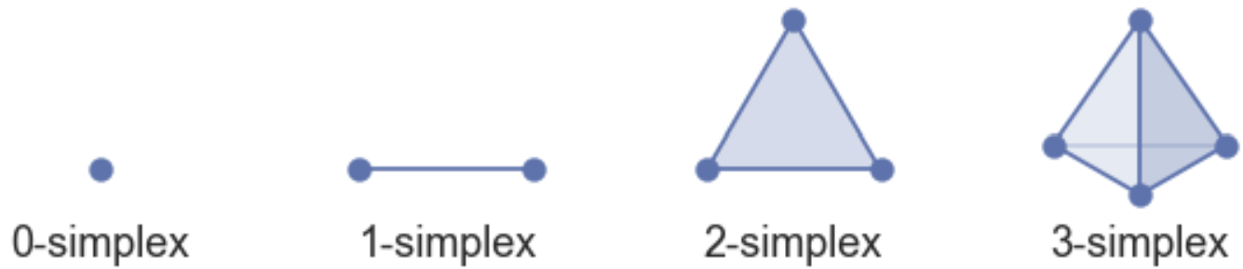
Uniform Manifold Approximation and Projection (UMAP)
How does the UMAP algorithm work?
Construct the manifold as a set of simplexes
K-simplex has k+1 fully connected nodes
Can construct high-dimensional shapes by joining simplices
  Simplices joined on common faces
Represent complex manifold as simplicial complexes
From UMAP documentation, Leland McInnis, 2018

Slide 56
Uniform Manifold Approximation and Projection (UMAP)
How does the UMAP algorithm work?
Example of simplicial complex construction
Start with some observations, 0-simplicies
Construct a first 1-simplex, joining faces of 2 0-simplicies
Add 2 more 1-simplices, constructing a first 2-simplex
Construct a second 2-simplex, creating a simplicial complex along the common face
Construct a third 2-simplex, extending the simplicial complex along the common face

Slide 57
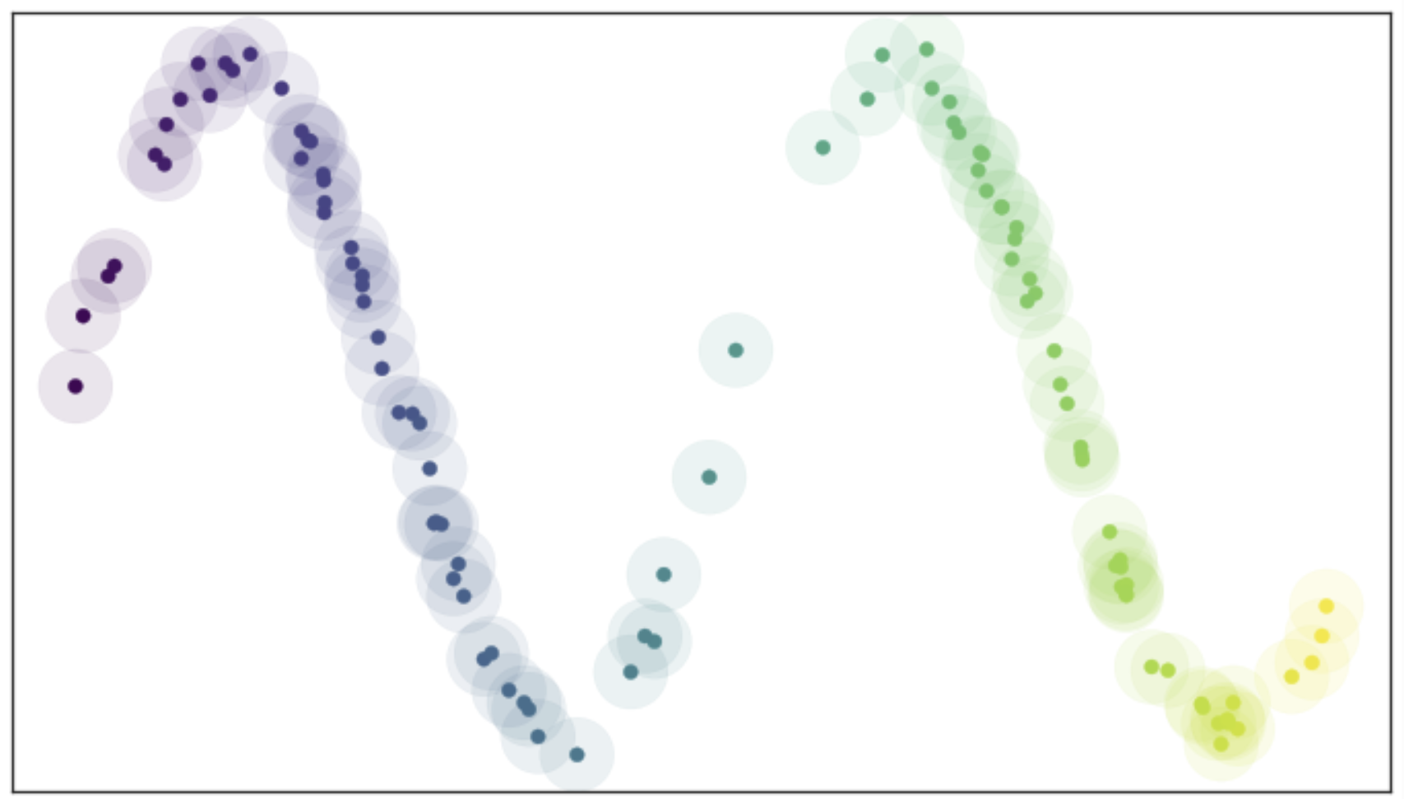
Uniform Manifold Approximation and Projection (UMAP)
How does the UMAP algorithm work?
Find manifold from connectivity of nearest neighbor graph
Place hyper-balls (circles in 2-d) of radius r on each point
Nearest neighbors within distance r
Ideal if vertices (observations) uniformly distributed
From UMAP documentation, Leland McInnis, 2018

Slide 58
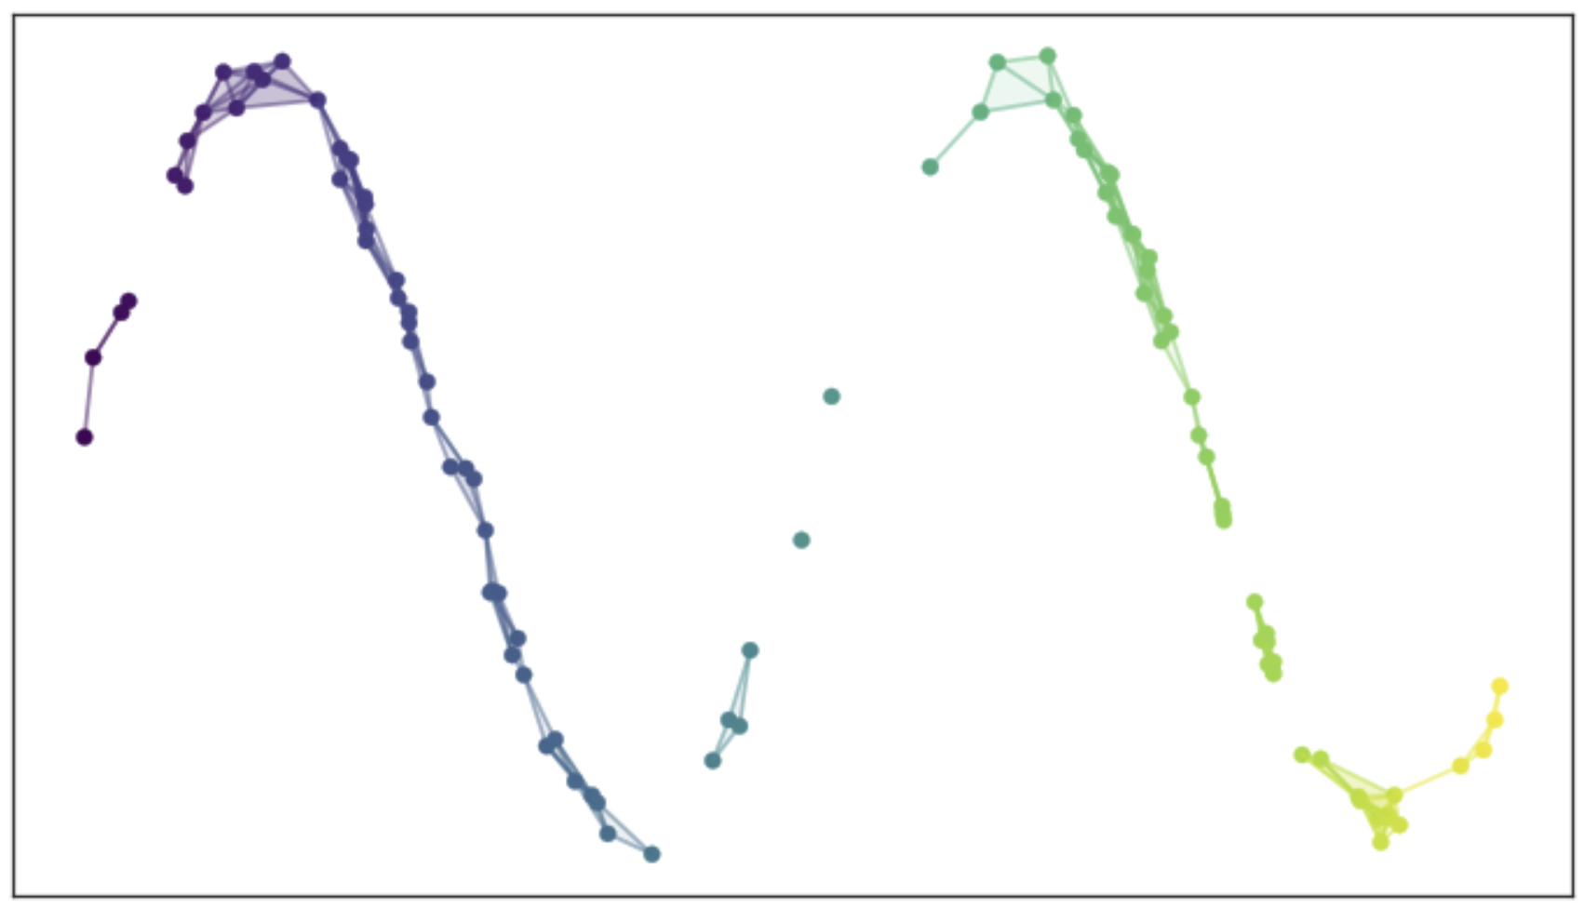
Uniform Manifold Approximation and Projection (UMAP)
How does the UMAP algorithm work?
Edges connect nearest neighbors within distance r
The resulting graph is not ideal!
Too dense in some places
Graph may have disconnected components
Discontinuous in other places
A poor representation of a smooth Reiman manifold
From UMAP documentation, Leland McInnis, 2018

Slide 59
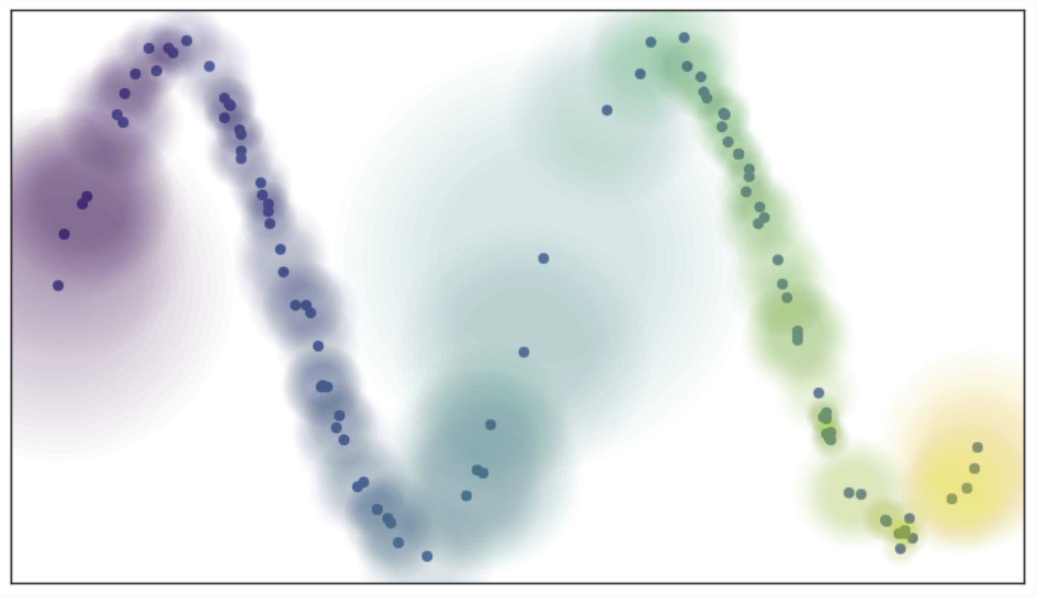
Uniform Manifold Approximation and Projection (UMAP)
How does the UMAP algorithm work?
Use ‘fuzzy balls’ to represent similarity
Example; probability (weight) of connection decays exponentially
Connect vertices on the manifold that are not uniformly distributed
From UMAP documentation, Leland McInnis, 2018

Slide 60
Uniform Manifold Approximation and Projection (UMAP)
How does the UMAP algorithm work?
Size of fuzzy ball determined by local density metric
Works since we assume a Reimann manifold, smooth and continuous first derivatives
From UMAP documentation, Leland McInnis, 2018

Slide 61
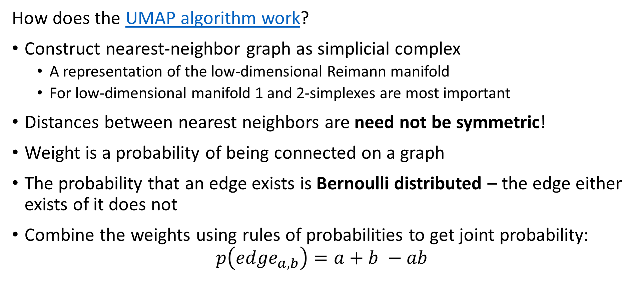
Uniform Manifold Approximation and Projection (UMAP)
How does the UMAP algorithm work?
Construct nearest-neighbor graph as simplicial complex
  A representation of the low-dimensional Reimann manifold
  For low-dimensional manifold 1 and 2-simplexes are most important
Distances between nearest neighbors are need not be symmetric!
Weight is a probability of being connected on a graph
The probability that an edge exists is Bernoulli distributed – the edge either exists of it does not
Combine the weights using rules of probabilities to get joint probability:
$$p\left({edge}_{a,b}\right)=a+b −ab$$

Slide 62
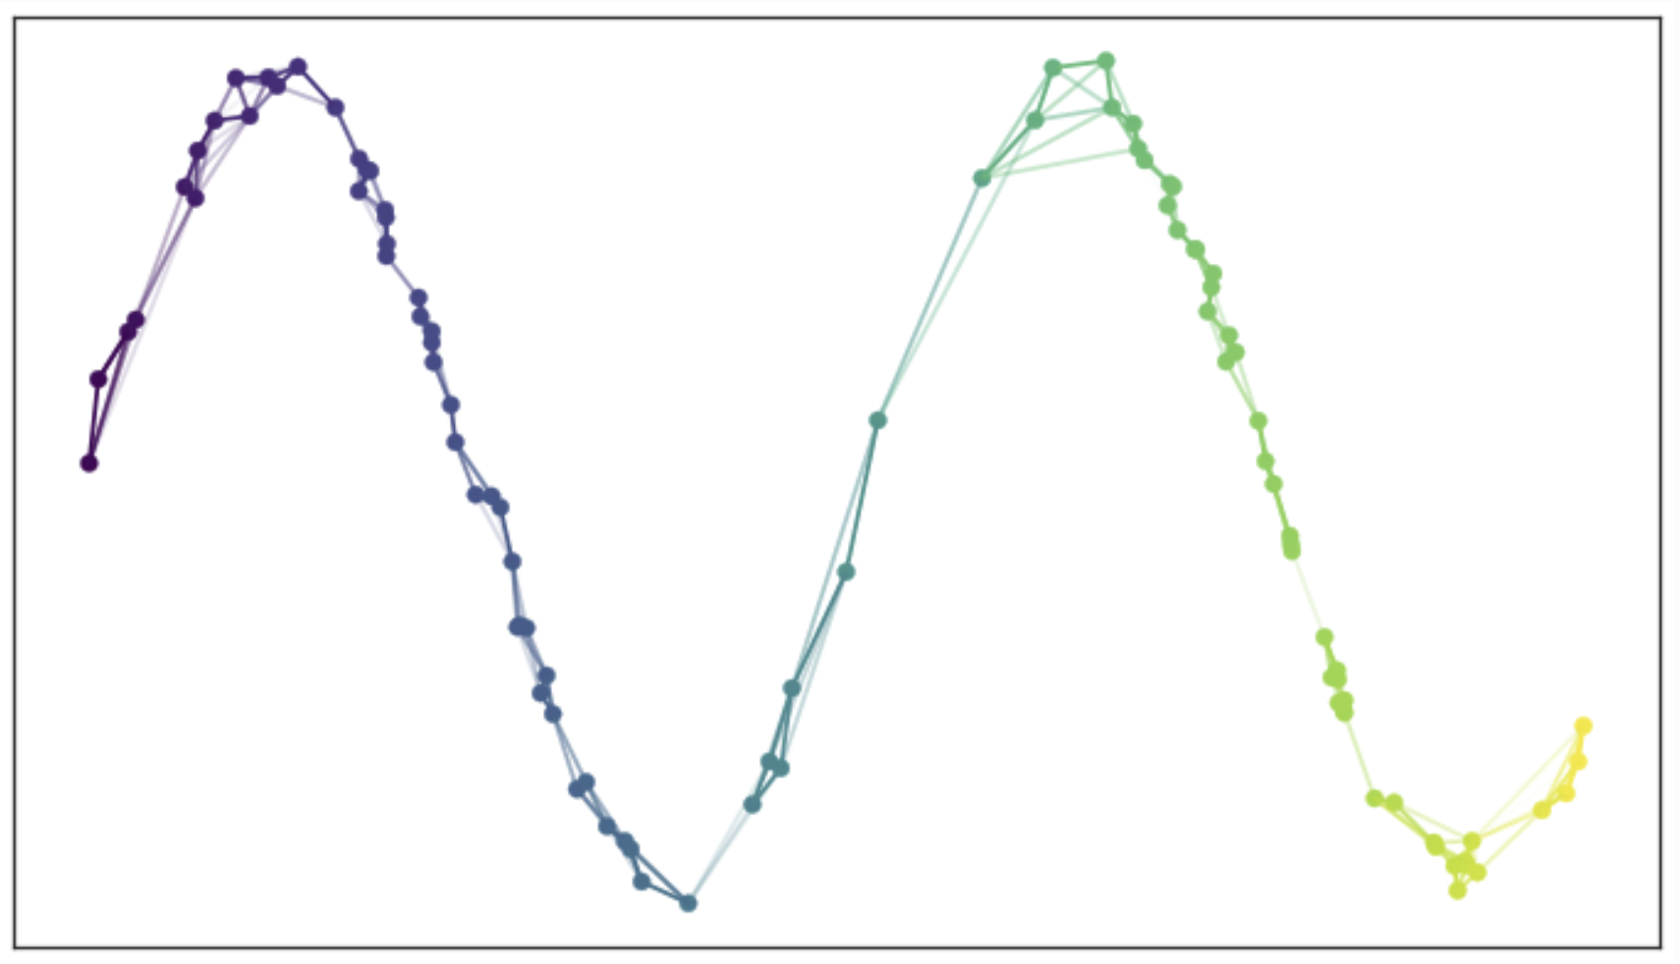
Uniform Manifold Approximation and Projection (UMAP)
How does the UMAP algorithm work?
Use the joint probabilities to define edges
Each observation is now connected to near neighbors in the simplicial complex
Graph is a map of the low-dimensional manifold
From UMAP documentation, Leland McInnis, 2018

Slide 63
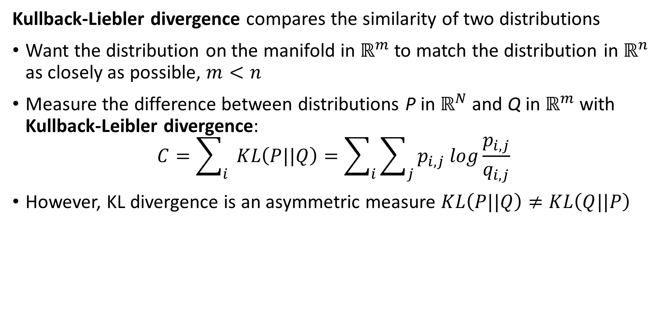
Uniform Manifold Approximation and Projection (UMAP)
Kullback-Liebler divergence compares the similarity of two distributions
Want the distribution on the manifold in $ℝ^{m}$ to match the distribution in $ℝ^{n}$ as closely as possible, $m<n$
Measure the difference between distributions P in $ℝ^{N}$ and Q in $ℝ^{m}$ with Kullback-Leibler divergence:
$$C=\sum_{i}{ }KL\left(P||Q\right)=\sum_{i}{\sum_{j}{p_{i,j} log\frac{p_{i,j}}{q_{i,j}}}}$$
However, KL divergence is an asymmetric measure $KL\left(P||Q\right)≠KL\left(Q||P\right)$

Slide 64
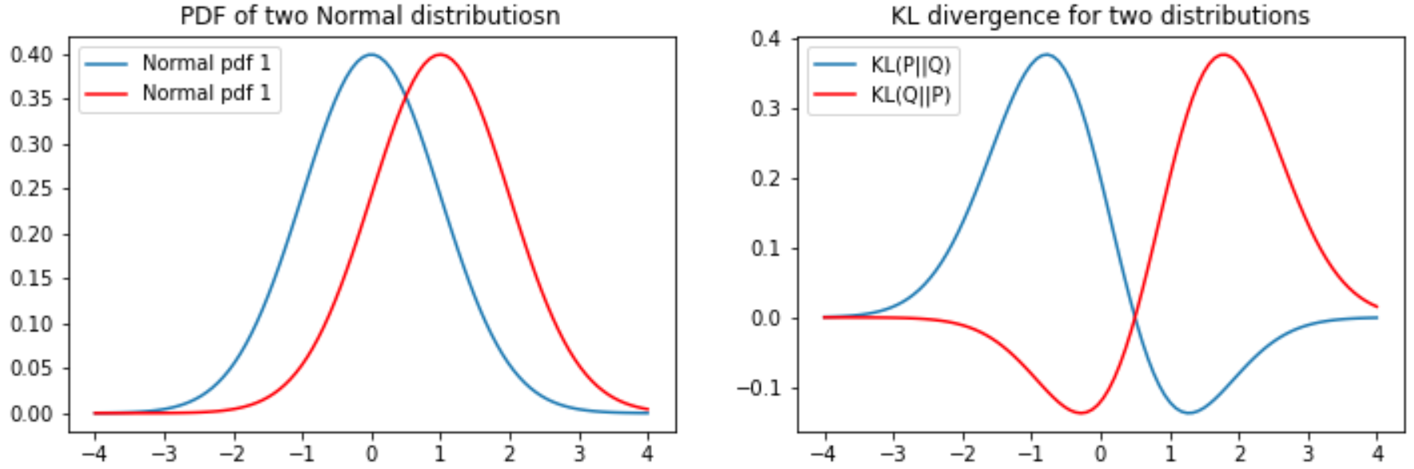
KL Divergence
The KL divergence is asymmetric
For two distributions the KL divergence depend on the order or arguments
Notice that the gradient becomes near zero on one side of the KL function

Slide 65
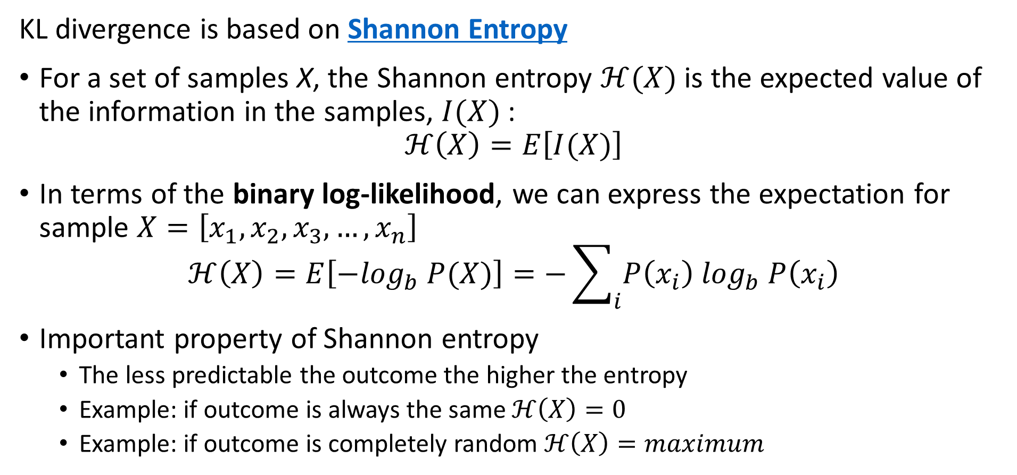
KL Divergence
KL divergence is based on Shannon Entropy
For a set of samples X, the Shannon entropy $ℋ(X)$ is the expected value of the information in the samples, $I(X)$:
$$ℋ\left(X\right)=E\left[I(X)\right]$$
In terms of the binary log-likelihood, we can express the expectation for sample $X=\left[x_{1},x_{2},x_{3},…,x_{n}\right]$
$$ℋ\left(X\right)=E\left[{−log}_{b} P(X)\right]=−\sum_{i}{P\left(x_{i}\right) \log_{b} P\left(x_{i}\right)}$$
Important property of Shannon entropy
  The less predictable the outcome the higher the entropy
  Example: if outcome is always the same $ℋ\left(X\right)=0$
  Example: if outcome is completely random $ℋ\left(X\right)=maximum$

Slide 66
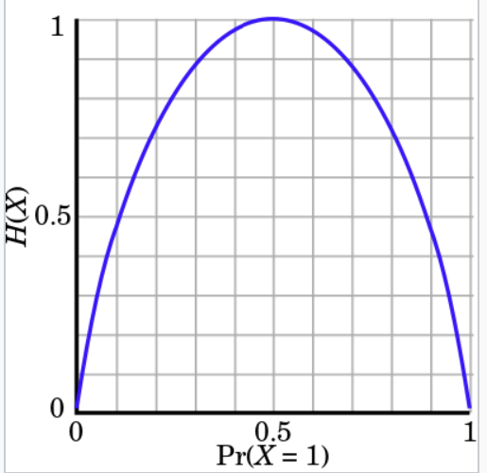
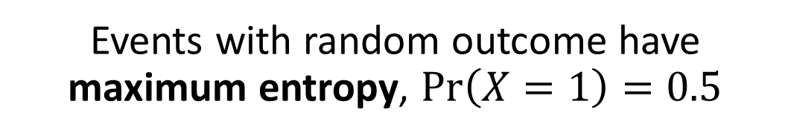
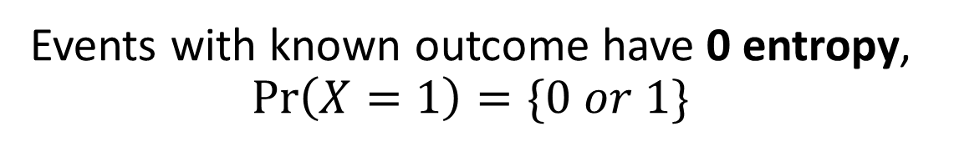
KL Divergence
Events with random outcome have maximum entropy, $\operatorname{Pr}\left(X=1\right)=0.5$
Understanding Shannon Entropy
Example: binomially distributed events
Events with known outcome have 0 entropy, $\operatorname{Pr}\left(X=1\right)=\{0 or 1\}$
Credit: Wikipedia commons

Slide 67
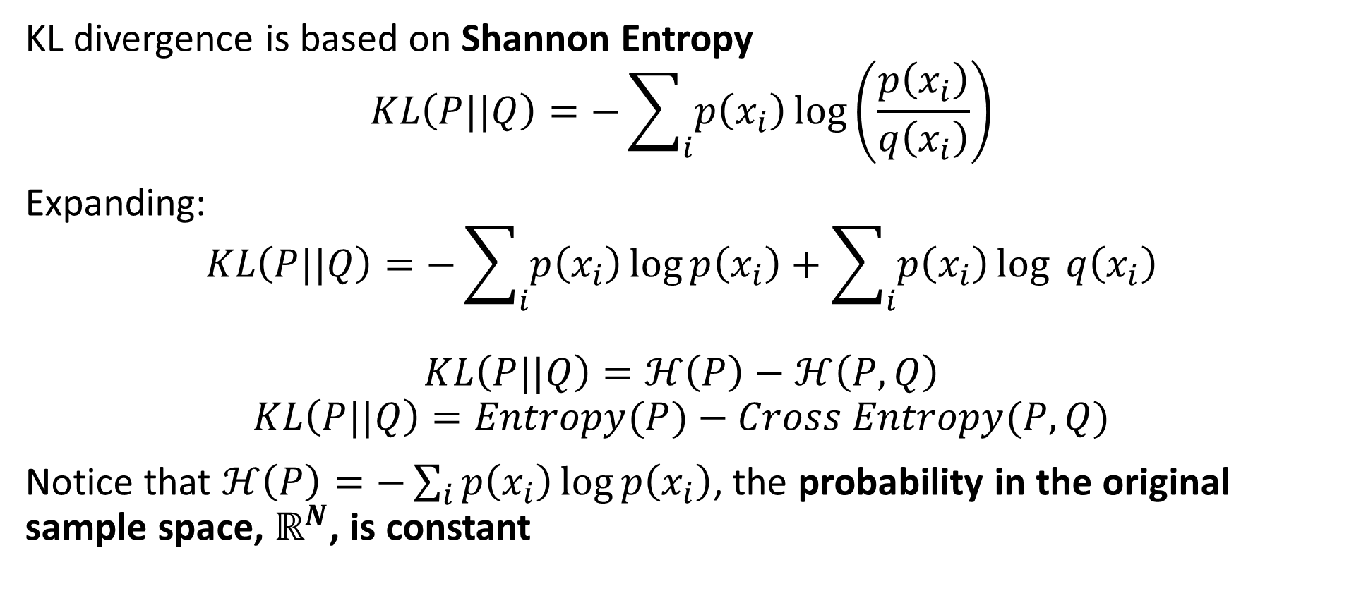
KL Divergence
KL divergence is based on Shannon Entropy
$$KL\left(P||Q\right)=−\sum_{i}{p\left(x_{i}\right)}\log\left(\frac{p\left(x_{i}\right)}{q\left(x_{i}\right)}\right)$$
Expanding:
$$KL\left(P||Q\right)=−\sum_{i}{p\left(x_{i}\right)}\log{p\left(x_{i}\right)}+\sum_{i}{p\left(x_{i}\right)}\log{q\left(x_{i}\right)}$$
$$KL\left(P||Q\right)=ℋ\left(P\right)−ℋ\left(P,Q\right)$$
$$KL\left(P||Q\right)=Entropy(P)−Cross Entropy(P,Q)$$
Notice that $ℋ\left(P\right)=−\sum_{i}{p\left(x_{i}\right)}\log{p\left(x_{i}\right)}$, the probability in the original sample space, $ℝ^{N}$, is constant

Slide 68
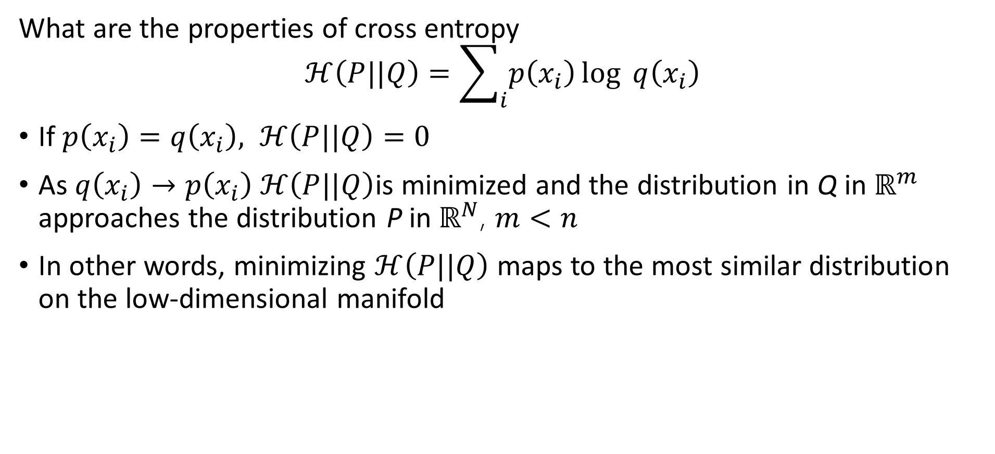
KL Divergence
What are the properties of cross entropy
$$ℋ\left(P||Q\right)=\sum_{i}{p\left(x_{i}\right)}\log{q\left(x_{i}\right)}$$
If $p\left(x_{i}\right)=q\left(x_{i}\right), ℋ\left(P||Q\right)=0$
As $q\left(x_{i}\right)→p\left(x_{i}\right) ℋ\left(P||Q\right)$is minimized and the distribution in Q in $ℝ^{m}$ approaches the distribution P in $ℝ^{N}$, $m<n$
In other words, minimizing $ℋ\left(P||Q\right)$ maps to the most similar distribution on the low-dimensional manifold

Slide 69
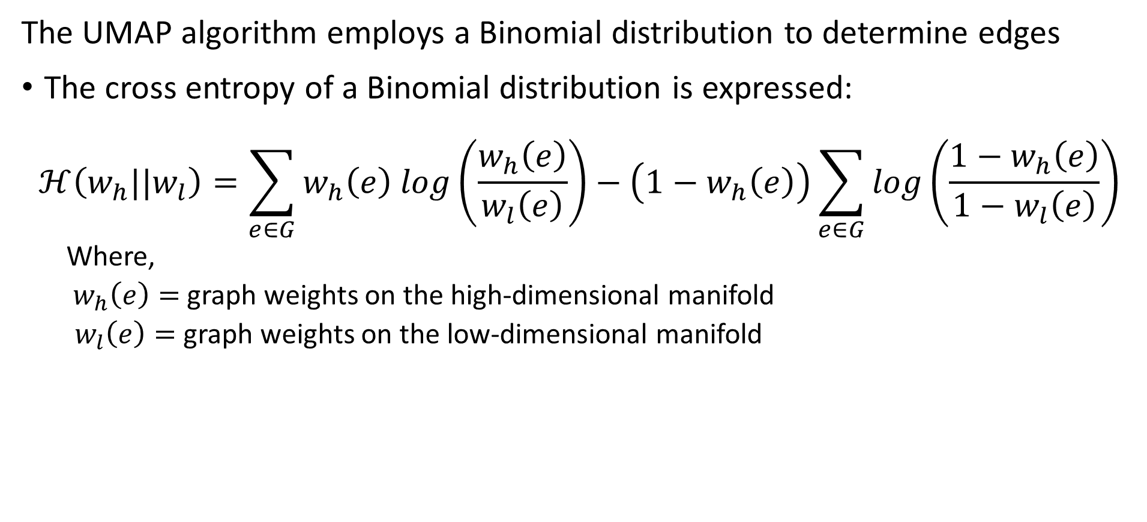
Uniform Manifold Approximation and Projection (UMAP)
The UMAP algorithm employs a Binomial distribution to determine edges
The cross entropy of a Binomial distribution is expressed:
$$ℋ\left(w_{h}||w_{l}\right)=\sum_{e∈G}^{ }{w_{h}\left(e\right) log\left(\frac{w_{h}\left(e\right)}{w_{l}\left(e\right)}\right)−\left(1−w_{h}\left(e\right)\right)\sum_{e∈G}^{ }{log\left(\frac{1−w_{h}\left(e\right)}{1−w_{l}\left(e\right)}\right)}}$$
  Where,
  $w_{h}\left(e\right)=$ graph weights on the high-dimensional manifold
  $w_{l}\left(e\right)=$ graph weights on the low-dimensional manifold

Slide 70
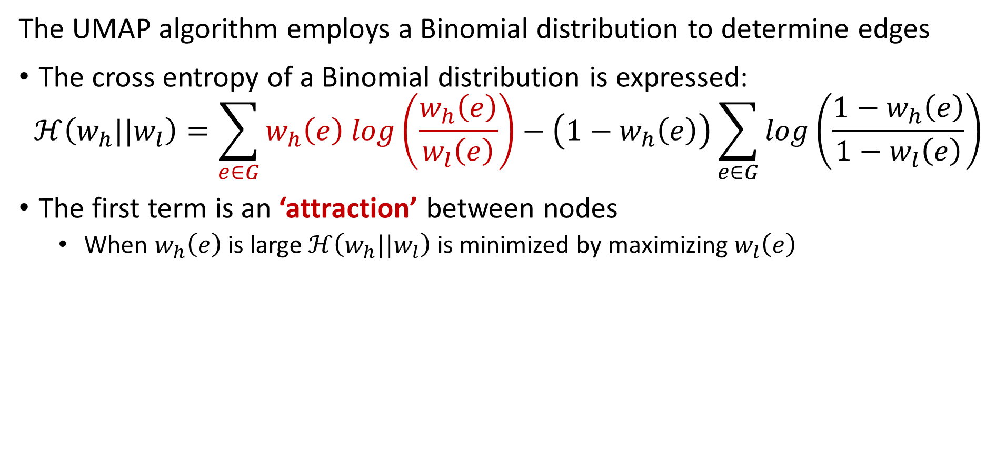
Uniform Manifold Approximation and Projection (UMAP)
The UMAP algorithm employs a Binomial distribution to determine edges
The cross entropy of a Binomial distribution is expressed:
$$ℋ\left(w_{h}||w_{l}\right)=\sum_{e∈G}^{ }{w_{h}\left(e\right) log\left(\frac{w_{h}\left(e\right)}{w_{l}\left(e\right)}\right)−\left(1−w_{h}\left(e\right)\right)\sum_{e∈G}^{ }{log\left(\frac{1−w_{h}\left(e\right)}{1−w_{l}\left(e\right)}\right)}}$$
The first term is an ‘attraction’ between nodes
  When $w_{h}\left(e\right)$is large $ℋ\left(w_{h}||w_{l}\right)$ is minimized by maximizing $w_{l}\left(e\right)$

Slide 71
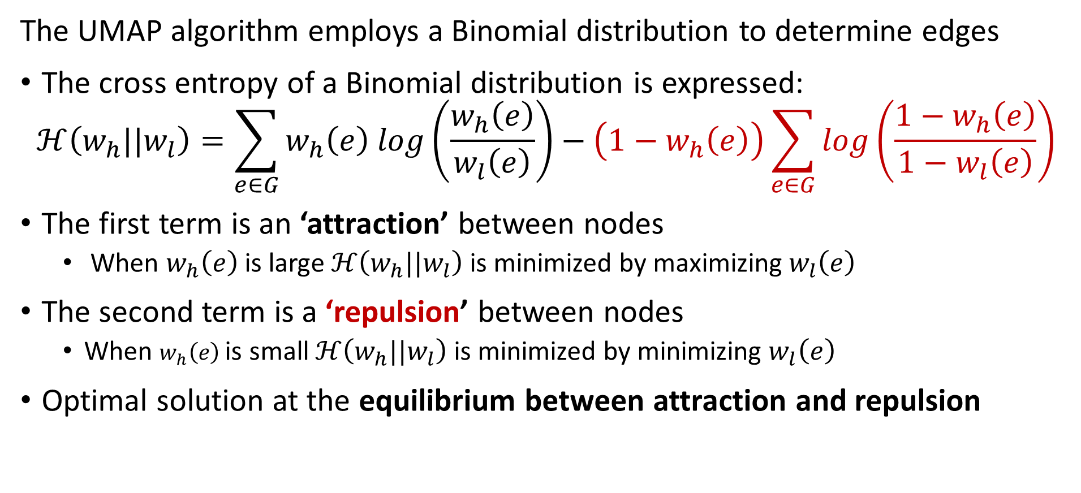
Uniform Manifold Approximation and Projection (UMAP)
The UMAP algorithm employs a Binomial distribution to determine edges
The cross entropy of a Binomial distribution is expressed:
$$ℋ\left(w_{h}||w_{l}\right)=\sum_{e∈G}^{ }{w_{h}\left(e\right) log\left(\frac{w_{h}\left(e\right)}{w_{l}\left(e\right)}\right)−\left(1−w_{h}\left(e\right)\right)\sum_{e∈G}^{ }{log\left(\frac{1−w_{h}\left(e\right)}{1−w_{l}\left(e\right)}\right)}}$$
The first term is an ‘attraction’ between nodes
  When $w_{h}\left(e\right)$is large $ℋ\left(w_{h}||w_{l}\right)$ is minimized by maximizing $w_{l}\left(e\right)$
The second term is a ‘repulsion’ between nodes
  When $w_{h}\left(e\right)$is small $ℋ\left(w_{h}||w_{l}\right)$ is minimized by minimizing $w_{l}\left(e\right)$
Optimal solution at the equilibrium between attraction and repulsion

Slide 72
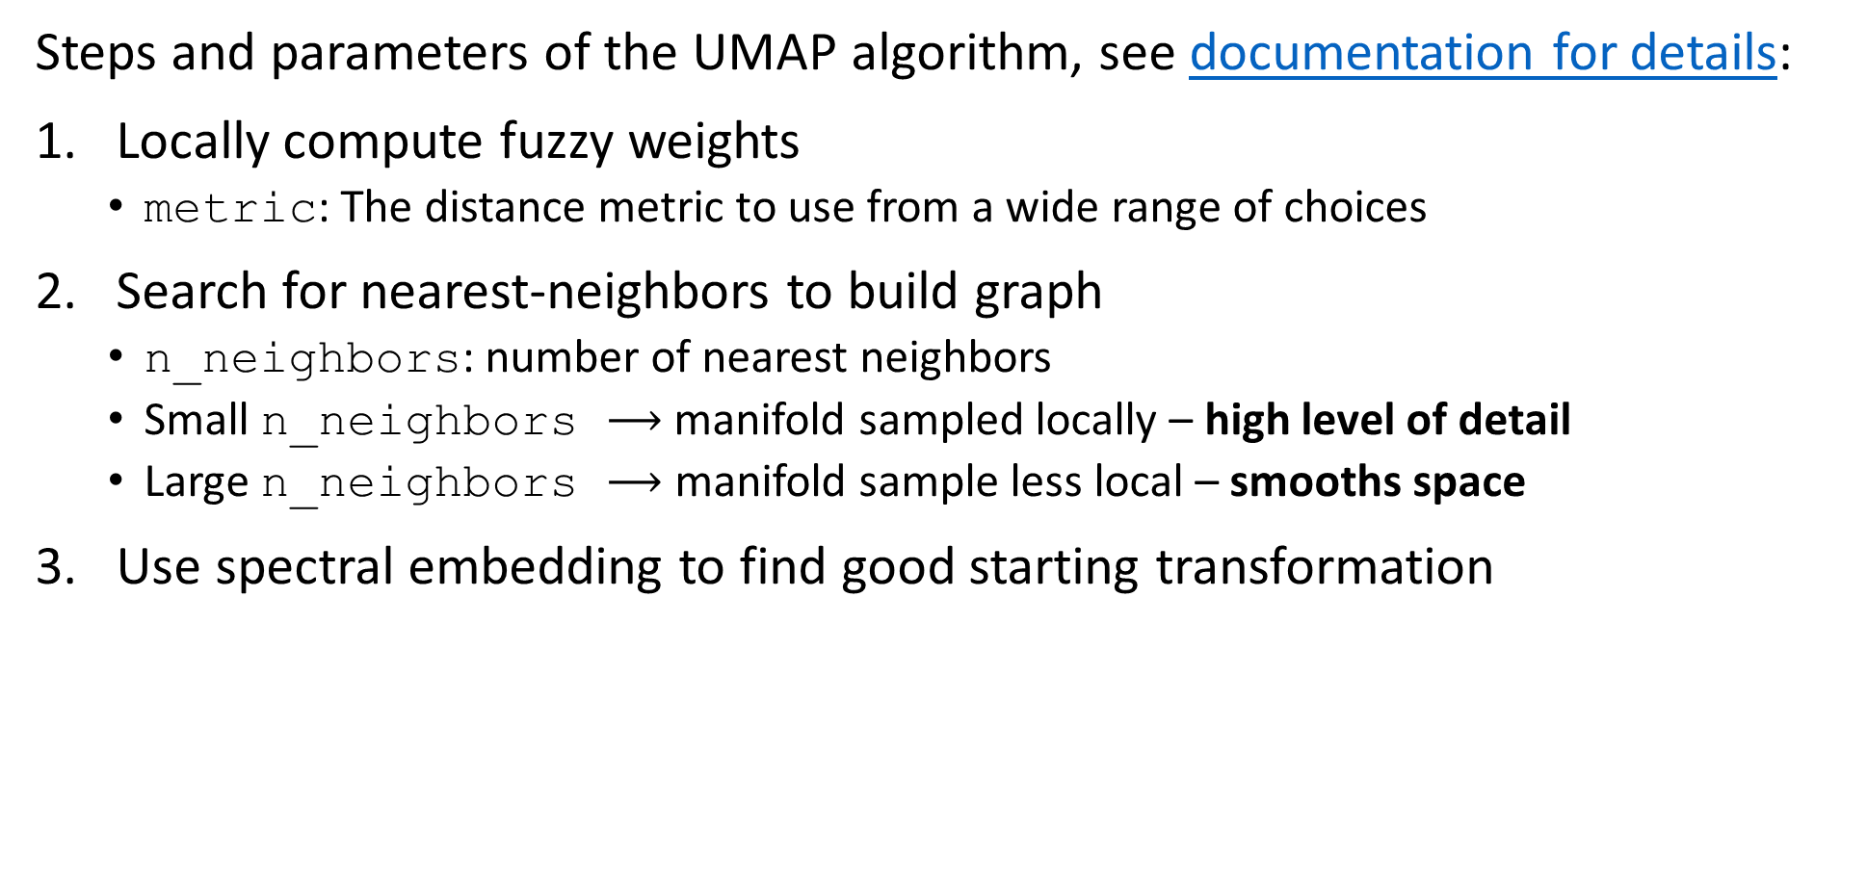
Uniform Manifold Approximation and Projection (UMAP)
Steps and parameters of the UMAP algorithm, see documentation for details:
Locally compute fuzzy weights
  metric: The distance metric to use from a wide range of choices
Search for nearest-neighbors to build graph
  n_neighbors: number of nearest neighbors
  Small n_neighbors $⟶$ manifold sampled locally – high level of detail
  Large n_neighbors $⟶$ manifold sample less local – smooths space
Use spectral embedding to find good starting transformation

Slide 73
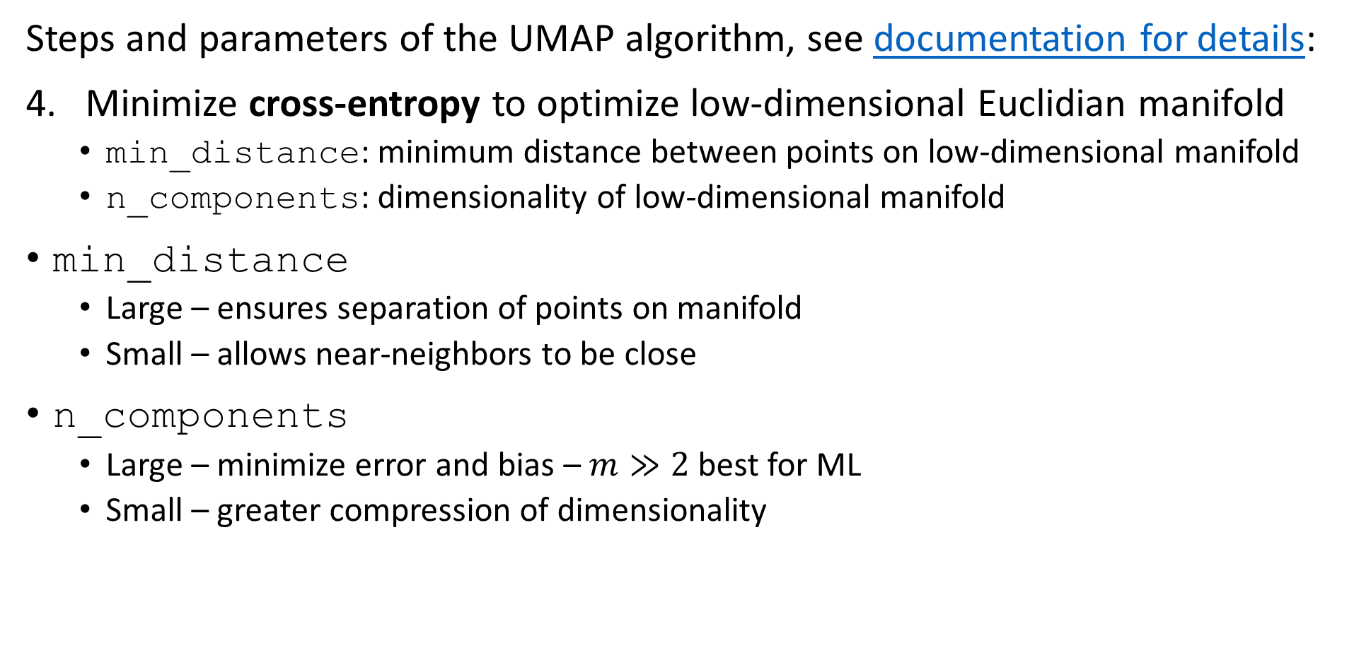
Uniform Manifold Approximation and Projection (UMAP)
Steps and parameters of the UMAP algorithm, see documentation for details:
Minimize cross-entropy to optimize low-dimensional Euclidian manifold
  min_distance: minimum distance between points on low-dimensional manifold
  n_components: dimensionality of low-dimensional manifold
min_distance
  Large – ensures separation of points on manifold
  Small – allows near-neighbors to be close
n_components
  Large – minimize error and bias – $m≫2$ best for ML
  Small – greater compression of dimensionality

Slide 74
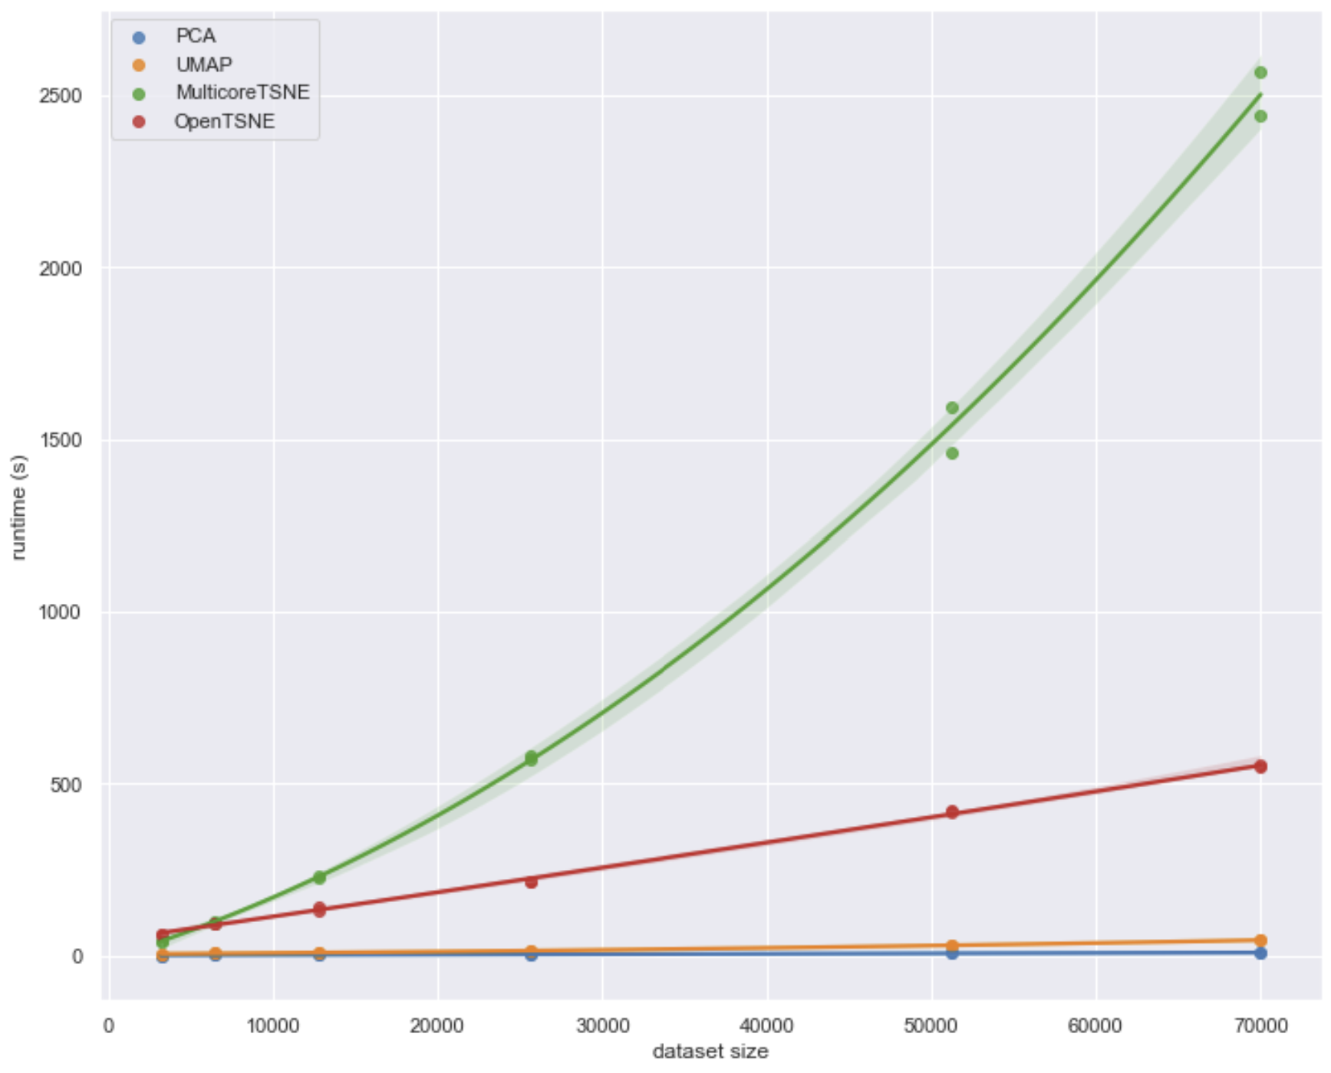
Uniform Manifold Approximation and Projection (UMAP)
How does UMAP performance compare?
UMAP significantly outperforms tSNE
From UMAP documentation, Leland McInnis, 2018

Slide 75
Projection Methods

Slide 76
Random Projection Methods
How can we overcome the curse of dimensionality?
Random projection methods sample random directions
Introduced in several contexts, including by Bingham and Mannila, 2001 and Achliptas, 2001
Alternative to PCA for very high dimensional spaces
Error of the random projection to lower dimensional space is bounded
Distance is therefore preserved
Random projections in Euclidean space tend to create spherical clusters
  Spherical clusters are easier for many algorithms to deal with

Slide 77
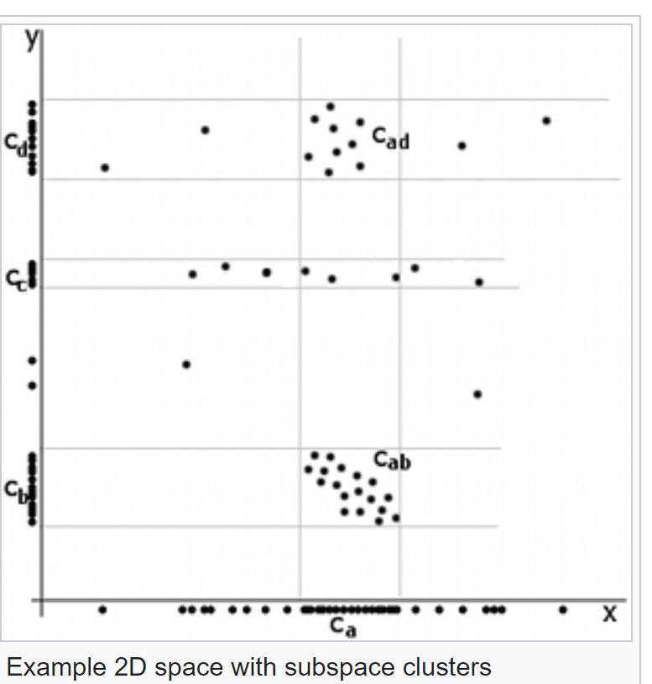
Random Projection Methods
Example of difficult dimensionality reduction
Cluster centers aligned along x axis
Apparent cluster along y axis
No apparent cluster along x axis
Credit Wikipedia commons

Slide 78
Random Projection Methods
Example of difficult dimensionality reduction
Highest variance direction aligned with axis
Eigenvector for largest eigenvalue along axis!
Principal components same as axes
No dimensionality reduction!
First Principal Component
Credit Wikipedia commons
Second Principle Component

Slide 79
Random Projection Methods
Example of difficult dimensionality reduction
  Cluster models will struggle
2 well defined clusters on both components
Cluster with low variance on first component, dispersed along second component - Not a spherical cluster!
First Principal Component
Credit Wikipedia commons
Second Principle Component

Slide 80
Subspace Projection Methods
How can we extend clustering to higher dimensions?
Subspace clustering samples many subspaces to find embedding
Limited scalability since there are infinite possible subspaces
Heuristic, based on downward closure property, improves scalability - addressed in a subsequent lesson
Python subspace clustering package in Chong You’s GitHub repository
We will not pursue this method further here
Random projection methods are a better alternative in many cases

Slide 81
Random Projection Methods
Construct random projection matrix, $R_{N×m}^{ }$, maps k high dimensional samples, $X_{k×N}:$
$${R_{N×m}^{ }: ℝ}^{N}→ℝ^{m}$$
Linear transformation is then
$$Y_{k×m}=R_{N×m}^{ }X_{k×N}$$
What are the properties of $R$?
  Example, let $R$ have values values $\left\{0,1\right\}$
  Elements of Y are linear superposition of projected elements of X
  $$y_{i,j}=\sum_{k}{r_{i,k}}x_{k,j}$$
  If $r_{i,j}=1$ elements in column i of $X_{ }$ are projected to elements in column j of $Y$
  If $r_{i,j}=0$ elements in column i of $X_{ }$ are not projection

Slide 82
Random Projection Methods
Construct random projection matrix, $R_{N×m}^{ }$, maps k high dimensional samples, $X_{k×N}:$
$$Y_{k×m}=R_{N×m}^{ }X_{k×N}$$
How can we construct $R_{N×m}^{ }$?
Original algorithm (Bingham and Mannila, 2001), selectes random directions by sampling Gaussian distribution
  Select Gaussian random unit vector as first row of R
  Select Gaussian random unit vector orthogonal to previously selected rows of R
  Repeat step 2 until R constructed
A probabilistic sampling method
  We have seen probabilistic sampling methods before, count-min-sketch, HyperLogLog, etc.

Slide 83
Random Projection Methods
Construct random projection matrix, $R_{N×m}^{ }$, maps k high dimensional samples, $X_{k×N}$
Original idea (Bingham and Mannila, 2001), selected random directions by sampling Gaussian distribution
Properties of Gaussian random projection
  By construction the projected samples Y in $ℝ^{m}$ are orthogonal
  The projection is normalized and therefore distance preserving
  The sample distribution in $ℝ^{m}$ has the same variance giving spherical clusters
But, the Gaussian random projection algorithm requires application of a Gramm-Schmidt orthogonalization at each step of construction of R
  Algorithm is computationally intensive

Slide 84
Random Projection Methods
How can we efficiently construct $R_{n×m}^{ }$?
Selected random directions by simple probabilistic sampling
Achliptas, 2001 proposed a database scale algorithm
The elements of R are randomly selected with the following probabilities, p:
  $$r_{i,j}=\sqrt{3}×\left\{\begin{aligned}+1, p=1/6 \\ 0, p=2/3 \\ −1, p=1/6\end{aligned}\right.$$
Resulting projection is a reasonable approximation of the Gaussian random projection

Slide 85
Random Projection Methods
The Johnson-Lindenstrauss lemma puts bounds on the error of random projections
For the simple case of a Euclidean space, the Johnson-Lindenstrauss lemma:
  Distance error $0≤ε≤1$
  u$,v$ are sample vectors in the original space, $ℝ^{N}$
  Define a linear map $f():ℝ^{N}→ℝ^{m}$, $N>m$
  The error is then bounded
$$\left(1−ε\right){\left\|u−v\right\|}^{2}≤{\left\|f\left(u\right)−f(v)\right\|}^{2}≤\left(1+ε\right){\left\|u−v\right\|}^{2}$$
The error distance of a random projection,${ Y}_{ }=R_{ }^{ }X$, is bounded by the Johnson-Lindenstrauss lemma

Slide 86
Random Projection Methods
How can we interpret the Johnson-Lindenstrauss lemma?
$$\left(1−ε\right){\left\|u−v\right\|}^{2}≤{\left\|f\left(u\right)−f(v)\right\|}^{2}≤\left(1+ε\right){\left\|u−v\right\|}^{2}$$
Start with the random projection ${f\left( \right): ℝ}^{N}→ℝ^{m}$, or${ Y}_{ }=R_{ }^{ }X$
We want the random projection to be distance preserving
  ${\left\|f\left(u\right)−f(v)\right\|}^{2}$ is the squared Euclidean distance in $ℝ^{m}$
  ${\left\|u−v\right\|}^{2}$ is the squared Euclidean distance in $ℝ^{N}$
  The error is bounded by a factor of $±ε$

Slide 87
Random Projection Methods
What are the implications of the the Johnson-Lindenstrauss lemma for dimensionality reduction?
$$\left(1−ε\right){\left\|u−v\right\|}^{2}≤{\left\|f\left(u\right)−f(v)\right\|}^{2}≤\left(1+ε\right){\left\|u−v\right\|}^{2}$$
After a lot of algebra, relationship between acceptable distance error, $ε$, and reduction to lower dimensional space $ℝ^{m}$ for k samples:
$$m_{min}≥\frac{4 log\left(k\right)}{\frac{ε^{2}}{2}−\frac{ε^{3}}{3}}$$
Notice that random projection cannot work for data where $m_{min}≥N$
Is an exponential trade-off between dimensionality reduction and preserving distance for fixed k

Slide 88


Random Projection Methods
Exponential trade-off between dimensionality reduction and preserving distance
Credit: Scikit-Learn team

Slide 89
Random Projection Methods
How does random projection compare to PCA?
Property | PCA | Random Projection
Preserves distance | Yes | Yes
Complexity | $$O(n^{2})$$ | $$\sim O(n^{ })$$
Minimum number of sample space dimensions | Works for most any sample space, $ℝ^{N}$ | $$m_{min}<N$$
Applicable to high-dimensional spaces | Yes, but slow | Yes
Produces spherical clusters | No | Yes
Projection to orthogonal space | Yes | Yes
Works for nonlinear spaces | Yes, kernel PCA | Using tensor projection
Works on aligned clusters | No | Yes

Slide 90
Summary

Slide 91
Summary
Dimensionality reduction is widely used in data mining
Review of high-dimensional spaces and the Curse of Dimensionality
PCA and SVD are efficient linear algorithms
  Find linear projections to lower dimensional hyperplane
  SVD applied directly to rectangular model matrix, no need to compute covariance matrix
Manifold learning for nonlinear dimensionality reduction and visualization in high dimensions
  Project to low dimensional manifold
  Can be distance preserving
  UMAP is (arguably) the state-of-the-art manifold learning algorithm

