Slide 1

Introduction to Nonparametric Bootstrap Methods
Steve Elston
Copyright 2018, 2019, 2020, 2021, 2022, 2023 2024, Stephen F Elston. All rights reserved.

Slide 2
Introduction
“There were others who had forced their way to the top from the lowest rung by the aid of their bootstraps.” James Joyce, ‘Ulysses’ 1922
Bootstrap and re-sampling methods are widely applicable statistical methods
Resampling methods are products of the computer age
Use computational resources unavailable until late 20th Century
Repeatedly re-sampling the data using nonparametric model relaxes some assumptions of classical statistical methods
Re-sampling methods draw heavily on the law of large numbers and the central limit theorem

Slide 3
Types of Resampling Methods
Commonly used re-sampling methods include:
Randomization or Permutation methods: aka exact tests
Have a long history; e.g. Fisher’s exact test (1922)
Practical approximate algorithms for larger data sets in computer era
Cross validation: resample into multiple folds without replacement
Leave n out method
Has origins in the 1950s
Widely used to evaluate machine learning (ML) models
Jackknife: leave one out re-sampling
Leave one out method
Early general purpose resampling method
Has origins in the 1950s
Nonparametric Bootstrap: resample with equivalent size and replacement - our focus here
Published by Prof Brad Efron in 1979

Slide 4
Nonparametric vs. Parametric Statistical Model
Many familiar statistic models are parametric, being based on a assumed likelihood model
Likelihood models based on a parametric distributions
Parametric models have lower variance estimates for statistics
But susceptible to poor choice of likelihood model
Example, least-squares error model uses a Normal likelihood
Parameters must be estimated
Location and scale in one-dimension
Betas and covariance in higher dimensions

Slide 5
Nonparametric vs. Parametric Statistical Model
Nonparametric model not based on a parametric likelihood
Use an empirical distribution estimated from observations
Statistical properties estimated from empirical distribution
Example, mean, variance, correlation, and ratio estimates
Potentially high variance estimates
Need sufficient sample size
Examples of nonparametric statistical estimators:
Permutation tests
Jackknife estimates
Nonparametric bootstrap – today’s topic

Slide 6
General Characteristics of Nonparametric Resampling Methods
Compute statistics with continuous derivatives from data samples
Repeatedly compute statistics from multiple resamples of dataset
The result converges to the sample distribution of the statistic being computed
Make minimal distributional assumptions, when compared to classical frequentist statistics

Slide 7
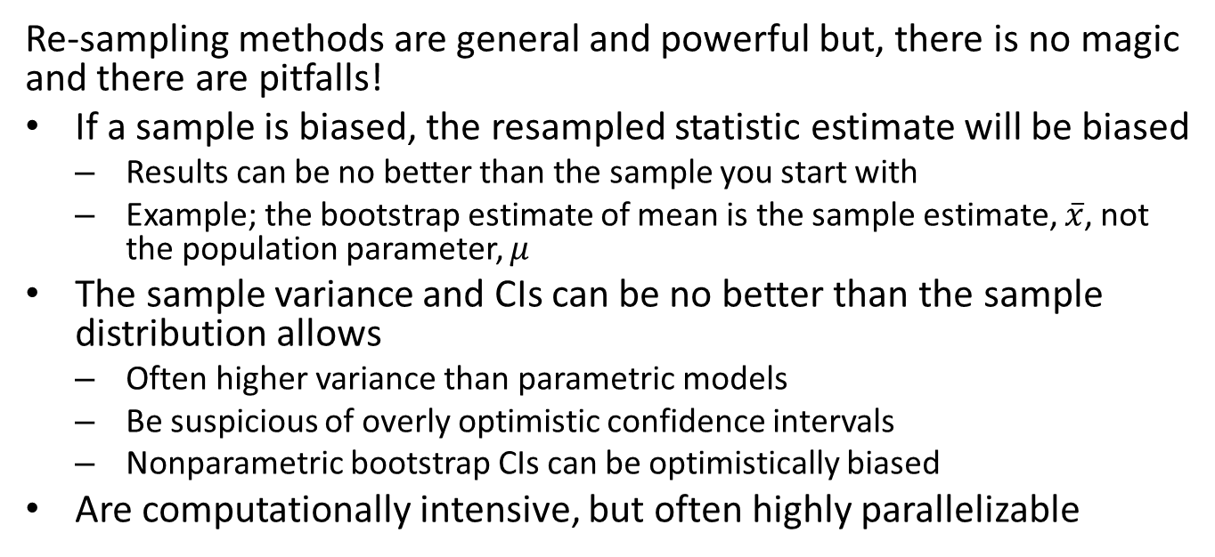
Pitfalls of Resampling Methods
Re-sampling methods are general and powerful but, there is no magic and there are pitfalls!
If a sample is biased, the resampled statistic estimate will be biased
Results can be no better than the sample you start with
Example; the bootstrap estimate of mean is the sample estimate, $\overset{‾}{x}$, not the population parameter, $μ$
The sample variance and CIs can be no better than the sample distribution allows
Often higher variance than parametric models
Be suspicious of overly optimistic confidence intervals
Nonparametric bootstrap CIs can be optimistically biased
Are computationally intensive, but often highly parallelizable

Slide 8
Point Estimates vs. Distribution Estimates
The goal of frequentist statistics is to compute a point estimate and confidence interval
Point estimate is the single most likely value for a statistic
Confidence interval expresses the uncertainty of the point estimate
Parametric confidence intervals are based on the properties of some assumed probability distribution
Are there alternatives to this classical frequentist approach?
Here we focus on nonparametric bootstrap methods which have no explicit probability model

Slide 9
Bootstrap Distribution
Rather than computing a point estimate directly, bootstrap methods compute a bootstrap distribution of a statistic
Bootstrap distribution comprises values of a statistic computed from bootstrap resamples of the original observations
Computing bootstrap distribution requires no assumptions about sample distribution!
Bootstrap resampling substitutes computer power for paper and pencil statistician power
Bootstrap resampling estimates the bootstrap distribution of a statistic
Compute mostly likely point estimate of the statistic, or bootstrap estimate
The bootstrap confidence interval is computed from the bootstrap distribution

Slide 10
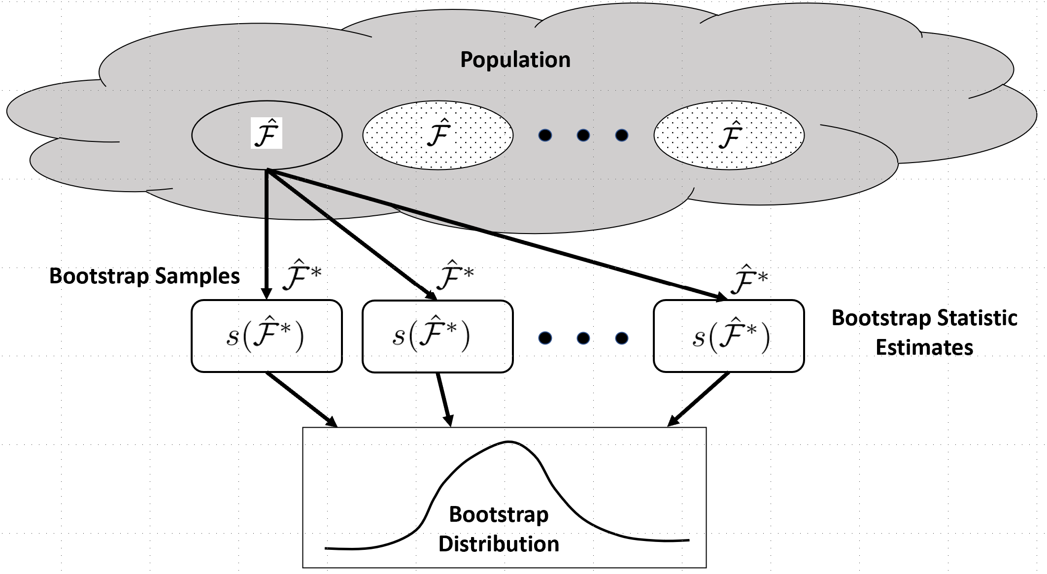
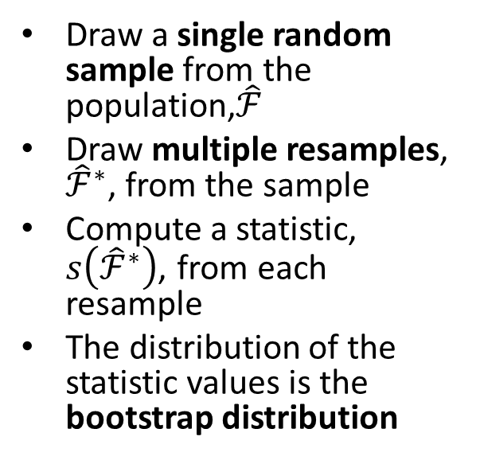
Bootstrap Distribution
Rather than repeatedly resample the population, bootstrapping repeatedly resamples an original sample
Draw a single random sample from the population,$\hat{ℱ}$
Draw multiple resamples, ${\hat{ℱ}}^{∗}$, from the sample
Compute a statistic, $s\left({\hat{ℱ}}^{∗}\right)$, from each resample
The distribution of the statistic values is the bootstrap distribution
Resampling estimates the bootstrap distribution of a statistic

Slide 11
One Sample Bootstrap Algorithm
The bootstrap distribution is accumulated by this simple algorithm:
From the n original observations, Bernoulli sample with replacement and sample size n
Resample is the same size as the original data sample!
Compute the statistic from the resample
Repeat steps 1 and 2 to accumulate the required number of bootstrap samples of the statistic
The mean of the bootstrap distribution is the bootstrap point estimate of the statistic

Slide 12


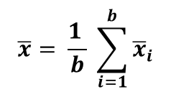


One Sample Bootstrap Algorithm
1
2
3
4
5
6
7
8
9
10
Data sample
s₁
s₂
8
7
4
7
1
1
3
2
8
1
${\overline{x}}_{1}$
b Bootstrap
Resamples with replacement, s_{i}
s₃
9
6
2
4
7
5
3
2
1
1
${\overline{x}}_{2}$
b Mean
Estimates, x_{i}, form bootstrap distribution
s_{b}
2
4
6
9
10
10
7
2
1
3
${\overline{x}}_{3}$
10
4
1
9
7
3
3
2
10
8
${\overline{x}}_{b}$
$${\overline{x}= \frac{1 }{b} \sum_{i=1}^{b}{{\overline{x}}_{i}}}_{ }$$
Bootstrap Mean Point Estimate
Outline of bootstrap resampling algorithm to compute mean

Slide 13
Propoerties of the Bootstrap Algorithm
Properties of the nonparametric bootstrap
By law of large numbers, bootstrap point estimate of a statistic converges to the population value
Larger number of resamples gives better estimate of bootstrap distribution
Efrom and Tibshirani (1993) and Efron and Hasti (2016) recommend using at least 200 bootstrap samples for point estimates
More recently authors recommend a larger number (e.g. 1,000-10,000) of resamples given low computer cost

Slide 14
Example; One Sample Bootstrap
Use sample of standardized scores of high school students
Dataset HSB2 is from the UCLA Institute for Digital Research & Education - Statistical Consulting ## id female race ses schtyp prog read write math science socst ## 70 0 4 1 1 1 57 52 41 47 57 ## 121 1 4 2 1 3 68 59 53 63 61 ## 86 0 4 3 1 1 44 33 54 58 31 ## 141 0 4 3 1 3 63 44 47 53 56 ## 172 0 4 2 1 2 47 52 57 53 61 ## 113 0 4 2 1 2 44 52 51 63 61 ## 50 0 3 2 1 1 50 59 42 53 61 ## 11 0 1 2 1 2 34 46 45 39 36 ## 84 0 4 2 1 1 63 57 54 58 51 ## 48 0 3 2 1 2 57 55 52 50 51

Slide 15
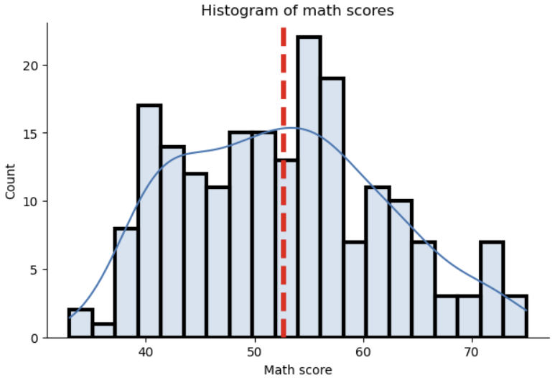
Example; One Sample Bootstrap
Histogram of the math scores

Slide 16
Example; One Sample Bootstrap
Function to compute single sample bootstrap estimate of statistic
def bootstrap_statistic(x, b, statistic): ''' Function Computes b one-sample bootstrap estimates of data x using statistic function. ''' n_samps = len(x) boot_vals = [] for _ in range(b): ## The heavy work is done here. The statistic is computed ## using the bootstrap sample of the observations boot_vals.append(statistic(nr.choice(x, size=n_samps, replace=True))) boot_estimate = np.mean(boot_vals) print('Bootstrap point estimate = {:6.2f}'.format(boot_estimate)) return(boot_estimate, boot_vals) bootstrap_mean_estimate, boot_means = bootstrap_statistic(math, 200, np.mean)
## Bootstrap point estimate = 52.63
Iterate over number of bootstrap resamples
Append to list of bootstrap resamples
Compute bootstrap statistic

Slide 17
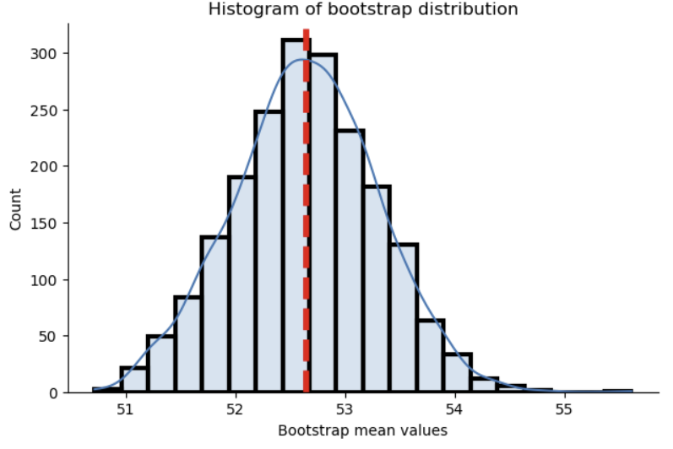
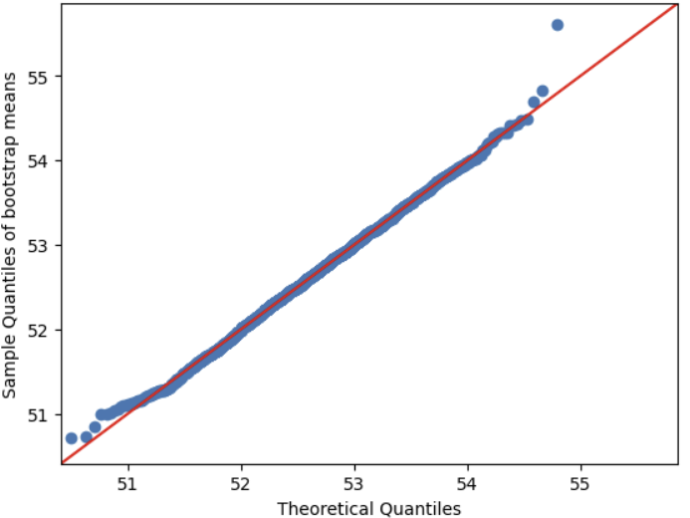
Example; One Sample Bootstrap
Distribution of 2000 bootstrap samples of mean estimate of math scores
## bootstrap point estimate = 52.64
Notes:
0

Slide 18
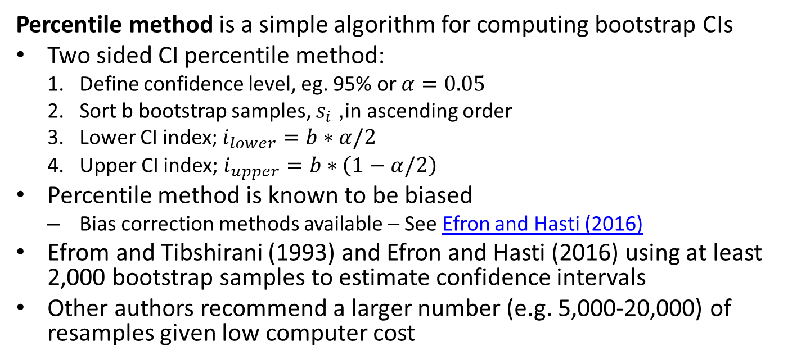
Bootstrap Confidence Intervals
Percentile method is a simple algorithm for computing bootstrap CIs
Two sided CI percentile method:
Define confidence level, eg. 95% or $α=0.05$
Sort b bootstrap samples, $s_{i}$, in ascending order
Lower CI index; $i_{lower}=b∗α/2$
Upper CI index; $i_{upper}=b∗\left(1−α/2\right)$
Percentile method is known to be biased
Bias correction methods available – See Efron and Hasti (2016)
Efrom and Tibshirani (1993) and Efron and Hasti (2016) using at least 2,000 bootstrap samples to estimate confidence intervals
Other authors recommend a larger number (e.g. 5,000-20,000) of resamples given low computer cost

Slide 19
Bootstrap Confidence Intervals
Bootstrap confidence intervals are known to be biased!
Often bootstrap CIs are overly optimistic
Bias can be significant for asymmetric distributions
In practice, bias correction can be applied – See Efron and Hasti (2016)

Slide 20
Why Not Just Use a One-Sample t-test?
A one-sample t-test is strictly valid for Normal distributions
One-sample t-test can be run quickly and with little code
Do we care if the distribution of the sample Normal?
By the CLT we know the sampling distribution of the mean estimate is Normal
The bootstrap distribution works for the sample distribution of any statistic

Slide 21
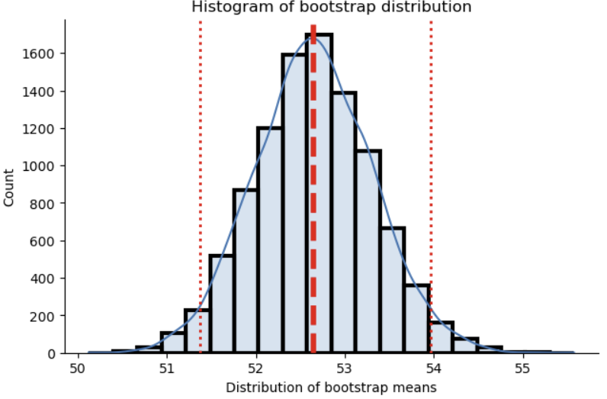
Example; One Sample Bootstrap
Bootstrap distribution of 10000 mean estimates of Math score with confidence intervals
## bootstrap point estimate = 52.64
## At alpha = 0.05, lower and upper bootstrap confidence intervals = 51.38 53.96

Slide 22
Example; One Sample Bootstrap
How can we interpret this result?
## bootstrap point estimate = 52.64
## At alpha = 0.05, lower and upper bootstrap confidence intervals = 51.38 53.96
The limits of the CI have the same sign and the CI does not include 0
With 95% confidence we can say the mean is significantly different from 0
We can reject the null hypothesis that the mean is 0

Slide 23
Two Sample Bootstrap
How can we apply the bootstrap algorithm for two-sample statistics?
Example, difference of means of two independently sampled populations
How to generate bootstrap samples?
Can we just sample the concatenation of the two samples?
No!
There is no guarantee of a correct number of resamples for each group
Imbalanced sampling leads to bias
Must independently resample the two sets of observations
Compute the statistic from the two independent resamples

Slide 24
Two Sample Bootstrap Algorithm
Example: algorithm to compute difference of means:
From original observations of length n and m, Bernoulli sample n and m values respectively with replacement
The number of resamples for each set of observations is the number of samples in each set of observations
Compute the two-sample statistic; e.g. difference of means
Repeat steps 1 and 2 to accumulate the required number of bootstrap samples
The mean of the bootstrap distribution is the bootstrap point estimate of the two-sample statistic

Slide 25
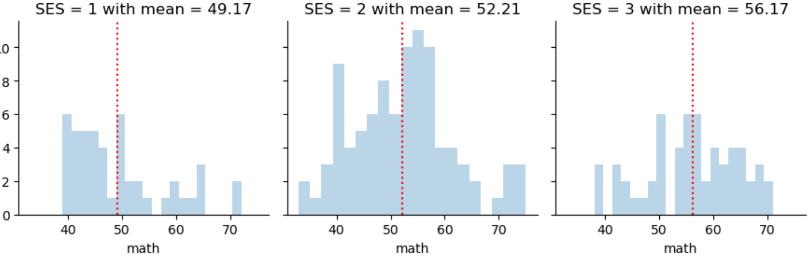
Example, Two Sample Bootstrap
Example; find the bootstrap distribution of the difference in math scores of different SES students
Is this difference statistically significant?

Slide 26
Example, Two Sample Bootstrap
def two_boot_two_stat(sample_1, sample_2, b, statistic_1, two_samp_statistic): ''' Function computes two sample and two statistic bootstrap estimate. - sample_1 and sample_2, independent obervation vectors - b, number of bootstrap samples to compute - statistic 1, statistic applied to the two independent bootstrap samples - two_sample_statistic, statistic applied to the independent bootstrap statistics ''' two_boot_values = [] n_samps_1 = len(sample_1) n_samps_2 = len(sample_2) for _ in range(b): ## Heavy lisfting is done here. First, the two independent bootstrap estimates ## are computed from independent bootstrap resamples. Second, the statistic ## of the two bootstrap estimates is computed. boot_estimate_1 = statistic_1(nr.choice(sample_1, size=n_samps_1, replace=True)) boot_estimate_2 = statistic_1(nr.choice(sample_2, size=n_samps_2, replace=True)) two_boot_values.append(two_samp_statistic(boot_estimate_1, boot_estimate_2)) boot_estimate = np.mean(two_boot_values) print('bootstrap point estimate = {:6.2f}'.format(boot_estimate)) return(boot_estimate, two_boot_values)
Iterate over number of bootstrap resamples
Draw resamples independently from both samples and Append to lists of bootstrap samples
Compute bootstrap statistic

Slide 27
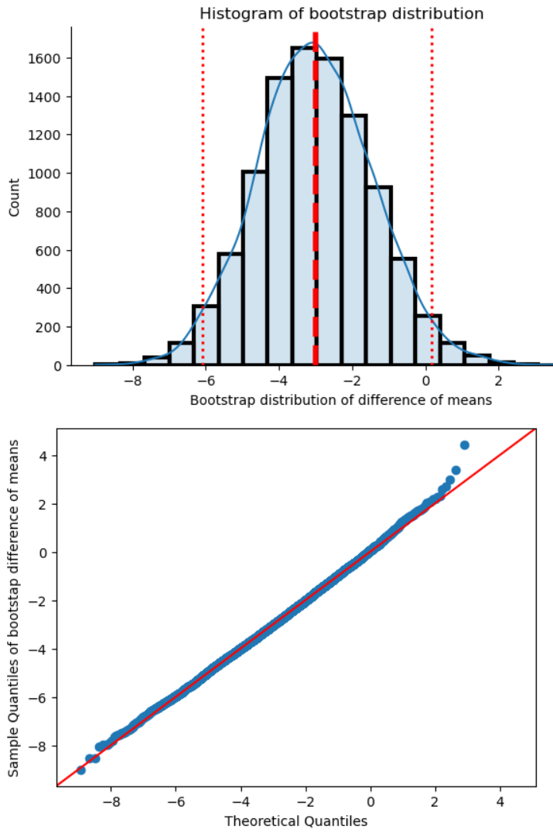
Example, Two Sample Bootstrap
Compute and display the bootstrap distribution of the difference of means
Test significance of Math scores for low and medium SES students
10000 bootstrap samples of difference of means
## bootstrap point estimate = -3.01
## At alpha = 0.05, lower and upper bootstrap confidence intervals = -6.08 0.18

Slide 28
Example, Two Sample Bootstrap
How can we interpret this result?
## bootstrap point estimate = -3.01
## At alpha = 0.05, lower and upper bootstrap confidence intervals = -6.08 0.18
The CI limits have opposite signs and the CI includes 0
Within 95% confidence we cannot say there is a significant difference in means
We cannot reject the null hypothesis!

Slide 29
Why Not Just Use a Two-Sample t-test?
A two-sample t-test is strictly valid for Normal distributions
The difference of means is clearly Normally distributed, per the CLT!
But other statistics do not have Normal distributions
Can try to find specialized tests and validate assumptions
Or just bootstrap!

Slide 30
Summary
Bootstrap estimation is widely useful and requires minimal assumption
Bootstrap distribution comprises values of a statistic computed from bootstrap resamples of the original observations (data sample)
Computing bootstrap distribution requires no assumptions about population distribution!
Bootstrap resampling substitutes computer power for paper and pencil statistician power
Bootstrap resampling estimates the bootstrap distribution of a statistic
Compute point estimate of the statistic, or bootstrap estimate
Compute bootstrap confidence interval from the bootstrap distribution

Slide 31
Summary
There are several variations of the basic nonparametric bootstrap algorithm
One sample bootstrap
Inference on single population
One sample statistics
Two sample bootstrap
Inference on different populations
Two sample statistics
Special cases
Correlation coefficients - part of your assignment

Slide 32
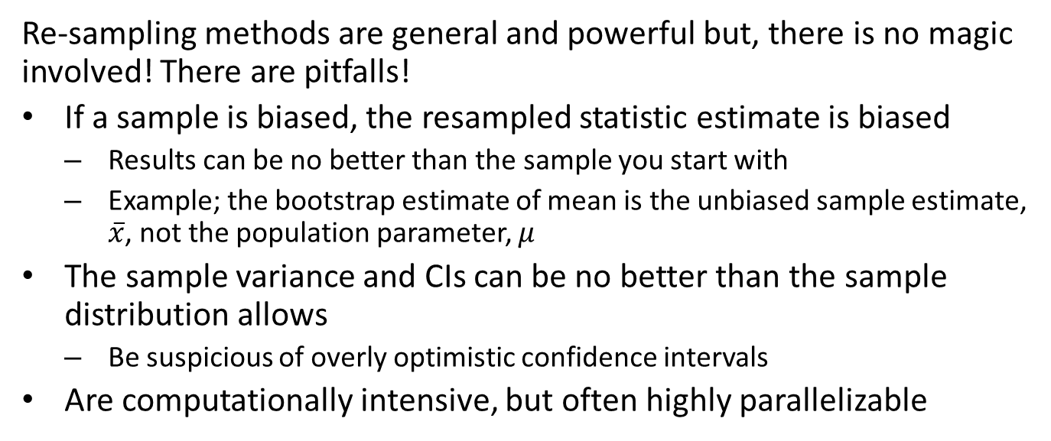
Summary
Re-sampling methods are general and powerful but, there is no magic involved! There are pitfalls!
If a sample is biased, the resampled statistic estimate is biased
Results can be no better than the sample you start with
Example; the bootstrap estimate of mean is the unbiased sample estimate, $\overset{‾}{x}$, not the population parameter, $μ$
The sample variance and CIs can be no better than the sample distribution allows
Be suspicious of overly optimistic confidence intervals
Are computationally intensive, but often highly parallelizable

