Slide 1

CSCI E-83 Perception for Scientific Visualization
Steve Elston
Copyright 2018, 2019, 2020, 2021, 2022, 2023 2024, 2025, 2026, Stephen F Elston. All rights reserved.

Slide 2
Why This Course?
21st Century datasets are large and complex
Complexity is harder to address than size
Complexity makes understanding of relationships in data difficult
Understanding is addressed with modern computer-intensive methods
Our focus is on the big ideas of computer-intensive statistical inference and data analysis arising in the late 20th and early 21st Centuries

Slide 3
Why This Course?
Data science is the science of understanding data
Complexity makes understanding the difficult part of data science!
Statistics is the science of making principled inferences from data
Inference leads to understanding
Understanding is essential for discovery
Inference is becoming harder as dataset complexity increases
Can’t we just use an LLM?
No!
LLMs are generative models not inferential models
LLMs and other AI models cannot produce understanding!

Slide 4
Why This Course?
What is the difference between statistical inference and predictive analytics?
Inference and prediction closely related
Prediction is the domain of machine learning; the easier part
Goal is accurate predictions
Prediction is a form of inference
Predictive inference does not quantify uncertainty
Prediction does not require any particular understanding of the domain or features used

Slide 5
Why This Course?
What is the difference between statistical inference and predictive analytics?
Statistical inference seeks to make discoveries by applying statistical models
Requires a combination of modeling and domain knowledge
Seek to understand changes in response to changes in independent variables
Quantify uncertainty in model parameter estimates
We focus on inference in this course
This is not machine learning and prediction course!

Slide 6
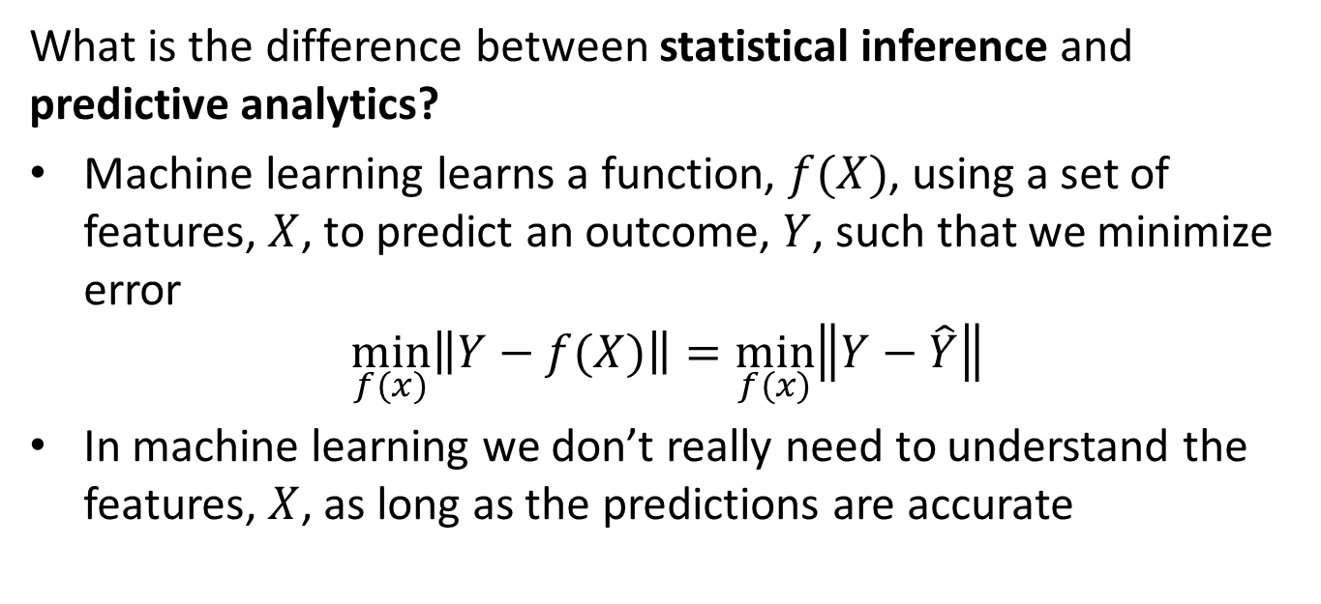
Why This Course?
What is the difference between statistical inference and predictive analytics?
Machine learning learns a function, $f(X)$, using a set of features, $X$, to predict an outcome, $Y$, such that we minimize error
$$\min_{f(x)}\left\|Y−f(X)\right\|=\min_{f(x)}\left\|Y−\hat{Y}\right\|$$
In machine learning we don’t really need to understand the features, $X$, as long as the predictions are accurate

Slide 7
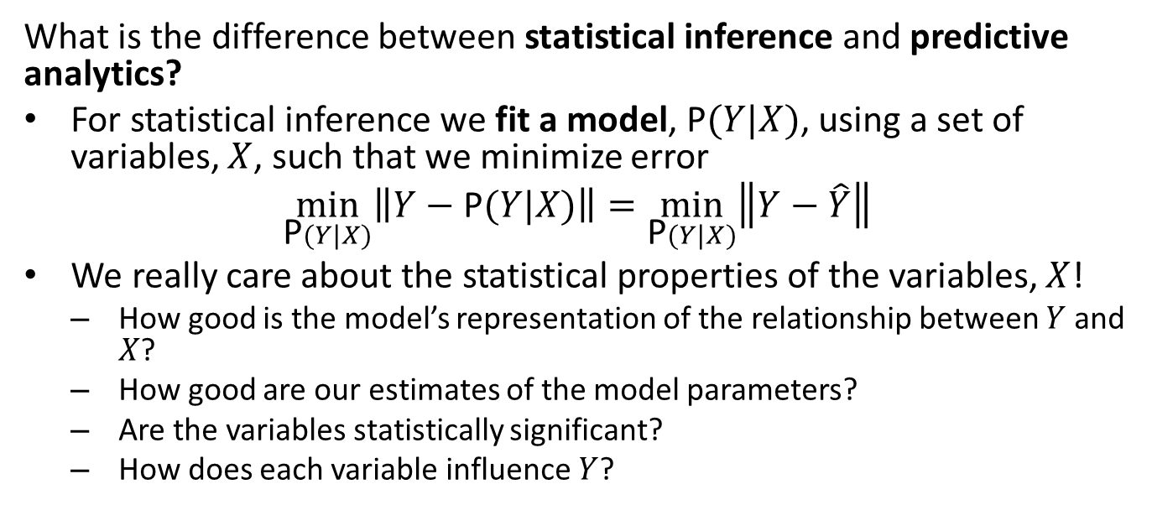
Why This Course?
What is the difference between statistical inference and predictive analytics?
For statistical inference we fit a model, P$(Y|X)$, using a set of variables, $X$, such that we minimize error
$$\min_{\text{P}(Y|X)}\left\|Y−\text{P}(Y|X)\right\|=\min_{\text{P}(Y|X)}\left\|Y−\hat{Y}\right\|$$
We really care about the statistical properties of the variables, $X$!
How good is the model’s representation of the relationship between $Y$ and $X$?
How good are our estimates of the model parameters?
Are the variables statistically significant?
How does each variable influence $Y$?

Slide 8
What We’ll Cover
Our focus is on the big ideas of computer-intensive statistical inference arising in the late 20th and early 21st Centuries
Exploratory data analysis (EDA) to understand relationships in big complex data sets
Linear models as a basis of inference
Non-Normal response models
Models for messy data, zero-inflation, over-dispersion, missing data, outliers
Properties of time series for data with serial correlation
Computer intensive resampling methods for building models and perfoming inference, Bootstrapping and MCMC Bayes
Bayesian hierarchical models for complex relationships
Causal inference for discovery of key effects

Slide 9
Main topics in this course
Our focus is on the big ideas of computer-intensive statistical inference arising in the late 20th and early 21st Centuries
2. Cis and Bootstrap resampling
3. Linear Models
6. Bayesian Models
11. Graphical Models
Foundations
4. Non-normal response models
9. Serial correlation of errors and values
1. EDA and Visualization
7. MCMC algorithms
Methods
5. Methods for messy data
6. Models for seasonality
12. Causal inference
10. Time series models
8. Hierarchical Bayes Models
Analyses

Slide 10
Course Objectives
This fast-moving survey course helps build your toolbox for modeling complex data
Apply a broad understanding of the theoretical and methodological basis of inference in data science
Understanding data relationships and inference
Statistical evaluation of models and model parameters
What confidence should have in our inferences?
Develop skills to explore data and model results
Understand methods to model complex and messy datasets

Slide 11
Course Organizartion

Slide 12

About your Instructor: Steve Elston
Instructor for Harvard since 2017
Data science consultant with several decades of experience
Lead team that commercialized Bell Labs S, now opensource R
Company co-founder and held executive positions in several industries
Creator of multiple edX courses, author of books and articles
Inventor on 5 patents
BS, physics and math (minor), University of New Mexico
MS and PhD, geophysics, Princeton University – John von Neuman Supercomputing Fellow
I love anything to do with natural history and the outdoors

Slide 13

Teaching Assistant: Melahat Tayli
Academic foundation in Chemistry (BSc, MSc)
PhD in Polymer Engineering & Science
Transitioned into Data Science; completing ALM in Data Science at Harvard Extension School (Feb 2026)
6 years of research experience in academia & industry
Enjoys creating supportive, engaging, and student-centered learning environments

Slide 14

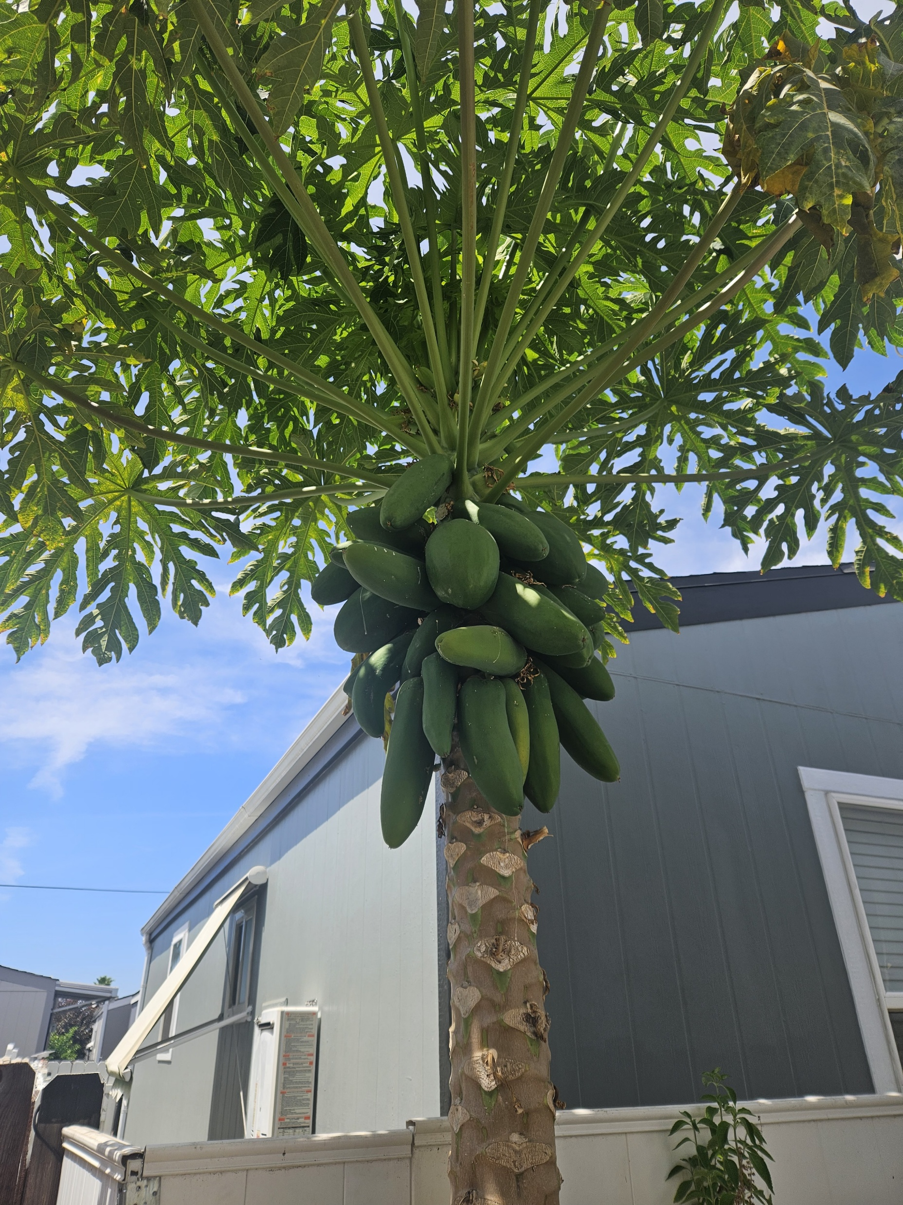
Teaching Assistant: Waree Protprommart
Capstone Project: Bird Flu Early Detection
A.L.M. Student in Data Science at HES
B.S. in Biology from Mount Saint Mary’s University
Substitute teaching K-12 part-time for STEM subjects
Worked as a research technician at the California Institute of Technology
Interned at the UCLA School of Engineering, researching robotic arm hand signal detection, & at the Valley Presbyterian Hospital Analyst Team.
Hobbies: Surfing, Hiking, Camping, Gardening, Zumba, & Dance.

Slide 15
Grading: Undergraduate
Activity | Grade weight
Participation (graded discussions) | 10%
Assignments | 90%

Slide 16
Grading: Graduate
Activity | Grade weight
Participation (graded discussions) | 10%
Assignments | 60%
Independent project proposal | 5%
Independent project report | 25%

Slide 17
Assignments
Hands-on assignments tie theory to practice applied to data examples
Most of us only recall methods we actually use
12 assignments provide hands-on experience
Lectures provide introduction only
Expect to work out some details
Do not hesitate to ask for help on concepts or coding!!
It is okay to display code and exception messages in your public Ed Discussion posts!

Slide 18
Grading: Graduate
Independent Graduate Project:
An end-to-end project you will execute independently
Pay careful attention to grading rubric in Canvas
Can be great addition to your data science project portfolio
Pick a problem of particular interest to you!
Plan to spend about 80 hours on your analysis and report
Sufficient data must be available
Must use analytical methods within the scope of this course - e.g. focus in EDA and inference, no predictive ML or deep learning!
Start thinking about your project soon - don’t put it off
Resources to help you get started are under the Project Module in Canvas
List of possible data sources: Far from comprehensive
Example project proposals and reports

Slide 19
Late Assignment Policy
Timely feedback is an important part of the learning process
To allow the timely release of solutions for assignments this course applied a late assignment policy:
Up to 1 day late - no penalty
Up to 2 days late - less 10%
Up to 3 days late - less 20%
Up to 4 days late - less 30%
Up to 5 days late - less 40%
More than 5 days late - no credit
Advice: start assignments and your project as soon as you can so you have time to address problems and ask questions!
Note: No extension is possible for Graduate Independent Projects!

Slide 20
Class Schedule
Class meeting Thursdays, 6:00 pm US Eastern Time:
Focus on theory to understand concepts
Limited time for code discussions
Section meetings Tuesdays, 6:00 pm US Eastern Time:
Focus on answer student questions - your questions!
Course concepts
Discus code and coding problems
Background and supplementary material as needed
All class meetings are recorded for on-demand viewing

Slide 21
Communications
Communicating with your instructors and other students is a significant aspect of participation in this course!
Ask questions about the course material, homework, etc.
Ask questions in the public forum so others can answer and gain from the discussion: if you have a question others do as well!
Answer other students’ questions
Comment on weekly graded discussion topics
Ed is the primary communications method
Generally, use public posts - okay to include code
Option to ask instructors private questions
Ask for the help you need!
Any communications by Canvas will likely be delayed!!

Slide 22
Communications
For private matters, you can directly communicate with the instructional team:
Grades
Late assignments
Etc.
Steve Elston: stephen_elston at g dot harvard dot edu
TAs, Melahat Tayli, met130 at g dot harvard dot edu and Waree Protprommart, wap185 at g dot harvard dot edu
Office hours: If you need individual assistance, please ask to schedule office hours. Don’t be shy!
Communications by Canvas may be significantly delayed!

Slide 23
Where can you find the course materials?
Read and understand the Syllabus!
Material specific to this course are in the Github repository
Slides
Notebooks for assignments
Data
Supplementary materials for review
Make sure you do your work in a branch or copy to another directory!
Assignment due dates, submissions, and grading in Canvas
Class assignments
Graduate independent projects
Solutions and examples under Modules
Assignments are being revised!
Do not start assignments before they are posted in Canvas
Do a pull on the GitHub repository to get updated notebooks

Slide 24
Using AI for this course
As AI (LLMs) is becoming a standard tool for professional data scientists, limited use is allowed for this course
Writing & Analysis: Your written reports, question responses and discussion post must be your own original work!
LLMs are quite helpful with research and learning
LLMs cannot think or reason
Understanding of which problems are worth solving, determining the best approaches for solutions and interpreting results are skills you need to develop!
Code Generation: You may use AI to generate discrete portions of code and to resolve exceptions
It’s the way we do things these days!
LLM generated code lets us test ideas quickly

Slide 25
Using AI for this course
As AI (LLMs) is becoming a standard tool for professional data scientists, limited use is allowed for this course
Validation of Results: You are responsible for validating the correctness, efficiency, and security of any AI-generated code.
LLMs have no way to evaluate if a algorithm actually solves a problem or exhibits undesirable behavior
You need to develop the skills to critically evaluate results
You must have the skills to determine approaches to improve results and correct undesirable behavior
Attribution & Integrity: Cite AI use per the Harvard Extension School Academic Integrity Policy!
See course syllabus in Canvas for additional policy details

Slide 26
Visualization and Exploration for Inference and Understanding

Slide 27
Why Exploration and Visualization?
Exploratory data analysis (EDA) tools are essential to good data science
Isn’t the goal of data science to build models for prediction?
Not always!
Often, we need to understand relationships found in data
Explain scientific or behavioral relationships
Show that a relationship is significant
Provide interpretable and actionable results
Our goal is to gain deep understanding for complex problems
EDA methods
Statistical inference

Slide 28
Main topics in this course
EDA and data visualization are essential methods for rigorous analysis and inference
2. Cis and Bootstrap resampling
3. Linear Models
6. Bayesian Models
Foundations
4. Non-normal response models
9. Serial correlation of errors and values
1. EDA and Visualization
7. MCMC algorithms
Methods
5. Methods for messy data
6. Models for seasonality
12. Causal inference
10. Time series models
8. Hierarchical Bayes Models
Analyses

Slide 29
Why Exploration and Visualization?
Exploratory data analysis (EDA) tools are essential to good data science
Actionable data science requires clear communications
Scientific visualization is a core data science communctions tool
Communicate with colleagues
Communicate with management
Communicate with customers and sponsors
Poor visualization leaves useful insights undiscovered!

Slide 30
Why Exploration and Visualization?
Exploratory data analysis (EDA) tools are essential to good data science
Why not just start building ML models?
Understanding relationships in data saves missteps and unexplained poor model performance
Which variables are actually important?
How do these variables behave?
Are there errors and outliers in the data?
Do the variables require transformation or recoding?

Slide 31
Why Exploration and Visualization?
Exploratory data analysis (EDA) uncovers basic properties of data
Do we have sufficient data to answer the questions we are trying to answer?
Are the required variables in the dataset?
Are there missing data and how can we treat with them?
What strata (levels) are present in the dataset?
Are the required combinations of categorical variables president?
Are there highly dependent (redundant) variables?

Slide 32
Why Exploration and Visualization?
Exploratory data analysis (EDA) uncovers basic properties of data
How are the variables coded?
Are integer type variables actually categorical?
What is the cardinality of categorical variables and is recoding required?
What are the distributions of the variables?
Is transformation required?

Slide 33
Human Perception for Scientific Visualization

Slide 34
Why is Perception Important?
Goal: Communicate information visually
Visualization technique maximize the information a viewer perceives
Gain insights when exploring relationships in data
Communicate insights to others
Limits of human perception are a significant factor in understanding complex relationships
Can apply results of the considerable research on human perceptions for data visualization

Slide 35
Use Aesthetics to Improve Perception
Use aesthetics to improve perception
We take a very broad view of the term ‘aesthetic’ here
A plot aesthetics is any property of a visualization which highlight aspects of the data relationships
Aesthetics are used to project additional dimensions of complex data
Plots generally restricted to 2-dimensional surface
Must project multiple dimensions of complex data on 2-d surface

Slide 36
Use Aesthetics to Improve Perception
Important note!!
I expect you to use good perceptual methodology for creating plots for your project!!

Slide 37
Organization of Plot Aesthetics
We can organize aesthetics by their effectiveness:
Easy to perceive plot aesthetics: help most people gain understanding of data relationships
Aesthetics with moderate perceptive power: useful properties to project data relationships when used sparingly
Aesthetics with limited perceptive power: useful within strict limits
Aesthetics with poor perceptive power: avoid these!!

Slide 38
Properties of Common Aesthetics
Property or Aesthetic | Perception | Data Types
Aspect ratio | Good | Any
Regression lines | Good | Numeric
Marker position | Good | Numeric, counts
Bar length | Good | Counts, numeric
Sequential color palette | Moderate | Numeric, counts, ordered categorical
Marker size | Moderate | Numeric, counts, ordered categorical
Line types | Limited | Categorical
Qualitative color palette | Limited | Categorical
Marker shape | Limited | Categorical
Area | poor | Numeric, counts, ordered categorical
Angle | poor | Numeric

Slide 39
Clutter, The Enemy of Perception

Slide 40
Unnecessary Clutter Inhibits Perception
Clutter can ruin an otherwise informative plot
The human brain can only take in so much detail at one time
Cluttered plots include unnecessary details
In the book Visual Display of Quantitative Information, 2001, Tufte points out that every unnecessary mark on a plot detracts from the viewer’s comprehension

Slide 41
Unnecessary Clutter Inhibits Perception
Clutter can often arises from attempts to show too much on one plot
Too many colors, shapes, line types, etc. lead to viewer confusion
Overplotting of markers and annotations render plots uninterpretable!
More on methods to display complex data in the next lesson

Slide 42
Labels and Legends

Slide 43
Proper Labels and Legends are Essential
Without labels and legends, a plot is uninterpretable!
Axes must be clearly labeled
Without clear axis labels the viewer has no idea what is being shown
Axis labels must include information on scale or transformations; e.g. is a log scale being shown?
Units of measurement on the axes must be clear

Slide 44
Proper Labels and Legends are Essential
Without labels and legends, a plot is uninterpretable!
Legends are essential for interpreting a plot
What properties markers represent must be clear
Color
Shape
Size
What lines properties represent must be clear
Color
Line style

Slide 45
Aspect Ratio

Slide 46
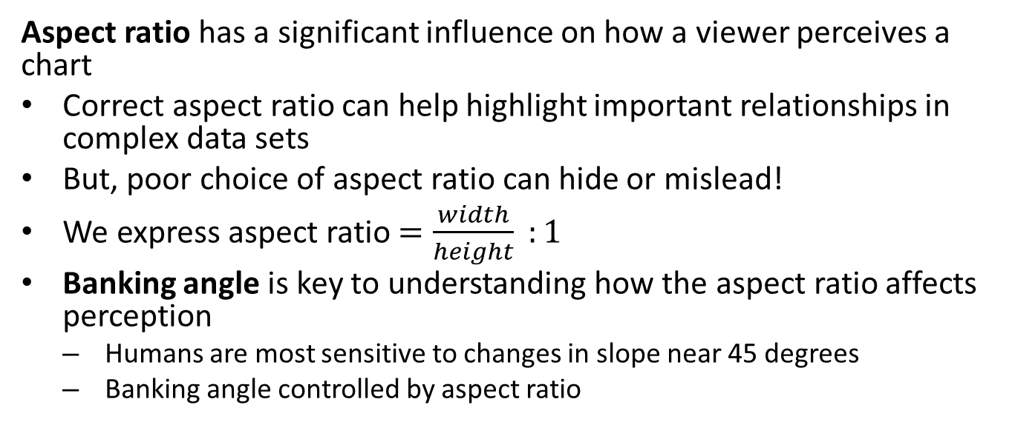
Aspect Ratio
Aspect ratio has a significant influence on how a viewer perceives a chart
Correct aspect ratio can help highlight important relationships in complex data sets
But, poor choice of aspect ratio can hide or mislead!
We express aspect ratio $=\frac{width}{height} :1$
Banking angle is key to understanding how the aspect ratio affects perception
Humans are most sensitive to changes in slope near 45 degrees
Banking angle controlled by aspect ratio

Slide 47
Example of Changing Aspect Ratio
Longest directly measured scientific time series in existence is the sunspot count:
## YEAR SUNACTIVITY ## 0 1700.0 5.0 ## 1 1701.0 11.0 ## 2 1702.0 16.0 ## 3 1703.0 23.0 ## 4 1704.0 36.0
* Longest directly observed temperature series starts in 1772

Slide 48
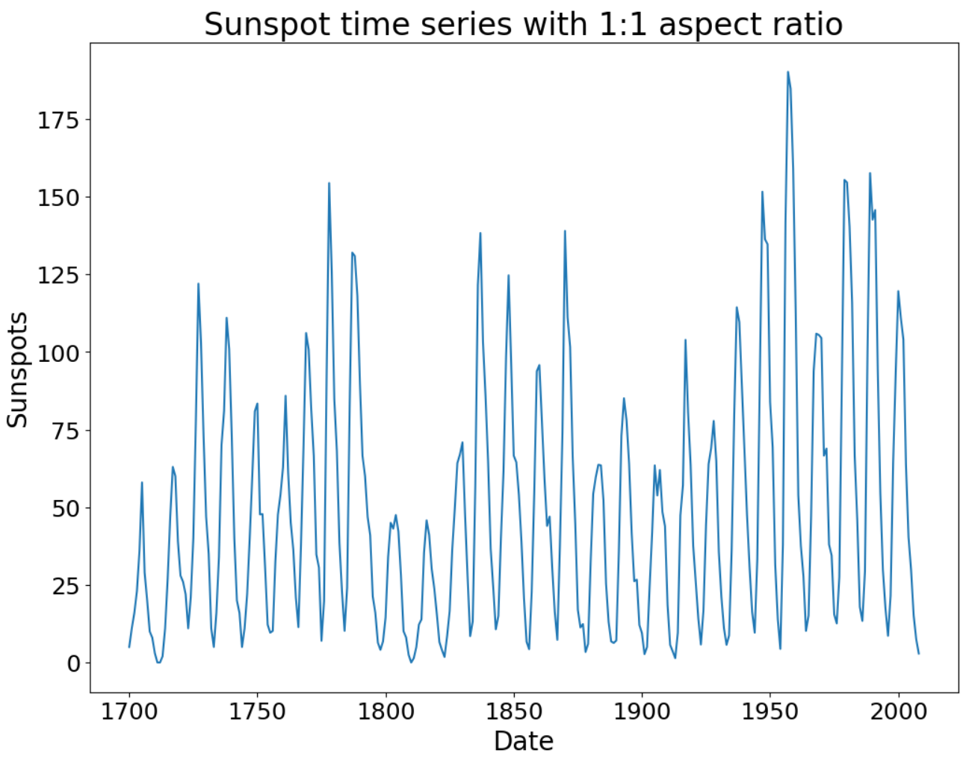
Example of Changing Aspect Ratio
Example uses data from 1700 to 1980
Aspect ratio is 1:1
Banking angle is near vertical
Can you perceive the asymmetry in these sunspot cycles?

Slide 49
Example of Changing Aspect Ratio
Notice how changing aspect ratio change perception of the asymmetry?
Aspect ratio is now 20:1
Banking angle is about 45 degrees for most of the cycles
Can you see the asymmetry in these cycles now?

Slide 50
Selection and Limitations of Color Pallets

Slide 51
Sequential and Divergent Color Palettes
Use of color as an aesthetic in visualization is a complicated subject.
Color is often used, also often abused!
A qualitative palette is a palette of individual colors for categorical values
Sequential palettes and divergent palettes are a sequence of colors
Numeric variables
Ordinal or ordered categorical variables
For examples of the foregoing palette types see the Seaborn Choosing Color Palettes Tutorial
To examine the wide range of available color pallets see Choosing Color Maps in Matplotlib

Slide 52
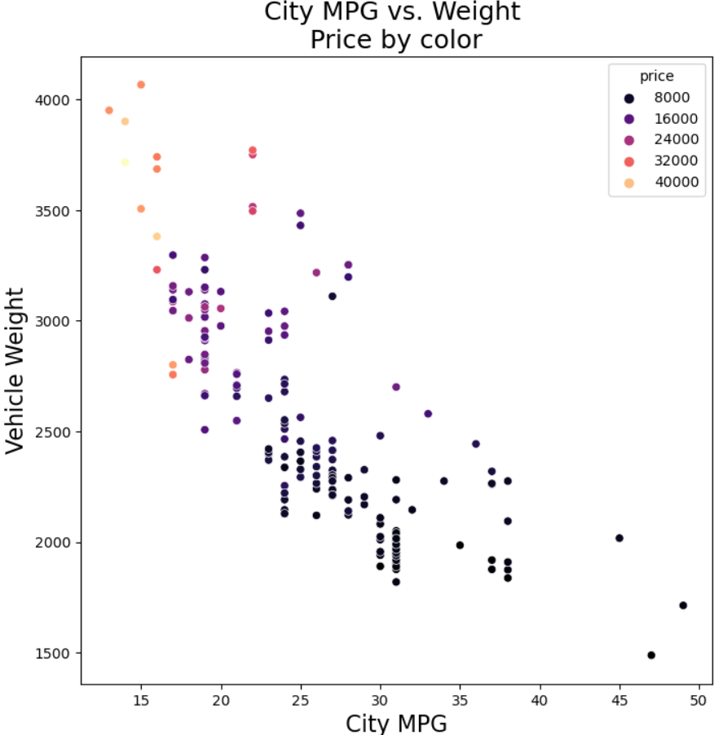
Auto Weight by Sequential Color Palette
Sequential pallet shows relative auto price
Darker colors lower price
Lighter colors indicate higher price
Can you see the pattern that emerges?

Slide 53
Limits of Color
Regardless of the approach there are some significant limitations
A significant number of people are color blind
Red-green color blindness is most common, primarily affecting men
Even the best sequential or divergent palettes show only relative value of numeric variables
Perception of exact numeric values is difficult, except in special cases
People cannot perceive large number of colors for categories
Warning! Avoid using meaningless color in graphics
Using color for no reason is a distraction!
Example: meaningless color for bar plots
Example: meaningless color in box plots

Slide 54
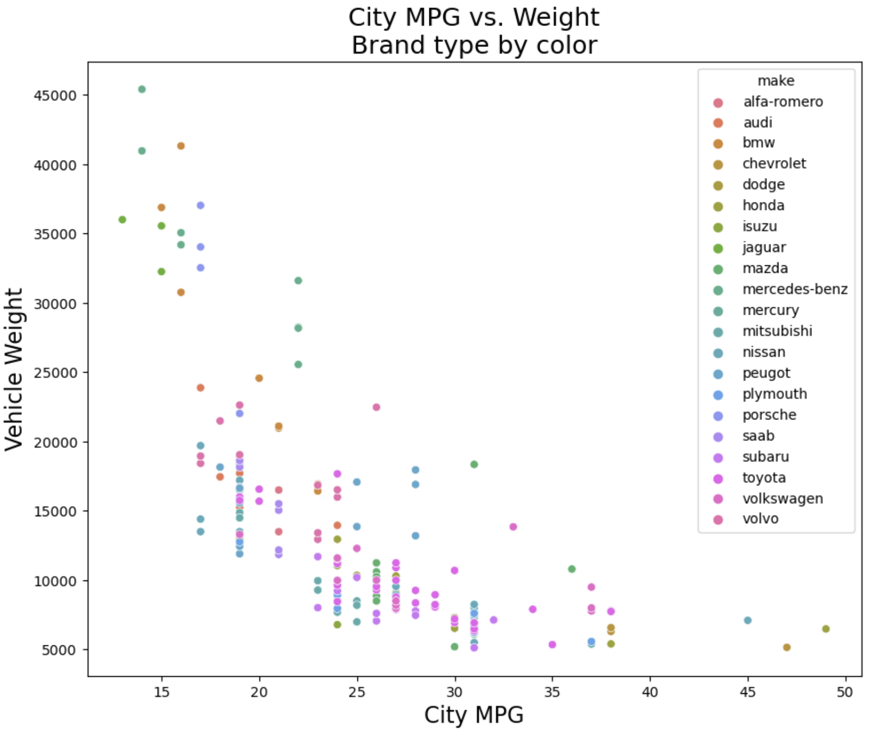
Limits of Color
Large qualitative color pallet reduces perception
This plot includes too many similar colors for the large number of categories
Virtually impossible to determine where autos from each make fall on the plot

Slide 55
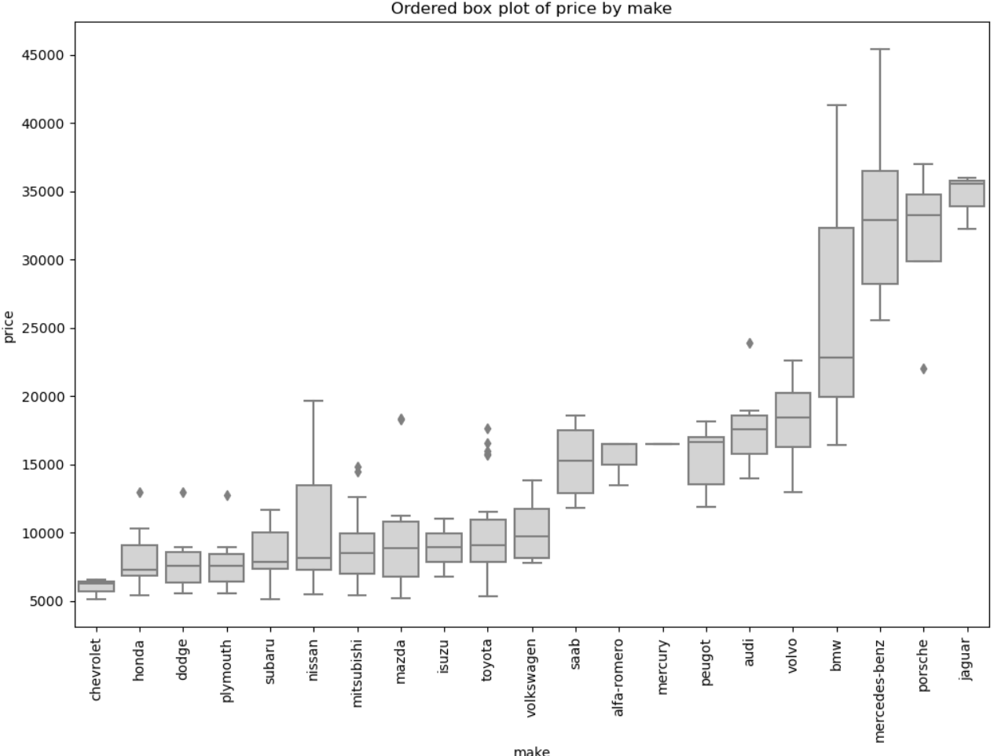
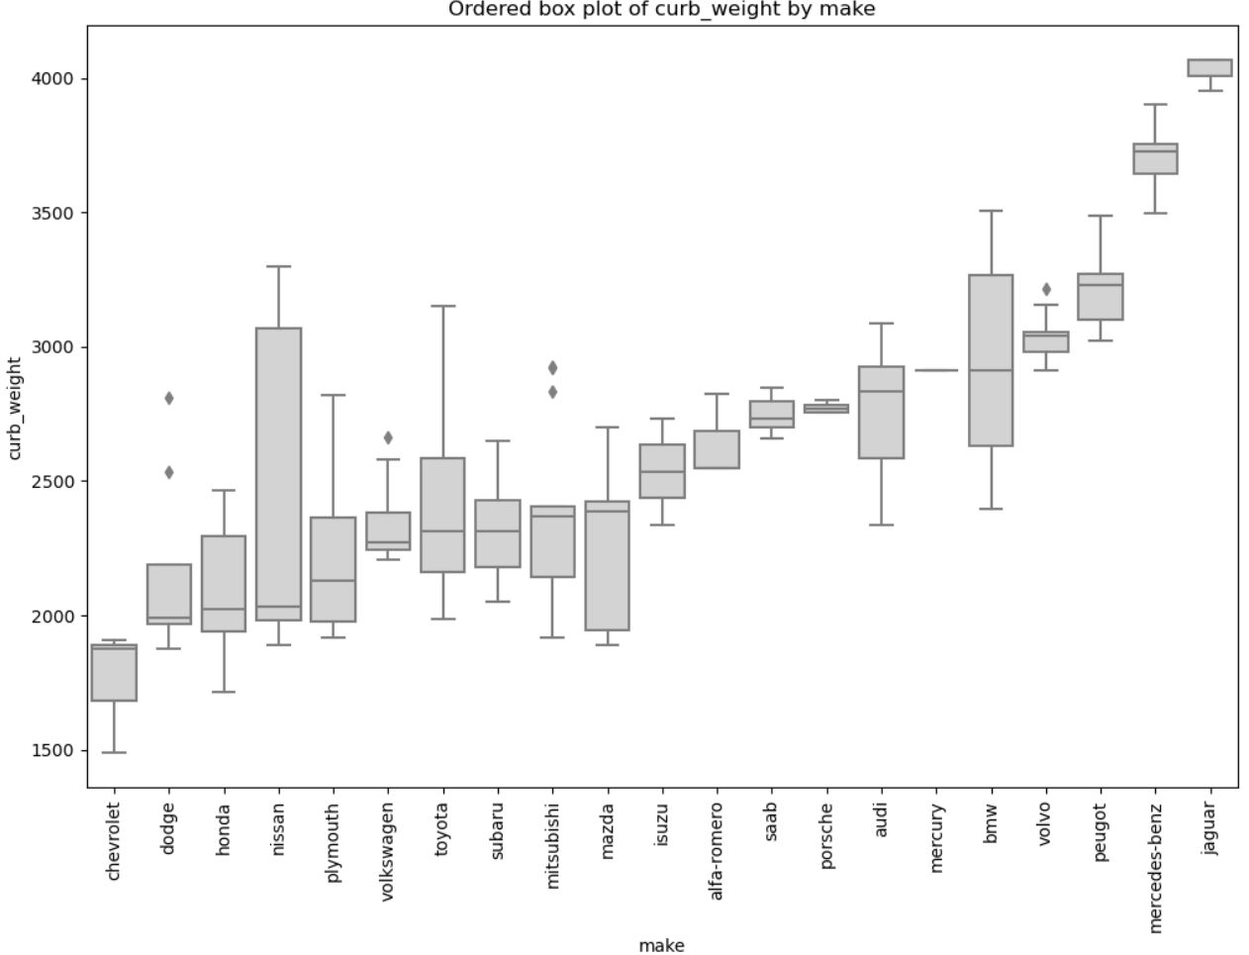
Limits of Color
Ordered box plot is an alternative to qualitative color and shape for variables with too many categories
Ordering improves perception, i.e. like ordered bar chart

Slide 56
Markers and Perception

Slide 57
Marker Size
Marker size is moderately effective aesthetic
Used properly, marker size can highlight important relationships in complex data sets
Numeric values
Ordinal variables
Viewers can generally perceive relative differences, but not actual values
Small size differences are not perceptible
Only relative relationship in numeric variables
Limited steps of ordinal variables

Slide 58
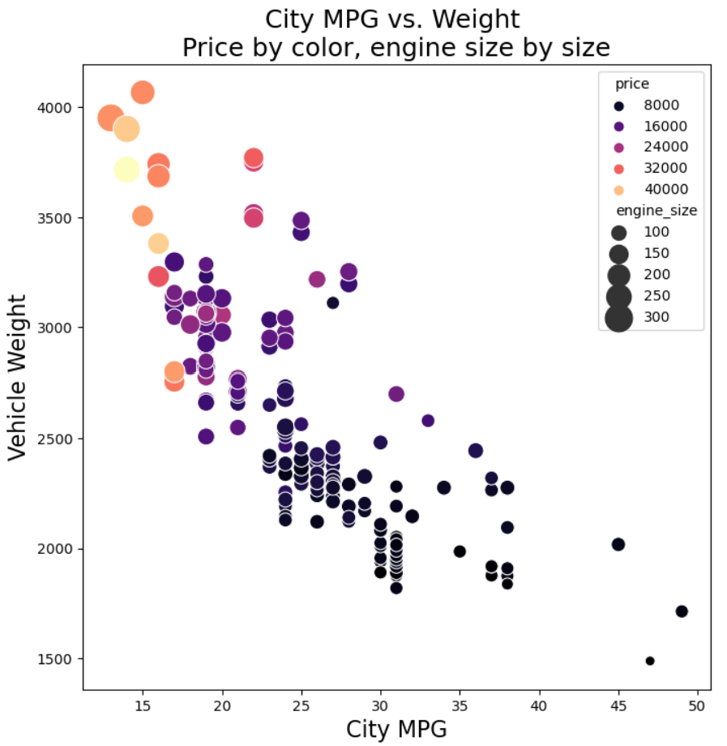
Engine Size by Marker Size and Price by Sequential Color Palette
Sequential color pallet for price, marker size for engine size
Color pallet same as previous example
Engine size by relative marker size
Can you see the patterns in this 4-dimensional projection?

Slide 59
Line Plots and Line Type
Line plots connect discrete, ordered, data points by a line
Can use different colors and line pattern types to differentiate categories
Only useful for a limited number of lines on one graph
Too many similar colors and line patterns on one plot leads to viewer confusion and poor perception
You can see examples of line styles supported in Matplotlib in this article

Slide 60
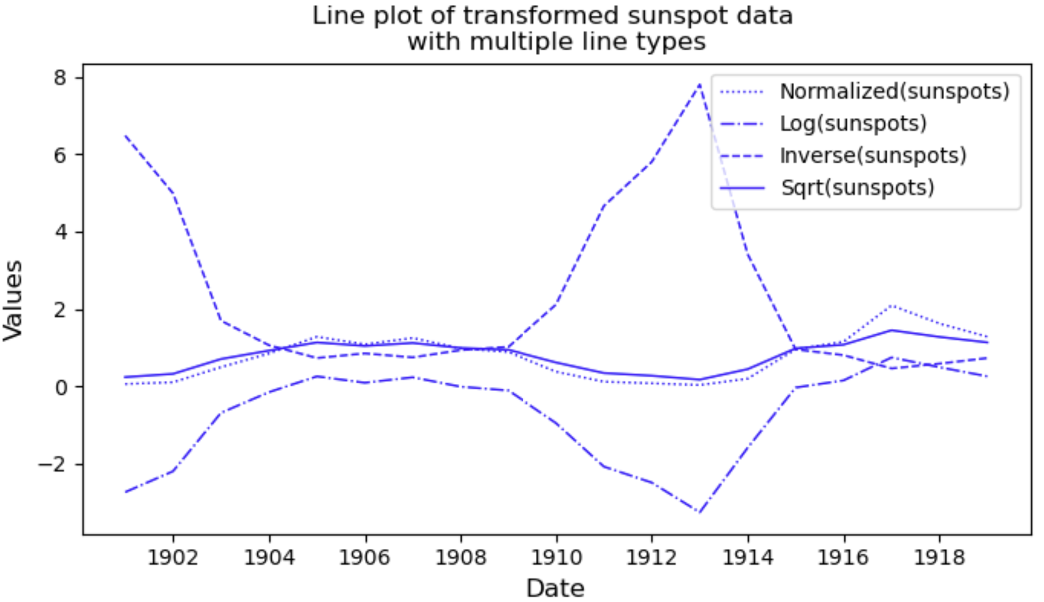
Limits of Line Type
Line type indicates type of transformation
It is easy to perceive the 4 line types
Only a limited number of line types can be perceived!

Slide 61
Marker Shape
Marker shape is useful for displaying categorical relationships
Aesthetic is only useful when two conditions are met:
The number of categories is small
Distinctive shape are chosen for the markers
Human perception limits the number of shapes humans can perceive well
You can find a list of Matplotlib marker shapes here

Slide 62
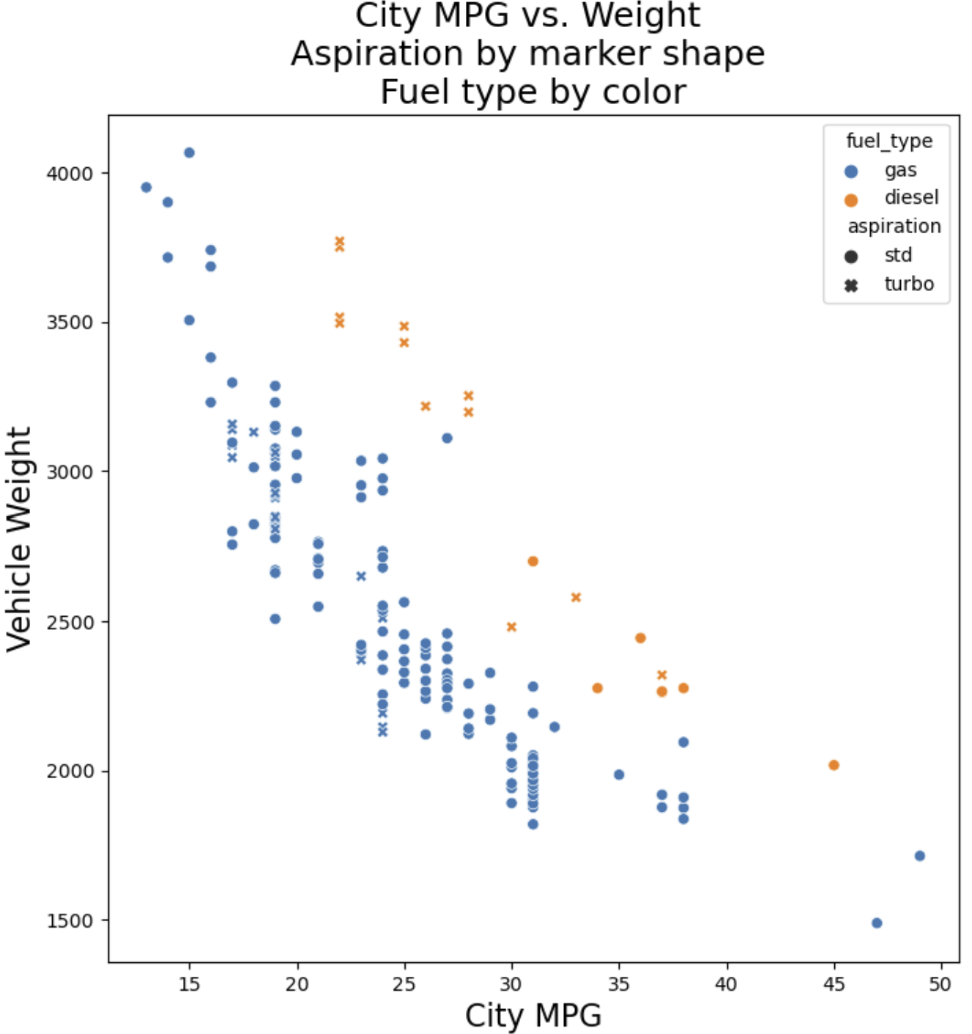
Aspiration by Marker Shape
Limited use of qualitative color and marker shape projects 4 dimensions
Limited color pallet for good perception
Limited number of marker shapes for good perception
Can you see the pattern that emerges?

Slide 63
Regression Lines for Visual Perception

Slide 64
Regression Lines
Regression lines draw viewers attention
Typically use a nonlinear regression line
Linear
Polynomial
Splines - piece wise model
Lowess - local nonlinear regression
Bootstrap confidence intervals show range of probable trends
More about bootstrap resampling later
Ideally want straight line relationship
Nonlinear relationships often arise from non-Normal distributions
Linear relationship is more intuitive

Slide 65
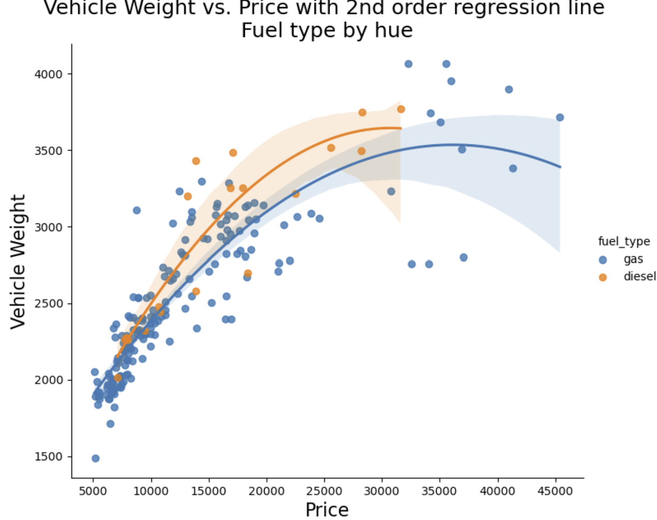
Regression Line and Transformation Example
Regression lines highlight the trends for gas and diesel engines
Second order polynomial fit produces curved lines

Slide 66
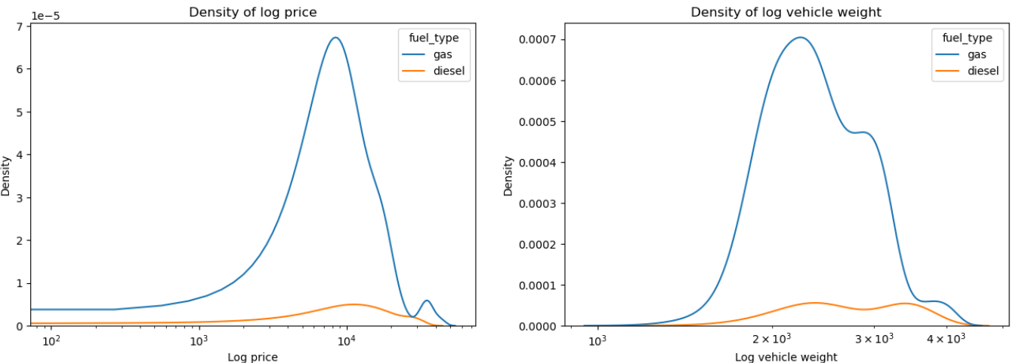
Regression Line and Transformation Example
What are the distributions of these variables?
Notice the right skew of these distributions

Slide 67
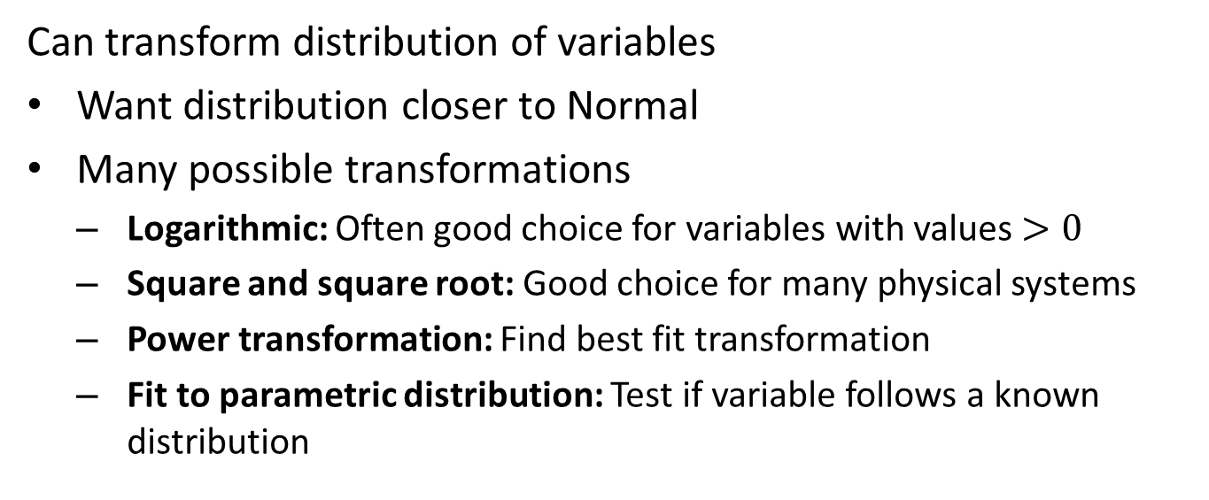
Regression Line and Tramsformation Example
Can transform distribution of variables
Want distribution closer to Normal
Many possible transformations
Logarithmic: Often good choice for variables with values $>0$
Square and square root: Good choice for many physical systems
Power transformation: Find best fit transformation
Fit to parametric distribution: Test if variable follows a known distribution

Slide 68
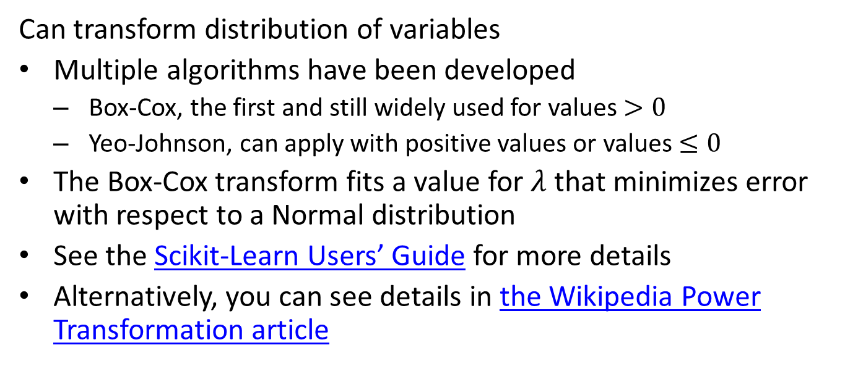
Regression Line and Tramsformation Example
Can transform distribution of variables
Multiple algorithms have been developed
Box-Cox, the first and still widely used for values $>0$
Yeo-Johnson, can apply with positive values or values $≤0$
The Box-Cox transform fits a value for $λ$ that minimizes error with respect to a Normal distribution
See the Scikit-Learn Users’ Guide for more details
Alternatively, you can see details in the Wikipedia Power Transformation article

Slide 69

Regression Line and Tramsformation Example
Transformed distributions
Distribution of logarithm of the curb weight is nearly symmetric

Slide 70
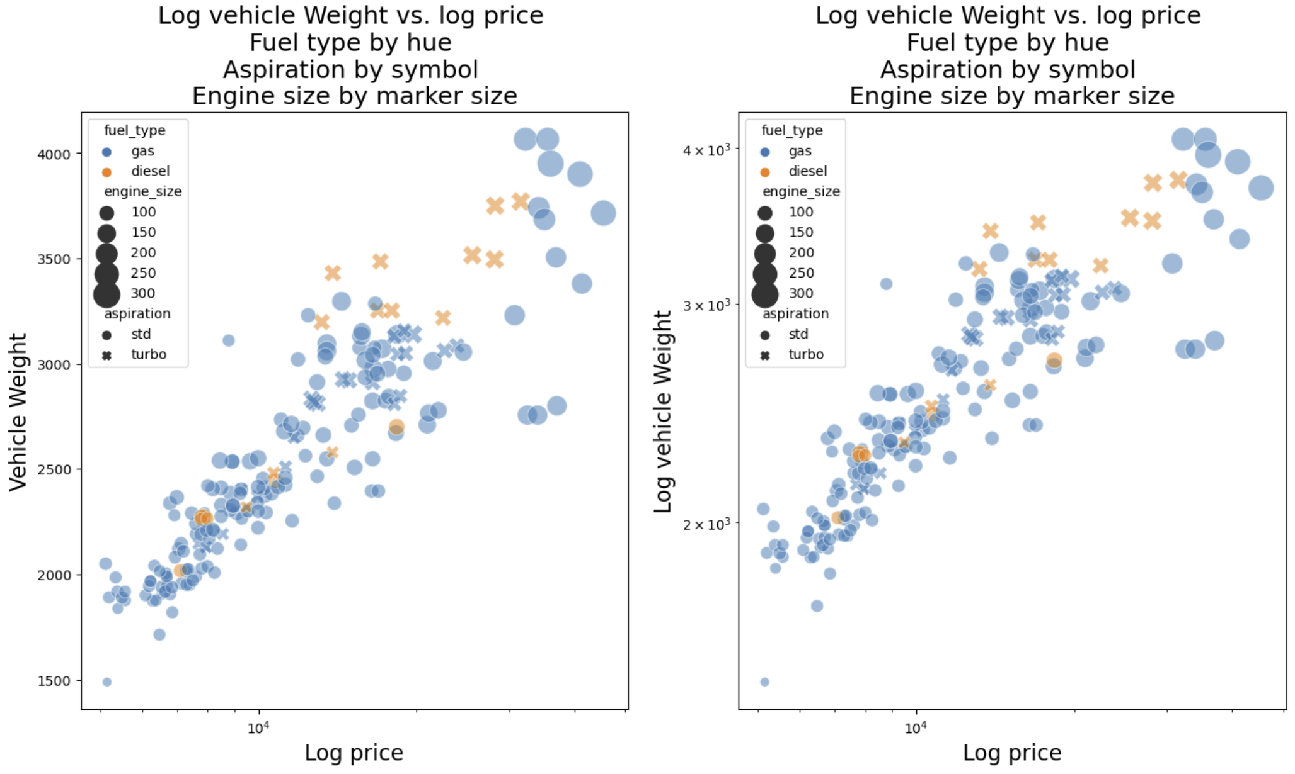
Regression Line and Tramsformation Example
Transform the distributions
Distribution of logarithm of the curb weight
The plots are fairly similar, log-log with less dispersion

Slide 71
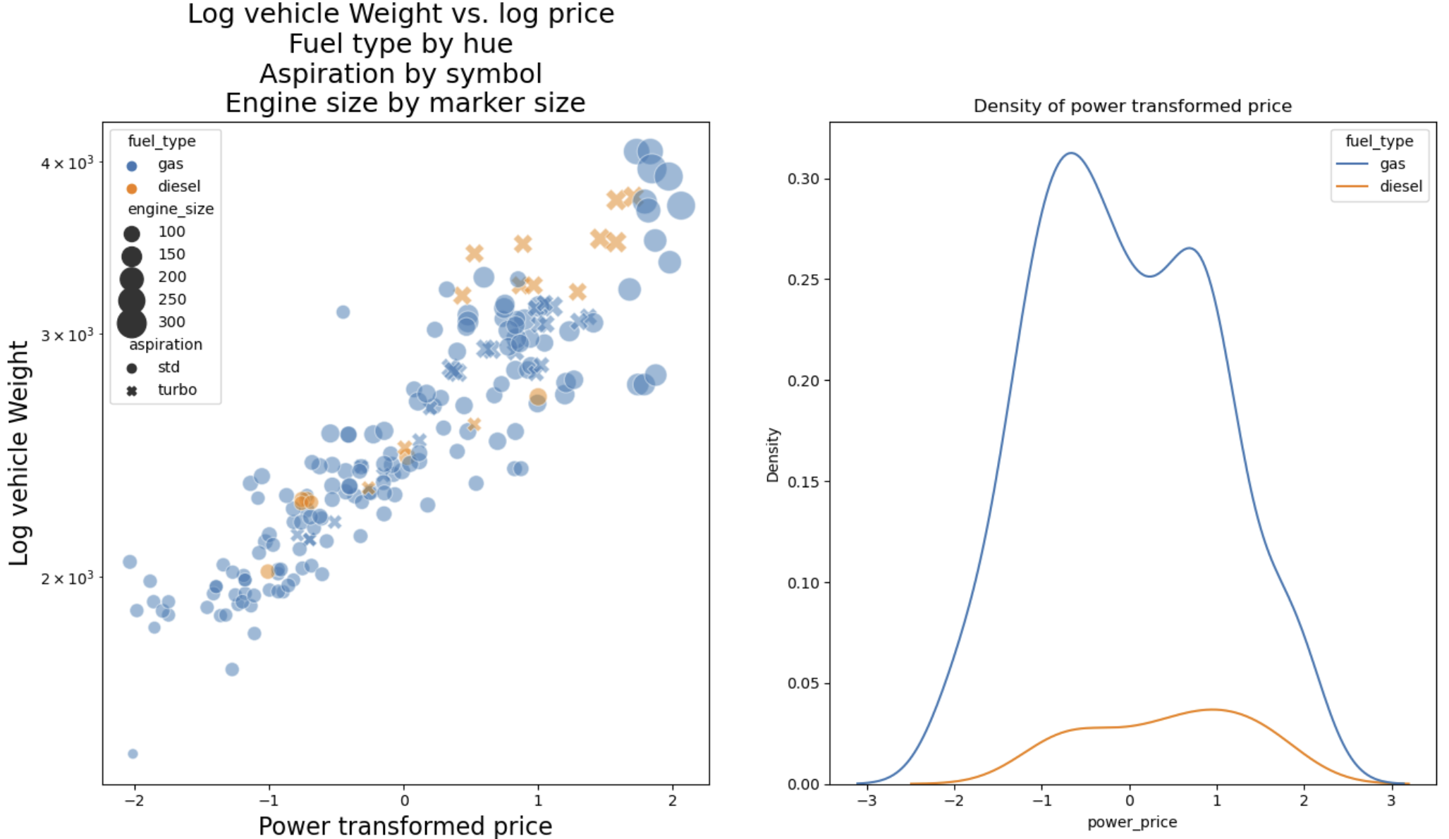
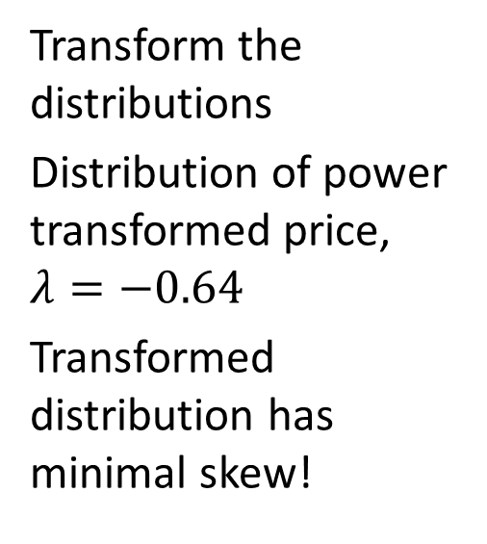
Regression Line and Transformation Example
Transform the distributions
Distribution of power transformed price, $λ=−0.64$
Transformed distribution has minimal skew!

Slide 72
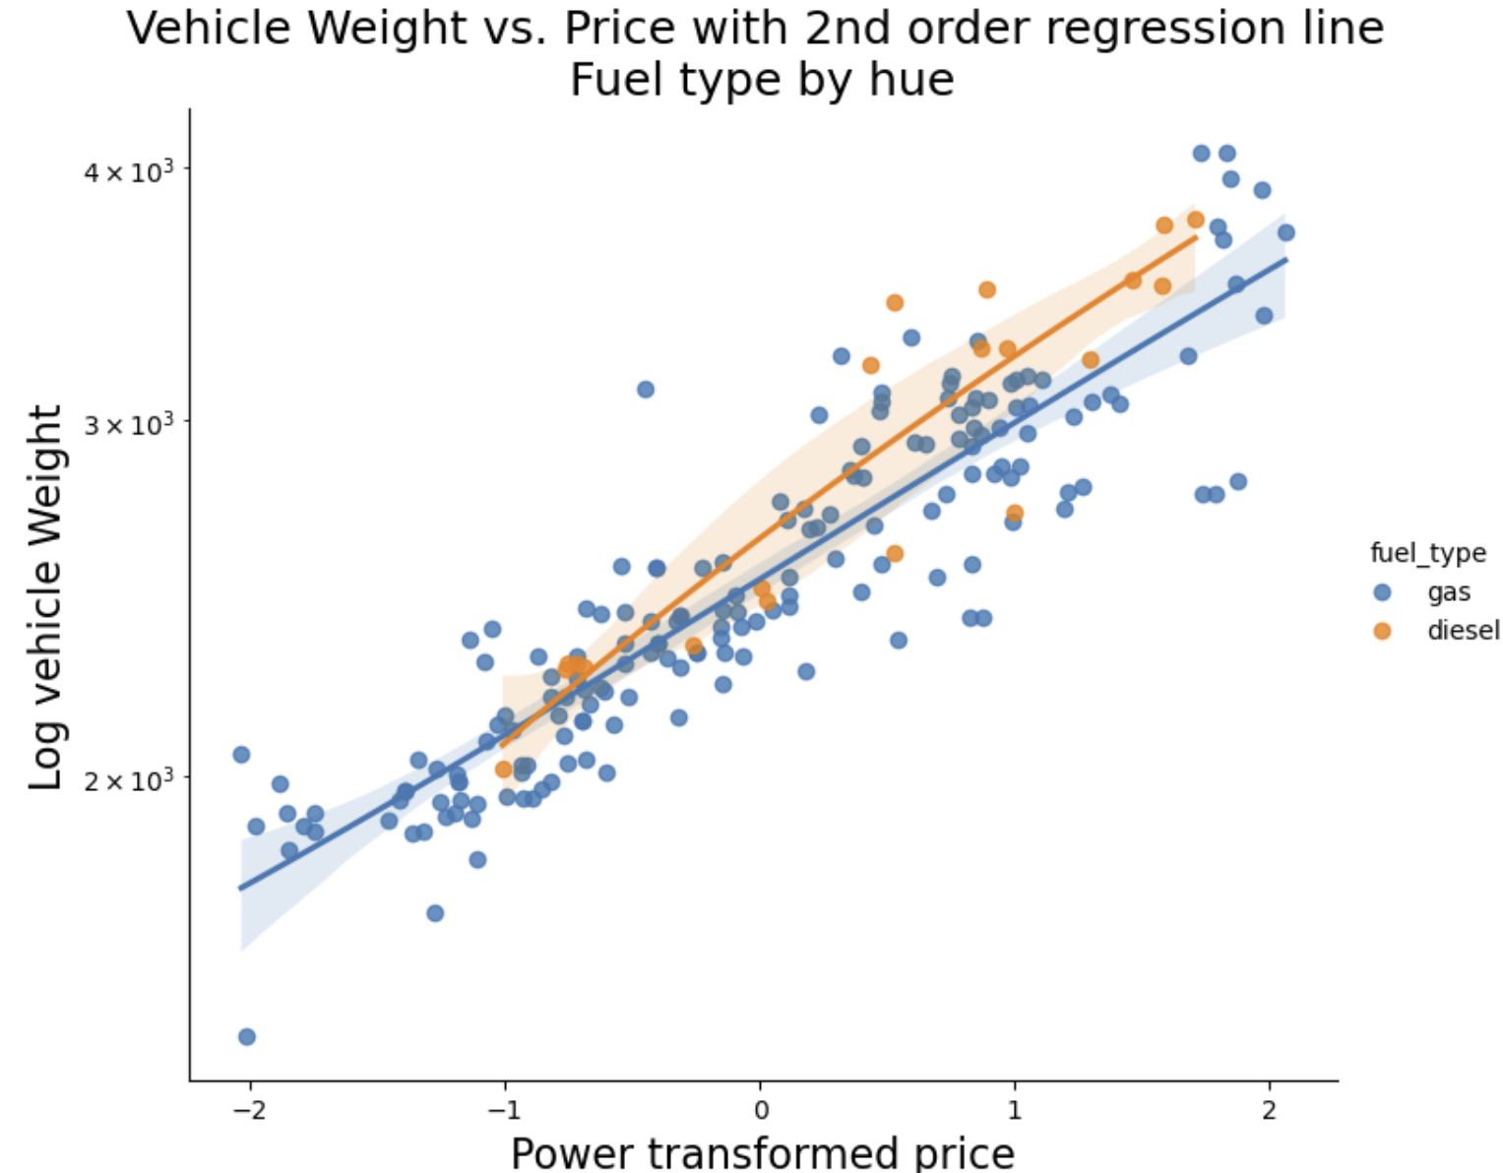
Regression Line and Tramsformation Example
Second order polynomial fit to transformed variables
Regression lines are nearly strait!

Slide 73
Summary
We have explored these key points
Visualization is a powerful EDA method
Understand relationships in data
Communicate data science insights
Proper use of plot aesthetics enable projection of multiple dimensions of complex data onto the 2-dimensional plot surface.
All plot aesthetics have limitations which must be understood to use them effectively
The effectiveness of a plot aesthetic varies with the type and the application
Regression lines help to focus viewer on trends
Transformations to linear relationships can be informative

Slide 74
Properties of Common Aesthetics
Property or Aesthetic | Perception | Data Types
Aspect ratio | Good | Any
Regression lines | Good | Numeric
Marker position | Good | Numeric, counts
Bar length | Good | Counts, numeric
Sequential color palette | Moderate | Numeric, counts, ordered categorical
Marker size | Moderate | Numeric, counts, ordered categorical
Line types | Limited | Categorical
Qualitative color palette | Limited | Categorical
Marker shape | Limited | Categorical
Area | poor | Numeric, counts, ordered categorical
Angle | poor | Numeric

