Slide 1

When One Thing Depends on Another; Conditional Probability
Steve Elston
Copyright 2018, 2019, 2020, 2021, 2022, 2023 2024, Stephen F Elston. All rights reserved.

Slide 2
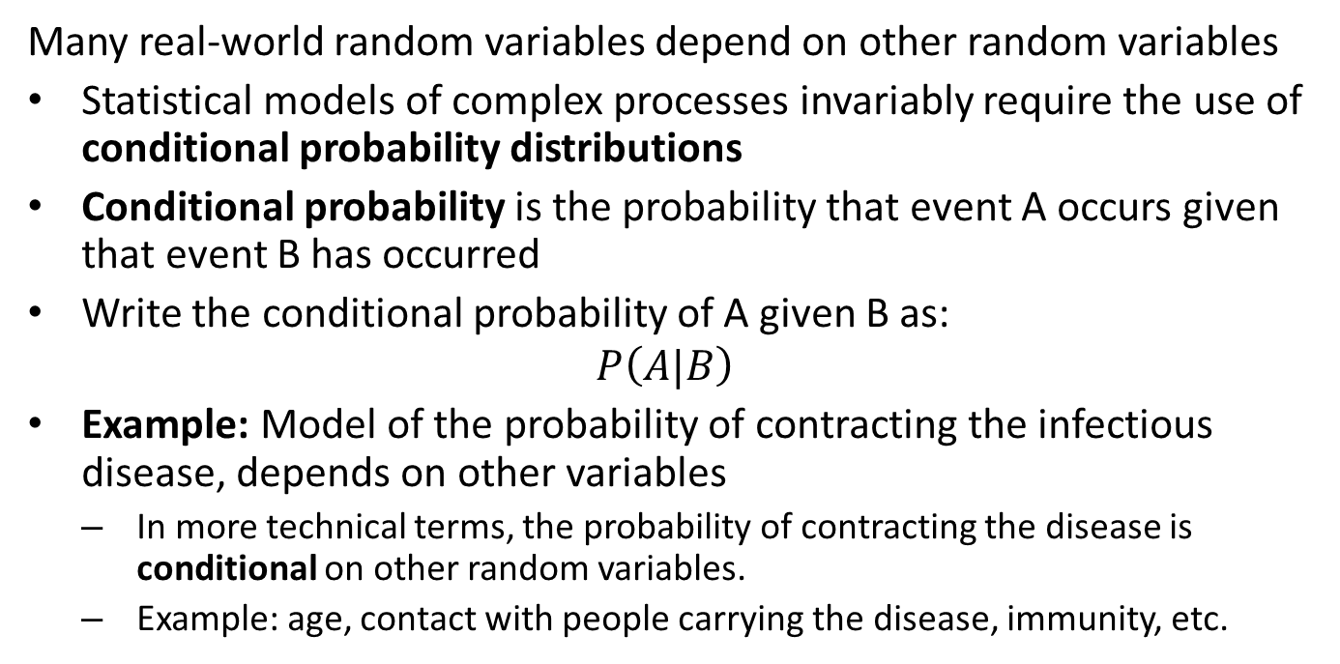
Introduction
Many real-world random variables depend on other random variables
Statistical models of complex processes invariably require the use of conditional probability distributions
Conditional probability is the probability that event A occurs given that event B has occurred
Write the conditional probability of A given B as:
$$P\left(A|B\right)$$
Example: Model of the probability of contracting the infectious disease, depends on other variables
In more technical terms, the probability of contracting the disease is conditional on other random variables.
Example: age, contact with people carrying the disease, immunity, etc.

Slide 3
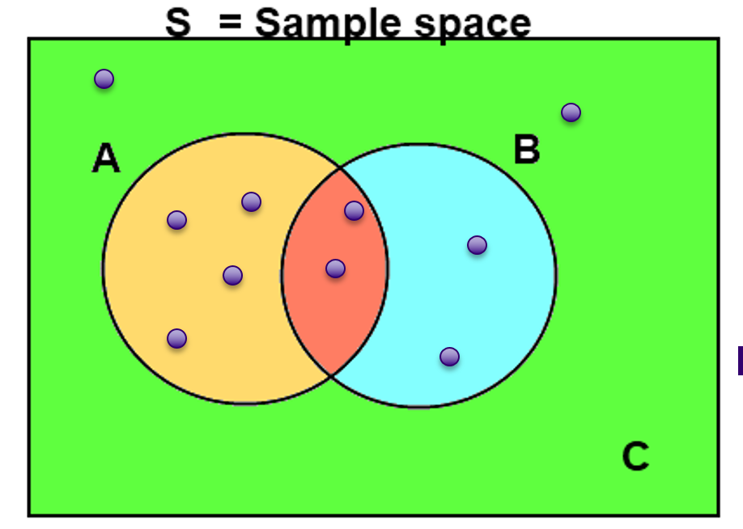
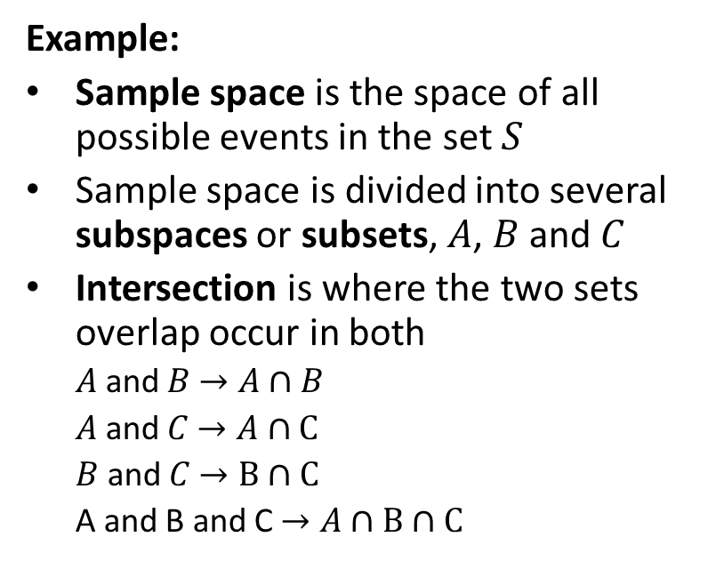
Properties of Conditional Probability
Example:
Sample space is the space of all possible events in the set $S$
Sample space is divided into several subspaces or subsets, $A$, $B$ and $C$
Intersection is where the two sets overlap occur in both
$A$ and $B$ $→A∩B$
$A$ and $C$ $→A∩C$
$B$ and $C$ $→B∩C$
A and B and C $→A∩B∩C$
Example of conditional probability of discrete events
credit, Wikipedia commons

Slide 4
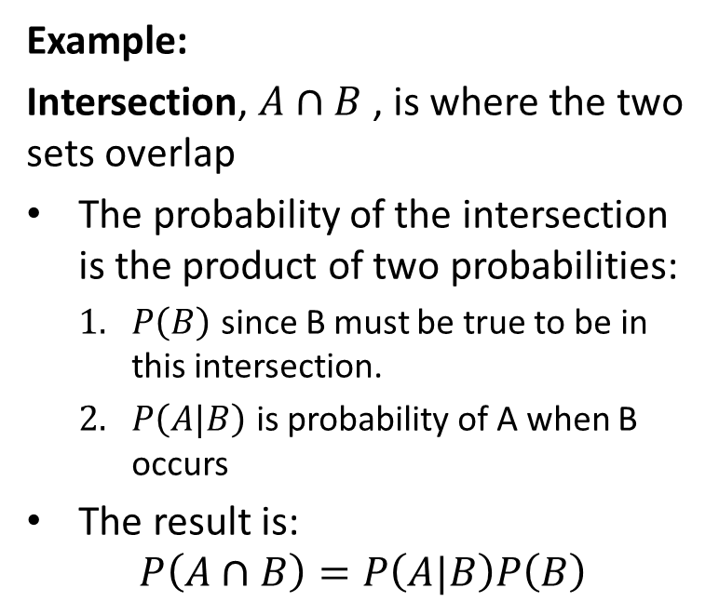
Properties of Conditional Probability
Example:
Intersection, $A∩B$ , is where the two sets overlap
The probability of the intersection is the product of two probabilities:
$P\left(B\right)$ since B must be true to be in this intersection.
$P\left(A|B\right)$ is probability of A when B occurs
The result is:
$$P\left(A∩B\right)=P\left(A|B\right)P\left(B\right)$$
Example of conditional probability of discrete events
credit, Wikipedia commons

Slide 5
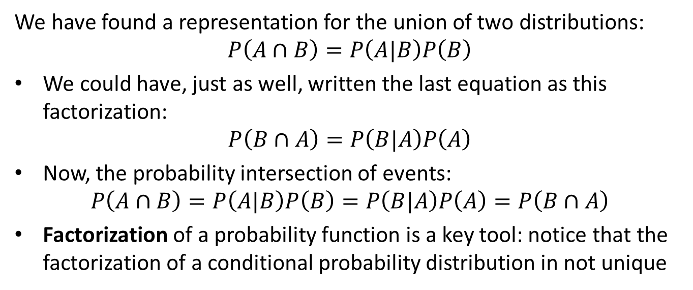
Properties of Conditional Probability
We have found a representation for the union of two distributions:
$$P\left(A∩B\right)=P\left(A|B\right)P\left(B\right)$$
We could have, just as well, written the last equation as this factorization:
$$P\left(B∩A\right)=P\left(B|A\right)P\left(A\right)$$
Now, the probability intersection of events:
$$P\left(A∩B\right)=P\left(A|B\right)P\left(B\right)=P\left(B|A\right)P\left(A\right)=P\left(B∩A\right)$$
Factorization of a probability function is a key tool: notice that the factorization of a conditional probability distribution in not unique

Slide 6
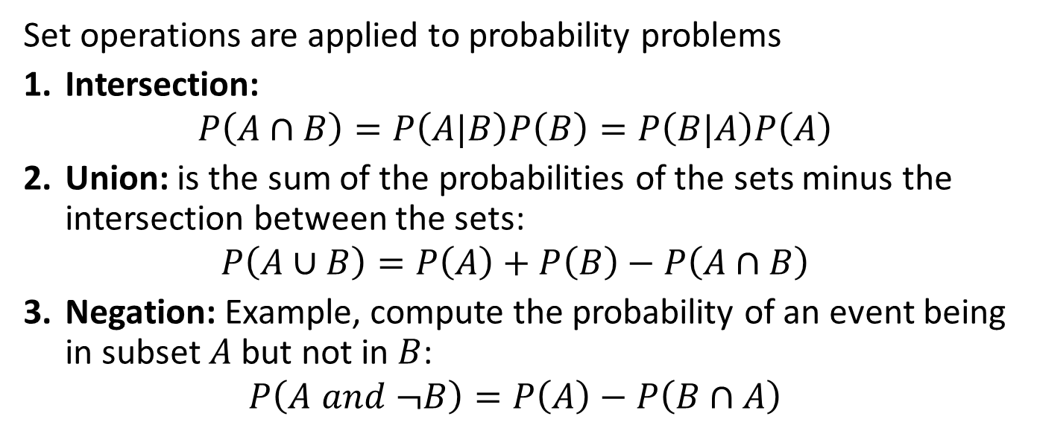
Set Operations and Probability
Set operations are applied to probability problems
Intersection:
$$P\left(A∩B\right)=P\left(A|B\right)P\left(B\right)=P\left(B|A\right)P\left(A\right)$$
Union: is the sum of the probabilities of the sets minus the intersection between the sets:
$$P\left(A∪B\right)=P\left(A\right)+P\left(B\right)−P\left(A∩B\right)$$
Negation: Example, compute the probability of an event being in subset $A$ but not in $B$:
$$P\left(A and ¬B\right)=P\left(A\right)−P\left(B∩A\right)$$

Slide 7
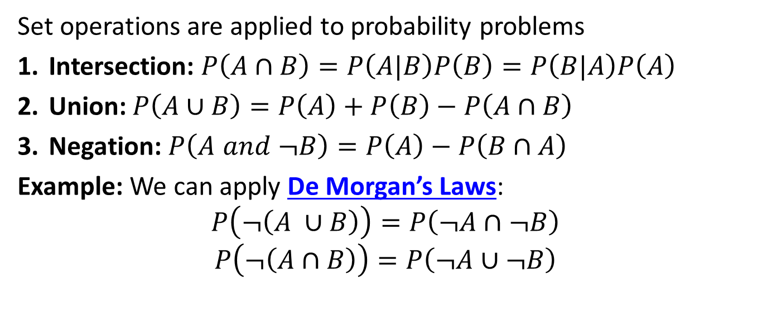
Set Operations and Probability
Set operations are applied to probability problems
Intersection: $P\left(A∩B\right)=P\left(A|B\right)P\left(B\right)=P\left(B|A\right)P\left(A\right)$
Union: $P\left(A∪B\right)=P\left(A\right)+P\left(B\right)−P\left(A∩B\right)$
Negation: $P\left(A and ¬B\right)=P\left(A\right)−P\left(B∩A\right)$
Example: We can apply De Morgan’s Laws:
$$P\left(¬\left(A ∪B\right)\right)=P\left(¬A∩¬B\right)$$
$$P\left(¬\left(A∩B\right)\right)=P\left(¬A∪¬B\right)$$

Slide 8
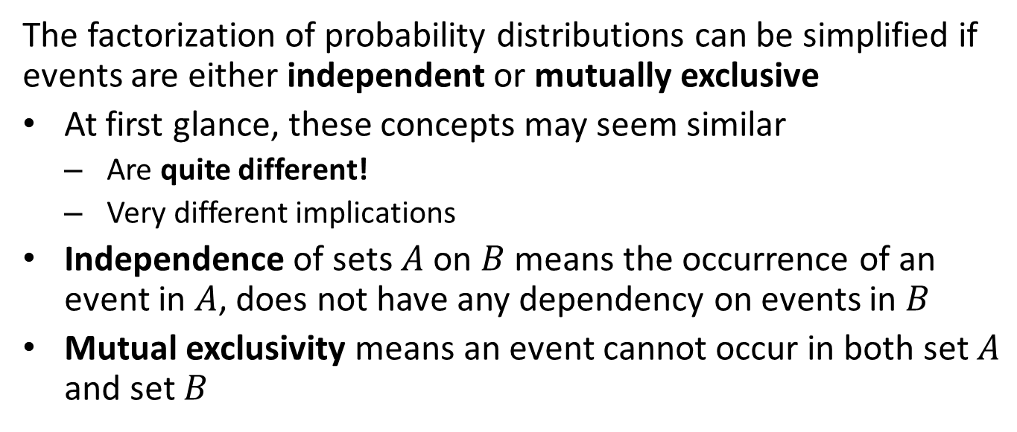
Independence and Mutual Exclusivity
The factorization of probability distributions can be simplified if events are either independent or mutually exclusive
At first glance, these concepts may seem similar
Are quite different!
Very different implications
Independence of sets $A$ on $B$ means the occurrence of an event in $A$, does not have any dependency on events in $B$
Mutual exclusivity means an event cannot occur in both set $A$ and set $B$

Slide 9
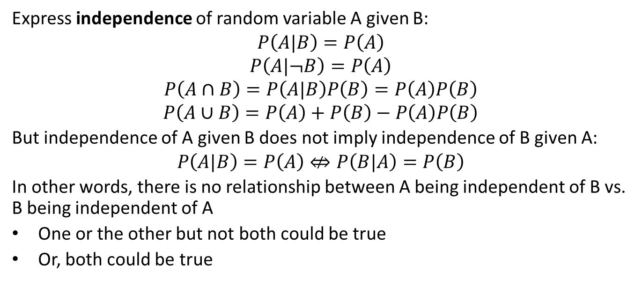
Independence
Express independence of random variable A given B:
$$P\left(A|B\right)=P\left(A\right)$$
$$P\left(A|¬B\right)=P\left(A\right)$$
$$P\left(A∩B\right)=P\left(A|B\right)P\left(B\right)=P\left(A\right)P\left(B\right)$$
$$P\left(A∪B\right)=P\left(A\right)+P\left(B\right)−P\left(A\right)P\left(B\right)$$
But independence of A given B does not imply independence of B given A:
$$P\left(A|B\right)=P\left(A\right)⇎P\left(B|A\right)=P\left(B\right)$$
In other words, there is no relationship between A being independent of B vs. B being independent of A
One or the other but not both could be true
Or, both could be true

Slide 10
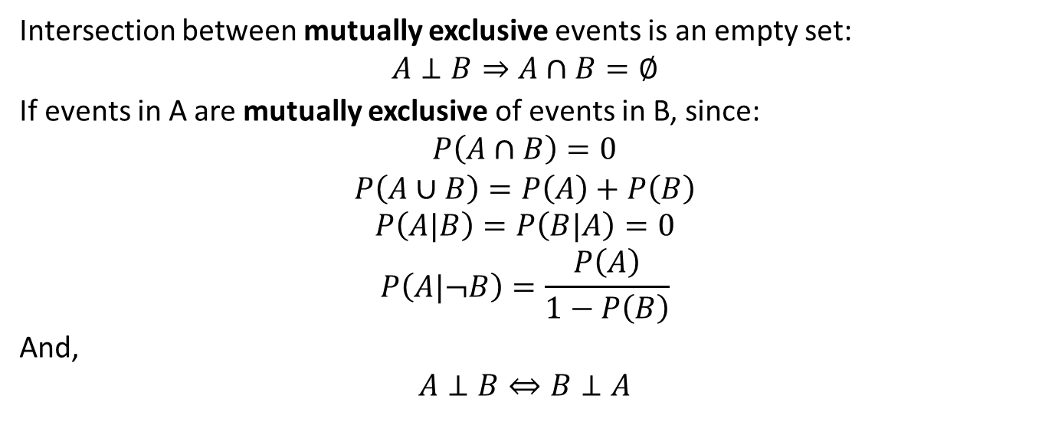
Mutual Exclusivity
Intersection between mutually exclusive events is an empty set:
$$A⊥B⇒A∩B=∅$$
If events in A are mutually exclusive of events in B, since:
$$P\left(A∩B\right)=0$$
$$P\left(A∪B\right)=P\left(A\right)+P\left(B\right)$$
$$P\left(A|B\right)=P\left(B|A\right)=0$$
$$P\left(A|¬B\right)=\frac{P\left(A\right)}{1−P\left(B\right)}$$
And,
$$A⊥B⇔B⊥A$$

Slide 11
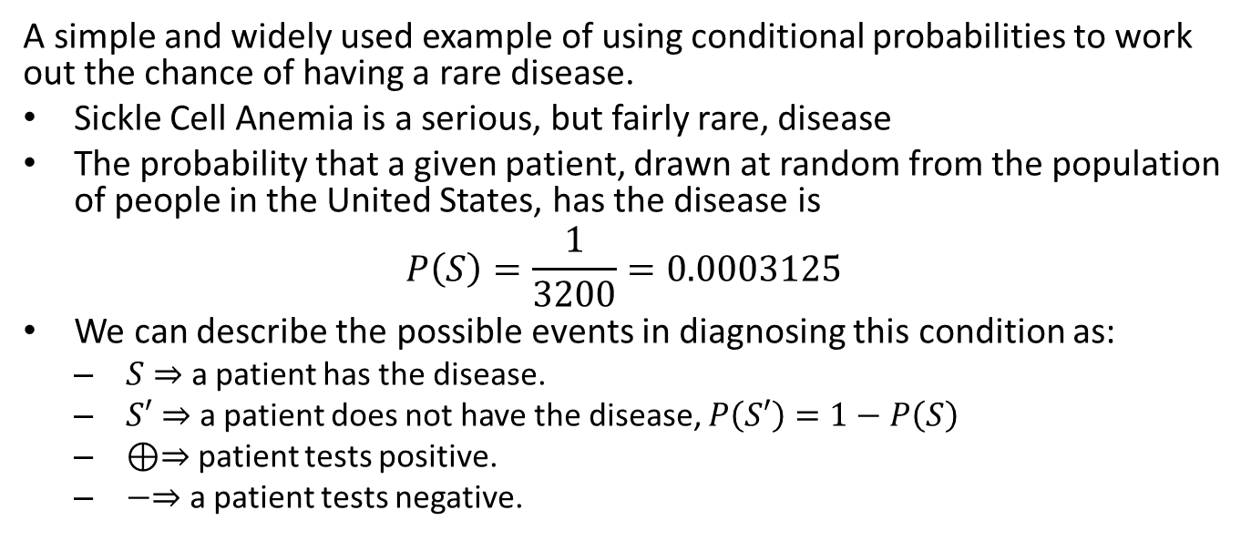
Conditional Probability Example
A simple and widely used example of using conditional probabilities to work out the chance of having a rare disease.
Sickle Cell Anemia is a serious, but fairly rare, disease
The probability that a given patient, drawn at random from the population of people in the United States, has the disease is
$$P\left(S\right)=\frac{1}{3200}=0.0003125$$
We can describe the possible events in diagnosing this condition as:
$S⇒$ a patient has the disease.
$S′⇒$ a patient does not have the disease, $P\left(S′\right)=1−P\left(S\right)$
$⊕⇒$ patient tests positive.
$−⇒$ a patient tests negative.

Slide 12
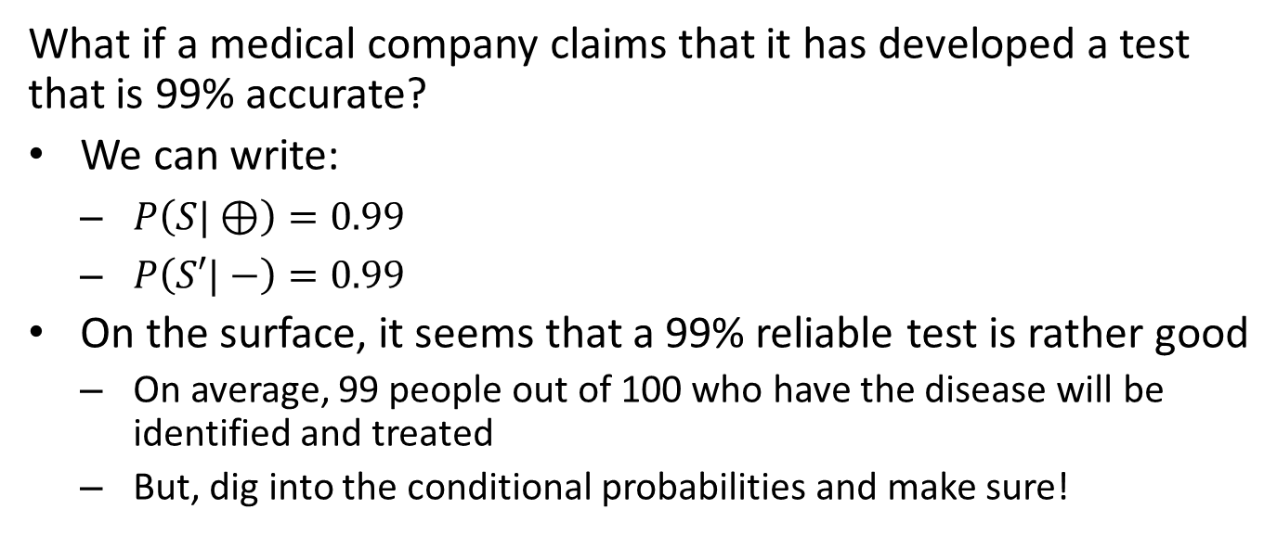
Conditional Probability Example
What if a medical company claims that it has developed a test that is 99% accurate?
We can write:
$P\left(S|⊕\right)=0.99$
$P\left(S′|−\right)=0.99$
On the surface, it seems that a 99% reliable test is rather good
On average, 99 people out of 100 who have the disease will be identified and treated
But, dig into the conditional probabilities and make sure!

Slide 13
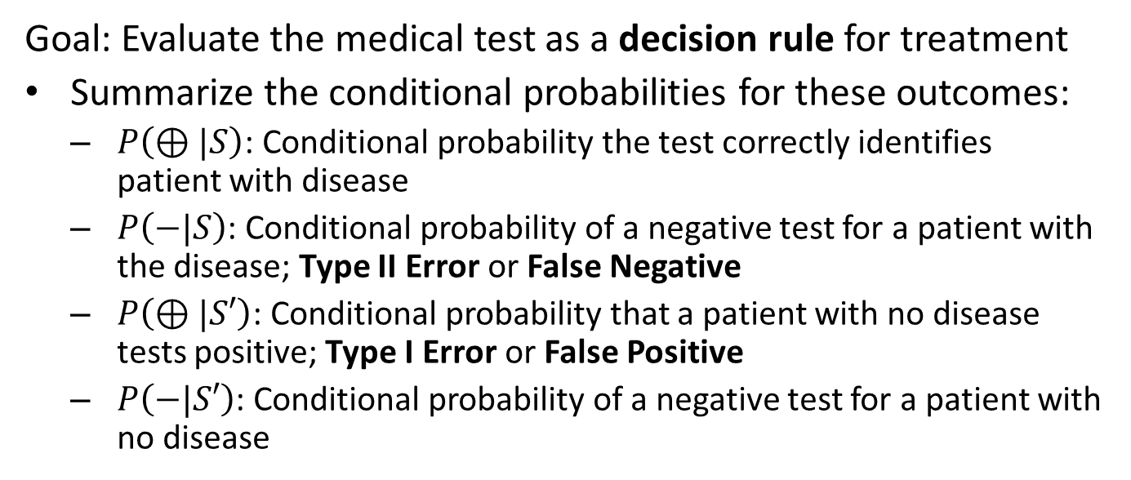
Conditional Probability Example
Goal: Evaluate the medical test as a decision rule for treatment
Summarize the conditional probabilities for these outcomes:
$P\left(⊕|S\right)$: Conditional probability the test correctly identifies patient with disease
$P\left(−|S\right)$: Conditional probability of a negative test for a patient with the disease; Type II Error or False Negative
$P\left(⊕|S′\right)$: Conditional probability that a patient with no disease tests positive; Type I Error or False Positive
$P\left(−|S′\right)$: Conditional probability of a negative test for a patient with no disease

Slide 14
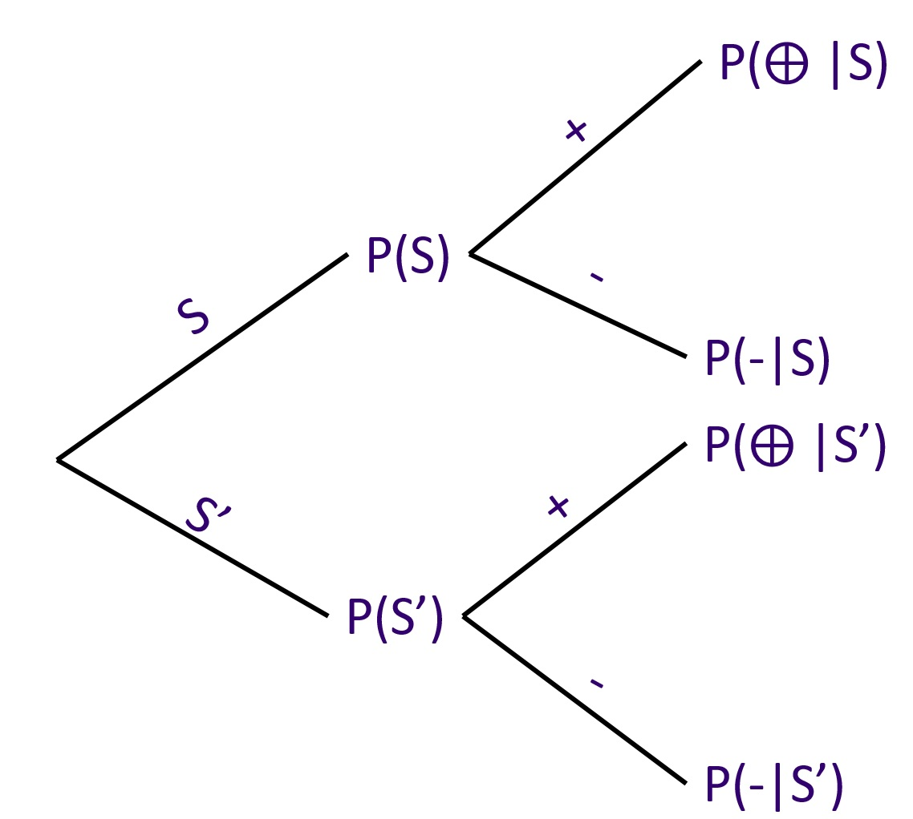
Conditional Probability Example
The directed acyclic graphical model (DAG) defines a conditional dependency structure
Multiply probabilities from root to leaves to get probabilities of outcomes
Sum probabilities of outcomes to ensure they add to 1.0
Graph showing dependency of conditional distribution

Slide 15
Conditional Probability Example
Four possible outcomes shown using a confusion matrix or truth table
Table shows conditional probabilities of each outcome
Tip: Make sure the numbers in your confusion matrix sum to 1.0
 | Positive Test | Negative Test
Disease | True Positive Rate | False Negative Rate
No Disease | False Positive Rate | True Negative Rate

Slide 16
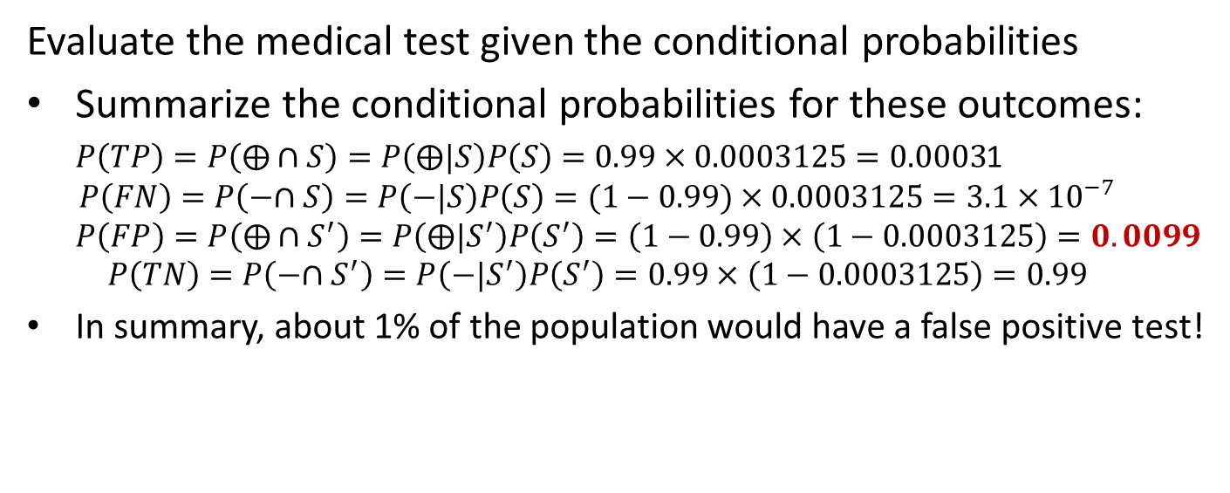
Conditional Probability Example
Evaluate the medical test given the conditional probabilities
Summarize the conditional probabilities for these outcomes:
$P\left(TP\right)=P\left(⨁∩S\right)=P\left(⨁|S\right)P\left(S\right)=0.99×0.0003125=0.0003$1
$$P\left(FN\right)=P\left(−∩S\right)=P\left(−|S\right)P\left(S\right)=(1−0.99)×0.0003125=3.1×{10}^{−7}$$
$$P\left(FP\right)=P\left(⨁∩S^{′}\right)=P\left(⨁|S^{′}\right)P\left(S^{′}\right)=\left(1−0.99\right)×\left(1−0.0003125\right)=0.0099$$
$$P\left(TN\right)=P\left(−∩S^{′}\right)=P\left(−|S^{′}\right)P\left(S^{′}\right)=0.99×\left(1−0.0003125\right)=0.99$$
In summary, about 1% of the population would have a false positive test!

Slide 17
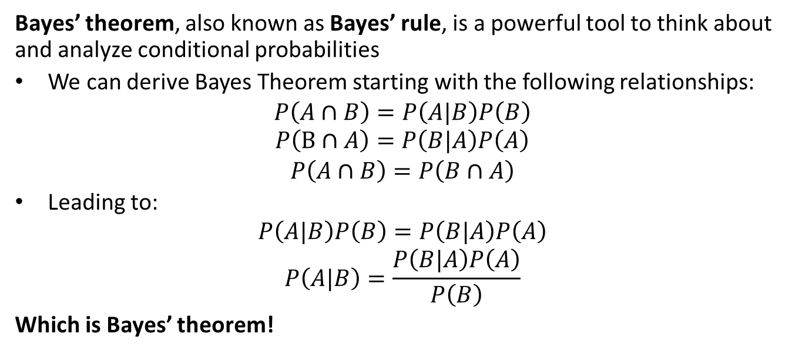
Conditional Distributions and Bayes’ Theorem
Bayes’ theorem, also known as Bayes’ rule, is a powerful tool to think about and analyze conditional probabilities
We can derive Bayes Theorem starting with the following relationships:
$$P\left(A∩B\right)=P\left(A|B\right)P\left(B\right)$$
$$P\left(B∩A\right)=P\left(B|A\right)P\left(A\right)$$
$$P\left(A∩B\right)=P\left(B∩A\right)$$
Leading to:
$$P\left(A|B\right)P\left(B\right)=P\left(B|A\right)P\left(A\right)$$
$$P\left(A|B\right)=\frac{P\left(B|A\right)P\left(A\right)}{P\left(B\right)}$$
Which is Bayes’ theorem!

Slide 18
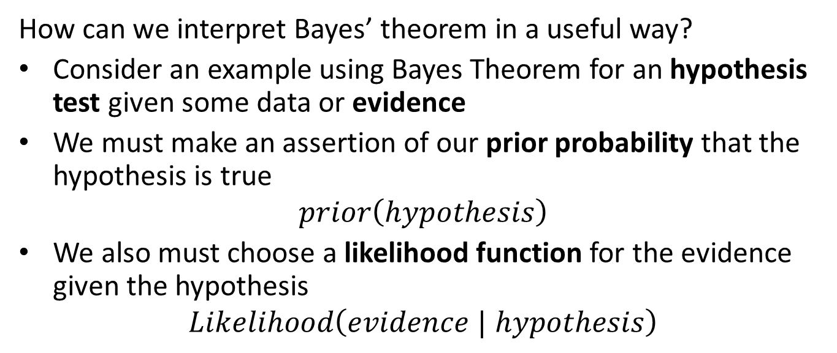
Interpreting Bayes Theorem
How can we interpret Bayes’ theorem in a useful way?
Consider an example using Bayes Theorem for an hypothesis test given some data or evidence
We must make an assertion of our prior probability that the hypothesis is true
$$prior\left(hypothesis\right)$$
We also must choose a likelihood function for the evidence given the hypothesis
$$Likelihood\left(evidence | hypothesis\right)$$

Slide 19
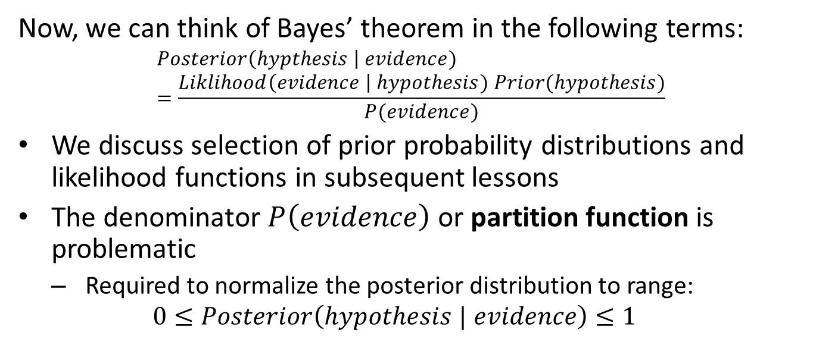
Interpreting Bayes Theorem
Now, we can think of Bayes’ theorem in the following terms:
$$Posterior\left(hypthesis \right| evidence)=\frac{Liklihood\left(evidence \right| hypothesis) Prior(hypothesis)}{P(evidence)}$$
We discuss selection of prior probability distributions and likelihood functions in subsequent lessons
The denominator $P\left(evidence\right)$ or partition function is problematic
Required to normalize the posterior distribution to range:
$$0≤Posterior\left(hypothesis | evidence\right)≤1$$

Slide 20
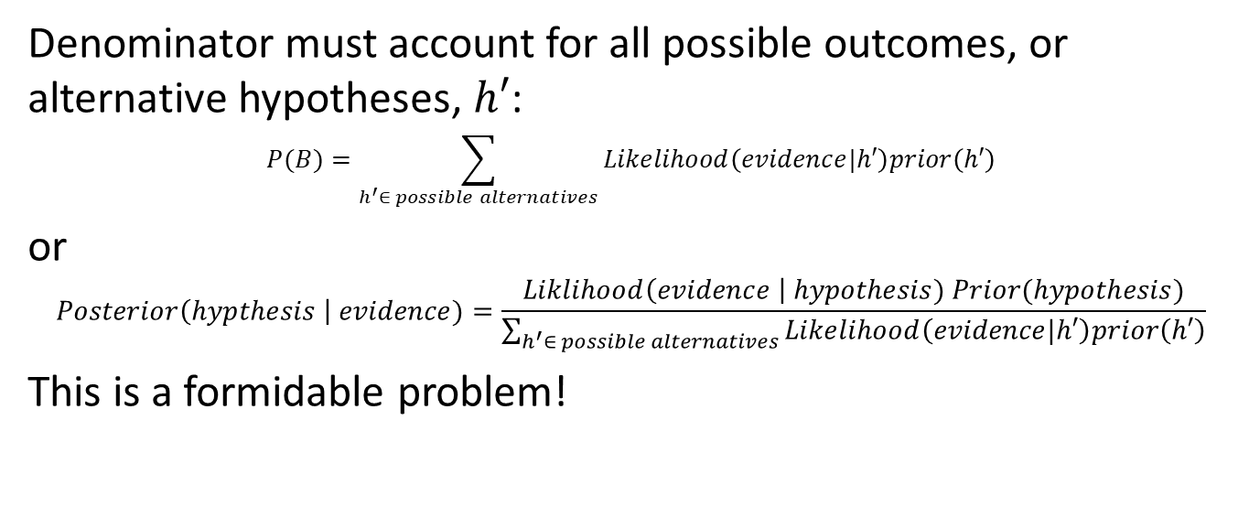
Interpreting Bayes Theorem
Denominator must account for all possible outcomes, or alternative hypotheses, $h′$:
$$P(B)=\sum_{h^{′}∈ possible alternatives}{Likelihood\left(evidence|h′\right)prior\left(h′\right)}$$
or
$$Posterior\left(hypthesis \right| evidence)=\frac{Liklihood\left(evidence \right| hypothesis) Prior(hypothesis)}{\sum_{h^{′}∈ possible alternatives}{Likelihood\left(evidence|h′\right)prior\left(h′\right)}}$$
This is a formidable problem!

Slide 21
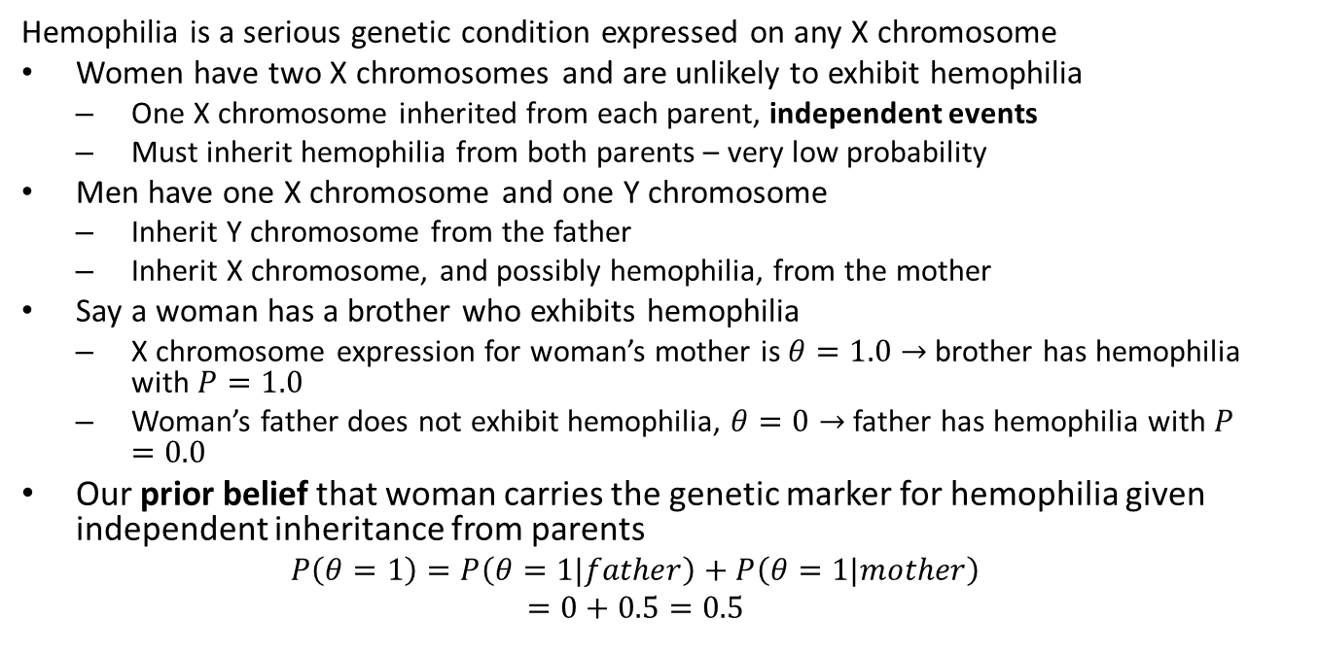
Bayes Theorem Example
Hemophilia is a serious genetic condition expressed on any X chromosome
Women have two X chromosomes and are unlikely to exhibit hemophilia
One X chromosome inherited from each parent, independent events
Must inherit hemophilia from both parents – very low probability
Men have one X chromosome and one Y chromosome
Inherit Y chromosome from the father
Inherit X chromosome, and possibly hemophilia, from the mother
Say a woman has a brother who exhibits hemophilia
X chromosome expression for woman’s mother is $θ=1.0→$ brother has hemophilia with $P=1.0$
Woman’s father does not exhibit hemophilia, $θ=0→$ father has hemophilia with $P=0.0$
Our prior belief that woman carries the genetic marker for hemophilia given independent inheritance from parents
$$P\left(θ=1\right)=P\left(θ=1|father\right)+P\left(θ=1|mother\right)$$
$$=0+0.5=0.5$$

Slide 22
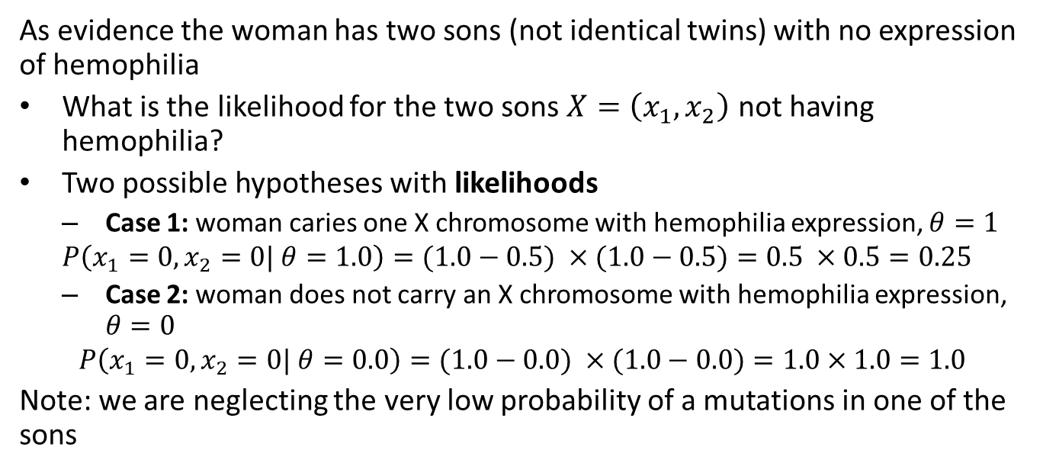
Bayes Theorem Example
As evidence the woman has two sons (not identical twins) with no expression of hemophilia
What is the likelihood for the two sons $X=\left(x_{1},x_{2}\right)$ not having hemophilia?
Two possible hypotheses with likelihoods
Case 1: woman caries one X chromosome with hemophilia expression, $θ=1$
$$P\left(x_{1}=0,x_{2}=0| θ=1.0\right)=(1.0−0.5) ×(1.0−0.5)=0.5 ×0.5=0.25$$
Case 2: woman does not carry an X chromosome with hemophilia expression, $θ=0$
$$P\left(x_{1}=0,x_{2}=0| θ=0.0\right)=(1.0−0.0) ×(1.0−0.0)=1.0×1.0=1.0$$
Note: we are neglecting the very low probability of a mutations in one of the sons

Slide 23
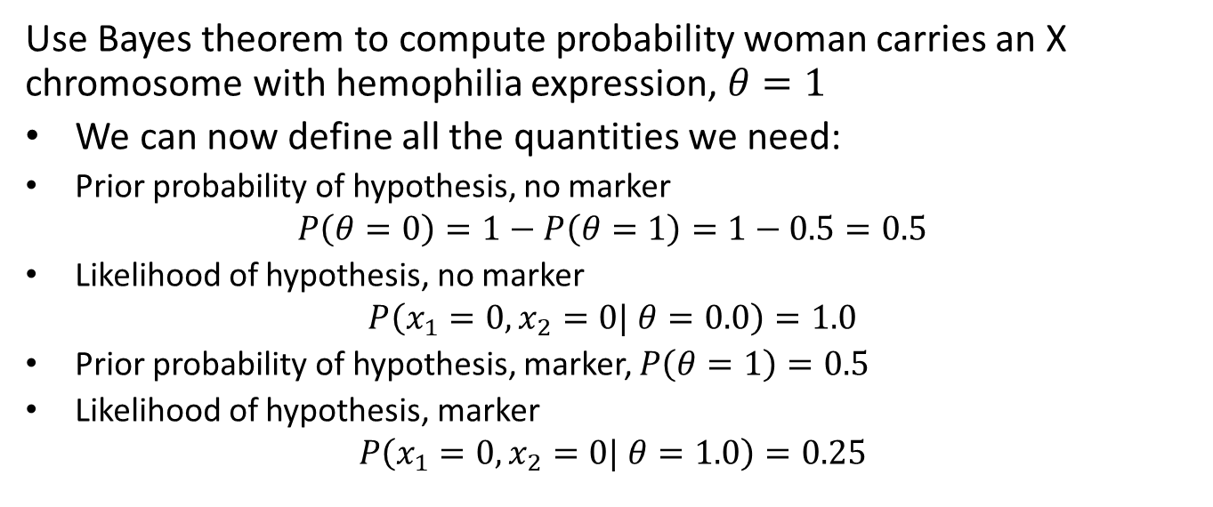
Bayes Theorem Example
Use Bayes theorem to compute probability woman carries an X chromosome with hemophilia expression, $θ=1$
We can now define all the quantities we need:
Prior probability of hypothesis, no marker
$$P\left(θ=0\right)=1−P\left(θ=1\right)=1−0.5=0.5$$
Likelihood of hypothesis, no marker
$$P\left(x_{1}=0,x_{2}=0| θ=0.0\right)=1.0$$
Prior probability of hypothesis, marker, $P\left(θ=1\right)=0.5$
Likelihood of hypothesis, marker
$$P\left(x_{1}=0,x_{2}=0| θ=1.0\right)=0.25$$

Slide 24
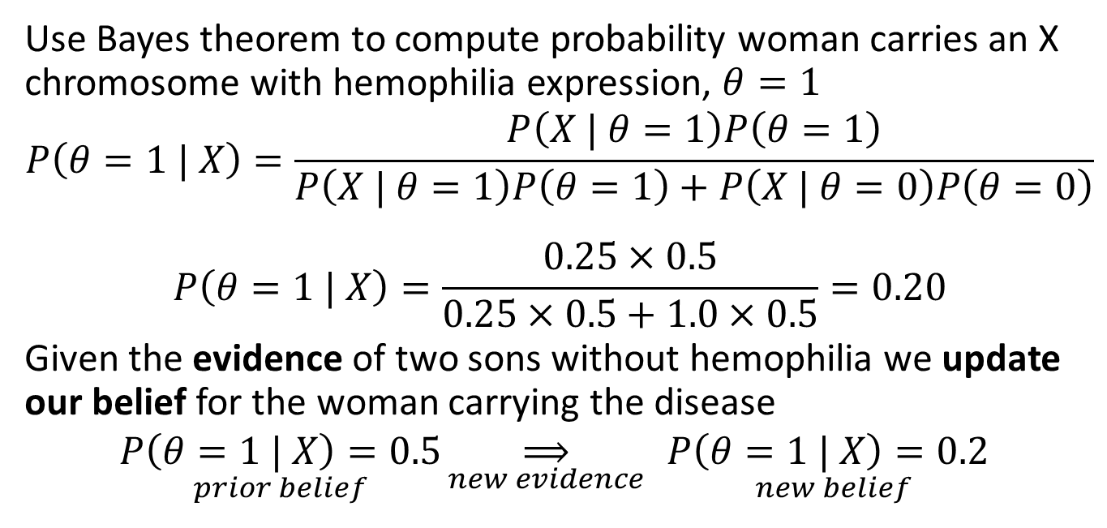
Bayes Theorem Example
Use Bayes theorem to compute probability woman carries an X chromosome with hemophilia expression, $θ=1$
$$P\left(θ=1 | X\right)=\frac{P\left(X | θ=1\right)P\left(θ=1\right)}{P\left(X | θ=1\right)P\left(θ=1\right)+P\left(X | θ=0\right)P\left(θ=0\right)}$$
$$P\left(θ=1 | X\right)=\frac{0.25×0.5}{0.25×0.5+1.0×0.5}=0.20$$
Given the evidence of two sons without hemophilia we update our belief for the woman carrying the disease
$$\underset{prior belief}{P\left(θ=1 | X\right)=0.5}\underset{new evidence}{⟹}{ }\underset{new belief}{P\left(θ=1 | X\right)=0.2}$$

Slide 25
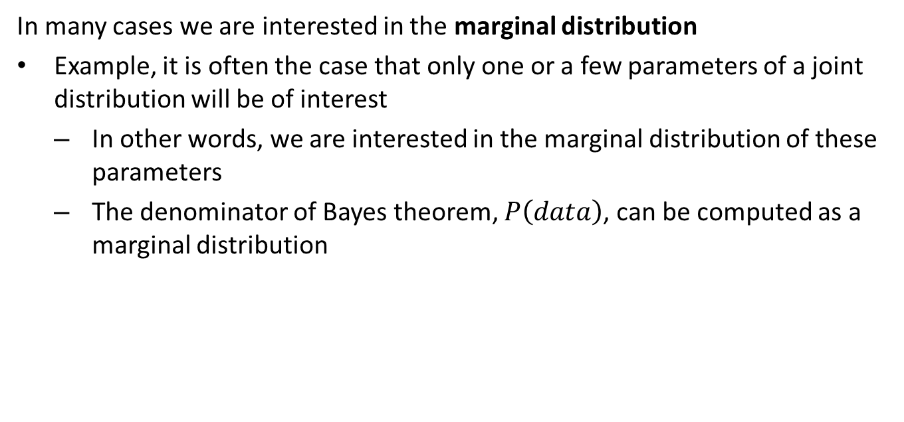
Marginal Distributions
In many cases we are interested in the marginal distribution
Example, it is often the case that only one or a few parameters of a joint distribution will be of interest
In other words, we are interested in the marginal distribution of these parameters
The denominator of Bayes theorem, $P\left(data\right)$, can be computed as a marginal distribution

Slide 26
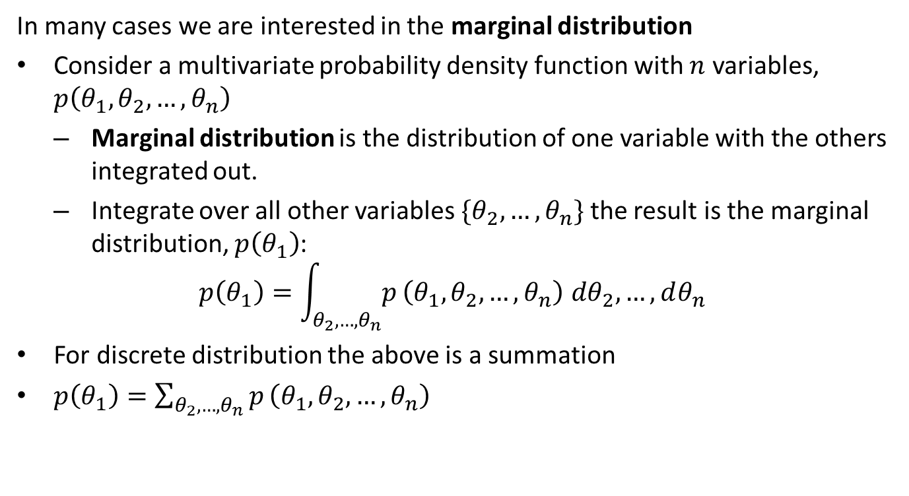
Marginal Distributions
In many cases we are interested in the marginal distribution
Consider a multivariate probability density function with $n$ variables, $p\left(θ_{1},θ_{2},…,θ_{n}\right)$
Marginal distribution is the distribution of one variable with the others integrated out.
Integrate over all other variables $\{θ_{2},…,θ_{n}\}$ the result is the marginal distribution, $p\left(θ_{1}\right)$:
$$p\left(θ_{1}\right)=\int_{θ_{2},…,θ_{n}}^{​}{p}\left(θ_{1},θ_{2},…,θ_{n}\right) dθ_{2},…,dθ_{n}$$
For discrete distribution the above is a summation
$p\left(θ_{1}\right)=\sum_{θ_{2},…,θ_{n}}^{​}{p}\left(θ_{1},θ_{2},…,θ_{n}\right)$

Slide 27
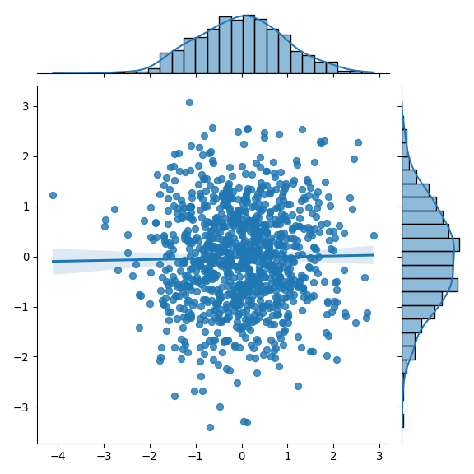
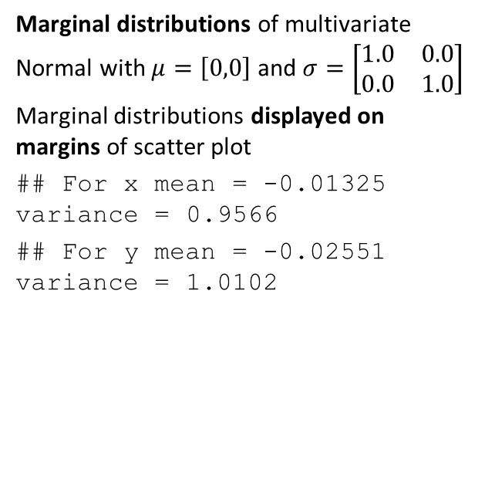
Example: Marginal Distribution
Marginal distributions of multivariate Normal with $μ=\left[0,0\right]$ and $σ=\left[\begin{matrix}1.0 & 0.0 \\ 0.0 & 1.0\end{matrix}\right]$
Marginal distributions displayed on margins of scatter plot
## For x mean = -0.01325 variance = 0.9566 ## For y mean = -0.02551 variance = 1.0102

Slide 28
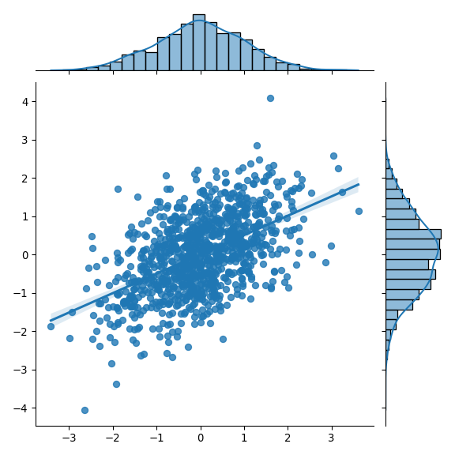
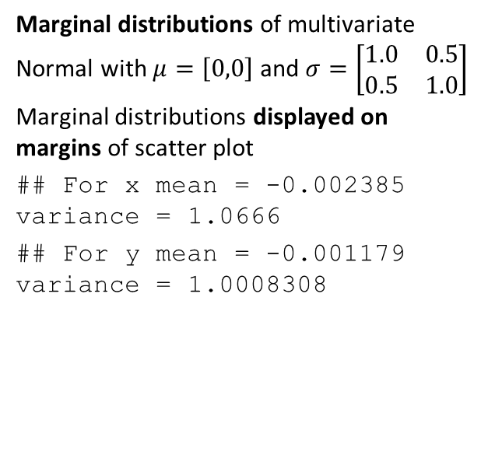
Example: Marginal Distribution
Marginal distributions of multivariate Normal with $μ=\left[0,0\right]$ and $σ=\left[\begin{matrix}1.0 & 0.5 \\ 0.5 & 1.0\end{matrix}\right]$
Marginal distributions displayed on margins of scatter plot
## For x mean = -0.002385 variance = 1.0666 ## For y mean = -0.001179 variance = 1.0008308

Slide 29
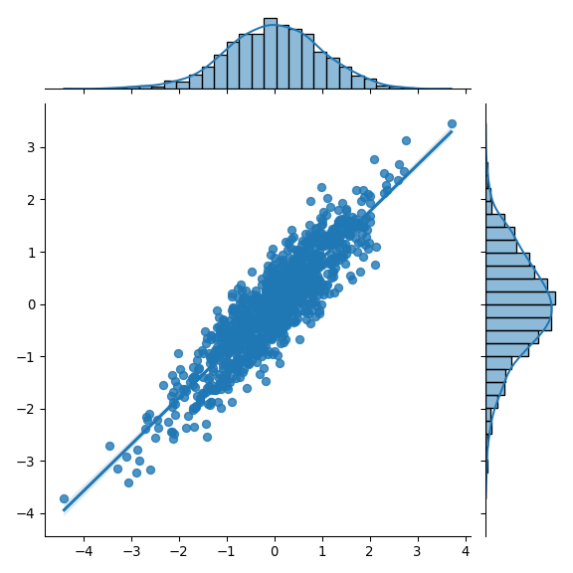
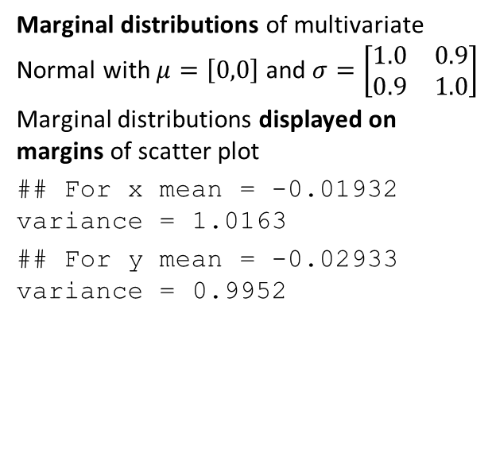
Example: Marginal Distribution
Marginal distributions of multivariate Normal with $μ=\left[0,0\right]$ and $σ=\left[\begin{matrix}1.0 & 0.9 \\ 0.9 & 1.0\end{matrix}\right]$
Marginal distributions displayed on margins of scatter plot
## For x mean = -0.01932 variance = 1.0163 ## For y mean = -0.02933 variance = 0.9952

Slide 30
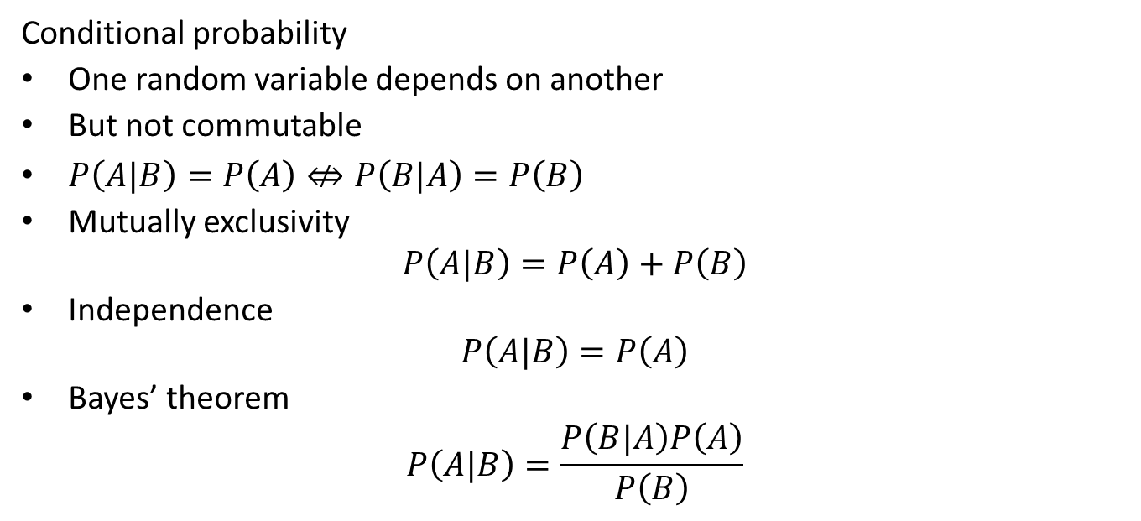
Summary
Conditional probability
One random variable depends on another
But not commutable
$P\left(A|B\right)=P\left(A\right)⇎P\left(B|A\right)=P\left(B\right)$
Mutually exclusivity
$$P\left(A|B\right)=P\left(A\right)+P\left(B\right)$$
Independence
$$P\left(A|B\right)=P\left(A\right)$$
Bayes’ theorem
$$P\left(A|B\right)=\frac{P\left(B|A\right)P\left(A\right)}{P\left(B\right)}$$

Slide 31

Summary
Marginal distribution
$$p\left(θ_{1}\right)=\int_{θ_{2},…,θ_{n}}^{​}{p}\left(θ_{1},θ_{2},…,θ_{n}\right) dθ_{2},…,dθ_{n}$$
Or,
$$p\left(θ_{1}\right)=\sum_{θ_{2},…,θ_{n}}^{​}{p}\left(θ_{1},θ_{2},…,θ_{n}\right)$$

