Slide 1

Complex and Messy Time Series
Steve Elston
Copyright 2025, 2026 Stephen F Elston. All rights reserved.

Slide 2
Spectral Properties of Time Series
The power spectrum of an image reveals fundamental properties
Power spectrum reveals frequency components of a time series
Low frequency components represent regions with slowly changing properties
High frequency components arise from local features with rapid changes
Filtering changes the power spectrum of a time series

Slide 3
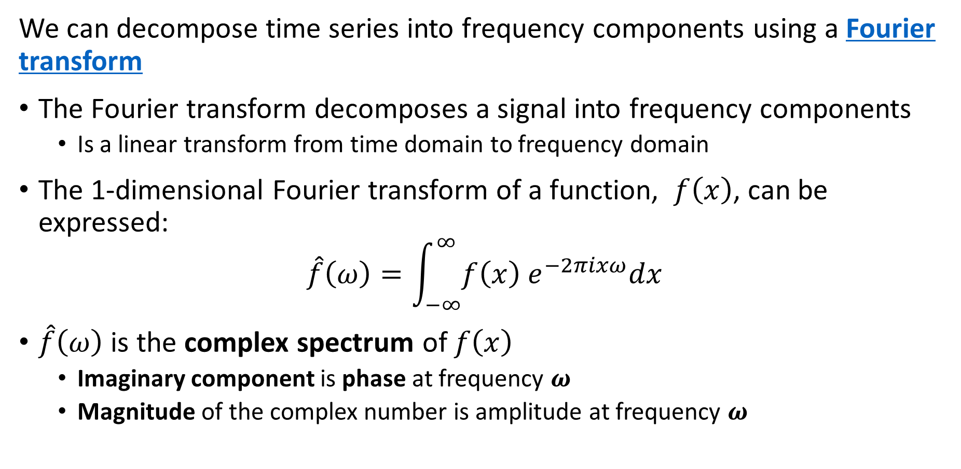
Spectral Properties of Time Series
We can decompose time series into frequency components using a Fourier transform
The Fourier transform decomposes a signal into frequency components
  Is a linear transform from time domain to frequency domain
The 1-dimensional Fourier transform of a function, $f\left(x\right)$, can be expressed:
$$\hat{f}\left(ω\right)=\int_{−∞}^{∞}{f\left(x\right) e^{−2πixω}dx}$$
$\hat{f}\left(ω\right)$ is the complex spectrum of $f\left(x\right)$
  Imaginary component is phase at frequency $ω$
  Magnitude of the complex number is amplitude at frequency $ω$

Slide 4
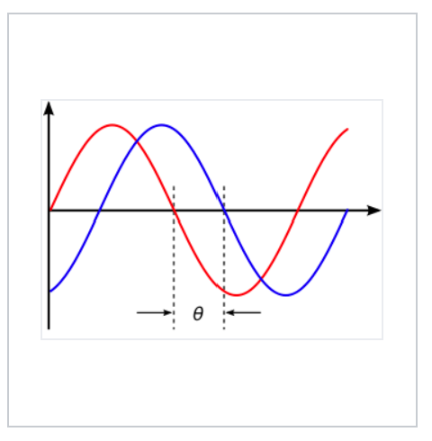
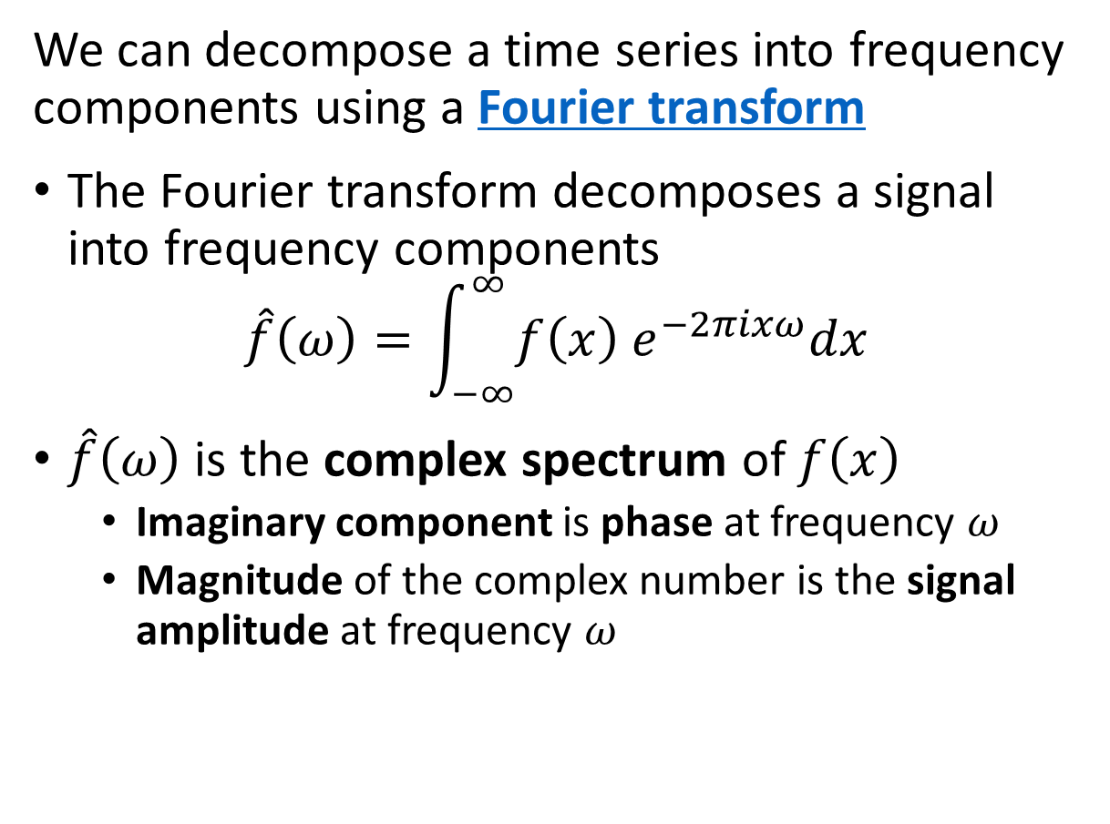
Spectral Properties of Time Series
We can decompose a time series into frequency components using a Fourier transform
The Fourier transform decomposes a signal into frequency components
$$\hat{f}\left(ω\right)=\int_{−∞}^{∞}{f\left(x\right) e^{−2πixω}dx}$$
$\hat{f}\left(ω\right)$ is the complex spectrum of $f\left(x\right)$
  Imaginary component is phase at frequency $ω$
  Magnitude of the complex number is the signal amplitude at frequency $ω$
Amplitude
Two sinusoidal signals with identical frequency and amplitude, phase shifted by θ
Credit, Wikipedia commons

Slide 5
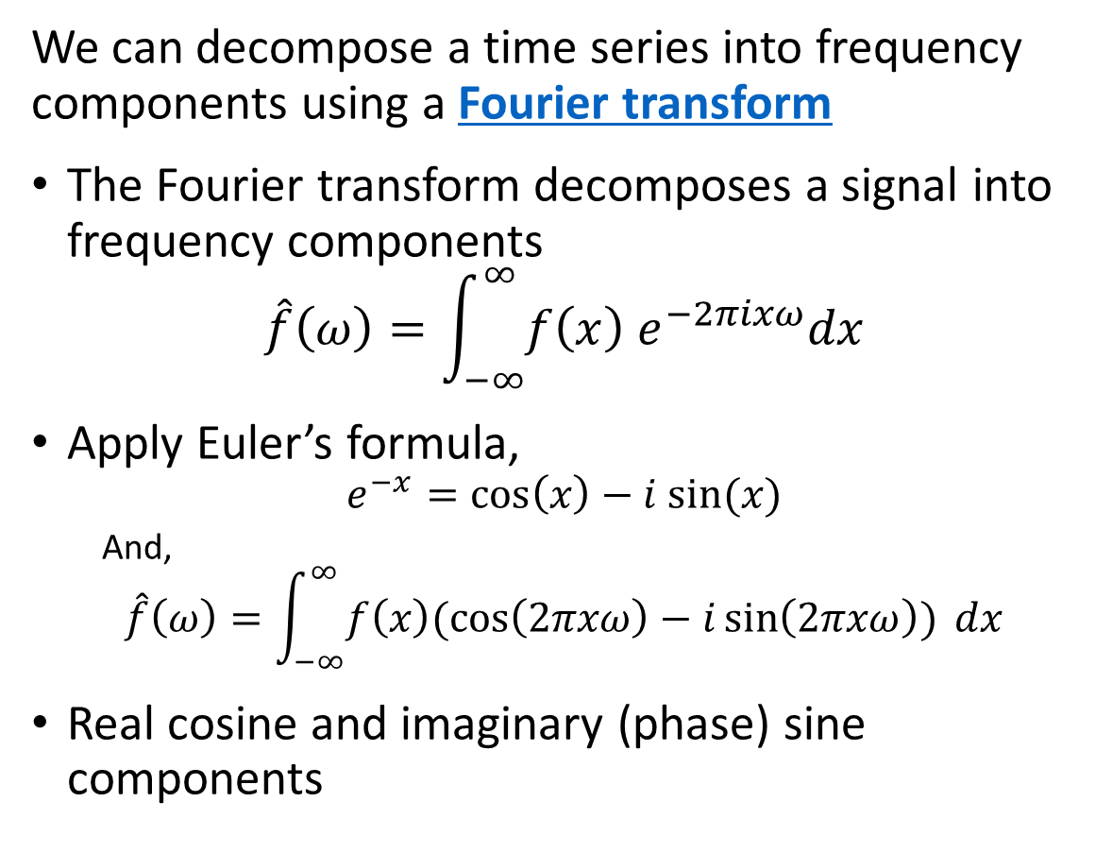
Spectral Properties of Time Series
We can decompose a time series into frequency components using a Fourier transform
The Fourier transform decomposes a signal into frequency components
$$\hat{f}\left(ω\right)=\int_{−∞}^{∞}{f\left(x\right) e^{−2πixω}dx}$$
Apply Euler’s formula,
$$e^{−x}=\cos\left(x\right)−i sin⁡(x)$$
  And,
$$\hat{f}\left(ω\right)=\int_{−∞}^{∞}{f\left(x\right)(\cos\left(2πxω\right)−i\sin\left(2πxω\right)) dx}$$
Real cosine and imaginary (phase) sine components
Amplitude
Two sinusoidal signals with identical frequency and amplitude, phase shifted by θ
Credit, Wikipedia commons

Slide 6
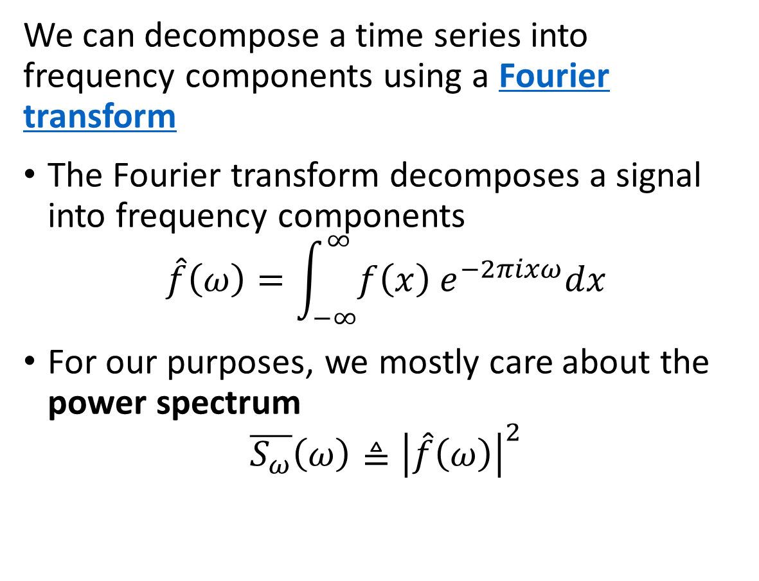
Spectral Properties of Time Series
We can decompose a time series into frequency components using a Fourier transform
The Fourier transform decomposes a signal into frequency components
$$\hat{f}\left(ω\right)=\int_{−∞}^{∞}{f\left(x\right) e^{−2πixω}dx}$$
For our purposes, we mostly care about the power spectrum
$$\overline{S_{ω}}\left(ω\right)≜{\left|\hat{f}\left(ω\right)\right|}^{2}$$
Amplitude
Two sinusoidal signals with identical frequency and amplitude, phase shifted by θ
Credit, Wikipedia commons

Slide 7
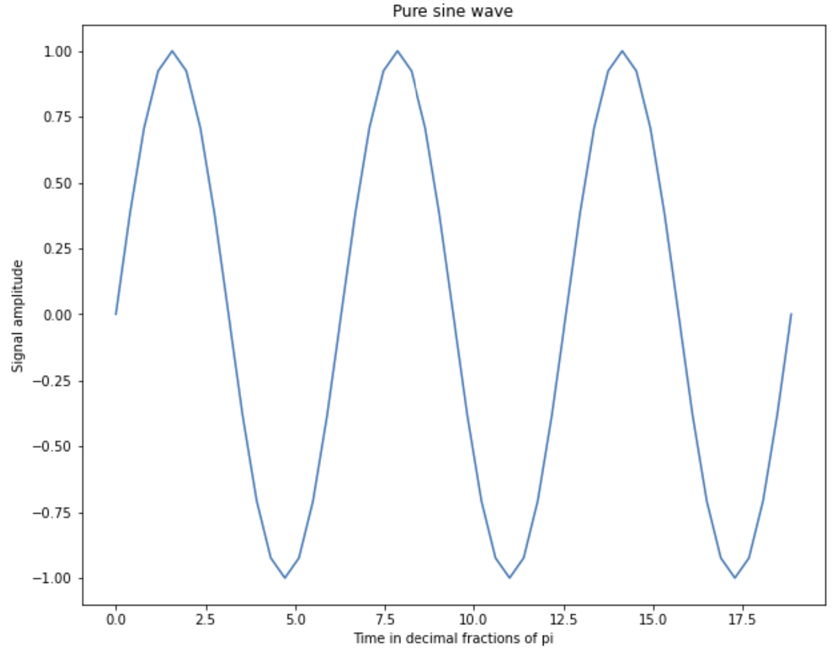
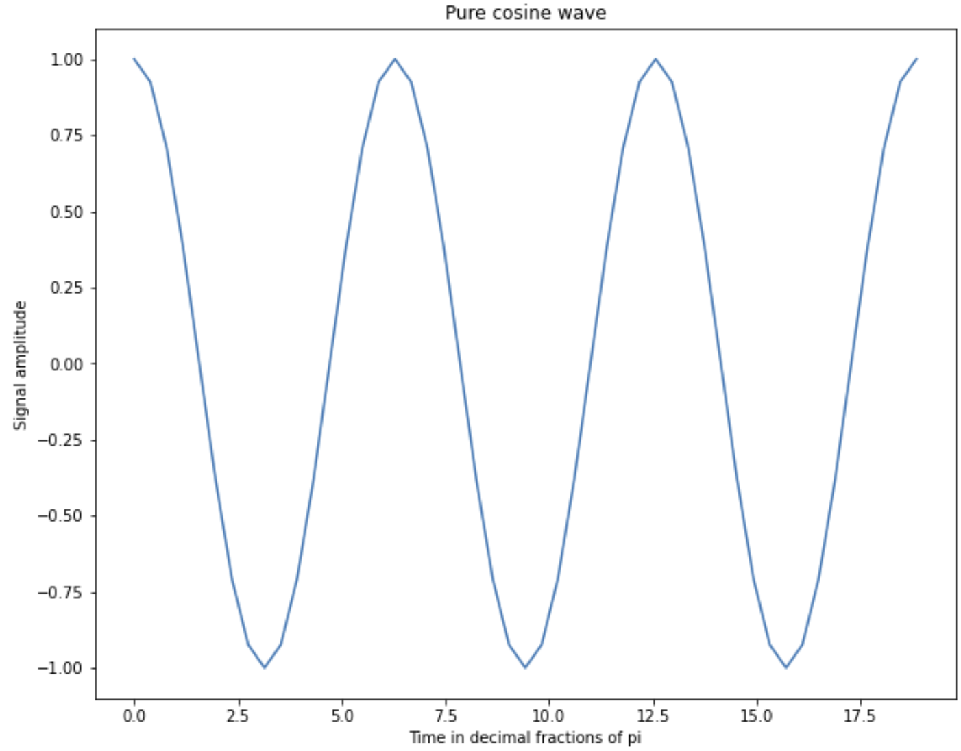
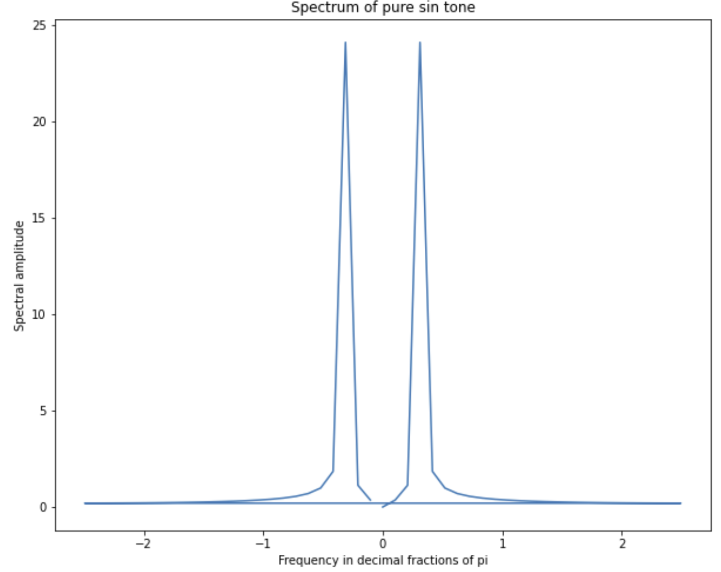
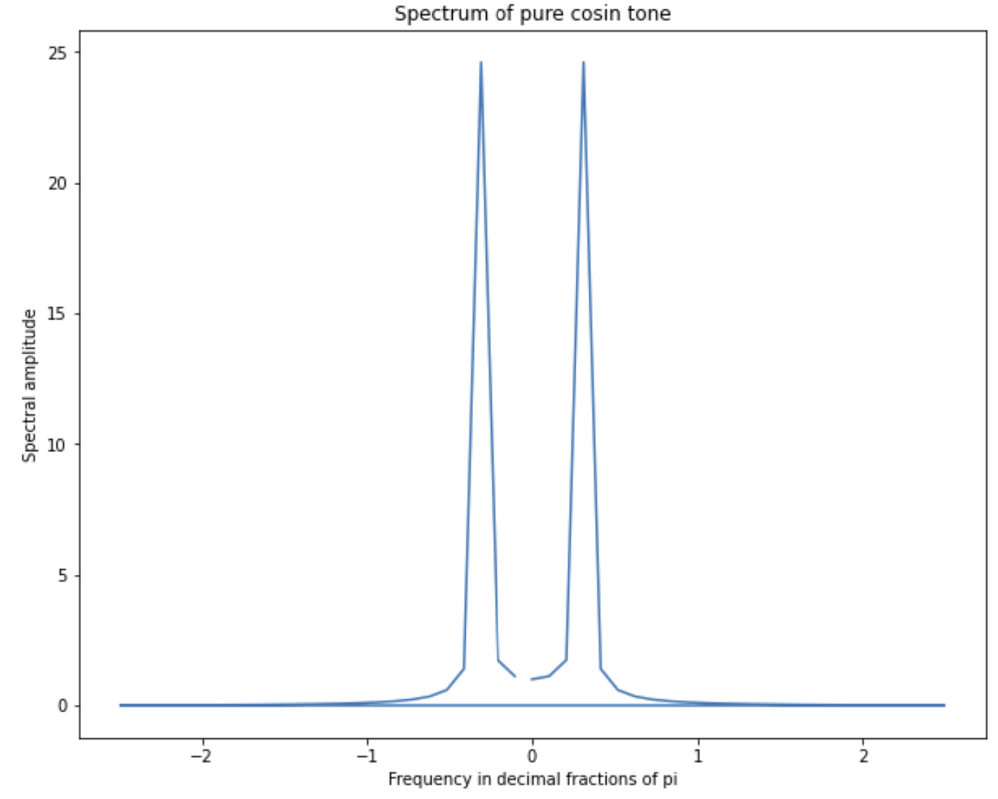
Spectral Properties of Time Series
Example of single frequency time series and their power spectrum

Slide 8
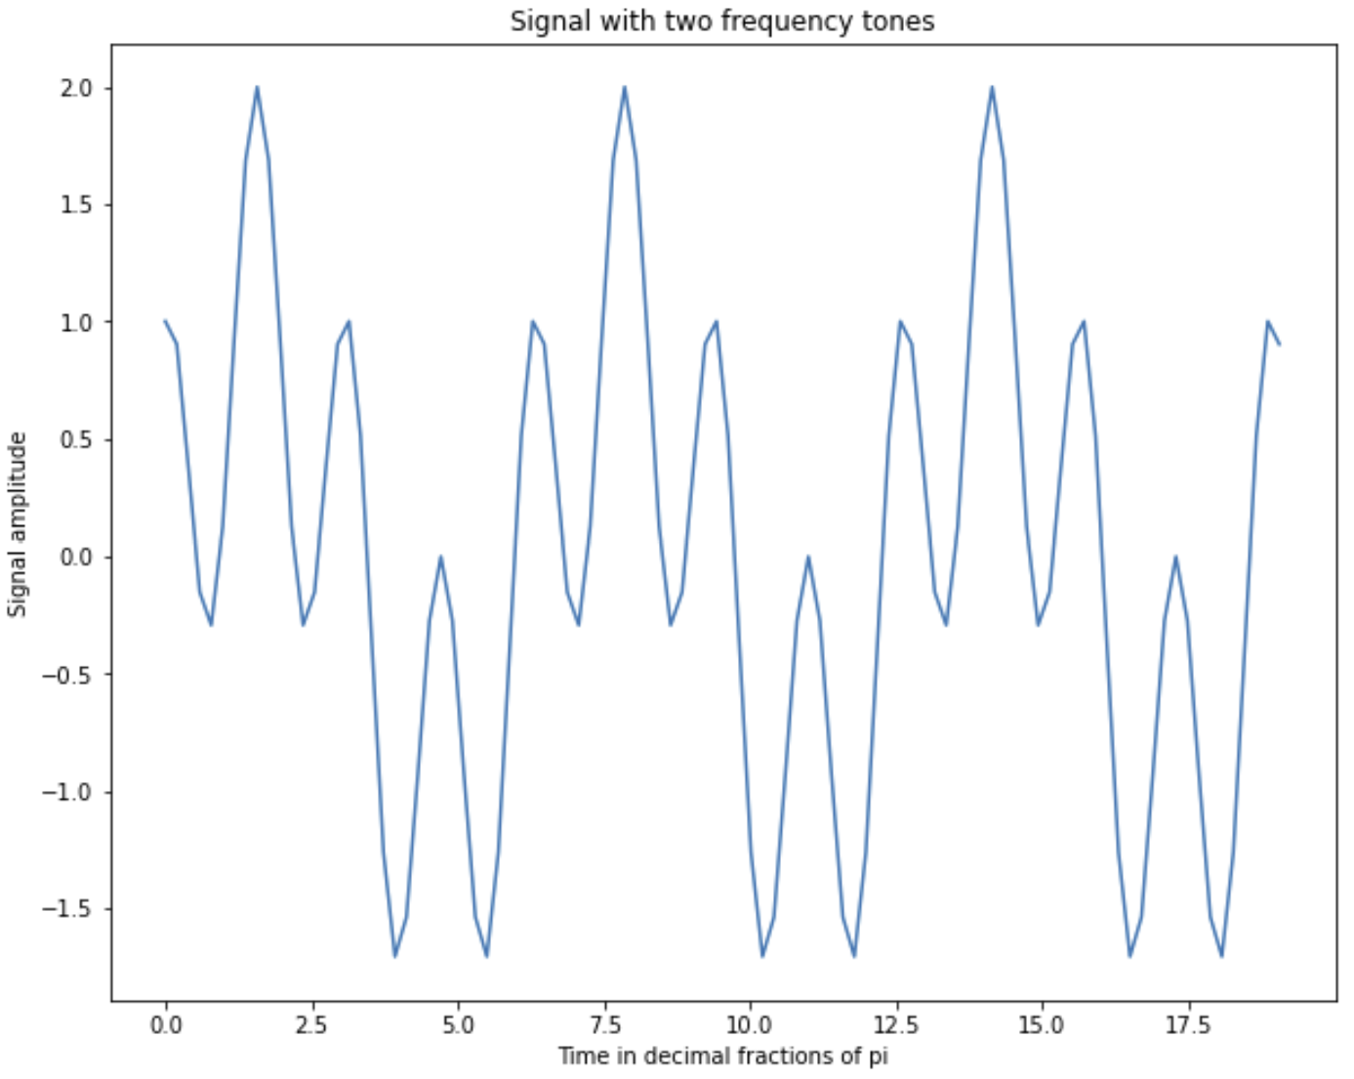
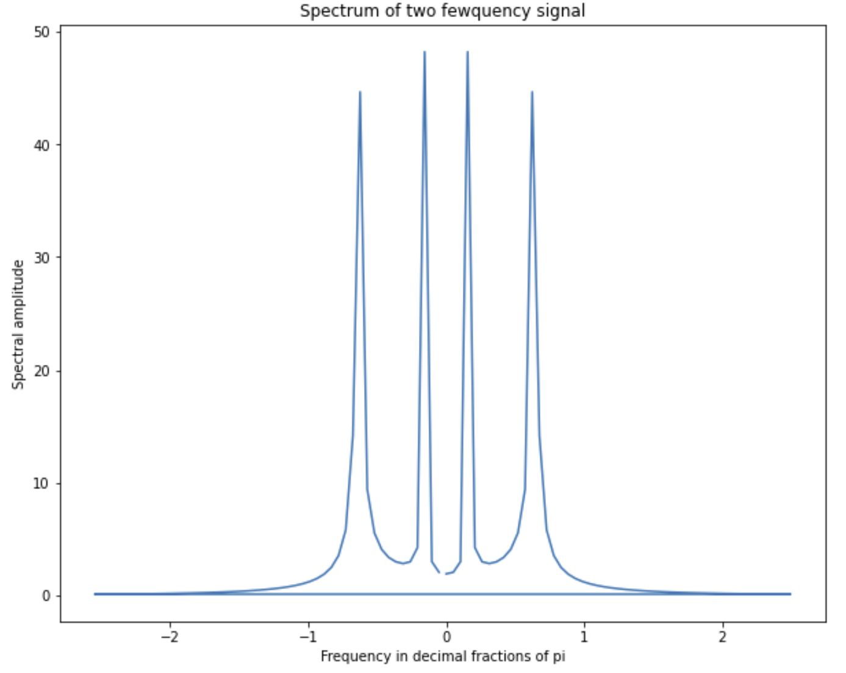
Spectral Properties of Time Series
Example of time series with two frequencies and the power spectrum

Slide 9
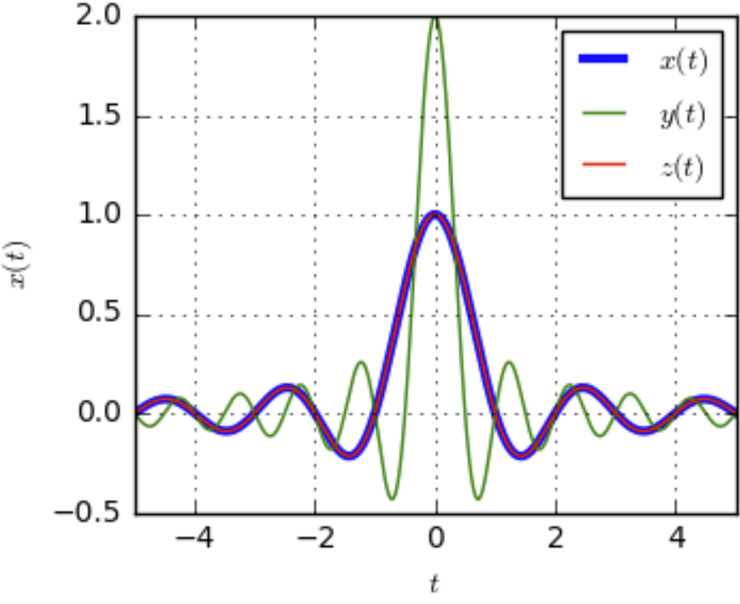
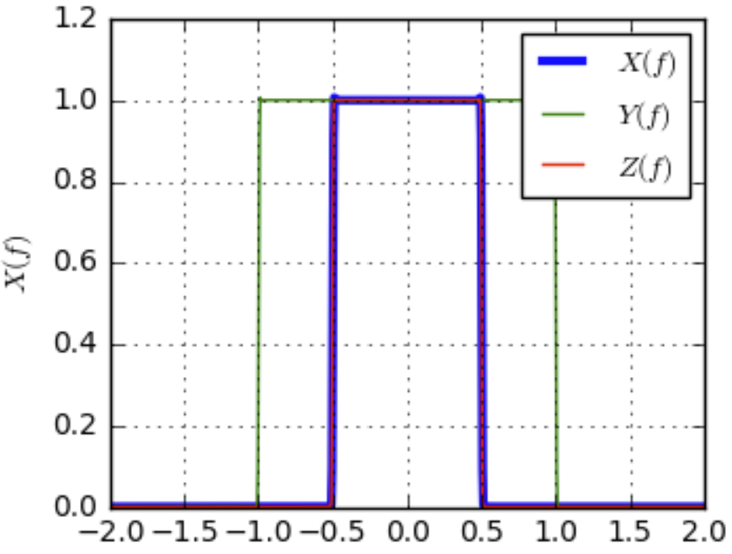
Spectral Properties of Time Series
Impulse in the time domain and Fourier transform in the frequency domain
Fourier Transform
Impulse in time domain
Impulse in frequency domain
Credit, DSP Illustrations
Relationship is invertible (inverse Fourier transform) and commutable – exchange time and frequency domain

Slide 10
PROFIT Model

Slide 11
PROFIT Model
The PROFIT model from Meta Research is a deterministic model well suited for some business forecasting problems
Uses a sophisticated piece-wise linear trend model
  Trend computed between breakpoints
  Breakpoints found with Bayesian model
  Complex trend model confounded by random walks
Multi-seasonal component modeled by Fourier decomposition
  Multiple harmonics per seasonal period
  Flexible modeling of complex seasonal patterns
Supports exogenous variables
PROFIT model assumes residual is non-informative

Slide 12
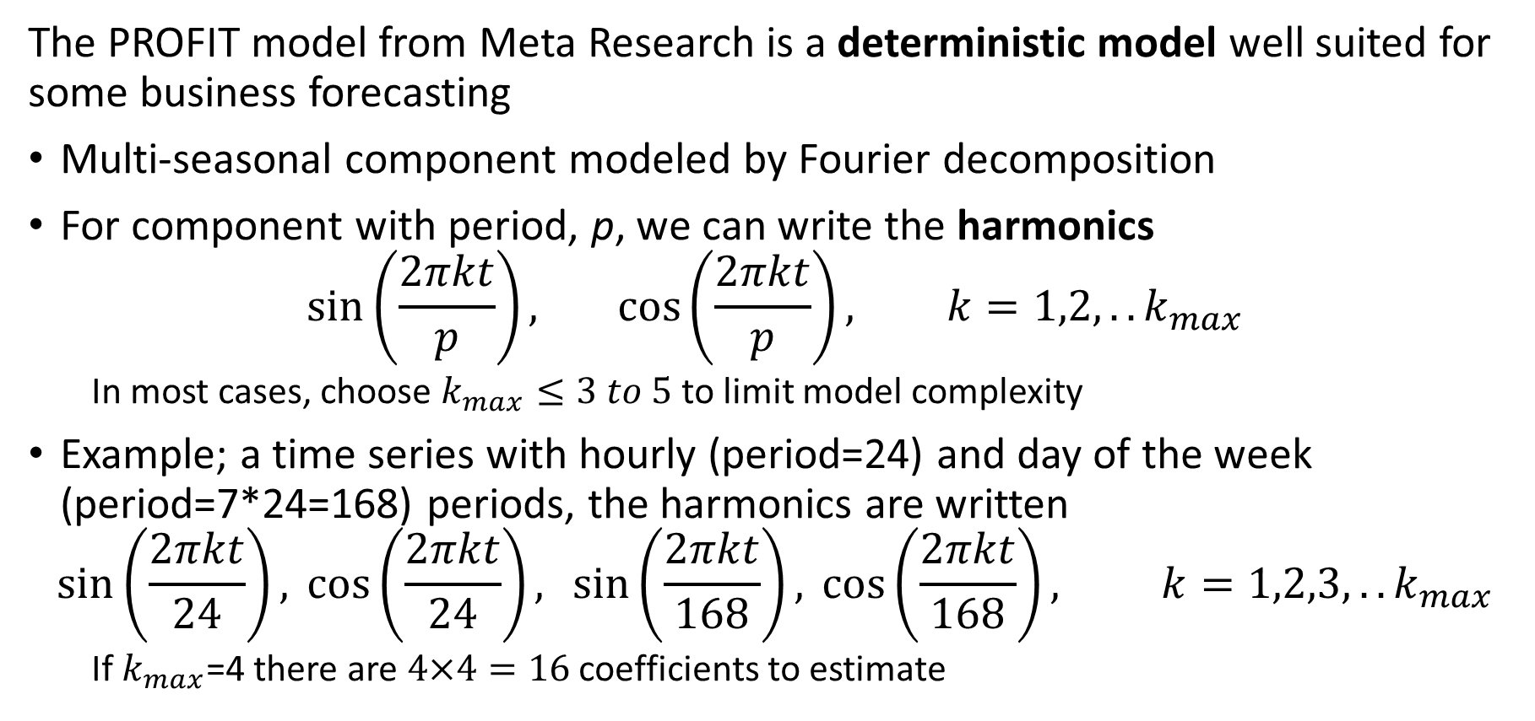
PROFIT Model
The PROFIT model from Meta Research is a deterministic model well suited for some business forecasting
Multi-seasonal component modeled by Fourier decomposition
For component with period, p, we can write the harmonics
$$\sin\left(\frac{2πkt}{p}\right), \cos\left(\frac{2πkt}{p}\right), k=1,2,..k_{max}$$
  In most cases, choose $k_{max}≤3 to 5$ to limit model complexity
Example; a time series with hourly (period=24) and day of the week (period=7*24=168) periods, the harmonics are written
$$\sin\left(\frac{2πkt}{24}\right), \cos\left(\frac{2πkt}{24}\right), \sin\left(\frac{2πkt}{168}\right), \cos\left(\frac{2πkt}{168}\right), k=1,2,3,..k_{max}$$
  If $k_{max}$=4 there are $4×4=16$ coefficients to estimate

Slide 13
PROFIT Model
The PROFIT model from Meta Research is a deterministic model well suited for some business forecasting problems
PROFIT model assumes residual is non-informative
  Model assumes no stochastic components in time series!
  ACF and PACF must have no significant nonzero lags
If significant ACF and PACF use SARIMAX
  Uses information in stationary residual
  Gives superior results for time series with stochastic components

