Slide 1

Introduction to Linear Models
Steve Elston
Copyright 2018, 2019, 2020, 2021, 2022, 2023 2024, 2025, Stephen F Elston. All rights reserved.

Slide 2
Introduction - Why linear models?
Linear models are widely used in statistics and machine learning
Understandable and interpretable
Generalize well, if properly fit
Highly scalable and computationally efficient
Can approximate fairly complex functions
  A basis of understanding complex models
Many non-linear models are locally linear at convergence
  We can learn a lot about the convergence of DL and RL models from linear approximations
In this lesson we take a frequentist view of the linear model
  Frequentist view uses maximum likelihood estimation (MLE)
  Bayesian view is alternative

Slide 3
Introduction - Why linear models?
Linear models are readily interpretable!
Human interpretability is important for models used for critical decisions
  Health care
  Safe operation of autonomous systems
  Social justice and other applications with human impact
  etc.
Complex and nonlinear model result in poor human intuition about expected response
Models generalize well
  Low chance of unexpected output
  Complex and nonlinear models vulnerable to unexpected output
Model coefficients provide information on response sensitivities to changes in independent variable values

Slide 4
Why Linear Models
What are the alternatives?
Linear models are saleable and interpretable
  Ideal if goal is inference and exploration
  Can identify data problems more easily
  May have lower prediction accuracy on some problems
Gradient boosted algorithms are go-to models for prediction on tabular data
  Known to give superior predictions, but clean data matter more!
  Interpretability is nearly impossible
  Limits inference and exploration opportunities
  Can bootstrap!
Neural network models give superior performance for unstructured data, but are generally uninterpretable

Slide 5
What is regression?
In statistics, regression refers to a family of models that attempt to predict the value of a numeric random variable
Regression is a common form of a linear model
Linear models are a building block of many statistical and ML methods:
  multivariate regression and principal components
  Analysis of variance (ANOVA)
  Polynomial regression
  Logistic regression for binary classification
  Poisson regression and other non-Normal response models
  Many time series models
  Survival models
  Etc.

Slide 6
Terminology
Machine Learning Terminology | Statistical Terminology
Regression vs classification | Normal vs non-Normal response
Learning algorithm or model | Model
Training | Fitting
Trained model | Fitted model
Supervised learning | Predictive modeling
The confusing division in terminology arises from different communities within statistics and machine learning

Slide 7
Terminology
Predicted Variable | Variables Used to Predict
y | x
Dependent | Independent
Endogenous | Exogenous
Response | Predictor
Response | Explanatory
Label | Feature
Regressand | Regressors
Outcome | Design
Left Hand Side | Right Hand Side
Different communities have created different terminology at different times for the variables in a machine learning models

Slide 8
Formulating the Linear Model

Slide 9
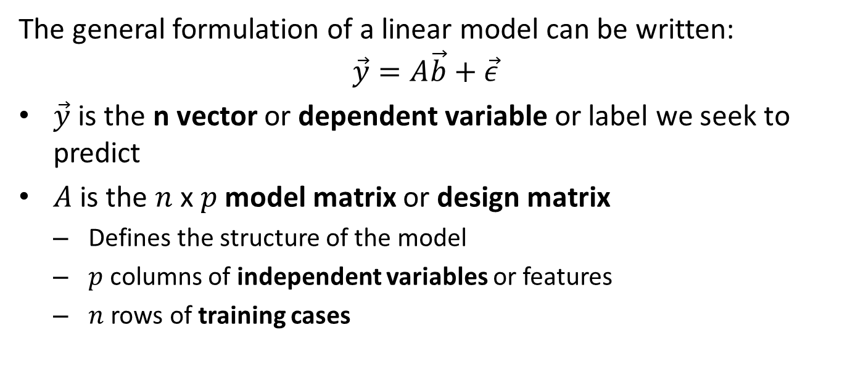
Formulating the Linear Model
The general formulation of a linear model can be written:
$$\vec{y}=A\vec{b}+\vec{ε}$$
$\vec{y}$ is the n vector or dependent variable or label we seek to predict
$A$ is the $n$ x $p$ model matrix or design matrix
  Defines the structure of the model
  $p$ columns of independent variables or features
  $n$ rows of training cases

Slide 10
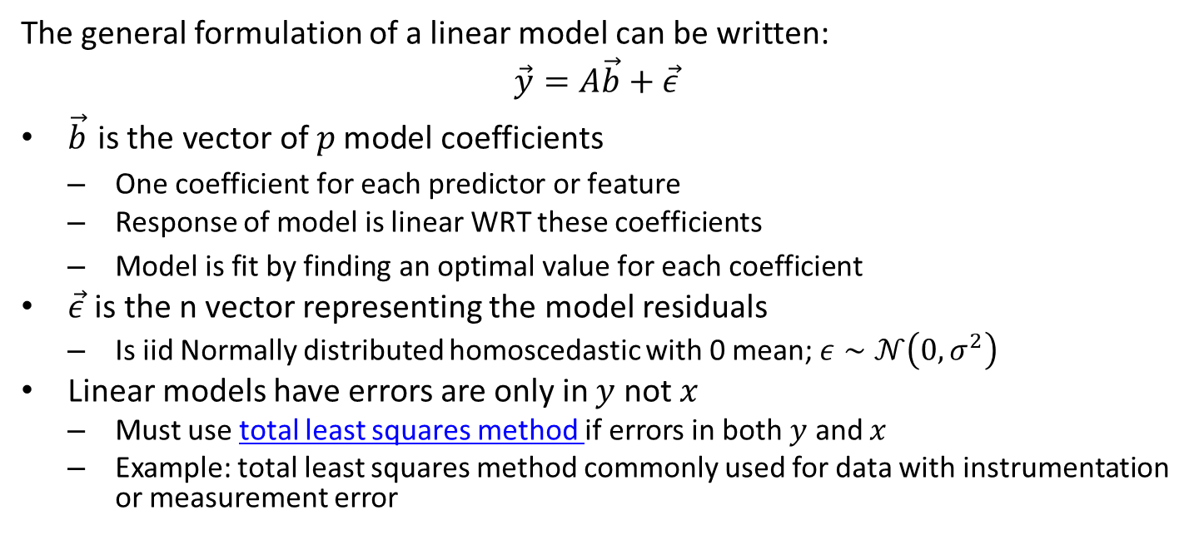
Formulating the Linear Model
The general formulation of a linear model can be written:
$$\vec{y}=A\vec{b}+\vec{ε}$$
$\vec{b} \text{is the vector of }p\text{ model coefficients}$
  $\text{One coefficient for each predictor or feature}$
  Response of model is linear WRT these coefficients
  $\text{Model is fit by finding an optimal value for each coefficient}$
$\vec{ε}$ is the n vector representing the model residuals
  Is iid Normally distributed homoscedastic with 0 mean; $ε∼𝒩\left(0,σ^{2}\right)$
Linear models have errors are only in $y$ not $x$
  Must use total least squares method if errors in both $y$ and $x$
  Example: total least squares method commonly used for data with instrumentation or measurement error

Slide 11
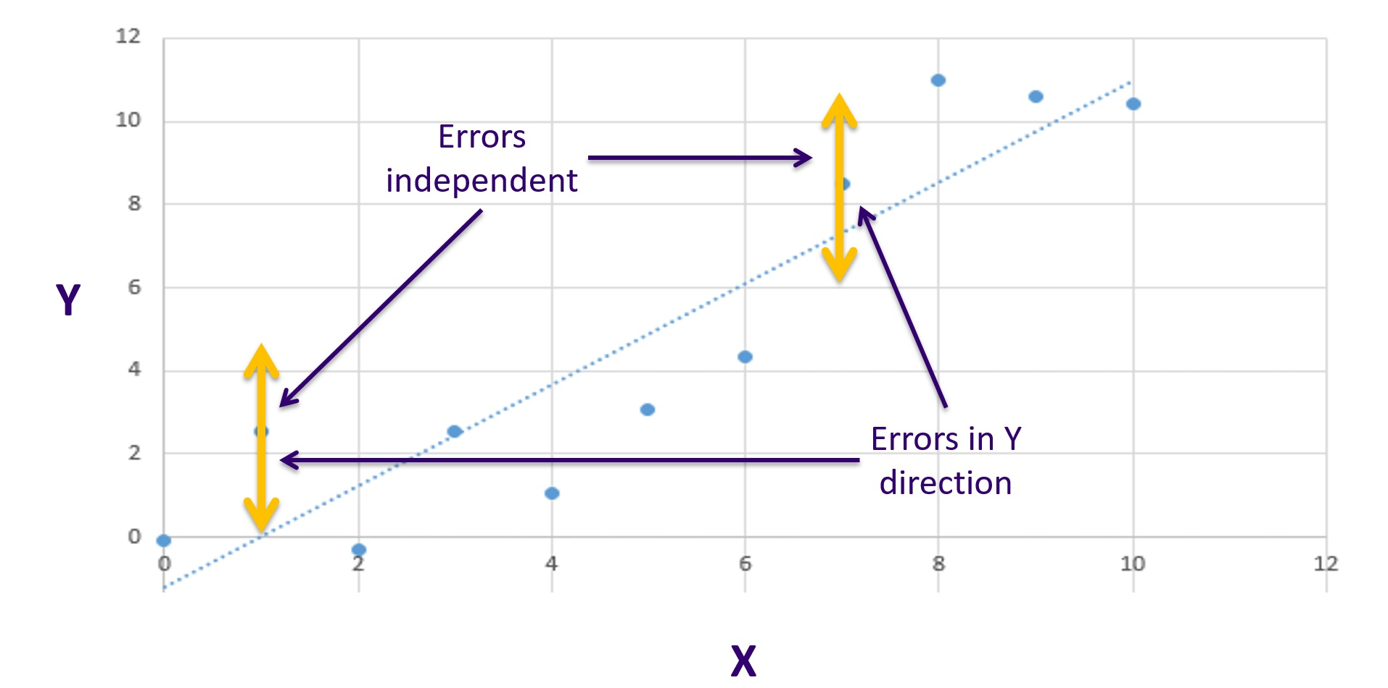
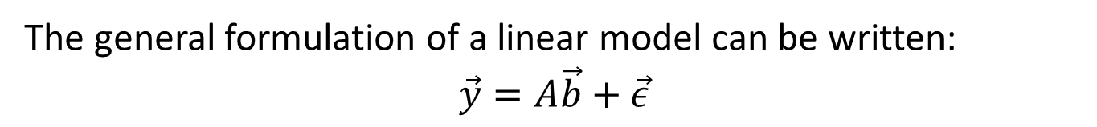
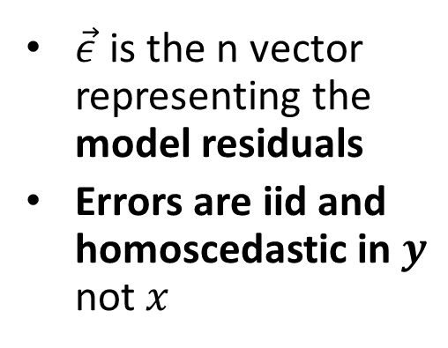
Formulating the Linear Model
The general formulation of a linear model can be written:
$$\vec{y}=A\vec{b}+\vec{ε}$$
$\vec{ε}$ is the n vector representing the model residuals
Errors are iid and homoscedastic in $y$ not $x$

Slide 12
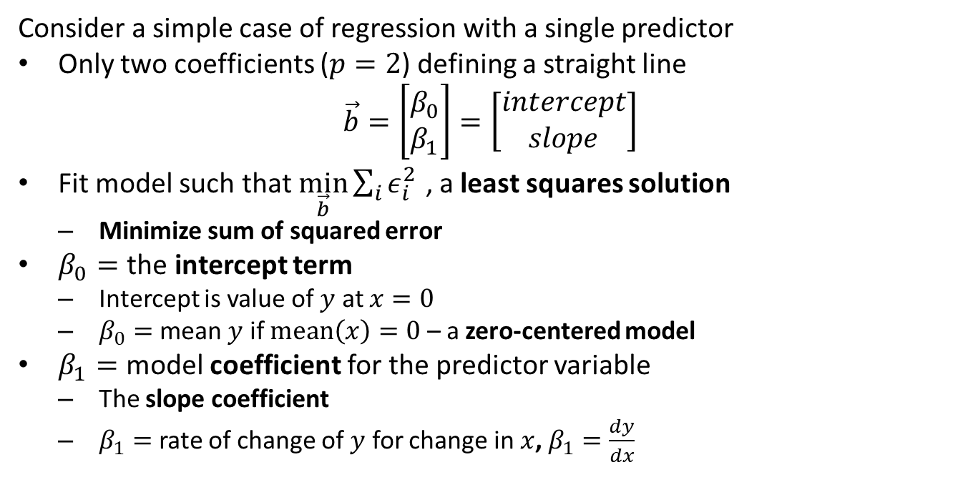
Single Predictor Regression
Consider a simple case of regression with a single predictor
Only two coefficients ($p=2$) defining a straight line
$$\vec{b}=\left[\begin{matrix}β_{0} \\ β_{1}\end{matrix}\right]=\left[\begin{matrix}intercept \\ slope\end{matrix}\right]$$
Fit model such that $\min_{\vec{b}}{\sum_{i}{ε_{i}^{2}}}$ , a least squares solution
  Minimize sum of squared error
$β_{0}=$ the intercept term
  Intercept is value of $y$ at $x=0$
  $β_{0}=$ mean $y$ if $mean\left(x\right)=0$ – a zero-centered model
$β_{1}=$ model coefficient for the predictor variable
  The slope coefficient
  $β_{1}=$ rate of change of $y$ for change in $x$, $β_{1}=\frac{dy}{dx}$

Slide 13
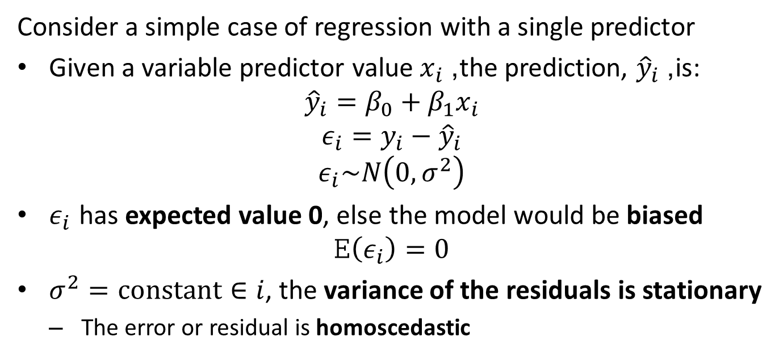
Single Predictor Regression
Consider a simple case of regression with a single predictor
Given a variable predictor value $x_{i}$, the prediction, ${\hat{y}}_{i}$, is:
$${\hat{y}}_{i}=β_{0}+β_{1}x_{i}$$
$$ε_{i}=y_{i}−{\hat{y}}_{i}$$
$$ε_{i}\sim N\left(0,σ^{2}\right)$$
$ε_{i}$ has expected value 0, else the model would be biased
$$E\left(ε_{i}\right)=0$$
$σ^{2}=constant∈i$, the variance of the residuals is stationary
  The error or residual is homoscedastic

Slide 14
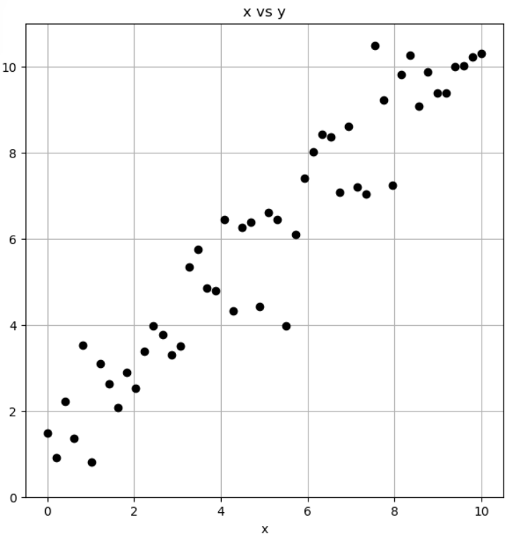
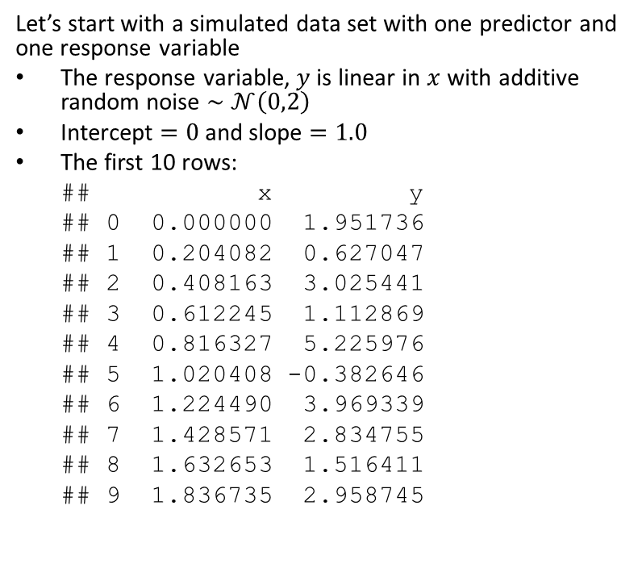
Example
Let’s start with a simulated data set with one predictor and one response variable
The response variable, $y$ is linear in $x$ with additive random noise $∼𝒩\left(0,2\right)$
Intercept $=0$ and slope $=1.0$
The first 10 rows:
## x y
## 0 0.000000 1.951736
## 1 0.204082 0.627047
## 2 0.408163 3.025441
## 3 0.612245 1.112869
## 4 0.816327 5.225976
## 5 1.020408 -0.382646
## 6 1.224490 3.969339
## 7 1.428571 2.834755
## 8 1.632653 1.516411
## 9 1.836735 2.958745

Slide 15
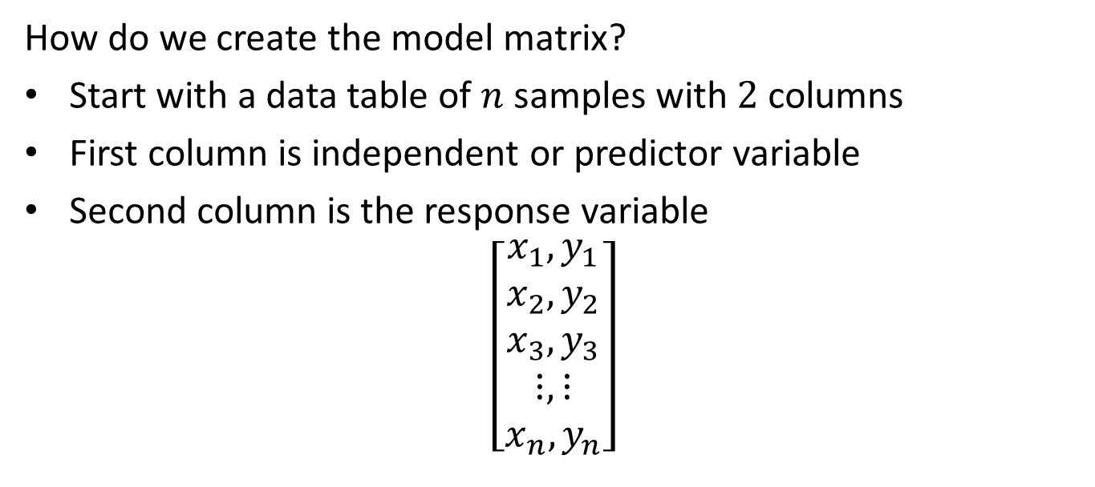
The Model Matrix
How do we create the model matrix?
Start with a data table of $n$ samples with $2$ columns
First column is independent or predictor variable
Second column is the response variable
$$\left[\begin{matrix}x_{1},y_{1} \\ x_{2},y_{2} \\ x_{3},y_{3} \\ ⋮,⋮ \\ x_{n},y_{n}\end{matrix}\right]$$

Slide 16
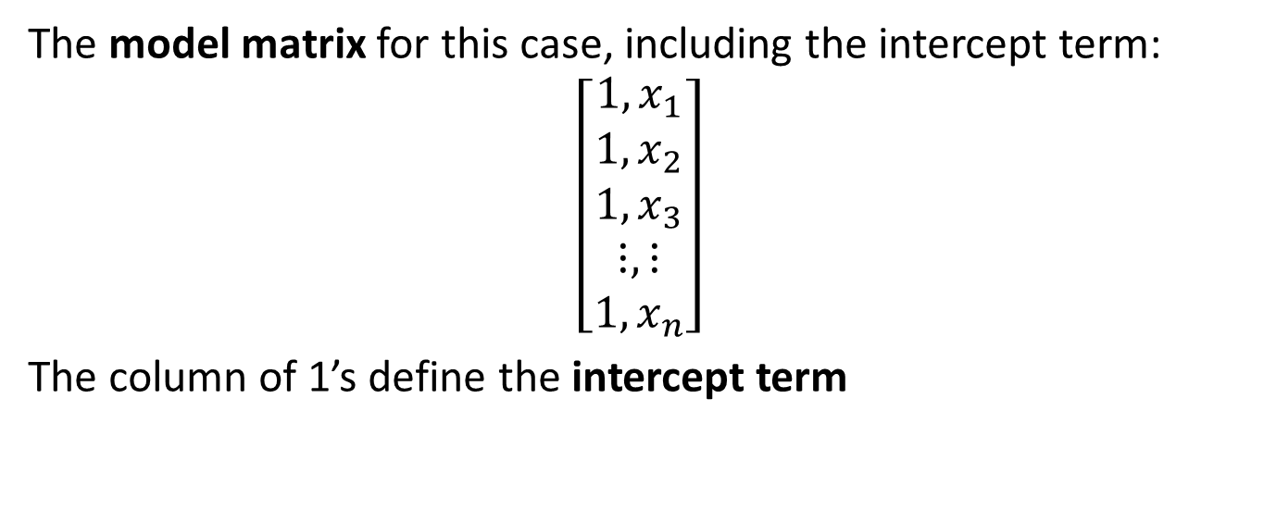
The Model Matrix
The model matrix for this case, including the intercept term:
$$\left[\begin{matrix}1,x_{1} \\ 1,x_{2} \\ 1,x_{3} \\ ⋮,⋮ \\ 1,x_{n}\end{matrix}\right]$$
The column of 1’s define the intercept term

Slide 17
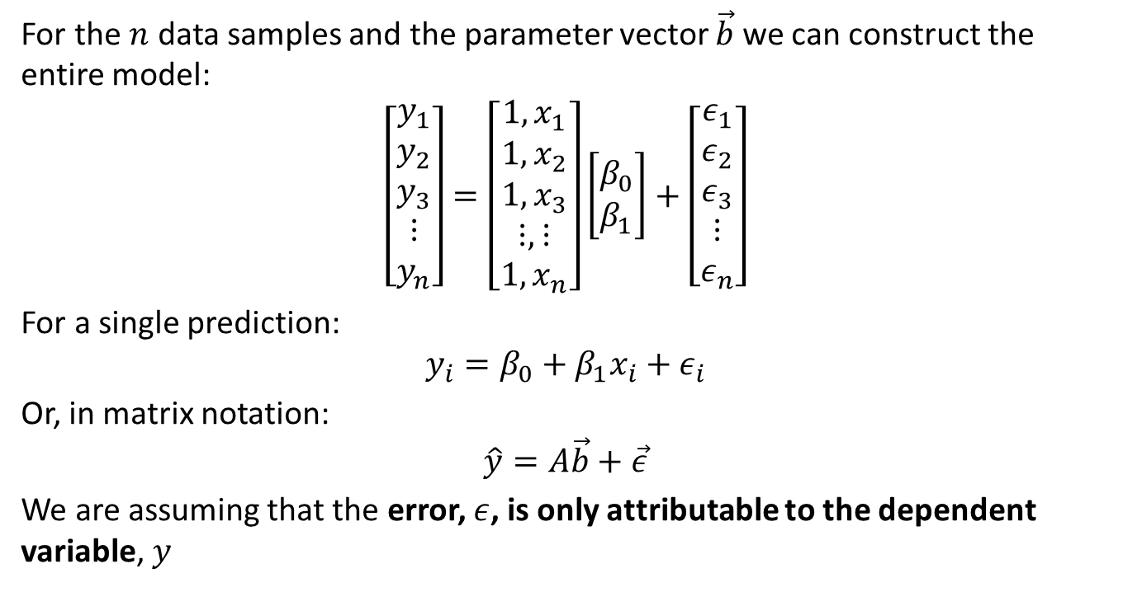
Constructing the Model
For the $n$ data samples and the parameter vector $\vec{b}$ we can construct the entire model:
$$\left[\begin{matrix}y_{1} \\ y_{2} \\ y_{3} \\ ⋮ \\ y_{n}\end{matrix}\right]=\left[\begin{matrix}1,x_{1} \\ 1,x_{2} \\ 1,x_{3} \\ ⋮,⋮ \\ 1,x_{n}\end{matrix}\right]\left[\begin{matrix}β_{0} \\ β_{1}\end{matrix}\right]+\left[\begin{matrix}ε_{1} \\ ε_{2} \\ ε_{3} \\ ⋮ \\ ε_{n}\end{matrix}\right]$$
For a single prediction:
$$y_{i}=β_{0}+β_{1}x_{i}+ε_{i}$$
Or, in matrix notation:
$$\hat{y}=A\vec{b}+\vec{ε}$$
We are assuming that the error, $ε$, is only attributable to the dependent variable, $y$

Slide 18
Estimating Model Parameters

Slide 19
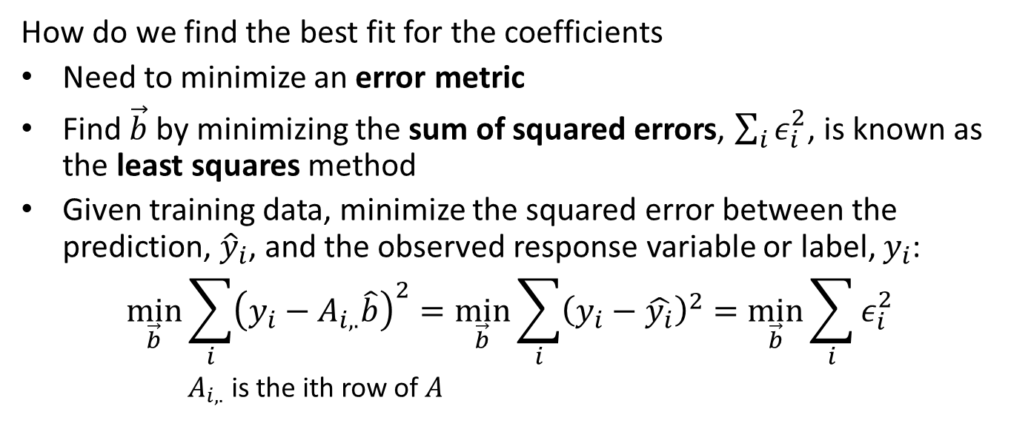
Estimating the Model Parameters
How do we find the best fit for the coefficients
Need to minimize an error metric
Find $\vec{b}$ by minimizing the sum of squared errors, $\sum_{i}^{​}{ε_{i}^{2}}$, is known as the least squares method
Given training data, minimize the squared error between the prediction, ${\hat{y}}_{i}$, and the observed response variable or label, $y_{i}$:
$$\min_{\vec{b}}\sum_{i}^{​}{{\left(y_{i}−A_{i,.}\hat{b}\right)}^{2}}=\min_{\vec{b}}\sum_{i}^{​}{{\left(y_{i}−\hat{y_{i}}\right)}^{2}}=\min_{\vec{b}}\sum_{i}^{​}{ε_{i}^{2}}$$
  $A_{i,.}$ is the ith row of $A$

Slide 20
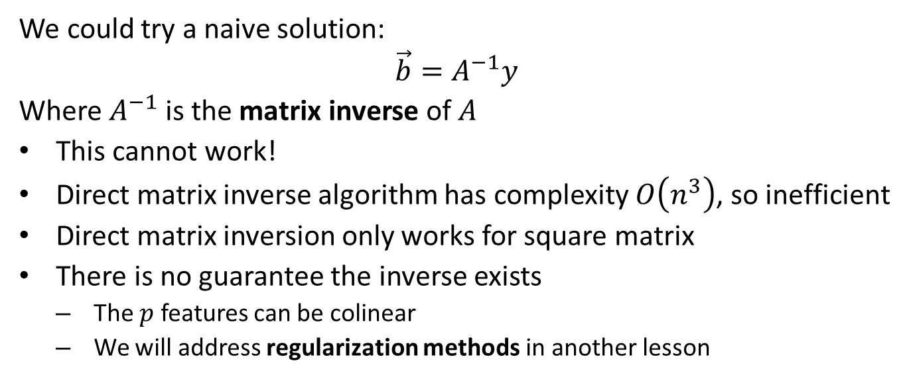
Estimating the Model Parameters
We could try a naive solution:
$$\vec{b}=A^{−1}y$$
Where $A^{−1}$ is the matrix inverse of $A$
This cannot work!
Direct matrix inverse algorithm has complexity $O\left(n^{3}\right)$, so inefficient
Direct matrix inversion only works for square matrix
There is no guarantee the inverse exists
  The $p$ features can be colinear
  We will address regularization methods in another lesson

Slide 21
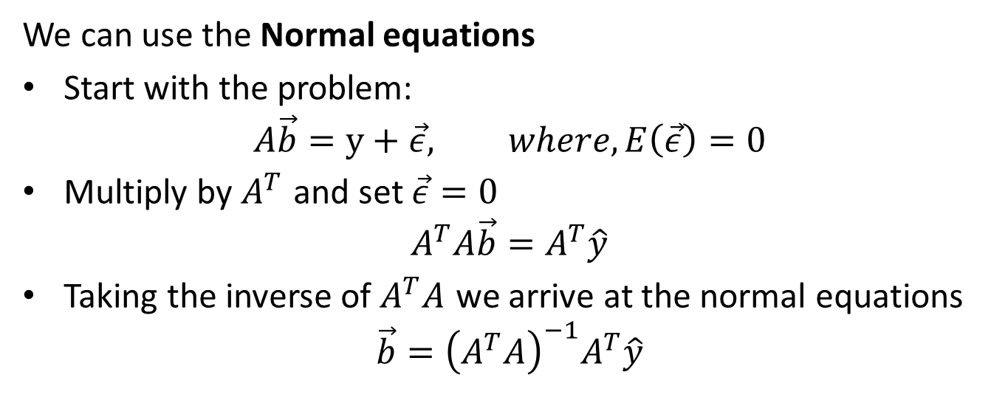
Estimating the Model Parameters
We can use the Normal equations
Start with the problem:
$$A\vec{b}=y+\vec{ε}, where, E\left(\vec{ε}\right)=0$$
Multiply by $A^{T}$ and set $\vec{ε}=0$
$$A^{T}A\vec{b}=A^{T}\hat{y}$$
Taking the inverse of $A^{T}A$ we arrive at the normal equations
$$\vec{b}={\left(A^{T}A\right)}^{−1}A^{T}\hat{y}$$

Slide 22
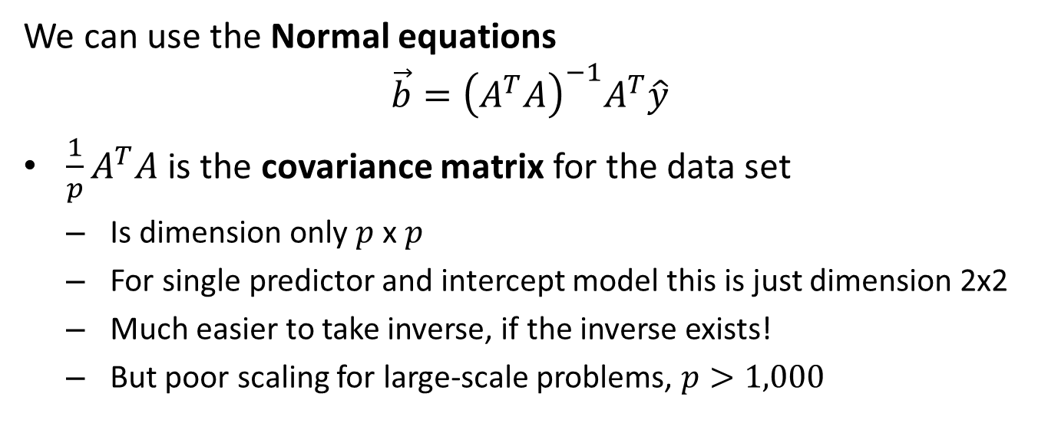
Estimating the Model Parameters
We can use the Normal equations
$$\vec{b}={\left(A^{T}A\right)}^{−1}A^{T}\hat{y}$$
$\frac{1}{p}A^{T}A$ is the covariance matrix for the data set
  Is dimension only $p$ x $p$
  For single predictor and intercept model this is just dimension 2x2
  Much easier to take inverse, if the inverse exists!
  But poor scaling for large-scale problems, $p>1,000$

Slide 23
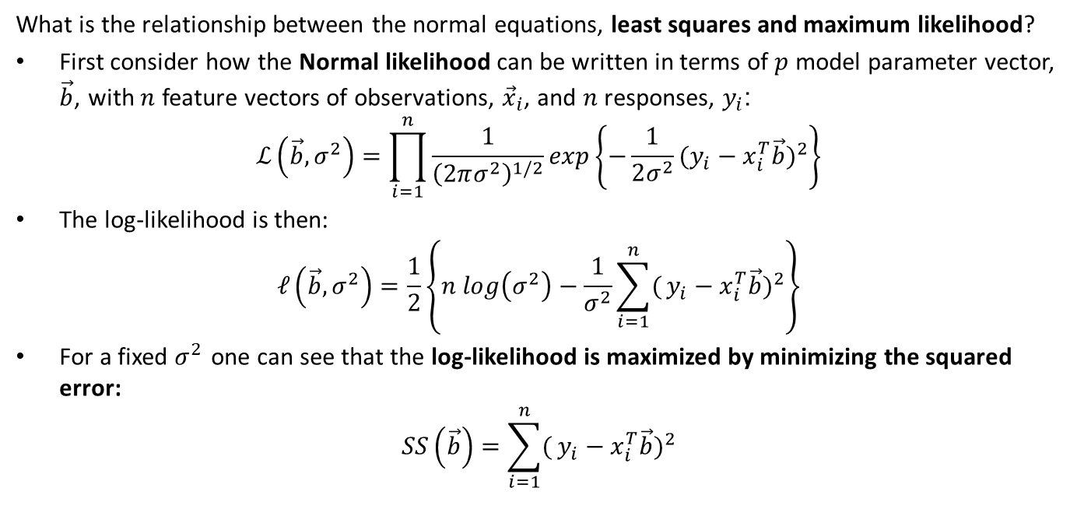
Estimating the Model Parameters
What is the relationship between the normal equations, least squares and maximum likelihood?
First consider how the Normal likelihood can be written in terms of $p$ model parameter vector, $\vec{b}$, with $n$ feature vectors of observations, ${\vec{x}}_{i}$, and $n$ responses, $y_{i}$:
$$ℒ\left(\vec{b},σ^{2}\right)=\prod_{i=1}^{n}{\frac{1}{{\left(2πσ^{2}\right)}^{1/2}}}exp\left\{−\frac{1}{2σ^{2}}(y_{i}−x_{i}^{T}\vec{b})^{2}\right\}$$
The log-likelihood is then:
$$𝓁\left(\vec{b},σ^{2}\right)=\frac{1}{2}\left\{n log\left(σ^{2}\right)−\frac{1}{σ^{2}}\sum_{i=1}^{n}{(}y_{i}−x_{i}^{T}\vec{b})^{2}\right\}$$
For a fixed $σ^{2}$ one can see that the log-likelihood is maximized by minimizing the squared error:
$$SS\left(\vec{b}\right)=\sum_{i=1}^{n}{(}y_{i}−x_{i}^{T}\vec{b})^{2}$$

Slide 24
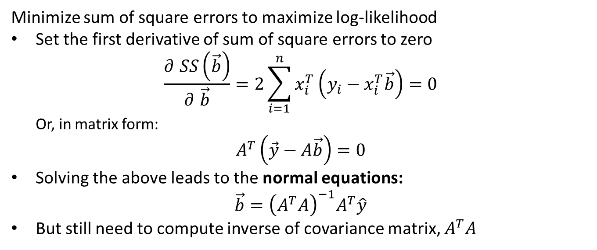
Estimating the Model Parameters
Minimize sum of square errors to maximize log-likelihood
Set the first derivative of sum of square errors to zero
$$\frac{∂ SS\left(\vec{b}\right)}{∂ \vec{b}}=2\sum_{i=1}^{n}{x_{i}^{T}}\left(y_{i}−x_{i}^{T}\vec{b}\right)=0$$
  Or, in matrix form:
$$A^{T}\left(\vec{y}−A\vec{b}\right)=0$$
Solving the above leads to the normal equations:
$$\vec{b}={\left(A^{T}A\right)}^{−1}A^{T}\hat{y}$$
But still need to compute inverse of covariance matrix, $A^{T}A$

Slide 25
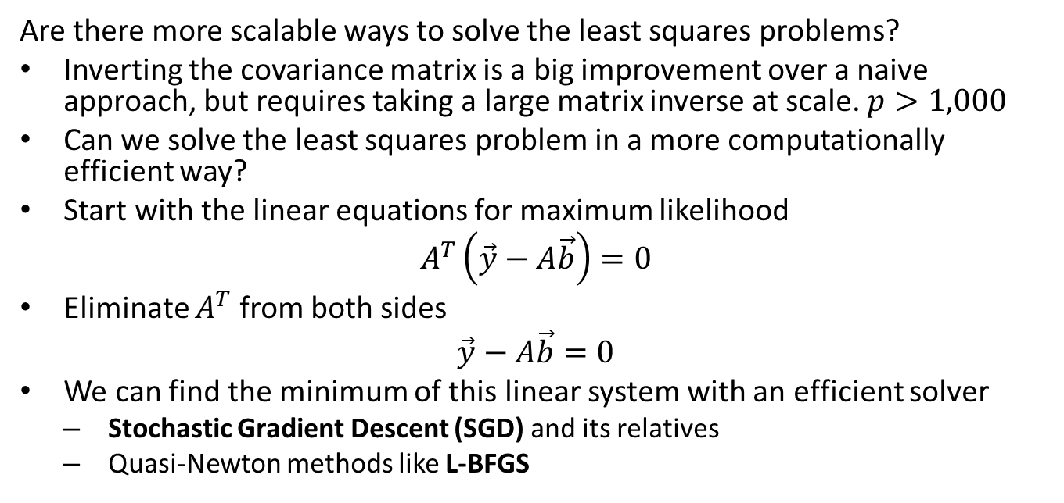
Estimating the Model Parameters
Are there more scalable ways to solve the least squares problems?
Inverting the covariance matrix is a big improvement over a naive approach, but requires taking a large matrix inverse at scale. $p>1,000$
Can we solve the least squares problem in a more computationally efficient way?
Start with the linear equations for maximum likelihood
$$A^{T}\left(\vec{y}−A\vec{b}\right)=0$$
Eliminate $A^{T}$ from both sides
$$\vec{y}−A\vec{b}=0$$
We can find the minimum of this linear system with an efficient solver
  Stochastic Gradient Descent (SGD) and its relatives
  Quasi-Newton methods like L-BFGS

Slide 26
Specifying Linear Models

Slide 27
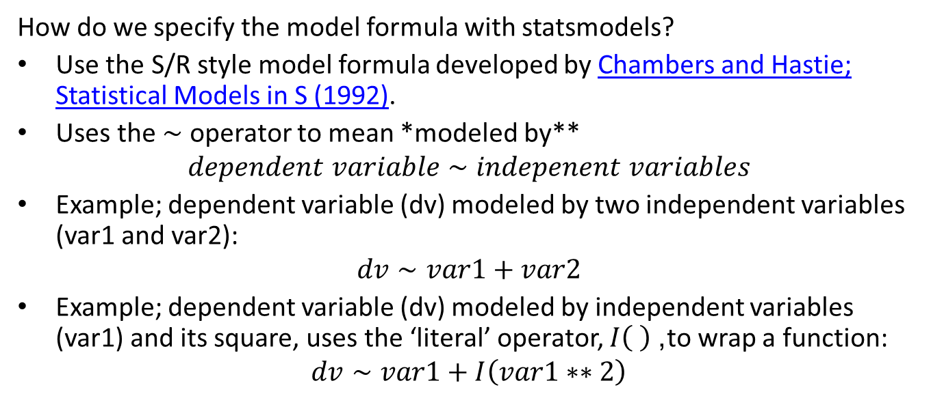
Example - Specifying the Model
How do we specify the model formula with statsmodels?
Use the S/R style model formula developed by Chambers and Hastie; Statistical Models in S (1992).
Uses the $∼$ operator to mean *modeled by**
$$dependent variable∼indepenent variables$$
Example; dependent variable (dv) modeled by two independent variables (var1 and var2):
$$dv∼var1+var2$$
Example; dependent variable (dv) modeled by independent variables (var1) and its square, uses the ‘literal’ operator, $I\left( \right)$, to wrap a function:
$$dv∼var1+I\left(var1∗∗2\right)$$

Slide 28
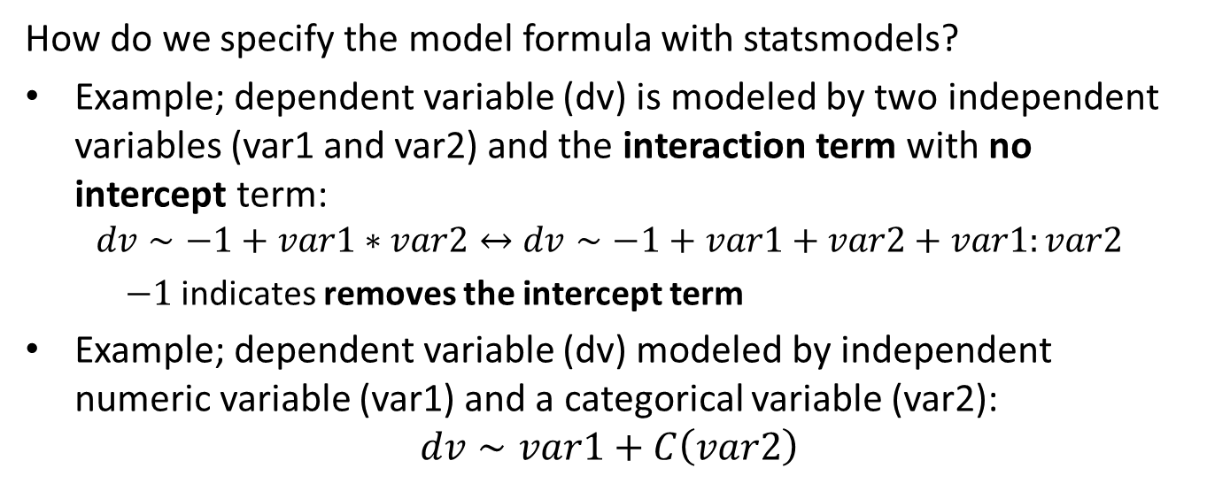
Example - Specifying the Model
How do we specify the model formula with statsmodels?
Example; dependent variable (dv) is modeled by two independent variables (var1 and var2) and the interaction term with no intercept term:
$$dv∼−1+var1∗var2↔dv∼−1+var1+var2+var1:var2$$
    $−1$ indicates removes the intercept term
Example; dependent variable (dv) modeled by independent numeric variable (var1) and a categorical variable (var2):
$$dv∼var1+C\left(var2\right)$$

Slide 29
Example – Fitting the Model
Let’s start with a simulated data set with one predictor and one response variable
The response variable, $y$ is linear in $x$ with additive random noise $∼𝒩\left(0,2\right)$
Intercept $=0$ and slope $=1.0$
The first 10 rows:
## x y
## 0 0.000000 1.951736
## 1 0.204082 0.627047
## 2 0.408163 3.025441
## 3 0.612245 1.112869
## 4 0.816327 5.225976
## 5 1.020408 -0.382646
## 6 1.224490 3.969339
## 7 1.428571 2.834755
## 8 1.632653 1.516411
## 9 1.836735 2.958745

Slide 30
Example - Fitting the Model
Fit the model using statsmodels.formula.api.ols with centered independent variable to create a linear model object
## Center the independent variable
sim_data.loc[:,'x_centered'] = np.subtract(sim_data.x, np.mean(sim_data.x))
## Define the regression model and fit it to the data
ols_model_centered = smf.ols(formula = 'y ~ x_centered', data=sim_data).fit()
## Print the model coefficient
print('Intercept = %4.3f Slope = %4.3f' % (ols_model_centered._results.params[0], ols_model_centered._results.params[1]))
## Intercept = 6.022 Slope = 0.882
We can now interpret this model?
  Intercept is the mean of the dependent variable
  Slope is the rate of change of the dependent variable for unit change in independent variable

Slide 31
Interpretation of Linear Models

Slide 32
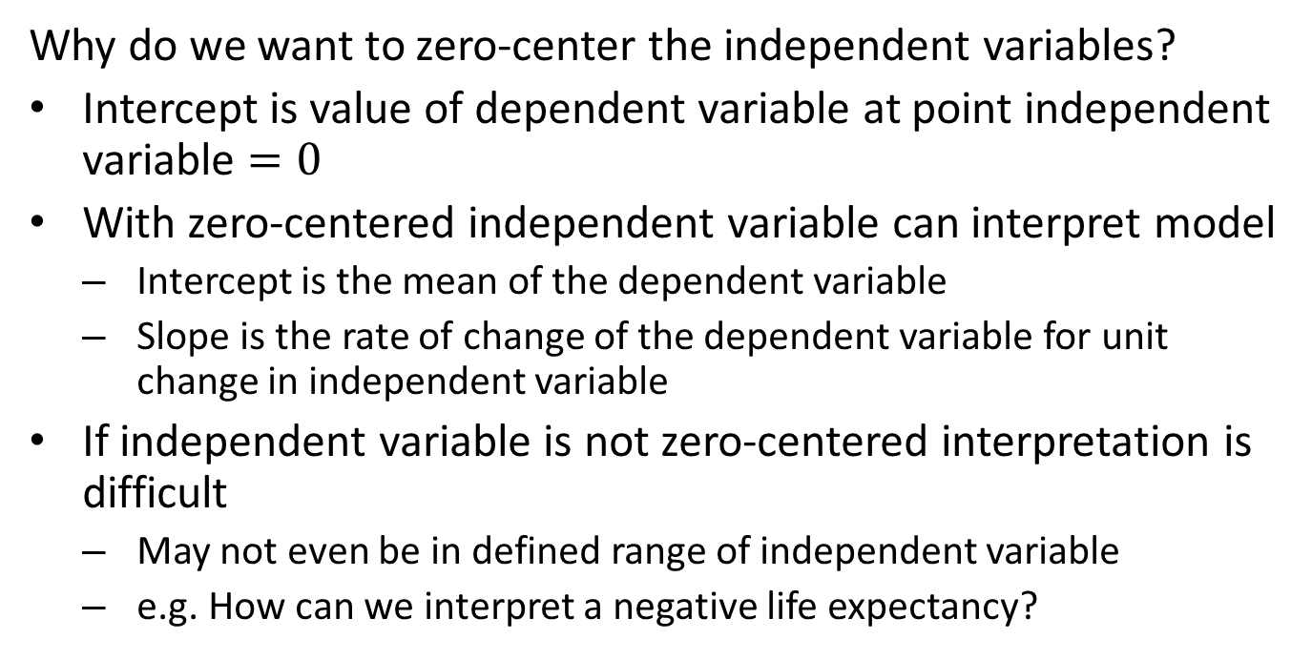
Example - Interpreting the Model
Why do we want to zero-center the independent variables?
Intercept is value of dependent variable at point independent variable $=0$
With zero-centered independent variable can interpret model
  Intercept is the mean of the dependent variable
  Slope is the rate of change of the dependent variable for unit change in independent variable
If independent variable is not zero-centered interpretation is difficult
  May not even be in defined range of independent variable
  e.g. How can we interpret a negative life expectancy?

Slide 33
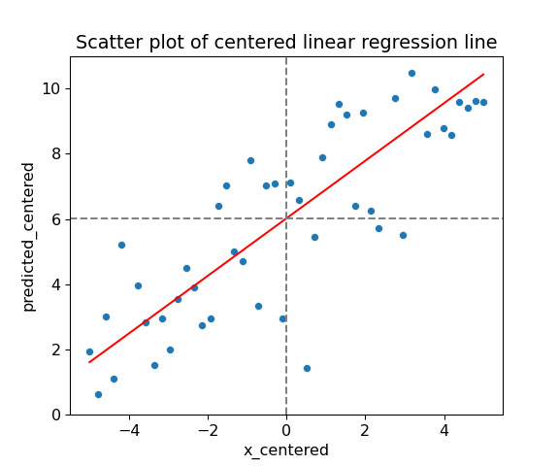
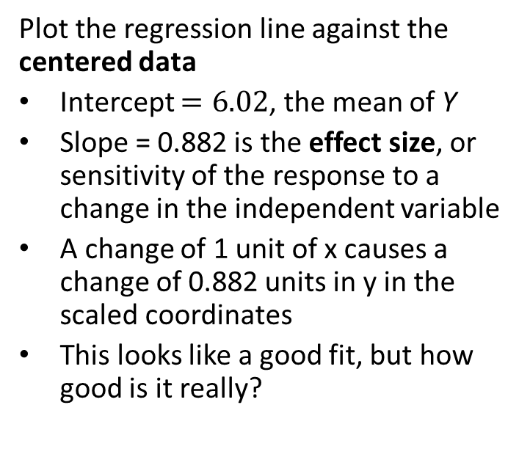
Example – Interpreting the Model
Plot the regression line against the centered data
Intercept $=6.02$, the mean of Y
Slope = 0.882 is the effect size, or sensitivity of the response to a change in the independent variable
A change of 1 unit of x causes a change of 0.882 units in y in the scaled coordinates
This looks like a good fit, but how good is it really?

Slide 34
Evaluating Linear Models

Slide 35
Evaluating Regression Models
When evaluating any statistical or machine learning model consider all evaluation methods available
No one method is most important all of the time
Different methods highlight different aspects of model performance
Don’t forget to check that the model makes senses for your application!
Methods discussed here are applicable to any regression model

Slide 36
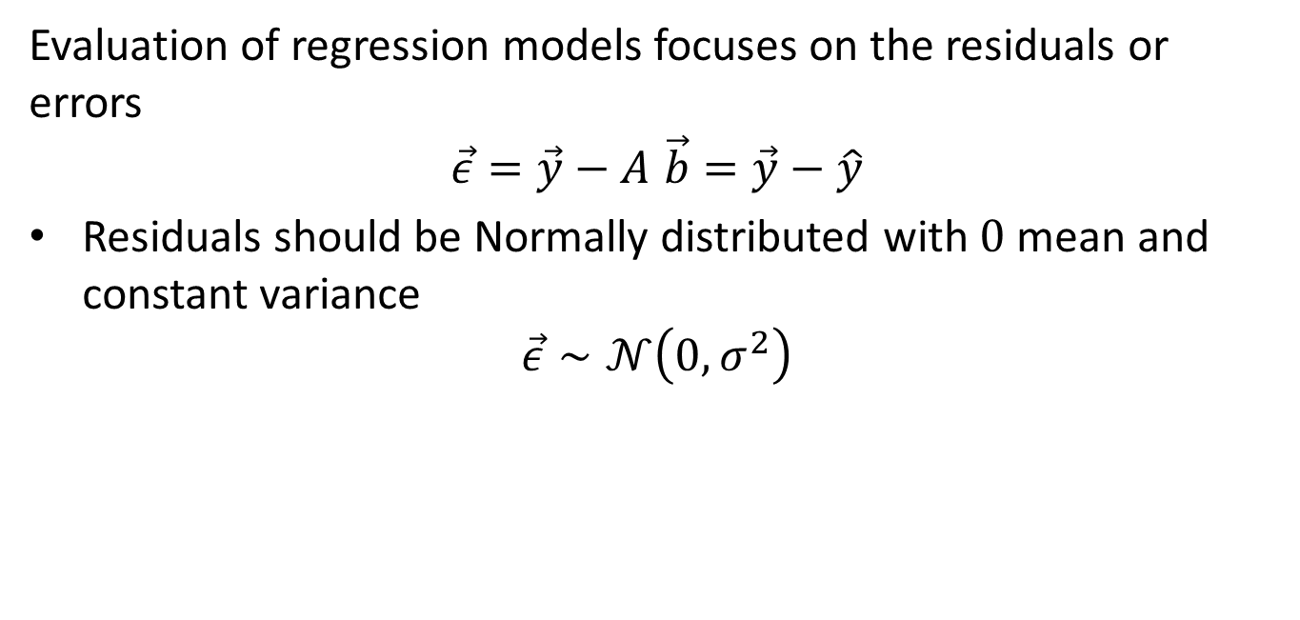
Evaluating Regression Models
Evaluation of regression models focuses on the residuals or errors
$$\vec{ε}=\vec{y}−A \vec{b}=\vec{y}−\hat{y}$$
Residuals should be Normally distributed with $0$ mean and constant variance
$$\vec{ε}∼𝒩\left(0,σ^{2}\right)$$

Slide 37
Evaluating Regression Models
Residual evaluation is important for any machine learning regression model!
Good model fit requires the residuals to be homoscedastic with respect to the fitted values
  Homoscedastic residuals have constant variance WRT the predicted values
  In other words the residuals are stationary WRT the predicted values
Any trend or structure in the residuals indicates a poor model fit
  If variance is not constant we say the residuals are heteroskedastic
  Heteroskedastic residuals indicate that model is a poor fit!

Slide 38
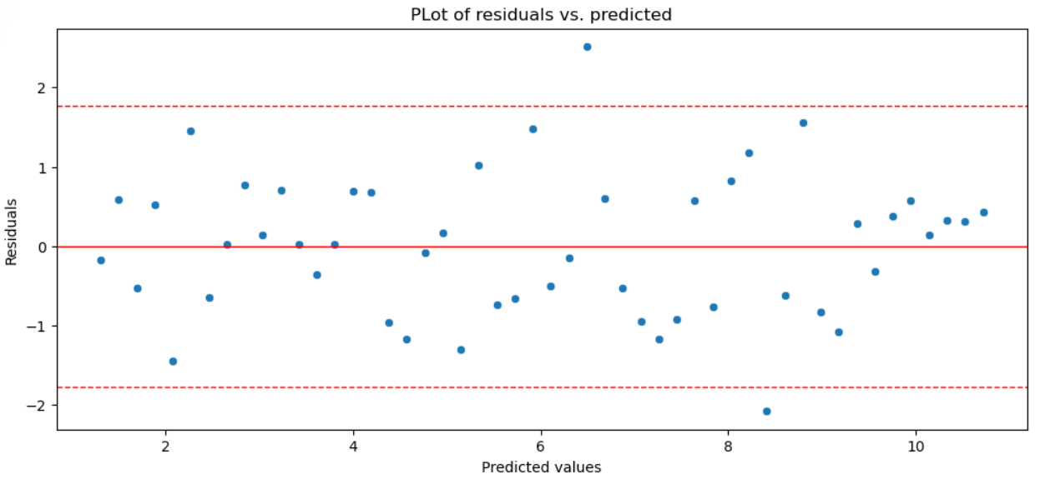
Evaluating Regression Models
Residual plots are a key diagnostic for any regression model
Plot residual against the predicted values
These residuals look homoscedastic - we are happy!

Slide 39
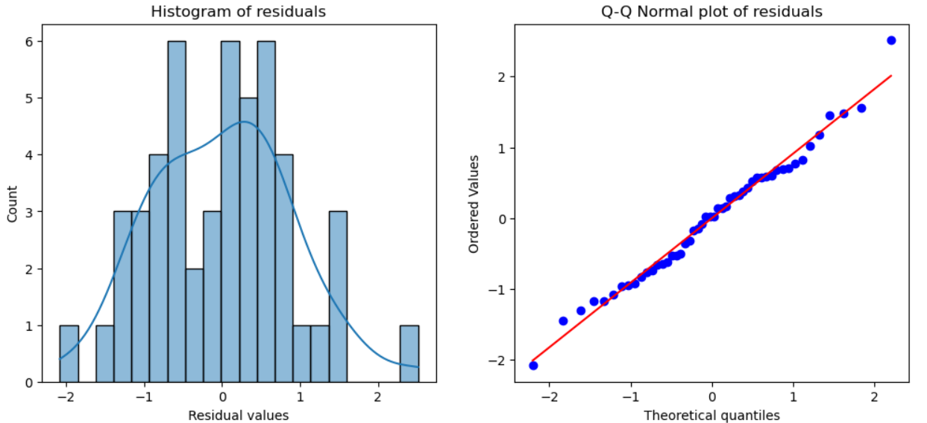
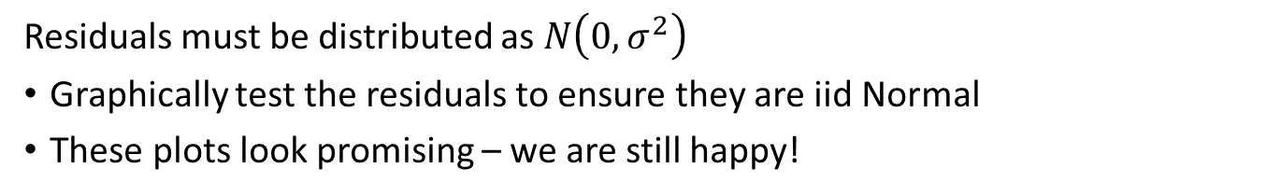
Evaluating Regression Models
Residuals must be distributed as $N\left(0,σ^{2}\right)$
Graphically test the residuals to ensure they are iid Normal
These plots look promising – we are still happy!

Slide 40
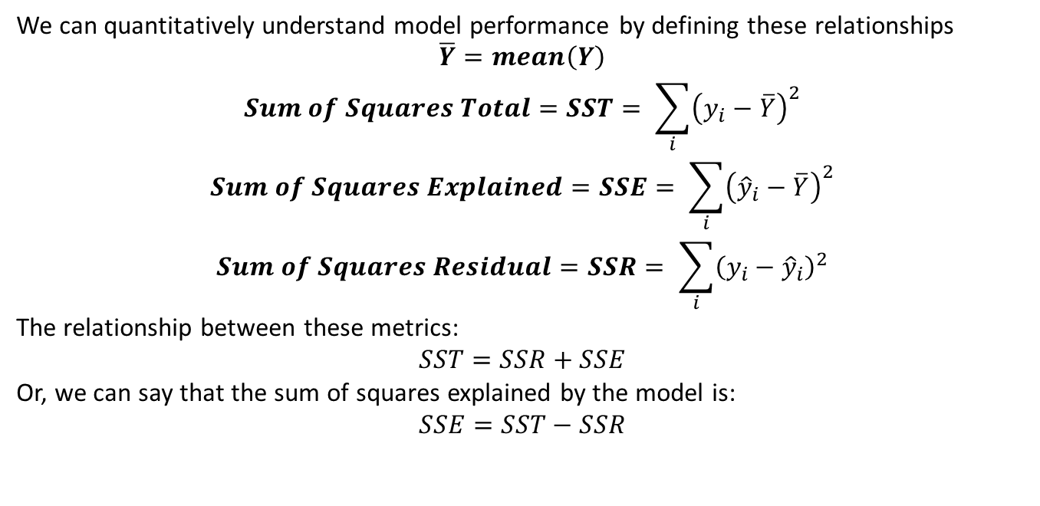
Evaluating Regression Models
We can quantitatively understand model performance by defining these relationships
$$\overline{Y}=mean\left(Y\right)$$
$$Sum of Squares Total=SST= \sum_{i}{{\left(y_{i}−\overline{Y}\right)}^{2}}$$
$$Sum of Squares Explained=SSE= \sum_{i}{{\left({\hat{y}}_{i}−\overline{Y}\right)}^{2}}$$
$$Sum of Squares Residual=SSR= \sum_{i}{{\left(y_{i}−{\hat{y}}_{i}\right)}^{2}}$$
The relationship between these metrics:
$$SST=SSR+SSE$$
Or, we can say that the sum of squares explained by the model is:
$$SSE=SST−SSR$$

Slide 41
Evaluating Regression Models
Compute the sums of squares for the running example
y_bar = np.mean(sim_data.y)
SST = np.sum(np.square(np.subtract(sim_data.y, y_bar)))
SSR = np.sum(np.square(sim_data.resids))
SSE = np.sum(np.square(np.subtract(sim_data.predicted, y_bar)))
print('SST = {0:6.2f}'.format(SST))
## SST = 494.61
print('SSE = {0:6.2f}'.format(SSE))
## SSE = 337.53
print('SSR = {0:6.2f}'.format(SSR))
## SSR = 157.08
print('SSE + SSR = {0:6.2f}'.format(SSE + SSR))
## SSE + SSR = 494.61
The model has explained most of the SST

Slide 42
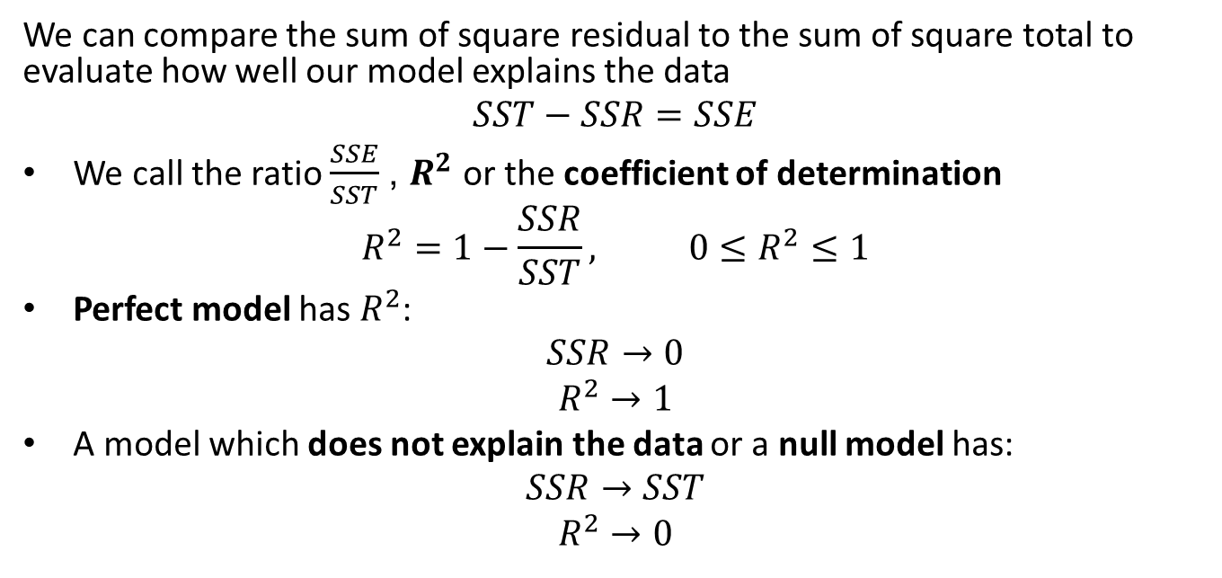
Evaluating Regression Models
We can compare the sum of square residual to the sum of square total to evaluate how well our model explains the data
$$SST−SSR=SSE$$
We call the ratio $\frac{SSE}{SST}$, $R^{2}$ or the coefficient of determination
$$R^{2}=1−\frac{SSR}{SST}, 0≤R^{2}≤1$$
Perfect model has $R^{2}$:
$$SSR→0$$
$$R^{2}→1$$
A model which does not explain the data or a null model has:
$$SSR→SST$$
$$R^{2}→0$$

Slide 43
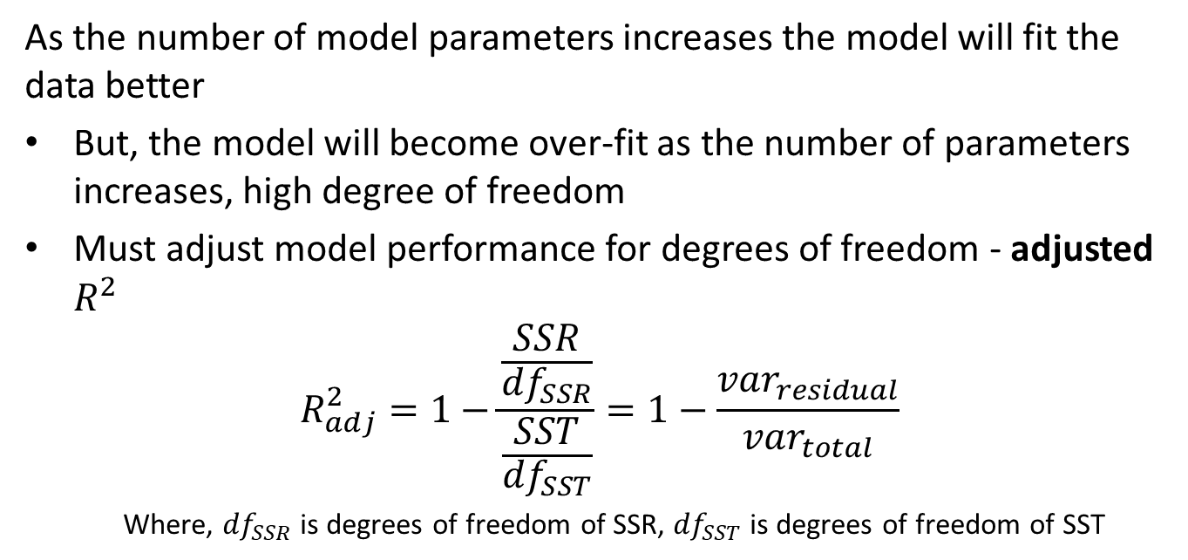
Evaluating Regression Models
As the number of model parameters increases the model will fit the data better
But, the model will become over-fit as the number of parameters increases, high degree of freedom
Must adjust model performance for degrees of freedom - adjusted $R^{2}$
$$R_{adj}^{2}=1−\frac{\frac{SSR}{{df}_{SSR}}}{\frac{SST}{{df}_{SST}}}=1−\frac{{var}_{residual}}{{var}_{total}}$$
    Where, ${df}_{SSR}$ is degrees of freedom of SSR, ${df}_{SST}$ is degrees of freedom of SST

Slide 44
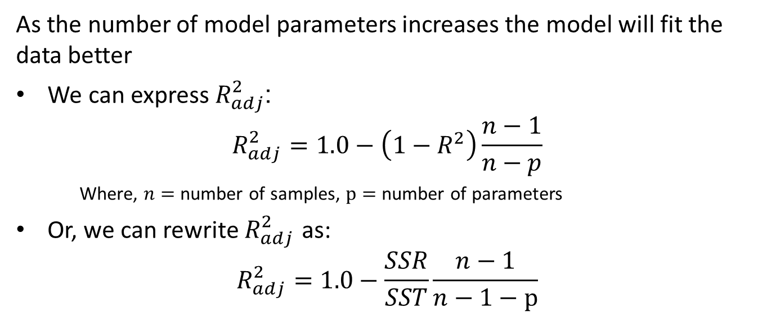
Evaluating Regression Models
As the number of model parameters increases the model will fit the data better
We can express $R_{adj}^{2}$:
$$R_{adj}^{2}=1.0−\left(1−R^{2}\right)\frac{n−1}{n−p}$$
    Where, $n=$ number of samples, $p=$ number of parameters
Or, we can rewrite $R_{adj}^{2}$ as:
$$R_{adj}^{2}=1.0−\frac{SSR}{SST}\frac{n−1}{n−1−p}$$

Slide 45
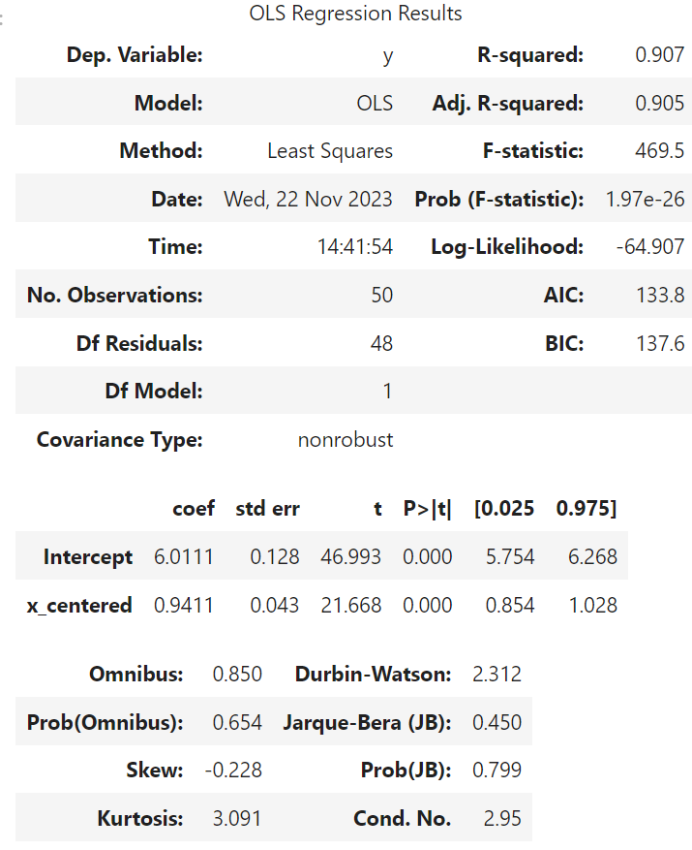
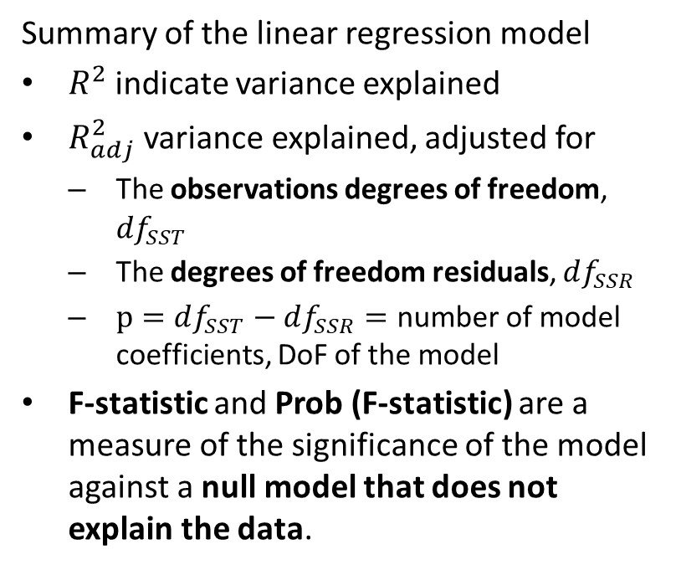
Evaluating Regression Models
Summary of the linear regression model
$R^{2}$ indicate variance explained
$R_{adj}^{2}$ variance explained, adjusted for
  The observations degrees of freedom, $df_{SST}$
  The degrees of freedom residuals, $df_{SSR}$
  $p=df_{SST}−df_{SSR}=$ number of model coefficients, DoF of the model
F-statistic and Prob (F-statistic) are a measure of the significance of the model against a null model that does not explain the data.

Slide 46
Evaluating Regression Models
Summary of the linear regression model
Model coefficients
Standard error of model coefficients should be less than the coefficients
T-statistic and p-value of the t-test for coefficient significance
95% confidence intervals of the model coefficients

Slide 47
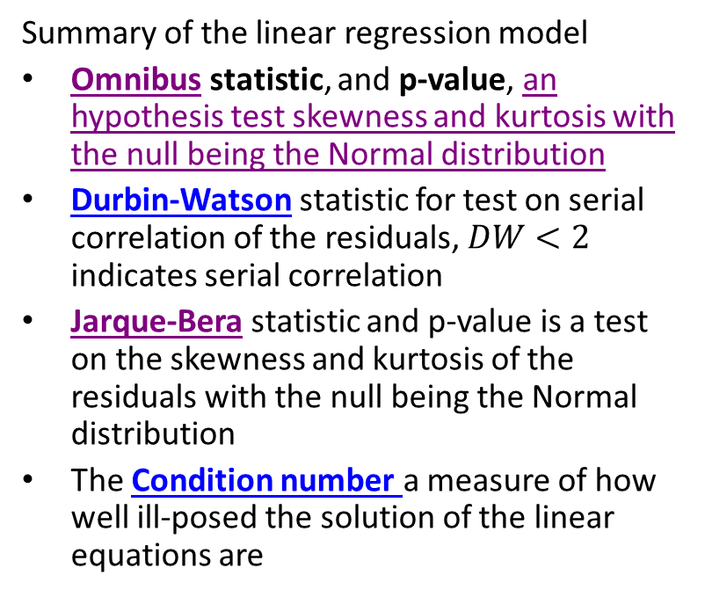
Evaluating Regression Models
Summary of the linear regression model
Omnibus statistic, and p-value, an hypothesis test skewness and kurtosis with the null being the Normal distribution
Durbin-Watson statistic for test on serial correlation of the residuals, $DW<2$ indicates serial correlation
Jarque-Bera statistic and p-value is a test on the skewness and kurtosis of the residuals with the null being the Normal distribution
The Condition number a measure of how well ill-posed the solution of the linear equations are

Slide 48
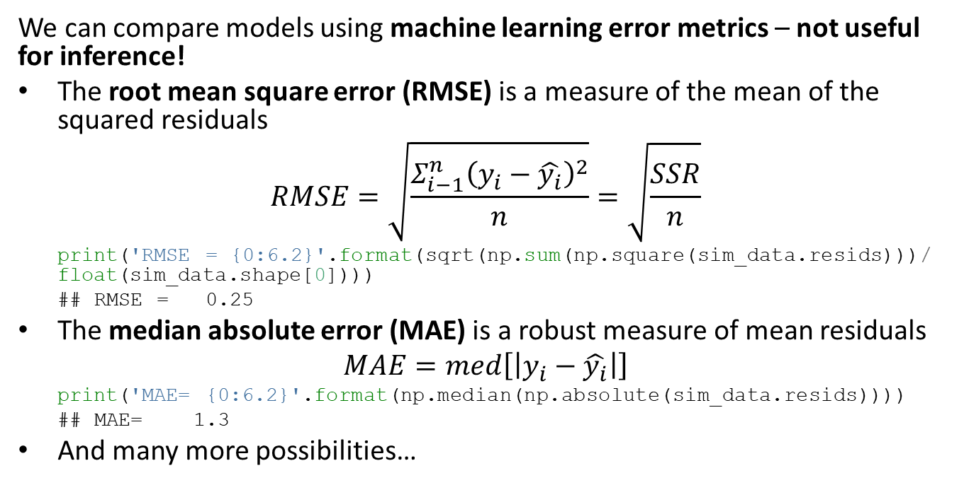
Evaluating Regression Models
We can compare models using machine learning error metrics – not useful for inference!
The root mean square error (RMSE) is a measure of the mean of the squared residuals
$$RMSE=\sqrt[ ]{\frac{Σ_{i−1}^{n}{\left(y_{i}−\hat{y_{i}}\right)}^{2}}{n}}=\sqrt[ ]{\frac{SSR}{n}}$$
print('RMSE = {0:6.2}'.format(sqrt(np.sum(np.square(sim_data.resids)))/ float(sim_data.shape[0])))
## RMSE = 0.25
The median absolute error (MAE) is a robust measure of mean residuals
$$MAE=med\left[\left|y_{i}−\hat{y_{i}}\right|\right]$$
print('MAE= {0:6.2}'.format(np.median(np.absolute(sim_data.resids))))
## MAE= 1.3
And many more possibilities…

Slide 49
Inference on Linear Models

Slide 50
Inference on Linear Models
Inference on linear models can be directly interpreted
For properly fit (not over-fit) the model coefficients are the effect size
Effect size is the change in the response for a unit change in the independent variable
Example: For effect size of 0.5 the response changes by 0.5 for a unit change in the independent variable

Slide 51
Inference on Linear Models
Inference on linear models can be directly interpreted
We can only perform inference on The confidence interval tells us the range of effect sizes arising from the sampling distribution

Slide 52
Extending Linear Models

Slide 53
Extending the Linear Model
We extend the linear model by adding new features or predictor variables
Higher order terms - e.g. polynomial regression
Other exogenous variables
We prefer the simplest model that does a reasonable job
  A parsimonious model has the minimum number of parameters required to explain the data
  The principle of Occam’s razor
Must consider the bias-variance trade-off

Slide 54
Extending the Linear Model
We prefer the simplest model that does a reasonable job
Must consider the bias-variance trade-off
High complexity model fits the training data well
  Low bias, fits the training data well
  But might not generalize well to new cases - high variance
Low complexity model can generalize to new cases
  low variance, error for new observations is low
  But does not fit training data as well - high bias

Slide 55
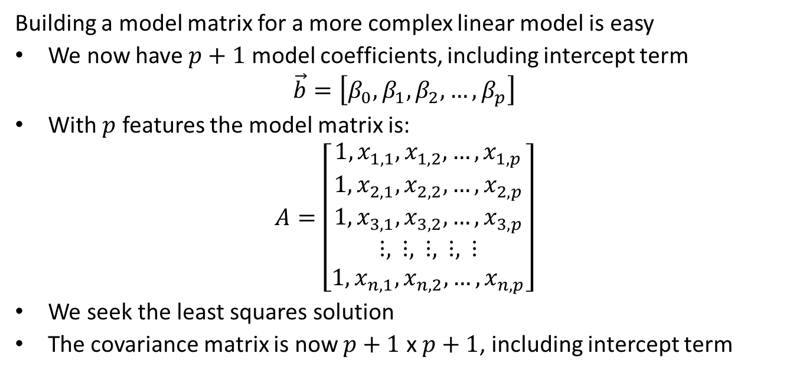
Extending the Linear Model
Building a model matrix for a more complex linear model is easy
We now have $p+1$ model coefficients, including intercept term
$$\vec{b}=\left[β_{0},β_{1},β_{2},…,β_{p}\right]$$
With $p$ features the model matrix is:
$$A=\left[\begin{matrix}1,x_{1,1},x_{1,2},…,x_{1,p} \\ 1,x_{2,1},x_{2,2},…,x_{2,p} \\ 1,x_{3,1},x_{3,2},…,x_{3,p} \\ ⋮, ⋮, ⋮, ⋮, ⋮ \\ 1,x_{n,1},x_{n,2},…,x_{n,p}\end{matrix}\right]$$
We seek the least squares solution
The covariance matrix is now $p+1$ x $p+1$, including intercept term

Slide 56
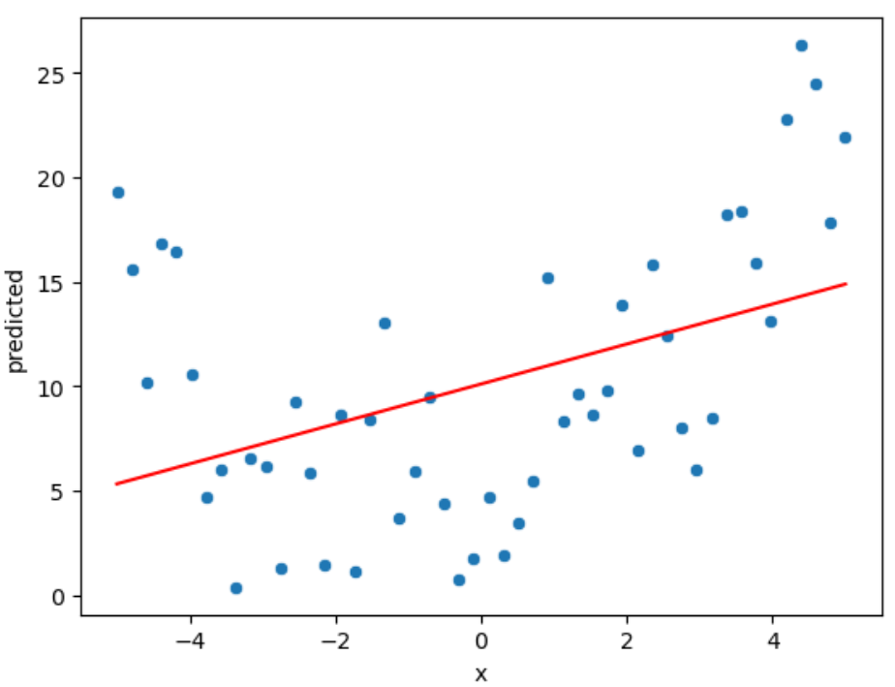
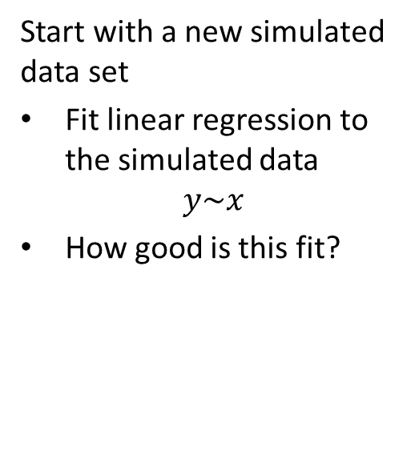
Example of Multi-Feature Linear Model
Start with a new simulated data set
Fit linear regression to the simulated data
$$y\sim x$$
How good is this fit?

Slide 57
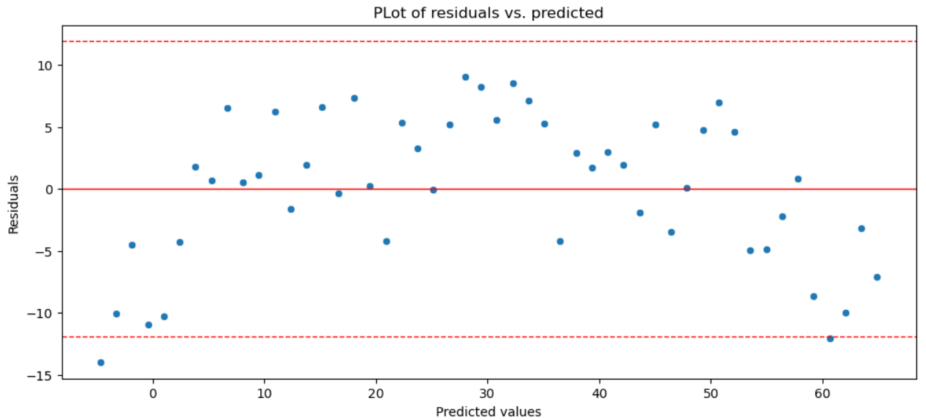
Example of Multi-Feature Linear Model
Let’s check the residuals
The trend of these residuals shows a curve
These residuals look heteroskedastic!

Slide 58
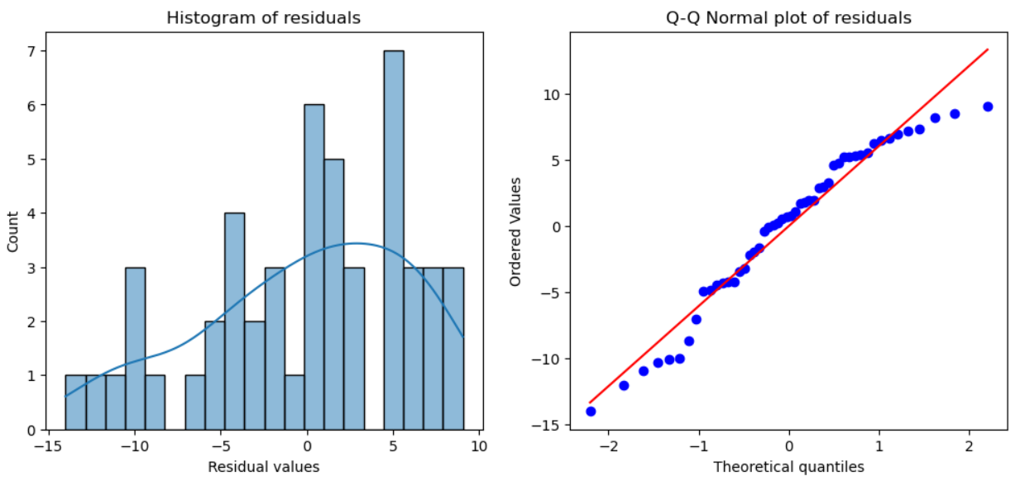
Example of Multi-Feature Linear Model
Let’s check the residuals
These residuals are right skewed and not Normally distributed!
Note the curve on the Q-Q Normal plot

Slide 59
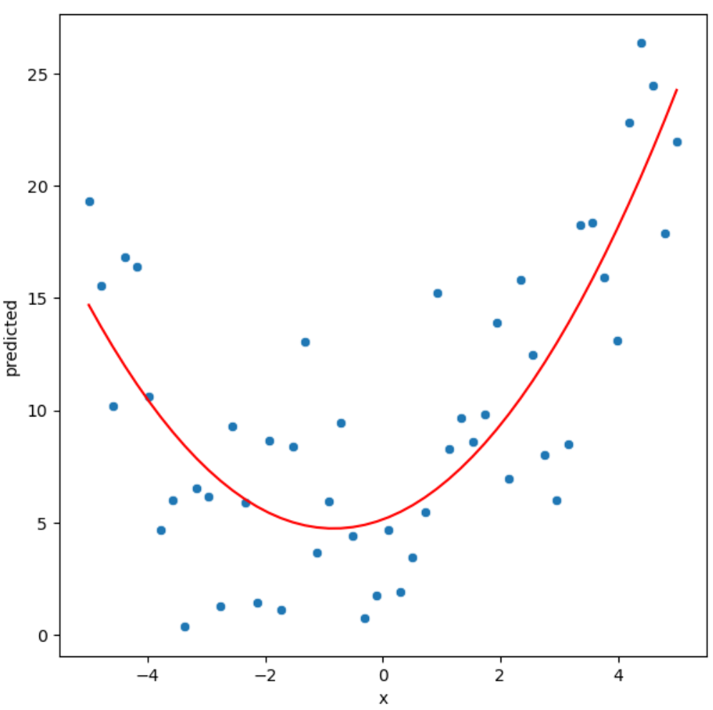
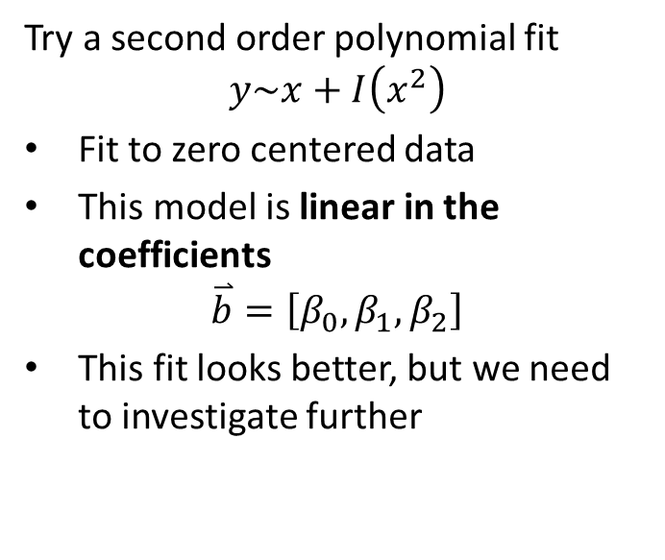
Example of Multi-Feature Linear Model
Try a second order polynomial fit
$$y\sim x+I\left(x^{2}\right)$$
Fit to zero centered data
This model is linear in the coefficients
$$\overset{⃑}{b}=\left[β_{0},β_{1},β_{2}\right]$$
This fit looks better, but we need to investigate further

Slide 60
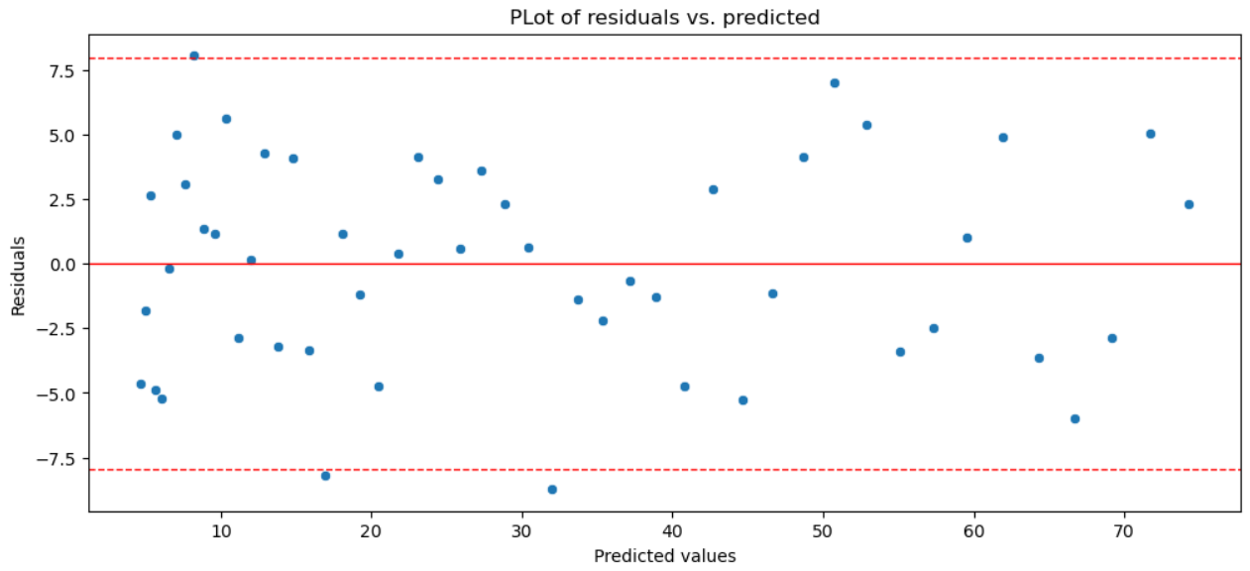
Example of Multi-Feature Linear Model
Let’s check the residuals
The residuals now look homoscedastic!
Variance looks fairly constant across the predictive values

Slide 61
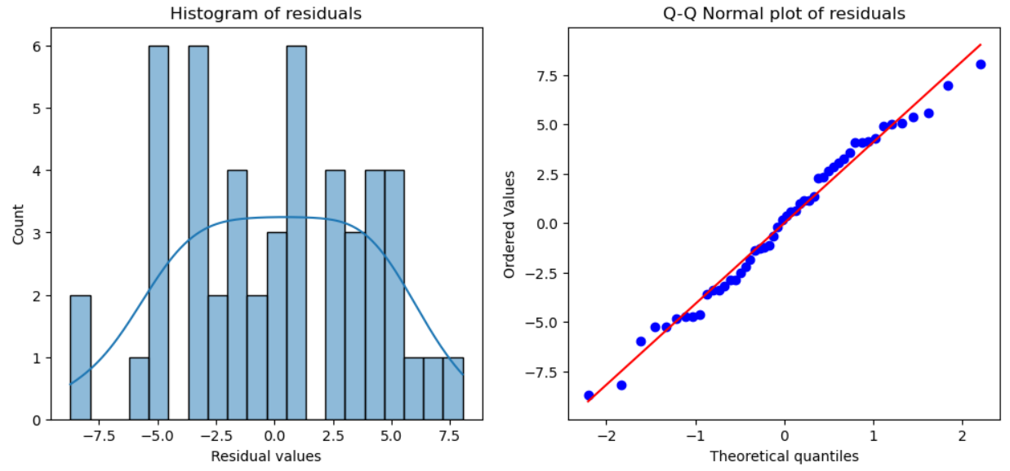
Example of Multi-Feature Linear Model
Let’s check the residuals
The residuals are now close to Normally distributed!
Note the nearly strait line of points on Q-Q Normal plot

Slide 62
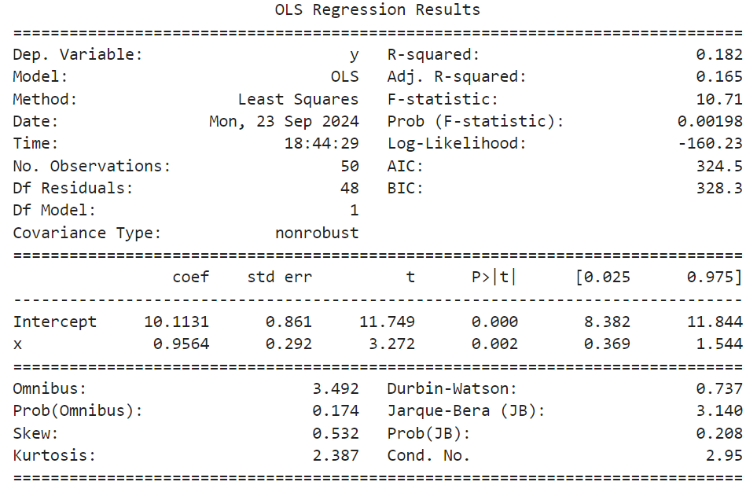
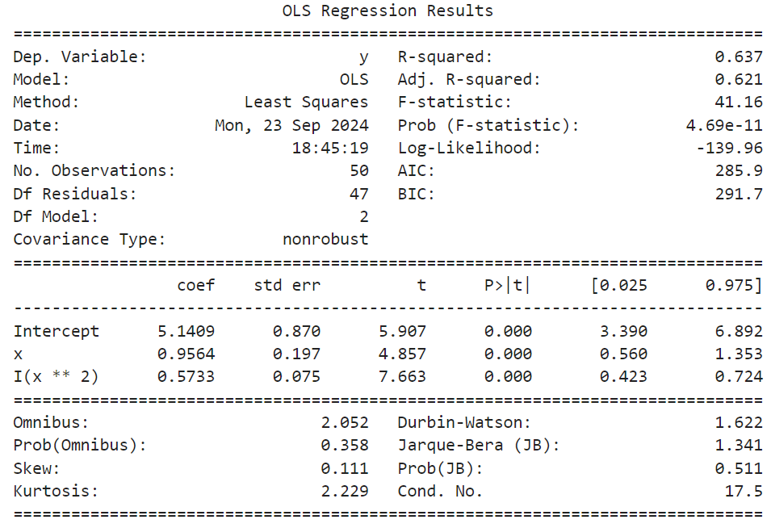
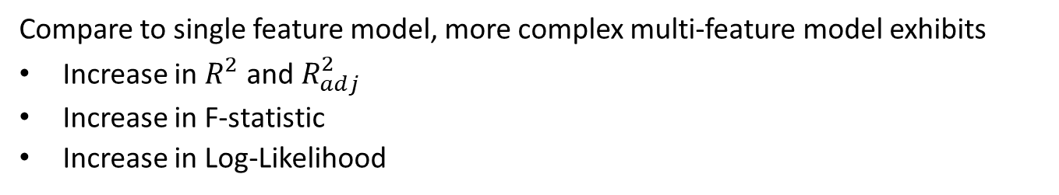
Example of Multi-Feature Linear Model
Compare to single feature model, more complex multi-feature model exhibits
Increase in $R^{2}$ and $R_{adj}^{2}$
Increase in F-statistic
Increase in Log-Likelihood
Single feature model
Multi-feature model

Slide 63
Example of Multi-Feature Linear Model
All parameters of both models are significant
Standard errors are less than an order of magnitude compared to the coefficients for the multi-feature model
The sensitivity of y to x is similar, but different standard error and CI
Significant second order effect in complex model
Single feature model
Multi-feature model

Slide 64
Example of Multi-Feature Linear Model
Compare to single feature model, more complex multi-feature model exhibits
Increased Durban-Watson statistic indicates reduced serial correlation of residuals
Decreased Jarque-Bara statistic indicates reduced skewness of residuals
More complex model has increased condition number
Single feature model
Multi-feature model

Slide 65
Summary
Linear models are a flexible and widely used class of models
Fit model coefficients by least squares estimation
Can use many types of predictor variables
SGD and L-FBGS algorithms allow massive scaling of linear models
We prefer a parsimonious model
  The principle of Occam’s razor
Must consider the bias-variance trade-off

Slide 66
Summary
There are a number of assumptions in linear models that you overlook at your peril!
The feature or predictor variables should be independent of one another
  This is rarely true in practice
  Multi-colinearity between features makes the model under-determined
We assume that numeric features or predictors have zero mean and about the same scale
  We do not want to bias the estimation of regression coefficients with predictors that do not have a 0 mean
  We do not want to have predictors with a large numeric range dominate training
  Example: income is in the range of 10s or 100s of thousands and age is in the range of 10s, but apriori income is no more important than age as a predictor
Values of each predictor or feature should be iid
  If variance changes with sample, the optimal value of the coefficient could not be constant
  Serial correlation in the predictor values, violates the iid assumption- but can account for this such as in time series models

Slide 67
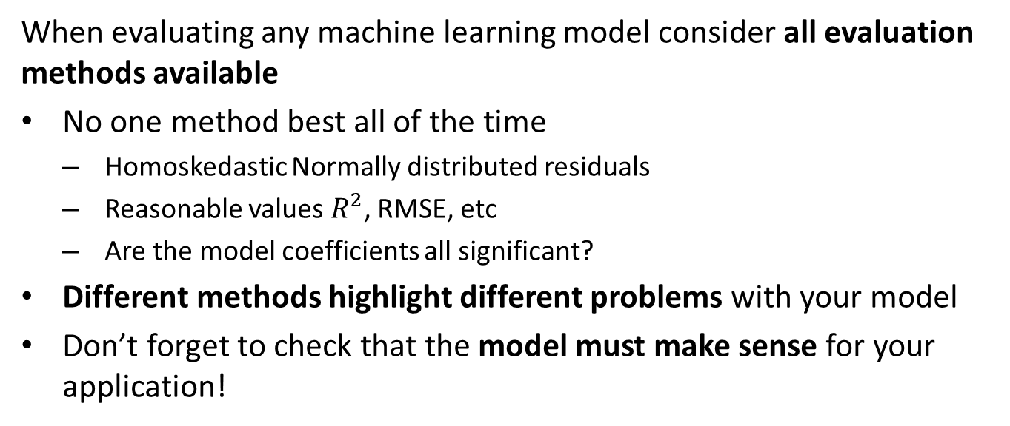
Summary
When evaluating any machine learning model consider all evaluation methods available
No one method best all of the time
  Homoskedastic Normally distributed residuals
  Reasonable values $R^{2}$, RMSE, etc
  Are the model coefficients all significant?
Different methods highlight different problems with your model
Don’t forget to check that the model must make sense for your application!

