Slide 1

Review of Probability
Steve Elston
Copyright 2018, 2019, 2020, 2021, 2022, 2023 2024, Stephen F Elston. All rights reserved.

Slide 2
Importance of Probability Theory
Probability theory is the basis of statistics, machine learning, and much AI
An understanding of probability theory is an important foundation to understand these methods
In this lesson we will review some basic concepts
Properties of probability distributions
Some commonly used probability distributions - focus on difficult to understand properties
Many texts provide comprehensive introductions to probability theory

Slide 3

Probability Theory Has a Long History
First probability textbook by Jacob Bernoulli, published posthumously in 1713
In the 21st Century, probability theory is an active area of research
First probability textbook Credit, Wikipedia commons

Slide 4
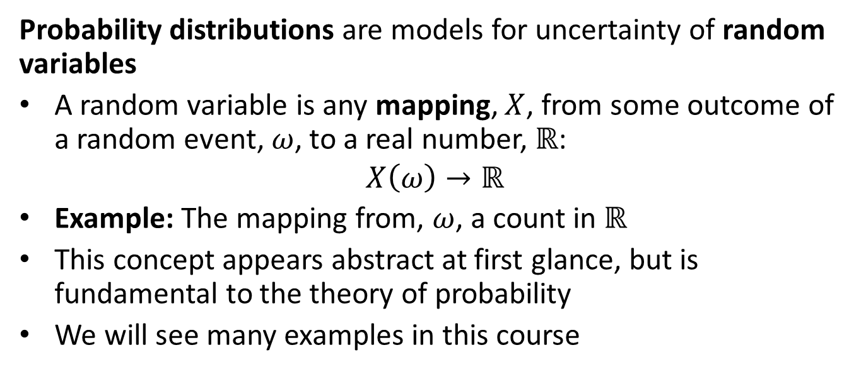
Probability Distributions
Probability distributions are models for uncertainty of random variables
A random variable is any mapping, $X$, from some outcome of a random event, $ω$, to a real number, $ℝ$:
$$X\left(ω\right)→ℝ$$
Example: The mapping from, $ω$, a count in $ℝ$
This concept appears abstract at first glance, but is fundamental to the theory of probability
We will see many examples in this course

Slide 5
Two Types of Probability Distributions
Discrete
Model countable events
Examples: count of people making a purchase, number of patients with disease,….
Characterized by a probability mass function (PMF)
Continuous
Examples: temperature, velocity, price,…….
Characterized by a probability density function (PDF)

Slide 6
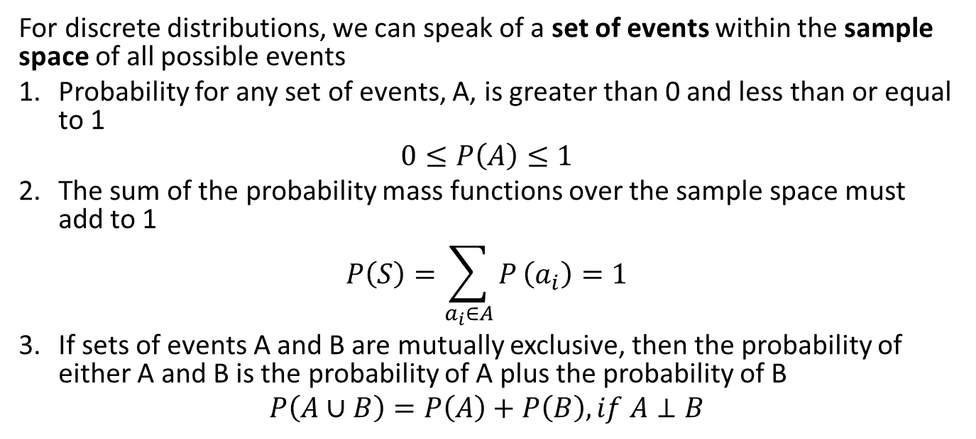
Axioms of Probability
For discrete distributions, we can speak of a set of events within the sample space of all possible events
Probability for any set of events, A, is greater than 0 and less than or equal to 1
$$0≤P\left(A\right)≤1$$
The sum of the probability mass functions over the sample space must add to 1
$$P\left(S\right)=\sum_{a_{i}∈A}^{​}{P}\left(a_{i}\right)=1$$
If sets of events A and B are mutually exclusive, then the probability of either A and B is the probability of A plus the probability of B
$$P\left(A∪B\right)=P\left(A\right)+P\left(B\right), if A⊥B$$

Slide 7
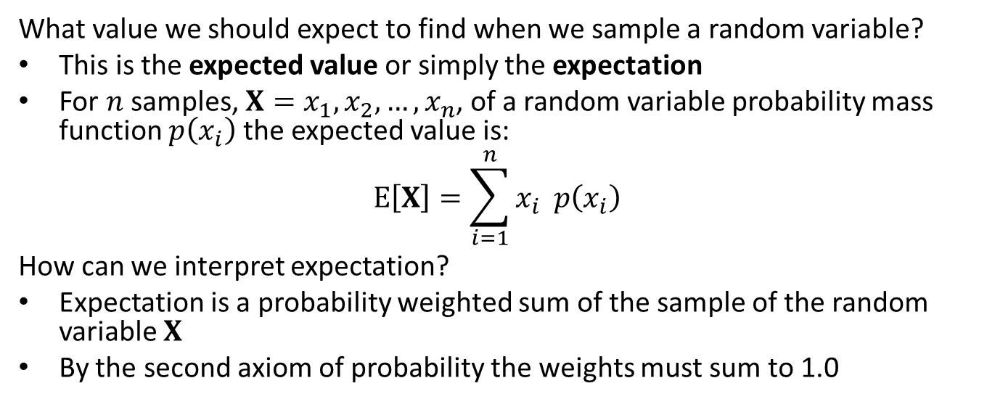
What do you expect: discrete distributions
What value we should expect to find when we sample a random variable?
This is the expected value or simply the expectation
For $n$ samples, $X=x_{1},x_{2},…,x_{n}$, of a random variable probability mass function $p\left(x_{i}\right)$ the expected value is:
$$E\left[X\right]=\sum_{i=1}^{n}{x_{i}} p\left(x_{i}\right)$$
How can we interpret expectation?
Expectation is a probability weighted sum of the sample of the random variable $X$
By the second axiom of probability the weights must sum to 1.0

Slide 8
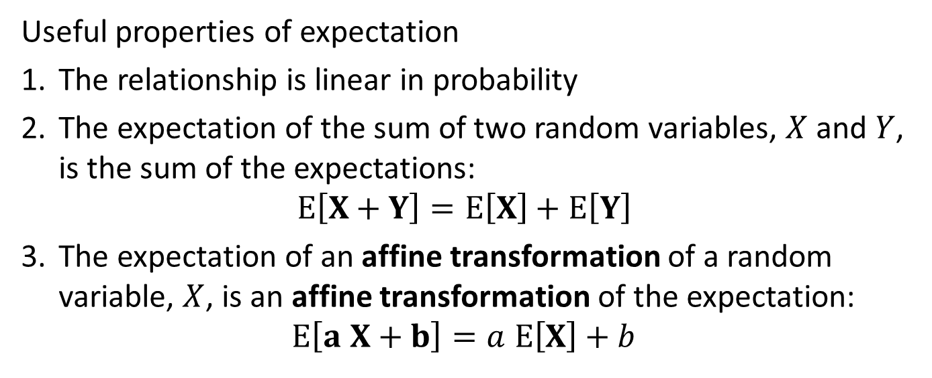
Properties of Expectation
Useful properties of expectation
The relationship is linear in probability
The expectation of the sum of two random variables, $X$ and $Y$, is the sum of the expectations:
$$E\left[X+Y\right]=E\left[X\right]+E\left[Y\right]$$
The expectation of an affine transformation of a random variable, $X$, is an affine transformation of the expectation:
$$E\left[a X+b\right]=a E\left[X\right]+b$$

Slide 9
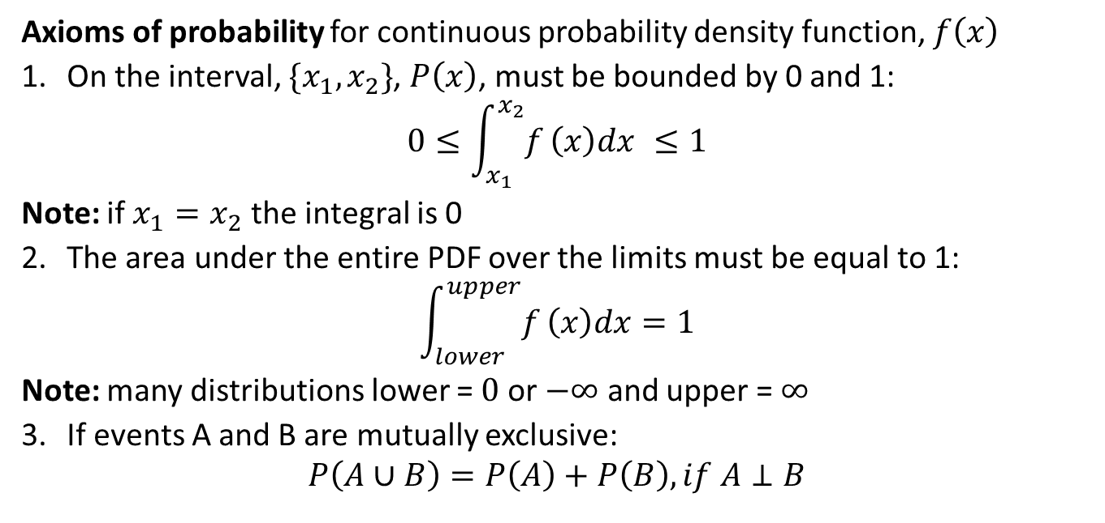
Axioms of probability for continuous distributions
Axioms of probability for continuous probability density function, $f\left(x\right)$
On the interval, $\{x_{1},x_{2}\}$, $P\left(x\right)$, must be bounded by 0 and 1:
$$0≤\int_{x_{1}}^{x_{2}}{f}\left(x\right)dx ≤1$$
Note: if $x_{1}=x_{2}$ the integral is 0
The area under the entire PDF over the limits must be equal to 1:
$$\int_{lower}^{upper}{f}\left(x\right)dx=1$$
Note: many distributions lower = $0$ or $−∞$ and upper = $∞$
If events A and B are mutually exclusive:
$$P\left(A∪B\right)=P\left(A\right)+P\left(B\right), if A⊥B$$

Slide 10
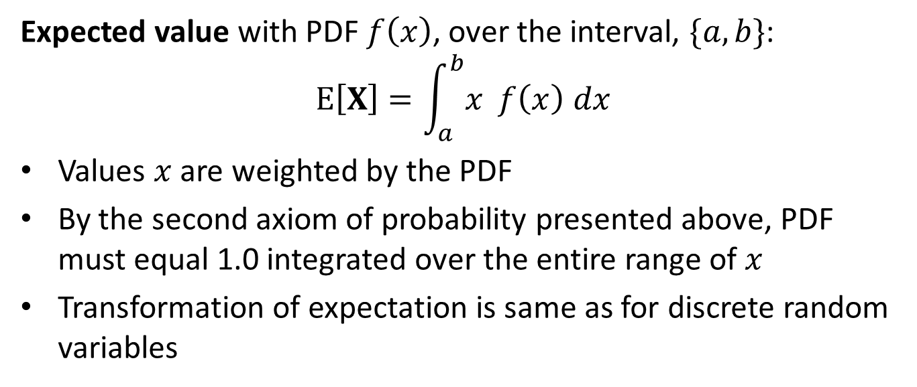
What do you expect: continuous distributions
Expected value with PDF $f\left(x\right)$, over the interval, $\{a,b\}$:
$$E\left[X\right]=\int_{a}^{b}{x} f\left(x\right) dx$$
Values $x$ are weighted by the PDF
By the second axiom of probability presented above, PDF must equal 1.0 integrated over the entire range of $x$
Transformation of expectation is same as for discrete random variables

Slide 11
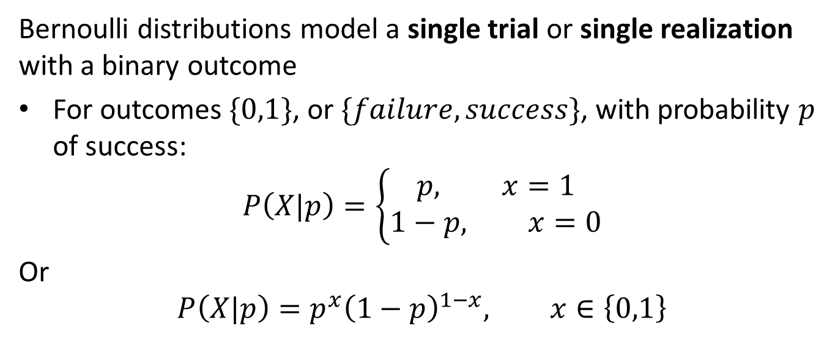
Bernoulli and Binomial Distributions
Bernoulli distributions model a single trial or single realization with a binary outcome
For outcomes $\{0,1\}$, or $\{failure,success\}$, with probability $p$ of success:
$$P\left(X|p\right)=\left\{\begin{aligned}p, x=1 \\ 1−p, x=0\end{aligned}\right.$$
Or
$$P\left(X|p\right)=p^{x}{\left(1−p\right)}^{1−x}, x∈\left\{0,1\right\}$$

Slide 12
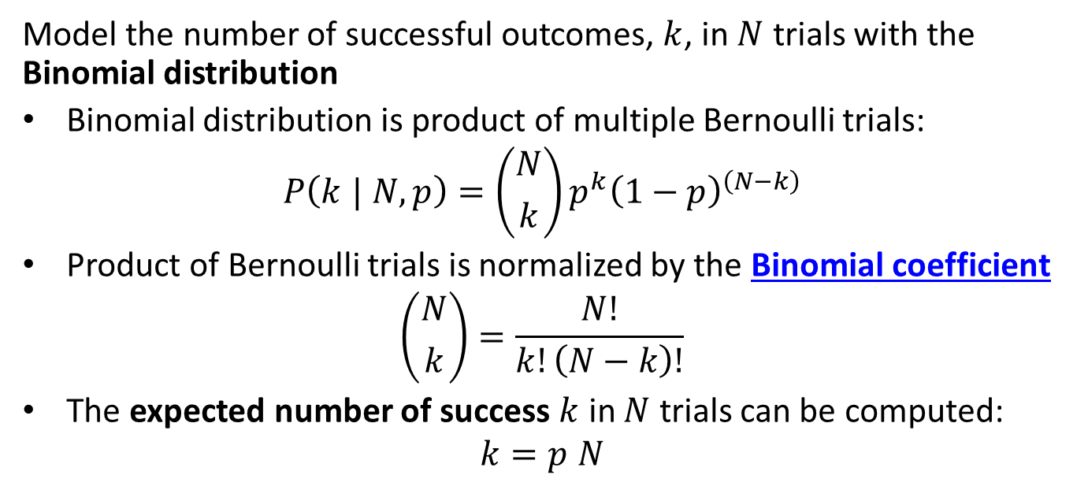
Bernoulli and Binomial Distributions
Model the number of successful outcomes, $k$, in $N$ trials with the Binomial distribution
Binomial distribution is product of multiple Bernoulli trials:
$$P\left(k | N,p\right)=\left({N \atop k}\right)p^{k}{\left(1−p\right)}^{\left(N−k\right)}$$
Product of Bernoulli trials is normalized by the Binomial coefficient
$$\left({N \atop k}\right)=\frac{N!}{k!\left(N−k\right)!}$$
The expected number of success $k$ in $N$ trials can be computed:
$$k=p N$$

Slide 13
Distributions for Multiple Outomes; the Categorical and Multinomial Distribution
Many real-world cases have many possible outcomes
In these cases need a probability distribution for multiple outcomes
Categorical distribution models multiple outcomes
Categorical Distribution is the multiple-outcome extension of the Bernoulli distribution, and is sometimes call the Multinoulli distribution.

Slide 14
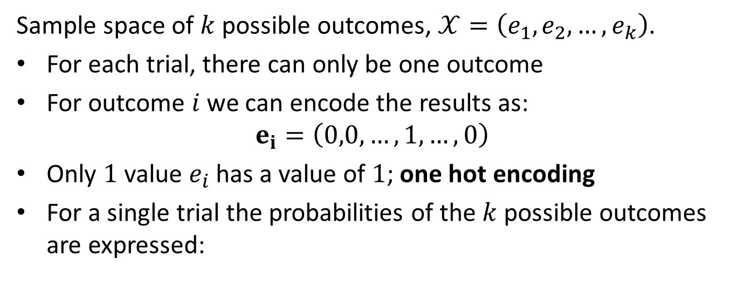
The Categorical distribution
Sample space of $k$ possible outcomes, $𝒳=\left(e_{1},e_{2},…,e_{k}\right)$.
For each trial, there can only be one outcome
For outcome $i$ we can encode the results as:
$$e_{i}=\left(0,0,…,1,…,0\right)$$
Only $1$ value $e_{i}$ has a value of $1$; one hot encoding
For a single trial the probabilities of the $k$ possible outcomes are expressed:

Slide 15
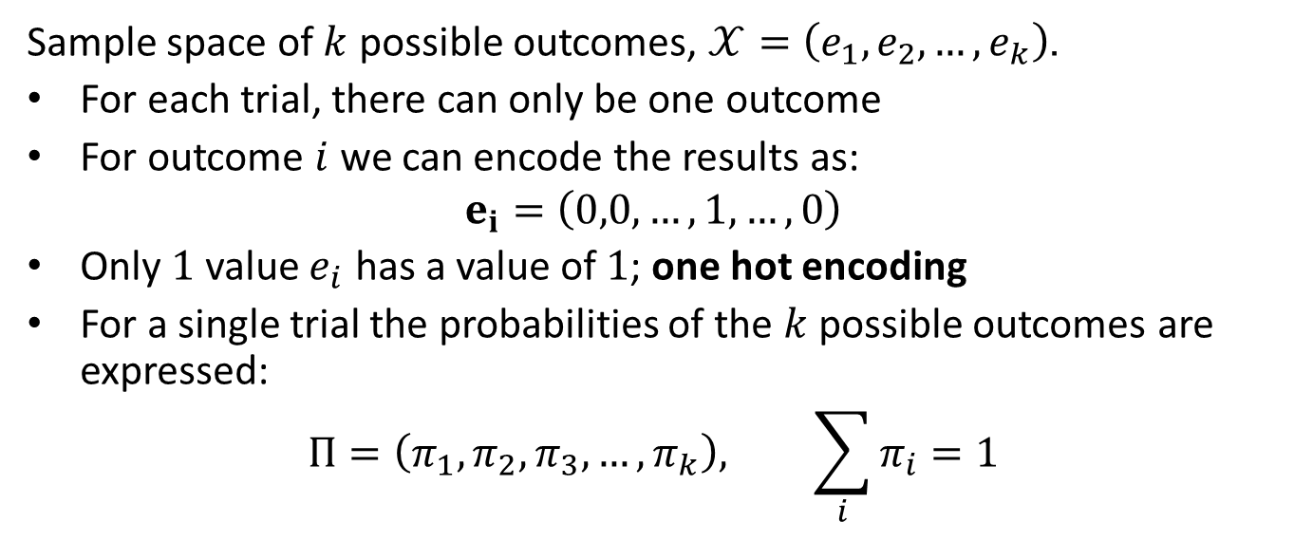
The Categorical distribution
Sample space of $k$ possible outcomes, $𝒳=\left(e_{1},e_{2},…,e_{k}\right)$.
For each trial, there can only be one outcome
For outcome $i$ we can encode the results as:
$$e_{i}=\left(0,0,…,1,…,0\right)$$
Only $1$ value $e_{i}$ has a value of $1$; one hot encoding
For a single trial the probabilities of the $k$ possible outcomes are expressed:
$$Π=\left(π_{1},π_{2},π_{3},…,π_{k}\right), \sum_{i}{π_{i}}=1$$

Slide 16
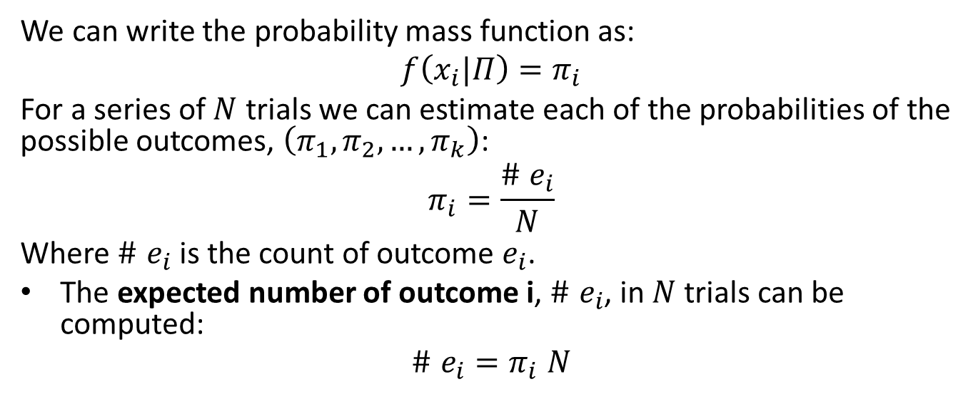
The Categorical distribution
We can write the probability mass function as:
$$f\left(x_{i}|Π\right)=π_{i}$$
For a series of $N$ trials we can estimate each of the probabilities of the possible outcomes, $\left(π_{1},π_{2},…,π_{k}\right)$:
$$π_{i}=\frac{\# e_{i}}{N}$$
Where $\# e_{i}$ is the count of outcome $e_{i}$.
The expected number of outcome i, $\# e_{i}$, in $N$ trials can be computed:
$$\# e_{i}=π_{i} N$$

Slide 17
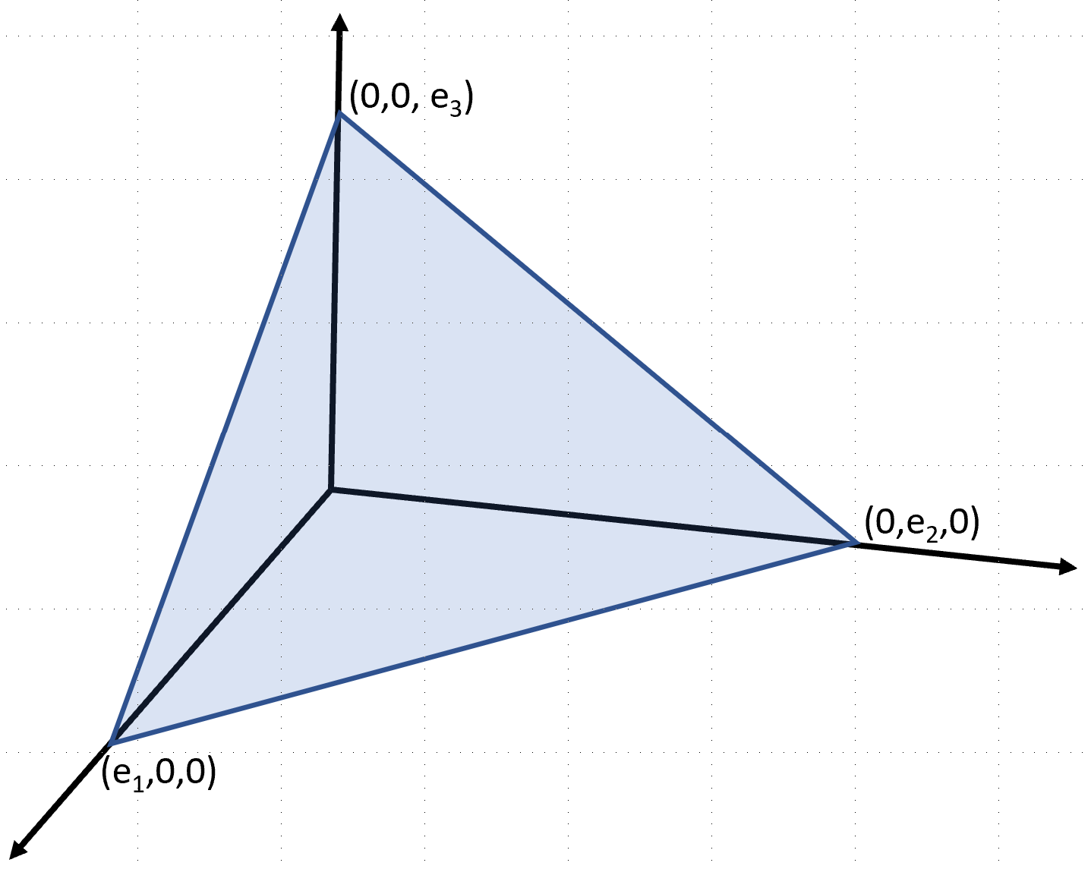
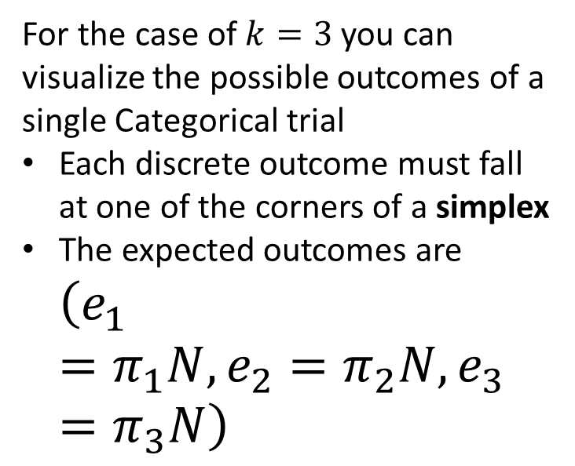
The Categorical distribution
For the case of $k=3$ you can visualize the possible outcomes of a single Categorical trial
Each discrete outcome must fall at one of the corners of a simplex
The expected outcomes are $\left(e_{1}=π_{1}N, {e_{2}=π}_{2}N,e_{3}=π_{3}N\right)$

Slide 18
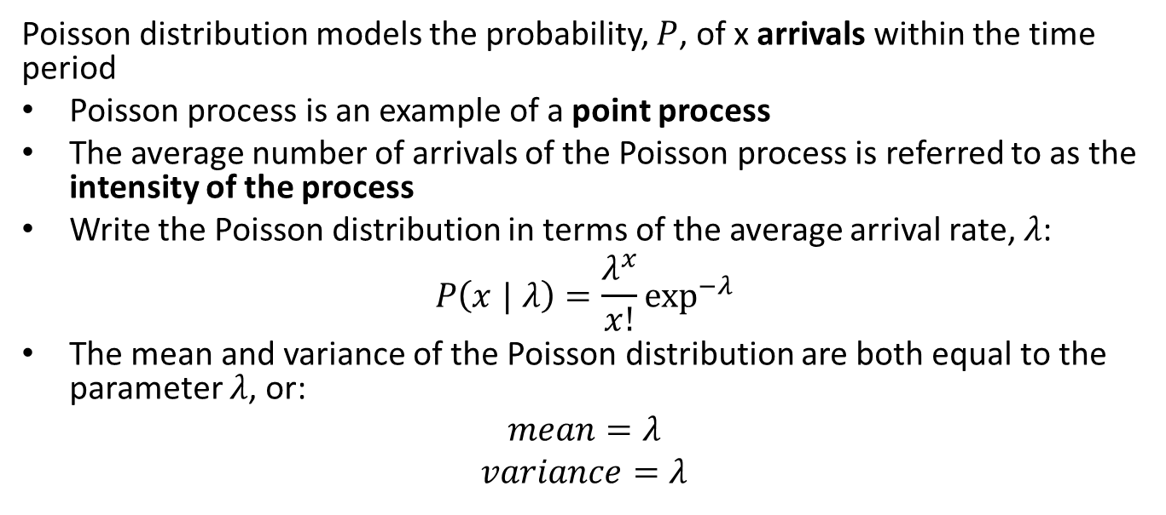
Poisson distribution
Poisson distribution models the probability, $P$, of x arrivals within the time period
Poisson process is an example of a point process
The average number of arrivals of the Poisson process is referred to as the intensity of the process
Write the Poisson distribution in terms of the average arrival rate, $λ$:
$$P\left(x | λ\right)=\frac{λ^{x}}{x!}\exp^{−λ}$$
The mean and variance of the Poisson distribution are both equal to the parameter $λ$, or:
$$mean=λ$$
$$variance=λ$$

Slide 19
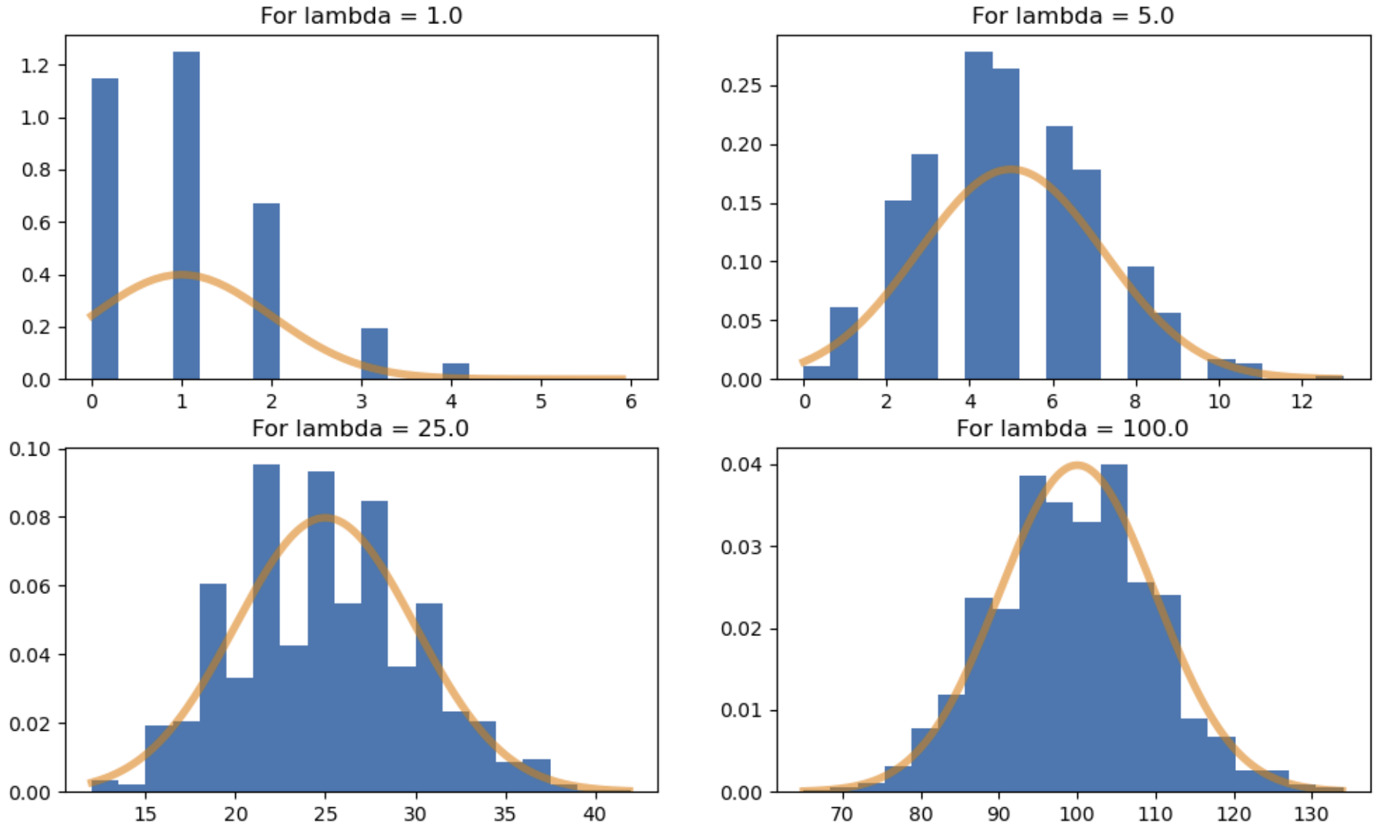
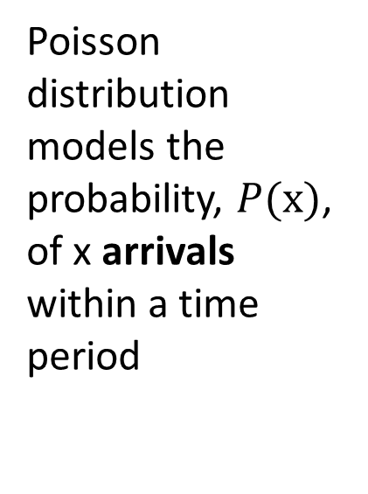
Poisson distribution
Poisson distribution models the probability, $P(x)$, of x arrivals within a time period
Poisson distribution for several arrival rates

Slide 20
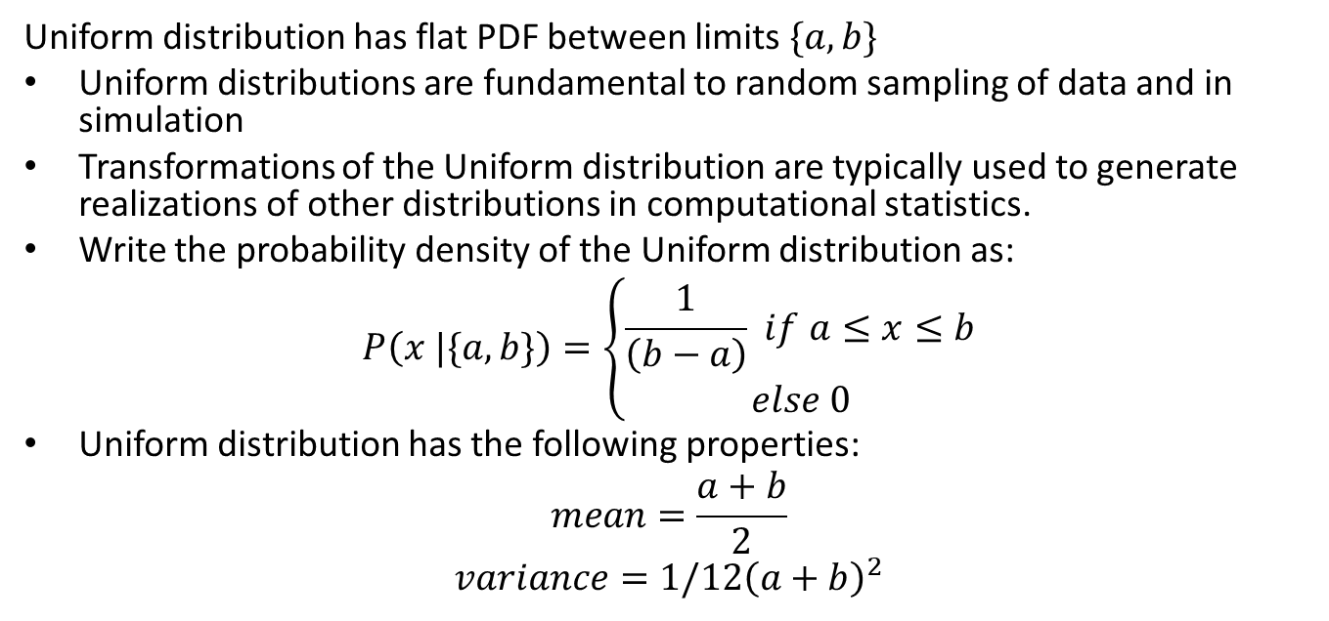
Uniform distribution
Uniform distribution has flat PDF between limits $\{a,b\}$
Uniform distributions are fundamental to random sampling of data and in simulation
Transformations of the Uniform distribution are typically used to generate realizations of other distributions in computational statistics.
Write the probability density of the Uniform distribution as:
$$P\left(x |\{a,b\}\right)=\left\{\begin{aligned}\frac{1}{\left(b−a\right)} if a≤x≤b \\ else 0\end{aligned}\right.$$
Uniform distribution has the following properties:
$$mean=\frac{a+b}{2}$$
$$variance=1/12{\left(a+b\right)}^{2}$$

Slide 21

Uniform distribution
The expectation of a uniform distribution on the interval $\{a,b\}$ is easy to work out:
$$E_{a−b}\left(X\right)=\int_{a}^{b}{x p\left(x\right) dx}$$
$$=\int_{a}^{b}{x dx}$$
$$=\frac{x^{2}}{2}|_{b}^{a}$$
$$=\frac{a+b}{2}$$
Which is the mean!

Slide 22
Normal distribution
The Normal distribution or Gaussian distribution is one of the most widely used probability distributions
The distribution of mean estimates of observations of a random variable drawn from any distribution converge to a Normal distribution by the central limit theorem (CLT)
Many physical processes produce Normal measurement values
Normal distribution has tractable mathematical properties

Slide 23
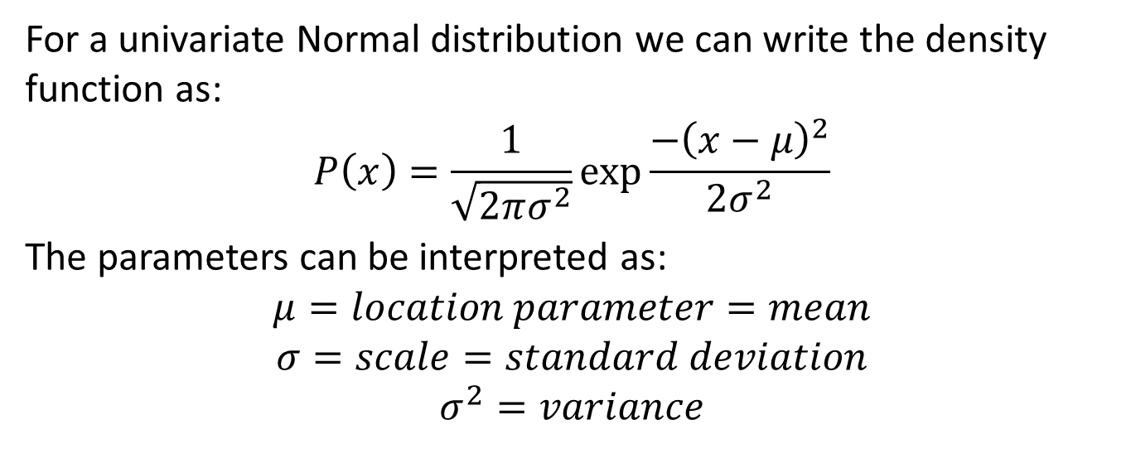
Normal distribution
For a univariate Normal distribution we can write the density function as:
$$P\left(x\right)=\frac{1}{\sqrt[ ]{2πσ^{2}}}exp\frac{−{\left(x−μ\right)}^{2}}{2σ^{2}}$$
The parameters can be interpreted as:
$$μ=location parameter=mean$$
$$σ=scale=standard deviation$$
$$σ^{2}=variance$$

Slide 24
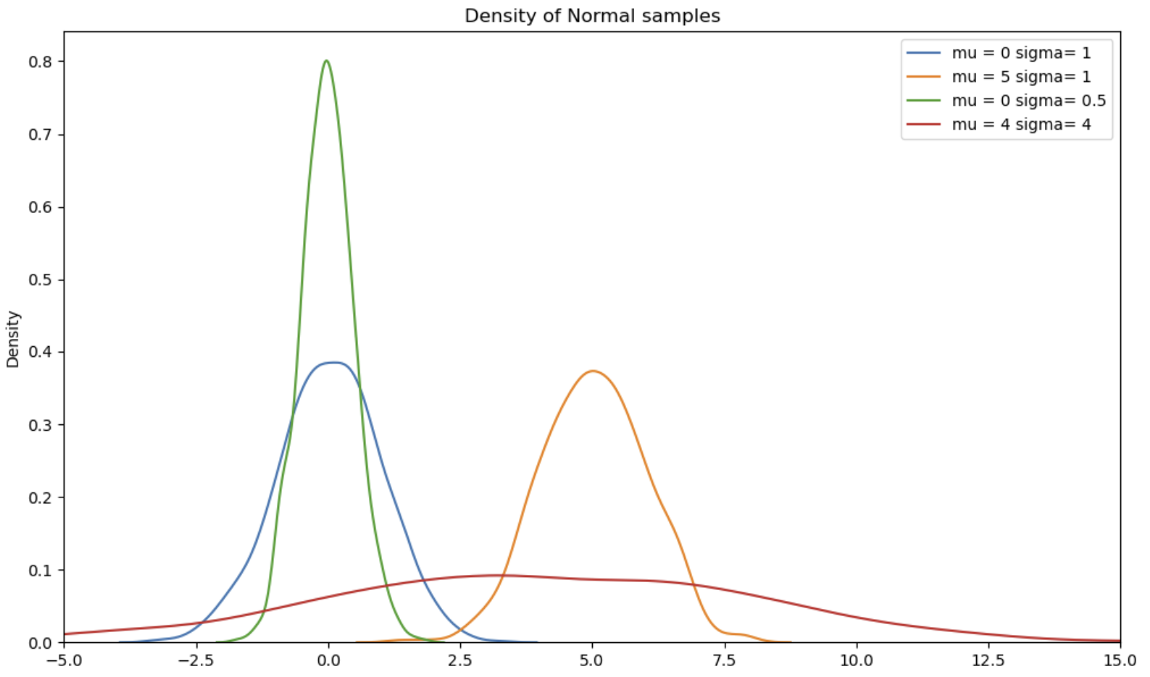
Normal distribution
Normal density for several paramter values

Slide 25
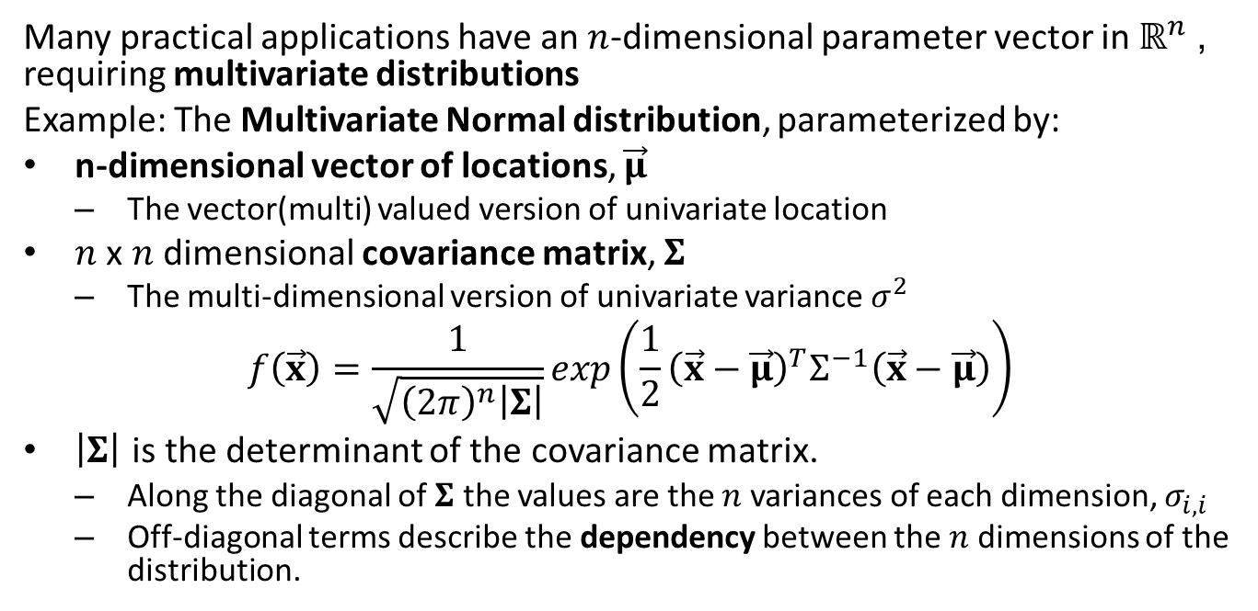
Multivariate Normal
Many practical applications have an $n$-dimensional parameter vector in $ℝ^{n}$, requiring multivariate distributions
Example: The Multivariate Normal distribution, parameterized by:
n-dimensional vector of locations, $\vec{μ}$
The vector(multi) valued version of univariate location
$n$ x $n$ dimensional covariance matrix, $Σ$
The multi-dimensional version of univariate variance $σ^{2}$
$$f\left(\vec{x}\right)=\frac{1}{\sqrt[ ]{{\left(2π\right)}^{n}\left|Σ\right|}}exp\left(\frac{1}{2}{\left(\vec{x}−\vec{μ}\right)}^{T}Σ^{−1}\left(\vec{x}−\vec{μ}\right)\right)$$
$\left|Σ\right|$ is the determinant of the covariance matrix.
Along the diagonal of $Σ$ the values are the $n$ variances of each dimension, $σ_{i,i}$
Off-diagonal terms describe the dependency between the $n$ dimensions of the distribution.

Slide 26
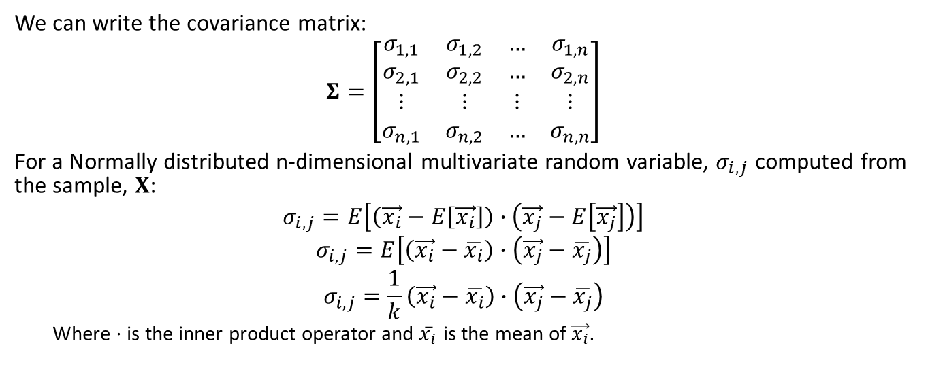
Multivariate Normal
We can write the covariance matrix:
$$Σ=\left[\begin{matrix}σ_{1,1} & σ_{1,2} & … & σ_{1,n} \\ σ_{2,1} & σ_{2,2} & … & σ_{2,n} \\ ⋮ & ⋮ & ⋮ & ⋮ \\ σ_{n,1} & σ_{n,2} & … & σ_{n,n}\end{matrix}\right]$$
For a Normally distributed n-dimensional multivariate random variable, $σ_{i,j}$ computed from the sample, $X$:
$$σ_{i,j}=E\left[\left(\vec{x_{i}}−E\left[\vec{x_{i}}\right]\right)∙\left(\vec{x_{j}}−E\left[\vec{x_{j}}\right]\right)\right]$$
$$σ_{i,j}=E\left[\left(\vec{x_{i}}−\overline{x_{i}}\right)∙\left(\vec{x_{j}}−\overline{x_{j}}\right)\right]$$
$$σ_{i,j}=\frac{1}{k}\left(\vec{x_{i}}−\overline{x_{i}}\right)∙\left(\vec{x_{j}}−\overline{x_{j}}\right)$$
Where $⋅$ is the inner product operator and $\overset{‾}{x_{i}}$ is the mean of $\vec{x_{i}}$.

Slide 27
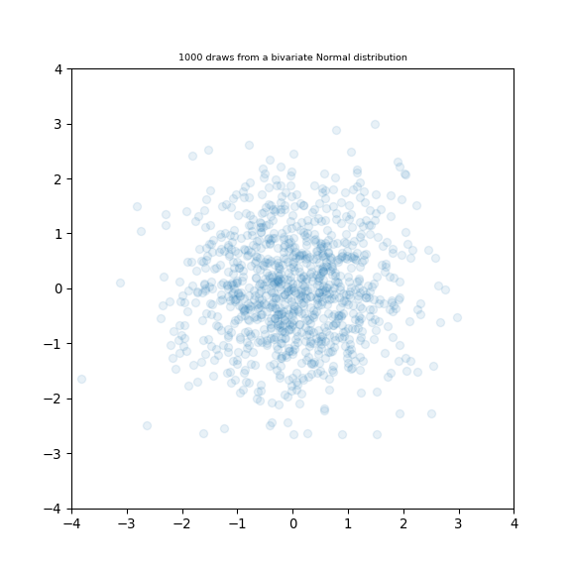
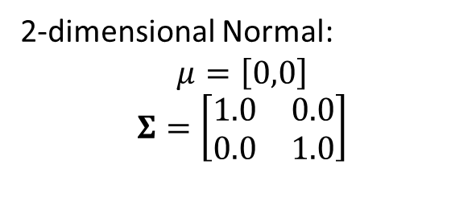
Multivariate Normal
2-dimensional Normal:
$$μ=\left[0,0\right]$$
$$Σ=\left[\begin{matrix}1.0 & 0.0 \\ 0.0 & 1.0\end{matrix}\right]$$

Slide 28
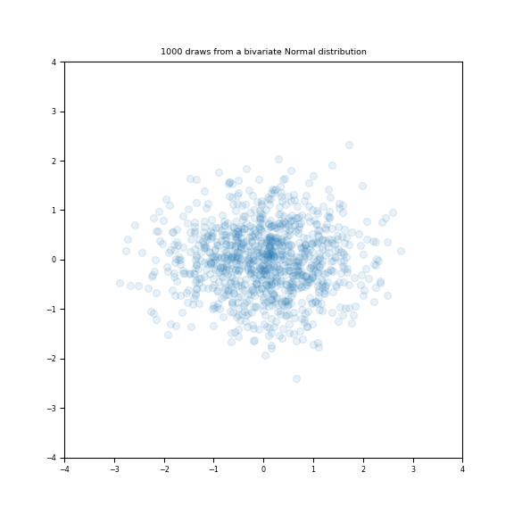

Multivariate Normal
2-dimensional Normal:
$$μ=\left[0,0\right]$$
$$Σ=\left[\begin{matrix}1.0 & 0.0 \\ 0.0 & 0.5\end{matrix}\right]$$

Slide 29
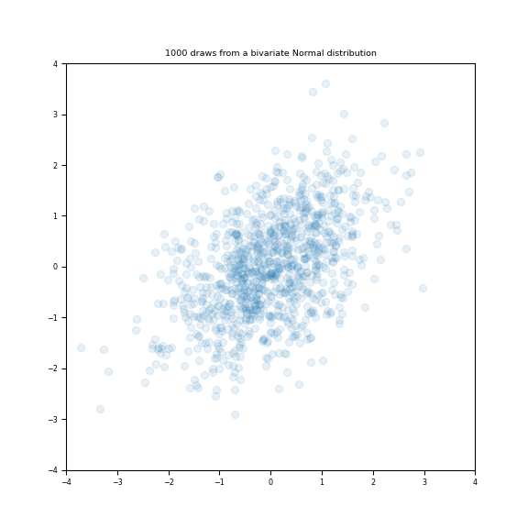

Multivariate Normal
2-dimensional Normal:
$$μ=\left[0,0\right]$$
$$Σ=\left[\begin{matrix}1.0 & 0.5 \\ 0.5 & 1.0\end{matrix}\right]$$

Slide 30
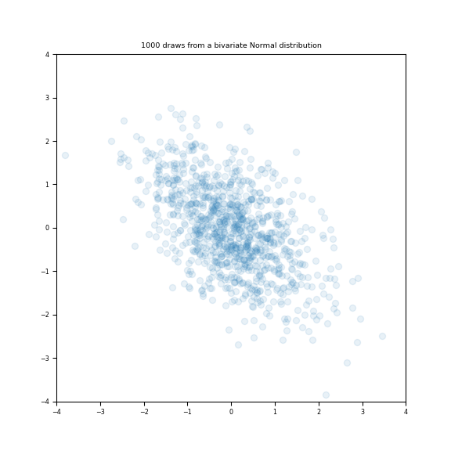

Multivariate Normal
2-dimensional Normal:
$$μ=\left[0,0\right]$$
$$Σ=\left[\begin{matrix}1.0 & −0.5 \\ −0.5 & 1.0\end{matrix}\right]$$

Slide 31
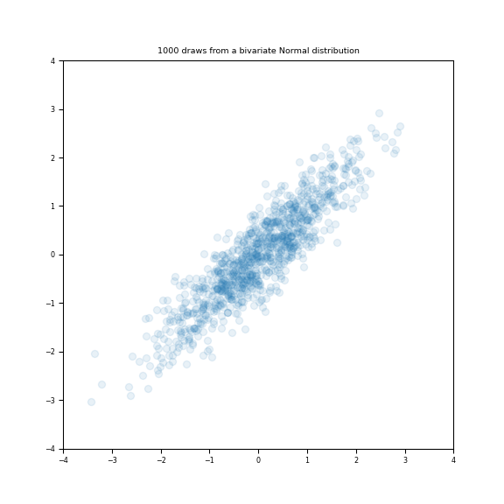

Multivariate Normal
2-dimensional Normal:
$$μ=\left[0,0\right]$$
$$Σ=\left[\begin{matrix}1.0 & 0.9 \\ 0.9 & 1.0\end{matrix}\right]$$

Slide 32
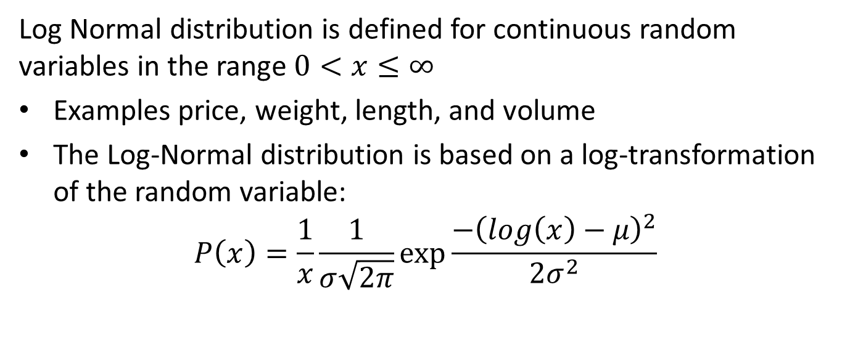
Log-Normal distribution
Log Normal distribution is defined for continuous random variables in the range $0<x≤∞$
Examples price, weight, length, and volume
The Log-Normal distribution is based on a log-transformation of the random variable:
$$P\left(x\right)=\frac{1}{x}\frac{1}{σ\sqrt[ ]{2π}}exp\frac{−{\left(log\left(x\right)−μ\right)}^{2}}{2σ^{2}}$$

Slide 33
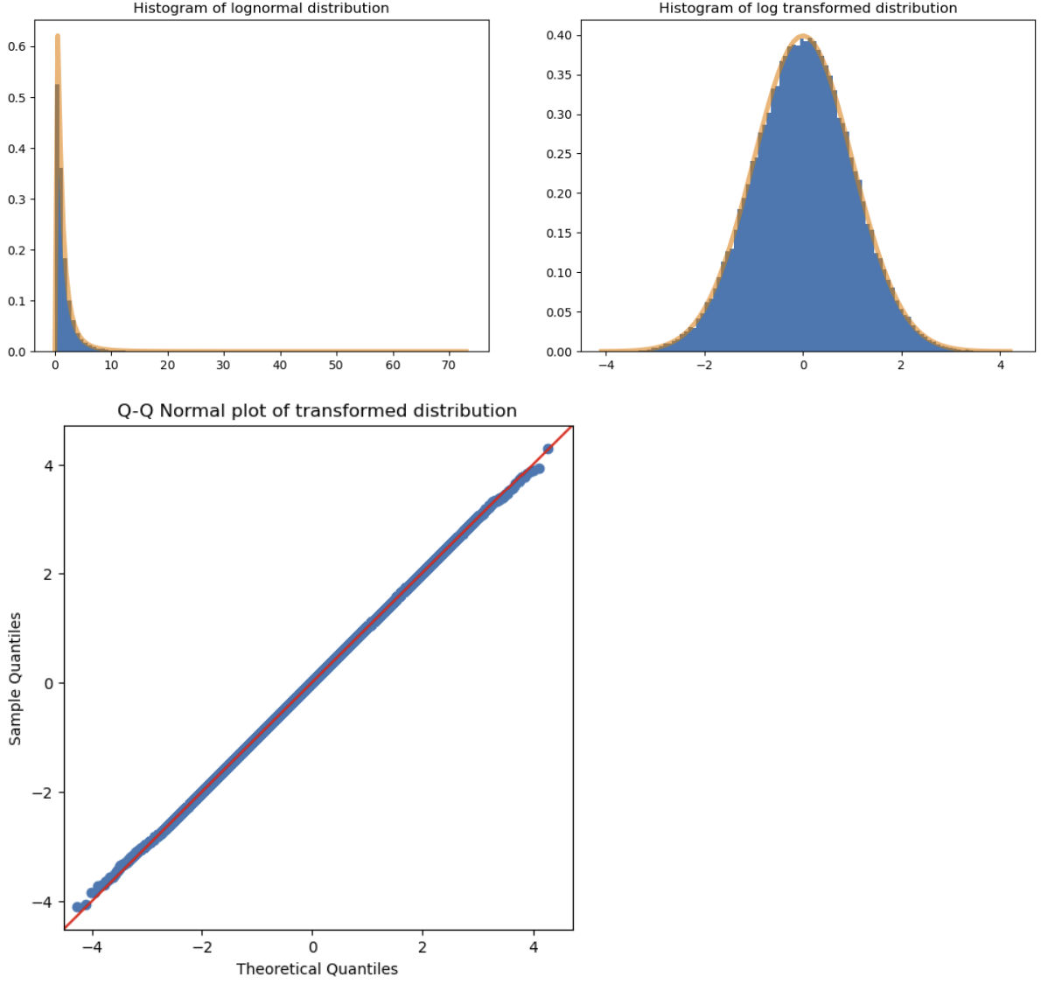
Log-Normal distribution
Log Normal and log transformed example

Slide 34
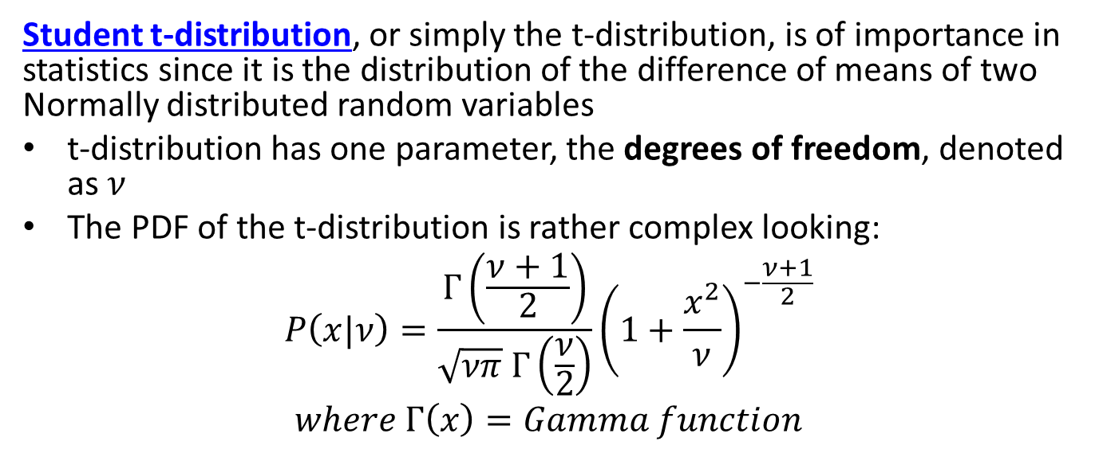
Student t-distribution
Student t-distribution, or simply the t-distribution, is of importance in statistics since it is the distribution of the difference of means of two Normally distributed random variables
t-distribution has one parameter, the degrees of freedom, denoted as $ν$
The PDF of the t-distribution is rather complex looking:
$$P\left(x|ν\right)=\frac{Γ\left(\frac{ν+1}{2}\right)}{\sqrt{νπ} Γ\left(\frac{ν}{2}\right)}{\left(1+\frac{x^{2}}{ν}\right)}^{−\frac{ν+1}{2}}$$
$$where Γ\left(x\right)=Gamma function$$

Slide 35
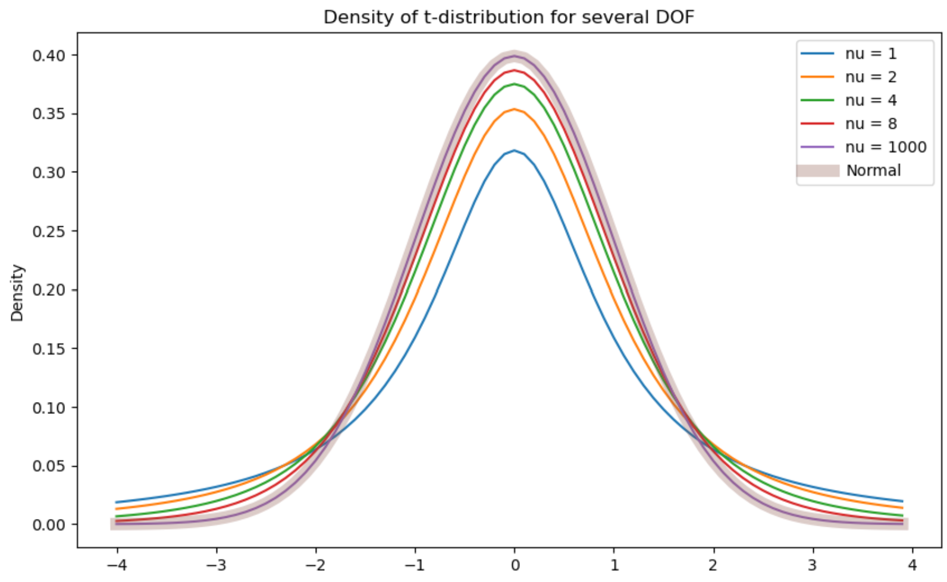
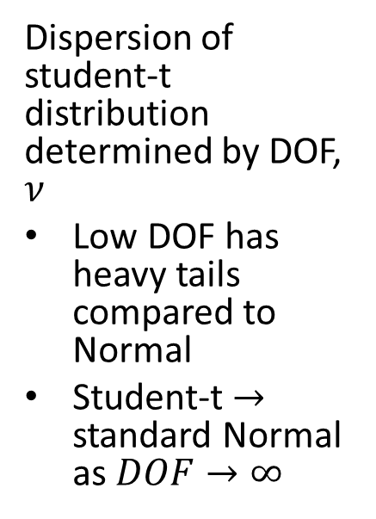
Student t-distribution
Dispersion of student-t distribution determined by DOF, $ν$
Low DOF has heavy tails compared to Normal
Student-t $→$ standard Normal as $DOF→∞$

Slide 36
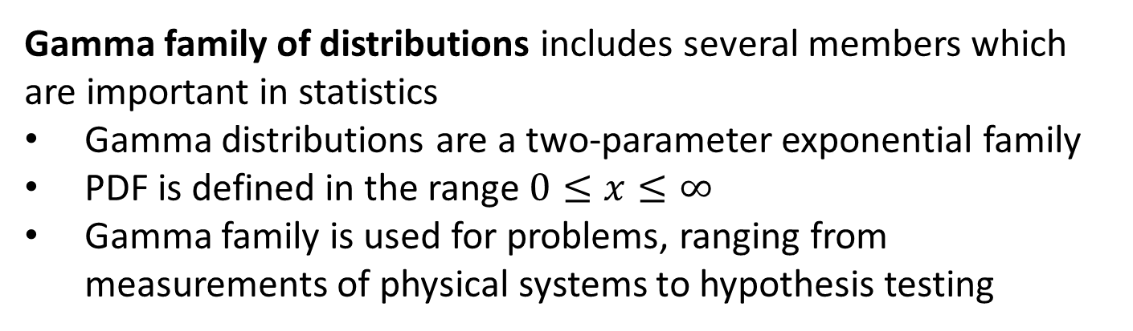
The Gamma and $Χ^{2}$distributions
Gamma family of distributions includes several members which are important in statistics
Gamma distributions are a two-parameter exponential family
PDF is defined in the range $0≤x≤∞$
Gamma family is used for problems, ranging from measurements of physical systems to hypothesis testing

Slide 37
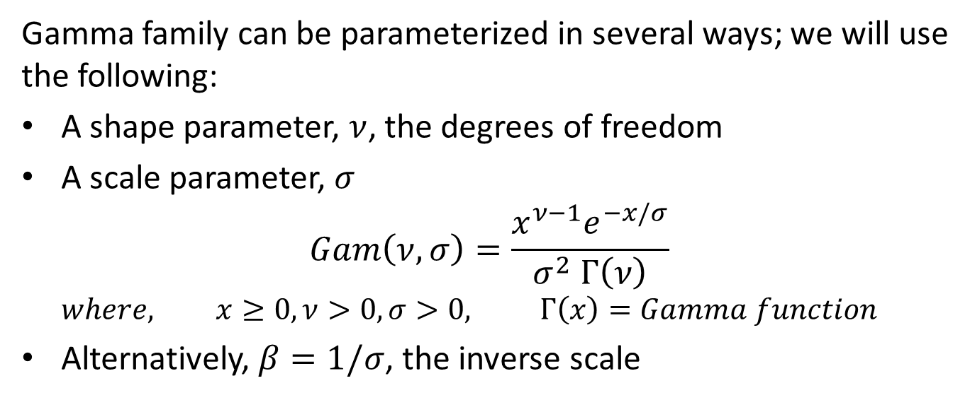

The Gamma and $Χ^{2}$distributions
Gamma family can be parameterized in several ways; we will use the following:
A shape parameter, $ν$, the degrees of freedom
A scale parameter, $σ$
$$Gam\left(ν,σ\right)=\frac{x^{ν−1}e^{−x/σ}}{σ^{2} Γ\left(ν\right)}$$
$$where, x≥0, ν>0,σ>0, Γ\left(x\right)=Gamma function$$
Alternatively, $β=1/σ$, the inverse scale

Slide 38
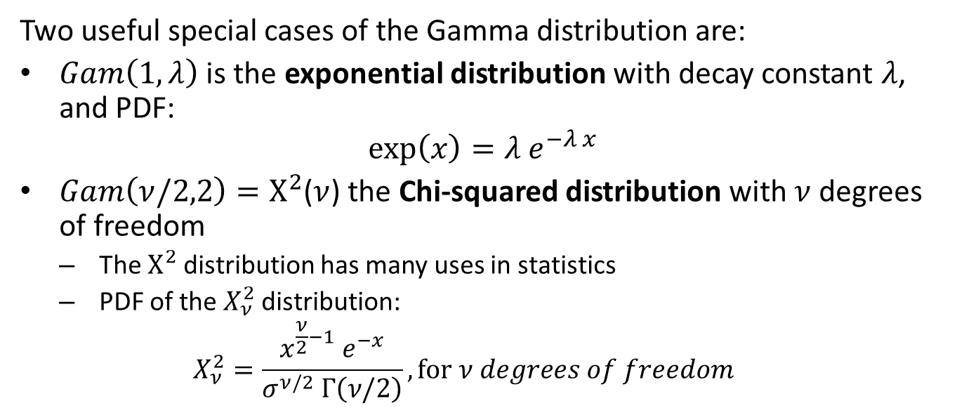
The Gamma and $Χ^{2}$distributions
Two useful special cases of the Gamma distribution are:
$Gam\left(1,λ\right)$ is the exponential distribution with decay constant $λ$, and PDF:
$$\exp\left(x\right)={λ e}^{−λ x}$$
$Gam\left(ν/2,2\right)=Χ^{2}$($ν$) the Chi-squared distribution with $ν$degrees of freedom
The $Χ^{2}$distribution has many uses in statistics
PDF of the $X_{ν}^{2}$distribution:
$$X_{ν}^{2}=\frac{x^{\frac{ν}{2}−1}{ e}^{−x}}{σ^{ν/2} Γ\left(ν/2\right)}, for ν degrees of freedom$$

Slide 39
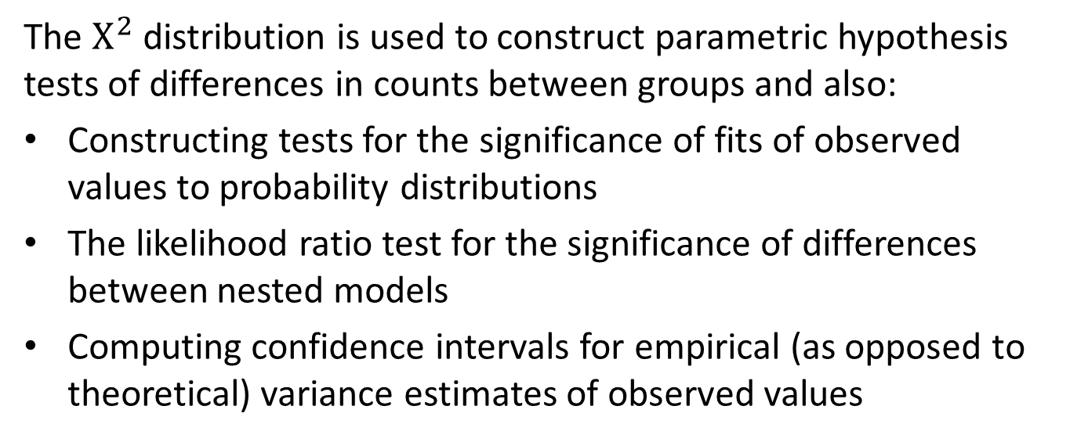

The $Χ^{2}$distribution
The $Χ^{2}$ distribution is used to construct parametric hypothesis tests of differences in counts between groups and also:
Constructing tests for the significance of fits of observed values to probability distributions
The likelihood ratio test for the significance of differences between nested models
Computing confidence intervals for empirical (as opposed to theoretical) variance estimates of observed values

Slide 40
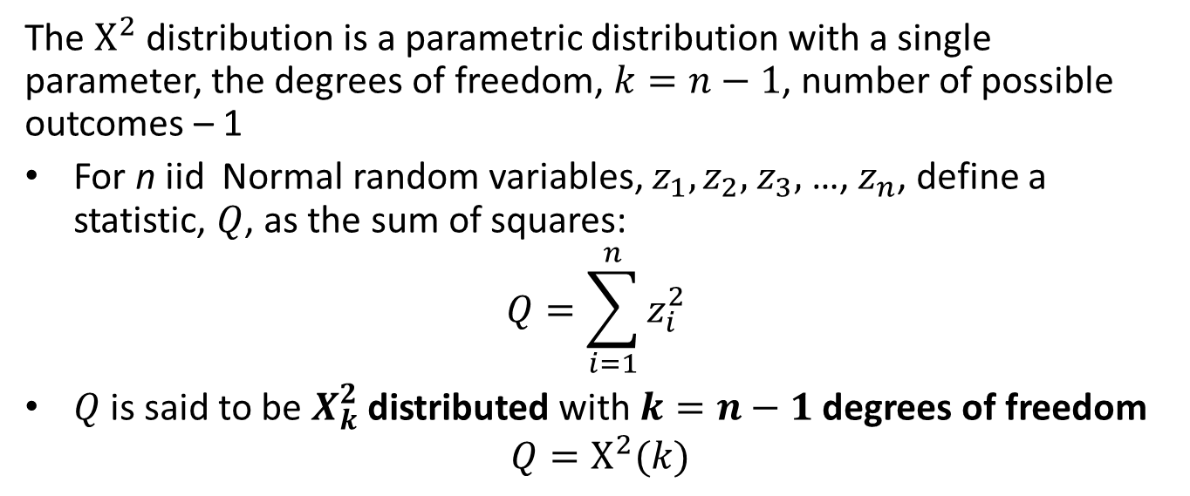
The $Χ^{2}$distribution
The $Χ^{2}$ distribution is a parametric distribution with a single parameter, the degrees of freedom, $k=n−1$, number of possible outcomes – 1
For n iid Normal random variables, $z_{1},z_{2},$ $z_{3},$ …, $z_{n}$, define a statistic, $Q$, as the sum of squares:
$$Q=\sum_{i=1}^{n}{{z_{i}^{2}}^{ }}$$
$Q$ is said to be $X_{k}^{2}$distributed with $k=n−1$ degrees of freedom
$$Q=Χ^{2}(k)$$

Slide 41
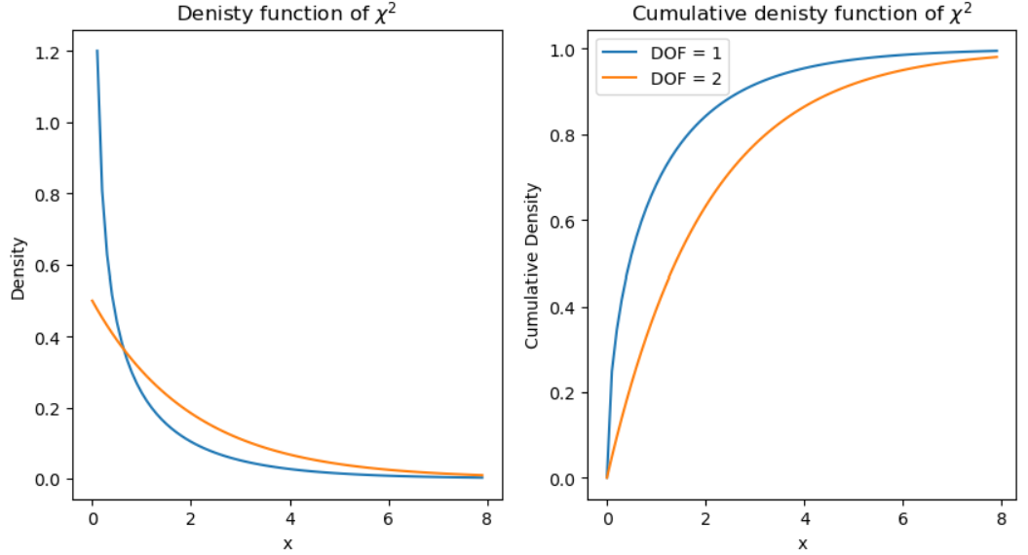
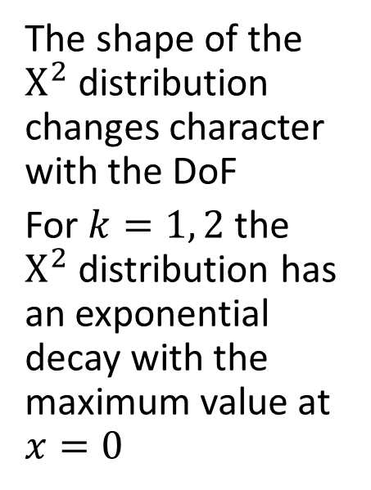
The $Χ^{2}$distribution
The shape of the $Χ^{2}$distribution changes character with the DoF
For $k=1, 2$the $Χ^{2}$distribution has an exponential decay with the maximum value at $x=0$

Slide 42
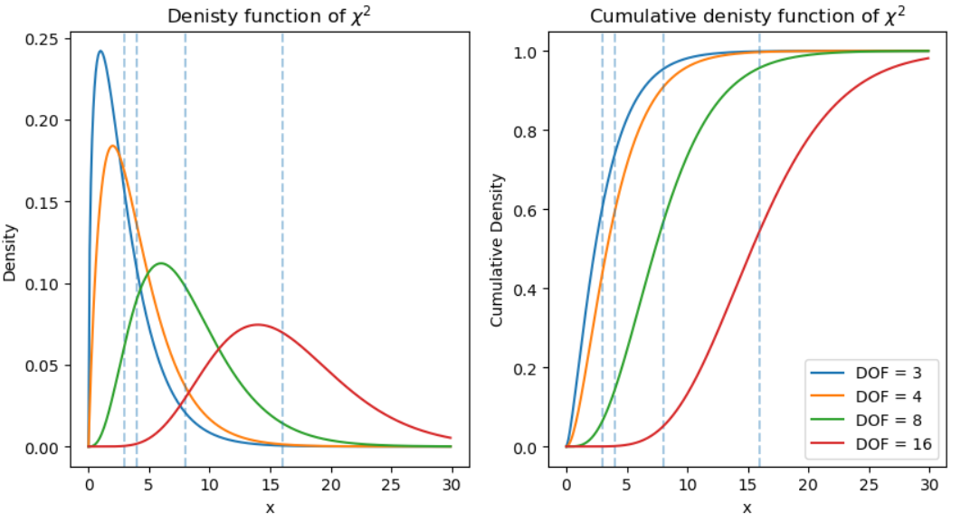
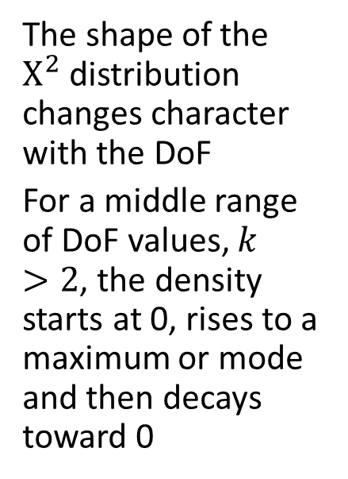
The $Χ^{2}$distribution
The shape of the $Χ^{2}$distribution changes character with the DoF
For a middle range of DoF values, $k>2$, the density starts at 0, rises to a maximum or mode and then decays toward 0

Slide 43
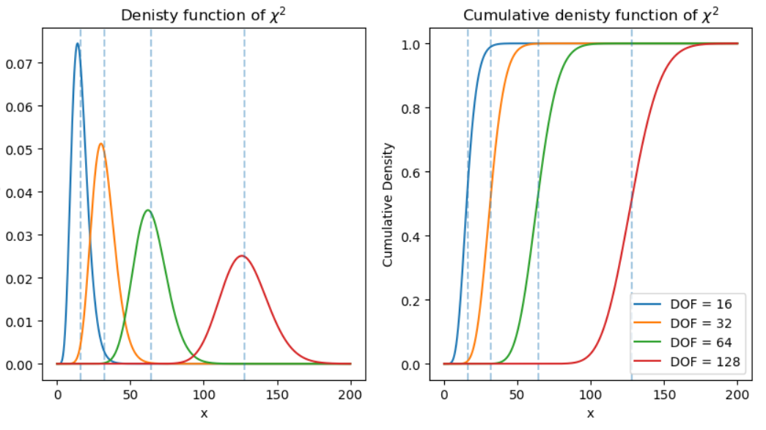
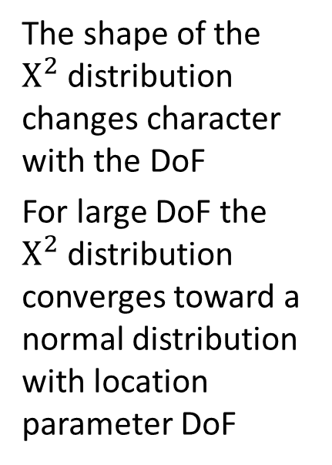
The $Χ^{2}$distribution
The shape of the $Χ^{2}$distribution changes character with the DoF
For large DoF the $Χ^{2}$distribution converges toward a normal distribution with location parameter DoF

Slide 44
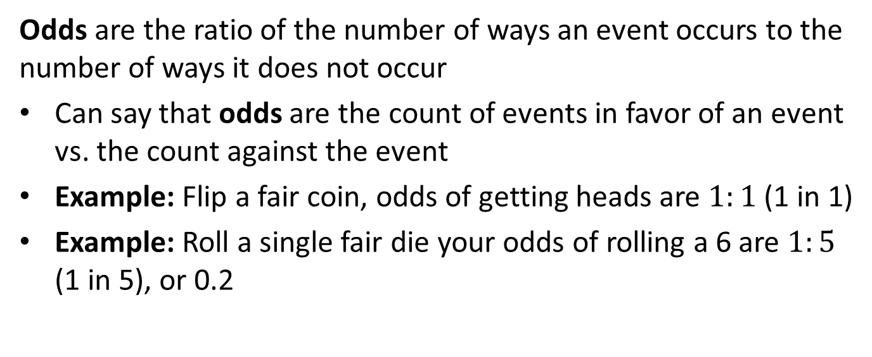
Odds
Odds are the ratio of the number of ways an event occurs to the number of ways it does not occur
Can say that odds are the count of events in favor of an event vs. the count against the event
Example: Flip a fair coin, odds of getting heads are $1:1$ (1 in 1)
Example: Roll a single fair die your odds of rolling a 6 are $1:5$ (1 in 5), or 0.2

Slide 45
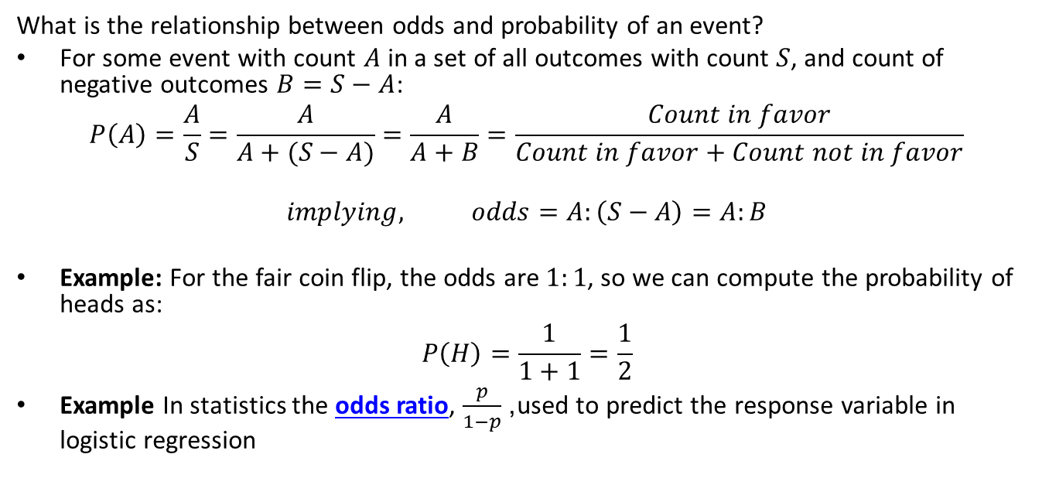
Odds
What is the relationship between odds and probability of an event?
For some event with count $A$ in a set of all outcomes with count $S$, and count of negative outcomes $B=S−A$:
$$P\left(A\right)=\frac{A}{S}=\frac{A}{A+(S−A)}=\frac{A}{A+B}=\frac{Count in favor}{Count in favor+Count not in favor}$$
$implying, odds=A:\left(S−A\right)=A:B$
Example: For the fair coin flip, the odds are $1:1$, so we can compute the probability of heads as:
$$P\left(H\right)=\frac{1}{1+1}=\frac{1}{2}$$
Example In statistics the odds ratio, $\frac{p}{1−p}$, used to predict the response variable in logistic regression

Slide 46

Summary
Axioms of probability; for discrete distribution
$$0<P\left(A\right)≤1$$
$$P\left(S\right)=\sum_{a_{i}∈A}^{​}{P}\left(a_{i}\right)=1$$
$$P\left(A∪B\right)=P\left(A\right)+P\left(B\right), if A⊥B$$
Expectation
$$E\left[X\right]=\sum_{i=1}^{n}{x_{i}} p\left(x_{i}\right)$$

Slide 47

Summary
The Categorical distribution
For outcome $i$ we one hot encode the results as:
$e_{i}=\left(0,0,…,1,…,0\right)$
For a single trial the probabilities of the $k$ possible outcomes are expressed:
$Π=\left(π_{1},π_{2},…,π_{k}\right)$
probability mass function as:
$$f\left(x_{i}|Π\right)=π_{i}$$
Multivariate Normal distribution, parameterized by n-dimensional vector of locations, $\vec{μ}$ and $n$ x $n$ dimensional covariance matrix $Σ$
$$f\left(\vec{x}\right)=\frac{1}{\sqrt[ ]{{\left(2π\right)}^{k}\left|Σ\right|}}exp\left(\frac{1}{2}{\left(\vec{x}−\vec{μ}\right)}^{T}Σ\left(\vec{x}−\vec{μ}\right)\right)$$

