Slide 1
Parameter Estimation and Likelihood
Steve Elston

Slide 2
Review
Sampling is a fundamental process in the collection and analysis of data
Sampling is important because we almost never have data on a whole population
Sampling must be randomized to preclude biases
As sample size increases the standard error of a statistic computed from the sample decreases by the law of large numbers
Key points to keep in mind:
Understanding sampling is essential to ensure data is representative of the entire population
Use inferences on the sample to say something about the population
The sample must be randomly drawn from the population
Sampling from distribution is the building block of simulation

Slide 3
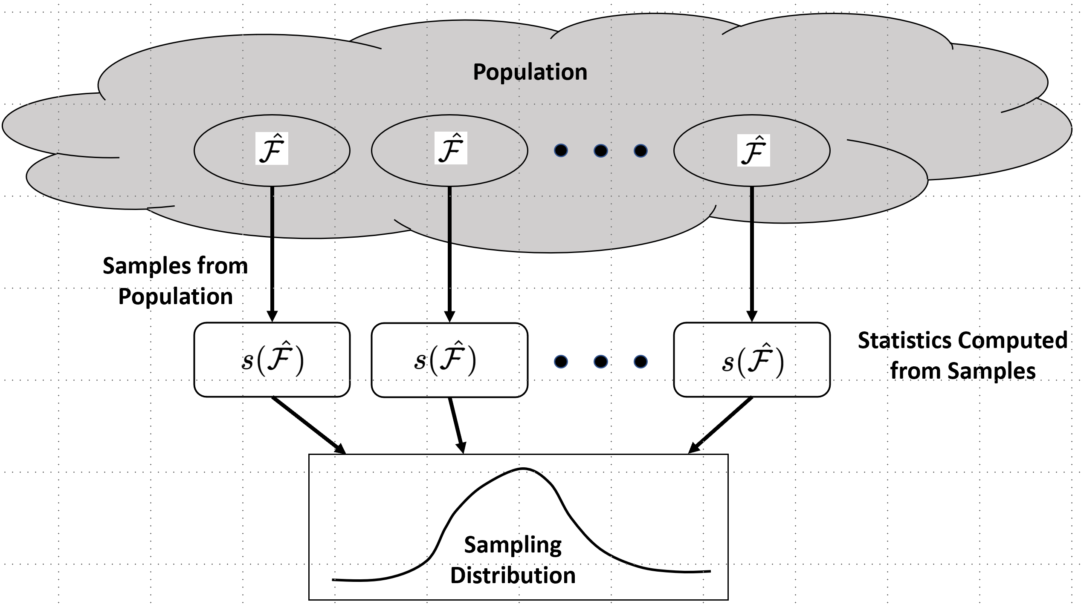

Review
Sampling of a population is done from an unknown population distribution, $ℱ$
Any statistic we compute for the generating process is an approximation for the population, $s\left(\hat{ℱ}\right)$
Sampling distribution of unknown population parameter

Slide 4
Review
The law of large numbers is a theorem that states that statistics of independent random samples converge to the population values as more samples are used
The law of large numbers is foundational to statistics and sampling theory
Assume that larger samples are more representatives of the population we are sampling
If the real world did not follow this theorem much of statistics, to say nothing of science and technology, would fail badly.

Slide 5
Introduction
The concept of likelihood and maximum likelihood estimation (MLE) have been at the core of much of statistical modeling for about 100 years
In 21st Century, likelihood and MLE continue to be foundational
Understanding the concept of likelihood and the use of MLE methods is key to understanding many parametric statistical methods
Likelihood is a measure of how likely a parametric model is to generate the observed data
MLE is a generic methods for parameter estimation
MLE used widely for machine learning models, including some deep learning models

Slide 6
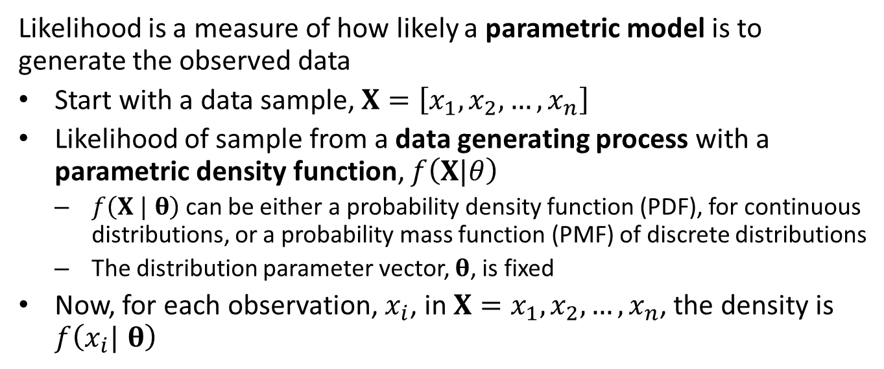
Likelihood and Density Functions
Likelihood is a measure of how likely a parametric model is to generate the observed data
Start with a data sample, $X=\left[x_{1},x_{2},…,x_{n}\right]$
Likelihood of sample from a data generating process with a parametric density function, $f\left(X|θ\right)$
$f\left(X | θ\right)$ can be either a probability density function (PDF), for continuous distributions, or a probability mass function (PMF) of discrete distributions
The distribution parameter vector, $θ$, is fixed
Now, for each observation, $x_{i}$, in $X=x_{1},x_{2},…,x_{n}$, the density is $f\left(x_{i}| θ\right)$

Slide 7
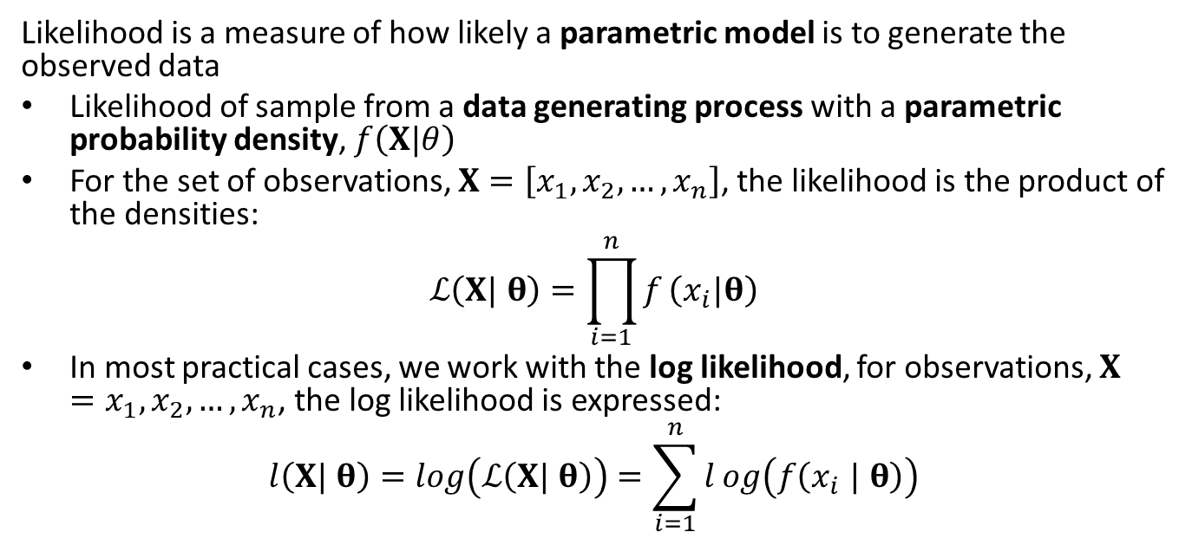
Likelihood
Likelihood is a measure of how likely a parametric model is to generate the observed data
Likelihood of sample from a data generating process with a parametric probability density, $f\left(X|θ\right)$
For the set of observations, $X=\left[x_{1},x_{2},…,x_{n}\right]$, the likelihood is the product of the densities:
$$ℒ\left(X| θ\right)=\prod_{i=1}^{n}{f}\left(x_{i}|θ\right)$$
In most practical cases, we work with the log likelihood, for observations, $X=x_{1},x_{2},…,x_{n}$, the log likelihood is expressed:
$$l\left(X| θ\right)=log\left(ℒ\left(X| θ\right)\right)=\sum_{i=1}^{n}{l}og\left(f\left(x_{i} | θ\right)\right)$$

Slide 8
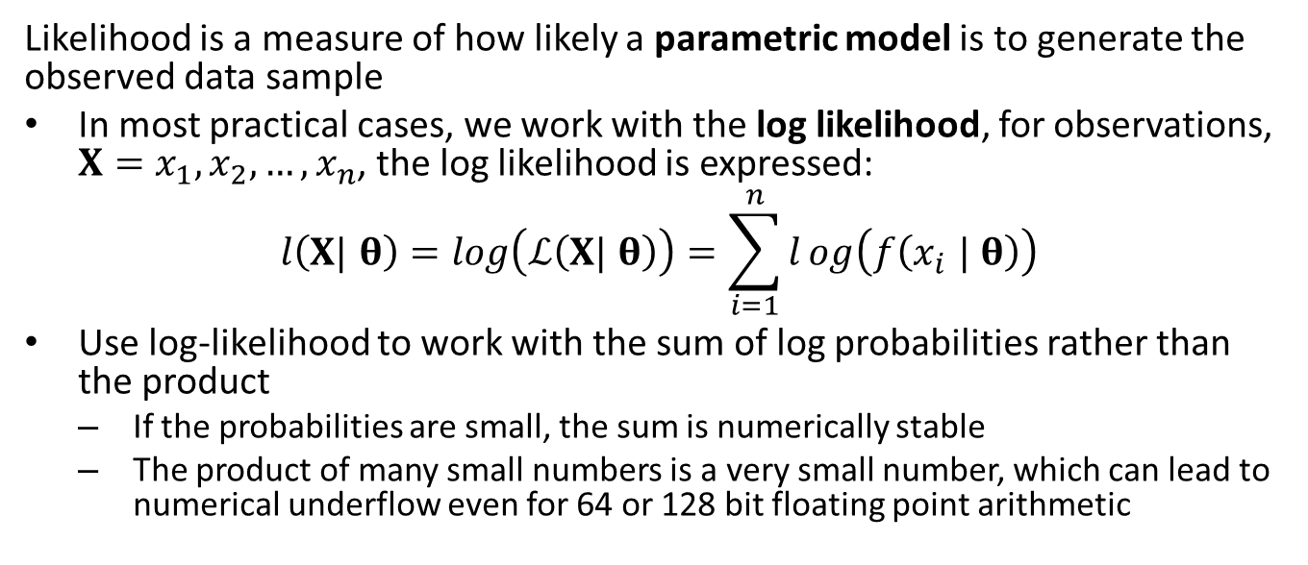
Likelihood
Likelihood is a measure of how likely a parametric model is to generate the observed data sample
In most practical cases, we work with the log likelihood, for observations, $X=x_{1},x_{2},…,x_{n}$, the log likelihood is expressed:
$$l\left(X| θ\right)=log\left(ℒ\left(X| θ\right)\right)=\sum_{i=1}^{n}{l}og\left(f\left(x_{i} | θ\right)\right)$$
Use log-likelihood to work with the sum of log probabilities rather than the product
If the probabilities are small, the sum is numerically stable
The product of many small numbers is a very small number, which can lead to numerical underflow even for 64 or 128 bit floating point arithmetic

Slide 9
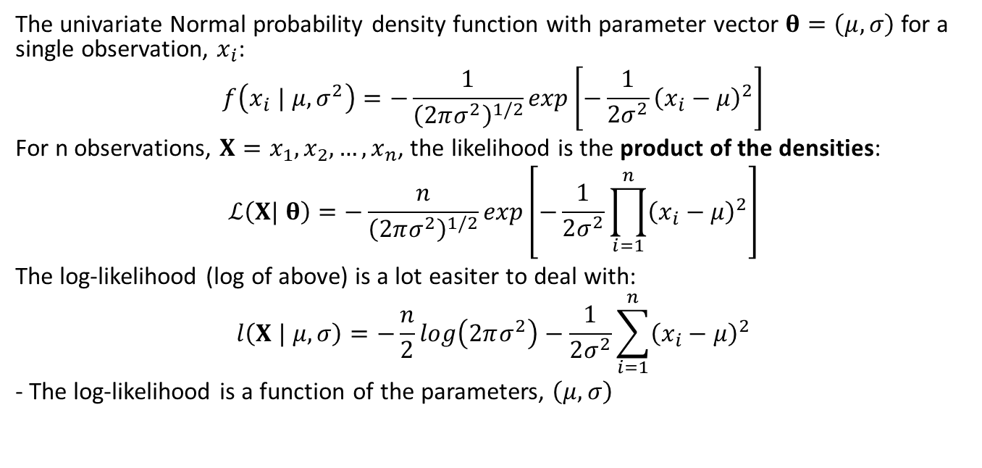
Normal Likelihood
The univariate Normal probability density function with parameter vector $θ=\left(μ,σ\right)$ for a single observation, $x_{i}$:
$$f\left(x_{i} | μ,σ^{2}\right)=−\frac{1}{{\left(2πσ^{2}\right)}^{1/2}}exp\left[−\frac{1}{2σ^{2}}{\left(x_{i}−μ\right)}^{2}\right]$$
For n observations, $X=x_{1},x_{2},…,x_{n}$, the likelihood is the product of the densities:
$$ℒ\left(X| θ\right)=−\frac{n}{{\left(2πσ^{2}\right)}^{1/2}}exp\left[−\frac{1}{2σ^{2}}\prod_{i=1}^{n}{{\left(x_{i}−μ\right)}^{2}}\right]$$
The log-likelihood (log of above) is a lot easiter to deal with:
$$l\left(X | μ,σ\right)=−\frac{n}{2}log\left(2πσ^{2}\right)−\frac{1}{2σ^{2}}\sum_{i=1}^{n}{{\left(x_{i}−μ\right)}^{2}}$$
- The log-likelihood is a function of the parameters, $\left(μ,σ\right)$

Slide 10
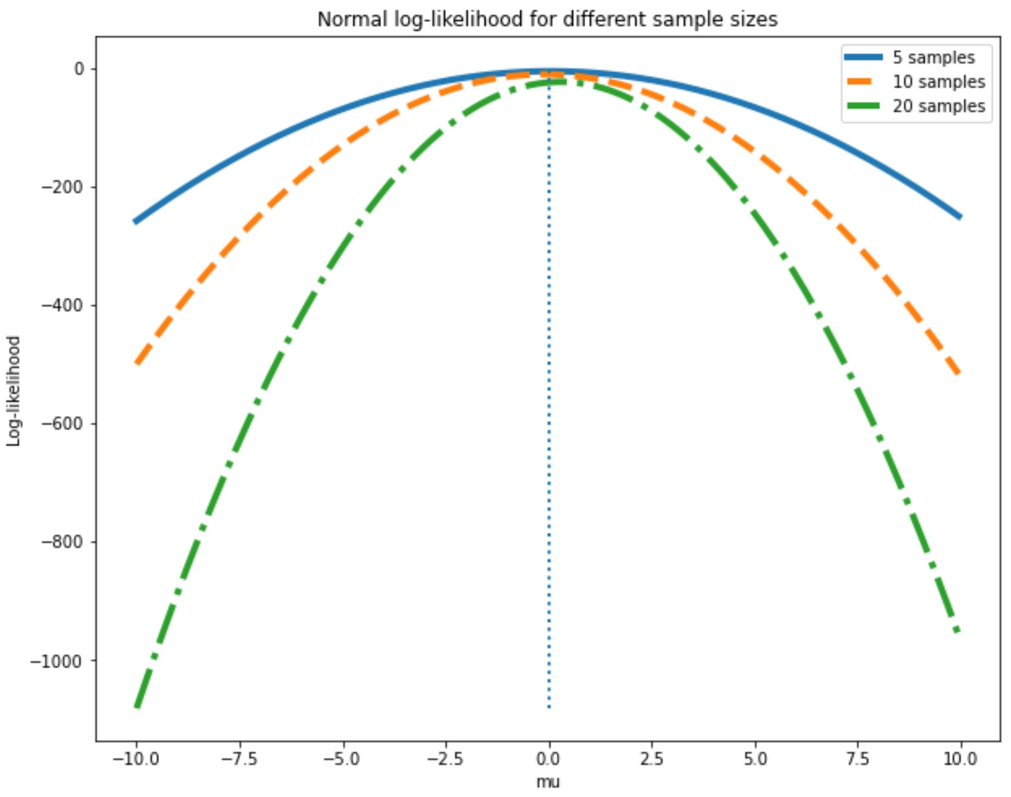
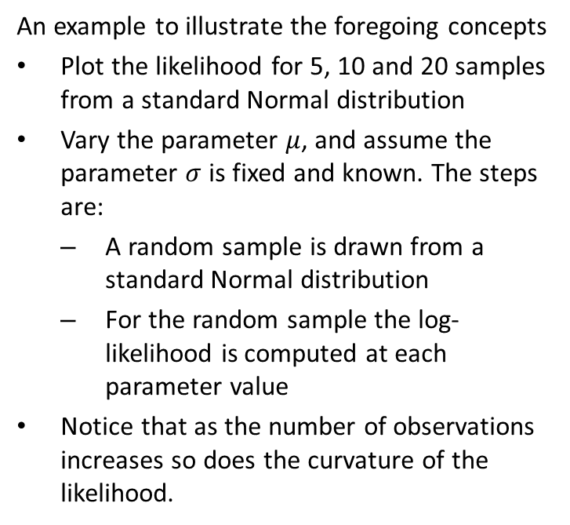
Normal Likelihood
An example to illustrate the foregoing concepts
Plot the likelihood for 5, 10 and 20 samples from a standard Normal distribution
Vary the parameter $μ$, and assume the parameter $σ$ is fixed and known. The steps are:
A random sample is drawn from a standard Normal distribution
For the random sample the log-likelihood is computed at each parameter value
Notice that as the number of observations increases so does the curvature of the likelihood.
Normal likelihood at different sample sizes

Slide 11
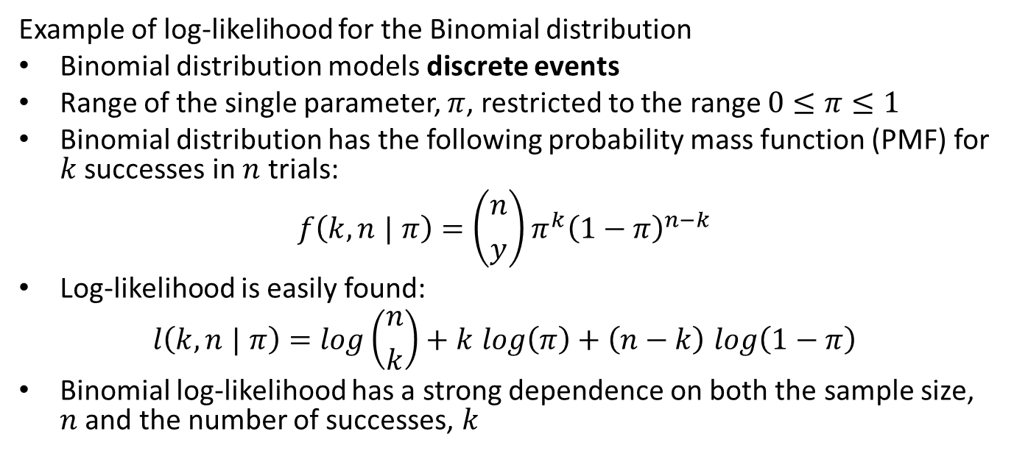
Binomial Likelihood
Example of log-likelihood for the Binomial distribution
Binomial distribution models discrete events
Range of the single parameter, $π$, restricted to the range $0≤π≤1$
Binomial distribution has the following probability mass function (PMF) for $k$ successes in $n$ trials:
$$f\left(k,n | π\right)=\left({n \atop y}\right)π^{k}{\left(1−π\right)}^{n−k}$$
Log-likelihood is easily found:
$$l\left(k,n | π\right)=log\left({n \atop k}\right)+k log\left(π\right)+\left(n−k\right) log\left(1−π\right)$$
Binomial log-likelihood has a strong dependence on both the sample size, $n$ and the number of successes, $k$

Slide 12
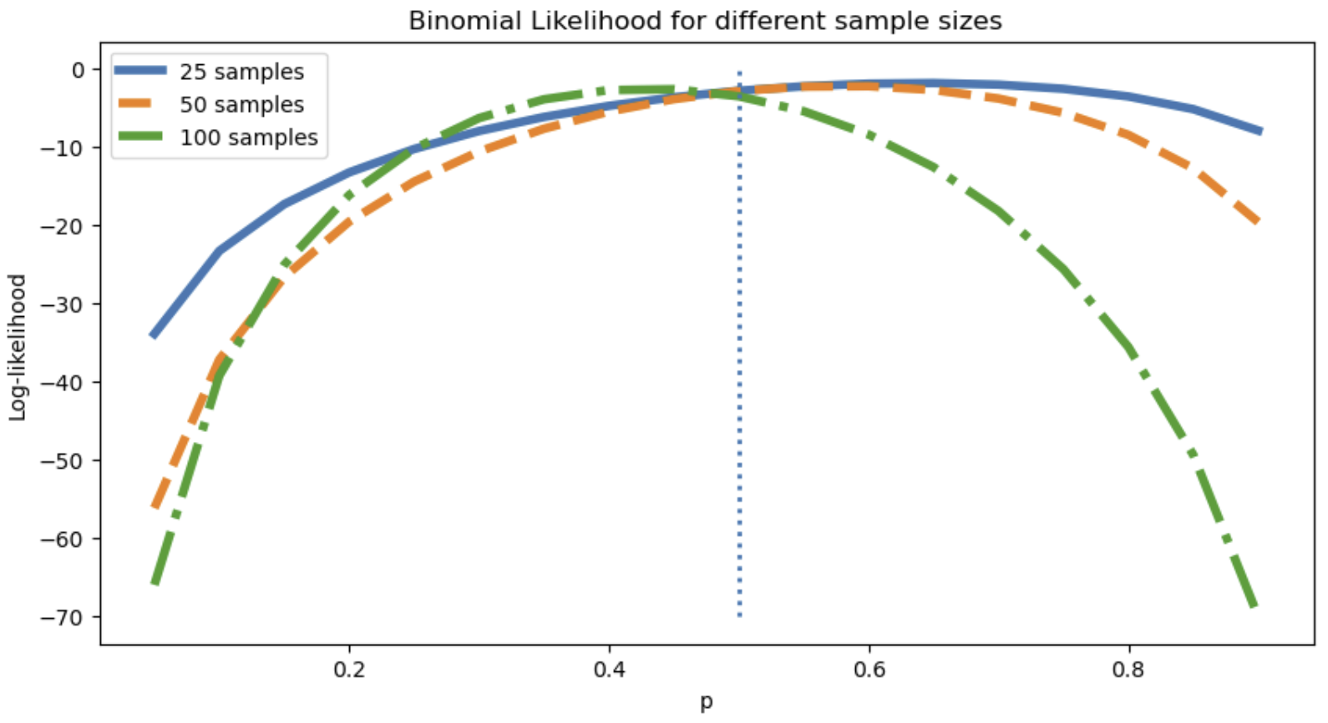
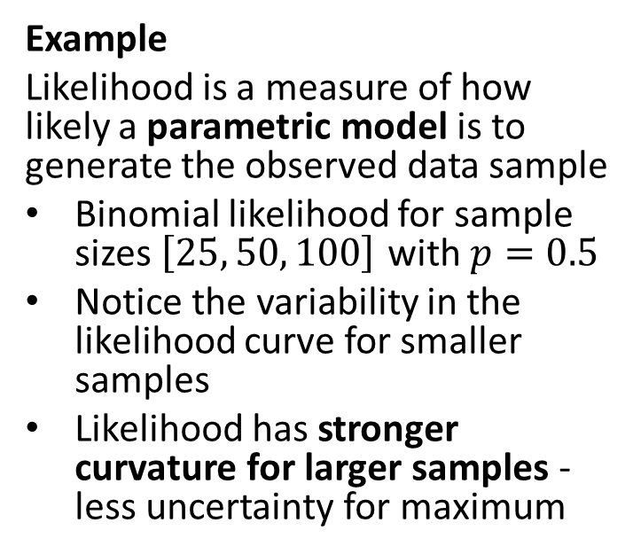
Binomial Likelihood
Example
Likelihood is a measure of how likely a parametric model is to generate the observed data sample
Binomial likelihood for sample sizes $\left[25, 50, 100\right]$ with $p=0.5$
Notice the variability in the likelihood curve for smaller samples
Likelihood has stronger curvature for larger samples - less uncertainty for maximum
Binomial likelihood at different sample sizes

Slide 13
Maximum Likelihood Estimator
Maximum likelihood estimator (MLE) is a foundational tool for much of statistical inference and machine learning
Given a log-likelihood function, find the model parameters which maximize it
Further, knowing the distribution allows us to quantify the uncertainty of the MLE parameter estimates
The model parameter estimates found by MLE are Normal for large samples, a remarkable property
The MLE is a point estimator, computes a single real valued vector
An estimate of a single parameter value, or point value, with the highest likelihood

Slide 14
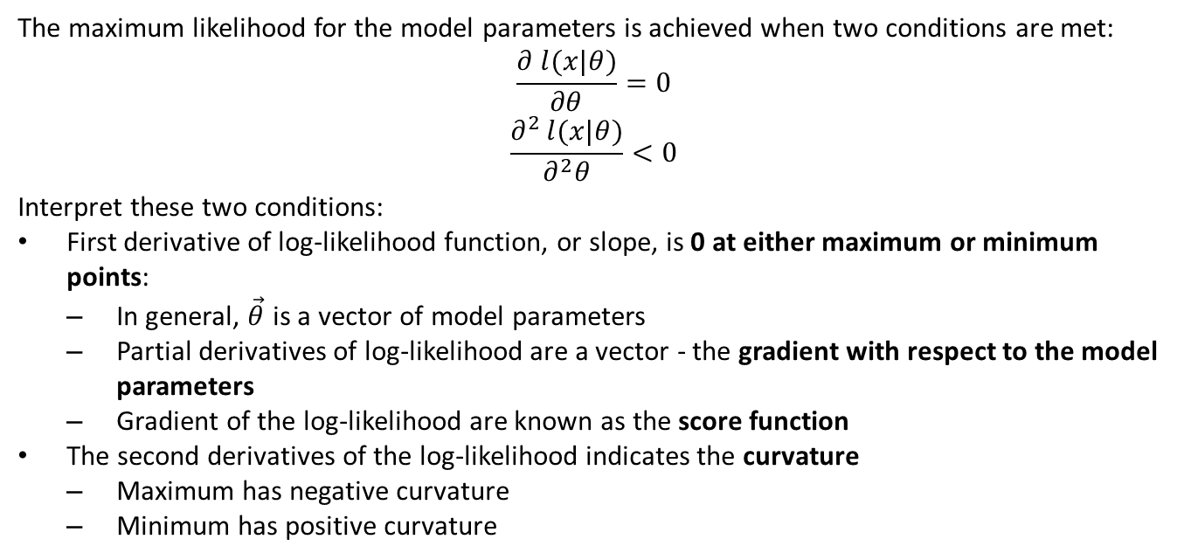
Maximum Likelihood Estimator
The maximum likelihood for the model parameters is achieved when two conditions are met:
$$\frac{∂ l(x|θ)}{∂θ}=0$$
$$\frac{∂^{2 }l(x|θ)}{∂^{2}θ}<0$$
Interpret these two conditions:
First derivative of log-likelihood function, or slope, is 0 at either maximum or minimum points:
In general, $\vec{θ}$ is a vector of model parameters
Partial derivatives of log-likelihood are a vector - the gradient with respect to the model parameters
Gradient of the log-likelihood are known as the score function
The second derivatives of the log-likelihood indicates the curvature
Maximum has negative curvature
Minimum has positive curvature

Slide 15
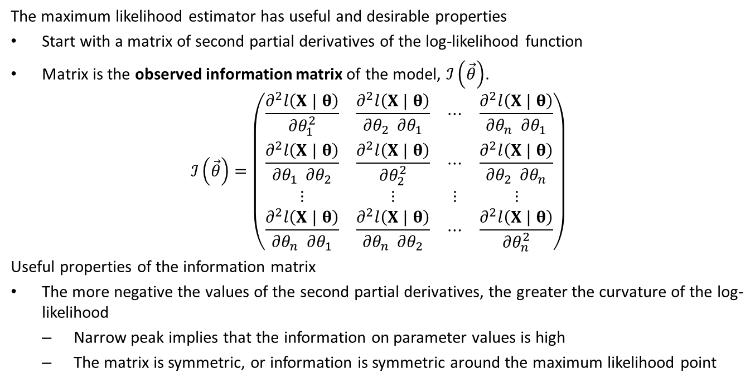
Fisher information and properties of MLE
The maximum likelihood estimator has useful and desirable properties
Start with a matrix of second partial derivatives of the log-likelihood function
Matrix is the observed information matrix of the model, $ℐ\left(\vec{θ}\right)$.
$$ℐ\left(\vec{θ}\right)=\left(\begin{matrix}\frac{∂^{2}l\left(X | θ\right)}{∂θ_{1}^{2}} & \frac{∂^{2}l\left(X | θ\right)}{∂θ_{2} ∂θ_{1}} & ⋯ & \frac{∂^{2}l\left(X | θ\right)}{∂θ_{n} ∂θ_{1}} \\ \frac{∂^{2}l\left(X | θ\right)}{∂θ_{1} ∂θ_{2}} & \frac{∂^{2}l\left(X | θ\right)}{∂θ_{2}^{2}} & ⋯ & \frac{∂^{2}l\left(X | θ\right)}{∂θ_{2} ∂θ_{n}} \\ ⋮ & ⋮ & ⋮ & ⋮ \\ \frac{∂^{2}l\left(X | θ\right)}{∂θ_{n} ∂θ_{1}} & \frac{∂^{2}l\left(X | θ\right)}{∂θ_{n} ∂θ_{2}} & ⋯ & \frac{∂^{2}l\left(X | θ\right)}{∂θ_{n}^{2}}\end{matrix}\right)$$
Useful properties of the information matrix
The more negative the values of the second partial derivatives, the greater the curvature of the log-likelihood
Narrow peak implies that the information on parameter values is high
The matrix is symmetric, or information is symmetric around the maximum likelihood point

Slide 16
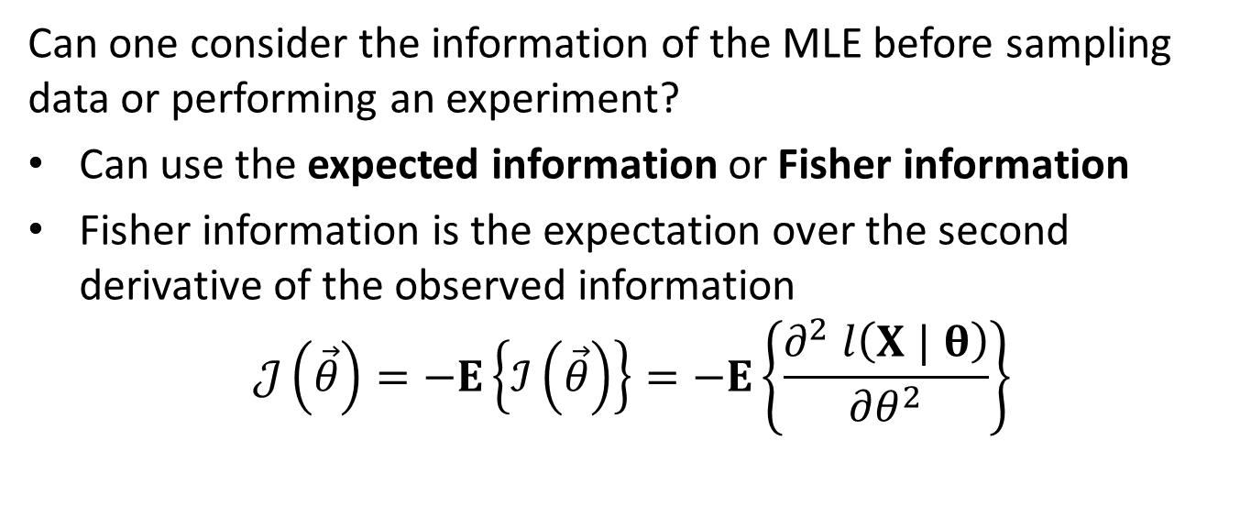
Fisher information and properties of MLE
Can one consider the information of the MLE before sampling data or performing an experiment?
Can use the expected information or Fisher information
Fisher information is the expectation over the second derivative of the observed information
$$𝒥\left(\vec{θ}\right)=−E\left\{ℐ\left(\vec{θ}\right)\right\}=−E\left\{\frac{∂^{2} l\left(X | θ\right)}{∂θ^{2}}\right\}$$

Slide 17
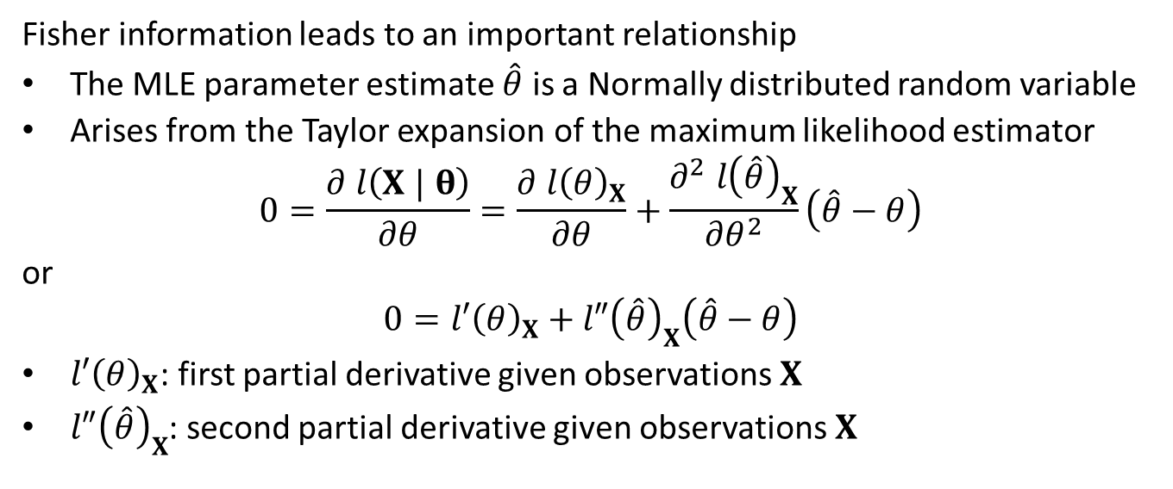
Fisher information and properties of MLE
Fisher information leads to an important relationship
The MLE parameter estimate $\hat{θ}$ is a Normally distributed random variable
Arises from the Taylor expansion of the maximum likelihood estimator
$$0=\frac{∂ l\left(X | θ\right)}{∂θ}=\frac{∂ l{\left(θ\right)}_{X}}{∂θ}+\frac{∂^{2} l{\left(\hat{θ}\right)}_{X}}{∂θ^{2}}\left(\hat{θ}−θ\right)$$
or
$$0=l′{\left(θ\right)}_{X}+l″{\left(\hat{θ}\right)}_{X}\left(\hat{θ}−θ\right)$$
$l′{\left(θ\right)}_{X}$: first partial derivative given observations $X$
$l″{\left(\hat{θ}\right)}_{X}$: second partial derivative given observations $X$

Slide 18
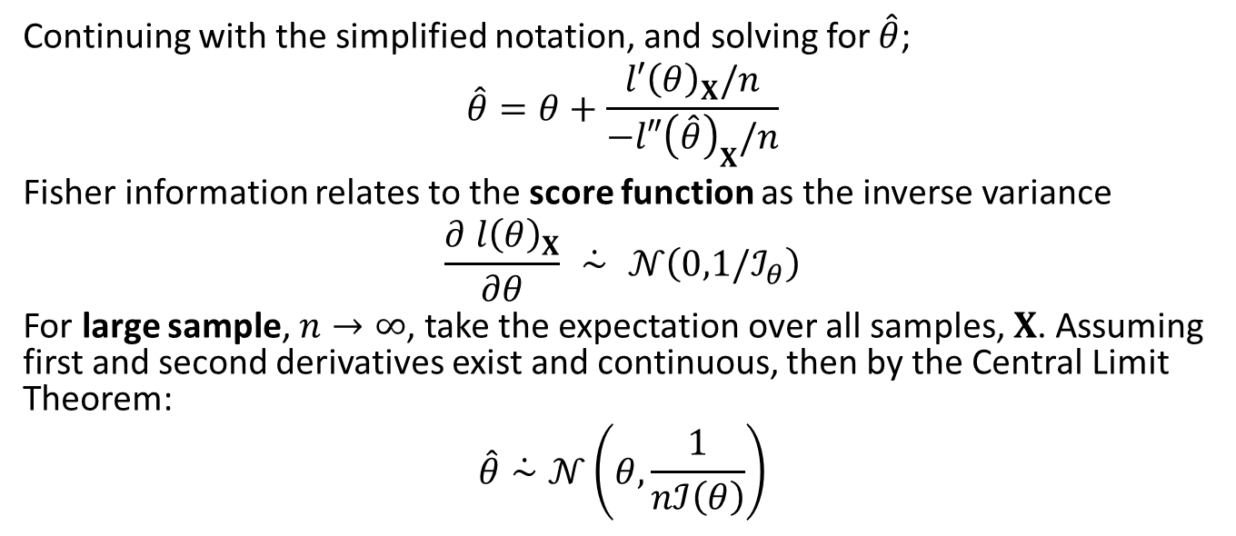
Fisher information and properties of MLE
Continuing with the simplified notation, and solving for $\hat{θ}$;
$$\hat{θ}=θ+\frac{l′{\left(θ\right)}_{X}/n}{−l″{\left(\hat{θ}\right)}_{X}/n}$$
Fisher information relates to the score function as the inverse variance
$$\frac{∂ l{\left(θ\right)}_{X}}{∂θ} \dot{∼} 𝒩\left(0,1/ℐ_{θ}\right)$$
For large sample, $n→∞$, take the expectation over all samples, $X$. Assuming first and second derivatives exist and continuous, then by the Central Limit Theorem:
$$\hat{θ}\dot{∼}𝒩\left(θ,\frac{1}{nℐ\left(θ\right)}\right)$$

Slide 19
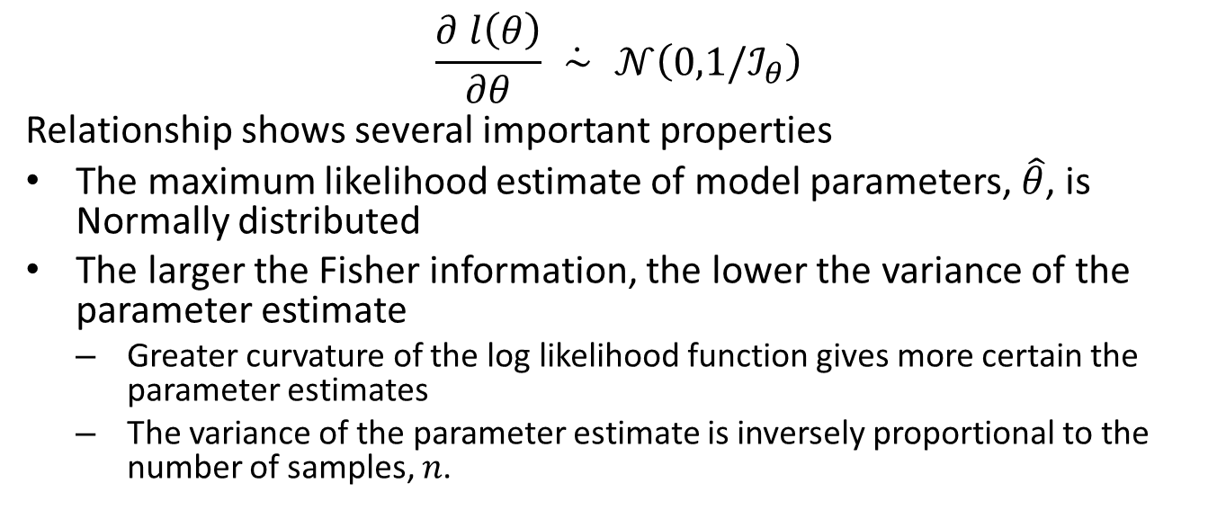
Fisher information and properties of MLE
$$\frac{∂ l\left(θ\right)}{∂θ} \dot{∼} 𝒩\left(0,1/ℐ_{θ}\right)$$
Relationship shows several important properties
The maximum likelihood estimate of model parameters, $\hat{θ}$, is Normally distributed
The larger the Fisher information, the lower the variance of the parameter estimate
Greater curvature of the log likelihood function gives more certain the parameter estimates
The variance of the parameter estimate is inversely proportional to the number of samples, $n$.

Slide 20
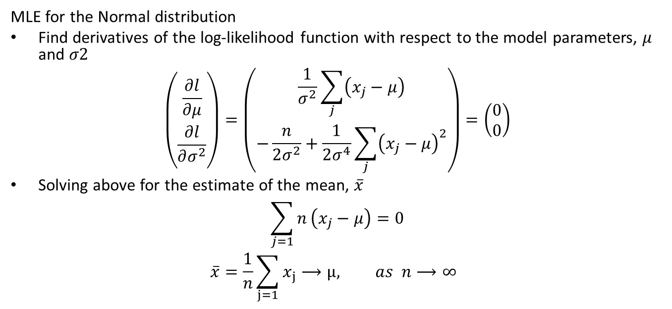
Example of MLE for Normal distribution
MLE for the Normal distribution
Find derivatives of the log-likelihood function with respect to the model parameters, $μ$ and $σ2$
$$\left(\begin{matrix}\frac{∂l}{∂μ} \\ \frac{∂l}{∂σ^{2}}\end{matrix}\right)=\left(\begin{matrix}\frac{1}{σ^{2}}\sum_{j}^{​}{\left(x_{j}−μ\right)} \\ −\frac{n}{2σ^{2}}+\frac{1}{2σ^{4}}\sum_{j}^{​}{{\left(x_{j}−μ\right)}^{2}}\end{matrix}\right)=\left(\begin{matrix}0 \\ 0\end{matrix}\right)$$
Solving above for the estimate of the mean, $\overset{‾}{x}$
$$\sum_{j=1}^{​}{n}\left(x_{j}−μ\right)=0$$
$$\overline{x}=\frac{1}{n}\sum_{j=1}^{​}{x_{j}}⟶μ, as n⟶∞$$

Slide 21
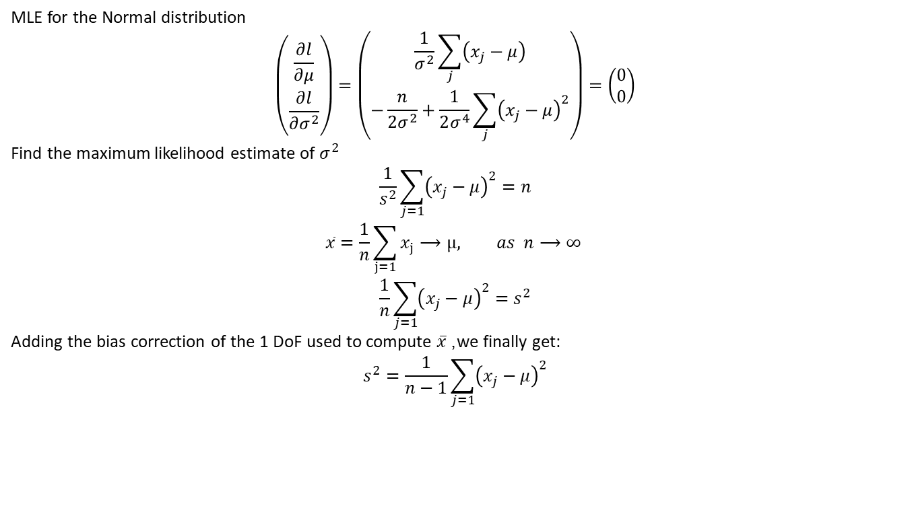
Example of MLE for Normal distribution
MLE for the Normal distribution
$$\left(\begin{matrix}\frac{∂l}{∂μ} \\ \frac{∂l}{∂σ^{2}}\end{matrix}\right)=\left(\begin{matrix}\frac{1}{σ^{2}}\sum_{j}^{​}{\left(x_{j}−μ\right)} \\ −\frac{n}{2σ^{2}}+\frac{1}{2σ^{4}}\sum_{j}^{​}{{\left(x_{j}−μ\right)}^{2}}\end{matrix}\right)=\left(\begin{matrix}0 \\ 0\end{matrix}\right)$$
Find the maximum likelihood estimate of $σ^{2}$
$$\frac{1}{s^{2}}\sum_{j=1}^{​}{{\left(x_{j}−μ\right)}^{2}}=n$$
$$\overline{x}=\frac{1}{n}\sum_{j=1}^{​}{x_{j}}⟶μ, as n⟶∞$$
$$\frac{1}{n}\sum_{j=1}^{​}{{\left(x_{j}−μ\right)}^{2}}=s^{2}$$
Adding the bias correction of the 1 DoF used to compute $\overset{‾}{x}$, we finally get:
$$s^{2}=\frac{1}{n−1}\sum_{j=1}^{​}{{\left(x_{j}−μ\right)}^{2}}$$

Slide 22

Example of MLE for Normal distribution
$$𝒥\left(\vec{θ}\right)=−E\left(\begin{matrix}\frac{∂^{2 }l}{∂^{2}μ} & \frac{∂^{2 }l}{∂^{ }μ{ ∂}^{ }σ^{2}} \\ \frac{∂^{2 }l}{∂^{ }μ{ ∂}^{ }σ^{2}} & \frac{∂^{2 }l}{∂^{2}σ^{2}}\end{matrix}\right)$$
$$=−E\left(\begin{matrix}\frac{−n}{σ^{2}} & −\frac{n}{{2σ}^{4}}\left(x_{j}−μ\right) \\ −\frac{n}{{2σ}^{4}}\left(x_{j}−μ\right) & −\frac{n}{{2σ}^{4}}+\frac{1}{σ^{6}}\sum_{j}^{​}{{\left(x_{j}−μ\right)}^{2}}\end{matrix}\right)$$
Now, by the law of large numbers $\overline{x}⟶μ, as n⟶∞$, and the above simplifies:
$$𝒥\left(\vec{θ}\right)=−E\left(\begin{matrix}\frac{−n}{σ^{2}} & 0 \\ 0 & −\frac{n}{{2σ}^{4}}\end{matrix}\right)$$

Slide 23
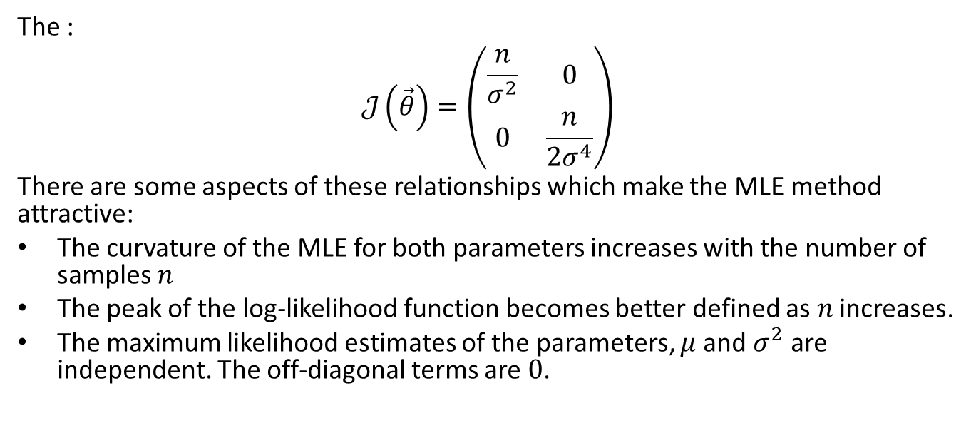
Example of MLE for Normal distribution
The :
$$𝒥\left(\vec{θ}\right)=\left(\begin{matrix}\frac{n}{σ^{2}} & 0 \\ 0 & \frac{n}{2σ^{4}}\end{matrix}\right)$$
There are some aspects of these relationships which make the MLE method attractive:
The curvature of the MLE for both parameters increases with the number of samples $n$
The peak of the log-likelihood function becomes better defined as $n$ increases.
The maximum likelihood estimates of the parameters, $μ$ and $σ^{2}$ are independent. The off-diagonal terms are $0$.

Slide 24
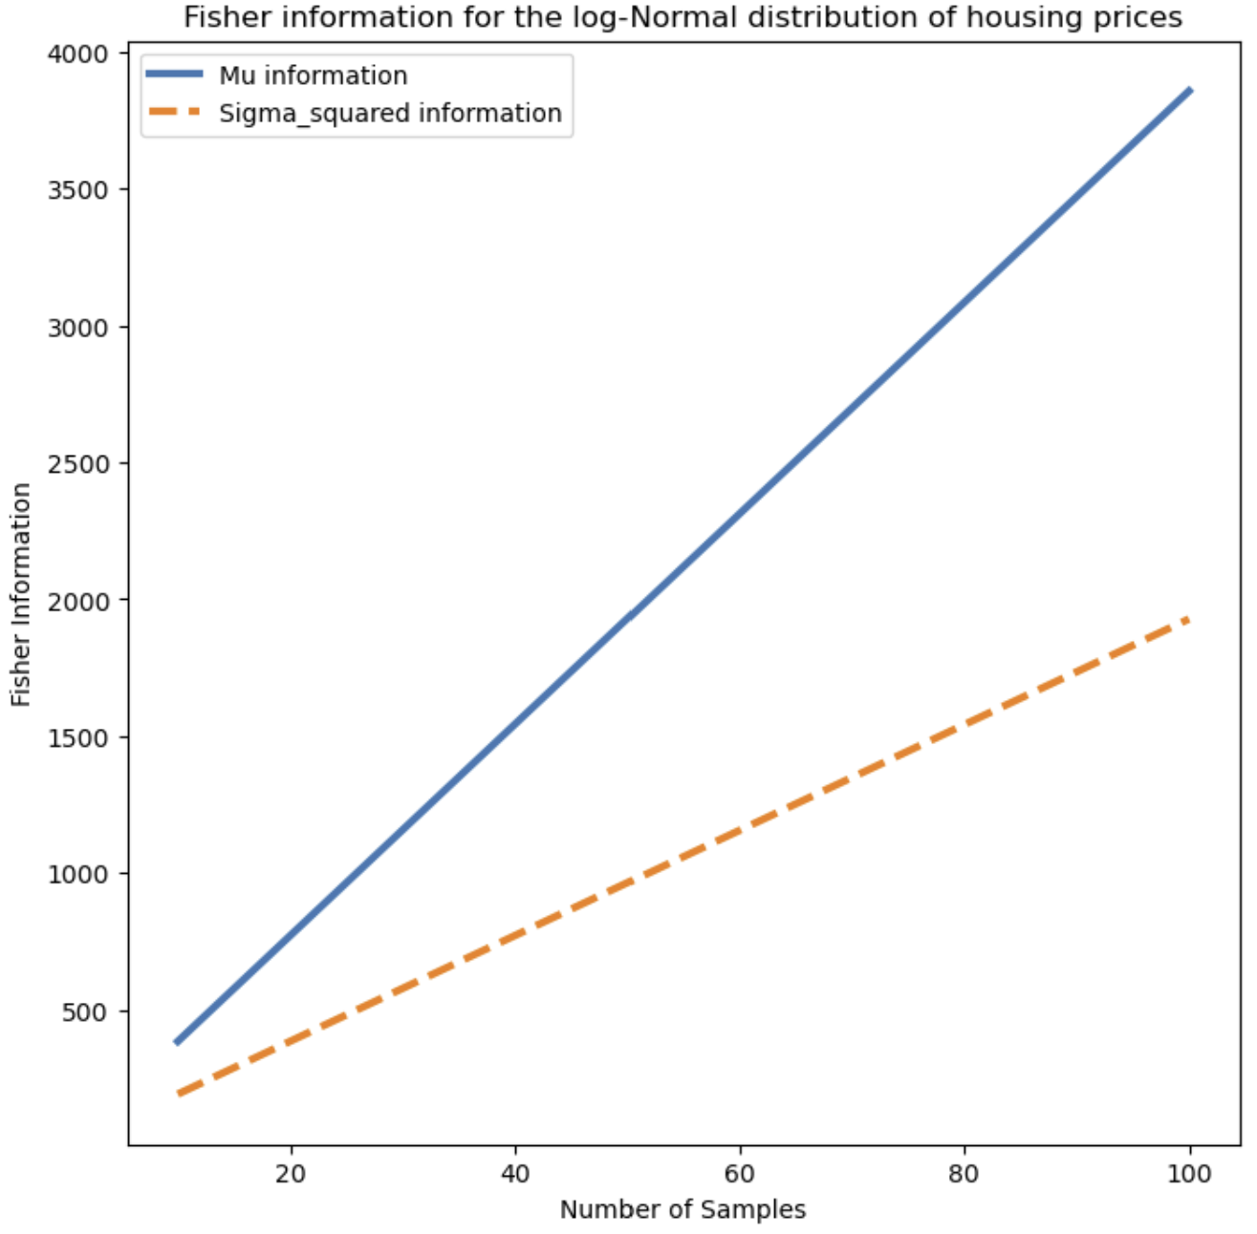
Fisher information and properties of MLE
Example of Fisher Information for Normal distribution
As sample size increases, Fisher Information decreases
Variance of MLE decreases with decreasing Fisher Information
Fisher Information for Normal distribution at different sample sizes

Slide 25
Finding Solutions Without a Closed Form
How do we generalize the MLE method beyond cases with a closed form solution
For example, logistic regression has a nonlinear log likelihood function
An approximate solution can be found by numerical optimization methods or root finding methods
Two widely used methods
Gradient descent, a first-order method
Newton’s method, quadratic approximation

Slide 26
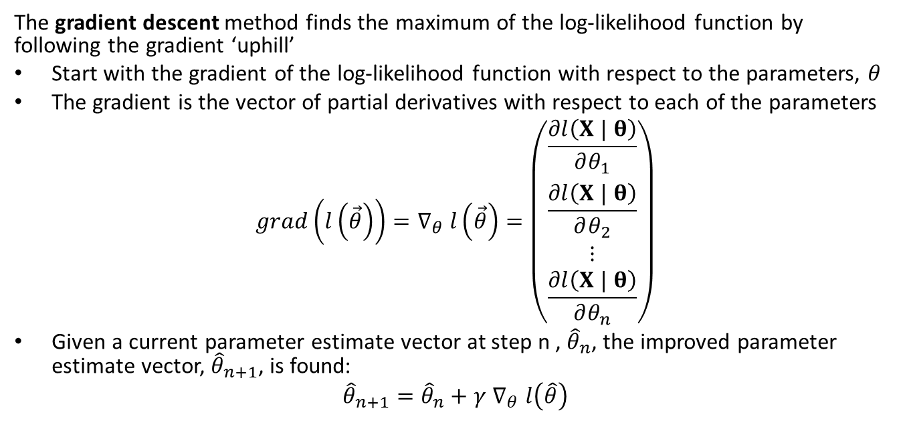
Gradient descent methods
The gradient descent method finds the maximum of the log-likelihood function by following the gradient ‘uphill’
Start with the gradient of the log-likelihood function with respect to the parameters, $θ$
The gradient is the vector of partial derivatives with respect to each of the parameters
$$grad\left(l\left(\vec{θ}\right)\right)=∇_{θ} l\left(\vec{θ}\right)=\left(\begin{matrix}\frac{∂l\left(X | θ\right)}{∂θ_{1}} \\ \frac{∂l\left(X | θ\right)}{∂θ_{2}} \\ ⋮ \\ \frac{∂l\left(X | θ\right)}{∂θ_{n}}\end{matrix}\right)$$
Given a current parameter estimate vector at step n , ${\hat{θ}}_{n}$, the improved parameter estimate vector, ${\hat{θ}}_{n+1}$, is found:
$${\hat{θ}}_{n+1}={\hat{θ}}_{n}+γ ∇_{θ} l\left(\hat{θ}\right)$$

Slide 27
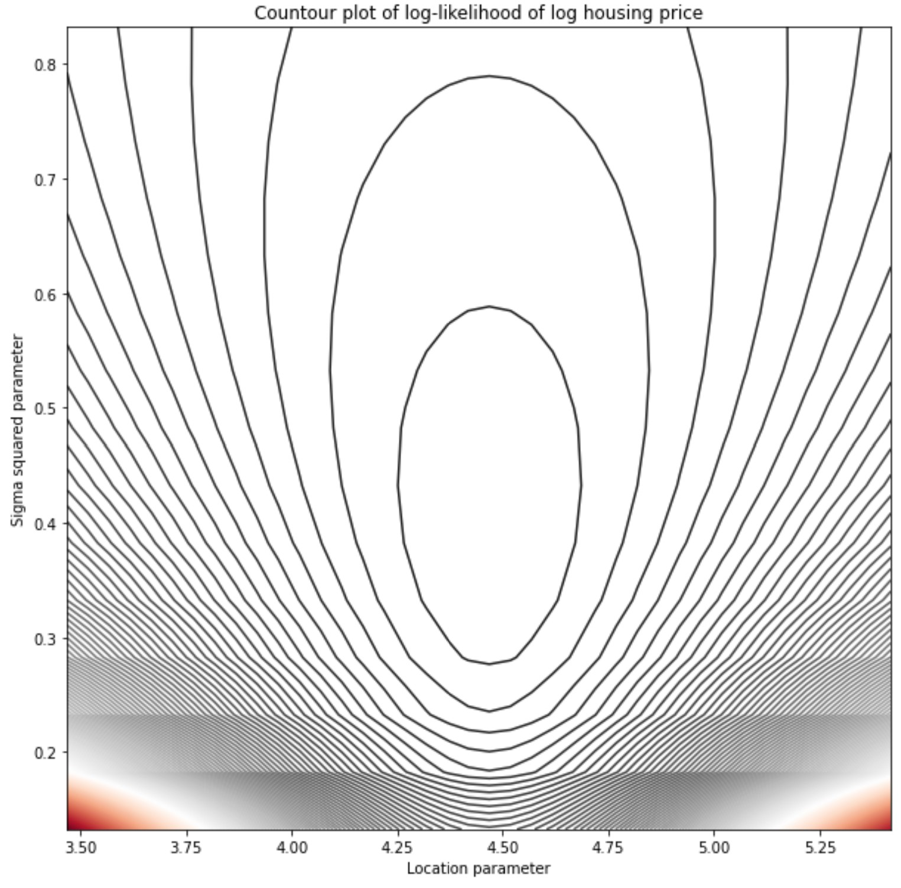
Gradient descent methods
The gradient descent method finds the maximum of the log-likelihood function by following the gradient ‘uphill’
Example: contour plot of Normal log-likelihood
Gradient descent following negative (minus) gradient to maximum of log-likelihood
Maximum gradient direction is perpendicular to contour lines - steepest uphill path
Notice difference between gradients (and information) between location and scale!
Contours of Normal Log-Likelihood

Slide 28
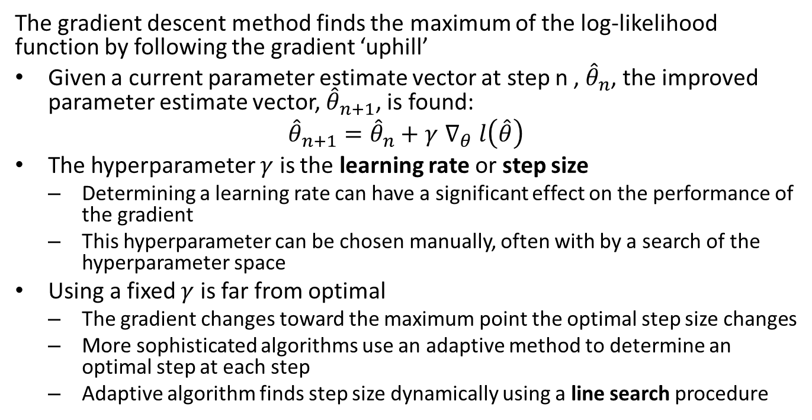
Gradient descent methods
The gradient descent method finds the maximum of the log-likelihood function by following the gradient ‘uphill’
Given a current parameter estimate vector at step n , ${\hat{θ}}_{n}$, the improved parameter estimate vector, ${\hat{θ}}_{n+1}$, is found:
$${\hat{θ}}_{n+1}={\hat{θ}}_{n}+γ ∇_{θ} l\left(\hat{θ}\right)$$
The hyperparameter $γ$ is the learning rate or step size
Determining a learning rate can have a significant effect on the performance of the gradient
This hyperparameter can be chosen manually, often with by a search of the hyperparameter space
Using a fixed $γ$ is far from optimal
The gradient changes toward the maximum point the optimal step size changes
More sophisticated algorithms use an adaptive method to determine an optimal step at each step
Adaptive algorithm finds step size dynamically using a line search procedure

Slide 29
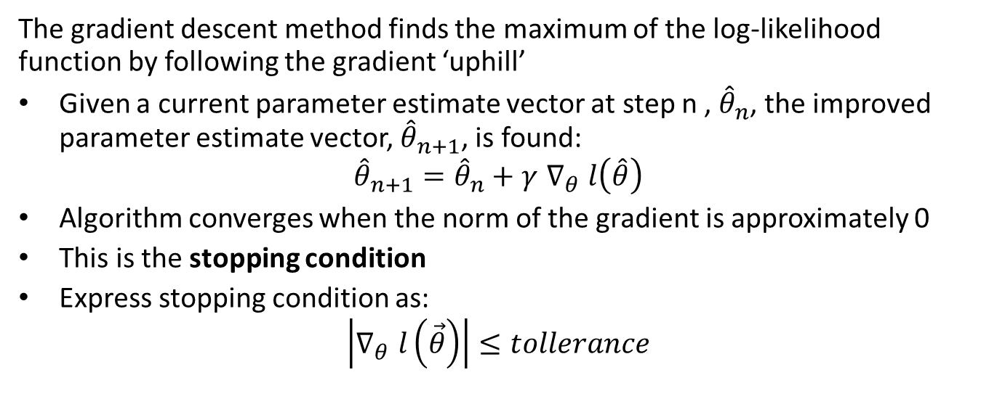
Gradient descent methods
The gradient descent method finds the maximum of the log-likelihood function by following the gradient ‘uphill’
Given a current parameter estimate vector at step n , ${\hat{θ}}_{n}$, the improved parameter estimate vector, ${\hat{θ}}_{n+1}$, is found:
$${\hat{θ}}_{n+1}={\hat{θ}}_{n}+γ ∇_{θ} l\left(\hat{θ}\right)$$
Algorithm converges when the norm of the gradient is approximately 0
This is the stopping condition
Express stopping condition as:
$$\left|∇_{θ} l\left(\vec{θ}\right)\right|≤tollerance$$

Slide 30
Gradient descent methods
Gradient with respect to model parameters is computed for each dimension of the model parameter vector
proceedure compute_grad(theta, observations): for each parameter: grad[theta_i] = grad(theta_i, observations) return grad define learning_rate proceedure update_weights(theta, grad): theta = theta + learning_rate * compute_grad(theta) return weights
The forgoing procedure can be vectorized or parallelized

Slide 31
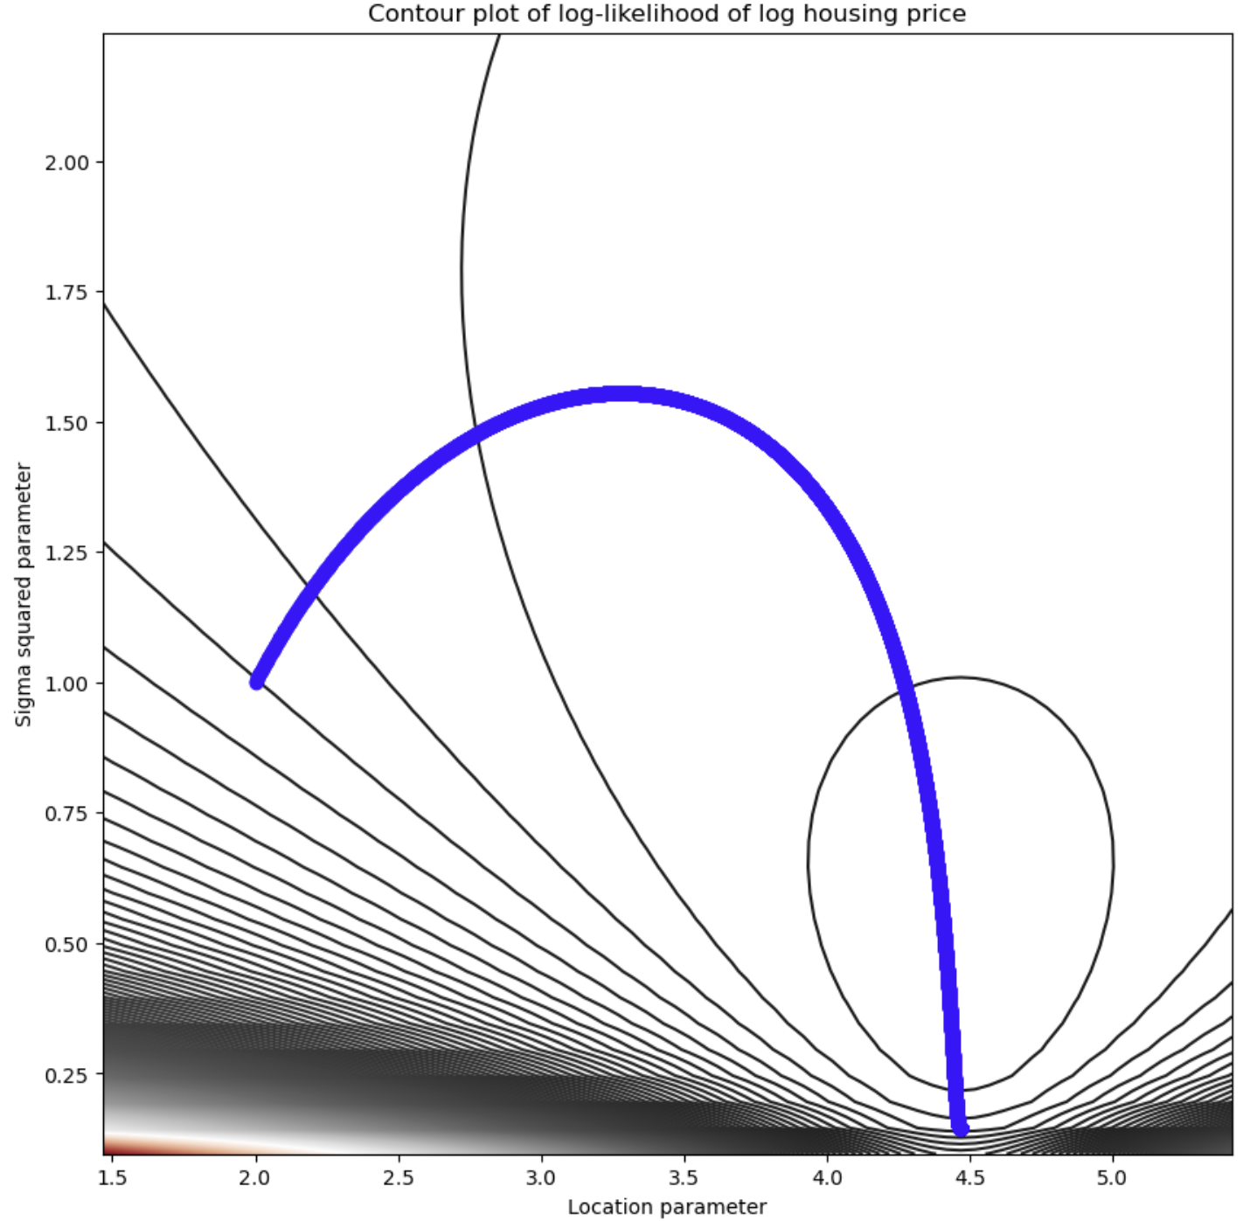
Gradient descent methods
The gradient descent method finds the maximum of the log-likelihood function by following the gradient ‘uphill’
The gradient is always perpendicular to the contours
Gradient descent on contour plot of log-likelihood

Slide 32
Stochastic Gradient descent methods
The simple gradient descent algorithm and Newton’s method have limited scalability
Basic algorithms require computing and summing the entire gradient vector
Calculation must be done as a single batch in memory, or batch gradient descent
Computing the full gradient at each step limits scalability
Stochastic gradient decent (SGD) algorithm computes the approximate expected gradient using a mini-batch
The mini-batch is a limited-size Bernoulli sample from the full set of cases
These gradient approximations are inherently noisy or stochastic, giving rise to the method’s name
Using mini-batches greatly increases scalability
While gradient estimates are less accurate, these estimates can be computed very quickly
SGD is highly scalable and the workhorse of many large-scale statistical methods
Mini-batch optimization is often referred to as online optimization since updates as cases arrive.

Slide 33
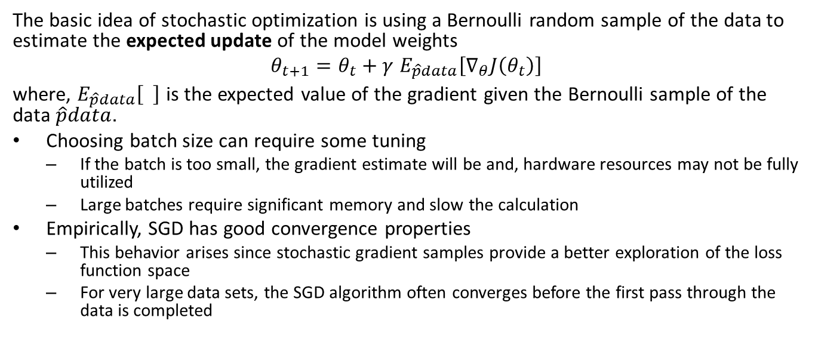
Stochastic Gradient descent methods
The basic idea of stochastic optimization is using a Bernoulli random sample of the data to estimate the expected update of the model weights
$$θ_{t+1}=θ_{t}+γ E_{\hat{p}data}\left[∇_{θ}J\left(θ_{t}\right)\right]$$
where, $E_{\hat{p}data}\left[ \right]$ is the expected value of the gradient given the Bernoulli sample of the data $\hat{p}data$.
Choosing batch size can require some tuning
If the batch is too small, the gradient estimate will be and, hardware resources may not be fully utilized
Large batches require significant memory and slow the calculation
Empirically, SGD has good convergence properties
This behavior arises since stochastic gradient samples provide a better exploration of the loss function space
For very large data sets, the SGD algorithm often converges before the first pass through the data is completed

Slide 34
Stochastic gradient descent (SGD)
The pseudo code for the SGD algorithm is:
define learning_rate procedure compute_expected_grad(theta, observations): for each parameter: grad[theta_i] = grad(theta_i, observations) return grad procedure update_weights(theta, grad): theta = theta + learning_rate * grad(theta) return weights
Procedure gradient_descent(cases, initial_weights) Random_sort(cases)
weights = intial_weights while(|grad| > stopping_criteria): mini-batch = sample_next_n(cases) grad = compute_expected_grad(theta, mini_batch) weights = update_weights(theta, grad)`
If the sampling continues for more than one cycle through the cases, the samples are biased
In practice, this small bias does not seem to mater much

Slide 35
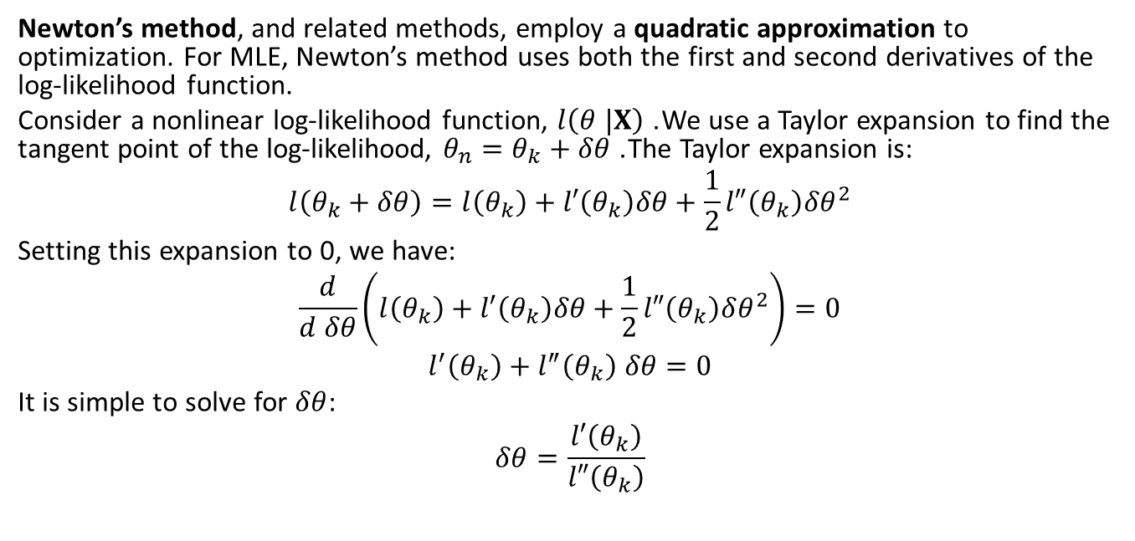
Newton’s method
Newton’s method, and related methods, employ a quadratic approximation to optimization. For MLE, Newton’s method uses both the first and second derivatives of the log-likelihood function.
Consider a nonlinear log-likelihood function, $l\left(θ |X\right)$. We use a Taylor expansion to find the tangent point of the log-likelihood, $θ_{n}=θ_{k}+δθ$. The Taylor expansion is:
$$l\left(θ_{k}+δθ\right)=l\left(θ_{k}\right)+l′\left(θ_{k}\right)δθ+\frac{1}{2}l″\left(θ_{k}\right)δθ^{2}$$
Setting this expansion to 0, we have:
$$\frac{d}{d δθ}\left(l\left(θ_{k}\right)+l′\left(θ_{k}\right)δθ+\frac{1}{2}l″\left(θ_{k}\right)δθ^{2}\right)=0$$
$$l^{′}\left(θ_{k}\right)+l^{″}\left(θ_{k}\right) δθ=0$$
It is simple to solve for $δθ$:
$$δθ=\frac{l′\left(θ_{k}\right)}{l″\left(θ_{k}\right)}$$

Slide 36
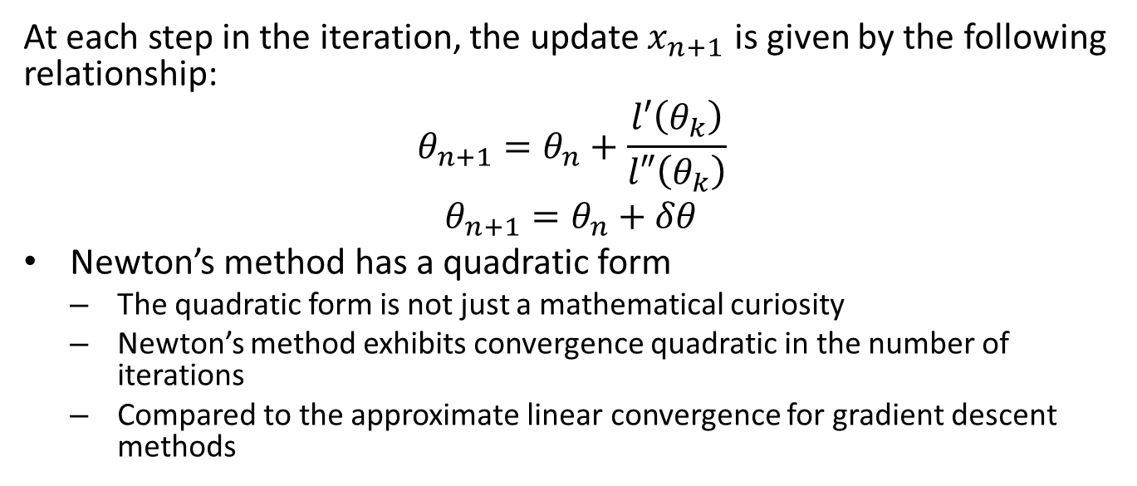
Newton’s method
At each step in the iteration, the update $x_{n+1}$ is given by the following relationship:
$$θ_{n+1}=θ_{n}+\frac{l′\left(θ_{k}\right)}{l″\left(θ_{k}\right)}$$
$$θ_{n+1}=θ_{n}+δθ$$
Newton’s method has a quadratic form
The quadratic form is not just a mathematical curiosity
Newton’s method exhibits convergence quadratic in the number of iterations
Compared to the approximate linear convergence for gradient descent methods

Slide 37
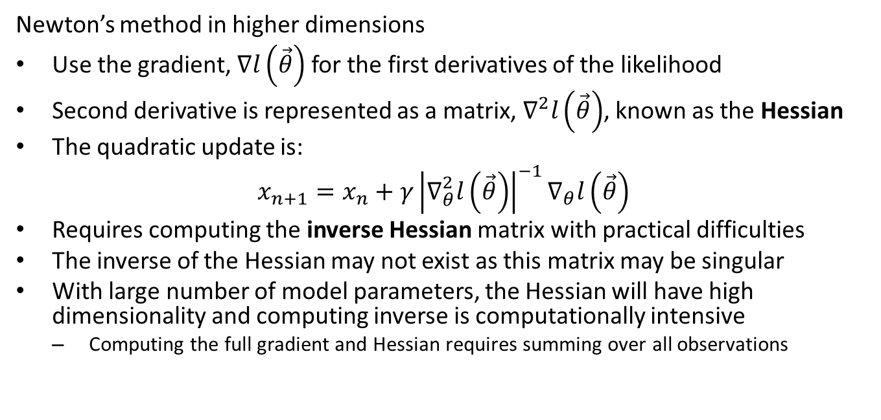
Newton’s method
Newton’s method in higher dimensions
Use the gradient, $∇l\left(\vec{θ}\right)$ for the first derivatives of the likelihood
Second derivative is represented as a matrix, $∇^{2}l\left(\vec{θ}\right)$, known as the Hessian
The quadratic update is:
$$x_{n+1}=x_{n}+γ{\left|∇_{θ}^{2}l\left(\vec{θ}\right)\right|}^{−1}∇_{θ}l\left(\vec{θ}\right)$$
Requires computing the inverse Hessian matrix with practical difficulties
The inverse of the Hessian may not exist as this matrix may be singular
With large number of model parameters, the Hessian will have high dimensionality and computing inverse is computationally intensive
Computing the full gradient and Hessian requires summing over all observations

Slide 38
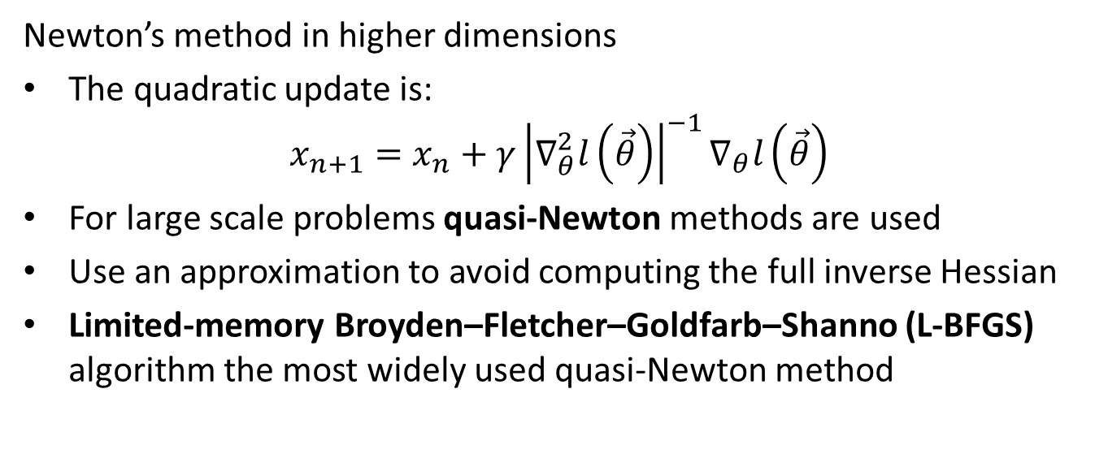
Newton’s method
Newton’s method in higher dimensions
The quadratic update is:
$$x_{n+1}=x_{n}+γ{\left|∇_{θ}^{2}l\left(\vec{θ}\right)\right|}^{−1}∇_{θ}l\left(\vec{θ}\right)$$
For large scale problems quasi-Newton methods are used
Use an approximation to avoid computing the full inverse Hessian
Limited-memory Broyden–Fletcher–Goldfarb–Shanno (L-BFGS) algorithm the most widely used quasi-Newton method

Slide 39
Limitations of MLE
The maximum likelihood estimator has a number of important limitations, including
Incorrect model for complex distributions
Parameter near limits
High dimensional problems
Correlated features

Slide 40
Incorrect model and complex distributions
In many real-world problems the distribution are not simple
Problematic for maximum likelihood methods
Consider a likelihood function that is only approximately correct
Population being modeled has a different distribution
Outliers in the form of erroneous samples
Example; maximum likelihood estimator for population with a mixture of simple distributions
Mixture has multiple modes
One mode is the maximum
Mode found by any gradient-based algorithm is dependent on the starting point
MLE algorithm will find the nearest local maximum
No guarantee of finding the actual maximum likelihood point

Slide 41
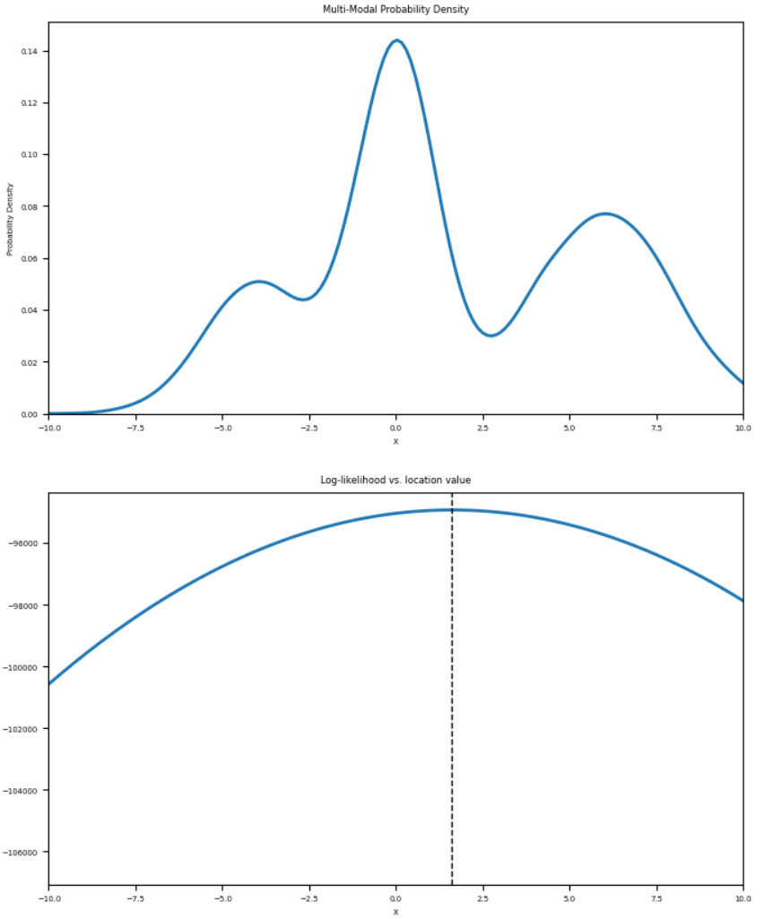
Incorrect model and complex distributions
Example; univariate Normal maximum likelihood estimator for mixture of 3 Normal distributions
Maximum likelihood is not a maximum of distribution

Slide 42
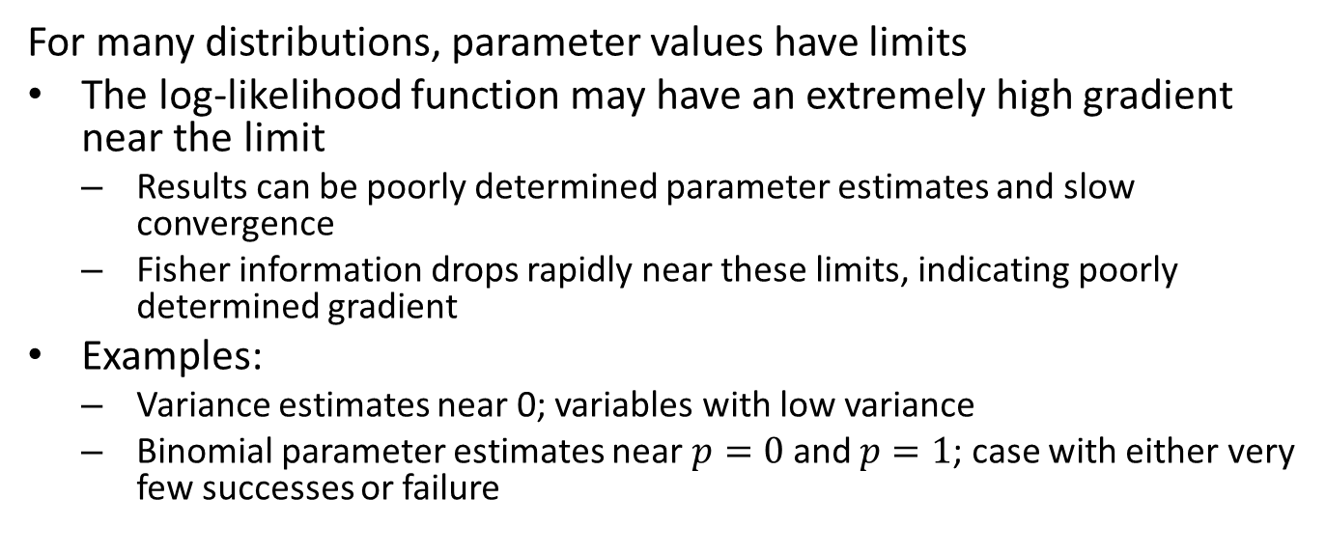
Parameter near limits
For many distributions, parameter values have limits
The log-likelihood function may have an extremely high gradient near the limit
Results can be poorly determined parameter estimates and slow convergence
Fisher information drops rapidly near these limits, indicating poorly determined gradient
Examples:
Variance estimates near 0; variables with low variance
Binomial parameter estimates near $p=0$ and $p=1$; case with either very few successes or failure

Slide 43
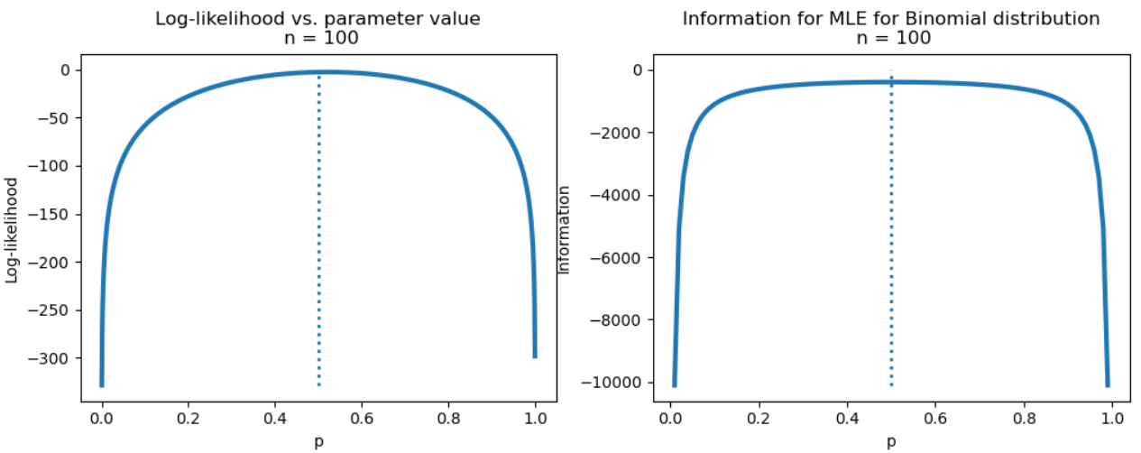
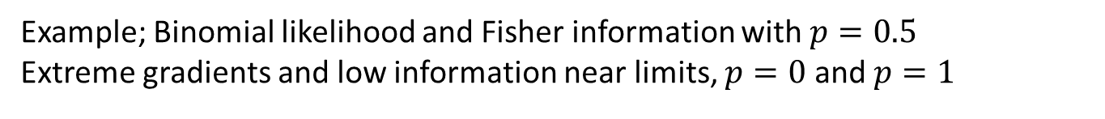
Parameter near limits
Example; Binomial likelihood and Fisher information with $p=0.5$ Extreme gradients and low information near limits, $p=0$ and $p=1$

Slide 44
High dimensional problems
The MLE method often finds poor solutions to problems in high dimensions
High dimensions means a large numbers of parameters
The likelihood function has corresponding high dimensionality; one dimension for each parameter
For high dimensional problems, it is often the case that the gradient and Hessian are not well determined
Uncertainty in the variables can lead to considerable uncertainty in determining the gradient in high dimensions
MLE algorithms may not converge or converge to results with a large uncertainty
Even with few parameters, MLE methods can have convergence problems
Example; difficulties fitting the variance parameter while fitting the location parameter for a univariate Normal distribution
We will discuss this problem later in the course

Slide 45
Correlated features
Theory assumes that the variables used for MLE are independent
In reality, never truly the case
Some variables have a high correlation to each other
MLE algorithm can breakdown since gradients will not be well determined
We will discuss this problem later in the course

Slide 46
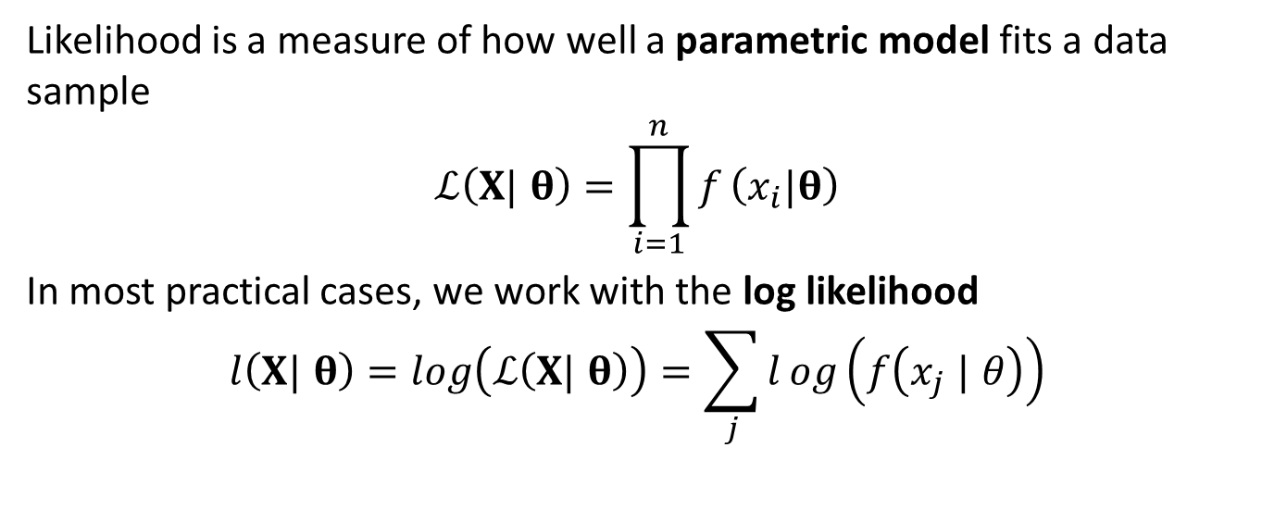
Summary
Likelihood is a measure of how well a parametric model fits a data sample
$$ℒ\left(X| θ\right)=\prod_{i=1}^{n}{f}\left(x_{i}|θ\right)$$
In most practical cases, we work with the log likelihood
$$l\left(X| θ\right)=log\left(ℒ\left(X| θ\right)\right)=\sum_{j}^{​}{l}og\left(f\left(x_{j} | θ\right)\right)$$

Slide 47
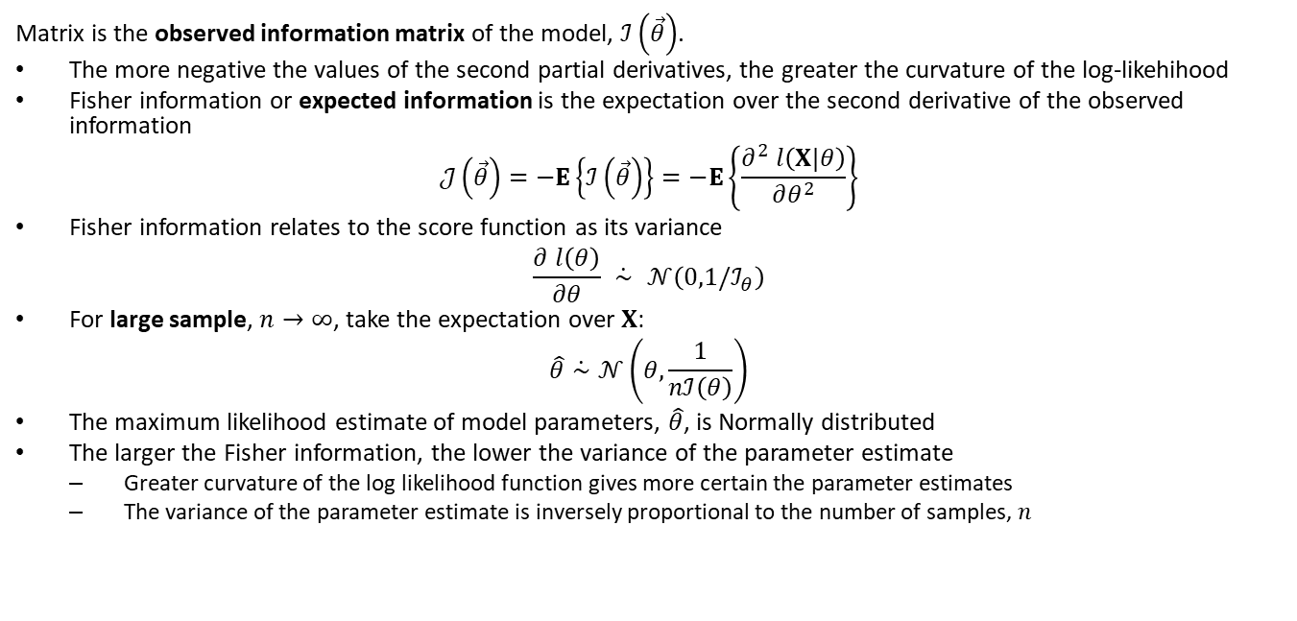
Summary
Matrix is the observed information matrix of the model, $ℐ\left(\vec{θ}\right)$.
The more negative the values of the second partial derivatives, the greater the curvature of the log-likehihood
Fisher information or expected information is the expectation over the second derivative of the observed information
$$𝒥\left(\vec{θ}\right)=−E\left\{ℐ\left(\vec{θ}\right)\right\}=−E\left\{\frac{∂^{2} l\left(X|θ\right)}{∂θ^{2}}\right\}$$
Fisher information relates to the score function as its variance
$$\frac{∂ l\left(θ\right)}{∂θ} \dot{∼} 𝒩\left(0,1/ℐ_{θ}\right)$$
For large sample, $n→∞$, take the expectation over $X$:
$$\hat{θ}\dot{∼}𝒩\left(θ,\frac{1}{nℐ\left(θ\right)}\right)$$
The maximum likelihood estimate of model parameters, $\hat{θ}$, is Normally distributed
The larger the Fisher information, the lower the variance of the parameter estimate
Greater curvature of the log likelihood function gives more certain the parameter estimates
The variance of the parameter estimate is inversely proportional to the number of samples, $n$

Slide 48
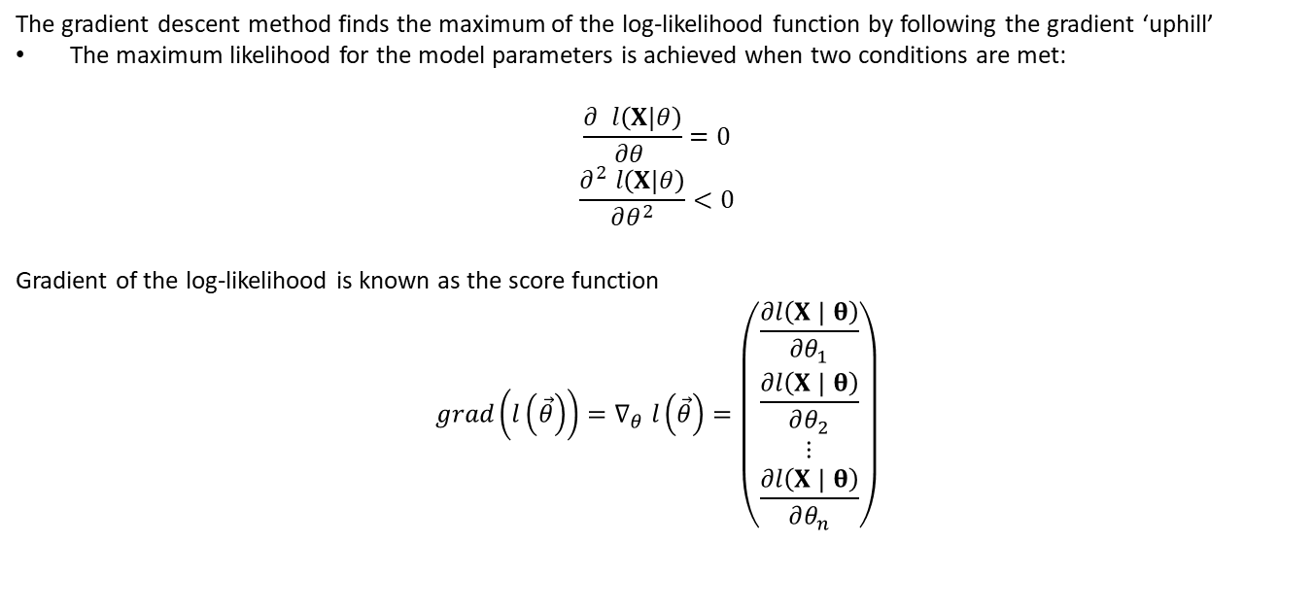
Summary
The gradient descent method finds the maximum of the log-likelihood function by following the gradient ‘uphill’
The maximum likelihood for the model parameters is achieved when two conditions are met:
$$\frac{∂^{ } l\left(X|θ\right)}{∂θ^{ }}=0$$
$$\frac{∂^{2} l\left(X|θ\right)}{∂θ^{2}}<0$$
Gradient of the log-likelihood is known as the score function
$$grad\left(l\left(\vec{θ}\right)\right)=∇_{θ} l\left(\vec{θ}\right)=\left(\begin{matrix}\frac{∂l\left(X | θ\right)}{∂θ_{1}} \\ \frac{∂l\left(X | θ\right)}{∂θ_{2}} \\ ⋮ \\ \frac{∂l\left(X | θ\right)}{∂θ_{n}}\end{matrix}\right)$$

Slide 49
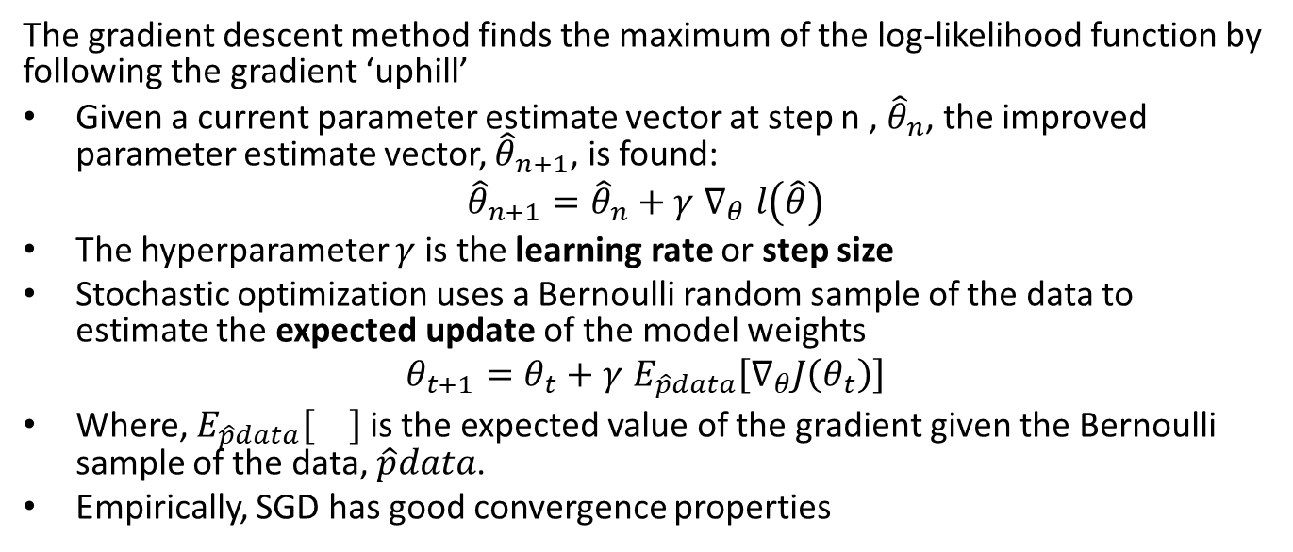
Summary
The gradient descent method finds the maximum of the log-likelihood function by following the gradient ‘uphill’
Given a current parameter estimate vector at step n , ${\hat{θ}}_{n}$, the improved parameter estimate vector, ${\hat{θ}}_{n+1}$, is found:
$${\hat{θ}}_{n+1}={\hat{θ}}_{n}+γ ∇_{θ} l\left(\hat{θ}\right)$$
The hyperparameter $γ$ is the learning rate or step size
Stochastic optimization uses a Bernoulli random sample of the data to estimate the expected update of the model weights
$$θ_{t+1}=θ_{t}+γ E_{\hat{p}data}\left[∇_{θ}J\left(θ_{t}\right)\right]$$
Where, $E_{\hat{p}data}\left[\right]$ is the expected value of the gradient given the Bernoulli sample of the data, $\hat{p}data$.
Empirically, SGD has good convergence properties

Slide 50
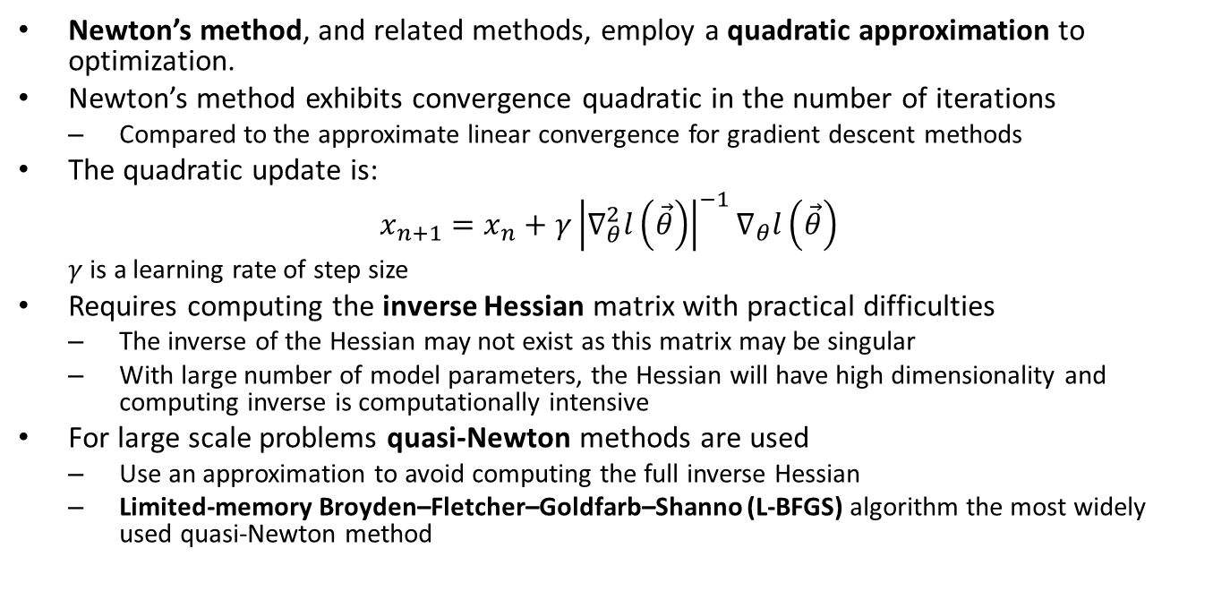
Summary
Newton’s method, and related methods, employ a quadratic approximation to optimization.
Newton’s method exhibits convergence quadratic in the number of iterations
Compared to the approximate linear convergence for gradient descent methods
The quadratic update is:
$$x_{n+1}=x_{n}+γ{\left|∇_{θ}^{2}l\left(\vec{θ}\right)\right|}^{−1}∇_{θ}l\left(\vec{θ}\right)$$
$γ$ is a learning rate of step size
Requires computing the inverse Hessian matrix with practical difficulties
The inverse of the Hessian may not exist as this matrix may be singular
With large number of model parameters, the Hessian will have high dimensionality and computing inverse is computationally intensive
For large scale problems quasi-Newton methods are used
Use an approximation to avoid computing the full inverse Hessian
Limited-memory Broyden–Fletcher–Goldfarb–Shanno (L-BFGS) algorithm the most widely used quasi-Newton method

Slide 51
Summary
The maximum likelihood estimator has a number of important limitations, including
Incorrect model and complex distributions
Parameter near limits
High dimensional problems
Correlated features

